Slide 1
Machine Learning with Episerver
10.28.19
Prepared by David Boland
Senior Developer, EMVP at Nansen
Twitter: @debpu06
Website: davidboland.site

Slide 2
What We’ll Cover
01
What actually is Machine Learning?
02
Why should I care?
03
How does Episerver come into play?
04
Next Steps
Notes:
AI vs ML, Buzzword Buzzword Buzzword. But what actually is ML? I’ll try to give a brief overview
Ok cool, so now that you know what ML is, why is everyone so jazzed about it?
What is Epi doing with ML? Quite a lot actually. We will go through some of the cool stuff they are doing.
Okay, now that I know what it is, what do I do with it?

Slide 3
What actually is Machine Learning?

Slide 4
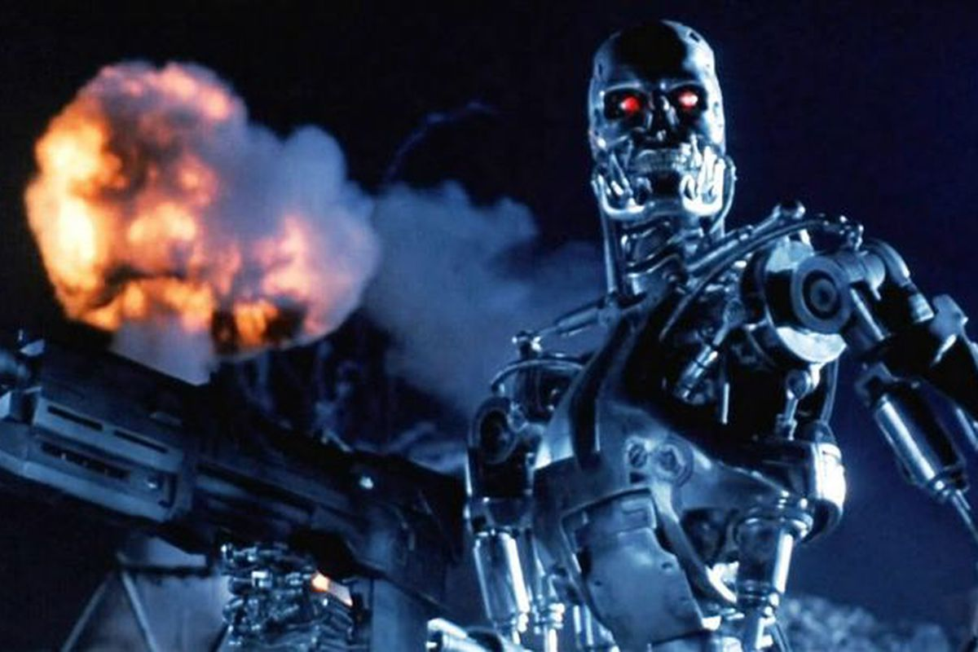
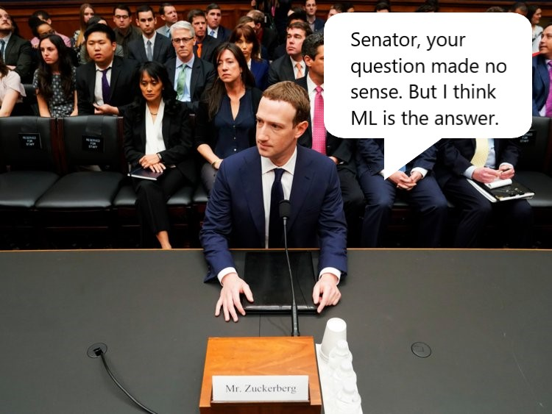
What it isn’t
Contrary to the buzz, it doesn’t solve all our problems.
Shouldn’t be confused with General AI
Notes:
Zuckerberg during his senate testimony cited improved ML to resolve lots of the discussed problems. Its not as simple as that.
Important to note that although they are kinda used interchangeably, ML is just a subset of AI
General AI is the term for essentially trying to mimic human intelligence in machines. Machine learning is all bout solving a specific task

Slide 5
What is Machine Learning?
Collect Data
Uses statistics to find patterns in large data sets and train models.
Build Model
Based on provided data, it tries to generalize and solve for any new data.
Uses the results to re-train models
Predict
Notes:
ML and Statistics are very intertwined. The major difference is that statistics is more to just analyze the data. ML is all about getting repeatable predictive results.
So how does it do this? Based on some data, it will generate statistical models. As new data comes in, it will try to make a prediction based on the data it got before.
Once it knows the actual result, it will optimize its model, and its ready for new data. That’s where the “learning” comes in.

Slide 6
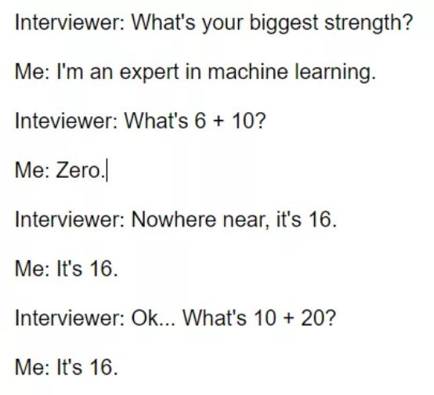
What is Machine Learning?
Algorithms?
Training?
Models?
Notes:
The Algorithm is what you use to build your statistical models. This is chosen based on what you are trying to accomplish. Ill explain more about that in a minute.
Based on the data we have, we run it through the algorithm. You specify the input values and the target value to predict. The result that gets spit out is your model.
The model is a statistical representation of whatever you are trying to predict. This model is continually refined as new data comes in and it gets re trained.

Slide 7
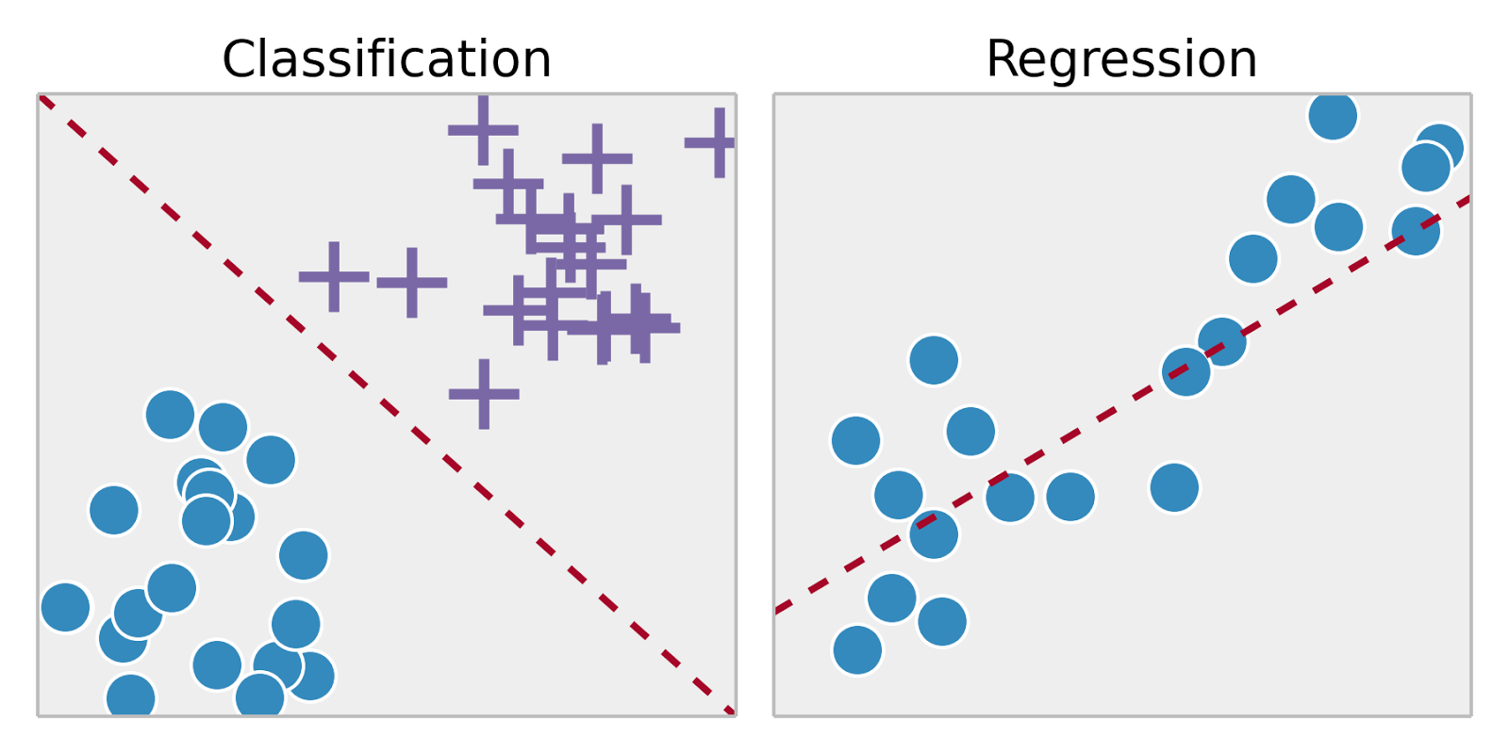
What is Machine Learning?
Supervised
vs Unsupervised
Regression vs Classification
Notes:
When it comes to the algorithms, there are two main categories. Supervised & unsupervised. Unsupervised is kinda like analyzing data with no clear goal in mind. Just trying to get insights to your data.
Supervised is trying to answer a specific question. Thats what we’ll focus on.
When it comes to supervised, there are two main types of algorithms, classification and regression. Classification deals with grouping items into categories. While Regression deals with predicting some value.
Does this image contain a dog?
What will be the price of this house given all these parameters?

Slide 8
What is Machine Learning?
Supervised
vs Unsupervised
Regression vs Classification
Notes:
When it comes to the algorithms, there are two main categories. Supervised & unsupervised. Unsupervised is kinda like analyzing data with no clear goal in mind. Just trying to get insights to your data.
Supervised is trying to answer a specific question. Thats what we’ll focus on.
When it comes to supervised, there are two main types of algorithms, classification and regression. Classification deals with grouping items into categories. While Regression deals with predicting some value.
Does this image contain a dog?
What will be the price of this house given all these parameters?

Slide 9
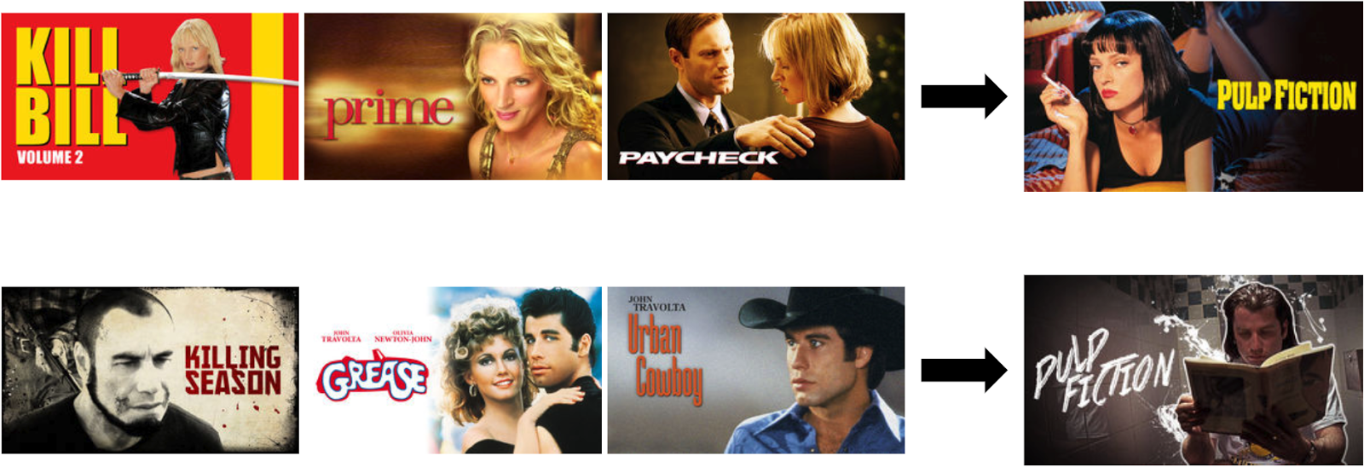
Machine Learning Examples
Notes:
Netflix not only recommends videos, but will customize image thumbnails based on your user journey

Slide 10
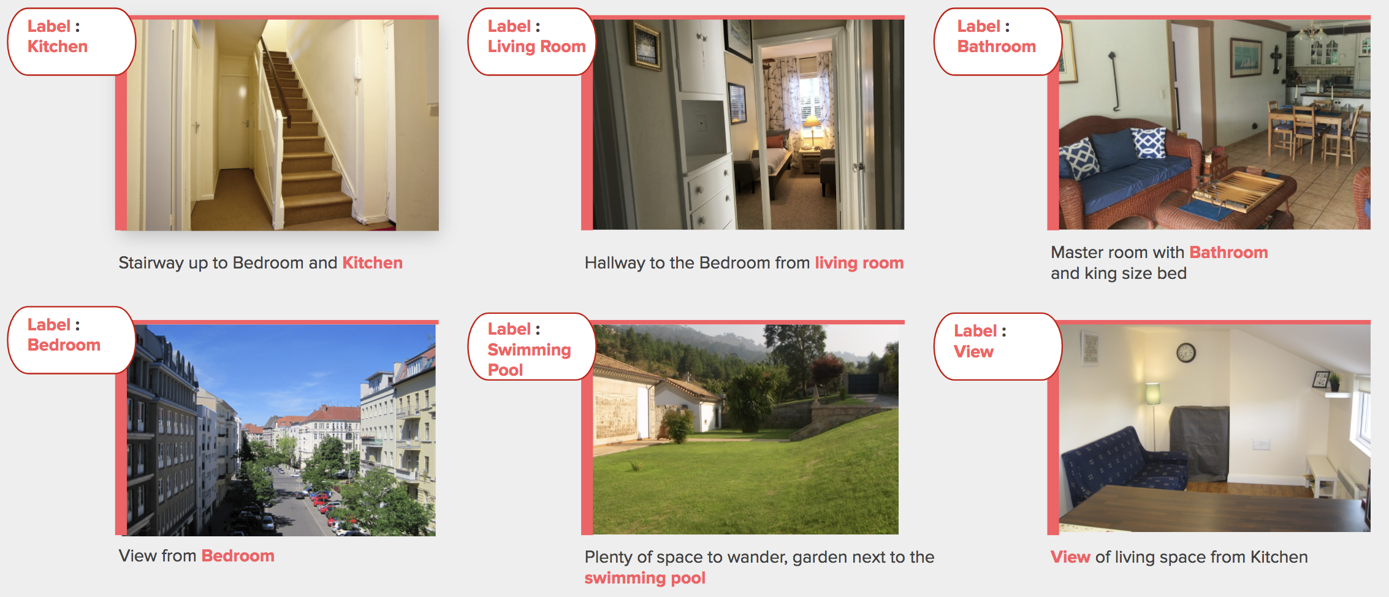
Machine Learning Examples
Notes:
AirBnB will use image classification to find incorrect labels to provide curation at scale

Slide 11
Machine Learning Examples
Curated feeds
Image tagging
User tracking
Notes:
Pretty much everything you see on social media is processed in some way through machine learning.

Slide 12
What is Machine Learning?
Netflix
AirBnB
Twitter, Facebook, etc
Notes:
FB, Twitter, and every other social network uses ML to provide curated timelines

Slide 13
Why Should I Care?

Slide 14
So What?
So machine learning is getting more and more popular. How does this affect me?
Well, I already use personalization on my site...
Notes:
Machine learning has been around for a long time. The reason it has taken off recently, especially in terms of web applications, is due to the increase in computing power, decrease in storage cost, and the increased access to Data
Google, FB, Target, pretty much every major retailer is using ML to create a more personalized experience. The more access to data they have, the more accurately they can create personalized web experiences for you.
For everyone who uses personalization, you probably notice that as you start to grow beyond 10, 20, 50+ segments, it gets had to maintain. Machine Learning excels at this type of processing.

Slide 15
So Why Machine Learning?
It allows for personalization at scale
Can create many more refined customer segments than can be done manually
Can continually update those segments, and where users fall in them, as new data comes in
Notes:
Target story

Slide 16
Episerver + Machine Learning

Slide 17
Episerver and Machine Learning
If you are using these Epi tools, you’re already doing a lot in terms of machine learning...

Slide 18
Personalized Search Results
Personalized Find changes the order of search results based on a customer’s purchase history, web browsing and email behavior

Slide 19
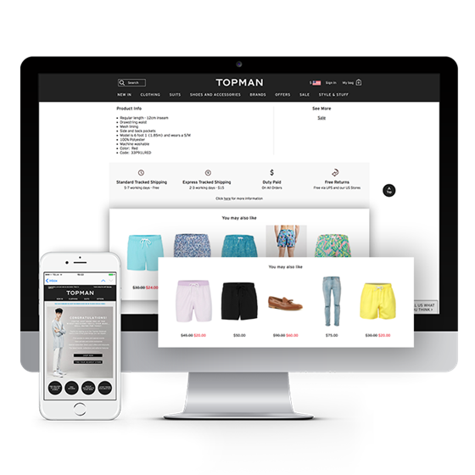
Personalized Recommendations
Every visitor is analyzed based on their individual customer journeys, and actions of similar customers.
It then personalizes page content and product recommendations.

Slide 20
Custom Emails
Personalized product recommendations for email campaigns
Triggered Emails
Notes:
Triggered Emails based on abandoned carts, pages visited

Slide 21
User Tracking
Insights provides a way to view your individual customer’s data and their journey
Allows for the creation of custom user segments

Slide 22
Whats Next?

Slide 23
Next Steps
The biggest issues sited for companies today is lack of:
People who know how to implement machine learning
Access to data
Notes:
We all have the ability now to accumulate more data, so the only thing standing in your way is knowing how to implement
There are a lot of tools out there, especially for devs, around machine learning. Because we are already in the Microsoft ecosystem, I wanted to focus there.
Microsoft has also made really great advancements around making machine learning accessible to non devs

Slide 24
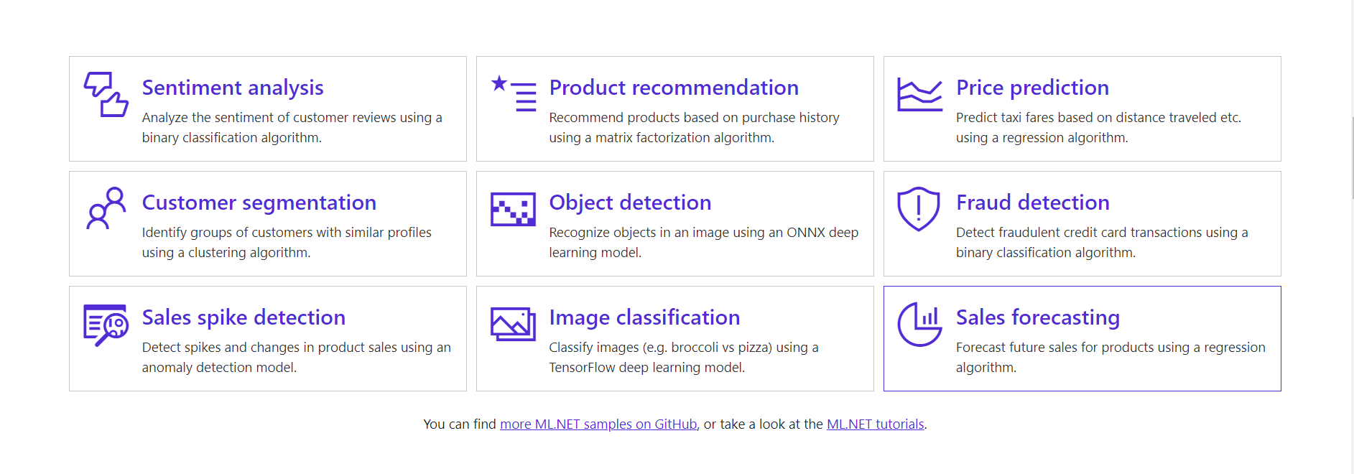
Next Steps - ML.NET for Developers
Notes:
ML.NET was just released earlier this year and is all open sourced.
They provide tutorials on lots of different algorithms based on what you are trying to predict

Slide 25
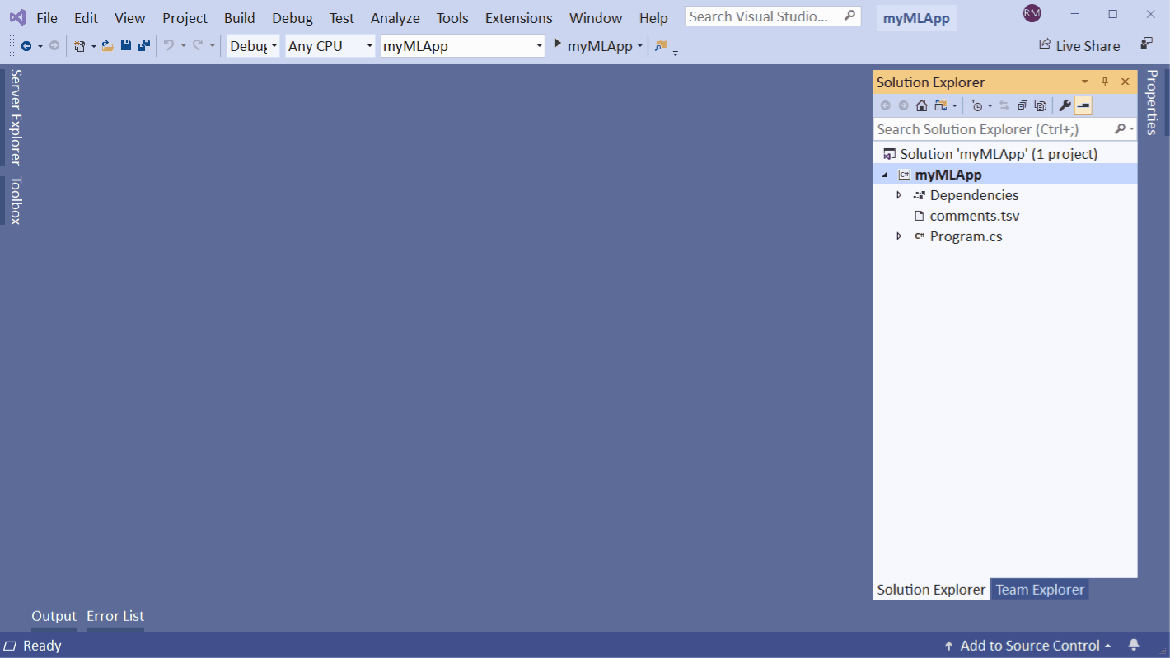
Next Steps - ML.NET for Developers
Notes:
They even include a visual studio extension called Model Builder that walks you through the workflow
It asks for your scenario
As well as your data
Trains the model
Lets you pick from some models that were built based on multiple algorithms
Then spits out the code that you need call to run data against that model

Slide 26
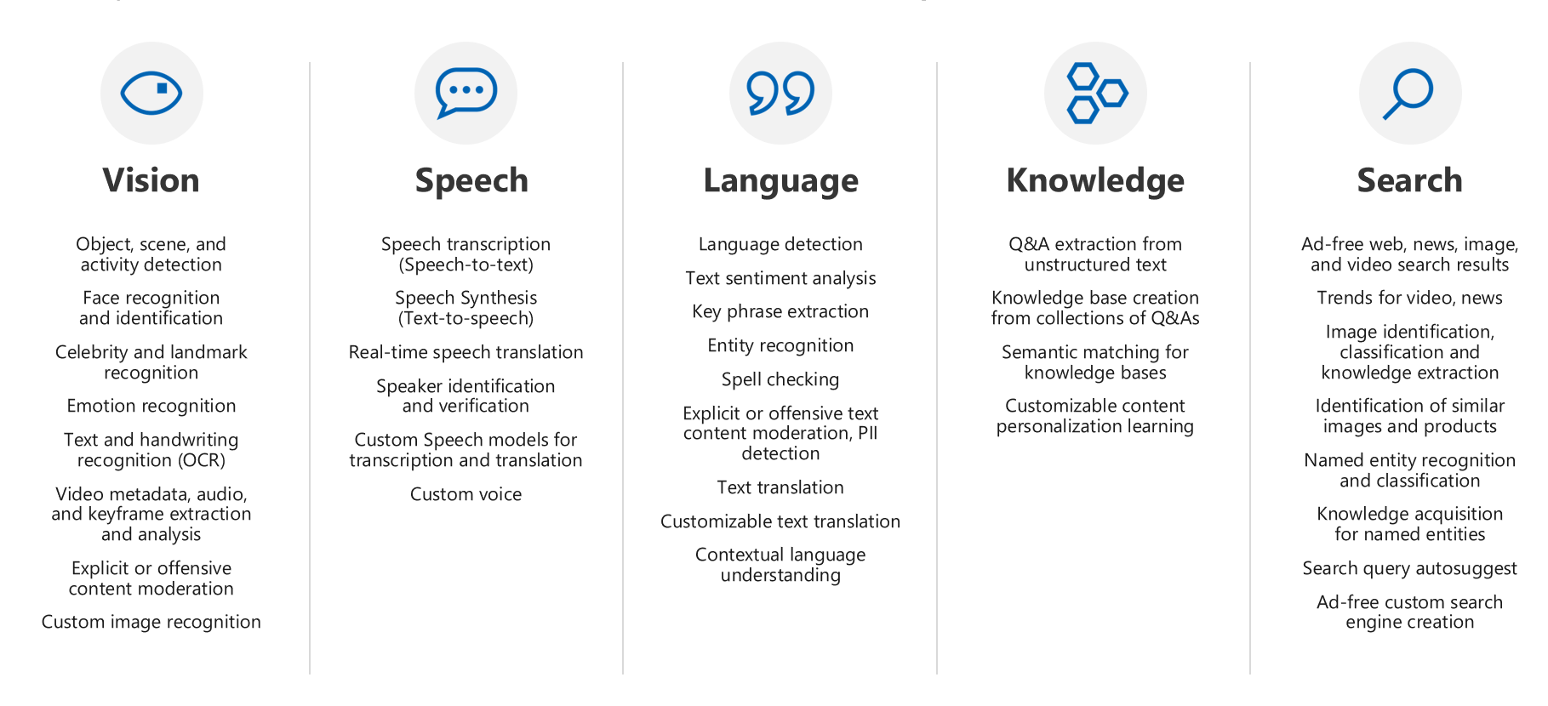
Next Steps - Azure Cognitive Services
Notes:
Some pre built APIs for accessing machine learningfeatures
Facial recognition
Image recognitions
etc

Slide 27
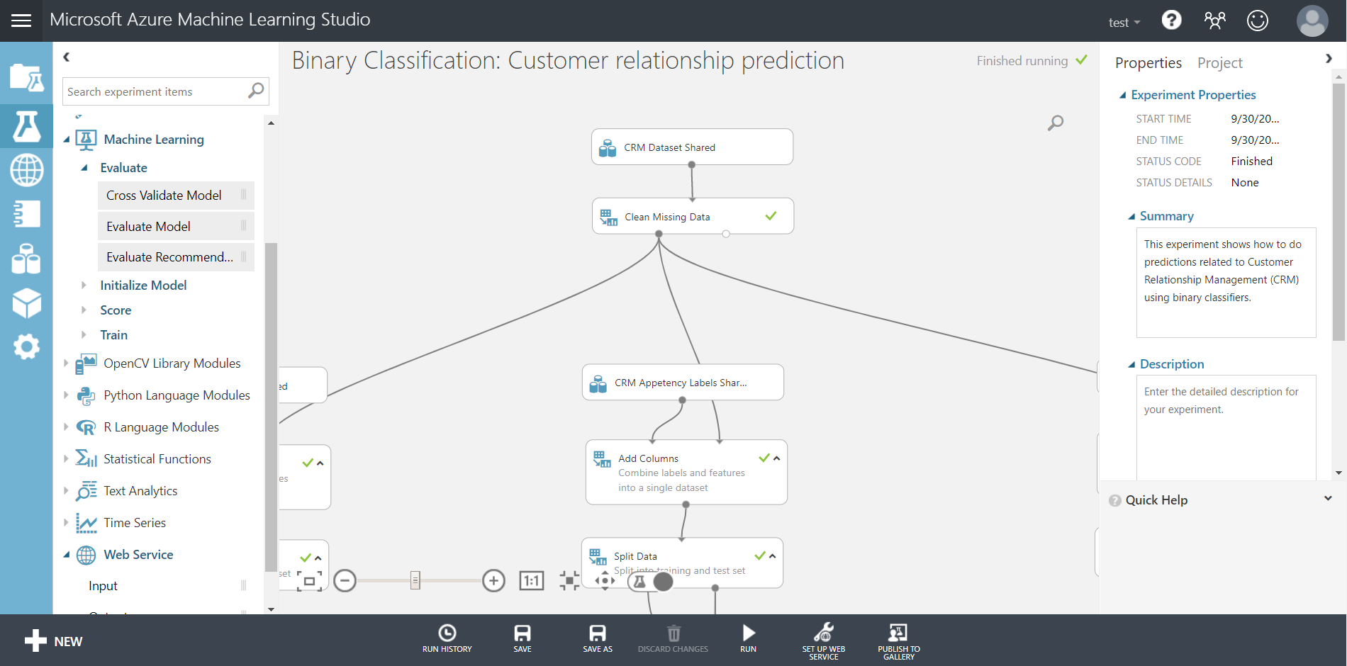
Next Steps - Azure Machine Learning Studio
Notes:
Azure ML Studio was built to bring ML to more less technical business members
Drag and drop interface that allows you to create workflows for every step of the data - algorithm - train - model workflow mentioned before
Built in experiments you can work from
Allows for creating and deploying web apps for accessing your models

Slide 28
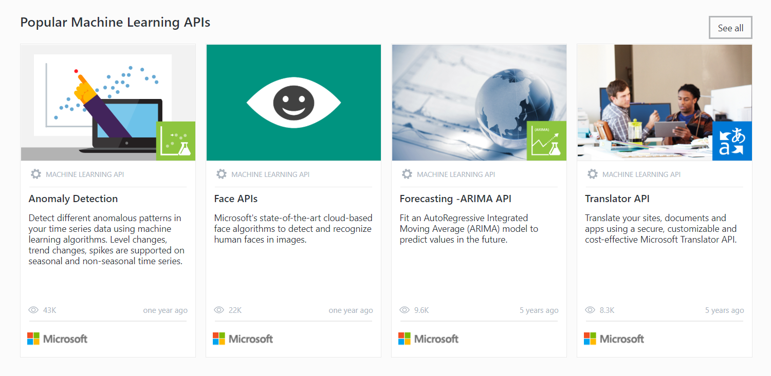
Next Steps - Azure Machine Learning Studio
Notes:
They have lots of pre built implementations

Slide 29
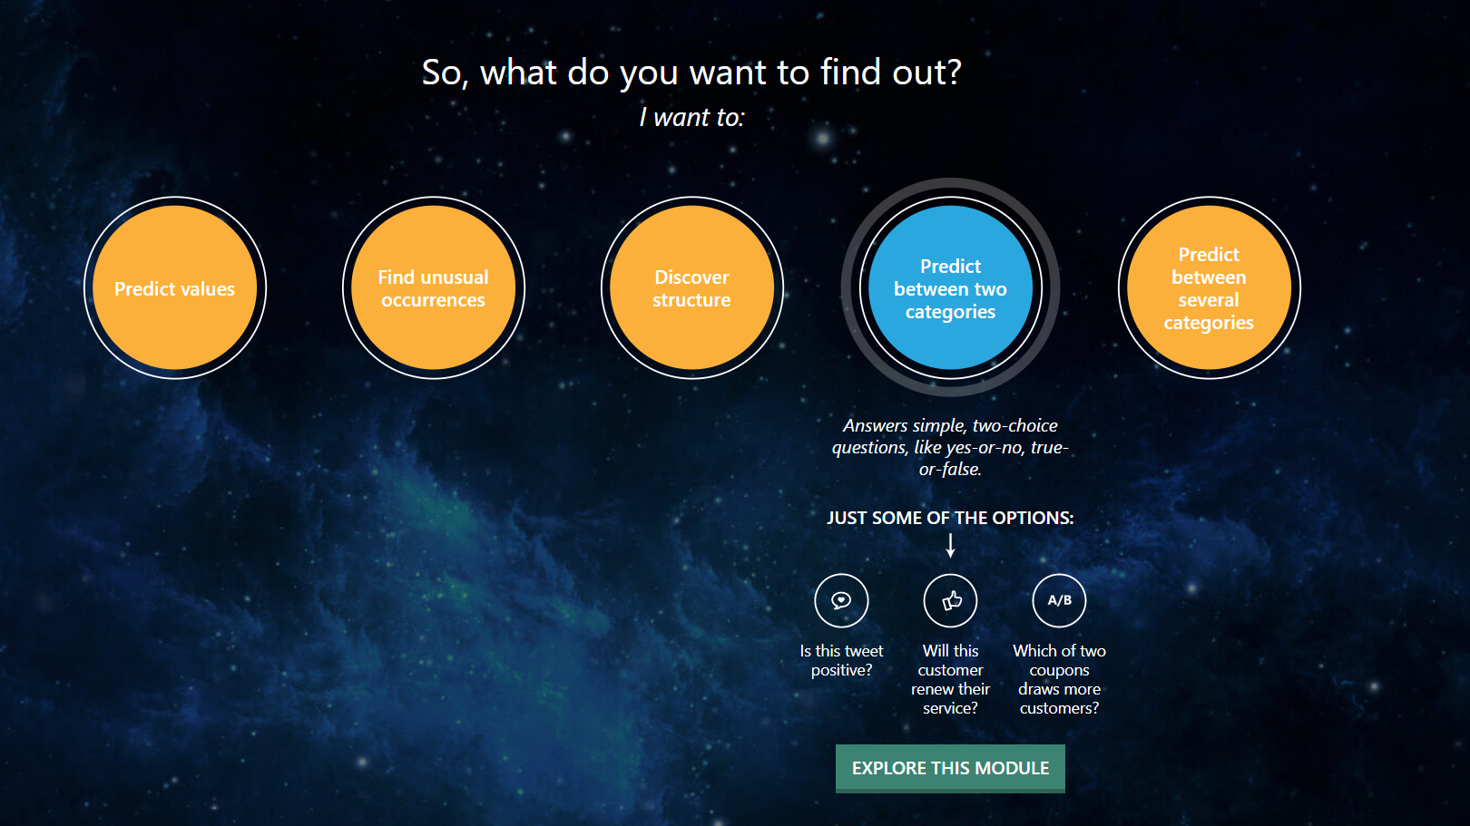
Next Steps - Azure Machine Learning Studio
Notes:
Even if you aren’t sure what you need, Microsoft has guides to help you figure it out.

Slide 30
So What’s the Future for Epi and Machine Learning?

Slide 31
Machine Learning Future with Episerver
Some things we have already seen
Previous Microsoft Machine Learning Code Bash at Ascend
Notes:
We won the code bash in 2017 using microsofts cognitive services facial recognition for Episerver login

Slide 32
Machine Learning Future with Episerver
Some things we have already seen
Previous Microsoft Machine Learning Code Bash at Ascend
Shoe demo at last year’s Ascend
Notes:
During last year’s ascend we started tracking users in store to collect more data for a more personalized experience

Slide 33
Machine Learning Future with Episerver
Some things we have already seen
Previous Microsoft Machine Learning Code Bash at Ascend
Shoe demo at last year’s Ascend
New image tagging functionality
Notes:
If you have seen the new mosey demo site, it uses cognitive services to tag images on upload to be used in searching, alt text, etc.

Slide 34
Machine Learning Future with Episerver
So what’s the future look like with Machine Learning and Episerver?
Notes:
Episerver already accomplishes a lot in an area that has a lot of value, personalization.
I think while that can continually be refined and expanded on, we can also look to incorporate ML into Episerver in other ways.
In reality its all open to you. Both for the editor and the end user.
Next step I would recommend learning how to ask the right questions. Once you have a clear question in mind, you can work to find a solution to it in ML.

Slide 35
Key Takeaways
01
There are lots of resources to help get you going with Machine Learning.
02
Machine Learning is big right now and Episerver has your back.
03
Focus first on the question you want to solve.
Notes:
Microsoft and other companies are really trying to make machine learning more accessible to the average user. There are tons of great resources out there.
Even if you feel you don’t have the bandwidth to look into other tools like the items discussed here, Episerver still has you covered.
Next step I would recommend learning how to ask the right questions. Machine learning is just a tool. Once you have a clear question in mind, you can work to find a solution to it in ML.

Slide 36
Key Takeaways
https://gallery.azure.ai/machineLearningAPIs
https://azuremlsimpleds.azurewebsites.net/simpleds/
https://dotnet.microsoft.com/apps/machinelearning-ai/ml-dotnet
Notes:
Ill be posting this presentation, but if anyone is interested there are some good ML resources
Gallery of dozens of pre built APIs you can deploy to your azure instance
Machine Learning “cheat sheet”. Once you have that question in mind, you can use this to help choose the right algorith for you
Link to ML.NET info, along with that visual studio plugin

Slide 37
Machine Learning + Episerver

