Slide 1

Available from
this library
ScienceDirect
is a leading resource of peer-reviewed science, technology & health information

Slide 2





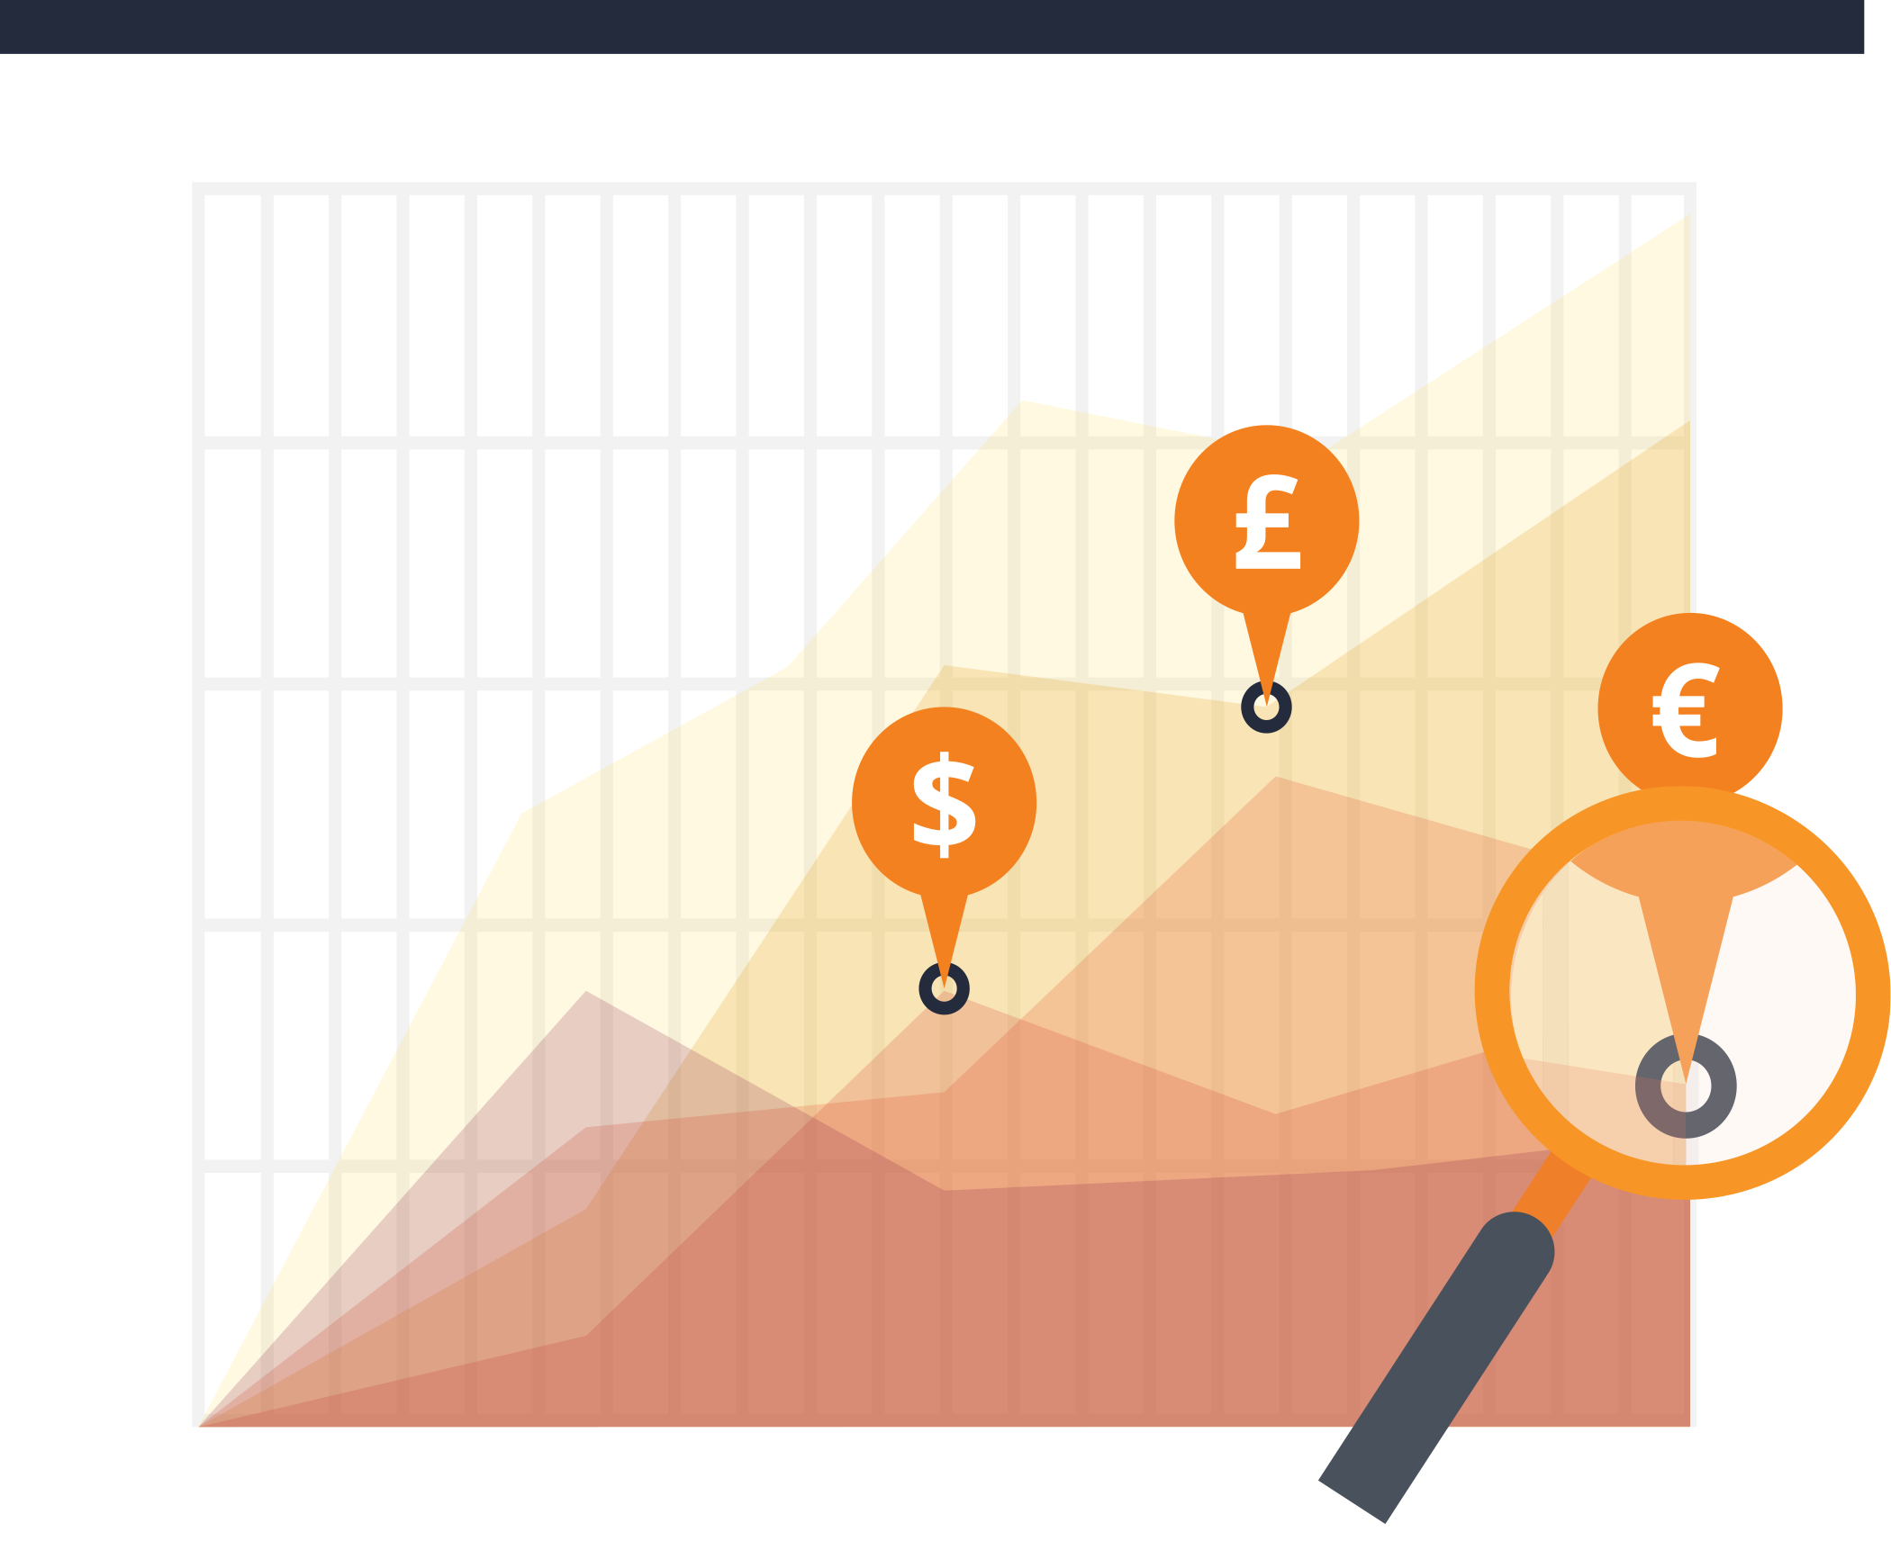






















Explore
24 major
disciplines:
Physical Sciences & Engineering
Health Sciences
Life Sciences
Social Sciences & Humanities

Slide 3




Discover over
39,000 books
Researchers, teachers &
students around the globe trust
the over 16 million authoritative
articles on ScienceDirect
Access more than
2,500 journals

Slide 4


Ready, set, discover
Use ScienceDirect & get
more relevant search results
1. Enter
your search
2. Run
your search
3. Save
your search
(to run again later)
Download the PDF at anytime while you read

Slide 5







ScienceDirect can recommend
other publications to you based
on the one you’ve selected
All of these options ― & more ― are available to you from this library & ScienceDirect

Slide 6



Stay current with ScienceDirect Alerts
Receive automatic updates
about new publications
Stay up-to-date in
your field
Get closer to the
research that
matters most to you

Slide 7


Never lose track of an article again
You can then:
Review
Simply sign in to your registered ScienceDirect account to keep track of your research and ensure you can find useful articles again when needed.
Save
Delete items
This new feature follows your activity, keeping track of the 100 most recent articles or book chapters you have viewed, sorted by date and time.
Download the full list of entries

Slide 8

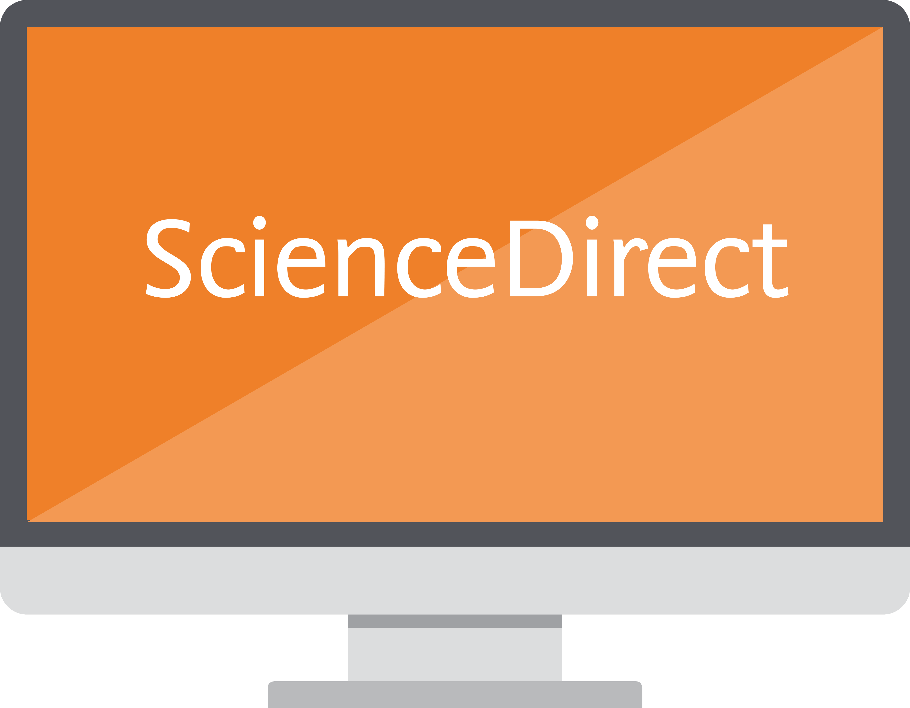


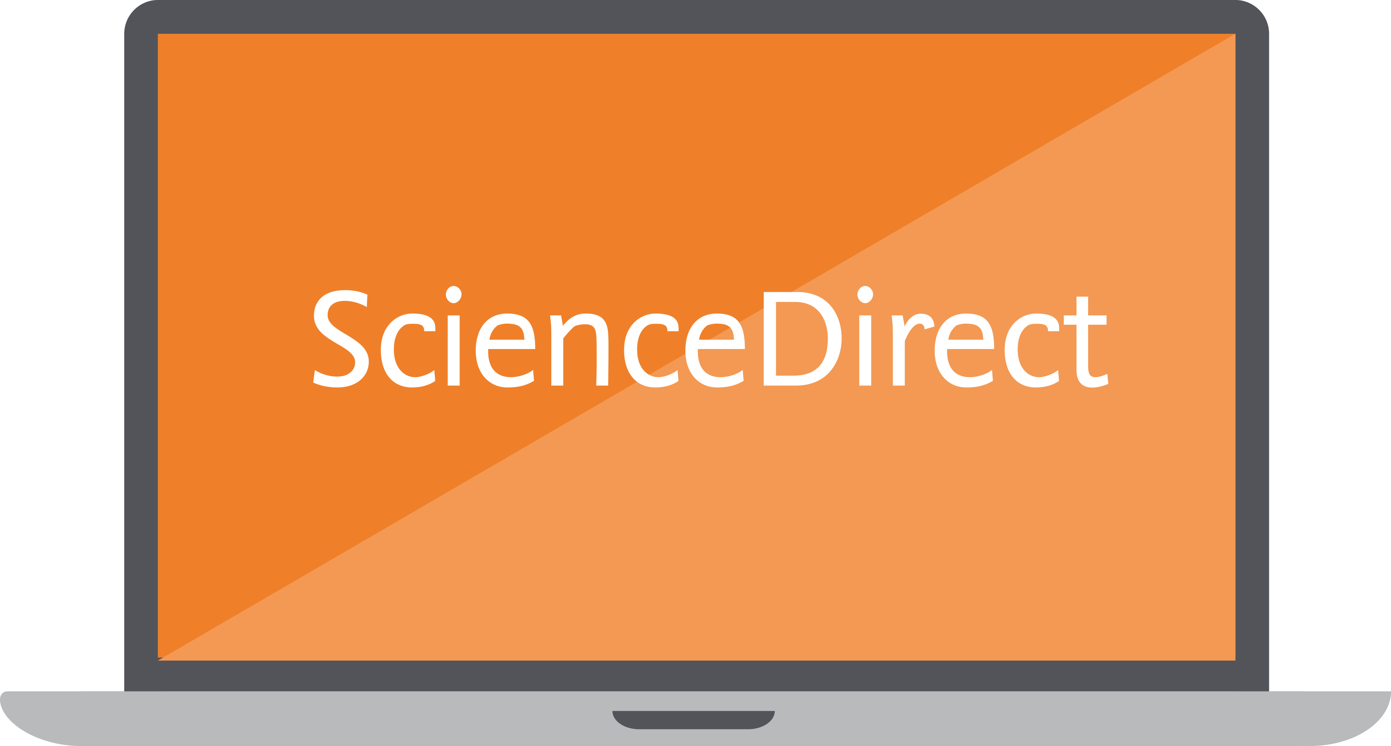

Access ScienceDirect
from your library:
Access
ScienceDirect remotely
Register on ScienceDirect for remote
access & keep your research going strong
wherever you are
And read on your:
Desktop – Laptop – Tablet – Mobile
  On campus
  At home
  At a conference
  In the field

Slide 9









You’ve found
the publications you need, now what?
Get organized
Mendeley is also an easy way to
network & collaborate with others,
especially if you’re working
on a team
With Mendeley, you can make
your own fully searchable library
in seconds
Put all your reading from ScienceDirect
in one place – export references & save
PDFs to Mendeley, a free reference manager

Slide 10


It’s that simple to get started on ScienceDirect & discover the publications you need
ScienceDirect is the place
to start for you to …
Stay more informed …
in your areas of interest
Be more effective …
in your research,
teaching or studies
Be more efficient …
with how and where
you work

Slide 11
ScienceDirect is the place
to start for you to …
Stay more informed …
in your areas of interest
All this is possible,
thanks to your
library
Be more effective …
in your research,
teaching or studies
Be more efficient …
with how and where
you work

