Slide 1
The Biodiversity Information for Development (BID) programme Background and current projects
Tim Hirsch, Deputy Director, GBIF Secretariat
Side event at CBD SBSTTA 21, 12th december 2017

Slide 2
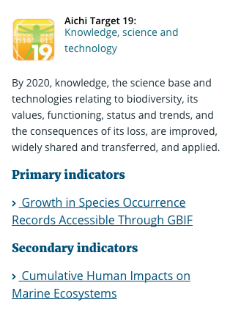
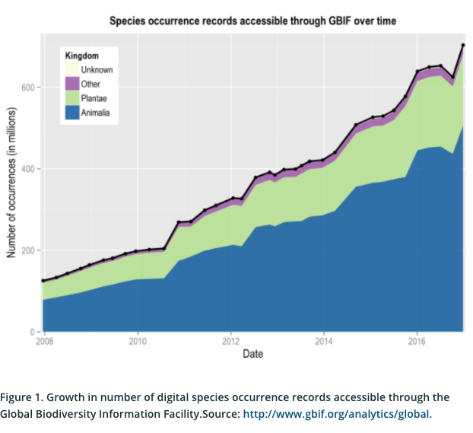
GBIF and cbd
Primary indicator of progress towards Aichi Target 19
https://www.bipindicators.net/indicators/growth-in-species-occurrence-records-accessible-through-gbif
Notes:
GBIF AND THE CBD
Growth in species occurrence records accessible through GBIF is the only fully-developed indicator for Aichi Target 19, recognized by the Biodiversity Indicators Partnership and formally adopted by the CBD. Target 19 deals with the improvement, sharing, transfer and application of biodiversity knowledge. GBIF produces regular metrics showing trends in the mobilization of data at the global level, and these metrics are also available at national scale to help countries to monitor progress towards this target. In addition, sharing of data through GBIF is recognized as providing important knowledge support for achieving a number of other targets, including: Target 9 on addressing the impact of invasive alien species; Target 10 on reducing threats to climate-vulnerable ecosystems such as coral reefs and mountains; Target 11 on expanding and improving protected areas; Target 12 on reducing the risk of species extinctions; and Target 13 on conserving genetic diversity for example among plant species important for crop development.

Slide 3
GBIF and CBD
CBD guidelines on improving accessibility of biodiversity related data and information - CBD/COP/DEC/XIII/31
THE GUIDELINES
Promote open data access through policy incentives
Promote the use of common data standards
Invest in digitization of natural history collections
Establish national biodiversity information facilities
Enhance national capacity in biodiversity informatics
…
https://www.cbd.int/decisions/cop/?m=cop-13

Slide 4
GBIF and CBD
THE GUIDELINES (continued)
…
Engage the public in biodiversity observation through citizen science networks
Encourage data sharing from the private sector
Develop national platforms for data discovery, visualization and use
Analyse data and information gaps to prioritize new data mobilization
Engage with and support regional and global networks for data mobilization
https://www.cbd.int/decisions/cop/?m=cop-13

Slide 5
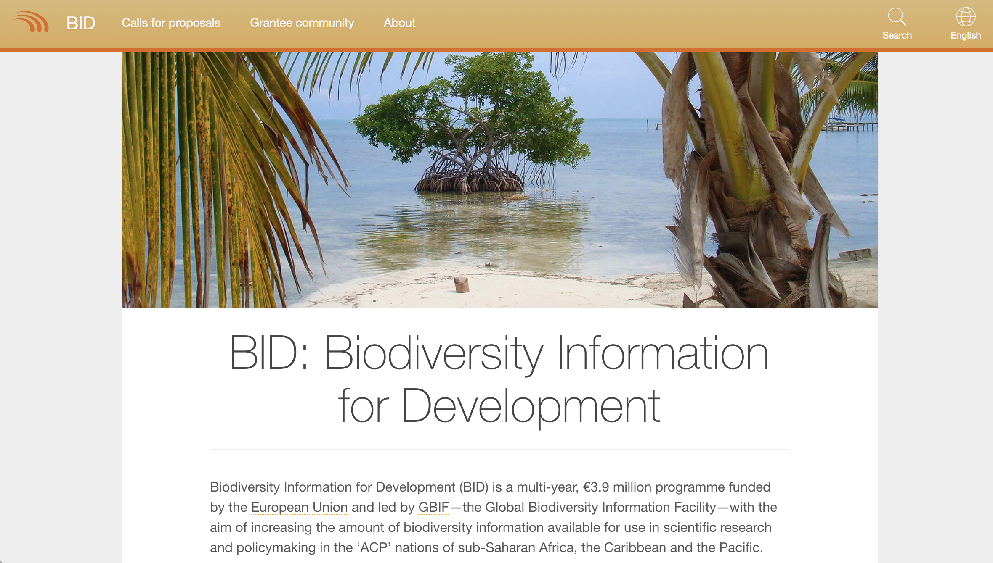
BID programme - overview
4- year programme 2015-19
Funded by EU under Biodiversity for Life flagship initiative
Aims to increase availability of biodiversity data for research and policy in Africa, Caribbean and Pacific
Enhance capacity to mobilize data using common standards through GBIF
https://www.gbif.org/programme/82243/bid-biodiversity-information-for-development

Slide 6
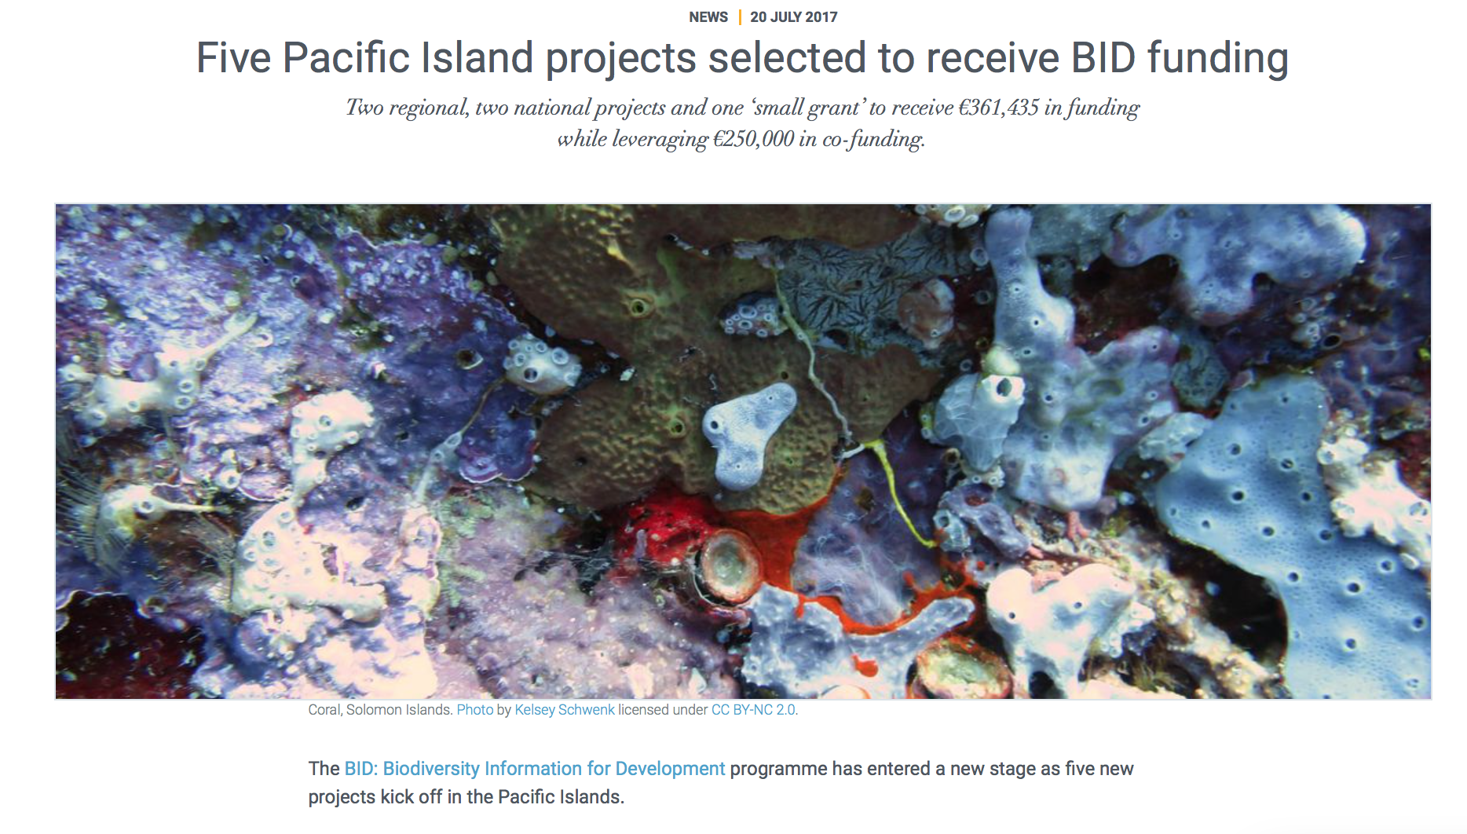
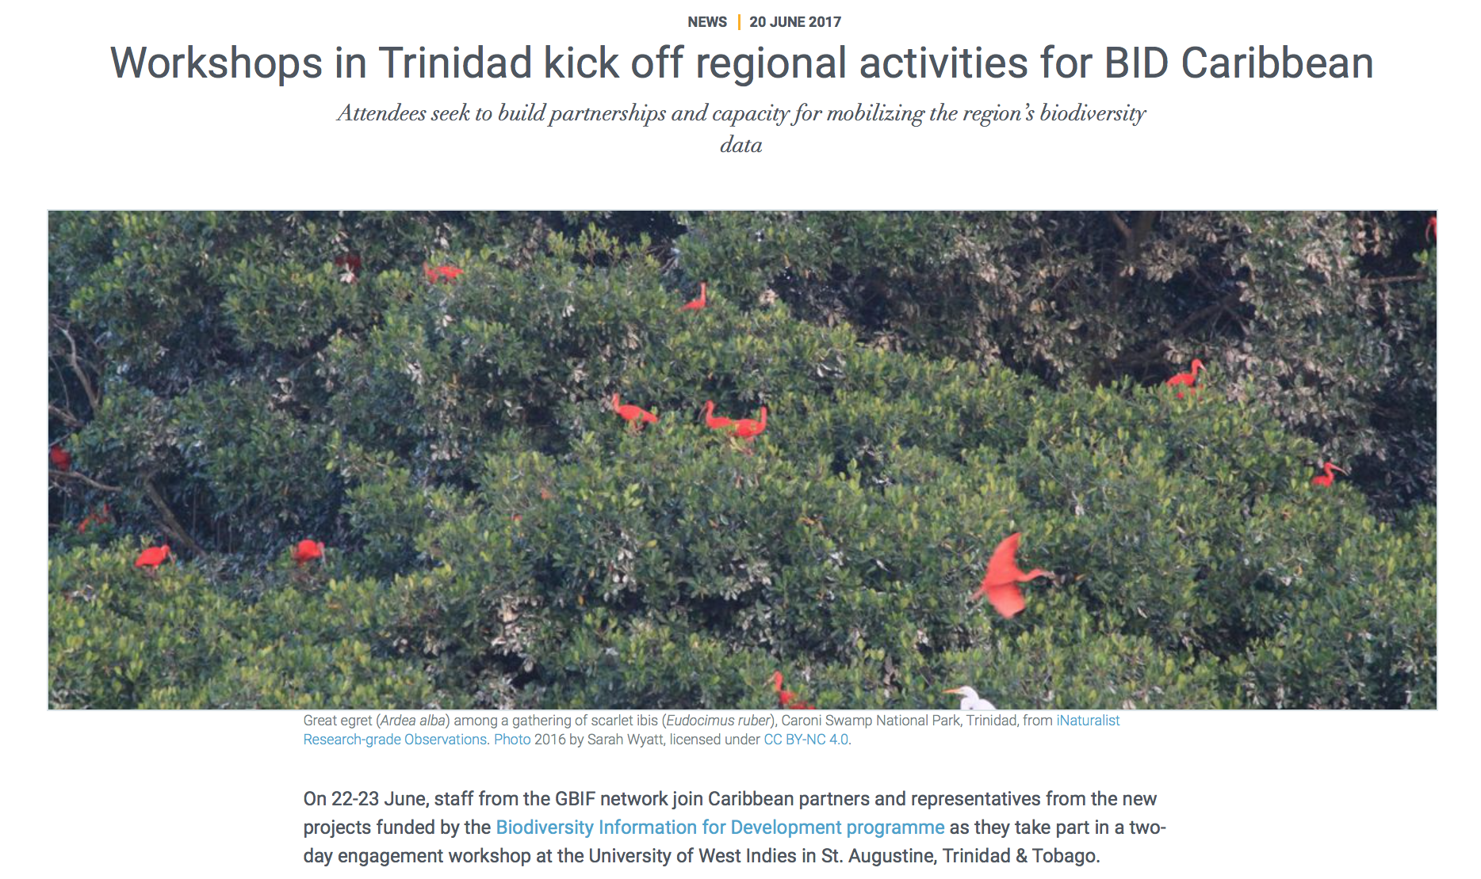
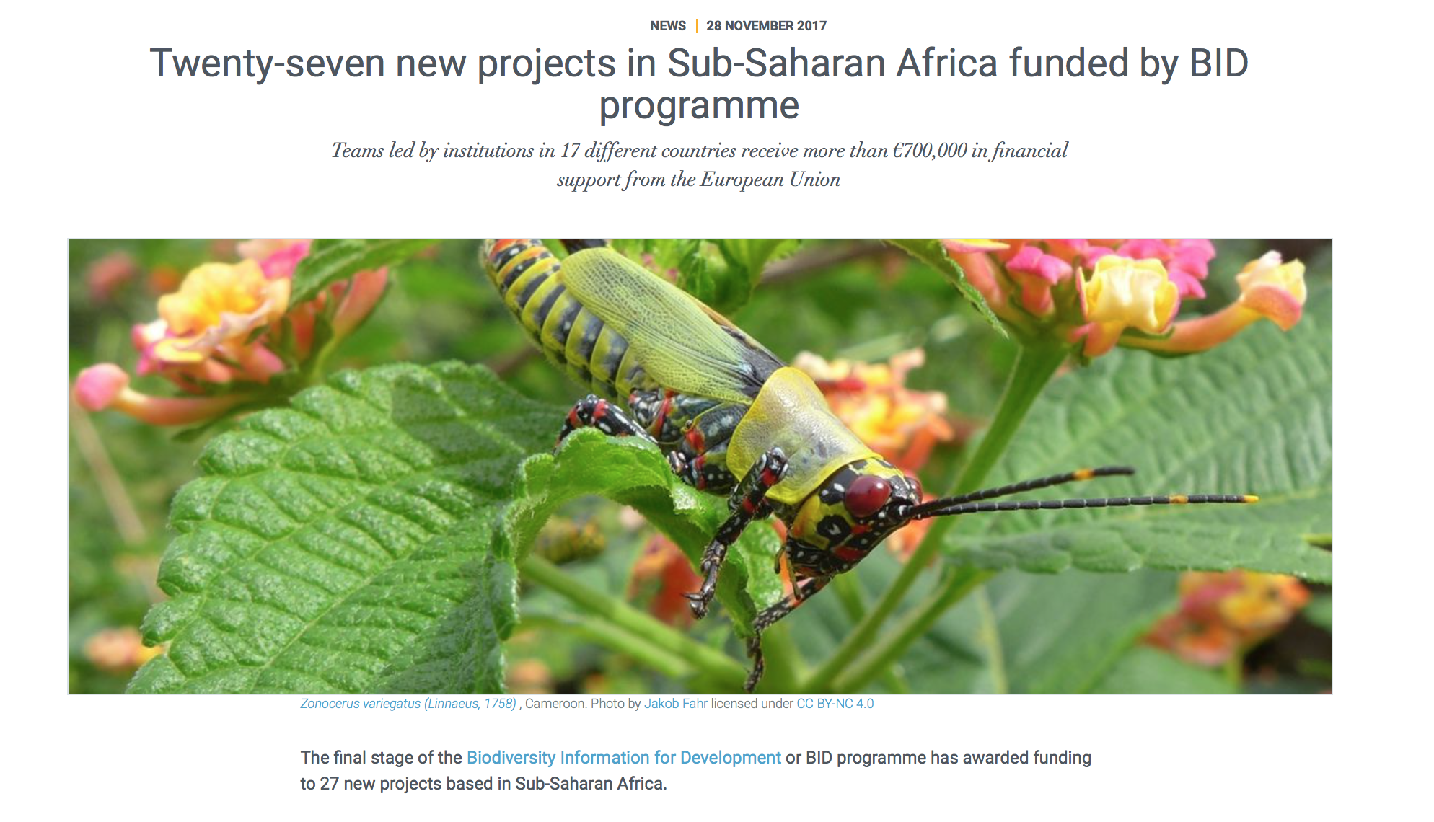
BID programme – project calls
4 calls for proposals for regional, national, small projects
50 projects in Africa (2 funding calls), 8 in Caribbean, 5 in Pacific
2nd Africa call (2017) drew 386 concept notes
https://www.gbif.org/programme/82243/bid-biodiversity-information-for-development

Slide 7
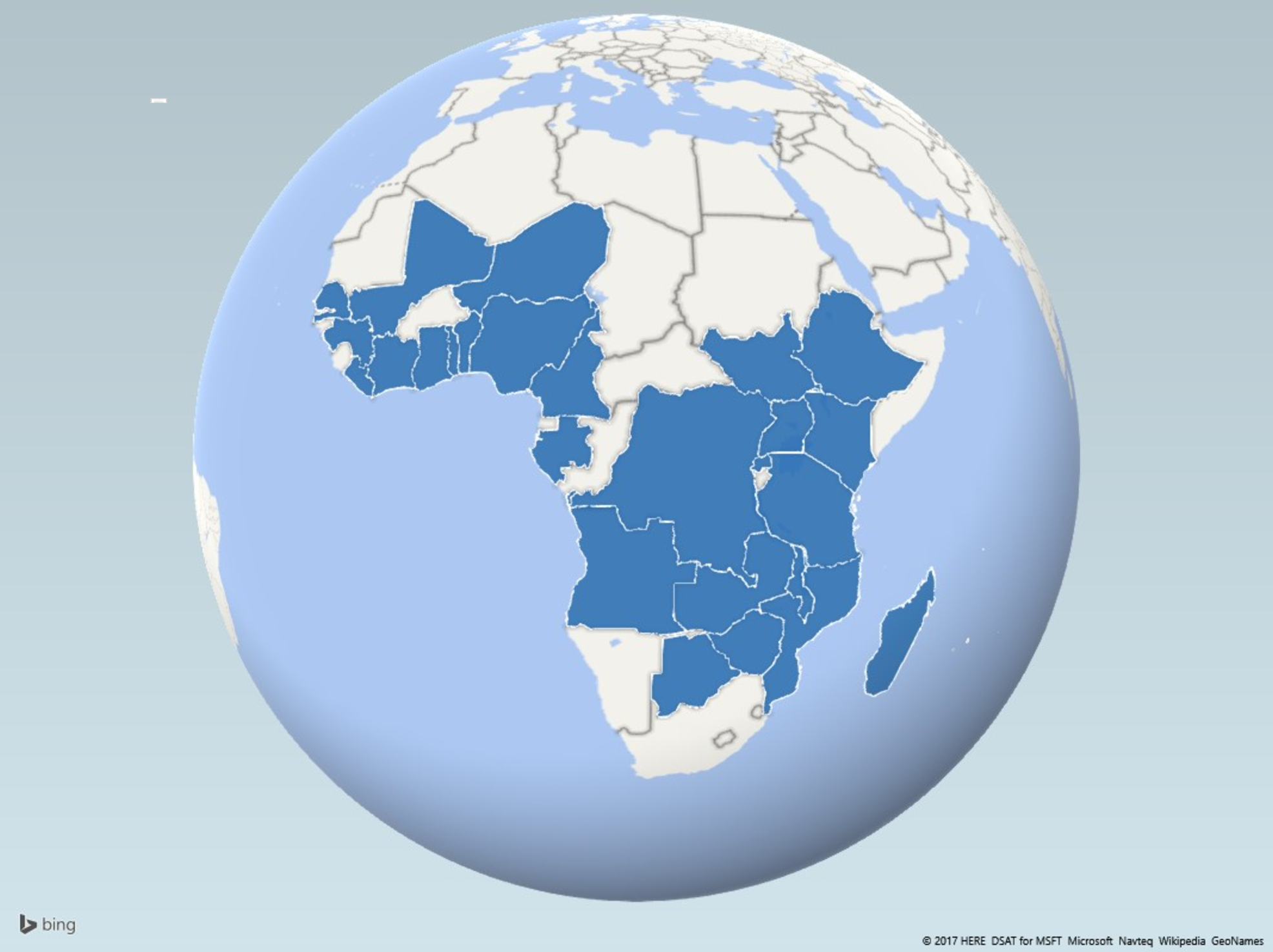
Bid programme – project locations

Slide 8
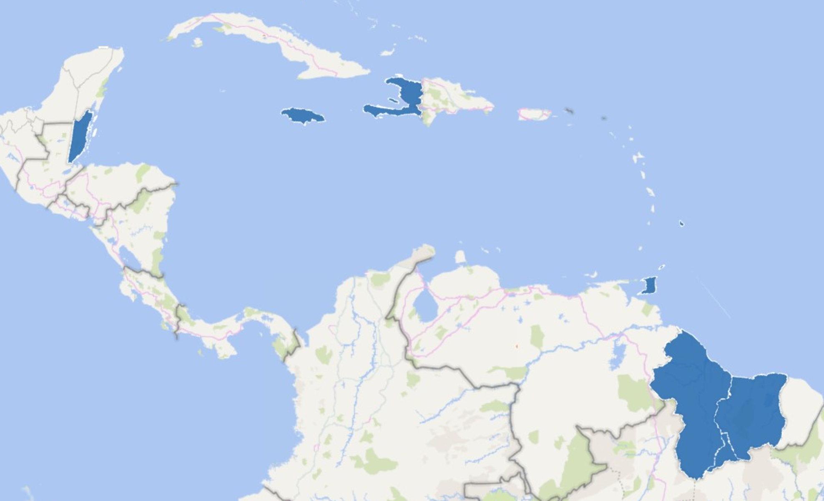
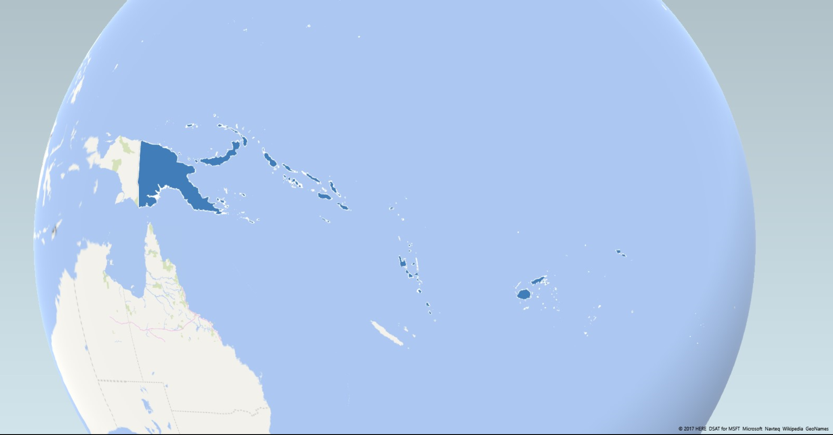
Bid programme – project locations

Slide 9
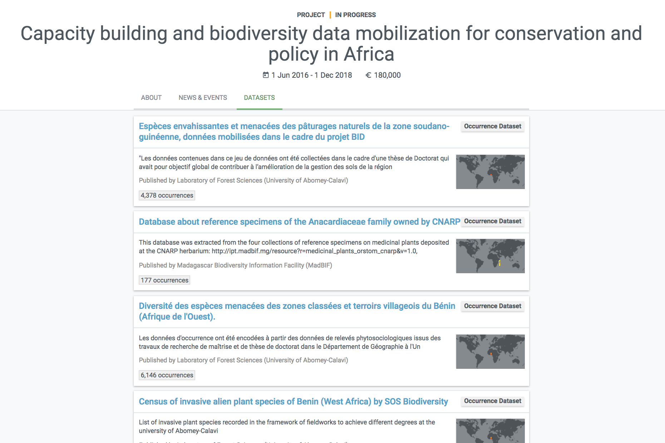
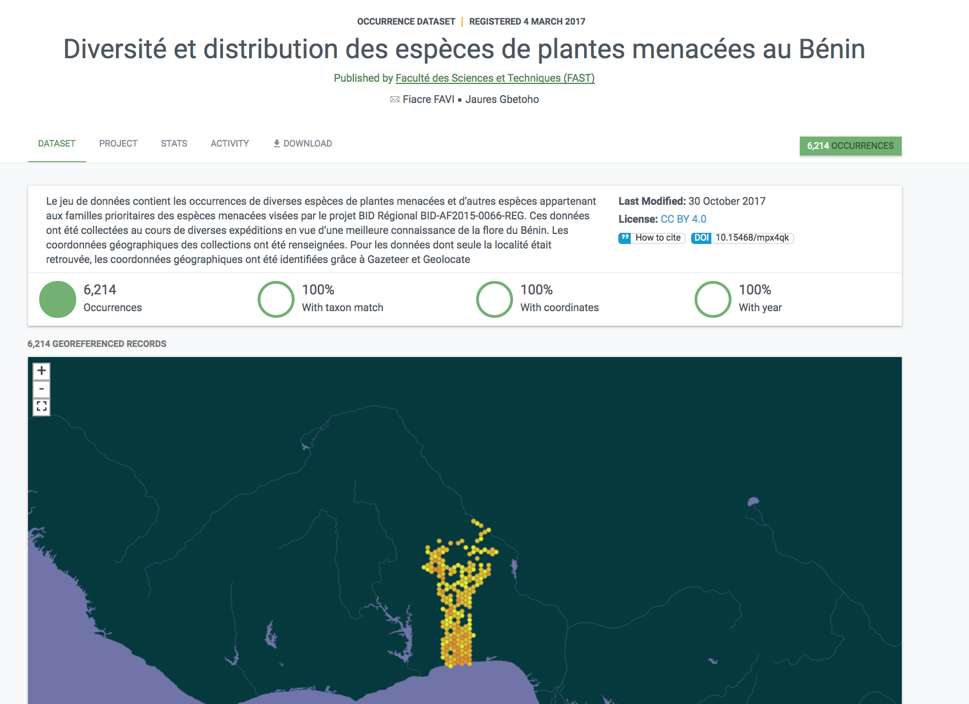
The bid projects – some early results
13 datasets on threatened and invasive species in 8 francophone African countries
https://www.gbif.org/project/82750/capacity-building-and-biodiversity-data-mobilization-for-conservation-and-policy-in-africa

Slide 10
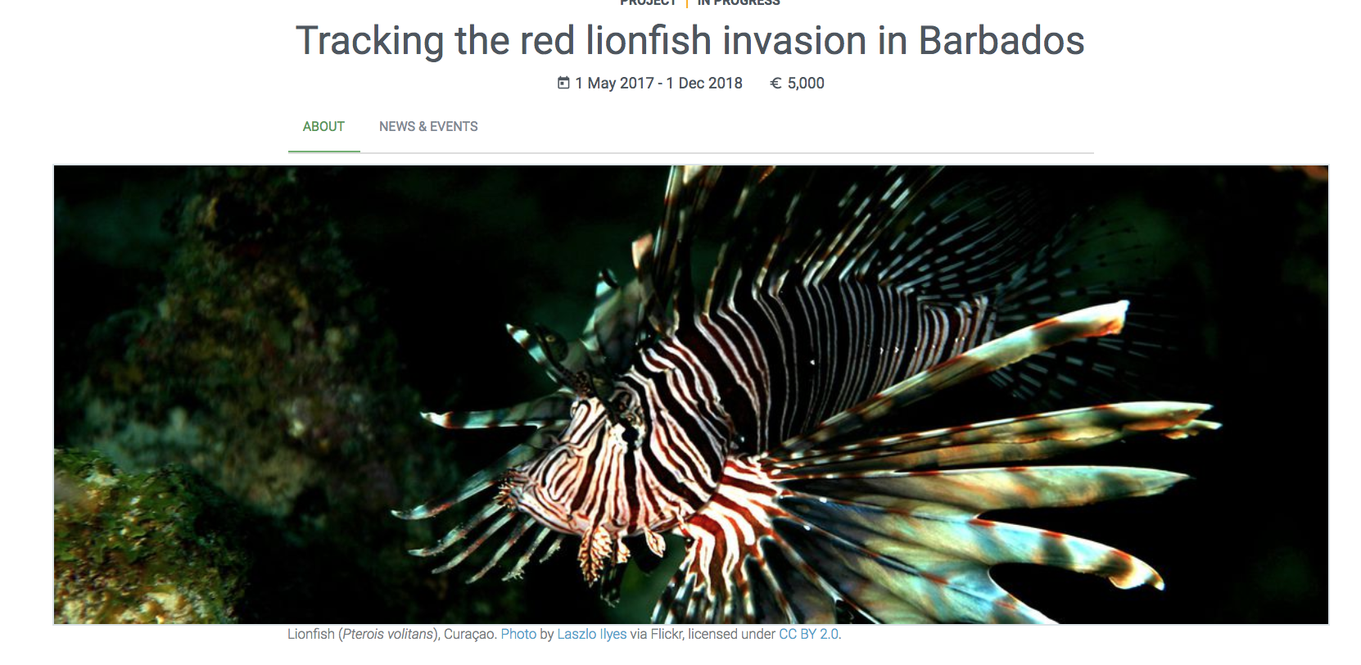
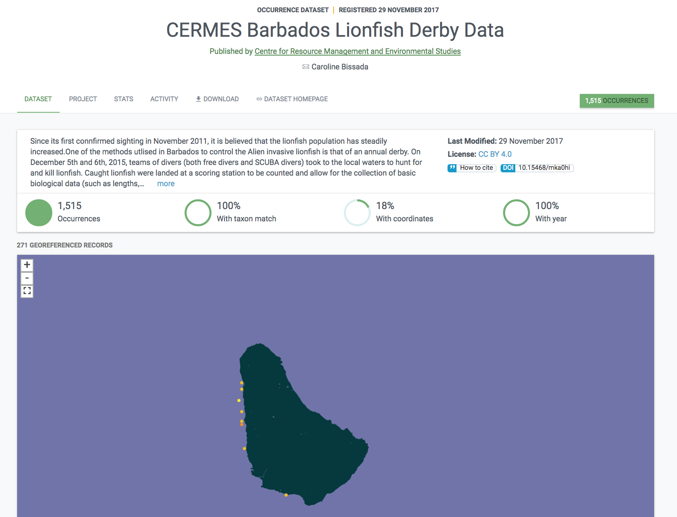
The bid projects – some early results
>1,500 records of invasive lionfish sightings/capture off Barbados coastline, data to inform invasive species management
https://www.gbif.org/project/83254/tracking-the-red-lionfish-invasion-in-barbados https://www.gbif.org/publisher/ca795017-46be-41d9-bd84-3c34997ae672

Slide 11
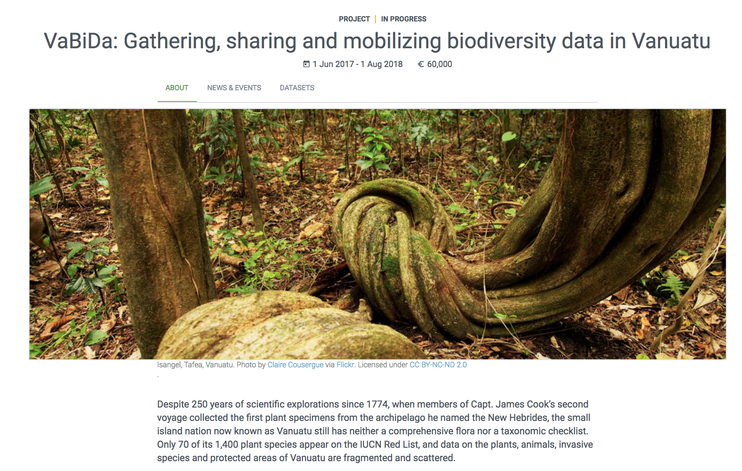
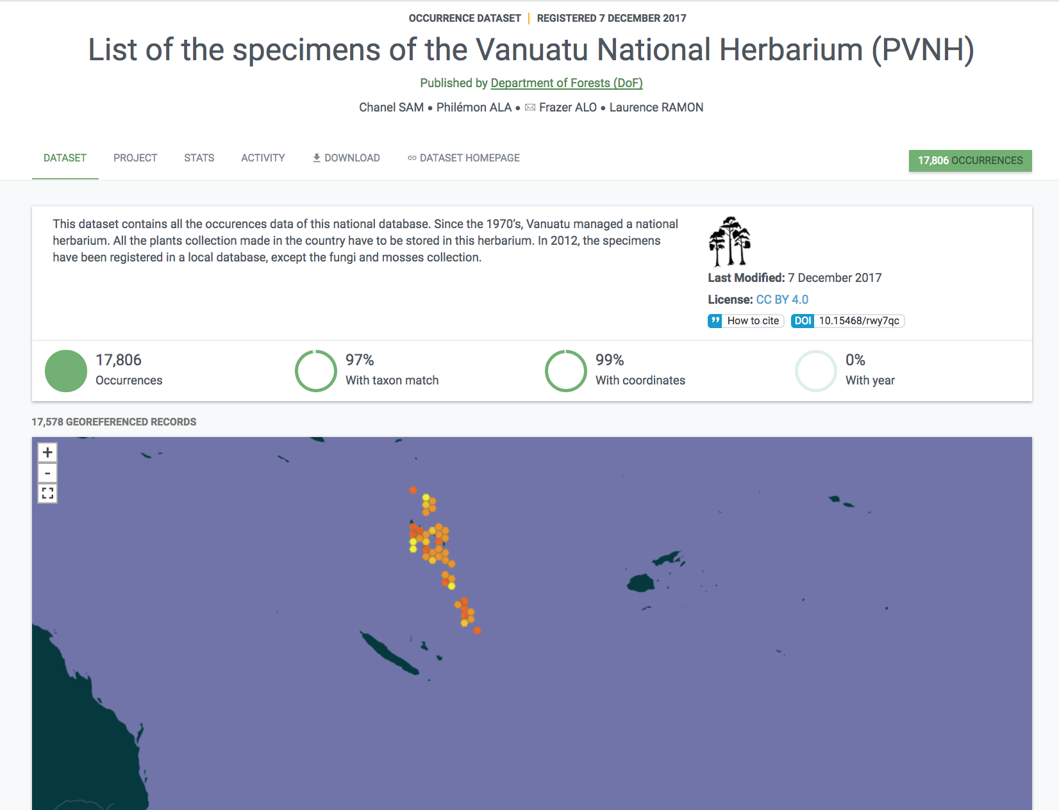
The bid projects – some early results
17,000 georeferenced plant specimen records from Vanuatu National Herbarium
Mobilising previously inaccessible data to inform environmental policies
https://www.gbif.org/project/83267/vabida-gathering-sharing-and-mobilizing-biodiversity-data-in-vanuatu

Slide 12
Biodiversity data mobilization and the sdgs
Informing policies on conservation and sustainable use in terrestrial and marine ecosystems

Slide 13
Biodiversity data mobilization and the sdgs
Informing policies on food security, for example data on distribution of crop wild relatives to prioritise conservation of genetic resources for future crop development

Slide 14
Biodiversity data mobilization and the sdgs
Informing policies on human health, for example data on distribution of disease hosts and vectors to model areas at risk from zoonotic disease outbreaks

Slide 15
Biodiversity data mobilization and the sdgs
Informing policies on climate change adaptation, for example data for models to project future areas of suitability for crops, economically-important wild species, invasion risk, protected areas etc.

Slide 16
Thank you!
thirsch@gbif.org
https://www.gbif.org/

