Slide 1
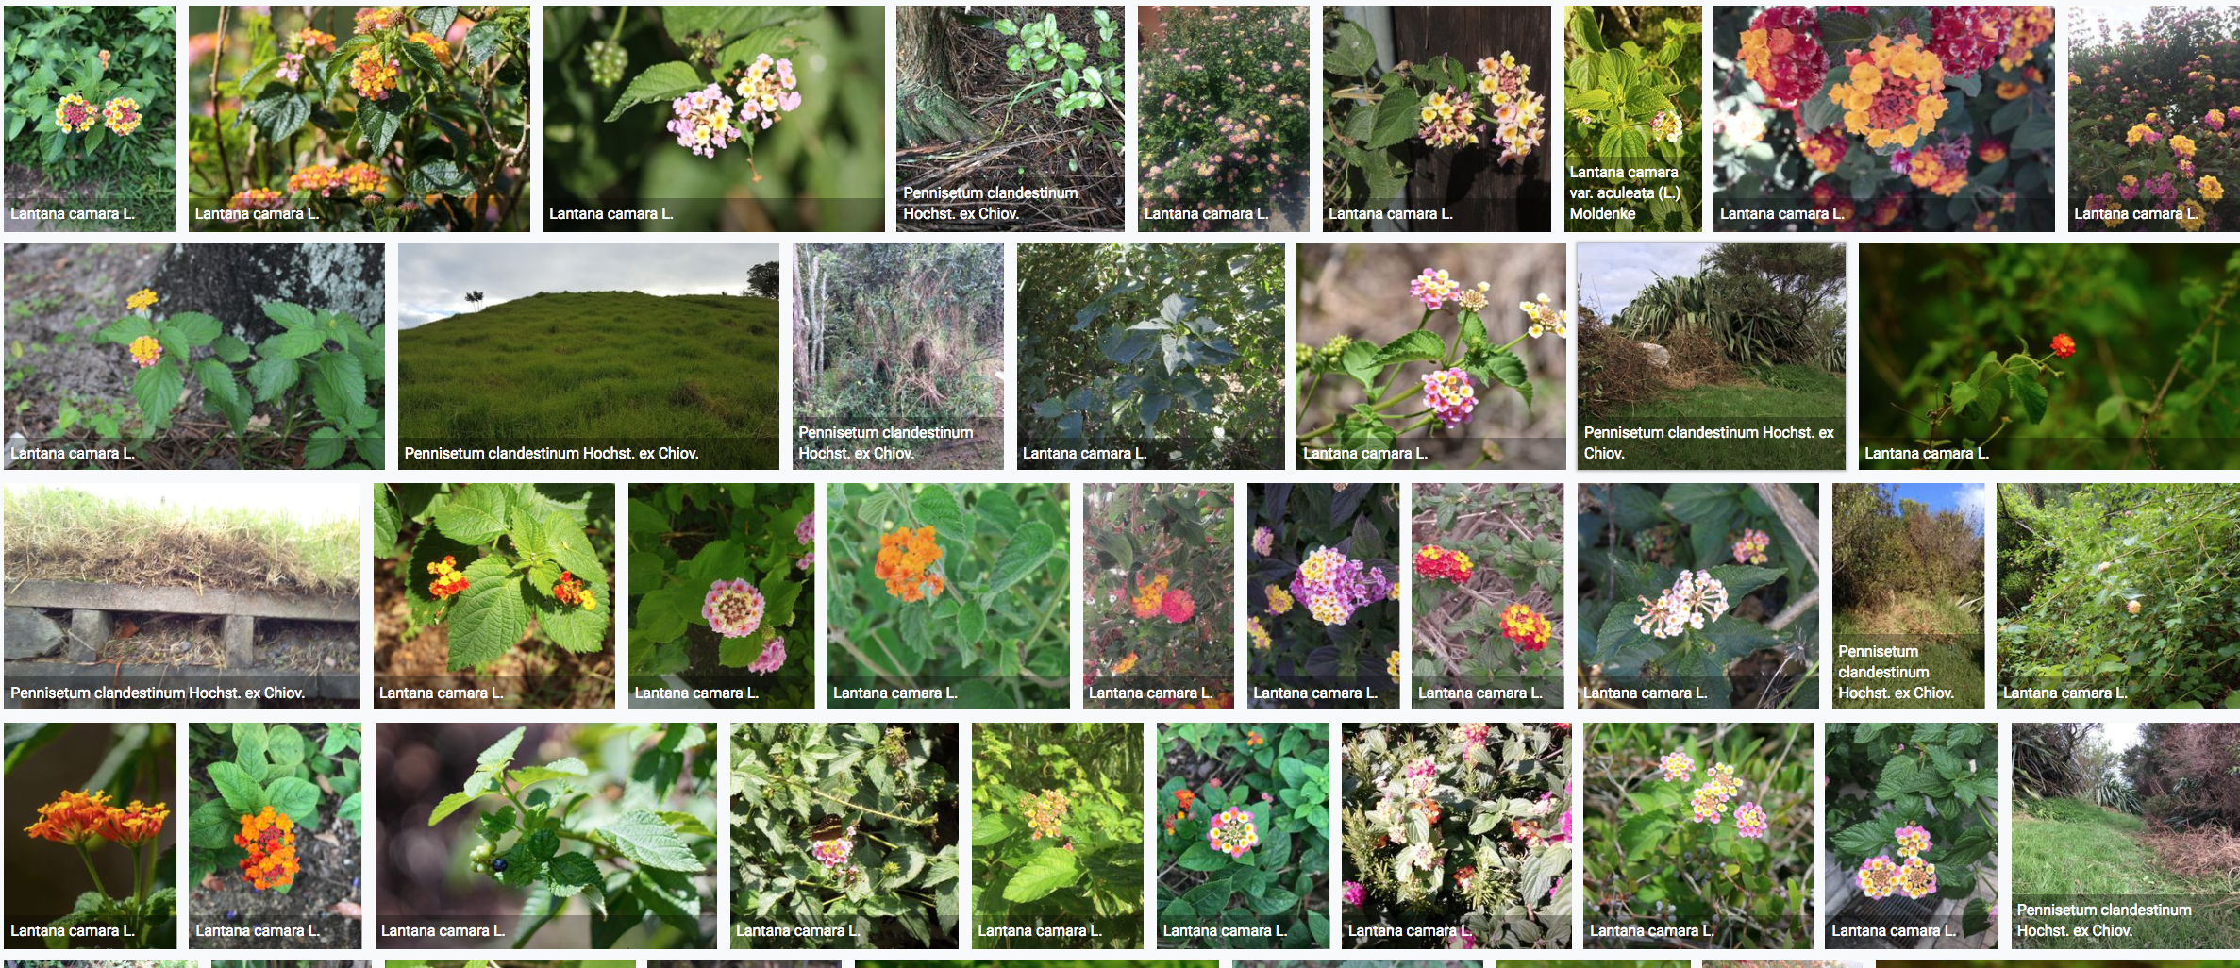
Open data helping to achieve Target 9
Tim Hirsch, Deputy Director, GBIF
Side event on invasive alien species, un biodiversity conference, sharm el sheikh, 19 November 2018

Slide 2
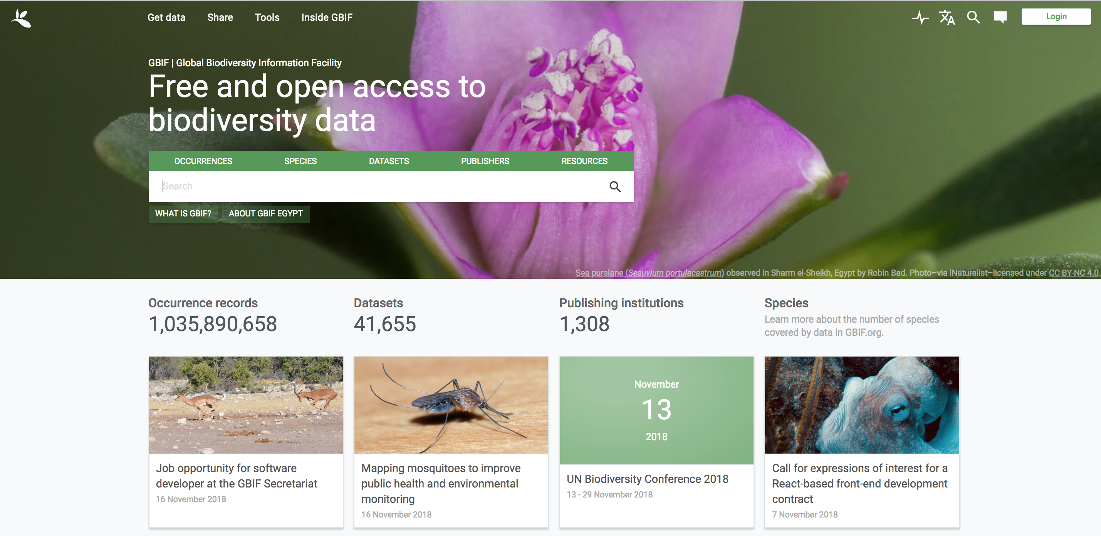
A platform for sharing evidence on all species
Over one billion records on where species have lived, and when they lived there
https://www.gbif.org/

Slide 3
Now includes checklists from the Global Register of Introduced and Invasive Species, covering 114 countries, islands and territories (so far)
https://www.gbif.org/dataset/search?publishing_org=cdef28b1-db4e-4c58-aa71-3c5238c2d0b5

Slide 4
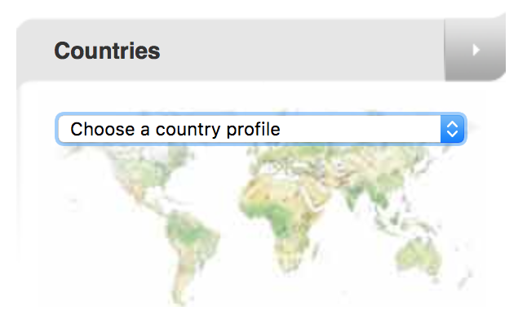
Access to invasive species data via the CBD clearing house mechanism …
https://www.cbd.int/

Slide 5
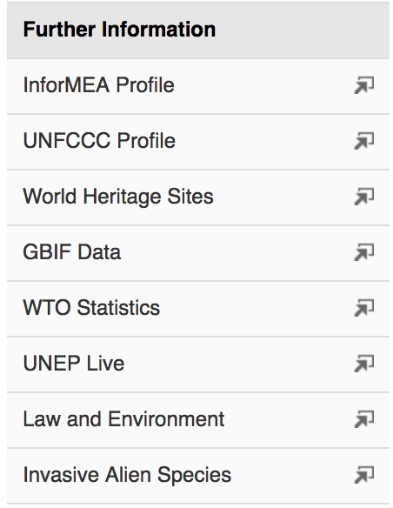
Linked from CBD country profile pages
https://www.cbd.int/countries/?country=eg

Slide 6
And from gbif country pages
https://www.gbif.org/country/EG/summary

Slide 7
country list example: egypt
Country editors credited, available for feedback to help data improvement and curation
https://www.gbif.org/dataset/7a9e2043-9b54-4ab8-9bb2-c95341dbee37

Slide 8
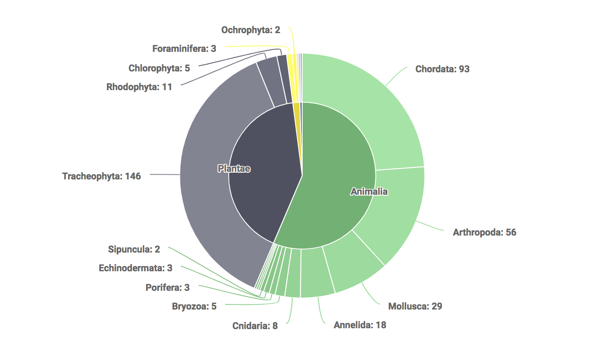
Country list example: egypt
https://www.gbif.org/dataset/7a9e2043-9b54-4ab8-9bb2-c95341dbee37

Slide 9
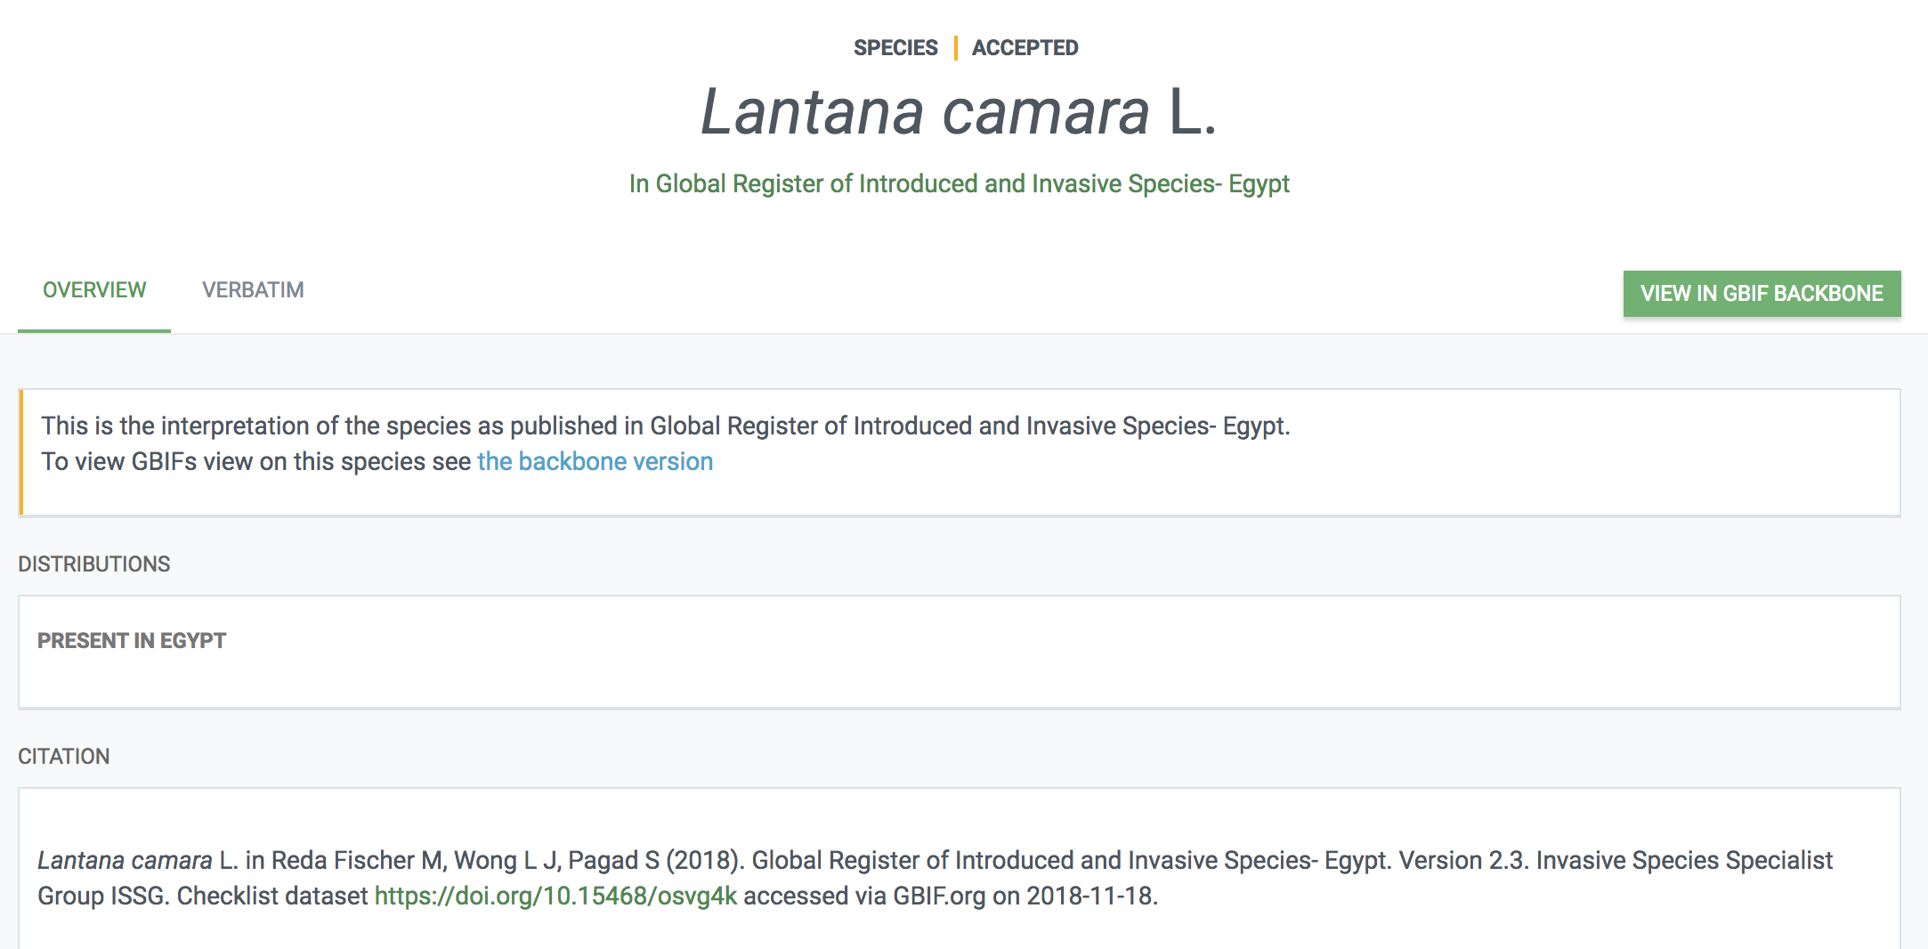
Country list example: egypt
Each species linked to other shared data through GBIF taxonomic backbone
https://www.gbif.org/species/134857213

Slide 10
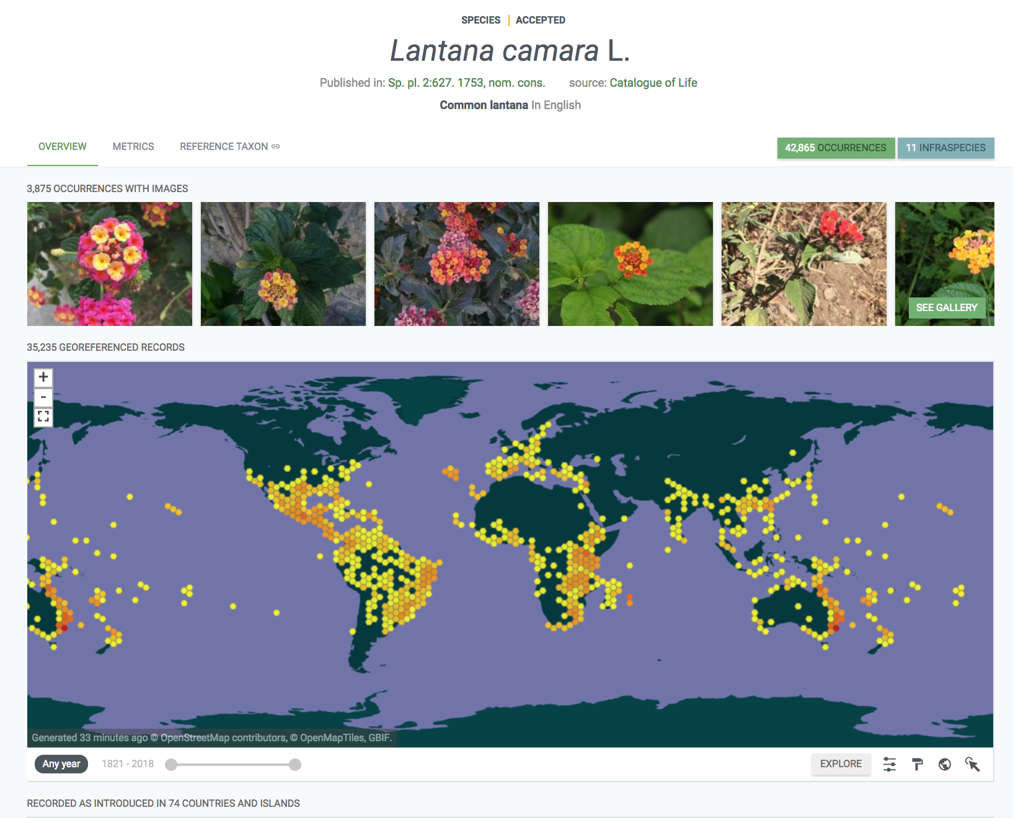
https://www.gbif.org/species/2925303

Slide 11
https://www.gbif.org/species/2925303

Slide 12
Enhancing capacity to mobilize, publish and curate invasive species data
https://www.gbif.org/project/83306/regional-and-national-alien-and-invasive-species-data-mobilization-and-capacity-building-in-the-pacific

Slide 13
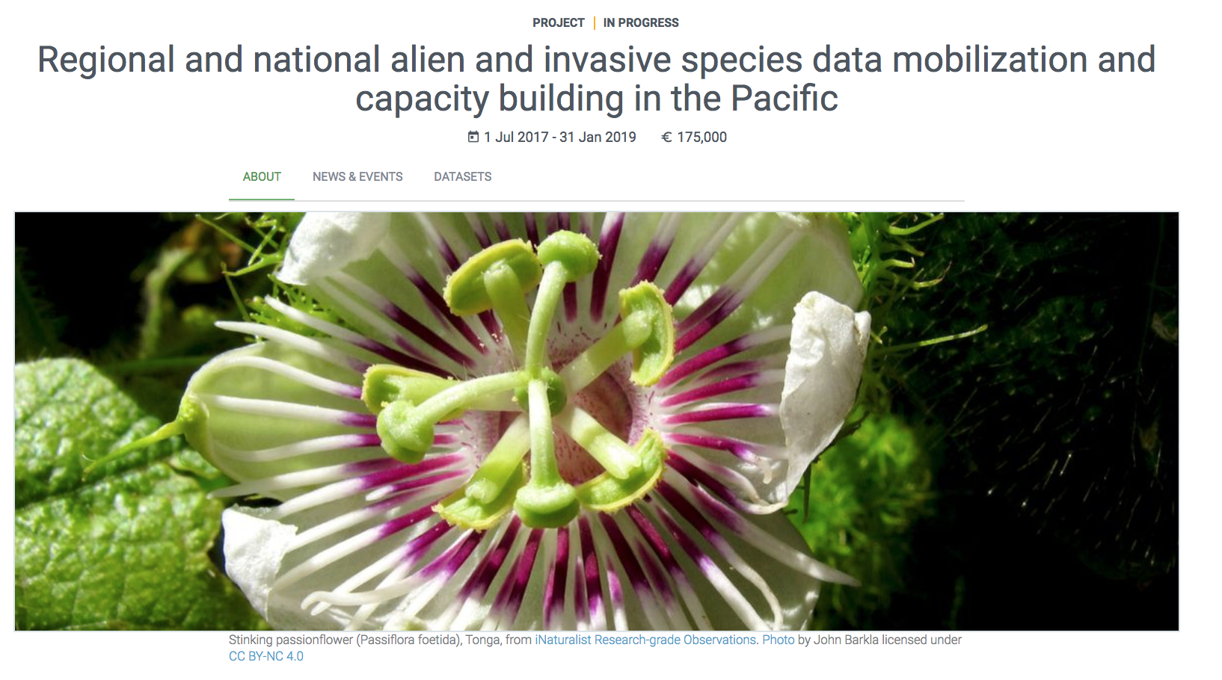
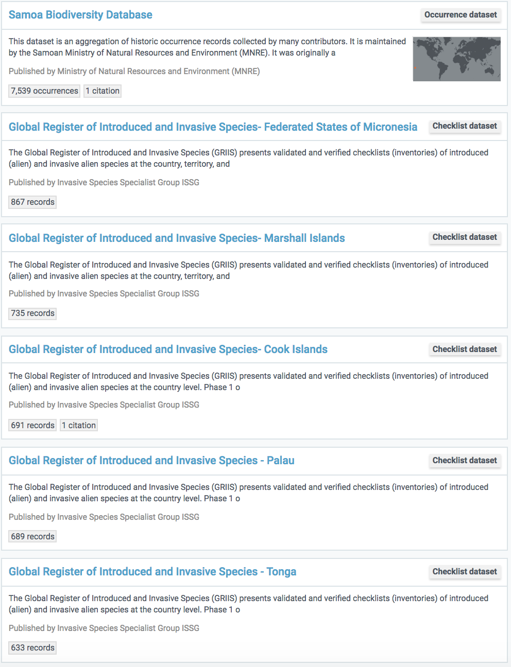
41 datasets covering invasive species information in 17 Pacific Island countries and territories
https://www.gbif.org/project/83306/regional-and-national-alien-and-invasive-species-data-mobilization-and-capacity-building-in-the-pacific

Slide 14
Thank you!
thirsch@gbif.org
شكرا لكم
https://www.gbif.org/

