Slide 1
Informatics in support of the post-2020 biodiversity agenda
Tim Hirsch, Deputy Director, GBIF Secretariat
Global taxonomy initiative forum, un biodiversity conference, sharm el sheikh, 16 november 2018

Slide 2
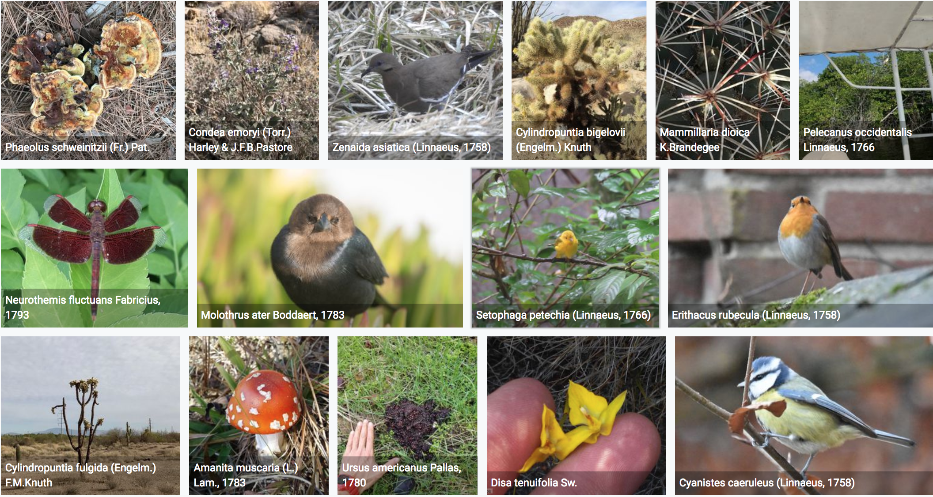
Or…
‘NERDS AND THE NEW DEAL FOR NATURE’
https://www.gbif.org/occurrence/gallery

Slide 3
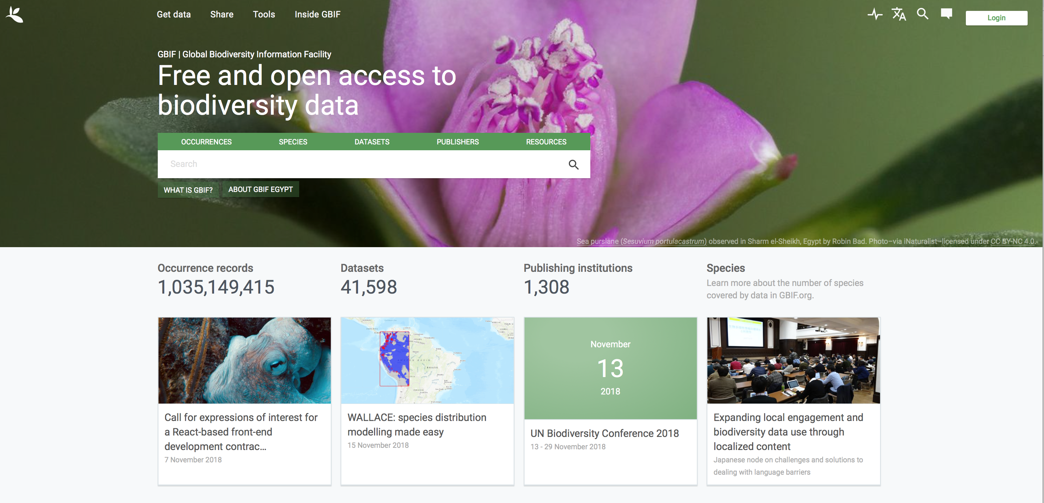
The power of sharing
https://www.gbif.org/

Slide 4
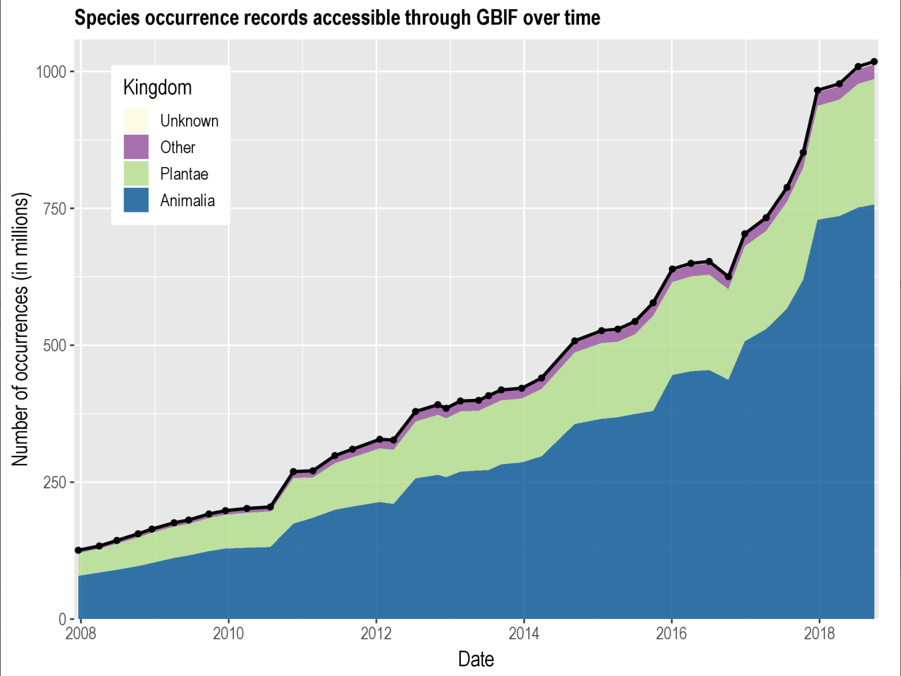
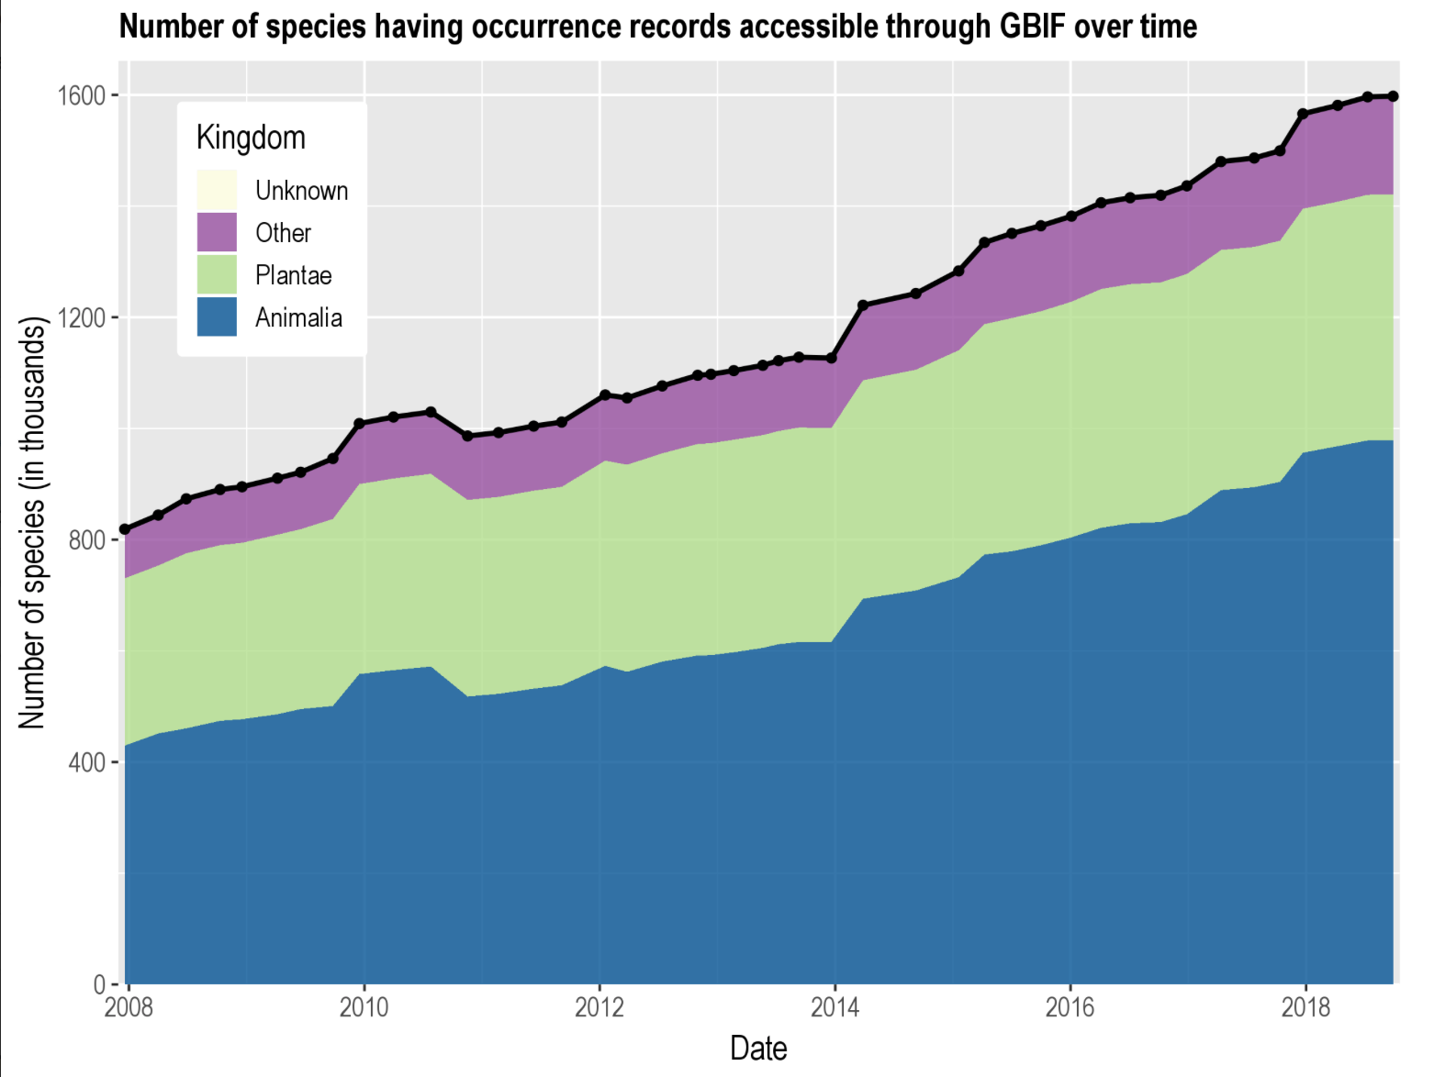
Supporting the strategic plan 2011-2020
‘By 2020, knowledge, the science base and technologies relating to biodiversity, its values, functioning, status and trends, and the consequences of its loss, are improved, widely shared and transferred, and applied.’
https://www.bipindicators.net/indicators/growth-in-species-occurrence-records-accessible-through-gbif

Slide 5
What’s wrong with this picture?
https://www.gbif.org/occurrence/search?q=

Slide 6
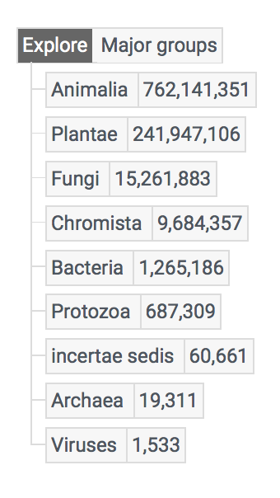
a bird’s eye view of the tree of life…
https://www.gbif.org/occurrence/taxonomy

Slide 7
Taxonomic bias in gbif-mediated data
vertical line at x = 0
‘Ideal’ N occurrences per class, where each class is sampled proportionally to its number of known species
Green and red bars show classes that are over- and under-represented in GBIF compared to ‘ideal’ sampling
Insects: <200M occurrences
Birds: >200M occurrences
Troudet J et al. (2017) Taxonomic bias in biodiversity data and societal preferences. Scientific Reports 7:9132. https://doi.org/10.1038/s41598-017-09084-6

Slide 8
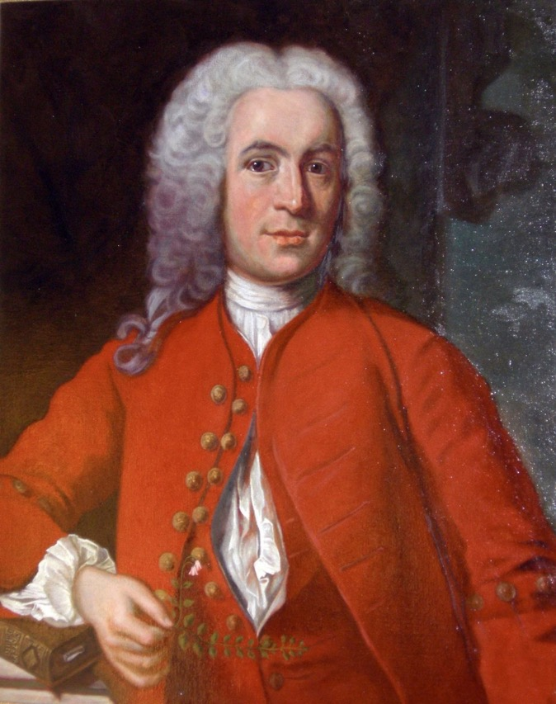
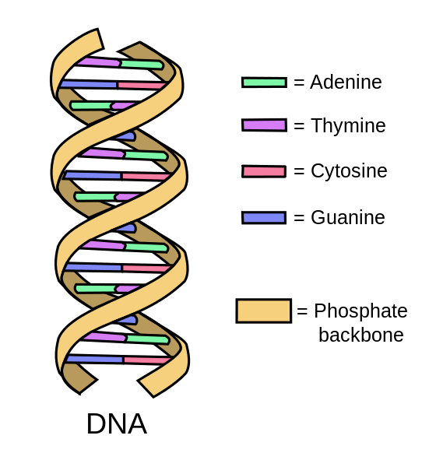
Disruptive Technologies
Wikipedia; 2008 Jeroen Rouwkema CC BY-SA 3.0

Slide 9
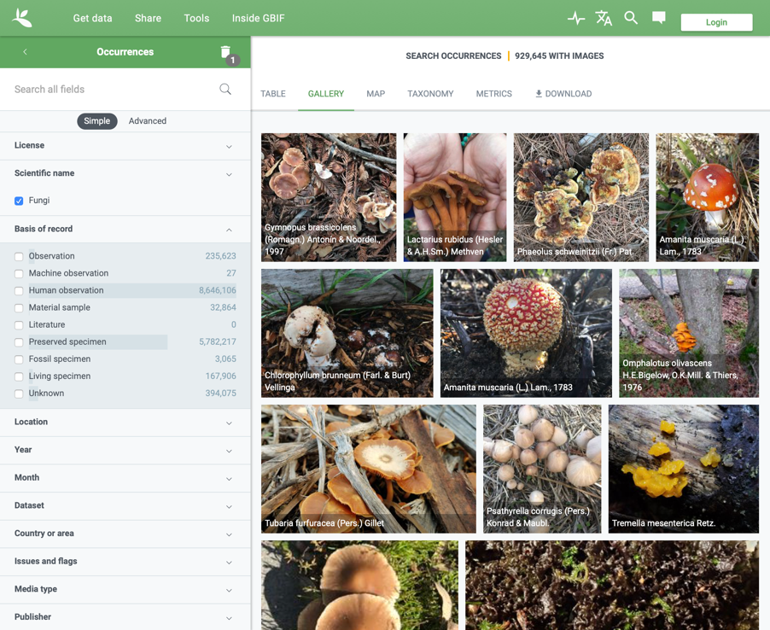
Fungi in gbif
15,261,883 occurrences
8.6m observations
5.7m specimens
11,667,185 georeferenced
929,645 with images
217,699 species
As for 9 October 2018

Slide 10
An Underrepresented Kingdom
”Being nameless, the dark taxa are not easily incorporated into [biodiversity data collections and legislation] and are consequently often omitted. They are, for example, usually left out of species counts of areas and therefore from decisions on nature conservation.”
—Ryberg M & Nilsson RH (2018) New light on names and naming of dark taxa. MycoKeys 30: 31-39. https://doi.org/10.3897/mycokeys.30.24376

Slide 11
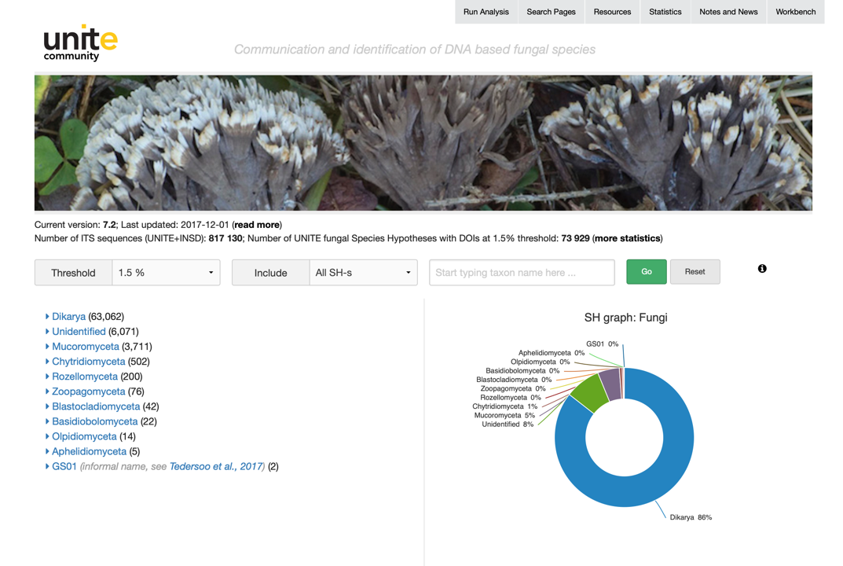
Species hypotheses as a communication and identification system
https://unite.ut.ee

Slide 12
Clustering fungal sequences
73,000 species hypotheses derived from >800,000 sequences
Each species hypothesis assigned a digital object identifier (DOI)
These serve as ‘operational taxonomic units’ to support discovery and description
SH 1.5%
SH 1%
Individuals

Slide 13
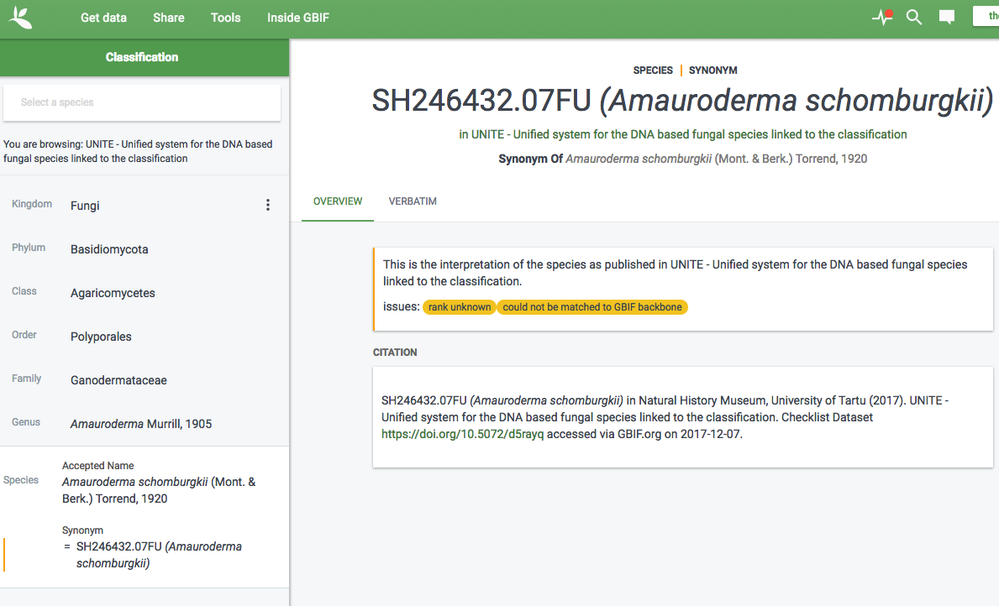
DOI connected to GBIF Backbone classification

Slide 14
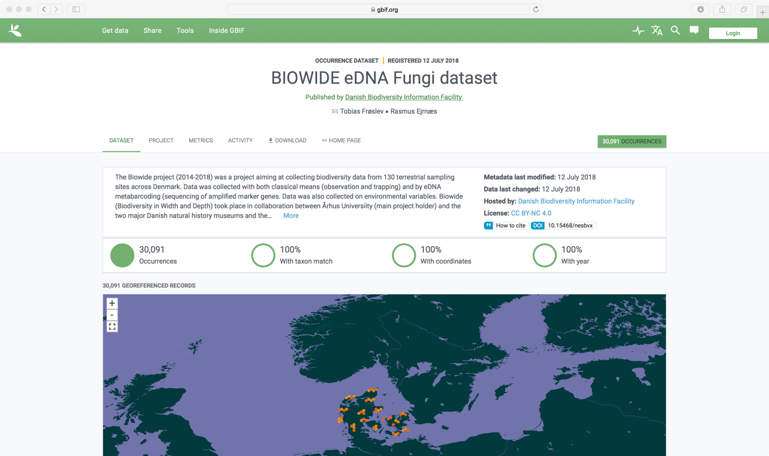

Slide 15
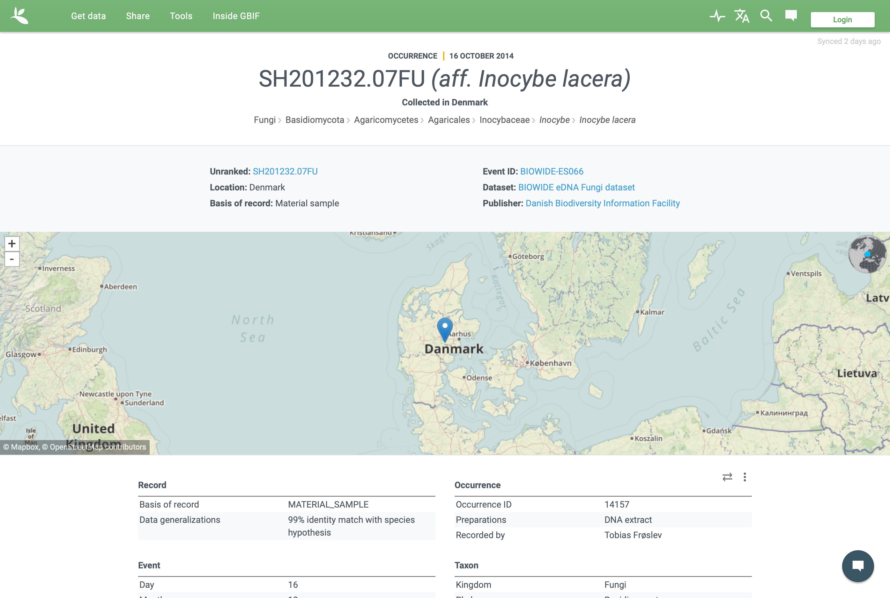
https://www.gbif.org/occurrence/1881138280

Slide 16
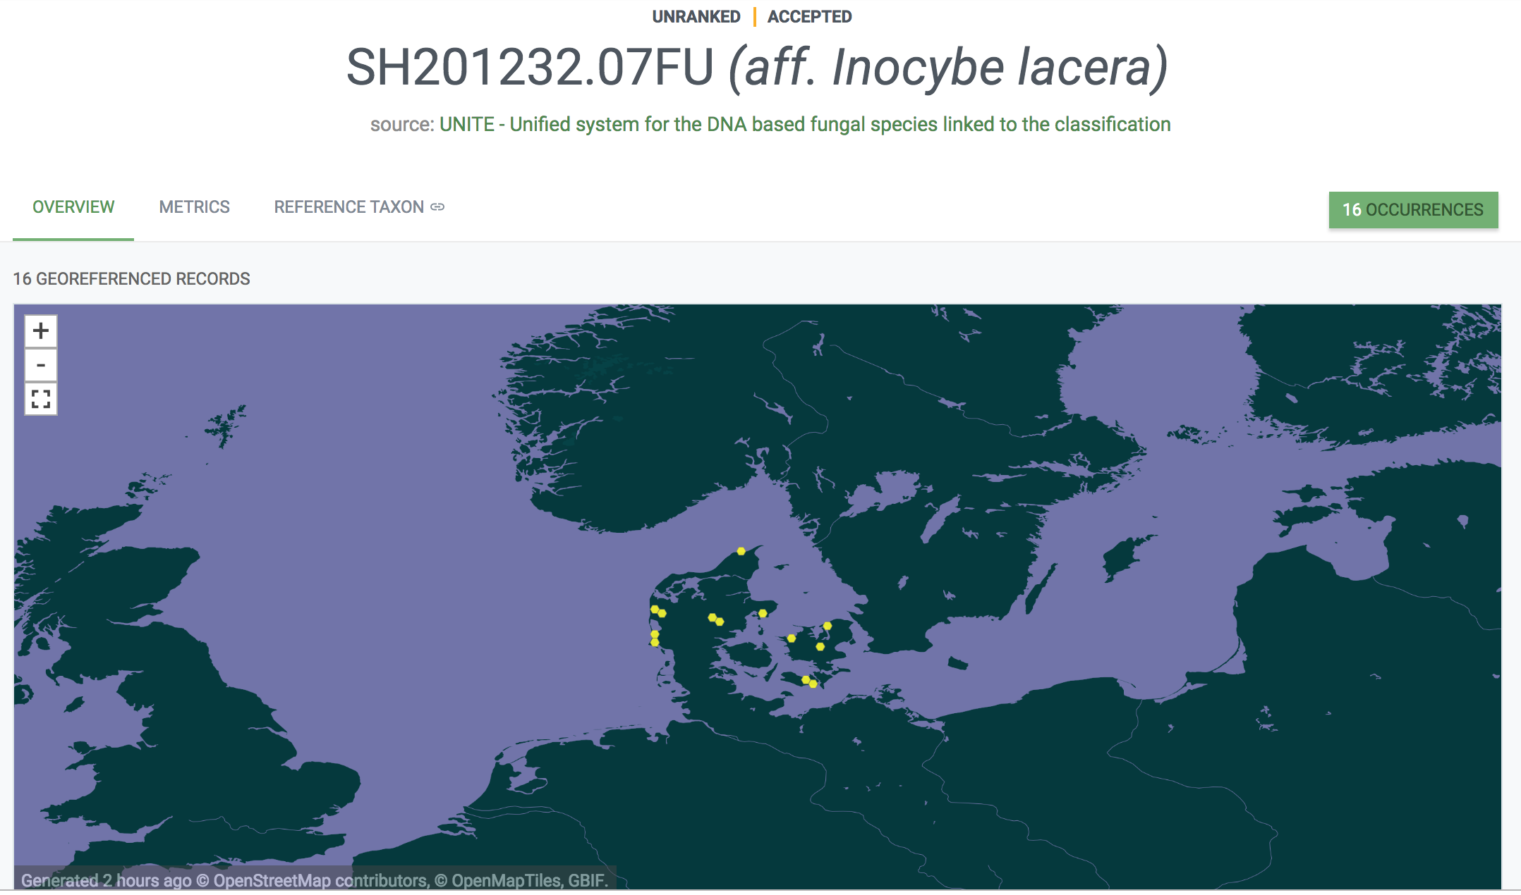
Helps to reveal true diversity of Danish fungi and their distribution
Supports new approaches to conservation taking ‘dark taxa’ into account
https://www.gbif.org/species/9814114

Slide 17
https://www.biodiversityinformatics.org

Slide 18
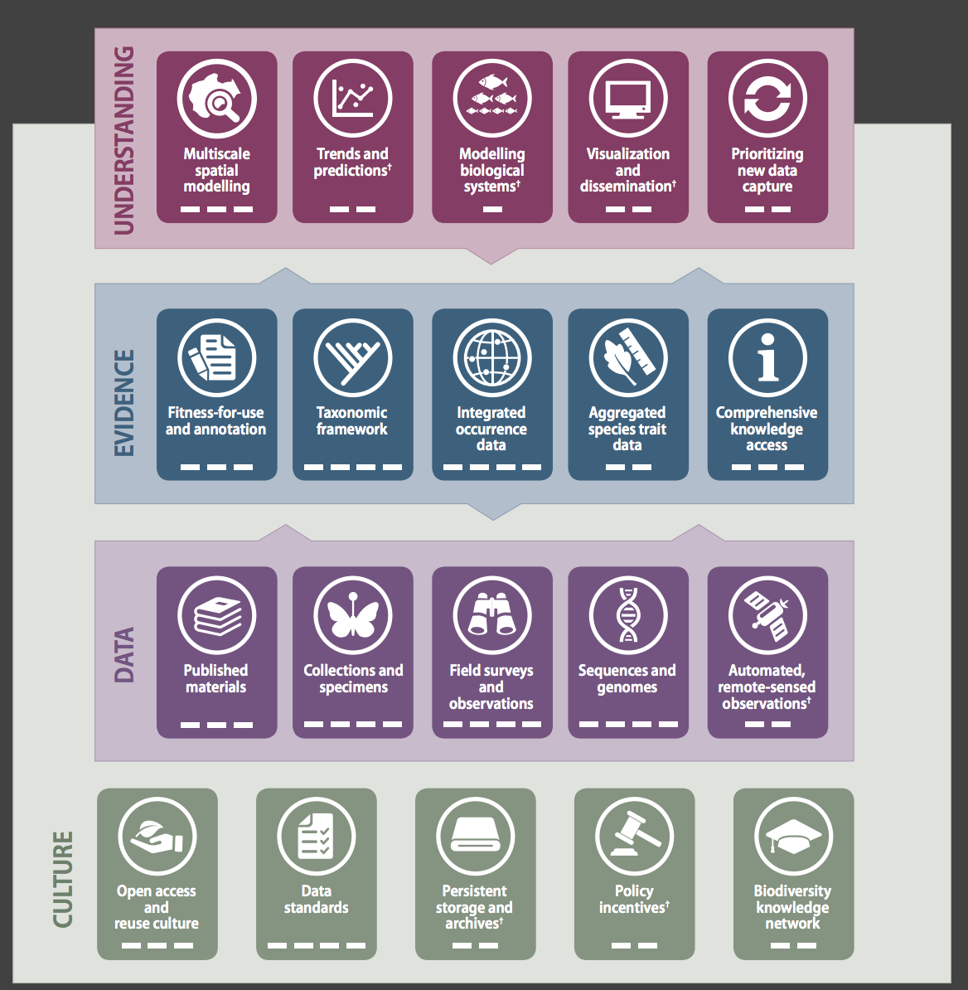
https://www.biodiversityinformatics.org

Slide 19
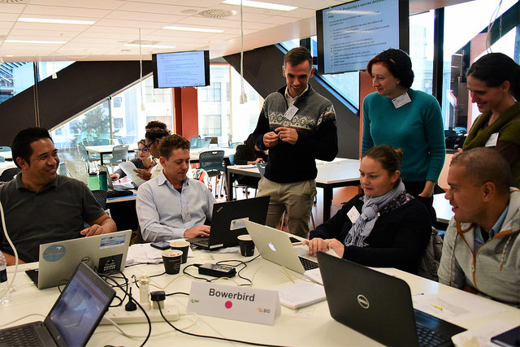
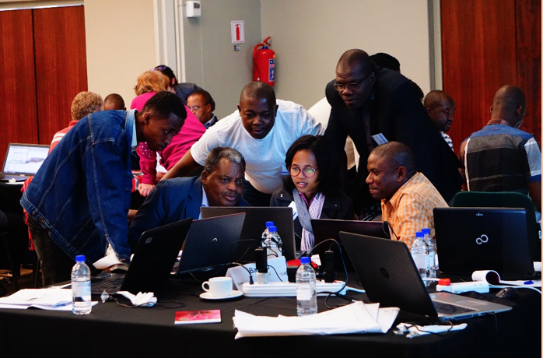
INFORMATICS CAPACITY BUILDING ESSENTIAL TO MOBILIZE TALENT AND PEOPLE IN SUPPORT OF THE NEW DEAL FOR NATURE
Multi-annual programme to support mobilization and use of data in ACP regions
63 projects in
www.gbif.org/bid

Slide 20
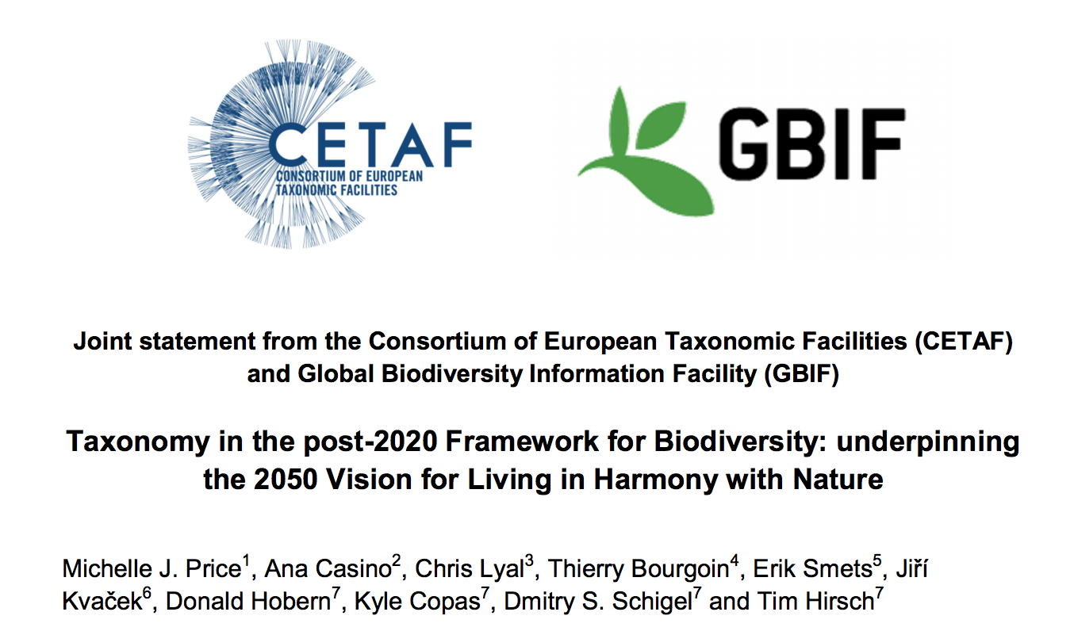
Taxonomy underpinning biodiversity discovery and understanding
Biodiversity information and the biodiversity knowledge network
Molecular genetics and genomics
Capacity building, training and outreach
https://attachments.cbd.int/Taxonomy_in_the_post-2020_Framework_for_Biodiversity_CETAF-GBIF_joint_statement.pdf

Slide 21
Thanks to:
Urmas Kõljalg University of Tartu, Estonia
Henrik Nilsson Gothenburg University
Dmitry Schigel GBIF Secretariat

