Slide 1
An UPDATE ON THE Connect PROJECT: Mainstreaming biodiversity information into the heart of government decision making

Slide 2
The Connect Project: Mainstreaming biodiversity information into the heart of government decision making
Four year project
$5,000,000
Global GEF allocation
3 showcase countries
Coordinated by UNEP-WCMC

Slide 3
Country partners, international partners
Uganda
Ghana
Mozambique
Notes:
We are very pleased to be working with three highly motivated countries
And a range of international partners and data providers

Slide 4
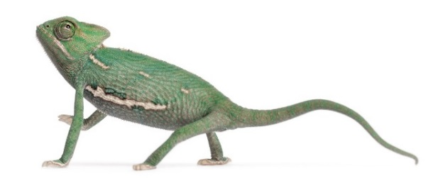
Project goal
To ensure biodiversity is taken into account in decision making across government sectors by improving end-users’ access to and use of biodiversity information and embedding biodiversity information within national development decision making processes.

Slide 5
Project objectives - global
Biodiversity data, information, and knowledge products, proof-of-concept models, good practices, lessons and tools, developed iteratively and through active showcasing and facilitated interaction with the three demonstration countries
Improved global understanding of and capacity to use and generate biodiversity information to influence development outcomes
Revision and development of project theory of change through practice and applied research.

Slide 6
Project objectives - national
Clearly understand the in-country demands for, and the barriers to using, biodiversity information within government decision making including clarifying the format, timing and packaging required
Mobilise and repackage existing biodiversity data and information from a range of sources (national and international) to meet a number of the above demands; and
Strengthen the connection between government decision makers and biodiversity and ecosystem services data providers in order to sustainably provide policy-relevant, spatially explicit information to meet ongoing national needs.

Slide 7
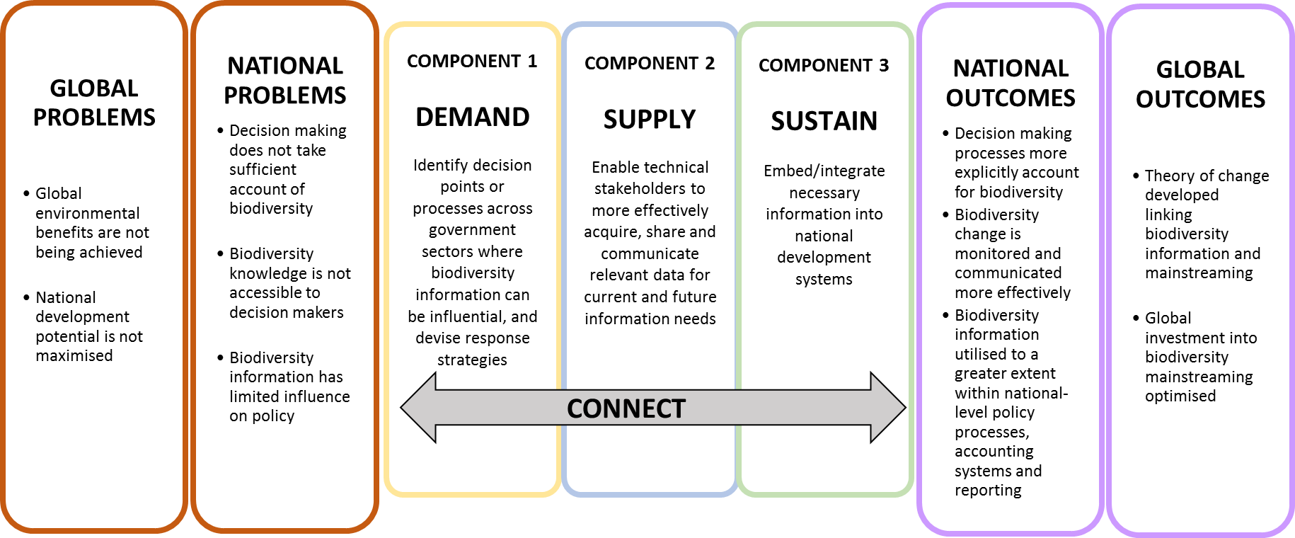
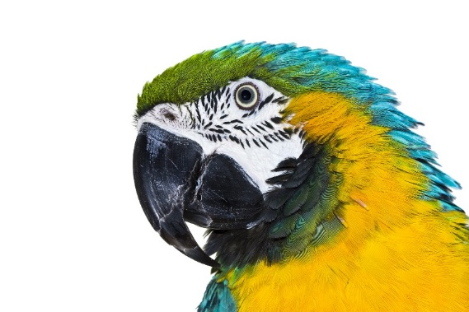
CONNECT: Mainstreaming biodiversity information into the heart of government decision making
Notes:
High level theory of change –
The ultimate goal is to help achieve sus. Dev. by bringing b/d to the heart of government d/m using actionable b/d info
SWITCH behaviour change as well as biodiversity information

Slide 8
Project progress Yr 1
Scoping and contracting
First national workshops
Global biodiversity information landscape review
International Technical Advisory and Upscaling Group
ToRs agreed
Members agreed and invitations sent
Global Communication Strategy
Communication tools
Website www.connectbiodiversity.com #Connectbiodiversity
Project flyer
Literature review of GEF biodiversity mainstreaming projects

Slide 9
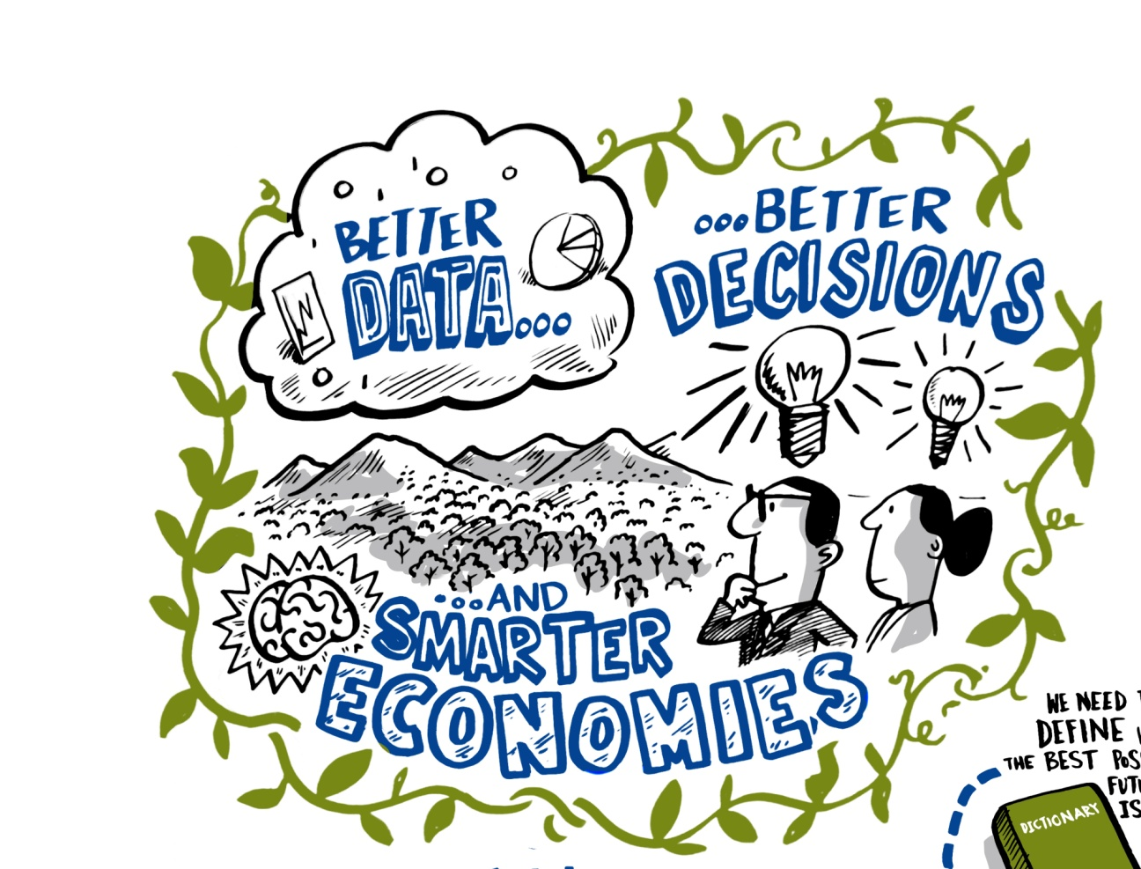
National perspectives
Professor Alfred Oteng-Yeboah (Ghana)
Mr Francis Ogwal (Uganda)

