Slide 1
TOWARDS AN ALLIANCE FOR BIODIVERSITY KNOWLEDGE
TIM HIRSCH, DEPUTY DIRECTOR, GBIF SECRETARIAT
COP SIDE EVENT ON ALLIANCE FOR BIODIVERSITY KNOWLEDGE, un biodiversity conference, SHARM EL SHEIKH, 21 NOVEMBER2018

Slide 2
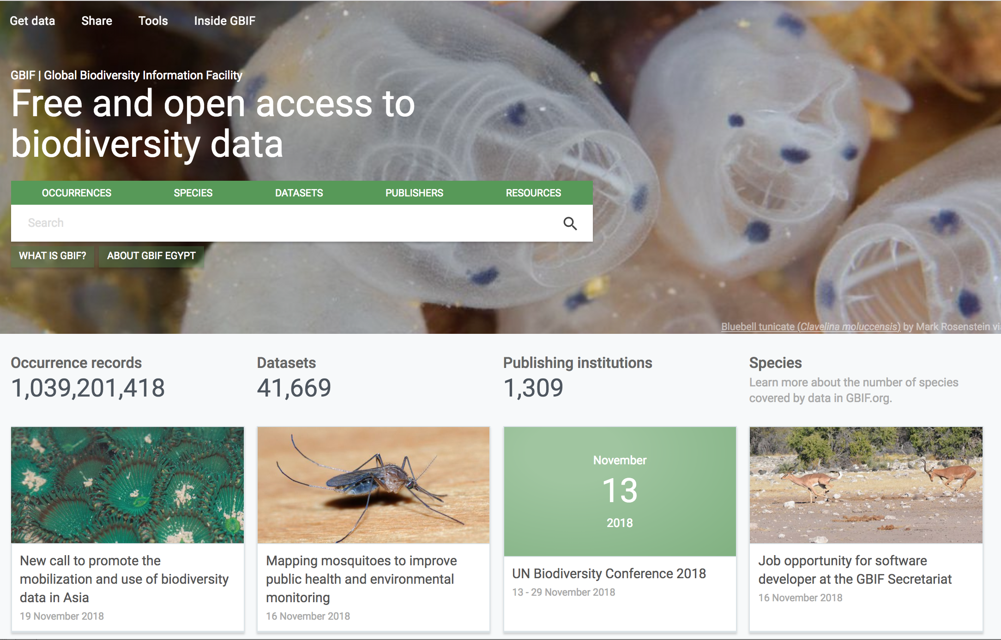
https://www.gbif.org/

Slide 3
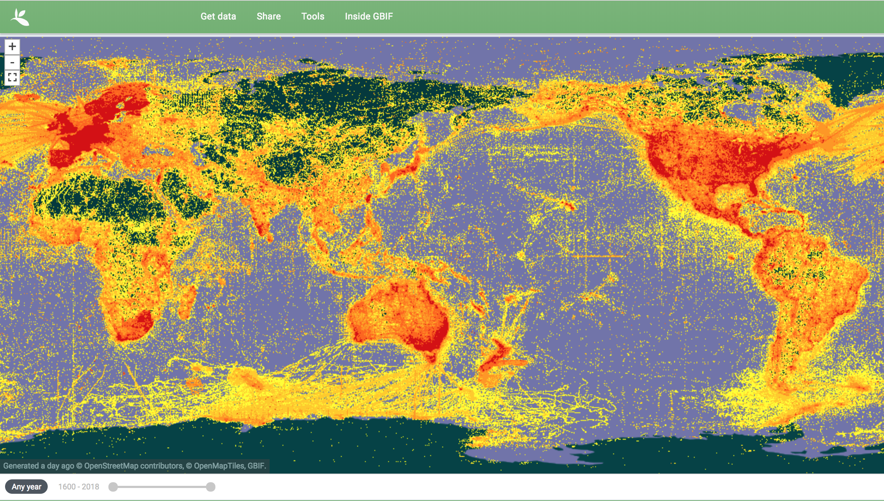
Stable, mature data infrastructure
https://www.gbif.org/

Slide 4
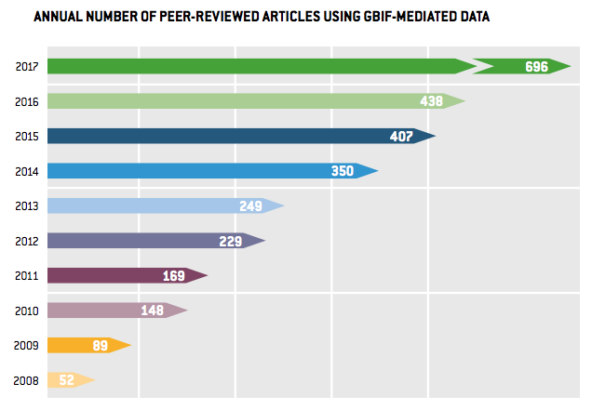
Stable, mature data infrastructure…
https://www.gbif.org/resource/search?contentType=literature&relevance=GBIF_USED&peerReview=true

Slide 5
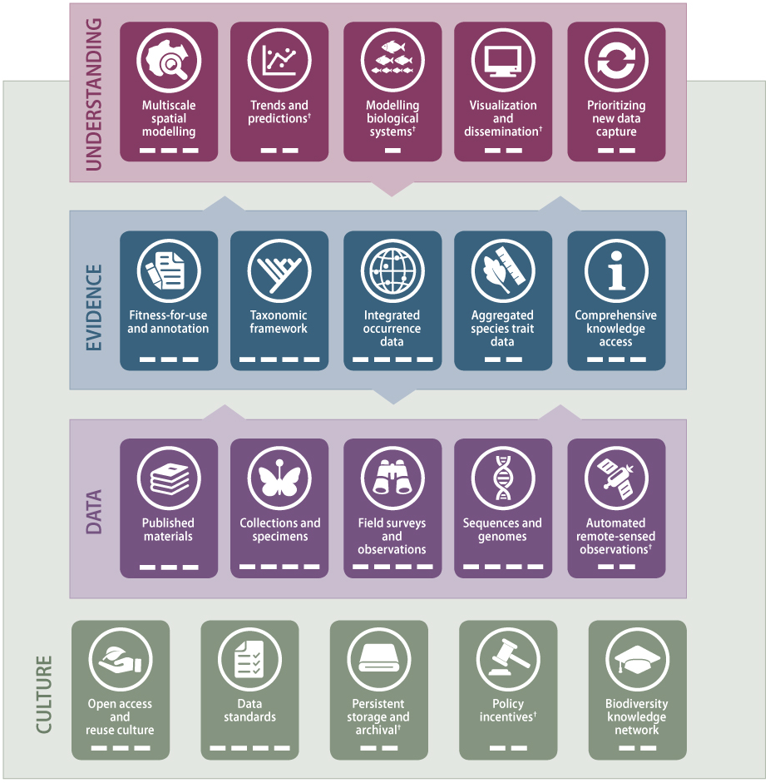
But… just part of wider data landscape
http://biodiversityinformatics.org/
Notes:
Attendees representing global data infrastructures, national data centres and major research institutions agreed on the
Most recently, Basque Government using it to establish guidelines and criteria for selecting and monitoring projects receiving or requesting public funds

Slide 6
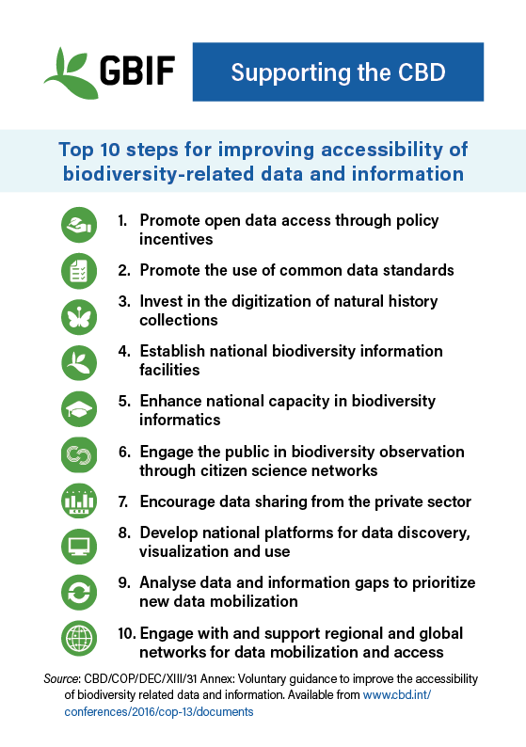

Slide 7
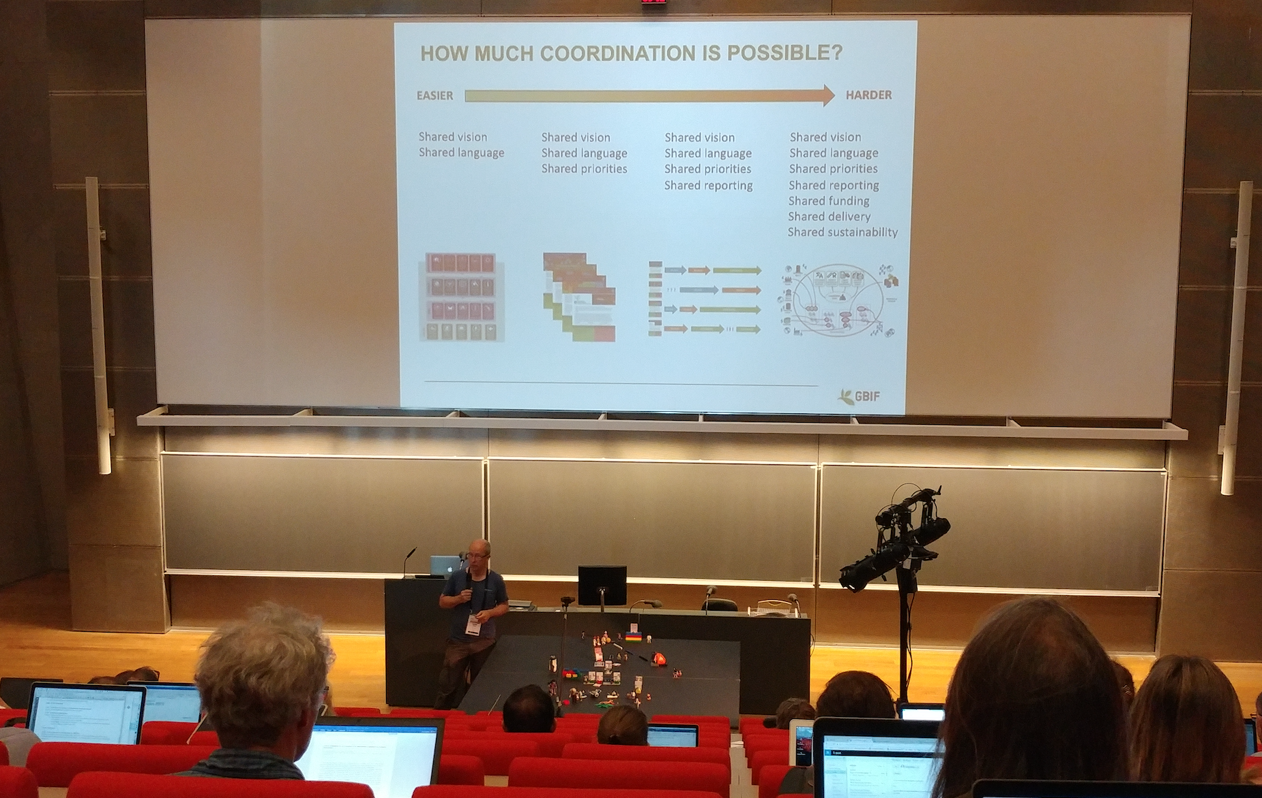
2nd global biodiversity informatics conference (GBiC2)
100+ experts addressing need to ‘establish a shared mechanism for planning and delivering a linked and open biodiversity data infrastructure’
https://www.biodiversityinformatics.org/

Slide 8
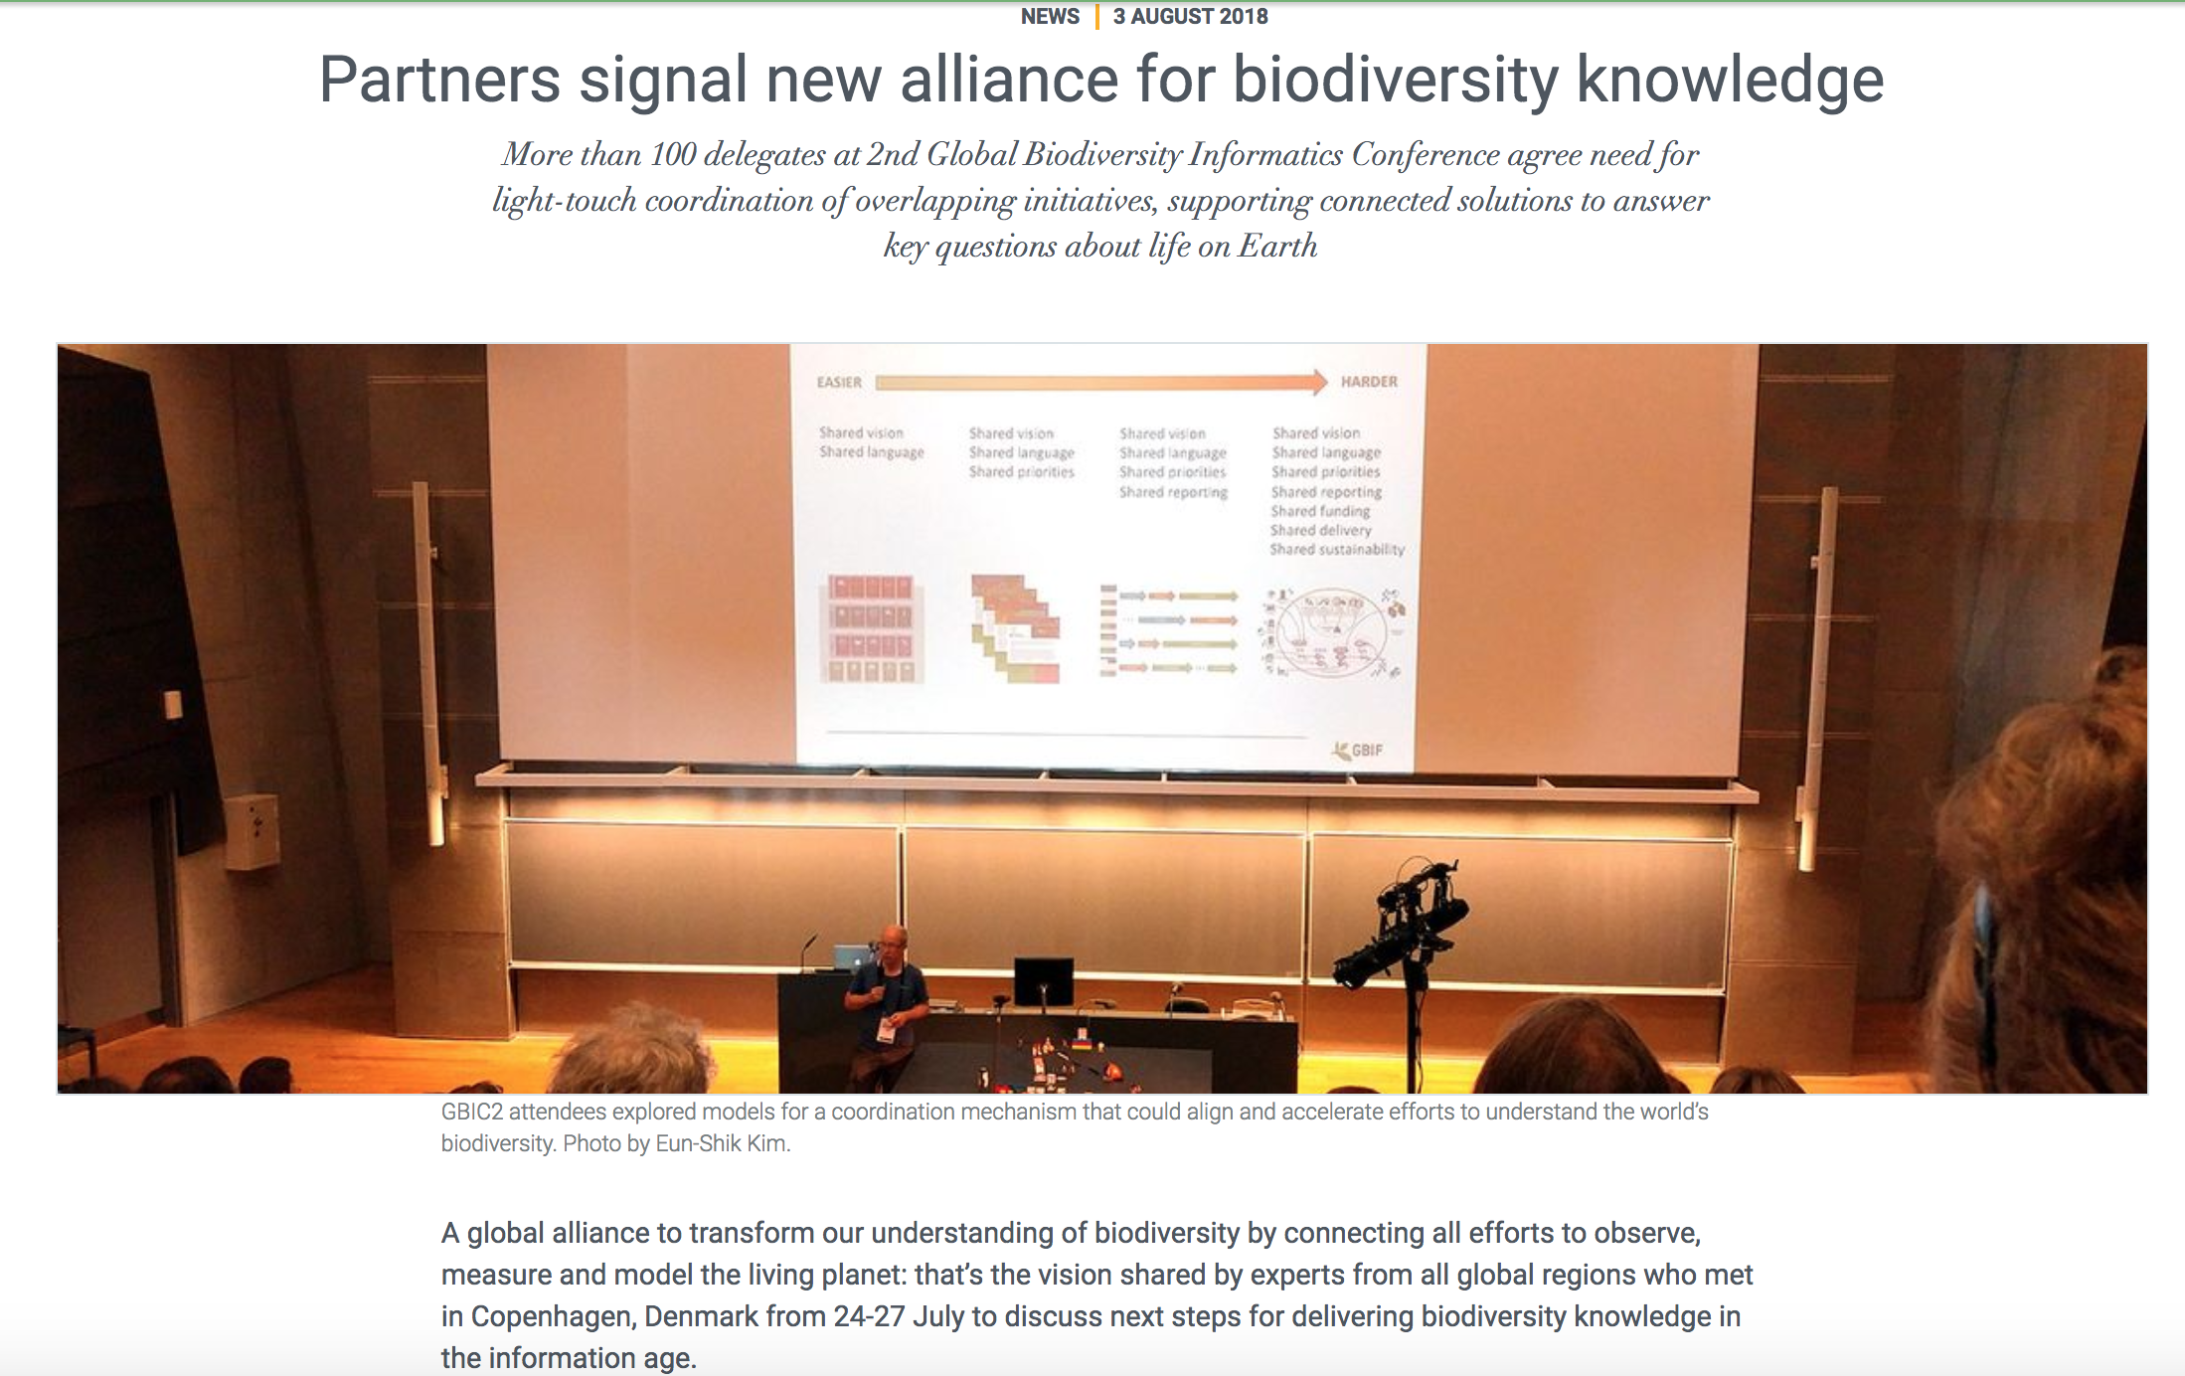
https://www.gbif.org/news/1XfnaCv0CQs4YmEC2qEGeE/partners-signal-new-alliance-for-biodiversity-knowledge

Slide 9
toward a post-2018 alliance for biodiversity knowledge
Stakeholders in collaborative planning and implementation
Global-scale data infrastructures
National or regional projects and infrastructures
Major institutions that host significant data and services
Organizations that depend on these infrastructures
E.g. CBD, FAO, CMS, IPBES, GEO BON, IUCN, WWF, CETAF, ICZN …
Communities and individuals with an interest in biodiversity
http://biodiversityinformatics.org/

Slide 10
COORDINATION REQUIREMENTS
Coordinate roadmap consultations
Coordinate selection of experts
Facilitate expert workshops
Consult on recommendations
Coordinate final revisions
Support proposal development
Guide stakeholders on roadmap requirements
Broker linkages between projects
Maintain overview of unmet needs
Communicate and translate roadmaps
Publish final consensus roadmap
Coordinate translations of roadmap
Publicise roadmap internationally
Coordinate letters of support
Coordinate support from other international stakeholders
Explain value proposition for roadmap components
Yes!
是!
Advise on standards and best practices
Coordinate with standards bodies
Maintain references to standards
Advise stakeholders how to align activity
Monitor and assure sustainability
Monitor status of developed components
Facilitate transfer of responsibility where necessary

Slide 11
Examples to explore
Apache Software Foundation (ASF)
The Apache Way: “Community, Merit, and Openness, backed up by Pragmatism and Charity” (http://theapacheway.com/about/)
ELIXIR
Unites European life science organizations to manage and safeguard the increasing volume of data being generated by publicly funded research (https://www.elixir-europe.org)
Global Alliance for Genomics and Health (GA4GH)
Policy-framing and technical standards-setting organization, seeking to enable responsible genomic data sharing within a human rights framework (https://www.ga4gh.org)
http://biodiversityinformatics.org/

Slide 12
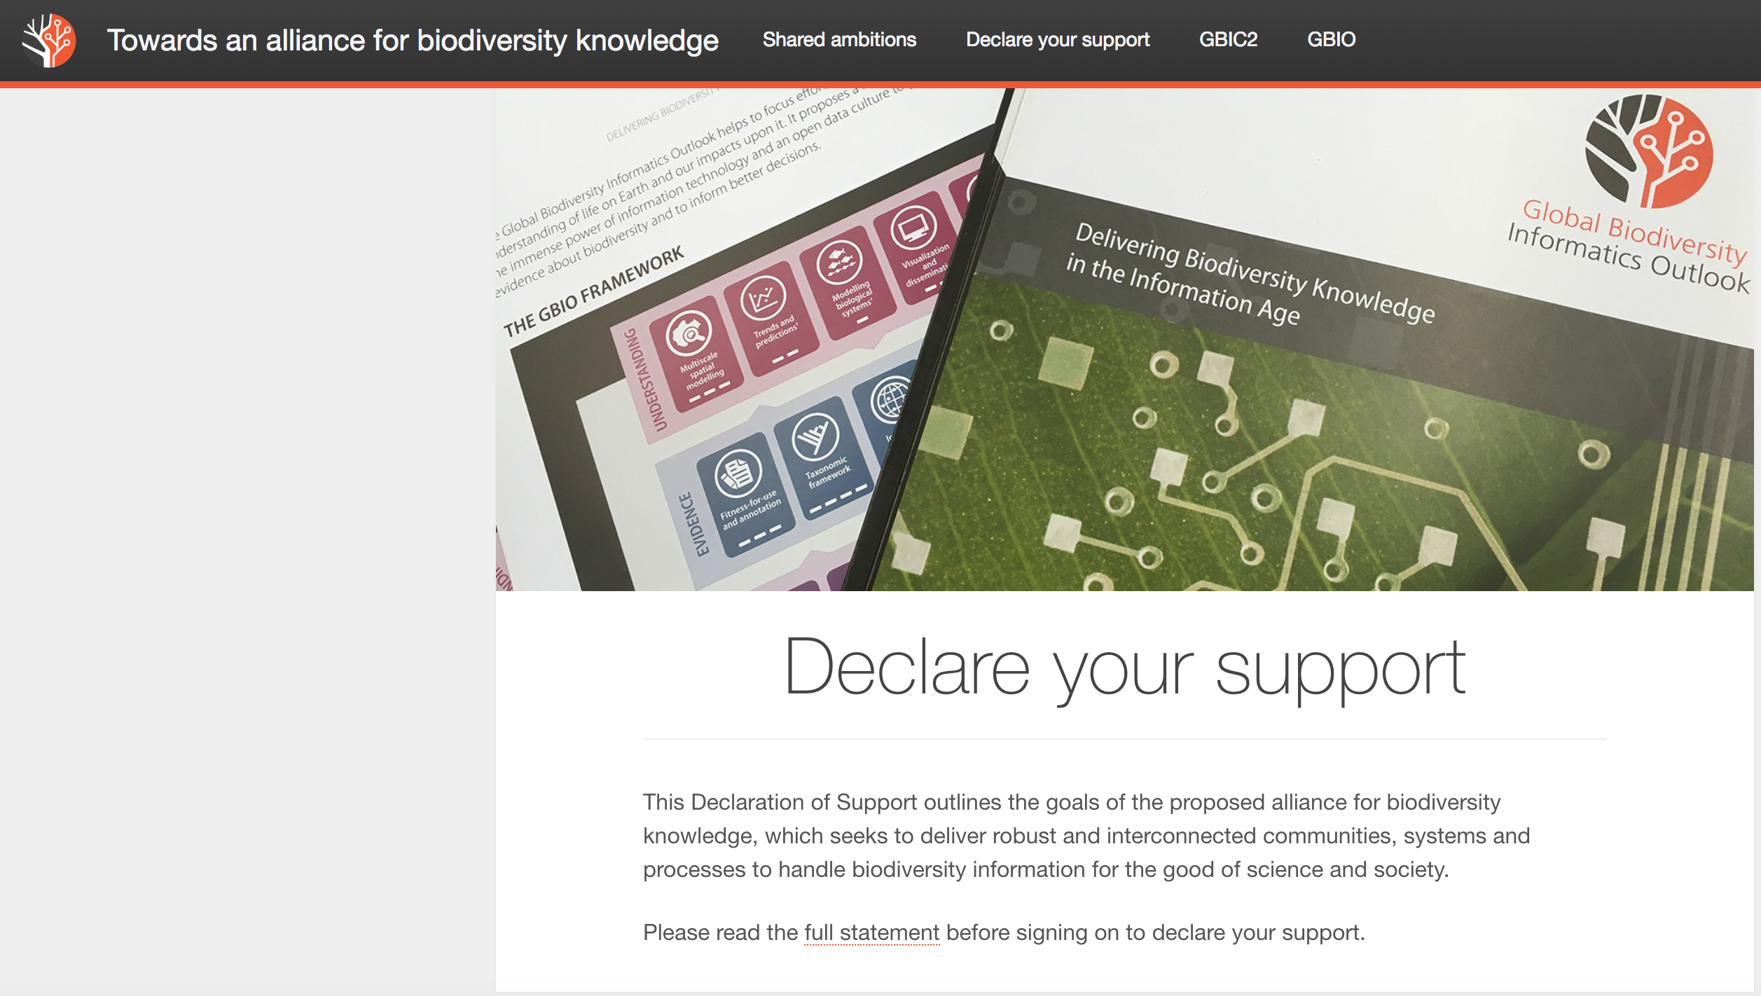
www.biodiversityinformatics.org

Slide 13
https://biodiversitynext.org/

