Slide 1
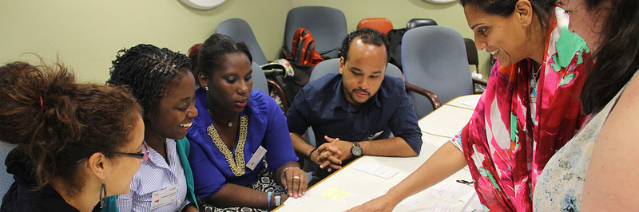

Building Capacity for Biodiversity Data Mobilization and Use
Andrew Rodrigues
21st SBSTTA Meeting, Montréal
12 Dec 2017
montreal, canada
Notes:
Introduce myself.
Who am I
What I’m working on – data use and the many aspects of that. How are we applying that aspect to the BID programme.

Slide 2
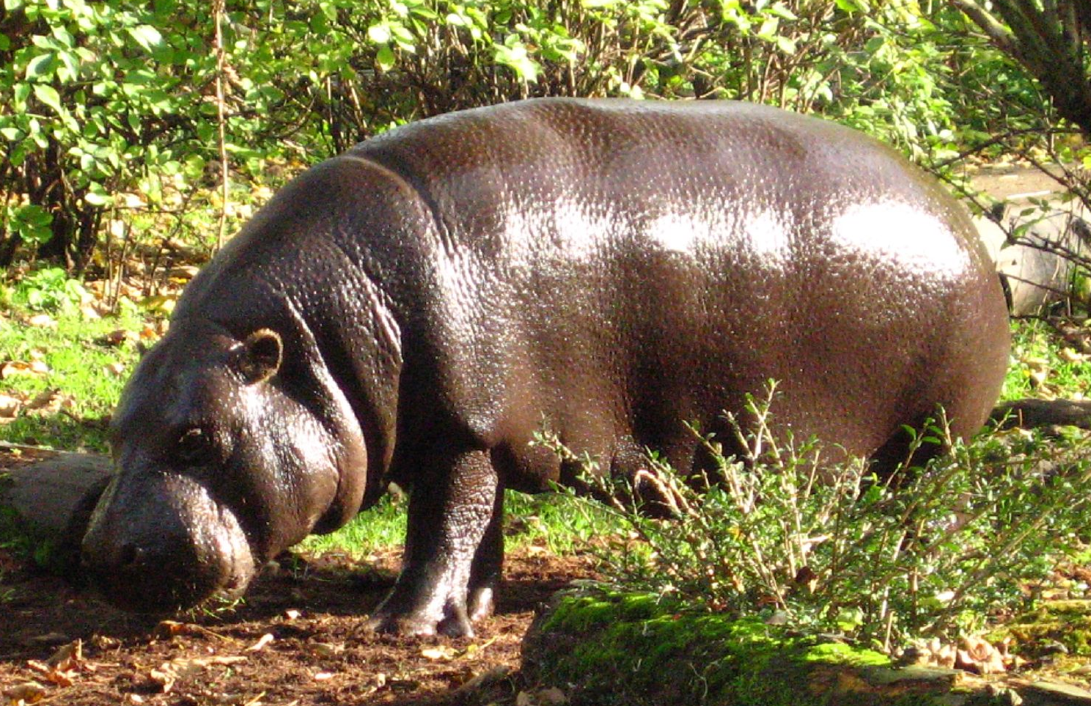
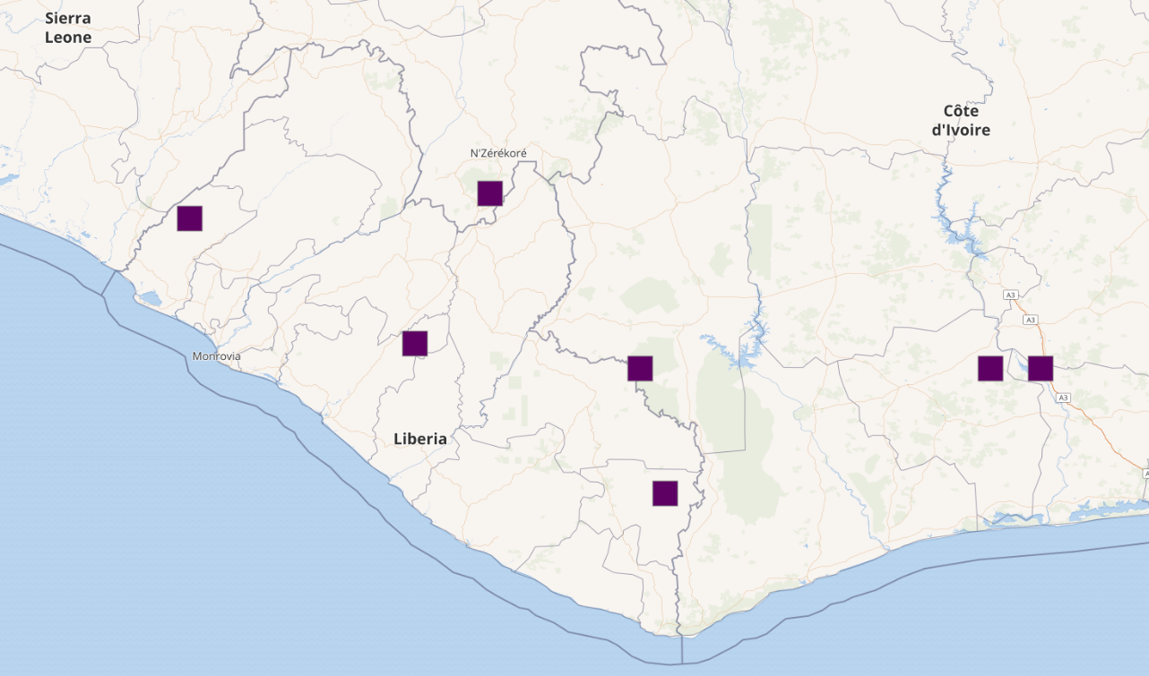
Challenge
1. DATA MOBILISATION
Marc Casarotto via Flickr.
Photo licensed under CC BY-NC-ND 2.0.
2. DATA USE
Observation & collection
Open Access Data
Evidence-based Policy
Notes:
How do we get from observation and collection to meaningful policy?
Data can predict range potentials of invasive alien species, identify high-risk areas for zoonotic disease transmission, infroma protected area expansion strategies and identify areas of high natural capital.
Progress made in the mobilisation of data with increasing number of resources developed over the years to support the movement of open data from observation to standardised data that can be shared with users from around the world.
The overall objective of the BID programme is improved management of natural capital for human well-being, through increased application of biodiversity information as evidence for
decision making.
This is an objective of other programmes too….

Slide 3
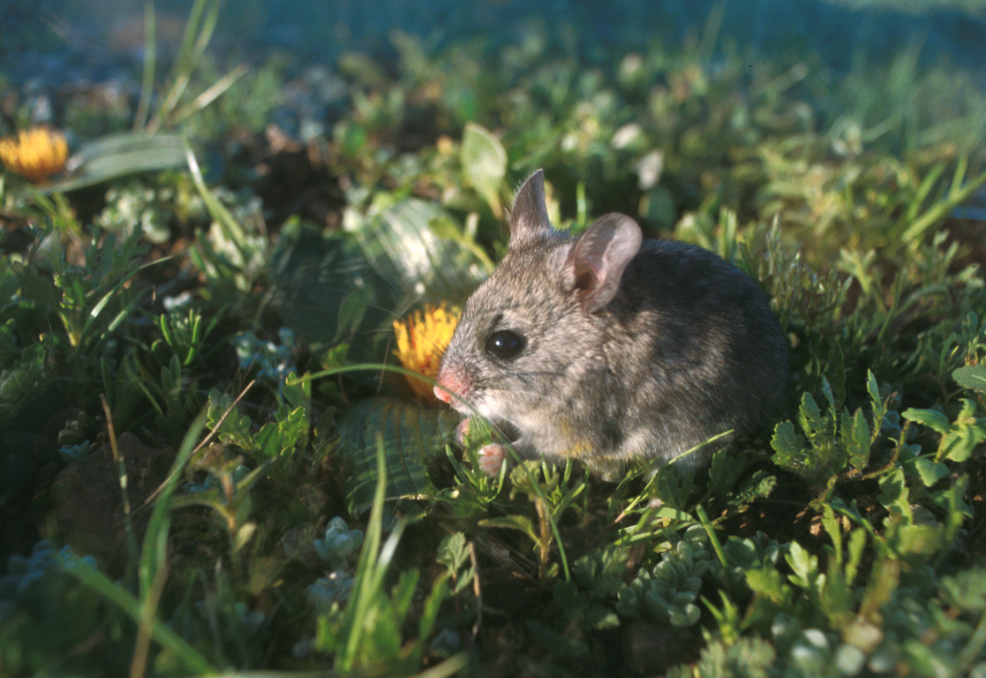






The African Biodiversity Challenge
Unlocking data for sustainable development
Matthew Child
Project Coordinator: Biodiversity Informatics, Biodiversity Information and Planning Division
M.Child@sanbi.org.za | +27 (0) 72 199 2454
Notes:
The overall aim of the project is incentivise the mobilisation of as many policy-relevant data as possible through a competition format.
We have collaboration agreements in place with the University of Rwanda, Ministry of Environment and Tourism in Namibia, Conservation Alliance of Ghana and Museums of Malawi.
The ABC project directly builds on the previous JRS Funded project which culminated in the Africa Rising conference, that brought together >100 delegates from across the continent to sign a declaration on biodiversity informatics.
A scoping project that set out to connect biodiversity informatics networks across the continent and develop a strategy for data mobilisation
Series of workshops to establish data priorities = toolkit
Culminated in the Africa Rising conference
Laid foundation for African Biodiversity Challenge

Slide 4

How many policy-relevant data are really mobilized?
RELEVANT
MOBILISED
ALL POTENTIAL DATA
Goal: to increase the overlap between mobilised and policy-relevant data.
Notes:
policy-makers will only incorporate such data if they are 1) accessible, 2) fit for use, and 3) relevant to national development agendas.
Currently, only 3.7% of the records freely accessible on the Global Biodiversity Information Facility (GBIF) were from Africa, of which 49% have been published through African organisations and South Africa contributes 97% of the total. There is thus a critical need to capacitate African countries to mobilise biodiversity data.

Slide 5
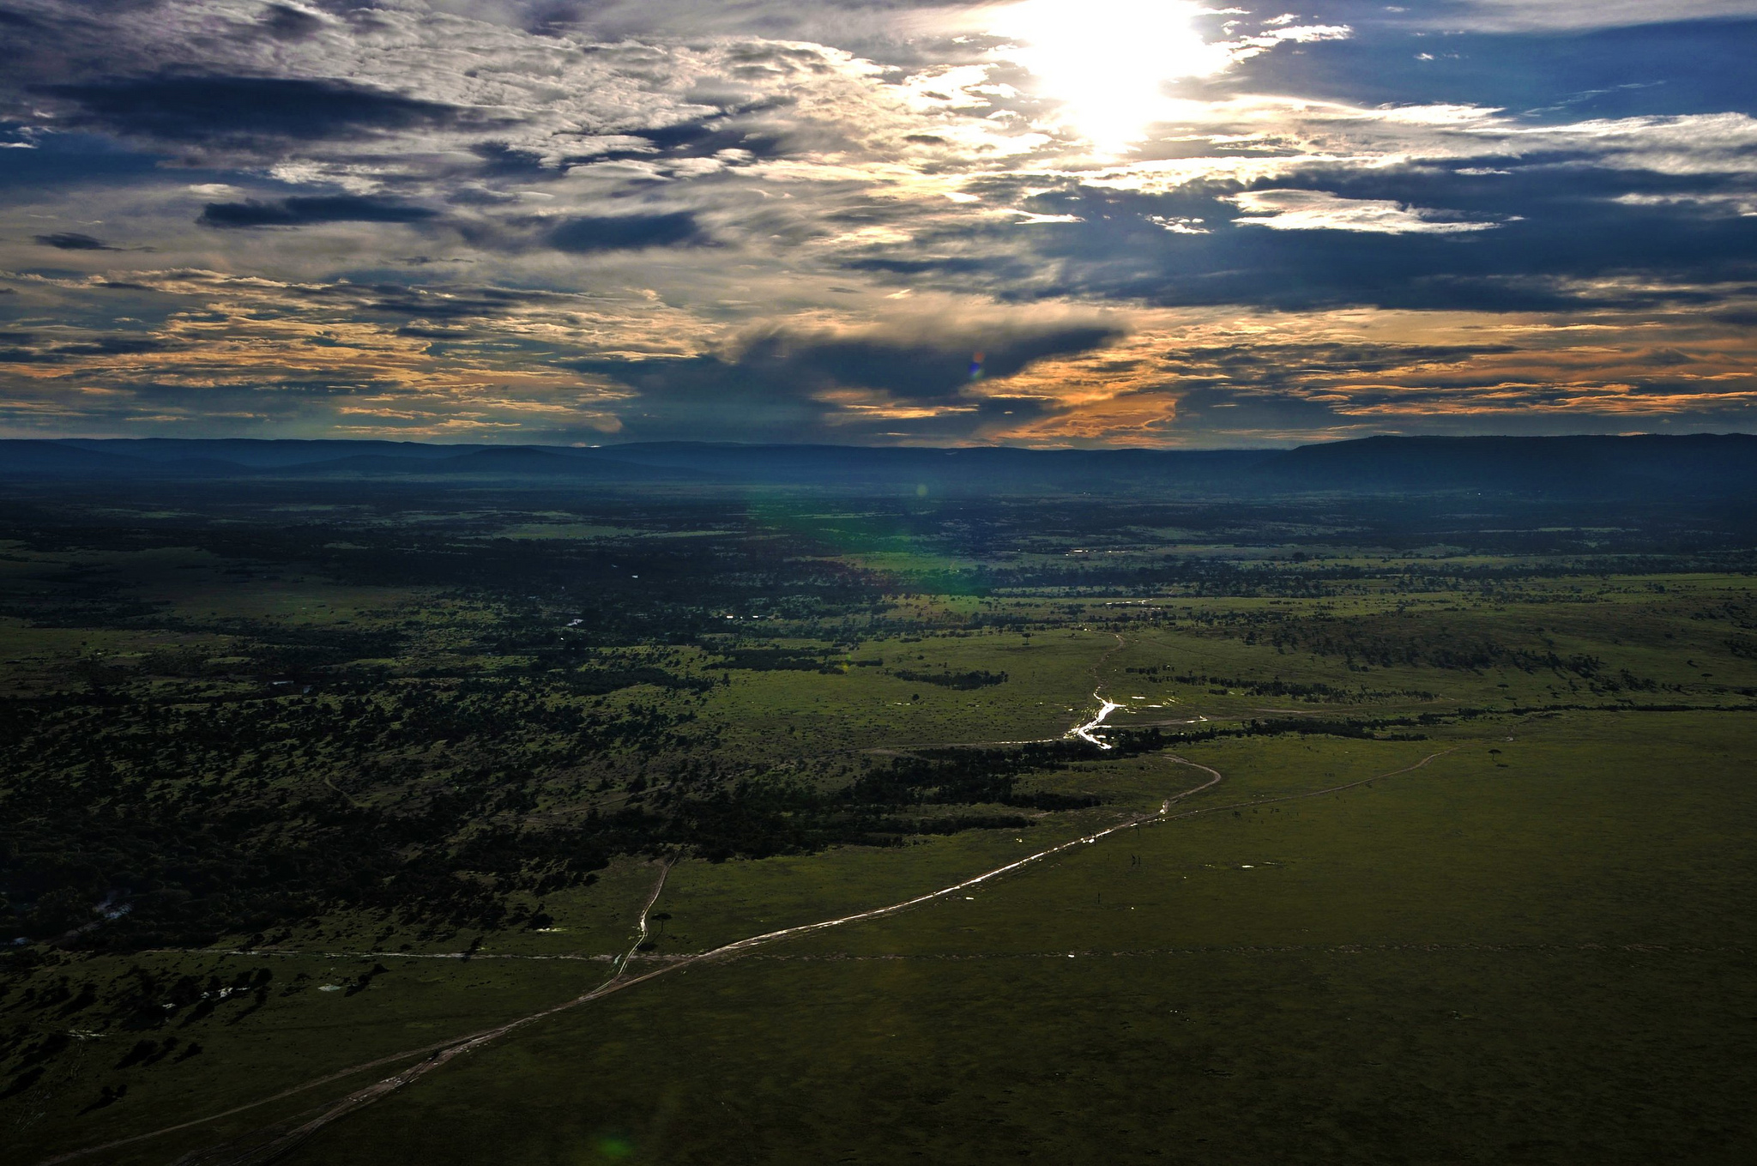
“Data exist, but information is scarce.”
Dr. Admassu Tsegaye and Dr. Abebe Getahun, University of Addis Ababa
African Biodiversity Challenge: goals
To capacitate and incentivise African countries to mobilise as many national biodiversity data of strategic importance as possible (through an adjudicated competition that evaluates quantity, quality and fitness for use) by developing a cohesive national biodiversity informatics network in support of the country’s sustainable development agenda.

Slide 6

How will the African Biodiversity Challenge develop effective networks?
The evolution of biodiversity informatics:
from silo to
self-organisation to
self-sustaining
Supply
$30,000
(country 1)
$20,000
(country 2)
$10,000
(country 3+4)
(volume and quality, info products)
Project Teams COMPETE!
Linking spin-off projects to community of funders
Evaluated on
Demand
(end user involvement and incorporation)
Sustainability
(MoUs in place / BIF development)
Notes:
We have selected project teams that can support project activities themselves and award cash prizes at the end of 2018 depending on the quality and quantity of deliverable submission.
A judging Panel (comprised of biodiversity informatics experts) will evaluate the deliverables based on:
Number of primary biodiversity records digitized, geo-referenced and DarwinCore formatted.
Any derived product that incorporates the mobilised data (data papers, Red List assessments, spatial layers, niche models, State of Environment Reports, etc.
Any evidence to demonstrate sustainability of the network, such as MoUs between data holders and end users, citations of datasets in national policies etc.
What project has had the greatest relative impact across the value chain?
What Project Team has designed systems to become self-sustaining?
Both final report and roadmap taken into account for context.

Slide 7
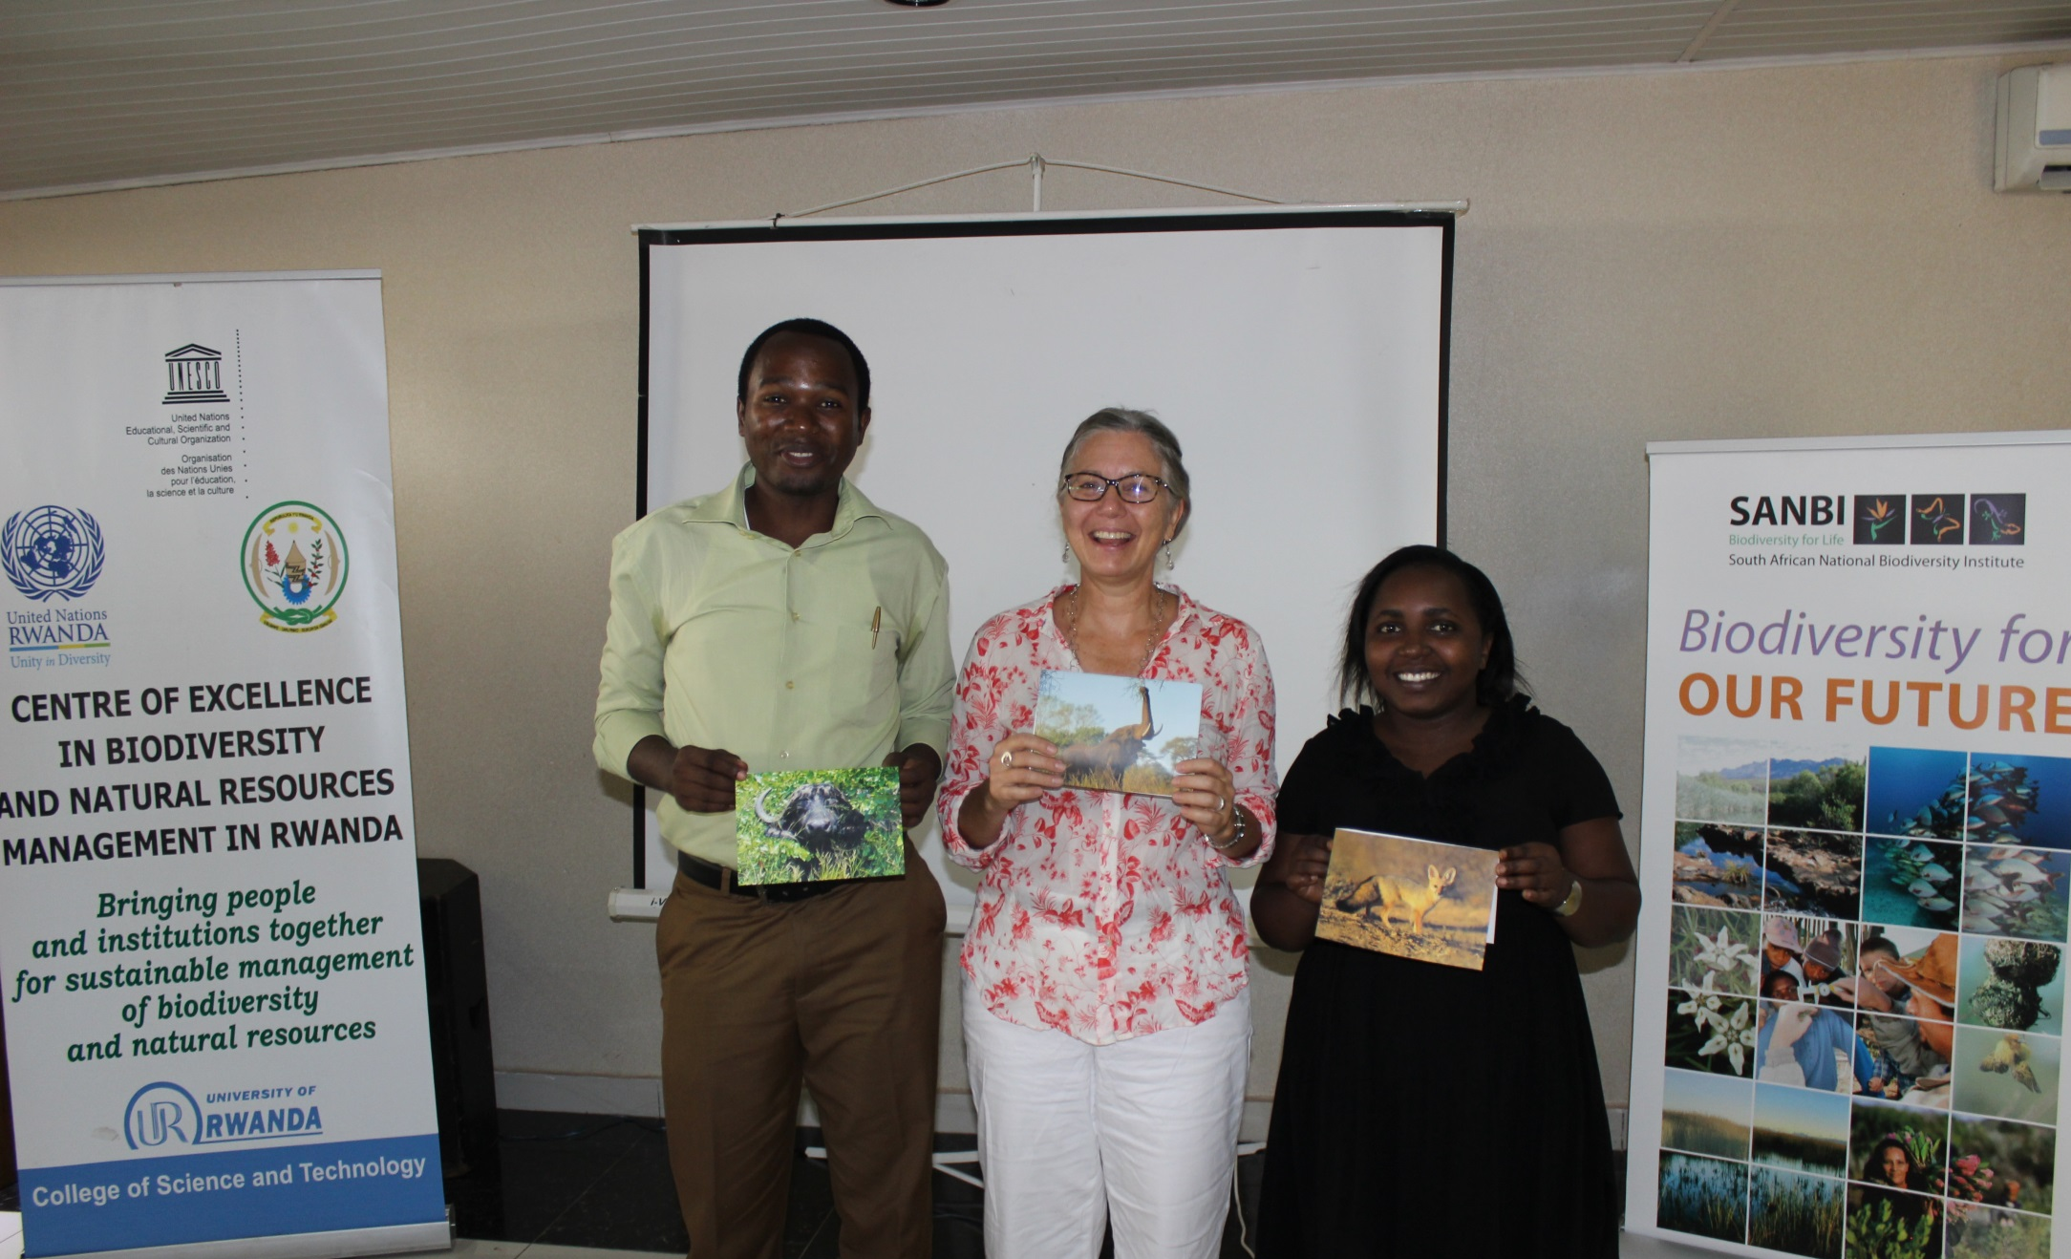
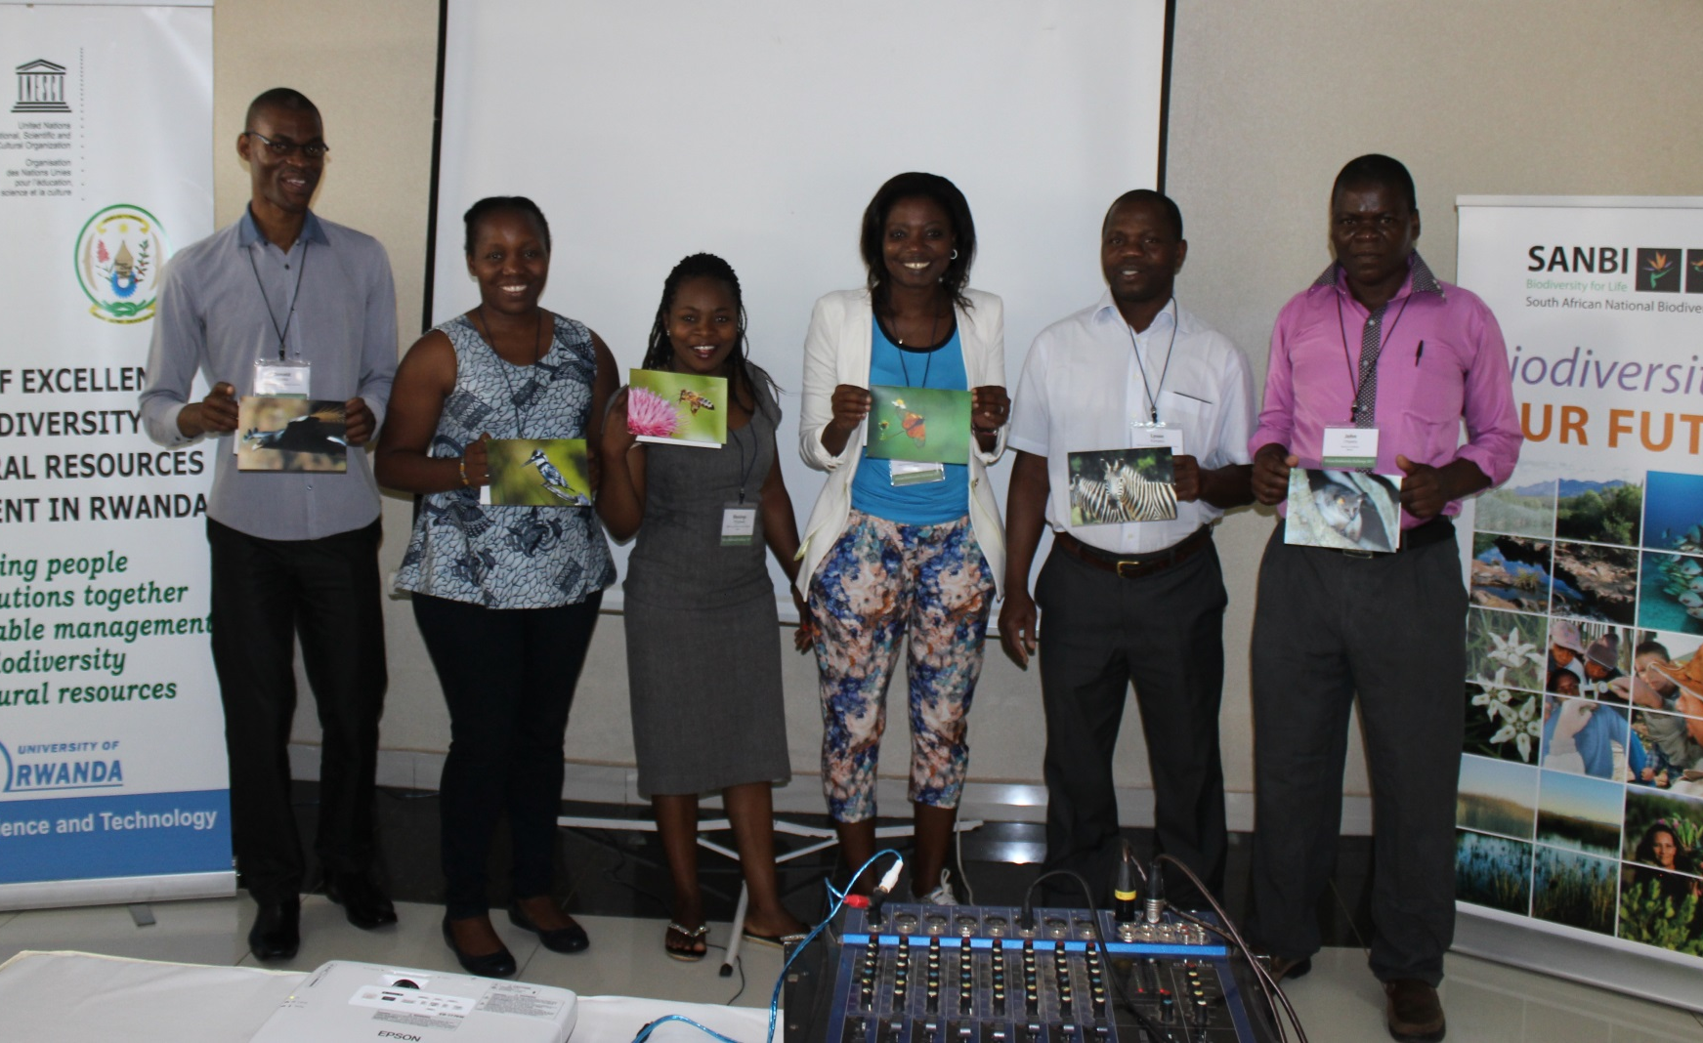
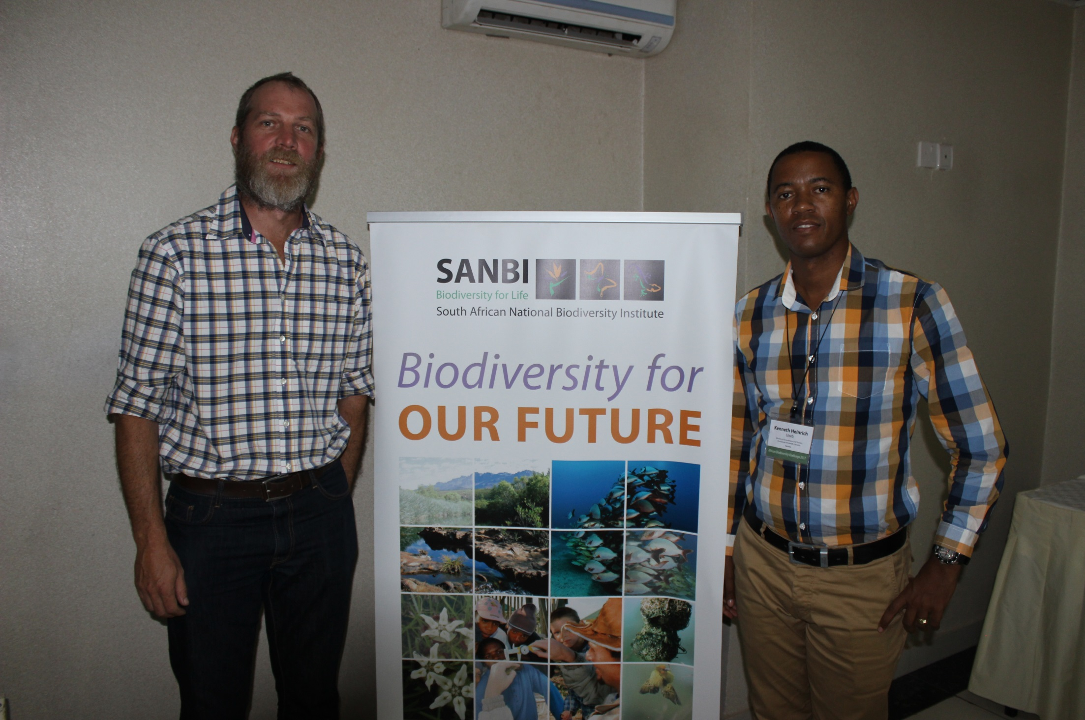
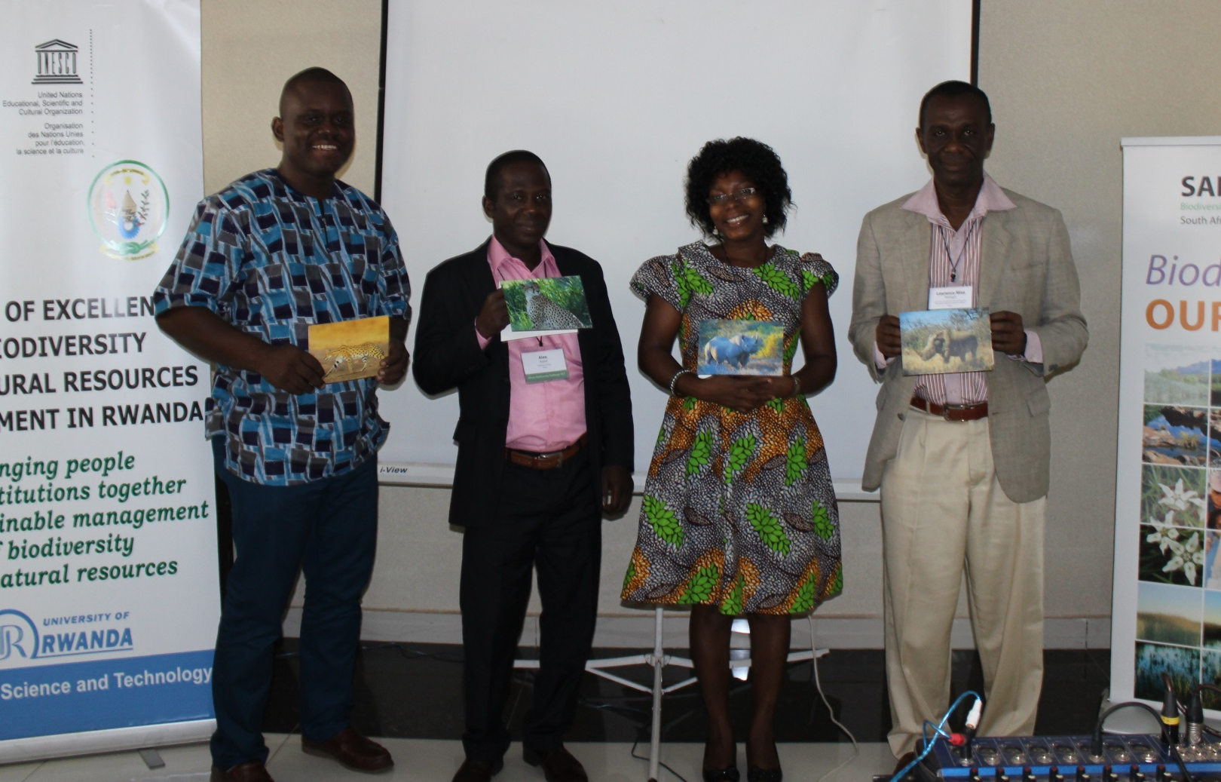
TEAM RWANDA
TEAM MALAWI
TEAM NAMIBIA
TEAM GHANA
Notes:
HOW BEST TO SUPPORT THESE TEAMS IN THEIR PROJECTS?
Rwanda
Institutions: University of Rwanda, ARCOS, REMA - ARCOS = Albertine Rift Conservation Society
REMA = Rwanda Environment Management Auhtority
Datasets: Freshwater macro-invertebrates
Publishing platform: ARBIMS (ARCOS)
End user targets: State of Freshwater Biodiversity Report
Malawi
Institutions: MoM, NHBG, WESM, NCST - Musuems of Malawi (MoM), National Herbarium and Botanical Gardens (NHBG), Wildlife Society of Malawi (WESM), National Commission for Science and Technology
Datasets: Specimens of threatened species, Nyala journal survey data
Publishing platform: NCST – Malawi GBIF node
End user targets: State of Environment Report / Red List assessments
Wi
Ghana
CA, A Rocha, CSIR, University of Ghana - Conservation Alliance (CA), Council for Scientific and Industrial Research
Community Resource Management Areas (CREMAs)
Datasets: CREMA surveys, under-utilised plant species specimens
Publishing platform: University of Ghana, GhaBIF
End user targets: Biodiversity Policy, UN Forest Forum, REDD+ policy
Namibia
Institutions: MET, GSNL, National Museum MET = Ministry of Environment and Tourism
GSNL = Greater Sossusvlei-Namib Landscape
Datasets: Wildlife survey and permit data, tracking data
Publishing platform: SANBI
End user targets: Policy briefs on wildlife utilisation policies, non-detriment findings for CITES

Slide 8
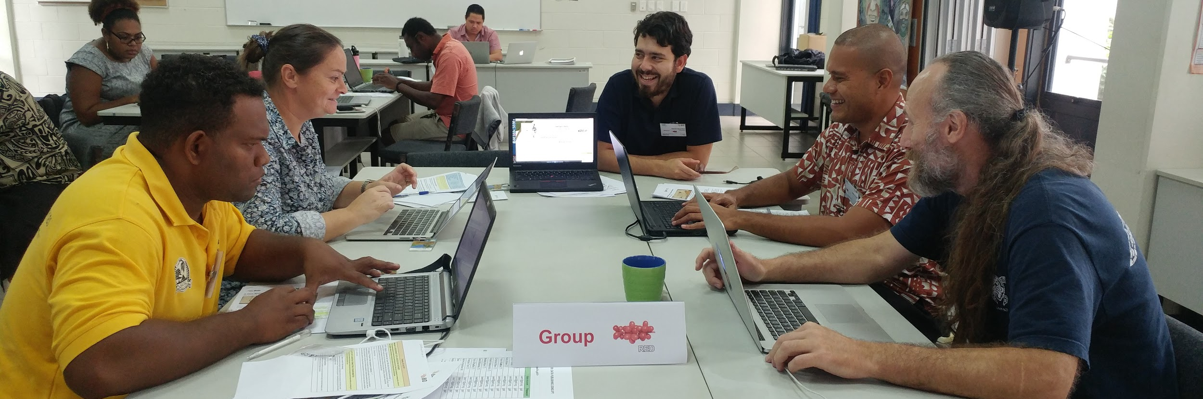
TRAining approach
Provide enhanced capacity for effective mobilization and use of biodiversity information through a strengthened community of practice supporting the implementation of funded projects
Notes:
Given that a number of regional inititatives have similar objectives, the focus of the training approach of the BID programme has been to strengthen a community of practice around the effective mobilization and use of data.
Goals
Collaborate across regional programmes
Provide centrally coordinated training workshops responding to identified needs within the programme projects
Identifying skilled professionals within project teams
Develop a mentor support network
Develop reusable curriculum
Certify the knowledge of participants
Provide language support

Slide 9
Bid Programme TimELINE
June 2016
March 2019
June 2016 – June 2017
Africa I small
June 2016 – June 2018
Africa I regional and national
May 2017 – October 2018
Caribbean and Pacific small
May 2017 – December 2018
Caribbean and Pacific regional and national
October 2017 – March 2019
Africa II national and small
Notes:
CE
Data mobilization workshops
Knowledge dissemination
Mobilize data
57 new resources registered with GBIF
Integrate information into policy and decision
Data mobilization has been running since 20126 built on training that has already been going on
Data use is
Developed by all three organisations
On-site and online content
Language support

Slide 10
Bid Programme TimELINE
Data mobilization and publishing workshops
June 2016 – June 2017
Africa I small
June 2016 – June 2018
Africa I regional and national
May 2017 – October 2018
Caribbean and Pacific small
May 2017 – December 2018
Caribbean and Pacific regional and national
October 2017 – March 2019
Africa II national and small
August 2016 Kigali
June 2017 Apia
July 2017 Port of Spain
December 2017 Cape Town

Slide 11
Bid Programme TimELINE
June 2016 – June 2017
Africa I small
June 2016 – June 2018
Africa I regional and national
May 2017 – October 2018
Caribbean and Pacific small
May 2017 – December 2018
Caribbean and Pacific regional and national
October 2017 – March 2019
Africa II national and small
Data use for decision-making workshops
April 2018
Cape Town
December 2018 Bogota?
September 2018 Auckland?

Slide 12
Data MObiliZAtion Workshop
DATA MOBILIZATION
Biodiversity informatics foundations
Planning a digitization project
Biodiversity data digitization
Data curation, formatting & transformation
Data publishing using IPT
Evaluation
Notes:
11 modules 3 preparatory
GBIF and other BDI initiatives, Basics of Biodiversity Informatics, Workshop sessions preliminary work
7 onsite
Foundations: Key Concepts and Darwin Core
Digitization project planning: how to decide what to do and when to do it?
Digitization planning practical exercise: Will it work?
Basic concepts of data cleaning, OpenRefine
Biodiversity data digitization: Biodiversity Data Types: With which kind of data are we working?,
Principles of data management in digitization
Data publishing concepts and introduction to the IPT
1 post workshop – Data Access via GBIF

Slide 13
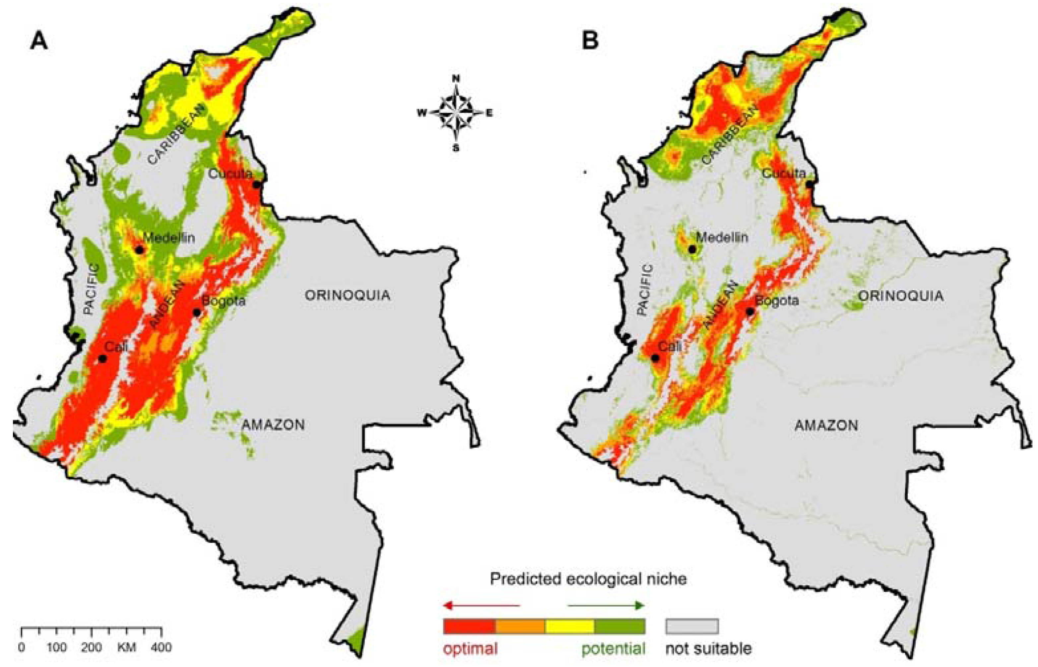
DATA USE FOR DECISION-MAKING Workshop
Biodiversity Information Products
Understanding in-country demands
Fitness for use
Ecological Niche Modelling
Global and National Red Lists
Sustaining the flow of information
Notes:
Clearly understand the in-country demands for, and the barriers to using, biodiversity information within government decision making including clarifying the format, timing and packaging required
Strengthen the connection between government decision makers and biodiversity and ecosystem services data providers in order to sustainably provide policy-relevant, spatially explicit information to meet ongoing national needs
Responds to the needs of the BID, SANBI ABC and UNEP-WCMC
Information Products
Themes

Slide 14
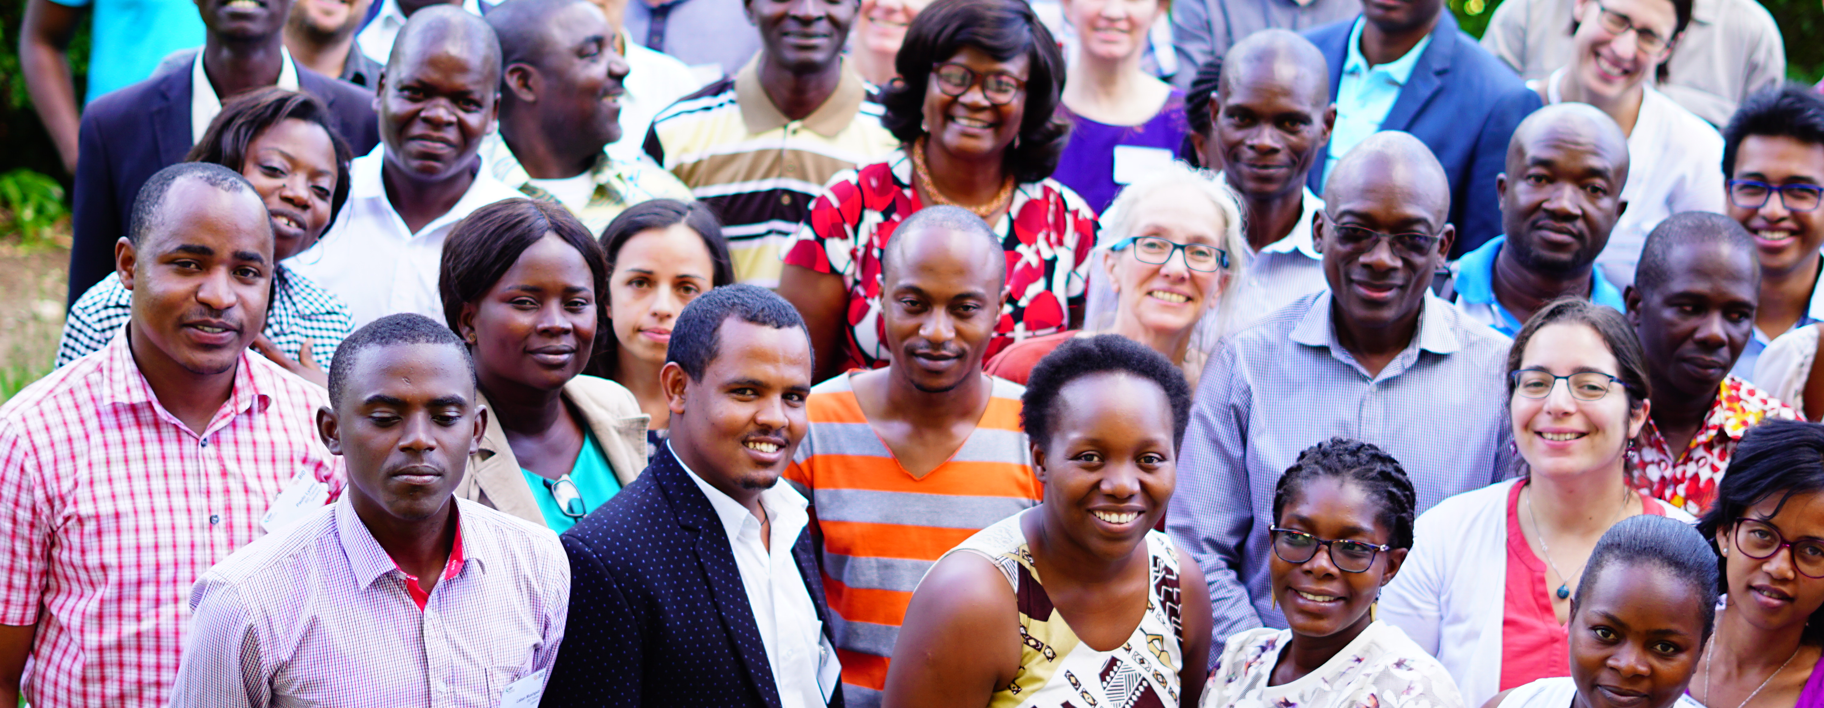
What is next?
Develop activities to strengthen the base of mentors, trainers and support materials
Expand the mentor network beyond BID
Enable ad-hoc use of training materials
Notes:
Built up diuring BID with specific regional calls
on 4th workshop with development of
IF they are interested in the programme they can be used fot
This is a programme that we will have refined over the duration of the programme and are willing to work with

Slide 15
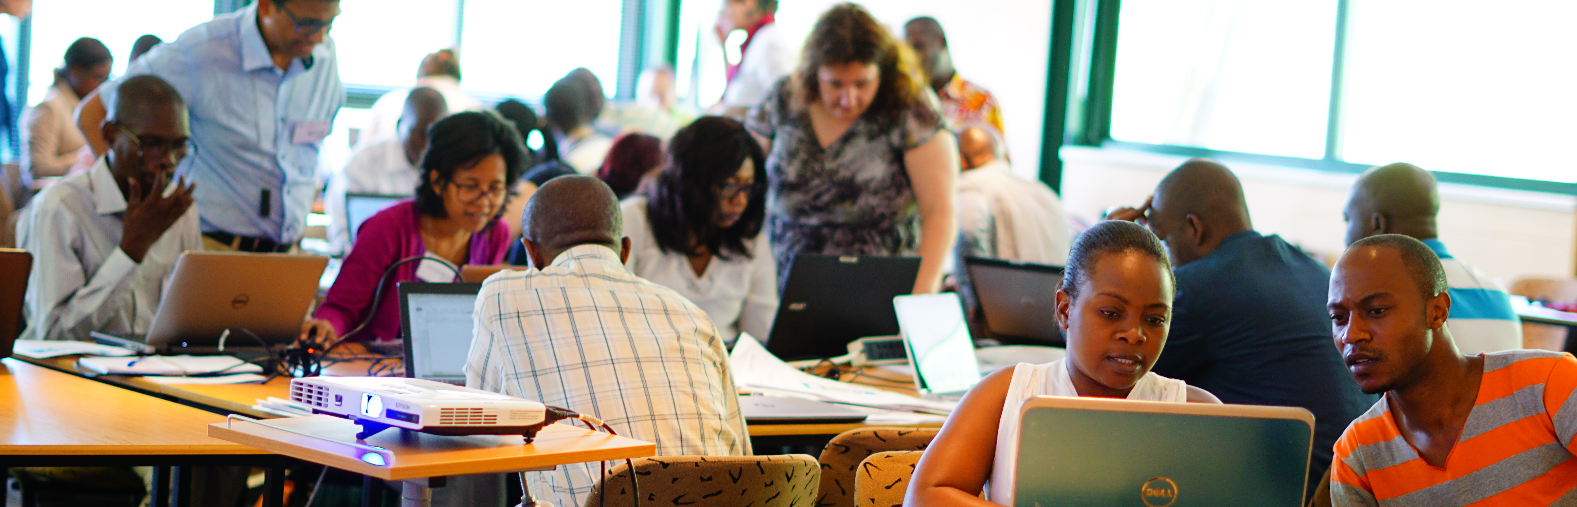
Thank you
Andrew Rodrigues
21st SBSTTA Meeting
12 Dec 2017
montreal, canada

