Slide 1
Overview slides
July 2023
Notes:
There are 4 variations of the title page created in the Master Slides. To choose another option right click on the slide > Layout > and choose your desired design
To change the background image: Right click on the background image > Format Background > Fill > Picture or texture fill > Picture source > Insert > From a file (or online) > select you image and press Open.

Slide 2


Datasets
Hosted portals
86,749
14
Country Participants
65
Peer-review papers
using data
8,981
Organizational Participants
Average records
downloaded per month (2023)
43
162.6 billion
Species
occurrence records
Publishers
2,103
2,335,503,515
By the numbers | 1 July 2023
www.gbif.org
Notes:
Frequently used slide, redone
Please copy and paste these to your slides and never make any changes to them directly in the toolkit.
Useful to see GBIF in its different modalities:
A window on biodiversity
An informatics infrastructure focuseD on tools and standards in service to science and society
A global network on bioinformatics

Slide 3
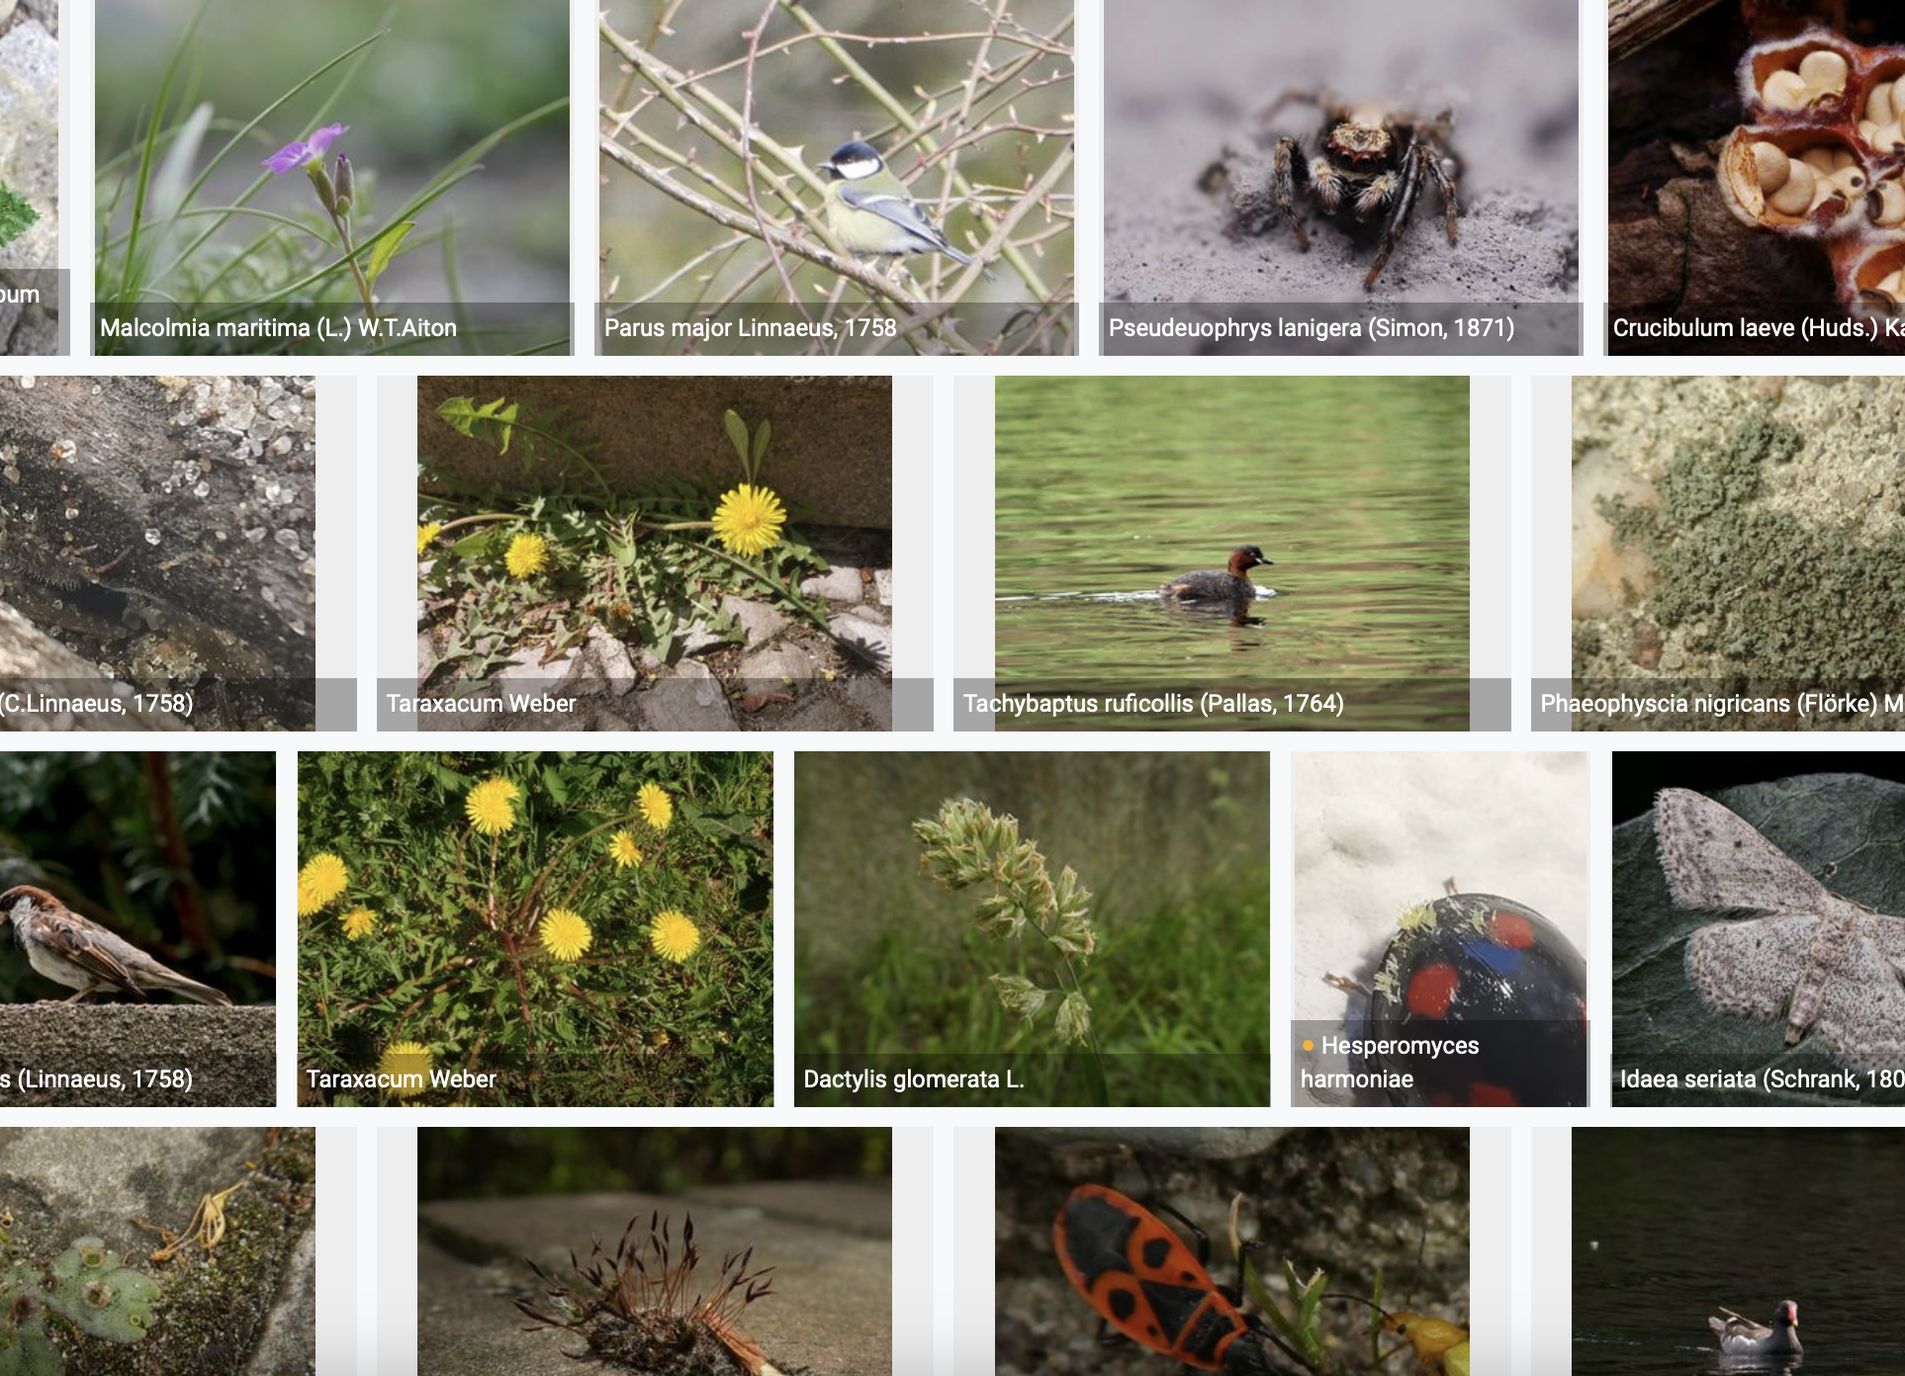
Species occurrence records with multimedia evidence: 2023
1 July 2023
146.1 million records with taxonomically identified images
87.6 million human observations
54.1 million specimens
1.4 million fossil specimens
1.1 million material samples
1,161,713 audio files
3,749 videos
https://www.gbif.org/occurrence/gallery

Slide 4
GBIF Participant countries
1 July 2023
Voting Participants
Associate Participants
Notes:
This map is fully editable. This map is a grouped element of all the countries in the world. All the countries are named correctly and can be accessed and selected via the Selection Pane.
There are ways you can edit and make changes to the map. But please remember to always make a copy of the map on your slide and never make changes to the toolkit version.
Please take a look at the next few slides to find out different ways of editing this map

Slide 5
GBIF network of data publishing institutions
3 July 2023
136
countries/areas with institutions
sharing data through GBIF
Number of active publishers by country or area - 1 July 2023

Slide 6
GBIF.org traffic by country: 2023
30 June 2023
Rank | Country/Territory | Visitors | Visits | Effective visits* | % Effective visits | 2022 rank | Pages / visit
1 | United States | 366,450 | 440,989 | 189,625 | 11.54% | 1 | 4.91
2 | Colombia | 167,479 | 215,799 | 97,110 | 5.91% | 2 | 4.32
3 | Mexico | 164,806 | 196,381 | 80,516 | 4.90% | 3 | 4.11
4 | Brazil | 141,032 | 169,067 | 76,080 | 4.63% | 5 | 4.49
5 | Spain | 117,209 | 150,301 | 75,151 | 4.58% | 6 | 6.39
6 | China | 90,745 | 127,266 | 72,542 | 4.42% | 3 | 11.27
7 | France | 136,368 | 164,432 | 70,706 | 4.30% | 9 | 4.99
8 | Germany | 122,811 | 151,275 | 68,074 | 4.14% | 10 | 6.14
9 | Indonesia | 79,478 | 99,458 | 56,691 | 3.45% | 7 | 5.99
10 | United Kingdom | 92,078 | 114,560 | 51,552 | 3.14% | 8 | 5.01
 | TOTAL | 2,916,104 | 3,645,750 | 1,640,588 | 100.00% |  | 5.40

Slide 7
Occurrences published by country: 2023
30 June 2023
Rank | Country/Territory | 2023 | 2022 total | 2022 rank
1 | United States | 18,622,564 | 123,152,046 | 1
2 | France | 10,088,060 | 40,243,552 | 2
3 | Sweden | 5,154,663 | 13,698,583 | 7
4 | United Kingdom | 3,448,624 | 14,602,384 | 6
5 | Chile | 3,030,177 | 907,724 | 30
6 | China | 3,011,304 | 426,236 | 41
7 | Netherlands | 2,589,082 | 30,330,743 | 3
8 | Denmark | 2,045,807 | 3,337,598 | 17
9 | Poland | 1,981,771 | 2,542,166 | 20
10 | Switzerland | 1,959,715 | 2,162,360 | 24
OTHER COUNTRIES + AREAS | OTHER COUNTRIES + AREAS | 12,529,399 | 66,653,115
TOTAL |  | 64,461,166 | 369,598,387
Notes:
This is a live doughnut pie chart representing different theme colours and how they work, placed next to one another.
You do not have to use the same exact chart, you can simply create your own by clicking on:
Insert tap on the ribbon > Click on Chart > chose a chart of your choice (in this example I chose, Doughnut) > add in your data in the automatically opened Excel sheet and see your chart changing and adopting to the new information you have entered in the data sheet.

Slide 8
Data download requests by country: 2023
30 June 2023
Rank | Country |  | 2023 | 2022 total | 2022 rank
1 | China | 21,150 |  | 36,844 | 1
2 | United States | 19,270 |  | 24,812 | 3
3 | Mexico | 12,542 |  | 27,172 | 2
4 | Colombia | 10,415 |  | 18,392 | 4
5 | Brazil | 9,504 |  | 14,777 | 5
6 | Spain | 7,532 |  | 9,280 | 7
7 | United Kingdom | 5,533 |  | 10,256 | 6
8 | France | 4,700 |  | 5,231 | 9
9 | Germany | 3,672 |  | 4,590 | 11
10 | Canada | 3,279 |  | 4,782 | 10
OTHER COUNTRIES + AREAS | ALL OTHERS | 53,695 |  | 75,107
TOTAL |  | 143,857 |  | 232,591
146
countries, islands & territories where users have ≥5 requested downloads
Notes:
NB: 2022 totals account for multiple recurrent downloads by scripts and bots that are discarded, accounting for (in Jan 2022):
Argentina: 1,592
Austria: 1,032
Belgium: 1,377
Canada: 1,648
Switzerland: 49,358
China: 13,498
India: 3,579
Japan: 124,927
Netherlands: 28,857
Norway: 3,615
United States: 51,186

Slide 9
Peer-reviewed publications using GBIF-mediated data
30 June 2023
Notes:
The next 3 slides are showcasing PPT standard or Live charts.
To create a chart simply click on the Insert tap on the ribbon > Click on Chart > chose a chart of your choice (in this example I chose, Bar) > add in your data in the automatically opened Excel sheet and see your chart changing and adopting to the new information you have entered in the data sheet.

Slide 10
Data use in peer-reviewed journals: 2023
30 June 2023
Peer-reviewed uses by country
Peer-reviewed uses by region
End of Year |  |  | 2023 total | 2022 total | 2022 rank
1 | United States |  | 192 | 306 | 2
2 | China |  | 179 | 309 | 1
3 | Brazil |  | 88 | 167 | 3
4 | United Kingdom |  | 87 | 149 | 4
5 | Germany |  | 75 | 126 | 6
6 | Mexico |  | 61 | 146 | 5
7 | Spain |  | 60 | 105 | 9
8 | Australia |  | 53 | 78 | 7
9 | France |  | 52 | 78 | 7
10 | India |  | 48 | 63 | 12

Slide 11
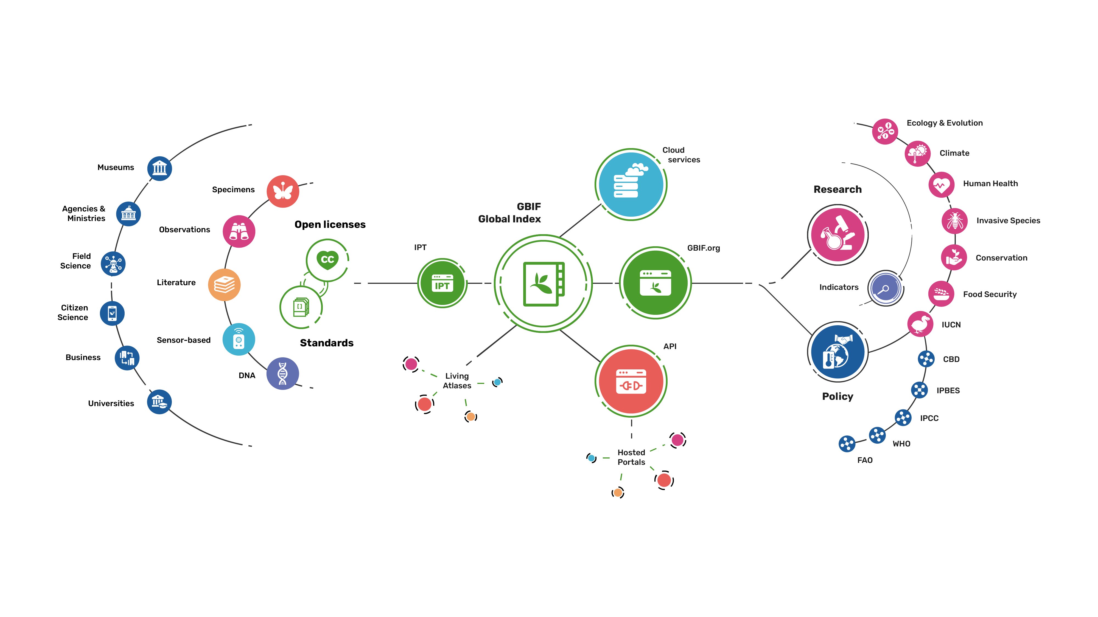
Providing biodiversity evidence for research and policy

Slide 12
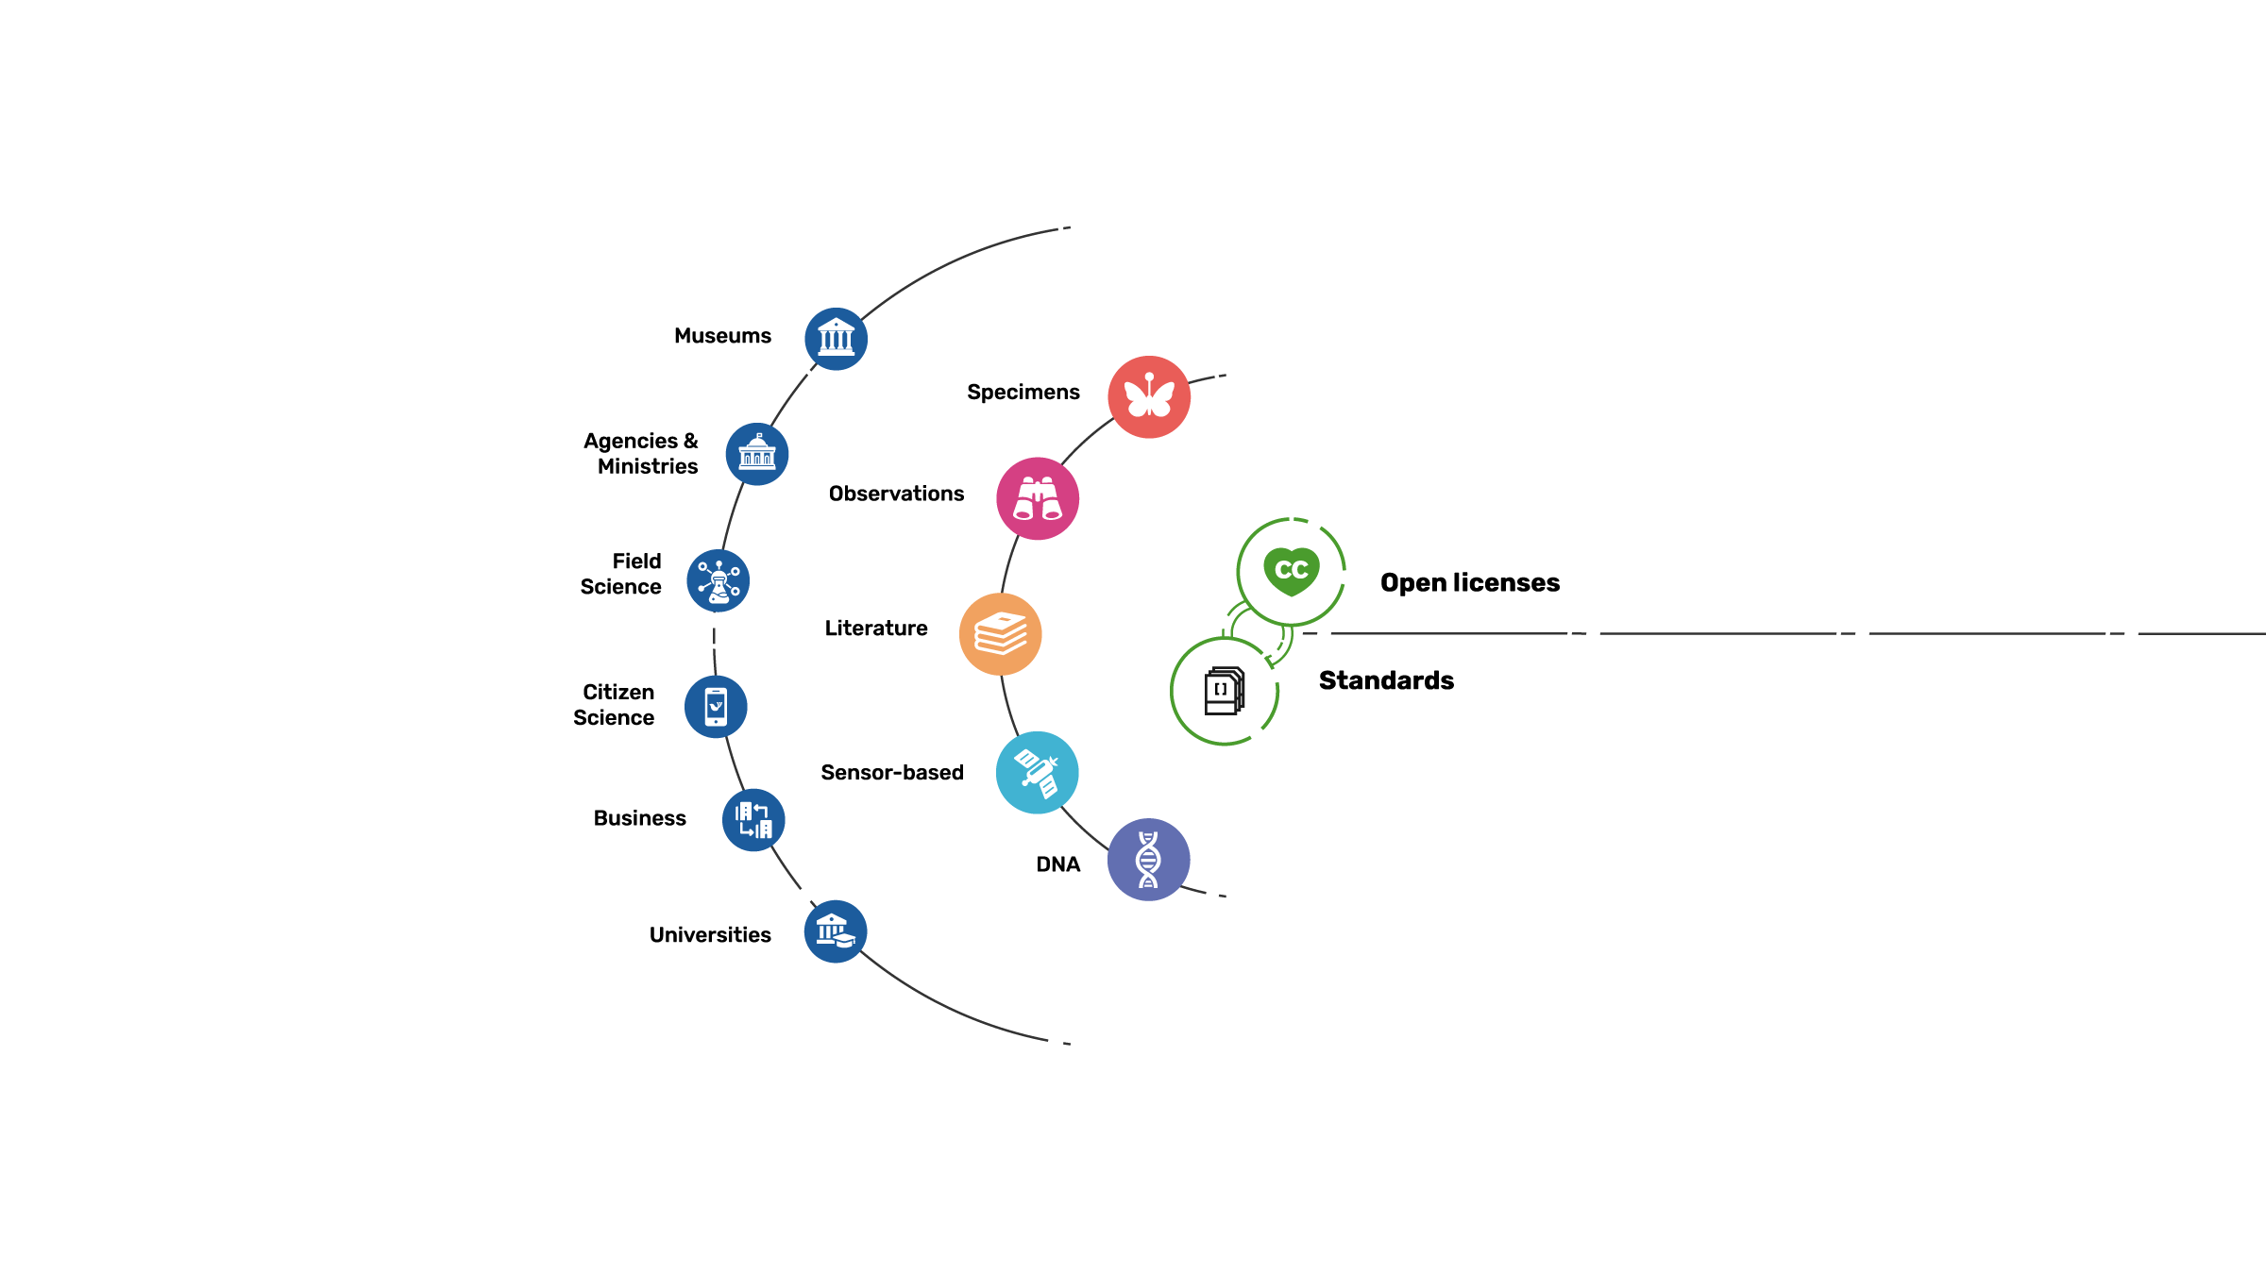
Sources of biodiversity evidence
Create
Combine sources
of evidence

Slide 13
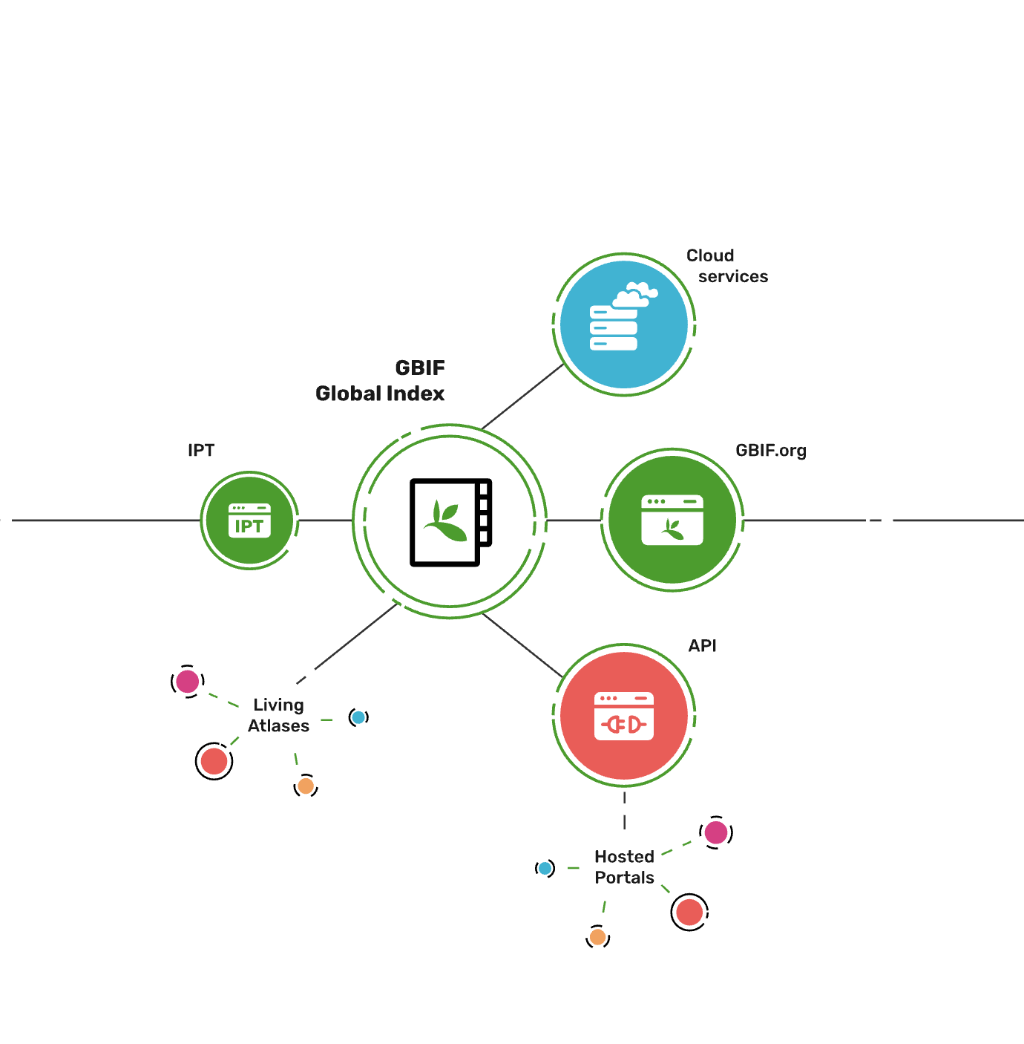
Access to biodiversity evidence
Share
FAIR and open access

Slide 14
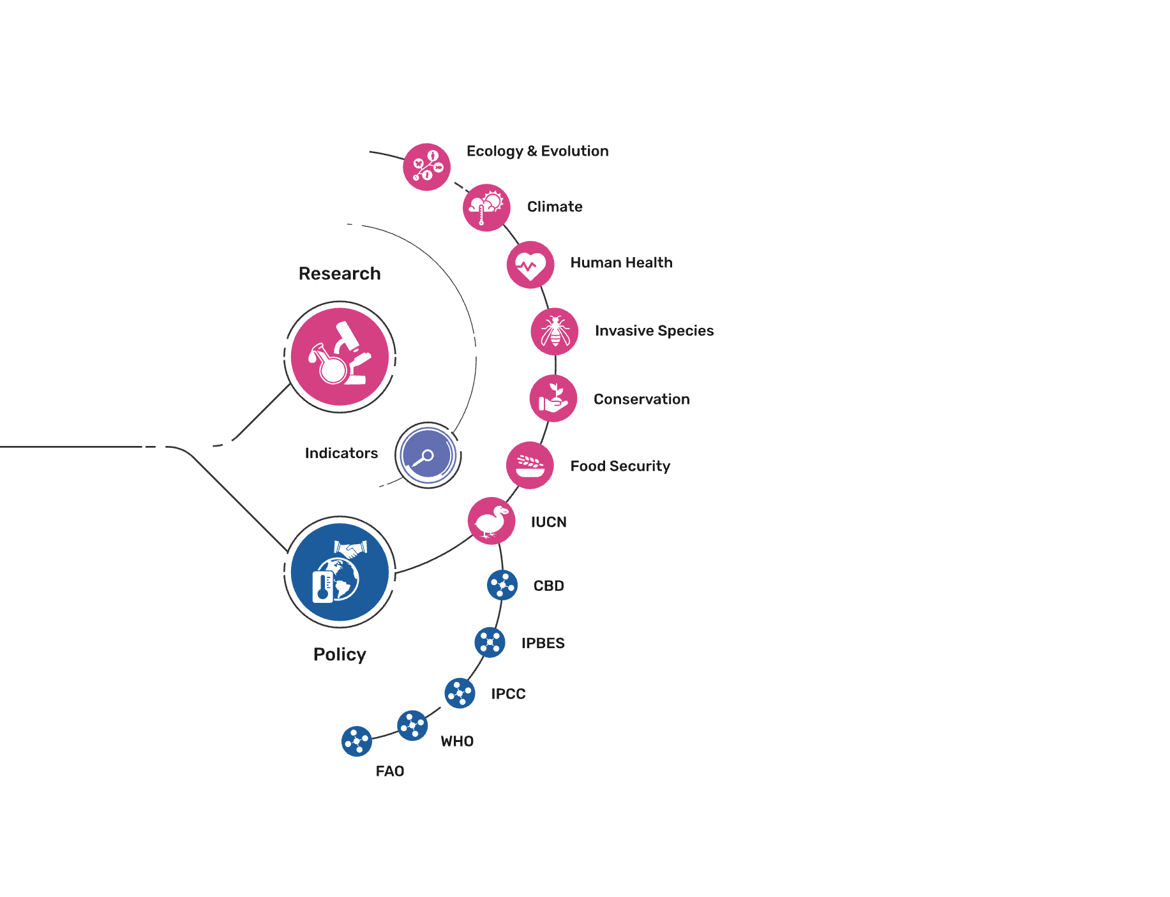
Uses of biodiversity evidence
Transform
Apply and use data

