Slide 1
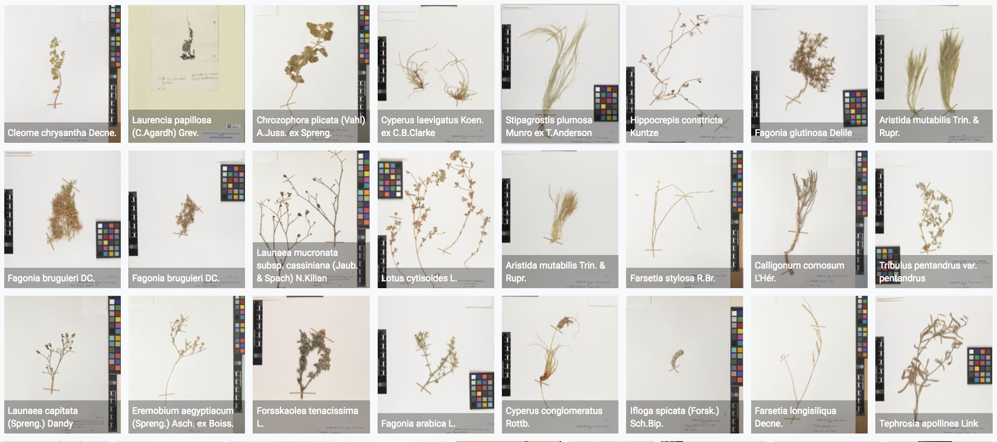
Returning benefits from open access biodiversity data
Tim Hirsch, Deputy Director, GBIF
Side event on Supporting data management for enhanced implementation and non-monetary benefit-sharing, un biodiversity conference, sharm el sheikh, 22 november 2018

Slide 2
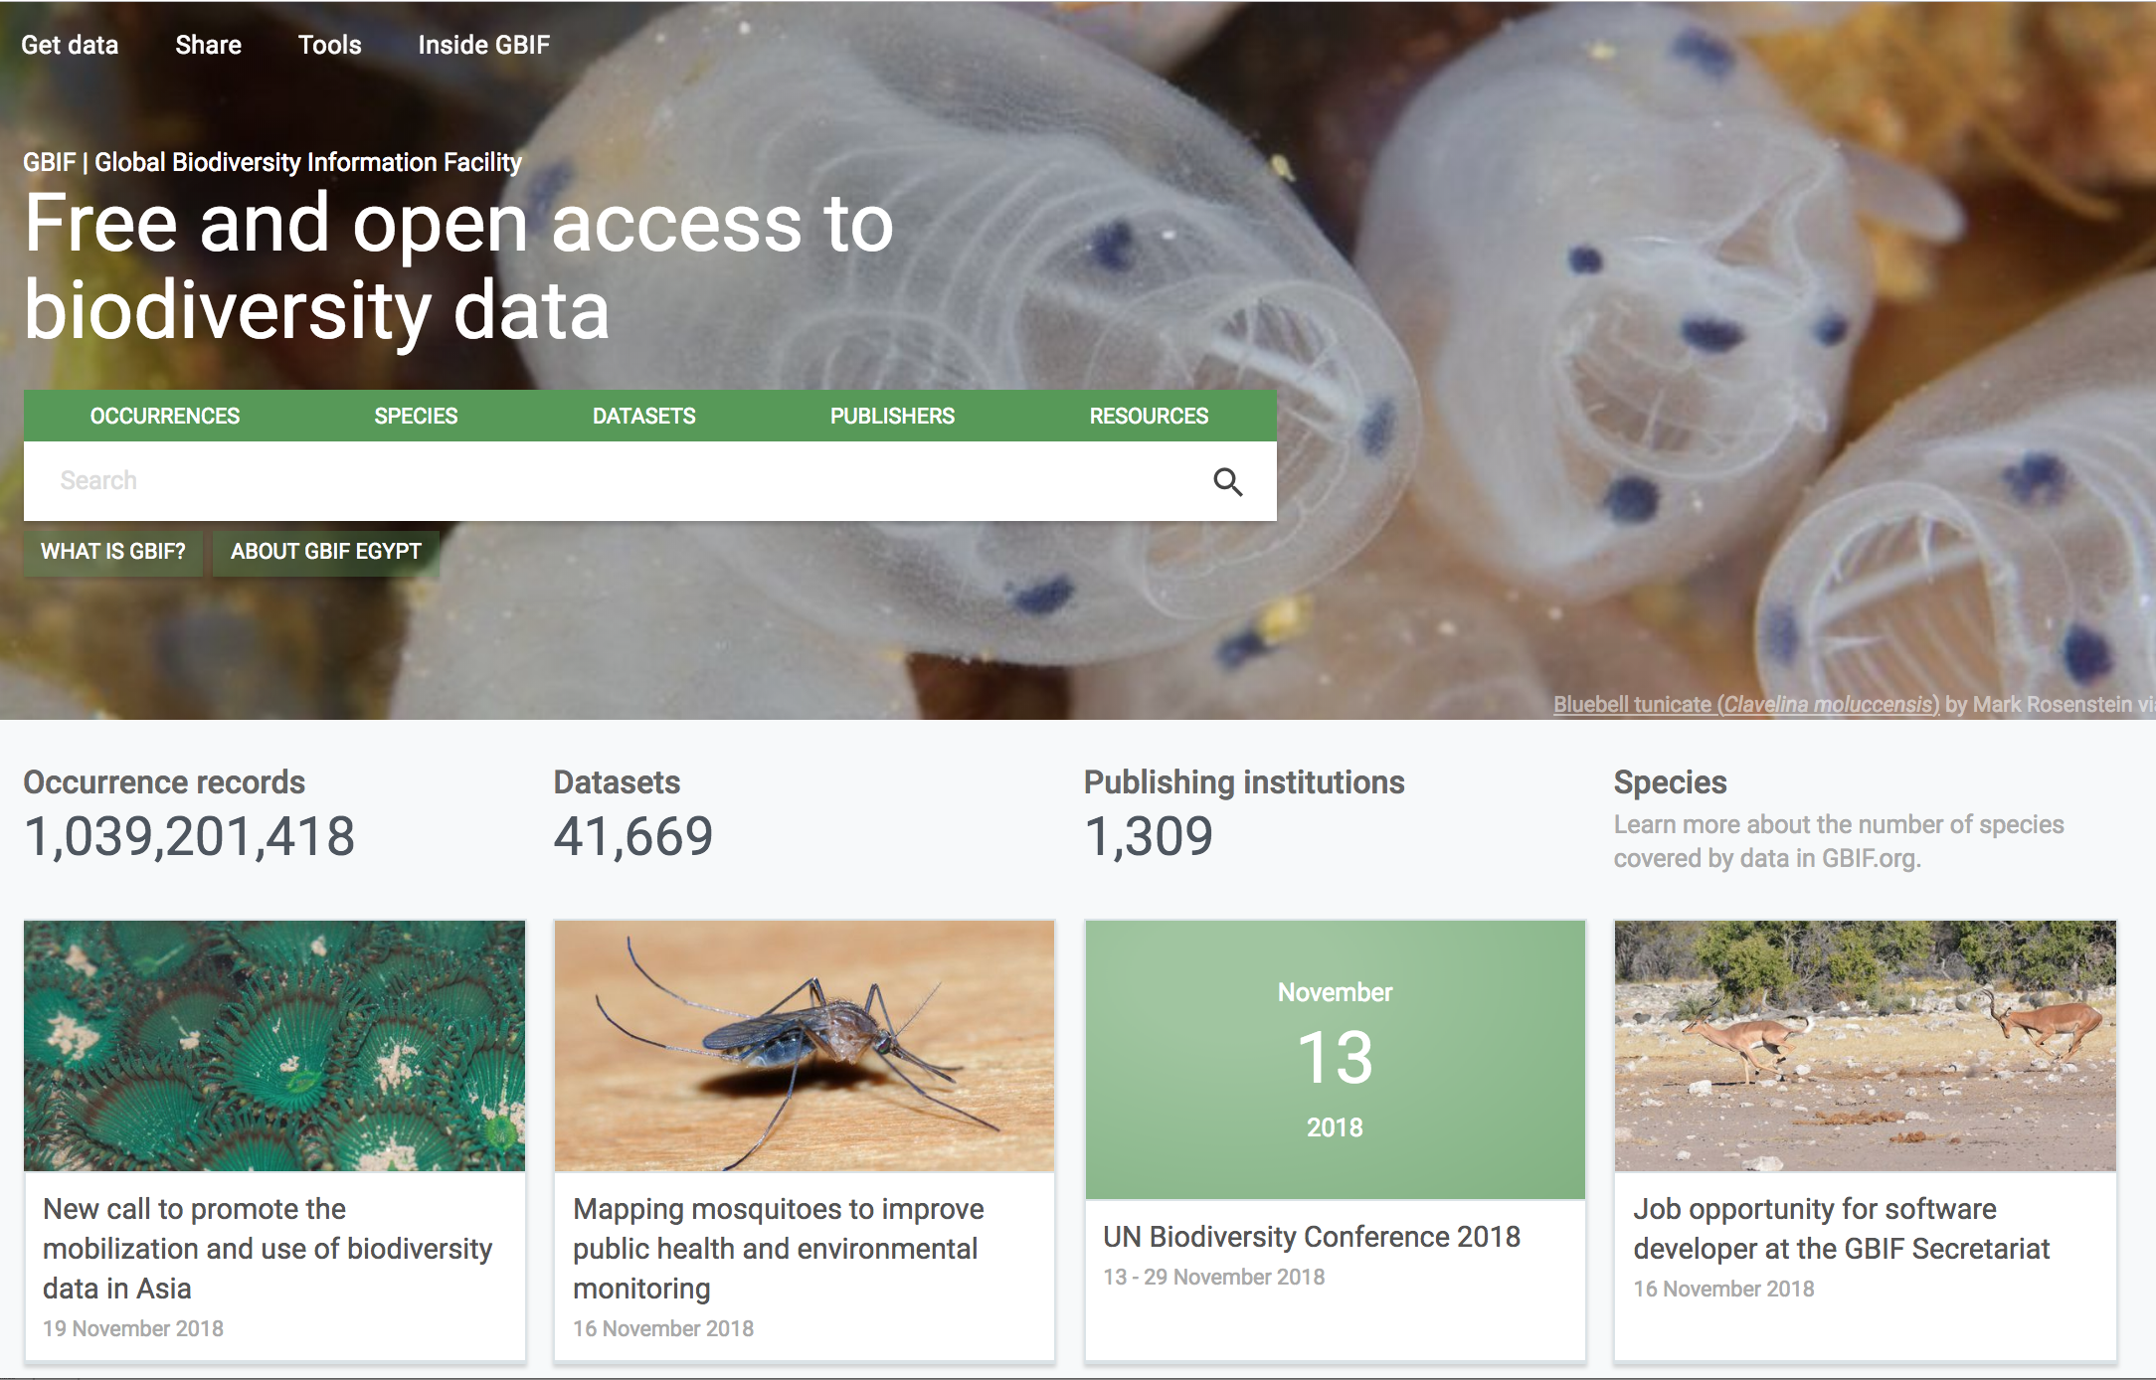
https://www.gbif.org/

Slide 3
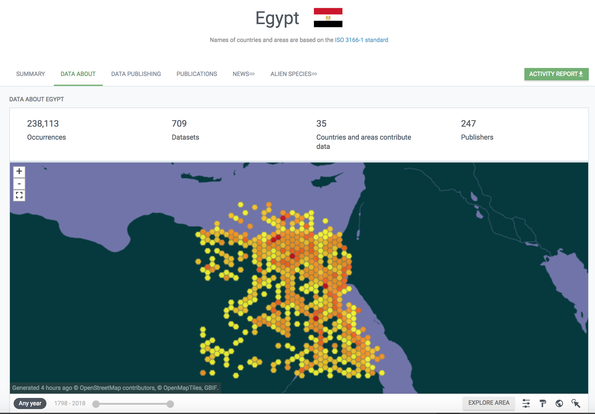
Repatriation of data through open access
https://www.gbif.org/country/EG/about

Slide 4
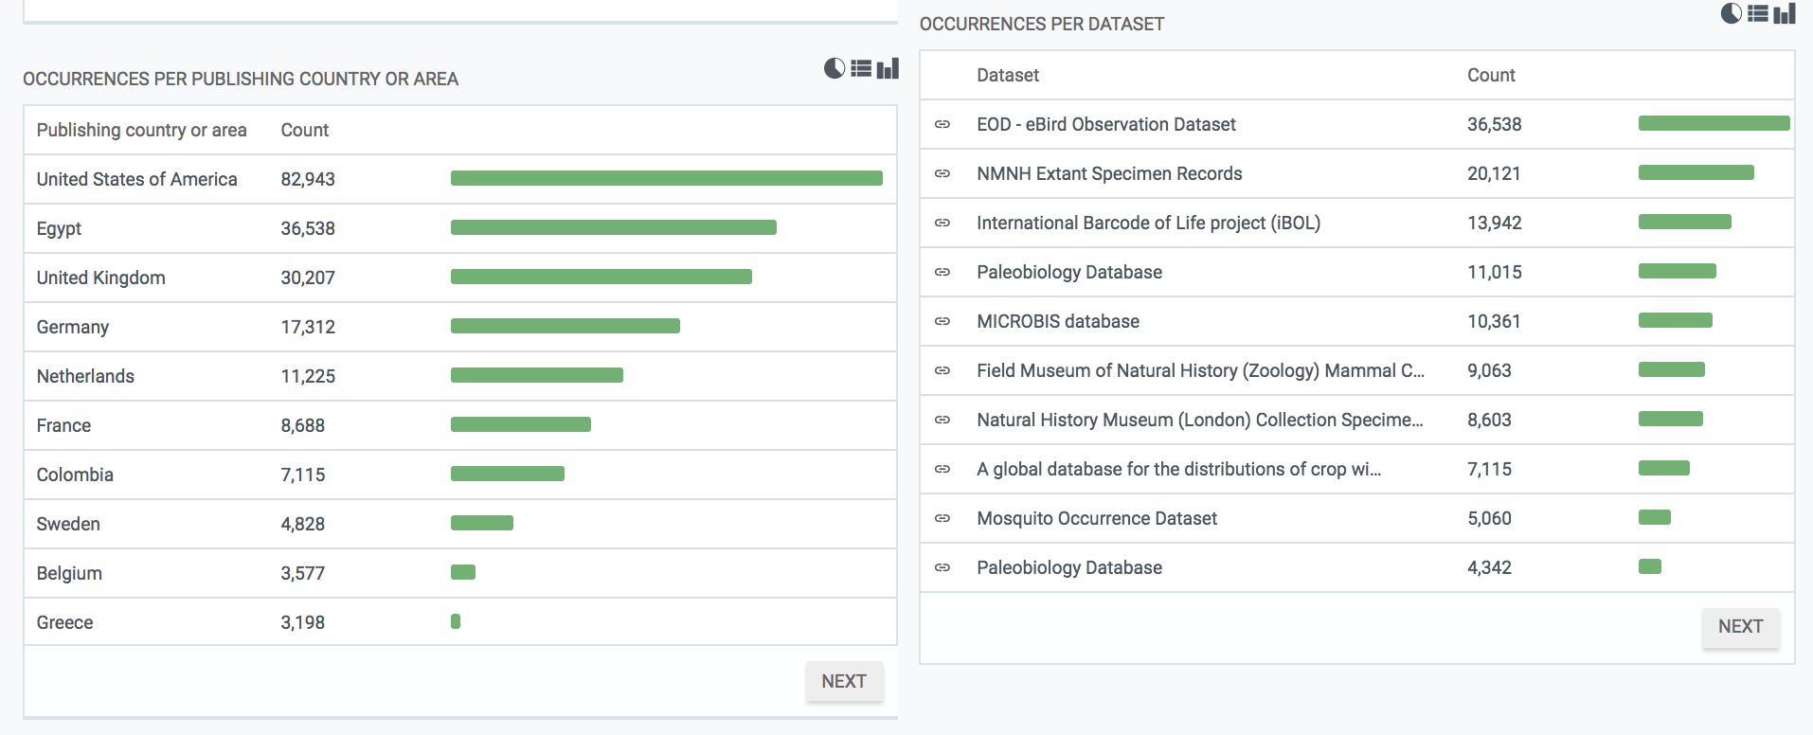
Repatriation of data through open access
https://www.gbif.org/country/EG/about

Slide 5
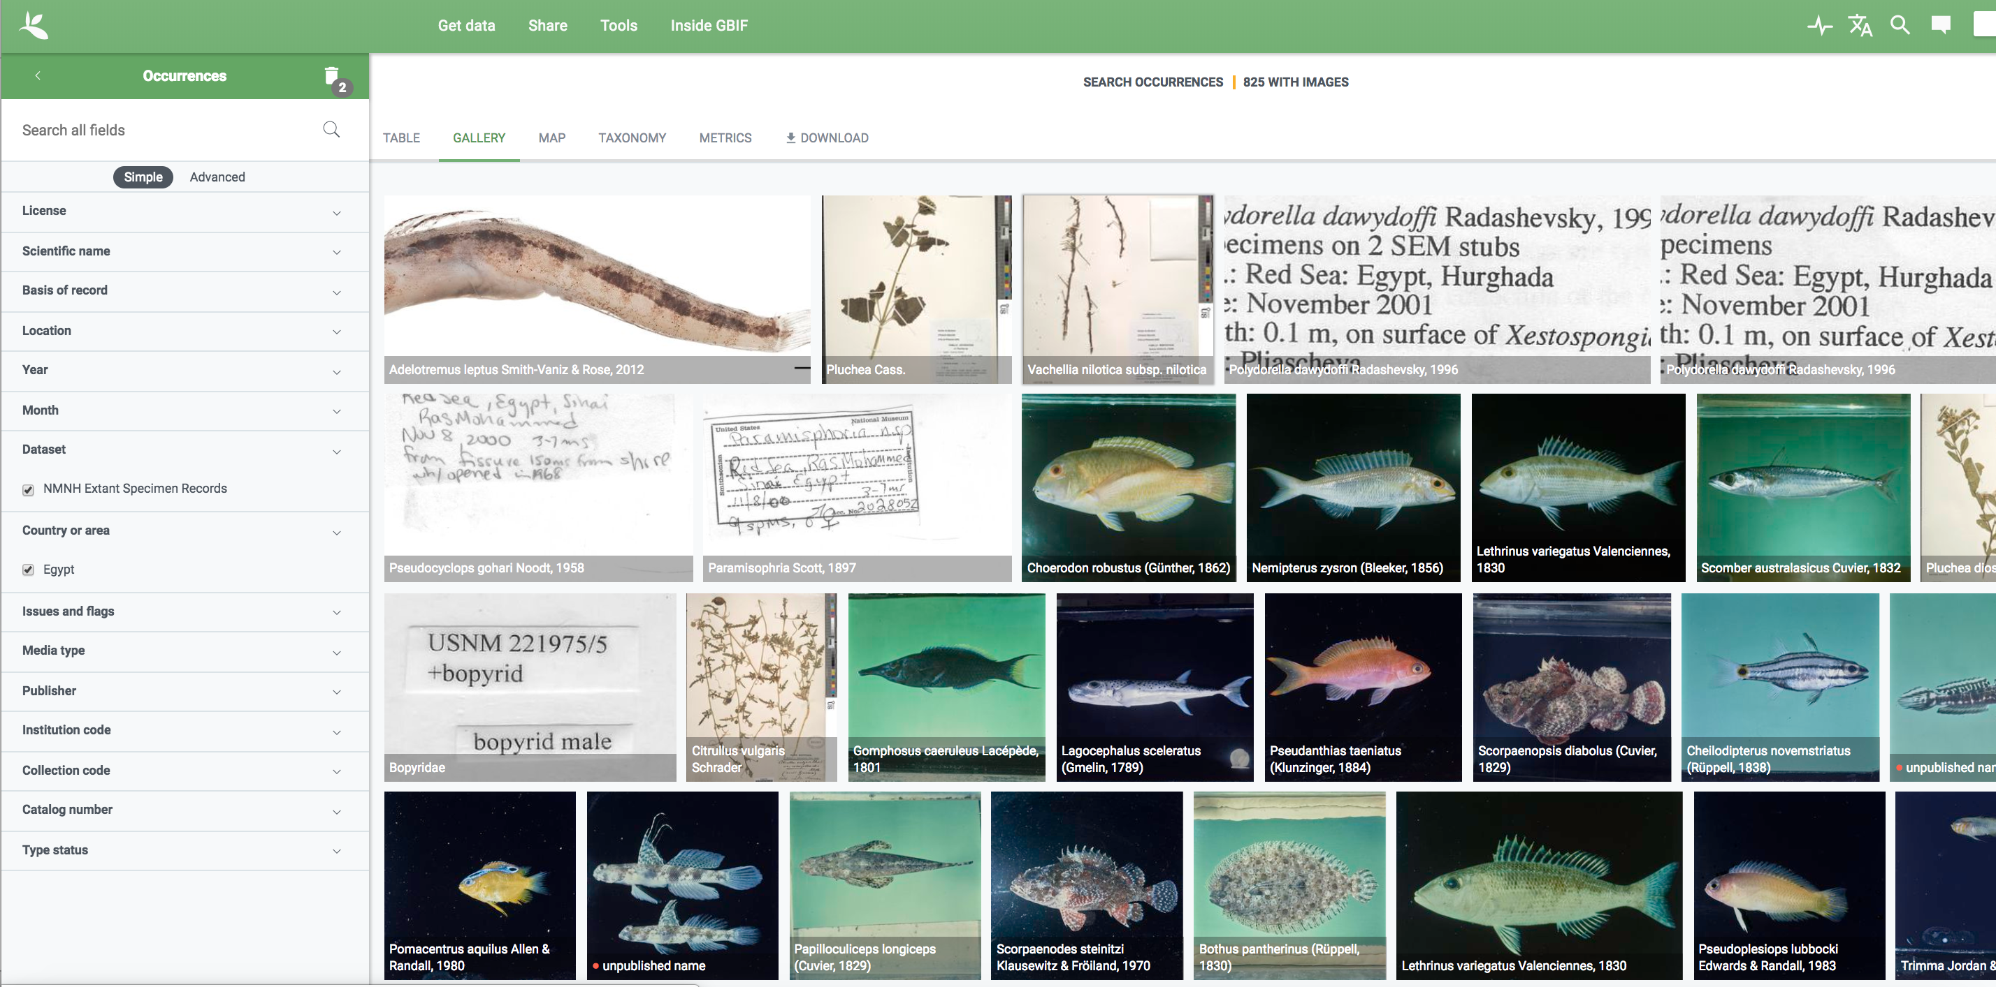
Repatriation of data through open access
https://www.gbif.org/country/EG/about

Slide 6
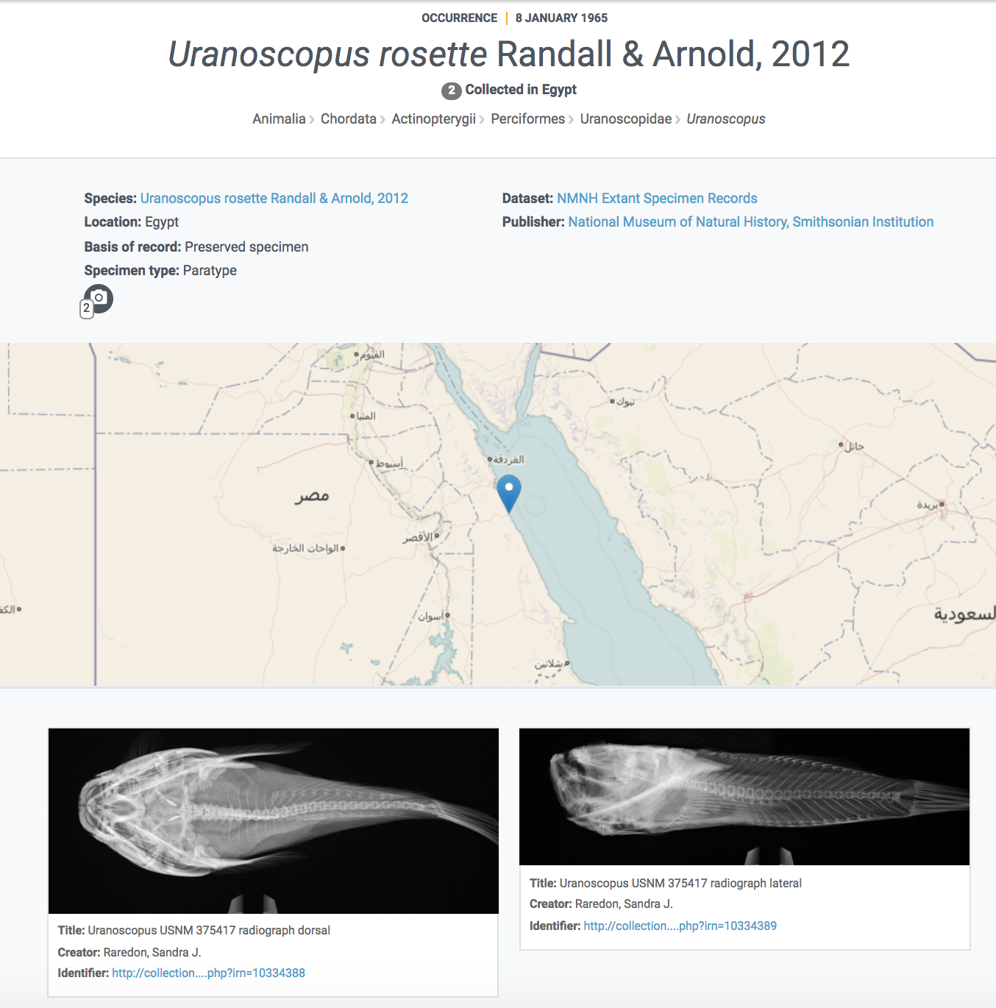
Repatriation of data through open access
https://www.gbif.org/occurrence/1317753479

Slide 7
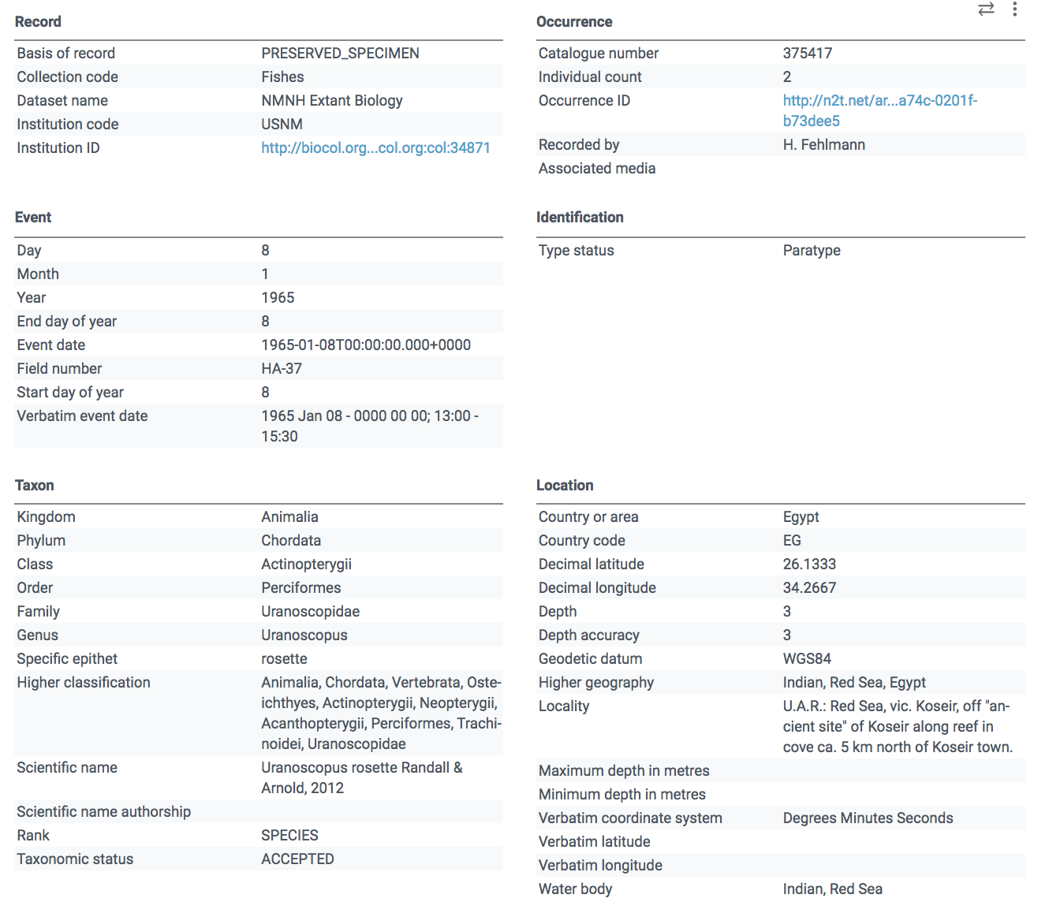
Repatriation of data through open access
https://www.gbif.org/occurrence/1317753479

Slide 8
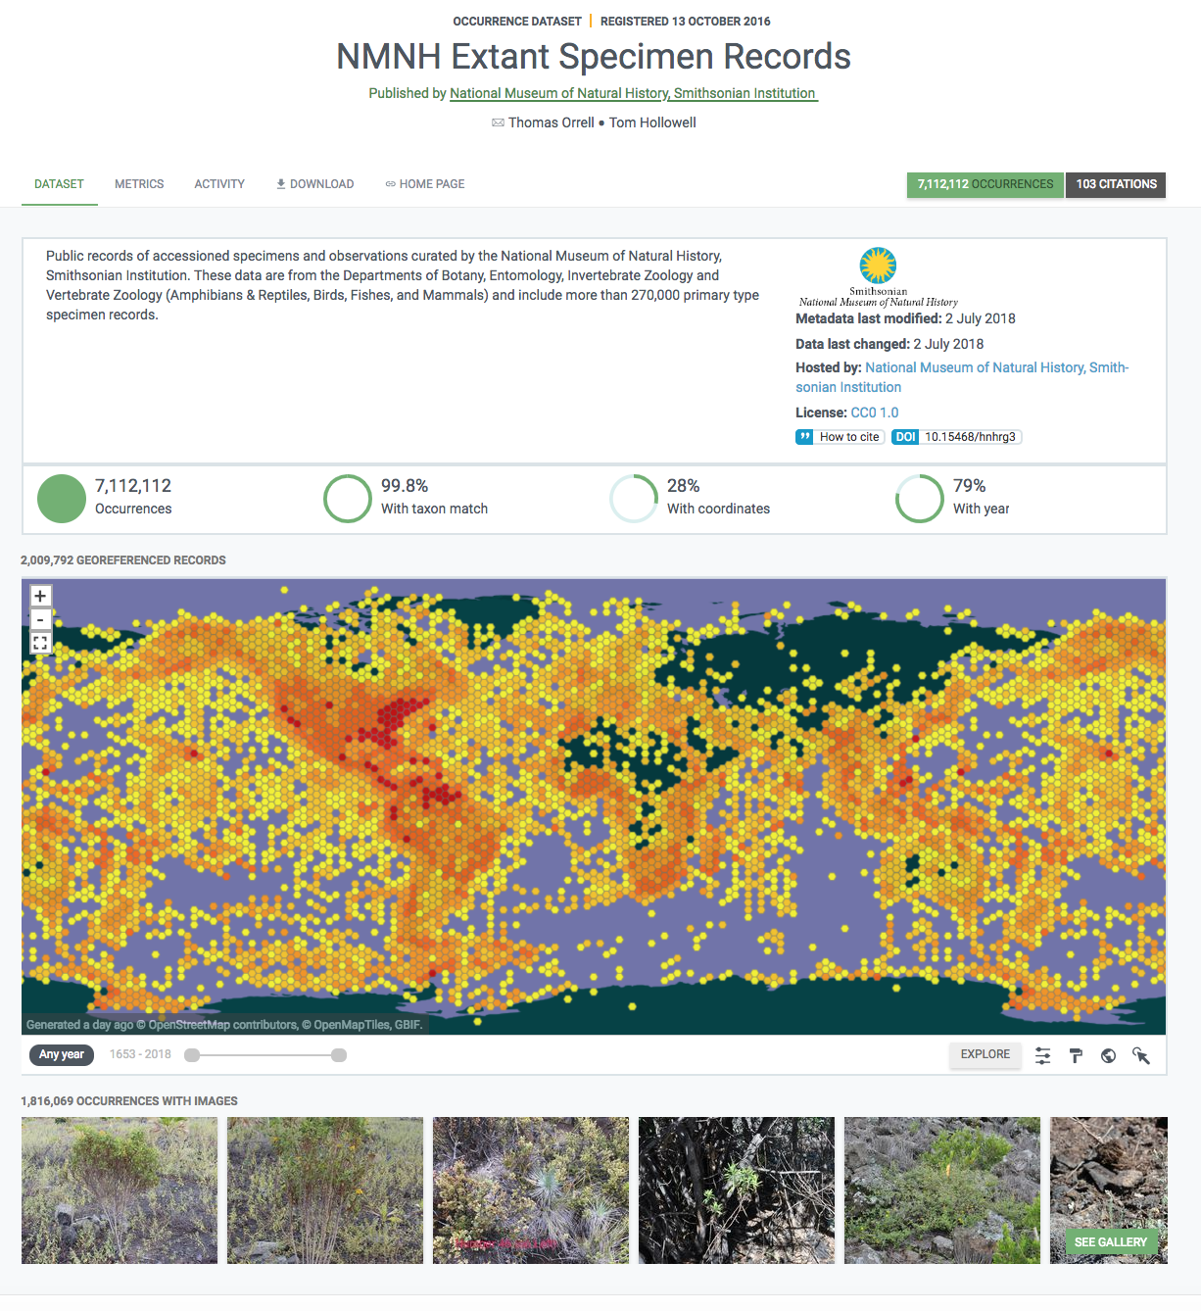
Repatriation of data through open access

Slide 9
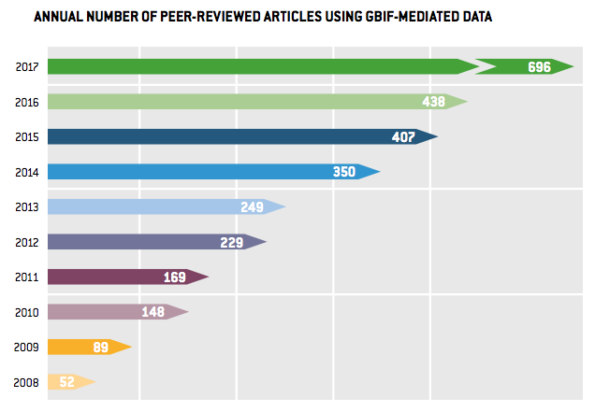
Gbif citations in research
https://www.gbif.org/resource/search?contentType=literature&relevance=GBIF_USED&peerReview=true

Slide 10
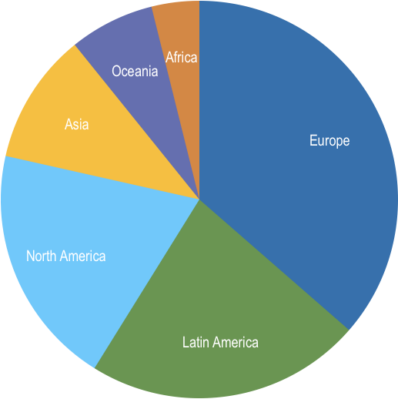
Peer-reviewed uses, by country and region 2018 to date
Total # of peer-reviewed papers by country
1 | United States | 130
2 | Brazil | 58
3 | Mexico | 55
3 | Australia | 44
5 | United Kingdom | 42
6 | Spain | 39
7 | China | 38
8 | Canada | 31
9 | Germany | 30
10 | France | 29
data access and use
Total # of papers by region
1 | Europe & Central Asia | 300
2 | Latin America & the Caribbean | 185
3 | North America | 162
4 | Asia | 88
5 | Oceania | 57
6 | Africa | 32

Slide 11
data access and use
Invasive alien species
Climate change
Species conservation and protected areas
Biodiversity and human health
Food, farming and biofuels
Advancing biodiversity science
https://www.gbif.org/science-review
https://www.gbif.org/resource/search?contentType=dataUse

Slide 12
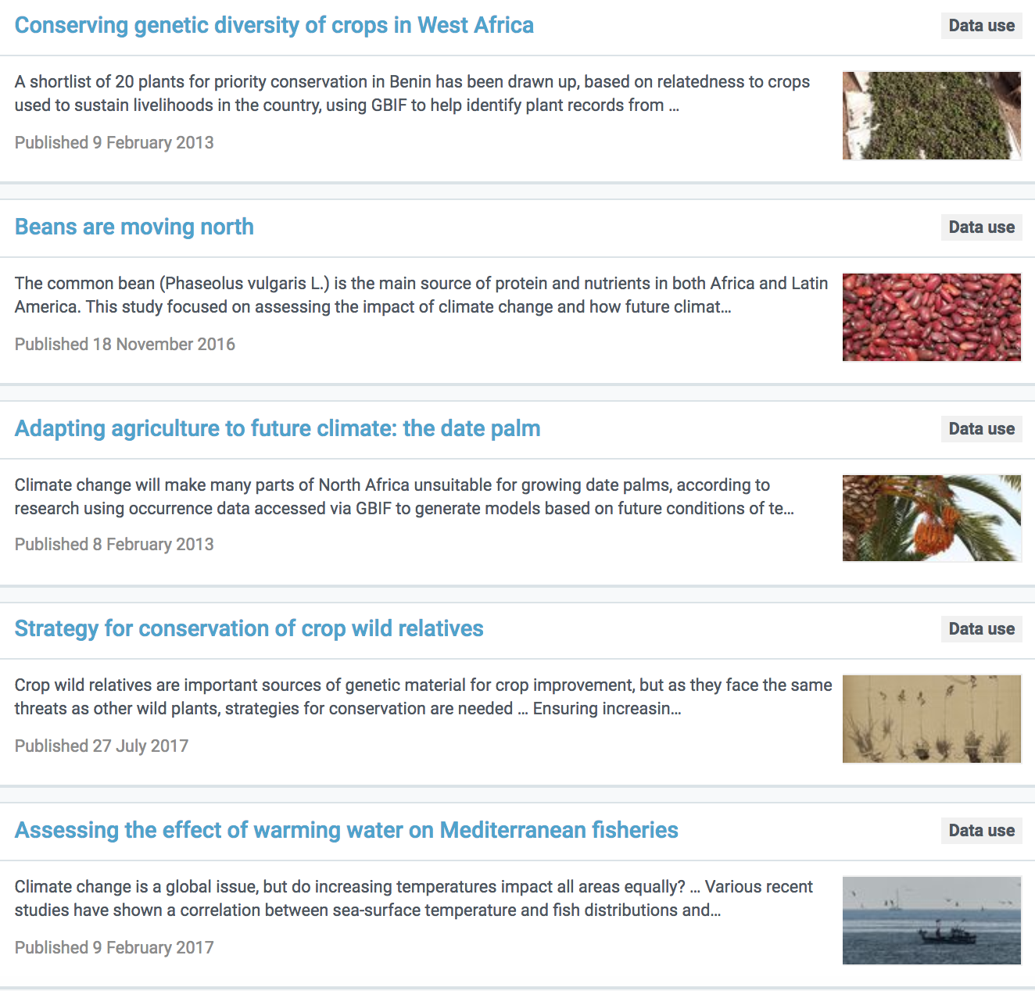
data access and use
https://www.gbif.org/resource/search?contentType=dataUse&topics=AGRICULTURE

Slide 13
Biodiversity Information for Development (BID)
Overall objective: Improved management of natural capital for human well-being; through increased application of biodiversity information as evidence for decision making
€3,9 million grant under the EuropeAid Biodiversity for Life (B4Life) flagship umbrella programme.
Further €1m in-kind contribution from GBIF
5-year programme 2015-2019 focussed on sub-Saharan Africa, Caribbean, Pacific (ACP) regions
https://www.gbif.org/bid
Notes:
The BID programme started in 2015 and is now approaching its final year of implementation. The main objective of the programme is to support biodiversity data mobilization in the Sub-Saharan, Caribbean and Pacific regions (ACP) for evidence-based decision-making.
This is underpinned by activities designed to develop capacity in these regions.

Slide 14
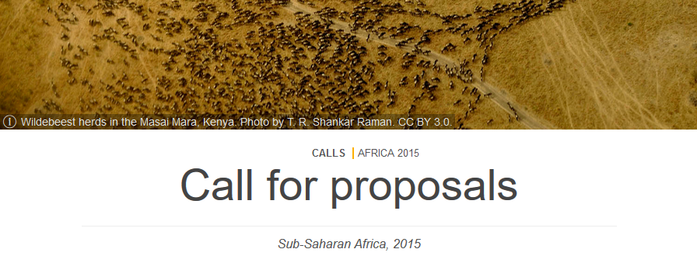
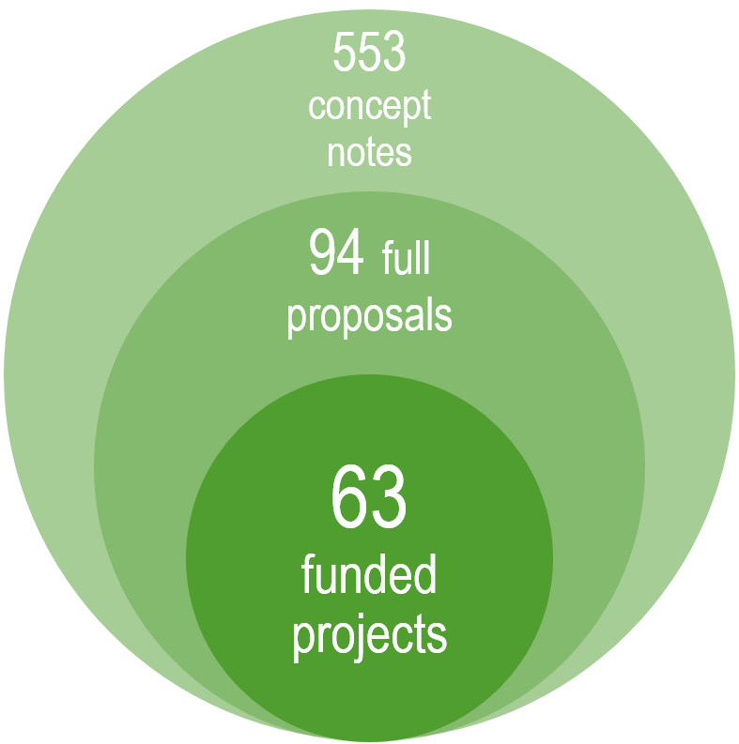
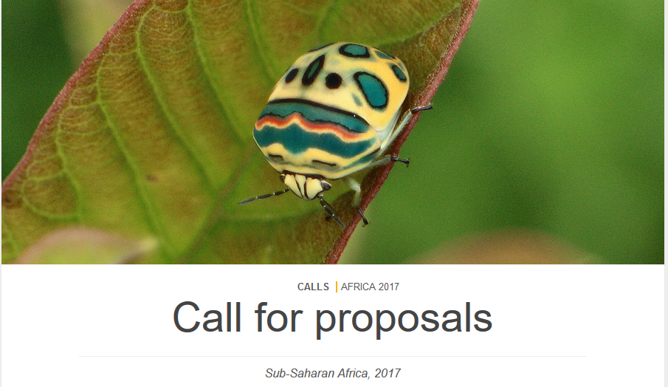
Four calls for proposals 2015 - 2017
Notes:
In the course of the BID programme we issued 4 calls for proposals. As you can see, we received a very strong response to these and the number of concept notes received illustrate the strong demand and interested in data mobilization projects and capacity development in these regions.
The majority of project proposals came from Africa where GBIF had already an established network. However, we’ve noted a growing interest from the Pacific and the Caribbean since the beginning of the BID programme.

Slide 15
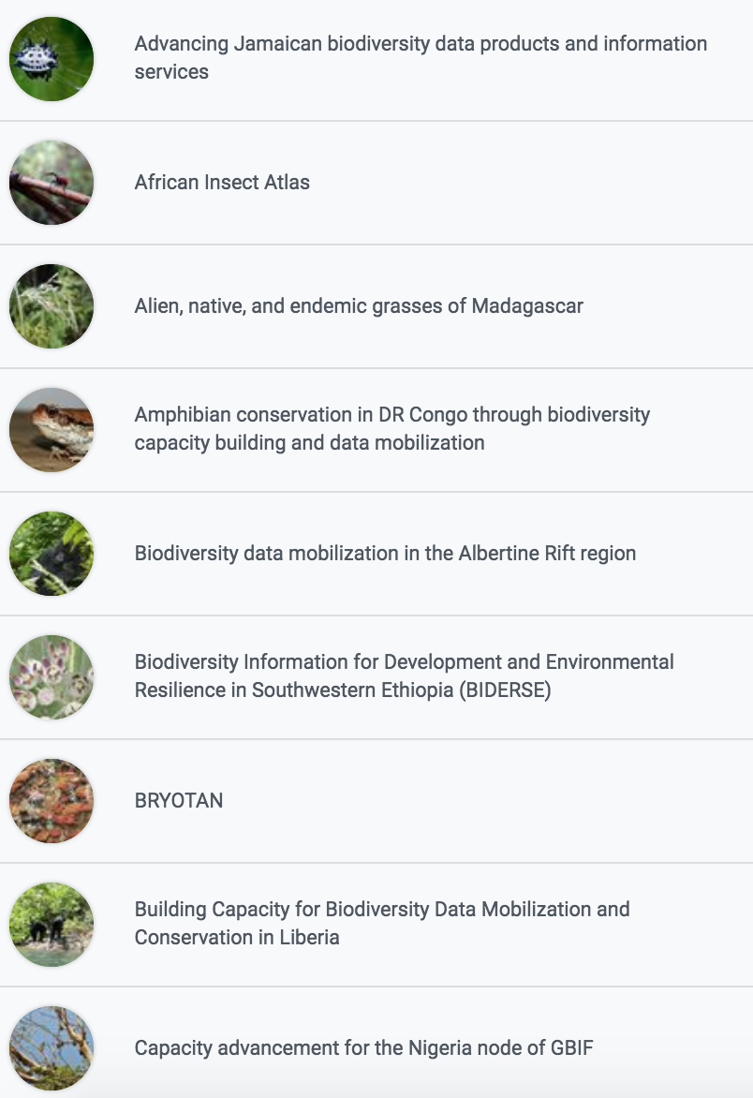
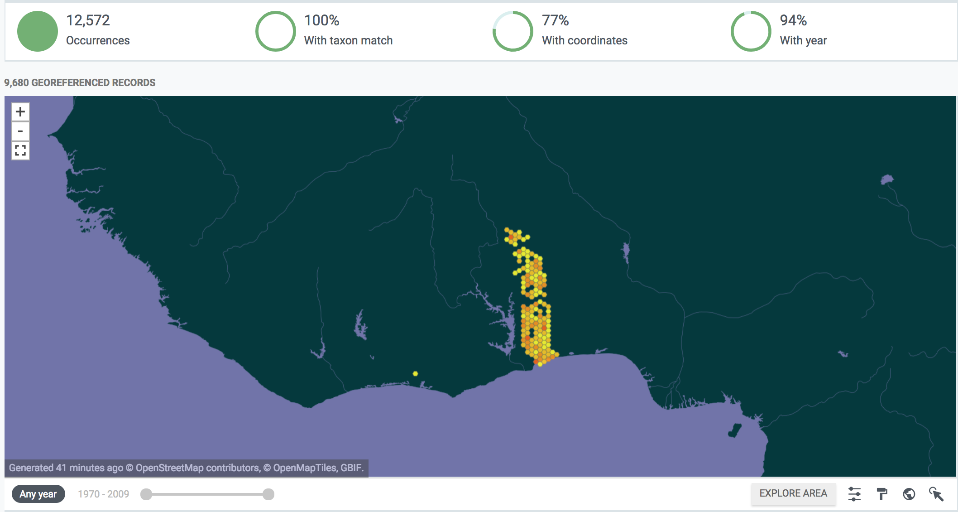
Bid projects
Mobilize data from collections, surveys, research etc
Build biodiversity information networks
Identify applications of data in research and policy
https://www.gbif.org/programme/82243/bid-biodiversity-information-for-development#projects

Slide 16
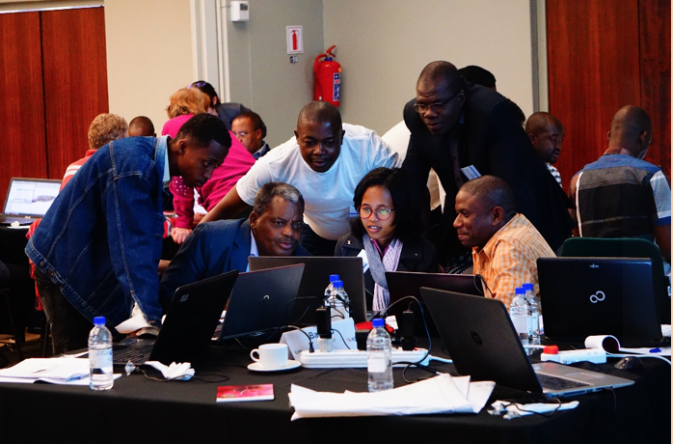
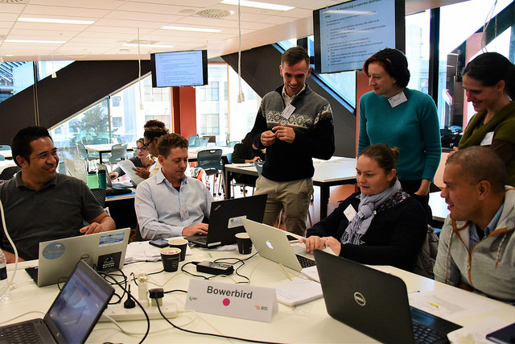
Building a community of practice
Capacity enhancement workshops for all funded projects
Volunteer mentors from global community assist in face to face training, continue one-on-one remote support
Today’s trainees are tomorrow’s mentors!
Already re-used in Asia, Balkans, Russia/C Asia
Curricula developed in:
Biodiversity data mobilization (plan digitization, understand standards, tools for sharing)
Data use for decision making (data cleaning, modelling, mapping, Redlisting, mainstreaming to priority policy needs)

Slide 17
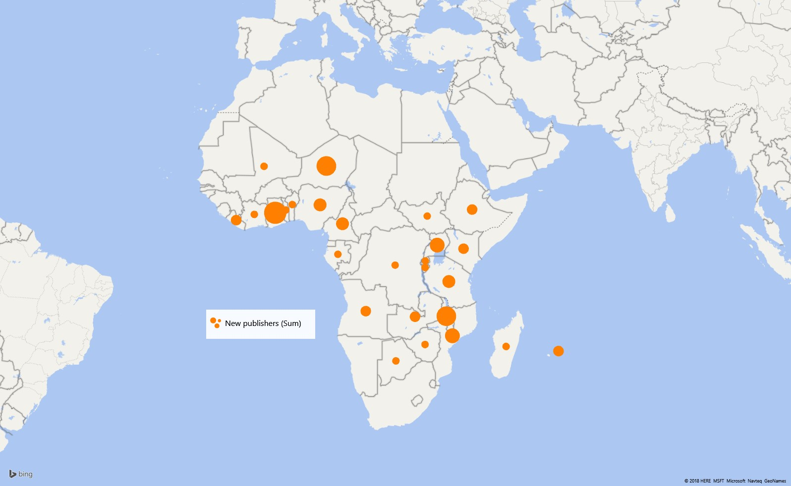
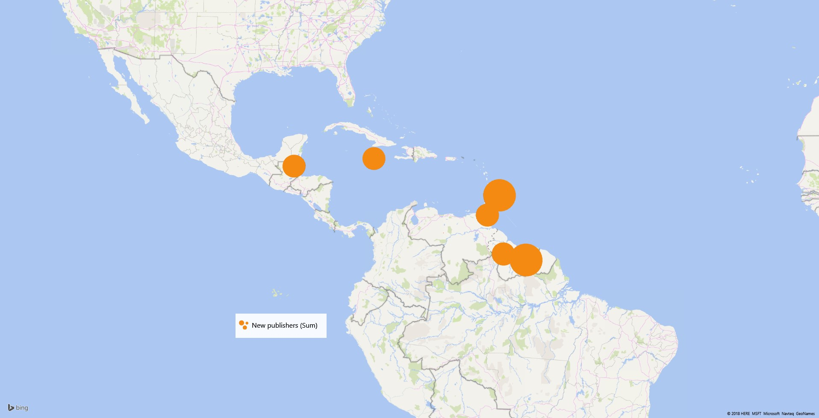
GBIF publishers registered since 2015
Geographic scope of new GBIF data publishers in Africa
Geographic scope of new GBIF data publishers in the Caribbean
Geographic scope of new GBIF data publishers in the Pacific
Notes:
The BID programme gave GBIF the opportunities to engage numerous data holding institutions. As a result, since 2015, the GBIF Secretariat received an increasing number of requests from data holding institutions located in the BID target regions to become GBIF data publishers. This is especially noticeable in the Pacific and the Caribbean regions where there were no GBIF data publishing institutions in BID eligible countries.
This represents an important growth in institutional capacity to publish biodiversity data.

Slide 18
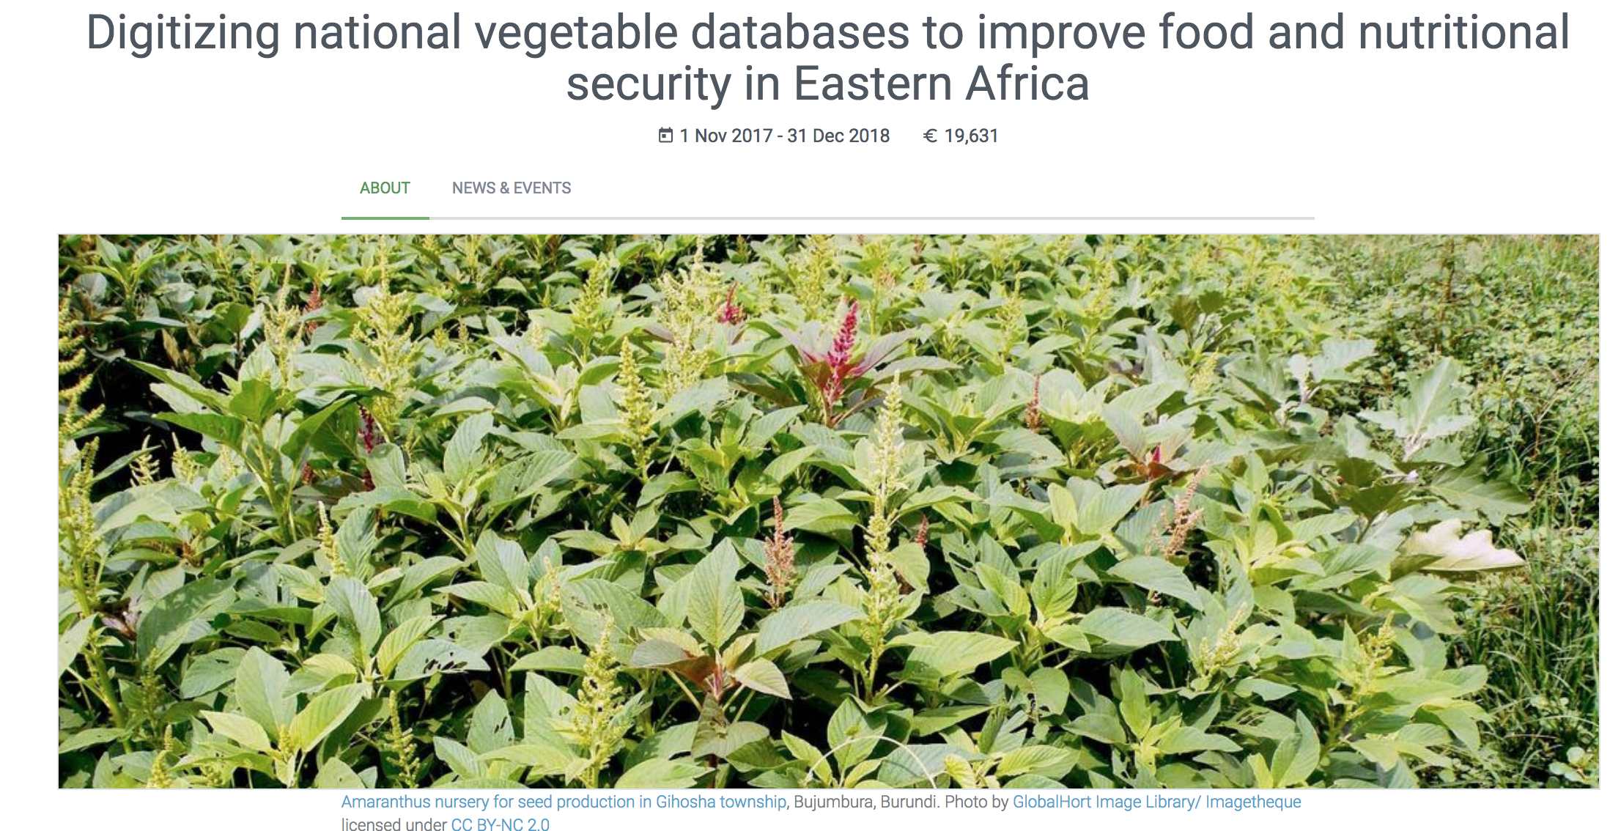
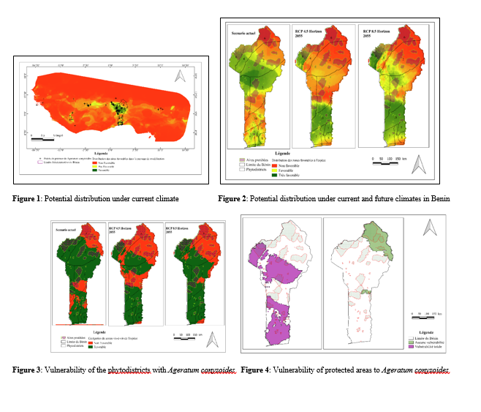
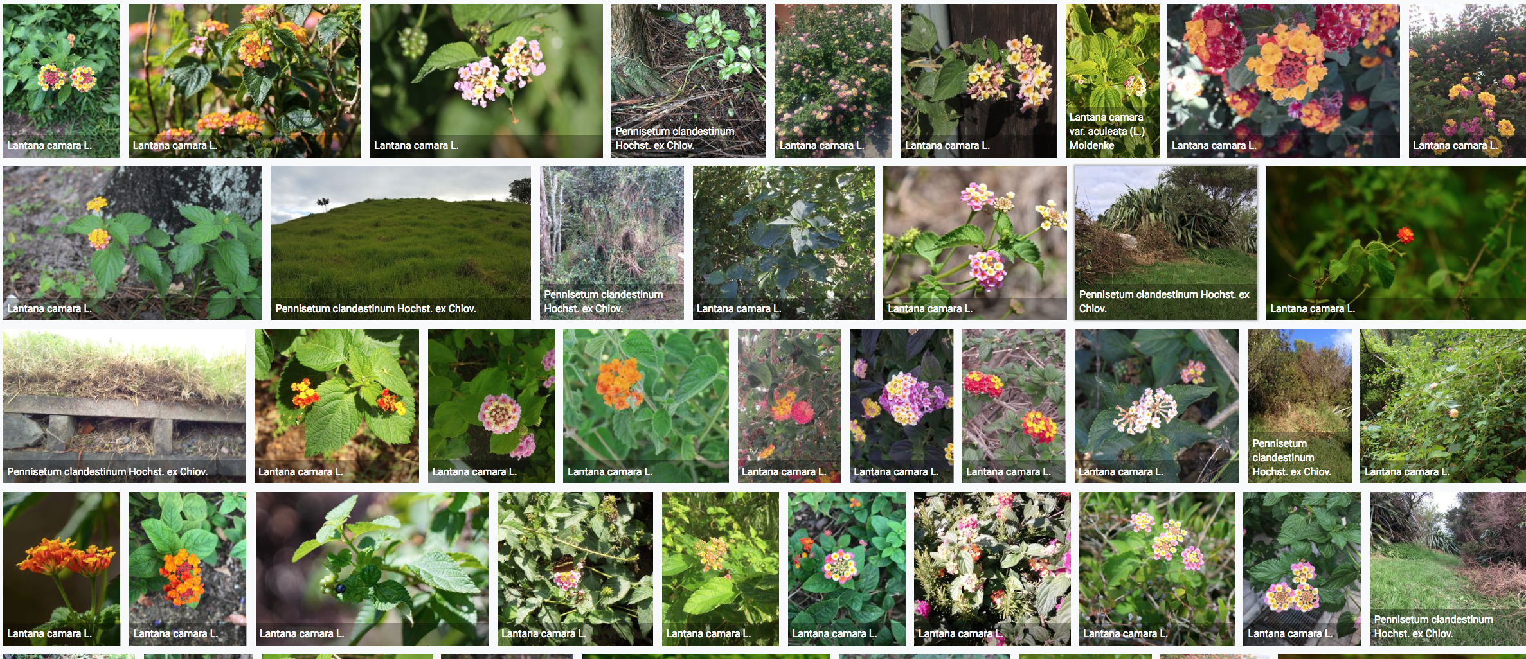
Types of data applications
Species assessment and protected area management
Agriculture and food security
Modelling impacts of climate change
Information for invasive species management

Slide 19
Thank you!

