Slide 1
Mobilizing data for decisions
Tim Hirsch, Deputy Director, GBIF
Side event on improving decisions with biodiversity information, un biodiversity conference, sharm el sheikh, 21 november 2018

Slide 2
Capacity enhancement in gbif
https://www.gbif.org/strategic-plan

Slide 3
Biodiversity Information for Development (BID)
Overall objective: Improved management of natural capital for human well-being; through increased application of biodiversity information as evidence for decision making
€3,9 million grant under the EuropeAid Biodiversity for Life (B4Life) flagship umbrella programme.
Further €1m in-kind contribution from GBIF
5-year programme 2015-2019 focussed on sub-Saharan Africa, Caribbean, Pacific (ACP) regions
https://www.gbif.org/bid
Notes:
The BID programme started in 2015 and is now approaching its final year of implementation. The main objective of the programme is to support biodiversity data mobilization in the Sub-Saharan, Caribbean and Pacific regions (ACP) for evidence-based decision-making.
This is underpinned by activities designed to develop capacity in these regions.

Slide 4
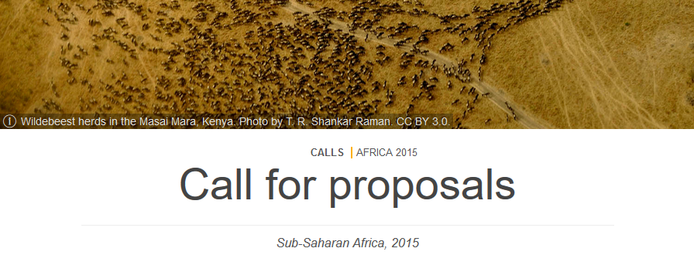
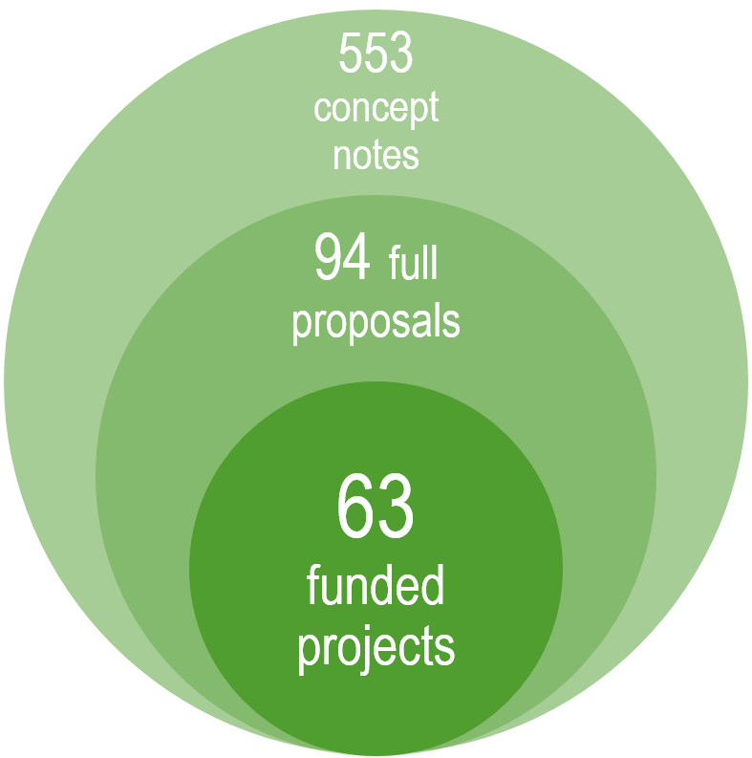
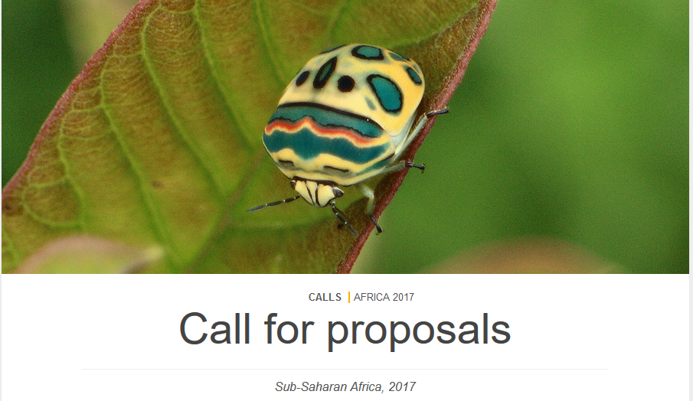
Four calls for proposals 2015 - 2017
Notes:
In the course of the BID programme we issued 4 calls for proposals. As you can see, we received a very strong response to these and the number of concept notes received illustrate the strong demand and interested in data mobilization projects and capacity development in these regions.
The majority of project proposals came from Africa where GBIF had already an established network. However, we’ve noted a growing interest from the Pacific and the Caribbean since the beginning of the BID programme.

Slide 5
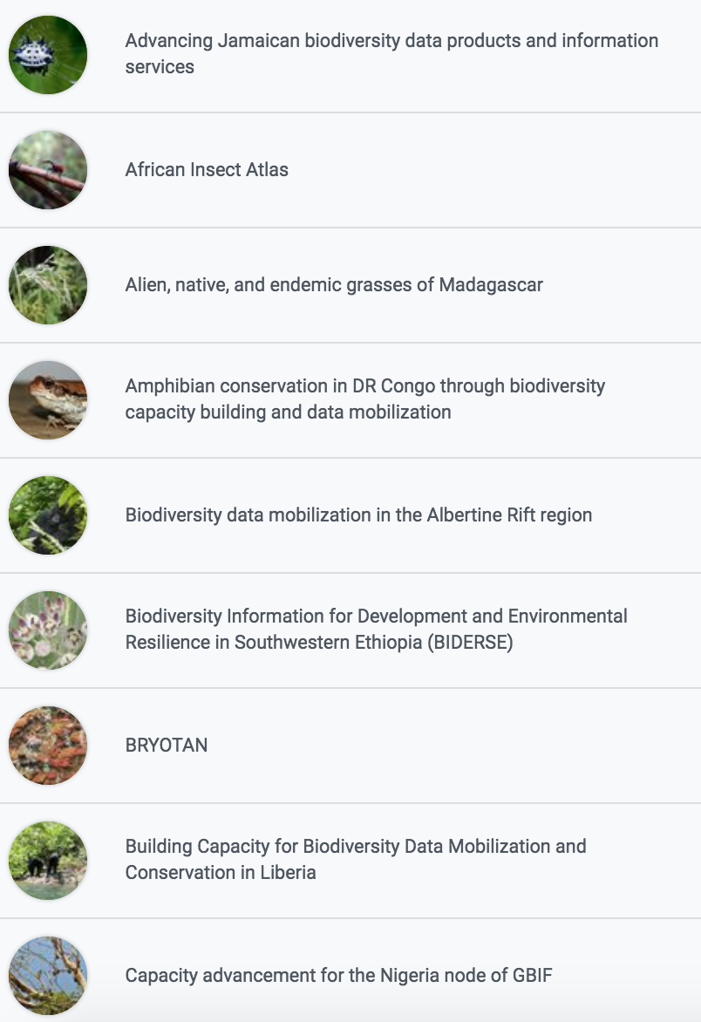
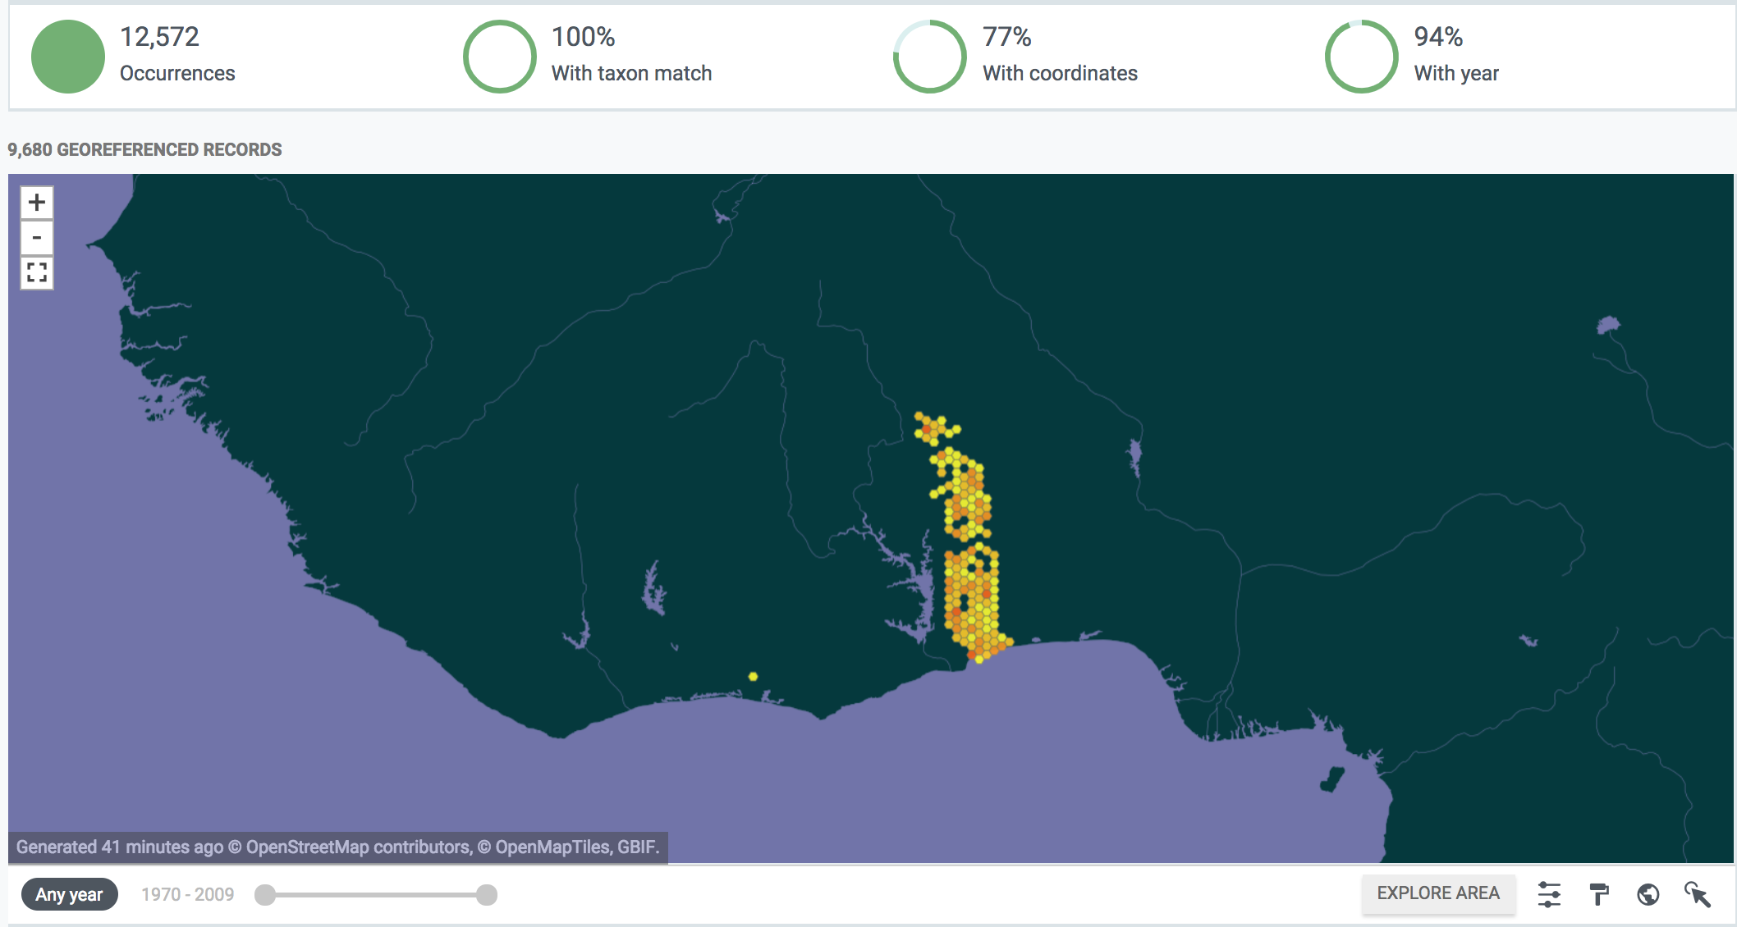
Bid projects
Mobilize data from collections, surveys, research etc
Build biodiversity information networks
Identify applications of data in research and policy
https://www.gbif.org/programme/82243/bid-biodiversity-information-for-development#projects

Slide 6
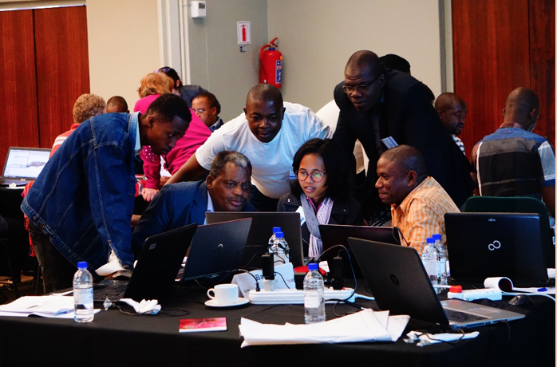
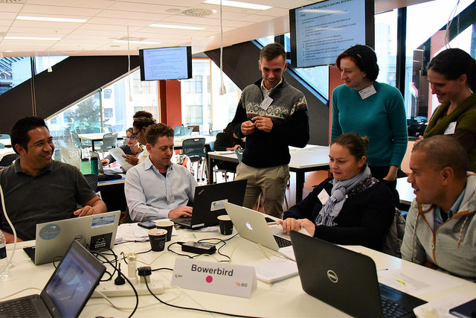
Building a community of practice
Capacity enhancement workshops for all funded projects
Volunteer mentors from global community assist in face to face training, continue one-on-one remote support
Today’s trainees are tomorrow’s mentors!
Already re-used in Asia, Balkans, Russia/C Asia
Curricula developed in:
Biodiversity data mobilization (plan digitization, understand standards, tools for sharing)
Data use for decision making (data cleaning, modelling, mapping, Redlisting, mainstreaming to priority policy needs)

Slide 7
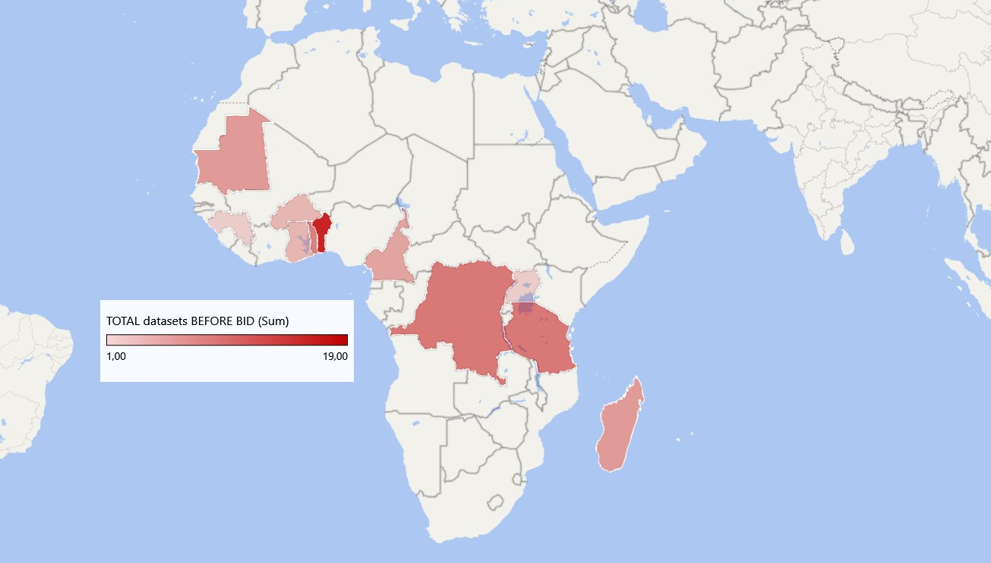
BID impact in sub-Saharan africa
65 datasets BEFORE BID
67 New GBIF publishers
Datasets published by BID target countries before BID
228 BID datasets (so far)
Datasets published under a BID project ID so far
BID target countries in sub-Saharan Africa: https://bid.gbif.org/en/calls/africa-2017/eligible-countries/
Data cut-off date: 05 November 2018

Slide 8
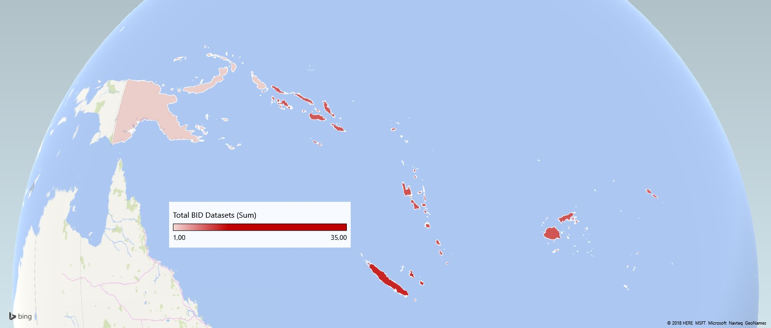
BID Impact in the Pacific
0 datasets BEFORE BID
21 New GBIF publishers
Datasets published by BID target countries before BID
63 BID datasets (so far)
Datasets published under a BID project ID so far
BID target countries in the Pacific: https://bid.gbif.org/en/calls/pacific-2016/eligible-countries/#pacific
Data cut-off date: 05 November 2018

Slide 9
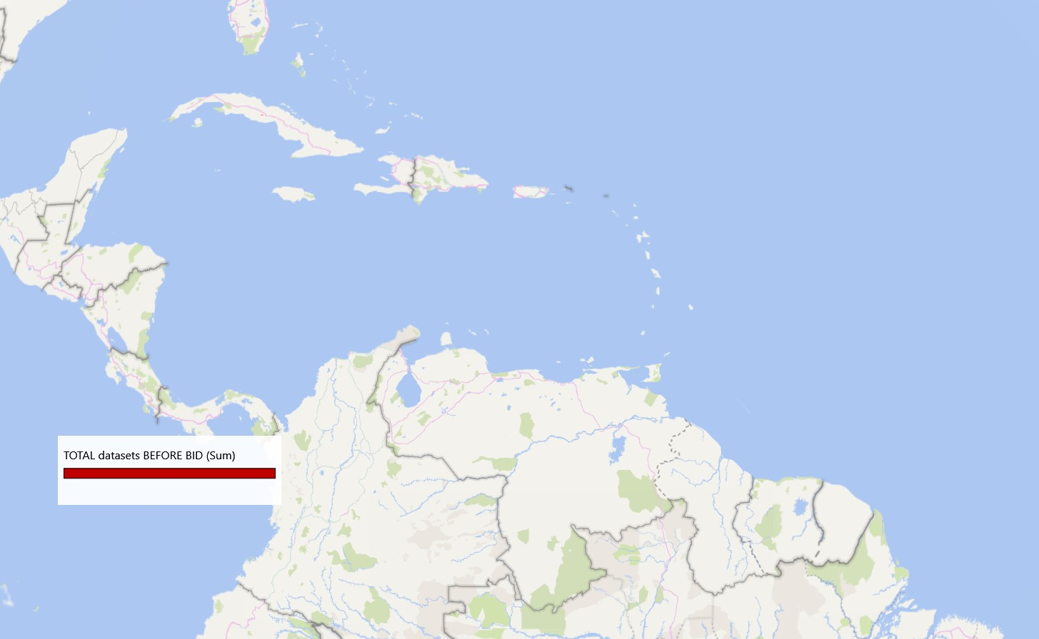
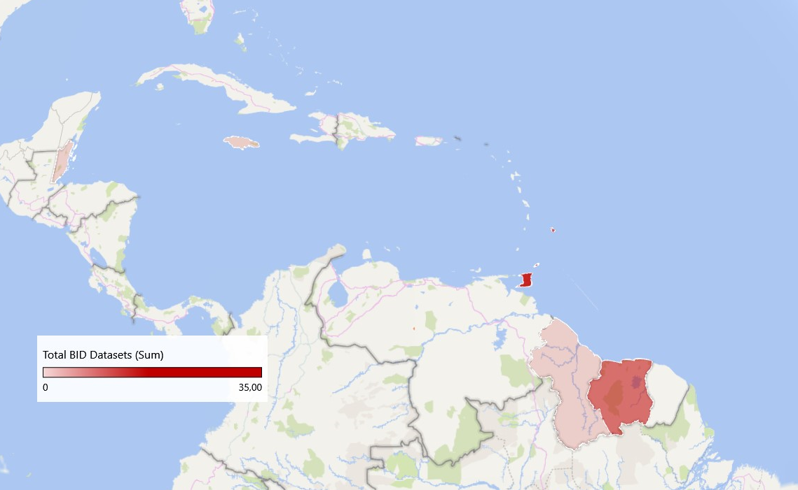
BID Impact in the Caribbean
0 datasets BEFORE BID
8
New GBIF publishers
Datasets published by BID target countries before BID
50 BID datasets (so far)
Datasets published under a BID project ID so far
BID target countries in the Caribbean: https://bid.gbif.org/en/calls/caribbean-2016/eligible-countries/#caribbean
Data cut-off date: 05 November 2018

Slide 10
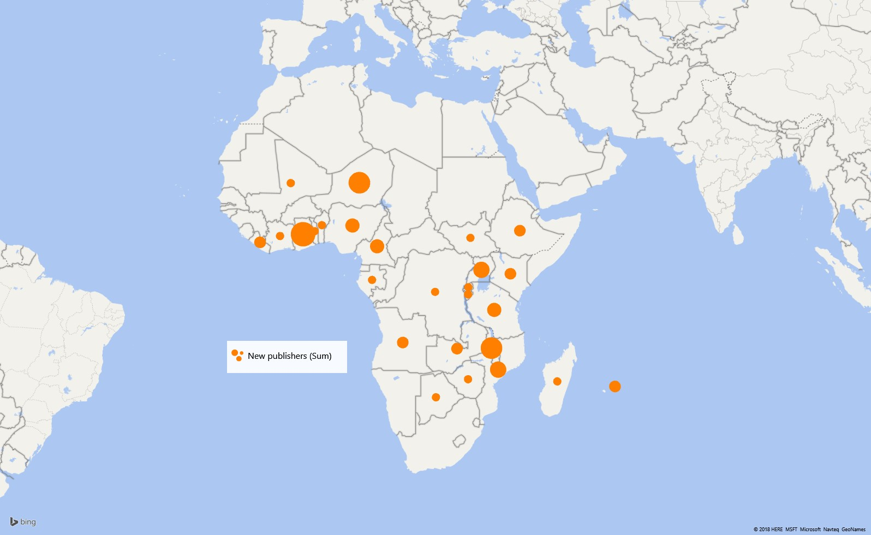
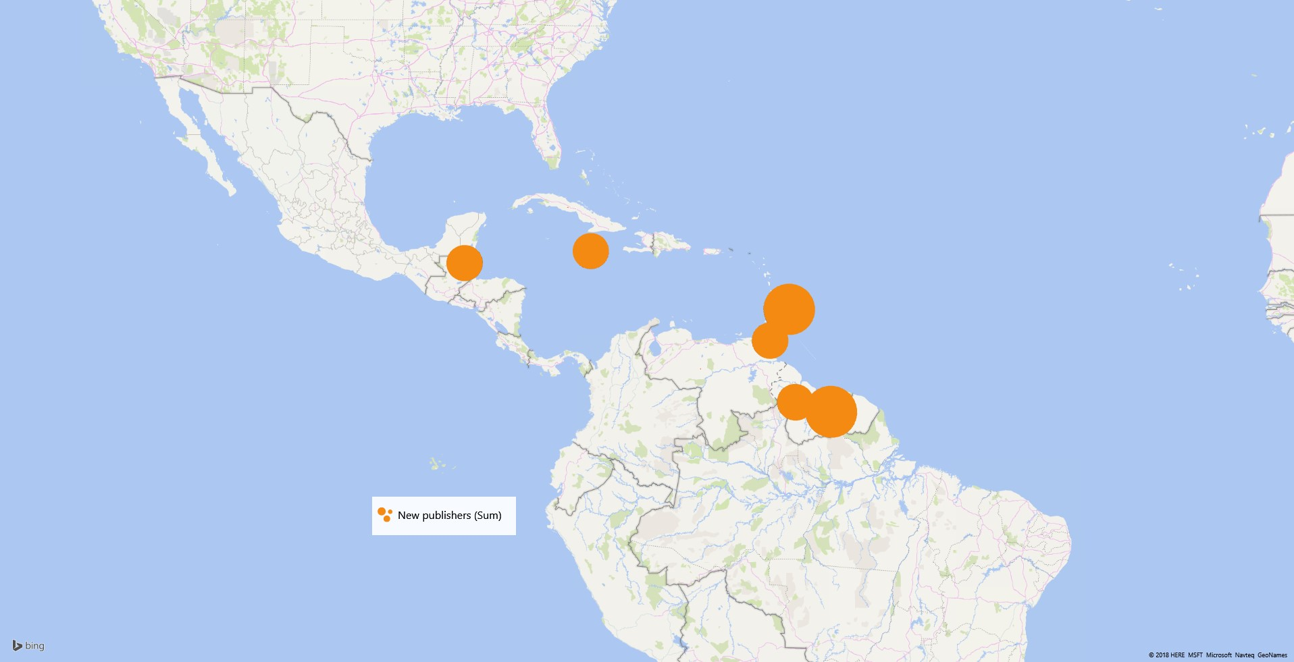
GBIF publishers registered since 2015
Geographic scope of new GBIF data publishers in Africa
Geographic scope of new GBIF data publishers in the Caribbean
Geographic scope of new GBIF data publishers in the Pacific
Notes:
The BID programme gave GBIF the opportunities to engage numerous data holding institutions. As a result, since 2015, the GBIF Secretariat received an increasing number of requests from data holding institutions located in the BID target regions to become GBIF data publishers. This is especially noticeable in the Pacific and the Caribbean regions where there were no GBIF data publishing institutions in BID eligible countries.
This represents an important growth in institutional capacity to publish biodiversity data.

Slide 11
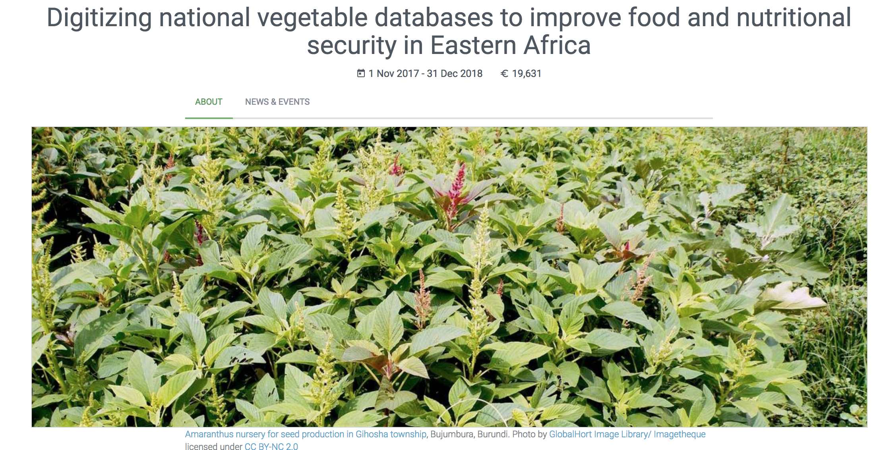
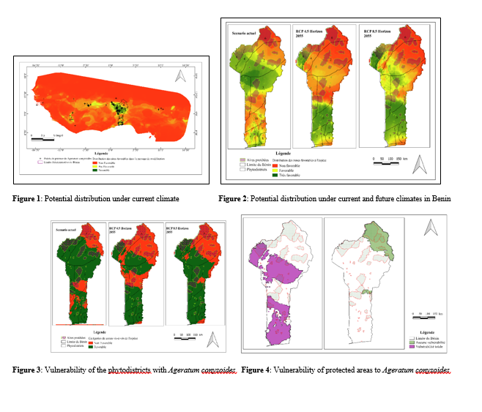
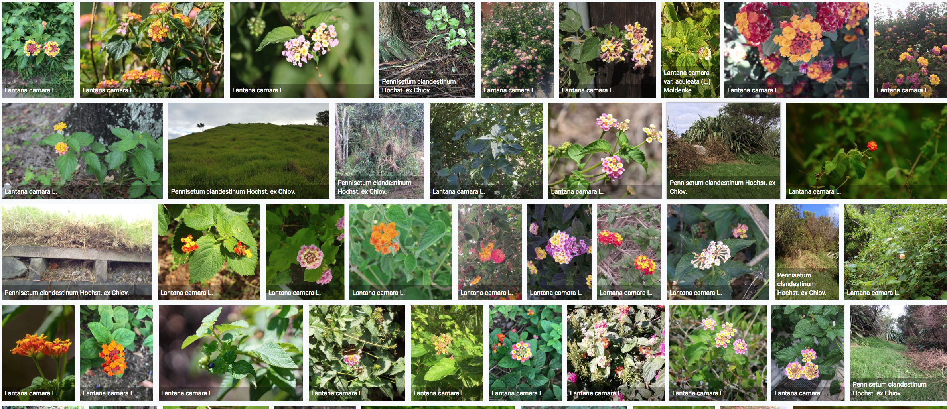
Types of data applications
Species assessment and protected area management
Agriculture and food security
Modelling impacts of climate change
Information for invasive species management

Slide 12
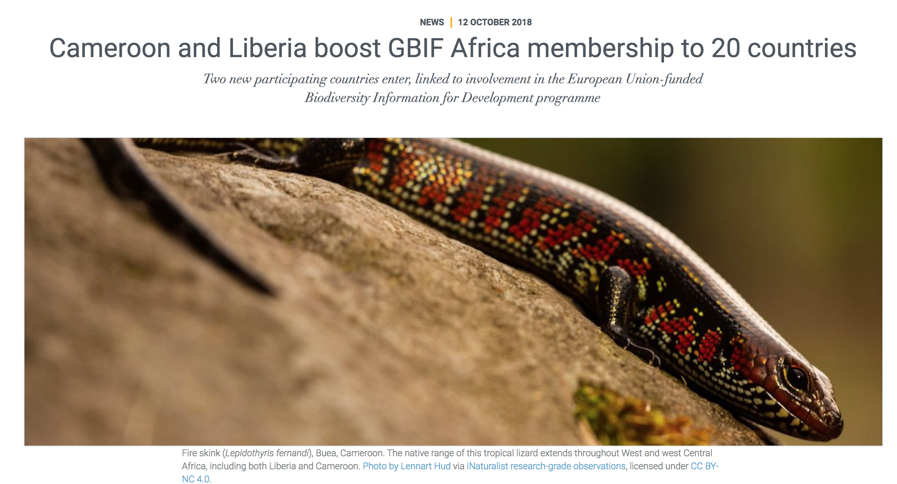
Expanded gbif membership
New countries and organizations joining GBIF during BID programme
Cameroon
Democratic Republic of Congo
Liberia
Mali
Niger
Nigeria
South Sudan
Zimbabwe
SPREP
https://www.gbif.org/news/4366hBP6hi6gaie0qKkgOi/cameroon-and-liberia-boost-gbif-africa-membership-to-20-countries

Slide 13
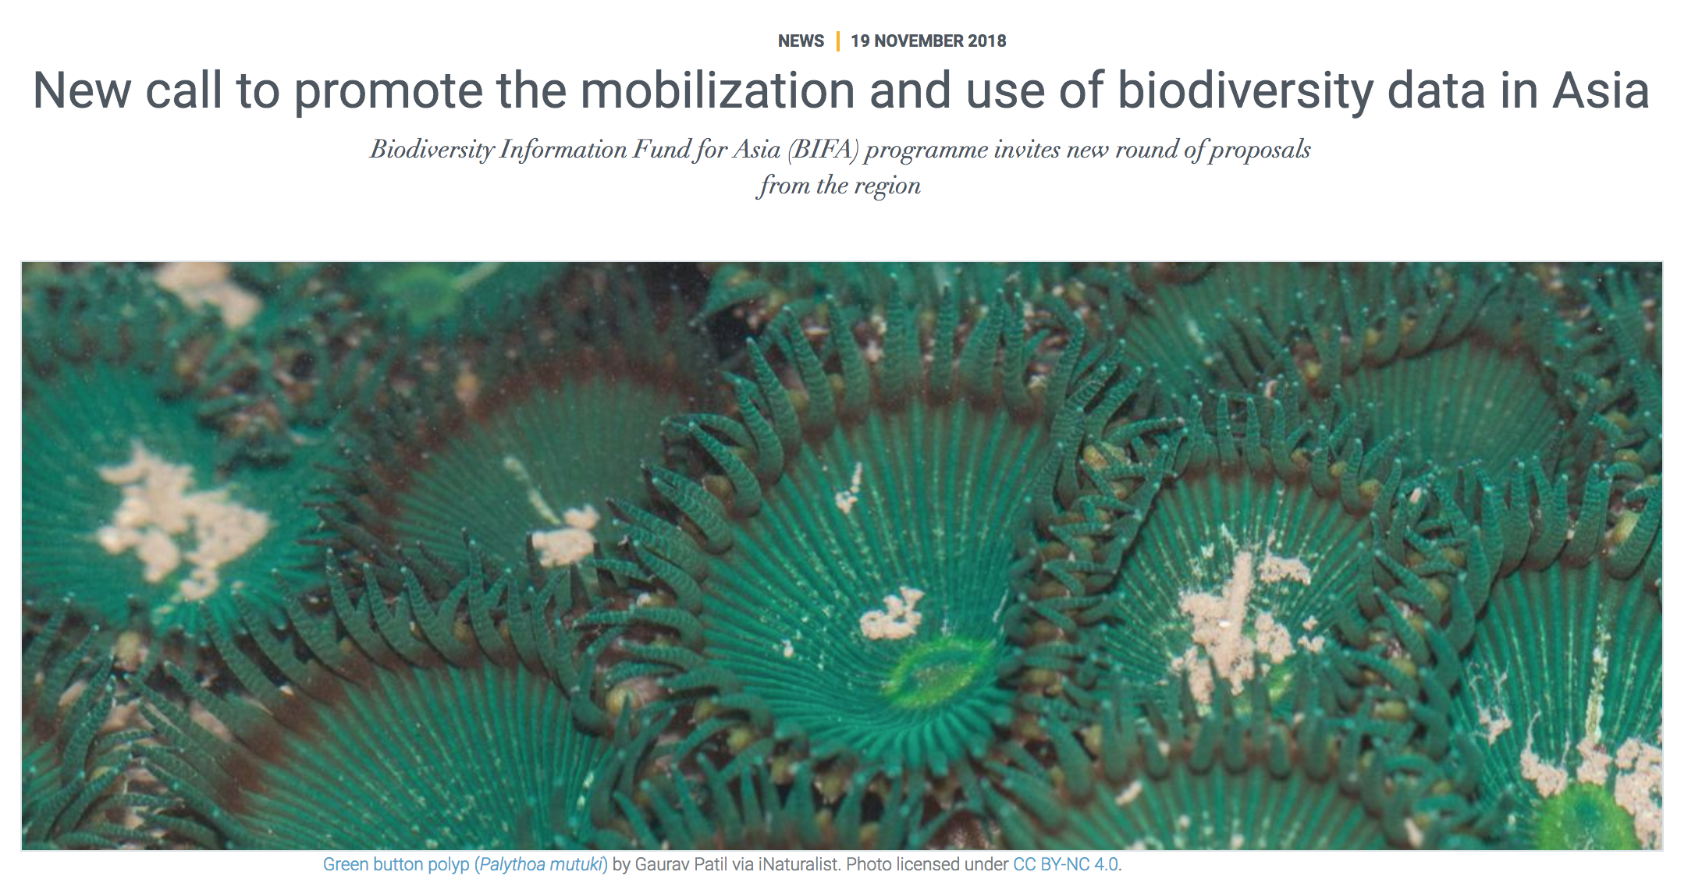
https://www.gbif.org/news/5iNrGgDbdKkiQqKeOuEGAG/new-call-to-promote-the-mobilization-and-use-of-biodiversity-data-in-asia

