Slide 1
BY THE NUMBERS | 31 March 2022
2,159,129,152
68,346
Datasets
Species occurrence records
1,813
7,011
Peer-review papers
using data
64
42
Country Participants
Organizational Participants
115.0 billion
Data-publishing institutions
Avg records downloaded/month (ytd 2022)
Notes:
Frequently used slide, redone
Please copy and paste these to your slides and never make any changes to them directly in the toolkit.
Useful to see GBIF in its different modalities:
A window on biodiversity
An informatics infrastructure focuseD on tools and standards in service to science and society
A global network on bioinformatics

Slide 2
Species occurrence records with MultiMedia evidence 31 March 2022
106 million records with taxonomically identified images
56.1 million human observations
44.9 million specimens
2.3 million material samples
1.3 million fossil specimens
851,292 audio files
2,785 videos
https://www.gbif.org/occurrence/gallery

Slide 3
Data From the GBIF Network 31 March 2022

Slide 4
GBIF Participant countries 31 March 2022
Voting Participants
Associate Participants
Notes:
This map is fully editable. This map is a grouped element of all the countries in the world. All the countries are named correctly and can be accessed and selected via the Selection Pane.
There are ways you can edit and make changes to the map. But please remember to always make a copy of the map on your slide and never make changes to the toolkit version.
Please take a look at the next few slides to find out different ways of editing this map

Slide 5
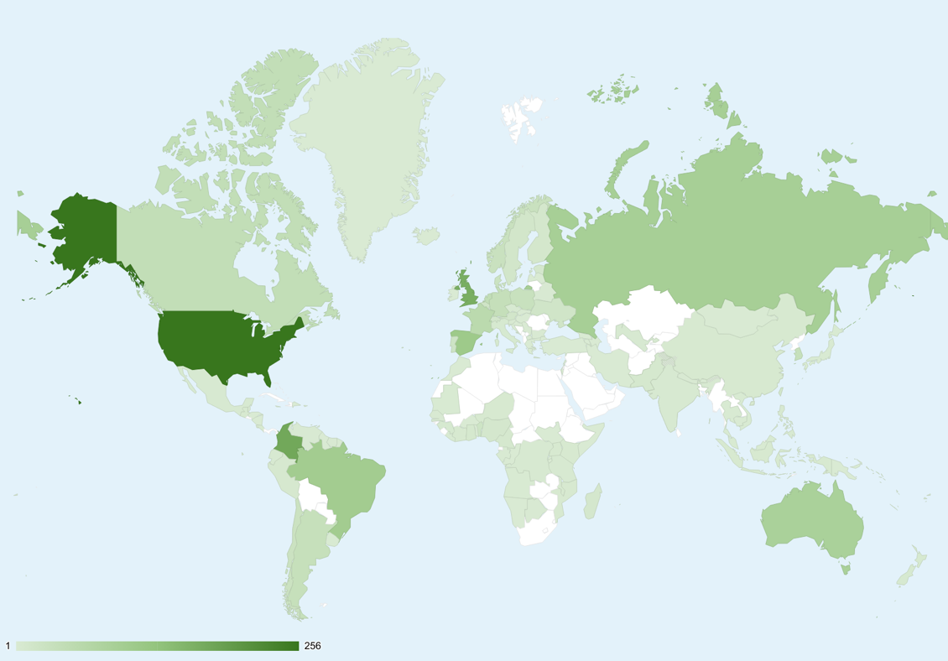
GBIF Network of Data publishing institutions March 2022
130
countries with institutions sharing data through GBIF
Top 10 countries: number of data publishers
1 | United States | 256
2 | Colombia | 175
3 | United Kingdom | 165
4 | Spain | 109
5 | Brazil | 100
6 | Russian Federation | 92
7 | Australia | 86
8 | France | 56
9 | Canada | 42
9 | Netherlands | 42

Slide 6
GBIF.org traffic by country 31 March 2022
Rank | Country/Territory | Visitors | Sessions | Effective visits* | % Effective visits | 2021 rank | Pages / session
1 | United States | 46,836 | 91,989 | 50,796 | 10.72% | 1 | 6.31
2 | Colombia | 27,113 | 56,989 | 26,990 | 5.70% | 4 | 5.26
3 | Mexico | 29,293 | 52,823 | 24,183 | 5.10% | 2 | 5.62
4 | Spain | 22,770 | 48,274 | 26,116 | 5.51% | 5 | 6.79
5 | Brazil | 22,924 | 44,971 | 23,929 | 5.05% | 3 | 6.26
6 | China | 11,207 | 35,725 | 25,443 | 5.37% | 11 | 13.73
7 | France | 14,540 | 30,952 | 15,909 | 3.36% | 6 | 6.23
8 | United Kingdom | 13,684 | 30,375 | 16,992 | 3.57% | 8 | 7.08
9 | Germany | 12,251 | 28,517 | 15,533 | 3.28% | 7 | 7.26
10 | India | 11,539 | 25,740 | 16,922 | 2.74% | 9 | 6.22
 | TOTAL | 402,724 | 881,181 | 473,899 | 100.00% |  | 6.80

Slide 7
Occurrences published by Country 31 March 2022
 |  |  |  | 2022 | 2021 total | 2021 rank
1 | United States |  | 110,750,756 |  | 145,520,357 | 1
2 | Canada |  | 21,422,776 |  | 24,595,830 | 2
3 | Netherlands |  | 18,651,425 |  | 2,609,622 | 17
4 | France |  | 12,210,325 |  | 1,229,583 | 24
5 | United Kingdom |  | 8,311,312 |  | 24,285,291 | 3
6 | Finland |  | 8,057,786 |  | 499,507 | 37
7 | India |  | 7,227,678 |  | 5,857,419 | 5
8 | Germany |  | 5,730,574 |  | 4,523,322 | 8
9 | Spain |  | 4,693,503 |  | 4,265,119 | 10
10 | Sweden |  | 3,526,256 |  | 5,466,063 | 7
OTHER COUNTRIES + AREAS | OTHER COUNTRIES + AREAS |  | 54,052,339 |  | 54,341,744
TOTAL |  |  | 254, 634,720 |  | 252,569,971
Notes:
This is a live doughnut pie chart representing different theme colours and how they work, placed next to one another.
You do not have to use the same exact chart, you can simply create your own by clicking on:
Insert tap on the ribbon > Click on Chart > chose a chart of your choice (in this example I chose, Doughnut) > add in your data in the automatically opened Excel sheet and see your chart changing and adopting to the new information you have entered in the data sheet.

Slide 8
Data download requests 31 March 2022
 |  |  | 2022 |  | 2021 total | 2021 rank
1 | United States |  |  | 29,135 | 36,467 | 2
2 | Switzerland |  |  | 10,006 | 4,372 | 14
3 | China |  |  | 8,506 | 42,639 | 1
4 | Mexico |  |  | 5,620 | 21,725 | 3
5 | Colombia |  |  | 4,016 | 16,414 | 4
6 | Brazil |  |  | 3,372 | 16,344 | 5
7 | Canada |  |  | 3,215 | 5,187 | 10
8 | India |  |  | 5,808 | 3,254 | 18
9 | Spain |  |  | 2,803 | 9,777 | 7
10 | United Kingdom |  |  | 2,683 | 11,605 | 6
OTHER COUNTRIES + AREAS | ALL OTHERS |  | 33,679,456 | 22,065 | 81,673
TOTAL |  |  | 236,212,264 | 94,284 | 253,140
117
countries, islands & territories where users have requested downloads (+5)

Slide 9
Peer-reviewed publications using GBIF-mediated data 31 March 2022
1,432
Notes:
The next 3 slides are showcasing PPT standard or Live charts.
To create a chart simply click on the Insert tap on the ribbon > Click on Chart > chose a chart of your choice (in this example I chose, Bar) > add in your data in the automatically opened Excel sheet and see your chart changing and adopting to the new information you have entered in the data sheet.

Slide 10
Data Use in peer-reviewed journals 31 March 2022
Peer-reviewed uses by country
Year-to-date |  |  |  | 2022 total | 2021 total | 2021 rank
1 | China |  | 75 |  | 227 | 2
2 | United States |  | 74 |  | 331 | 1
3 | Brazil |  | 42 |  | 142 | 3
4 | United Kingdom |  | 40 |  | 140 | 4
5 | Spain |  | 33 |  | 102 | 7
6 | Germany |  | 31 |  | 131 | 5
7 | Mexico |  | 30 |  | 130 | 6
8 | France |  | 18 |  | 78 | 8
8 | India |  | 18 |  | 35 | 19
10 | Australia |  | 17 |  | 70 | 9
10 | Canada |  | 17 |  | 67 | 10
Notes:
This is a live doughnut pie chart representing different theme colours and how they work, placed next to one another.
You do not have to use the same exact chart, you can simply create your own by clicking on:
Insert tap on the ribbon > Click on Chart > chose a chart of your choice (in this example I chose, Doughnut) > add in your data in the automatically opened Excel sheet and see your chart changing and adopting to the new information you have entered in the data sheet.

Slide 11
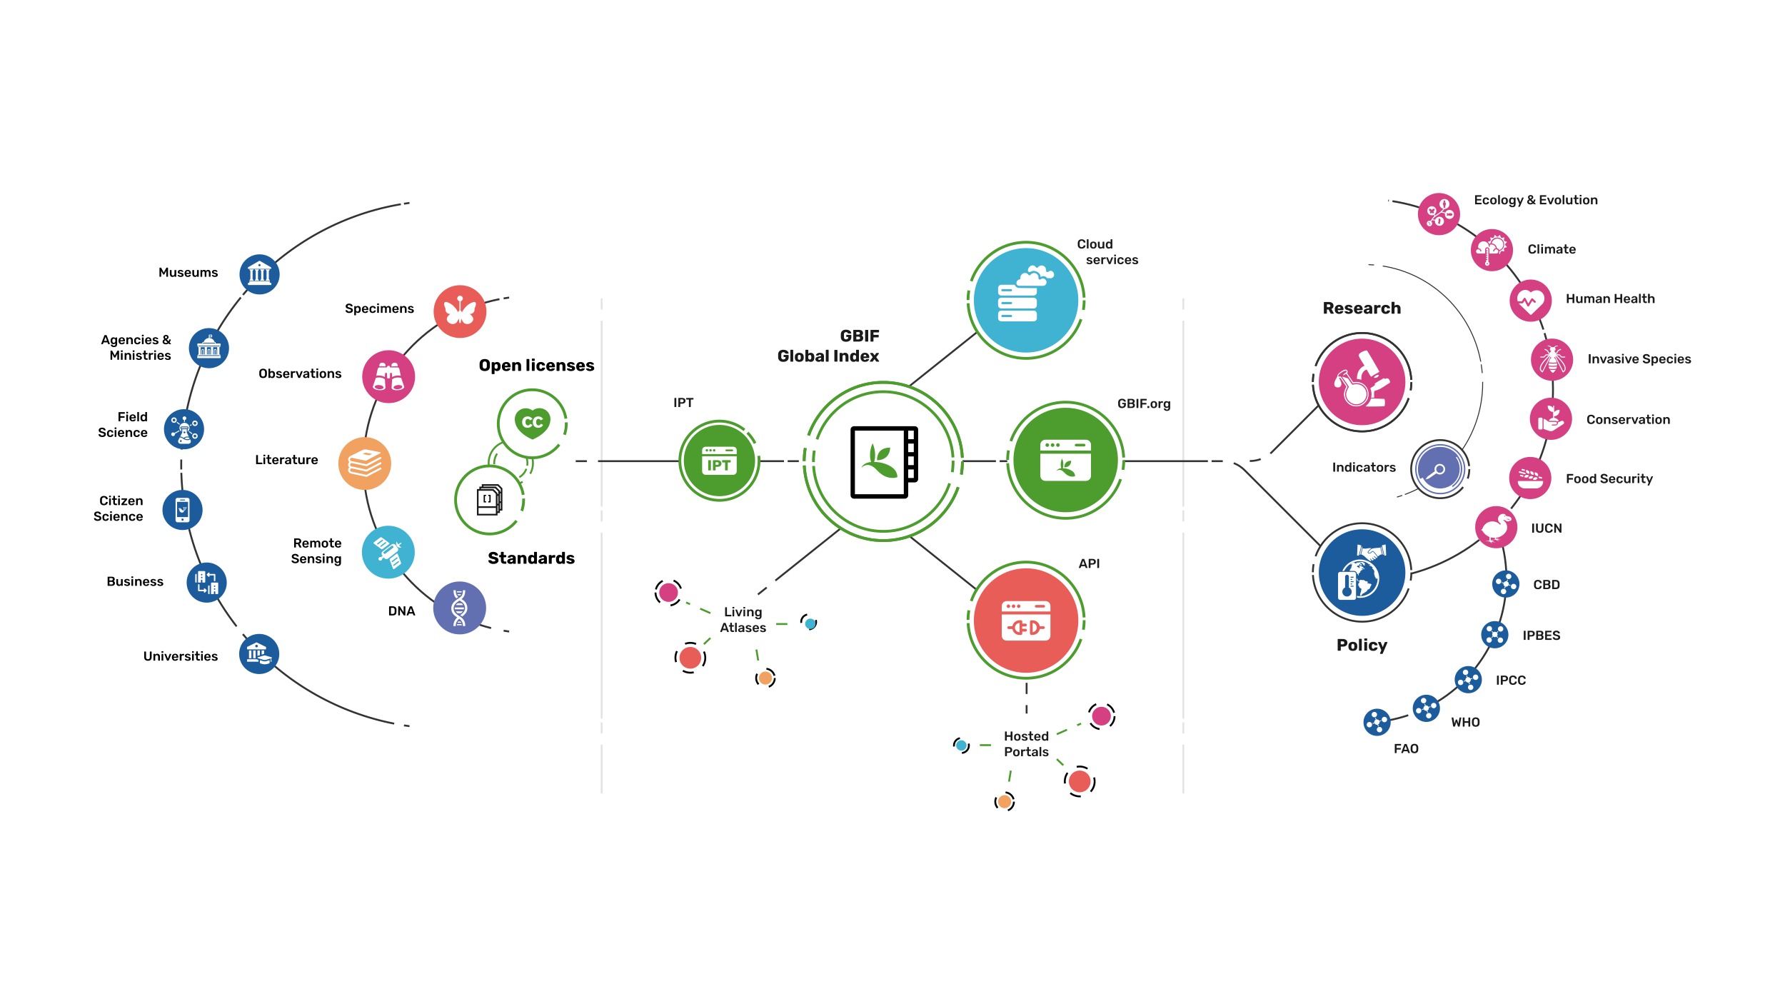
Providing biodiversity Evidence for research and policy

Slide 12
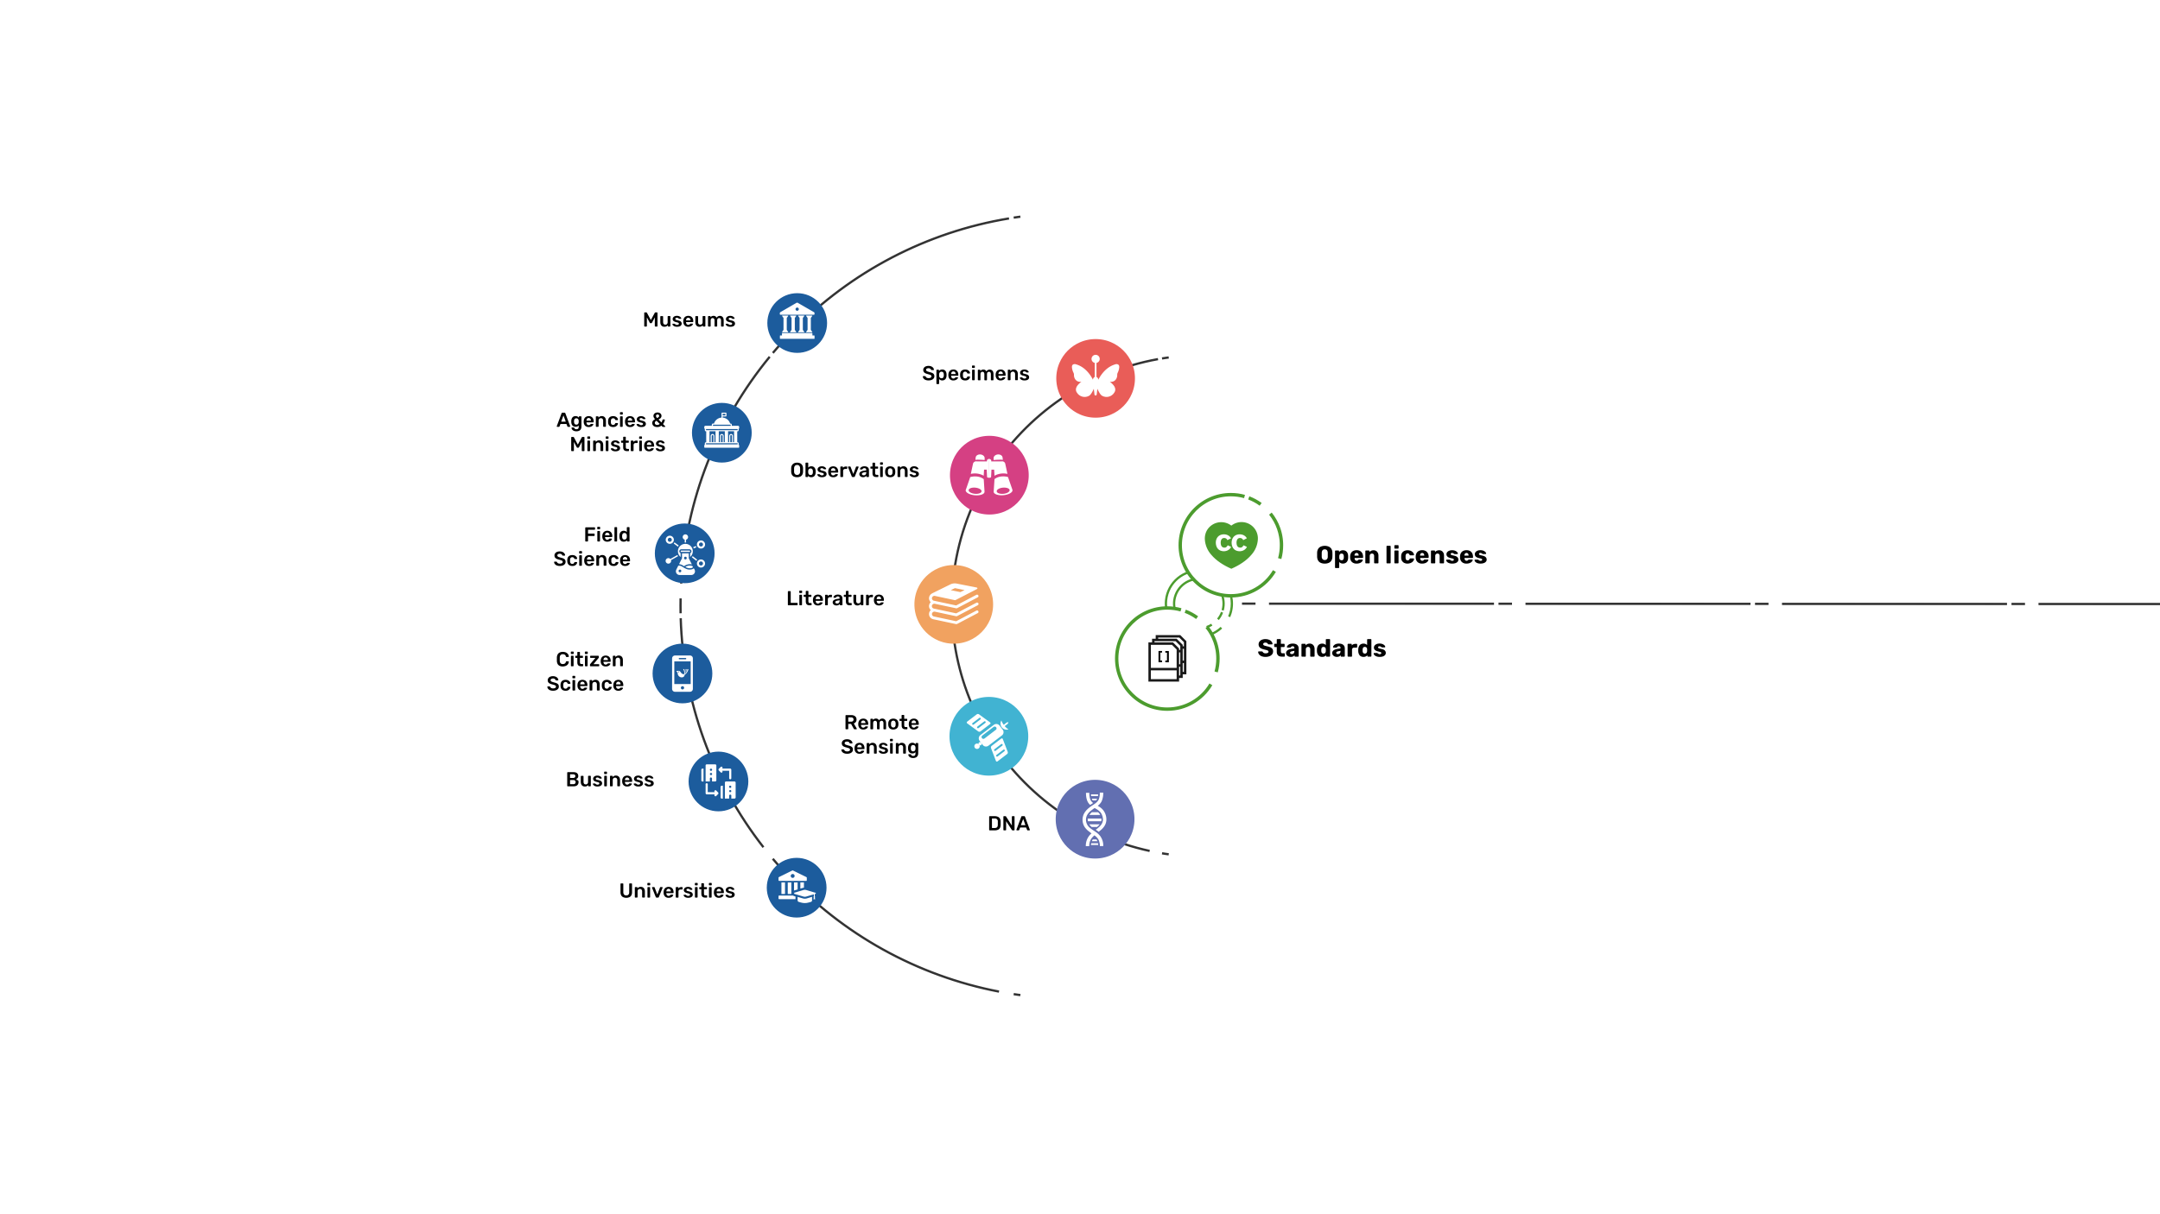
Sources of biodiversity Evidence
Create
Combine sources of evidence

Slide 13
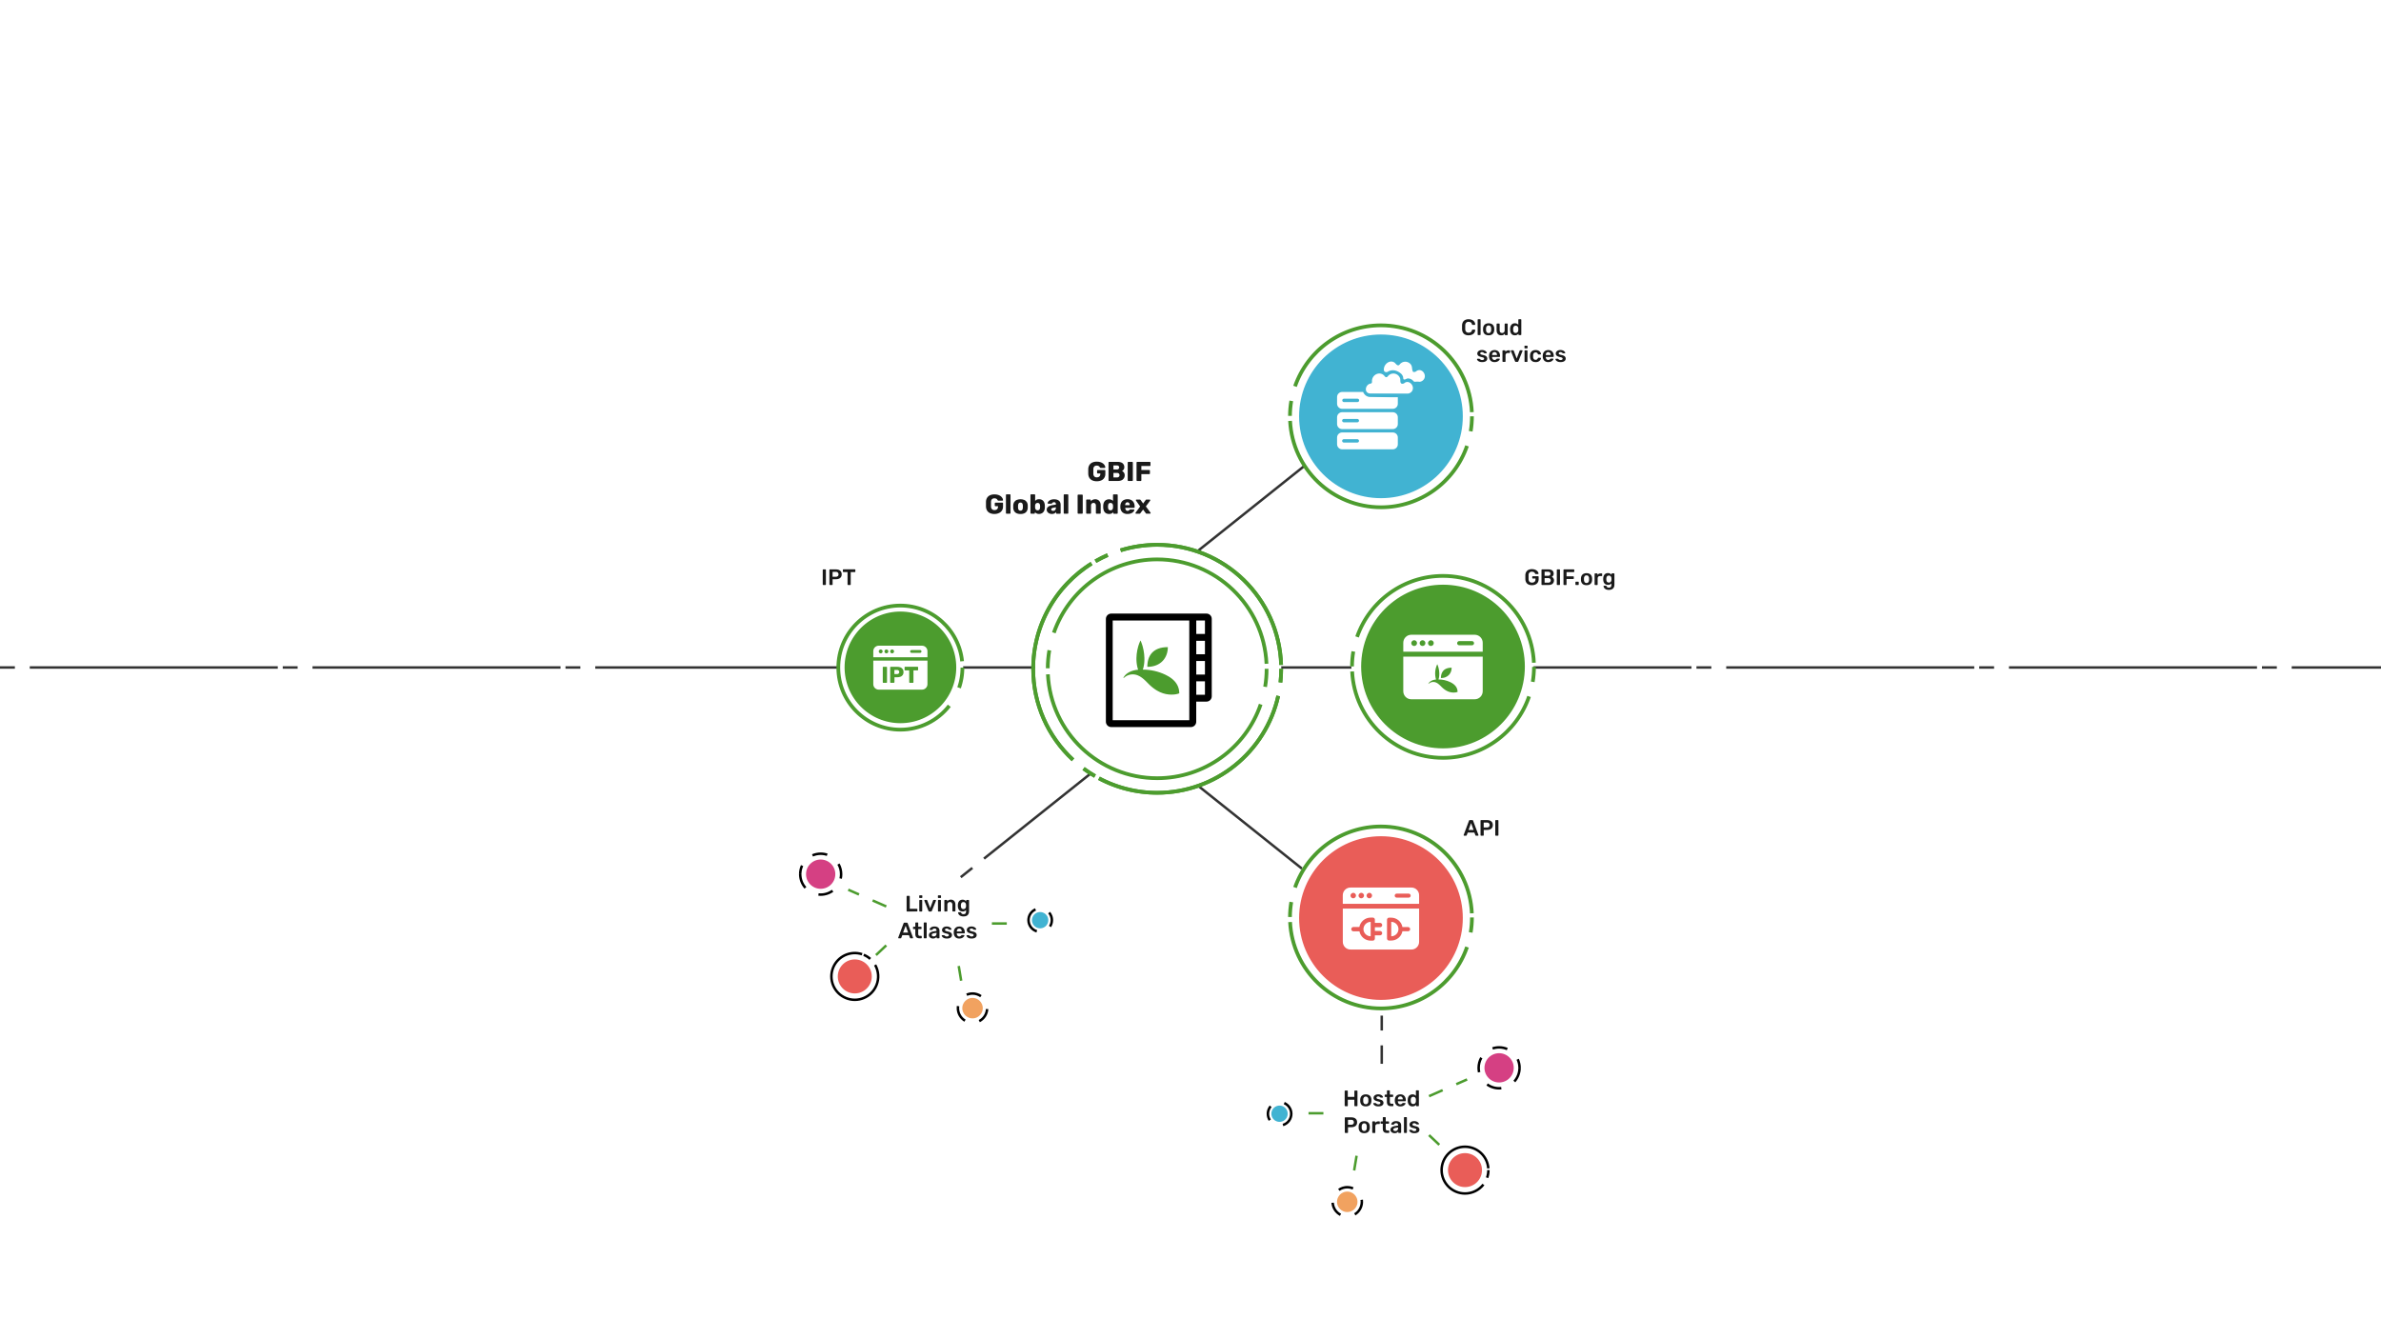
Access to biodiversity EvidencE
Share
FAIR and open access

Slide 14
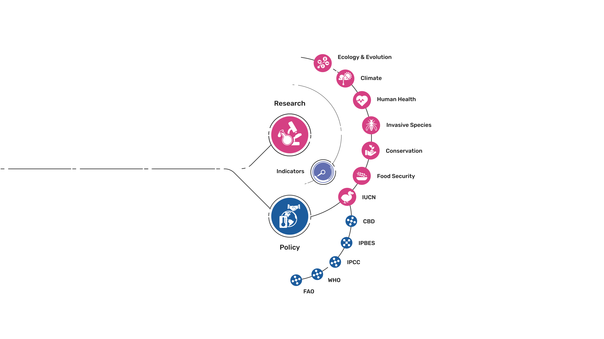
Uses of biodiversity Evidence
Transform
Apply and use data

