Slide 1
We all have mental health
Lesson PowerPoint

Slide 2

What is mental health?
Mental health is about our feelings, our thinking, our emotions and our moods.
Looking after our mental health is just as important as looking after our physical health.

Slide 3

True or false?

Slide 4
We all have mental health
True

Slide 5
Our physical health is more important than our mental health
False

Slide 6
If I want to talk about my mental health, I always have to ask a doctor
False

Slide 7
One way to manage our mental health is to talk about it with someone we trust
True

Slide 8
‘We all have mental health’ animation
Watch here: youtube.com/watch?v=DxIDKZHW3-E&feature=youtu.be

Slide 9

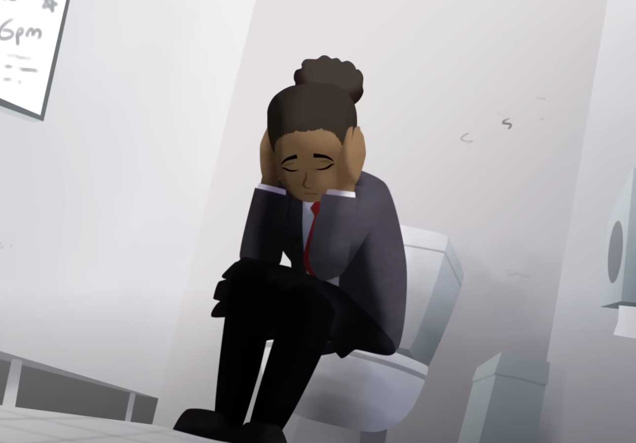
Discuss:
What was going on for Sasha in the animation?

Slide 10
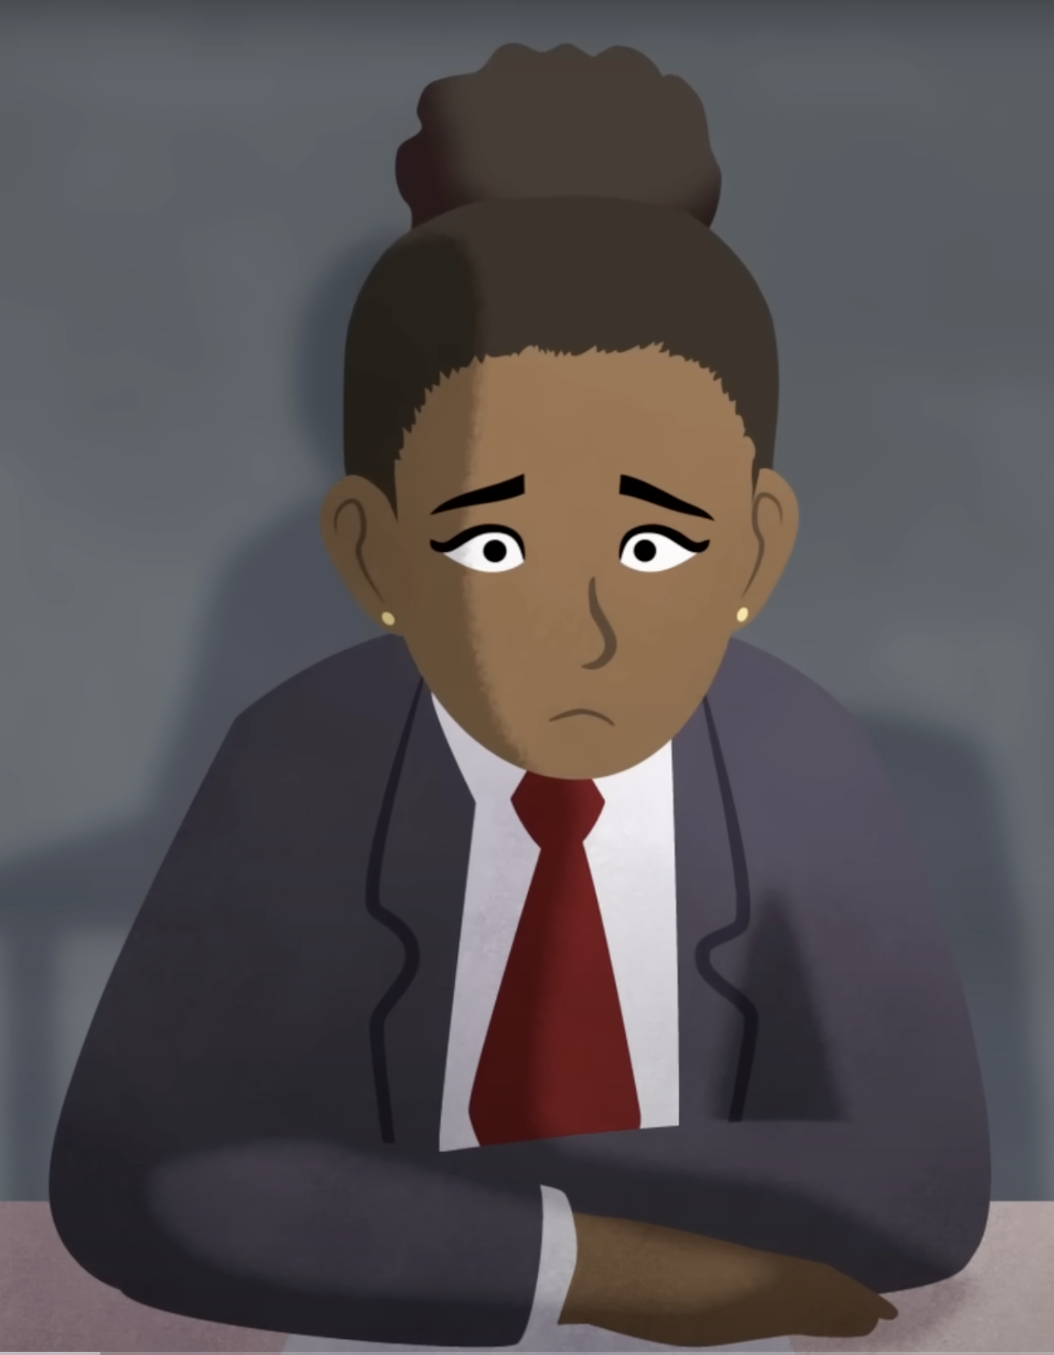
Sasha
Worried about doing well at school
Sasha spoke to her mum about how she was feeling
Sasha was able to help herself by taking some time out
Sasha’s feelings went away after a little while
Sasha’s feelings are everyday feelings that come and go

Slide 11
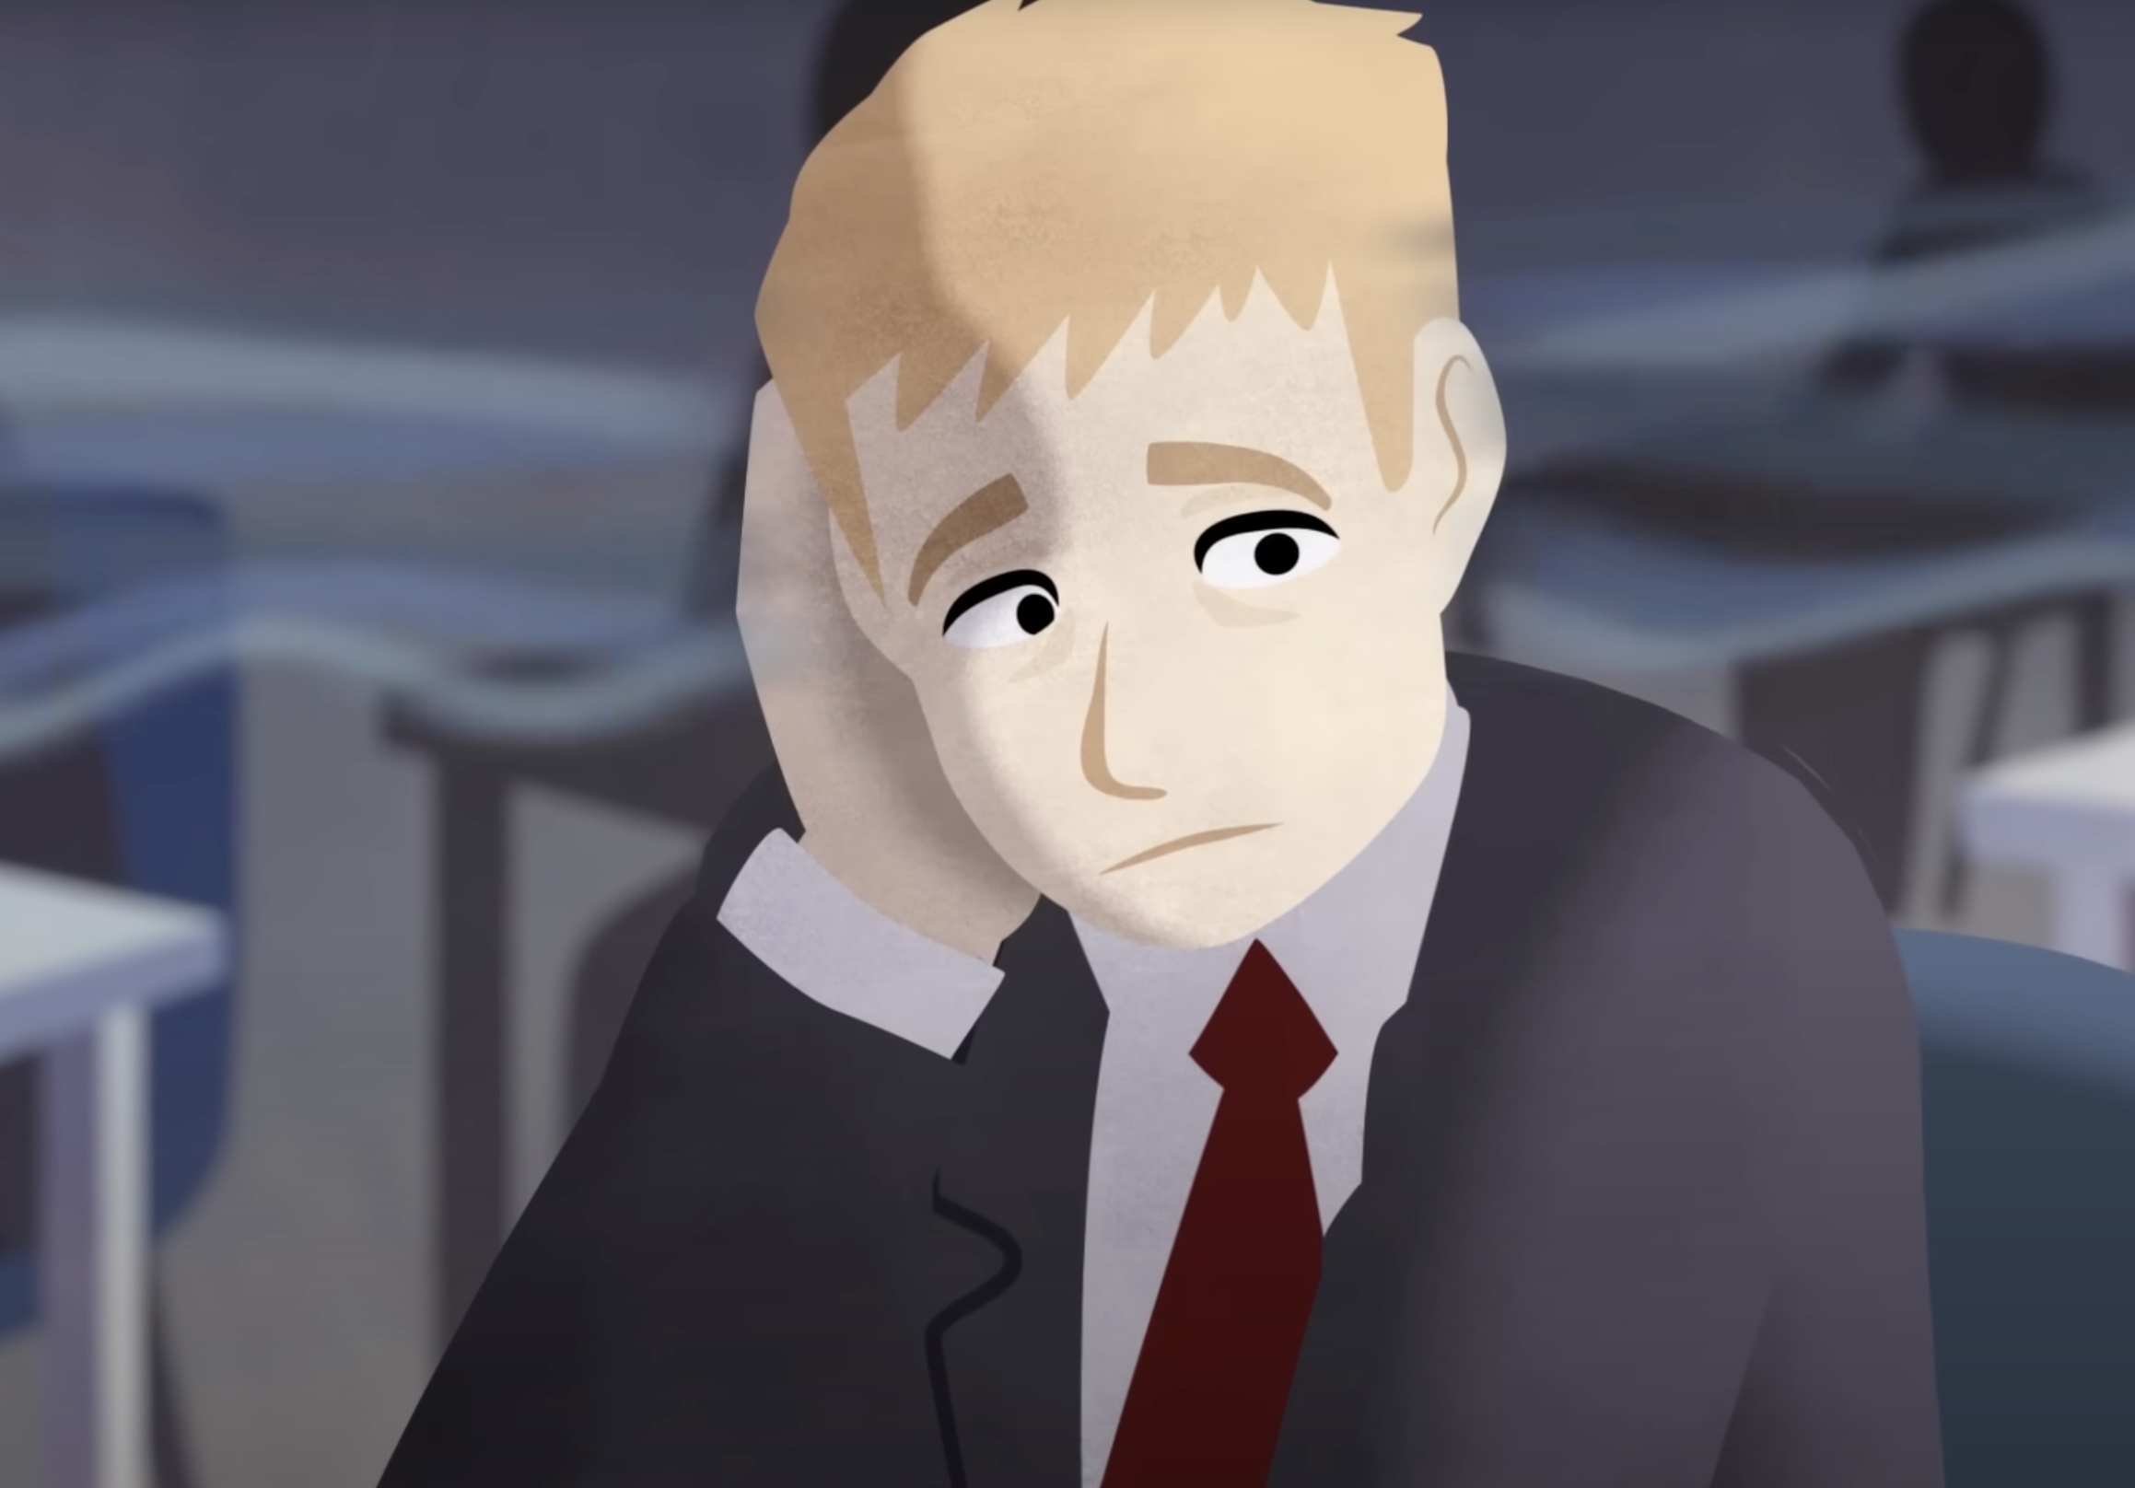
Discuss:
What was going on for André in the animation?

Slide 12
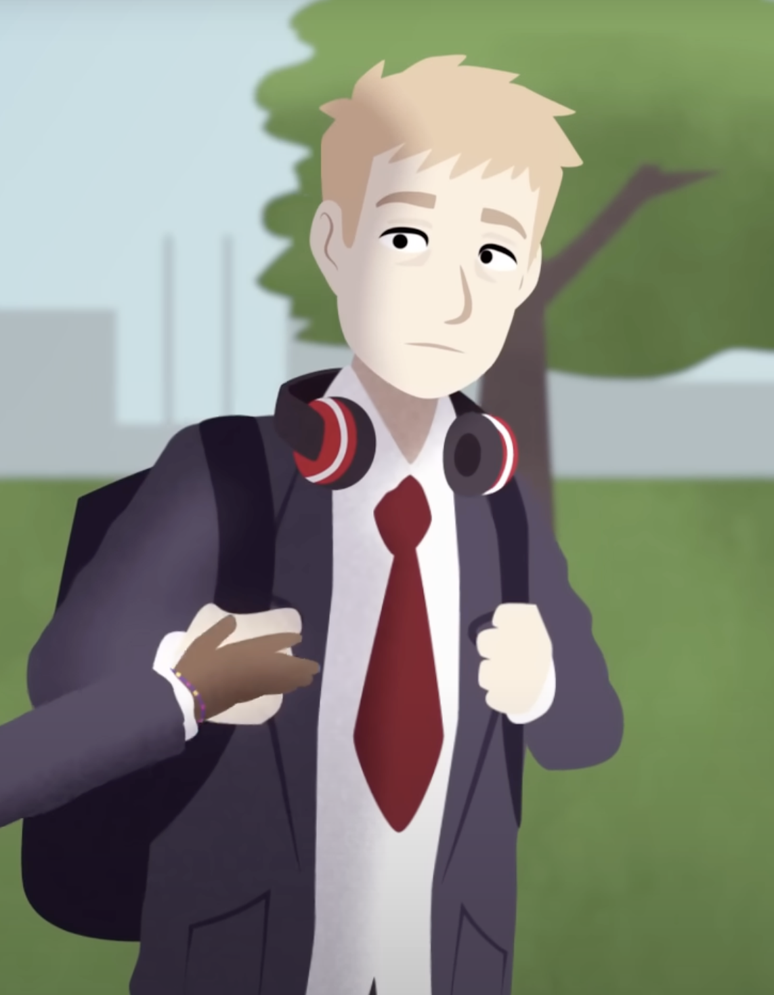
André
André’s feelings were long lasting and stopped him from doing what he enjoys
Taking some time out did not help in the way that it did for Sasha
Talking to someone and joining a club helped André to manage his overwhelming feelings

Slide 13
Everyday feelings and overwhelming feelings

Slide 14
Everyday feelings come and go and are a normal reaction to what is happening in our lives. They are always changing and don’t usually hang around for
too long.
Overwhelming feelings hang around for a long time, change the way we feel and behave and may stop us from doing what we want to in life. You might have heard people call them a mental health problem, mental illness or mental disorder.

Slide 15


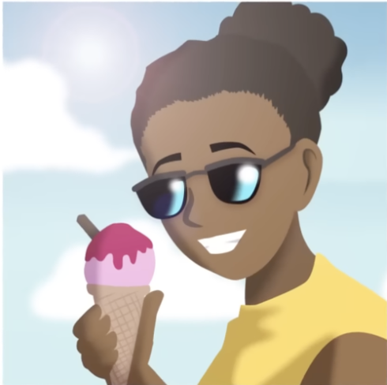
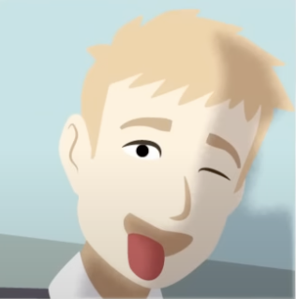
Everyday feelings
Overwhelming feelings

Slide 16
How can we look after our own mental health?

Slide 17
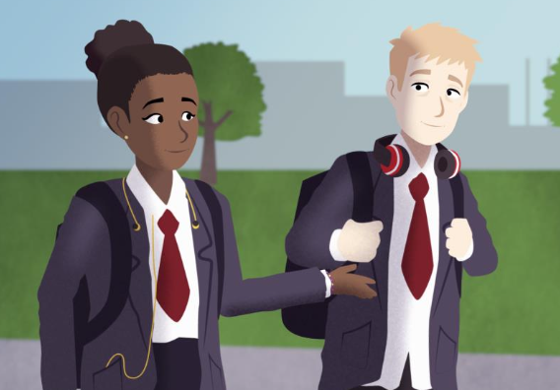
Discuss:
How did Sasha and André look after their mental health?

Slide 18
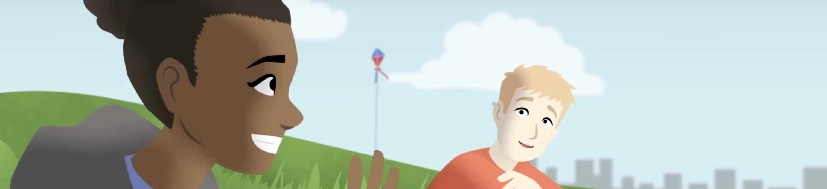
Sasha spoke to her mum about how she was feeling and took some time away from everything by making herself a hot chocolate and watching a film
André spoke to Sasha and his head of year, and signed up to the football club

Slide 19
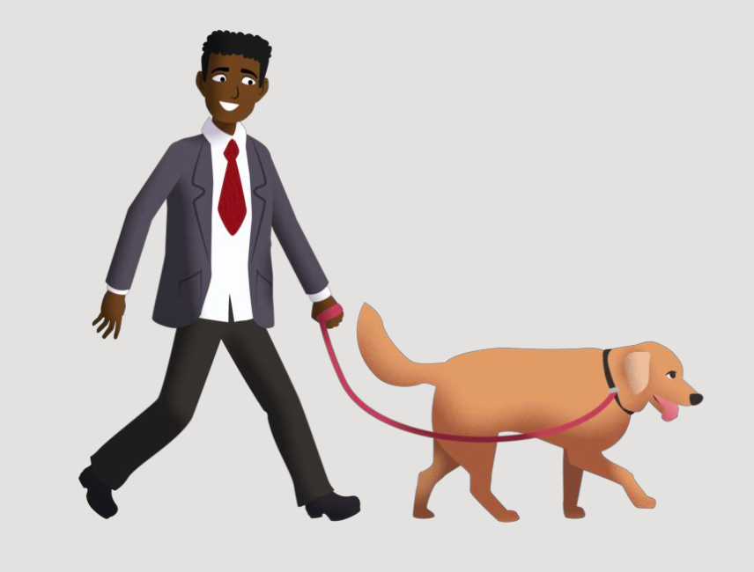
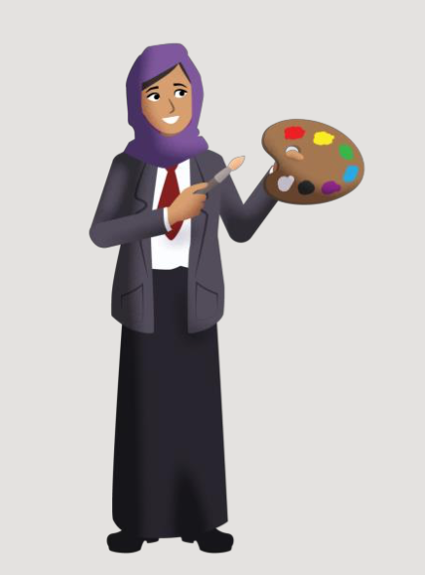
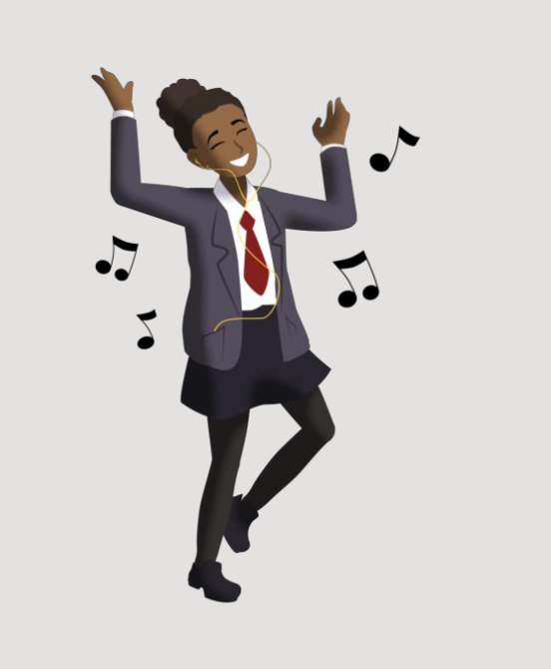
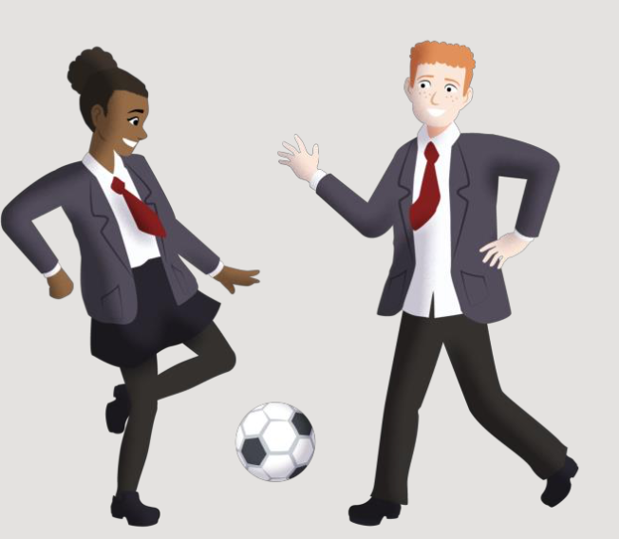
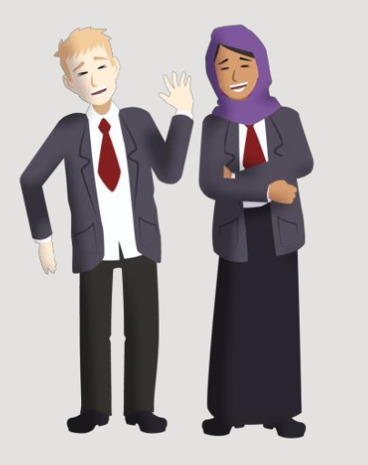
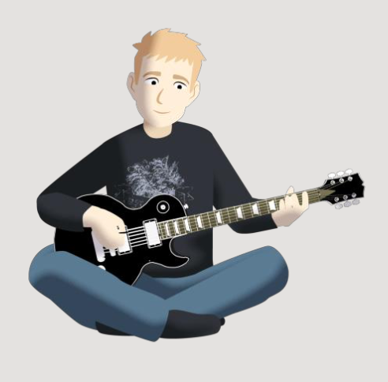
How can we look after our mental health?

Slide 20
Where can
I find support?

Slide 21

In your school you can talk to…
Insert support options at your school

Slide 22
Other places
Anna Freud: www.annafreud.org
ChildLine: www.childline.org.uk Tel. 0800 1111
The Mix: www.themix.org.uk
[Optional: insert any other organisations in your local area where young people can find support]

Slide 24
Additional activities

Slide 25

Stress bucket
Things that make me feel stressed are…
Some ways to help my stresses go away are…

