Slide 1
EXTRAMAMMARY PAGET DISEASE
ANTHONY ROSSI MD
IG & Twitter: @DrAnthonyRossi
ASSISTANT ATTENDING – DERMATOLOGY SERVICE
MEMORIAL SLOAN KETTERING CANCER CENTER
WEILL CORNELL MEDICAL COLLEGE

Slide 2
Relevant Disclosures
BIOFRONTERA – CONSULTANT , RESEARCH SUPPORT
REGENERON – ADVISORY BOARD
SKIN CANCER FOUNDATION – RESEARCH GRANT
SOCIETY OF MSKCC – RESEARCH SUPPORT
ASLMS – RESEARCH SUPPORT
ASDS BOARD MEMBER
I will be discussing OFF-LABEL treatment

Slide 3
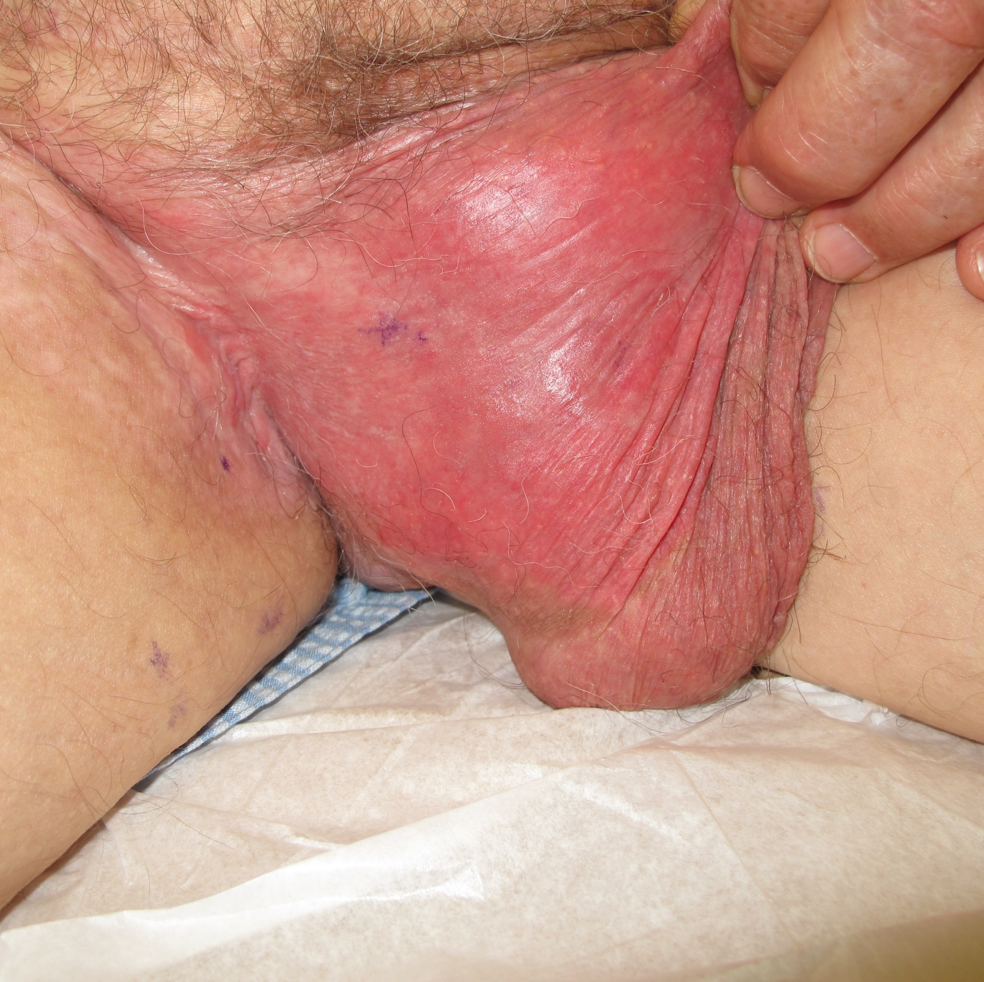





EXTRAMAMMARY PAGET DISEASE
Epidemiology
Clinical Diagnosis
Workup
Treatment
Management / Prognosis

Slide 4
EXTRAMAMMARY PAGET DISEASE
Extramammary Paget disease (EMPD)
  Pathogenesis controversial.
  75% - Primary EMPD - Primary intraepidermal neoplasm.
  Originating from intraepidermal part apocrine gland ducts /pluripotent keratinocyte stem cells / Toker cells (intraepidermal cells; nipple, milk line, vulva; described in 1970)
  25 % - Secondary EMPD - Represents an epidermotropic spread from another primary tumor.
  Adenocarcinoma – dermal adnexal gland or a local organ with contiguous epithelium; gastrointestinal, genitourinary (e.g. prostate, bladder, urethra) gynecological tumor (e.g. vagina, cervix, endometrium, Bartholin glands).
    Rare reports of tumors arising in distant organs

Slide 5
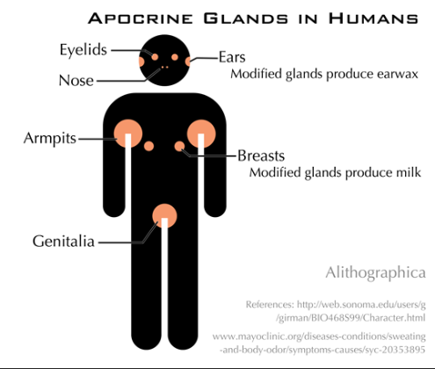
EXTRAMAMMARY PAGET’S DISEASE
Demographic
Area rich in apocrine glands
The most common location is the
  Vulvar region 50%
  Perineum
  Perianal region
  Scrotum
  Penis
  Axilla, buttocks, thighs, eyelids, and external auditory canal
  Ectopic EMPD (chest, arms, fingers, knees, back, and cheeks)
Middle-age/elderly people (range 45–85 years)
Female-to-male ratio of 4:1 (except for Japan and Korea)
EMPD of the scrotum or penis (penoscrotal) is a less common variety and has been estimated to have an incidence of 1/3.7 million males annually

Slide 6
Presentation
EMPD had a predilection for the body folds.
Delay in diagnosis of years
Recurrent tumors reported in many studies
EMPD should be considered in the differential diagnosis of treatment-refractory dermatoses, in particular tinea cruris, eczema, and psoriasis

Slide 7
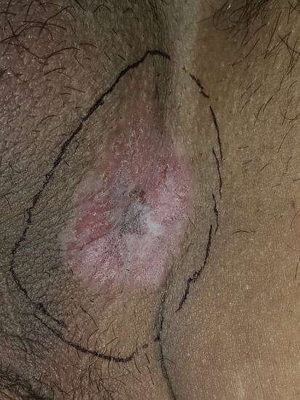
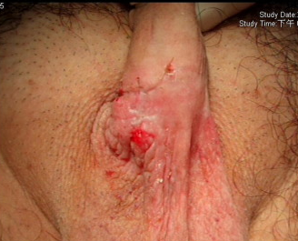
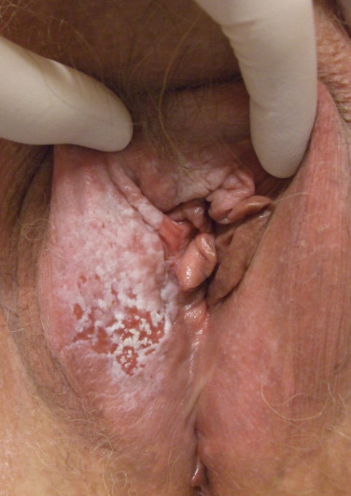
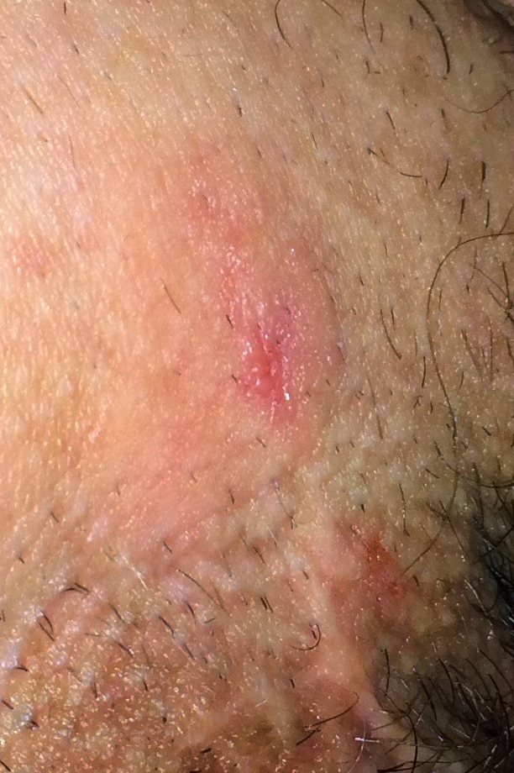
EXTRAMAMMARY PAGET DISEASE
Clinical Features
Slowly enlarging, well-demarcated, erythematous, eczematous, or leucoplakic plaque
Pruritus – most common symptom
Diagnosis is often delayed (by 4 months to 15 years)
Looks similar to eczema, contact dermatitis, fungal infection, psoriasis, lichen sclerosus, Bowen’s disease, superficial basal cell carcinoma, and mycosis fungoides
Location as a clue to underlying disease
PERIANAL
PERINEUM
SCROTUM
VULVA

Slide 8
WORKUP
High degree of clinical suspicion
Biopsy of rash not improving or persistent
May need multiple biopsies to confirm the diagnosis
Broad shave biopsy capturing epidermis and dermis
Punch biopsies for thicker lesions
Detailed review of systems and physical examination should be performed in all patients.
Palpation of all lymph nodes
Rectal examination
Sigmoidoscopy
Cystoscopy
Women: PAP exam; breast examination / mammography, and colposcopy
Men: Prostate exam

Slide 9

Workup
Age-appropriate malignancy screening should be performed at baseline to distinguish between primary and secondary EMPD
Largest study (Schmitt, 2018): 11.4% (15/132) had occult internal adenocarcinoma
EMPD may precede an associated internal malignancy by 5 years.

Slide 10
IMAGING
Imaging studies (CT scan Chest Abdomen Pelvis with / without contrast)
  Directed by anatomic location of the involved skin and the sex of the patient.
  Augment physical and endoscopic examination in assessing possible undetected internal malignancy
Positron emission tomography (PET) scan may be helpful in assessing regional lymph nodes and locating distal disease
  patients with dermal invasion
  Palpable lymph nodes
  Positive ROS
PET-CT detected 3 occult metastasis among 33 patients (Zhu, 2009); yield: 9%
CT scan detected 3 occult metastasis among 132 patients (Schmitt, 2018); yield: 2.3%

Slide 11
Location Location Location
LOCATION – Plays a role in predicting the risk of associated carcinoma
  Genital disease – associated with carcinoma in 4-7%
  Perianal disease – associated with underlying colorectal carcinoma in 25 – 35% of cases
Currently SLNB is not routinely recommended for EMPD
  Can consider if invasive disease (Depth threshold)
Laboratory bloodwork
PSA (besides screening PSA) may have low yield
CEA may have high false positive rate in literature
No data for checking CA19-9, AFP

Slide 12
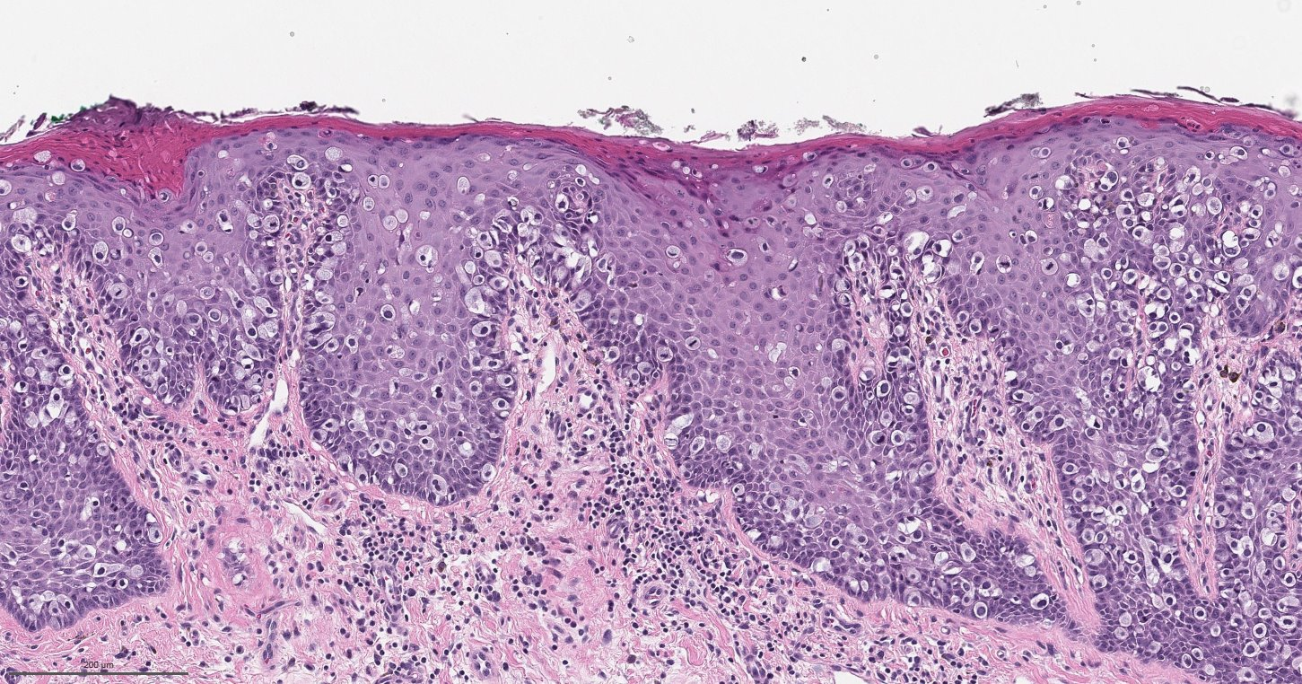
HISTOLOGY
DDX of Pagetoid Cells:
SCCis
Melanoma
MF
Porocarcinoma
Sebaceous carcinoma
Mammary Paget Disease
Epidermotropic Metastasis
Merkel Cell Carcinoma
.
Notes:
The epidermis is diffusely infiltrated with large vacuolated cells that have a bluish cytoplasm; these are called Paget cells. These distinctive cells are found in the lower epidermis and may proliferate to the rete ridges and adnexa. The epidermis shows varying degrees of acanthosis, hyperkeratosis, and parakeratosis. With histochemical analysis, Paget cells are stained with sialomucin by using periodic acid–Schiff (PAS) followed by diastase digestion.
It is important to keep in mind the differential diagnosis of tumors with an epidermotropic growth pattern and the importance of immunohistochemical staining in the histologic workup of such tumors. The following should all be considered ^{[8]} :
Squamous cell carcinoma in situ
Melanoma
Mycosis fungoides
Eccrine porocarcinoma
Sebaceous carcinoma of the eyelid
Mammary Paget disease (PD) and EMPD
Merkel cell carcinoma
Epidermotropic metastases

Slide 13
Immunohistochemistry
EMPD typically stains CK7+ CK20+/- p63- SOX10- CEA+
Vulvar EMPD secondary to Mullerian adenocarcinoma may stain positively with PAX8 and ER/PR.
Marker | Primary EMPD | Secondary EMPD | SCCis | MIS | Merkel cell carcinoma
CK7 CK20 GCDFP CEA MUC1 MUC5AC P63 SOX10 CDX2 PAX8 ER PR | + +/- + + + + - - +(perianal) - - | + + - + - - +/- +/- +/- | + - - - - - + - - - - | - - - - - - - + - - - | +/- + - - -

Slide 14
HISTOLOGY
PATHOLOGY AND IMMUNOHISTOCHEMISTRY – MAY HELP with RISK OF UNDERLYING MALIGNANCY
CK7:
Type II keratin; marker of simple nonkeratinizing epithelia.
Generally expressed in various adenocarcinomas (lung, breast, thyroid, endometrium, cervix, ovary, salivary gland and upper GI tract) urothelial carcinoma and Paget disease.
Site specific markers such as GCDFP (genital with apocrine involvement) and CDX2 and CK20 (perianal). EMPD is negative for SOX10, p63, PAX8, ER and PR.
HER2 and AKT may predict invasive disease and lymph node metastasis, but studies are small and require further evaluation
CK20:
Epithelial marker with restricted expression compared to CK7
In EMPD suggest underlying internal malignancy; urothelial carcinoma / colorectal adenocarcinoma (secondary EMPD)
CDX2:
CDX2 is a transcription factor that regulates the development of the epithelium of the small and large intestine.
Fairly specific marker of GI origin for adenocarcinomas

Slide 15
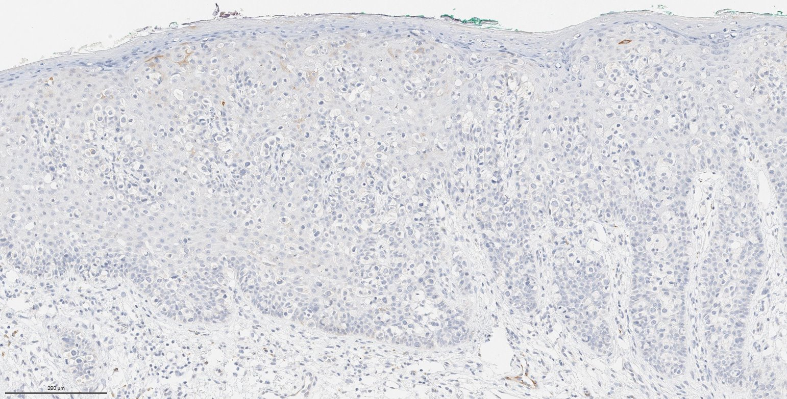
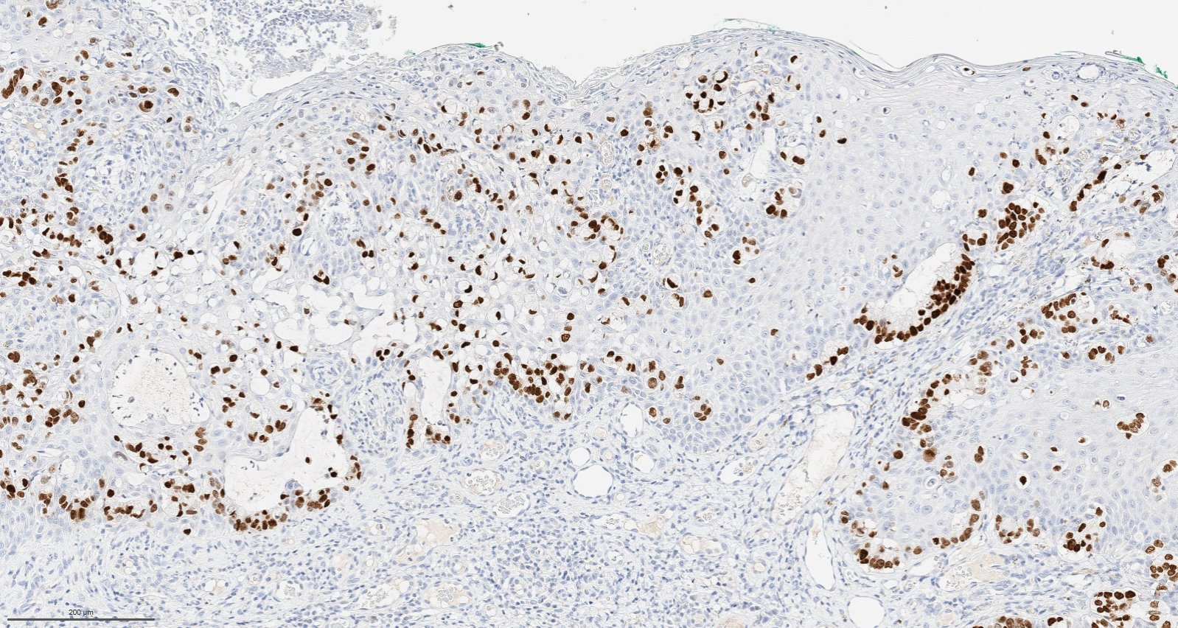
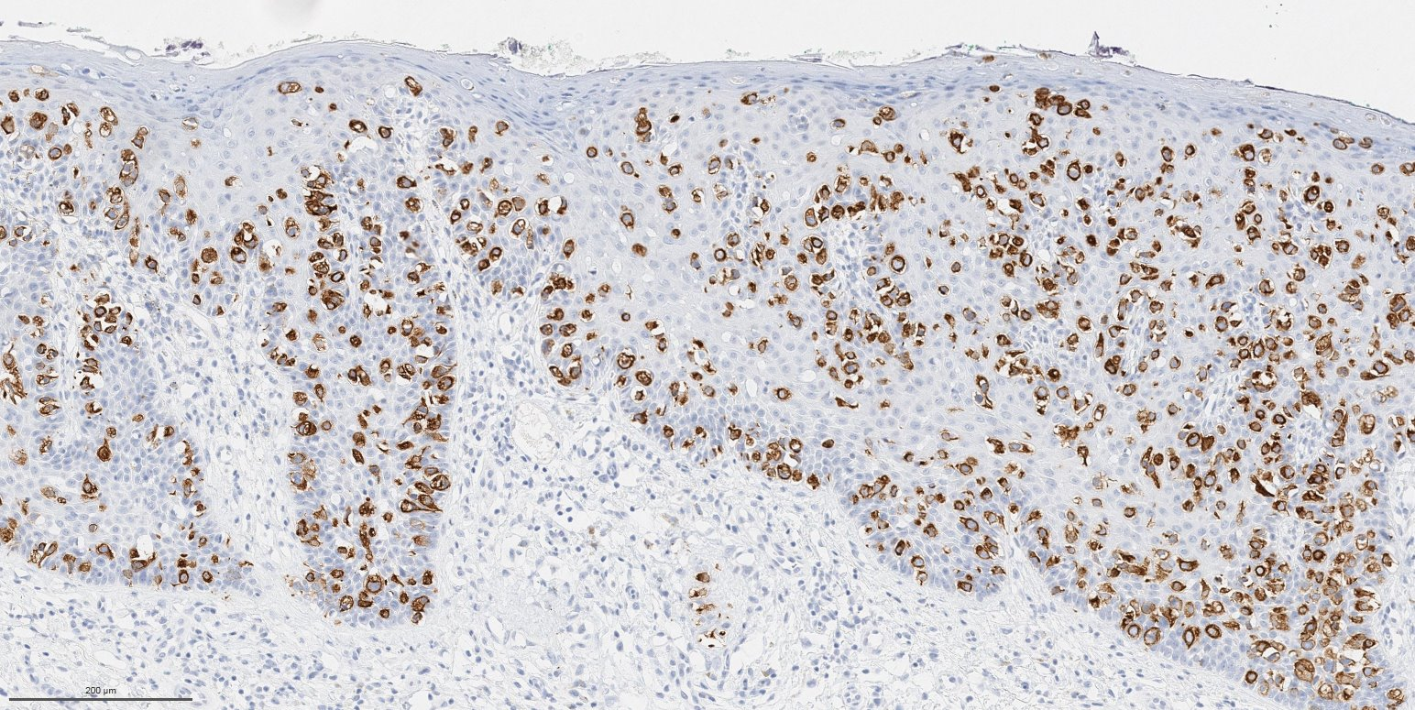
CK7 (x10)
CDX2 (x10)
CD20 (x10)
.

Slide 16
Management
Nonspecific clinical appearance and multifocal growth – difficult to ascertain extent
Surgery (WLE 1-5cm reported ): mainstay of treatment for EMPD
Even with WLE, recurrence is frequent (30-60%)
Mohs Micrographic Surgery / Complete Circumferential Peripheral and Deep Margin Assessment (CCPDMA)
Nonsurgical treatment imiquimod 5% cream, 5-FU cream, CO2 laser, RT, PDT
Lopes Filho LL, et al. An Bras Dermatol. 2015;90(2):225-31.
Lee SJ, et al. Int J Dermatol. 2011;50(5):508-15.

Slide 17
Follow up
Follow-up is recommended every 6 months for 3 years and then yearly until at least 5 years following diagnosis.
Clinical examinations, including regional and laboratory monitoring (PSA, CEA, CA19-9, AFP) are recommended biannually for the first 3 years for aggressive EMPD without metastasis.
Annual screening using CT or PET-CT/MRI may be considered in EMPD with aggressive features.
In cases of metastatic EMPD where CEA is elevated, CEA levels may be used to monitor treatment progress.

Slide 18
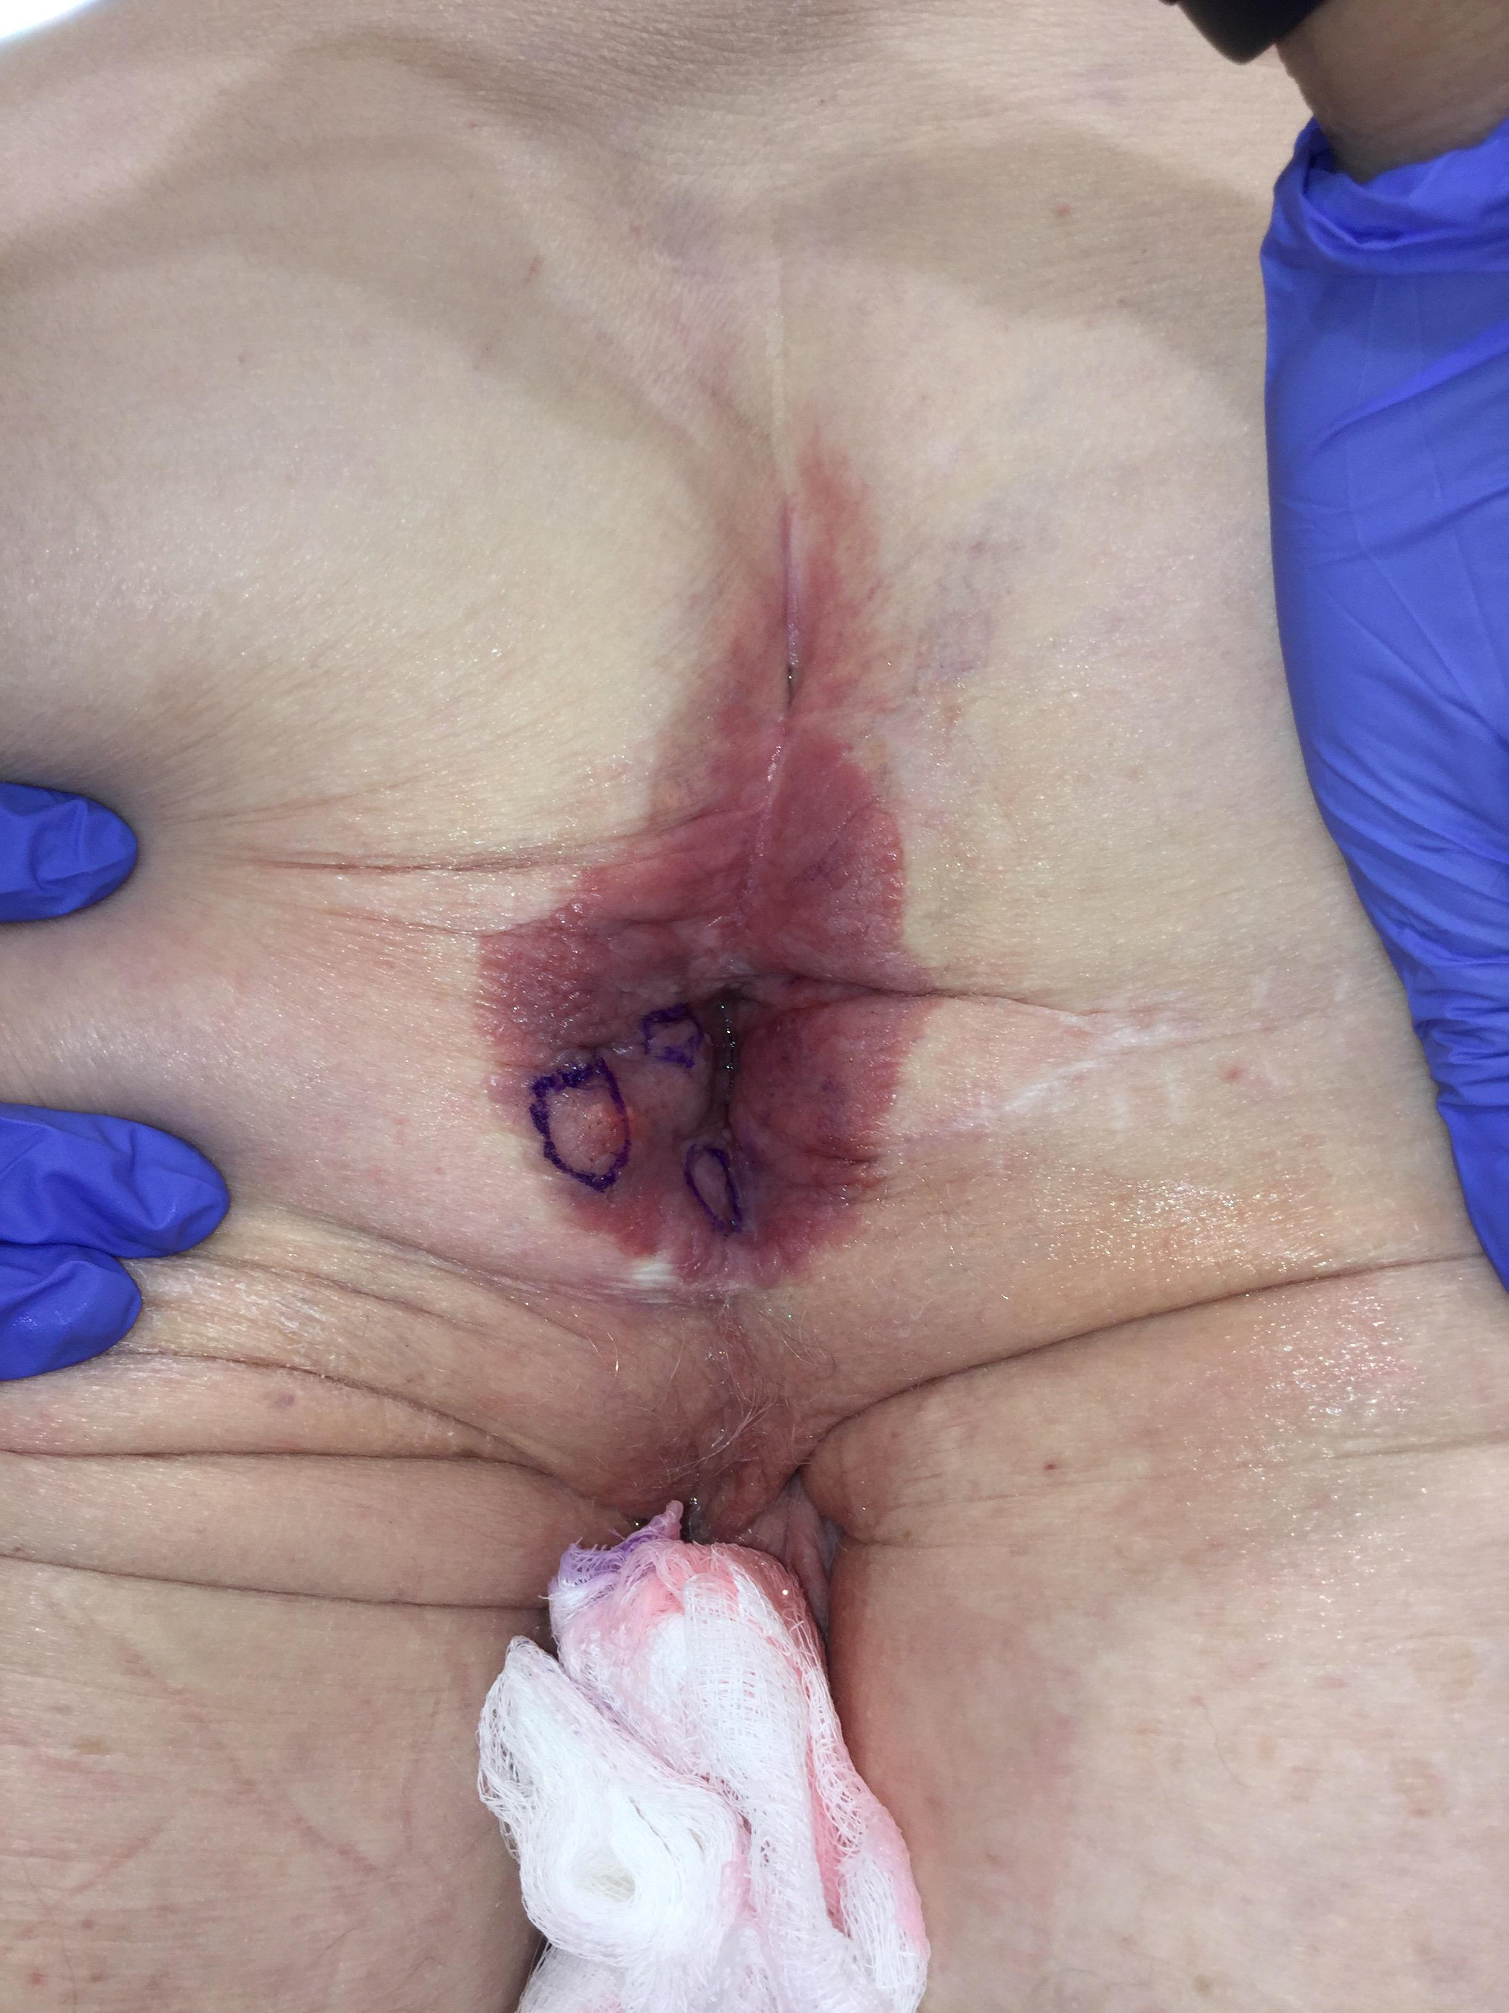
Patient with recurrent perianal EMPD s/p resection many years ago
Now with recurrence and inguinal lymph node metastasis

Slide 19
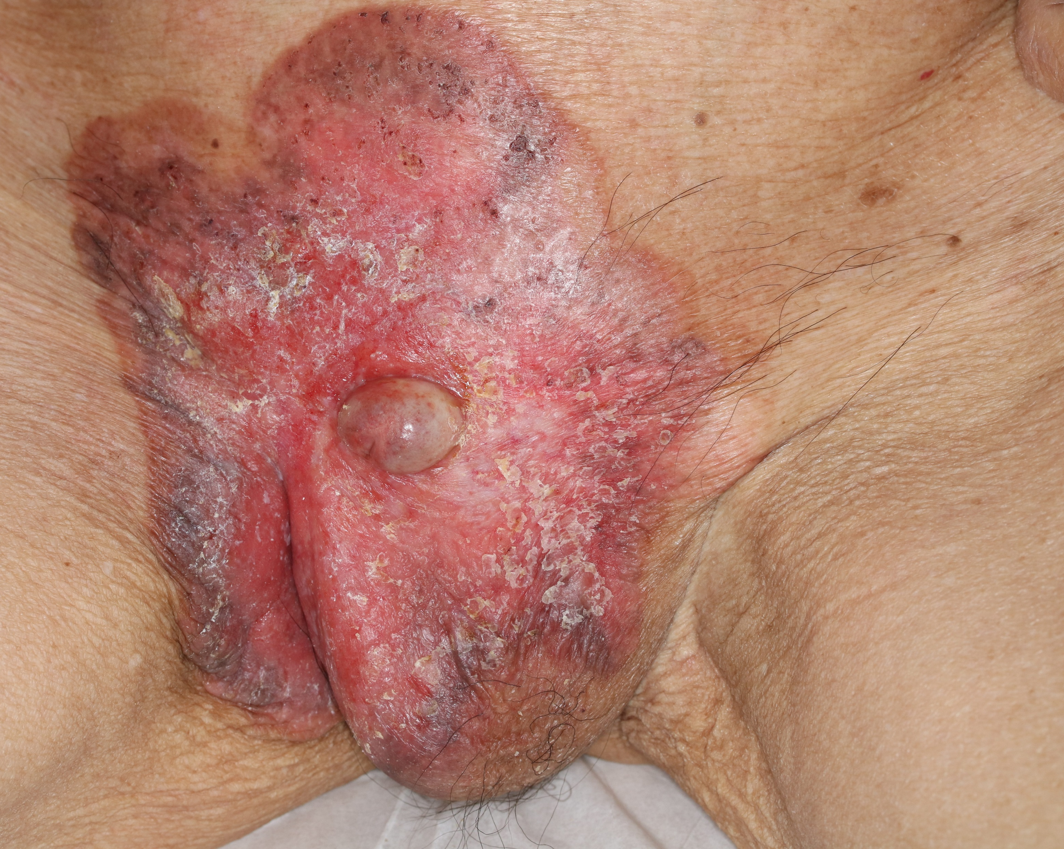
Advanced / Metastatic Disease

Slide 20
RESEARCH STUDIES
Evaluate a comprehensive evaluation with RCM and genetic testing, in addition to clinical, histopathological, and systemic screening on patients with recent diagnosis of EMPD referred to our center. The objective of the study was to describe the clinical, RCM, and genetic characteristics of these patients

Slide 21
Methods
Prospective cases presenting from July 2017 to present with a diagnosis of EMPD
Underwent RCM
Underwent IMPACT testing
Inclusion criteria:
Adult (>18 years old) patients with biopsy-proven diagnosis of primary (i.e. first diagnosis), recurrent, or secondary (i.e. presence of a subjacent primary tumor) EMPD, that were referred to our center for evaluation and management were included.
Exclusion criteria:
We excluded patients that denied participating in the study or those in which RCM was not possible to complete (e.g. pain, ulceration, etc).

Slide 22
Results
36 clinical sites in 33 patients were included.
Mean age was 71.2 years (range 54 – 96 years); 21 patients (67.7%) were males.
Mean duration of disease prior to diagnosis was 32.1 months (range 6 – 96 months).
Main location was genitourinary area (82.1%).
1o had invasive disease
17 out of 36 lesions (47.2%) had history of prior treatment and were categorized as ‘recurrent / persistent’ EMPD on our initial evaluation.
  Prior treatments included: WLE (n=4; 23.5%), Vulvectomy (n=4; 23.5%), imiquimod (n=3; 17.6%), WLE twice (n=2; 11.8%), RT (n=1; 5.9%), ED&C (n=1; 5.9%), imiquimod and PDT (n=1; 5.9%), and WLE and RT (n=1; 5.9%).
11 patients had prior history of cancer
2 patients had metastatic disease

Slide 23
Characteristic | Descriptive data
Age (y), mean (SD, range)* | 71.7 (8.7, 54 – 96)
Gender (male, %)* | 24 (70.6%)
Location (n, %)**
Axilla | 1 (2.7%)
Genitourinary | 1 (2.7%)
Inguinal | 2 (5.5%)
Inguinoscrotal | 6 (16.6%)
Perianal | 4 (11.1%)
Perineum | 3 (8.3%)
Pubis | 4 (11.1%)
Scrotum | 10 (27.7%)
Vulva | 5 (13.9%)
Immunostains (n, %)***
CK7 | 30 / 31 (96.8%)
CK20 | 5 / 15 (33.3%)
CDX2 | 4 / 7 (57.1%)
AR | 3 / 4 (75.0%)
PR | 0 / 8 (0%)
ER | 5 / 8 (62.5%)
Her2 | 3 / 8 (37.5%)
EMA | 5 / 5 (100%)
CEA | 8 / 9 (88.9%)
Cam 5.2 | 8 / 11 (72.7%)
AE1/3 | 3 /3 (100%)

Slide 24
Increasing Use

Slide 25
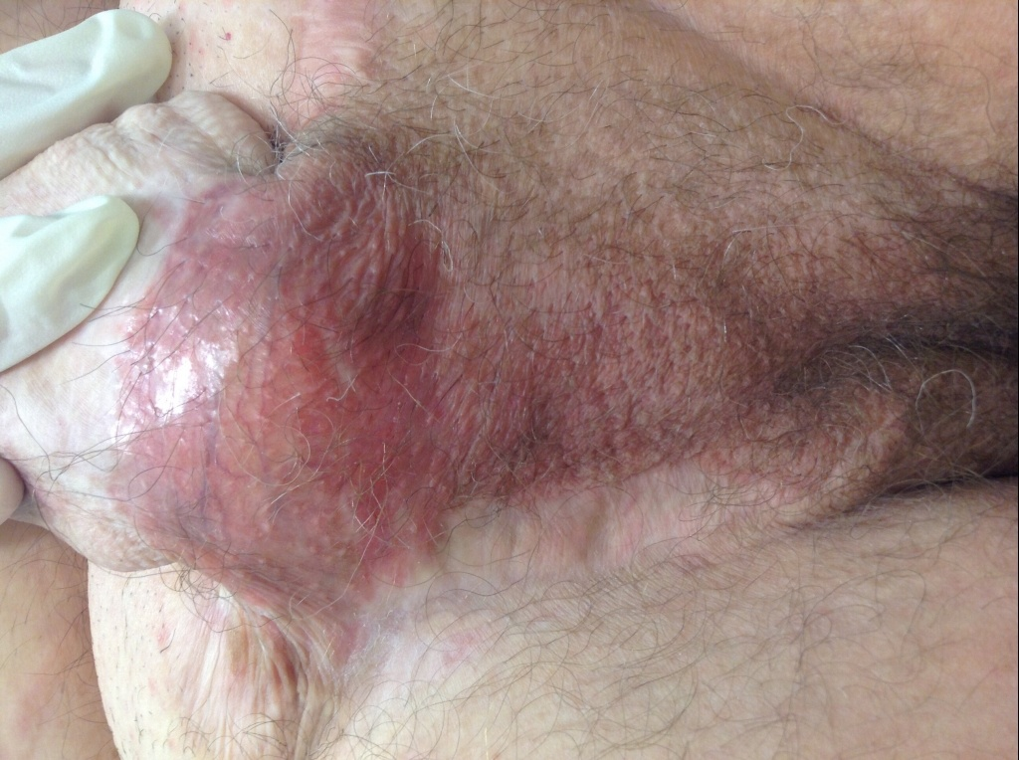
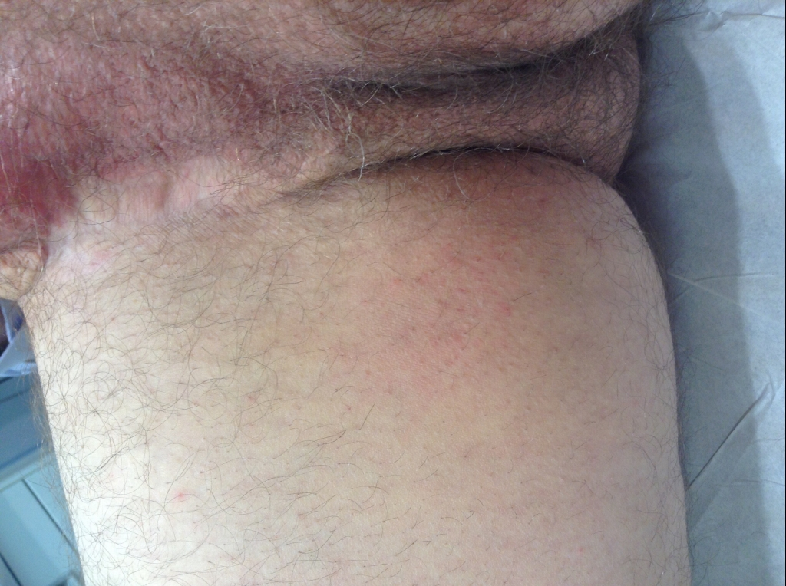
VS9: (-)
VS10: (-)
VS11: (-)
VS13: suspicious
VS4: (-)
VS12: suspicious
VS17: suspicious
VS3: (-)
VS14: suspicious
Biopsy 1
VS24: negative
VS15: suspicious
VS25 & VS26: suspicious
VS5: isolated dendritic
Biopsy 5
VS16: suspicious
Biopsy 2
Biopsy 3
VS6: (-)
VS22: suspicious
VS7: (-)
VS18: dendritic cells
Biopsy 4
VS19: dark areas (+)
VS8: (-)
VS21: erosion
VS20: cluster of cells
VS23: suspicious
Notes:
1. Right anterior scrotum margin / punch biopsy:
- Subtle changes consistent with Paget's disease
2. Left anterior scrotal margin / punch biopsy:
- Subtle changes worrisome for Paget's disease, see note
Note: immunohistochemical stains are pending; an addendum will follow.
3. Central scrotum / punch biopsy:
- Subtle changes worrisome for Paget's disease, see note
Note: immunohistochemical stains are pending; an addendum will follow.
4. Right posterior scrotum / punch biopsy:
- Spongiotic dermatitis overlying fibrotic dermis; no Paget's disease
seen
Note: immunohistochemical stains and PAS-D are pending; an addendum will
follow.
5. Right inguinal crease / punch biopsy:
- Spongiotic dermatitis overlying fibrotic dermis suggestive of scar,
inflamed; no Paget's disease seen
6. Right ventral penile shaft / punch biopsy:
- Spongiotic dermatitis; no Paget's disease seen
Note: immunohistochemical stains and PAS-D are pending; an addendum will
follow.

Slide 26
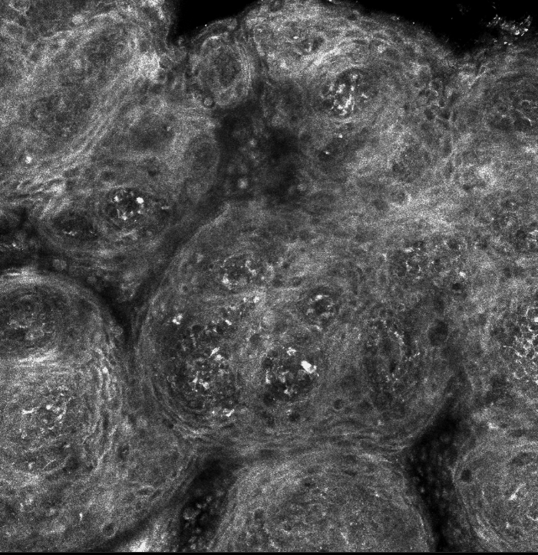
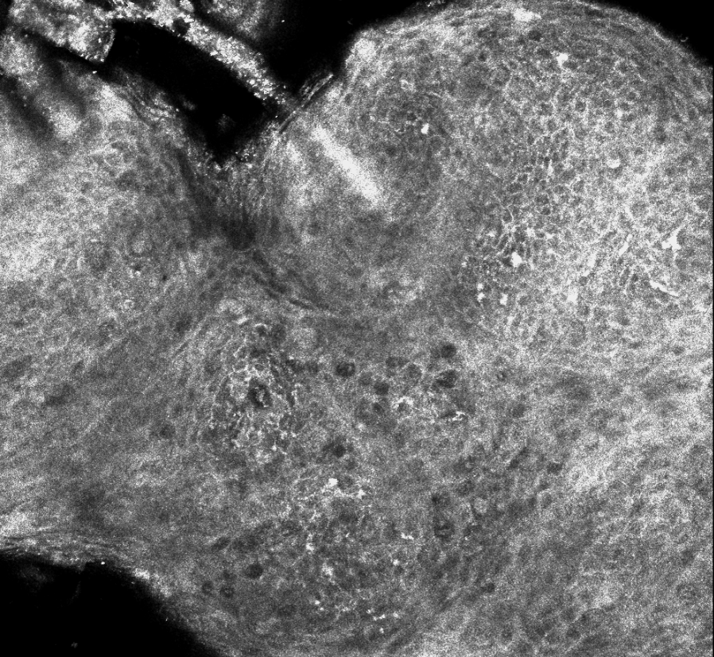
RCM

Slide 28
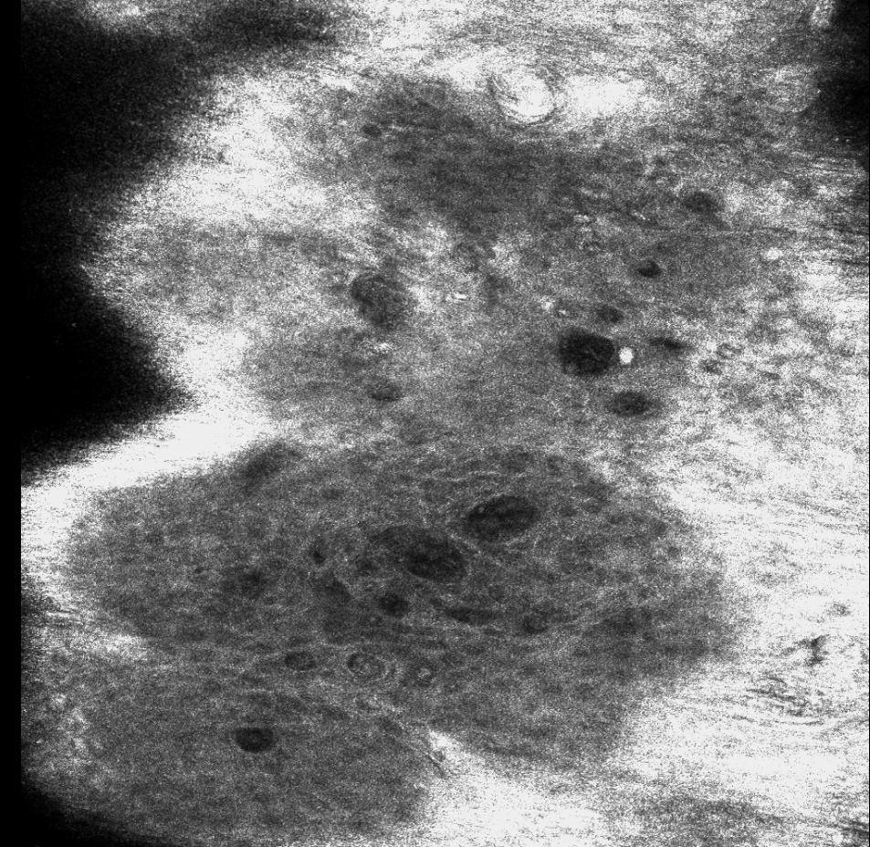
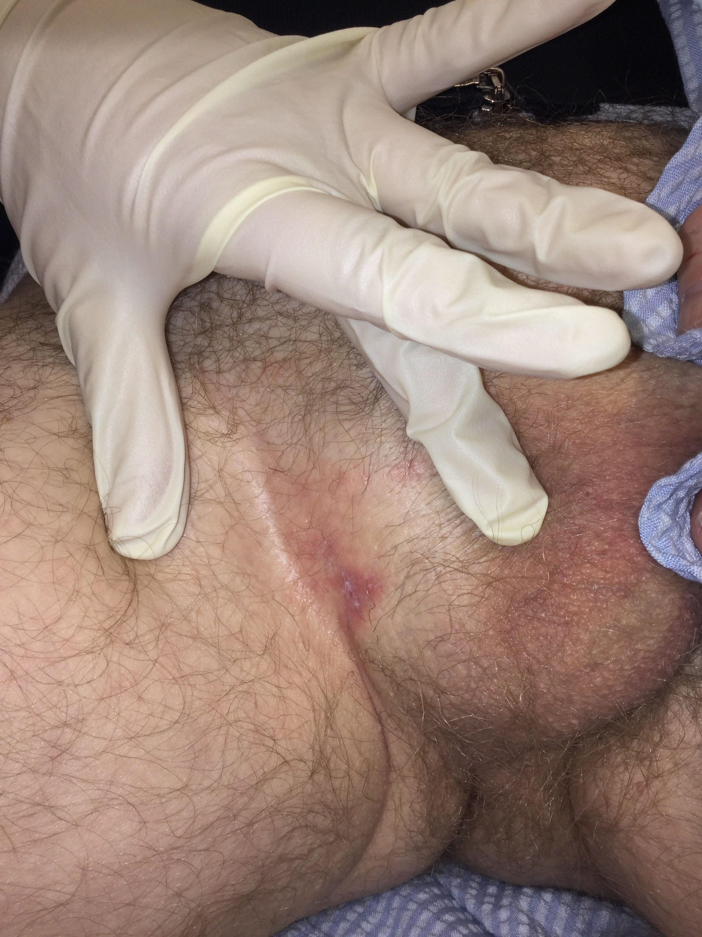

Slide 29
Table 1: Demographic characteristics and reflectance confocal microscopy features (N=28).
Abbreviations: AR= androgen receptor; PR= progesterone receptor; ER= estrogen receptor. *Total number of cases tested for CK7=26; CK20=14; CDX2=6; AR=4; PR=8; ER=8; Her2=8; EMA=4; CEA=8; CAM5.2=8; AE1/3=3
RCM features† | EMPD positive sites (n=31) | EMPD negative sites (n=10) | p-value
- Suprabasal epidermis
Atypical honeycomb | 20 (64.5%) | 0 (0%) | <0.001
Streaming of the epidermis | 3 (9.6%) | 0 (0%) | 0.56
Dendritic cells in the epidermis | 8 (25.8%) | 1 (10.0%) | 0.46
Dark holes | 28 (90.3%) | 0 (0%) | <0.001
- DEJ and superficial dermis
Dark cells at the DEJ | 9 (29.0%) | 0 (0%) | 0.083
Disruption of the DEJ | 12 (29.3%) | 0 (0%) | <0.001
Glandular nests | 21 (67.7%) | 0 (0%) | <0.001
Inflammation | 21 (32.2%) | 10 (100%) | 0.084
Plump cells | 9 (29.0%) | 0 (0%) | 0.083
Horizontal vessels | 12 (38.7%) | 9 (90%) | 0.009
Vertical vessels | 28 (90.3%) | 1 (10%) | <0.001
Fibrosis | 4 (12.9%) | 9 (90%) | <0.001
Ring pattern | 0 (0%) | 10 (100%) | <0.001

Slide 30
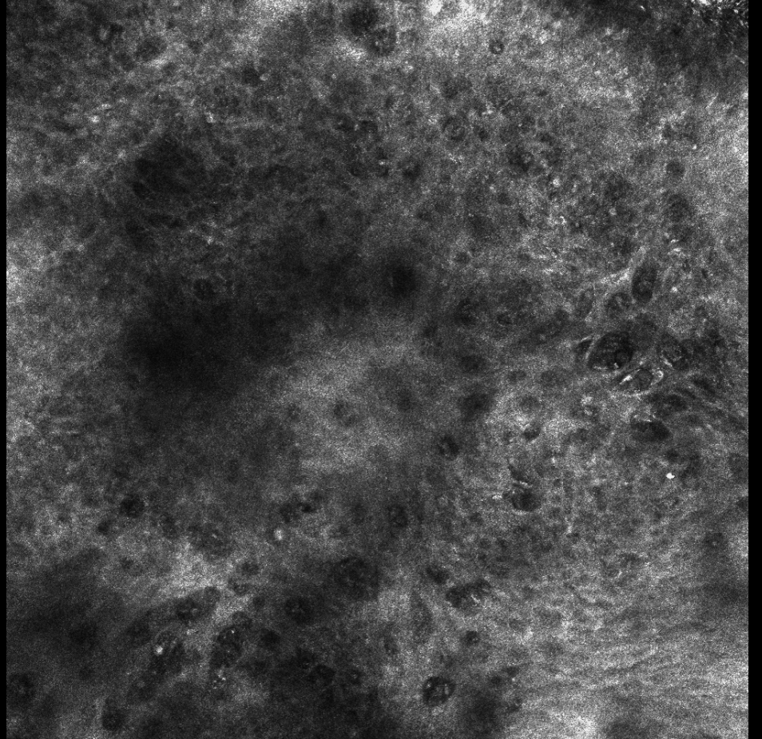

Slide 31
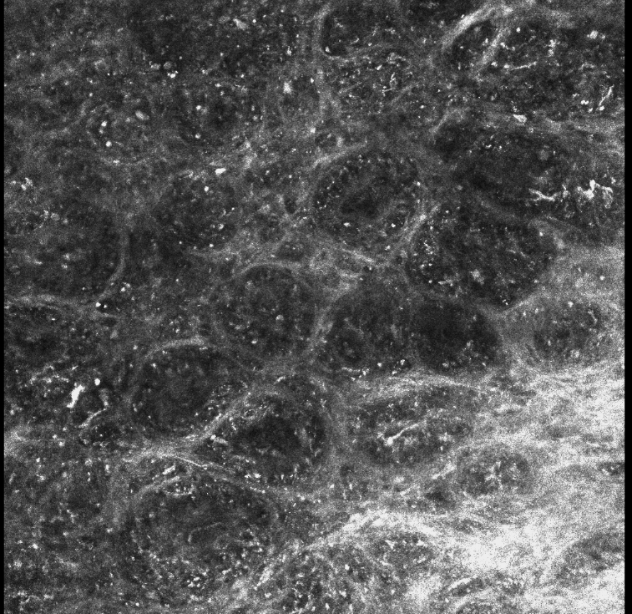
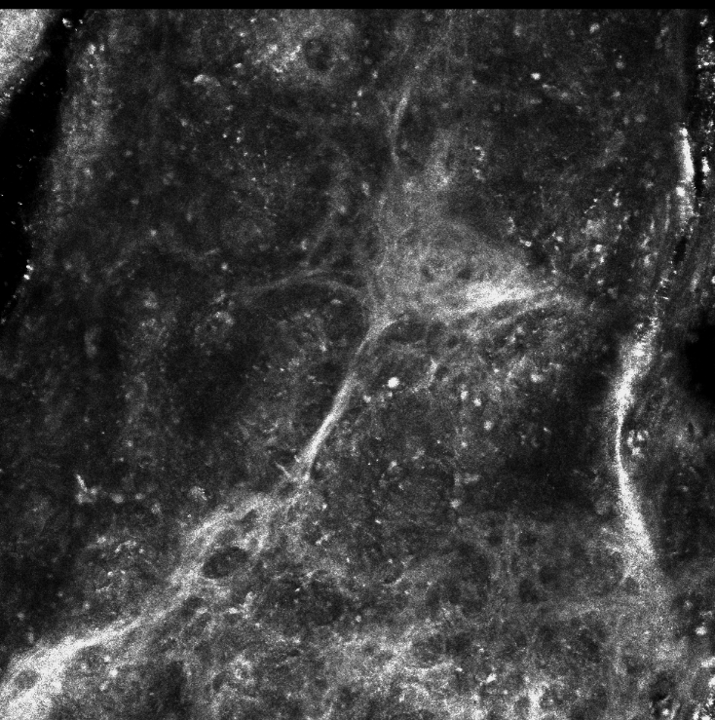

Slide 32
RCM Findings
RCM had a sensitivity of 96.7% (95% CI 83.3–99.9%) for EMPD diagnosis
Main RCM findings of EMPD-positive cases were ‘dark cells in the epidermis’ (90.3%) and glandular nests (67.7%)
Disruption of the DEJ was more common in invasive EMPD cases (83.3% vs 25.9%; p=0.01).

Slide 33
Surgical Cohort n = 21
5 (33.3%) had prior treatment before presentation
15 EMPD lesions (41.6% total; 71.4% of the surgically treated patients) were treated with SE in dermatology under local anesthesia.
6 (16.6%) EMPD lesions were treated in the operating room under general anesthesia by urology (n=2) or gynecology (n=4).
1 Male patient (50%) had positive margins and 2 female patients (50%) treated with vulvectomy had positive margins.
When comparing SE with WLE (or vulvectomy), 0% patients had positive margins after SE vs 50% in the WLE group (p=0.015)

Slide 34
SURGERY GUIDED BY RCM
15 Staged Excision Cases
Mean presurgical size was 4.8 cm (SD 3.3; range 0.5 – 10 cm)
Mean number of surgical stages needed to clear margins was 1.9 (SD 0.9; 1.0 – 3.0 stages)
Mean margin size needed to obtain negative margins was 1.8 cm (SD 1.1; range 1.0 – 5.0)
Fourteen out of 15 (93.3%) cases were cleared with margins of 3.0 cm or less.
Mean final defect size was 11.1 cm (SD 4.7; range 1.5 – 17.0 cm).
After a mean follow up time of 18.3 months (SD 13.5 range 3 – 47 months) no recurrences

Slide 35
Case no. | Age | Gender | Site of EMPD | Size (cm) | Prior tx | No Stages | margins (cm) | Follow-up (m)
1* | 72 | Male | I / S (right) | 10 x 9 | WLE | 2 | 1.5 | 38
 |  |  | I / S (left) | 1.5 x 1 |  | 2 | 2.0 | 20
2 | 75 | Male | Perineum | 3 x 3 |  | 1 | 1.0 | 39
3** | 72 | Male | Perineum | 1 x 1 | WLE | 1 | 1.0 | 47
4 | 82 | Male | Inguinoscrotal | 6.9 x 3 |  | 1 | 1.0 | 25
5 | 78 | Male | Inguinoscrotal | 1.5 x 1 | Imiquimod | 3 | 3.0 | 21
6 | 70 | Male | Inguinoscrotal | 6 x 4 |  | 2 | 1.5 | 16
7 | 78 | Female | Axilla | 6 x 6 |  | 1 | 1.5 | 15
8 | 76 | Male | Pubis | 9.5 x 7 | Imiquimod | 3 | 2.0 | 12
9 | 65 | Male | Pubis | 10 x 9 |  | 1 | 1.0 | 10
10 | 81 | Male | Scrotum | 6 x 5 |  | 1 | 1.0 | 9
11 | 68 | Male | Inguinoscrotal | 1.5 x 1 |  | 3 | 1.5 | 8
12 | 62 | Male | Scrotum | 6 x 4 |  | 2 | 1.0 | 8
13 | 80 | Male | Scrotum | 4.6 x 2.5 |  | 3 | 3.0 | 4
14 | 76 | Male | Inguinoscrotal | 5.5 x 3 |  | 3 | 5.0 | 4

Slide 36
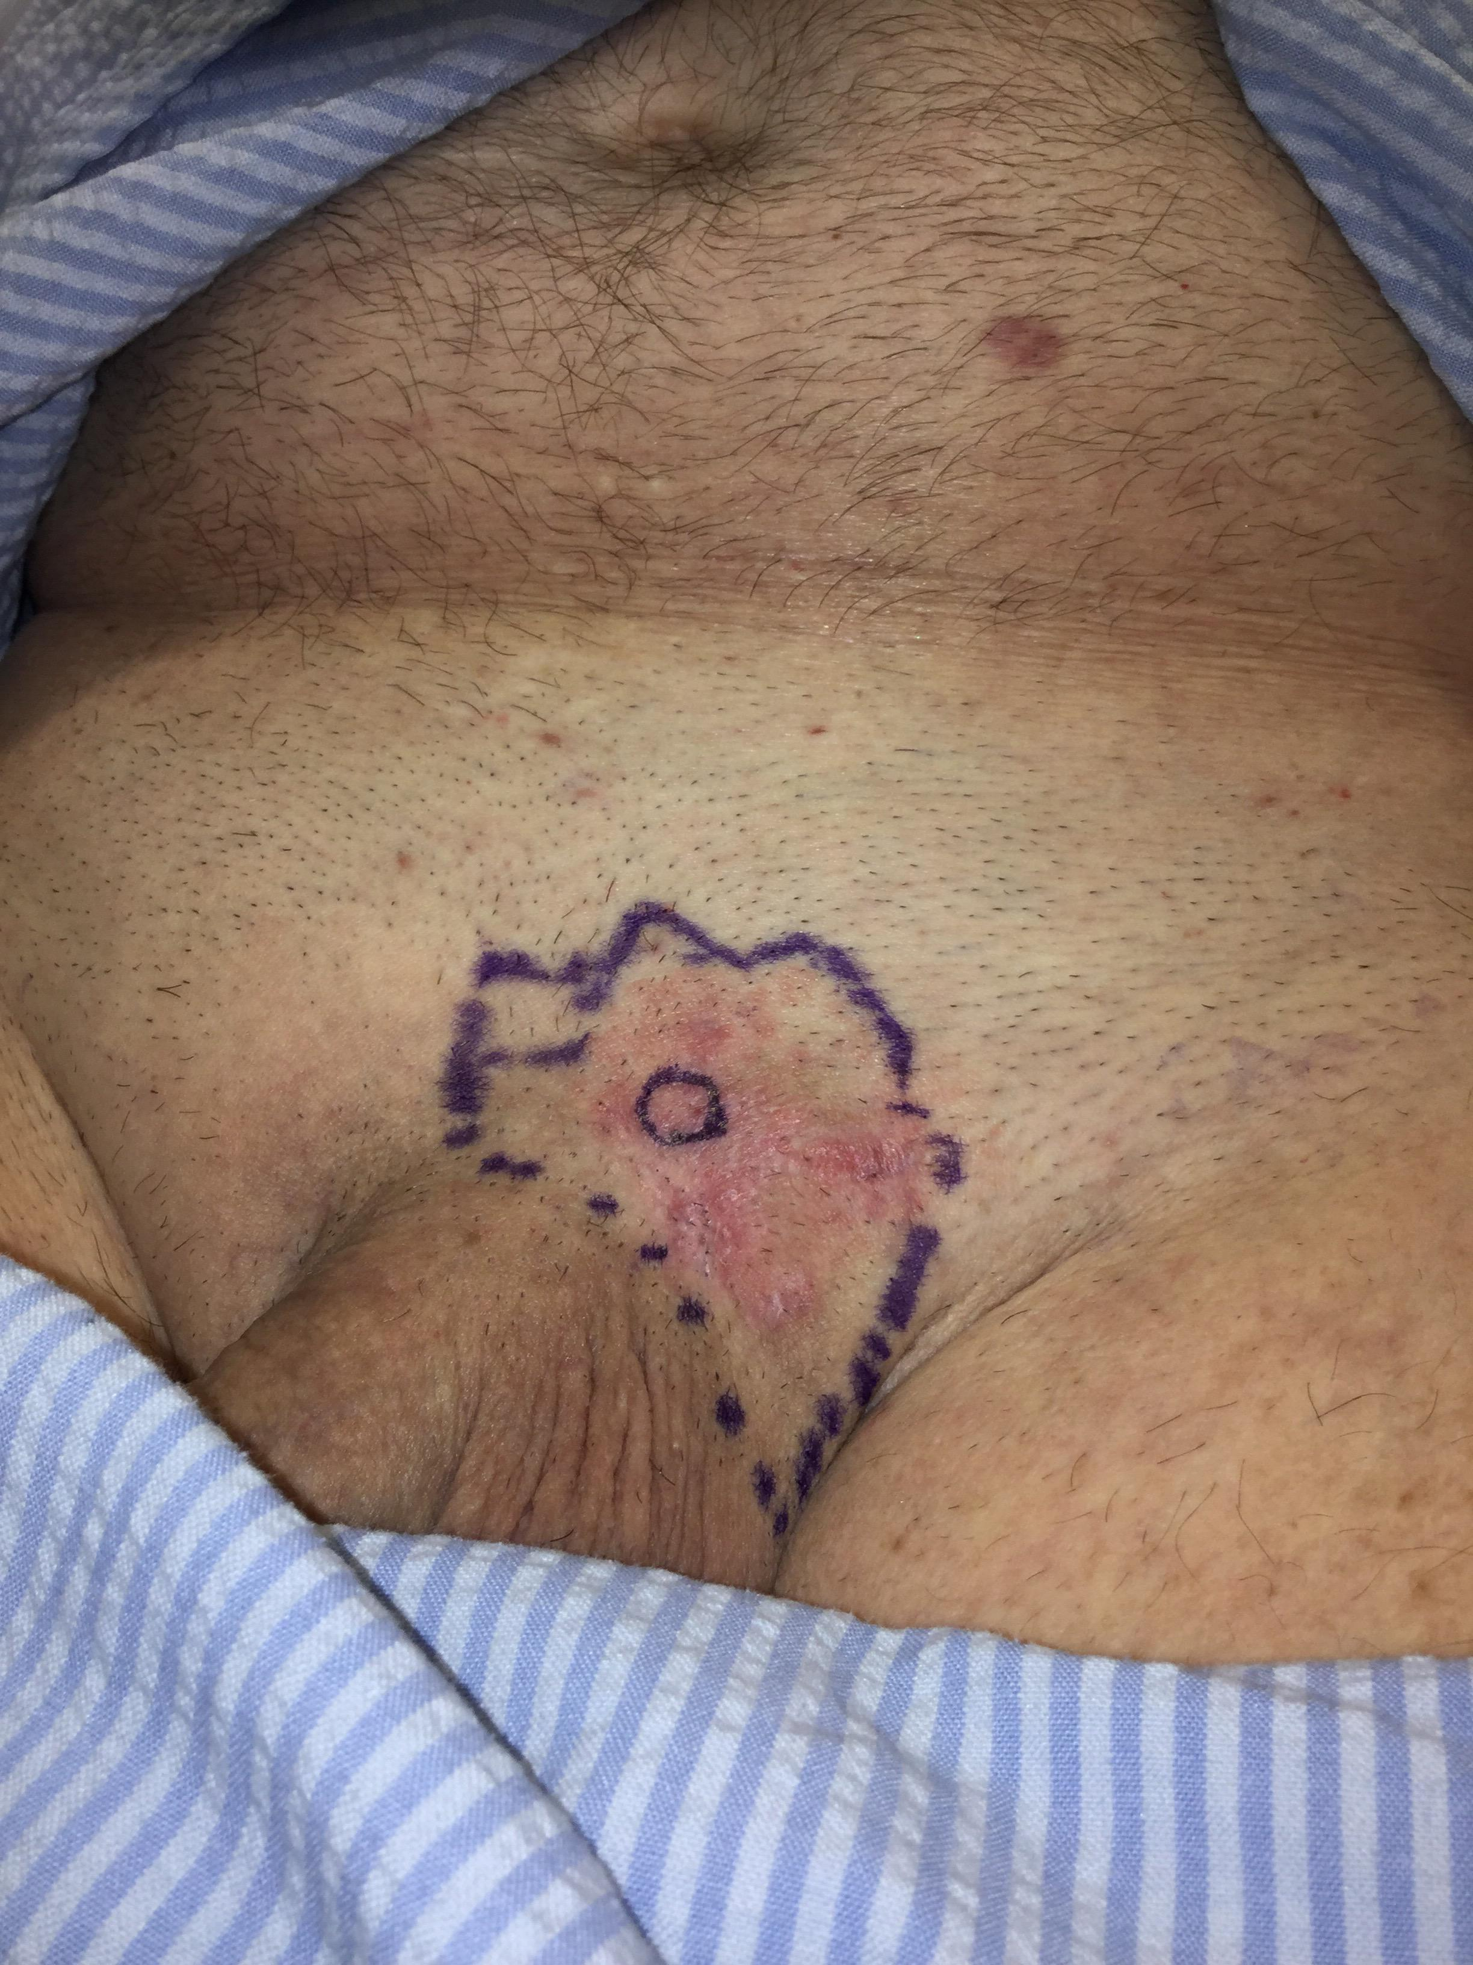
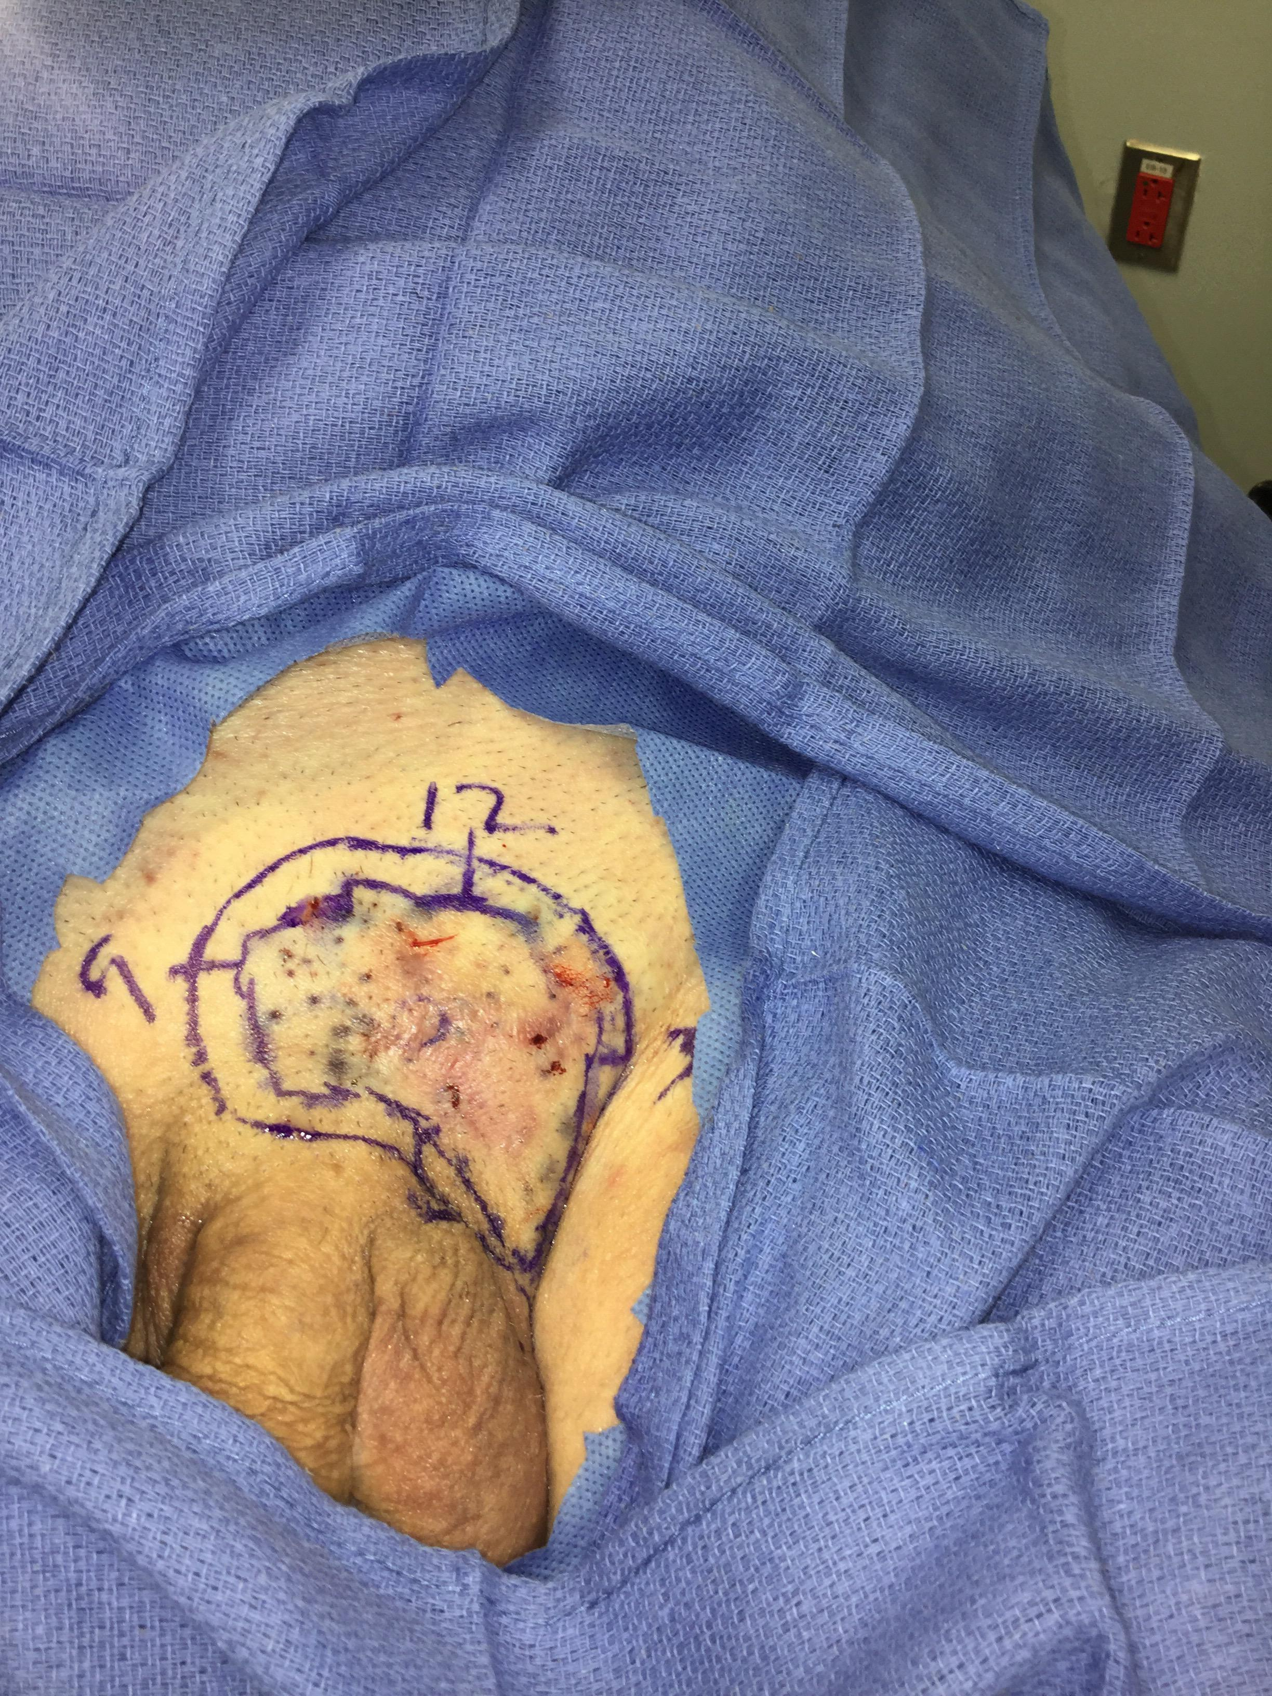

Slide 37
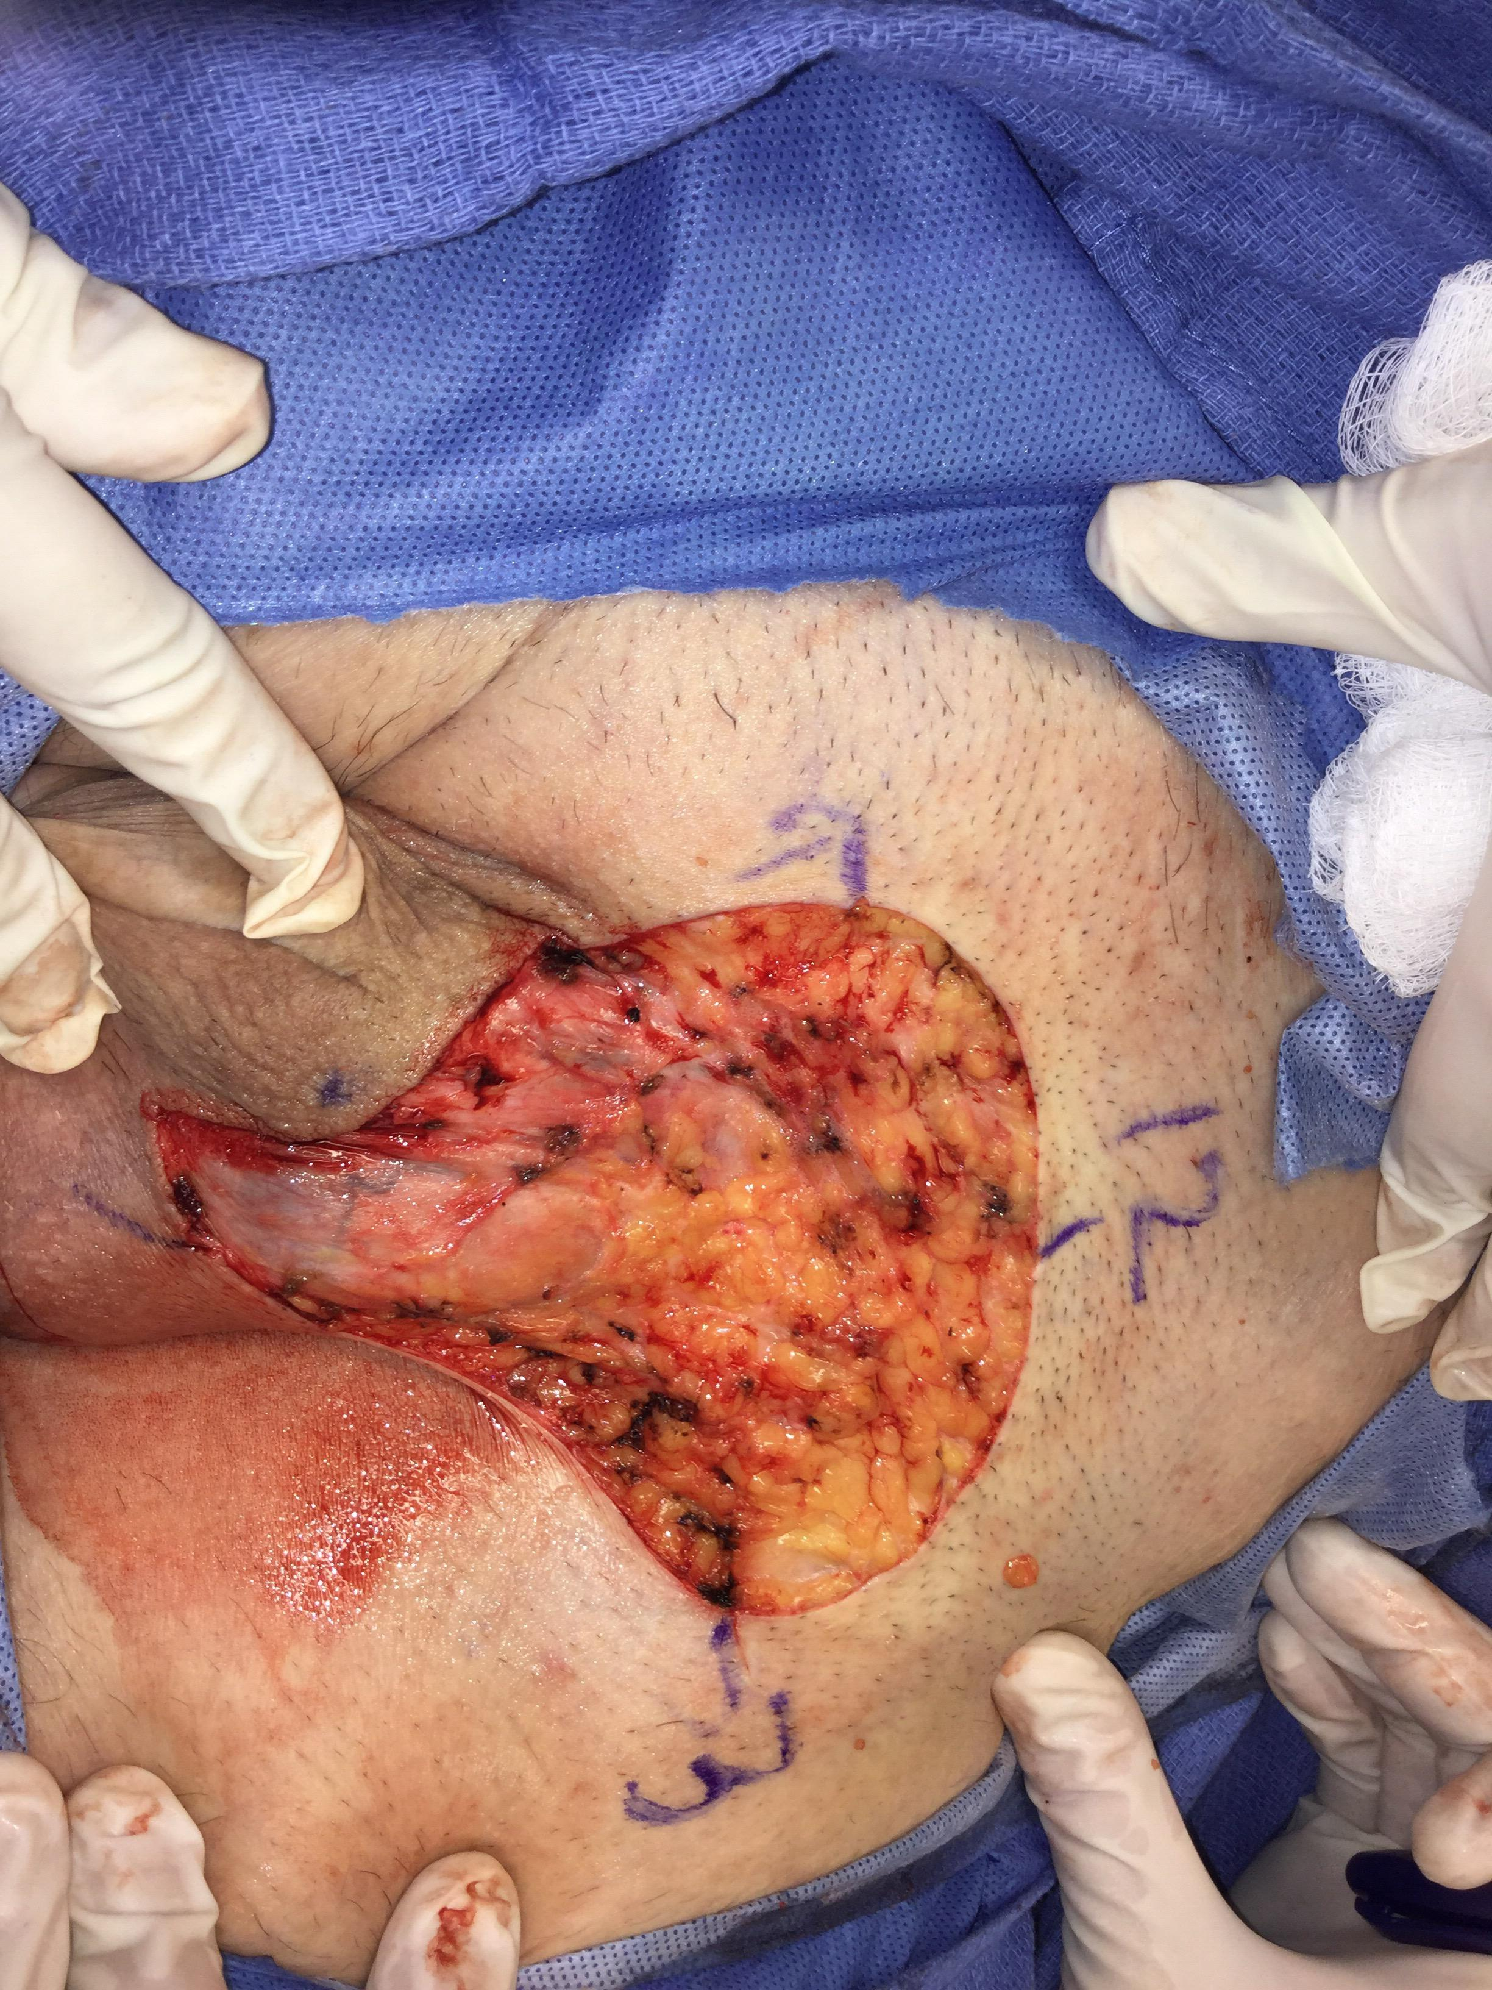
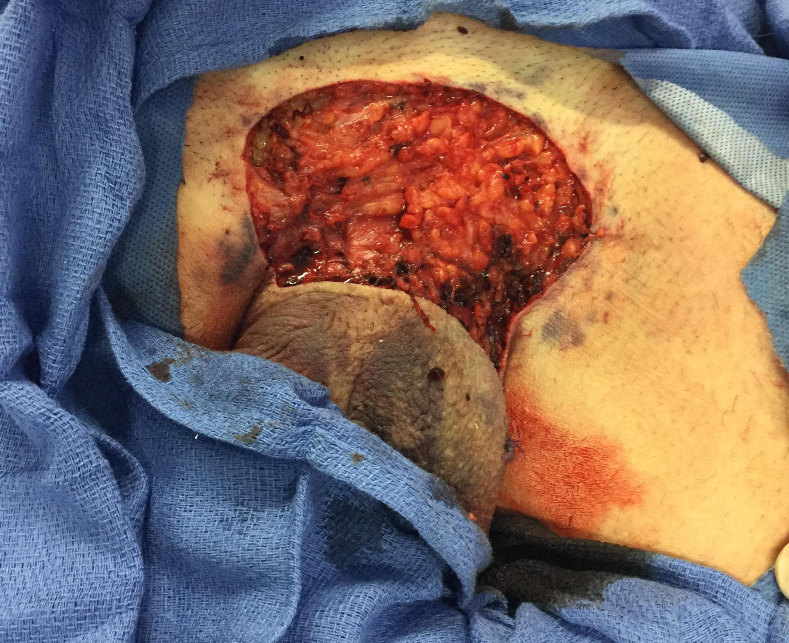

Slide 38
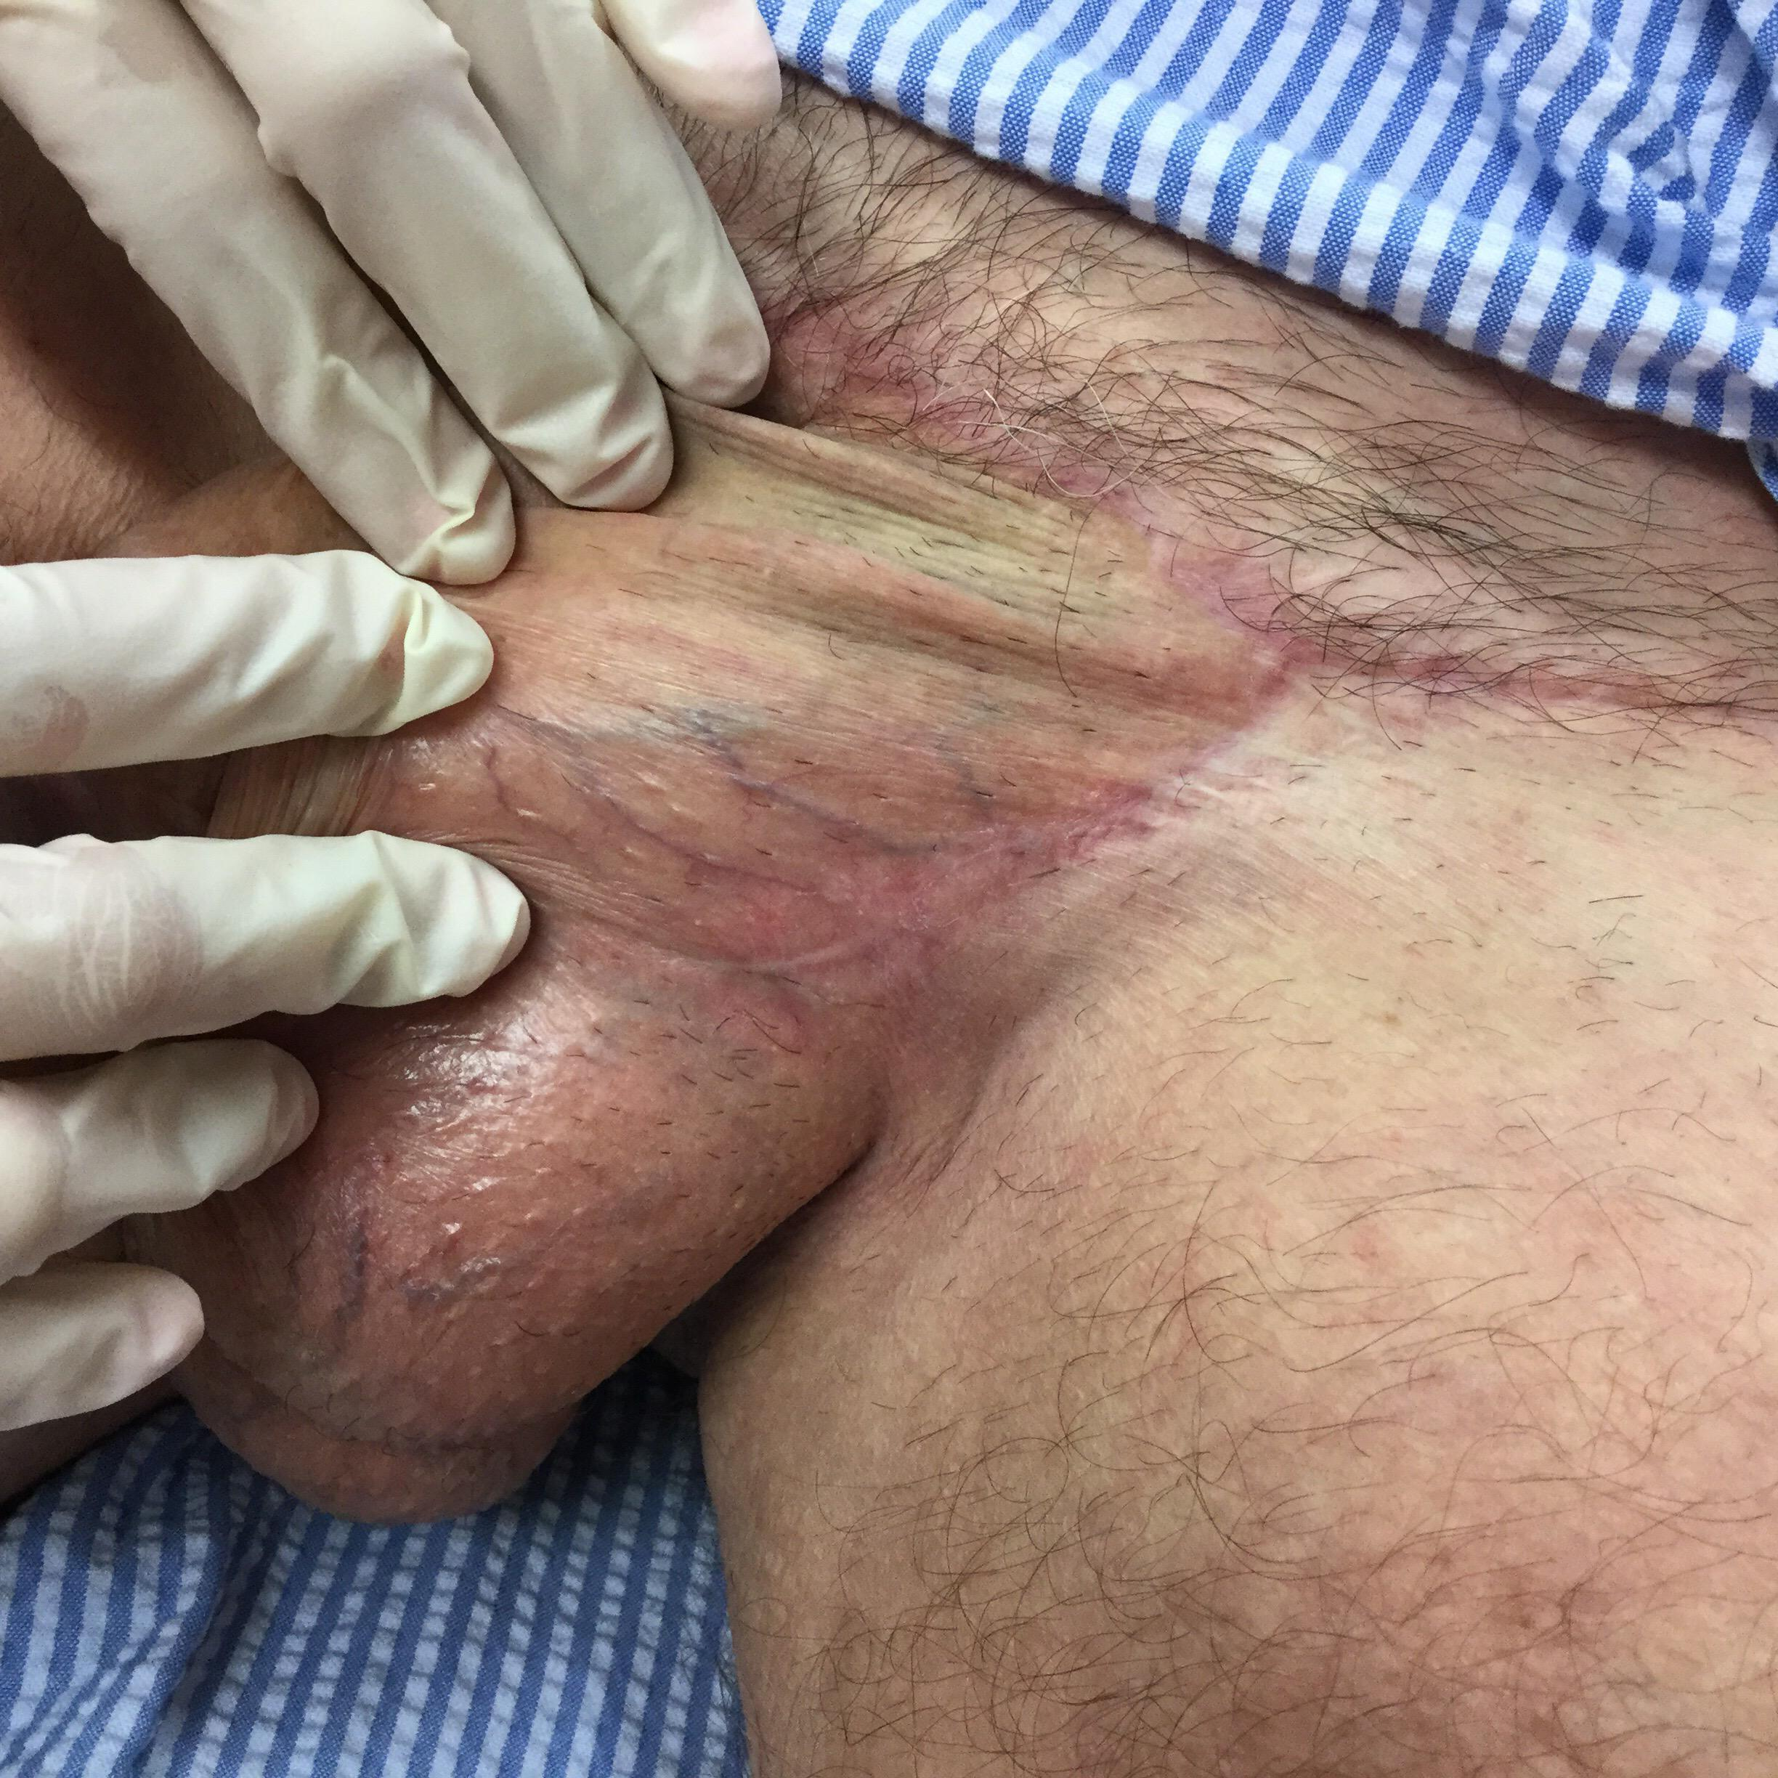

Slide 39
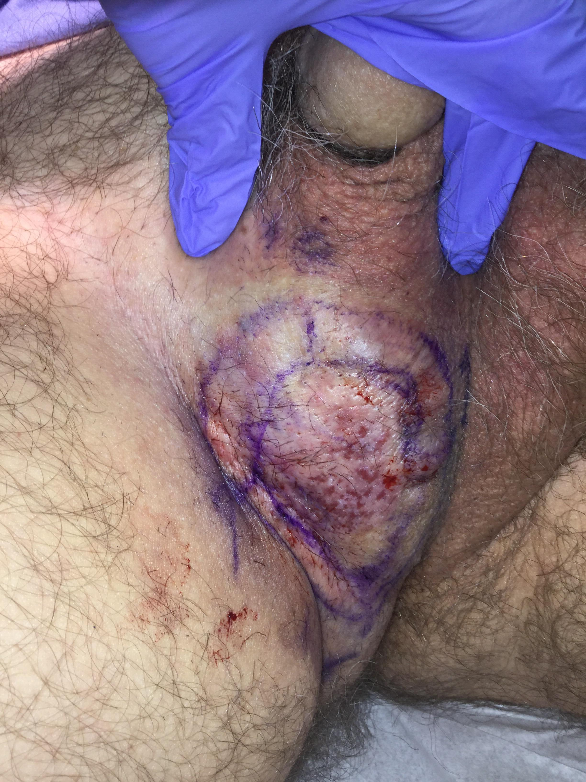
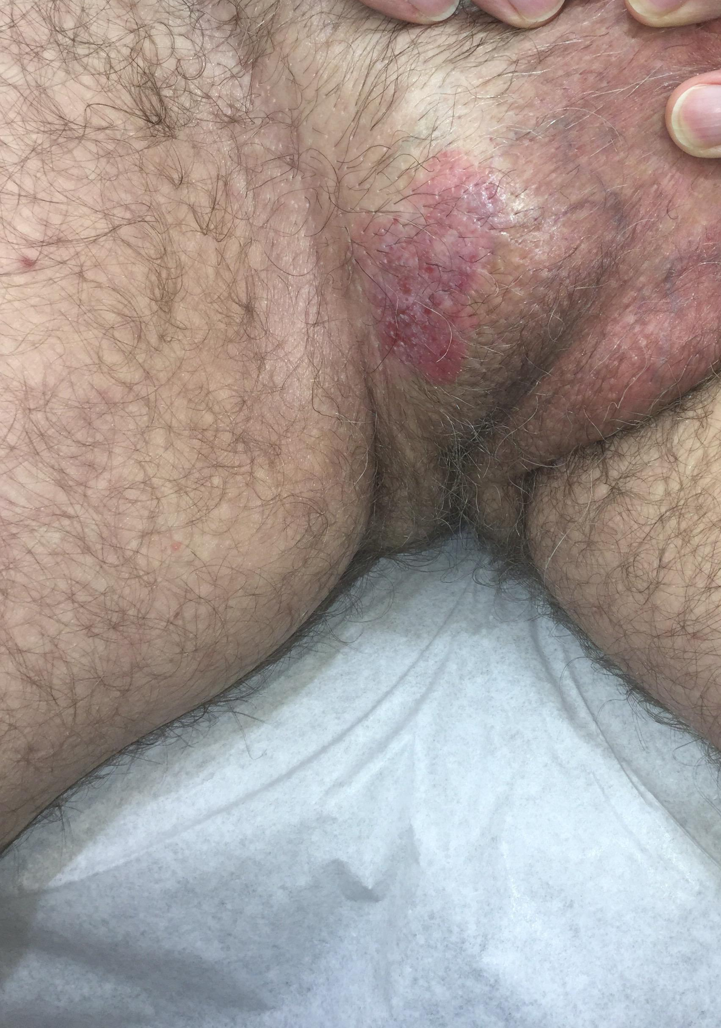

Slide 40
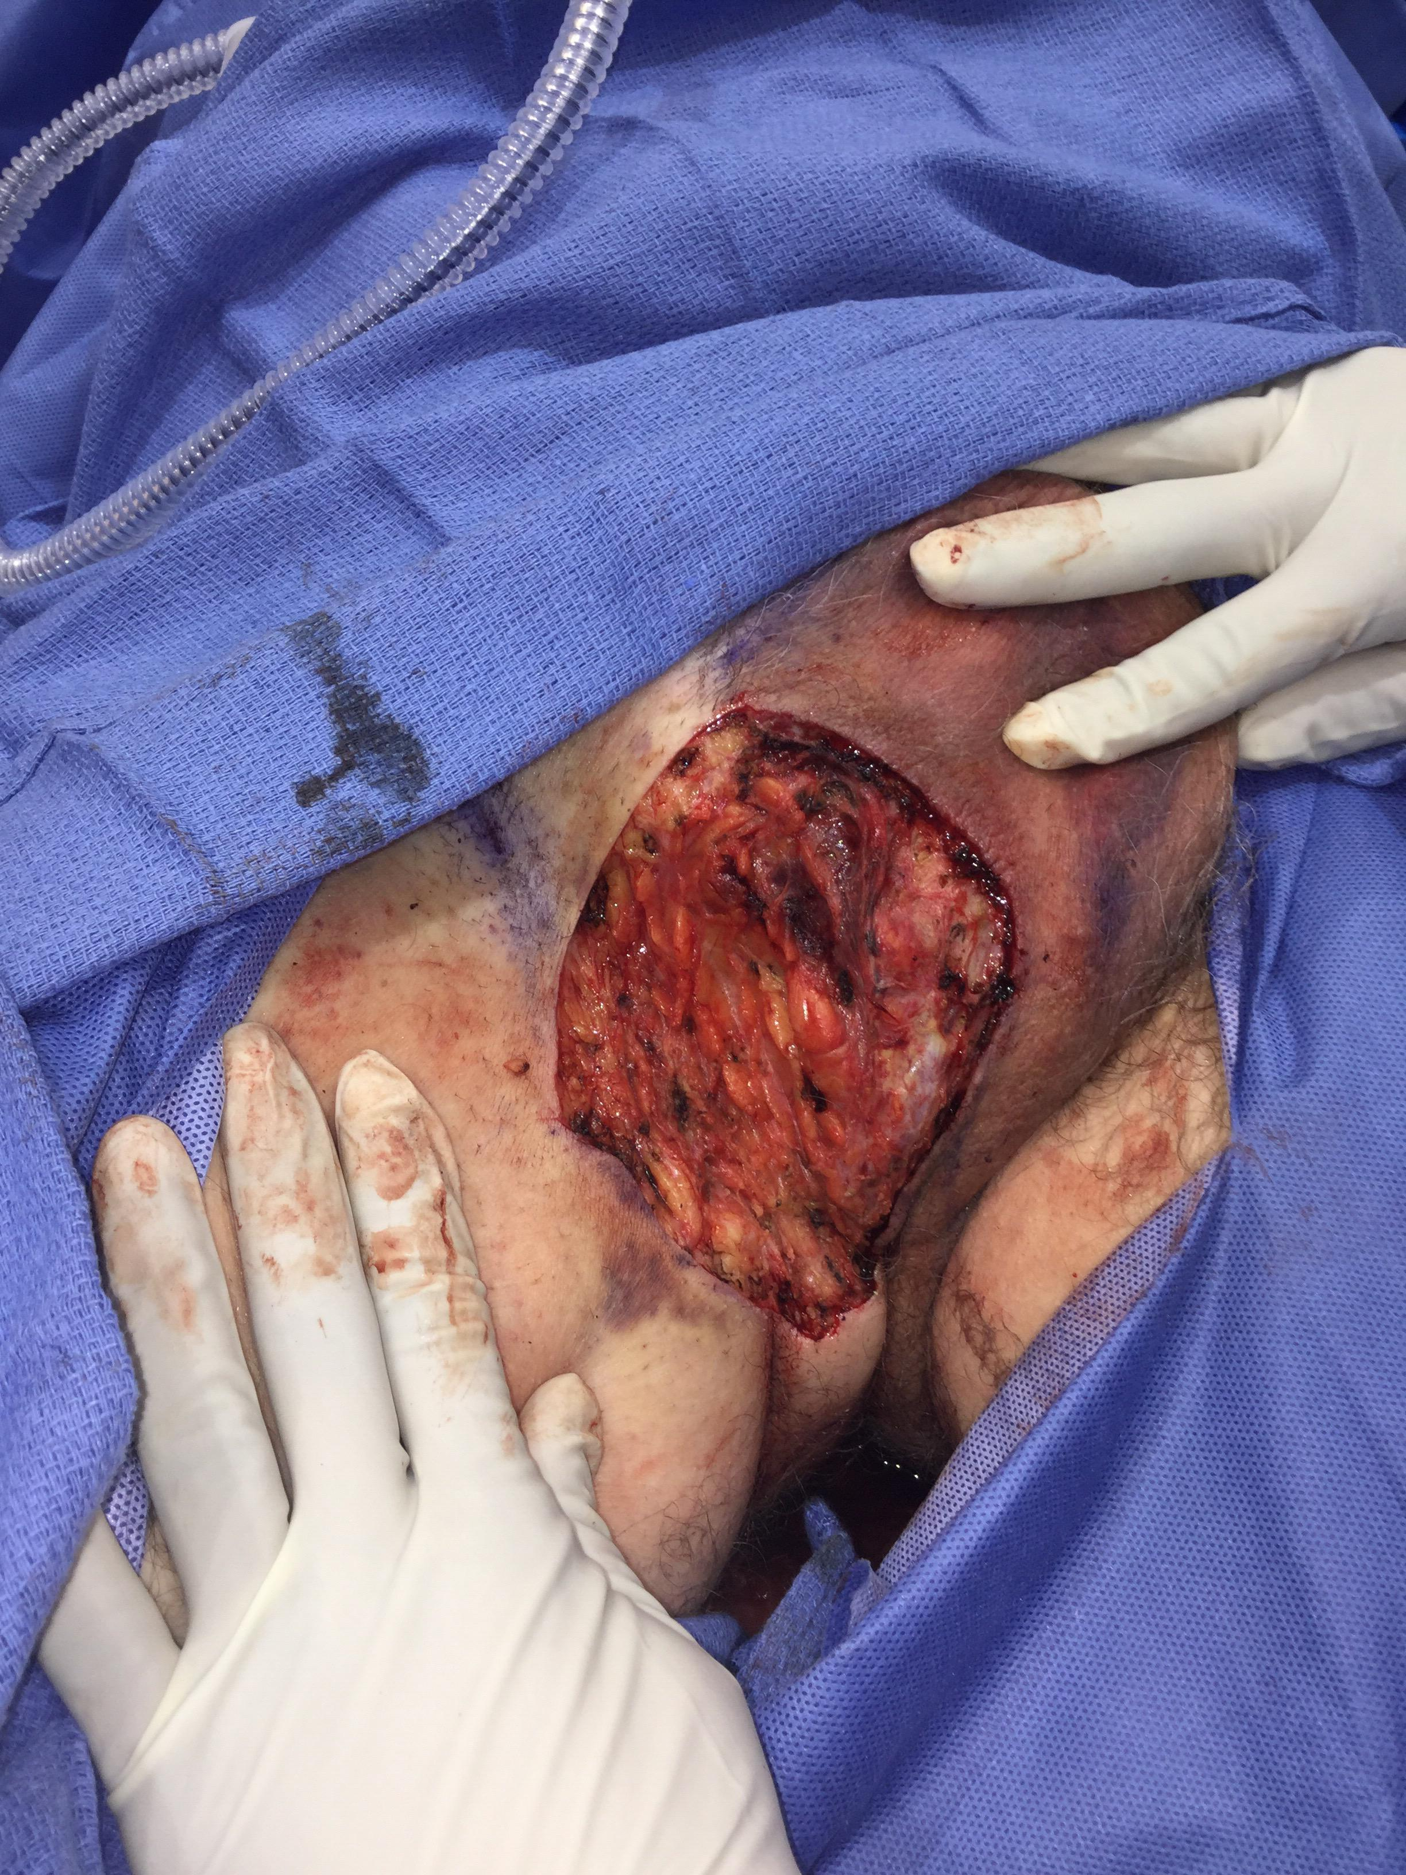
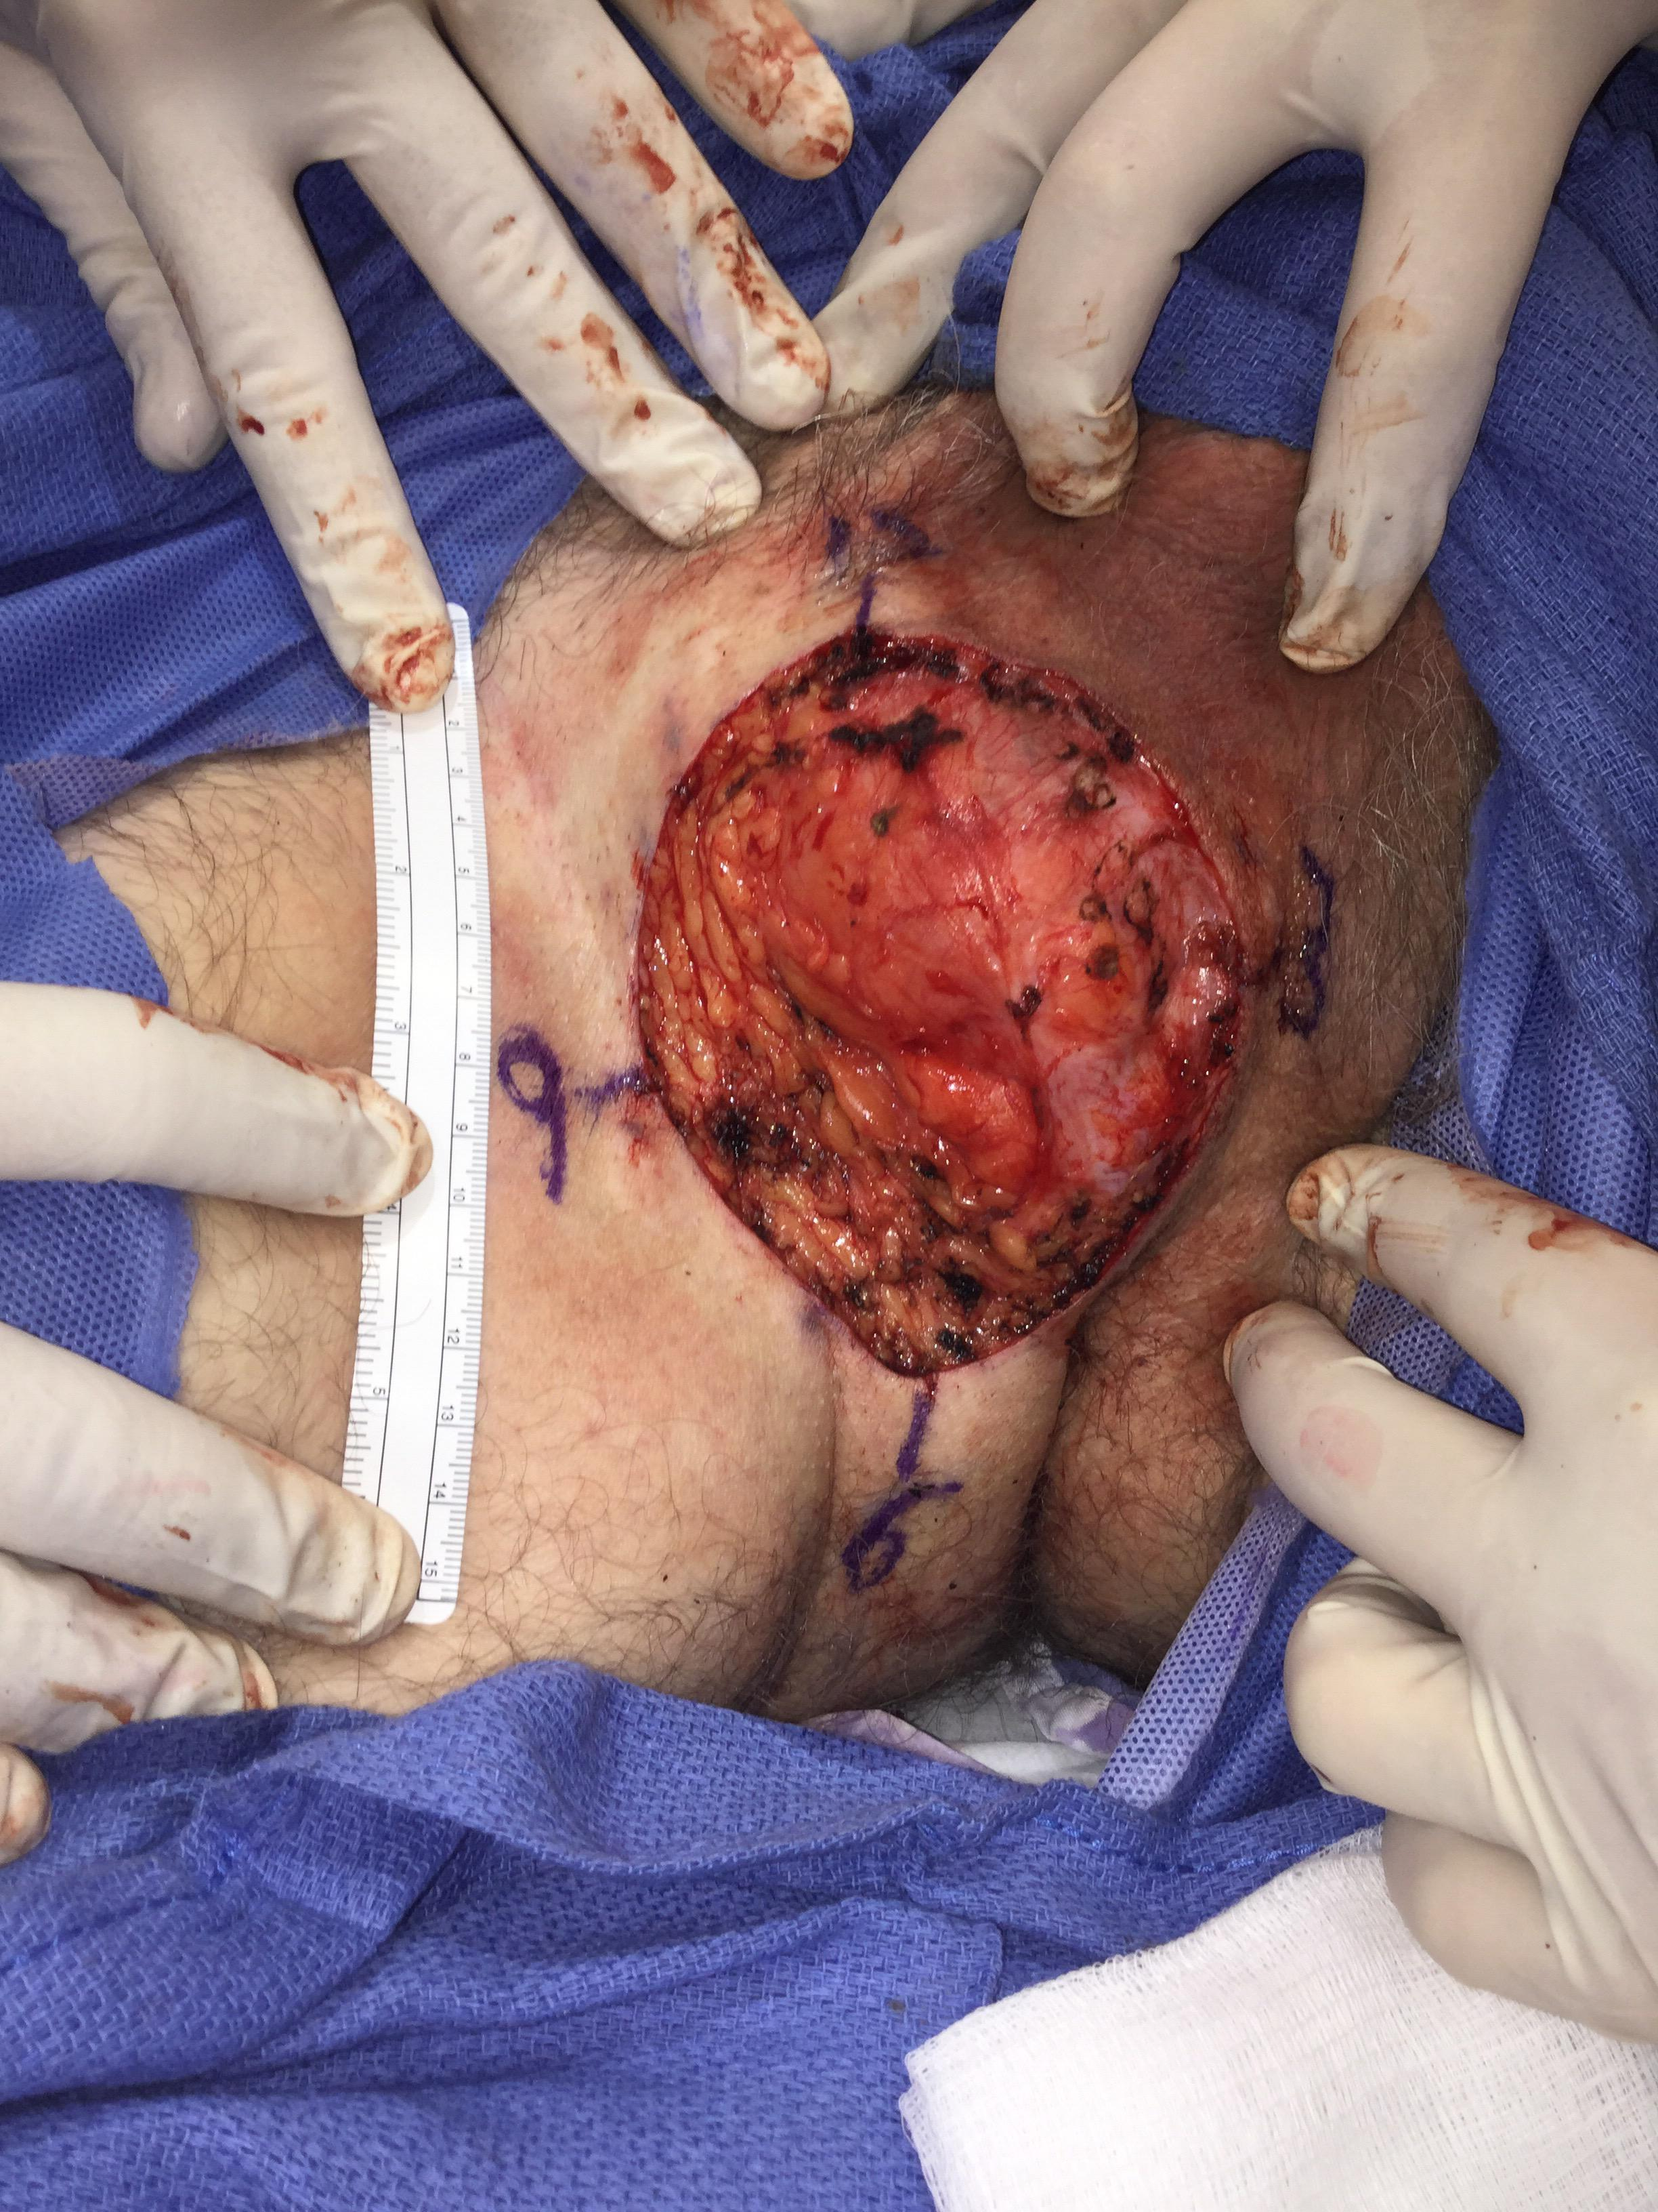

Slide 41
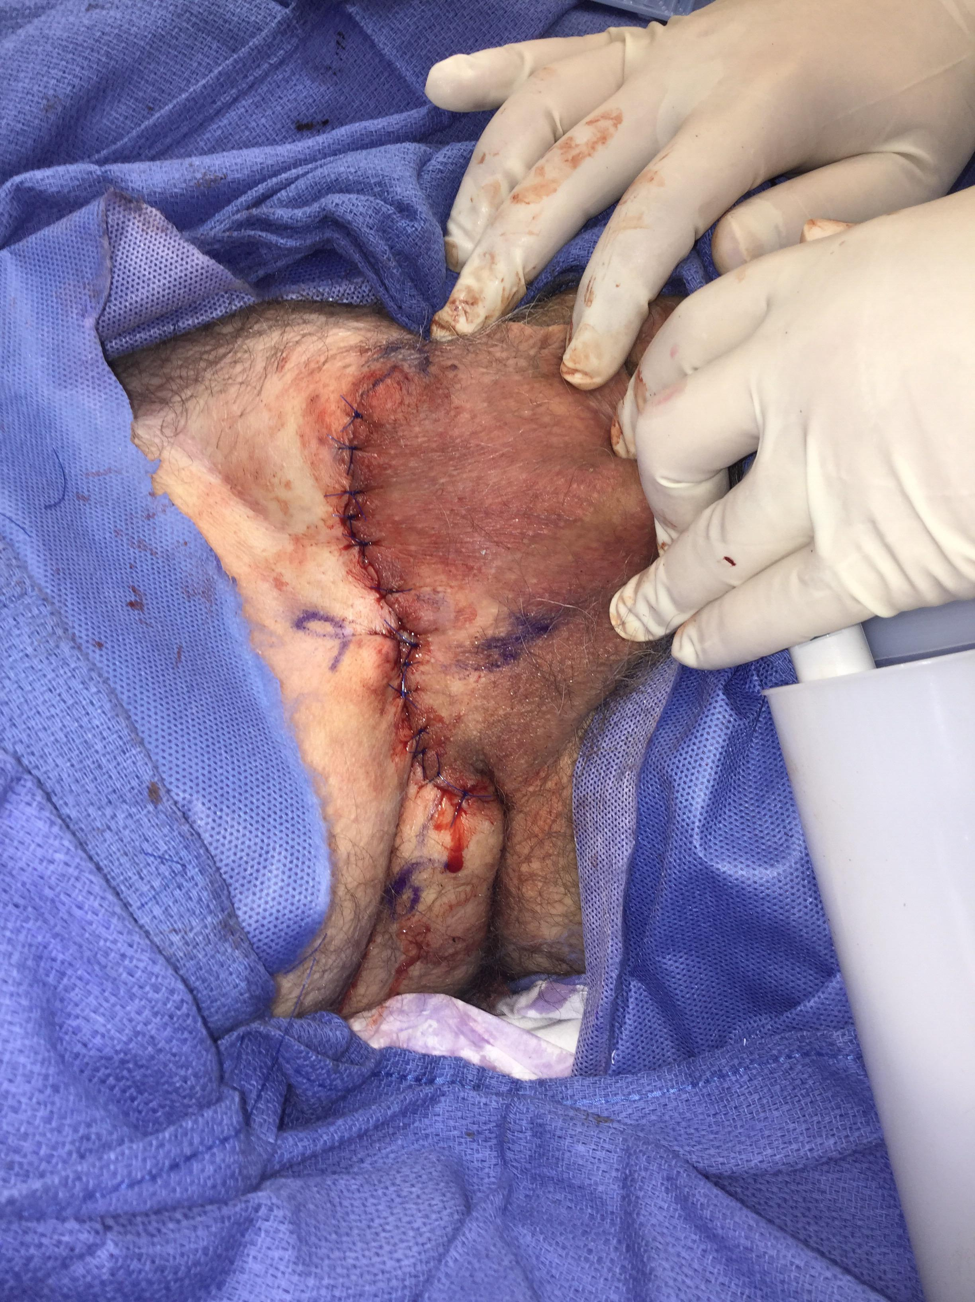
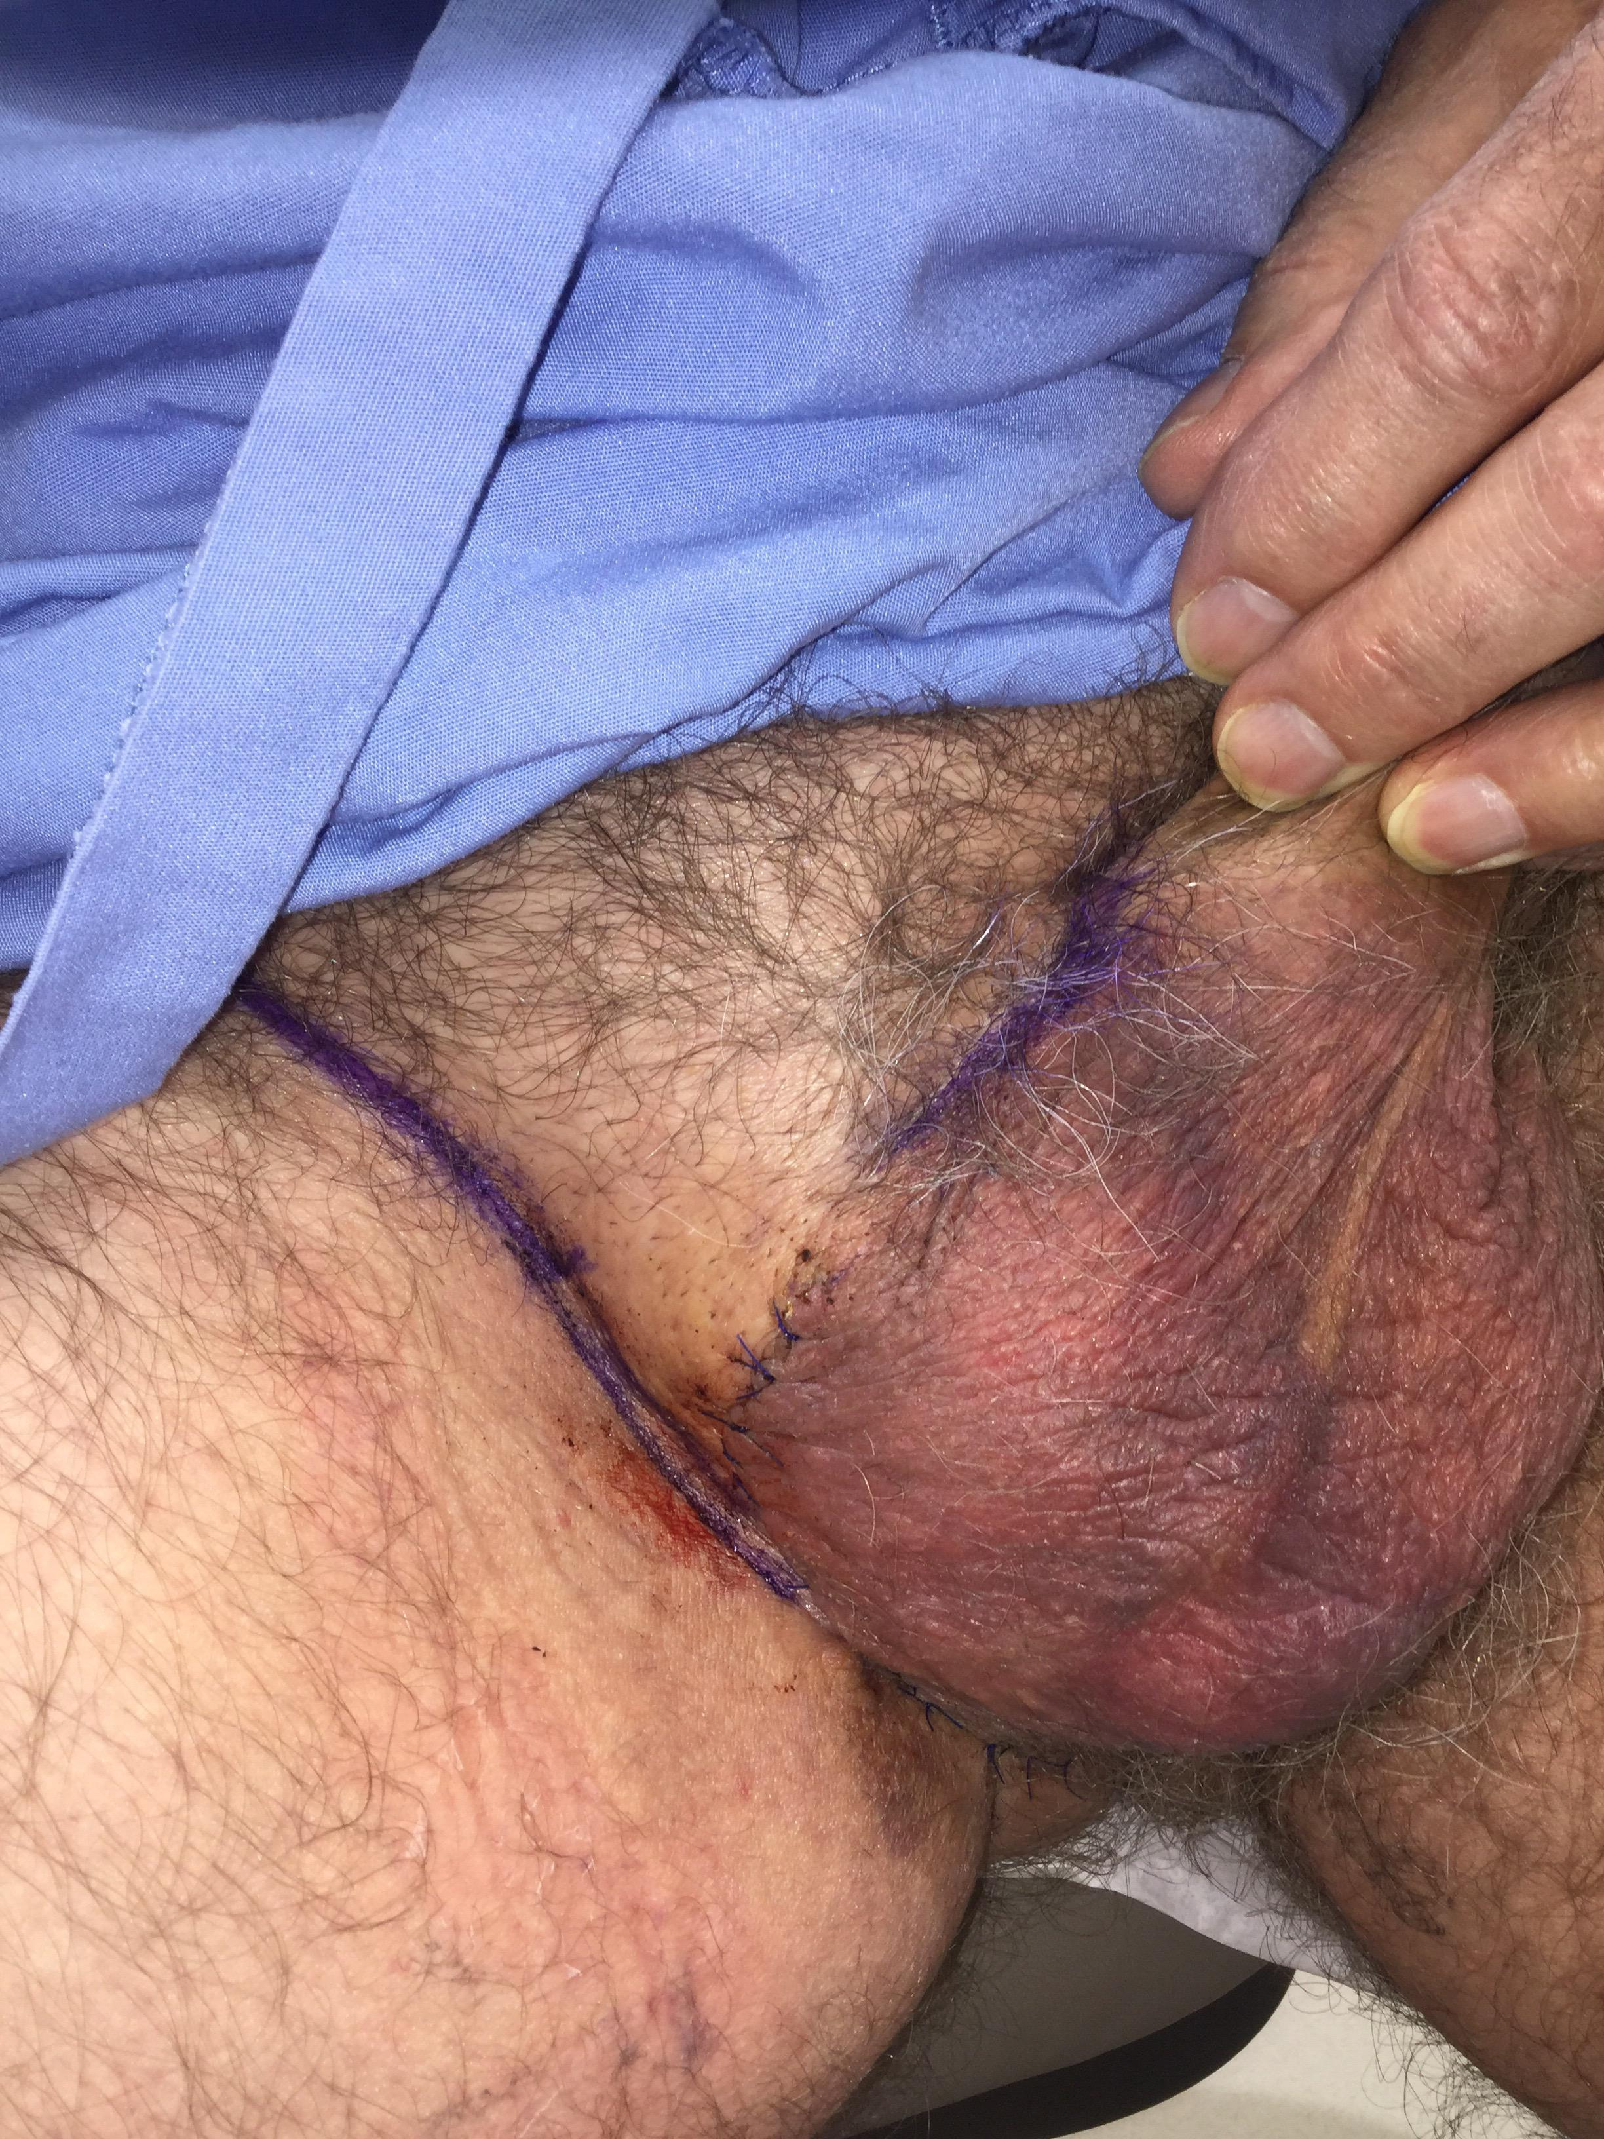

Slide 42
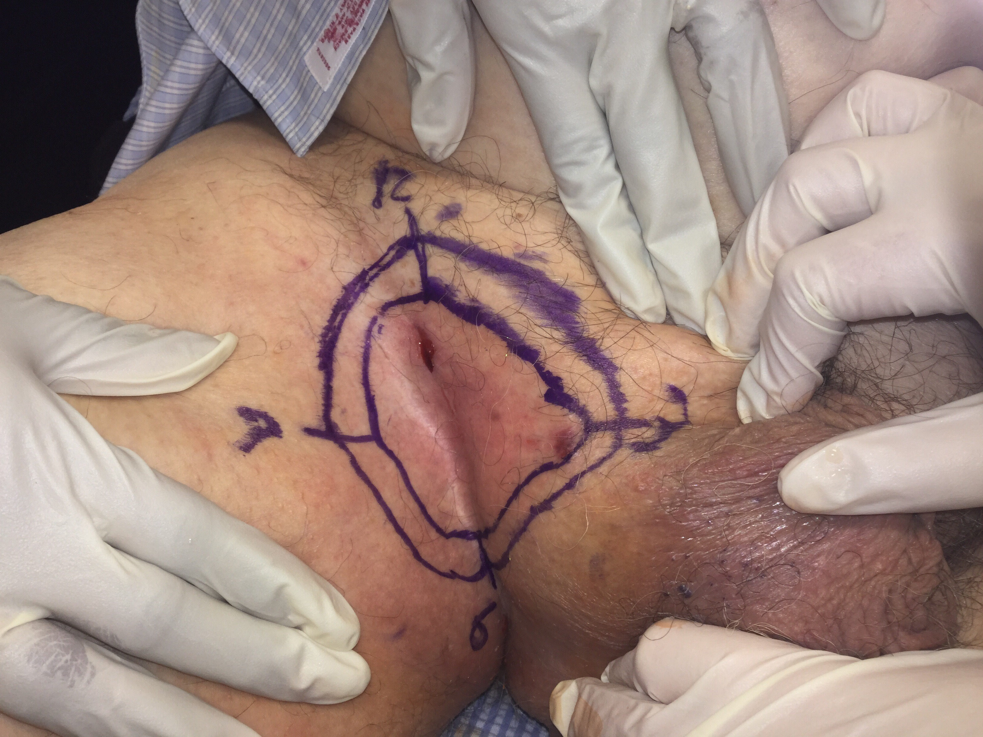
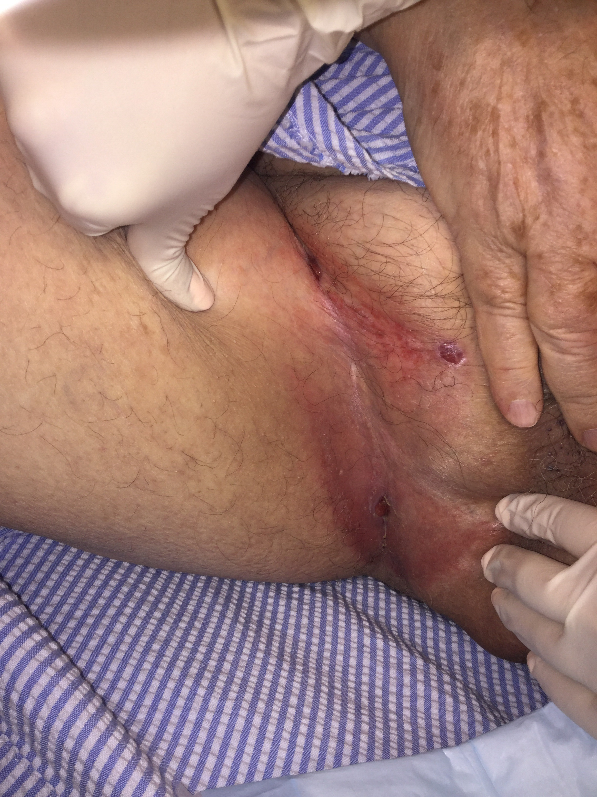

Slide 43
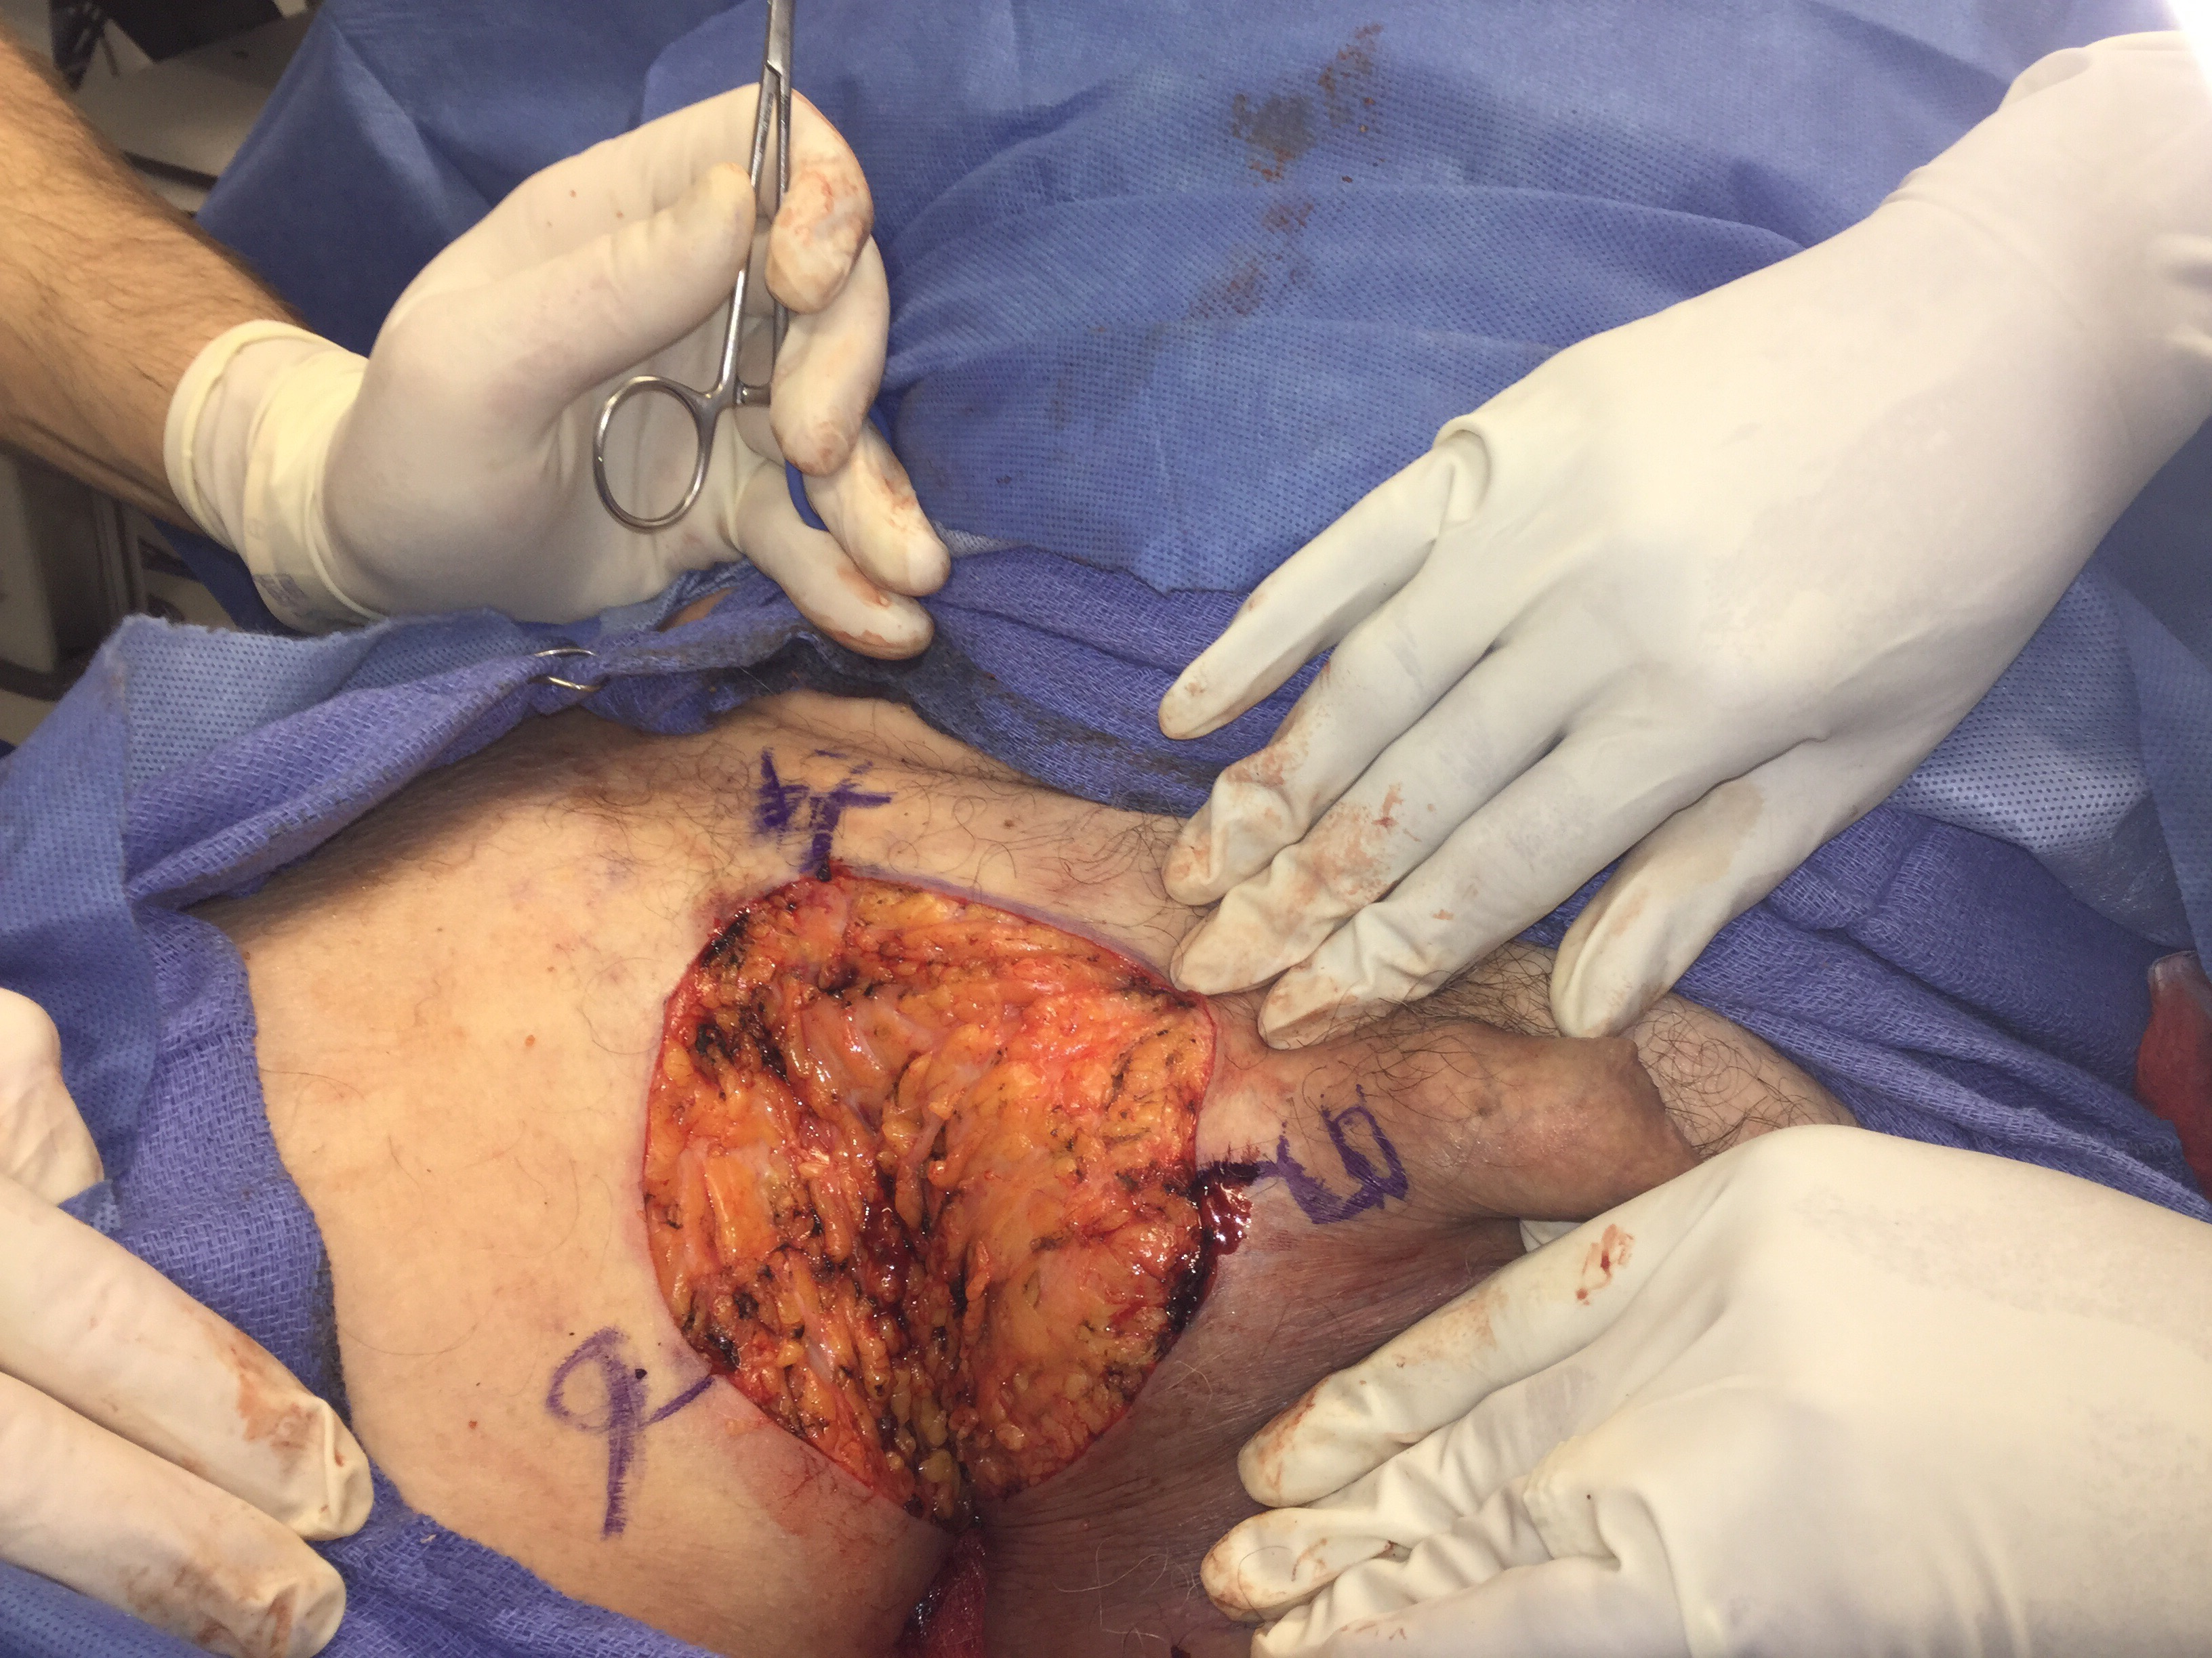
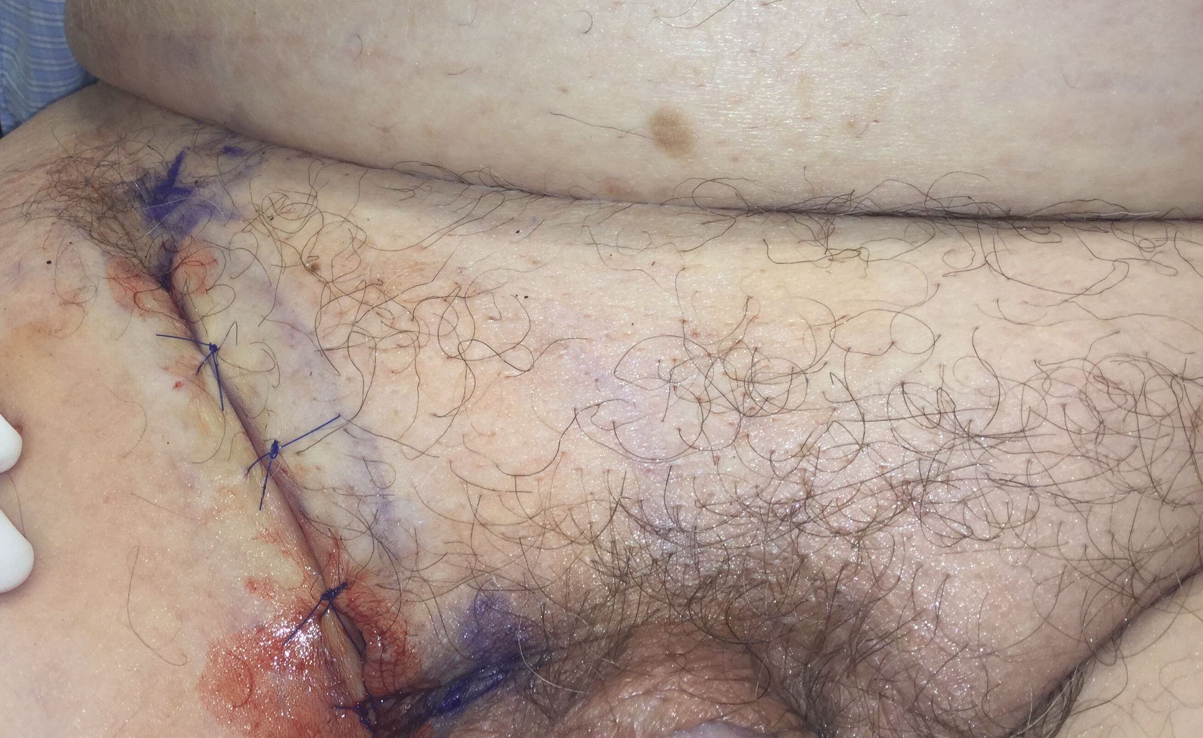

Slide 44
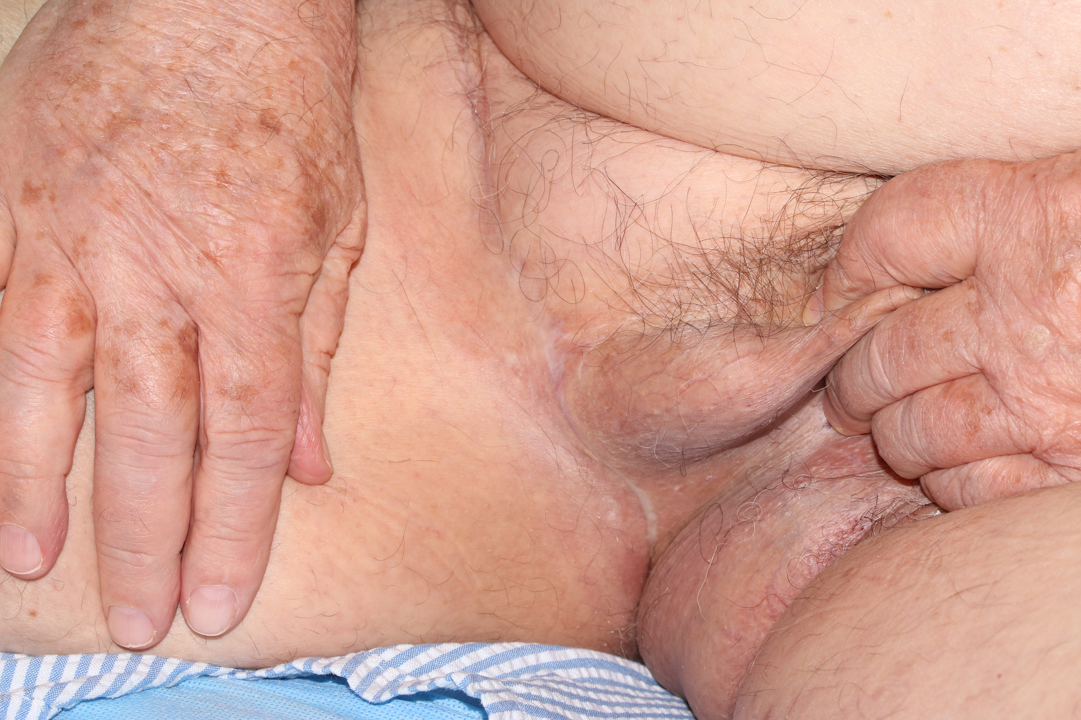

Slide 45
Perianal and Non Surgical Cases
Role of Imiquimod
Radiation Therapy
Photodynamic Therapy
Systemic Therapy / Targeted Therapy

Slide 46
12 treated with non-surgical modalities
6 (50%) had prior treatment before presentation to our group.
RT (n=5; 41.6%)
Imiquimod (n=5; 41.6%)
ALA-PDT (n=1; 8.3%)
Of these, 25% recurred (1 imiquimod, 2 RTs)
Mean follow-up for non-surgical cohort was 25.3 months (SD 18.8; range 9 - 70 months).
3 patients rejected treatment following our initial evaluation (1 treated with imiquimod and recurred 17 years later, a female with positive margins after a vulvectomy, and a 96-year-old declined tx

Slide 47
Genetic Analysis and Building a Patient Deriver Xenograft Model
IMPACT Testing – 28 samples sent - 25 patients analayzed for mutational analysis
Sending tissue for PDX model – collected 17 samples from 16 patients
  Only one tumor has grown to date
  Next step is to look at receptor status of tumor and implant a hormone pellet if the tumor is hormone receptor postivie
Sending tissue to Liang for evaluation

Slide 48
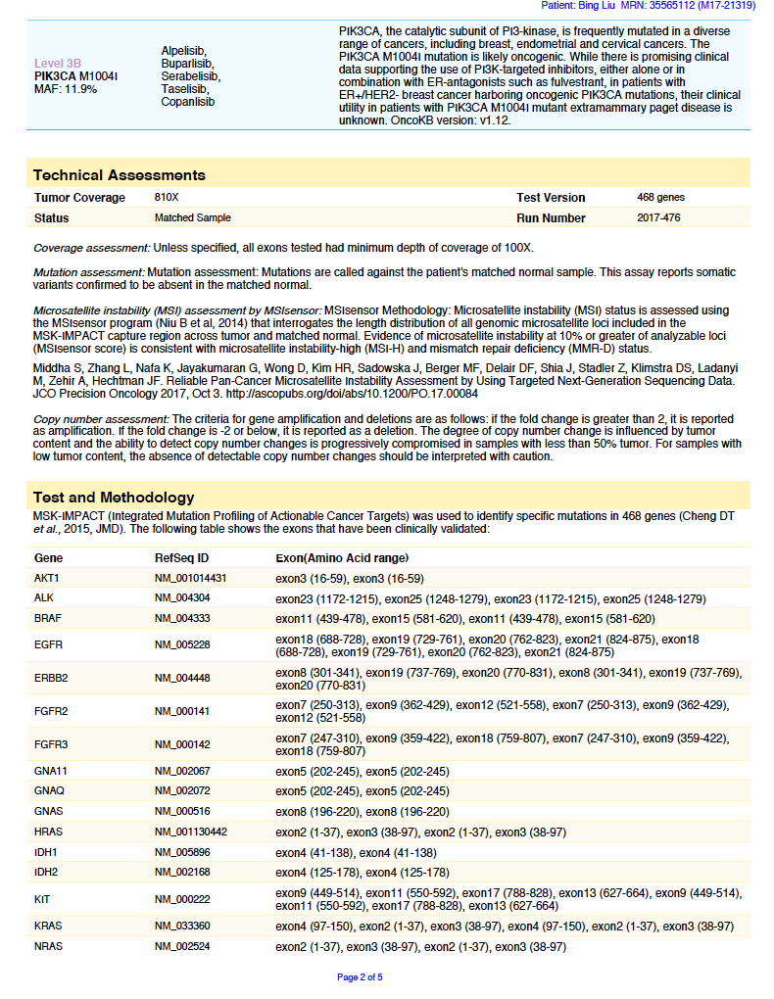
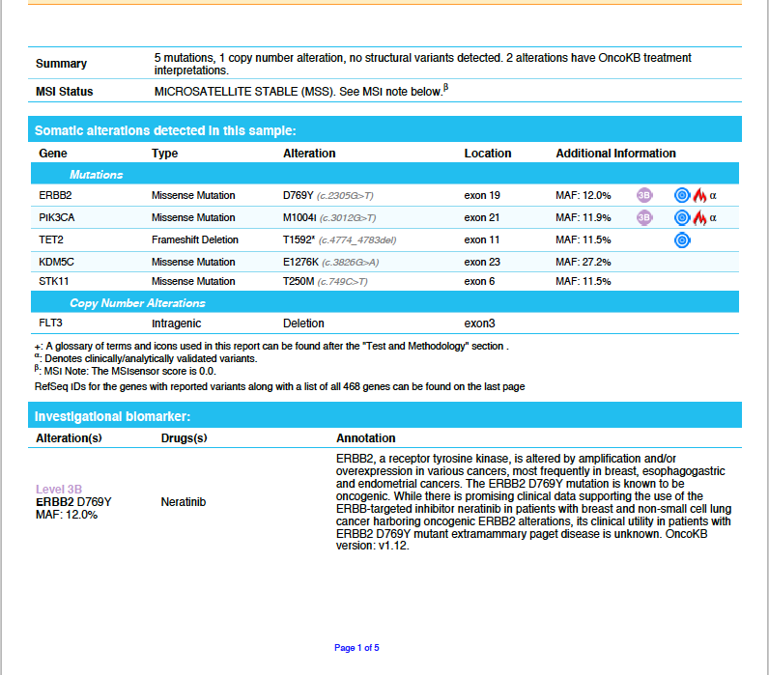

Slide 49
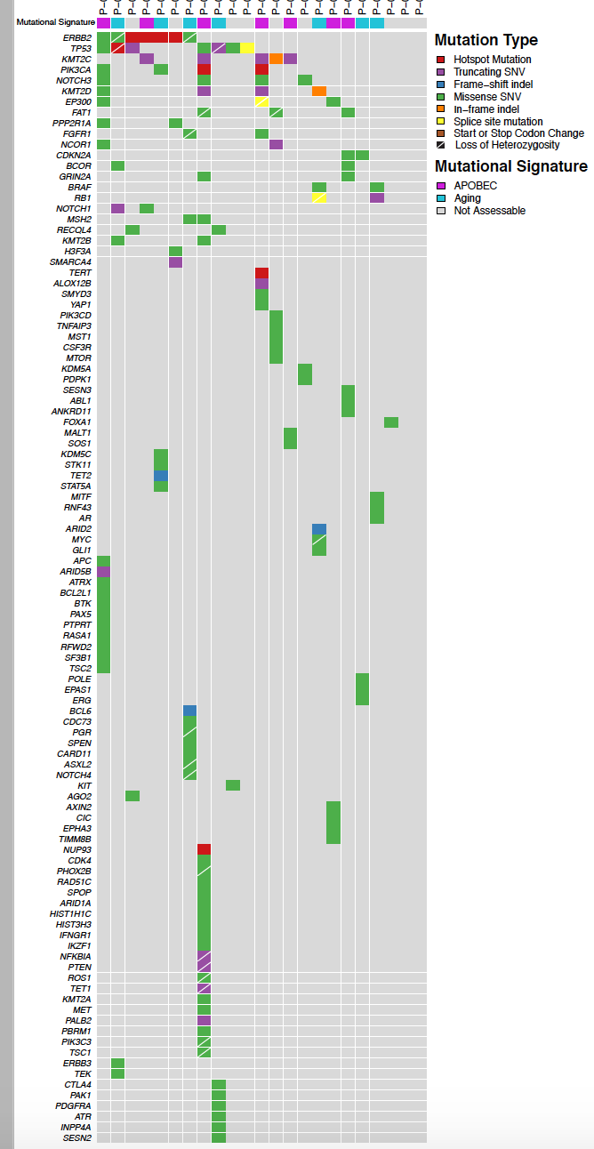
Genetic Heat Map
25 samples being
analayzed

Slide 50
  Common genes
  ERBB2 – receptor tyrosine kinase:
    scrotum, scrotum, axilla, perianal; vulva
  PIK3CA: Perineum; Inguinoscrotal; vulva; perianal; scrotum
    tumors with HER2 amplification or PI3K mutation are selectively dependent for growth on the PI3K pathway
  TP53
  KMT2
  Metastatic EMPD Case
  BRAF with Myc Driver mutation identified on PDX model

Slide 51
Next steps – associate Molecular profile with site and outcomes
In terms of the molecular profile
In a perianal case - mutations are seen similar to other colitis-associated cancers
  both develop in an inflammatory background
Specifically, the TP53 mutation, MYC amplification, HER2 mutation, and absence of Wnt alteration (i.e., APC) are all common in colitis-associated cancers
HER2 has been associated with EMPD:
for colorectal cancers, HER2 mutation is not commonly a driver and would be unlikely to have a good response to targeted therapy
  (There were no responses to neratinib in colorectal cancer in the HER2/HER3 mutant basket trial led here by David Hyman (PMID 29420467).)

Slide 52
The mice are still alive

Slide 53
BRAF F468S is insensitive to current RAF inhibitors

Slide 54
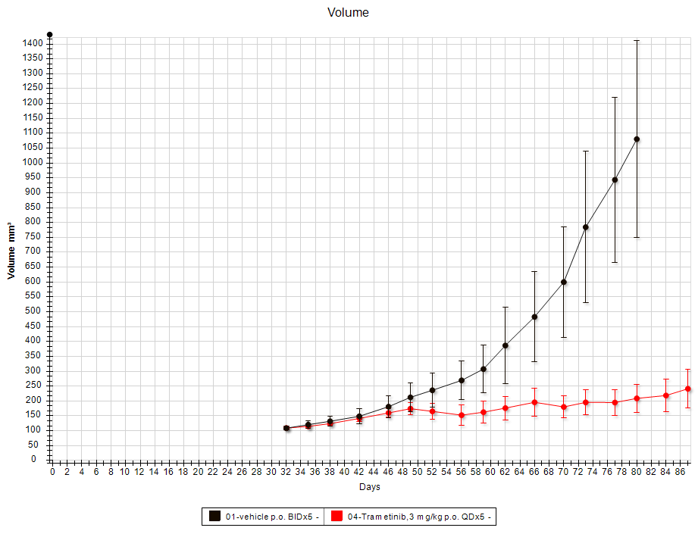
The EMPD PDX with BRAF F468S mutation is sensitive to MEK inhibitor
P1
P2, P3…
Drug Treatment

Slide 55
Summary
EMPD remains a challenging condition to diagnose, treat and monitor
MULTIDISCIPLINARY CARE
Recurrences are frequent with any modality even with Mohs surgery.
Multiple factors affect recurrence:
  Primary / secondary / type of previous treatment
Imiquimod may have a role in EMPD in situ and recurrences where surgery is not feasible or acceptable.
Currently one phase II clinical trial examining the efficacy of imiquimod in vulvar Paget's disease actively enrolling patients (ClinicalTrials.gov Identifier: NCT02385188)

Slide 56
Thanks : ROSSIA@mskcc.org
Thanks to MSKCC Team – RNs: Phyllis Bellia, Diana Badalova, Kelly Leskovics
Andres Erlendsson MD PhD; Miguel Cordova MD; Saud Alessia MD; Cristian Navarette
Max Polanksy MD; Shanara Musthaq MS
Pier Selenica; Marissa Matter;
Zhan Yao PhD
Assistant Lab Member – Neil Rosen Lab
Assistant Attending; Department of Molecular Pharmacology
  Liang Deng MD, PhD

