Slide 1
HireRight EWS Vendor Registration Process
2026

Slide 3
Process
Vendors register via a (HireRight-provided) microsite URL
  Vendors log into the microsite and begin the registration and pre-credentialing process. The process takes approximately 20 minutes.
Vendors will be requested to complete and return HireRight’s electronic EWS Service Agreement.
  EWS Service Agreement completion triggers the HireRight credentialing process.
  Credentialing (3-5 business days)
Vendors will be issued a HireRight EWS account upon passing the credentialing process.
  Credentialing Successful: Customers are provided the results of the credentialing and are notified when their account setup is complete. Program depending, you can start ordering right away. Ordering may be restricted until credentialing and/or additional addendums are received.
  Credentialing Unsuccessful: Vendor will be informed.

Slide 4

Please take note:
To complete the registration, you will need to have:
Legal, Business Entity (Company) Information
Authorization to Sign Subscriber and Service Agreements

Slide 5
Have an Existing HireRight Account?
HireRight’s Vendor account set up team will check if you, the Vendor, have an existing HireRight account.
  If YES, HireRight Credentialing may be able to expedite the credentialing process for your new EWS account.
  If NO, we’ll quickly get your account created but we’ll need to complete a few more steps.
If your company name and address exist as an active account in our system, HireRight will re-use the credentialing information from the first account set up process.
    NOTE: Company name and address on both accounts must match exactly.

Slide 6
What is Credentialing?
Credentialing enables HireRight to confirm that its subscribers are valid legal entities and that they will comply with the Fair Credit Reporting Act (“FCRA”) and other applicable laws.
This helps HireRight verify the presence of an ongoing business with a permissible purpose for obtaining consumer background report information and adequate security to protect said information.
If you already have an account with HireRight, you may not be subjected to the onsite inspection again; HireRight will review your existing account to verify.

Slide 7
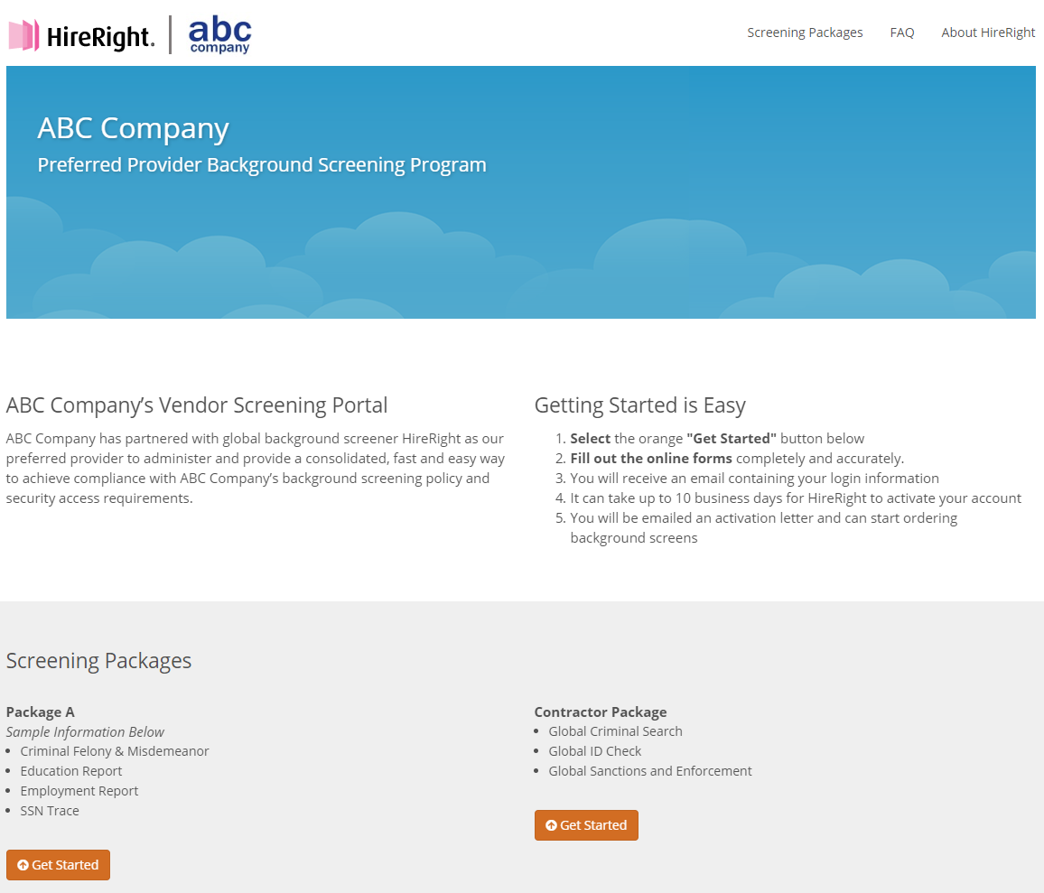


Example of Microsite Registration
Loaded with your pre-determined package/account options
Supplemented with FAQs and embedded media
Click the link. Microsite may also display: Register Here

Slide 8
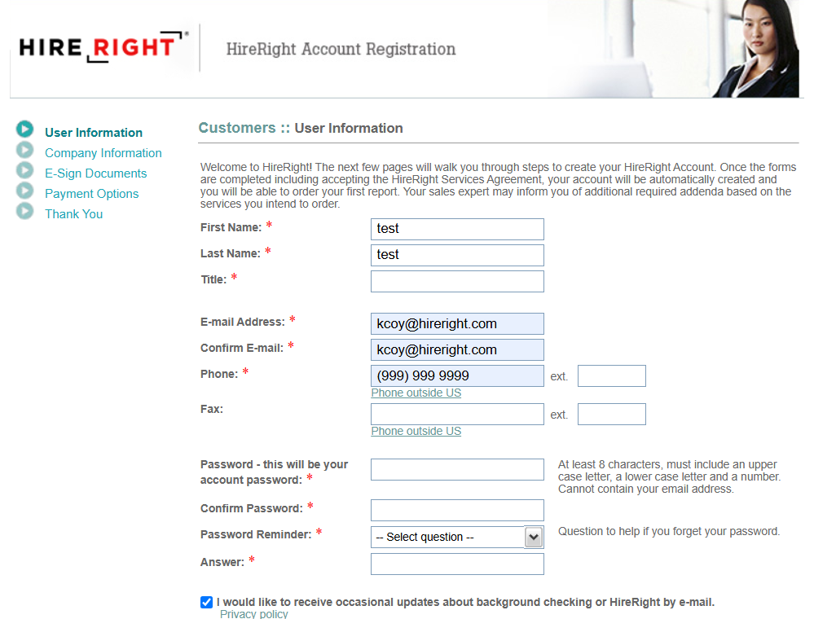
Vendor Online Registration (Example)
Complete User Information page
with your name, email, phone
number and create a password
Click Continue

Slide 9
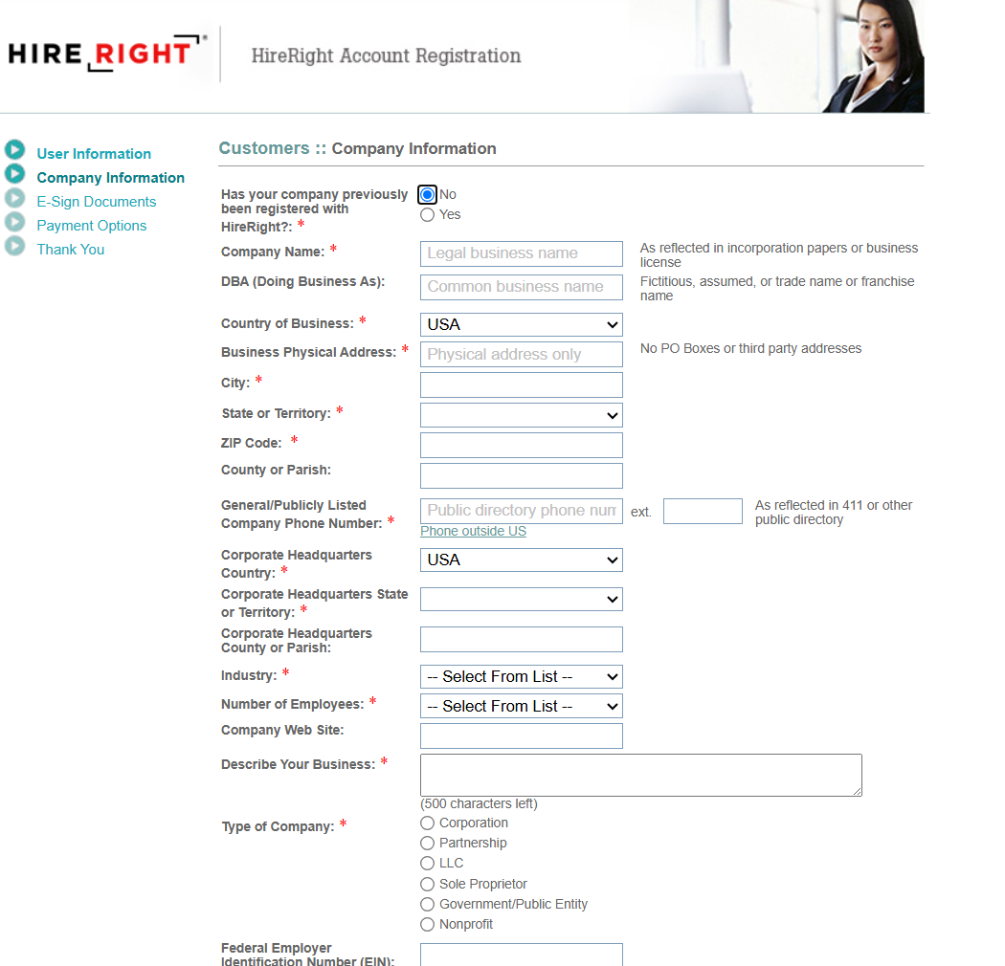
Customer Online Registration: Company Information
Enter in your company information

Slide 10
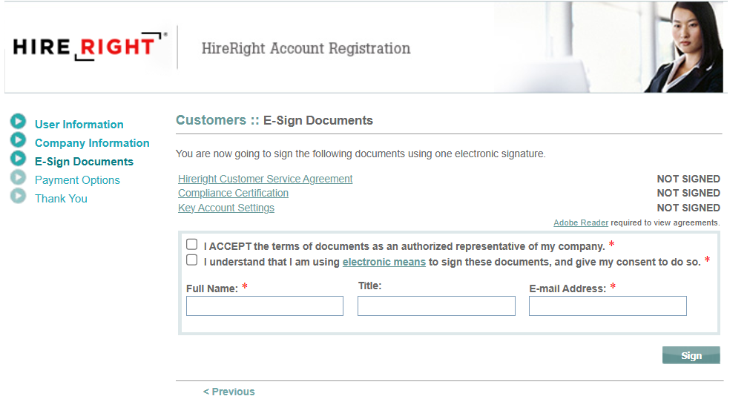
Customer Online Registration: Electronically Sign EWS Documents

Slide 11
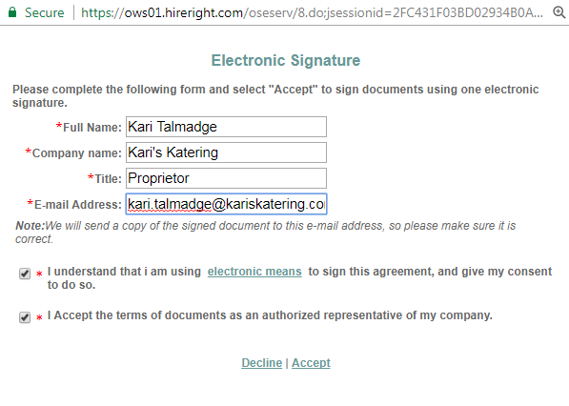
Customer Online Registration: Electronic Signature

Slide 12
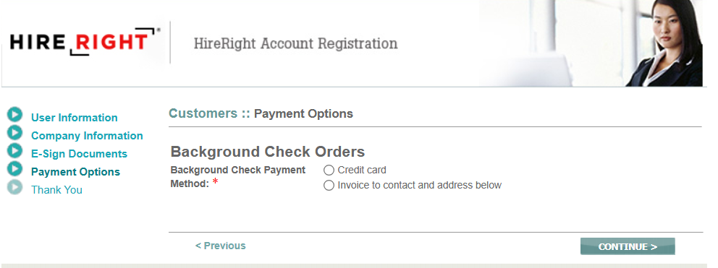
Customer Online Registration: Billing Information

Slide 13
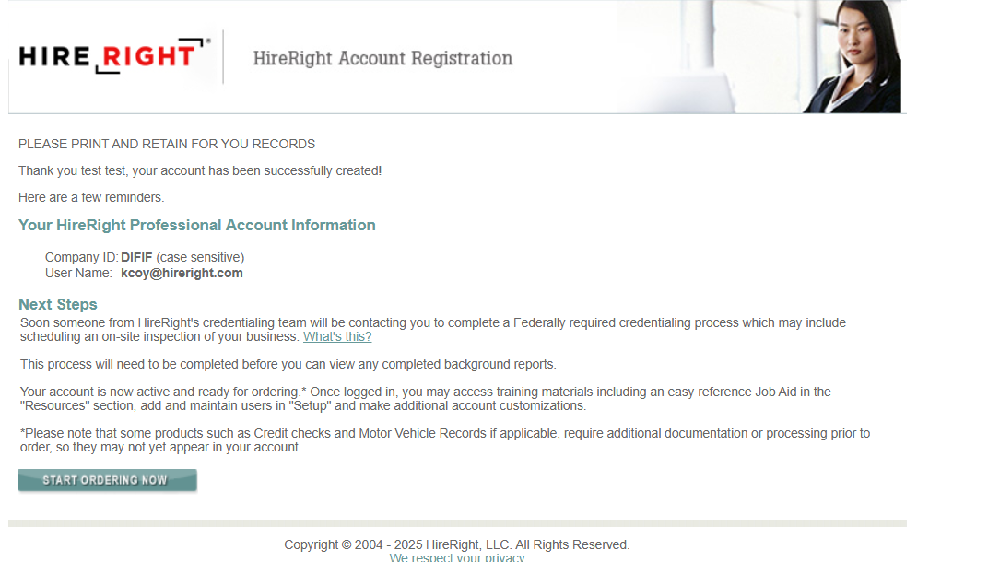
Customer Online Registration: Account Created Notification
Depending on your program, ordering may be restricted until Account Credentialing has passed

Slide 14
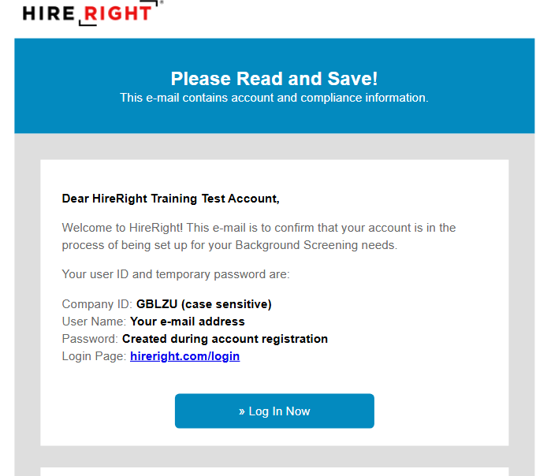
Registration Email is also emailed to the Vendor

Slide 15
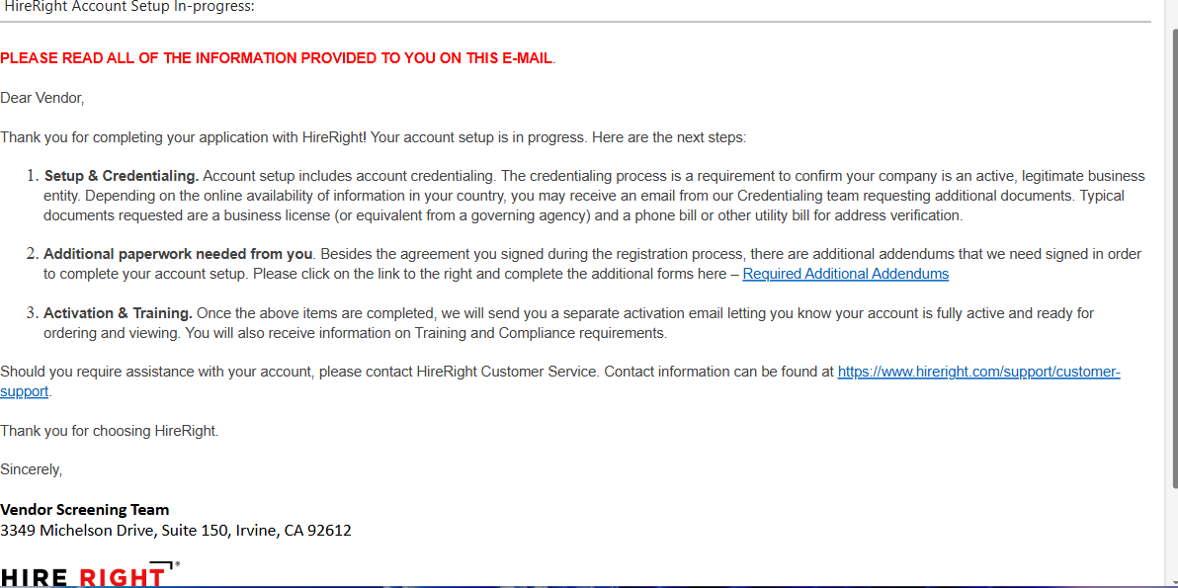
Vendor Screening will provide an email when set up is in progress
May not be required for your EWS program

Slide 16
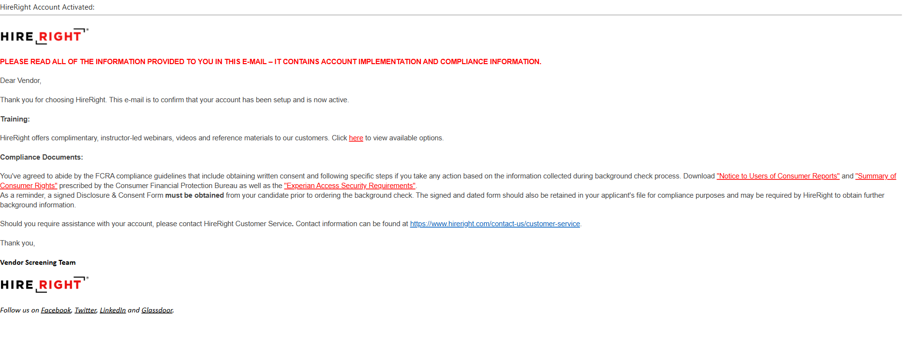
Activation Email
Sign up for free training sessions

