Slide 1
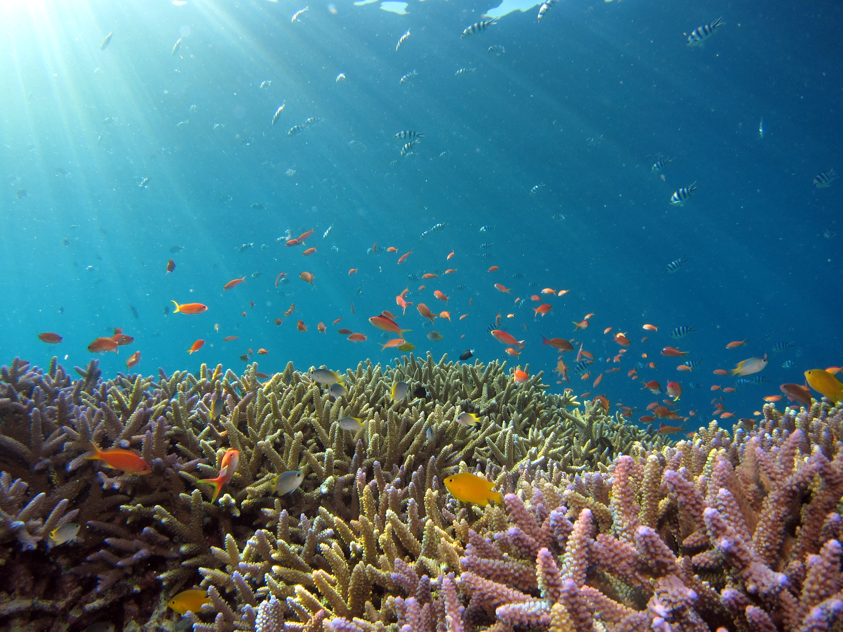
[Client Name] has recently joined the Ocean Wise Plastic Reduction Program!

Slide 2
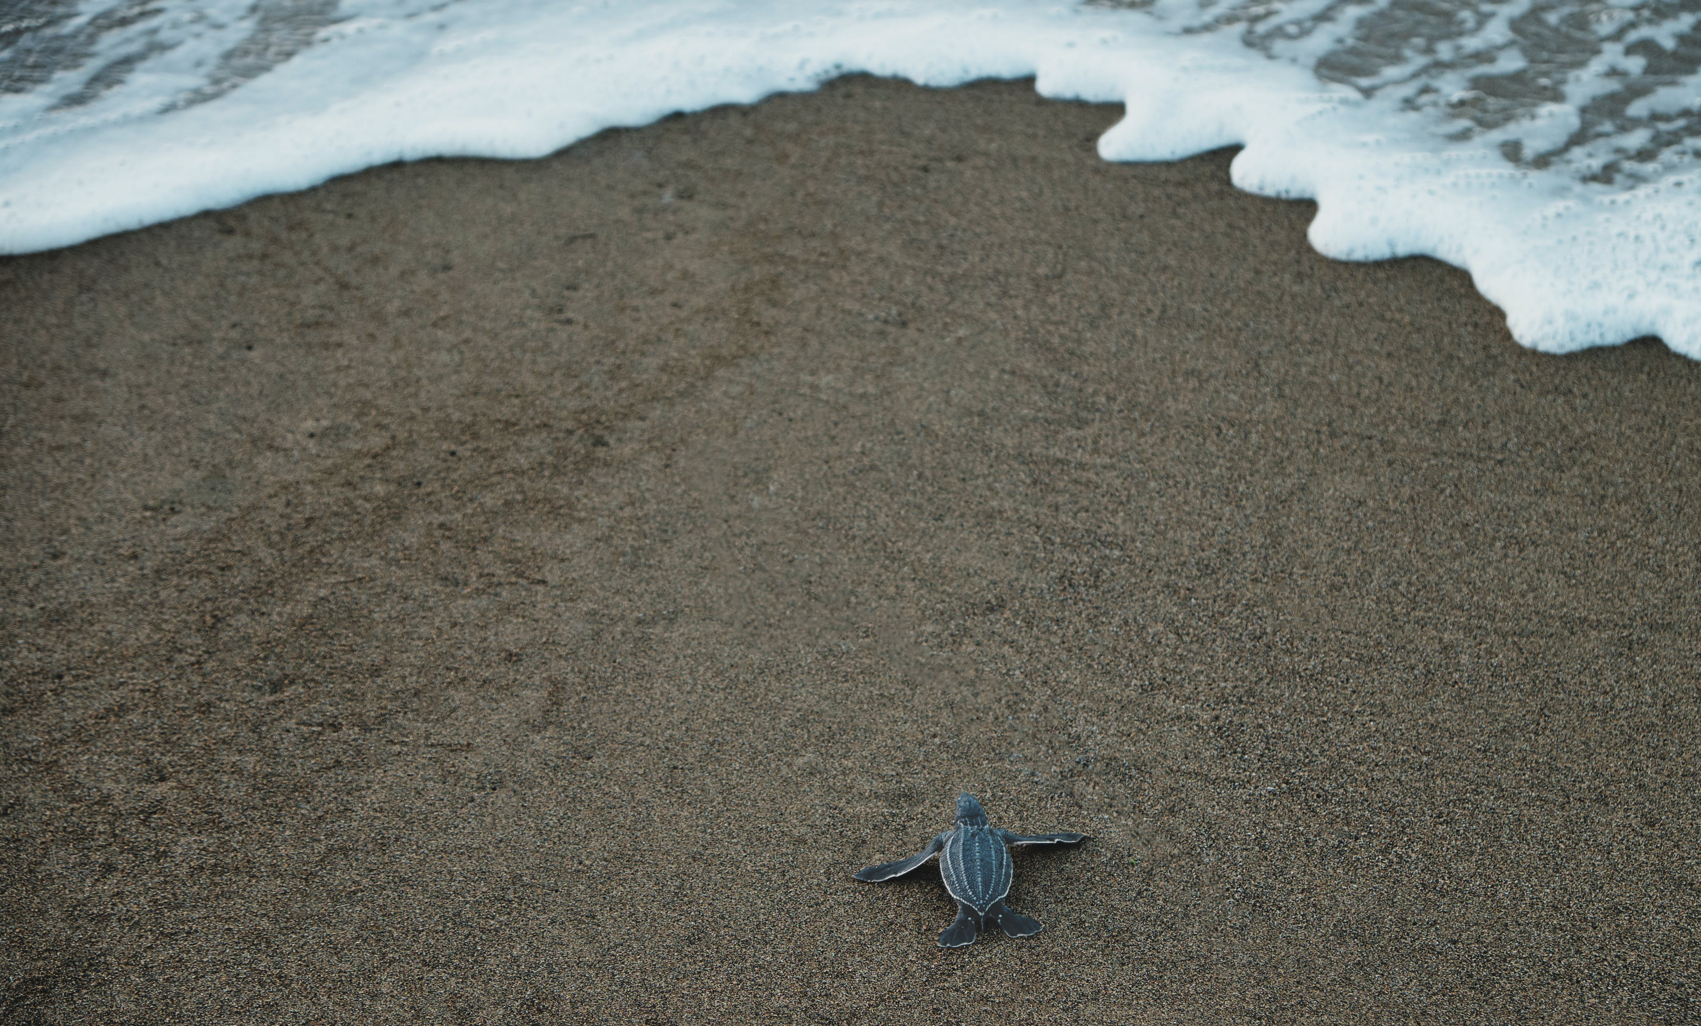
We're happy to share that we're beginning our journey to reduce unnecessary plastics at [business location/city].
With Ocean Wise's support, over the next several months, we'll be undergoing waste measurements and looking for ways to adapt to using less plastic.
We're committed to making a difference in our business practices for the ocean.
Being a Plastic Reduction Partner will help make this transition as smooth as possible.

Slide 3

About Ocean Wise
​Ocean Wise is a globally focused conservation organization on a mission to restore and protect our ocean.
Through research, education, public engagement, and international collaborations, we empower communities to fight three major ocean challenges: ocean pollution, overfishing and climate change. By equipping and empowering individuals, communities, industries, and governments, we can create a future where people and our ocean can thrive.
Visit ocean.org to learn more.

Slide 4
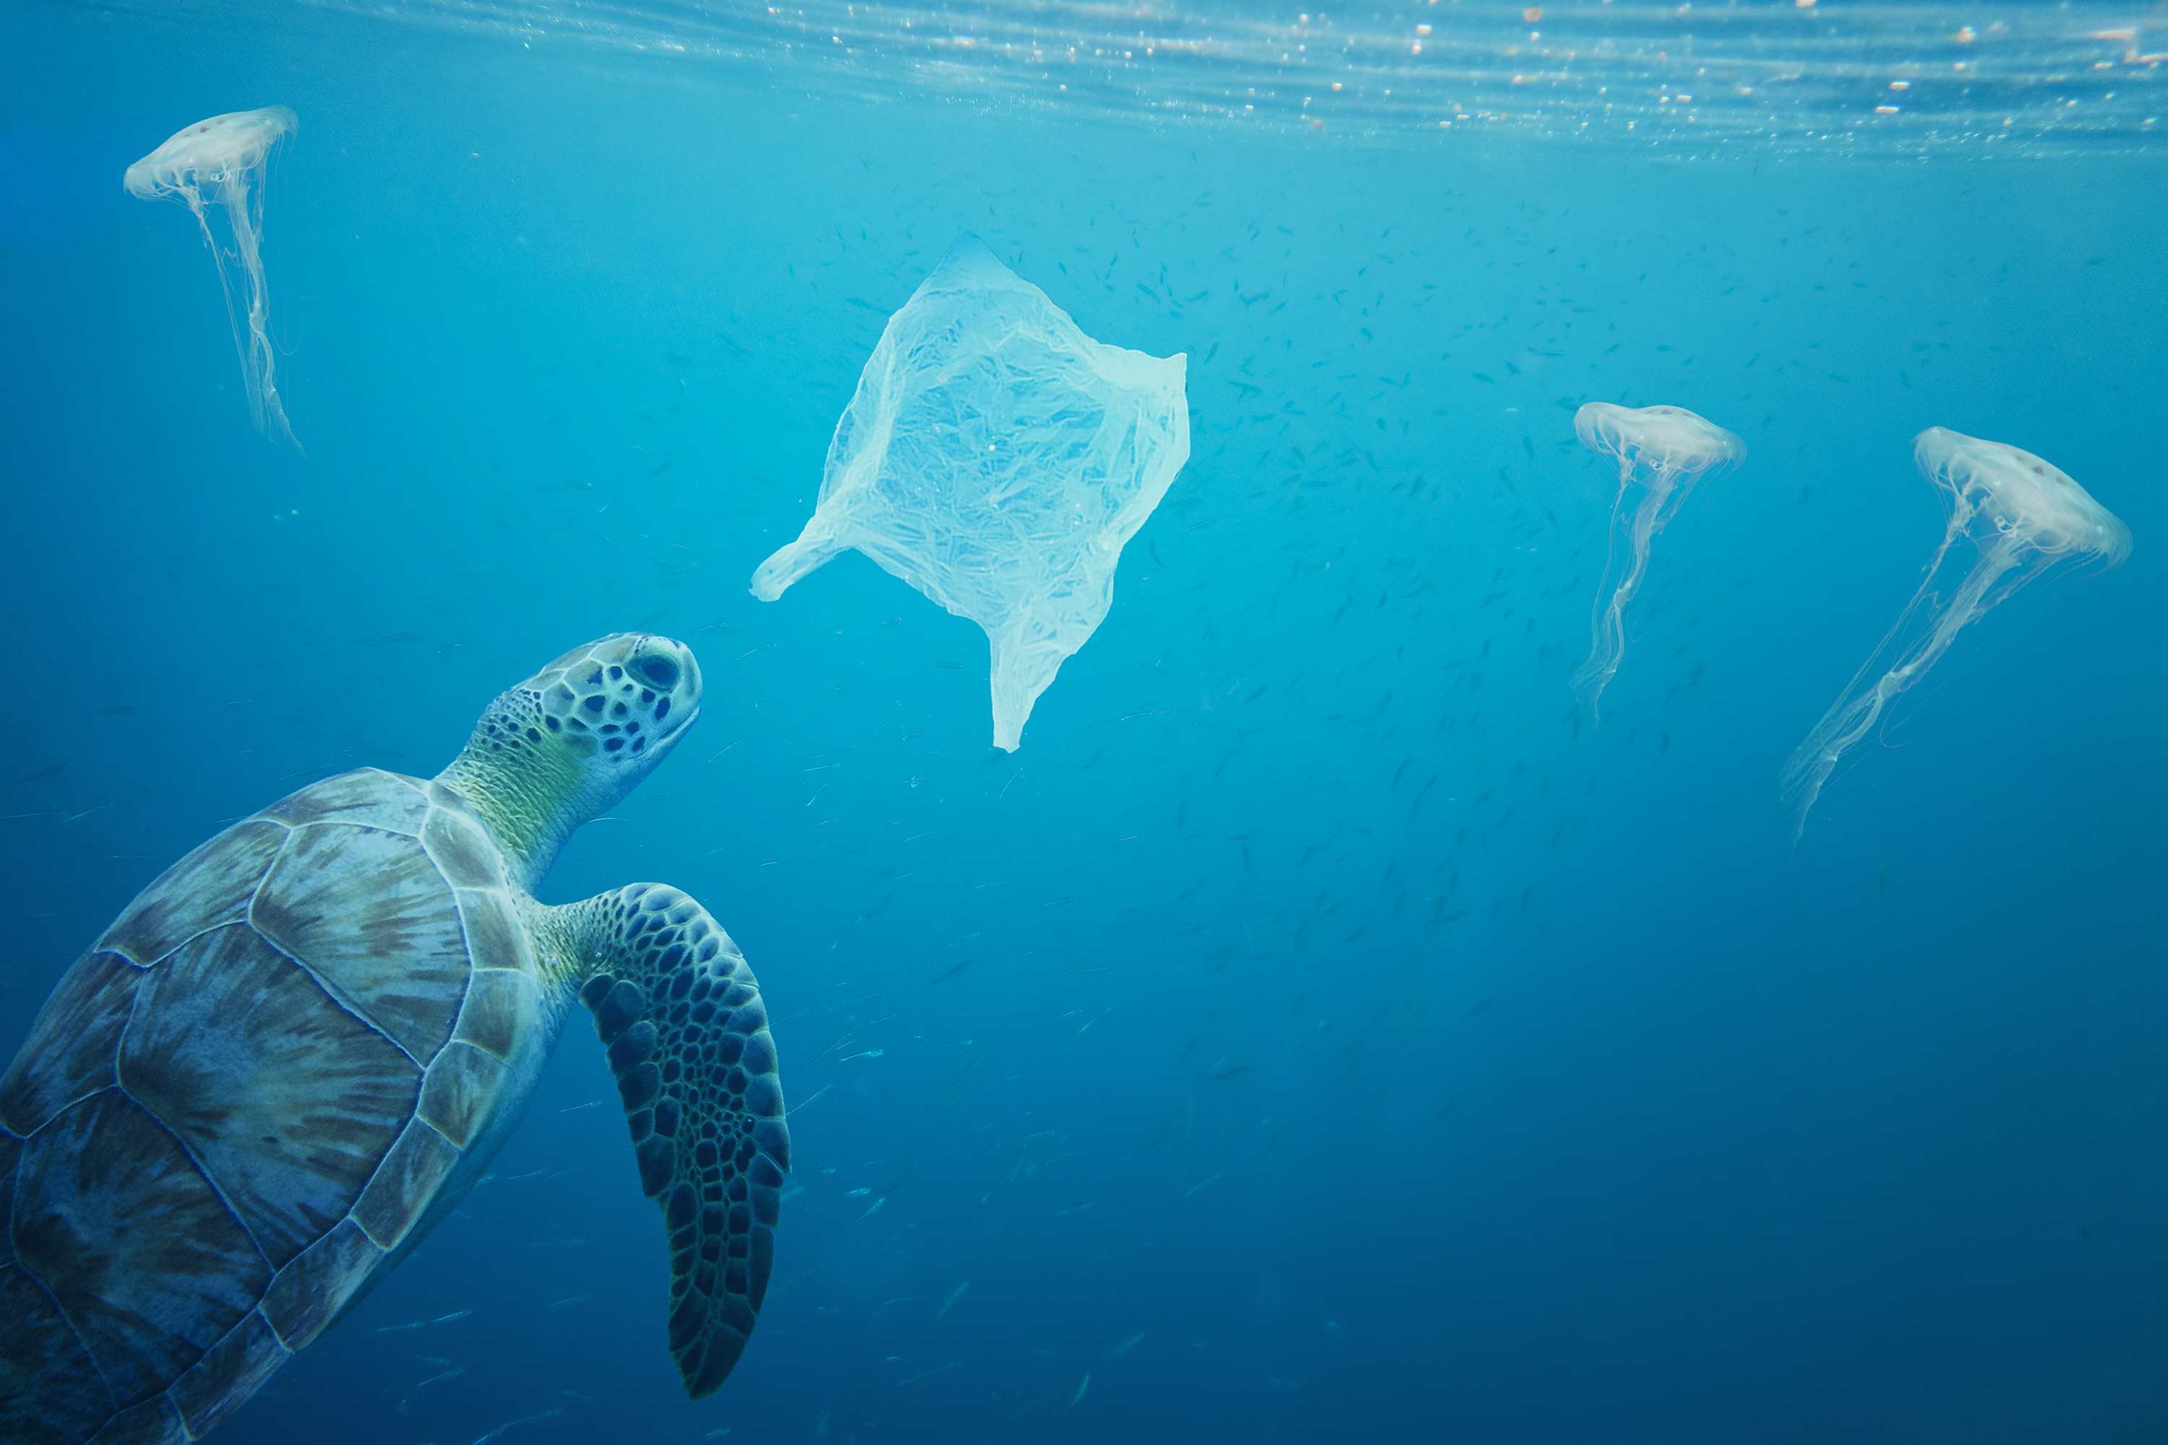
About Plastic Pollution
Plastic is in every part of our world, including our ocean.
Plastics have become so pervasive that they have entered our food chain, our water supply, even the air we breathe – causing growing concerns for our health. ​Our plastic waste is also threatening ocean life. It is damaging the marine environment, harming more than 800 marine species, and reducing the ocean’s ability to combat climate change.​
The time to take action is now. ​By adopting
solutions that are already available, we can reduce the flow of plastic into the ocean by 80%.

Slide 5
Our Impact
[This is a space to share findings so far, celebrating victories big and small]
What has been the biggest challenge?
What has been easier than expected?

