Slide 1
Special Assistance Consultative Committee March 8th 2018 Start – 10:00

Slide 2
Housekeeping
Toilet facilities available outside the function suite, on the left
Tea & coffee available throughout the group meeting outside the function room
Working lunch at 12:30
No fire drill planned today
Agenda
Introduction from Adrian Witherow, Chief Operating Officer EDI
Welcome and introductions
Edinburgh Airport Presentation;
Summary of PRM Service performance and operational review
Airport assistance equipment utilised
Assisted Passengers airport journey ‘what does it look like?‘
Passenger satisfaction surveys
Website – Proposed suggestions for improvements and enhancements
Training
Hidden Disabilities
AOB

Slide 3
Edinburgh Airport Welcomes:

Slide 4
Overview of the Special Assistance Consultative Committee objectives
Analyse Edinburgh Airport`s current performance, with regard to how the airport supports their passengers who require special assistance
Propose possible improvements or enhancements
Input into the suitability of current, and future, airport infrastructure, from varying PRM perspectives
Input into the suitability of training - especially disability confidence and awareness modules - from varying PRM perspectives
Provide feedback from service users about recent travelling experiences, and present possible issues for consideration

Slide 5
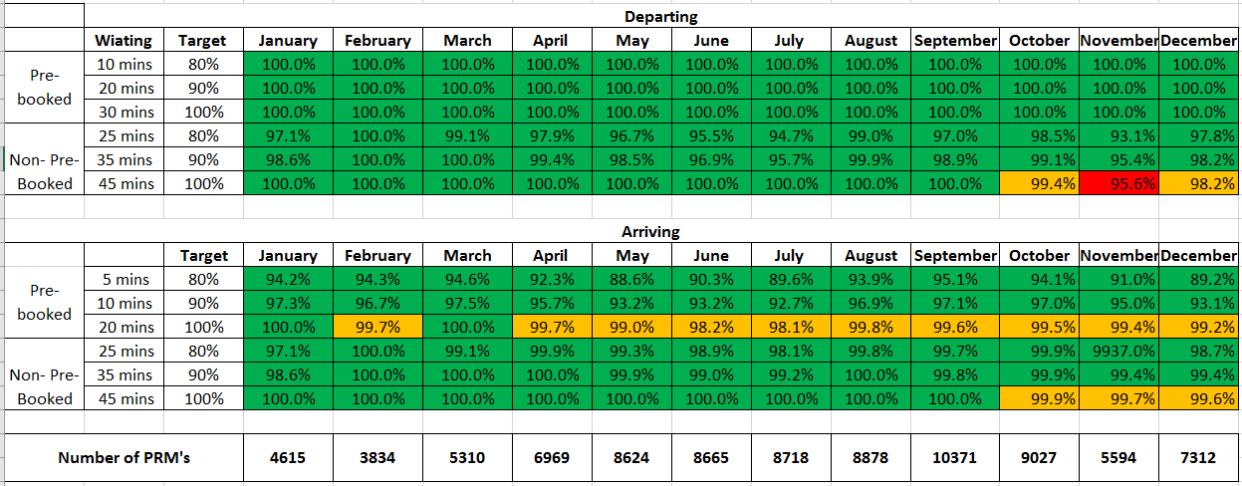
Summary of PRM service performance and operational overview
Current Service Level – ECAC Targets & Results

Slide 6
Category Breakdown
What does our assistance operation look like

Slide 7
Summary Statistics
 | PRM Passengers | % growth
2016 | 74,769
2017 YTD | 87,917
Differential | 13,148 | 17.7%
In 2017 assisted 87,917 PRM passengers to date, 0.64% of total passengers are PRMs
On average of 240 PRM passengers handled each day, varying between lows of 100 and highs of over 500 PRM passengers, fluctuations from day to day can be over 100 PRMs
Our busiest day last year was on the 22nd December where we assisted 560 PRM Passengers
Approximately 80% of passengers pre-notify their requirements to us
Operating a fleet of 5 Ambulift vehicles and 3 mini-bus’s

Slide 8
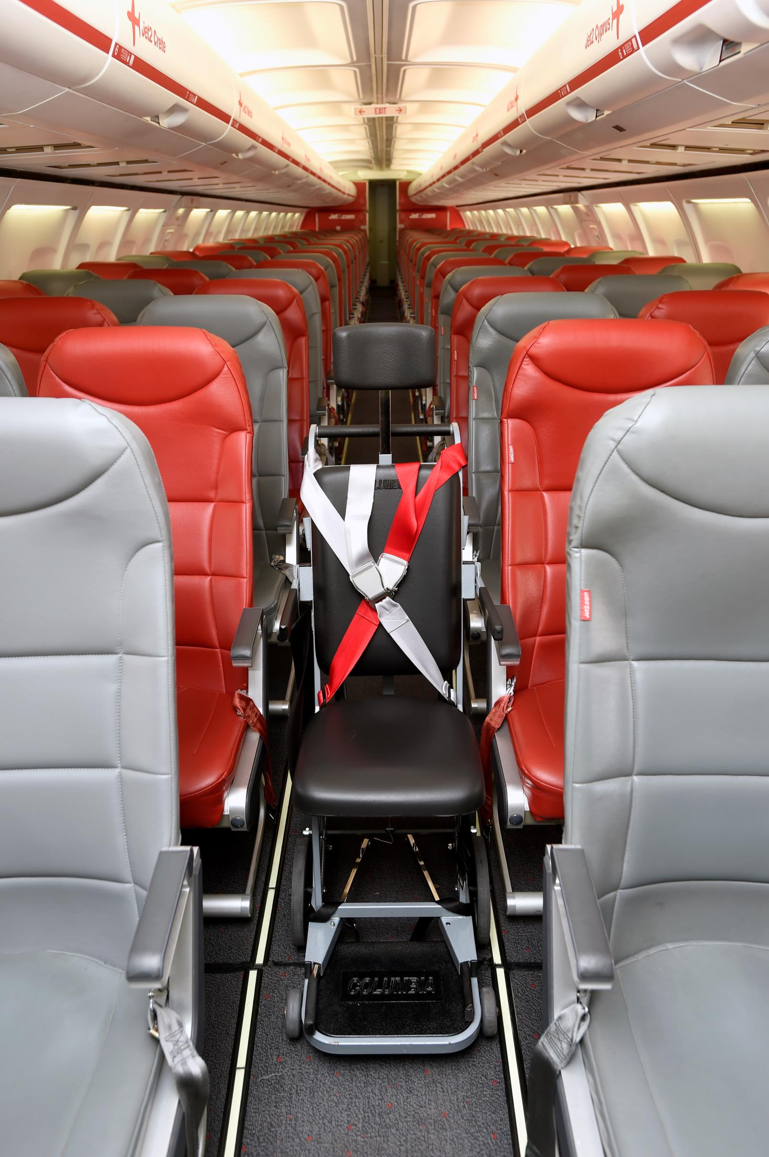
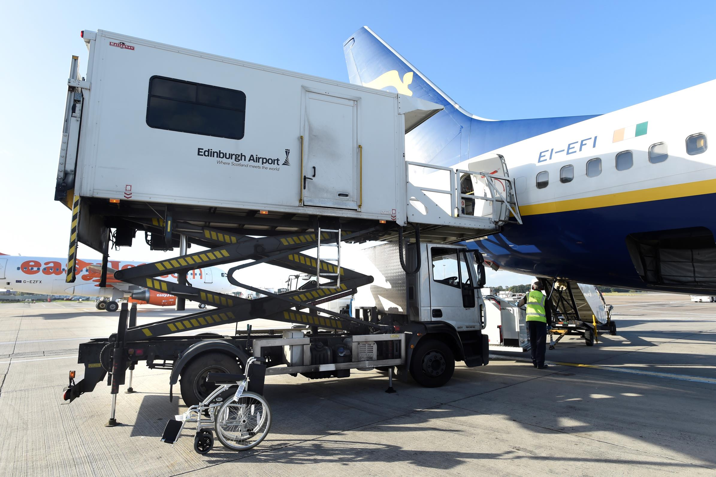
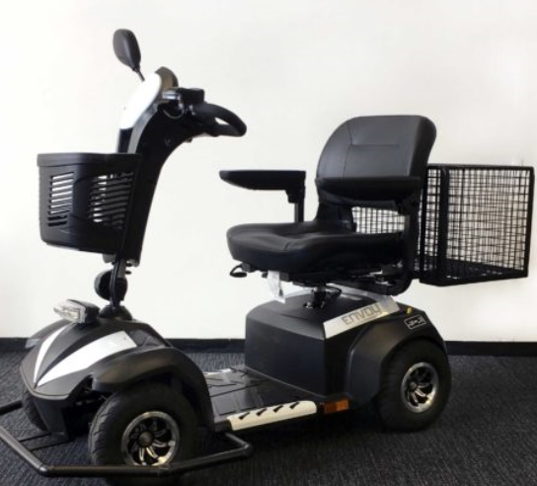
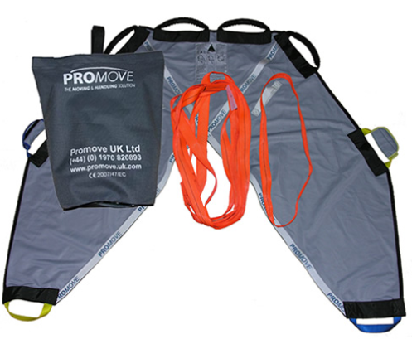
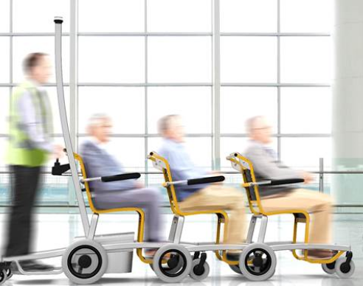
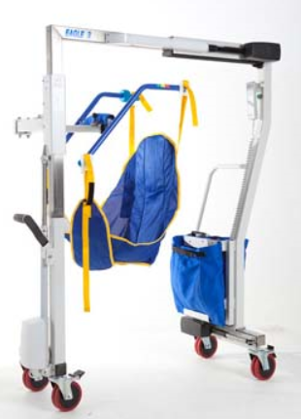
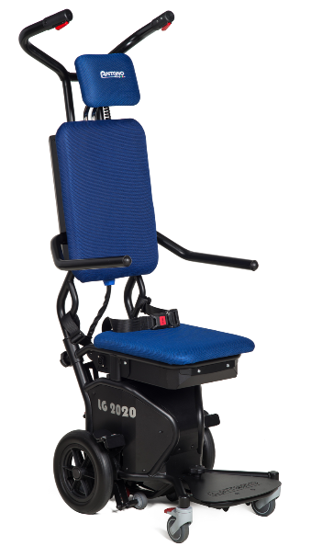
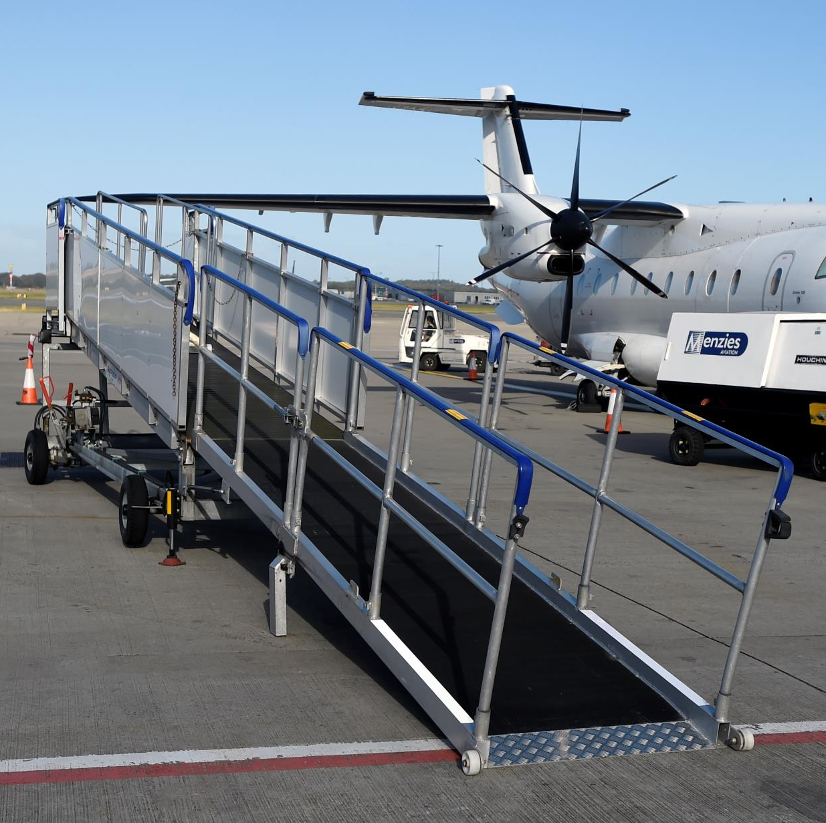
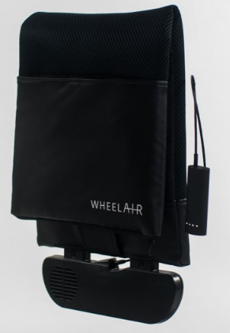
Current Equipment utilised

Slide 9
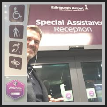
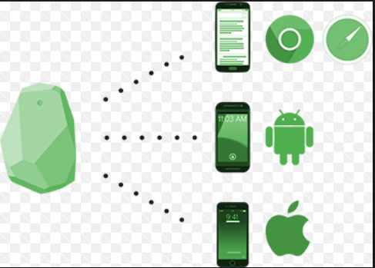
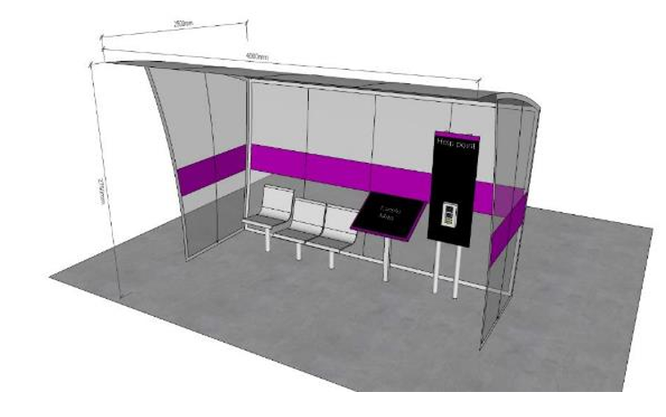
New Technology Used

Slide 10
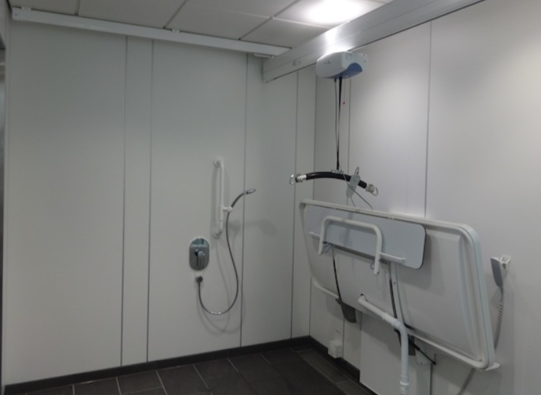
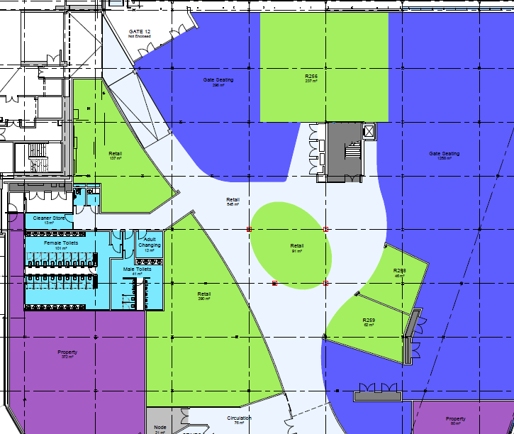
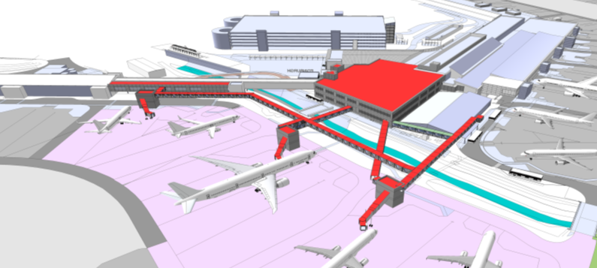
Edinburgh Airport Terminal Expansion

Slide 11
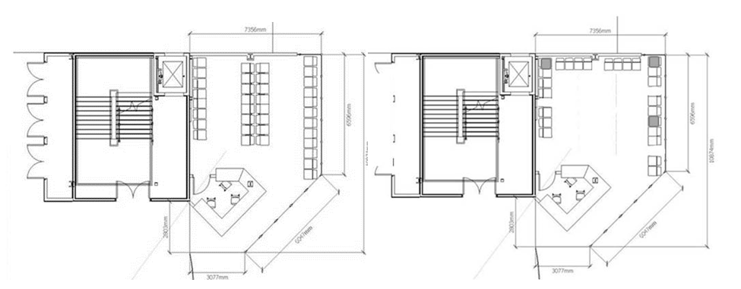

Slide 12
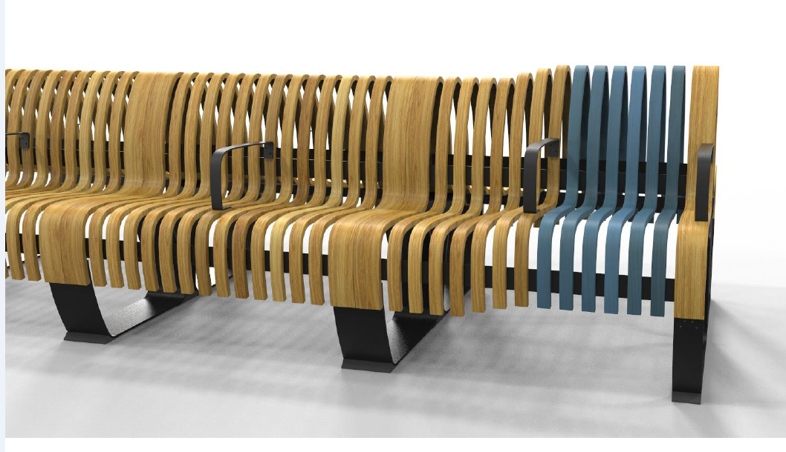
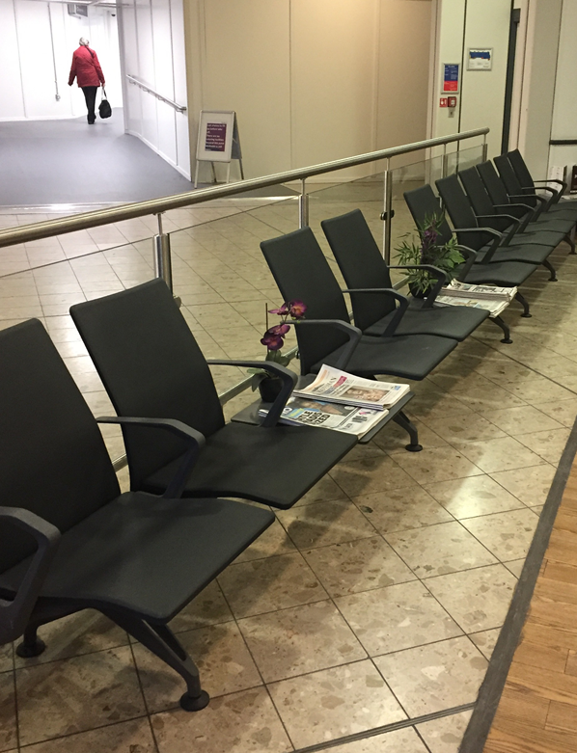

Slide 13
Your Journey
What areas do we do well?
What areas could we do better?
What areas are most important to you?
Departures
Arrivals
Booking Process
Boarding/Assistance on to the aircraft
On flight experience
Travel to the Airport
Special assistance Reception (Airside)
Assistance off the aircraft
Help Points
Security
Immigration
Special assistance reception
Check-in
Baggage reclaim

Slide 14
Customer Feedback
Passenger Satisfaction Survey
Currently only 0.5% of our passengers leave feedback through the CAA survey
Our target is to increase this to 1% by end of 2018
We are looking to review the current survey to make it more specific to our passengers’ journey
We are also going to launch a separate hidden disability survey from April 2018
All complaints should be acknowledged in 24 hours and investigated 5 days from date of submission
We have a specific passenger experience team who support us with the collation of this information
Common reasons for complaints Inbound waiting time Assistance not provided Staff attitude and behaviour | Actions Taken Communication improved between Airlines our staff improved Thorough investigations and increased customer focus training Staff performance audits + investment in more equipment

Slide 15
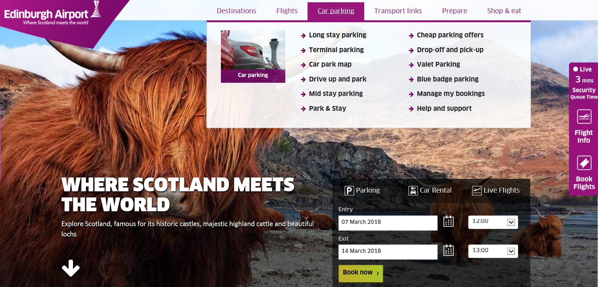
Website
Usability – How easy is it to use?
Navigation – Can you find everything you’re looking for?
Relevance – What is useful to you?
Improvements – What could we do better?

Slide 16
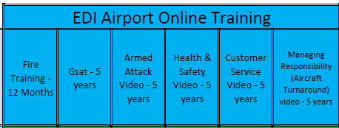
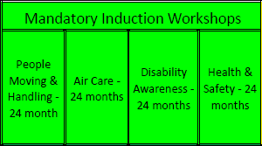
Training
New recruitment process which includes advanced training
Roll out of new E-Learning course to all staff
Security staff training tailored specifically for hidden disabilities
EDI compulsory training now includes Disability Awareness course
Refresher training for all Special Assistance staff

Slide 17
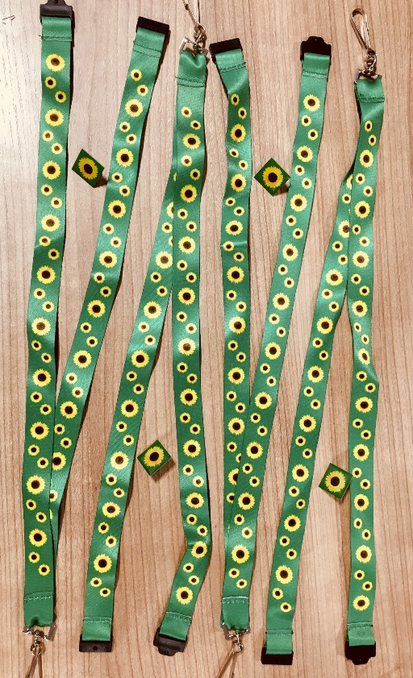
Hidden Disabilities
Not all disabilities look like this…
Some disabilities look like this…
Passengers with Additional Needs/Hidden Disabilities can wear a lanyard and/or pin badge to make staff aware, allowing our teams to tailor their approach.
You may use the lanyards or pins whether or not you have requested assistance. You will also gain access to our Family and Special Assistance Lane in security.
If you would like a lanyard and/or pin we can send them by post or you can collect them at our Special Assistance Reception on your day of travel.

Slide 18
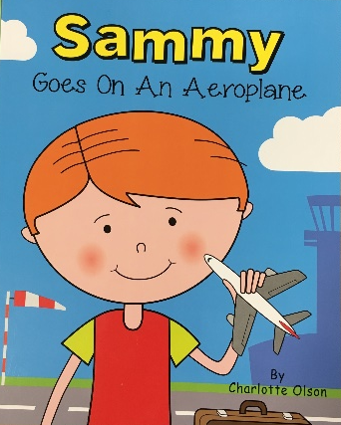
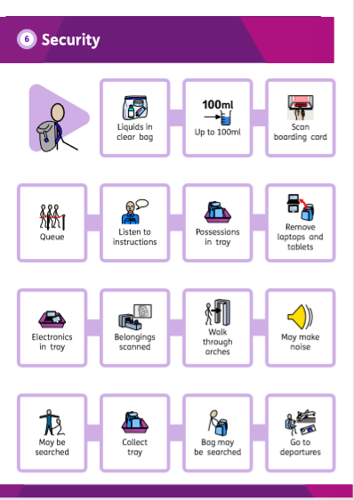
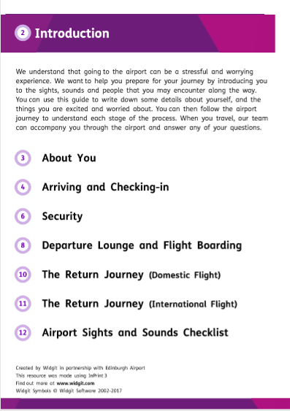
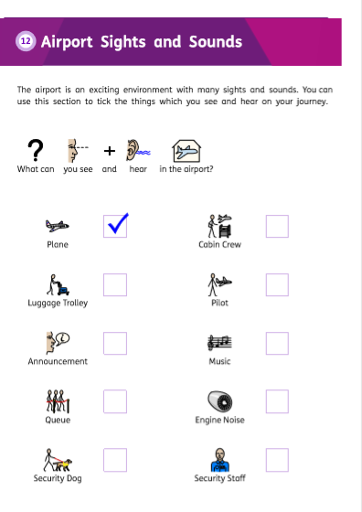
The Additional Needs Service
We offer an Additional Needs service for passengers on the
autism spectrum or with complex additional needs.
Our resources;
Edinburgh Airport’s Social Story
Suzie goes on an aeroplane
Sammy goes on an aeroplane
Lanyard and/or pin badge
All of the above can be requested prior to
a visit and sent out to you
How to book;
Email AdditionalNeeds@EdinburghAirport.com

Slide 19
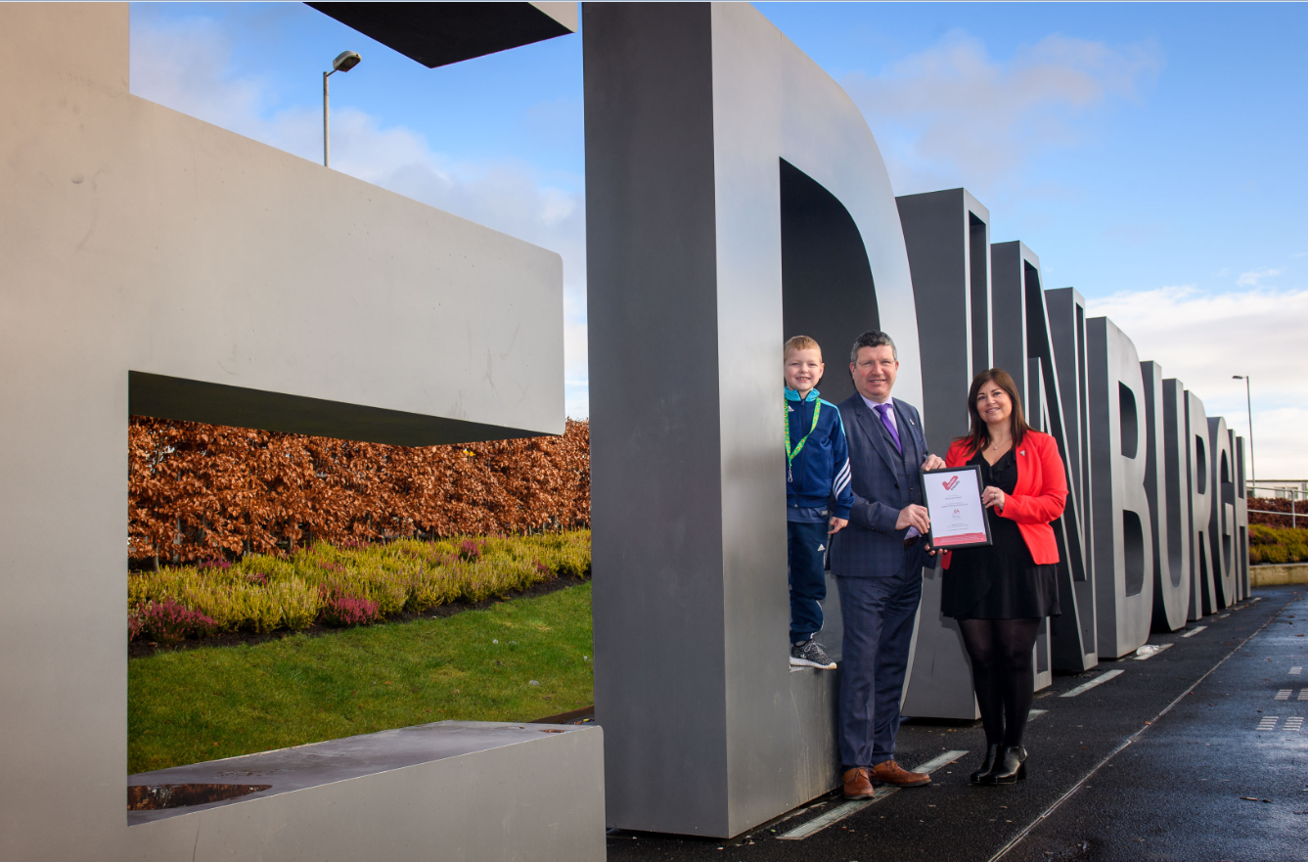
Our Autism Friendly Award 2018 !!!!!

Slide 20
AOB

