Slide 1
Special Assistance Consultative Committee September 27th 2018 Start – 10:00

Slide 2
Housekeeping
Toilet facilities available outside the function suite, on the left
Tea & coffee available throughout the group meeting outside the function room
Working lunch at 12:30
No fire drill planned today
Agenda
- Introduction from David Feltham , Director of Passenger Experience and Operations, EDI
- Welcome and introductions
- Update on Actions from last Meetings
Summary of PRM service performance and operational overview
Infrastructure update
Details of guest groups invited to evaluate passenger’s airport journey over the last 6 months
Passenger satisfaction survey results
Website – progress report including presentation from Recite
Training – feedback regarding EDI online disability awareness course
- Guest Speaker - Ryanair
- AOB

Slide 3
Edinburgh Airport Welcomes:

Slide 4
Special Assistance Consultative Committee Action Plan
Requirement | Action
Layout for Special Assistance reception | Layout agreed as open plan, with the inclusion of wheelchair spaces Single seat design preferred, with consideration for colour contrast Flooring not colour specific, but must include contrast and not be reflective Special Assistance partition to be low and transparent
Adult Changing Facility | Consider door locking mechanisms Monitor passenger usage from nearby reception area Review interior décor options, to include contrasting colours
Propose quiet route through the airport | Ross Gilpin to discuss with infrastructure design team
Review Airside reception opening hours | Currently operating between 07.00 – 19.00. Ross Gilpin to discuss with OmniServ
Airport infrastructure and passenger journey | Ross Gilpin and Andy Wright to schedule user groups, in order to evaluate and provide feedback on current, as well as future, infrastructure and passenger airport experience
Review EDI online disability awareness training | Web link for airport staff online training package to be circulated to committee members once updates are completed.
Consider Thistle card implementation at EDI | Ross Gilpin to investigate further
Website updates and alterations | Produce Special Assistance service video Add Special Assistance Tab to Home page Create user-friendly Search option Improve advice page for guide dog users Create Special Assistance specific maps, to include toilets, help points etc

Slide 5
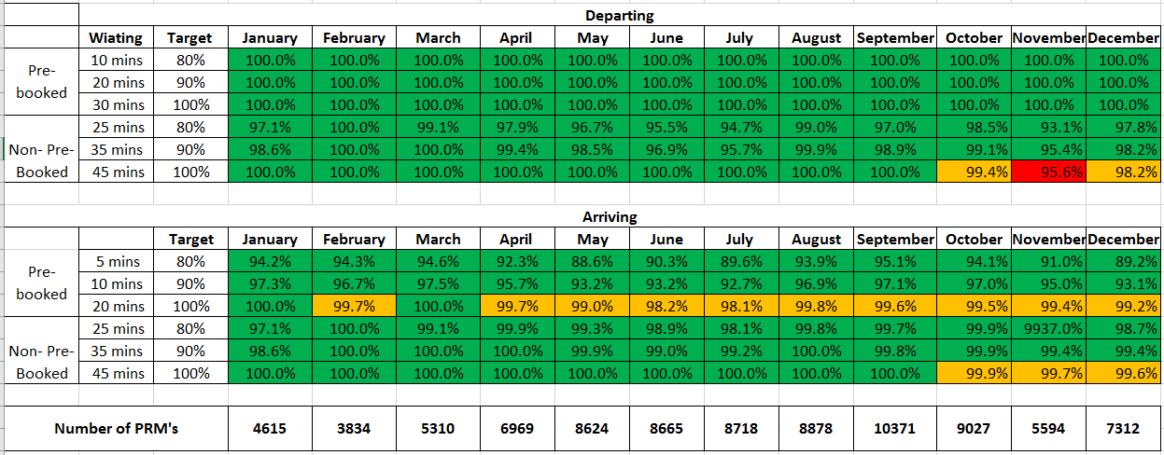
Summary of PRM service performance and operational overview
Current Service Level – ECAC Targets & Results

Slide 6
Category Breakdown
What does our assistance operation look like

Slide 7
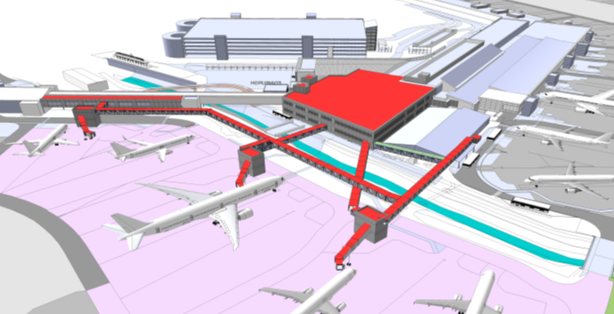
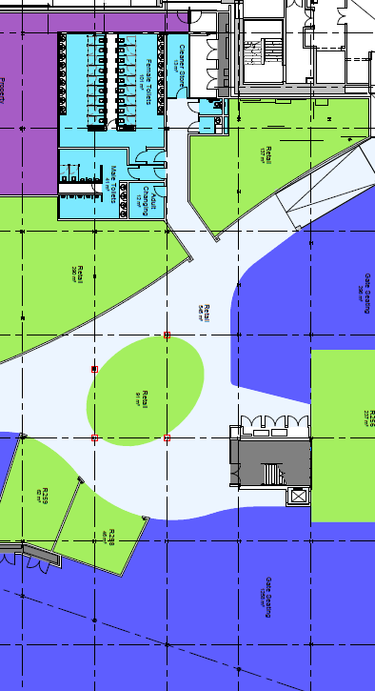
Edinburgh Airport Terminal Expansion

Slide 8
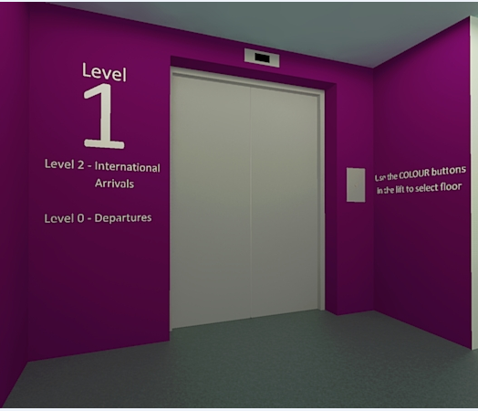
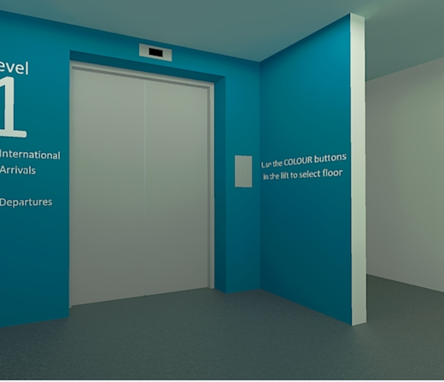
Edinburgh Airport Lift Nodes

Slide 9
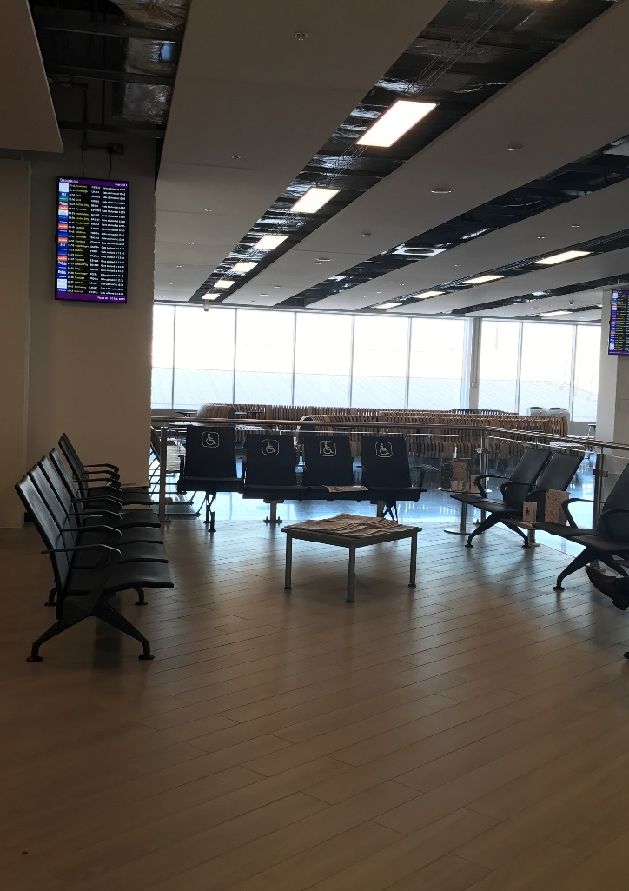
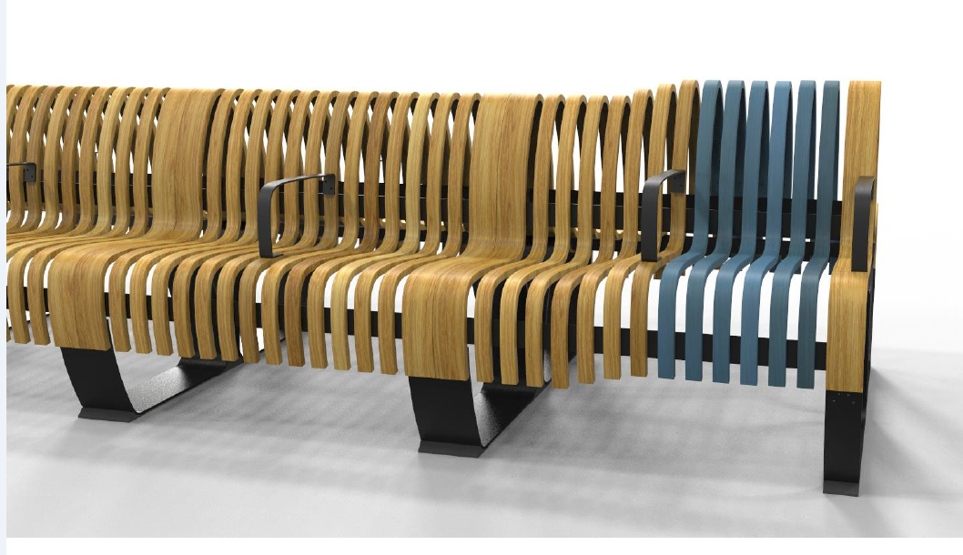
Terminal Expansion Update

Slide 10
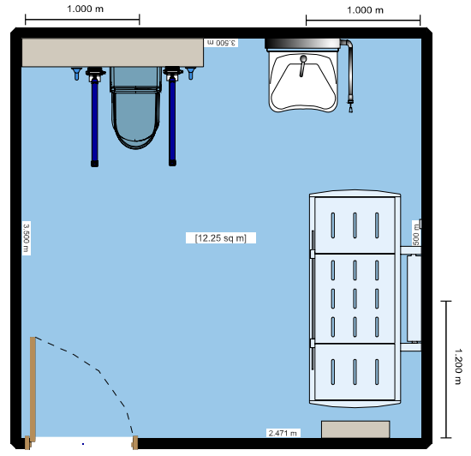
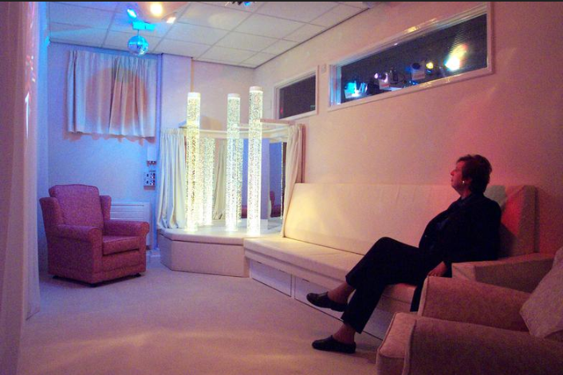
Still to Come ………
Changing Places
Quiet room/Adult sensory room
Further design of the Airside Reception Area

Slide 11
Aim
Creating a relaxed environment for passengers
Accessible for wheel chairs
Distractions e.g. games and books
Homely environment
Sense of adventure, getting passengers excited before a flight

Slide 12
Needs and Wants
Needs
Larger screens
Replace bucket chairs
Replace chipped table
Newspaper stand
Signage
Space for wheel chairs
Wants
Ambience – Sound and smell
Sweet jar
Flowers
Greenery

Slide 13
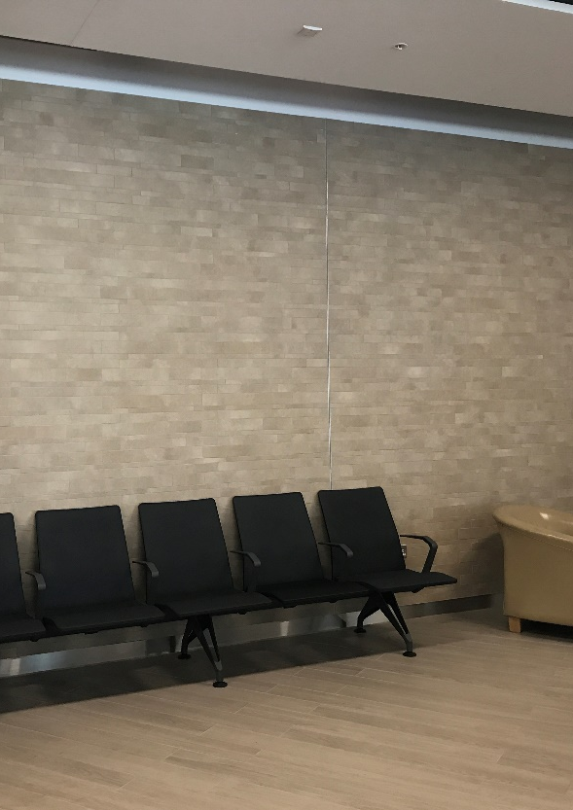
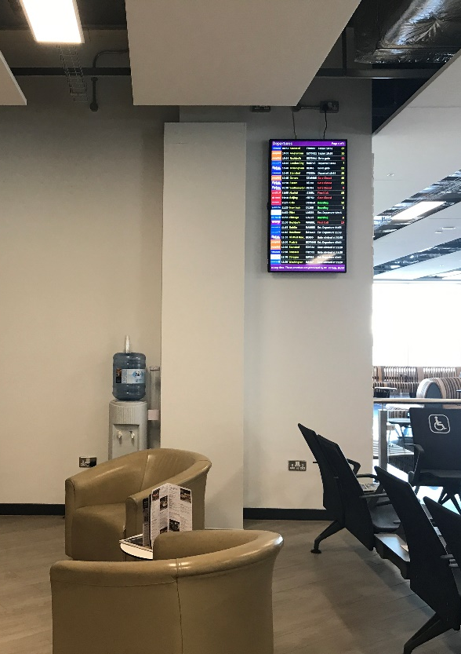
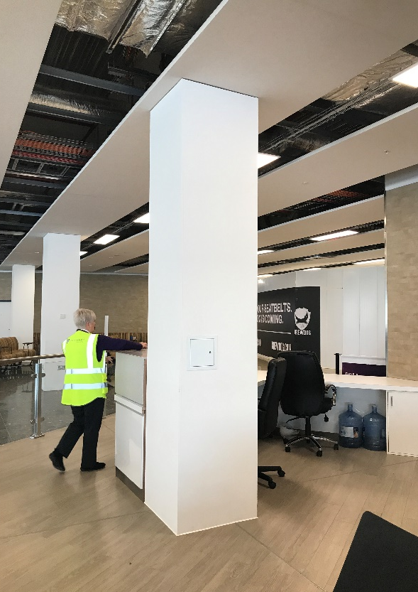
Space

Slide 14
Concept
Bucket Chair
News paper stand
Storage
Hexagon shelving
Moss pillar
Plants
Signage
Accessories

Slide 15
5. Moss Pillar
Meld Ltd
Oasis

Slide 16
1. Meld Ltd

Slide 17
7. Signage
‘SPECIAL ASSISTANCE RESERVED SEATING’

Slide 18
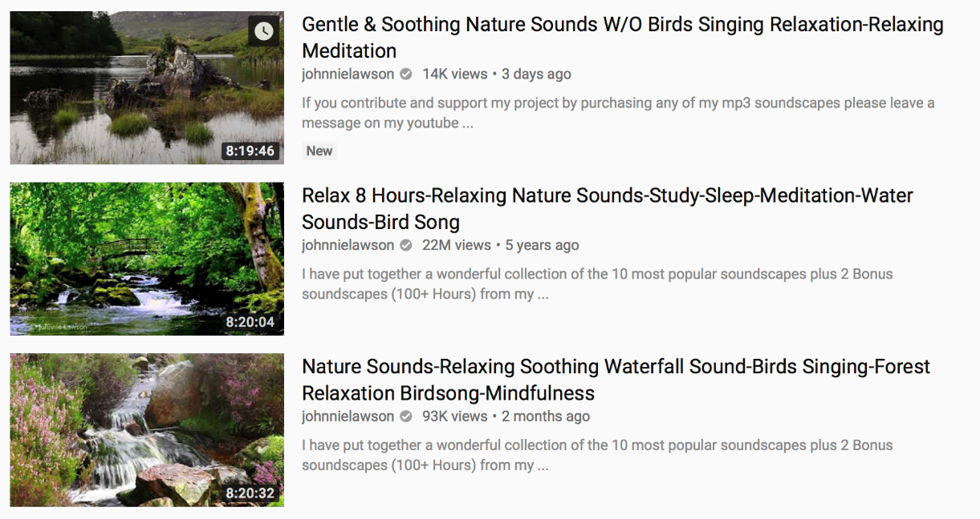
Audio
Audio has been proven to relax people by 65%
Possible options include:
Classic FM
Relaxed music playlist
Nature noises e.g. birds, running water
Local Edinburgh bird sounds
Play through a speaker using YouTube or Spotify
Would be possible to play a nature clip on screens

Slide 19
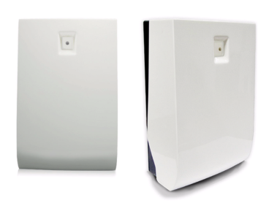
Smell
Company - Eco Scent
Scenting a space can reduce stress and anxiety, especially in waiting lounges for those nervous travellers.
Types of diffuser
Free standing or wall mounted
Areas of interest
PRM – 70 square meters
Action
Trial small diffuser in PRM
Scent Samples
Amber & Lavender
Green tea & Lemon
Morning dew
The Fragrance
Harbor Mist

Slide 20
Guest Groups Actions
No Help point at the Tram Stop
Poor standard of help points (low quality, poor information, poorly located)
Drop off area extremely confusing
Wayfinding in the airport (Landside)
Clock to have numbers not symbols
Music too loud in coffee shops
Hearing loops not working
Accessible disabled toilets
Security Staff awareness of hidden disabilities
Airside Reception services
Guide dog area airside
More promotion of the services available

Slide 21
Passenger Satisfaction Surveys

Slide 22
Passenger Satisfaction Surveys

Slide 23
Customer Feedback
Compliments vs Complaints
Common reasons for complaints Arrival Waiting Time Landside Reserved Seating Resourcing level | Actions Taken Investment in new equipment to improve passenger experience Focus on passenger waiting times and improvement in staff training. Understand the operation to adjust staff accordingly (Summer flight schedule/TEX/baggage reclaim)

Slide 24
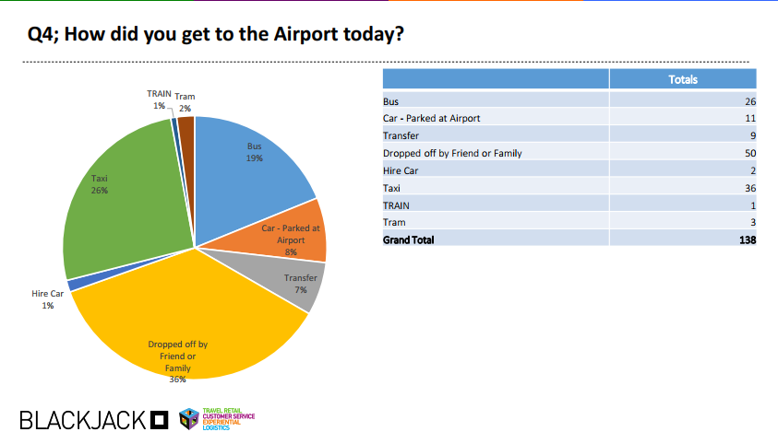
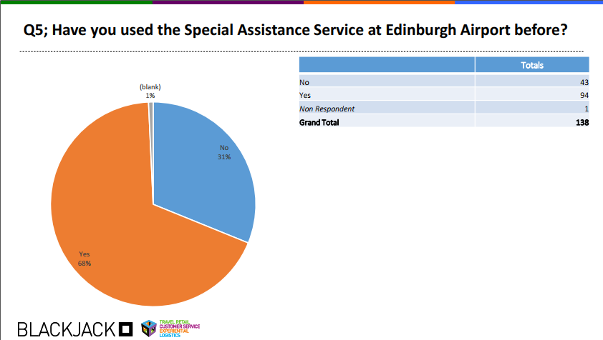
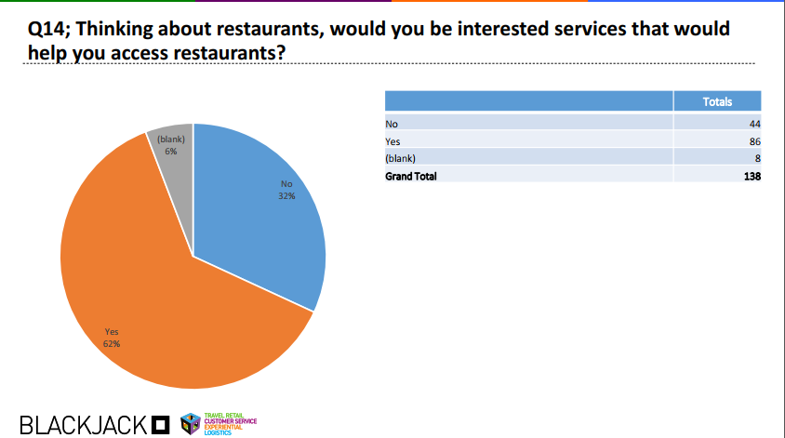
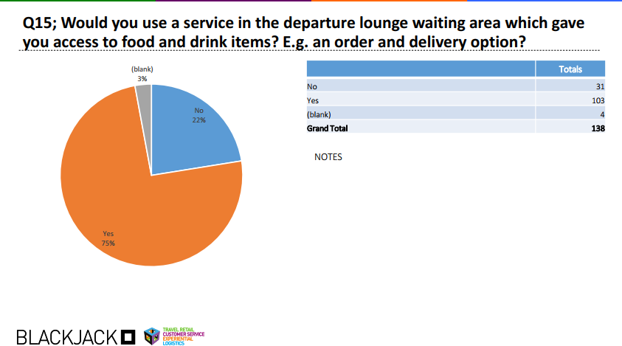
Airside Reception Survey

Slide 25
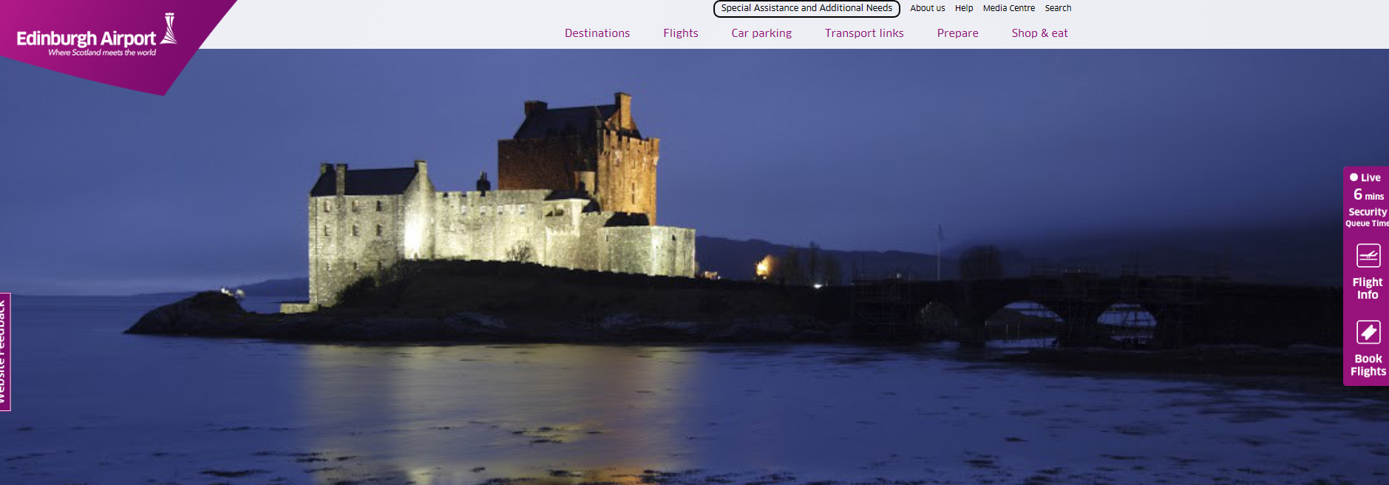
Website Update
Marc Dabs – Recite Presentation on an accessibility format
Various changes on the website as advised in last meeting
Search option and tab for Special assistance is now on the front page and more clear to see.

Slide 26
Training Update
E-learning Disability Awareness Training discussion
Deaf Awareness Training roll out
Hidden Disability Training to support Additional Needs Service
Security Officer refresher training in Hidden Disabilities
Review of Operational Training provided

Slide 27
Ryanair

Slide 28
AOB

