Slide 1
Overview: Warm Springs Power Pathway Project
Cathy Ehli, General Manager, Warm Springs Power & Water Enterprises
JD Podlesnik, Senior Director, Transmission Delivery, PGE
Tony Gunsaulis, Senior Project Manager, PGE
Wendy Veliz, Senior Manager, Local Government Affairs, PGE
October 2025| Initial Project Overview for Jefferson County, OR

Slide 2
Agenda
Introductions
Confederated Tribes of Warm Springs (CTWS) and Warm Springs Power and Water Enterprises (WSPWE) Introduction
Project Context
Project Overview
Current Status
Project Schedule

Slide 3
Project context
A long, valued partnership
In 1980, we became co-licensees to build the re-regulating dam and powerhouse at Pelton Round Butte. Since 2001, we have co-owned and operated the project.
Together, we work closely on an ambitious science-based salmon reintroduction program to restore fish runs to the Deschutes River.
A vital, aging transmission line
Bethel-Round Butte 230 kV transmission line was built in the 1960s as part of the Pelton Round Butte project.
The line travels from Lake Billy Chinook to the Salem area, connecting with substations at the southeast edge of PGE’s service area, taking advantage of existing right-of-way across the Cascade Mountains.
Identified by the Oregon Public Utility Commission as a project to study for increasing PGE’s capacity to import more electricity from diverse generation resources and address known constraints that are most pronounced in spring and summer.
Will enable up to 3,000 megawatts of additional electricity from the interface PGE shares with Bonneville Power Administration.

Slide 4
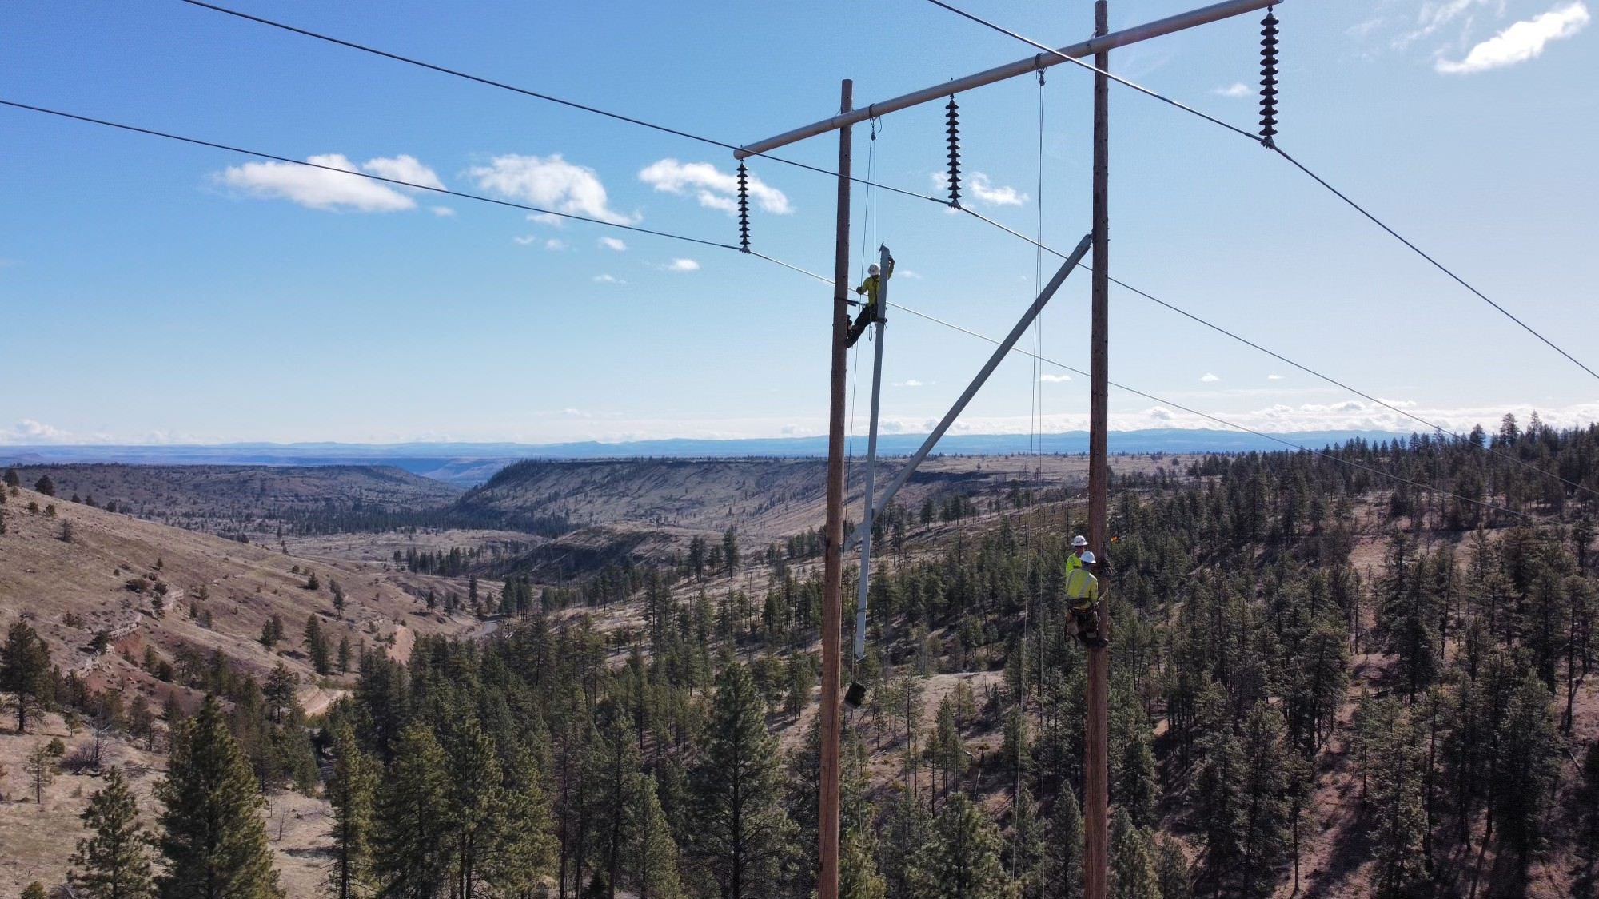
Confederated Tribes of Warm Springs
Project Introduction
In 2023, CTWS was selected to receive a $250 million grant from the U.S. Department of Energy to help advance vital transmission upgrades
New transmission capacity on the Warm Springs Reservation will enable the development of generation infrastructure, accommodate new industrial development, create job opportunities, and bring revenue to tribal communities
Will improve reliability and help meet growing electrical demand from customers in PGE’s service area, which includes about half of Oregon’s population and two thirds of the state’s commercial and industrial activity

Slide 5
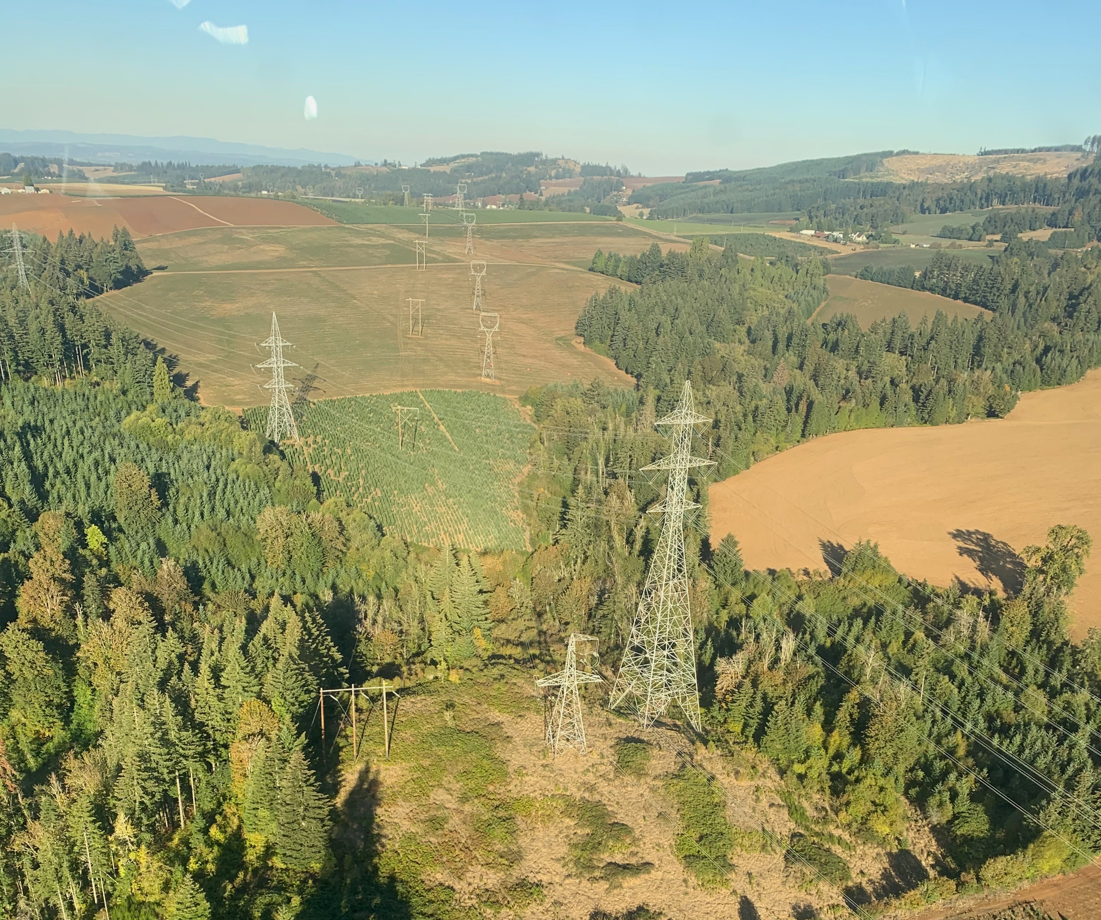
Transmission Structures

Slide 6
Economic Development and Community Benefits
Overview
Over 700 construction jobs are estimated to be created over the life of this project
Enhances Central Oregon’s broadband infrastructure network with fiber optic lines
Creates job training and pre-apprenticeship program to benefit Central Oregon, including Warm Springs Reservation
Attracts new business and job opportunities on Reservation and through Central Oregon throughout construction process
Expands capacity for Confederated Tribes of Warm Springs and surrounding region to bring potential new energy projects online

Slide 7
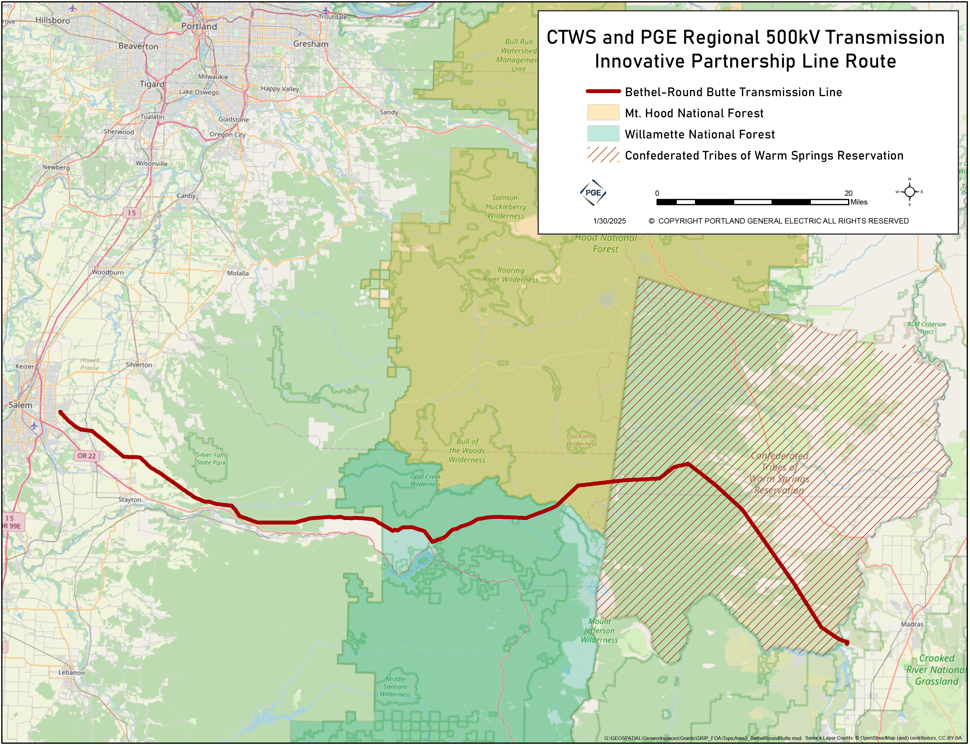
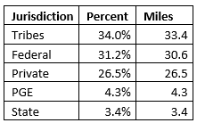
Bethel Round Butte Route and Quick Facts
98 Miles from Bethel substation to Round Butte substation
The Confederated Tribes of Warm Springs (CWTS) received a grant from the DOE for $250 million
Targeted in-service 2032
Property ownership:

Slide 8
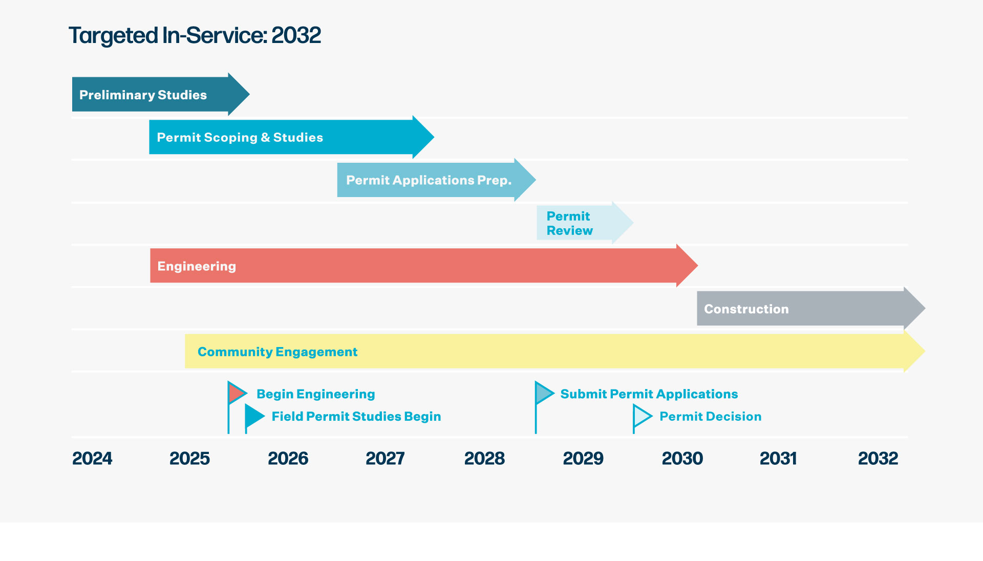


1499 days
2058 days
435 days
772 days
525 days
261 days
667 days
2024
Jan 1 - Aug 30
Aug 1 - Jul 18
Jul 18 - Jul 21
Jul 21 - Jul 21
Aug 1 - May 1
Aug 15, 2025
Jul 21, 2028
May 1 - Nov 21
Oct 1, 2025
Jul 23, 2029
Jun 30, 2025
Jan 1 - Nov 21

Slide 9
Appendix
Confidential and Proprietary

Slide 10
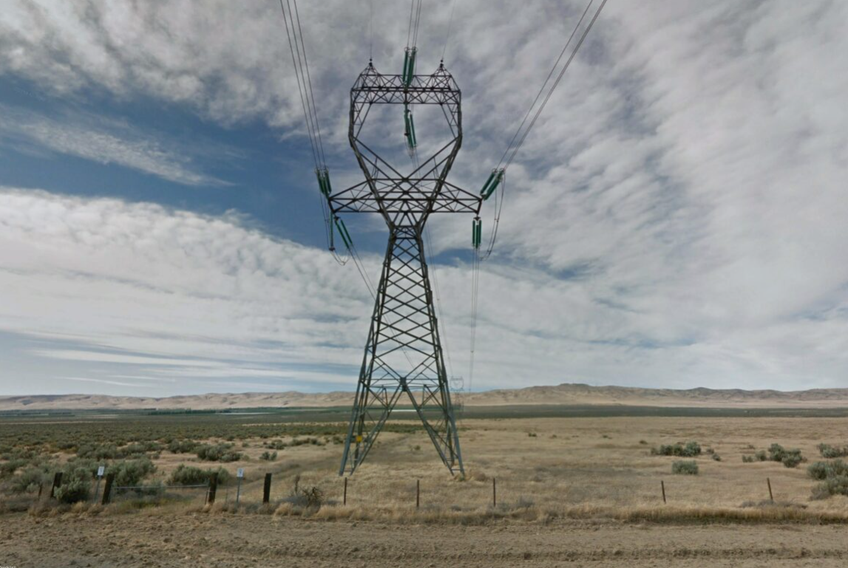
Option 1: Single Circuit Tower
Preliminary Concept Only

Slide 11
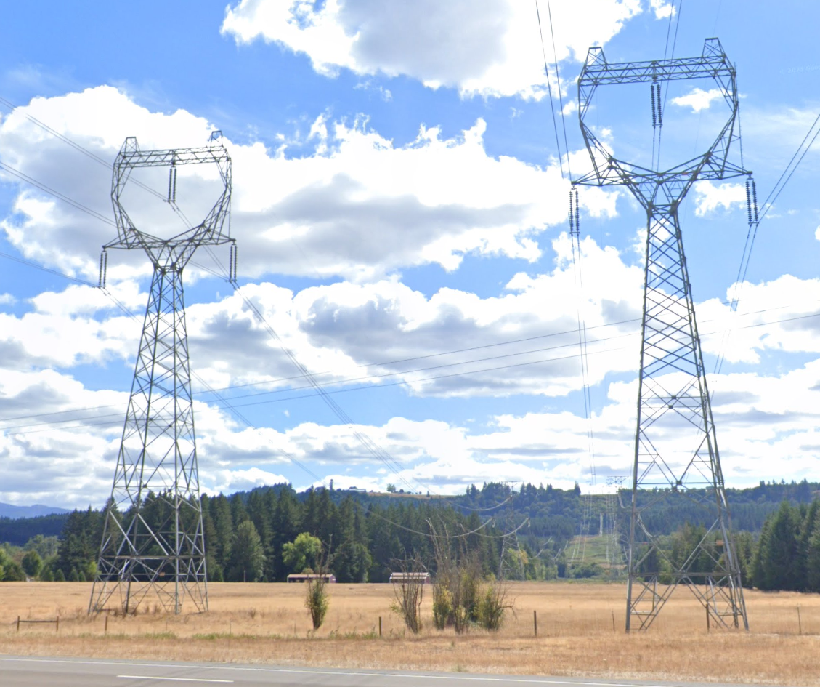
Option 2: Two Parallel Single Circuit Towers
Preliminary Concept Only

