Slide 1
Note to Bill.com Accounting Firm
This deck is for introducing Bill.com to a partner/colleague
It can be used as a standalone presentation, to introduce a demo, or to insert into a presentation on a broader set of your practice
To ready this deck for use, follow these instructions
  Drop in a PNG of your logo on the following slide in the white space provided
  Enter company name below logo space
  Add date of presentation
  Add presenter photo, name, and contact info to slide 9

Slide 2
Bill.com Overview for [PARTNER NAME]
Add Firm Logo
Bill management for our clients
Date

Slide 3















The Leading SaaS Platform for B2B Payments
65
Top-100 firms
$60B
Moved
3M
Members
Customer Validation
Proven Scale
Strong Network
Partners
Notes:
Bill.com is the leading SaaS platform for B2B payments. They make it simple for thousands of businesses, banks, and accounting firms to connect and do business. Bill.com is used and trusted by the best for over 10 years.

Slide 4
Bill Management – Why Bill.com
We partner with Bill.com, the intelligent business payments platform, to manage the complexities of our client’s bill payment needs.
Together, we ensure the highest levels of security balanced with our clients preferred level of control and involvement in the bill pay process.

Slide 5
Bill.com benefits our firm and accounting clients
Outsourcing bill pay delivers benefits to both
Accounting Practice Benefits
Client Benefits
Profitability
We serve more clients in less time with the new intelligent payments platform
Security
We worry less about fraud and hacking, Bill.com protects at the client and payment levels
Efficiency
We manage priorities from a single view and know where to focus attention
Satisfaction
We give clients the simplicity and control they want while solving their bill pay headaches
Payment preference
We securely pay vendors the way our clients want to pay them
Simplicity
We offer clients the simplest, most secure way to manage bill payments

Slide 6
Why Client Bill Pay
Benefits to the
Tax Practice
Organized bill payments prevent messy and disorganized client books
Clients will have properly documented expenses for tax purposes
A valuable solution that takes away client pain around bill management
You are cross-selling additional services, generating more fees for the firm

Slide 7
Why Client Bill Pay
Benefits to the
Audit Practice
Organized bill payments prevent messy and disorganized client books
Clients will have properly documented expense purpose, timing, and approval trail for audit purposes
Documented separation of duties
Large amounts of data are digitally stored and organized

Slide 8
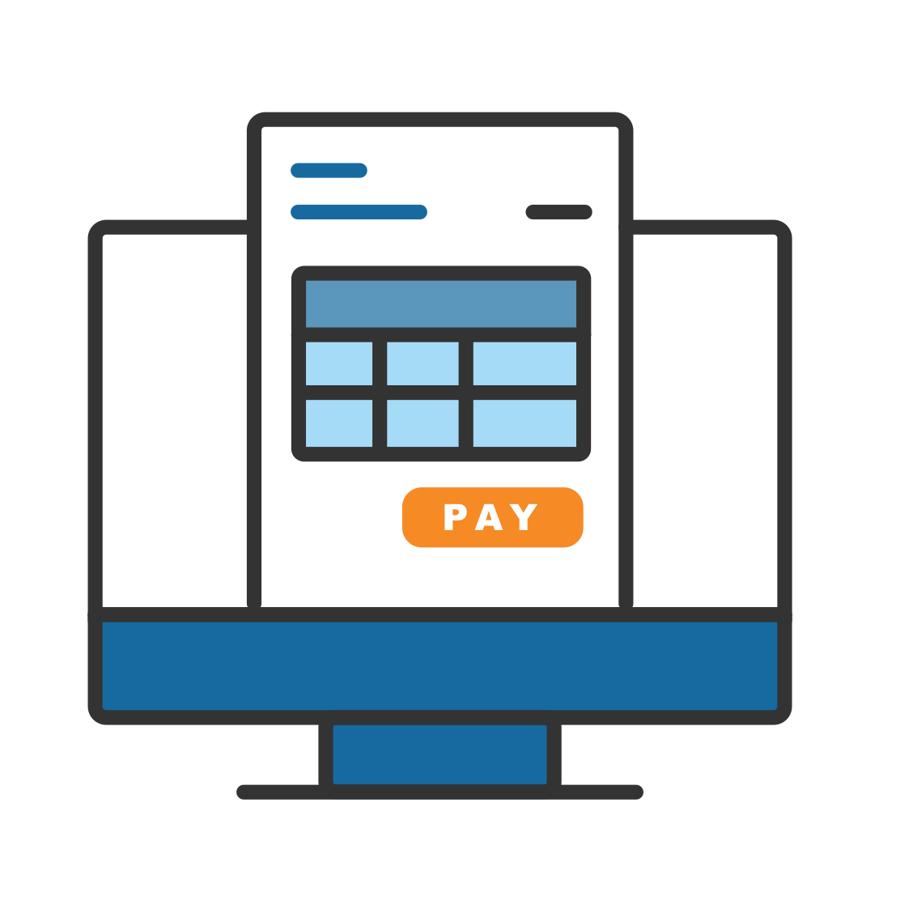
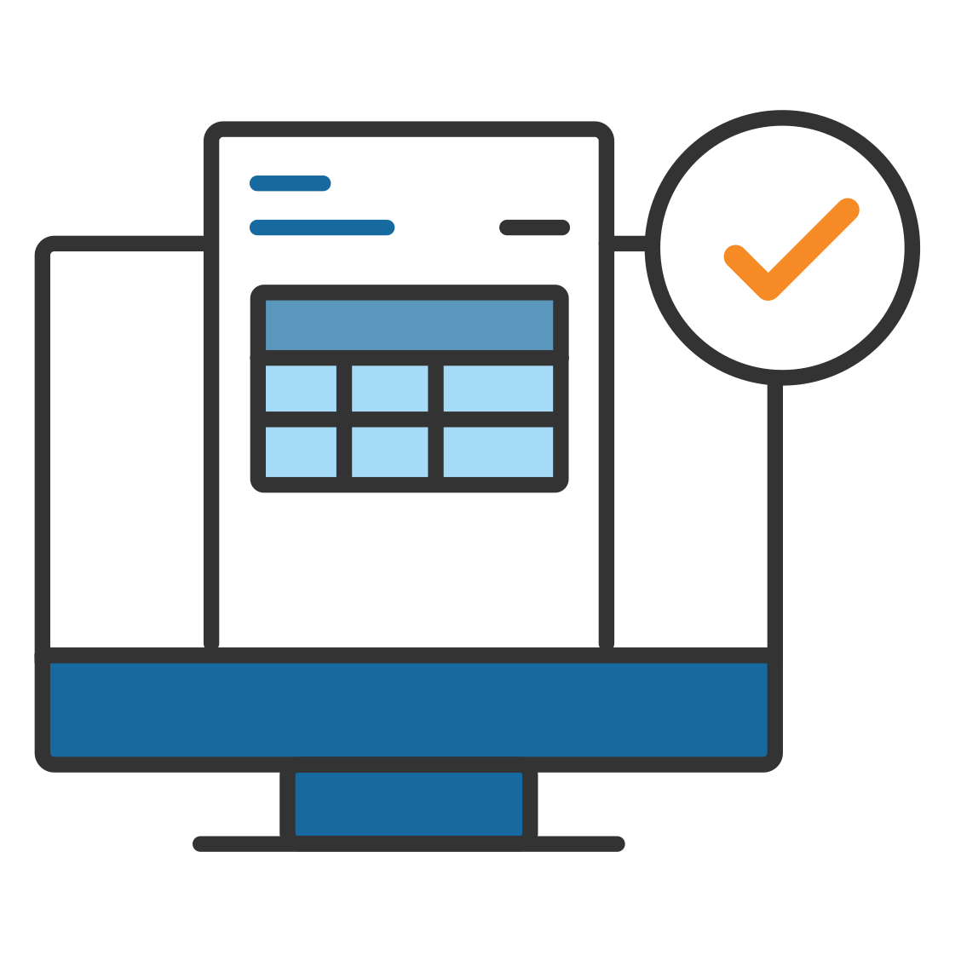


We Simplify and Secure Client Payments
4 Easy Steps
ENTER
APPROVE
PAY
ACCOUNT
Send bills via email
View and approve bills online from any device
We pay
We sync details with accounting system
Paperless
Automated
Secure
Efficient
Notes:
[This slide has a build.] AP
With Bill.com, the end-to-end payables process is simplified and automated. Bill.com is built from the ground up as a solution to track documentation, incorporate collaboration, and keep up to date records of expenses and revenue in the accounting software.
Throughout the process there are built in fraud prevention features, resulting in an automated payables process that is protected and takes less time to manage.

Slide 9

Bill.com is Secure
Designed With Firm and Client Security and Privacy In Mind
SOC 1 and SOC 2 attested
Encryption of data in motion and at rest consistent with leading industry practices
Automated payments solution for top US banks
Payments made digitally through Bill.com keep your bank account and routing information private
Protection against check fraud through automated Positive Pay service

Slide 10



What our peers have to say about Bill.com
"Bill.com is leading the industry in the move toward zero data entry. Every accounting professional on the planet should be taking a very hard look at Bill.com."
"Bill.com's web interface, payment network, approval feature set, user roles, and fraud protection make it a game changer for businesses and accounting firms."
“Our relationship with Bill.com offers firms a proven way to leverage technology to grow, establish a competitive advantage, and satisfy and retain clients."
JOE WOODARD, CEO AND FOUNDER
WOODARD CONSULTING
LAURA REDMOND, PARTNER
CLOUD CONSULTANCY LLC
ERIK ASGEIRSSON, PRESIDENT AND CEO
CPA.COM, AN AICPA COMPANY

Slide 11
Next Steps
Identifying and talking to your clients about Bill.com

Slide 12
Identifying Clients That Need Bill.com
Missing papers and expense documentation
Disorganized and out-of-date books
and files that require cleanup
Slow, manual accounting and bill
payment processes
No segregation of duties or
documented payment approvals
If you see any of these
characteristics in tax clients,
Bill.com can help.
Refer your client to our outsourced accounting team.
Notes:
The best candidates for Bill.com have the following characteristics:
Pay more than 10 bills each month
Are disorganized today, but have a desire for more efficiency
Want better cash flow management
Don’t have a dedicated employee looking after their billing
Are growing too fast and need help managing back-office functions

Slide 13



Recommending Bill.com to Clients
Talking Points
  Easier online bill pay
  The simplest, most secure
  way to manage payments
  Transparent cash flow
  See important payment details
  and documents, all in one place
  Mobile collaboration
  Convenient access for anytime,
  anywhere bill management
Provide materials about our accounting services and Bill.com – we can help!

Slide 14
Thank You!

