Slide 1
CANUTEC Services and the ERG2024
Presented to the 2024 Indigenous Public Safety Conference
Fady Al Zarka
Manager, Research and Publishing Services
October 25th, 2024

Slide 2
Outline
- Who are we?
Emergency Response Guidebook (ERG)
- Overview of different sections
Other Information
- CANUTEC and TDG Contacts
- What do we do?
- Information on Emergencies
CANUTEC
- Scenarios

Slide 3
CANUTEC – Who are we?
Notes:
Anyone want to take a guess what CANUTEC stands for? acronym

Slide 4
CANUTEC – Who We Are
Government of Canada
CANUTEC
Transport Canada
Safety / Security
Intermodal Surface Security and Emergency Preparedness
CANUTEC is the Canadian Transport Emergency Centre operated by the Intermodal Surface Security and Emergency Preparedness within Transport Canada.
It’s a national emergency centre in the event of a spill or exposure to dangerous goods during transport.
Since 1979, CANUTEC has been a free, 24/7 service.

Slide 5
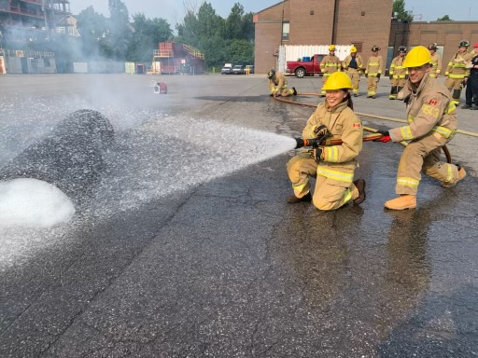
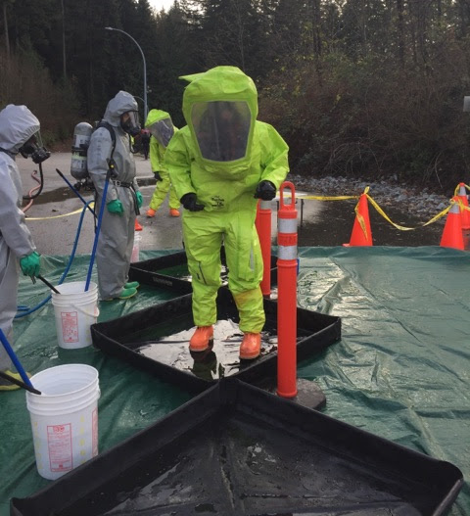
CANUTEC – Who We Are
Emergency Response Advisors
Scientists with chemistry, biochemistry, biology and chemical engineering backgrounds
Continuous training
Bilingual (English and French)
Technician Training at Ottawa Fire Center
Photo by: Ottawa Fire
Training at JIBC
Photo by: JP Morency
Notes:
All advisors have at least a bachelor’s degree in chemistry or a science related field. In addition to that, the advisors are trained in:
Training: (SAME AS FIRST RESPONDERS)
Hazmat technician TCS and HERS
Tank cars and highway tanks.
Radiation Safety (RSO)
TDG Act & Regulations
CBRNE
Etc.

Slide 6
CANUTEC – What do we do?

Slide 7
CANUTEC Overview
CANUTEC
Emergency Response Guidebook (ERG)
Technical advice
Company Registration
Safety Data Sheet (SDS) database
Maintain technical databases
Communication, Information Sharing
Plume dispersion models
Research and special projects
Simulations
Awareness Sessions
Assist general public
TDG regulations
Notes:
Quick Overview of what CANUTEC covers! You see there are many points mentioned here: We will be covering them in the next slides

Slide 8
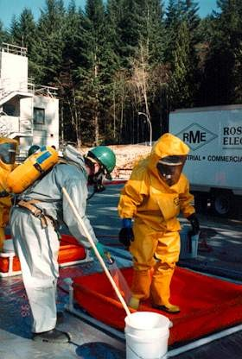
CANUTEC – What We Do
1. Provide technical advice 24/7/365
Chemical, physical and toxicological properties
Product incompatibility
Immediate public safety actions
Isolation and evacuation distances
Potential health effects
Personal Protective Equipment (PPE) requirements
Decontamination
Mitigation techniques
Protection measures for life, property and environment
Notes:
CANUTEC can provide a wide array of information to callers:
Mitigation techniques for fire. Although CANUTEC advisors are not experts in fire mitigation, they can provide a recommendation for when a chemical is involved. For example:
Recommend if water can be used or not with that product
Recommend which type of foam to use (AR-FFF or other)
Recommend what product to use (dry sand, Class D extinguisher, etc.)
Mitigation techniques for explosives. Once again, CANUTEC advisors are not experts (can direct to NRCAN), but can still recommend actions like resolubilization of a crystallized organic peroxide or wetting damaged fireworks before moving them.

Slide 9
CANUTEC – What We Do
CANUTEC
Consignors and Manufacturers
Carriers / Shippers (road, rail, air & marine)
First Responders (firefighters, police, hazmat, etc.)
Federal / Provincial / Municipal Government & EMP
Provincial and Federal Specialists
Other Emergency Centre
2. Coordinate communications and share information
Notes:
We receive calls from transport companies or shippers in the case of incidents with dangerous goods.
Hospitals contact us to obtain a product’s ingredients and/or an SDS.
Poison control centres often need SDS’s or refer calls from the public.
Provincial and Federal Specialists (explosives, radioactive materials, infectious materials, etc.)
Manufacturers register with CANUTEC
Many calls regarding regulation questions.

Slide 10
CANUTEC – What We Do
3. Participate in simulations
CANUTEC provides the opportunity for fire departments, Public Authorities and Industry to practice their emergency response scenarios during their training exercises.
During these types of calls, the Emergency Response Advisor will assist the person calling and provide advice for each steps of the scenario.
CANUTEC can help build and plan the scenarios.
CANUTEC participates in about 300 simulations per year.
Notes:
CANUTEC offers the possibility to Fire Departments and industries to participate in exercize scenarios (simulations)
During the call, the advisor will ask many questions and guide the caller throughout the intervention.
Don’t be afraid to call, it’s very beneficial (F/D won’t think or know to call CANUTEC if they don’t know what we do).
It gives a good idea of the questions that CANUTEC asks during a real emergency.

Slide 11
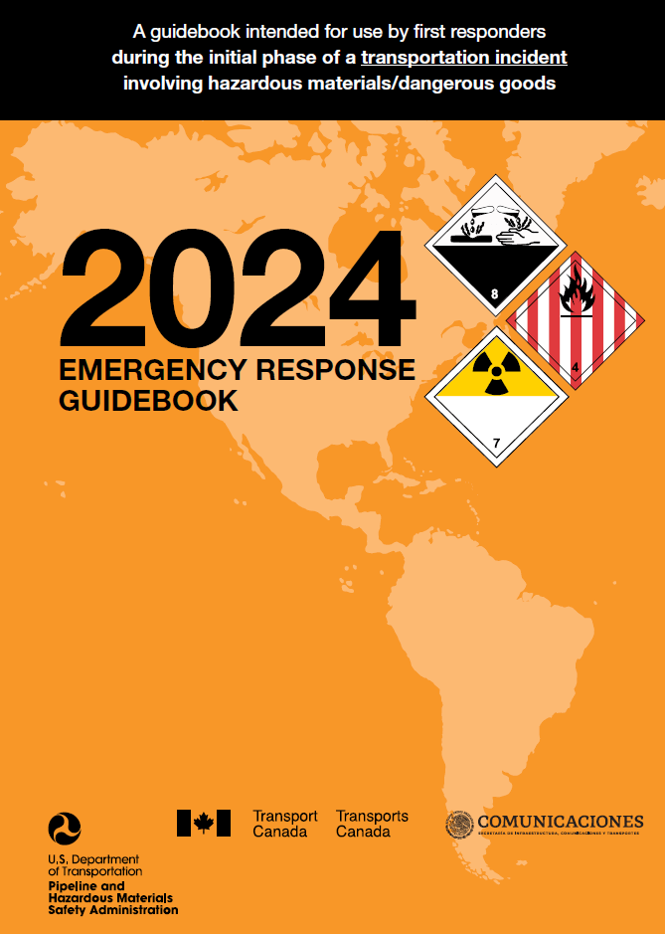
CANUTEC – What We Do
Collaborate with the production of the Emergency Response Guidebook (ERG)
International project with:
U.S.
Mexico
Argentina
Published every 4 years

Slide 12
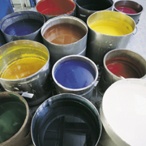
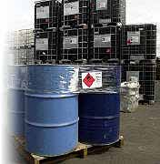
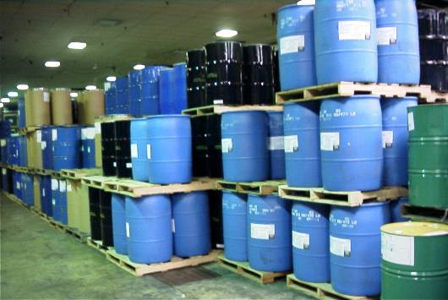
CANUTEC – What We Do
5. Register companies and maintain Safety Data Sheet (SDS) database
CANUTEC manages close to 4 million SDS in electronic format (~40 000 SDS are received every month)
Over 10 000 companies are registered with CANUTEC
Information described and transmitted to emergency response scene
SDS information is specifically critical for non-transport related incidents
6. Maintain technical databases
Notes:
4 million SDS value obtained in March 2023.
10 000 companies value obtained in June 2023 (includes up to date and suspended)
6. CAS, CRS, etc.

Slide 13
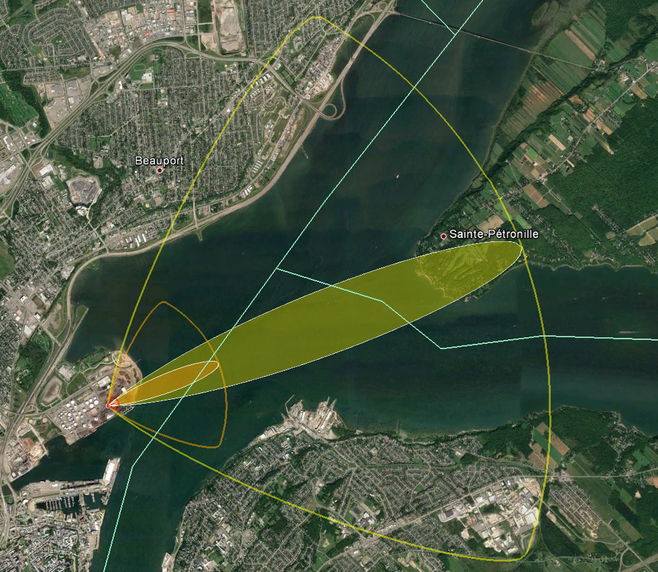
CANUTEC – What We do
7. Generate plume dispersion models
Example
Ammonia leak from a rail car
Notes:
CANUTEC advisors can generate plume dispersion models for toxic inhalation hazard (TIH) gases to assist first responders
We can generate plume using various software (CERES) and can request more complex plumes from Environment Canada that show progression of vapour cloud over time.
In this example:
Location: Quebec City / Île d’Orléans
Red Area: Initial Isolation Zone / IDLH
Orange Area: STEL
Yellow Area: Downwind Protective Action Zone / TWA

Slide 14
CANUTEC – What We Do
8. Research related to emergency response topics
CANUTEC chemicals database (CANUTEC Application Suite)
CANUTEC website articles
Detection devices
Personal Protection Equipment (PPE)
Lithium battery fires
9. Participate in special projects
Panorama Exercise (tabletop exercise)
BLEVE project (research)
Jack Rabbit II, LNG Project (research)
Notes:
Build scenarios regarding incidents involving dangerous goods for Panam Games and Vancouver Olympic Games.
Vulcan / Athena: two series of simulation exercises to improve Canada's response capabilities in the event of an incident involving a train carrying flammable liquids such as crude oil
Panorama: Tabletop exercise performed by the TDG directore to evaluate regional response effectiveness to a petroleum crude oil (UN1267 / Class 3, PG II) unit train derailment involving several tank cars
Jack Rabbit: Evaluate chlorine dispersion potential and its characteristics in emergency situations, in collaboration with USA and the Department of Homeland Security (DHS)
LNG Project: Project to evaluate the applicability of guidance in the ERG as they pertain to Liquefied Natural Gas

Slide 15
CANUTEC – What We Do
10. CANUTEC can also:
Provide basic advice on TDG Regulations
Prepare and participate in TDG Awareness Sessions
Assist the general public during emergencies

Slide 16
Notes:
Example call starts at the 1:50 minute mark

Slide 17
CANUTEC –
Information on Emergencies

Slide 18
Call Handling Procedures
CANUTEC handles approximately 30,000 communications and 2,000 emergencies per year.
All calls are handled immediately by the advisors, then dealt with according to their priority.
Timely provision of technical information is critical and requires immediate treatment in emergency situations.
Due to the privileged information criteria under the TDG Act, the information received at CANUTEC cannot be shared or widely disseminated.
Notes:
Mention Article 24 – TDG Act
All pertinent information is properly disseminated to our internal stakeholders when required. Since all information received by CANUTEC in regards to dangerous goods incidents are privileged, they can only be divulged for public safety purposes. As such, the information should not be used for any inspection, audit or assessment.

Slide 19
CANUTEC – Emergencies by Class for 2023*
Class 1 | Explosives
Class 2 | Gases
Class 3 | Flammable Liquids
Class 4 | Flammable Solids; Substances Liable to Spontaneous Combustion; Substances That on Contact with water Emit Flammable Gases
Class 5 | Oxidizing Substances and Organic Peroxides
Class 6 | Toxic and Infectious Substances
Class 7 | Radioactive Materials
Class 8 | Corrosives
Class 9 | Miscellaneous Products, Substances or Organisms
Other | Includes incidents with unidentified or non-regulated** DGs and mixed loads***
Number of Emergencies (Year 2023)
Class of Dangerous Goods (1 to 9)
Notes:
*Includes primary and subsidiary classes. Possibly multiple DGs per incident
**Non-Regulated refers to a substance not regulated in Canada
***Mixed load refers to a means of containment with several classes
Most common: Class 2 Gases, Class 3 Flammable Liquids, Class 8 Corrosives
Class 2 = LPG, propane, anhydrous ammonia
Class 3 = gas, diesel, petroleum crude oil
Class 8 = hydrochloric acid (muriatic), sodium hydroxide (caustic), sulphuric acid
Non-regulated= coal cars, some sulfur products, waste

Slide 20
Emergency Response Guidebook (ERG)
Notes:
We have now reached the 2nd part of the presentation.
How many never used the ERG? Who did? In what circumstances? Why? How?

Slide 21
Emergency Response Guidebook (ERG)
The ERG is primarily a guide to aid First Responders during an incident involving dangerous goods in transport:
By quickly identifying the specific, or generic, hazards of the material(s) involved
By protecting themselves and the general public during the initial response phase of the incident
Before an emergency – become familiar with this guidebook!
Without the proper training/equipment, do not take on an offensive role during an incident.
Notes:
Initial Phase : First 15-30 min of an incident
Guide = general (ex.: 1202 and 1203 are together)
The guide helps first responders with an incident involving DGs in transport.
With the guide, first responders can:
- Quickly determine hazards.
- Protect themselves and the public.

Slide 22
Emergency Response Guidebook (ERG)
The ERG is published every 4 years. It is available in:
Paper format;
PDF format;
Online version;
Mobile App for smartphones (Android, Apple).
Training material is available on CANUTEC’s website:
Summary of the changes made to the 2024 edition;
Training package;
Awareness video.
Notes:
1st Canadian edition was in 1979 and 1st American edition was in 1980.
In 1994, a NAFTA initiative led to a jointly published ERG in 1996 between Canada, the United States and Mexico
The first jointly released ERG was released as the ERG1996
The ERG was, from then on, jointly published in three languages (English, French and Spanish)
In the US, the US DOT PHMSA (Pipeline and Hazardous Materials Safety Administration) contributes to the ERG publication
The Guide is published every 4 years and is now available in more than 30 languages.
In Canada, each year approximately 120,000 ERGs are provided free of charge to Canadian fire fighters, police officers and emergency medical services (EMS) in addition to a desktop version (ERGO) and an online version (ERG Online). Mobile applications for Android and iOS (only in English) have also been developed by third parties.

Slide 23
Emergency Response Guidebook (ERG)
How to obtain free paper copies:
Paper copies of the ERG2024 are distributed for free to Canadian First Responders from public emergency services (police, fire department, ambulance services, etc.).
The distribution policy can be found at the following website: Emergency response guidebook: paper copy
To order free paper copies, please submit your request by filling the ERG order form.

Slide 24
Overview of the ERG
The main sections are:
WHITE section
Flowchart (How to use the ERG)
Table of Markings, Labels and Placards
Rail Car Identification Chart
Road Trailer Identification Chart
YELLOW section (list of materials by ID (UN) number)
BLUE section (list of materials by name)
ORANGE section (appropriate emergency response guides)
GREEN section (initial isolation and protective action distances for highlighted substances)
Notes:
White section: highly recommend to read BEFORE AN emergency, you will know what to do with the ERG and how the ERG can help you.
Green section: TIH (Toxic by Inhalation) vapors/gases

Slide 25
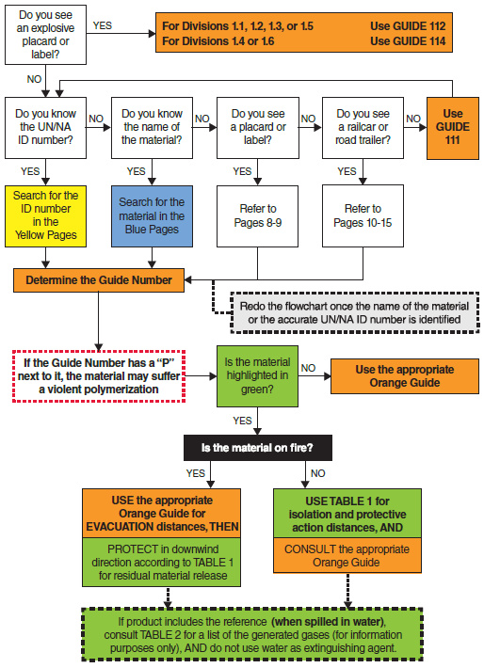
How to use the ERG
The flowchart is found at the beginning of the ERG.
This flowchart will help you choose the correct Guide (ORANGE section) for your incident – given the information that is available.
Start the flowchart at the top, left hand corner, and follow until your situation applies.

Slide 26
YELLOW Section
In this section, the substances are listed in numerical order of their 4-digit ID (UN) numbers.
The ID (UN) number is followed by the 3-digit Guide number (ORANGE section) and the name of the material (see next slide).
Please note that some substances are highlighted in green and you may need to refer to the GREEN section for initial isolation and protective action distances. The ORANGE section may be consulted for other safety recommendations or when a fire is involved.
Notes:
If product is on fire and highlighted in green, you still go to the orange section under fire hazard

Slide 27
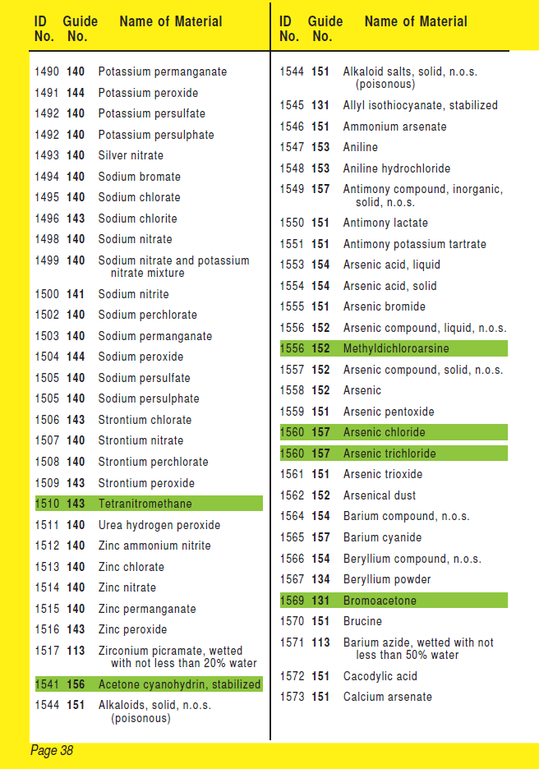
Refer to the
GREEN section
for distances

Slide 28
BLUE Section
In this section, the substances are listed in alphabetical order of the material name.
The name of the material is followed by the 3-digit Guide number (ORANGE section) and the ID (UN) number (see next slide).
Please note that some substances are highlighted in green and you may need to refer to the GREEN section for initial isolation and protective action distances. The ORANGE section may be consulted for other safety recommendations or when a fire is involved.

Slide 29
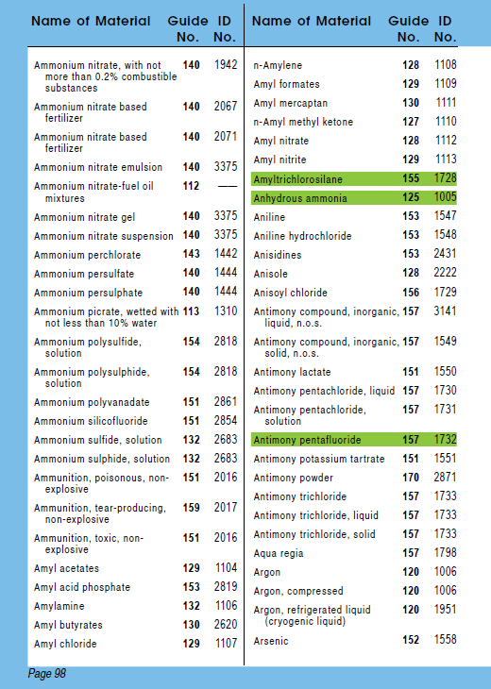
Refer to the GREEN section
for distances

Slide 30
ORANGE Section
Each guide in the ORANGE section applies to a group of materials with similar chemical and toxicological characteristics.
Each guide recommends safety and emergency response procedures to protect yourself and the public.
There are three main parts in each guide:
Potential Hazards
Public Safety
Emergency Response

Slide 31
ORANGE Section
Guide 112
Potential Hazards
Public
Safety
Emergency Response
Fire or
Explosion
Primary Information
Fire
Spill or
Leak
Health
Protective Clothing
First Aid
Evacuation
In Potential Hazards, depending on the primary hazard for the substances, the subsection Fire or Explosion or Health will appear first (see next slide).

Slide 32
Primary Hazard: Fire or Explosion
Secondary Hazard: Health

Slide 33
ORANGE Section
The Potential Hazard section provides:
Information on health and fire / explosion
The Public Safety section provides:
General info on protective clothing and respiratory protection;
The Evacuation subsection provides :
Immediate isolation distance, regardless of the quantity involved;
A suggested evacuation perimeter for large spill or fire situations AND/OR a reference to Table 1 - Initial Isolation and Protective Action Distances (GREEN section).
These sections are always found on the left-hand page

Slide 34
ORANGE Section
The Emergency Response section provides:
Emergency response actions to mitigate the incident;
Instructions to follow in case of a fire;
Actions to be taken in case of a spill/leak;
Specific first aid guidance for a product or a guide.
This section is always found on the right-hand page
NOTE: General first aid guidance is now found in a new section situated before Guide 111.
Overview
Usage
Other info
CANUTEC

Slide 35
GREEN Section
If the material is highlighted in green in the YELLOW and BLUE sections, you may need to refer to the GREEN section.
The GREEN section of the ERG consists of three parts :
TABLE 1 - Initial Isolation and Protective Action Distances;
TABLE 2 - Water-Reactive Materials which Produce Toxic Gases;
TABLE 3 - Initial Isolation and Protective Action Distances for Large Spills for Different Quantities of Six Common Toxic by Inhalation (TIH) Gases.
Notes:
Table 2 – information purpose only, no distance there, simply to know what gases are produced when product is spilled in water

Slide 36
GREEN Section – Table 1
TABLE 1 - Initial Isolation and Protective Action Distances suggests distances to protect people from vapours resulting from spills involving dangerous goods that are:
Toxic by inhalation (TIH);
Materials that produce toxic gases upon contact with water.
In this table, the substances are in numerical order of their ID (UN) numbers. Some materials indicate to consult Table 3 for more information.
Overview
Usage
Other info
CANUTEC

Slide 37
GREEN Section – Table 1
Table 1 provides, for small and large spills, suggested distances for:
The Initial Isolation Zone; and
The Protective Action Zone for day and night.
The distances show the areas likely to be affected during the first 30 minutes after the materials are spilled, and this distance could increase with time.
Overview
Usage
Other info
CANUTEC

Slide 38
Table 1 – Small and Large Spills
The definitions are as follows:
Small spill: Quantities that are 208 liters or less. This generally corresponds to a spill from a single small package (for example, a drum), a small cylinder, or a small leak from a large package.
Large spill: Quantities that are greater than 208 liters. This usually involves a spill from a large package, or multiple spills from many small packages.
Overview
Usage
Other info
CANUTEC

Slide 39
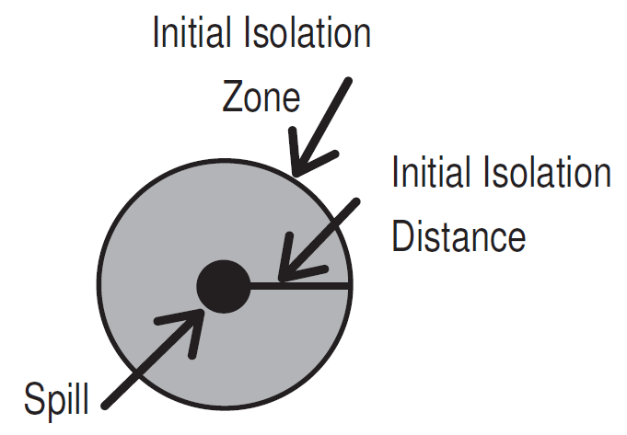
Table 1 – Initial Isolation Zone
The distances for the initial isolation zone are found in Table 1 under “First Isolate”.
This distance defines the radius of a zone (Initial Isolation Zone) surrounding the spill in ALL DIRECTIONS.
The public within this zone should be evacuated.
Protective clothing and respiratory protection are required.
Overview
Usage
Other info
CANUTEC

Slide 40
Table 1 – Protective Action Zone
The distances for the protective action zone are found in Table 1 under “Then Protect”.
This distance defines an area DOWNWIND from the incident in which people are at risk of harmful exposure.
The responders must choose a protective action:
Evacuation;
Shelter-in-place; or
A combination of both.
Overview
Usage
Other info
CANUTEC

Slide 41
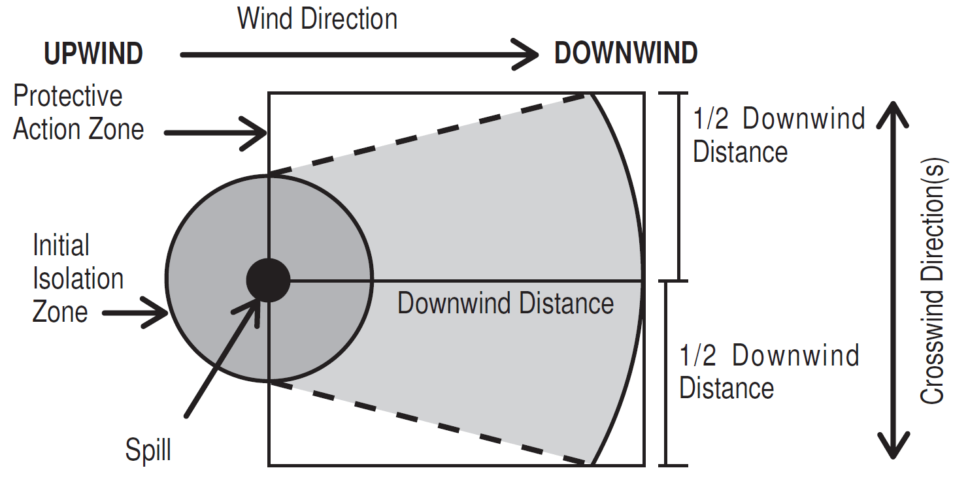
Table 1 – Protective Action Zone
For practical purposes, the Protective Action Zone is a square, whose length and width are the same as the distance shown in Table 1.
Overview
Usage
Other info
CANUTEC

Slide 42
Table 1 – Protective Action Zone
The protective action distances are divided into daytime and nighttime because the atmospheric conditions will affect the size of the hazardous area.
Day: after sunrise, before sunset
Night: between sunset and sunrise
The Protective Action Zones are determined not only by the presence of gases/vapours but their concentration in the air.
Overview
Usage
Other info
CANUTEC

Slide 43
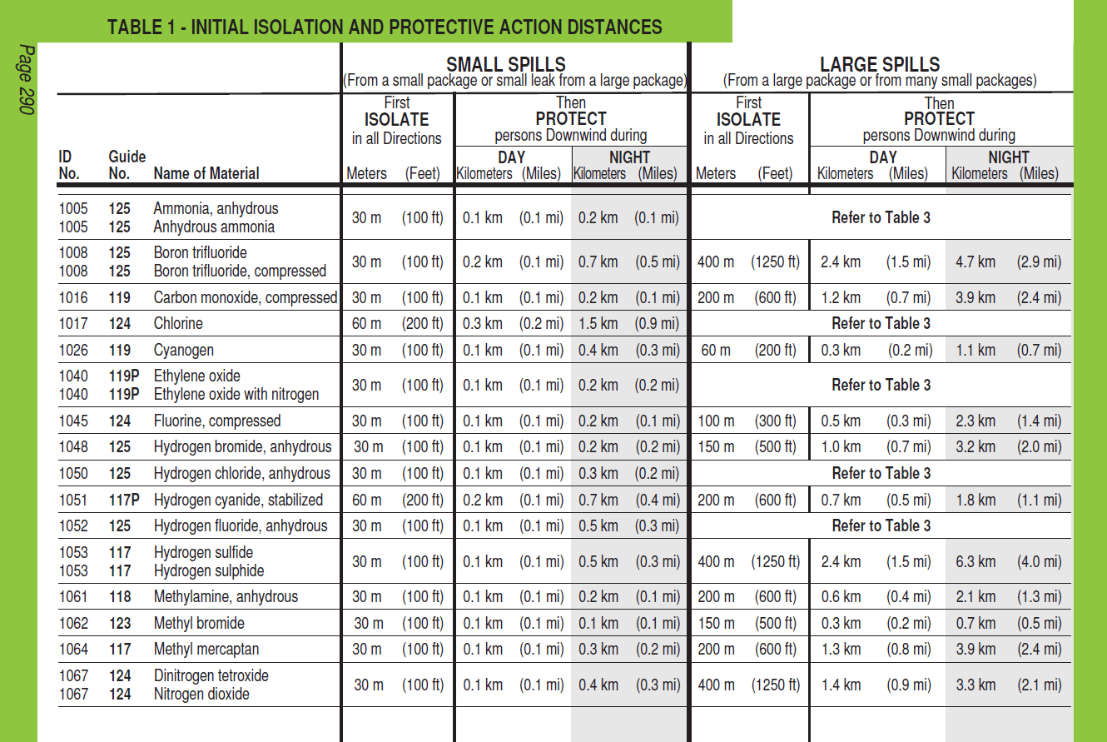
43

Slide 44
GREEN Section – Table 2
TABLE 2 - Water-Reactive Materials which Produce Toxic Gases contains:
A list of materials that produce large amounts of Toxic Inhalation Hazard (TIH) gases when spilled in water and identifies the TIH gases produced.
The substances are presented in numerical order of their ID (UN) numbers (see next slide).
As shown below, these Water-Reactive materials are easily identified in Table 1 as their name is immediately followed by (when spilled in water).
Overview
Usage
Other info
CANUTEC

Slide 45
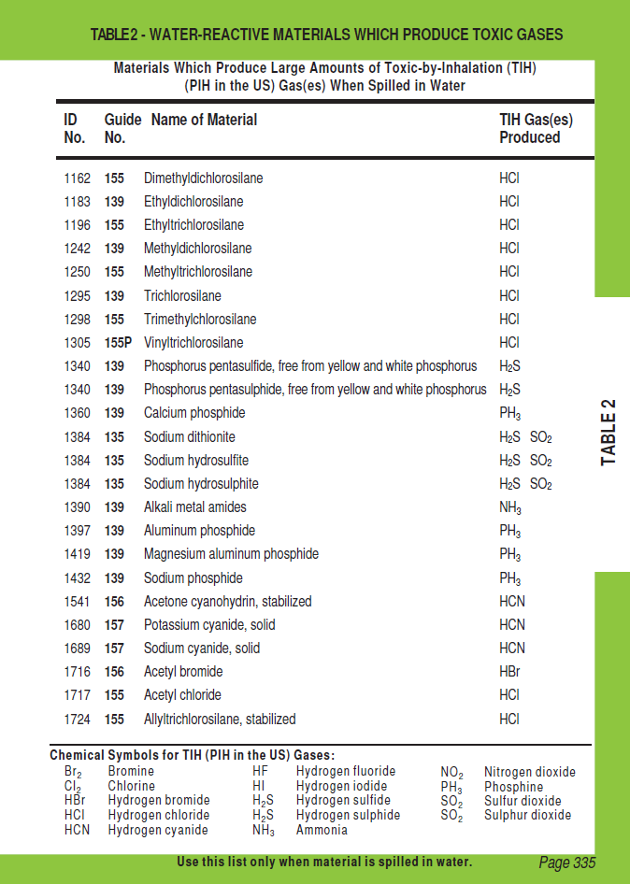

Slide 46
GREEN Section – Table 2
Important:
The TIH gases produced, indicated in Table 2, are for information purposes only. These TIH gases have already been taken into consideration in the distances of Table 1.
For example, Table 2 indicates that UN1162 - dimethyldichlorosilane, when spilled in water, will generate HCl (hydrogen chloride gas). In Table 1, you must refer to the distances for dimethyldichlorosilane and not the distances for hydrogen chloride gas.
Overview
Usage
Other info
CANUTEC

Slide 47
GREEN Section – Table 3
TABLE 3 - Initial Isolation and Protective Action Distances for Large Spills for Different Quantities of Six Common TIH Gases contains:
A list of Toxic Inhalation Hazard materials that may be more commonly encountered.
The materials are:
UN1005 - Ammonia, anhydrous / Anhydrous ammonia
UN1017 - Chlorine
UN1040 - Ethylene oxide and Ethylene oxide with nitrogen
UN1050 - Hydrogen chloride, anhydrous and UN2186 - Hydrogen chloride, refrigerated liquid
UN1052 - Hydrogen fluoride, anhydrous
UN1079 - Sulfur dioxide / Sulphur dioxide
Overview
Usage
Other info
CANUTEC

Slide 48
GREEN Section – Table 3
Table 3 provides initial isolation and protective action distances for LARGE SPILLS (more than 208 litres) involving different container types (therefore, different volume capacities) for daytime and nighttime situations and different wind speeds.
The materials are in numerical order of their ID (UN) number (see next slide).
Overview
Usage
Other info
CANUTEC

Slide 49
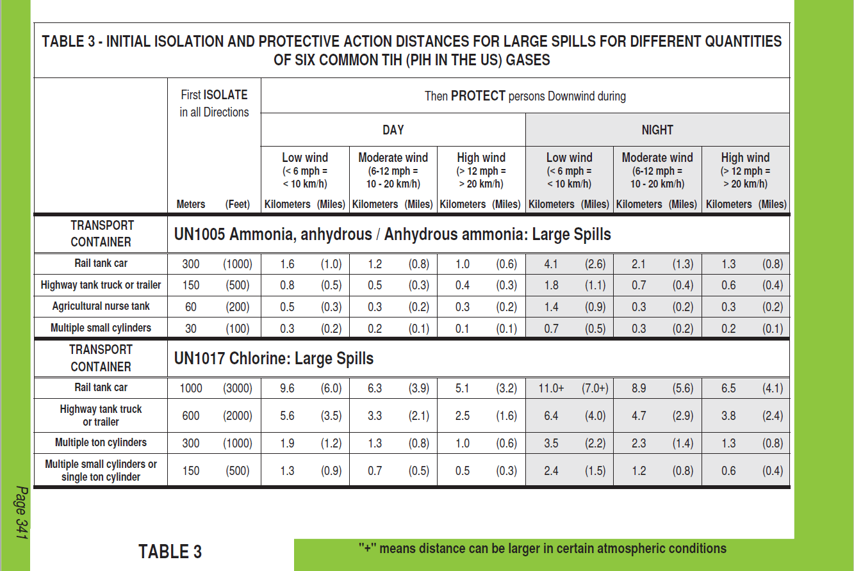

Slide 50
GREEN Section – Table 3
These materials will be identified in Table 1 with the mention: Refer to Table 3.

Slide 51
Scenario Guidelines
For each of the following scenarios:
Identify the product in the YELLOW or BLUE Sections;
Find the appropriate Guide in the ORANGE Section;
Identify the suggested distances in the ORANGE and/or GREEN Sections;
Describe the main characteristics and hazards of the substance.

Slide 52
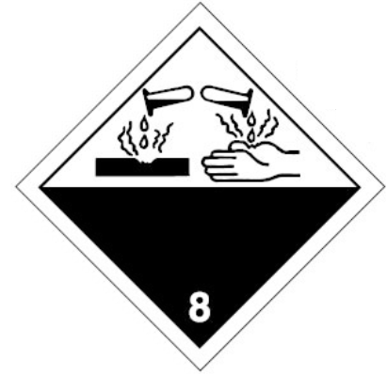
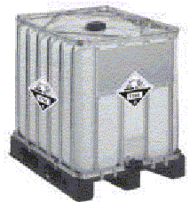
Scenario 1
A 1000-litre tote container is leaking.
1824

Slide 53
Scenario 1 – Solution
The ID (UN) number is 1824 and it is a corrosive product (Class 8 placard);
In the YELLOW section, this product corresponds to Caustic soda, solution or Sodium hydroxide, solution and refers to Guide 154;
The substance is not highlighted in green; therefore, the GREEN section does not apply.

Slide 54
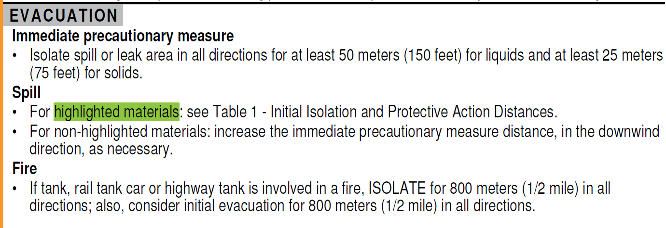
Scenario 1 – Solution
Since the product is not highlighted in green, use the suggested distances found in Guide 154 under EVACUATION.

Slide 55
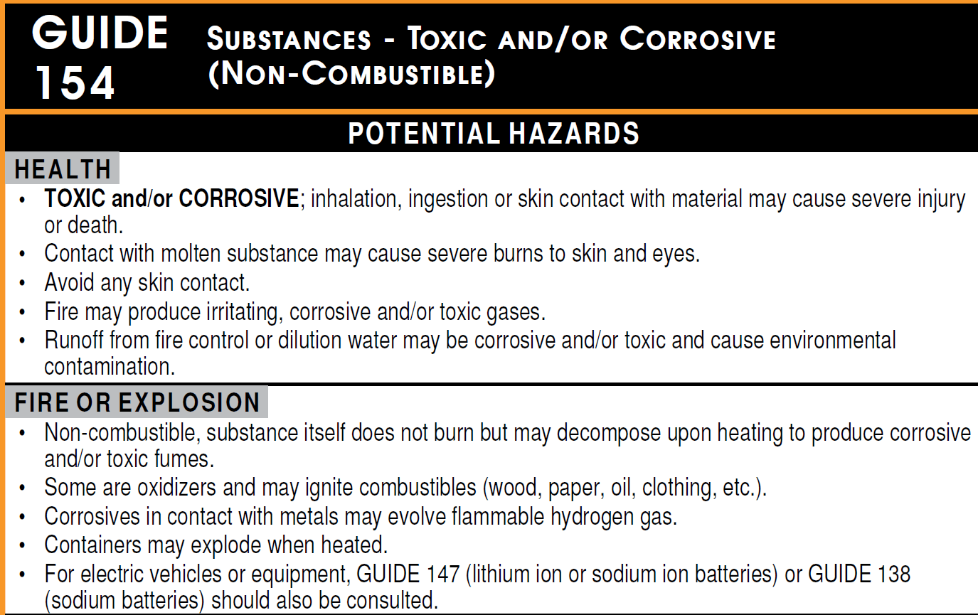
Scenario 1 – Solution
Main characteristics and hazards of the substance are found in Guide 154 under POTENTIAL HAZARDS.
Given that the primary danger associated with Sodium hydroxide is health (corrosive), the HEALTH section precedes the FIRE OR EXPLOSION section.

Slide 56
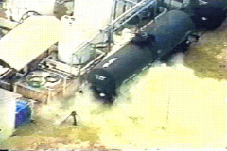
Scenario 2
A rail tank car is leaking during the day, at a well-known facility in your area, where chlorine rail cars are the only dangerous goods being handled.
Source: KTVI-TV St. Louis, Missouri, USA

Slide 57
Scenario 2 – Solution
The product involved is Chlorine;
In the BLUE section, this product indicates that the ID (UN) number is 1017 and refers to Guide 124;
The substance is highlighted in green; therefore, since there is a spill (and no fire), the initial isolation and protective action distances must be taken from Table 1.

Slide 58
Scenario 2 – Solution
Table 1 - Initial Isolation and Protective Action Distances for UN1017 - Chlorine shows that for large spills, Table 3 must be consulted for isolation and protective action distances.

Slide 59
Scenario 2 – Solution
For a rail car, the initial isolation distance (First Isolate) suggested in Table 3 is 1000 metres. The protective action distances (Then Protect) must be taken during the day, depending on the wind speed (9.6 km, 6.3 km or 5.1 km).

Slide 60
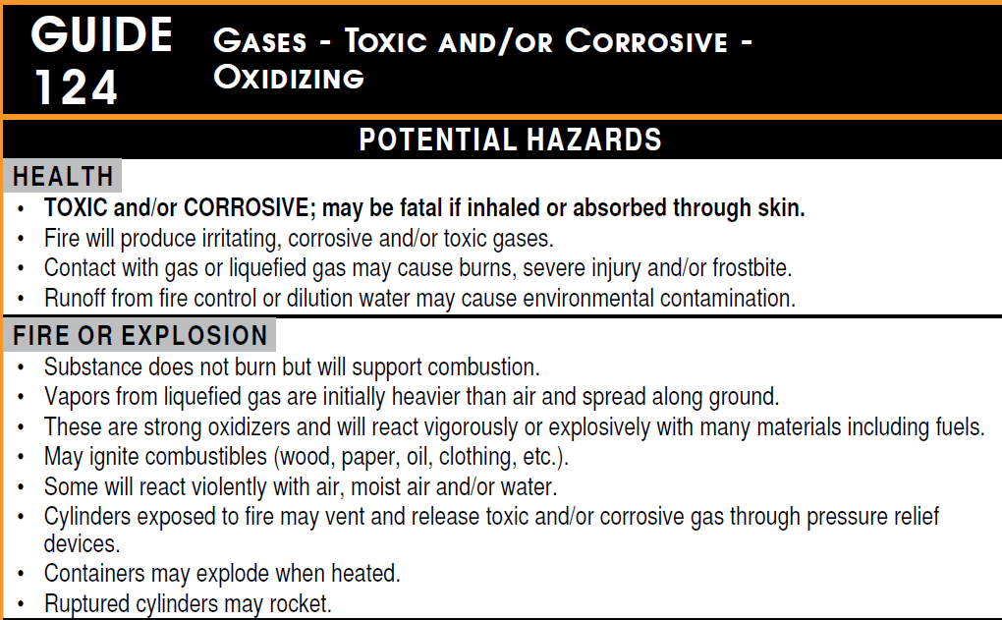
Scenario 2 – Solution
Main characteristics and hazards of the substance are also found in Guide 124 under POTENTIAL HAZARDS.
Given that the primary danger associated with Chlorine is health, the HEALTH section precedes the FIRE OR EXPLOSION section.

Slide 61
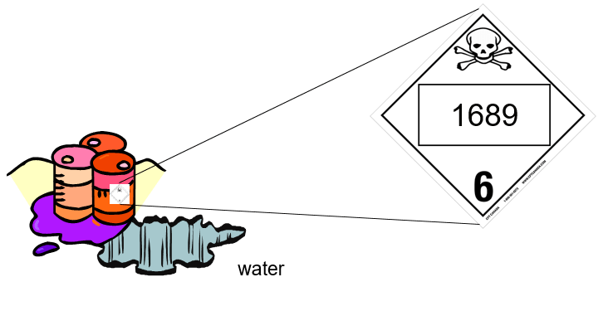
Scenario 3
A drum is leaking in a puddle of water.

Slide 62
Scenario 3 – Solution
The ID (UN) number is 1689 and it is a toxic product (Class 6.1 label);
In the YELLOW section, this product is Sodium cyanide, solid and refers to Guide 157;
The substance is highlighted in green; therefore, since there is a spill (and no fire), the initial isolation and protective action distances must be taken from Table 1.

Slide 63
Scenario 3 – Solution
In Table 1, UN1689 includes (when spilled in water) meaning that the product is a water-reactive;
Since the product is leaking in a puddle of water, Table 1 will have to be used for suggested isolation and protective action distances.

Slide 64
Scenario 3 – Solution
In Table 1, when the material name is immediately followed by (when spilled in water), Table 2 will indicate the TIH gases produced;
For UN1689, the gas produced is HCN (Hydrogen cyanide).

Slide 65
Scenario 3 – Solution
IMPORTANT:
The TIH gases produced, indicated in Table 2, are for information purposes only. These TIH gases have already been taken into consideration in the distances of Table 1.
For UN1689, in Table 1, you must refer to the distances for Sodium cyanide, solid and not the distances for Hydrogen cyanide gas (HCN).

Slide 66
Scenario 3 – Solution
For UN1689, Table 1 suggests distances specifically when the product is spilled in water. If this was not the case, the GREEN section does not apply, and the suggested distances found in Guide 157 under EVACUATION must be used.

Slide 67
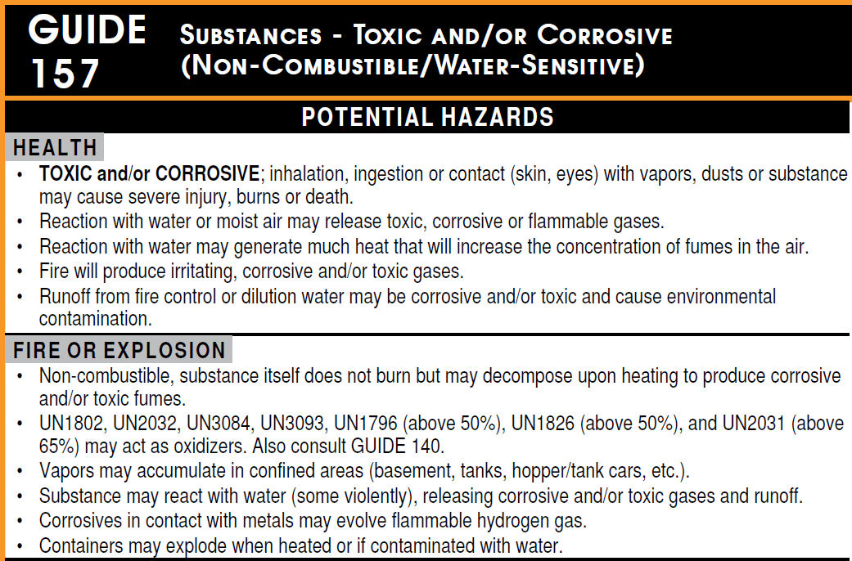
Scenario 3 – Solution
Main characteristics and hazards of the substance are found in Guide 157 under POTENTIAL HAZARDS.
Given that the primary danger associated with Sodium cyanide, solid is health (toxic), the HEALTH section precedes the FIRE OR EXPLOSION section.

Slide 68
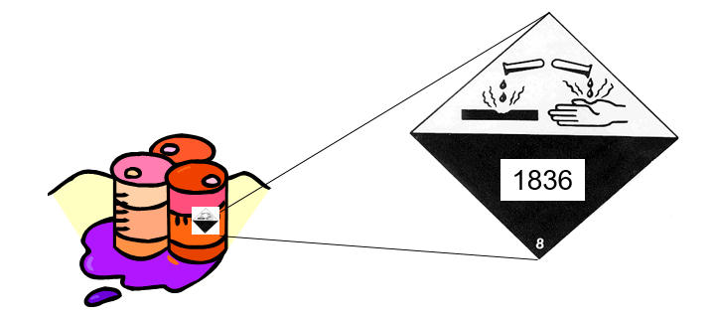
Scenario 4
A drum containing this substance is punctured and is leaking on the ground.

Slide 69
Scenario 4 – Solution
The ID (UN) number is 1836 and it is a corrosive product (Class 8 label);
In the YELLOW section, this product is Thionyl chloride and refers to Guide 137;
The substance is highlighted in green; therefore, since there is a spill (no fire), the initial isolation and protective action distances must be taken from Table 1.

Slide 70
Scenario 4 – Solution
For this product, Table 1 has two separate entries for UN1836: one entry for (when spilled on land) and another entry for (when spilled in water);

Slide 71
Scenario 4 – Solution
Since the product is spilled on the ground, the initial isolation distance in Table 1 (First Isolate) is 30 metres in all directions for a small spill;
Additionally, the protective action distances (Then Protect) for day and night will have to be taken from Table 1.

Slide 72
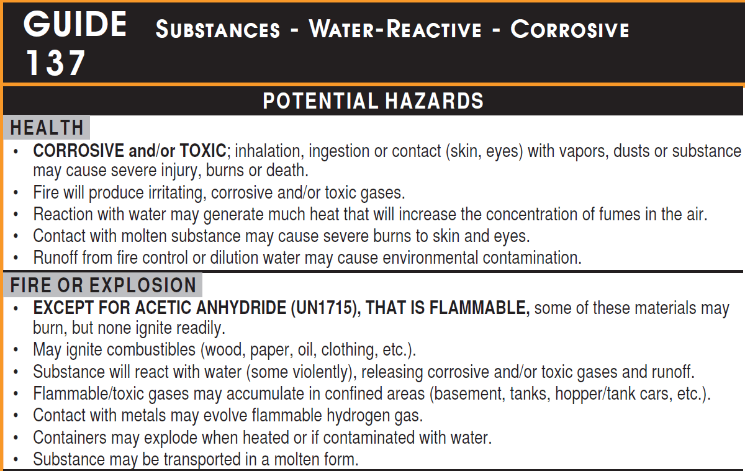
Scenario 4 – Solution
Main characteristics and hazards of the substance are found in Guide 137 under POTENTIAL HAZARDS.
Given that the primary danger associated with Thionyl chloride is health (corrosive), the HEALTH section precedes the FIRE OR EXPLOSION section.

Slide 73
CANUTEC and TDG Contacts

Slide 74
CANUTEC
In case of an emergency, dial, 24 hours a day, 7 days a week:
1-888-CAN-UTEC (1-888-226-8832), or
(613) 996-6666, or
*666 on a cellular (Canada only).
In a non-emergency situation (for example a simulation), please call the information line available 24 hours a day, 7 days a week at (613) 992-4624.
By email: CANUTEC@tc.gc.ca

Slide 75
CANUTEC Registration Services
In charge of ERG distribution
Manage the CANUTEC Registration System (CRS)
How to contact the registration team:
By phone: 1-613-947-5048
Toll-free: 1-888-706-0195
By email: canutec.services@tc.gc.ca

Slide 76
TDG Contacts
For questions related to the TDG Regulations TDG Regional Offices
Region | Telephone Number | Email address
Atlantic | 1-866-814-1477 | TDG-TMDAtlantic@tc.gc.ca
Quebec | 1-514-633-3400 | TMD-TDG.Quebec@tc.gc.ca
Ontario | 1-416-973-1868 | TDG-TMDOntario@tc.gc.ca
Prairie & Northern | 1-888-463-0521 | TDG-TMDPNR@tc.gc.ca
Pacific | 1-604-666-2955 | TDGPacific-TMDPacifique@tc.gc.ca
General TDG information: TDG-TMD@tc.gc.ca
Safety Awareness Team:
TC.TDGSafetyAwareness-SensibilisationalasecuriteduTMD.TC@tc.gc.ca
Response Operations Team (ERAP Program):
TC.ChiefResponseOperations-ChefOperationsDeReponse.TC@tc.gc.ca

Slide 77
Thank you! Questions?

Slide 78
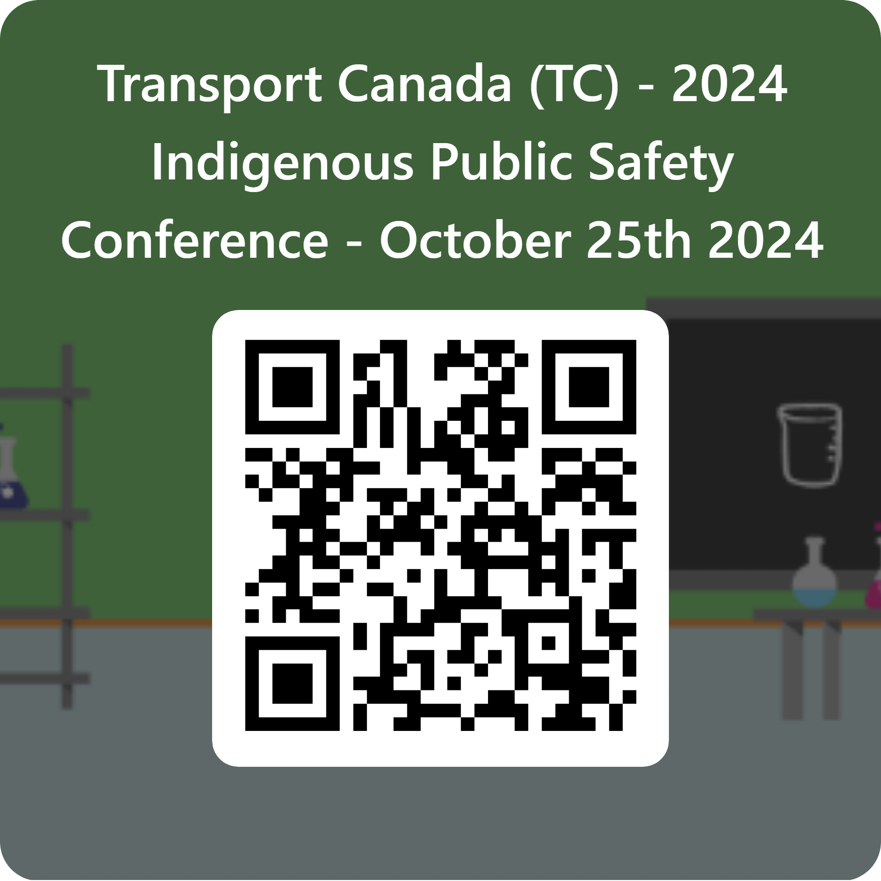
Feedback
Please click on the link below or scan the QR code to send us your feedback on the presentation!
Link: https://forms.office.com/r/ekQUy41MLu

Slide 79
Legislation Overview

Slide 80
Legislation Overview
CANUTEC and the TDG Regulations
According to Part 3 (Documentation) of the TDG Regulations, the shipping document must contain the following information:
The words “24-Hour Number” or " Numéro 24 heures " or an abbreviation of these words, followed by a telephone number, including the area code, at which the shipper can be reached immediately for technical information about the dangerous goods in transport, without breaking the telephone connection made by the caller
A shipper can use:
A 24-hour number of their choice; or
CANUTEC’s phone number (if they are registered with CANUTEC).
To register with CANUTEC: tc.canada.ca/canutec
Notes:
CANUTEC services are free of charge for Canadian consignors.
The services are 24/7 basis therefore consignors who are unable to provide assistance around the clock may use CANUTEC number.
To be able to use CANUTEC’s number, the shipper or distributor must have a CANUTEC registration approved.

Slide 81
Legislation Overview
According to Part 8 (Reporting Requirements) of the TDG Regulations, certain reports must be submitted to CANUTEC. Here are some of the criteria to report:
A means of containment was damaged to the extent that its integrity is compromised
If someone required immediate medical treatment, if the death of a person occurred, or if an evacuation/shelter in place was required
The closure of a facility, a road, a main railway line, an aerodrome or a main waterway
Dangerous goods accident or incident by air
Undeclared or misdeclared dangerous goods
The lost or theft of dangerous goods
Unlawful interference with dangerous goods
When an ERAP is implemented

Slide 82
Emergency Response Assistance Plan (ERAP)

Slide 83
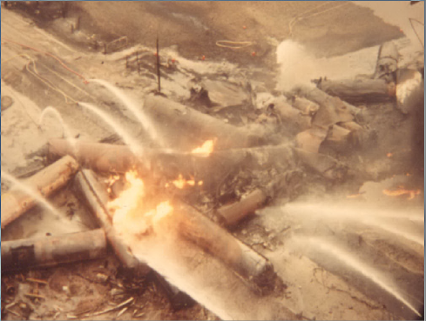
What is an ERAP?
A recommendation from the Grange report following the 1979 Mississauga derailment
Approved by Transport Canada for high-risk products (e.g., flammable liquids, flammable solids, propane, chlorine, anhydrous ammonia, explosives)
Provides specialized assistance to first responders
Requirement under the TDG Act
Notes:
CP cars derailment: Biggest peacetime evacuation (200 000 people over weeks) Twenty-four of the train's 106 cars went off the tracks, and several were carrying butane and propane.
NO ONE KNEW WHAT TO DO! No fatalities but anhydrous ammonia was released and a lot of explosions and fire.
An ERAP or Emergency Response Assistance Plan is a plan that describes what is to be done in the event of a transportation accident involving certain higher risk dangerous goods. The plan is intended to assist local emergency responders by providing them with technical experts and specially trained and equipped emergency response personnel at the scene of an incident.
The 1979 derailment clearly demonstrated a need for specialized response teams and equipment to provide support to first responders during major releases of high-risk dangerous goods.

Slide 84
Requirement for an ERAP
WHO NEEDS AN ERAP?
Persons who import certain dangerous goods into Canada or offer for transport those dangerous goods in Canada may require an ERAP (TDG Regulations, part 7).
In cases when no one imports those dangerous goods into Canada or offers the goods for transport in Canada, the person handling or transporting those goods may require the ERAP.
WHAT DANGEROUS GOODS NEED AN ERAP?
Only certain dangerous goods in certain quantities, means of containment or modes or transport need an ERAP.

Slide 85
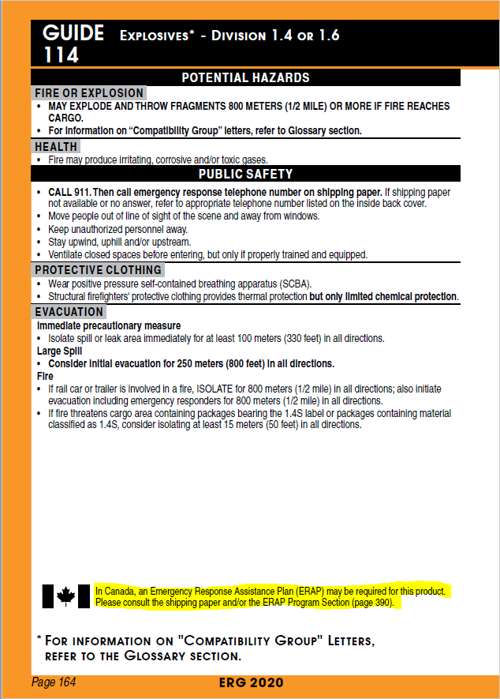
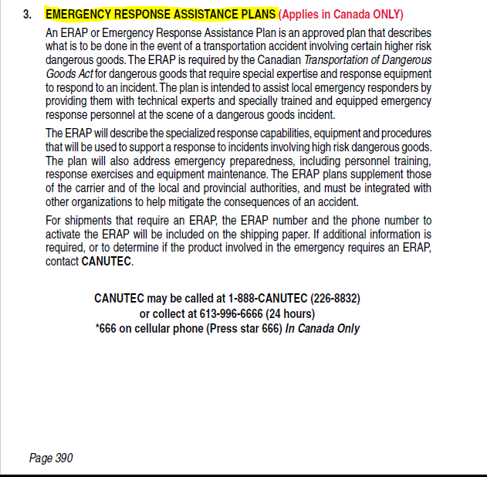
Requirement for an ERAP
Notes:
When a ERAP may be needed for a product, a Canadian flag is printed on the bottom left page of a guide, with the mention:
In Canada, an Emergency Response Assistance Plan (ERAP) may be required for this product. Please consult the shipping paper and/or the ERAP Program Section (page 390).

Slide 86
ERAP: What can you expect?
Shipping document
ERAP / PIU 2-XXXX-(YYY) and telephone number
ERAP required
SUPPORT FOR DANGEROUS GOODS WITH AN APPROVED ERAP
By telephone | Technical and/or emergency response advice Support will be provided in the 10 minutes following the initial request
On site* | Emergency response personnel with appropriate equipment Support provided will vary depending on the nature and severity of an incident as well as the needs of the resources on site
*During the implementation of the plan, ERAP holders are responsible for using due diligence and responding in a reasonable timeframe, given the location of the site, meteorological conditions, site accessibility and other circumstances.
Notes:
ERAP can be found on shipping documents (see number and phone number and if called you can expect: table info)
Tier 1 = telephone
Tier 2 = On site with specialized people

Slide 87
Tools and Resources

Slide 88
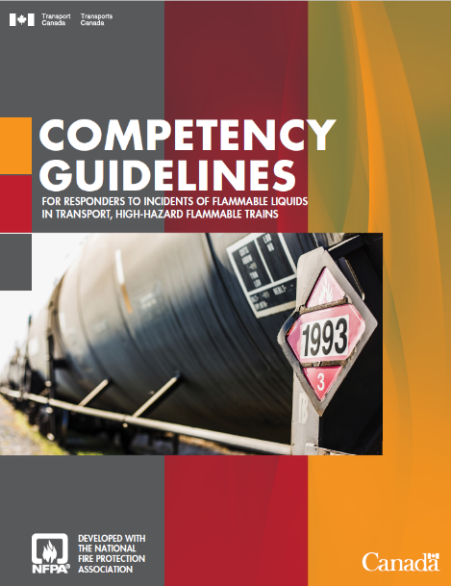
Tools Available to First Responders
Competency Guidelines
Downloadable presentation on Emergency Preparedness and Response for Incidents Involving Dangerous Goods
Video on Responding to Railcar Incidents Involving Flammable Liquids
Self-paced online training: Alternative Fuel Vehicles Training Program for Emergency Responders

Slide 89
Tools Available to First Responders
Use a simple railcar ID search to see whether a railcar on a train is carrying hazardous materials
View the contents of the entire train
View emergency contact information for all Class I railroads and AMTRACK
Notes:
All North American Class I railroads are using the app.
The AskRail app is a collaborative effort among all North American Class I railroads, the Association of American Railroads, Railinc Corp. and the Transportation Technology Center, Inc.
At this time, the app concentrates on single-car information on participating regional railroads.
AskRail is available in English in the U.S., Canada and Mexico. A French-language version is being developed for use in French-speaking Canadian provinces.
Request the application
For security reasons, only qualified emergency responders who have completed rail emergency training sponsored by one of the Class I freight railroads or at the Security and Emergency Response Training Center (SERTC) can download and use the AskRail app. In addition, railroads can offer the app to known emergency responders along their routes.
Visit their website: http://www.askrail.us/ or Rail Association of Canada (RAC): http://www.railcan.ca/

Slide 90
Tools Available to First Responders
The Canadian Emergency Response to Flammable Liquids Incidents in Transport (CERFLIT) is a series of online courses, resources, and support materials
The curriculum and materials have been designed to help communities, and firefighters at every level, become better prepared to manage an incident involving flammable liquids being transported by road or rail
Find out more and access the three levels of this training by clicking the link: Canadian emergency response to flammable liquids in transport

Slide 91
Safety Awareness Program

Slide 92
TDG Safety Awareness Program
TDG Safety Awareness Kits
Aimed at four specific audiences: First Responders, Communities/Municipalities, Industry and the General Public.
Kits include information on:
Emergency preparedness and response;
Protective Direction No. 36;
Safety Advisories (e.g., lithium batteries);
Bulletins;
CANUTEC;
And much more!
Updated regularly and available online :
Awareness Materials and FAQ

Slide 93
TDG Safety Awareness Program
“You’re not alone!” Documents
Helps local emergency planners prepare for potential rail incidents involving the transportation of dangerous goods.
Contains tools for police, rescue, health and firefighting responders to help remediate the effects of a rail incident.
Guide link : You're not alone! - Emergency response planning rail incidents involving flammable liquids

Slide 94
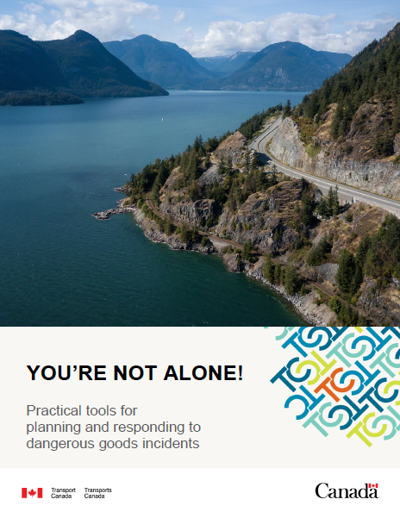
TDG Safety Awareness Program
“You’re not alone!” Documents
A new practical guide containing:
Aide-mémoire: Now 15 classes and divisions of dangerous goods
Dangerous Goods Incident Worksheet: To take notes when using the aide-mémoire, step by step
Dangerous Goods Incident Pre-plan Worksheet
Instruction guidelines included
Guide link : You're not alone! - Practical tools planning responding dangerous goods incidents

Slide 95
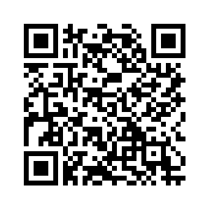
TDG Safety Awareness Program
TDG Newsletter
Available upon request and distributed electronically free of charge to more than 10,000 subscribers in Canada and abroad.
Provides useful information on the safe transportation of dangerous goods.
Subscribe now at:
http://www.tc.gc.ca/eng/tdg/newsletter-menu-268.htm

