Slide 1
Content Validation
Zalando content validations are provided as a one time service as a convenience to the partner prior to Integration. During integration and throughout live business trading, partners are expected to fully adhere to the Zalando Image and Content Guidelines without exceptions.

Slide 2
Content
ETHICAL SOURCING STANDARDS
GENERAL REQUIREMENTS
MINIMUM REQUIREMENTS
HOW TO
WOMEN
MATERNITY
MEN
KIDS
SETS & MULTI PACKS
SHOES
JEWELLERIES
BAGS & LUGGAGE
ACCESSORIES
ELECTRONICS
TOYS
BEAUTY
OTHER

Slide 3
ETHICAL SOURCING STANDARDS
All companies of the Zalando Group are committed to trading responsibly. We want our customers to know that the goods we sell and procure have been produced in an ethical, safe and environmentally conscious manner.
Further, we want the images portrayed in our assortment to consider social and ethical values. Complementary to our Code of Conduct for Business Partners, our Ethical Sourcing Standards define which commodities are excluded from sourcing, or will be excluded in the future due to their form of production, materials or thematic depictions.
THE STANDARDS COVER THREE MAIN AREAS:
Animal welfare and biodiversity policy
Responsible marketing policy
Prohibited activities policy
These standards apply to all our business partners, including, but not limited to: suppliers, agents, trading companies and service providers (hereinafter “Business Partners”) of Zalando SE and all its subsidiaries (hereinafter “Zalando”). To see the full list of materials and practices in violation of our policies, please follow the link below.
ETHICAL SOURCING STANDARDS
Also consider for kids articles the Safety of Children’s Clothing – Cords & Drawstrings on Children’s Clothing:
EN 14682:2014

Slide 4
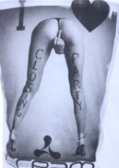
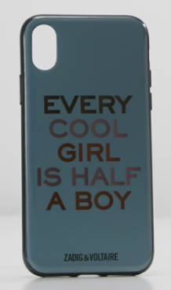
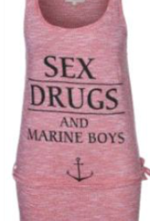
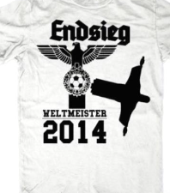
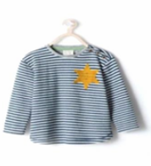
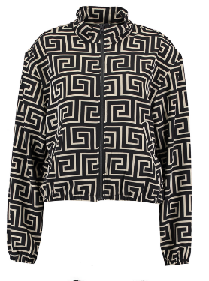
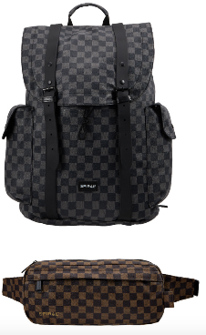
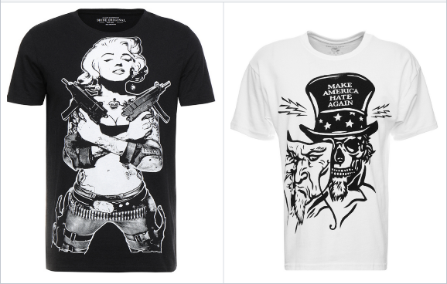
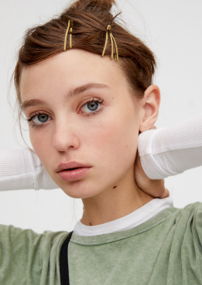
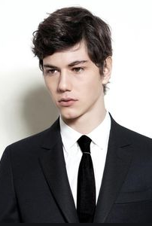
ETHICAL SOURCING STANDARDS - EXAMPLES
Pornographic prints
Discriminatory prints / images
Political extreme statements
Registered designs
Pornographic assortments
Violence glorifying
Under-aged models for adult categories
Pornographic images

Slide 5
GENERAL IMAGE REQUIREMENTS
TECHNICAL REQUIREMENTS
Aspect ratio (width x height): 1 : 1.44
Minimum size: 762 x 1100 pixel
Best practice size: 1800 x 2600 pixel
Maximum size: 6000 x 9000 pixel
Image type: JPEG
Colour mode: RGB
Upright format
BACKGROUND REQUIREMENTS
Model images must have a light grey background, use colour CODE: R:241;G:241;B:241
Packshot images must have a white background, use colour CODE: R:255;G:255;B:255
*Zalando adds automatically light grey background to packshots for a consistent shop structure
No disturbing items in the background, edges, plants or chairs
No big colour gradients in the background
PLEASE MAKE SURE YOUR IMAGES MEET THE ZALANDO GUIDELINES LINKED BELOW

Slide 6
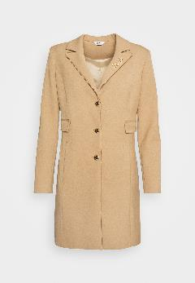
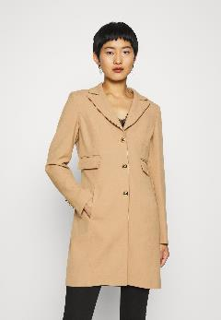
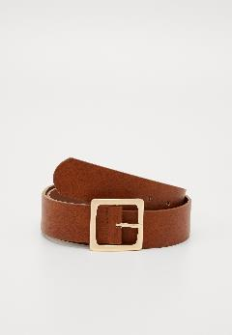
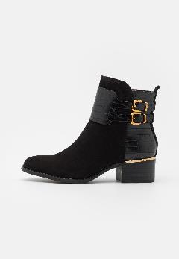
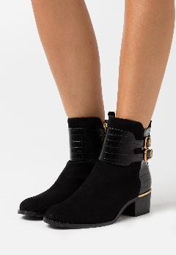
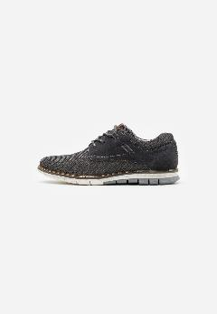
MINIMUM REQUIREMENTS*
For textiles, underwear, beachwear, nightwear.
Model views are not allowed for kids underwear and beachwear.
or
For bags, accessories, jewellery, headwear, belts, scarves, gloves, etc.
Also for beauty, toys and electronics.
Frontal packshot with white background
Frontal model view with grey background
Packshot with white background
For women’s shoes.
or
For men’s and kids shoes.
Model images are not necessary.
Packshot with white background
Model view with grey background
Packshot with white background
*minimum requirements are not valid for premium partners

Slide 7
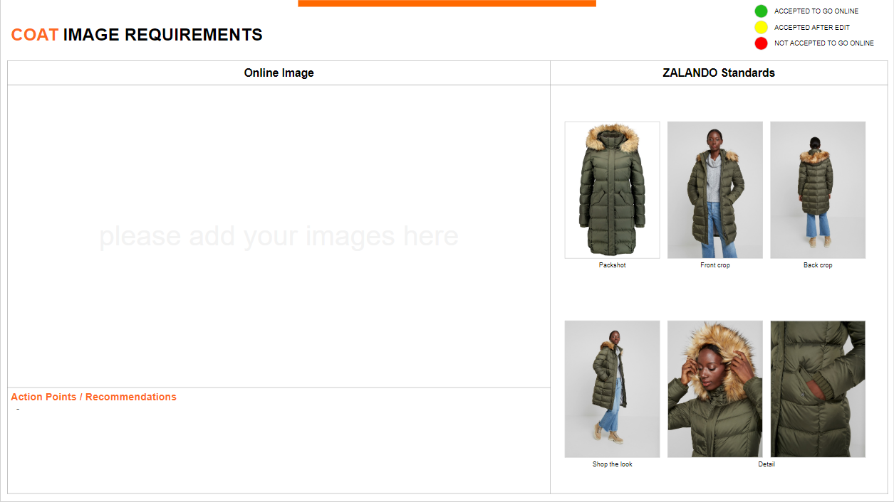
HOW TO GUIDE
After our validation the background of the slide will be colored accordingly:
accepted to go online
accepted after edit
not accepted to go online
Online Image:
Here you can add your images for the validation.
ZALANDO Standards:
Here you can see example images of Zalando articles and how they are presented in the shop. They are used as a benchmark to validate your images.
Action Points / Recommendations:
Here we will address issues that we have with the images in the following way:
If the background is green, then the points written here will be mostly recommendations
If the background is yellow or red, then you need to address those points

Slide 8
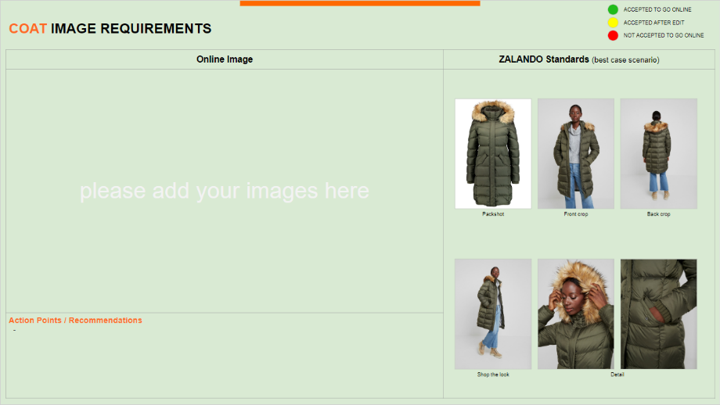
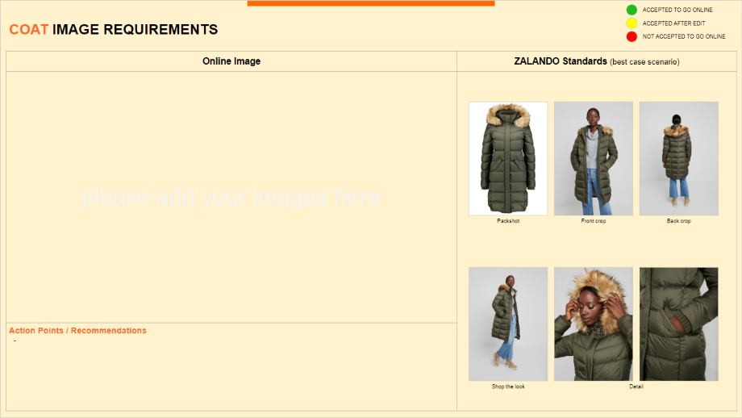
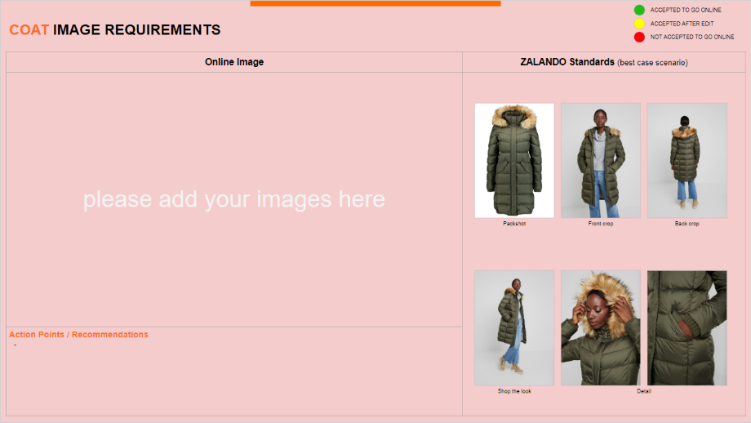
HOW TO GUIDE
ACCEPTED TO GO ONLINE
ACCEPTED AFTER EDIT
NOT ACCEPTED TO GO ONLINE

Slide 9
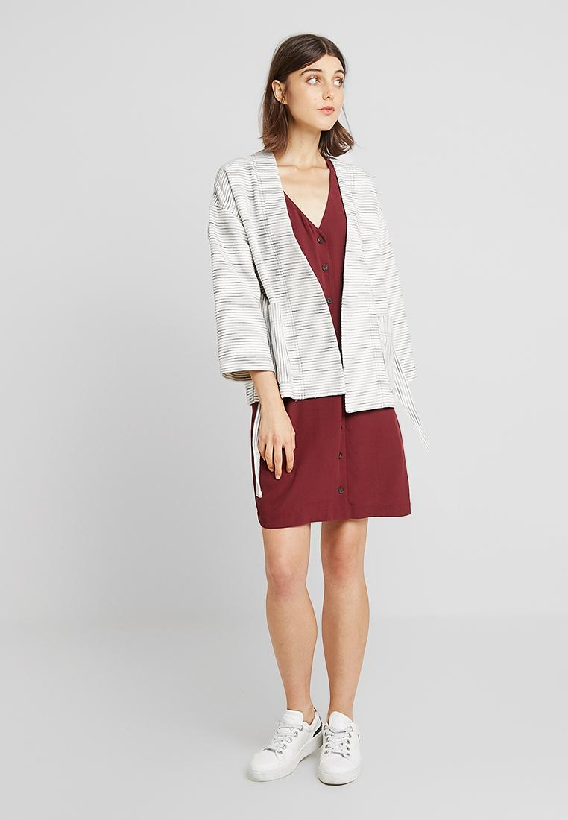
WOMEN’S TEXTILE

Slide 10
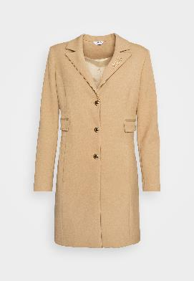
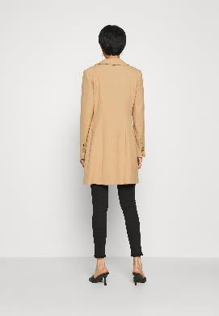
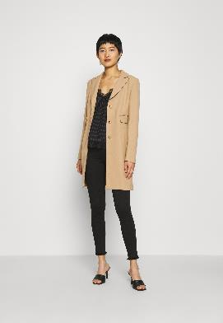
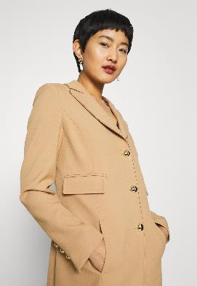
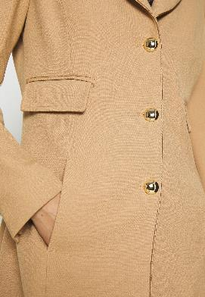
COAT IMAGE REQUIREMENTS
Packshot
Front crop
Back crop
Action Points / Recommendations
Shop the look
Detail

Slide 11
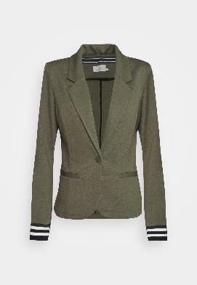
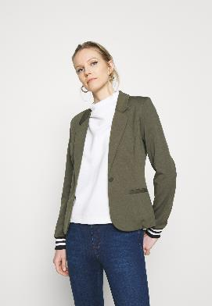
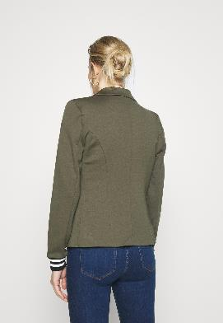
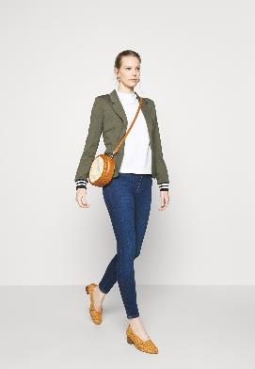
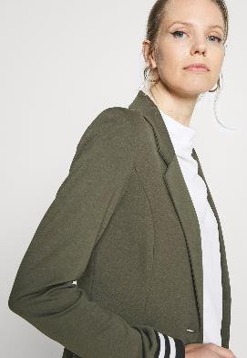
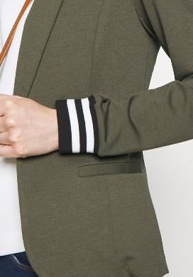
JACKET/ BLAZER IMAGE REQUIREMENTS
Packshot
Front crop
Back crop
Action Points / Recommendations
Shop the look
Detail

Slide 12
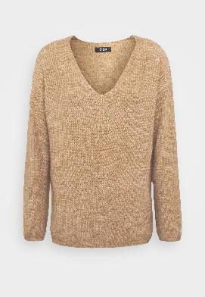
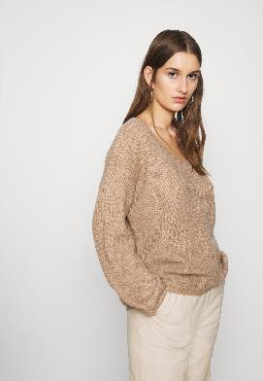
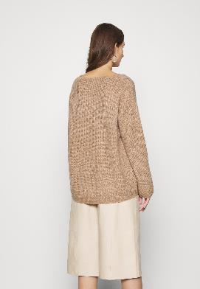
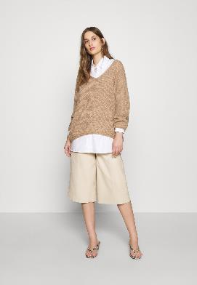
TOPS IMAGE REQUIREMENTS
Packshot
Front crop
Back crop
Action Points / Recommendations
Shop the look
Detail

Slide 13
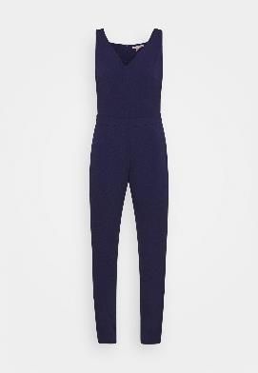
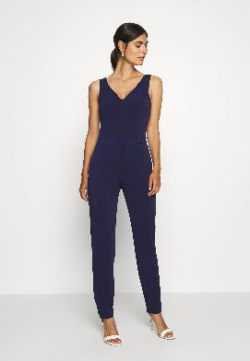
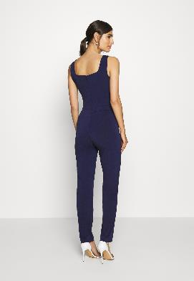
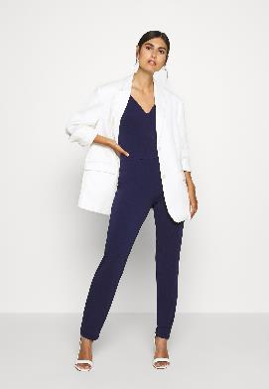
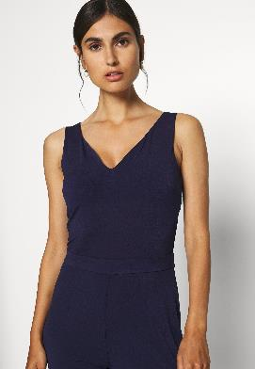
JUMPSUIT IMAGE REQUIREMENTS
Packshot
Front crop
Back crop
Action Points / Recommendations
Shop the look
Detail

Slide 14
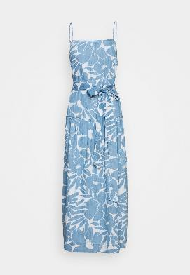
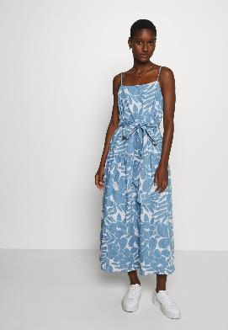
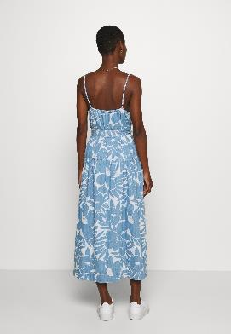
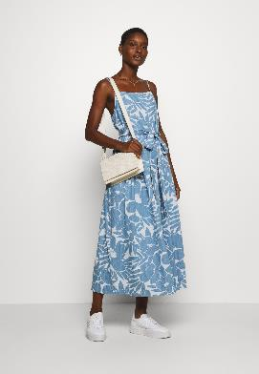
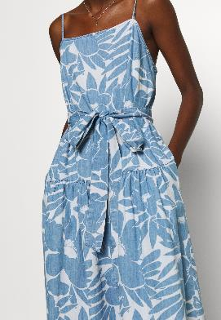
DRESS IMAGE REQUIREMENTS
Packshot
Front crop
Back crop
Action Points / Recommendations
Shop the look
Detail

Slide 15
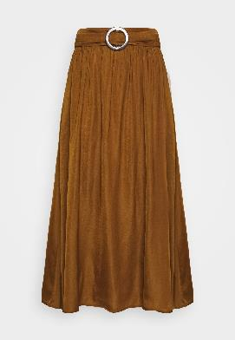
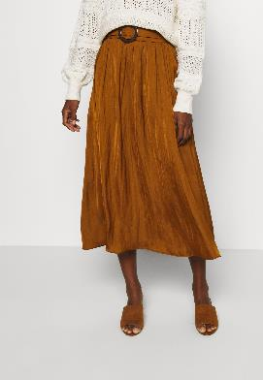
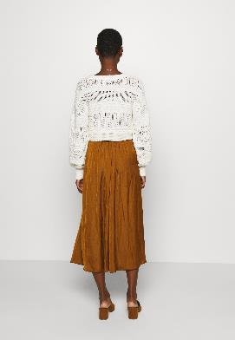
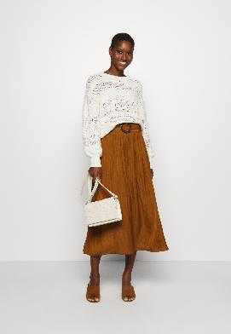
SKIRT IMAGE REQUIREMENTS
Packshot
Front crop
Back crop
Action Points / Recommendations
Shop the look
Detail

Slide 16
TROUSER IMAGE REQUIREMENTS
Packshot
Front crop
Back crop
Action Points / Recommendations
Shop the look
Detail

Slide 17
SHORTS IMAGE REQUIREMENTS
Packshot
Front crop
Back crop
Action Points / Recommendations
Shop the look
Detail

Slide 18
WOMEN’S UNDERWEAR & BEACHWEAR

Slide 19
SPORTS BRA IMAGE REQUIREMENTS
Packshot
Front crop
Back crop
Action Points / Recommendations
Shop the look
Detail

Slide 20
TOPS IMAGE REQUIREMENTS
Packshot
Front crop
Back crop
Action Points / Recommendations
Shop the look
Detail

Slide 21
PANTS IMAGE REQUIREMENTS
Packshot
Front crop
Back crop
Action Points / Recommendations
Shop the look
Detail

Slide 22
SUSPENDER IMAGE REQUIREMENTS
Packshot
Front crop
Back crop
Action Points / Recommendations
Shop the look
Detail

Slide 23
BIKINI TOPS IMAGE REQUIREMENTS
Packshot
Front crop
Back crop
Action Points / Recommendations
Shop the look
Detail

Slide 24
BIKINI PANTS IMAGE REQUIREMENTS
Packshot
Front crop
Back crop
Action Points / Recommendations
Shop the look
Detail

Slide 25
BIKINI SETS IMAGE REQUIREMENTS
Packshot
Front crop
Back crop
Action Points / Recommendations
Shop the look
Detail

Slide 26
SWIMSUIT IMAGE REQUIREMENTS
Packshot
Front crop
Back crop
Action Points / Recommendations
Shop the look
Detail

Slide 27
TIGHTS IMAGE REQUIREMENTS
OR
Front crop
Back crop
Action Points / Recommendations
Detail

Slide 28
STAY UPS IMAGE REQUIREMENTS
OR
Front crop
Back crop
Action Points / Recommendations
Detail

Slide 29
SOCKS IMAGE REQUIREMENTS
Packshot
Action Points / Recommendations
Detail

Slide 30
WOMEN’S NIGHTWEAR

Slide 31
TOPS IMAGE REQUIREMENTS
Packshot
Front crop
Back crop
Action Points / Recommendations
Shop the look
Detail

Slide 32
PANTS IMAGE REQUIREMENTS
Packshot
Front crop
Back crop
Action Points / Recommendations
Shop the look
Detail

Slide 33
BATHROBES/ KIMONOS IMAGE REQUIREMENTS
Packshot
Front crop
Back crop
Action Points / Recommendations
Shop the look
Detail

Slide 34
MATERNITY

Slide 35
DRESS IMAGE REQUIREMENTS
Packshot
should have a slight angle to show the bump
Front crop
Back crop
Action Points / Recommendations
Shop the look
Detail - Nursing function

Slide 36
TOPS IMAGE REQUIREMENTS
Packshot
should have a slight angle to show the bump
Front crop
Back crop
Action Points / Recommendations
Shop the look
Detail - Nursing function

Slide 37
TROUSER IMAGE REQUIREMENTS
Packshot
should have a slight angle to show the bump
Front crop
Back crop
Action Points / Recommendations
Shop the look
Detail

Slide 38
SWIMSUIT IMAGE REQUIREMENTS
Packshot
should have a slight angle to show the bump
Front crop
Back crop
Action Points / Recommendations
Shop the look
Detail

Slide 39
MEN’S TEXTILE

Slide 40
COAT IMAGE REQUIREMENTS
Packshot
Front crop
Back crop
Action Points / Recommendations
Shop the look
Detail

Slide 41
JACKET/ SUIT JACKET IMAGE REQUIREMENTS
Packshot
Front crop
Back crop
Action Points / Recommendations
Shop the look
Detail

Slide 42
TOPS IMAGE REQUIREMENTS
Packshot
Front crop
Back crop
Action Points / Recommendations
Shop the look
Detail

Slide 43
TROUSER IMAGE REQUIREMENTS
Packshot
Front crop
Back crop
Action Points / Recommendations
Shop the look
Detail

Slide 44
TROUSER IMAGE REQUIREMENTS
Packshot
Front crop
Back crop
Action Points / Recommendations
Shop the look
Detail

Slide 45
MEN’S UNDERWEAR, NIGHTWEAR & SWIMWEAR

Slide 46
UNDERWEAR IMAGE REQUIREMENTS
Packshot
Back crop
Action Points / Recommendations
Shop the look
Detail

Slide 47
TOPS IMAGE REQUIREMENTS
Packshot
Front crop
Back crop
Action Points / Recommendations
Shop the look
Detail

Slide 48
PANTS IMAGE REQUIREMENTS
Packshot
Front crop
Back crop
Action Points / Recommendations
Shop the look
Detail

Slide 49
SWIMWEAR IMAGE REQUIREMENTS
Packshot
Back crop
Action Points / Recommendations
Shop the look
Detail

Slide 50
BATHROBES/ KIMONOS IMAGE REQUIREMENTS
Packshot
Front crop
Back crop
Action Points / Recommendations
Shop the look
Detail

Slide 51
SOCKS IMAGE REQUIREMENTS
Packshot
Action Points / Recommendations
Detail

Slide 52
KIDS TEXTILE

Slide 53
SNOWSUIT/ JUMPSUIT IMAGE REQUIREMENTS
Front packshot
Back packshot
Action Points / Recommendations
Detail

Slide 54
COAT IMAGE REQUIREMENTS
Front packshot
Back packshot
Action Points / Recommendations
Detail

Slide 55
JACKET IMAGE REQUIREMENTS
Front packshot
Back packshot
Action Points / Recommendations
Detail

Slide 56
TOPS IMAGE REQUIREMENTS
Front packshot
Back packshot
Action Points / Recommendations
Detail

Slide 57
DRESS IMAGE REQUIREMENTS
Front packshot
Back packshot
Action Points / Recommendations
Detail

Slide 58
SKIRT IMAGE REQUIREMENTS
Front packshot
Back packshot
Action Points / Recommendations
Detail

Slide 59
TROUSER IMAGE REQUIREMENTS
Front packshot
Back packshot
Action Points / Recommendations
Detail

Slide 60
KIDS UNDERWEAR, BEACHWEAR & NIGHTWEAR

Slide 61
ONESIE IMAGE REQUIREMENTS
Front packshot
Back packshot
Action Points / Recommendations
Detail

Slide 62
UNDERWEAR TOPS IMAGE REQUIREMENTS
Front packshot
Back packshot
Action Points / Recommendations
Detail

Slide 63
UNDERWEAR IMAGE REQUIREMENTS
Front packshot
Back packshot
Action Points / Recommendations
Detail

Slide 64
UNDERSHIRTS IMAGE REQUIREMENTS
Front packshot
Back packshot
Action Points / Recommendations
Detail

Slide 65
PANTS IMAGE REQUIREMENTS
Front packshot
Back packshot
Action Points / Recommendations
Detail

Slide 66
BODY IMAGE REQUIREMENTS
Front packshot
Back packshot
Action Points / Recommendations
Detail

Slide 67
NIGHTWEAR SETS IMAGE REQUIREMENTS
Front packshot
Back packshot
Action Points / Recommendations
Detail

Slide 68
SWIMSUIT IMAGE REQUIREMENTS
Front packshot
Back packshot
Action Points / Recommendations
Detail

Slide 69
BIKINI SETS IMAGE REQUIREMENTS
Front packshot
Back packshot
Action Points / Recommendations
Detail

Slide 70
TIGHTS IMAGE REQUIREMENTS
Front packshot
Back packshot
Action Points / Recommendations
Detail

Slide 71
SOCKS IMAGE REQUIREMENTS
Packshot
Action Points / Recommendations
Detail

Slide 72
SHOES

Slide 73
WOMEN’S SHOES IMAGE REQUIREMENTS
Packshot
(left shoe pointing to the left)
Model view
Top view
Action Points / Recommendations
Side view
Back view
Sole view

Slide 74
WOMEN’S BOOTS IMAGE REQUIREMENTS
Packshot
(left shoe pointing to the left)
Model view
Overknees and boots from 40 cm height
Action Points / Recommendations
Side view
Back view
Sole view

Slide 75
MEN’S SHOES IMAGE REQUIREMENTS
Packshot
(left shoe pointing to the left)
Top view
Side view
Action Points / Recommendations
Back view
Sole view
Detail

Slide 76
MEN’S BOOTS IMAGE REQUIREMENTS
Packshot
(left shoe pointing to the left)
Top view
Side view
Action Points / Recommendations
Back view
Sole view
Detail

Slide 77
KIDS SHOES IMAGE REQUIREMENTS
Packshot
(left shoe pointing to the left)
Top view
Side view
Action Points / Recommendations
Back view
Sole view
Detail

Slide 78
KIDS BOOTS IMAGE REQUIREMENTS
Packshot
(left shoe pointing to the left)
Top view
Side view
Action Points / Recommendations
Back view
Sole view
Detail

Slide 79
JEWELLERIES

Slide 80
HAIR ACCESSORY IMAGE REQUIREMENTS
Packshot
Action Points / Recommendations
Back view
Detail

Slide 81
EARRINGS IMAGE REQUIREMENTS
Packshot
Action Points / Recommendations
Back view
Detail

Slide 82
NECKLACE IMAGE REQUIREMENTS
Packshot
Action Points / Recommendations
Back view
Detail

Slide 83
PENDANT IMAGE REQUIREMENTS
Packshot
Action Points / Recommendations
Back view
Detail

Slide 84
BRACELET IMAGE REQUIREMENTS
Packshot
Action Points / Recommendations
Back view
Detail

Slide 85
RING IMAGE REQUIREMENTS
Packshot
Action Points / Recommendations
Back view
Model view

Slide 86
WATCH IMAGE REQUIREMENTS
Packshot
Action Points / Recommendations
Back view
Model view
Detail

Slide 87
CUFFLINKS IMAGE REQUIREMENTS
Packshot
Action Points / Recommendations
Back view
Model view
Detail

Slide 88
BAGS & LUGGAGE

Slide 89
WALLET IMAGE REQUIREMENTS
Packshot
Action Points / Recommendations
Back view
Inside view
Detail

Slide 90
CLUTCH/ EVENING BAG IMAGE REQUIREMENTS
Packshot
Shop the look
Action Points / Recommendations
Back view
Inside view
Detail

Slide 91
BAG IMAGE REQUIREMENTS
Packshot
Shop the look
Action Points / Recommendations
Back view
Inside view
Detail

Slide 92
BACKPACK IMAGE REQUIREMENTS
Packshot
Shop the look
Action Points / Recommendations
Back view
Inside view
Detail

Slide 93
TRAVEL BAG IMAGE REQUIREMENTS
Packshot
Shop the look
Action Points / Recommendations
Back view
Inside view
Detail

Slide 94
LUGGAGE IMAGE REQUIREMENTS
Packshot
Shop the look
Action Points / Recommendations
Back view
Inside view
Detail

Slide 95
ACCESSORIES

Slide 96
GLASSES IMAGE REQUIREMENTS
Packshot
Action Points / Recommendations
Back view
Model view
Detail

Slide 97
BELTS IMAGE REQUIREMENTS
Packshot
Action Points / Recommendations
Back view
Model view
Detail

Slide 98
SUSPENDERS IMAGE REQUIREMENTS
Packshot
Action Points / Recommendations
Back crop
Detail

Slide 99
TIES IMAGE REQUIREMENTS
Packshot
Action Points / Recommendations
Back view
Model view
Detail

Slide 100
BOW TIES IMAGE REQUIREMENTS
Packshot
Action Points / Recommendations
Back view
Model view
Detail

Slide 101
POCKET SQUARES IMAGE REQUIREMENTS
Packshot
Action Points / Recommendations
Back view
Model view
Detail

Slide 102
SCARF IMAGE REQUIREMENTS
OR
OR
Packshot
Action Points / Recommendations
Model view
Detail

Slide 103
GLOVES IMAGE REQUIREMENTS
Packshot
Action Points / Recommendations
Inside view
Outside view
Detail

Slide 104
BEANIES IMAGE REQUIREMENTS
Packshot
Action Points / Recommendations
Back view
Model view
Detail

Slide 105
CAPS IMAGE REQUIREMENTS
Packshot
Action Points / Recommendations
Back view
Model view
Detail

Slide 106
HATS IMAGE REQUIREMENTS
Packshot
Action Points / Recommendations
Back view
Model view
Detail

Slide 107
SETS & MULTI PACKS

Slide 108
SETS IMAGE REQUIREMENTS
Packshot
(every item must be displayed)
Front crop
Back crop
Action Points / Recommendations
Shop the look
Detail

Slide 109
SUITS IMAGE REQUIREMENTS
Packshot
(every item must be displayed)
Front crop jacket
Back crop jacket
Action Points / Recommendations
Shop the look
Front crop trouser
Back crop trouser

Slide 110
NIGHTWEAR SETS IMAGE REQUIREMENTS
Packshot
Front crop
Back crop
Action Points / Recommendations
Shop the look
Detail

Slide 111
MULTI PACKS IMAGE REQUIREMENTS
Packshot
(every item must be displayed from bottom left to top right)
Front crop
Back crop
Action Points / Recommendations
Shop the look
Front crop of second item

Slide 112
SOCKS MULTI PACK IMAGE REQUIREMENTS
OR
Packshot
Packshot
Action Points / Recommendations

Slide 113
TOYS

Slide 114
DOLLS IMAGE REQUIREMENTS
Packshot
Action Points / Recommendations
Back view
Detail

Slide 115
CUDDLE TOYS IMAGE REQUIREMENTS
Packshot
Action Points / Recommendations
Back view
Detail
Detail

Slide 116
OTHERS IMAGE REQUIREMENTS
Packshot
Action Points / Recommendations
Back view
others
Detail

Slide 117
ELECTRONICS

Slide 118
HEADPHONES IMAGE REQUIREMENTS
Packshot
Action Points / Recommendations
Further views

Slide 119
HEADPHONES IMAGE REQUIREMENTS
Packshot
Action Points / Recommendations
Further views

Slide 120
HEADPHONES IMAGE REQUIREMENTS
Packshot
Action Points / Recommendations
Further views

Slide 121
SPEAKER IMAGE REQUIREMENTS
Packshot
Action Points / Recommendations
Back view
Model view
Detail

Slide 122
BEAUTY

Slide 123
NAIL VARNISH IMAGE REQUIREMENTS
Packshot
Action Points / Recommendations
2nd Image
Colour / Texture

Slide 124
LIPSTICK IMAGE REQUIREMENTS
OR
Packshot
Action Points / Recommendations
Colour / Texture

Slide 125
LIP GLOSS IMAGE REQUIREMENTS
OR
Packshot
Action Points / Recommendations
Detail
Colour / Texture

Slide 126
SKIN CARE IMAGE REQUIREMENTS
OR
Packshot
Action Points / Recommendations
Colour / Texture

Slide 127
MAKE-UP IMAGE REQUIREMENTS
OR
Packshot
Action Points / Recommendations
2nd Image
Colour / Texture

Slide 128
SKIN TONE MAKE-UP IMAGE REQUIREMENTS
OR
Packshot
Action Points / Recommendations
Colour / Texture

Slide 129
SKIN TONE MAKE-UP IMAGE REQUIREMENTS
OR
Packshot
Action Points / Recommendations
Colour / Texture
Colour / Texture

Slide 130
EYE MAKE-UP IMAGE REQUIREMENTS
OR
Packshot
Action Points / Recommendations
Colour / Texture
Colour / Texture

Slide 131
EYE MAKE-UP IMAGE REQUIREMENTS
OR
Packshot
Action Points / Recommendations
Colour / Texture
Colour / Texture

Slide 132
SET IMAGE REQUIREMENTS
Packshot
Action Points / Recommendations
2nd Image

Slide 133
SET IMAGE REQUIREMENTS
Packshot
Action Points / Recommendations
2nd Image
3rd Image
4th Image

Slide 134
HAIR STYLING IMAGE REQUIREMENTS
OR
Packshot
Action Points / Recommendations
2nd Image

Slide 135
FRAGRANCE IMAGE REQUIREMENTS
OR
Packshot
Action Points / Recommendations

Slide 136
BEAUTY ACCESSORIES IMAGE REQUIREMENTS
OR
Packshot
Action Points / Recommendations

Slide 137
OTHER

Slide 138
OTHER IMAGE REQUIREMENTS
Packshot
Action Points / Recommendations

