Slide 1
Enter client team
Enter media owner
E.g. Germany DD/MM/YYYY
Enter full name and email address

Slide 2
The Amazon Ads Challenge
Come up with a breakthrough creative concept for one of your clients that uses the Amazon canvas to drive a measurable outcome, such as purchase, awareness, or engagement.
Demonstrate how your concept connects minimum two different Amazon properties (e.g. a Fire TV takeover and an Alexa experience, or a Twitch stream and an Amazon Fresh pop-up experience) in an innovative way.
You can use a current client RFP or business challenge as the basis for your submission. We look forward to guiding you through the suite of Amazon Ads products and innovating on them. Good luck!

Slide 3
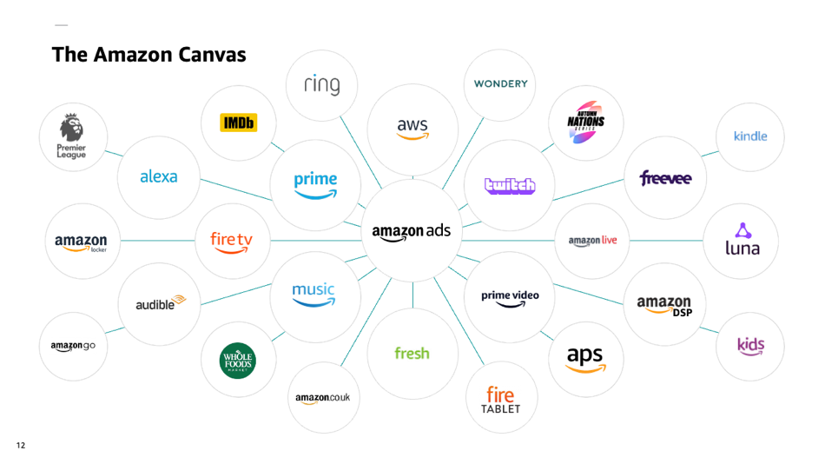
The Amazon Canvas

Slide 4
We’re happy to be part of your ideation / brainstorm session as well as a midpoint check-in to review where you are, offer feedback and answer any outstanding questions you may have. You will have the chance to tell us about your specific client challenge, objectives and KPIs, for us to come up with the best solution together.
Your main points of contact for Amazon Ads are detailed in the final slide of this document. Please reach out to schedule the brainstorm and midpoint check-in, or to answer any Amazon-specific questions you may have.
You can find details around which clients are eligible to enter, inspiration in the form of case studies, details about our brands, as well as information on how the winning team’s campaign will be put live, on The Breakthrough Idea website. Broader questions relating to the contest can be sent to thebreakthroughidea@essencemediacom.com
We are here to help
Please see the Amazon Ads page within the contest website to watch videos from experts and links to our solutions across the business to help you familiarise yourself with a few of our offerings.

Slide 5
Creative best practices
Creative tip #1
Our best concepts emerge when a brand’s DNA can connect seamlessly with Amazon’s DNA, e.g.
Disney creates magic and wonder through storytelling, Amazon delivers magic through bringing customers’ wants and desires to reality
Coca-Cola’s “open happiness” tagline can bridge to the happiness people feel when they open an Amazon box
Creative tip #2
We believe best ideas can be described in one sentence, or a PR headline e.g.
Ad Council Updates Alexa’s Response to “What Is Love” in Inclusivity Campaign
Pringles Brings Video Game Zombie to Life in Twitch Livestream
Creative tip #3 Think of how to use Amazon products in innovative ways, e.g.
Watch shoppable recipe videos on Fire TV, add ingredients to Amazon Fresh cart
Scan a QR code on an Amazon Locker to reveal an AR experience on the Amazon mobile app
Play a game with the Twitch community to unlock discounts for the Amazon.com store
1
2
3

Slide 6
The Breakthrough Amazon creative idea
The best creative ideas start with a strong customer insight, so draw on our library of research to get started. Your concept should tap into the different elements of the Amazon canvas and put the customer first. In one slide, give us…
An outline of your brand challenge and client objectives
A PR headline or one sentence description of your idea
An insight and a short paragraph describing your idea
Campaign overview
How do different elements of the Amazon canvas play a role to create a holistic campaign?
How are you innovating using Amazon canvas to achieve client objectives?
Does this creative idea sit within a broader campaign plan for the brand?
How are you thinking of the end customer experience?
How will you ultimately drive ACTION?
Summarise the full partnership on 1-2 slides.
1
2
How to complete this document
There are three sections to complete for your submission;
Measurement Demonstrate how you would measure the success of your campaign and link it back to your client’s objectives.
3

Slide 7
The Breakthrough creative idea
Idea title
-Insert Here-
An outline of your brand challenge and client objectives
A PR headline or one sentence description of your idea
An insight and a short paragraph describing your idea
-Insert Here-

Slide 8
Campaign overview
-Insert Here-
How do different elements of the Amazon canvas play a role to create a holistic campaign?
How are you innovating using Amazon canvas to achieve client objectives?
Does this creative idea sit within a broader campaign plan for the brand?
How are you thinking of the end customer experience?
How will you ultimately drive ACTION?
Summarise the full partnership on 1-2 slides.

Slide 9
Measurement
-Insert Here-
Demonstrate how you would measure the success of your campaign and link it back to your client’s objectives.

Slide 10
KPI’s A visual representation of the idea
-Insert Here-

Slide 11
Contact details per market
US Amazon Ads Kevin Conetta (conettak@amazon.com)
Twitch Karen Kwarta (kkwarta@twitch.tv) Canada Amazon Ads Chris Sharpe (csharpen@amazon.com)
Twitch Christopher Walton (chrisads@amazon.com)
UK Amazon Ads Frances Sinclair (sinfranc@amazon.co.uk)
Twitch Matthew Poysden (poysdm@twitch.tv) Germany Amazon Ads Chris Henning (chrhenni@amazon.de)
Twitch Bastian Pasinksi (pasinsb@twitch.tv)
France Amazon Ads Olivier Kuijper (okuijper@amazon.fr)
Twitch Anne-Carole Roussou (aroussou@twitch.tv)
Spain Amazon Ads Brenda Beato (brendabc@amazon.es)
Twitch Marta Alvarez Ruiz (martalvr@twitch.tv)
Italy Amazon Ads Sonia Pepe (pepes@amazon.it)
Twitch Gianluca Mottola (gianluam@twitch.tv)
Amazon Advertising Contact Details

