Slide 1

The Administration of Occupational Safety and Health
Strategy 2023-2028
Presentation – June 8, 2022

Slide 2

Future vision
Main Objectives
Strategic focus
Measurable goals
Actions
Values
Where?
until the year 2028
What?
until the year 2024
THE GLOBAL GOALS
How?
until the year 2023

Slide 3


The main challenges ahead
PEOPLE’S WILLINGNESS TO
CHANGE
INCREASED DEMAND FOR
DIGITIZATION IN MONITORING AND EDUCATION
INCREASED INTERCONNECTION OF INFORMATION SYSTEMS
CHANGES IN JOBS
MEASURABLE
GOALS AND USES OF STATISTICS
REACH DIFFERENT GROUPS THROUGH EDUCATION AND INFORMATION
IMPLEMENTATION OF CHANGES
SIMPLIFICATION AND HARMONIZATION OF WORKING PRACTICES
EIGHT KEY CHALLENGES

Slide 4
Future vision until the year 2028
With dynamic work in the field of occupational health and safety, which is constantly developing in line with rapid changes in the labor market, the AOSH has contributed to the improvement of the well-being, health and safety of employees.
Successful occupational health and safety is a joint project between employers and employees to maintain and improve safety and facilities at workplaces, thus preventing workplace accidents, mishaps and employee discomfort.
Good health brings increased productivity to the economy and benefits to society. Reliable information and analysis of data on the development of the main risk factors in the work environment allows us to prioritize in monitoring, prevention and information dissemination.
Innovation, improvement and simplification are key aspects of our work and we have been leaders in promoting methods, both new and well-known, to improve occupational health and safety in the workplace.
EVERYONE SAFE HOME FROM WORK

Slide 5





Our main goals
The AOSH’s strategy is structured around five main goals. Each one of them should contribute to long-term improvements and positive changes in order to make the future vision a reality.
WELLNESS
SAFETY
PARTICIPATION
FIVE MAIN GOALS
SIMPLIFICATION
ADJUSTMENT

Slide 6
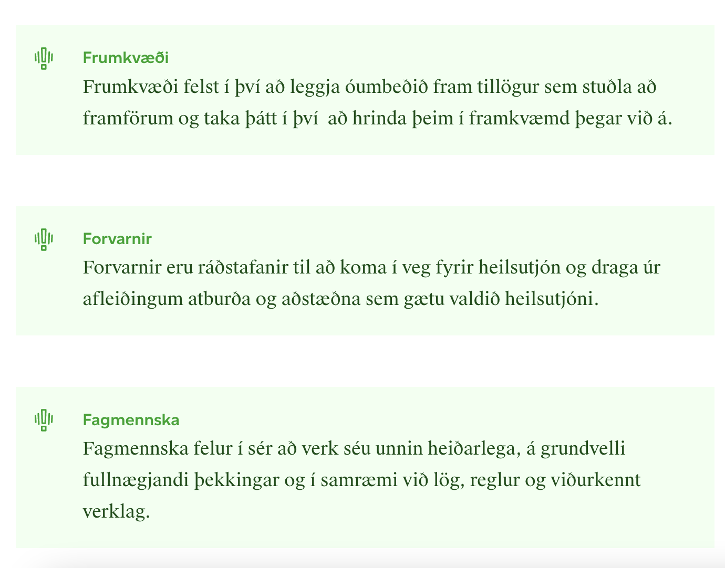
Our values
THE VALUES ARE THE CORE OF OUR ACTIVITIES

Slide 7
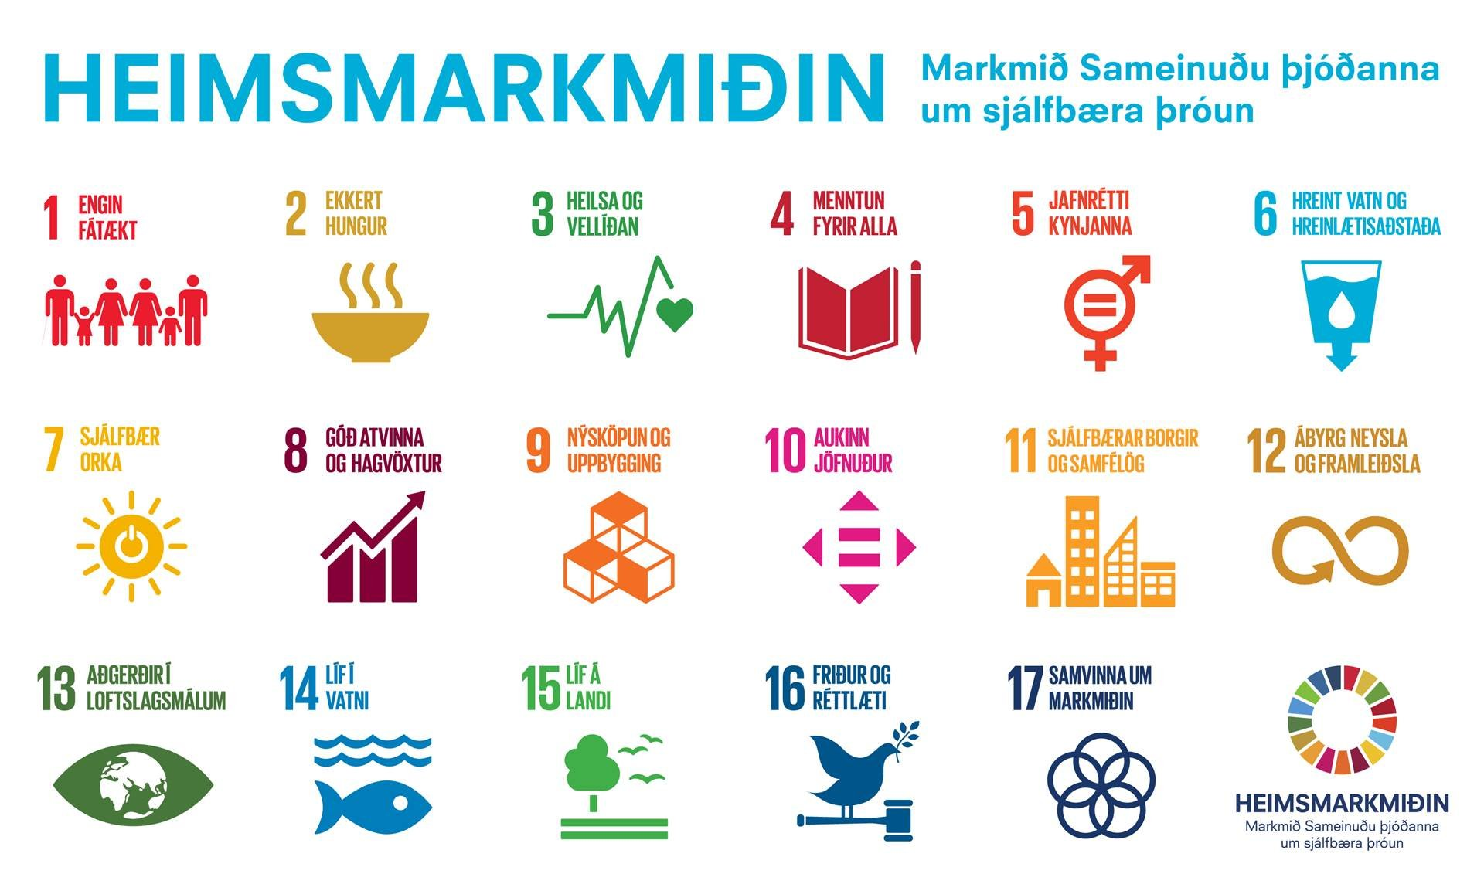
United Nations
Global Goals for sustainable development
The Global Goals are an action plan for the benefit of humanity, the Earth and prosperity. When choosing actions to implement the strategy's priorities, the United Nations' Global Goals will be considered.
Notes:
Is it in line with the presentation to talk about the focus of "the strategy" or "our" focus??

Slide 8

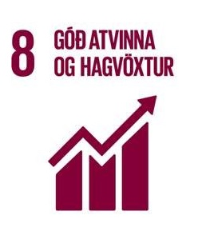


SAFETY
WELLNESS
PARTICIPATION
SIMPLIFICATION
ADJUSTMENT

Slide 9
SAFETY
We monitor the organization of safety issues at workplaces, heavy machinery and the use of dangerous substances and identify the main risk factors in the environment.
WELLNESS
We want to promote the good health and well-being of all employees in the Icelandic labor market through education, strong prevention work and risk-based monitoring.
PARTICIPATION
We encourage workplaces to participate in systematic occupational health and safety work, as a good workplace culture and a healthy environment lead to social and financial benefits for all of us.
SIMPLIFICATION
We work purposefully to harmonize work processes, improve quality and simplify our approach and external communication through digital means and guided by an interdisciplinary approach
ADJUSTMENT
We foresee much faster changes in the labor market in the coming years, which will affect people's working environment and working methods, and occupational safety considerations must be considered in light of this.

Slide 10
1
WELLNESS
Reduce people's absence from work with increased occupational safety and health.
Facilitate a general discussion about the importance of a good workplace culture, including workplace communication, in an ever-changing environment, to promote well-being and prevent negative interactions such as harassment, violence and bullying.
Reduce work-related musculoskeletal problems. Musculoskeletal problems are the second main cause of disability in this country.
Increase the public's awareness of work-related employee burnout and how to prevent it.
We want to promote the good health and well-being of all employees in the Icelandic labor market through education, strong prevention work and risk-based monitoring.

Slide 11
2
SAFETY
Promote innovation in the field of occupational health and safety, such as through digital processes and tools and dissemination of education.
Reduce work accidents in the domestic labor market through targeted prevention measures.
Raise the awareness of individual groups in the labor market about occupational health and safety, such as employees who do not understand Icelandic, young people and employees who perform risky jobs.
Create a discussion venue for forward-looking and issue-driven discussion about occupational health and safety in civil engineering in a broad sense.
Communicate the causes of occupational accidents and their development to interested parties so that a quick and safe response can be made.
We monitor the organization of safety issues at workplaces, heavy machinery and the use of dangerous substances and identify the main risk factors in the environment.
Notes:
Not quite sure if it should be in possessive case

Slide 12
3
PARTICIPATION
Support and encourage workplaces in Iceland to establish systematic occupational health and safety work based on the collaboration of employers, managers and employees.
Promote the participation of everyone in the workplace, i.e. employer, managers and employees, in active occupational health and safety work where everyone takes responsibility for good occupational health and safety and well-being in the workplace.
Encourage workplaces to develop a written Health and Safety Plan that addresses all five pillars of occupational health and safety.
Encourage social discussion about the importance of occupational health and safety in order to promote a positive public image and attitude towards occupational health and safety work.
Increase collaboration with the university community and other research institutions on research in the field of occupational health and safety.
We encourage workplaces to participate in systematic occupational health and safety work, as a good workplace culture and a healthy environment lead to social and financial benefits for all of us.

Slide 13
4
ADJUSTMENT
Assess and respond to the effects of increased technology on the work environment, both positive and negative effects, such as working with machines and robots, job simplification and monotonization.
Assess the impact of a hybrid labor market on the occupational health and safety of employees.
Assess the impact of the increased demand for the provision of health and social services in users' private homes on the occupational health and safety of employees.
Strengthen dialogue with stakeholders, i.a. members of the labor market, regarding the labor protection of those who carry out online work (e.g. platform workers) and those who work in other countries than their employer is established in.
Encourage a discussion about the environmental impact of the use of heavy machinery and equipment, together with the importance of occupational health and safety in the workplace, and encourage the use of environmentally friendly heavy machinery and equipment.
We foresee much faster changes in the labor market in the coming years, which will affect people's working environment and working methods, and occupational safety considerations must be considered in light of this.

Slide 14
5
SIMPLIFICATION
Promote the development of digital service processes that improve service and user experience, where information technology is used efficiently to increase quality and reliability.
Strengthen the organization's monitoring by simplifying and developing processes, innovation and the use of technology, such as digital monitoring, in accordance with good governance.
Establish increased professional collaboration across the organization and promote professional project management.
Strengthen the quality of inspections and follow-up of workplaces.
We work purposefully to harmonize work processes, improve quality and simplify our approach and external communication through digital means and guided by an interdisciplinary approach

