Slide 1
Administrative Agenda
Welcome
Instructor Introduction
Zoom Meeting Window
Course Materials
Attendance
Student Introductions

Slide 2
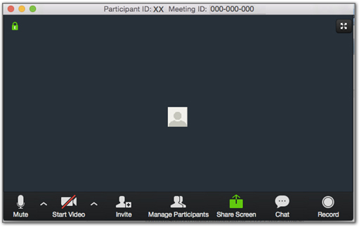
Navigating the Meeting Window
Notes:
Bottom tool bar
Mute: Control your own audio output. Start Video: Control your video output.
Invite: Use this advanced option if you want to invite users other than your site participants to participate in the meeting.
Manage Participants: Opens a pop-up window listing all participants. From this window you can:
mute participants, disable video,prevent other participants from sharing their screens,lock the meeting so no new participants can enter
Share Screen: Share your full desktop or specific windows. Starting Screen Share minimizes the main meeting window and highlights the window you are sharing (if you’re sharing a window and not the desktop). You can stop sharing at any time by clicking Stop Share.
Chat: Communicate with all participants or to send messages to specific participants by clicking on their name in the participants list.
Record: Clicking Record starts recording for the session. Recordings are stored locally on your computer in the folder set in Settings -> Recording. Participants will not be able to record sessions without the host’s permission. If a participant does record the session, the recording will be stored locally on the participant’s computer.
Keyboard shortcuts for common actions
Ctrl+Alt+Shift: Move focus to Zoom's meeting controls
Alt: Turn on/off the option “Always show meeting control toolbar” in Accessibility Settings
Alt+V: Start/Stop your Video
Alt+A: Mute/unmute your Audio
Alt+M: Mute/unmute everyone except host Note: For the meeting host only
Alt+S: Launch share screen window and stop screen share Note: Will only work when meeting control toolbar has focus
Alt+T: Pause or resume screen share Note: Will only work when meeting control toolbar has focus
Alt+R: Start/stop local recording
Alt+C: Start/stop cloud recording
Alt+P: Pause or resume recording
Alt+N: Switch camera
Alt+F: Enter or exit full screen
Alt+H: Display/hide In-Meeting Chat panel
Alt+U:Display/hide Participants panel
Alt+I: Open Invite window
Alt+Y: Raise/lower hand
Alt+Shift+T: Screenshot
Ctrl+2: Read active speaker name

Slide 3
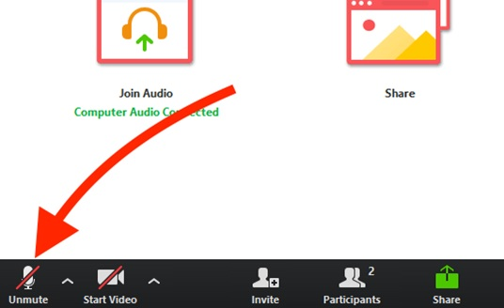
Mute your audio
Mute/Unmute your audio and start/stop your video.

Slide 4
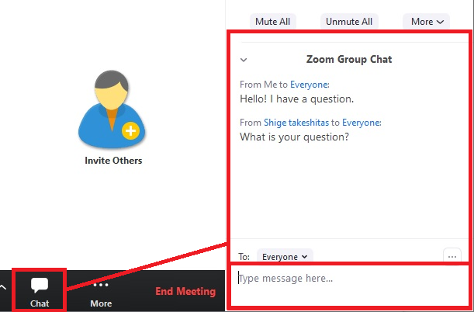
Chat pod
Use chat pod to ask questions/comments.

Slide 5
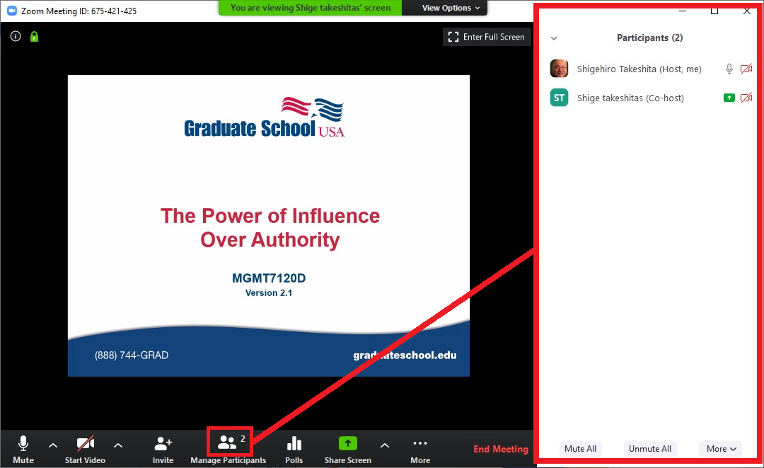
Participant Button
Click on participant button to change the layout.

Slide 6
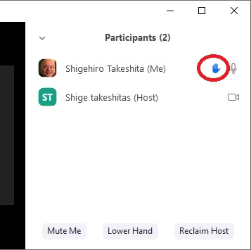
Raise hand
Raise your hand in the Participants pod if you want to talk or have a question.
Notes:
How to raise your hand in Zoom
1. During a meeting, click on the icon labeled "Participants" at the bottom center of your PC or Mac screen.
2. At the bottom of the window on the right side of the screen, click the button labeled "Raise Hand."
Click "Raise Hand" if you want to say something in the meeting. Zoom
Your digital hand is now raised. Lower it by clicking the same button, now labeled "Lower Hand."
The same method can be used to raise your hand in a Zoom meeting on a mobile device, simply tap
"Raise Hand" at the bottom left corner of the screen. The hand icon will turn blue and the text below it
will switch to say "Lower Hand" while your hand is raised.

Slide 7
Course Materials
Bookmarked and Comment-Enabled
Notes:
All GSUSA Participant Guides are PDF documents and are comment-enabled.
You can navigate within the content of the course guide and annotate the guide using sticky notes and highlighting text.
Students must have Acrobat Reader, a free software, to use the comment-enabled features.
Some participant course guides have full .pdf form functionality, i.e., fill-in blanks, boxes, add comments, highlight text, and navigate within the content. If your course guide is .pdf fillable, you will see this note in the upper left-hand corner of the document.
Please Note: Even if the file is not form fillable, students can still add notes and exercise answers using the add a note function and save the file.

Slide 8
Course Materials
May be form filled and comment enabled.
Notes:
Some participant course guides have full .pdf form functionality, i.e., fill-in blanks, boxes, add comments, highlight text, and navigate within the content.
If your course guide is .pdf fillable, you will see the GREEN note in the upper left-hand corner of the document.

Slide 9
Course Materials
May be form filled and comment enabled.

Slide 10
Attendance
Each person will be called on to introduce themselves.
This Photo by Unknown Author is licensed under CC BY-NC
Notes:
Suggestion: Use an Ice Breaker, click link below for ideas.
https://symondsresearch.com/icebreakers-for-online-teaching/

