Slide 1
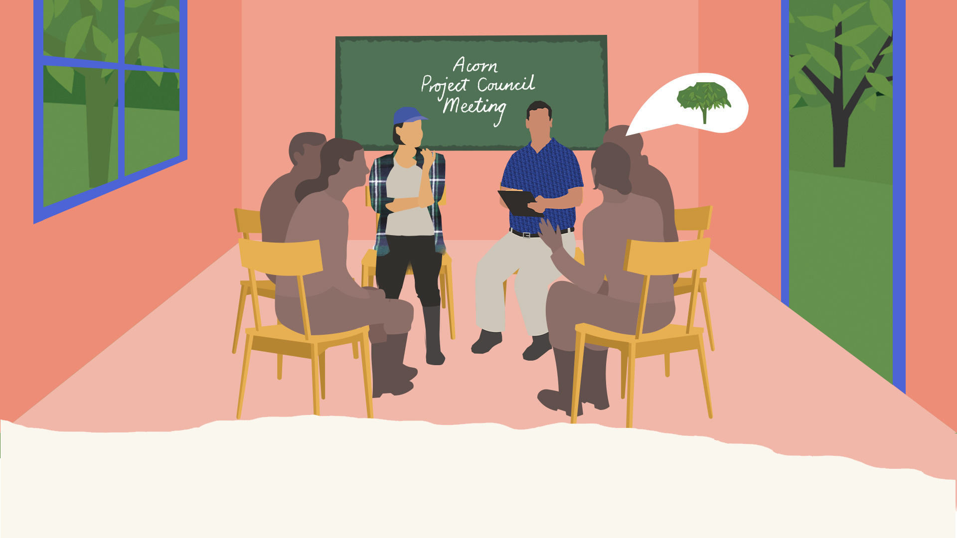
The Acorn Project Council
Last updated: February 2025
A guide to understanding the roles and responsibilities of the Project Council(s)

Slide 2
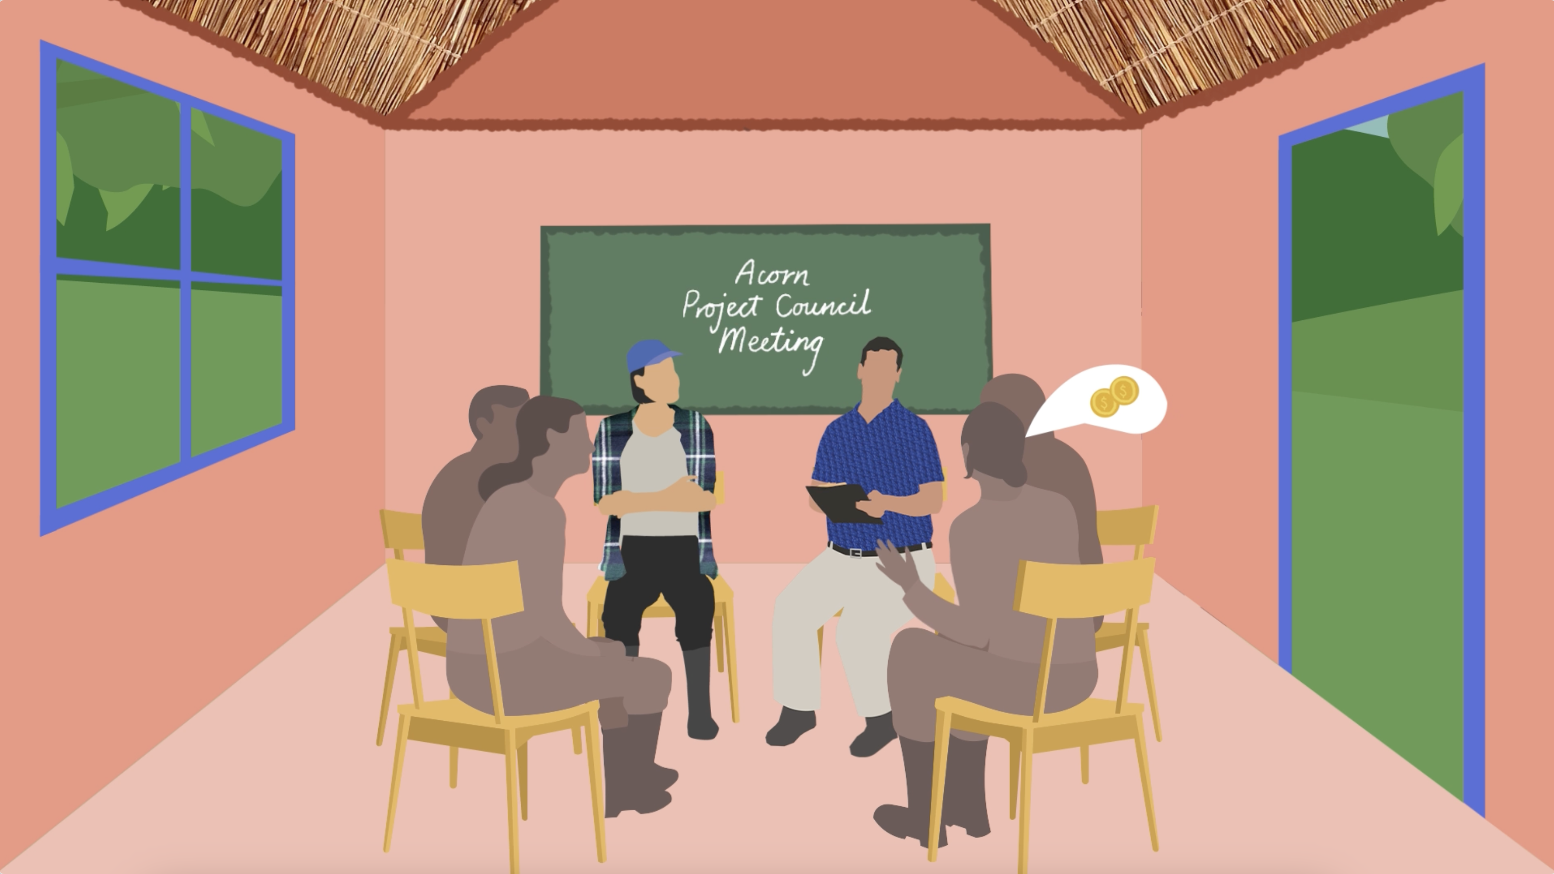
What is the Acorn Project Council?
The Project Council(s) is where important decisions related to the Acorn project are made, and where all farmers and affected communities can have an active voice about the project through their representatives.
There must be at least 1 Project Council per project. Each Project Council must hold at least 2 meetings each year.
Project Councils allow for:
Inclusive decision-making
Transparency and accountability
Local stakeholder representation and engagement
Governance and oversight mechanism
Participant and community input
Conflict resolution
Building trust

Slide 3
Who is part of the Project Council?
Every Acorn project must have at least one Project Council throughout the project's lifetime. The Project Council must include at least one community representative, farmer representatives, and local partner / subcontracting partner. Additional optional stakeholders include: Acorn, government / authorities, farmer cooperatives.
Community
representatives
Farmer
representatives
Local partner
representative
Not participating in the Acorn program
Represent the wider community
At least 1 community representative present
Votes on decisions, except the Benefit Sharing Mechanism
Participating in the Acorn program
Represents participating farmers
Number of farmer representatives determined by project size & need
Votes on all decisions related to Acorn project, including the Benefit Sharing Mechanism
Local partner or sub-contracting partner
Helps determine number of project councils and number of farmer representatives
Plans, organizes and prepares meetings
Communicates upcoming meetings ahead of time
Submits report & evidence to Acorn
4

Slide 4
Representatives’ Roles & Responsibilities
All representatives are responsible for engaging with the groups they represent, including collecting feedback (positive and/or negative) before meetings, and informing important decisions made after meetings.
Farmer representatives should engage with their respective farmers participating in the Acorn project
Example:
Representative A represents farmers with small land sizes
Representative B represents farmers from Village B
Representative C represents farmers with low social status
Representative D represents farmers from Village D
Representative E represents farmers who are women
Community representatives should engage with community members and Indigenous groups.
Examples of communication channels:
WhatsApp messages, SMS, or phone calls
Engaging farmers during trainings
Visiting farms
Attending existing community meetings
Attending religious/public announcements
Suggestion boxes in villages
5

Slide 5
Local Partner’s Roles & Responsibilities
Local Partners and sub-contracting partners are responsible for planning and organizing each project council meeting. This includes covering all expenses required for the project council meeting (e.g. venue hire, transport, materials, food and water).
✅
Partner representatives should ensure that meetings are open participation for all attendees, and are responsible for:
Creating the meeting agenda together with representatives (see next slide)
Gathering perspectives, feedback, experiences and ideas from Farmer / Community Representatives
Ensuring decisions are made using the decision-making mechanism decided at the start of the meeting
Submitting Project Council report to Acorn, including meeting minutes (recommended)
6

Slide 6
Creating a meeting agenda
The agenda is created by the Local Partner together with the Project Council representatives. This agenda should be shared with Acorn before each meeting and should be included in the Acorn Project Council Report. Consider adding the following categories:
Benefit-sharing mechanism
E.g. Monetary or in-kind payment, payment timing
Agroforestry / Project Design
E.g. Species suitability, farmer training
The meeting agenda must allow for Participants to confirm satisfaction with the benefit-sharing mechanism and for any complaints to be raised and discussed. During the meeting, someone will need to take notes.
Grievances
E.g. complaints/concerns raised and feedback on the method for reporting grievances
Livelihood / Ecological Conditions
E.g. trends in water and food availability, and soil and crop health
Project Monitoring
E.g. how local stakeholders can take part in monitoring of biodiversity
7

Slide 7
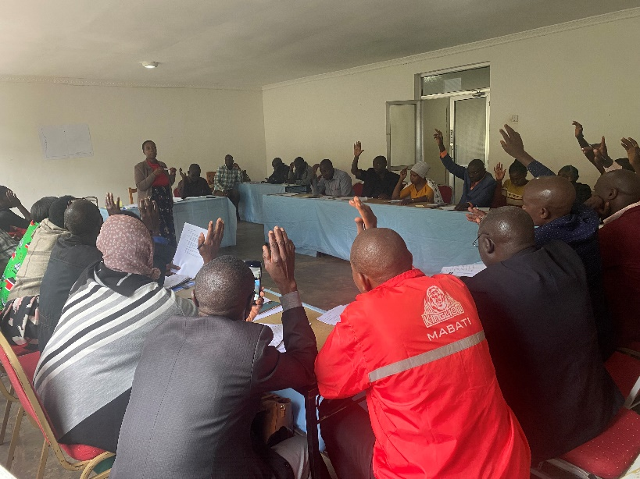
What is a decision-making mechanism?
A decision-making mechanism is how the Project Council will make important decisions about project activities. The decision-making mechanism must be agreed upon at the start of each project council meeting.
Only mandatory project council members can participate in decision making
Important considerations:
There must be an option to vote anonymously to encourage equal power in decision-making, regardless of differences in gender, social status, religion, influence in the community, etc.
At least 25% of farmer representatives must be present in the Project Council meeting to make legitimate decisions
Examples of decision-making mechanism:
Majority vote (>50%) of farmer and community representatives
All mandatory project council attendees agree (consensus)
Majority vote (>50%) of farmer representatives
8

Slide 8
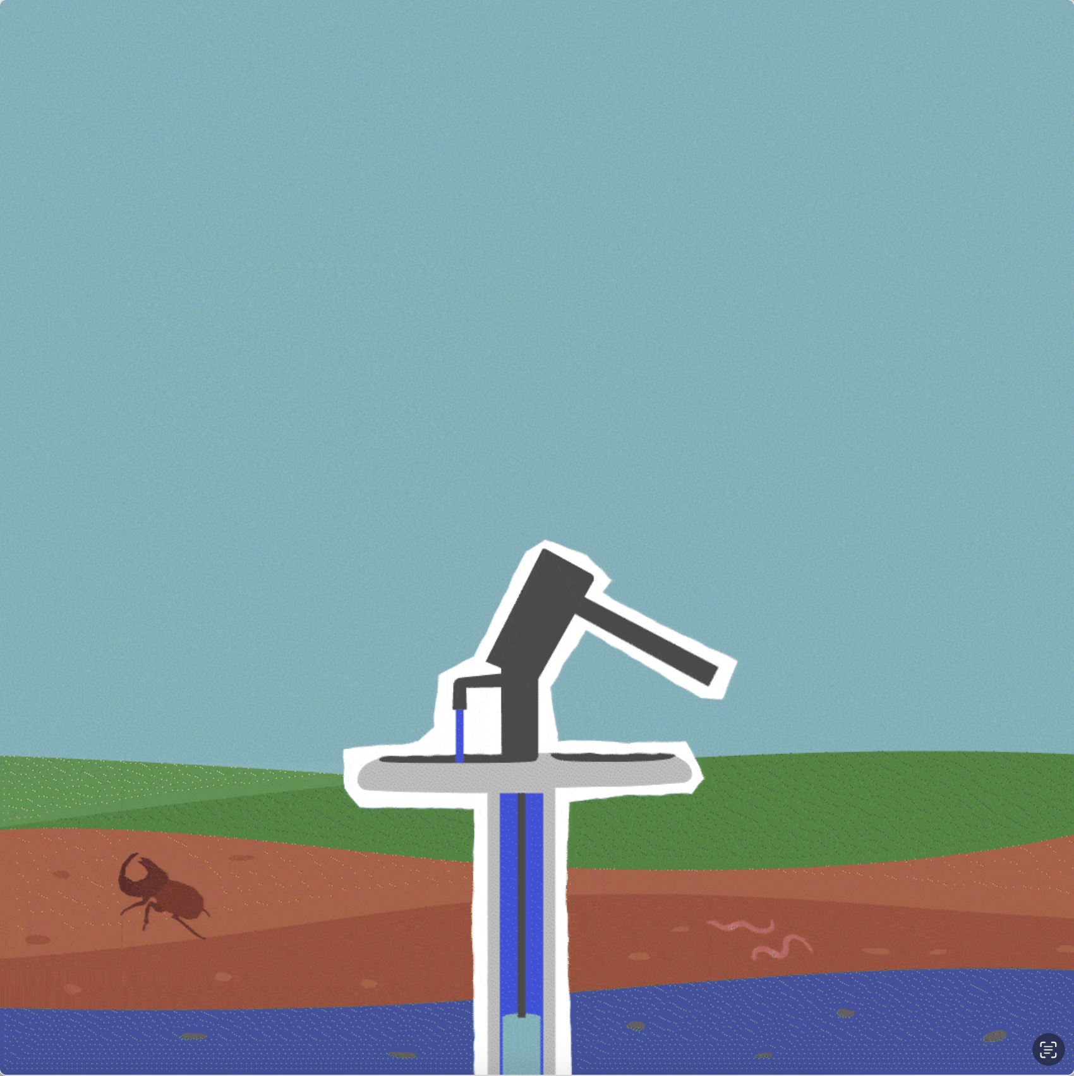
Who gets to vote?
For decisions that need to be voted on, there is an important difference in what the farmer representatives can vote for versus the community representatives.
Only farmer representatives can vote on money or benefit-related topics e.g. changing farmer payment from community investments to monetary
All representatives can vote for project-related topics, such as:
Changing a method for reporting complaints (e.g. from emails to calls)
Adopting a new tree species in an updated agroforestry design
Creating an activity to monitor present of wildlife on farms
This illustration shows farmer representatives voting for part of the payment to go towards a community water hole. Important note: any time there is a change or update to the Benefit-Sharing Mechanism, the representatives must vote again.
9

Slide 9
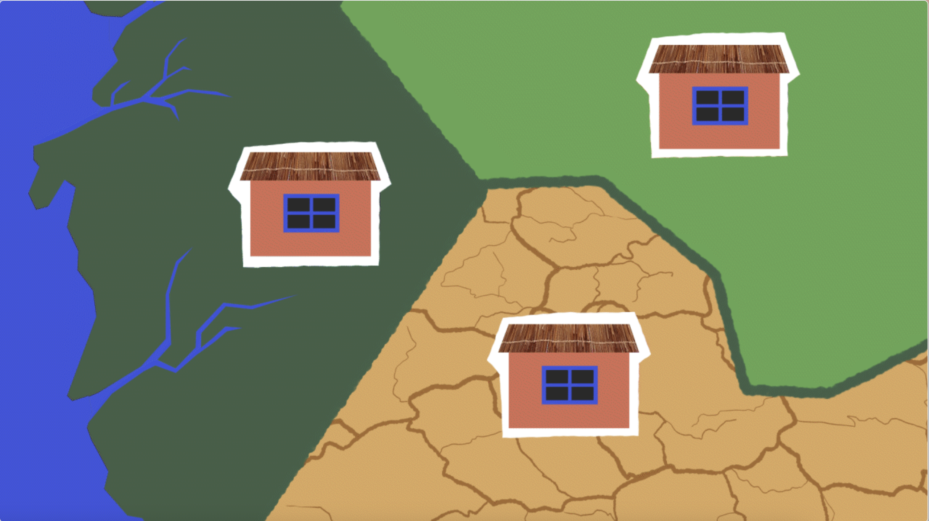
Multiple project councils
For some projects, we advise more than one Project Council, particularly for large projects that have many participants across different regions. This allows for better representation and separate decisions to be made per project area based on the needs of different farmer groups, as farmers may have different needs in different regions.
To enhance oversight, each Acorn Participant should be linked to one Project Council that will represent them.
Factors to consider for multiple project councils:
Number of farmers
Distance between farmer groups
Different agroforestry designs
Gender norms/roles in decision making
This illustration shows 3 different regions in the same project that have 3 different project councils to address differing needs.
10

Slide 10
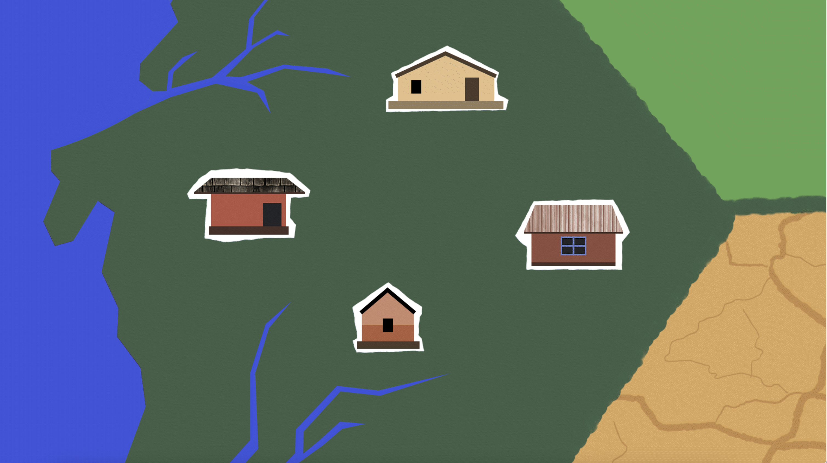
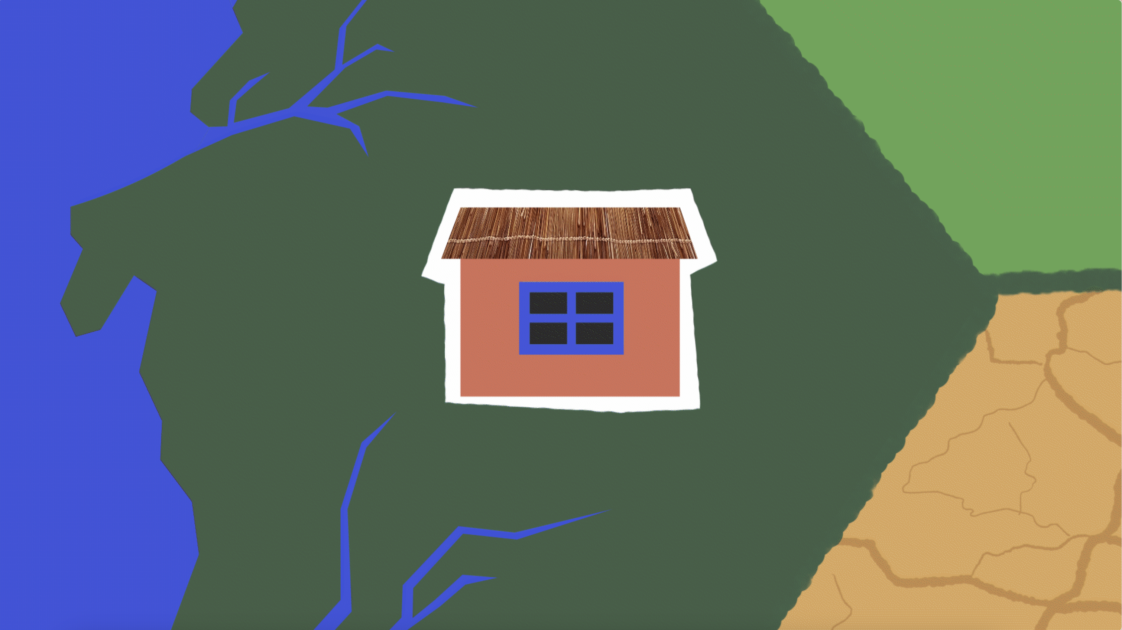
Multiple project councils structure
Here is an example of how multiple project councils can work in practice. There are 3 different levels: the village level, the regional level, and the project level. The village level and regional level structure would be replicated across other regions in one project.
Local Partner may want to consider organizing annual meetings between representatives or facilitators to exchange tips and best practices.
Community Meetings (Village level)
Community meetings may already take place as usual
At least 1 farmer representative joins the meeting to hear feedback from participants (to bring to Project Council meeting)
Project Council Meetings (Regional level)
Local Partner, farmer representatives, community representatives must meet and vote on important decisions (must be held at least 2x a year)
Follows normal Project Council times, structure and responsibilities e.g. decision-making mechanism, submit report and evidence
This illustration shows different villages with their own community meetings. The farmer representatives that are present in these community meetings, then join the regional Project Council meeting with other community representatives and Local Partner representative. This structure is replicated across the other regions your project is active.
11

Slide 11
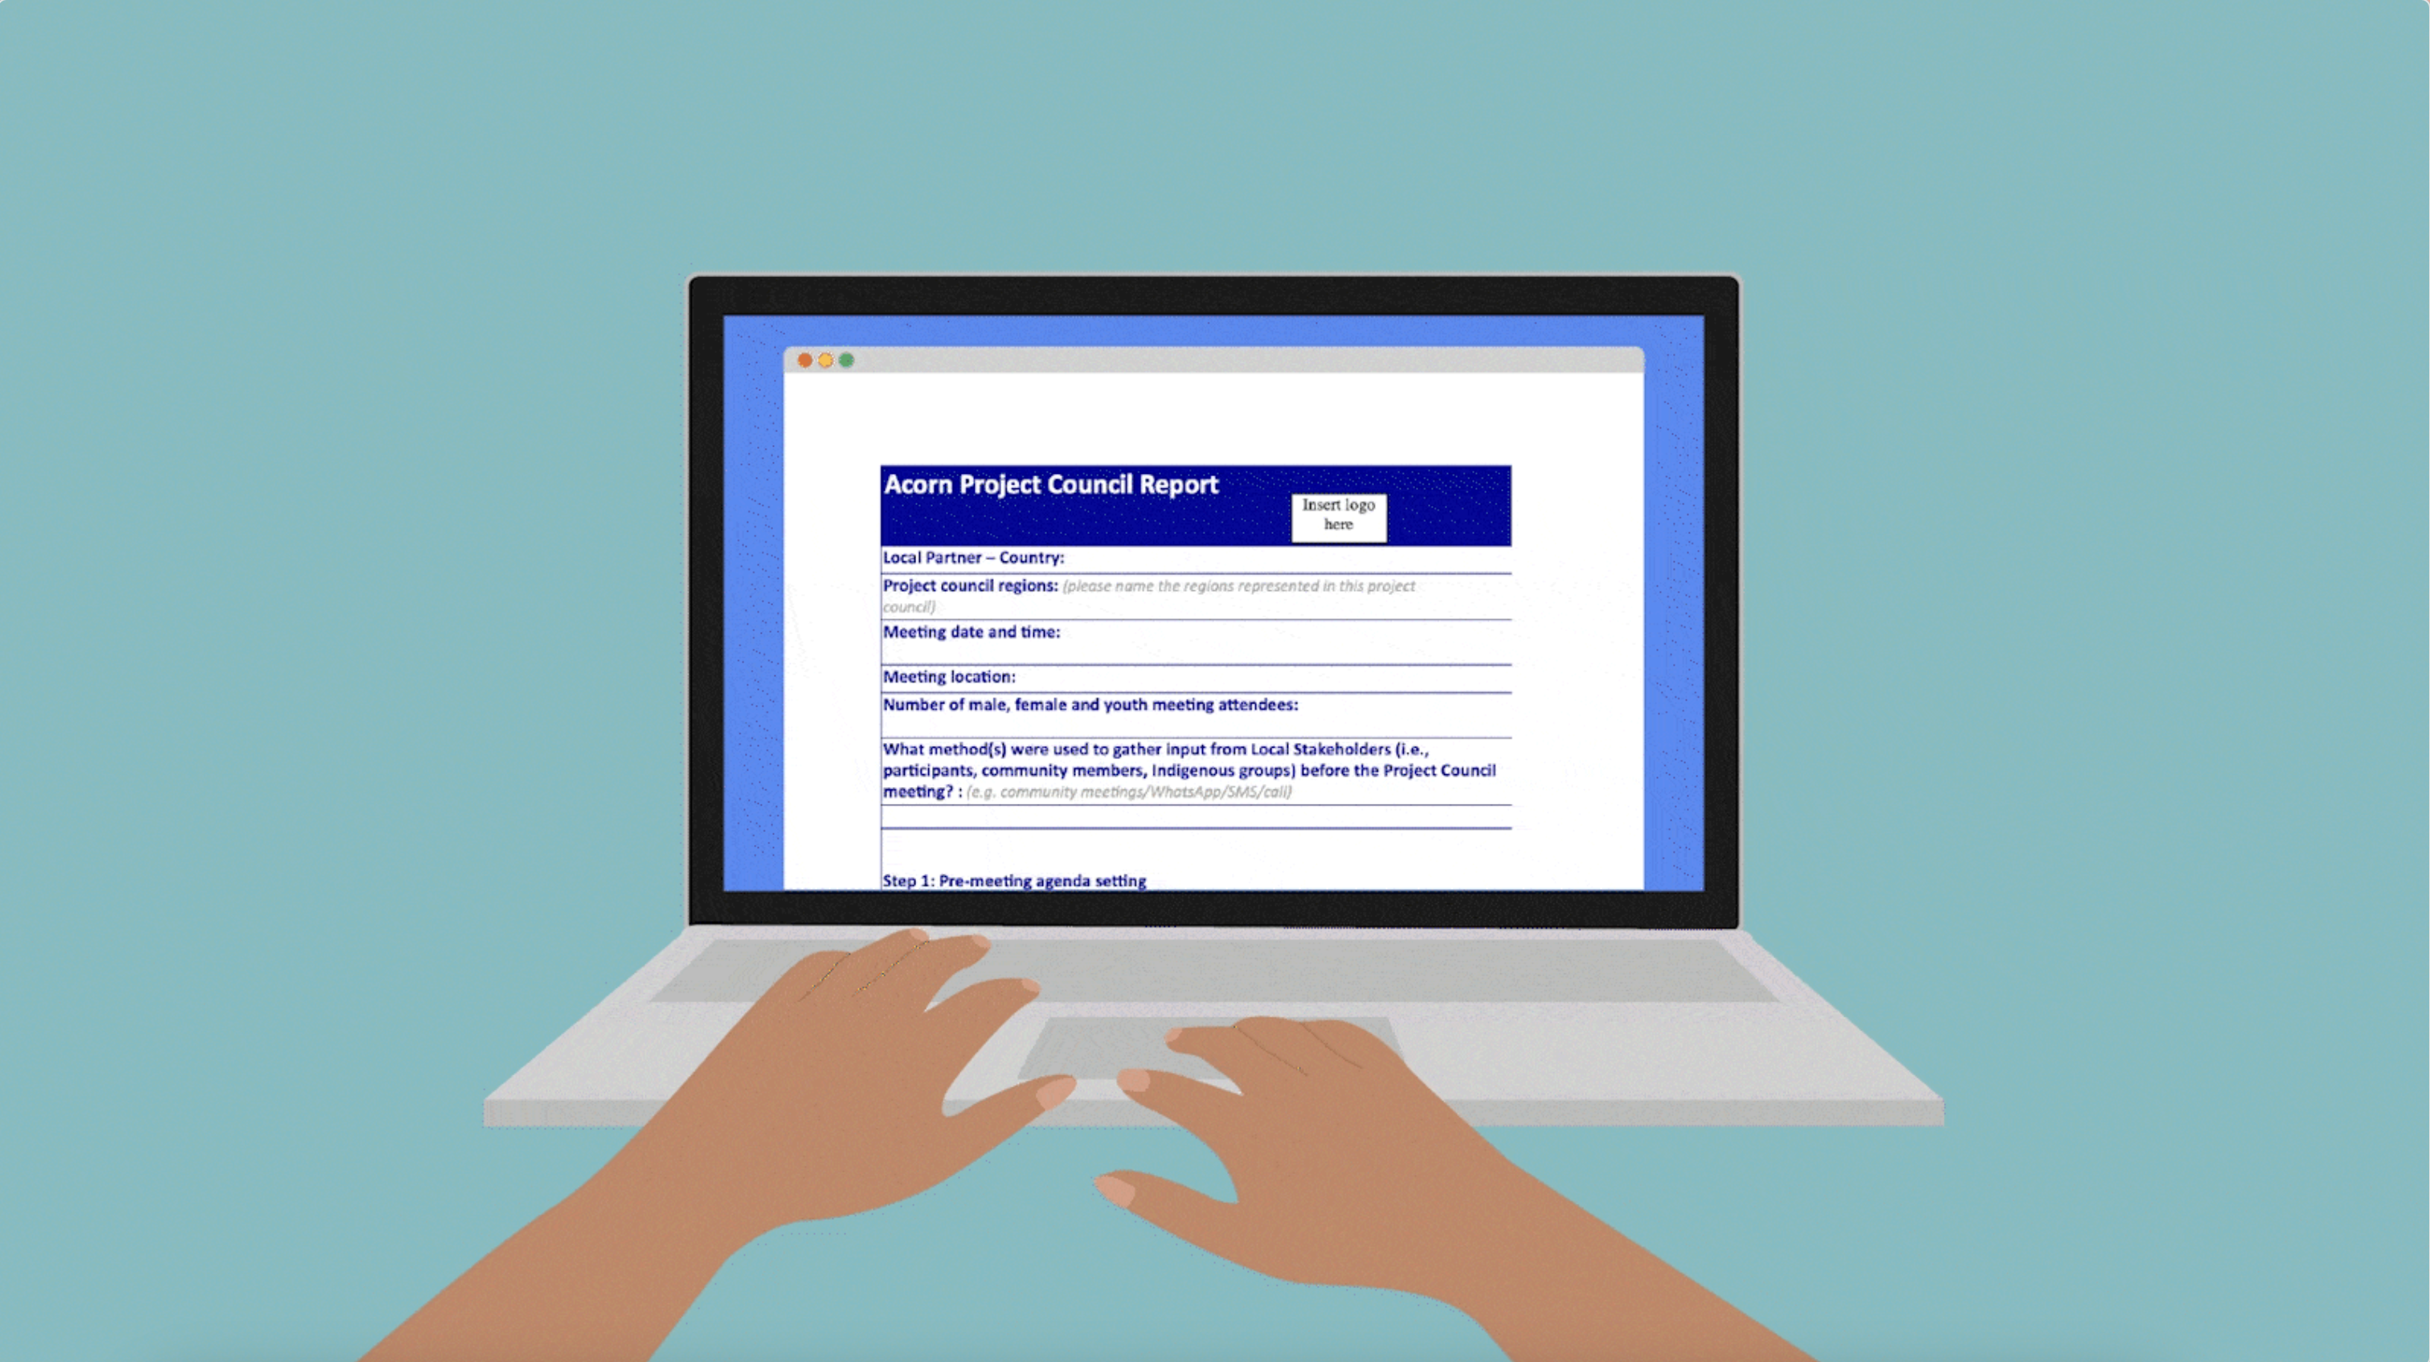
What do you need to submit to Acorn?
After every Project Council meeting, the Local Partner must complete the Project Council template report and submit it to their Acorn account manager within 35 days of the meeting.
The report must include:
A summary of the meeting minutes and the decisions made
An attendance list with signatures from all attendees
Photos or videos of the meeting
For multiple project councils, each Project council must submit their own report.
The outcomes of the Project Council meeting should be communicated back to Acorn participants. It would be ideal to provide evidence of this back to Acorn, which can include: screenshots of text messages, photos or videos, or posters.
12

Slide 12
Additional Resources
Acorn Training Material: Implementing Your Project Council
Project Council Report Template
This 7-minute video simplifies all the basic information you need to know about the Acorn Project Council. Subtitles available.
This 4-minute video explains all you need to know and understand about multiple project councils. Subtitles available.
13

