Slide 1
FAQs About Acorn
What is the Acorn program?

Slide 2
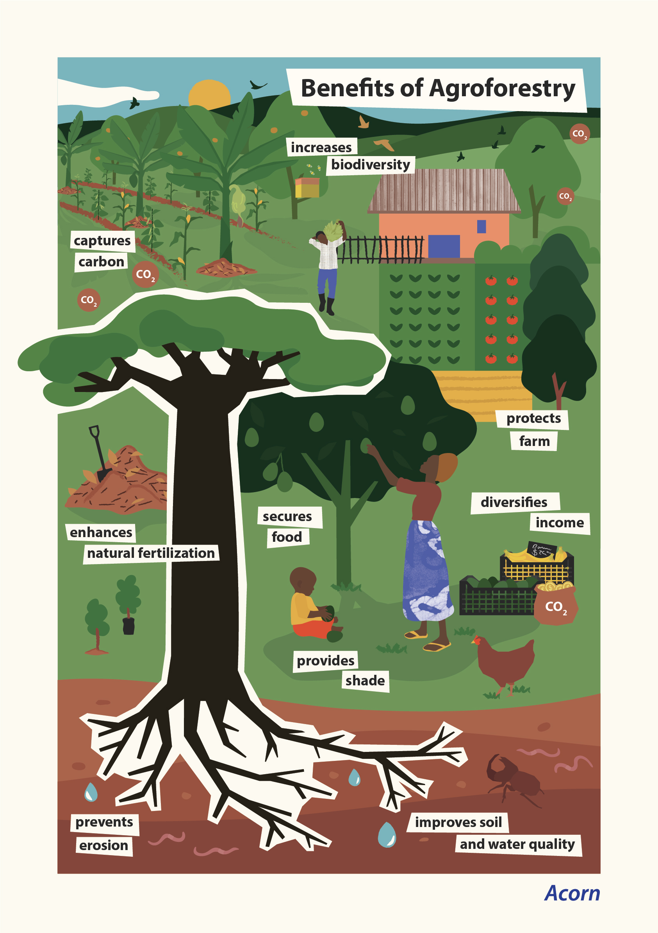
“What is agroforestry?”
Agroforestry is a farming practice that plants trees on farmland:
Trees can be planted either among, along or bordering crops. Long-term benefits include:
Healthier soil, which can lead to less reliance on fertilizers.
Protection from erosion.
Shade for farmers, their animals and crops during hot, dry days.

Slide 3
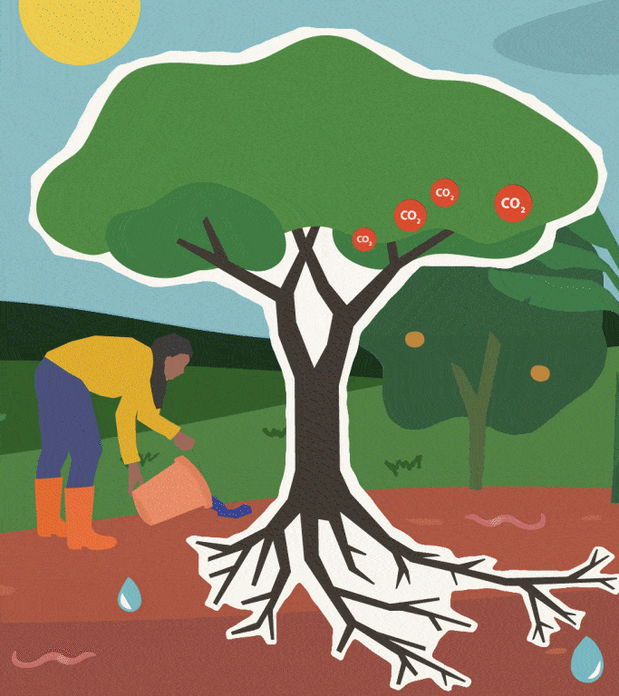
What do trees need to grow?
Trees need water, sunlight, minerals and carbon dioxide (CO2) to grow.
Trees take CO2 from the air and store it in their trunks, branches, leaves and roots.
How trees help fight climate change
Greenhouse gases like CO2 are the main cause of climate change
One natural solution is to remove carbon from the atmosphere and store it in growing trees
Farmers can get paid for planting and growing trees on their farm!

Slide 5
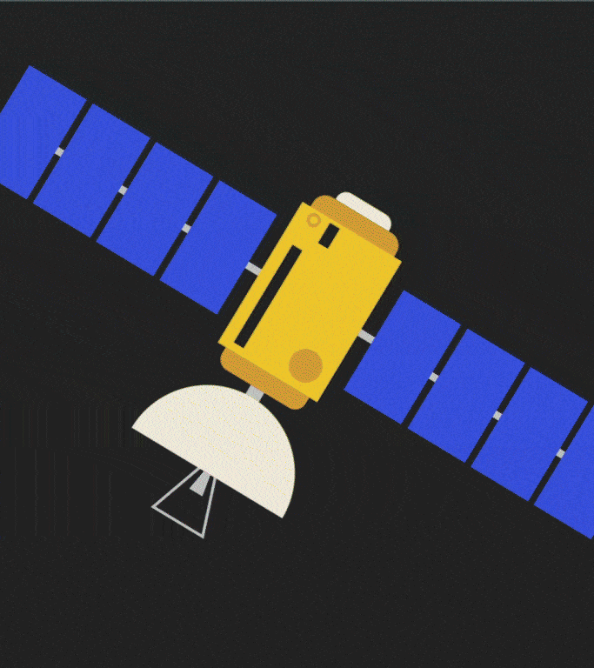
”How does Acorn’s carbon income work?”
With our Acorn program, farmers can receive carbon income
The bigger their trees grow, the more carbon they store. The more carbon that is stored, the more money farmers can receive
How does Acorn measure CO2 in your trees?
Each year, we measure tree growth through satellite technology in space. We can estimate how much carbon farmers’ trees have stored in one year on a single plot.

Slide 6
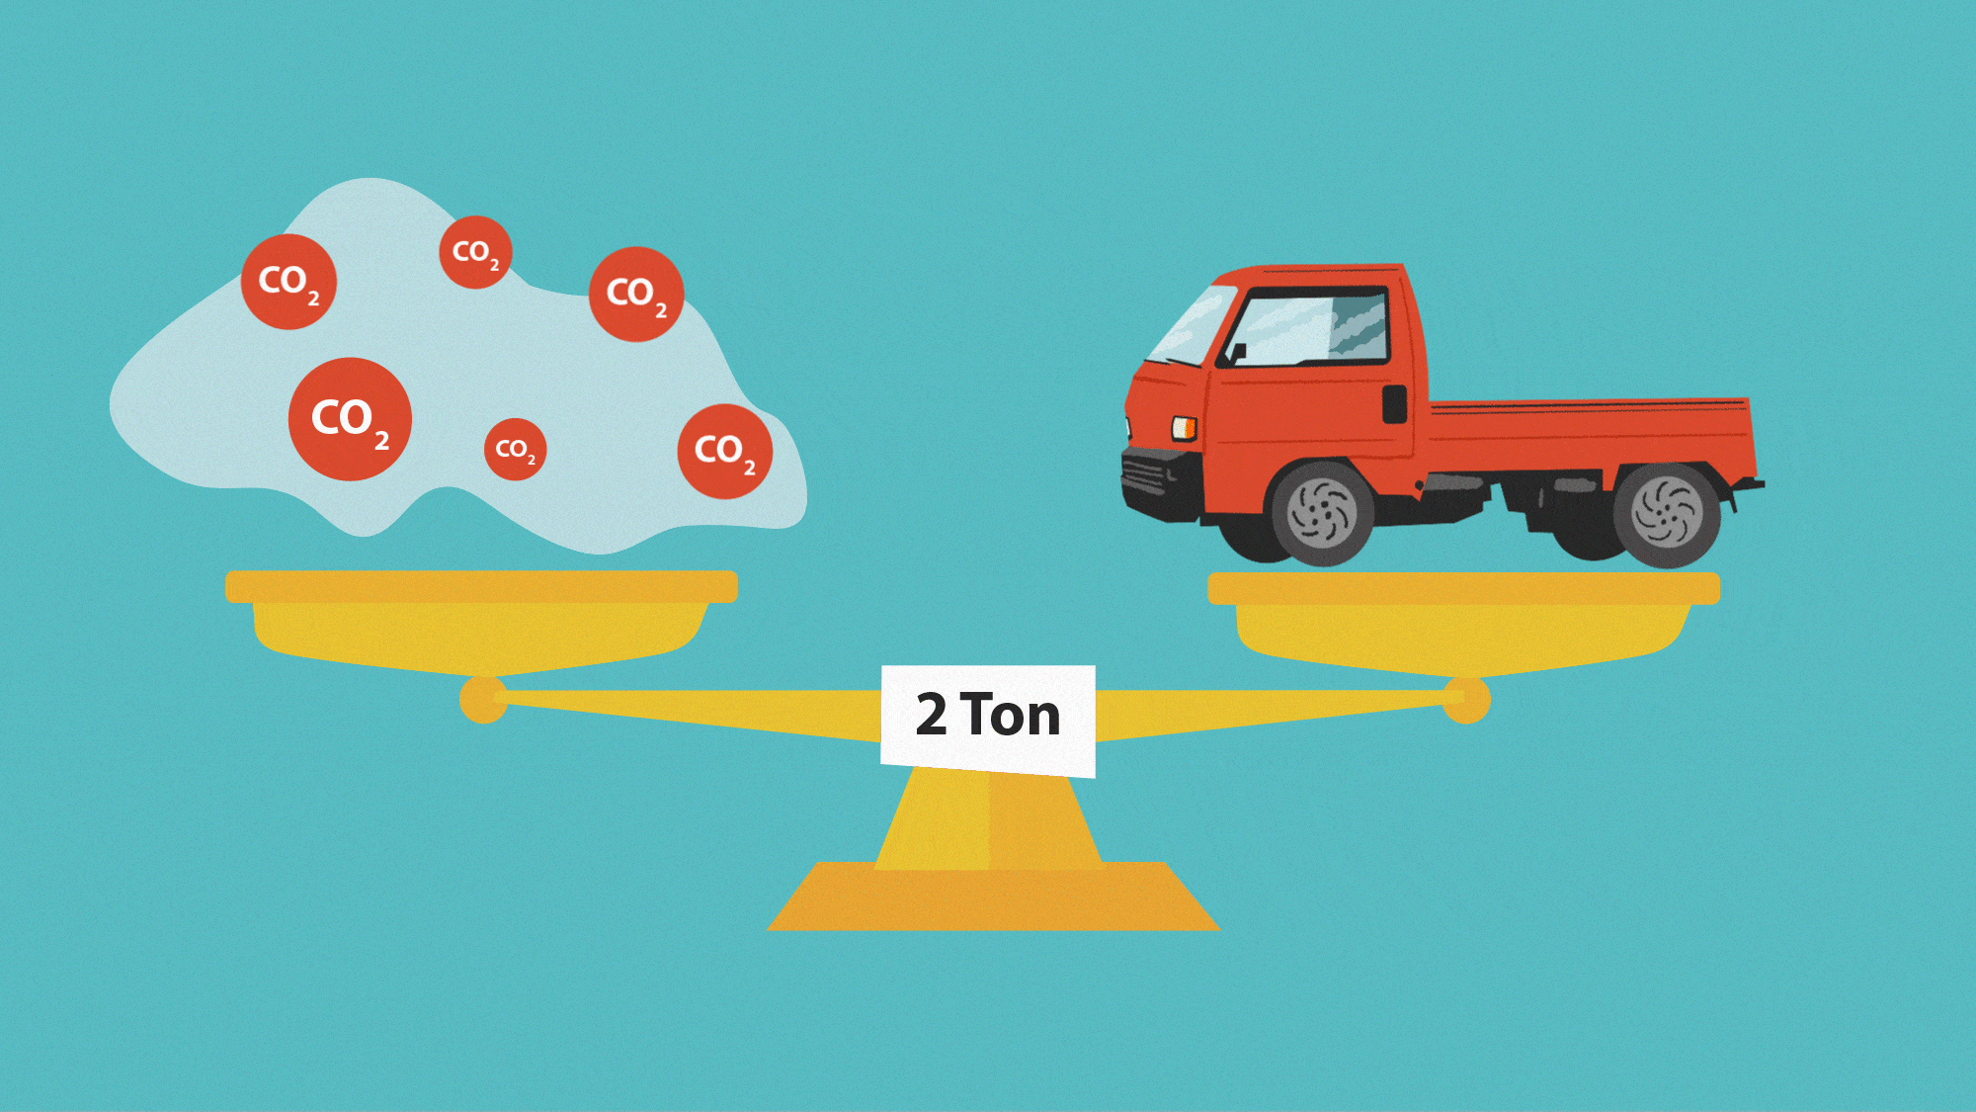
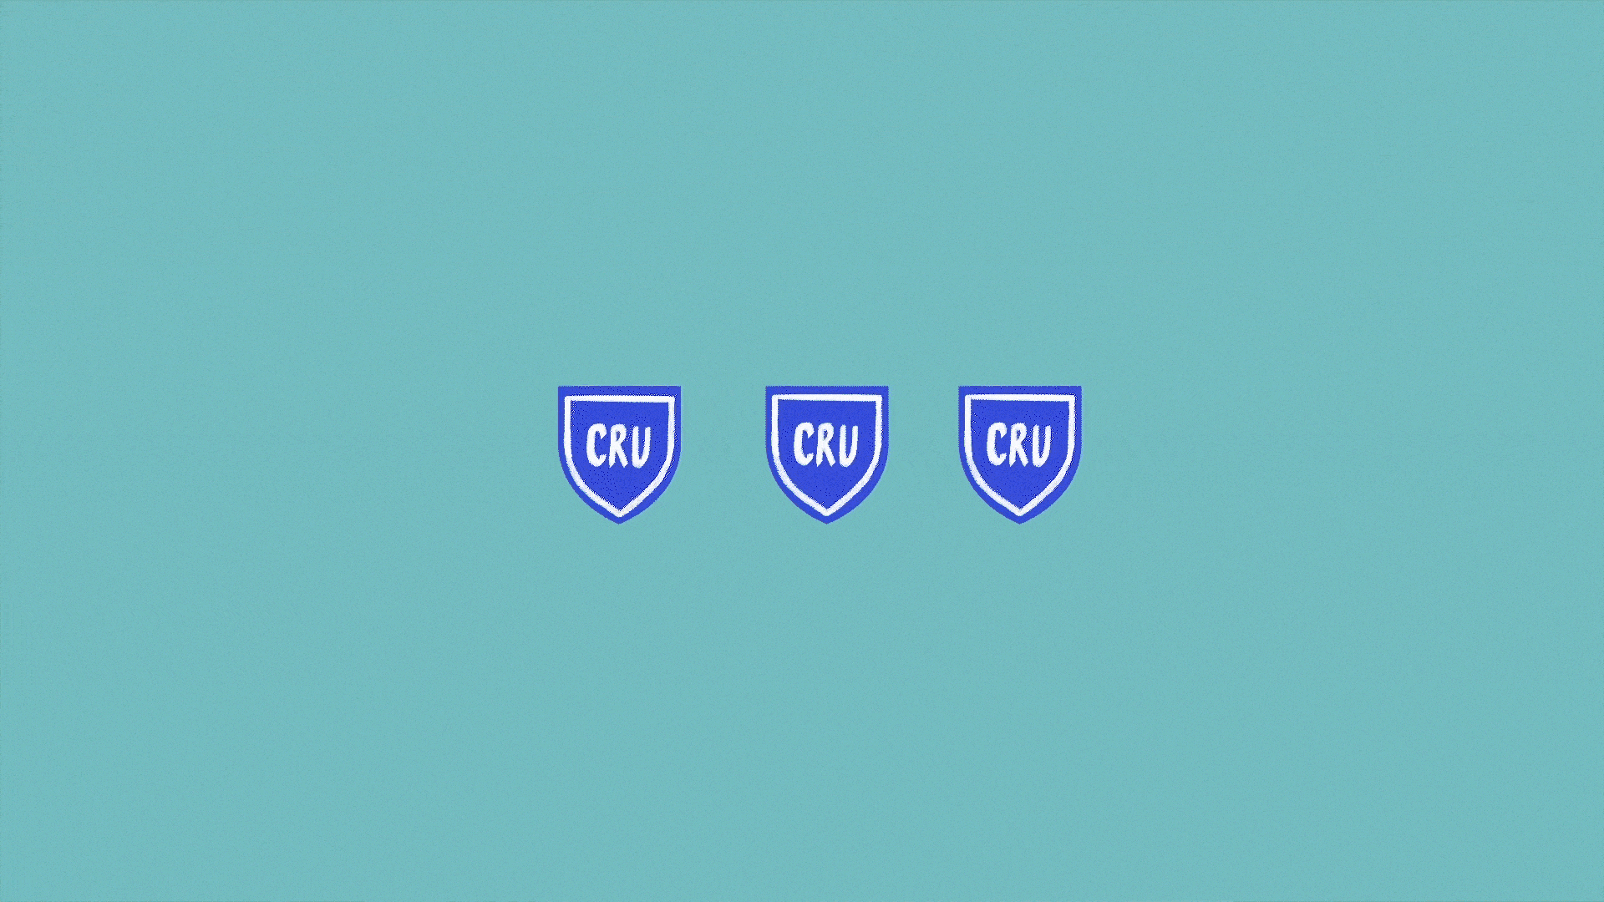
How much is 1 ton of CO2?
Each 1 ton of CO2 stored in trees = 1 Acorn Carbon Removal Unit (CRU)
Once trees have grown big enough to store 1 ton of CO2, we can sell the CRUs in our Acorn marketplace.
How much money do you receive?
80% of the sales revenue goes to the farmers, 10% goes to local organization and 10% goes to Acorn for administration and operation costs

Slide 7
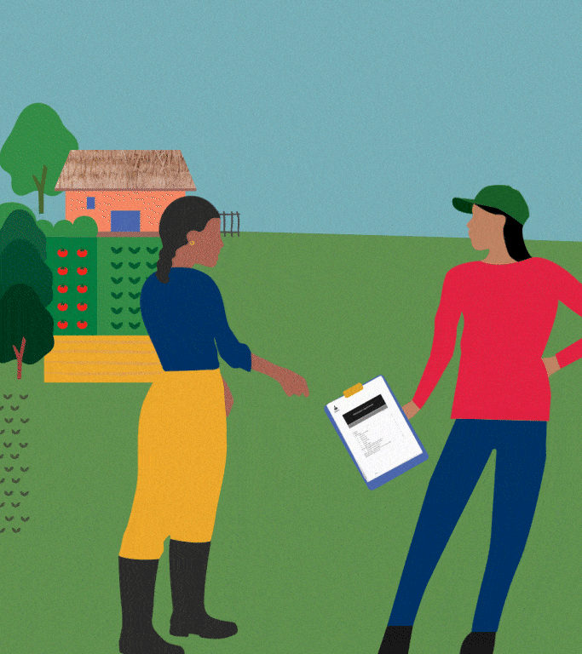
“How do I join Acorn?”
Step 1. Meet with local organization representative
Farmers are eligible if:
Acorn is the only agroforestry-carbon project they are signed up to,
They owns between 0.1 and 10 hectares of land.
*Farmers may also eligible if you planted new trees in the last 5 years.
Step 2. Farm registration
A data collector will be sent by the local organization to go to a farmer and meet with them on their land to register their details.

Slide 8
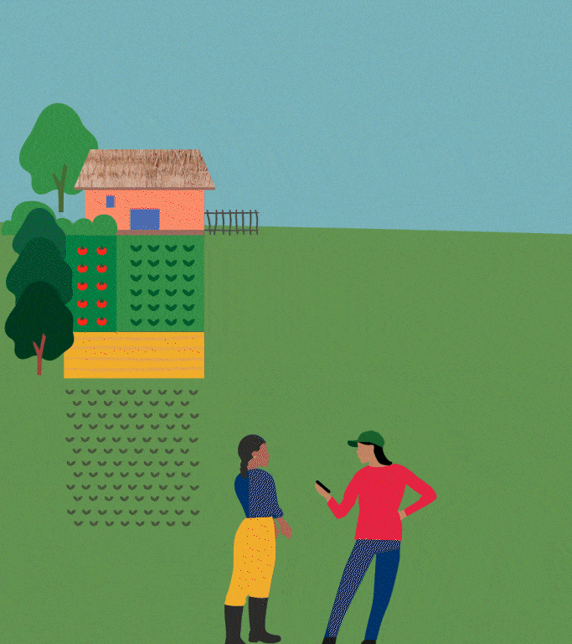
When the data collector arrives:
If farmers want to join Acorn, they will be asked to provide proof of land ownership, and to sign the Participant Agreement + Data Sharing Consent Form:
The Participant Agreement: explains farmer’s rights in the Acorn program
The Data Sharing Consent form: acknowledges that farmers are the owner of their data and that they give Acorn permission to use their data in our system,
After providing these details,
The data collector will map the boundaries of the farm and upload the farmer profile into the Acorn system for check and approval by the local organization.

Slide 9
“What else should I know?”
Long-term tree care and growth
As part of the Acorn program, trees should stay healthy and remain on their farm for the next 25 years.
Try not to
cut down trees
This may result in a lower carbon income. Remember, trees can grow slowly, so it may take some time before farmers see the first payment.
Getting
involved
For any questions, feedback, or ideas: farmers can always participate in Project Council meetings or talk to their representative.

