Slide 1
WELLBEING
ALL ABOUT FEELINGS

Slide 2
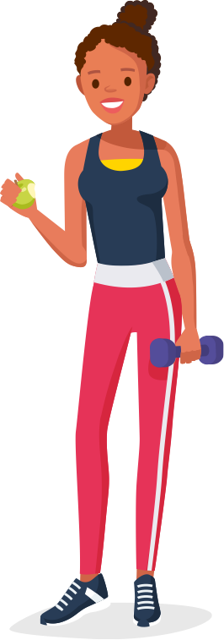
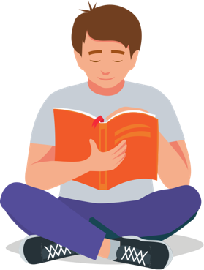
WHAT ARE WE GOING TO LEARN?
Today, we're going to explore the importance of wellbeing and how to talk about our feelings, as well as identifying some of the things that make us feel good.

Slide 3
RESPECT. YOUR RULES.
Today, we’re going to be talking about sensitive topics. It’s really important that we all show each other respect. Use some of the words below to write your own three rules that you’d like everyone to follow.
HEAR
RESPECT
KIND
SENSITIVITY
EMPATHY
LISTEN
UNDERSTAND
SPEAK
Let’s share and agree on our ground rules.

Slide 4
STARTER ACTIVITY
HOW ARE YOU DOING?

Slide 5
WELLBEING SELF-ASSESSMENT
What do we mean when we
talk about ‘wellbeing’?
Start by completing the Wellbeing Self Assessment Activity Sheet. Circle the emoji that best describes your feelings about different areas of your life.
You don’t need to share this with anyone if you don’t want to.

Slide 6





WELLBEING LEVEL
Look at the emojis you circled.
Count the different colours to see which you have most of.
FEELING LOW
We all have bad days and tomorrow you might feel differently.
However if not, find someone you can talk to.
COULD BE BETTER
It’s not all bad, but things could be much rosier. Speak to
someone you trust about whether you need some extra help.
DOING OK
You have ups and downs. Perhaps there are some
specific areas you can work on to boost your wellbeing.
FEELING GOOD
You’re generally in a happy place. Keep it up and see if there
are things you can do to feel even better.
POSITIVE VIBES
You’re doing great. Now you can focus on helping those around
you to feel just as good.
REMEMBER
There is no right or wrong way to feel and we all feel differently from time to time. But
if you would like some support, speak to an adult you trust.

Slide 7
ACTIVITY 1
GROWING AND CHANGING

Slide 8

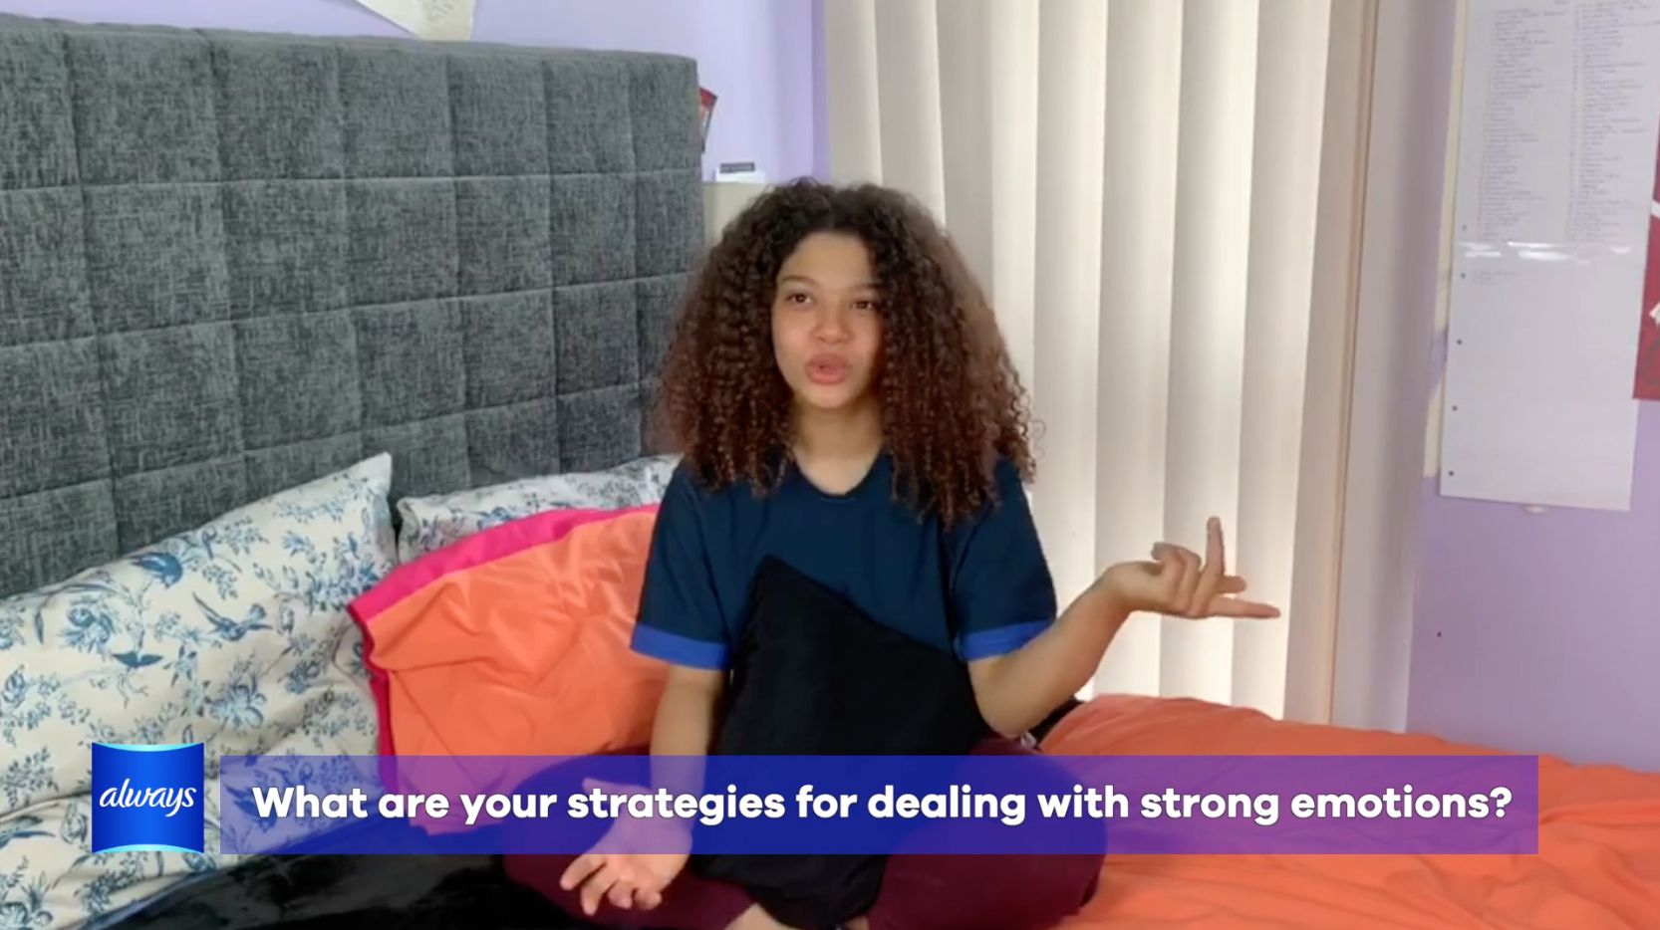

REAL TEEN STORIES
Watch the video where teens talk about how they deal with changing emotions.
What stands out to you about what they said?
Are there any things you empathise with?
Note down any phrases that the students use to talk about their feelings.
Notes:
CLICK TO PLAY

Slide 9
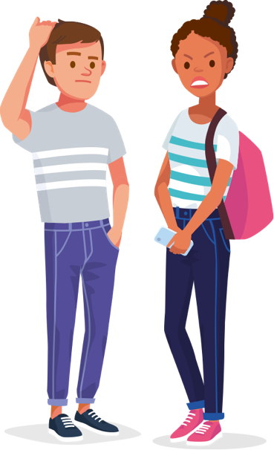

TALKING ABOUT FEELINGS
Your friend is worried about the emotional and physical changes they’re going through. They want
to speak to an adult, but they don’t know what to say.
Can you give them some examples of how
they could talk about the way they feel?
For example:
When I get anxious, it feels like I have a tangled knot in my stomach that I can’t unravel.
When I have PMS, I feel so sensitive as if
I could snap if anything doesn’t go my way.
Extension:
what advice would you give the young people in these examples?

Slide 10
ACTIVITY 2
RESPONDING
TO EMOTIONS

Slide 11

RECOGNISING EMOTIONS
In teams, come up with as many emotions
as you can in 1 minute.
HAPPY
ANGRY
EMOTIONS
Extension:
can you separate the emotions you listed into positive and negative? Could some be both?
EMBARRASSED

Slide 12
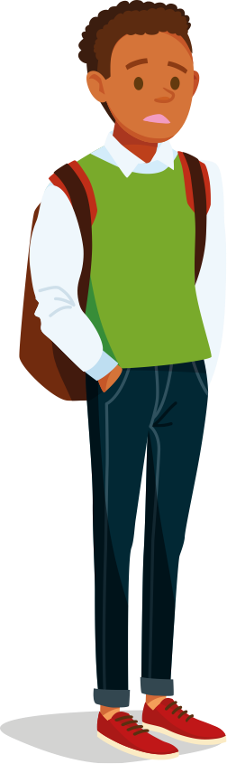
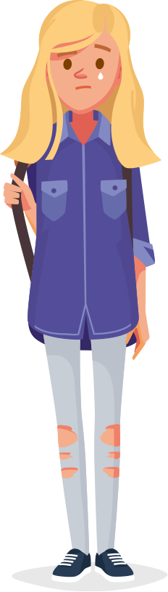
DEALING WITH EMOTIONS
It's completely normal to feel a range of emotions.
Getting angry, overexcited or nervous is just a part of life.
Although we can't control our emotions, we can control the way that we act when a strong feeling takes hold. In fact, the way we control our response to our emotions is just like a muscle - we can train ourselves to get stronger with practice.
From the list you created, what emotions do you think people can find challenging at times?

Slide 13
RESPONDING TO EMOTIONS
In your groups, read through the Responding to Emotions Activity Sheet.
Discuss these questions for each scenario and be ready to feed back.
How might each person
feel in this scenario?
How might it negatively affect
what they do next?
What could they do to change
their initial response to their
emotions?
How could they act
in a positive way?
Extension:
create your own scenario for another member of the class to discuss?

Slide 14
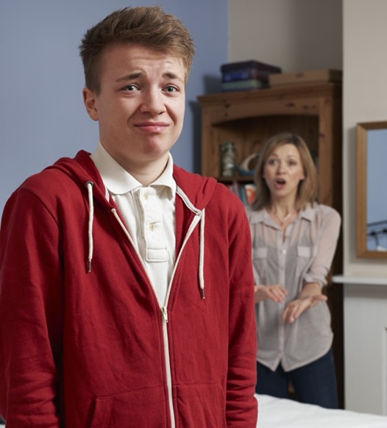
SCENARIO CARD 1
WHAT DID YOU DECIDE?
It’s Friday and Jordan is supposed to spend tomorrow at his friend’s house, but his mum has just told him that he can’t go because he hasn’t completed his household tasks for the week.

Slide 15
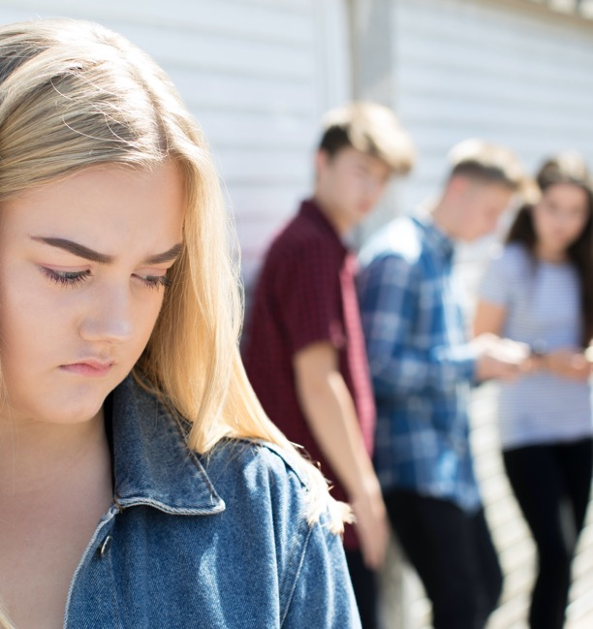
SCENARIO CARD 2
WHAT DID YOU DECIDE?
Ellie’s period starts unexpectedly at school one day. She asks a friend to
help and they give her a pad to use.
At breaktime, she notices a group of students laughing and pointing at her and as she walks past, they shout out insults about her being on her period.

Slide 16
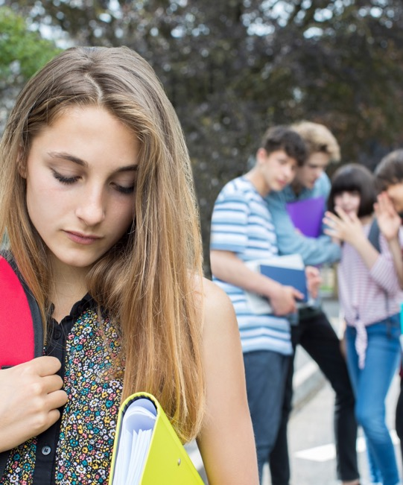
SCENARIO CARD 3
WHAT DID YOU DECIDE?
Candice has seen Sienna handing out invitations to her birthday party all day, but school is over, and she hasn’t received one. She asks Sienna and she tells her that she doesn’t have space for everyone, so she’s not invited.

Slide 17
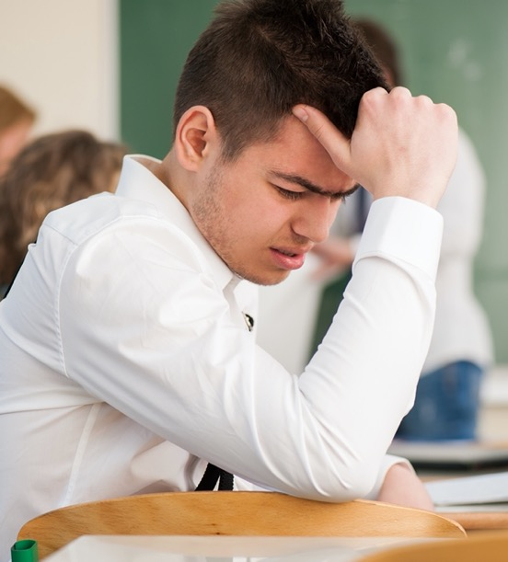
SCENARIO CARD 4
WHAT DID YOU DECIDE?
Shivam gets his maths test results back from the teacher. His score is one of the lowest in the class and he will have to repeat the test next week at break time, plus his maths teacher says she will ring home to speak to his parents.

Slide 18
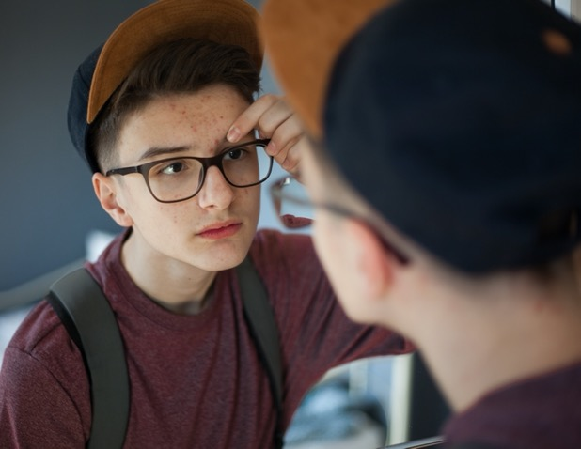
SCENARIO CARD 5
WHAT DID YOU DECIDE?
Zach wakes up to find that he has broken out in spots all over his face. He is due to give a performance in his drama class today.

Slide 19
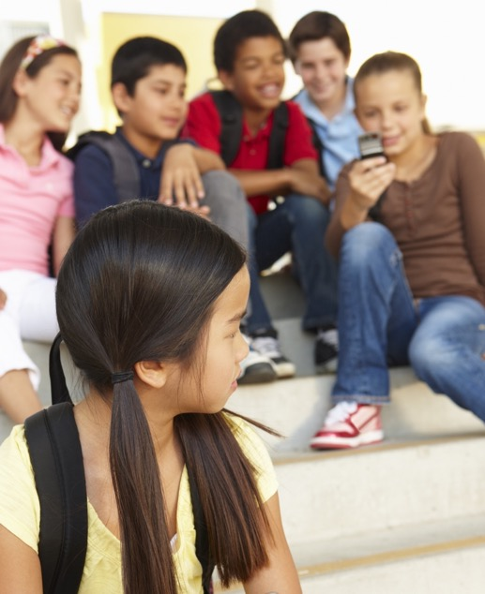
SCENARIO CARD 6
WHAT DID YOU DECIDE?
Aleah leaves her bag in the classroom and when she comes back to get it, she sees that her friends have taken out her phone and are reading her private messages.

Slide 20
KNOWING WHEN IT’S NOT OK
A range of emotions is normal, but if you’re experiencing any or all of these symptoms frequently, it could be an indication of depression.
Not wanting to do things that you previously enjoyed
Avoiding friends or social situations
Eating more or less than normal
Feeling irritable, upset, miserable or lonely
Feeling tired and not having any energy
If you’re regularly experiencing any or all of these symptoms, or anything else doesn’t feel right, speak to a trusted adult and get help.
Source: https://www.nhs.uk/conditions/clinical-depression/symptoms/

Slide 21
KNOWING WHEN IT’S NOT OK
Another common mental illness is anxiety.
Here are some of the signs to watch out for:
Feeling nervous, on edge, or panicky all the time
Feeling out of control
Having trouble sleeping
Low appetite
Finding it difficult to concentrate
Heart beating really fast or thinking you’re having a heart attack
If you’re regularly experiencing any or all of these symptoms, or anything else doesn’t feel right, speak to a trusted adult and get help.
Source: https://www.nhs.uk/conditions/generalised-anxiety-disorder/symptoms/

Slide 22


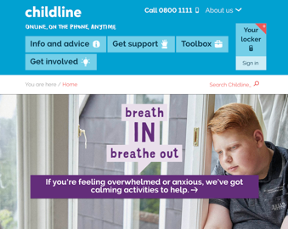
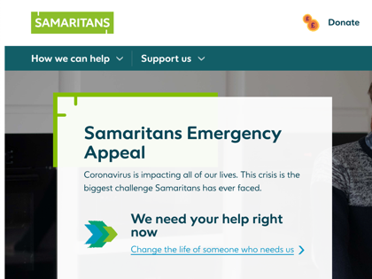
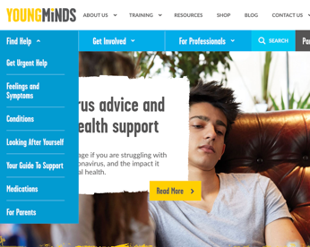
WHERE TO GO FOR HELP AND SUPPORT
If you’re worried about yourself or someone else,
speak to a trusted adult or teacher for advice.
You could also visit one of these websites for further support.
childline.org.uk
samaritans.org
youngminds.org.uk

Slide 23
ACTIVITY 3
HEALTHY AND UNHEALTHY
BEHAVIOURS

Slide 24
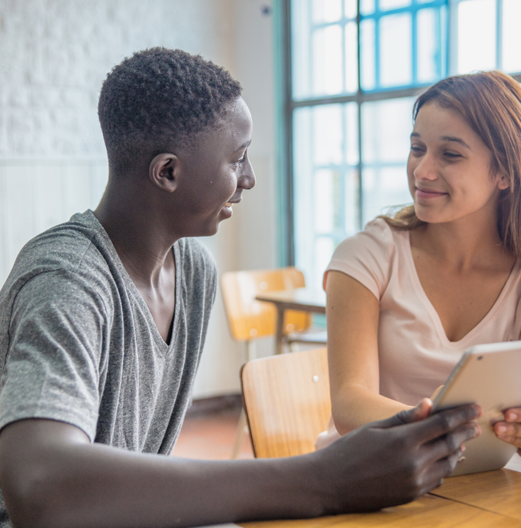
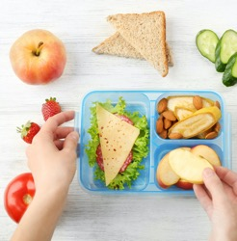

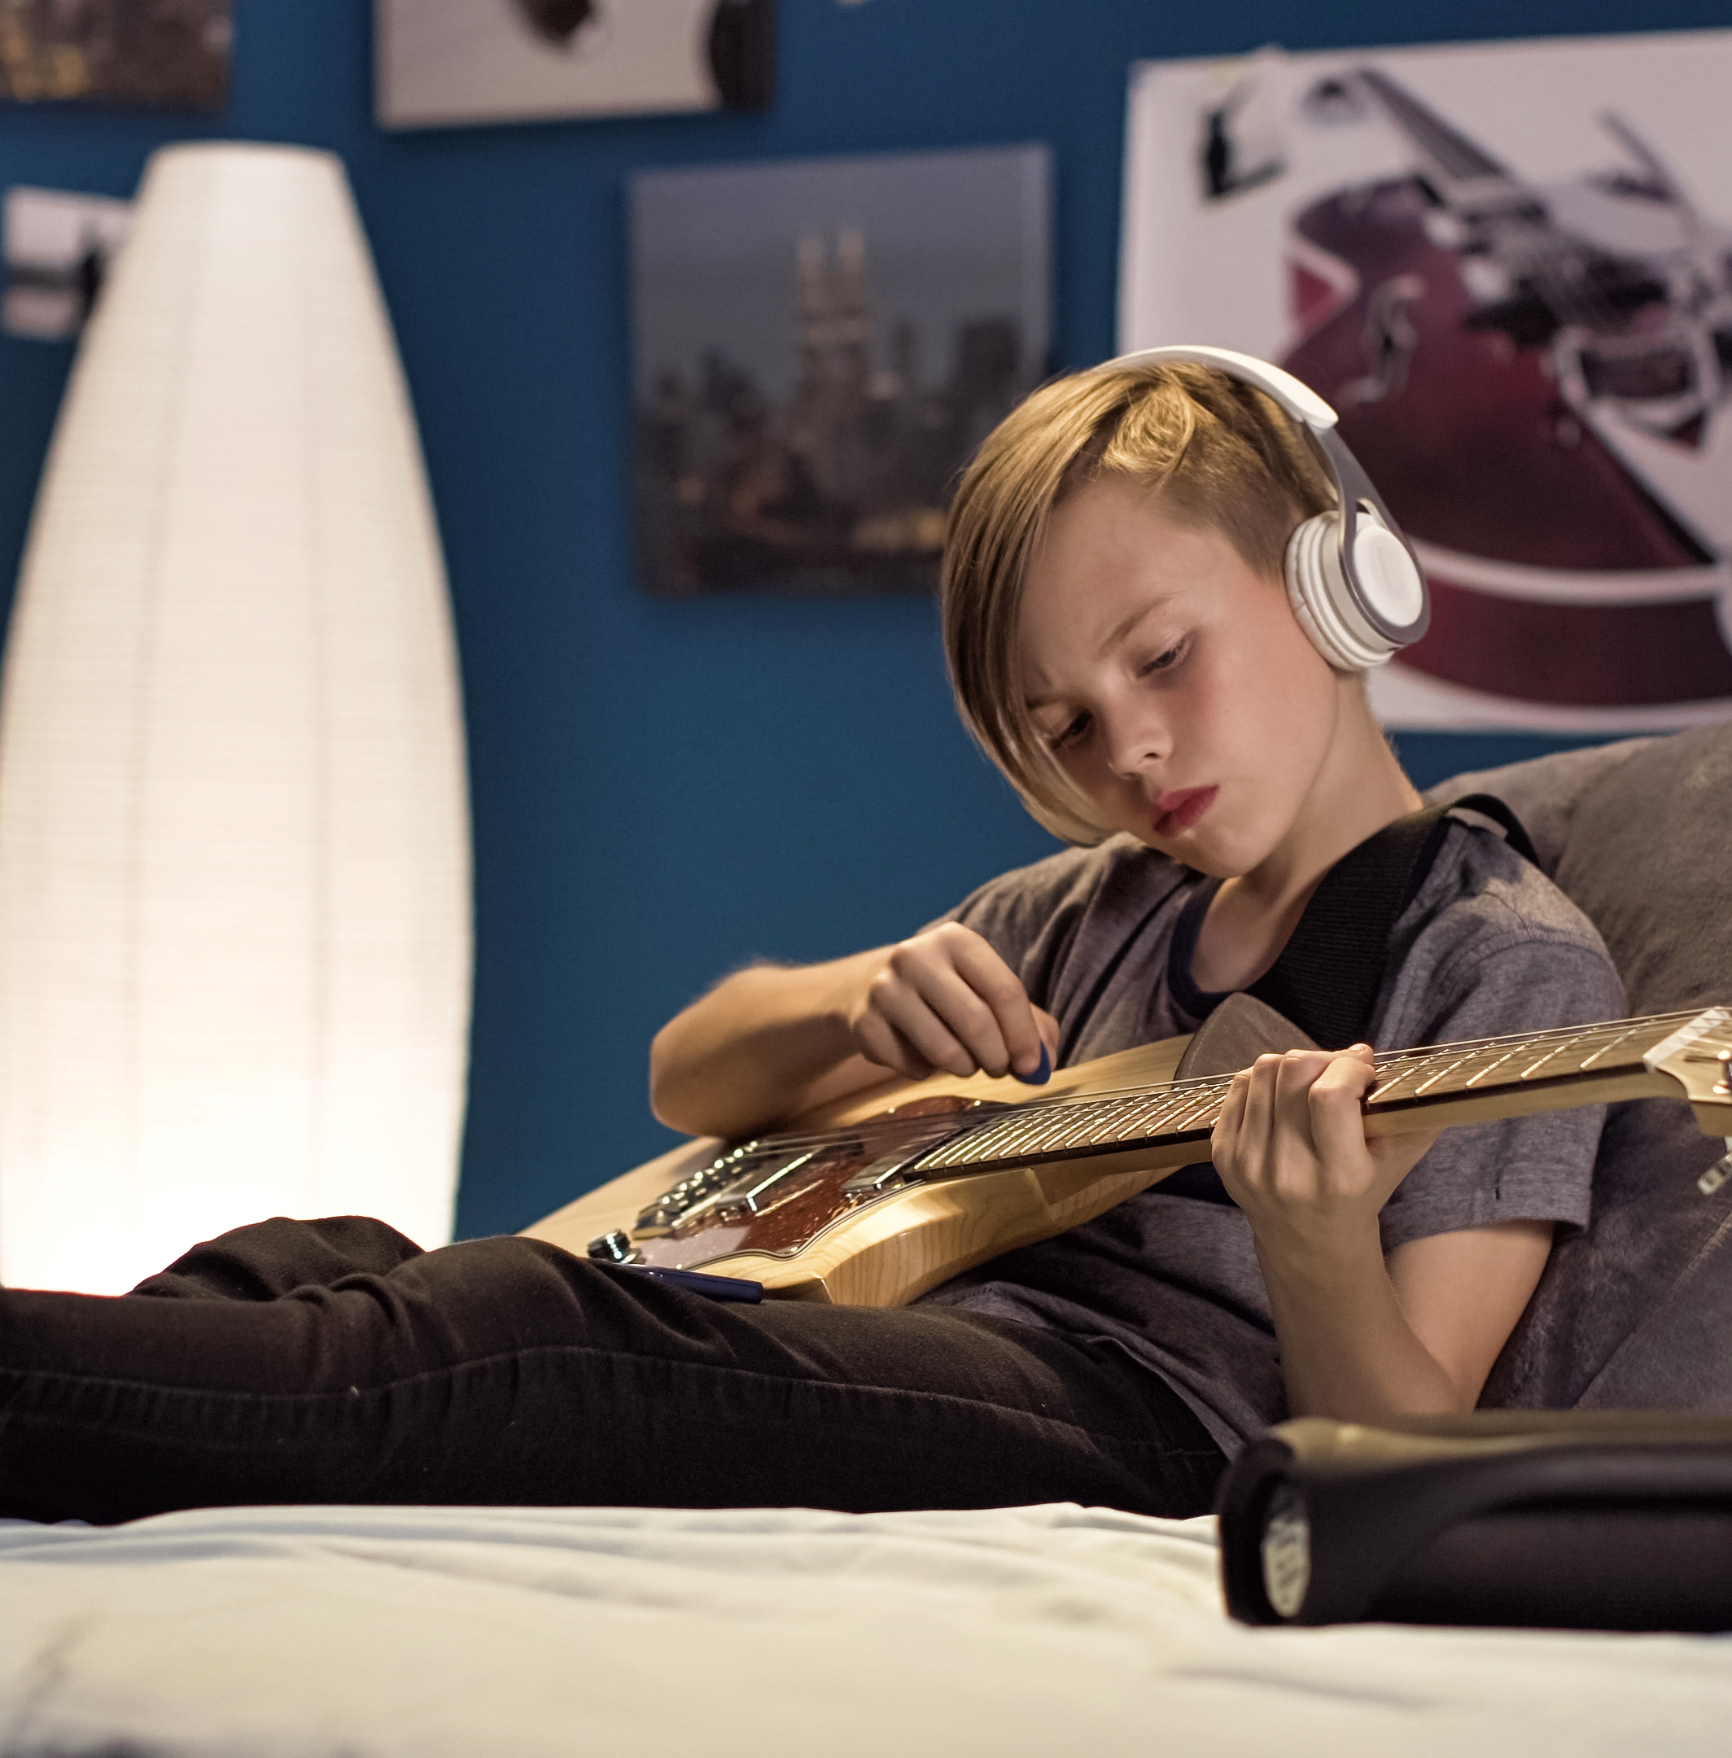
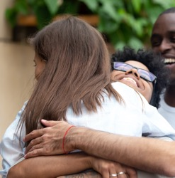
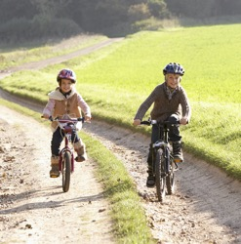
SELF-CARE SUPERSTARS
One important way we can boost our overall wellbeing is through
our lifestyle choices. These are just some of the activities that can
have a positive impact. How and why do you think they do this?
Help others
Eat well
Take time out
Learn a skill
Connect with others
Exercise regularly

Slide 25
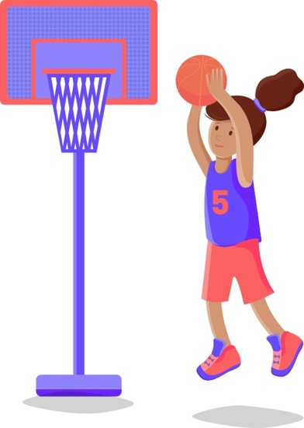

STAY CONFIDENT, STAY ACTIVE
Exercise is a fantastic way to build your confidence.
Here are some tips for being active during puberty:
You may notice you sweat more. To prevent body odour,
wash after exercise and reapply deodorant.
Having a period doesn’t mean you can’t exercise. The Always Platinum Pad uses technology to help prevent against leaks even when you move.
Tampons are also a great option for all sports, and one of the few types of period protection you can use while swimming.
For more tips on boosting your confidence levels, watch the How To Be More Confident Video.
How do you think exercise helps to build confidence?

Slide 26
HEALTHY AND UNHEALTHY BEHAVIOURS
Complete the Healthy and Unhealthy Behaviours Activity Sheet.
Start by categorising these behaviours.
SMOKING | ONLINE GAMING | EATING SUGARY FOODS
VOLUNTEERING | PLAYING GUITAR | DRINKING ALCOHOL
EATING 5 A DAY | MEETING FRIENDS IN THE PARK
Extension:
design a badge or symbol
to promote better wellbeing which could be displayed around your school or worn on uniforms.

Slide 27
ACTIVITY 4
TRACKING YOUR EMOTIONS

Slide 28

TRACKING YOUR EMOTIONS
Keep an emotions diary over the next week.
At the end of each day:
Reflect on any occasion where you felt a strong emotion – positive or negative – and how this impacted your actions.
Reflect on anything that made you feel relaxed or happy.
Reflect on any situation you found difficult.
Did you use the strategies we discussed today to cope?

Slide 29
REFLECTION
SELF-ASSESSMENT

Slide 30
REFLECTION
Return to your Wellbeing Self Assessment from the start of the lesson. Focus on one area where you would like to feel more positive and write down one thing you have learned that you could try to put into action over the coming weeks.

Slide 31
WELLBEING
ALL ABOUT FEELINGS

