Slide 1
Climate Change: Key Facts
This presentation covers the causes of climate change, its U.S. impacts, and ways to limit future warming
Version: November 2025
Notes:
This presentation covers what’s driving climate change, how it’s impacting the U.S., and what we can do. The slides feature free resources from Climate Central, an independent group of scientists and communicators who research and report the facts about our changing climate and how it affects people’s lives. Climate Central is a policy-neutral nonprofit organization.
We’d like your feedback. Please consider taking a two-minute survey about your experience with this slide deck.

Slide 2


Outline
What’s driving climate change?
How is climate change affecting the U.S.?
What can we do?
When these symbols appear:
Check speaker notes for links to local graphics available in English and Spanish
Check speaker notes for links to updated versions of the graphic

Slide 3
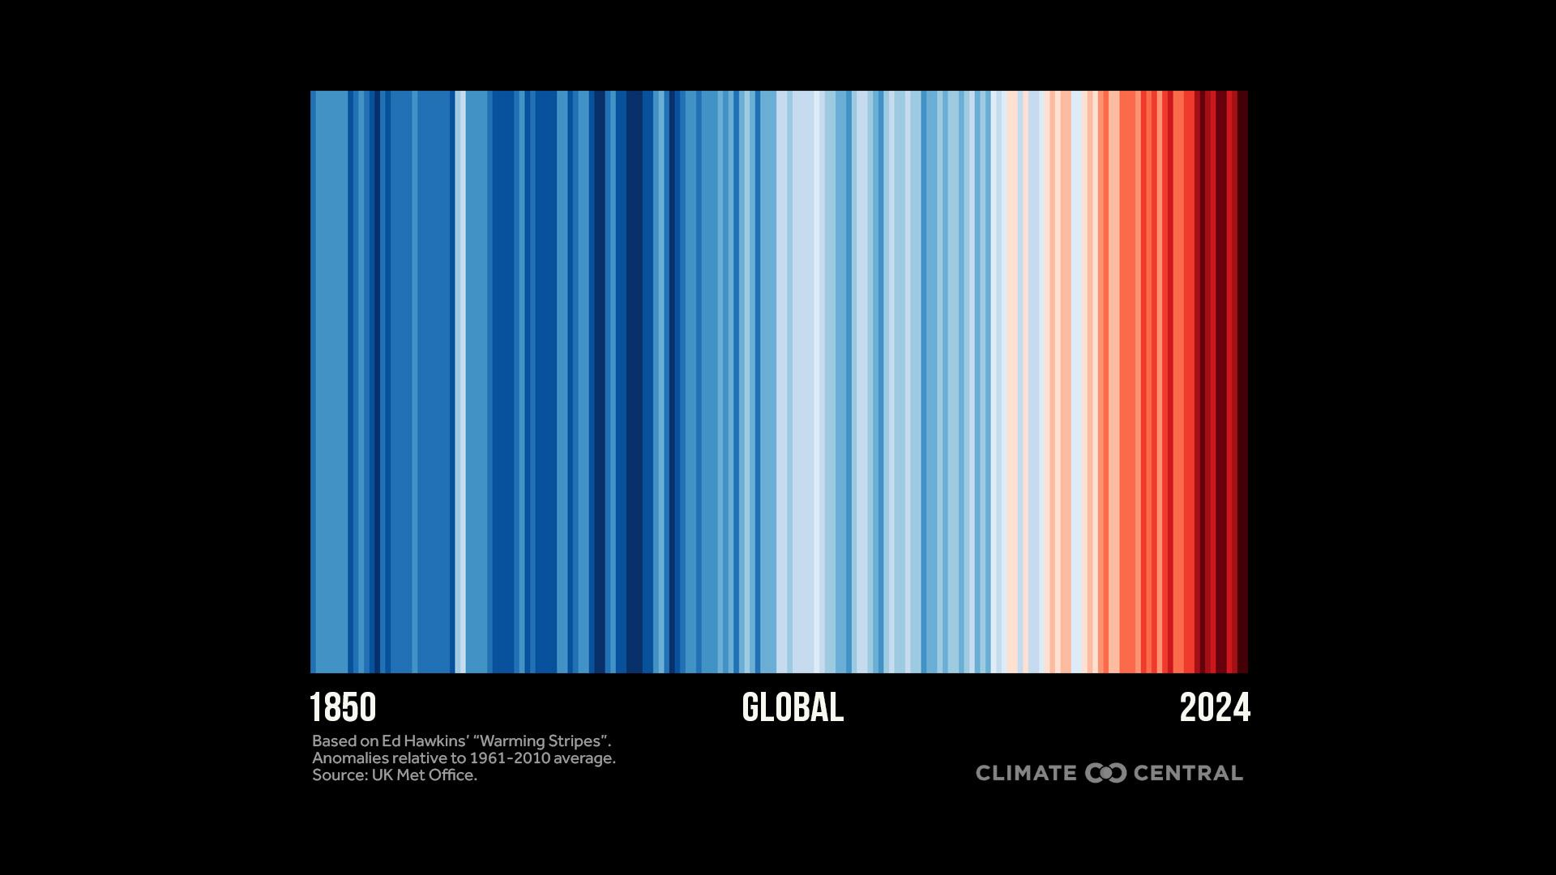
Notes:
📍 Download local graphics for 195 U.S. cities and 49 states.
Each stripe represents the global temperature averaged over one year, from 1850 to 2024. Red stripes are years that were hotter than the 1961-2010 average; blue stripes are years that were cooler. This global warming stripes graphic shows a rapid shift from blue to red stripes in recent decades as heat-trapping pollution has warmed the planet.
Read more: Warming Stripes: U.S. Cities and States (2025)

Slide 4
What’s driving global climate change?
Notes:
This part of the presentation:
explains how human-caused carbon pollution traps heat and causes the planet to warm
reviews observed global warming trends

Slide 5
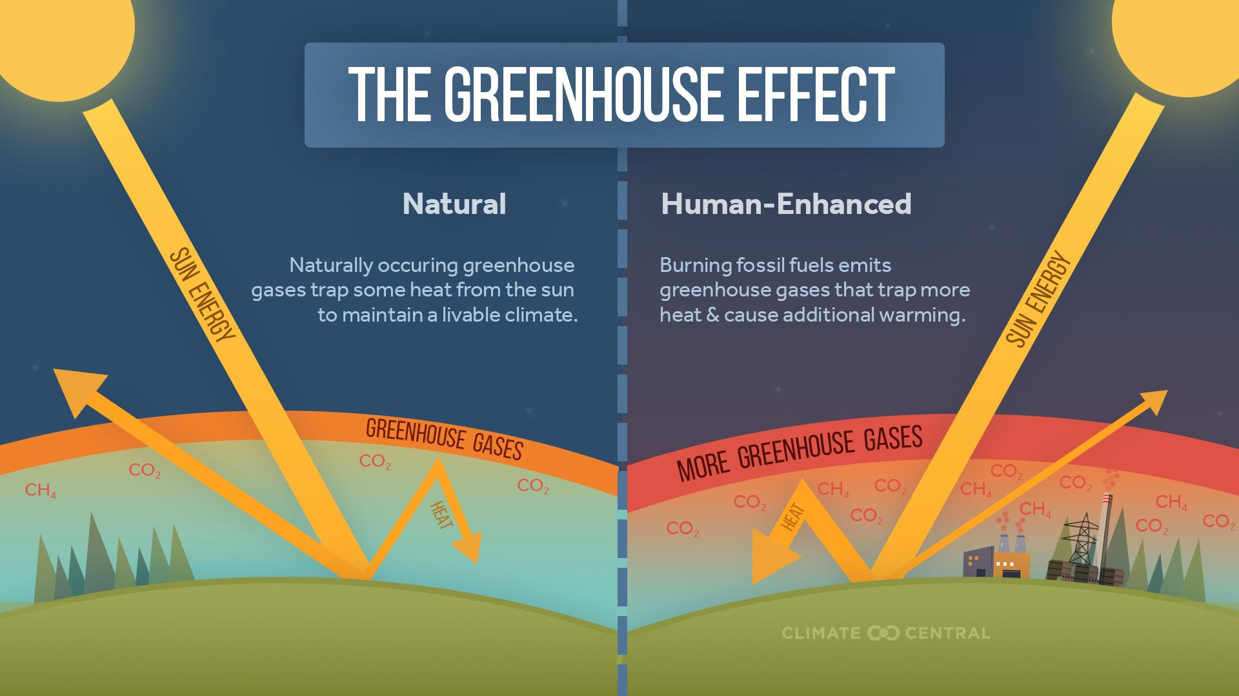
Notes:
Greenhouse gases warm the Earth by trapping heat in the atmosphere. Scientists first demonstrated this fact in the 1800s.
Earth’s atmosphere contains a mix of gases that sustain life by absorbing some solar radiation, allowing living organisms to breathe, and transporting water.
One class of gases, known as greenhouse gases, traps heat near Earth’s surface. These heat-trapping greenhouse gases include carbon dioxide (CO2), methane (CH4), nitrous oxide (N2O), and water vapor.
Greenhouse gases play a key role in regulating life-sustaining temperatures on Earth. Without any greenhouse gases, the energy that the Earth receives from the sun would radiate back into space, making our planet far too cold to support life. Too high a concentration, however, can trap a dangerous amount of heat.
Read more: Heat-Trapping Pollution (2024)

Slide 6
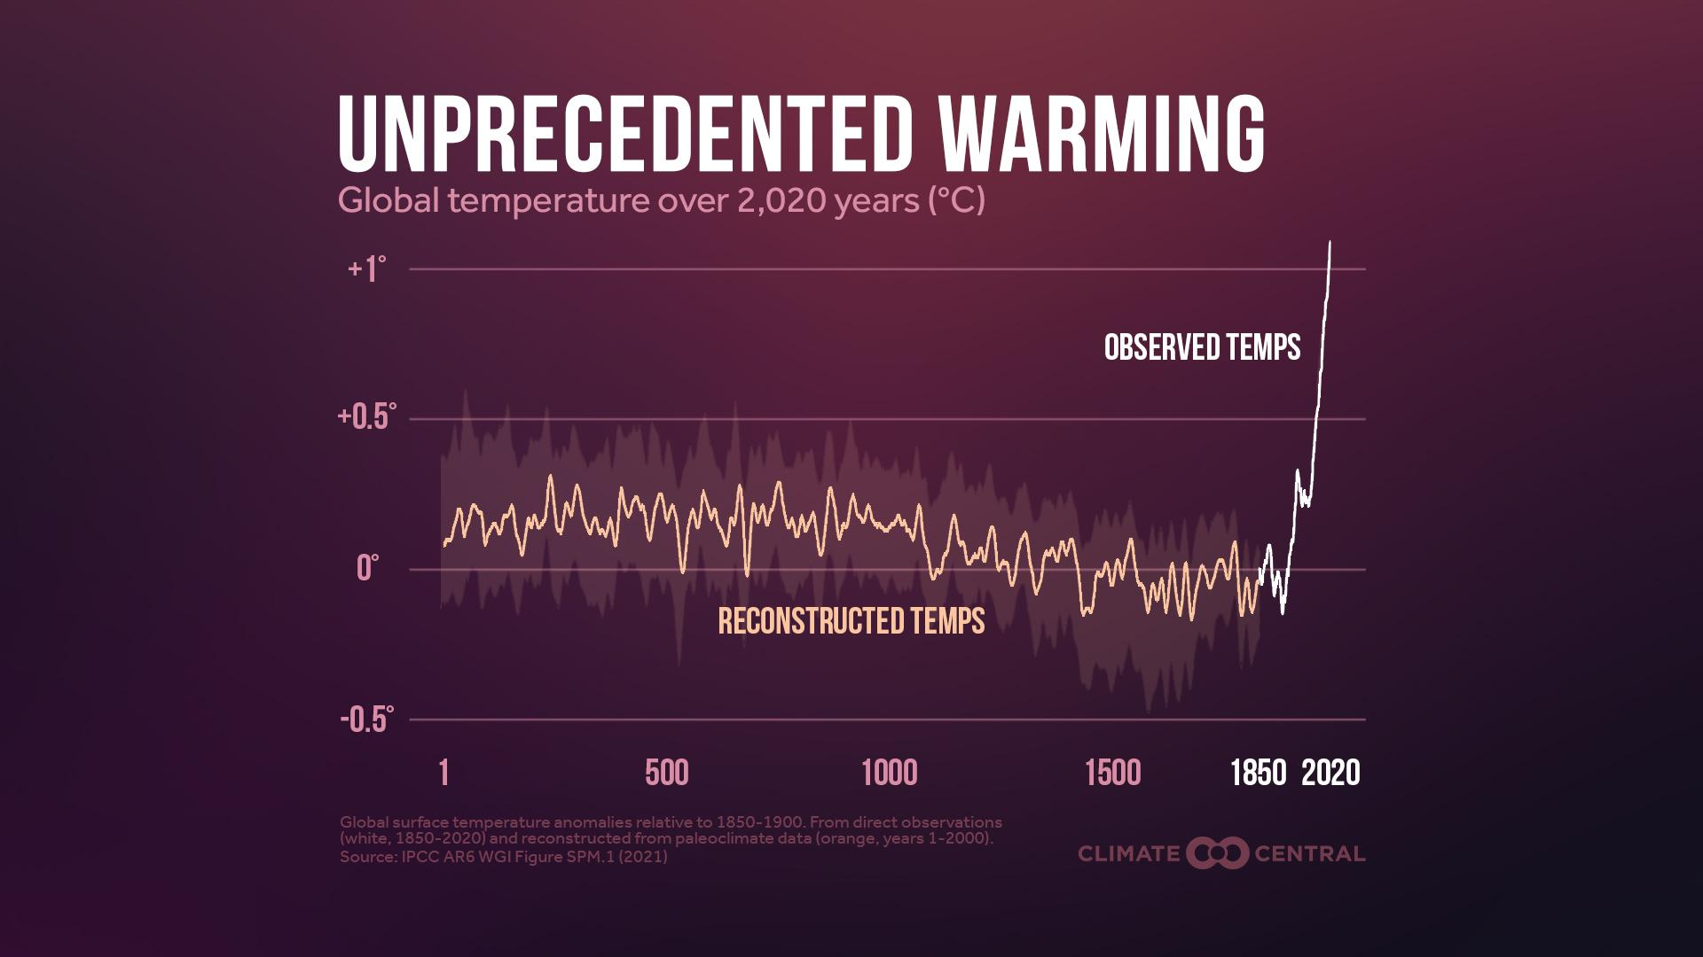
Notes:
Although a natural greenhouse effect has affected temperatures on Earth for millions of years, there is scientific consensus that human activities, particularly burning fossil fuels, is amplifying the natural greenhouse effect and causing rapid warming that goes far beyond natural variability.
Read more: Heat-Trapping Pollution (2024)

Slide 7
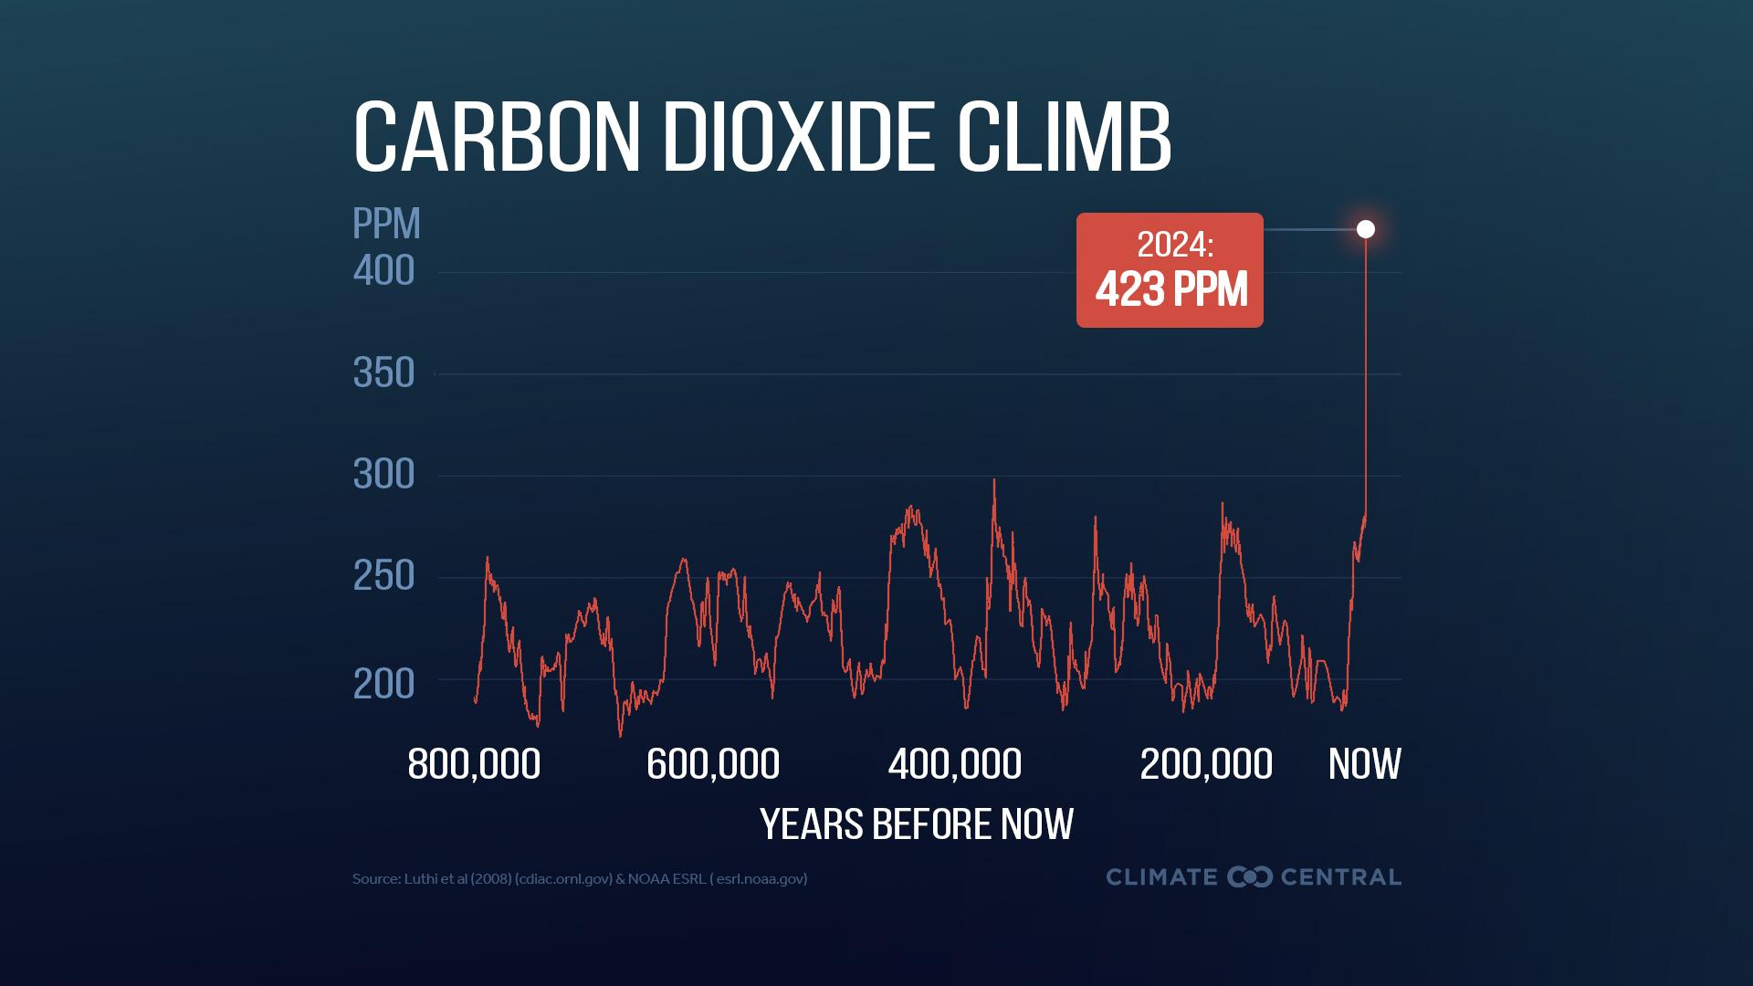
Notes:
⭐ Download the latest version of this graphic here.
Human activities since the Industrial Revolution — mainly the burning of fossil fuels such as coal, oil, and natural gas (mainly composed of methane gas) — have caused a sharp rise in global emissions of greenhouse gases.
As a result, atmospheric concentrations of greenhouse gases (including CO2, shown here) are now higher than any point in at least the previous 800,000 years — and they continue to rise at a rapid rate.
The extra heat trapped in the atmosphere by CO2 and other greenhouse gases is causing rapid warming.
Read more: Heat-Trapping Pollution (2024)

Slide 8
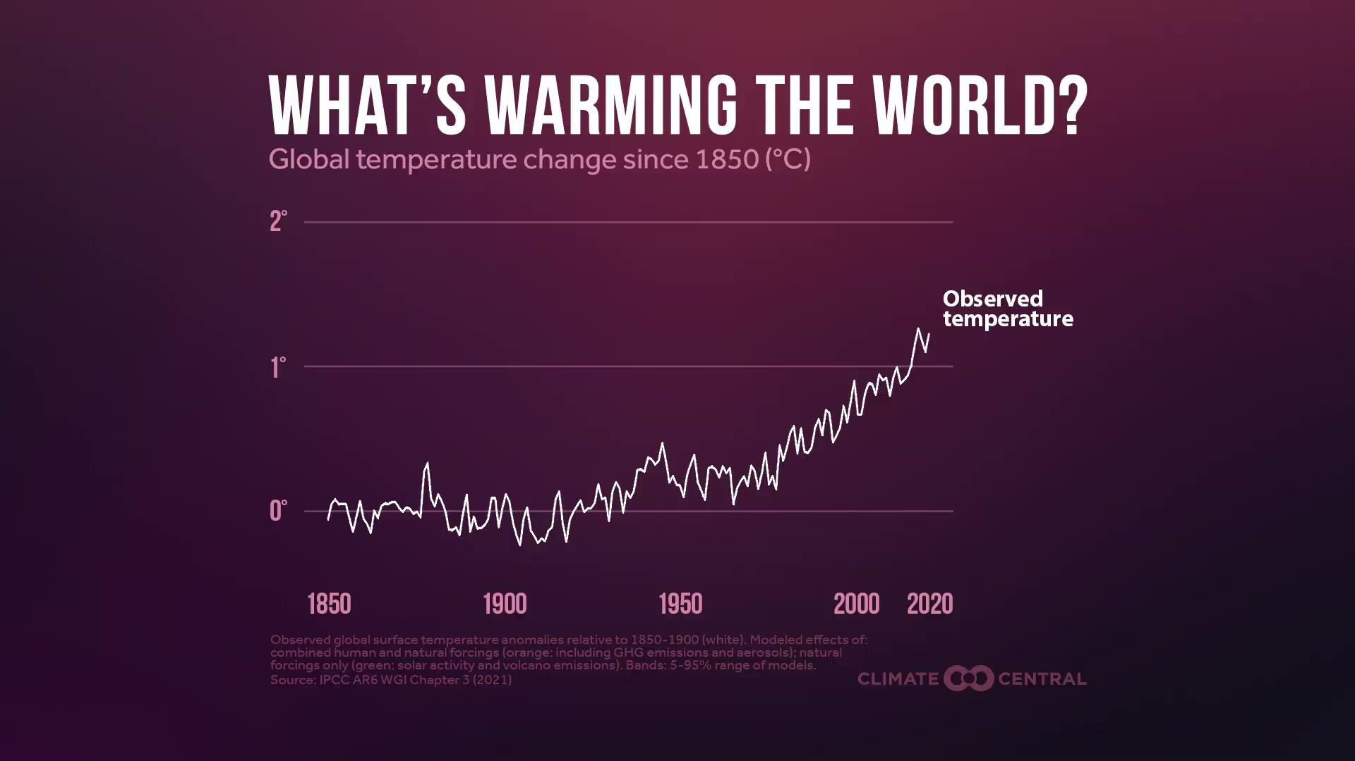
Notes:
Click here to download the animation.
The main cause of rapid global warming today is heat-trapping pollution from human activities.
Climate has changed throughout Earth’s long history – including very rapidly at points in the deep past.
But the warming observed since 1850 cannot be explained by natural drivers of climate change — including El Niño, changes in the activity of the sun, and emissions from large volcanoes.
Climate models can only explain observed warming since 1850 when they include the effects of human activities — especially the increasing concentrations of heat-trapping greenhouse gas pollution.
Read more: Five Things to Know About Earth’s Hottest Year (2023)

Slide 9
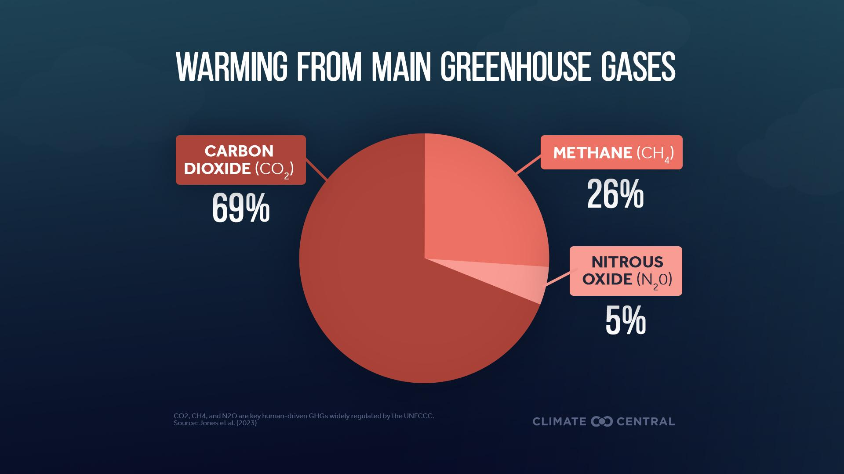
Notes:
Carbon dioxide, methane, and nitrous oxide are the three human-driven greenhouse gases that have contributed the most to global warming. The atmospheric concentration of each gas has increased rapidly since 1850.
The vast majority (95%) of human-caused warming is due to CO2 and methane. Due to their effects on global climate, these greenhouse gases are widely regulated by the United Nations and the EPA in the U.S., with nearly 200 countries setting targets to reduce emissions of each.
Water vapor is the most abundant greenhouse gas in the atmosphere, but since human activity only has a small direct impact on its levels, it is not included in indicators of human-caused warming.
Read more: Heat-Trapping Pollution (2024)

Slide 10
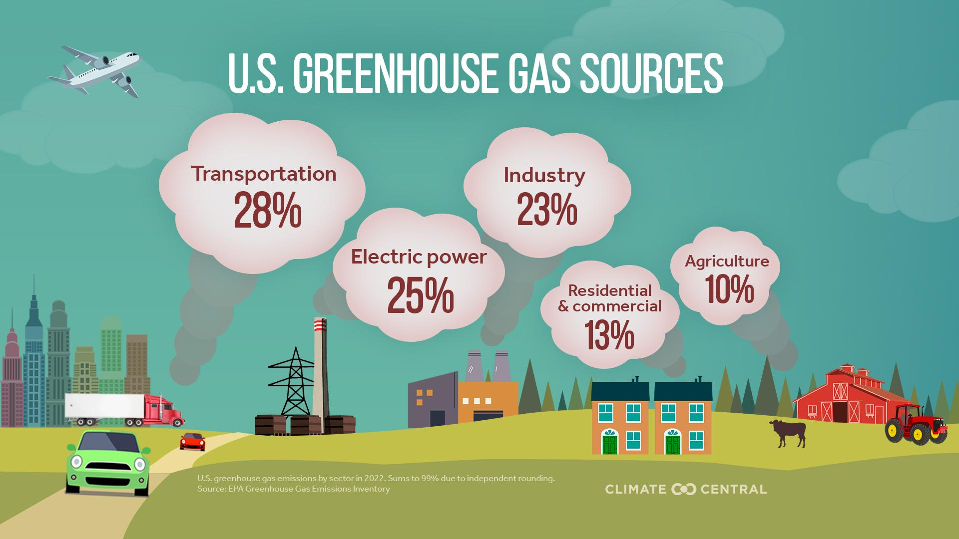
Notes:
Most U.S. greenhouse gas emissions come from transportation, electric power, and industry.
The U.S. contributes significantly to global CO2 emissions, with both the highest cumulative historical emissions and among the highest per-person emissions of any country.
About 97% of U.S. transportation emissions come from CO2 produced during the combustion of fossil fuels such as gasoline and diesel in internal combustion engines — mostly in cars and trucks.
The electric power sector generates and distributes electricity to homes, businesses, factories, electric vehicles, and farming operations.
The industrial sector produces goods and raw materials such as steel, cement, concrete, feedstock chemicals, minerals, and paper. Industrial emissions primarily come from CO2 produced during combustion of fossil fuels used to power factories and machinery.
Read more: Heat-Trapping Pollution (2024). Click here to compare global and U.S. emissions sources.

Slide 11
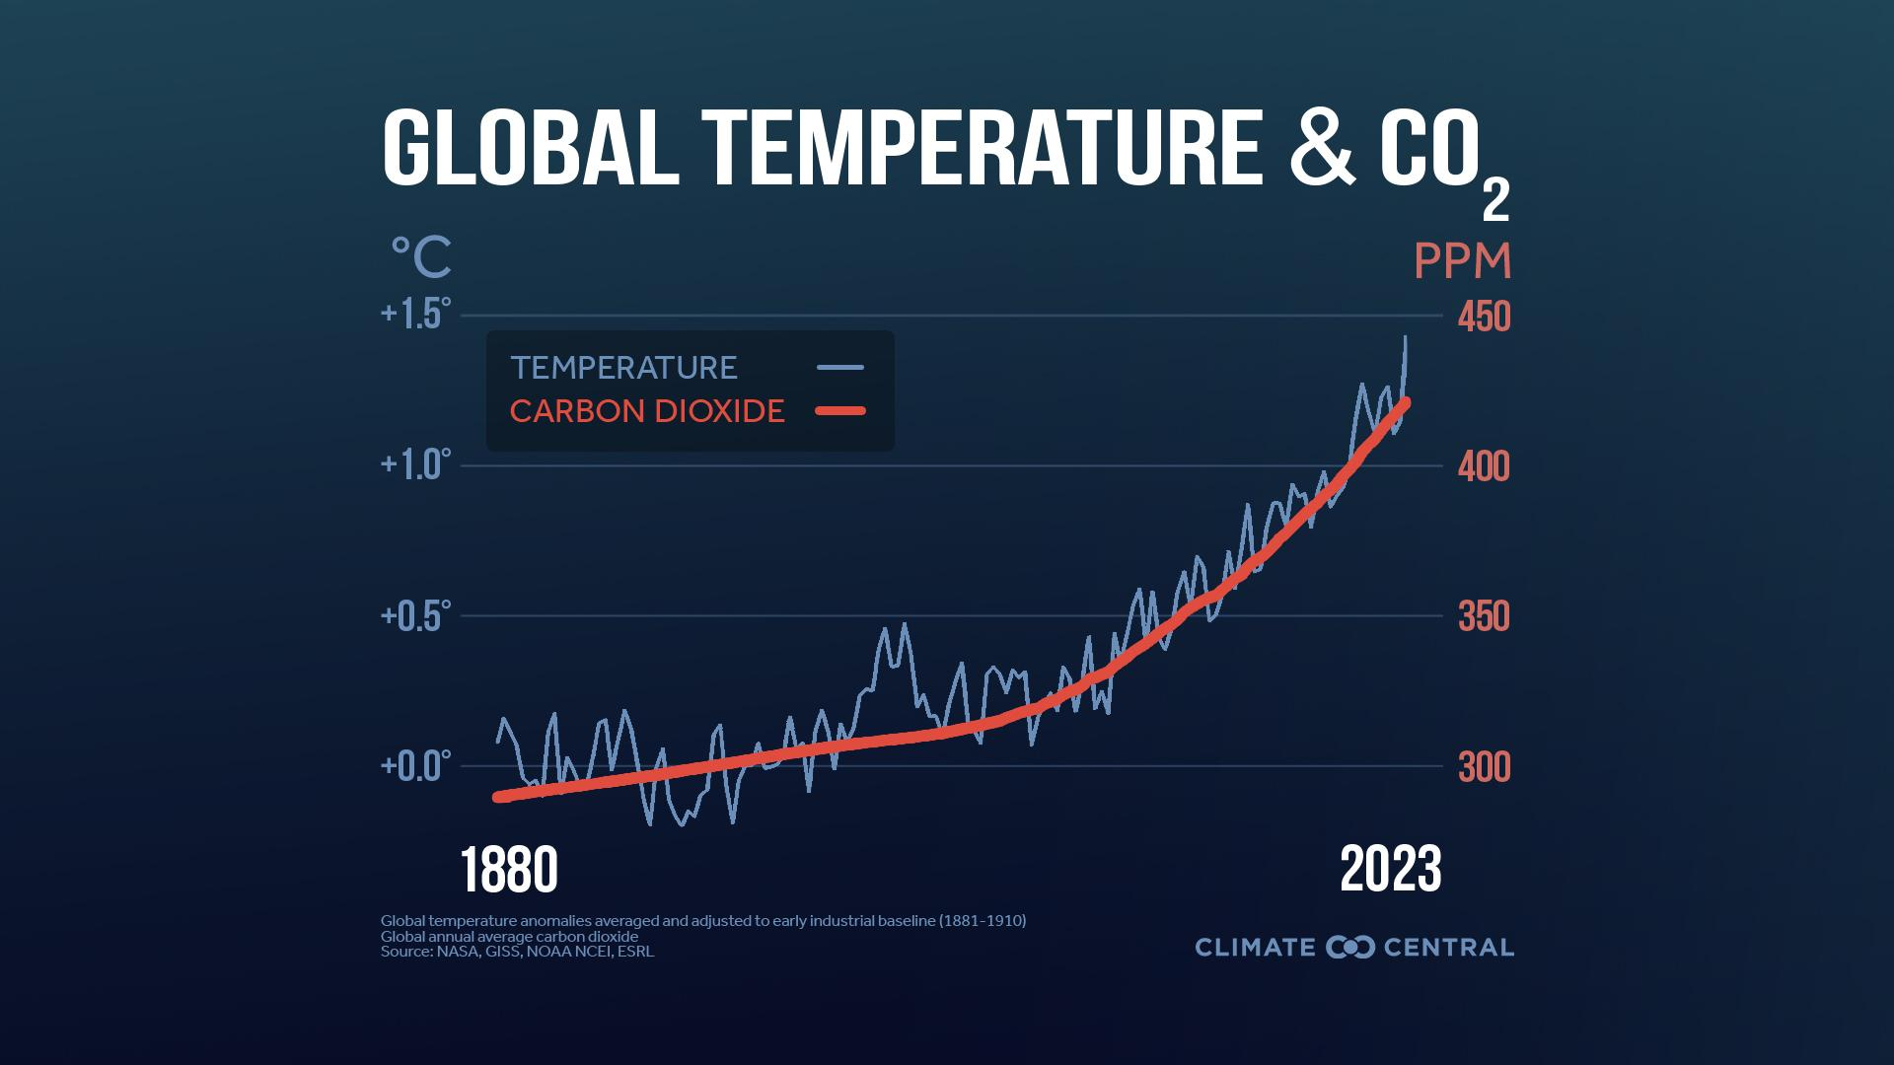
Notes:
⭐ Download the latest version of this graphic here.
Direct observations of both temperature and atmospheric CO2 concentrations since 1880 show a linked rise in both since the Industrial Revolution. There is scientific consensus that rising carbon pollution is driving warming.
Read more: Heat-Trapping Pollution (2024)

Slide 12

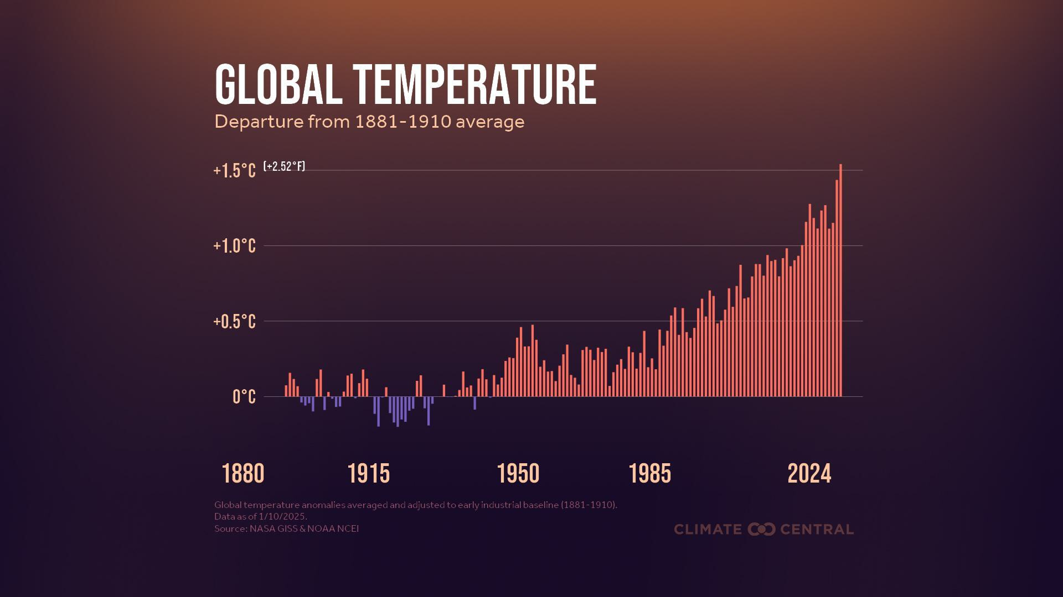
Notes:
⭐ Download the latest version of this graphic here.
Global greenhouse gas emissions from burning coal, oil, and methane gas continued to climb in 2024. This continued heat-trapping pollution contributed to record-breaking global average temperatures in 2024 — reaching 1.54°C (2.77°F) above the early industrial (1881-1910) baseline and surpassing 2023 as the hottest year on record.
Read more: Off-the-Charts Heat: 2024 Global and U.S. Temperature Review (2025)

Slide 13
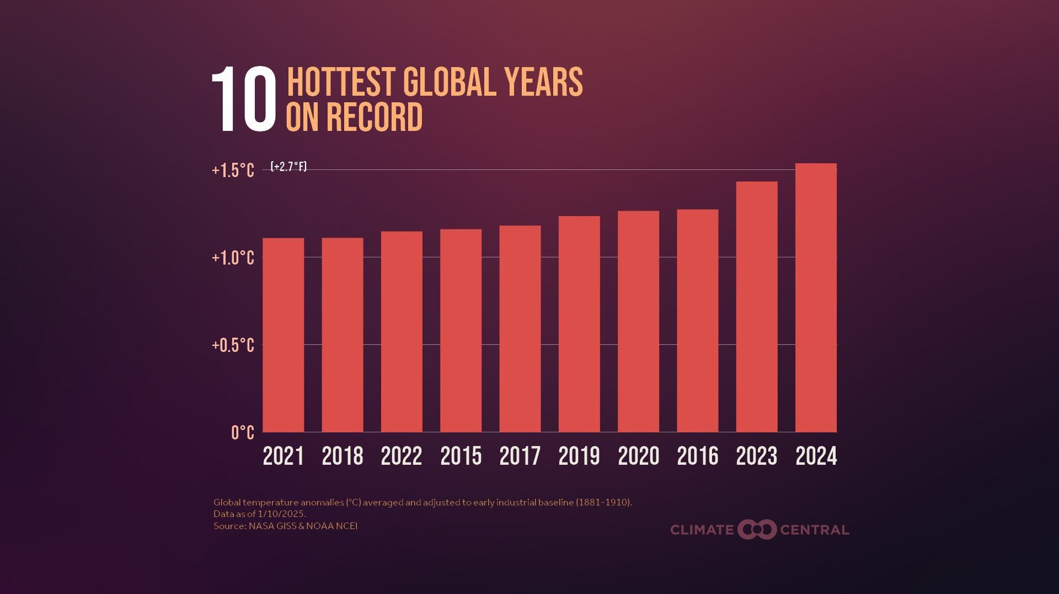
Notes:
⭐ Download the latest version of this graphic here.
According to the latest combined data from NOAA and NASA, the global surface temperature in 2024 ranked highest in the 145-year record at 1.54°C (2.77°F) above the early industrial (1881-1910) baseline average. The top eleven hottest years on record for the planet have occurred in the last eleven years, now including 2024.
Read more: Off-the-Charts Heat: 2024 Global and U.S. Temperature Review (2025)

Slide 14
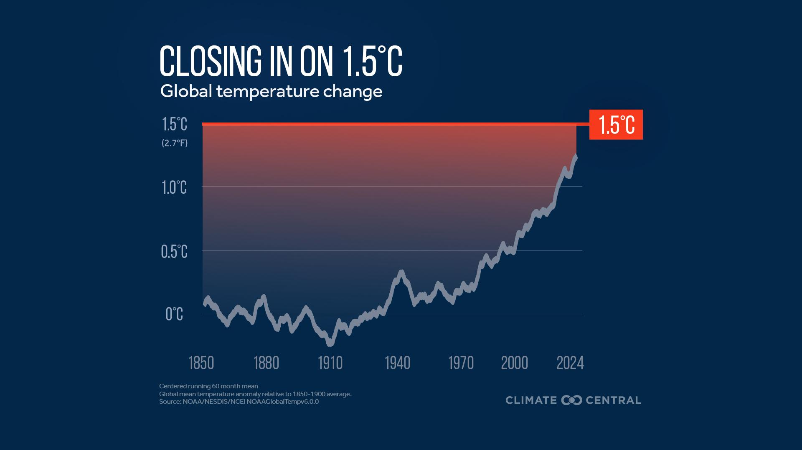
Notes:
⭐ Download the latest version of this graphic here.
In 2024, annual global average temperatures exceeded 1.5°C above pre-industrial levels for the first time ever. In 2015, nearly every country in the world signed on to the landmark Paris Agreement to keep global warming well below 2°C (3.6°F) above pre-industrial levels — with an aspirational limit of 1.5°C (2.7°F).
The limits set by the Paris Agreement, however, refer to a long-term average of global temperatures over multiple decades, meaning that the occurrence of 1.5°C of warming for a single year does not equate to exceeding the Paris Agreement threshold.
Read more: COP29: Global Climate Conference (2024)

Slide 15
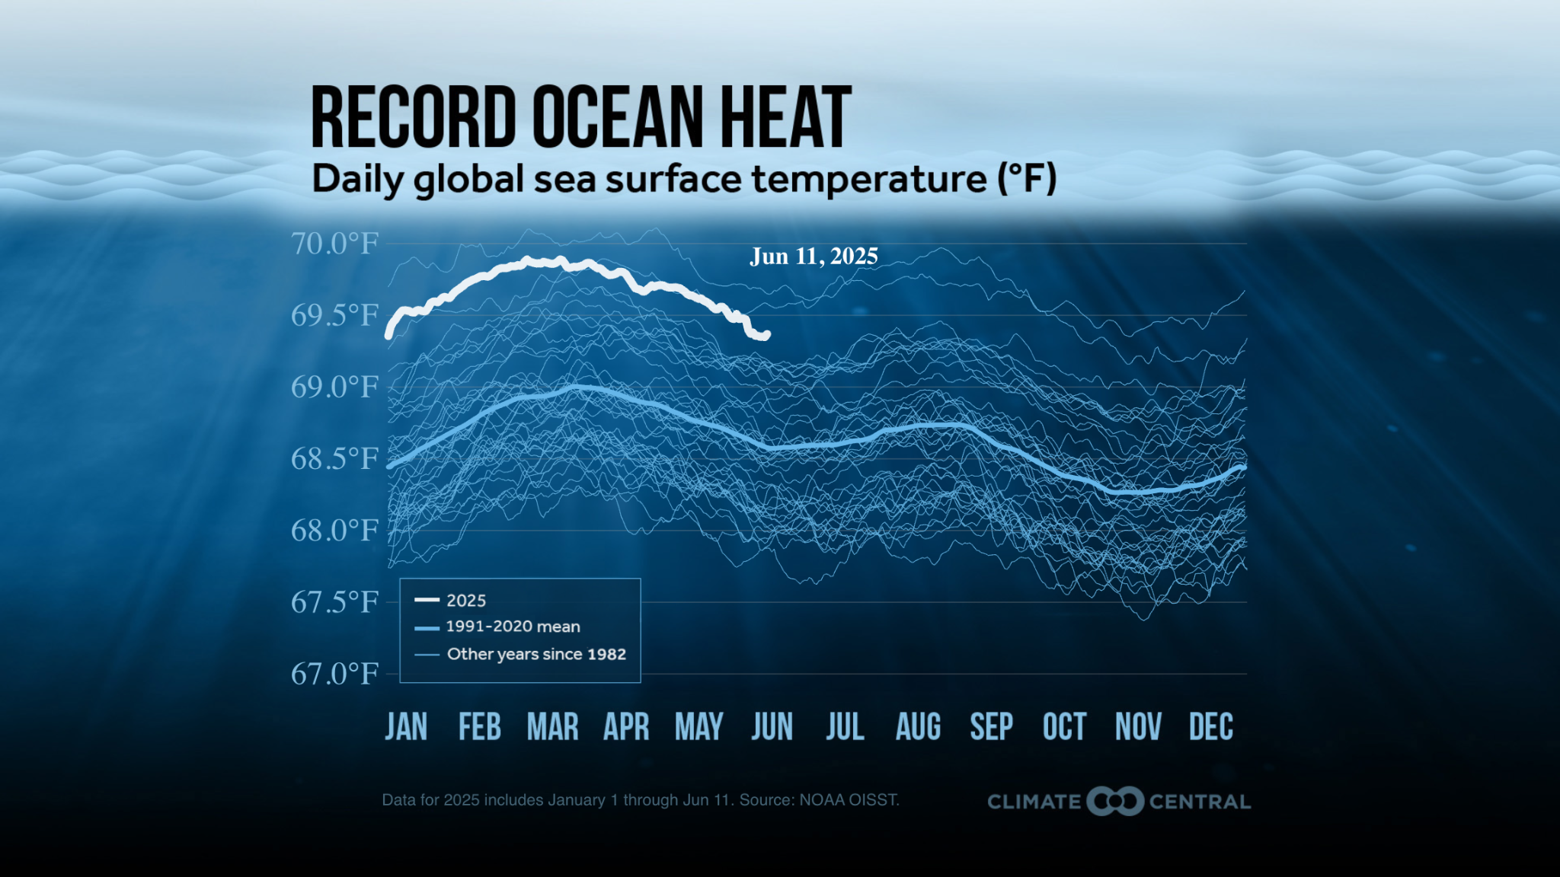
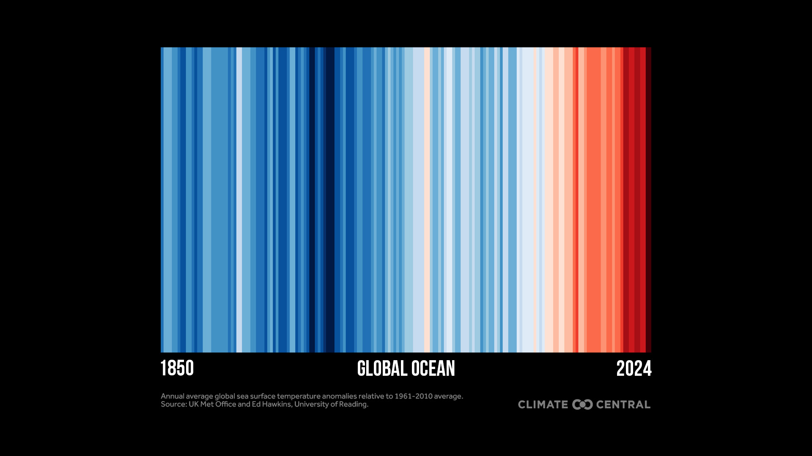
OCEAN TEMPS
Notes:
⭐ Click here to download a graphic showing daily sea surface temperature data for the global ocean and select basins, from 1982 to the present.
It's not just the atmosphere that's warming — it's our oceans too. We all depend on the ocean. It regulates climate and affects weather on land. It hosts vast biodiversity, provides nutrition for billions, and underpins livelihoods and cultures around the world.
But ocean warming disrupts each of these critical functions. And as the planet has warmed in recent decades, about 90% of the excess heat has gone into the ocean — mostly the surface ocean, which has warmed steadily as a result.
Read more: Rapid Ocean Warming (2025)

Slide 16
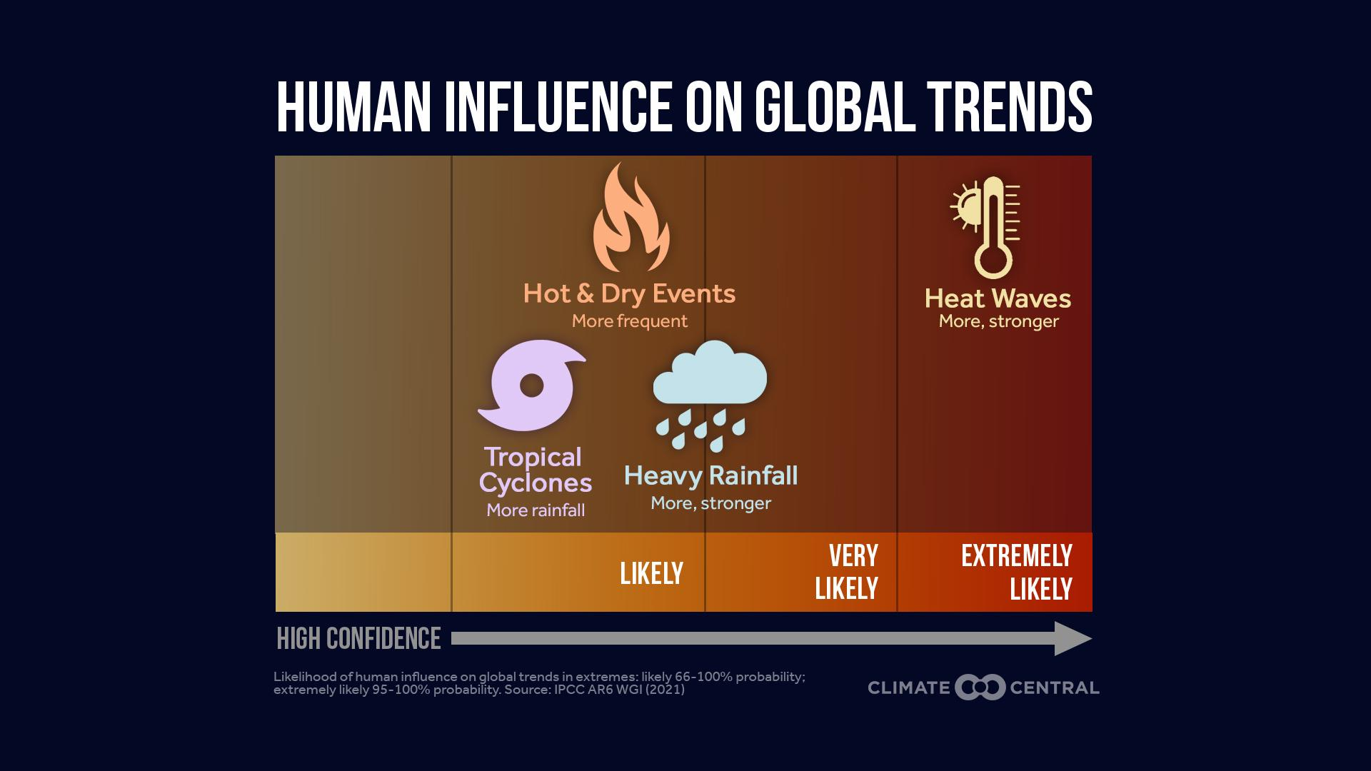
Notes:
Attribution science quantifies whether and to what extent human-caused climate change has influenced the frequency or intensity of specific weather events and their long-term trends. Scientists measure links between climate change and weather events by using models to compare a world without human-caused climate change to our current climate.
Scientific confidence in the attribution of more frequent and intense extreme heat to human-induced climate change is considerably higher than for global trends in other types of extremes. In some cases, that's because it's unclear how a type of extreme weather — tornadoes, for example — will respond to climate change. In other cases — such as thunderstorms — there is insufficient data to make a strong link.
Read more: Climate Reporting Resources (2024)

Slide 17
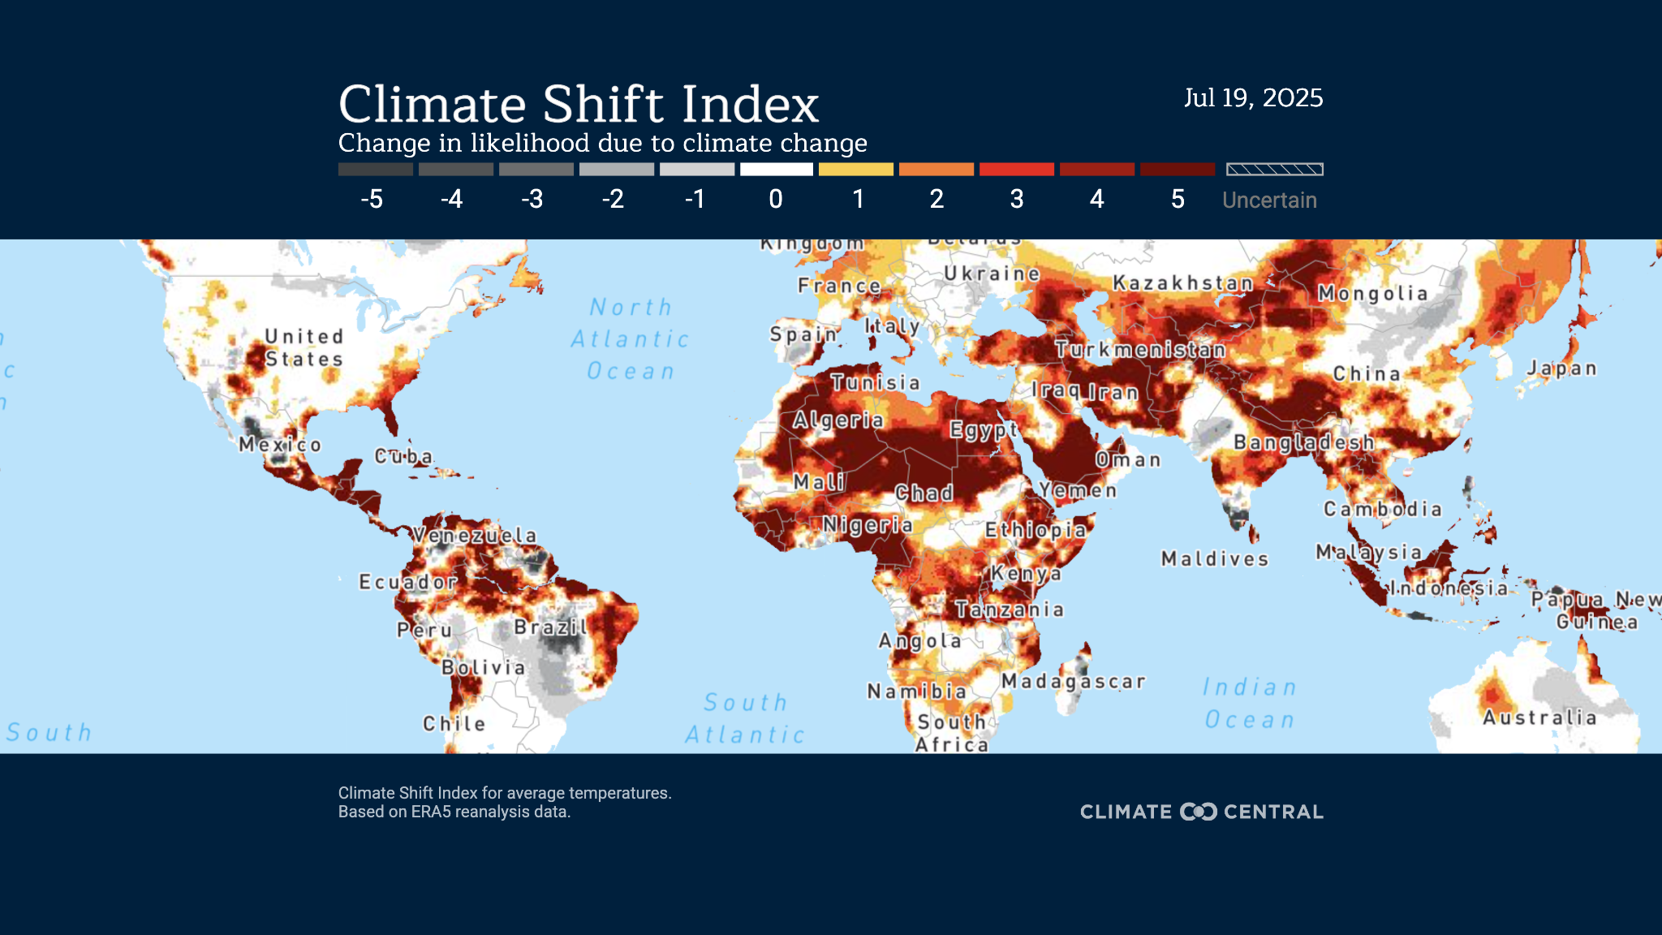
Notes:
⭐ Download the latest version of this graphic here.
Climate Central’s Climate Shift Index (CSI) applies the latest peer-reviewed attribution science to map the influence of climate change on temperatures across the globe, every day.
For example, according to the CSI, during the Northern Hemisphere summer (June-August) of 2025, global exposure to climate change-driven heat peaked on July 19, 2025. On this day, around 50% of the global population (about 4.1 billion people) experienced temperatures strongly influenced by climate change (CSI level 2 or higher).
Read more: People Exposed to Climate Change: June-August 2025 (2025)
Explore Climate Central’s Climate Shift Index® Global Map and Climate Shift Index: Ocean to see the influence of human-caused climate change on air temperatures and ocean temperatures around the world, every day.

Slide 18
How is climate change affecting the U.S.?
Notes:
This part of the presentation summarizes impacts of global climate change on the U.S. The slides present a brief summary of how climate change is affecting six different types of extreme weather, and why this matters.

Slide 19
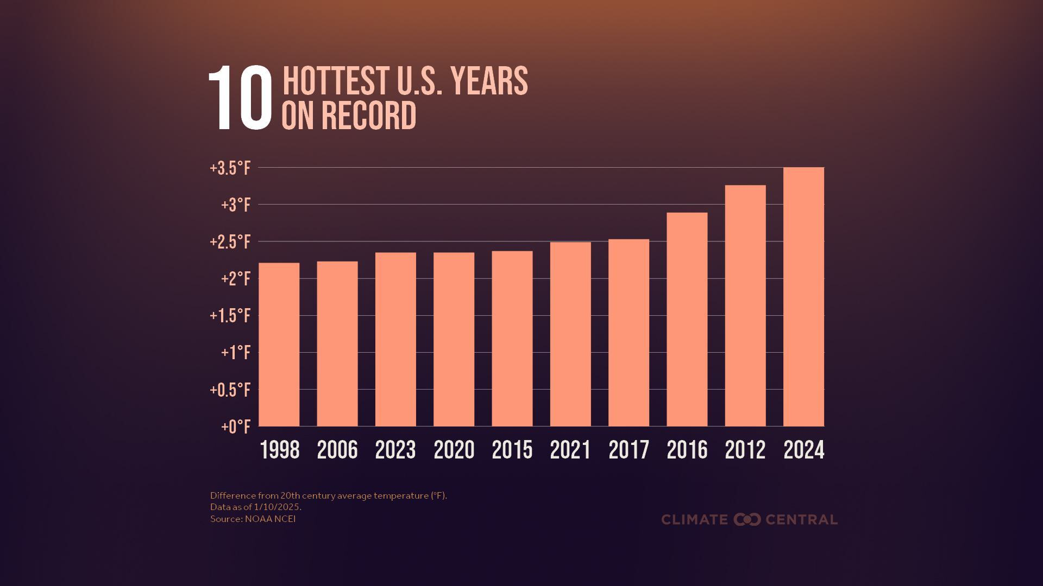
Notes:
⭐ Download the latest version of this graphic here.
The warming trends discussed in the previous section are evident in the U.S. – the contiguous U.S. had its hottest year on record in 2024 as well, with an annual average temperature 3.5°F above the 20th-century average. The eight warmest years for the U.S. have all occurred since 2012.
While 2024 was the warmest year for the contiguous U.S. as a whole, it was also the hottest year on record for 76 of 243 major U.S. cities analyzed by Climate Central.
Read more: Off-the-Charts Heat: 2024 Global and U.S. Temperature Review (2025)

Slide 20
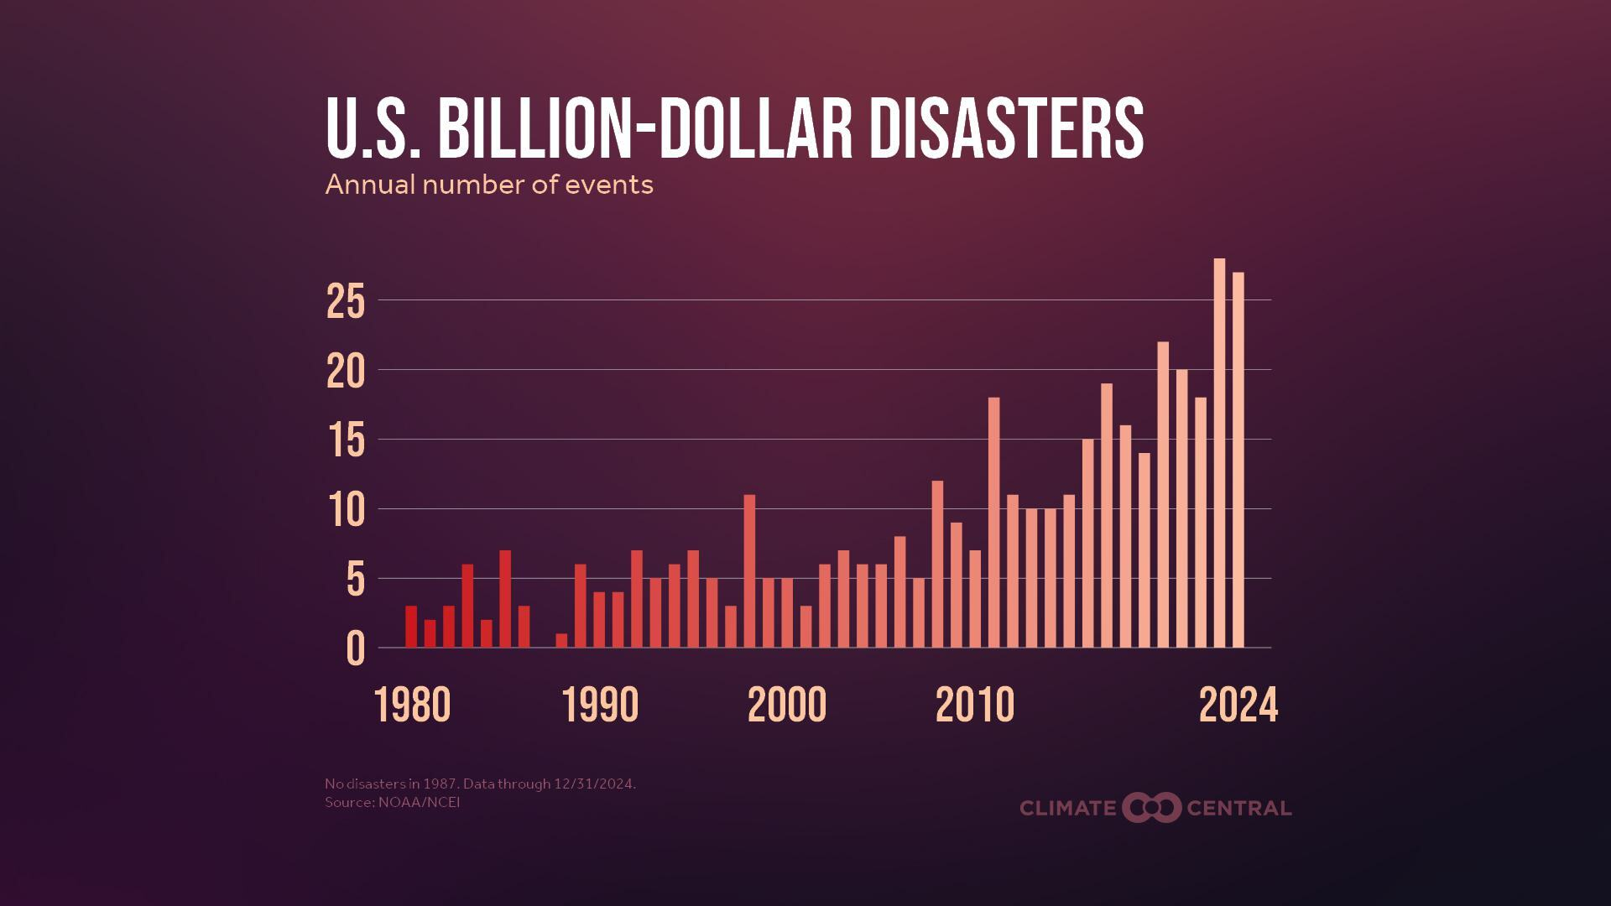
Notes:
⭐ Download the latest version of this graphic here.
More frequent and/or intense extreme weather events affect the U.S. through major events like billion-dollar disasters. These trends in extreme weather can also threaten the health, safety, and wellbeing of people, ecosystems, and human-built systems.
The frequency and cost of billion-dollar weather and climate disasters in the U.S. have increased dramatically since 1980 — resulting in devastating losses.
Both 2023 and 2024 shattered previous records with 28 and 27 billion-dollar disasters, respectively. Each of these events accounted for for at least $1 billion in damages.
During the first six months of 2025, there were 14 separate billion-dollar weather and climate disasters in the U.S., costing $101.4 billion.
The rise in billion-dollar disasters is due both to our warming climate and to the growing number of people, homes, and businesses in at-risk areas.
Read more: Now at Climate Central: U.S. Billion-Dollar Weather and Climate Disasters (2025) and U.S. Billion-Dollar Disasters: 1980-2024 (2024)

Slide 21
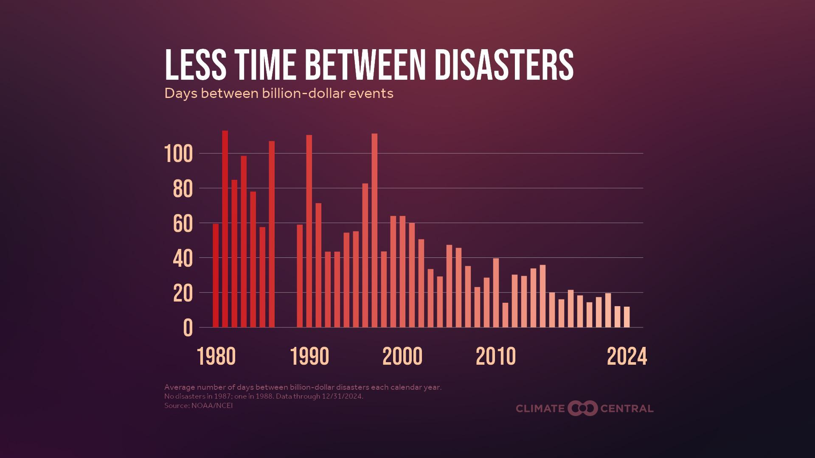
Notes:
The frequency of billion-dollar disasters in the U.S. has increased dramatically.
The average time between billion-dollar disasters in 2024 was just 12 days — a striking decrease from an average of 82 days between disasters in the early 1980s.
Read more: Now at Climate Central: U.S. Billion-Dollar Weather and Climate Disasters (2025) and U.S. Billion-Dollar Disasters: 1980-2024 (2024)

Slide 22
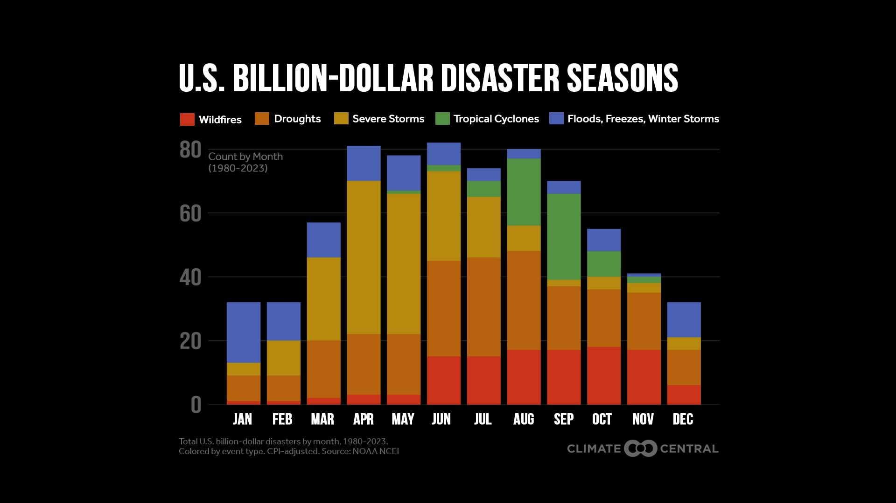
Notes:
📍 Download versions of this graphic for nine major U.S. regions.
Nationwide, tropical cyclones (which include hurricanes) are the most costly type of billion-dollar disaster; severe storms are the most frequent. Each U.S. region faces a different set of disaster risks each season.
Billion-dollar severe storms and floods are generally most common during spring, especially in the Upper Midwest, Ohio Valley, South, Southeast, and Northeast.
During the summer and fall, billion-dollar wildfires dominate across the western U.S. and tropical cyclones raise risks in the South, Southeast, and Northeast.
Read more: Billion-Dollar Disaster Seasons (2024)

Slide 23
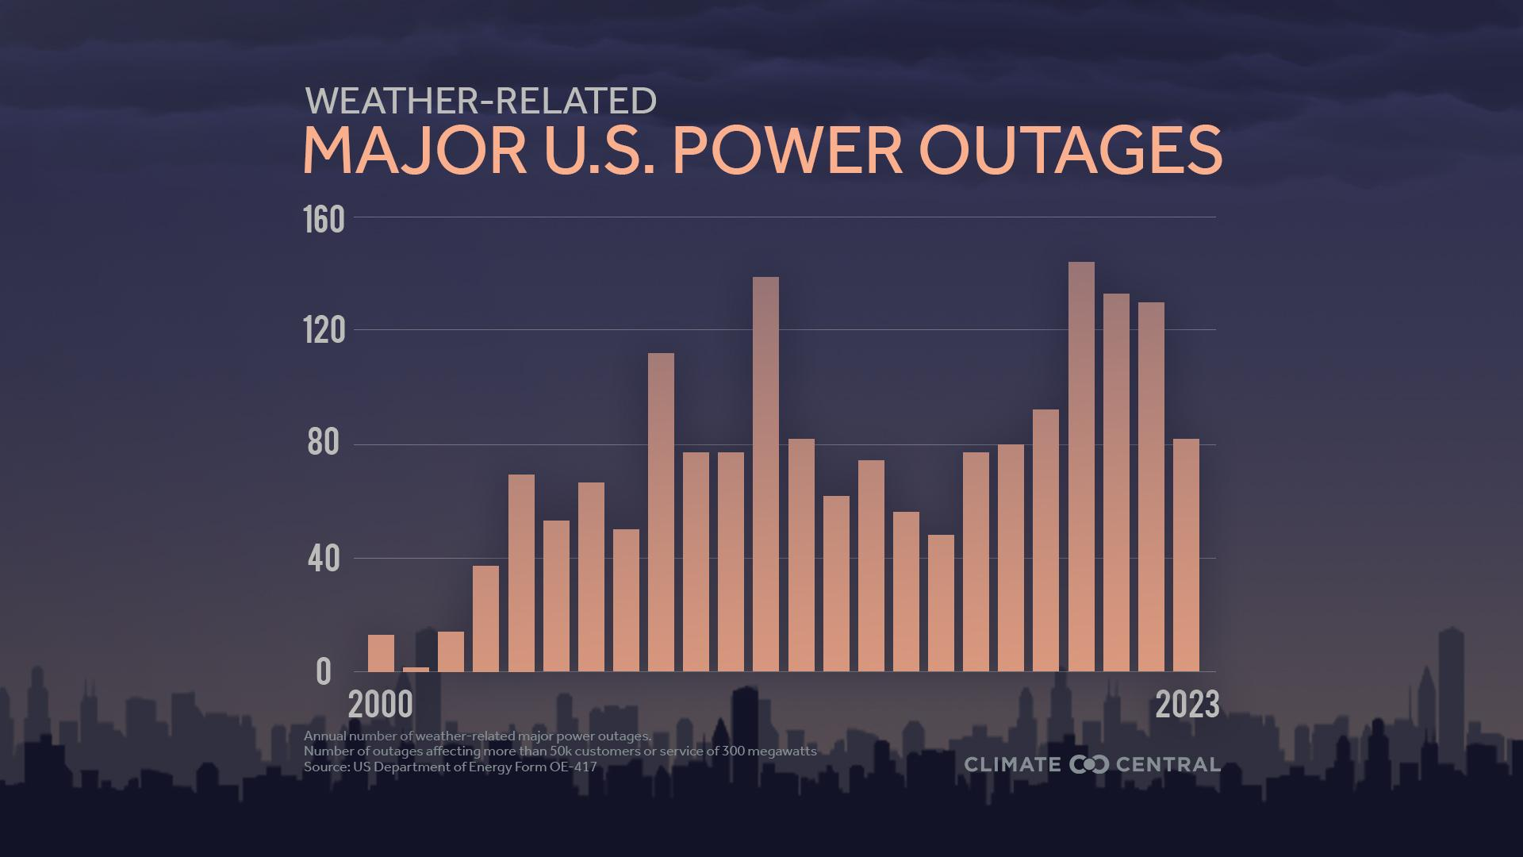
Notes:
📍Download graphics showing weather-related power outages in the lower 48 U.S. states from 2000-2023.
Many types of extreme weather are becoming more frequent or intense because of human-caused climate change. These events put stress on aging energy infrastructure and are among the leading causes of major power outages in the U.S.
Of all major U.S. power outages reported from 2000 to 2023, 80% (1,755) were due to weather.
Most weather-related outages were caused by severe weather (58%), winter storms (23%), and tropical cyclones including hurricanes (14%).
Power outages and hot weather are a dangerous mix. When blackouts overlap with the need to cool homes, schools, and businesses, the risks compound for heat-sensitive populations. Heat season outages now (2014-2023) happen 60% more often than during 2000-2009.
Read more: Weather-related Power Outages Rising (2024) and Heat Season Power Outages (2024)

Slide 24
Extreme Heat
Notes:
Extreme Heat
More frequent and intense extreme heat — the deadliest natural hazard in the U.S. — is a direct result of a warming planet.
See Extreme Weather Toolkit: Extreme Heat for quick facts (in English and Spanish) and the latest Climate Central resources on extreme heat and climate change.

Slide 25
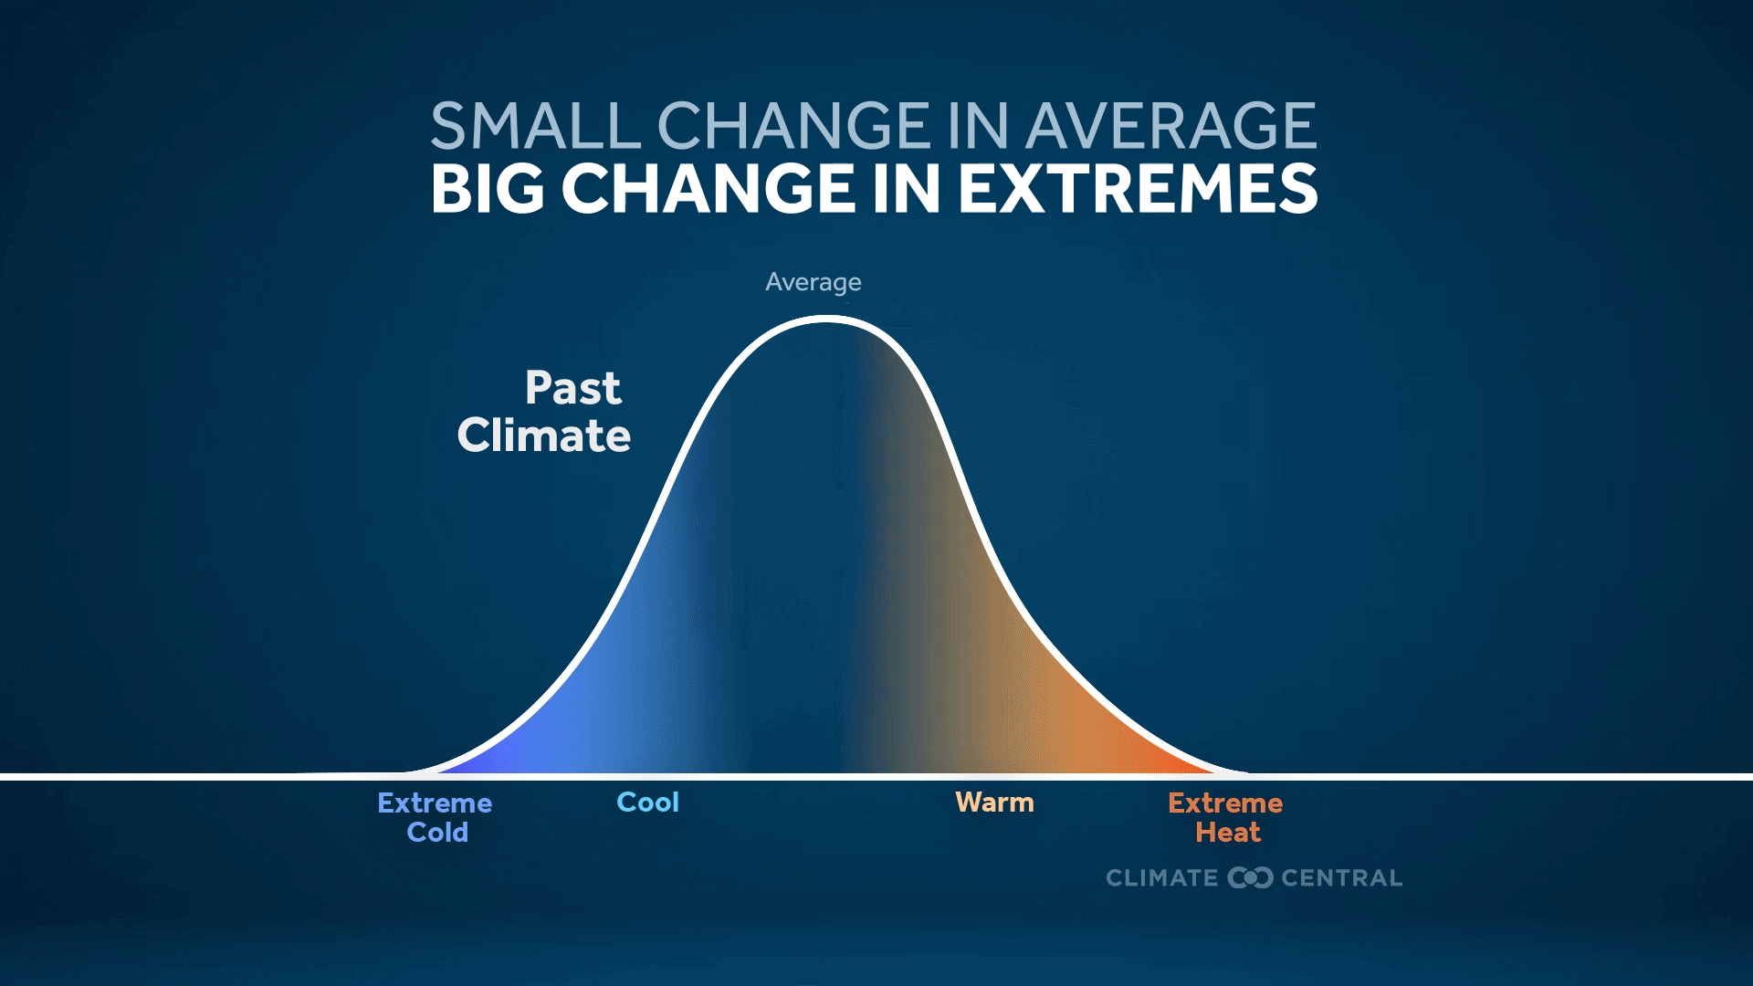
Notes:
Click here to download the animation.
At first, 1.5°C of global warming may seem like a small amount. Locally, temperatures fluctuate far more than that from day to night or winter to summer. But as a global average, this warming limit represents a very consequential amount of warming.
The risks for people, economies, and ecosystems across the planet rise with every fraction of a degree of global warming. To understand why, it’s important to recognize that a relatively small increase in average temperatures causes a relatively large increase in the frequency and intensity of extreme heat — which is the deadliest weather-related hazard in the U.S.
⭐ Explore Climate Central’s Local Records Tracker for the latest data and graphics showing the changing frequency of daily record-high and record-low temperatures in 247 U.S. cities.

Slide 26
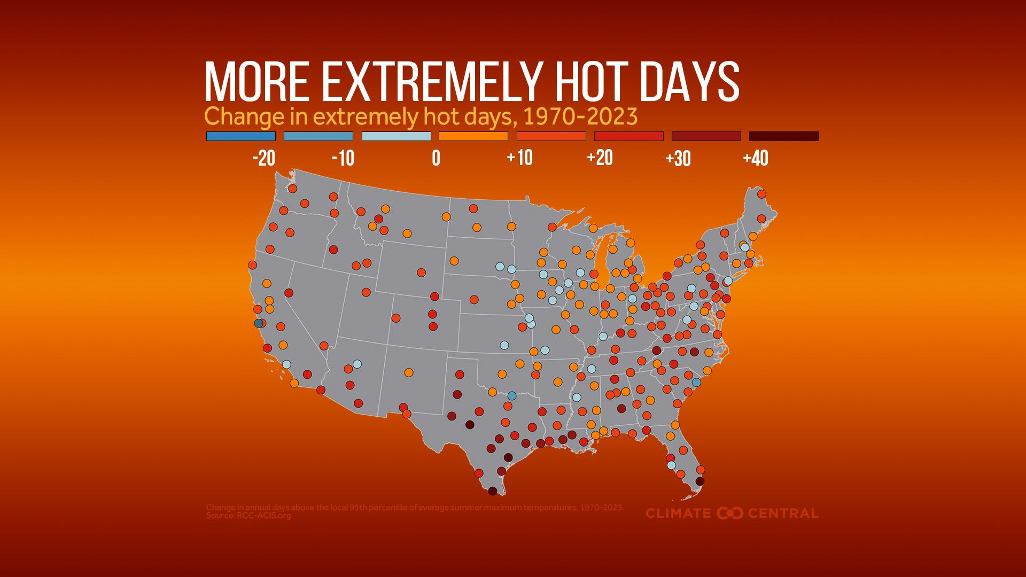
Notes:
📍 Download local graphics for 242 U.S. cities.
From 1970 to 2023, extremely hot days have become more frequent in 88% (212) of 242 U.S. locations analyzed by Climate Central.
Most of the locations analyzed (172, or 71%) now experience at least one additional week’s worth of extremely hot days than in the early 1970s.
Heat is the deadliest weather-related hazard in the U.S.
Read more: More Extremely Hot Days for School Sports (2024)
⭐ Explore Climate Central’s Local Records Tracker for the latest data and graphics showing the changing frequency of daily record-high and record-low temperatures in 247 U.S. cities.

Slide 27
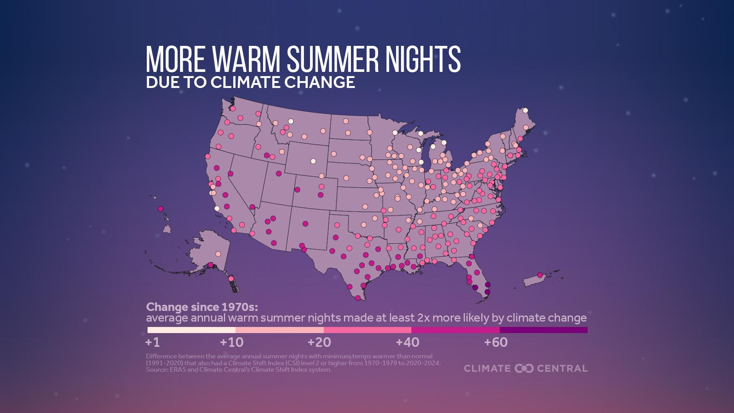
Notes:
📍 Download local graphics for 240+ U.S. cities: line graph or bar chart.
As our climate warms, summer is heating up across the U.S. Summer warming isn’t all about scorching days — it’s also about sweltering nights.
Summertime nights have warmed in 231 U.S. locations analyzed by Climate Central — by 3.1°F on average.
When nights don’t cool off enough relative to peak daytime temperatures, people have a harder time cooling off. Heat is the deadliest weather-related hazard in the U.S., and warm nights can worsen heat stress and related health risks during the hottest time of year.
Climate change is having a growing influence on the frequency of sweltering summer nights since 1970 in all but one of the 247 major U.S. cities analyzed. On average, these cities currently experience about 27 warmer-than-normal summer nights with a strong climate change fingerprint each year, compared to one such night annually during the 1970s.
Read more: Warm Summer Nights Influenced by Climate Change (2025)

Slide 28
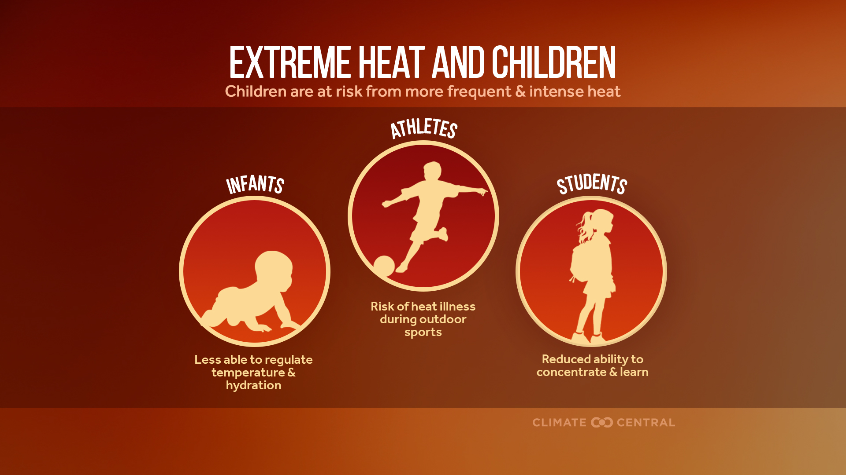
Notes:
Children — especially babies, younger kids, and athletes — are among those most vulnerable to heat-related illness. Babies and younger children have difficulty regulating their core body temperature and can be more vulnerable to hot weather. Young children sweat less and acclimate to heat more slowly than adults. During outdoor sports or play, kids may ignore or miss symptoms of heat stress.
Without effective measures to adapt to a warming world, children will experience worse health impacts –- including a potential increase in heat-related emergency room visits.
Heat impacts aren’t felt equally. Studies have shown that urban heat islands are more likely to be found in predominantly lower-income and non-white communities.
Future generations are likely to face accelerating change and intensifying risks — particularly from heat waves –- with continued warming. Ultimately, a commitment to rapid, sustained cuts to carbon pollution is the most impactful action to slow the rate of warming and set younger generations on a different path, toward a safer future.
Read more: Extreme Heat Risks for Children (2024) and Climate Change & Children's Health: Extreme Heat (2024)

Slide 29
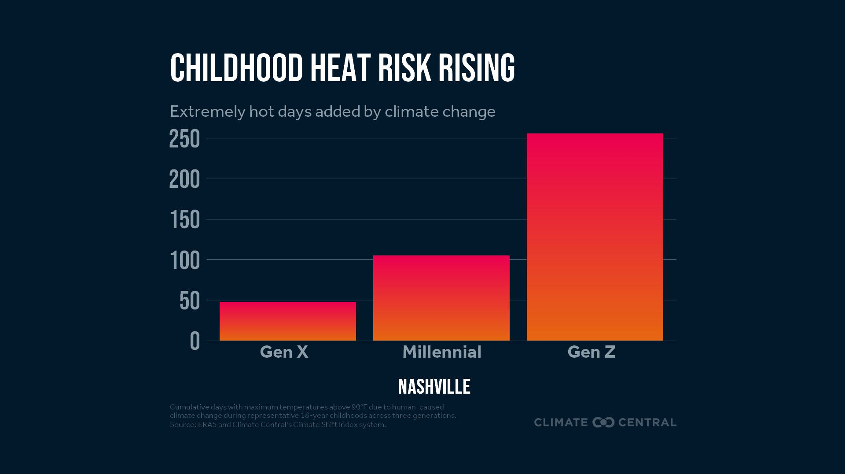
Notes:
📍 Download local graphics for 247 U.S. cities.
Because of human-caused climate change, young people today are experiencing far more extreme heat during childhood than previous generations did.
On average across 247 major U.S. cities, heat-trapping pollution is causing kids today to experience two- to four-times more extreme heat than previous generations did during childhood.
Read more: Childhood Heat Risk Rising (2025)
Explore the tool to see how climate change has influenced the extreme heat you’ve faced over your lifetime — and compare your experience to people in other locations and generations.

Slide 30
Heavy Rain and Flooding
Notes:
Heavy Rain and Flooding
Climate change is bringing heavier rainfall extremes and increased, inequitable flood risk to many parts of the U.S.
See Extreme Weather Toolkit: Heavy Rain and Flooding for quick facts (in English and Spanish) and the latest Climate Central resources on heavy rain and flooding.

Slide 31
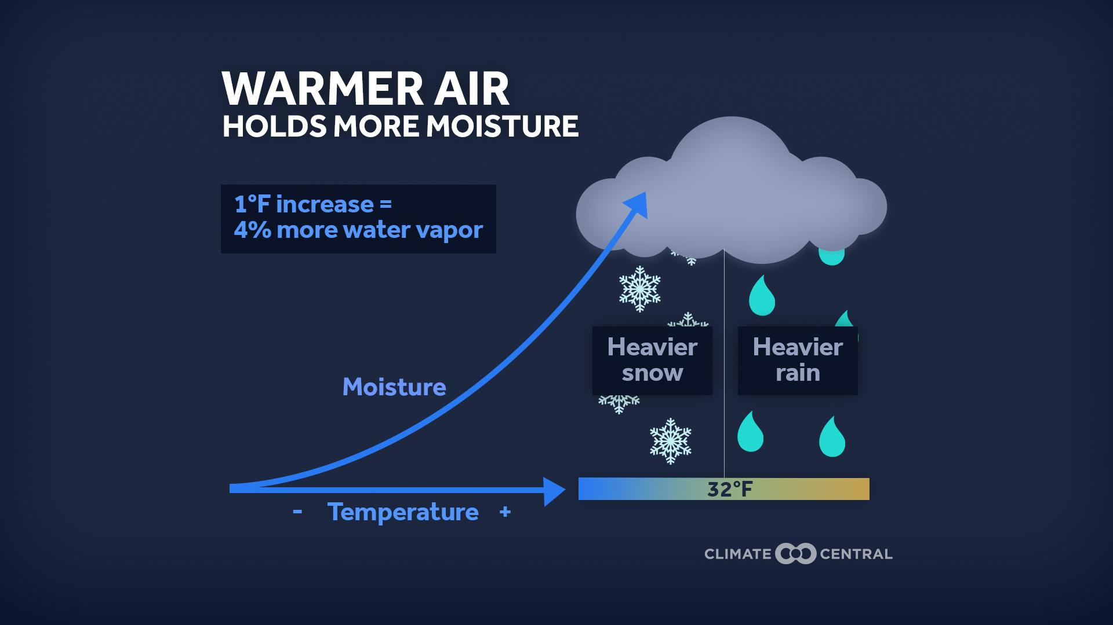
Notes:
For every 1°F of warming, the air can hold 4% more moisture, increasing the chances of heavier downpours that contribute to flash flooding hazards.
Heavy downpours bring more rain, faster — causing flash flooding and landslides that can displace families, drown crops, damage infrastructure, and expose people to hazardous debris, contaminants, and water-borne disease.
Read more: Heavier Rainfall Rates in U.S. Cities (2025)

Slide 32
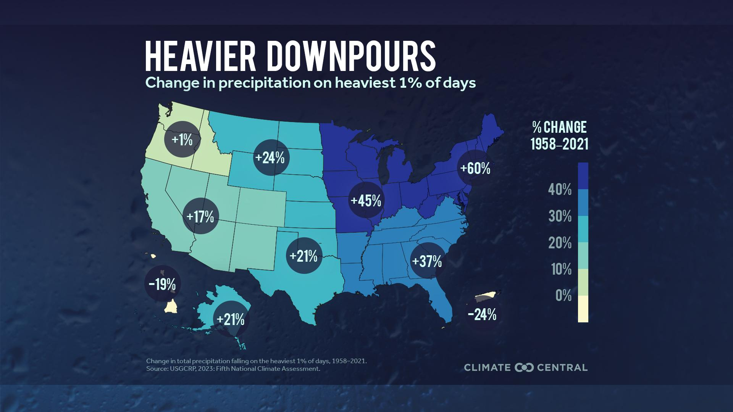
Notes:
📍 Download local graphics for 144 U.S. cities.
As the climate has warmed over the last six decades, the heaviest rainfall events have become wetter in all major regions of the continental U.S., led by: the Northeast, Midwest, and Southeast.
Heavy downpours bring more rain, faster — raising the risks of flash flooding and landslides that can displace families, drown crops, damage infrastructure, and expose people to hazardous debris, contaminants, and water-borne disease.
The rapid onset of flash floods limits time for people to get out of harm’s way.
People of color and those living in mobile homes are disproportionately exposed to flooding, especially in rural areas and in the southern U.S. Children are among the most vulnerable to the physical, mental, and emotional health impacts experienced during and after a flood.
Read more: Extreme Precipitation in a Warming Climate (2024) and Climate Change and Inland Flooding (2024)

Slide 33
Drought
Notes:
Drought
Rising global temperatures are altering the water cycle and increasing the risk of drought in parts of the U.S.
The U.S. has experienced significant droughts of all three types in the past decades and centuries. Drought can lead to short- and long-term impacts on water supplies, agriculture, ecosystems, wildfire risk, public health, and more.
See Extreme Weather Toolkit: Drought for quick facts (in English and Spanish) and the latest Climate Central resources on drought.

Slide 34
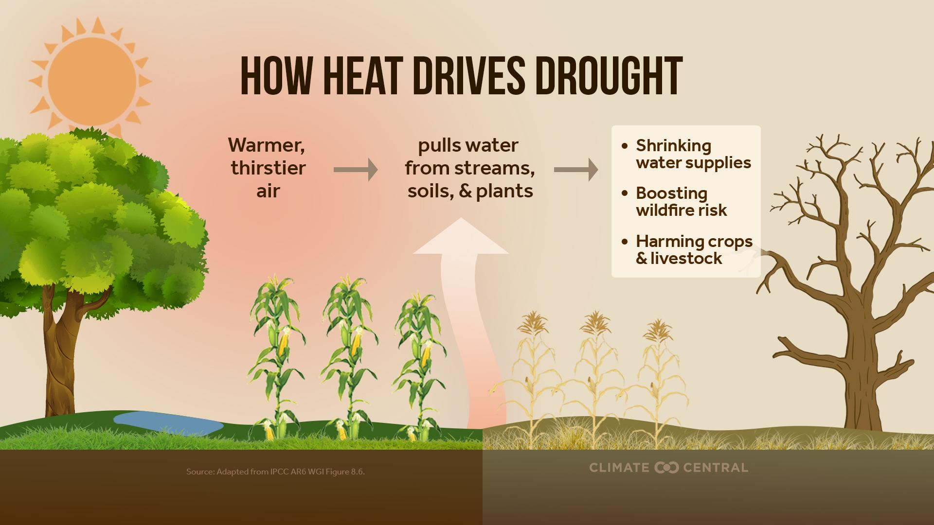
Notes:
The relentless rise in heat-trapping pollution is warming the planet and changing the dynamics of drought — and its effects on water security, food supplies, wildfire, and ecosystems.
As temperatures rise, the atmosphere gets thirstier and pulls more water from streams, soils, and plants — causing or worsening drought and fueling wildfire risk. Emerging research shows that, in our warming climate, the atmosphere’s growing demand for water is an increasingly important cause of drought in the western U.S. and around the globe.
Historically, a lack of rain and snow was the leading cause of drought in the western U.S. But since 2000, atmospheric thirst due to human-caused warming has taken the lead in driving drought in the region.
Read more: Warmer, Thirstier Air Worsens Drought (2025)

Slide 35
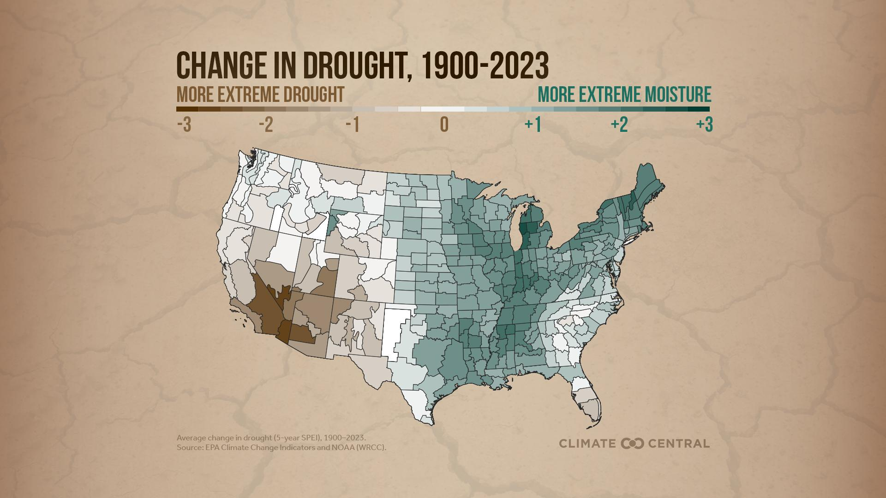
Notes:
Since the early 20th century, the western U.S. has become drier. The Southwest, along with California and Nevada, have experienced the most extreme drought intensification across the country.
Over the same period, the eastern U.S., and especially the Northeast and Upper Midwest, have generally become wetter.
As temperatures rise, the atmosphere’s capacity to absorb and hold moisture increases exponentially. In this way, the atmosphere acts like a sponge that grows about 4% larger for every 1°F of warming — both absorbing more moisture from Earth’s surface and raining out more water.
This is how climate warming intensifies the water cycle and amplifies both heavy rainfall and drought.
As warming intensifies and evaporative demand increases further, the finite supply of water from streams, soils, and plants at the land’s surface will eventually fail to keep up with demand — causing or worsening drought.
Read more: Warmer, Thirstier Air Worsens Drought (2025)

Slide 36
Wildfire
Notes:
Wildfire
More frequent hot, dry, windy conditions contribute to more wildfires that put people and ecosystems at risk.
See Extreme Weather Toolkit: Wildfire for quick facts (in English and Spanish) and the latest Climate Central resources on wildfires.

Slide 37
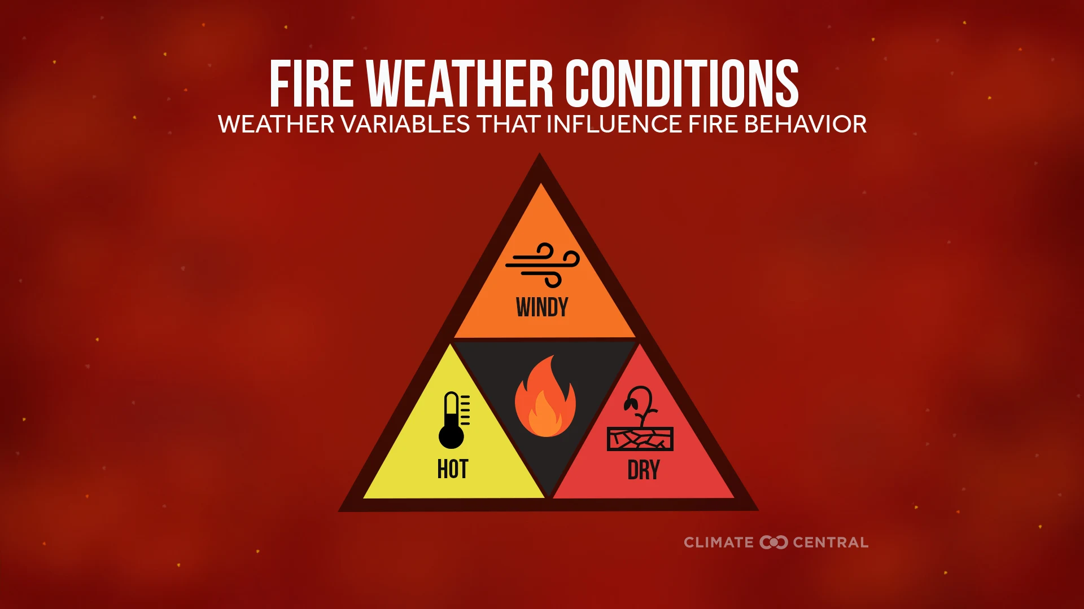
Notes:
Wildfires are sparked either by natural events (generally lightning) or by human activities. But people started 87% of U.S. wildfires from 2001 to 2024, accounting for almost half of all acres burned over that period.
Regardless of how fires start, more frequent hot, dry, windy conditions — known as fire weather — prime the landscape for wildfires to ignite and spread.
Climate change is causing more frequent fire weather across the U.S. Warming temperatures and increasingly dry air, vegetation, and soils make it easier for fires to spread, and harder to fight or prevent.
As fire weather becomes more prevalent, there are more days when extreme conditions can turn small blazes into big ones or fuel the growth of large wildfires.
Read more: More Frequent Fire Weather (2025)

Slide 38
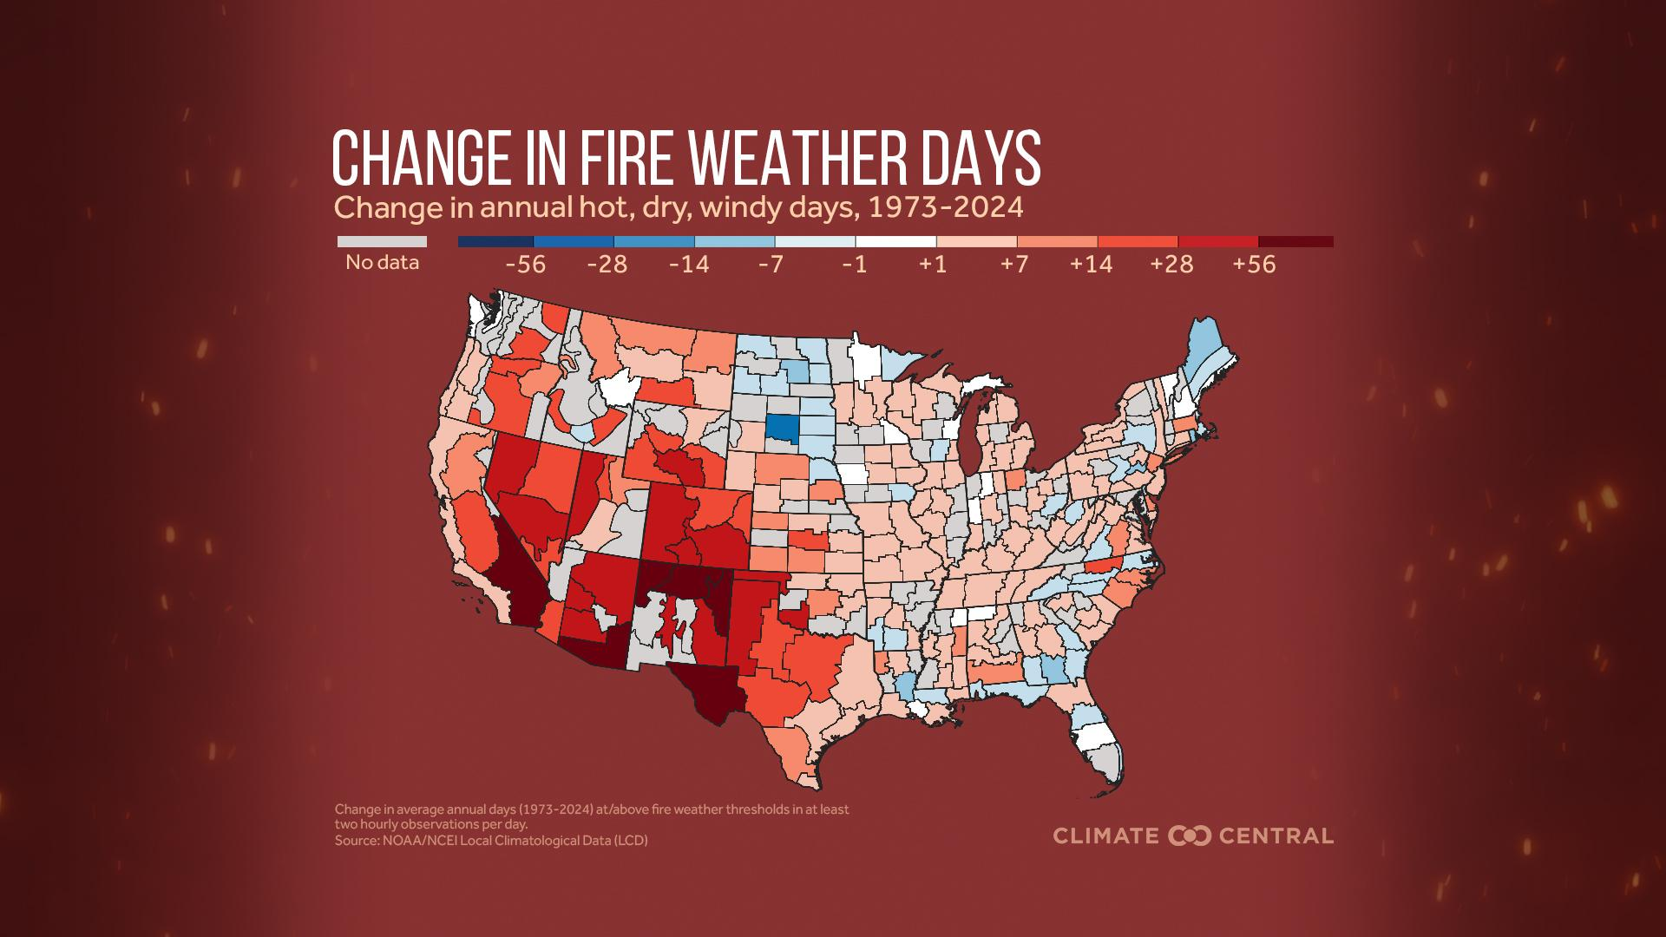
Notes:
📍 Download local graphics for 245 climate divisions spanning the contiguous U.S.
Wildfire seasons are lengthening and intensifying, particularly in the western U.S. Parts of the eastern U.S. have seen smaller but impactful increases in fire weather days.
The western U.S. has experienced a strong increase in the average annual number of fire weather days since 1973.
Areas in Southern California, New Mexico, Texas, and Arizona have experienced some of the largest increases in annual fire weather days, with some areas now seeing around two more months of fire weather per year compared to a half century ago.
Read more: More Frequent Fire Weather (2025)

Slide 39
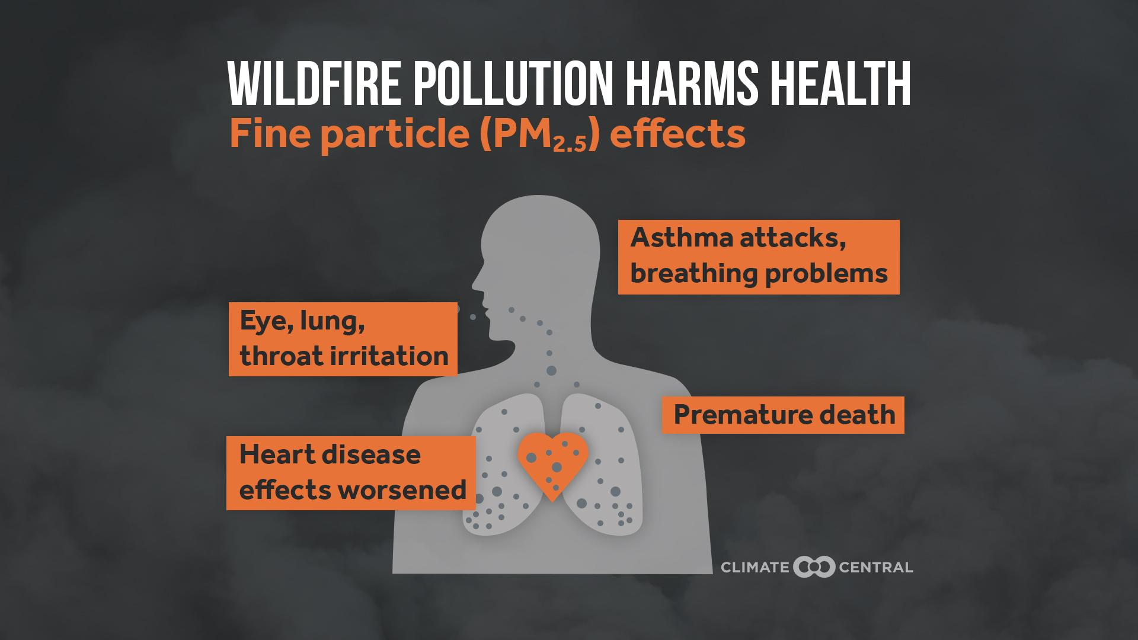
Notes:
When people breathe in wildfire smoke, these tiny particles can make their way deep into the lungs and even into the bloodstream, causing a range of health effects from minor irritation to serious cardiovascular and respiratory illness.
Wildfire smoke can also affect learning outcomes. A recent study found that exposure to PM2.5 from wildfire smoke corresponds to lower test scores among U.S. students aged eight to 14 years.
Wildfire smoke is hazardous for everyone. But some people face higher risks, including the elderly, pregnant people, children, and those with chronic conditions such as asthma, COPD, and heart disease. Some people, including wildland firefighters, first responders, and outdoor workers, also face higher risks of exposure to fire and smoke during wildfire outbreaks.
Read more: Climate Change Worsens Wildfire Smoke (2025) and Burning Fossil Fuels Worsens Air Quality (2025)

Slide 40
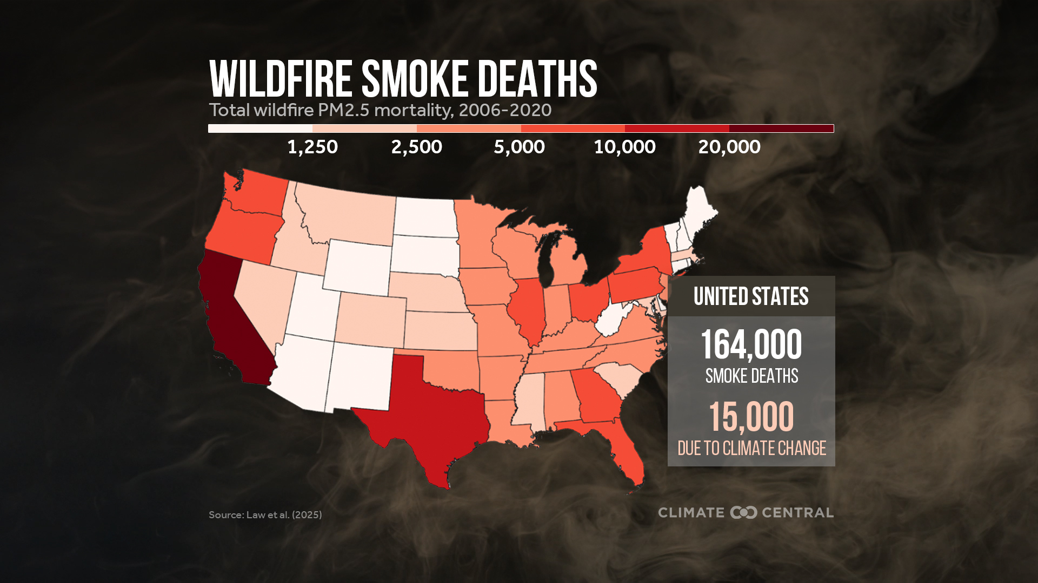
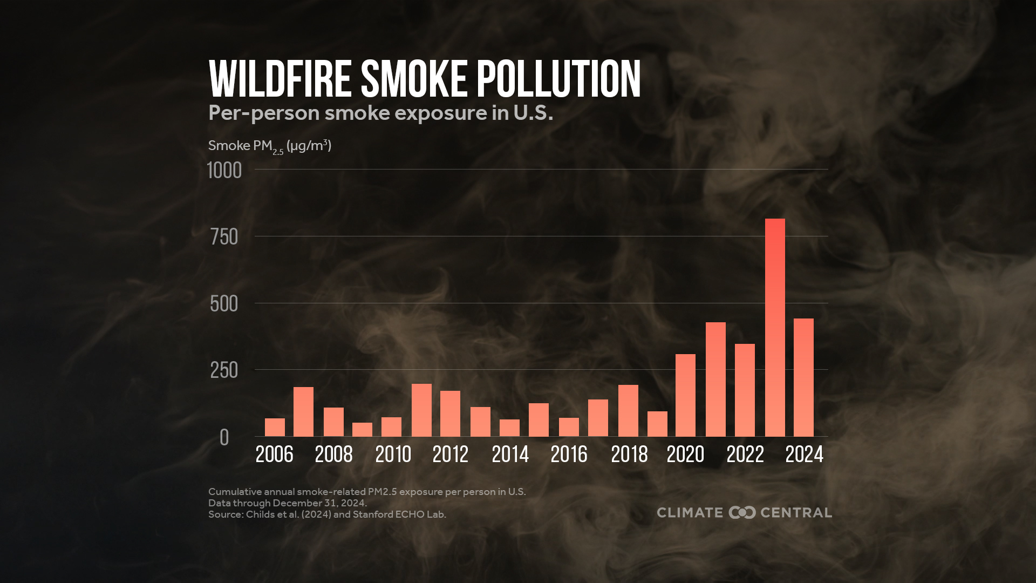
Notes:
Human-caused climate change has fueled more fire activity in the western U.S., increased the frequency and intensity of fire weather, and expanded burned areas across the U.S.
Emerging research shows that climate change is also making wildfire smoke and the related health effects worse. Per-person exposure to harmful wildfire smoke in the U.S. was four times higher during 2020-2024, on average each year, than during 2006-2019.
Wildfire smoke can spread hundreds or even thousands of miles away, harming health far from areas with active fires.
New research shows that wildfire smoke caused 164,000 premature deaths in the U.S. from 2006 to 2020 — and that climate change accounted for about 15,000 of those smoke-related deaths.
Read more: Climate Change Worsens Wildfire Smoke (2025)

Slide 41
Severe Storms
Notes:
Severe Storms
Severe weather is defined as a thunderstorm that produces a tornado, winds of at least 58 mph, and/or hail at least 1 inch in diameter. The relationship between climate change and severe storms is a complex and active area of research. As our climate continues to warm, certain conditions favorable to thunderstorms and tornadoes are occurring more often and severe weather activity is expanding into historically less-active seasons and regions.
See Extreme Weather Toolkit: Severe Weather for quick facts (in English and Spanish) and the latest Climate Central resources on severe weather.

Slide 42
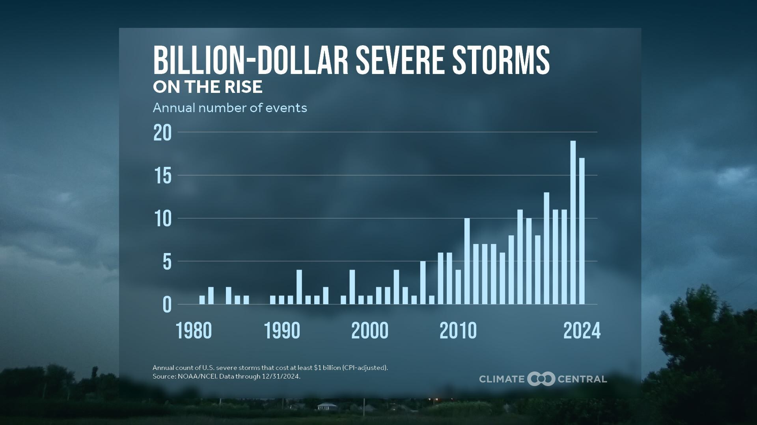
Notes:
Severe storms account for half of all U.S. billion-dollar weather and climate disasters that have impacted the nation since 1980.
The frequency of billion-dollar severe storms has increased dramatically in recent decades, with 2023 and 2024 ranking as the top two years on record.
These trends reflect both the rising frequency and intensity of extreme weather and the growing number of people, homes, and businesses exposed to these hazards.
Partly due to their high frequency, severe storms are the leading cause of weather-related power outages in the U.S.
Read more: Severe Storm Super Hazards (2024)

Slide 43
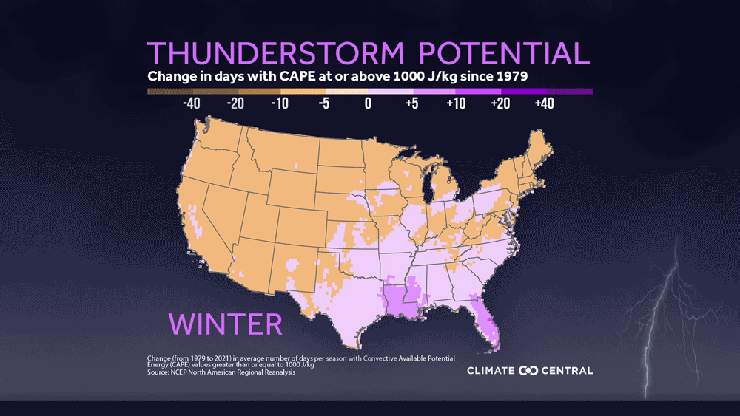
Notes:
Click here to download the animation.
As our climate continues to warm, certain conditions favorable to severe thunderstorms and tornadoes are occurring more often and severe weather activity is expanding into historically less-active seasons and regions.
Convective available potential energy (CAPE) is a measure of the amount of energy available to fuel thunderstorms, and is one indicator of thunderstorm severity.
Since 1979, parts of the eastern U.S. have seen up to 10-15 more days of high CAPE values during both spring and summer — prime time for thunderstorms.
Read more: Changing Thunderstorm Potential (2022)

Slide 44
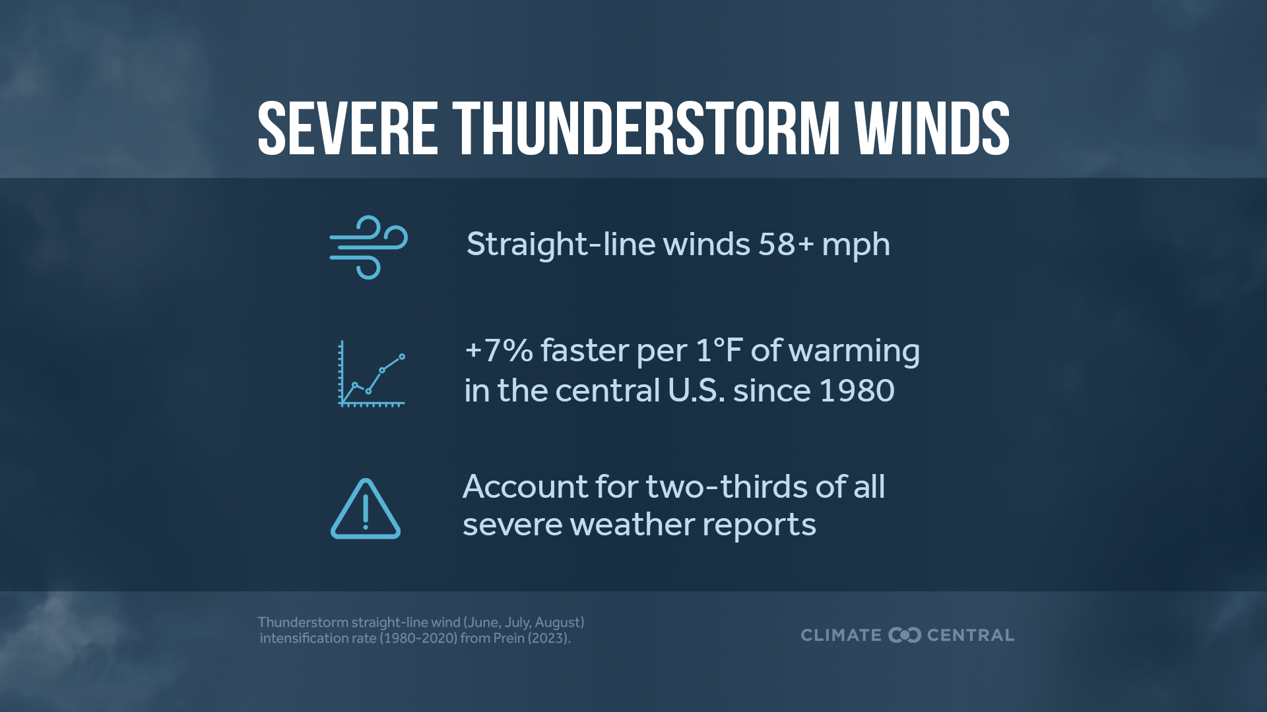
Notes:
Thunderstorm straight-line winds are a common severe weather hazard. These non-rotating winds originating from thunderstorms are classified as “damaging” when their speed exceeds 58 mph. These are the most common severe storm hazards by far: damaging crops, buildings, energy grids, and threatening safety.
The response of thunderstorm straight-line winds to climate change is an active area of study. But emerging research suggests links between human-caused climate change and increases in the speed, frequency, and area of impact from damaging thunderstorm straight-line winds.
Thunderstorm straight-line winds during June, July, and August have intensified in the central U.S. at a rate of about 7% per 1°F (13% per 1°C) of warming (1980-2020).
Looking to the future, research suggests that large and long-lived straight-line wind events called derechos are projected to become more frequent, widespread, and intense by the end of the century for most of the central and eastern U.S. in scenarios with intermediate and very high levels of warming.
Read more: Thunderstorm Straight-Line Winds (2025)

Slide 45
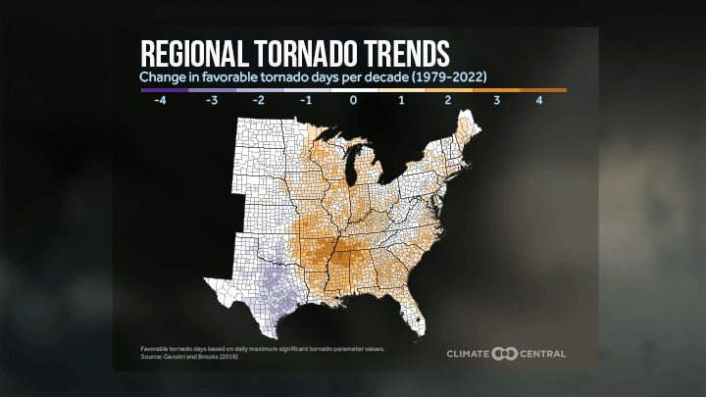
Notes:
Click here to download the animation.
Even though a warming climate provides more energy for the thunderstorms that spawn tornadoes, it’s still unclear how climate change is affecting wind shear — the necessary spin that generates tornadoes. How tornadoes react to a changing climate continues to be vigorously researched, and some trends are surfacing.
The frequency of favorable tornado days (indicated by daily maximum significant tornado parameter values) has increased significantly in parts of Mississippi, Alabama, Arkansas, Tennessee, Kentucky, Missouri, Illinois, and Indiana since 1979.
As more tornado outbreaks occur east of the Mississippi River in the Southeast and Mid-South, the boundaries of “Tornado Alley” are being redrawn. Enhanced tornado hazards, combined with increasing human exposure and socioeconomic vulnerability, can dramatically increase the risks of disastrous tornadoes in these regions.
Read more: Severe Storm, Supercell, and Tornado Trends (2023)

Slide 46
Coastal Flooding
Notes:
Coastal Flooding
The frequency of coastal floods has risen sharply in recent decades. Rising sea levels due to human-caused warming will continue to increase both tidal flooding and flooding from extreme weather events in the years ahead.
See Extreme Weather Toolkit: Coastal Flooding for quick facts (in English and Spanish) and the latest Climate Central resources on coastal flooding.

Slide 47
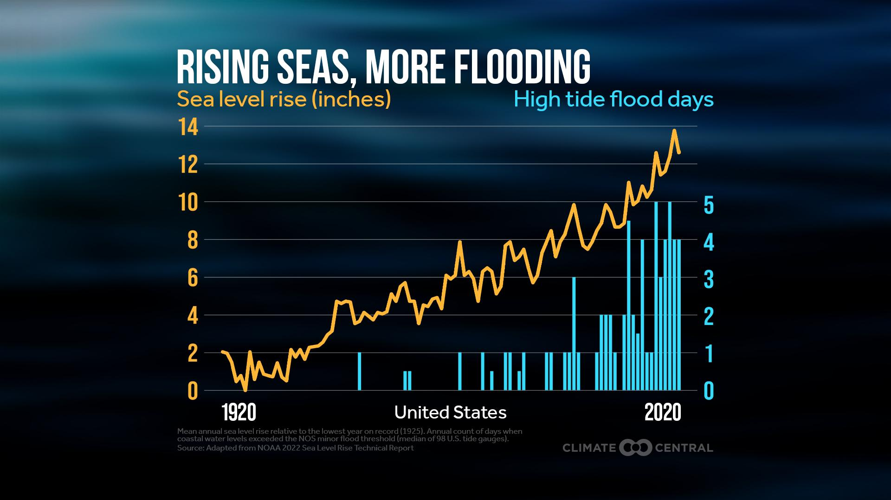
Notes:
📍 Download local graphics for 35 coastal U.S. locations.
The oceans have absorbed 90% of the extra heat caused by carbon pollution. As oceans heat up, the volume of seawater expands — causing sea levels to rise. Melting glaciers and ice sheets also contribute to rising sea levels.
Global mean sea level rose by nearly 8 inches from 1901 to 2018, according to the latest IPCC reports. Studies indicate that roughly 70% of the observed rise since the 1970s is the result of human activity.
In our warming climate, it no longer takes a strong storm to flood streets, homes, businesses, and ecosystems along the coast. High tide flooding — also called nuisance flooding or sunny day flooding — is becoming more common in the U.S. The annual frequency of U.S. high tide flooding has more than doubled since 2000.
Sea levels are expected to continue rising with continued human emissions of carbon pollution. Coastal flood frequency is projected to more than triple by 2050 (relative to 2020) to reach a national average of 45 to 85 flood days per year.
Read more: Rising Seas, Flooding Coasts (2023)

Slide 48
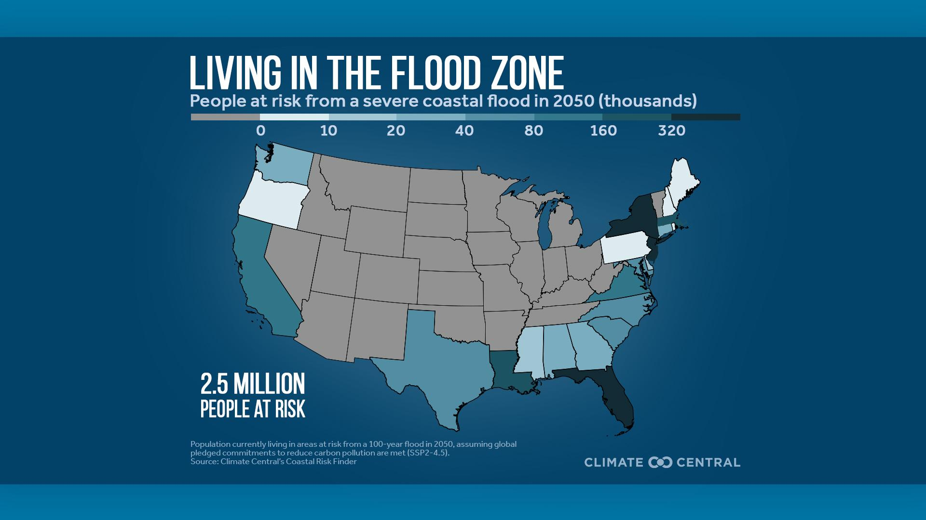
Notes:
📍 Download local graphics for 22 coastal U.S. states and Washington, D.C.
Sea level rise is accelerating along U.S. coasts. According to NOAA, sea levels along U.S. coasts are expected to rise as much over the next 30 years (10-12 inches, on average) as they did over the last 100 years. As sea levels rise, flooding is becoming more common along U.S. coasts, where 30% of the population lives.
According to Climate Central analysis, around 2.5 million Americans in 1.4 million homes live in areas at risk from a severe coastal flood in 2050 under projections that assume global pledged commitments to reduce carbon pollution are met. Florida, New York, and New Jersey have the most people and homes in areas at risk from a severe coastal flood.
Older adults are disproportionately exposed to coastal flood risk. Nearly 540,000 people aged 65 and older live in at-risk areas.
Read more: New U.S. Coastal Risk Map and Analysis (2025)

Slide 49
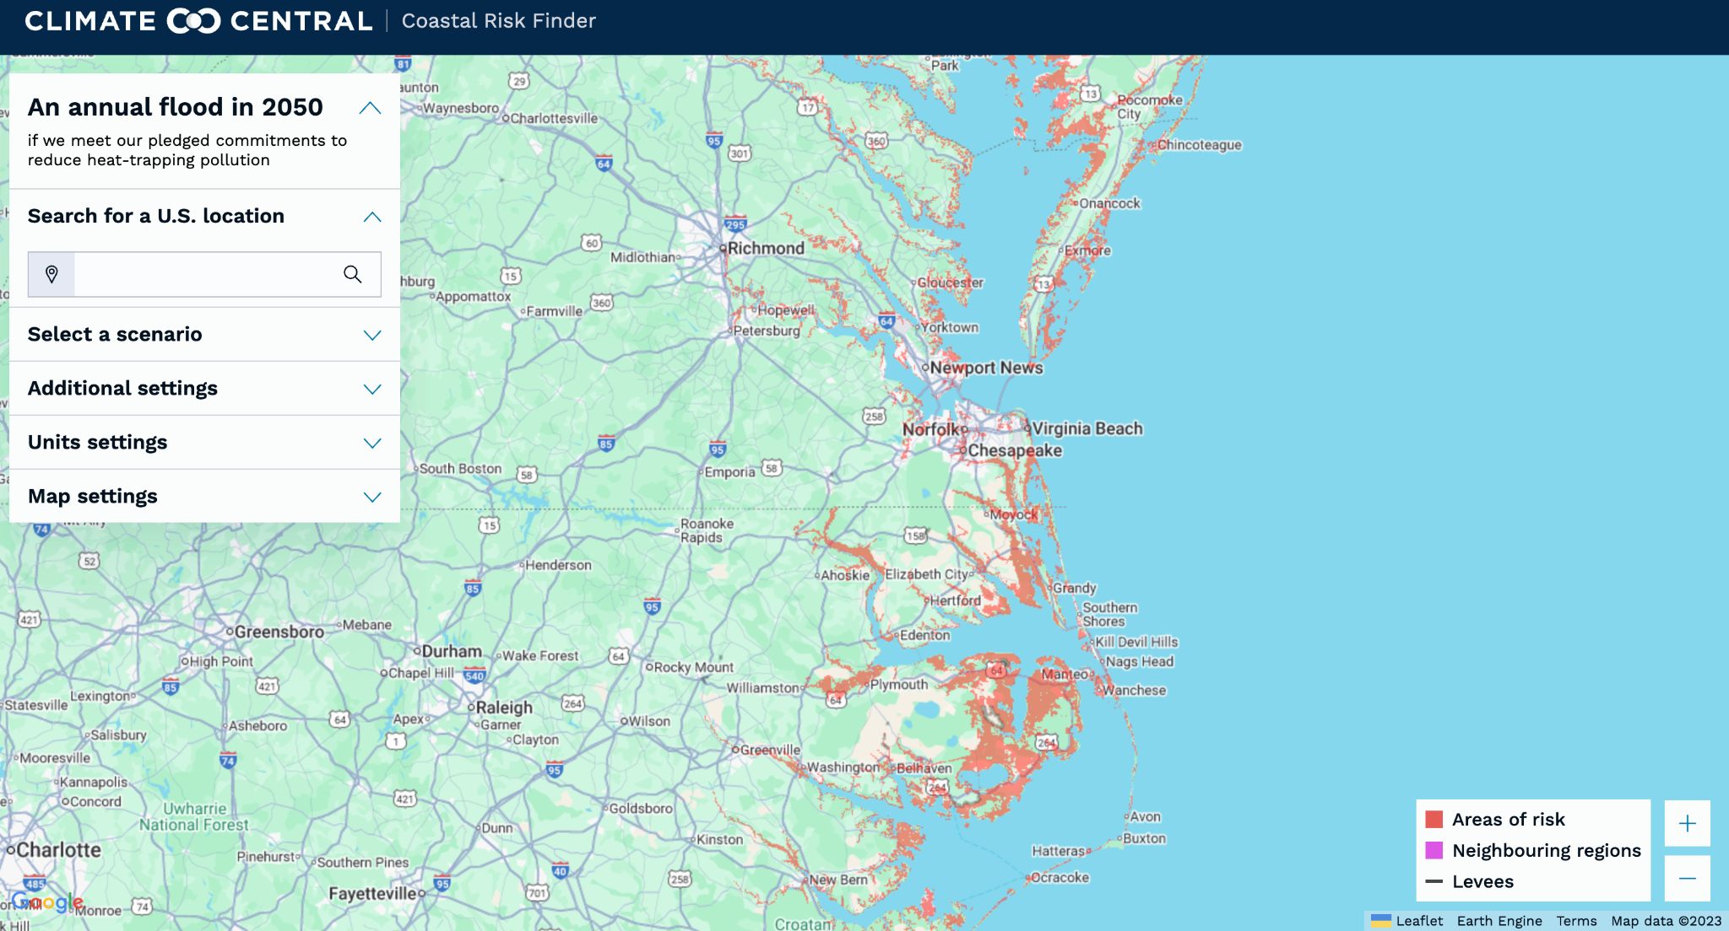
Notes:
Climate Central’s Coastal Risk Finder provides maps and analysis of the people, homes, and land projected to be at risk from worsening coastal flooding driven by rising seas in different U.S. geographies under various scenarios or pathways for reducing heat-trapping pollution.

Slide 50
Hurricanes
Notes:
Tropical Cyclones (Hurricanes)
Warming oceans fuel stronger tropical cyclones (including hurricanes) that bring more heavy rainfall and higher storm surge when they make landfall.
See Extreme Weather Toolkit: Tropical Cyclones for quick facts (in English and Spanish) and the latest Climate Central resources on tropical cyclones.

Slide 51
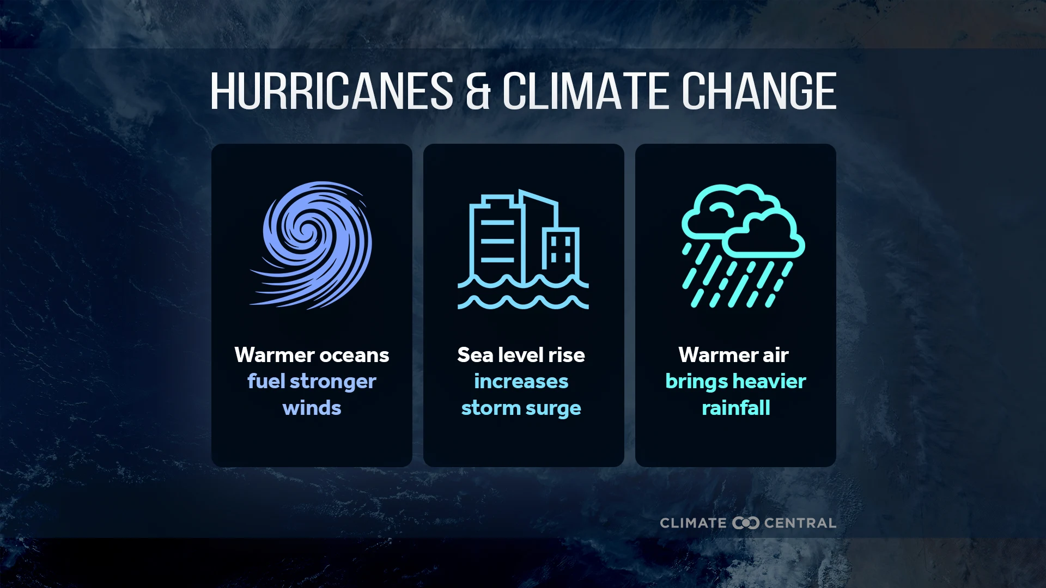
Notes:
Warming of the surface ocean due to human-caused climate change is causing more tropical cyclones to reach the most severe categories. Globally, human-caused warming has increased the likelihood of a hurricane developing into a Category 3 or stronger by about 5% per decade since 1979. The latest IPCC report concludes that the proportion of very intense (Category 4 and 5) tropical cyclones is projected to increase globally with continued global warming.
Climate change increased maximum wind speeds for every Atlantic hurricane in 2024, according to a Climate Central analysis based on new peer-reviewed research, and is increasing the fraction of storms that undergo rapid intensification.
Although the frequency of tropical storms is not necessarily increasing, sea level rise can amplify potential storm surge when storms do occur, putting coastal residents at particular risk.
Tropical cyclone rainfall rates are increasing by more than 1% per year, with further increases expected with further warming. This higher rainfall intensity, combined with the fact that climate change is enabling tropical cyclones to maintain more of their strength after making landfall, increases the risk of inland flooding, which accounts for more than half of past U.S. hurricane fatalities.
Read more: Reporting Resources: Hurricanes and Climate Change (2025)

Slide 52
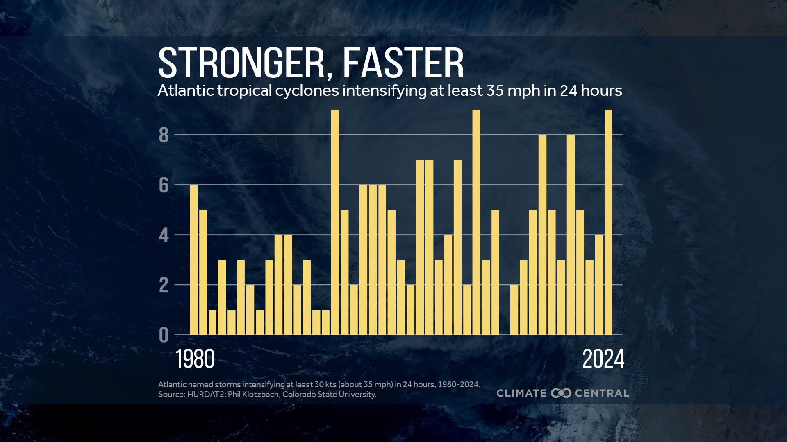
Notes:
About 80% of major hurricanes (Category 3-5) undergo rapid intensification — defined as an increase in the maximum sustained winds of a tropical cyclone of at least 30 kt (about 35 mph) in a 24-hour period.
Research suggests that warmer sea surface temperatures may contribute to an increased fraction of tropical cyclones that undergo rapid intensification.
Forecasting rapid intensification can be challenging, which contributes to the high human and economic toll of such storms.
Read more: Reporting Resources: Hurricanes and Climate Change (2025)
Explore Climate Central’s Climate Shift Index: Tropical Cyclones tool to see how much climate change has added to the strength of a storm’s winds.

Slide 53
Changing Ecosystems
Notes:
Heat trapping pollution also impacts ecosystems through changes in average conditions and extreme events. These ecological changes can affect human health, agriculture, and more. People and animals depend on ecosystems for basic needs such as food, clean air, and clean water. They’re also integral to regional economies, recreation, and cultural traditions.

Slide 54
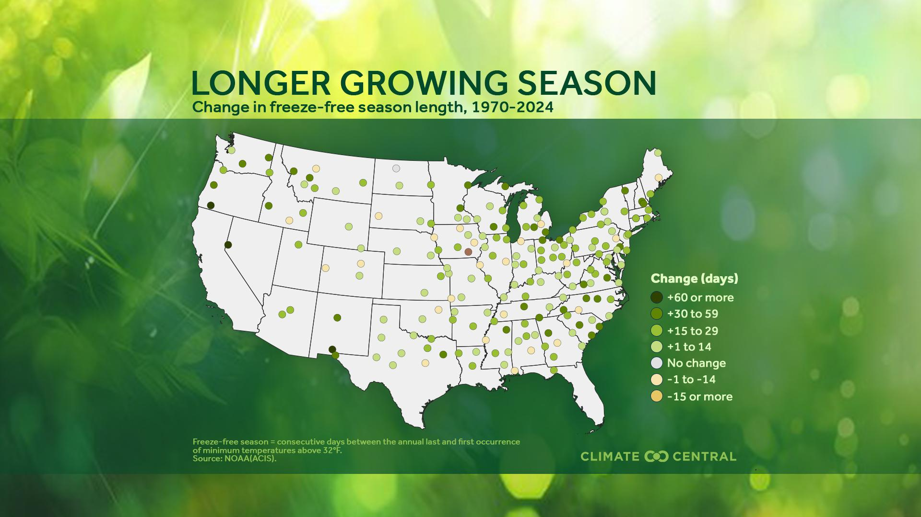
Notes:
📍 Download local graphics for 198 U.S. cities.
For example, warming trends lead to more freeze-free days each year — giving plants more time to grow and release allergy-inducing pollen.
The freeze-free growing season lengthened in 87% (172) of 198 U.S. cities analyzed since 1970. These 172 cities saw their freeze-free season lengthen by 20 days on average. Cities across the Northwest (+24 days) and Southwest (+20 days) have experienced the largest average change.
Lengthening growing seasons can also affect farmers’ planting, irrigation, pest management, and harvest schedules and strategies.
Read more: Longer Growing Season, Longer Allergy Season in 172 U.S. Cities (2025)

Slide 55
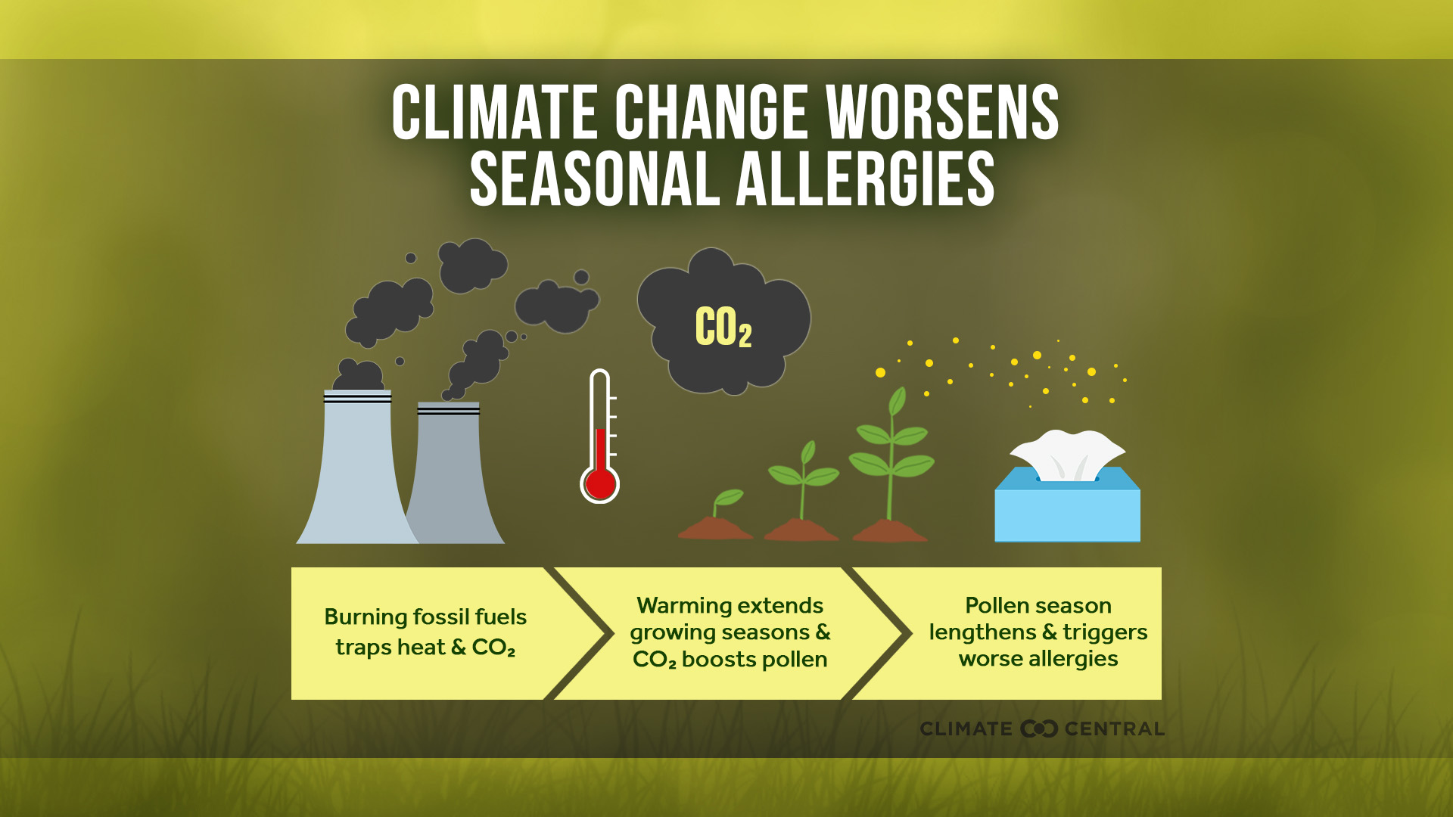
Notes:
A 2021 study found that human-caused warming was a primary driver of North American pollen seasons lengthening (by 20 days on average) from 1990 to 2018.
In addition to the effects of warming, higher levels of planet-warming CO2 in the air can boost pollen production in plants, particularly in grasses and ragweed.
With continued high rates of CO2 pollution, the U.S. could face up to a 200% increase in pollen production by the end of this century, according to a 2022 study.
Longer and more intense pollen seasons can have serious consequences for people with respiratory illnesses like asthma — particularly for children. These burdens are unequally shared. Black and Puerto Rican children are between two and three times more likely to have asthma than white children, and are therefore more at risk for allergic asthma.
Read more: Longer Growing Season, Longer Allergy Season in 172 U.S. Cities (2025)

Slide 56
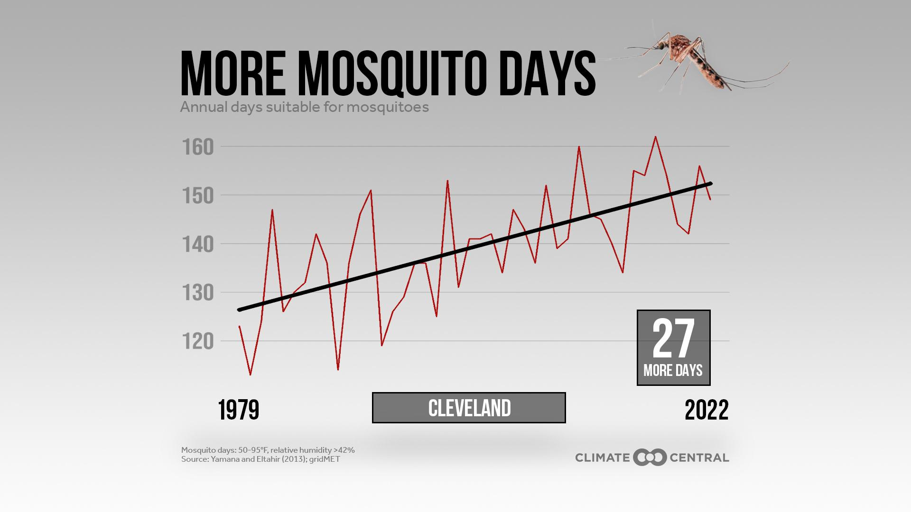

Notes:
📍 Download local graphics for 242 U.S. cities.
Mosquitoes thrive in warm, humid weather. As our climate warms, many places are becoming more hospitable to mosquitoes — and the health risks they can carry. As spring and fall temperatures warm, mosquitoes can emerge earlier and survive later into the year.
Climate Central assessed mosquito weather trends from 1979 to 2022 in 242 U.S. locations. Over this period, 173 locations saw annual mosquito days increase — by 16 days on average.
Read more: Mosquito Days (2023)

Slide 57
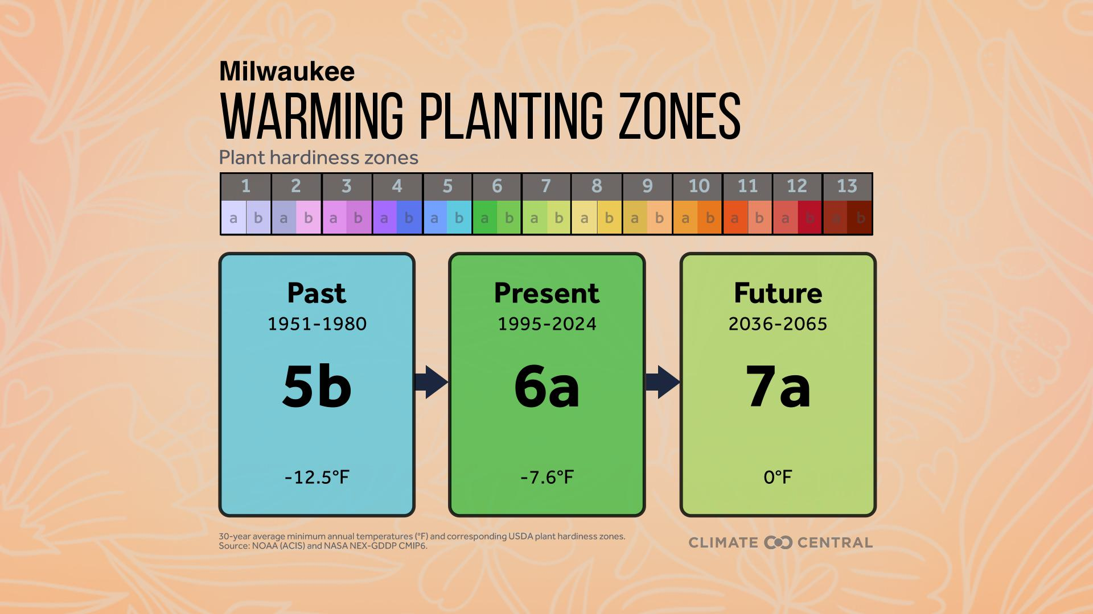
Notes:
📍 Download local graphics for 243 U.S. cities.
Gardeners and farmers across the U.S. look to plant hardiness zones for guidance on which plants to grow. These zones, based on the coldest temperatures of the year, determine which plants can grow and thrive in different parts of the country.
About 67% of 243 U.S. locations analyzed have already shifted to warmer planting zones from the past (1951-1980) to the present (1995-2024). Alaska, the Northwest, and the Southwest have been most affected.
With continued heat-trapping pollution, 90% of locations are likely to shift to warmer planting zones by the middle of the century (2036-2065). The Upper Midwest is likely to be most affected.
If carbon pollution continues, these shifts could continue or even accelerate, forcing farmers and gardeners to adapt by selecting plants adapted to a wider and warmer range of temperatures.
Read more: Warming Planting Zones (2025) and Growing Degree Days (2022)

Slide 58
What can we do?
Notes:
If recent pollution and warming trends continue, people and ecosystems will face increasing risks. But there are many options to cut heat-trapping pollution from energy, transportation, buildings, agriculture, and more.
Every fraction of a degree of avoided warming counts toward a safer future — especially for younger generations.
This part of the presentation reviews climate solutions that can displace fossil fuels, slow rates of warming, and ensure a safer future in the U.S. and around the globe.
Adapting to the current impacts of climate change is also critical to ensure the health, safety, and wellbeing of people, ecosystems, and economies on a rapidly-warming planet.

Slide 59
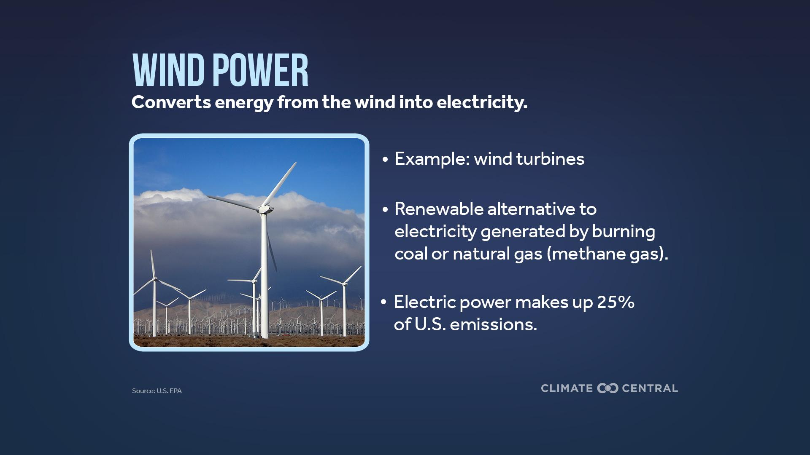
Notes:
Electric power (generated from burning coal and methane gas) is the leading source of heat-trapping pollution in 17 U.S. states, and accounts for 25% of U.S. greenhouse gas emissions.
As demand for electricity continues to grow, producing more clean electricity from renewable sources like solar and wind will be key to meeting surging demand while reducing heat-trapping pollution.
Wind turbines convert energy from the wind into electricity, providing a clean, renewable alternative to electricity generated by burning fossil fuels such as coal or natural gas (methane gas).
Read more: Clean Energy Investment in Every State (2024)

Slide 60
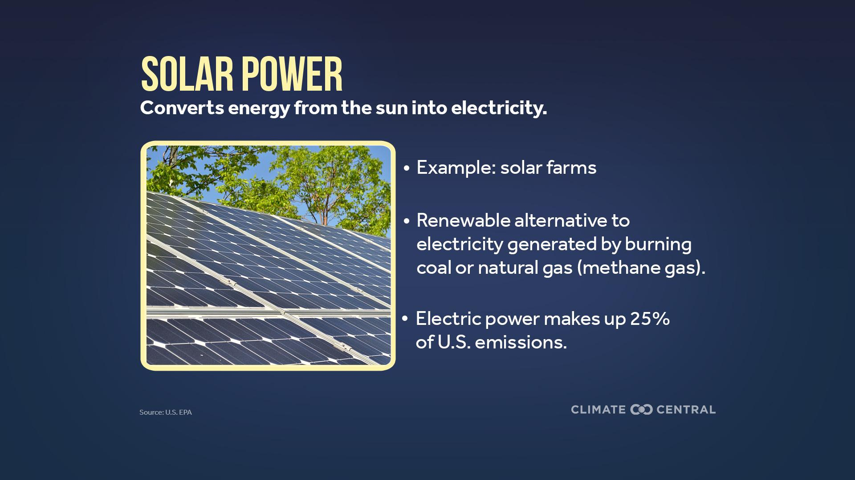
Notes:
Solar power is another source of clean, renewable electricity, and a leading alternative to burning fossil fuels.
The costs of onshore wind, solar photovoltaics, and electric vehicle (EV) batteries have all decreased sharply since 2000 (NCA5 Fig 32.8).
Plummeting costs and rapid adoption around the globe have made these clean energy sources the most cost-competitive source of new energy globally. In 2024, utility-scale solar and onshore wind projects were 41% and 53% cheaper, respectively, than the lowest-cost fossil fuel alternatives.
Read more: Clean Energy Investment in Every State (2024)

Slide 61
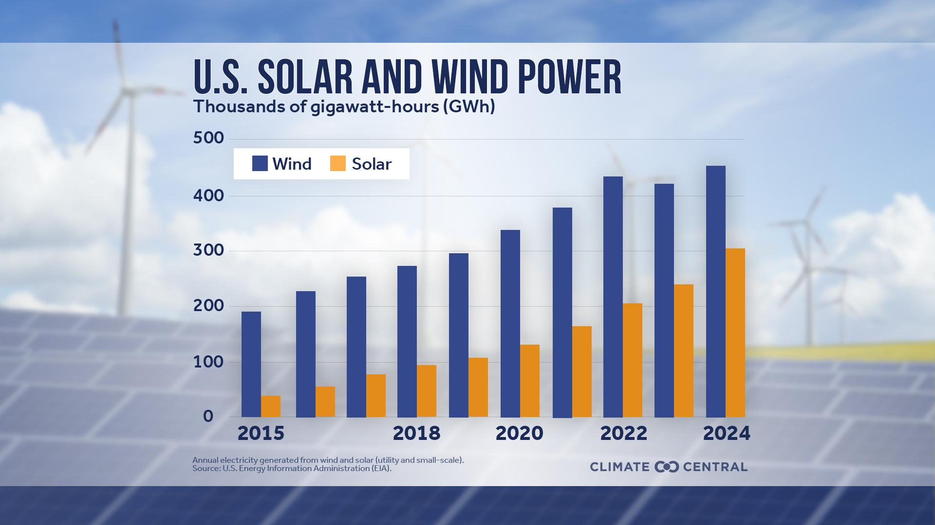
Notes:
Solar and wind are growing worldwide and in the U.S. In 2024, the U.S. generated a record 756,621 gigawatt-hours (GWh) of electricity from solar and wind — enough to power the equivalent of more than 70 million average American homes. That’s more than triple the amount generated a decade ago, in 2015.
This recent progress in the U.S. clean energy transition faces significant headwinds in 2025 from new federal energy and climate policies.
As of fall 2025, the U.S. has rolled back landmark 2021-2022 policies to boost clean energy and climate resilience, and is set to withdraw from the Paris Agreement by January 2026.
Even under these prior policies and commitments, further acceleration in wind and solar energy generation would have been needed for the U.S. to meet its prior climate goal (to cut heat-trapping emissions 50% below 2005 levels by 2030).
Read more: A Decade of Growth for U.S. Solar and Wind (2025)

Slide 62

Notes:
📍 Download graphics for U.S. states.
U.S. electricity demand grew in 2024 and is forecast to continue to rise with demand from electrification, manufacturing, and data centers. An increasing share of that growing demand is being met by solar and wind.
Together, solar and wind accounted for 17% of total U.S. electricity generation in 2024 — a greater share of the electricity mix than ever before.
Although the majority (58%) of U.S. electricity still comes from planet-warming fossil fuels, the relative contribution of fossil fuels to the overall energy mix is decreasing as solar and wind grow.
This decrease reflects a drop in electricity generated from coal — which accounted for about half of the electricity mix in the early 2000s compared to 15% in 2024, when it was surpassed by combined solar and wind power.
Over the same period, however, electricity generated by burning natural gas (methane gas) has nearly tripled, slowing the nation’s transition away from fossil fuels.
In 2024, 30 states generated at least 10% of their in-state electricity from solar and wind combined (compared to 25 states in 2023).
Read more: A Decade of Growth for U.S. Solar and Wind (2025)

Slide 63

Notes:
📍 Download graphics for U.S. states.
Although the U.S. has reduced emissions by about 1% per year since 2005, this pace is not fast enough to cut heat-trapping emissions 50% below 2005 levels by 2030 (the national goal prior to 2025). Reaching these targets requires action at the state and local levels.
There are dozens of options to reduce emissions in any sector of the economy. And each state has a different mix of emissions sources, requiring tailored climate solutions.
Read more: Climate Solutions in Every State (2023)

Slide 64

Notes:
Transportation is the leading source of heat-trapping pollution in the U.S. About 97% of U.S. transportation emissions come from CO2 produced during the combustion of fossil fuels such as gasoline and diesel in internal combustion engines — mostly in cars and trucks.
Replacing fossil fuel-powered vehicles with electric vehicles (EVs) can reduce tailpipe emissions and avoid additional warming, while also improving air quality.
An EV requires about half of the energy that a gasoline-powered car uses. This increased efficiency translates into less heat-trapping pollution, regardless of the source of electricity powering the grid that EVs plug into.
On average across all U.S. states, driving an EV reduces CO2 emissions by 66% compared with a gasoline-powered vehicle. As clean electricity continues to grow, emissions associated with EVs will continue to decrease.
Read more: Clean Energy Investment in Every State (2024)

Slide 65

Notes:
Click here to download the animation.
More EVs than ever are on the road in the U.S., with a surge in sales over the last five years. Public charging infrastructure supports growing EV adoption.
By January 2025, there were nearly 196,000 public EV charging ports in the U.S. — a more than 6-fold increase from 2016. Despite the recent expansion of EV charging infrastructure, continued growth in EV sales would require more public chargers — especially in areas with sparse coverage.
Read more: Electric Vehicle Charge Up (2025)

Slide 66


Notes:
📍 Download graphics for 242 U.S. cities.
A growing body of research shows that urban forests — the trees in cities and surrounding communities — and other green spaces can help cities adapt to climate change.
America’s growing urban population is particularly vulnerable to extreme heat, heavy rainfall, and poor air quality — all amplified in a warming world.
By cooling air and surface temperatures, trees reduce the health hazards from extreme heat. Trees also soak up rainfall, filter the air, and absorb harmful carbon pollution.
Each year, trees across 242 urban counties in the U.S. help avoid about 110 billion gallons of stormwater runoff. That’s equivalent to nearly 167,000 Olympic-sized swimming pools. These urban trees also reduce nearly 4 billion pounds of air pollution and absorb roughly 150 million tons of carbon dioxide equivalent (or CO2e, including CO2 and other greenhouse gases) annually.
Read more: The Power of Urban Trees (2023)

Slide 67

Notes:
📍 Download graphics and explore data showing how the built environment boosts temperatures within 65 major U.S. cities.
Reducing excess heat is important, especially in urban areas since the built environment further amplifies both average temperatures and extreme heat in cities.
This so-called urban heat island effect can make cities hotter than outlying areas, both during the day and at night.
Trees help reduce surface temperatures and cool the air by shading heat-absorbing buildings and pavement. Shade trees also provide immediate relief for people working, playing, or exercising outdoors.
Plants also help cool the air by releasing water vapor from their leaves, a process called transpiration.
Read more: Urban Heat Hot Spots in 65 Cities (2024) and The Power of Urban Trees (2023)

Slide 68

Notes:
The oceans play a key role in livelihoods, food supplies, and climate.
The oceans are the planet’s largest store of carbon — holding around 45 times more than the atmosphere and 12 times more than ecosystems on land.
Oceans also absorb around 90% of the extra heat caused by carbon pollution and remove about 26% of the CO2 released by humans each year from burning fossil fuels.
But human-caused warming and continued carbon pollution put tremendous pressure on marine ecosystems and processes that remove and hold carbon long term.
Restoring and protecting oceans can be a climate solution, but must be paired with deep and rapid cuts to carbon pollution.
Read more: World Oceans Day (2023)

Slide 69

Notes:
Rising sea levels worsen storm surges, coastal flooding, and shoreline erosion. Coastal communities can take steps to increase their resilience to these risks.
Restoring coastal wetlands, installing human-made coastal defences, modifying homes, and building on higher ground can all decrease the risk of flooding.
Residents and officials who understand their local risks can make more informed decisions about where to live and how to prepare.
Use Climate Central’s Coastal Risk Finder to explore adaptation strategies and examples of ongoing or completed projects in every coastal U.S. state.

Slide 70

Notes:
Click here to download the animation.
📍 Download graphics for U.S. states.
Most Americans are concerned about climate change and support a range of climate policies.
But research shows that, although 65% of Americans are concerned about climate change, they incorrectly think that only 43% of Americans are concerned. These perception gaps exist in nearly every U.S. state as well.
These misperceptions matter because they can affect whether or not we talk about climate change, or take action on the issue.
That’s why talking about climate change, in addition to sharing the facts and the science, is a key climate solution.
Read more: Most People Want Climate Action (2025) and Climate Concern: More common than we think (2022)

Slide 71

Sign up to receive Climate Matters in your inbox each week.
climatecentral.org/climate-matters
Climate Central is an independent group of scientists and communicators who research and report the facts about our changing climate and how it affects people’s lives.
Climate Central is a policy-neutral 501(c)(3) nonprofit.
For more information, visit climatecentral.org.
Notes:
Climate Central’s Climate Matters program produces free weekly climate reporting resources in English and Spanish, localized for 245+ U.S. cities.
Each week, Climate Matters publishes new data analysis, localized graphics, explainer articles, and other climate science resources.
Sign up to receive Climate Matters in your inbox weekly: https://www.climatecentral.org/climate-matters
We’d like your feedback. Please consider taking a two-minute survey about your experience with this slide deck.

Slide 72






More Climate Central resources:
Climate Matters
Climate Shift Index
Coastal Risk Finder
Local Climate Information
Notes:
Visit the Climate Matters archive for for thousands of graphics like the ones in this presentation, along with science explainers, data files, and interactive tools.
See Local Climate Information and search by location for relevant local data and information about climate change impacts.
Climate Central’s Coastal Risk Finder provides maps and analysis of the people, homes, and land projected to be at risk from worsening coastal flooding driven by rising seas in different U.S. geographies under various scenarios or pathways for reducing heat-trapping pollution.
Explore Climate Central’s Climate Shift Index® Global Map and Climate Shift Index: Ocean to see the influence of human-caused climate change on air temperatures and ocean temperatures around the world, every day.

