Slide 1
Hydrogen offshore, an example of european innovation ?
Ekium presentation
Gwenaëlle Benoit, Innovation Leader

Slide 2
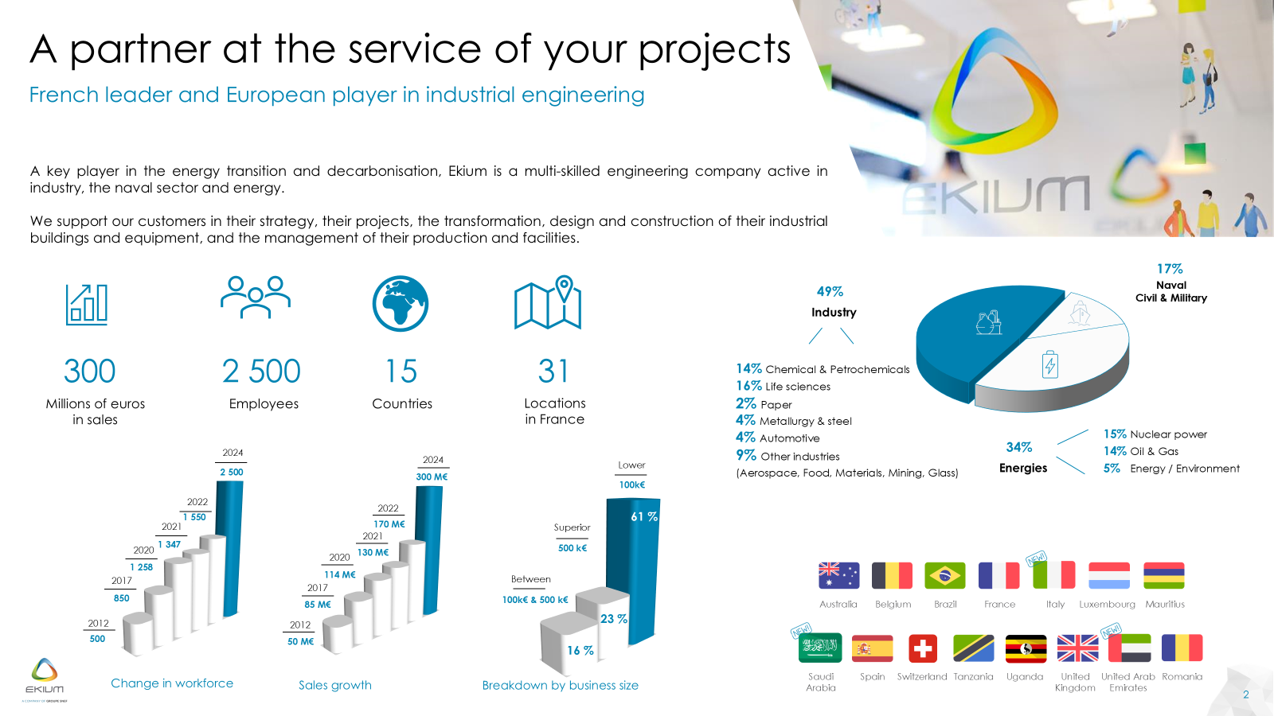

Slide 3
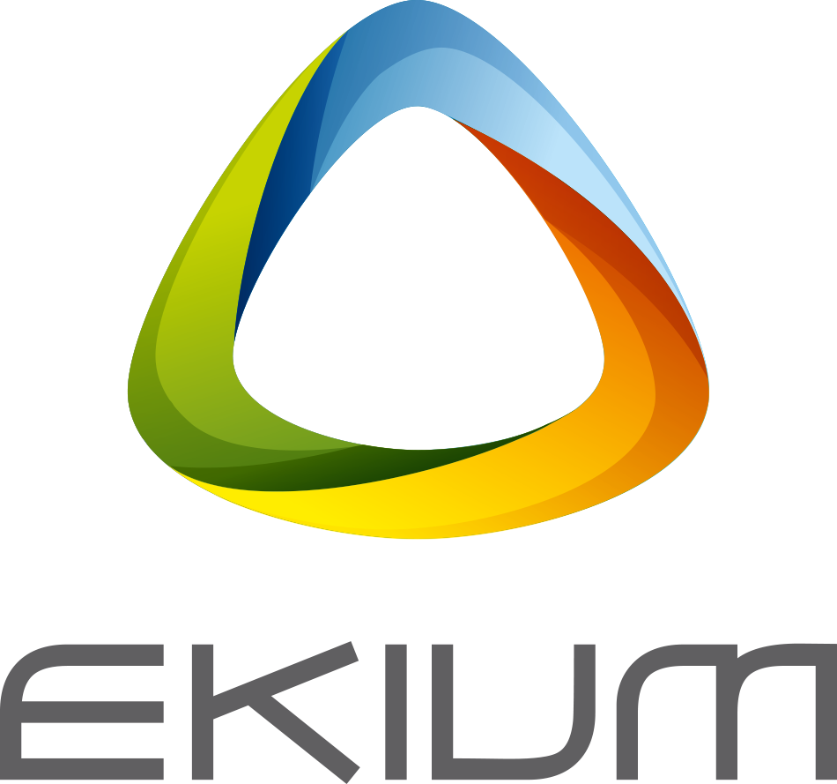
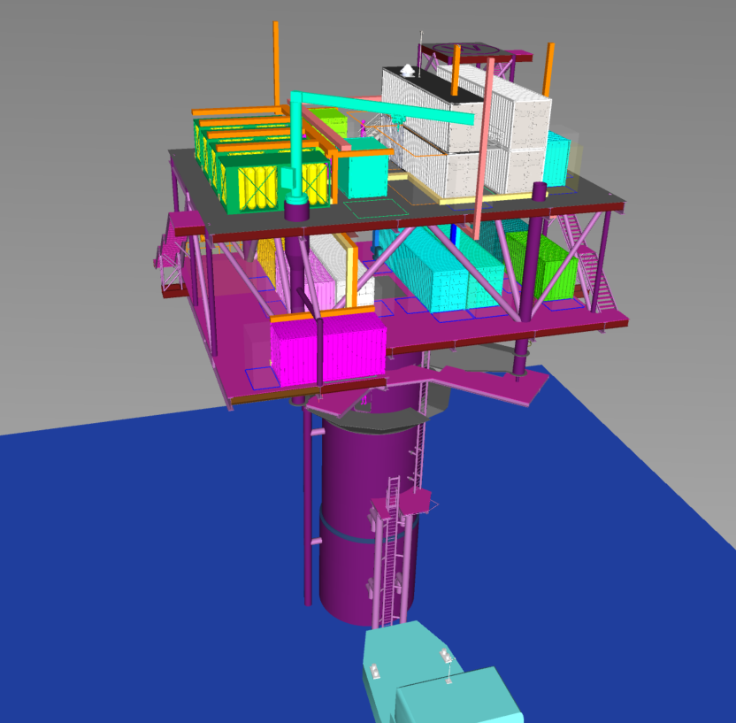
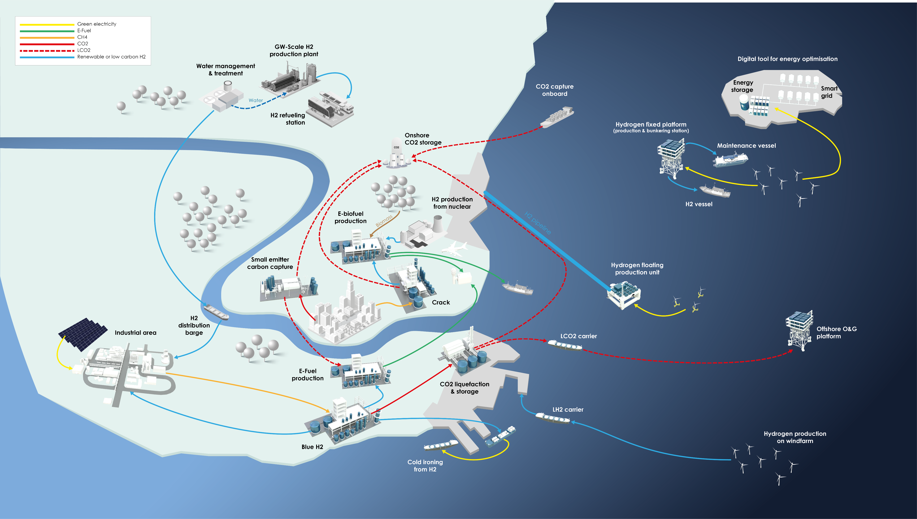
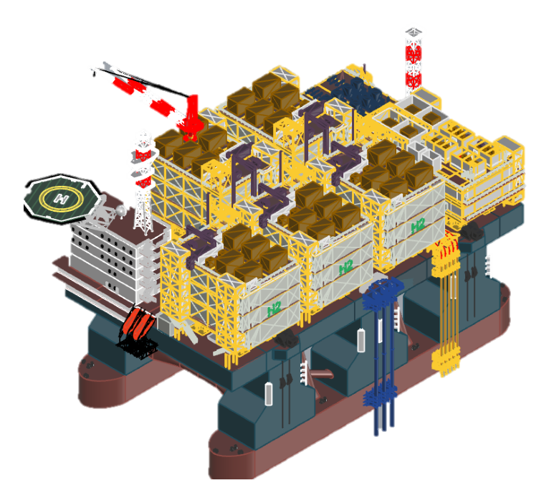
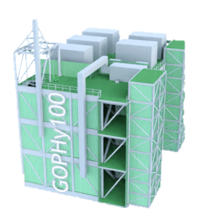
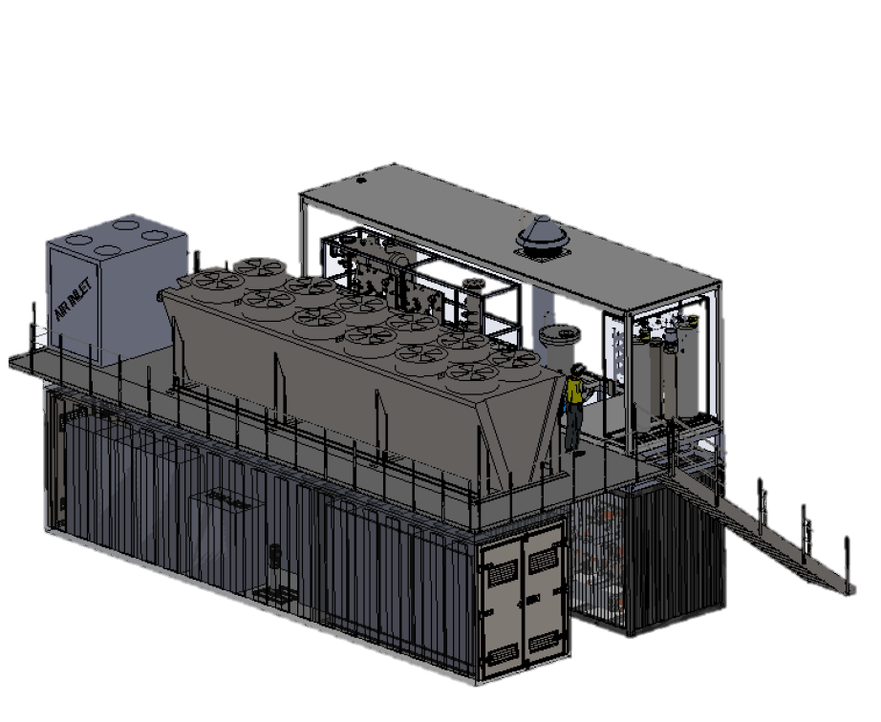
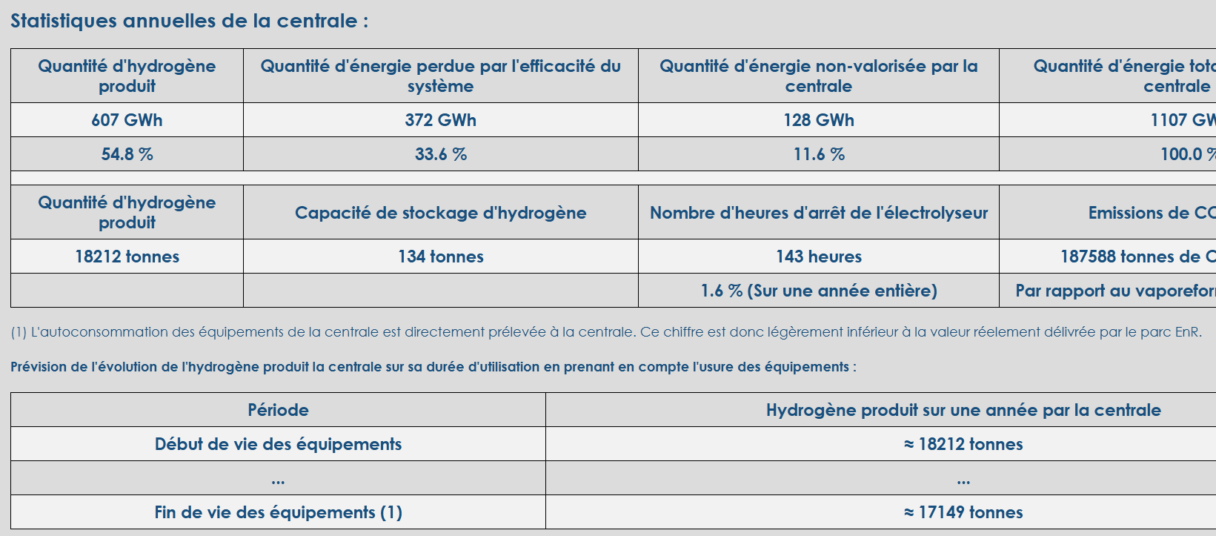
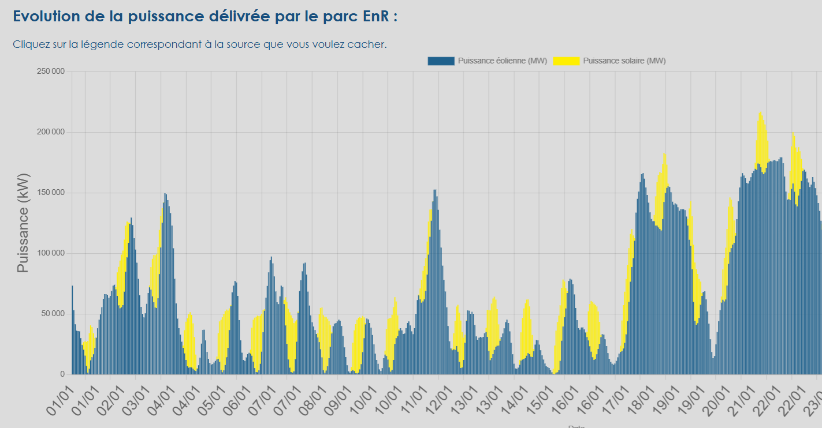
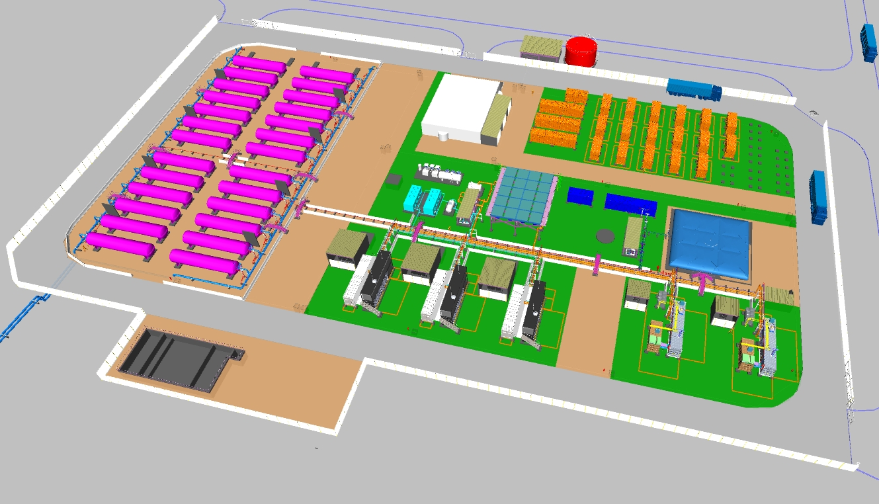
H2 & value chain : our expertise
Experienced teams
Electrolysers integration and balance of plant optimization, including water treatment and re-use
From 1,5 MW to 500 MW
References from small to massive renewable hydrogen production.
Systems’ knowledge
Storage and back-up facilities design required to guarantee the overall system functioning
Dynamic operation and grid support
Special attention was taken to topics related to energy intermittency management
Thermal Optimisation
Sensible to the plant’s overall efficiency, our designs are thermally optimised recovering and valorising waste heat

Slide 4
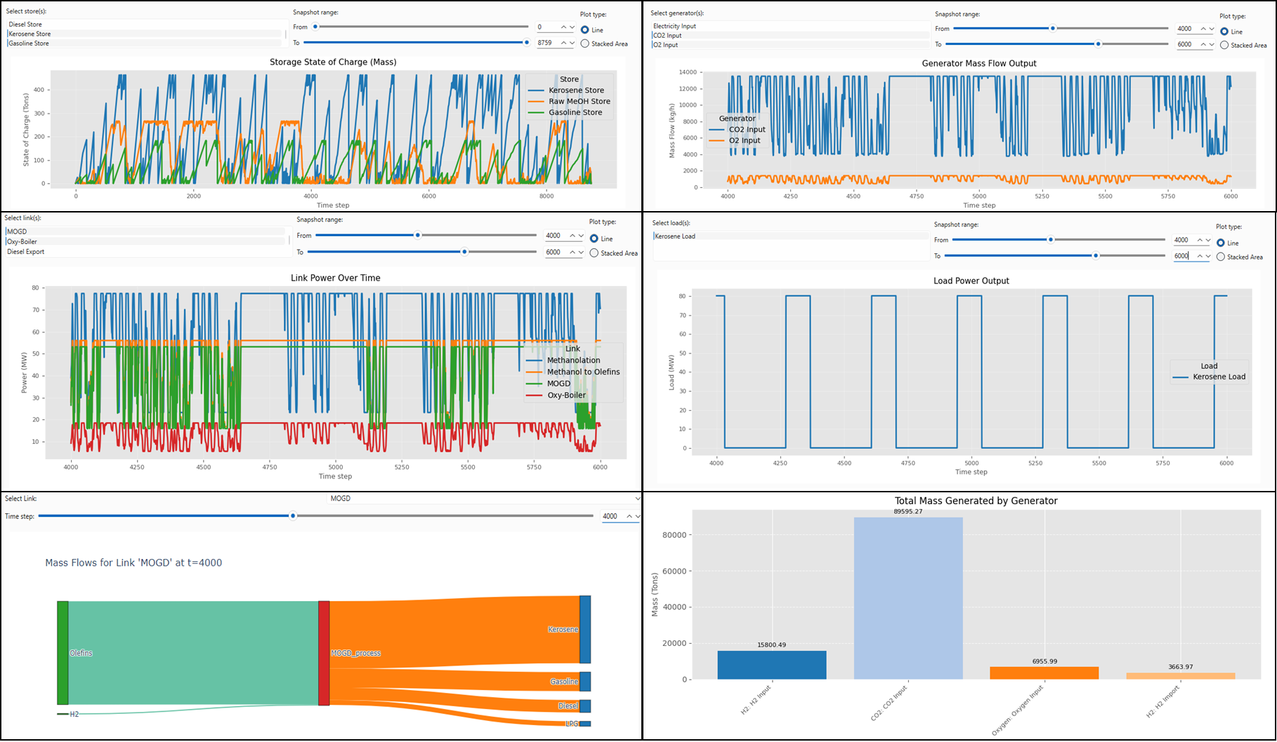
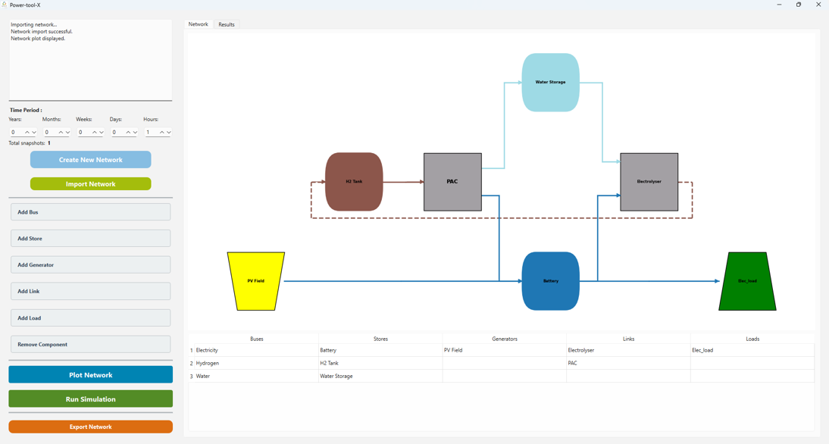
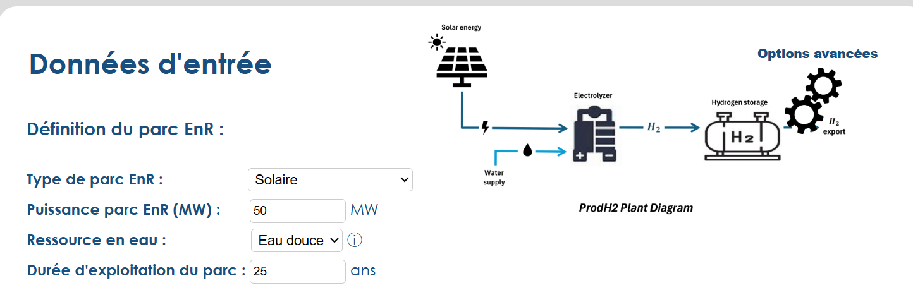
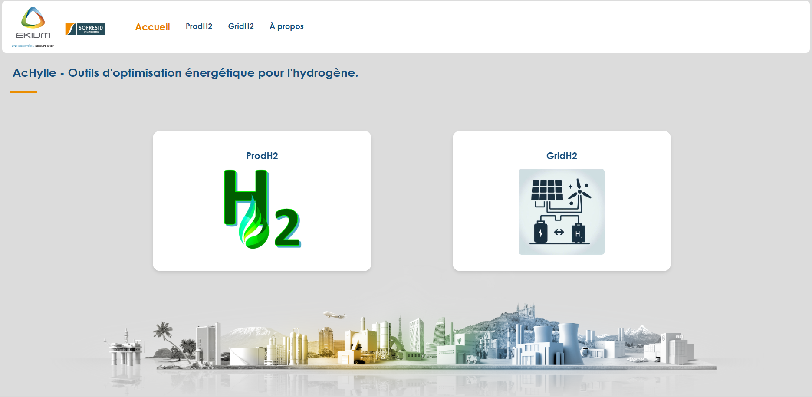
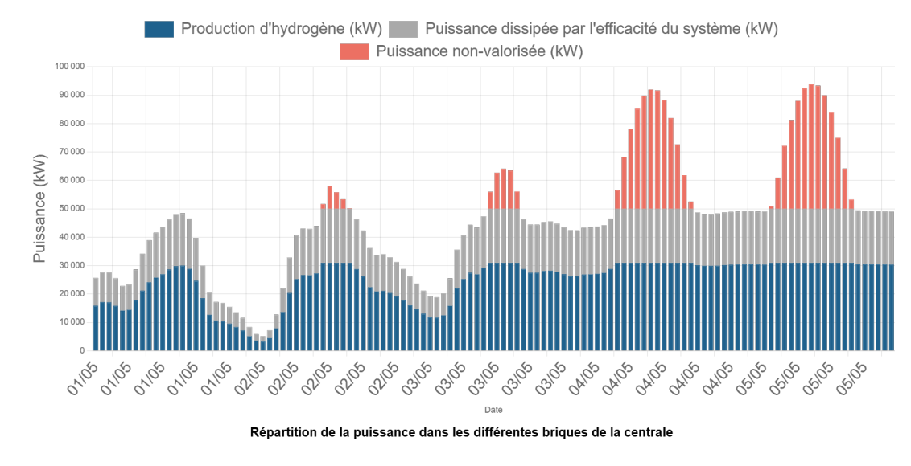
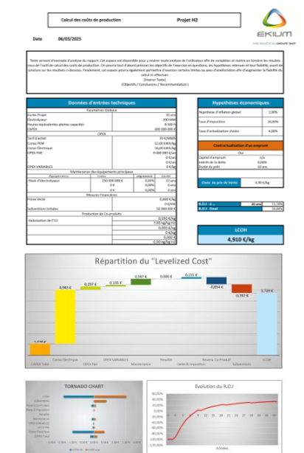
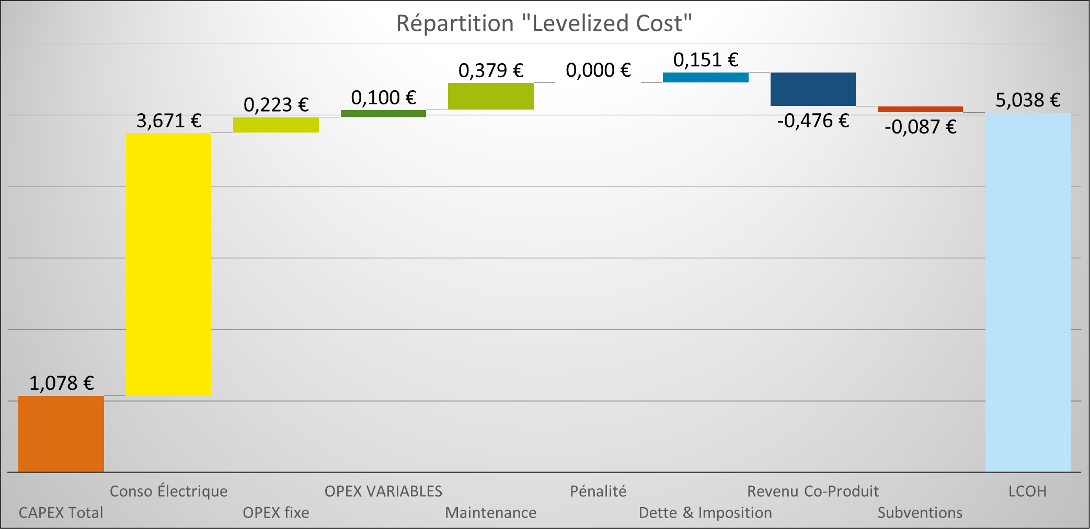
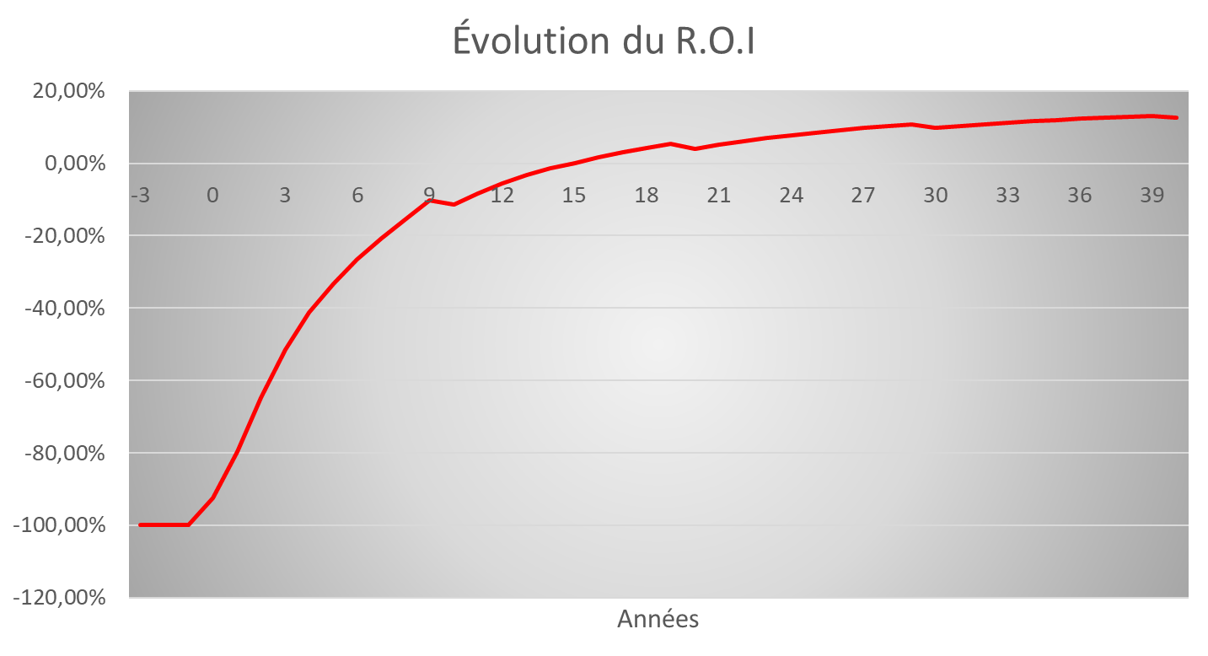
Tools development - Accelerating the energy transition
FALCON
Power-to-X
Multi-vector temporal modelling
Versatility / Optimisation / Scenarios
AcHYlle
H2 production
Intermittency simulation
H2 Grid Optimisation
Production / Storage / Renewable Energy
LCOX Tool
Detailed economic and financial analysis
Accuracy / Flexibility / R.O.I.

Slide 5
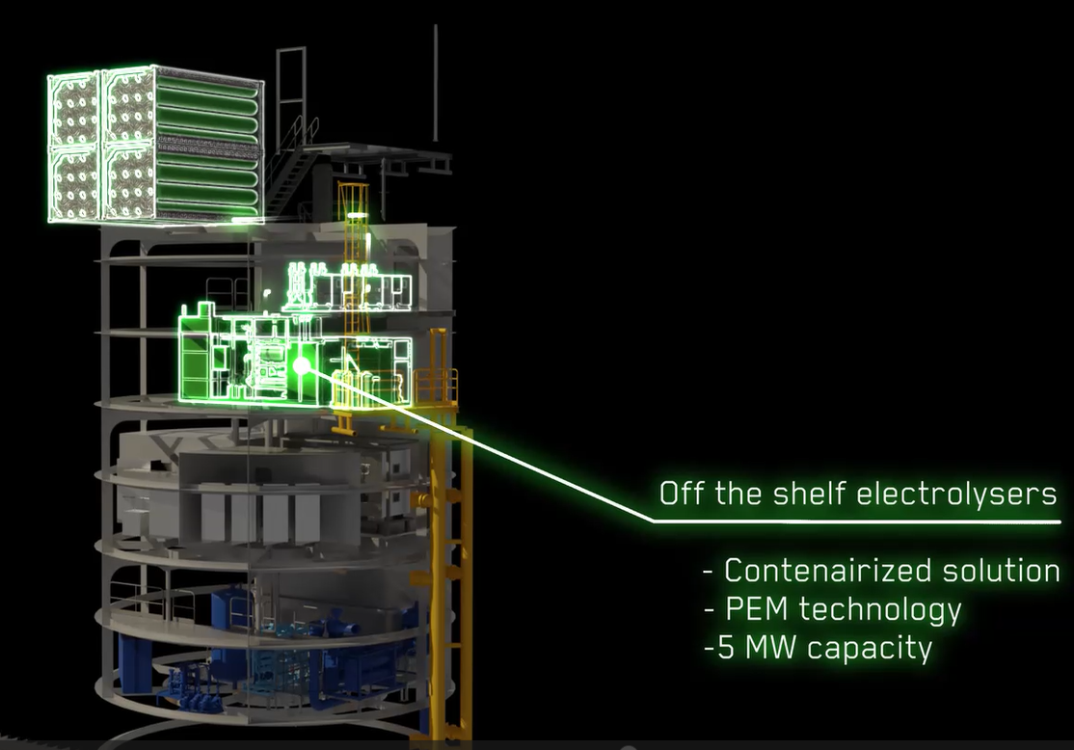
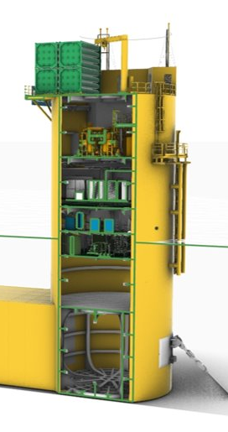
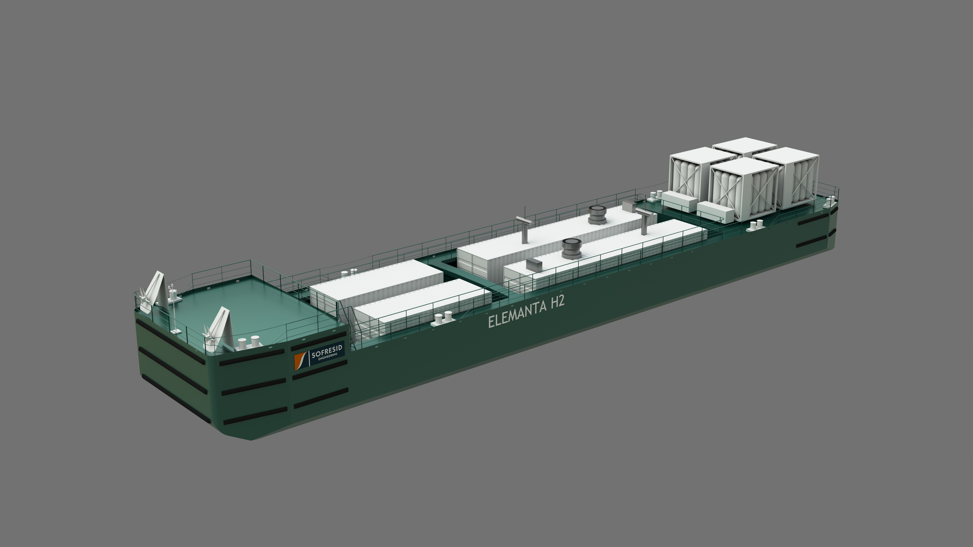
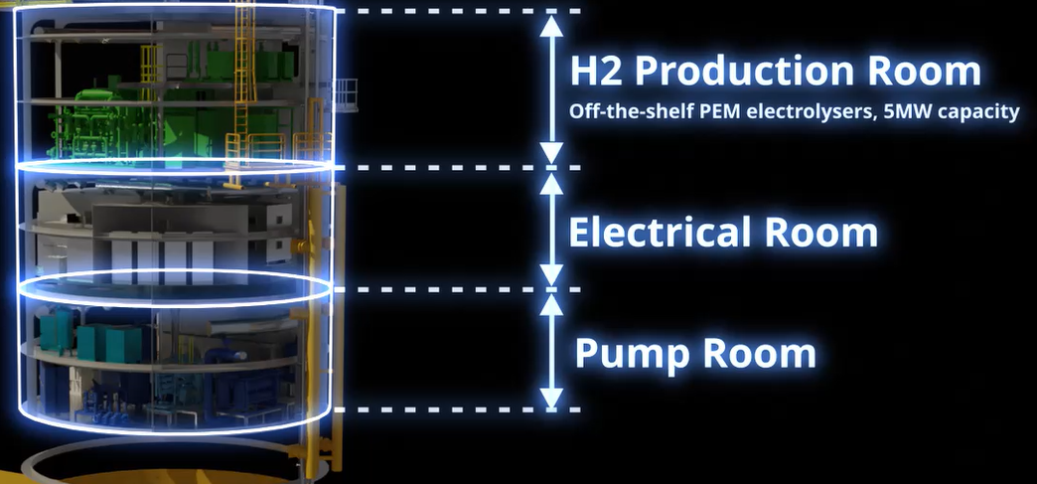
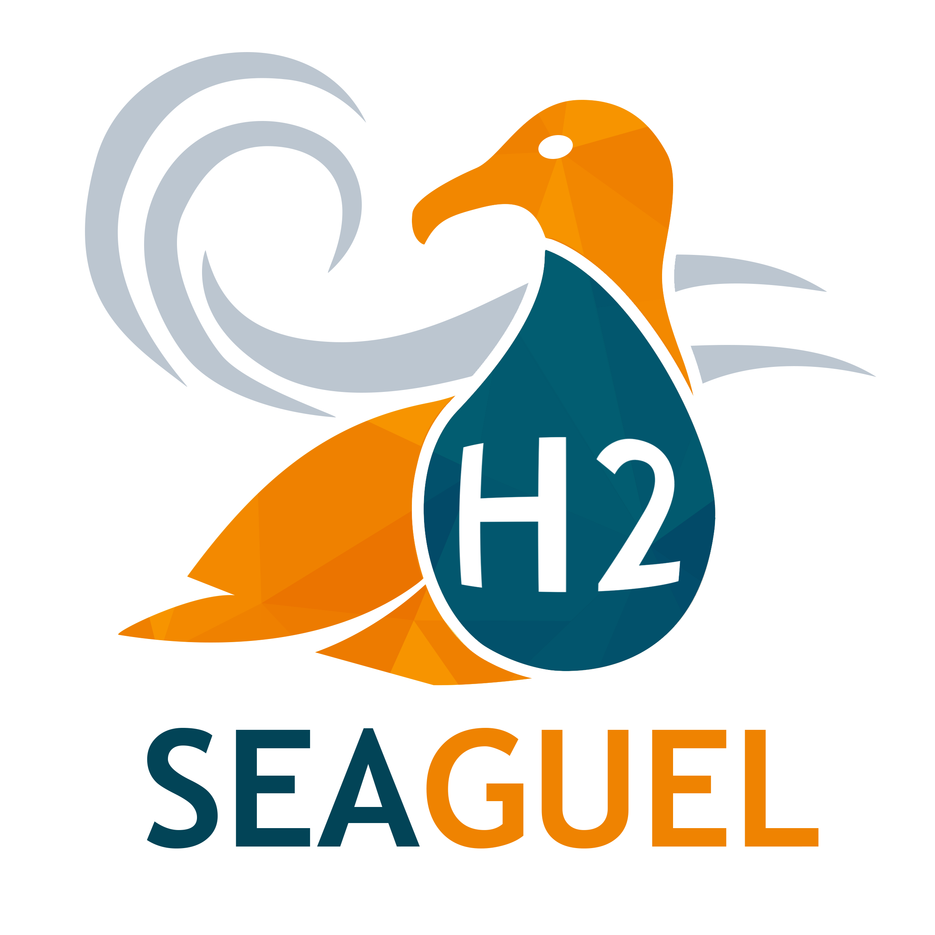
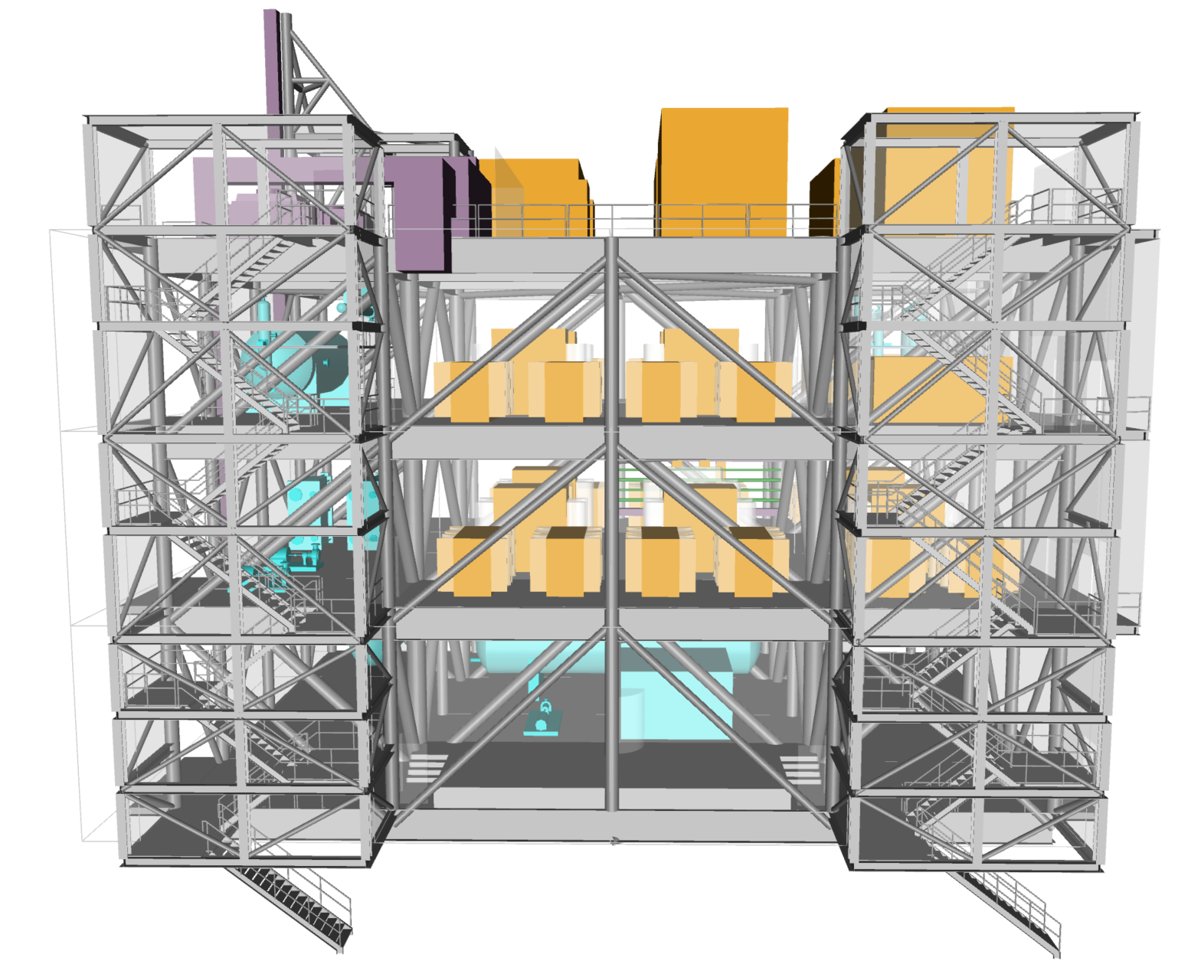
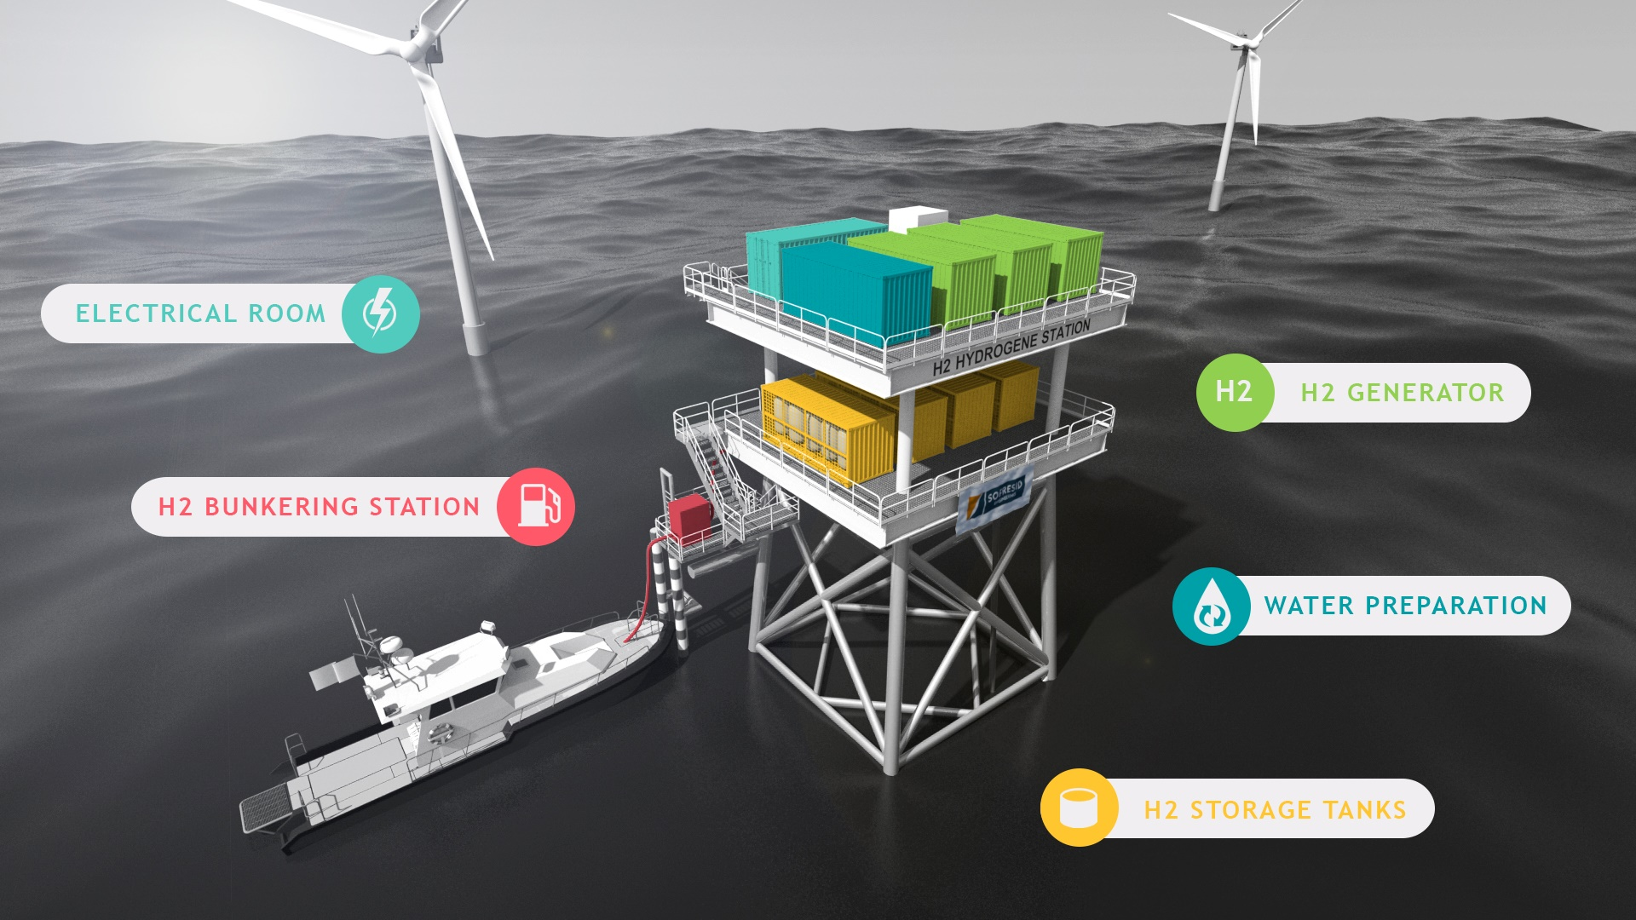
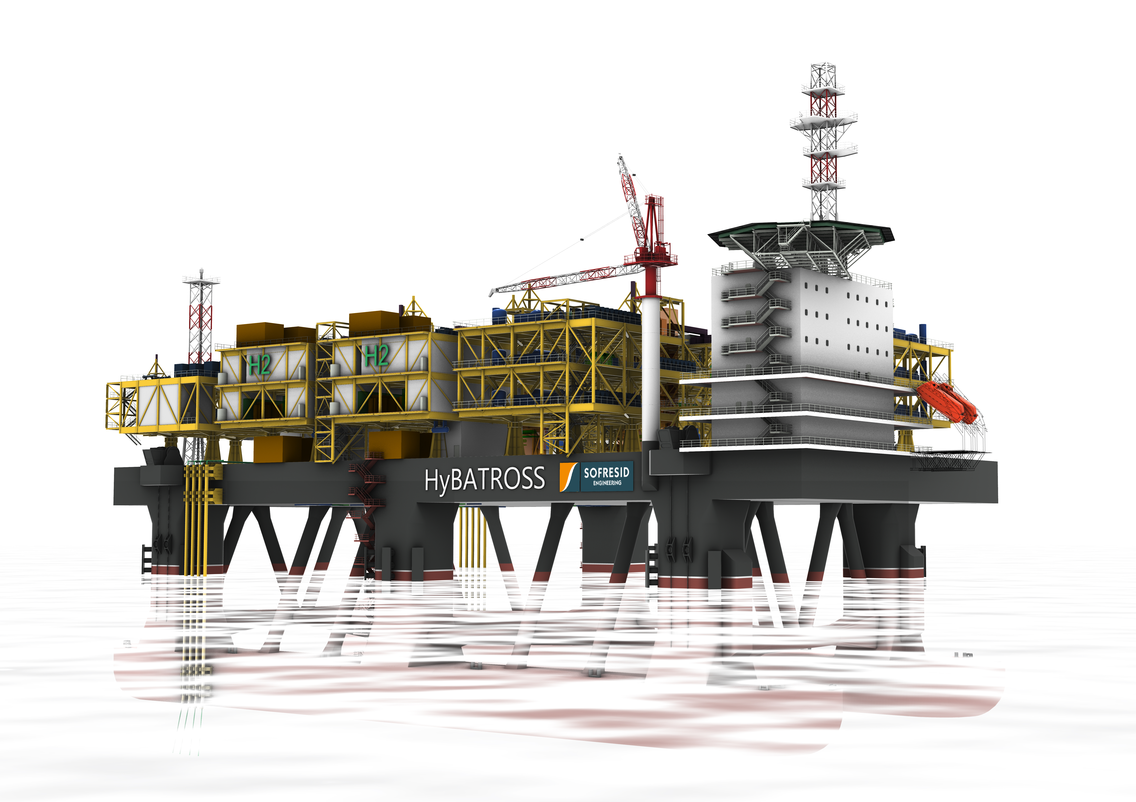
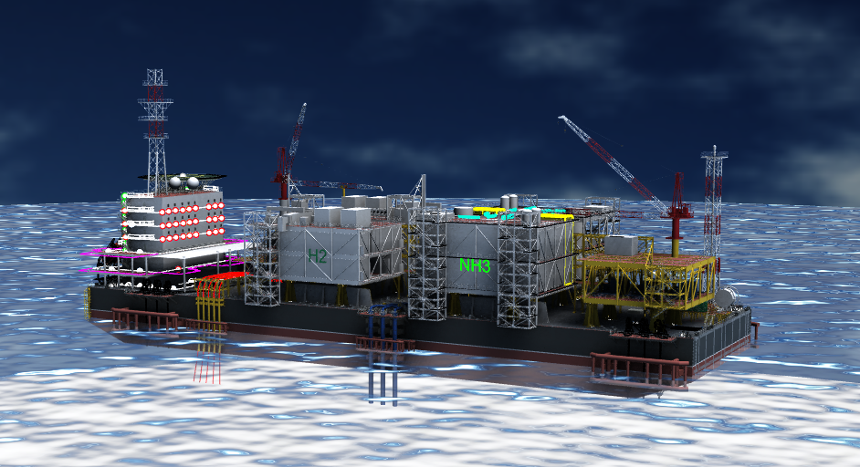
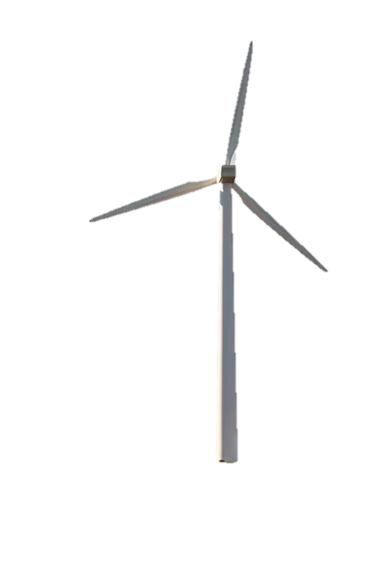
Renewable hydrogen – Offshore production & distribution
Hydrogen production on windfarm foundation
Multiservices vessel
Ship power at shore – electrification and decarbonisation of ports Floating modular product, including a common technical platform, on which various technological bricks are added – as required:
Electricity production from LNG, H2, NH3, methanol, e-fuels,... H2 production/storage/distribution Heat/cold/drinking water production Ballast water treatment
1.5MW H2 demonstrator project in Rouen
Conceptual designs for marinization and integration of 5MW PEM electrolysers and 1t H2 storage at 500bar
Optimized integration to reach a compact design - General arrangement, preliminary layouts
Safety review including HAZID
Cost estimation CAPEX / OPEX / LCOH
Elemanta® H2
Hydrogen distribution
Offshore H2 & NH3 massive production
Offshore production of renewable hydrogen on a floating asset with a modular 100-500MW approach: semi-submersible & FPU concepts 100MW PEM (GOPHY) Module Development: PEM Electrolyzers, Compression, Electrical Module, Water Treatment/Cooling, Export Current developments: direct electrolysis of seawater, production of different energy carriers (ammonia, methanol, LOHC/LIHC, etc...)
Production and distribution of low-carbon fuel to wind farm maintenance vessels (H2, NH3, e-fuel)
Development and integration of technological building blocks:
Seawater treatment Water Electrolysis Compression/Conversion H2 Storage Bunkering System
GOPHY
HyBATROSS ®

Slide 6
