Slide 1

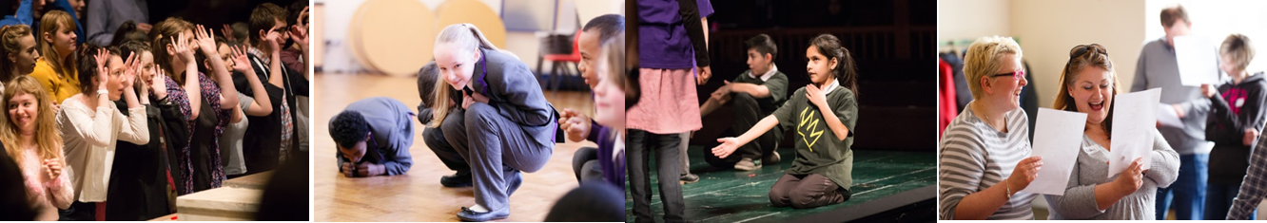
Notes:
Aims of ASP
Findings of our recent research project
Benefits of becoming an Associate School

Slide 2
The Associate Schools Programme
Transforming the teaching of Shakespeare to improve learning outcomes.
A network and community of teachers and senior leaders committed to an arts-rich education.
Open pathways from the classroom into training, leadership and talent development opportunities that increase the life choices of young people and help to diversify theatre audiences and workforce.
Build a robust evidence base that demonstrates the value of rehearsal room approaches to Shakespeare and cultural learning.
Notes:
Long-term partnership programme
Areas of structural disadvantage i.e. areas that are disadvantaged by the way resources are allocated.
15 theatres and 280 state maintained primary and secondary schools across England
Combination of Shakespeare’s work and RSC teaching approaches to improve learning outcomes for young people.

Slide 3
Practice
Embedding Rehearsal Room Approaches
Teacher Professional Development
Skill-sharing and networking
Cluster meetings
Further opportunities: Playmaking Festivals, First Encounters touring productions, Shakespeare Ambassadors student voice programme, Next Generation talent development pipeline
Notes:
Rehearsal Room Approaches
direct parallels between teaching and learning about Shakespeare in the classroom and the way that actors and directors work on a play in a rehearsal room
active and collaborative
viscerally and embodied engagement
make choices about the interpretation of plot, characters, themes and language of the play
Why?
breakthrough in Shakespeare positively impacts on language development, writing skills, self-esteem, raising aspirations, increasing life-chances.
Supports young people to build skills for life and work.

Slide 4
Partnership Clusters
32 partnership clusters:
Partnership of RSC, Lead Associate School/s and Associate Regional Theatre Partner (where applicable)
Approx. 280 schools and over 1000 teachers across England
Primary, secondary and specialist state funded schools and FE colleges in areas of structural disadvantage

Slide 5
Research: Time to Act
Randomised Control Trial (RCT)
45 primary schools​
Year 5 classes​
Classes were randomised into two groups: ​Intervention and Control
A Teacher-Research Network
Notes:
Independent Research Organisation since 2021
First performing arts organisation to have this status.
Dr Matthew Collins & Dr Lynsey McCulloch
RCT
Both groups tested before and after the intervention.
Intervention: 20 hours of Shakespeare teaching, using RSC teaching approaches, over Spring and Summer Terms 2023.
Control: teachers delivered their existing curriculum to Year 5 students. Receiving intervention in 2024.
Teacher Research Group
14 teachers across ASP
Focused on groups of children that were not meeting age-related expectations or who were at risk of not meeting their potential in other ways.

Slide 6
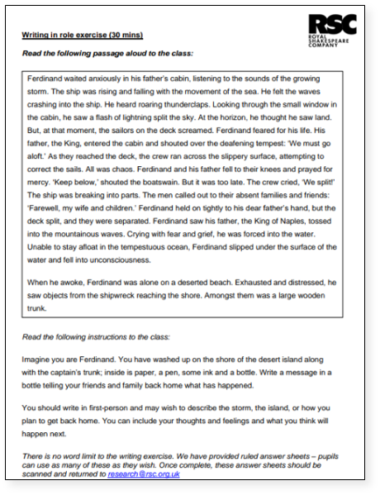
RCT: Measures
Writing Measure
Teacher Reflective Journal
Myself As a Learner Scale
Notes:
Writing Measure: writing in role as Ferdinand

Slide 7
RCT: Writing Measure
Richer, broader and more sophisticated vocabulary
13.8% more ‘sophisticated’ words.
24.3% higher use of rarer verbs.
Better grasp of linguistic structures and devices
20% more clauses within sentences and clauses at greater length.
18.9% greater use of complex sentences.
Were better at writing in character and expressing emotion
27.4% more words relating to emotion.
Broader understanding of abstract terms and descriptions
6.7% more abstract vocabulary (words relating to emotion, cognition and concepts outside of the physical world).
Notes:
Intervention group writing compared with control group writing
Significant improvements in language and written skills
Lexis (vocab), syntax (linguistic structures and devices) & semantics (meaning)

Slide 8
Randomised Control Trial
Teacher Reflective Journals emphasised:
Pupil engagement, trust and confidence
Demand for teaching resources
Changes to teacher professional identity
Myself as a Learner Scale:
17.3% more confident in their ability to work out what to do next when stuck
13.8% more confident with language
12.6% more confident in taking a considered approach to tackling work
11.3% more confident in their own ability as a good learner
9.9% more confident in wider problem-solving.
Notes:
Myself as a Learner
Greatest differences with regards to feelings towards agency and ability.

Slide 9
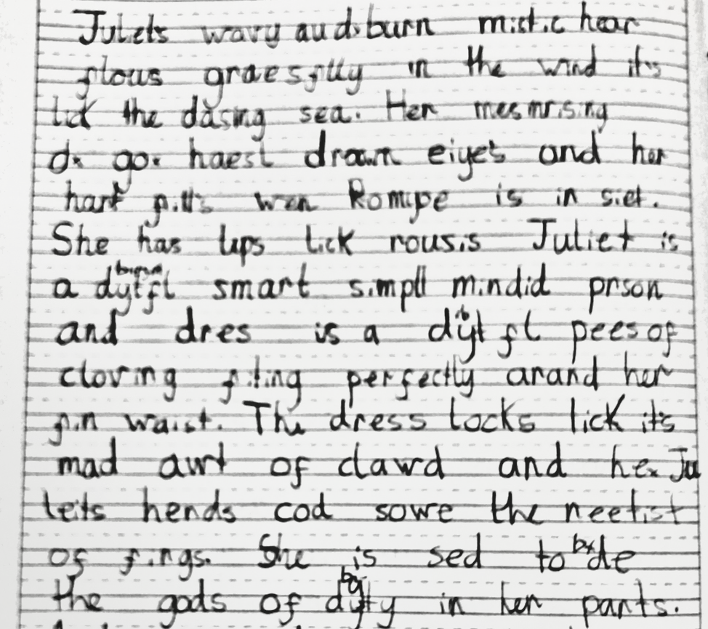
T
R
N
Teacher Research Network
Juliet's wavy auburn mystic hair flows gracefully in the wind. It's like the dashing sea. Her mesmerising honest brown eyes and her heart fill when Romeo is in sight. She has lips like roses. Juliet is a beautiful smart simple-minded person and her dress is a beautiful piece of clothing fitting perfectly around her thin waist. The dress looks like it's made out of cloud and Juliet's hands could sew the neatest of things. She is said to be the goddess of beauty in her parts. And when she giggles the whole world brightens up in her laughter and Juliet can shine like the god of music. When she dances, it’s like the stars are taking her to heaven. She is just perfect in everything and she loves to sing with the birds and Juliet loves to feed the squirrels in her free time. At parties the more he dances with grace the brighter the stars shine. By the break of day, she's still grooving, singing and dancing, not even breaking a sweat.
ORGINAL SCAN
CORRECTED SPELLING
Notes:
14 teachers across ASP
YP not meeting age-related expectations or otherwise at risk of not meeting their potential
Used existing measurement tools & new, inclusive measures
Impact of RSC approaches and Shakespeare’s language on literacy, wellbeing, and social and emotional development
Example from Jade from NPAT; Year 3 student

Slide 10

T
R
N
Teacher Research Network
Juliet's wavy auburn mystic hair flows gracefully in the wind. It's like the dashing sea. Her mesmerising honest brown eyes and her heart fill when Romeo is in sight. She has lips like roses. Juliet is a beautiful smart simple-minded person and her dress is a beautiful piece of clothing fitting perfectly around her thin waist. The dress looks like it's made out of cloud and Juliet's hands could sew the neatest of things. She is said to be the goddess of beauty in her parts. And when she giggles the whole world brightens up in her laughter and Juliet can shine like the god of music. When she dances, it’s like the stars are taking her to heaven. She is just perfect in everything and she loves to sing with the birds and Juliet loves to feed the squirrels in her free time. At parties the more he dances with grace the brighter the stars shine. By the break of day, she's still grooving, singing and dancing, not even breaking a sweat.
ORGINAL SCAN
CORRECTED SPELLING
Notes:
Emphasis on stand-out vocabulary and complex sentence structure.

Slide 11
What next?
Advocacy
Tools – Outcomes Framework
More Research – impact long-term
Notes:
Presented these findings at parliament, ACE, working with other agencies to urge change
Policymakers should recognise the impact of arts-rich education and embed in education policy and decision making
Developing assessment tool; allow schools to gather their own data
Measure more long-term effects
Break

Slide 12
Associate Schools – The Ask
Committed to engage with the programme for at least two years.
At least two nominated teachers that will lead the programme in their school.
Fully supported by senior management and school governors.
Attendance at CPDs, cluster meetings and involvement in cluster activities (which may include costs).

Slide 13
Benefits of Joining
A vibrant regional and national network
Embedded outcomes framework for measuring impact
Developing the teaching practice of Shakespeare in your school
Accessing unique opportunities for staff development
Working with RSC artists and learning practitioners
Taking part in local and national performance festivals and other events celebrating the creativity of young people
Talent development & youth leadership

Slide 14
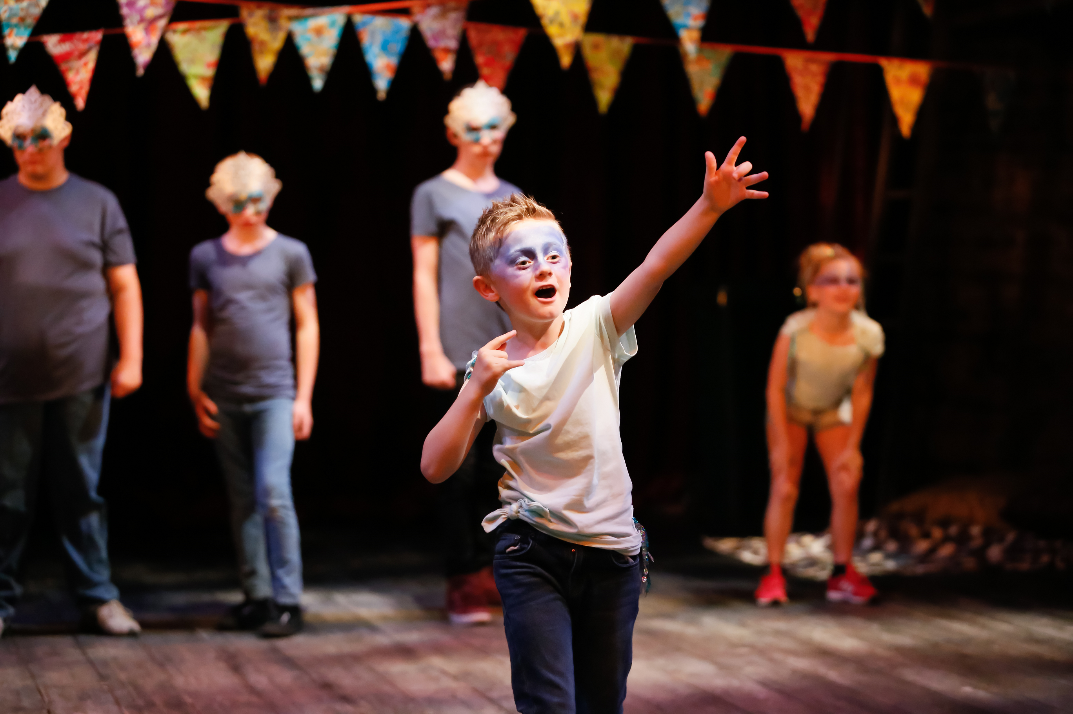

Slide 15
More information www.rsc.org.uk/learn/associate-schools-programme www.rsc.org.uk/learn/research associate.schools@rsc.org.uk

Slide 16
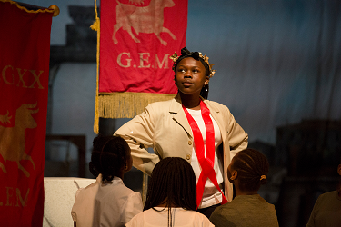
The Role of a Lead Associate School

