Slide 1
XYZ Company
Change all Red text on this slide to Navy before presenting
Date
[Presenter Name]
GUARDIAN® is a registered service mark of The Guardian Life Insurance Company of America®. ©Copyright 2022 The Guardian Life Insurance Company of America. 2022-139974 (07/24)

Slide 2
XYZ Company
Change all Red text to White on this slide before presenting
Date
[Presenter Name]
GUARDIAN® is a registered service mark of The Guardian Life Insurance Company of America®. ©Copyright 2022 The Guardian Life Insurance Company of America. 2022-139974 (07/24)

Slide 3
Guardian benefits available to you as an employee of [XYZ company]:
[Dental Insurance] [Dental Plan]
[Vision Insurance]
[Life Insurance]
[Disability Insurance][[Short Term Disability Insurance][Long Term Disability Insurance]
[Critical Illness Insurance] [Specified Disease Insurance]
[Accident Insurance]
[Cancer Insurance]
[Hospital Indemnity Insurance] [Accident and Sickness Indemnity Insurance]

Slide 4
Guardian benefits available to you as an employee of [XYZ company]:
Dental
Long Term Disability
Short Term Disability
Vision
Life
Accident
Cancer
Critical Illness
Hospital Indemnity

Slide 5
Behind every bright future is a GuardianTM
years of experience protecting families with insurance solutions
160+
As one of the largest mutual insurance companies, we know what matters most: putting the needs of our customers first.
Serving 29 million customers*
29
Fortune 250 company with a strong foundation
250
* Guardian internal reporting, 2022

Slide 6
Dental Insurance from Guardian can help protect your health
Quality Care, Choice, and Cost Savings
Provides access to one of the nation’s largest dental networks
Can save you money if you use a Guardian in-network dentist
Helps protect your health with quality preventive care
Helps pay for more extensive and often unexpected expenses such as fillings, crowns, and root canals

Slide 7
Save with Guardian Dental Insurance
Cost of dental work with Guardian insurance using an in-network dentist vs. without Guardian dental insurance.
Average cost of a root canal, associated dental work, and a crown¹
Guardian makes it easy
No ID cards needed [Remove bullet in NM]
Quick and easy claims payments
Convenient payroll deduction
Most plans cover 100% of preventive care costs
Cost with no dental insurance | Your in-network cost with Guardian Dental Insurance | Your estimated savings with Guardian Dental Insurance
$2,400 | $1,600 | $800
1For Illustrative purposes only. Covered benefits and benefit amounts may vary by employer-sponsored plan. See your plan for specific coverage amounts.

Slide 8
Your Guardian PPO Dental Plan
[Network Name] | In-Network | Out-of-Network
Plan Year Deductible: Individual Family Limit Waived for | [$XX] [X per family] [Preventive] | [$XX] [X per family] [Preventive]
Charges covered for you (co-insurance): Preventive Care (e.g. cleanings) Basic Care (e.g. fillings) Major Care (e.g. crowns, dentures) Orthodontia | [XX%] [XX%] [XX%] [XX%] | [XX%] [XX%] [XX%] [XX%]
Annual Maximum Benefit | [$X,XXX] | [$X,XXX]
Maximum Rollover Rollover Threshold Rollover Amount Rollover In-network Amount Rollover Account Limit | [Yes] [$X,000] [$X,000] [$X,000] [$X,000] | [Yes] [$X,000] [$X,000] [$X,000] [$X,000]
Lifetime Orthodontia Maximum | [$X,XXX] | [$X,XXX]
Dependent Age (Non-student/student) | To age [XX] | To age [XX]

Slide 9
Your Guardian Dental PPO Plan Options
DentalGuard Preferred Network | Option 1: Value Plan |  | Option 2: NAP Plan
Calendar Year Deductible | In-Network | Out-of-Network | In-Network | Out-of-Network
Individual Family Limit Waived for | [$XX] [X] per family [Preventive] | [$XX] [X] per family [Preventive] | [$XX] [X] per family [Preventive] | [$XX] [X] per family [Preventive]
Co-Insurance Preventive Care (e.g., cleanings) Basic Care (e.g., fillings) Major Care (e.g., crowns, dentures) | [XXX%] [XX%] [XX%] | [XXX%] [XX%] [XX%] | [XXX%] [XX%] [XX%] | [XXX%] [XX%] [XX%]
Annual Maximum Benefit | [$X,XXX] | [$X,XXX] | [$X,XXX] | [$X,XXX]
Dependent Age (Non-Student/Student) | To age [XX] | To age [XX] | To age [XX] | To age [XX]

Slide 10
Your Guardian Dental PPO Plan Options
DentalGuard Preferred Network | Option 1: NAP Plan |  | Option 2: Value Plan
Calendar Year Deductible | In-Network | Out-of-Network | In-Network | Out-of-Network
Individual Family Limit Waived for | [$XX] [X] per family Preventive | [$XX] [X] per family Preventive | [$XX] [X] per family Preventive | [$XX] [X] per family Preventive
Co-Insurance Preventive Care (e.g., cleanings) Basic Care (e.g., fillings) Major Care (e.g., crowns, dentures) Orthodontia | [XXX%] [XX%] [XX%] [XX% | [XXX%] [XX%] [XX%] [XX%] | [XXX%] [XX%] [XX%] [XX%] | [XXX%] [XX%] [XX%] [XX%]
Annual Maximum Benefit | [$X,XXX] | [$X,XXX] | [$X,XXX] | [$X,XXX]
Lifetime Orthodontia Maximum (Children) | [$X,XXX] | [$X,XXX] | [$X,XXX] | [$X,XXX]
Dependent Age (Non-Student/Student) | To age [XX] | To age [XX] | To age [XX] | To age [XX]

Slide 11
Your Guardian PPO Dental Plan
For Tiered Dental Plans Only – for 2 Tiers
Dental Plan | Tier 1 Coverage | Tier 2 Coverage
DentalGuard Preferred Network | For DG6 plans: [Gold][Gold, Silver] For DG7 plans: [Elite, Connect] | DG6 plans: [Silver, Out of Network][Out of Network] For DG7 plans: [Out of Network]
Calendar year Deductible | [$XXX] | [$XXX]
Individual Family Limit Waived for | [$XX] [X per family] [Preventive]
Charges covered for you (co-insurance): Preventive Care (e.g. cleanings) Basic Care (e.g. fillings) Major Care (e.g. crowns, dentures) Orthodontia | [XX%] [XX%] [XX%] [XX%] | [XX%] [XX%] [XX%] [XX%]
Annual Maximum Benefit | [$X,XXX] (applies to all levels)
Maximum Rollover Rollover Threshold Rollover Amount Rollover In-network Amount Rollover Account Limit | [Yes] [$X,000] [$X,000] [$X,000] [$X,000]
Lifetime Orthodontia Maximum | [$X,XXX]
Dependent Age (Non-student/student) | To age [XX]

Slide 12
Get the ‘Maximum’ from Your Dental Benefits
Max Rollover Feature
Here is an example of how the Maximum Rollover feature works¹
Guardian rolls over a portion of your unused annual maximum into your Maximum Rollover Account (MRA)
To qualify you must have one visit with a paid claim and must not have exceeded the paid claims threshold
Your MRA may not exceed the MRA limit.
Plan Annual Maximum² | Threshold | Maximum Rollover Amount | Maximum Rollover Account Limit
$X,XXX | $X,XXX | $X,XXX | $X,XXX
Maximum Claims Reimbursements | Claims amount that determines rollover eligibility | Additional dollars added to Plan Annual Maximum for future years | Plan Annual Maximum plus Maximum Rollover cannot exceed $X,XXX in total
Year 1
Year 2
Year 3
1 For illustrative purposed only. Covered benefits and benefit amounts may vary by employer-sponsored plan. See your plan for specific coverage amounts. 2 If a plan has a different annual maximum for PPO benefits vs non-PPO benefits, ($1500 PPO/$1,000 non-PPO for example) the non-PPO maximum determines the Maximum Rollover plan.

Slide 13
Get the ‘Maximum’ from Your Dental Benefits
Max Rollover Feature – with an In-Network Rollover
Here is an example of how the Maximum Rollover feature works¹
Guardian rolls over a portion of your unused annual maximum into your Maximum Rollover Account (MRA)
To qualify you must have one visit with a paid claim and must not have exceeded the paid claims threshold
Your MRA may not exceed the MRA limit.
Plan Annual Maximum² | Threshold | Maximum Rollover Amount | In-Network Only Rollover Amount | Maximum Rollover Account Limit
$X,XXX | $X,XXX | $X,XXX | $X,XXX | $X,XXX
Maximum Claims Reimbursements | Claims amount that determines rollover eligibility | Additional dollars added to Plan Annual Maximum for future years | Additional dollars added to Plan Annual Maximum for future years if only In-Network providers were used during the benefit year | Plan Annual Maximum plus Maximum Rollover cannot exceed $X,XXX in total
Year 1
Year 3
Year 2
Year 4
1 For illustrative purposed only. Covered benefits and benefit amounts may vary by employer-sponsored plan. See your plan for specific coverage amounts. 2 If a plan has a different annual maximum for PPO benefits vs non-PPO benefits, ($1500 PPO/$1,000 non-PPO for example) the non-PPO maximum determines the Maximum Rollover plan.

Slide 14
It’s easy to use your Guardian dental benefits
No ID cards needed
Simply provide your Group ID number at your first office visit: [XXXXXX]
Or, access your ID card online:
Mobile App: Download Guardian’s Provider and ID Card app to your mobile phone or tablet
Online: Go to guardianlife.com and select Register & Login, then access your ID card in the Forms and Materials section

Slide 15
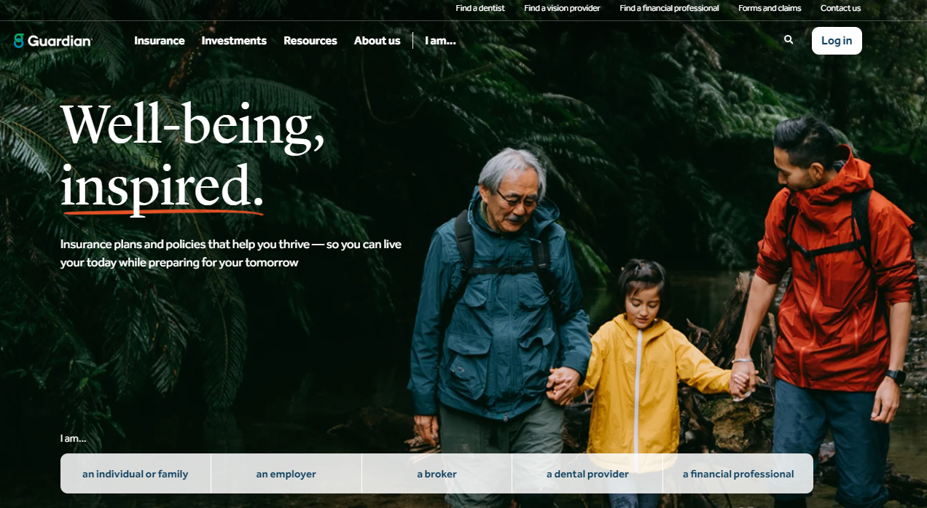
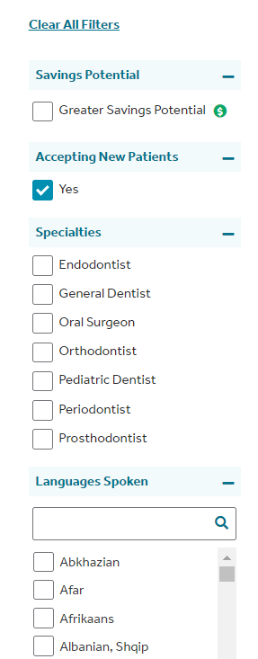
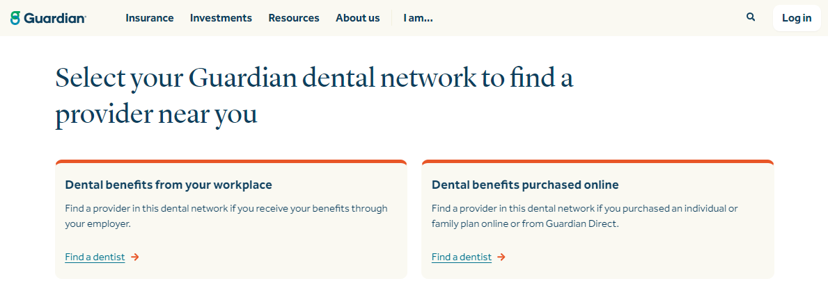
How to Find a Dental Provider
1
4
Smile. Finding a dentist in the Guardian network is easy.
Go to guardianlife.com and click “Find a dentist”
Under “Dental benefits from your workplace” click “Find a dentist”
Search for a dentist in your area
Select the Plan Type
Enter your search parameters
Customize your search by distance, specialty, and language spoken
[Include for Tiered Dental Plans only: Click on “Greater Savings Potential to sort the providers who offer the largest discount]
[To find dentists in Mexico, scroll to the bottom of the “Find a Provider” page and click the following link: For dentists in Mexico, download a directory]
2
3
Away from your computer? No problem.
Download the GUARDIAN® Providers & ID Card app to your mobile phone or tablet and find a dentist on the go. Visit guardianlife.com to download the app.

Slide 16
Why do you need Vision insurance?
Keep an eye on your vision health and savings
Regular vision exams can detect major medical problems, such as¹:
Glaucoma
Diabetes
High blood pressure
Increased stroke risk
Pays for services and eyesight correction that medical insurance plans don’t typically cover
Covers preventive care like routine eye wellness exams and retinal screenings
Provides discounts on new eyeglasses, contact lenses, and corrective surgery like Lasik
¹ American Academy of Ophthalmology, 20 Surprising Health Problems an Eye Exam Can Catch, https://www.aao.org/eye-health/tips-prevention/surprising-health-conditions-eye-exam-detects, 2020.

Slide 17
It’s easy with Guardian Vision insurance
Providing everyone in the family with quality eye care
For just a few dollars a month, you get affordable coverage that saves you time and money
[No ID cards needed] [Remove for NM]
Convenient payroll deductions
A strong nationwide network of providers, including retail locations such as Costco, Walmart, and Visionworks

Slide 18
Your Guardian Vision Plan - [Avesis][VSP][Davis] Network
Covered Services: | In-Network | Out-of-Network
Office Visit Copay | [$XX] | Amount over up to [$XX]
Materials Copay | [$XX] | You pay based on a schedule – see your kit for details
Frames | [XX% of amount over $XX] | Amount over up to [$XX]
Costco Frame Allowance | [$XX] | Not applicable
Elective Contact Lenses (In lieu of frames and lenses) | [Amount over $XX] | Amount over up to [$XX]
Contact Lenses (Medically Necessary* with prior approval) | [$XX] | Amount over up to [$XX]
Contact Lenses (Fitting and Evaluation) (if included in the plan) | [XX%] off UCR | Not Applicable
Laser Correction Surgery Discount | Average [0%] discount | Not applicable
Service Frequencies:
Exams | [Insert frequency] | [Insert frequency]
Lenses | [Insert frequency] | [Insert frequency]
Frames | [Insert frequency] | [Insert frequency]
NOTE: Insert appropriate frequency in chart above for Exams/ Lenses/Frames:
[Every calendar year][Every 2 calendar years][Every 12 months][Every 24 months]
DELETE THIS BOX ONCE DONE

Slide 19
Your Guardian Vision Plan Choices –[VSP and Davis Vision]
Plan Choices: | [VSP Vision] |  | [Davis Vision] | Out of network
Covered Services: | In-Network | Out-of-Network | In-Network | Out-of-Network
Office Visit Copay | [$XX] | Amount over up to [$XX] | [$XX] | Amount over up to [$XX]
Materials Copay | [$XX] | You pay based on a schedule – see your kit for details | [$XX] | You pay based on a schedule – see your kit for details
Frames | [XX% of amount over $XX] | Amount over up to [$XX] | [XX% of amount over $XX] | Amount over up to [$XX]
Costco Frame Allowance | [$XX] | Not applicable | [$XX] | Not applicable
Elective Contact Lenses (In lieu of frames and lenses) | [Amount over $XX] | Amount over up to [$XX] | [Amount over $XX] | Amount over up to [$XX]
Contact Lenses (Medically Necessary* with prior approval) | [$XX] | Amount over up to [$XX] | [$XX] | Amount over up to [$XX]
Contact Lenses (Fitting and Evaluation) (if included in the plan) | [XX%] off UCR | Not Applicable | [XX%] off UCR | Not Applicable
Laser Correction Surgery Discount | Average [0%] discount | Not applicable | Average [0%] discount | Not applicable
Service Frequencies:
Exams | [Insert frequency] | [Insert frequency] | [Insert frequency] | [Insert frequency]
Lenses | [Insert frequency] | [Insert frequency] | [Insert frequency] | [Insert frequency]
Frames | [Insert frequency] | [Insert frequency] | [Insert frequency] | [Insert frequency]
NOTE: Insert appropriate frequency in chart above for Exams/ Lenses/Frames:
[Every calendar year][Every 2 calendar years][Every 12 months][Every 24 months]
DELETE THIS BOX ONCE DONE

Slide 20
How to use your Guardian vision [and dental] benefits
Use in all states except NM
No ID Cards needed
Simply provide your Group ID number at your first office visit: [XXXXXX]
Or, access your ID card online:
Mobile App: Download Guardian’s Provider and ID Card app to your phone or tablet.
Online: Go to guardianlife.com and select “Log in.” From the homepage you can access your ID card.
Enrollment | Client Name

Slide 21
How to use your Guardian vision [and dental] benefits
Use this slide in NM –
ID Cards are required
Access your ID card online
Mobile App: Download Guardian’s Provider and ID Card app to your phone or tablet.
Online: Go to guardianlife.com and select “Log in.” Once logged in to your Guardian account, click “View all” to view, print or download your ID card.
Enrollment | Client Name

Slide 22
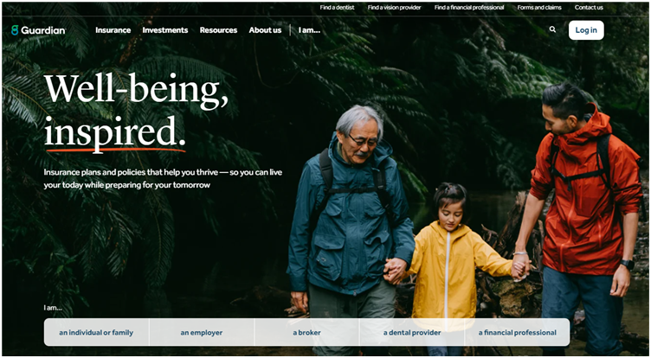
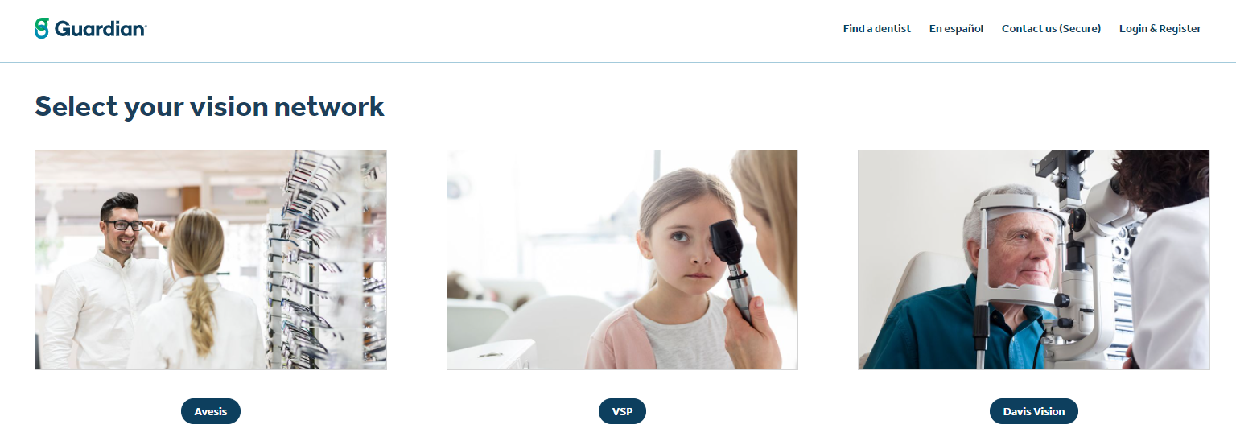
How to Find a Vision Provider
2
Finding a vision provider in the Guardian network is easy
1
Go to guardianlife.com
Click “ Find a vision provider”
Select your vision network
Enter your search parameters
Follow the directions for a list of vision providers convenient to you
3
Away from your computer? No problem.
Download the Guardian Provider app for your phone or tablet and find a vision provider on the go. Visit guardianlife.com to download the app.

Slide 23
Life Insurance
Products and options – designed to promote accessibility and flexibility
Guardian’s Group Life Insurance is underwritten and issued by The Guardian Life Insurance Company of America, New York, NY. Products are not available in all states. Policy limitations and exclusions apply. Optional riders and/or features may incur additional costs. If there is a discrepancy between this document and the Certificate/Group Policy issued by The Guardian Life Insurance Company of America, the Group Policy will govern. Guardian, its subsidiaries, agents, and employees do not provide tax, legal, or accounting advice. Consult your tax, legal, or accounting professional regarding your individual situation. GUARDIAN® is a registered service mark of The Guardian Life Insurance Company of America®. ©Copyright 2022 The Guardian Life Insurance Company of America. Generic Policy Form # GP-1-LIFE-15. The state approved form is the governing document. For NY, the Policy Form No. is GP-1-LIFE-12-NY.
2022-147635 [Exp 12/24]

Slide 24
Why do you need Life Insurance?
Smart, affordable protection for you and your family
Provides a benefit to help pay expenses and provide financial protection for those who depend on you.
Can cover things like mortgage, legal, medical fees, childcare, education, and outstanding debts.
Three unique benefits only life insurance provides:
- Paid directly to your beneficiaries
- Generally, not subject to income taxes*
- The value is not affected by market conditions
Flexible coverage that you can update as your life changes.
*Life insurance death benefit is generally not subject to income taxes.

Slide 25
How much Life Insurance protection do you need?
Guardian makes it easy!
Simplified enrollment and affordable group coverage
Convenient payroll deduction
[Available for [spouse] [and] [children]
Take the coverage with you if you leave your current employer
A general guideline is to have a policy equal to seven to ten times your annual salary*:
=
X
7-10 Years
Annual Salary
Policy Amount
*This is Guardian's Rule of Thumb based on experience and may not apply universally to every individual and their unique set of circumstances.

Slide 26
Your Life Insurance options
 | [Employer-paid/ Basic Life] | [Employee-paid/ Voluntary Term Life]
Employee Benefit | [$XX or X salary] | [$XK increments to a max of $XX][X salary to a max of $XX] [$XX with no health questions*] [You have a [special] opportunity to enroll with no health questions.*]
[Spouse Benefit] | [$XX] | [$XK increments to a max of $XX or XX% of employee] XX% of employee] [$XX with no health questions*]
[Child(ren) benefit] [To age XX, XX if full-time student] | [$XX] | [$XK increments to a max of $XX or XX% of employee] [XX% of employee] [$XX with no health questions*]
[Accidental Death and Dismemberment] | [Included][N/A] | [Included][optional][N/A]
Guarantee Issue* You are not required to answer health questions to qualify for coverage up to and including the specified amount, when you sign up for coverage during the initial enrollment period. | [N/A] | [Employee: $XX] [Spouse: $XX] Dependent children: $XX]
Age reduction Benefits are reduced by a certain percentage as you age | [[x]% at age [XX], [x]% at age [XX], etc.] | [[x}% at age {XX], [x]% at age [XX] etc.]
[Portability] | [Included][N/A] | [Included][N/A]
Conversion Allows you to continue your coverage after your group plan is terminated. | [Included][N/A] | [Included][N/A]
[*To apply for life insurance coverage above this amount, or if you have been previously declined for coverage, a brief application and a few health questions will be required.]

Slide 27
Accidental Death and Dismemberment Insurance
Products and options – designed to promote accessibility and flexibility
Guardian’s Group Accidental Death and Dismemberment Insurance is underwritten and issued by The Guardian Life Insurance Company of America, New York, NY. Products are not available in all states. Policy limitations and exclusions apply. Optional riders and/or features may incur additional costs. If there is a discrepancy between this document and the Certificate/Group Policy issued by The Guardian Life Insurance Company of America, the Group Policy will govern. GUARDIAN® is a registered service mark of The Guardian Life Insurance Company of America (GLIC) New York, NY. ©Copyright 2022 The Guardian Life Insurance Company of America. Generic Policy Form No. GP-1-ADD-15. The state approved form is the governing document. For NY, the Policy Form No. is GP-1-AD&D-12R-NY.
2022-147635 [Exp12/24]

Slide 28
Your Accidental Death and Dismemberment Insurance benefit
Benefit | [Enhanced] Accidental Death and Dismemberment
Employee Benefit | [$XXK] increments to a max of [$X00K]
[Spouse Benefit] | [$XXK] increments to a max of [$XXK], not to exceed [XX%] of employee’s amount]
[Childe(ren) Benefit] [To Age 26, if full-time student] | [$XK] increments to a max of [$XXK], not to exceed [X%] of employee’s amount]
Age Reductions | [XX% at age 70] [XX% at age 75]
[Enhanced AD&D Features Include:] | [Child education benefit, spouse education & retraining benefit, seatbelt and airbag benefit, day care expense, and repatriation.]

Slide 29
Disability Insurance
Service and support – there when you need us
Guardian’s Group Disability Insurance is underwritten and issued by The Guardian Life Insurance Company of America, New York, NY. Products are not available in all states. Policy limitations and exclusions apply. Optional riders and/or features may incur additional costs. If there is a discrepancy between this document and the Certificate/Group Policy issued by The Guardian Life Insurance Company of America, the Group Policy will govern. This policy provides disability income insurance only. It does NOT provide basic hospital, basic medical or major medical insurance. Guardian, its subsidiaries, agents and employees expressly disclaim any responsibility for and do not maintain, control, recommend, or endorse third-party sites, organizations, products, or services and make no representation as to the completeness, suitability, or quality thereof. Guardian, its subsidiaries, agents, and employees do not provide tax, legal, or accounting advice. Consult your tax, legal, or accounting professional regarding your individual situation. GUARDIAN® is a registered service mark of The Guardian Life Insurance Company of America®. ©Copyright 2022 The Guardian Life Insurance Company of America. Generic Policy Form No. GP-1-LTD-15; GP-1-STD-15. The state approved form is the governing document.
2022-139894 (06/24)

Slide 30
What is Disability Insurance?
Help protect your paycheck if you are unable to work
Replaces a portion of your income if you’re diagnosed with a serious illness or experience an injury that prevents you from doing your job.
Easy enrollment through your workplace
Affordable group rates
Timely and efficient claims review and payment
Extensive resources and support to help you get back to work and living a productive life

Slide 31
What’s the difference between Short Term and Long Term Disability Insurance?
Include this slide if both STD/LTD are sold
Short Term Disability Insurance
Long Term Disability Insurance
Replaces a portion of your paycheck in the early stages of a disability
Pays you a weekly cash benefit
Provides a portion of your income if you are unable to work for an extended period of time
Pays you a monthly cash benefit, which can last up to retirement age if you become disabled

Slide 32
Your Disability Insurance options
Use this slide for Standard STD/LTD & LTD Choice
 | Short Term Disability | Long Term Disability
Coverage Amount | [XX%] of salary to a maximum [$XXXX]/week | [XX%] of salary to a maximum [$XXXX]/month
[For Reenrollment: Special Opportunity] | [Enroll for up to XX% of your salary to a maximum of [$XXXX] per week] | [Enroll for up to XX% of your salary to a maximum of [$XXXX] per month]
Maximum Payment Period | [XX] weeks | [Up to age 65][Social Security retirement age ][2 Years or to Age 70][5 Years or to Age 70][To Age 70].
Accident Benefits Begin | Day [X] | Day [X]
Illness Benefits Begin | Day [X] | Day [X]
Pre-existing conditions | [N/A] [X] months look back; [X] months after; [X] week limitation] | [X] months look back [XX months after; exclusion]

Slide 33
Submitting a Claim with TeleGuardSM
This is an optional slide if TeleGuard is offered
One call is all it takes.
Inform your physician that a Guardian representative will be contacting their office by phone to obtain medical information concerning your claim.
Have personal information ready, as well as your physician’s contact information, before you call the TeleGuard intake unit.
Call Guardian’s
in-house TeleGuard intake unit to initiate your claim at :
1-888-262-5670
8am – 8pm ET.
Your Guardian Claim Team will contact your employer and physician for any needed information and will contact you when a claim decision is made.

Slide 34
Critical Illness Insurance
Guardian’s Group Critical Illness Insurance is underwritten and issued by The Guardian Life Insurance Company of America, New York, NY. Products are not available in all states. Policy limitations and exclusions apply. Optional riders and/or features may incur additional costs. This is a limited plan of supplemental health insurance that provides the specified financial support, as a lump sum or indemnity payment, following the diagnosis of a critical illness. This is not minimum essential coverage as defined by federal law. This coverage will not reimburse for hospital or medical expenses. Generic Policy Form # CI-23-P, et al. The state approved form is the governing document. This advertising content is not currently intended for anyone in the state of New Mexico.
Guardian® is a registered trademark of The Guardian Life Insurance Company of America® ©Copyright 2023 The Guardian Life Insurance Company of America.
2023-160130 (Exp 08/25)

Slide 35
What is Critical Illness Insurance?
Financial protection to help you cope
Get paid a lump sum benefit payment if you suffer a serious illness, such as a heart attack, stroke, or cancer.
It pays you in addition to your medical insurance, no matter what type of plan you have.
The benefits are paid directly to you, and you decide how to use them.
It’s an affordable way to supplement and pay for the additional expenses your health insurance doesn’t cover.

Slide 36
Critical Illness Wellness Benefit
Include if Wellness Benefit is included with plan
Get money back for taking care of yourself
Receive a [$XX] benefit payment once a year when you or a covered individual completes a routine wellness screening such as*:
Mammogram
Colonoscopy
Chest x-ray
Fasting blood glucose test
PSA blood test
Routine/annual physicals
Immunizations
And more…
For a complete list of covered wellness screenings go to Guardian Anytime.
*One Wellness Benefit per calendar year per covered person if a covered person has a wellness test or procedure performed while coverage is in force. See your plan details for benefit amounts.

Slide 37
Your [Critical Illness] [Specified Disease] Plan
 | Employee | Dependents
Benefit Amount | [$X,XXX] increments to a max of [$XX,XXX/$X,XXX] or [$XX,XXX] | Spouse¹ [$XXXX] increments to a max of [$XXXXX/$X,XXX] or [$XX,XXX] (not to exceed XX% of employee amount) Child² [25%][50%] of employee amount
Benefit Reduction | [XX%] at age [XX]
Portability | [Included ][N/A]
Pre-existing Conditions Any condition for which you, in the specified time period prior to coverage in this plan, consulted with a physician, received treatment, or took prescribed drugs | [N/A] [X] month look back period, [X] month exclusion period] [X] month look back period, [X] months treatment free, {X} month exclusion period]
Health Screening | Annual payment of [$XX] per insured individual when you and/or your covered dependents² complete certain routine wellness procedures or screenings
Guaranteed issue Health questions are required if the elected amount exceeds the guaranteed issued amount [For reenrollment: You have a special opportunity to enroll - Your acceptance in the plan is guaranteed with no health questions.] | Employee: [$X,XXX] Spouse: [$X,XXX] Child: [$X,XXX]
Dependent age² | Childbirth to [XX] years
Cancer Vaccine Benefit​ | [$XX] per lifetime for receiving a cancer vaccine​
¹In Washington, a Spouse includes a state-registered domestic partner.
²In Washington, coverage may be continued for disabled children age 26 and older per the terms of the Certificate of Coverage.

Slide 38
Your [Critical Illness] [Specified Disease] Plan
Conditions | 1ST Occurrence | 2ND Occurrence
Invasive Cancer (Leukemia, Multiple Myeloma) | [100%] | [100%][50%]
Carcinoma In Situ | [30%] | Not covered
Skin Cancer | [$250 per lifetime] | Not covered
BRCA1 or BRCA2 Mutation | [30%] | Not covered
Bone Marrow Failure (including Stem Cells) | [100%] | [50%]
Stroke - Moderate | [50%] | [25%]
Stroke - Severe | [100%] | [50%]
Transient Ischemic Attack (TIA) | [10%] | Not covered
Heart Attack | [100%] | [100%][50%]
Heart Failure | [100%] | [100%][50%]
Coronary Artery Disease (Stents, Angioplasty, Thrombectomy) | [10%] | Not covered
Coronary Artery Disease – requiring a bypass | [50%] | Not covered
Kidney Failure | [100%] | [100%][50%]
Major Organ Failure (Liver, Pancreas, Lungs) | [100%] | [100%][50%]
[Infectious/Contagious Disease*] | [30%] | Not covered
[First occurrence benefits also available for conditions such as neurological, chronic, [mental health], [pregnancy and childbirth], additional disorders, [and/or] childhood illnesses and disorders. See plan documents for more details.] [* We do not pay this benefit for any disease or illness that is not specifically listed in the definition of infectious or contagious diseases. Guardian covers only the first occurrence of an infectious disease, and pays one benefit per person, per lifetime. ]

Slide 39
The value of Critical Illness Insurance
Use for Critical Illness
Jamie suffered a heart attack & then a stroke a few years later
Bob has critical illness insurance and suffered a heart attack & then a stroke a few years later
Medical insurance covers most of the cost but they are left with some out-of-pocket costs.
Medical insurance covers most of the cost but he is left with some out-of-pocket costs.
Medical
She does not have critical illness insurance.
His critical illness insurance paid him a lump sum benefit for both illnesses.
Critical Illness
Jamie used all of her savings to pay off the extra expenses she incurred from being unable to work while she was sick.
Bob uses his benefit payment for out-of-pocket expenses and has money left over for a well-deserved vacation.
Expense
Hypothetical example for illustrative purposes only.

Slide 40
The value of Specified Disease Insurance
Use for Specified Disease
Jamie suffered a heart attack & stroke a few years later
Bob has specified disease insurance and suffered a heart attack & stroke a few years later
Medical insurance covers most of the cost but they are left with some out-of-pocket costs.
Medical insurance covers most of the cost but he is left with some out-of-pocket costs.
Medical
She does not have specified disease insurance.
His specified disease Insurance paid him a lump sum benefit for both illnesses.
Specified Disease
Jamie used all of her savings to pay off the extra expenses she incurred from being unable to work while she was sick.
Bob uses his benefit payment for out-of-pocket expenses and has money left over for a well-deserved vacation.
Hypothetical example for illustrative purposes only.
Expense

Slide 41
It’s easy with Guardian [Critical Illness] [Specified Disease] Insurance
Help protect your savings when the unexpected occurs.
[No health questions to answer] [Simple Enrollment with a few health questions]
Affordable group rates
Convenient payroll deductions
Fast and accurate claim submissions
Take the coverage with you if you leave your current employer

Slide 42
Accident Insurance
Guardian’s Group Accident Insurance is underwritten and issued by The Guardian Life Insurance Company of America, New York, NY. Products are not available in all states. Policy limitations and exclusions apply. Optional riders and/or features may incur additional costs. This is a limited plan of supplemental health insurance that provides the specified financial support, as a lump sum or indemnity benefit, for insured injury from a covered accident. This is not minimum essential coverage as defined by federal law. This coverage will not reimburse for hospital or medical expenses. Generic Policy Form # GP-1-ACC-18. The state approved form is the governing document. This advertising content is not currently intended for anyone in the state of New Mexico.
Guardian® is a registered trademark of The Guardian Life Insurance Company of America® ©Copyright 2023 The Guardian Life Insurance Company of America.
2023-160131 (Exp 08/25)

Slide 43
What is Accident Insurance?
Note: Bracketed text is optional - remove if not included in the plan
Note: Bracketed text is optional - remove if not included in the plan
Accidents can happen to anyone at anytime
It’s an extra layer of protection that pays you when you suffer an unexpected, qualifying accident.
Supplements your medical plan — no matter what other insurance you have
Benefit payment paid directly to you, based on covered injuries, treatments and services
Use the money for any purpose, whether for medical or non-medical expenses
[Extra protection for child athletes — [XX%] increase in your benefit if a covered dependent child is injured while playing an organized sport — must be 18 years or younger] [Remove for NY]
[Start each year with [$XXX] in your Rainy Day Fund and, if you don’t use any of it, a part of it keeps rolling over to the next year.¹]
[Your benefits are automatically increased each year by 5% to help with increasing medical costs²]
[Get a benefit if you and your family are injury-free for 5 years³]
[1. The Rainy Day Fund does not apply to benefits without frequency limitation or Wellness claims. See plan documents for covered benefits.] [2.Automatic Increase Benefit - covered person must be insured under the certificate for 12 consecutive months before the first adjustment is apply. Increase is for the first 5 years of coverage. Does not apply to disability, hospital confinement due to sickness, and wellness benefit.][3. Injury Free Benefit - to be eligible, a covered person must be continuously insured with no break in coverage for 5 years. Break in coverage is defined as any length of time the employee loses coverage under the certificate or rider and then is covered again.]

Slide 44
Accident Wellness Benefit
Use slide if Wellness Benefit is included
Get money back for taking care of yourself.
Receive a [$XX] benefit payment once a year when you complete a routine health screening such as:*
Mammogram
Immunizations (including COVID-19 vaccines)
Routine/Annual Physicals (including COVID-19 testing)
Colonoscopy
Chest x-ray
Pap smear
PSA blood test
And more…
For a complete list of covered screenings go to Guardian Anytime.
*One Wellness Benefit per calendar year per covered person if a covered person has a wellness test or procedure performed while coverage is in force. See you plan for details for benefit amounts.

Slide 45
Your Accident Insurance Plan
Benefit | Coverage details
Accident Coverage Type | [On][Off Job]
[Accidental Death and Dismemberment (AD&D)] | Employee [$XX,000]; Spouse¹ [$XX,000]; Child² [$X,000]
Payment Features | Based on a schedule (see your employee kit)
[Child Organized Sports Benefit (must be 18 years or younger)] | [XX%] increase to child benefits]
[Rainy Day Fund] | [$XXX per year]
[Automatic Increase Benefit] | [5% per year, for 5 years]
[Injury-Free BenefitTM] | [$XXX]
[Wellness Benefit] | [Annual payment of ($XX) per insured individual when you and/or your covered dependents² complete certain routine wellness procedures or screening]
Portability | [Included /N/A]
Dependent Age² | Childbirth to [XX] years
¹In Washington, a Spouse includes a state-registered domestic partner.
²In Washington, coverage may be continued for disabled children age 26 and older per the terms of the Certificate of Coverage.

Slide 46
The value of Accident Insurance
Jane tore the cartilage in her knee
Sue has accident insurance and tore the cartilage in her knee
Medical insurance covers most of the cost but they are left with some out-of-pocket costs.
Medical insurance covers most of the cost by they are left with some out-of-pocket costs.
Medical
She does not have accident insurance.
Sue’s accident insurance paid her a lump sum benefit for her covered injuries, an MRI, knee brace and follow-up doctor visits.
Accident
Jane uses her savings to pay off the extra expenses incurred from being unable to work while e she was out.
She uses this benefit payment to pay off her out-of-pocket expenses and even has money left over for a camping trip.
Expense
Hypothetical example for illustrative purposes only.

Slide 47
It’s easy with Accident Insurance
Financial support when you need it most
No health questions to answer
Affordable group rates
Convenient payroll deductions
Fast and accurate claim submissions
Take the coverage with you if you leave your current employer

Slide 48
Accident Product Details
Summary of plan limitations and exclusion
This plan will not pay benefits for any injury caused by or related to:
Declared or undeclared war, act of war, or armed aggression; service in the Armed Forces, National Guard, or military reserves of any state or country; taking part in a riot or civil disorder; or commission of, or attempt to commit a felony
Intentionally self-inflicted injury, while sane or insane; suicide or attempted suicide, while sane or insane
Voluntary use of any poison, chemical, prescription or nonprescription drug or controlled substance unless: (1) it was prescribed for a covered person by a doctor, and (2) it was used as prescribed. In the case of a non-prescription drug, this Plan does not pay for any Accident resulting from or contributed to by use in a manner inconsistent with package instructions. "Controlled substance" means anything called a controlled substance in Title II of the Comprehensive Drug Abuse Prevention and Control Act of 1970, as amended from time to time.
The covered person being legally intoxicated
Travel or flight in any kind of aircraft, including any aircraft owned by or for the employer except as a fare-paying passenger on a common carrier
Participation in any kind of sporting activity for compensation or profit, including coaching or officiating
Riding in or driving any motor-driven vehicle in a race, stunt show or speed test
Participation in hang gliding, bungee jumping, sail gliding, parasailing, parakiting, parachuting, ballooning, zorbing, and/or skydiving
[Job related or on the job injuries; (**NOTE – Included when coverage type is quoted as “Off Job”)]
Injuries to a dependent child received during the birth
An accident that occurred before the covered person is covered by this plan
Sickness, disease, mental infirmity or medical or surgical treatment
Employees must be legally working in the United States in order to be eligible for coverage. Underwriting must approve coverage for employees on temporary assignment: (a) exceeding one year; or (b) in an area under travel warning by the U.S. Department of State, subject to state specific variations.
[If either the Disability Rider or Hospital Confinement Sickness rider is offered include the following pre-ex language (NOTE: In the state of CA, when Wellness is included the Hospital Confinement Sickness must be included and this language will be utilized): A pre-existing condition includes any condition for which an employee, in the specified time period prior to coverage in this plan, consults with a physician, receives treatment, or takes prescribed drugs. Please refer to the plan documents for specific time periods. State variations may apply. This applies to the Disability or Hospital Confinement Sickness riders only.]
This proposal summarizes the major features of the Guardian Accident benefit plan. It is not intended to be a complete representation of the proposed plan. For full plan features, including exclusions and limitations, please refer to your policy.

Slide 49
Cancer Insurance
Guardian’s Group Cancer Insurance is underwritten and issued by The Guardian Life Insurance Company of America, New York, NY. Products are not available in all states. Policy limitations and exclusions apply. Optional riders and/or features may incur additional costs. This is a limited plan of supplemental health insurance that provides the specified financial support, as a lump sum or indemnity payment, following the diagnosis of a covered cancer. This is not minimum essential coverage as defined by federal law. This coverage will not reimburse for hospital or medical expenses. Generic Policy Form # GP-1-CAN-IC-12, et al; GP-1-LAH-12R. The state approved form is the governing document. This advertising content is not currently intended for anyone in the state of New Mexico. Guardian® is a registered trademark of The Guardian Life Insurance Company of America® ©Copyright 2023 The Guardian Life Insurance Company of America.
2023-160134 (08/25)

Slide 50
What is Cancer Insurance?
Focus on your recovery, not your finances
If you are diagnosed with cancer and receive radiation or chemotherapy treatment, or are hospitalized for surgery, Guardian pays you benefits based on diagnosis, certain procedures, screenings and treatments
It pays you in addition to your medical insurance, no matter what type of plan you have.
The benefits are paid directly to you.
You decide how to use them, whether for medical or non-medical expenses.

Slide 51
Cancer Screening Benefit
Get money back for taking care of yourself
Receive a [$XX] benefit payment once a year when you complete a cancer screening* such as:
Bone marrow testing
Colonoscopy
Mammogram
Pap smear
PSA blood test
Plus, an additional cancer screening follow-up benefit.
For a complete list of covered screenings go to Guardian Anytime.
*One Screening Benefit per calendar year per covered person if a covered person has a screening test or procedure performed while coverage is in force. See your plan details for benefit amounts.

Slide 52
Your Cancer Options
Delete column if plan was not sold. Check to make sure matches sold plan
In Washinton, the dependent age limit is 26
Benefit | (Option 1: Value Plan) | (Option 2: Advantage Plan) | (Option 3: Premier Plan)
Initial Diagnosis Benefit Amount | Employee: $2,500 Spouse: $2,500 Child: $2,500 | Employee: $5,000 Spouse: $5,000 Child: $5,000 | Employee: $7,500 Spouse: $7,500 Child: $7,500
Initial Diagnosis Benefit Waiting Period | [30 days; waived] | [30 days; waived] | [30 days; waived]
Cancer Screening | $50; $50 for Follow-Up screening | $75; $75 for Follow-Up screening | $100; $100 for Follow-Up screening
Guarantee Issue/Conditional Issue
Pre-existing condition | [XX] month look back period, [XX]-month exclusion period | [XX] month look back period, [XX]-month exclusion period | [X] month look back period, [XX]-month exclusion period
Dependent Age Limit | Childbirth to [26] years

Slide 53
The value of Cancer Insurance
Sam was diagnosed with kidney cancer
Mary was diagnosed with kidney cancer and has cancer insurance
Medical insurance covers most of the cost but they are left with some out-of-pocket costs.
Medical insurance covers most of the cost but they are left with some out-of-pocket costs.
Medical
Mary’s cancer insurance paid her a lump sum benefit based on her diagnosis, certain procedures and treatments.
She does not have cancer insurance.
Cancer
Sam uses her savings to pay off the out-of-pocket expenses she incurred during treatment.
She uses this benefit payment to pay her out-of-pocket expenses and even has money left over for childcare.
Expense
Hypothetical example for illustrative purposes only.

Slide 54
It’s easy with Cancer Insurance
Focus on your recovery, not your finances
Affordable group rates
Convenient payroll deductions
Fast and accurate claim submissions
Take the coverage with you if you leave your current employer

Slide 55
[Hospital] [Accident and Sickness] Indemnity Insurance
Guardian’s Group [Hospital Indemnity Insurance] [Accident and Sickness Indemnity Insurance] is underwritten and issued by The Guardian Life Insurance Company of America, New York, NY. Products are not available in all states. Policy limitations and exclusions apply. Optional riders and/or features may incur additional costs. This is a limited plan of supplemental health insurance that provides the specified financial support, as a lump sum or indemnity payment, following a covered hospitalization. This is not minimum essential coverage as defined by federal law. This coverage will not reimburse for hospital or medical expenses. Generic Policy Form # GP-1-HI-15. The state approved form is the governing document. This advertising content is not currently intended for anyone in the state of New Mexico.
Guardian® is a registered trademark of The Guardian Life Insurance of America® ©Copyright 2023 The Guardian Life Insurance Company of America.
2023-160133 (Exp 08/25)

Slide 56
What is [Hospital][Accident and Sickness] Indemnity Insurance?
A Trip to the Hospital Can Really Set You Back
If you are admitted to a hospital, this coverage pays you regardless of any other coverage you may have.
It can help pay for out-to-pocket costs associated with being hospitalized, such as high deductibles and copays, travel to and from the hospital for treatment or childcare services while recovering.
Benefit payments are made directly to you.
Use the money for any purpose, medical or non-medical.

Slide 57
Health Screening Benefit
Include if Health Screening Benefit is included with Plan
Get money back for taking care of yourself.
Receive a [$XX] benefit payment once a year when you complete a health screening* such as:
Mammogram
Colonoscopy
Immunizations
Routine/Annual Physicals (including COVID-19 testing)
Chest x-ray (preventative screening, not diagnostic)
Fasting blood glucose test
PSA blood test
And more…
For a complete list of covered health screenings go to Guardian Anytime.
*One Health Screening Benefit per year per covered person if a covered person has a health screening test or procedure performed while coverage is in force. See your plan details for specific amounts.

Slide 58
Your [Hospital] [Accident and Sickness] Indemnity Insurance Plan
In Washington the dependent age limit is 26
 | Benefits
Hospital/ICU Admission | [$X,XXXX] per admission, limited to [X] admission(s) per insured and [X] day(s) per covered family per benefit year
Hospital/ICU Confinement | [$XXX/$XXX] per day, limited to [XX] admissions per insured per benefit year
Inpatient Surgery | [$XXX / $X,XXX] per day, limited to [X] days of surgery per insured per benefit year
Outpatient Surgery (Category1/Category2) | [$XXX / $X,XXX] per day, limited to [X] days of surgery per insured per benefit year
Diagnostic Tests | [$XXX] per day, limited to [X] days per insured per benefit year
Ambulance Ground/Air | [$XXX] per day, limited to 2 days per insured per benefit year
[For reenrollments: You have a special opportunity to enroll] | [Acceptance in the plan is guaranteed with no health questions]
Portability | [Included] [N/A]
Dependent Age Limit | Childbirth to [26] years
[Pre-Existing Conditions Limitations] | [N/A] [X] month look back period, [X] month exclusion period] [X] month look back period, [X] months treatment free, [X] month exclusion period]
[Pregnancy] | [Normal Pregnancy is excluded][Normal pregnancy/delivery included with a 9-month waiting period] [Normal pregnancy included with NO 9- month waiting period]
[Health Screening Benefit] | [Annual payment of ($XX) per insured individual when you and/or your covered dependents complete certain health screenings]

Slide 59
The value of Hospital Indemnity Insurance
Use for all states except Colorado
Ellie became ill and was admitted to the hospital
Kevin has hospital indemnity insurance and became ill and was admitted to the hospital
Medical insurance covers most of the cost but she is left with some out-of-pocket costs.
Medical insurance covers most of the cost but he is left with some out-of-pocket costs.
Medical
She does not have hospital indemnity insurance.
Kevin’s hospital indemnity insurance paid him lump sum benefit for being admitted to the hospital for 2 days.
Hospital
Ellie uses her savings to pay her hospital bill.
Kevin uses this benefit payment to pay his out-of-pocket expenses and even has money left over for some video games.
Expense
Hypothetical example for illustrative purposes only.

Slide 60
The value of Accident and Sickness Indemnity Insurance
Use for Colorado
Ellie became ill and was admitted to the hospital
Kevin has accident and sickness indemnity insurance and became ill and was admitted to the hospital
Medical insurance covers most of the cost but she is left with some out-of-pocket costs
Medical insurance covers most of the cost but he is left with some out-of-pocket costs.
Medical
She does not have Hospital Indemnity insurance
Kevin’s accident and sickness indemnity insurance paid him lump sum benefit for being admitted to the hospital for 2 days.
Hospital
Ellie uses her savings to pay off her hospital bill
Kevin uses this benefit payment to pay his out-of-pocket expenses and even has money left over for some video games.
Expense
Hypothetical example for illustrative purposes only.

Slide 61
It’s easy with Guardian Hospital] [Accident and Sickness] Indemnity insurance
Financial support when you need it most
No health questions to answer
Affordable group rates
Convenient payroll deductions
Fast and accurate claim submissions
Take the coverage with you if you leave your current employer

Slide 62
Thank you
Notes:
Thank you!

