Slide 1

Words & Stones
Step 3

Slide 2

WHO

Slide 3

WHEN

Slide 4

HOW

Slide 5

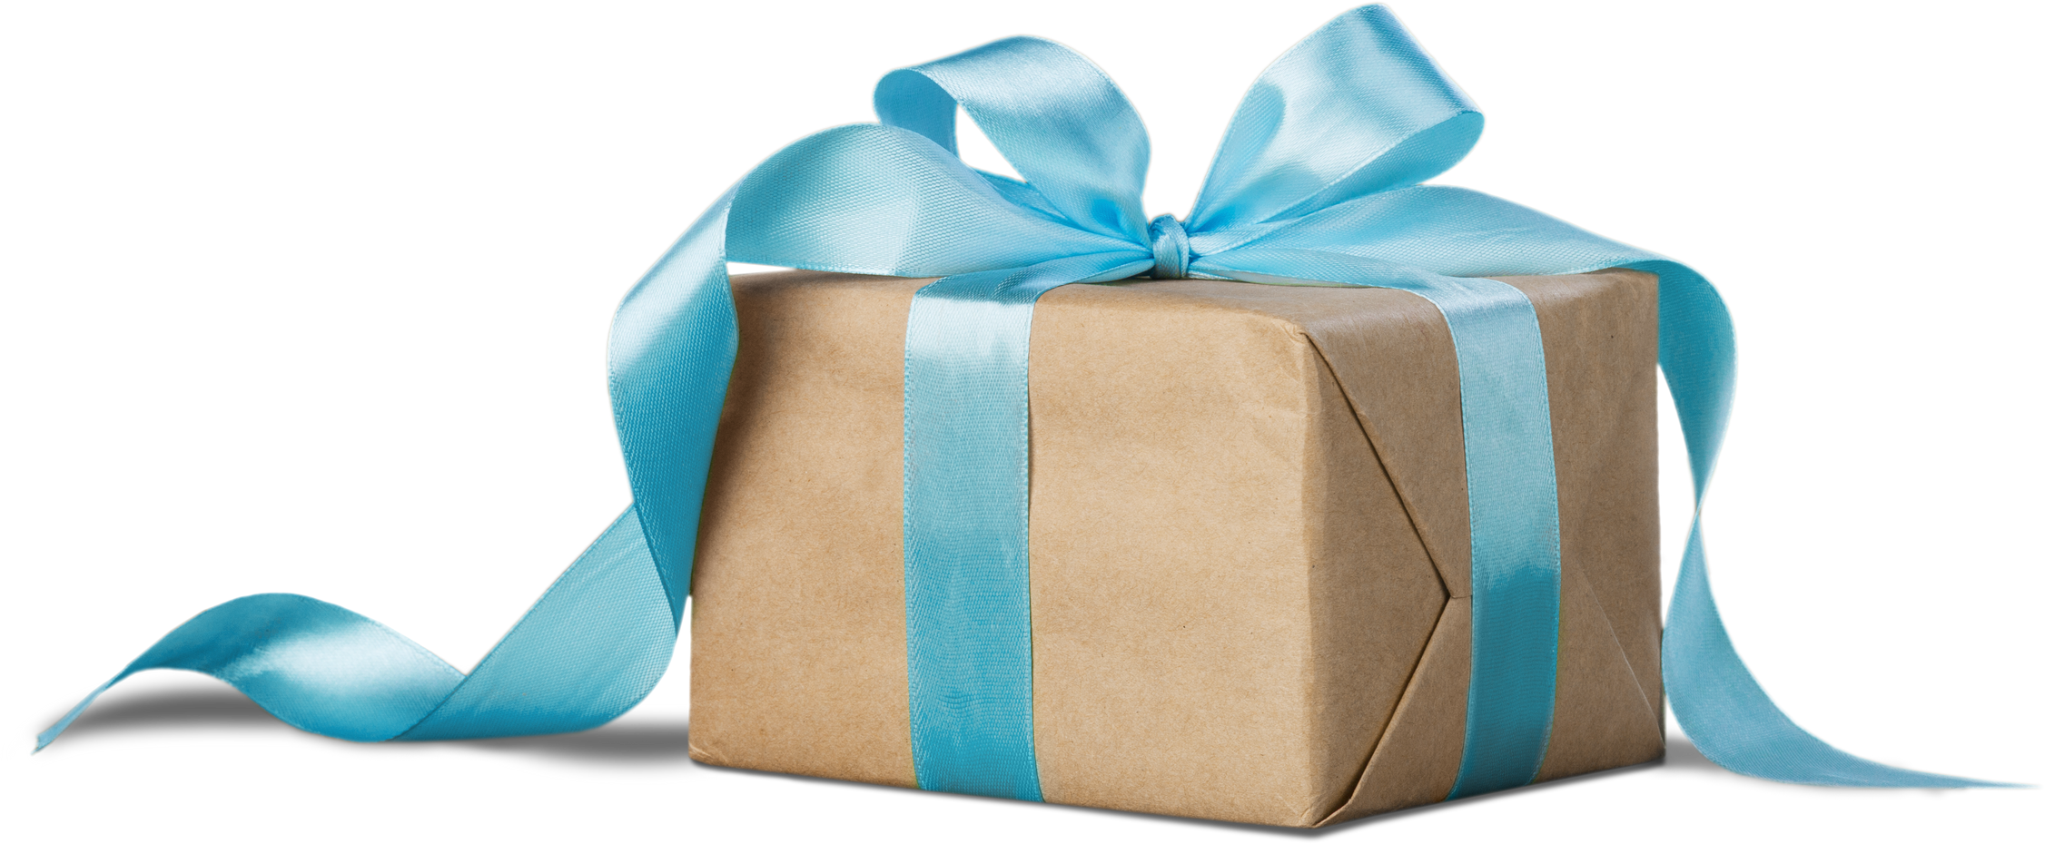
WHAT

Slide 6
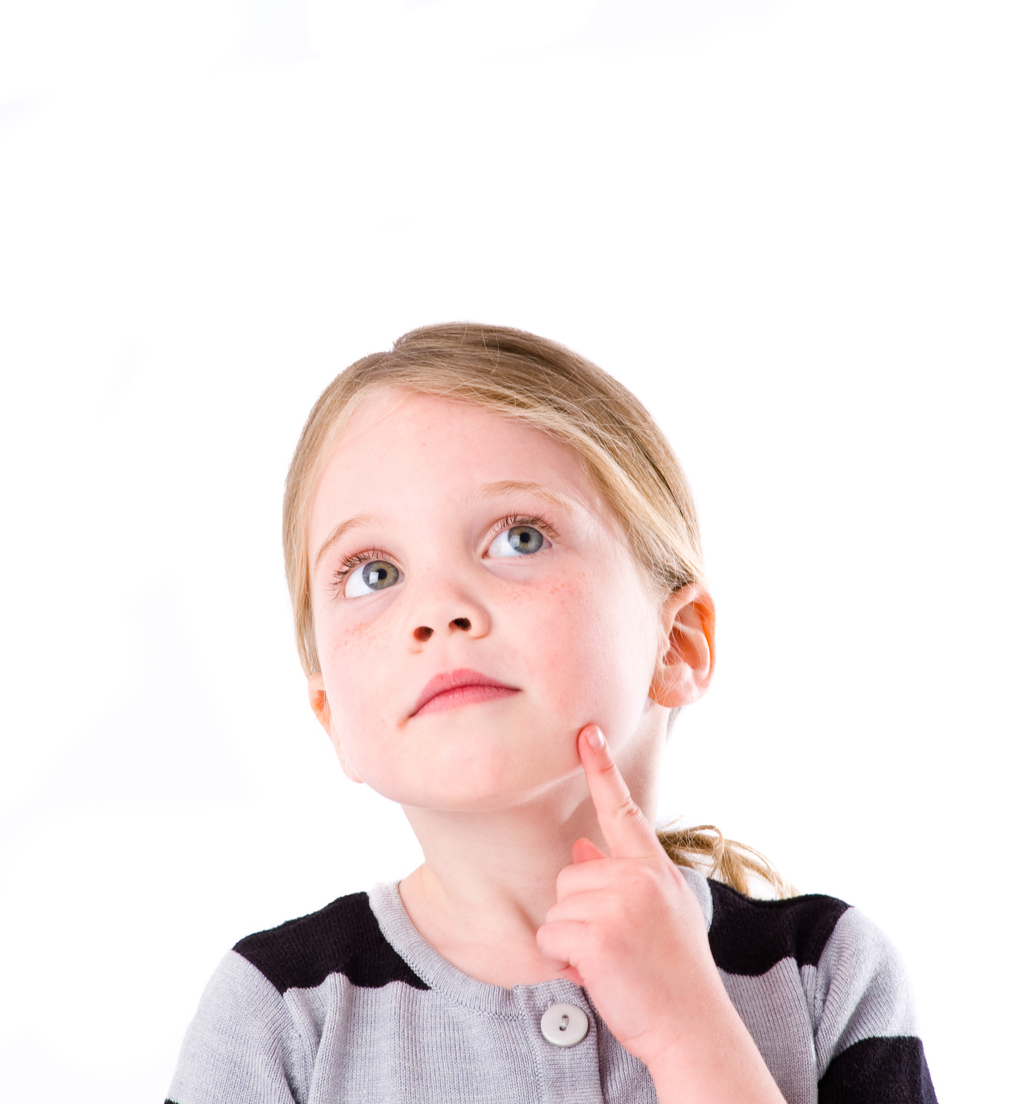
WHY

Slide 7

WHERE

Slide 8
tall - taller - tallest
old - older - oldest
young - younger - youngest
he/she/it is taller than ...
he/she/it is older than ...
he/she/it is younger than ...

