Slide 1
All About Polar Bears
Notes:
© POLAR BEARS INTERNATIONAL
This presentation is for the use of teachers, PBI Ambassadors, and other affiliates or associates for the sole purpose of education. Please respect the photographers who have generously donated the use of their images and do not duplicate or disassemble this presentation other than for its recommended use. For additional information, please see our website at www.polarbearsinternational.org.
For more information or to access images for other purposes, please contact PBI at: info@pbears.org.

Slide 2
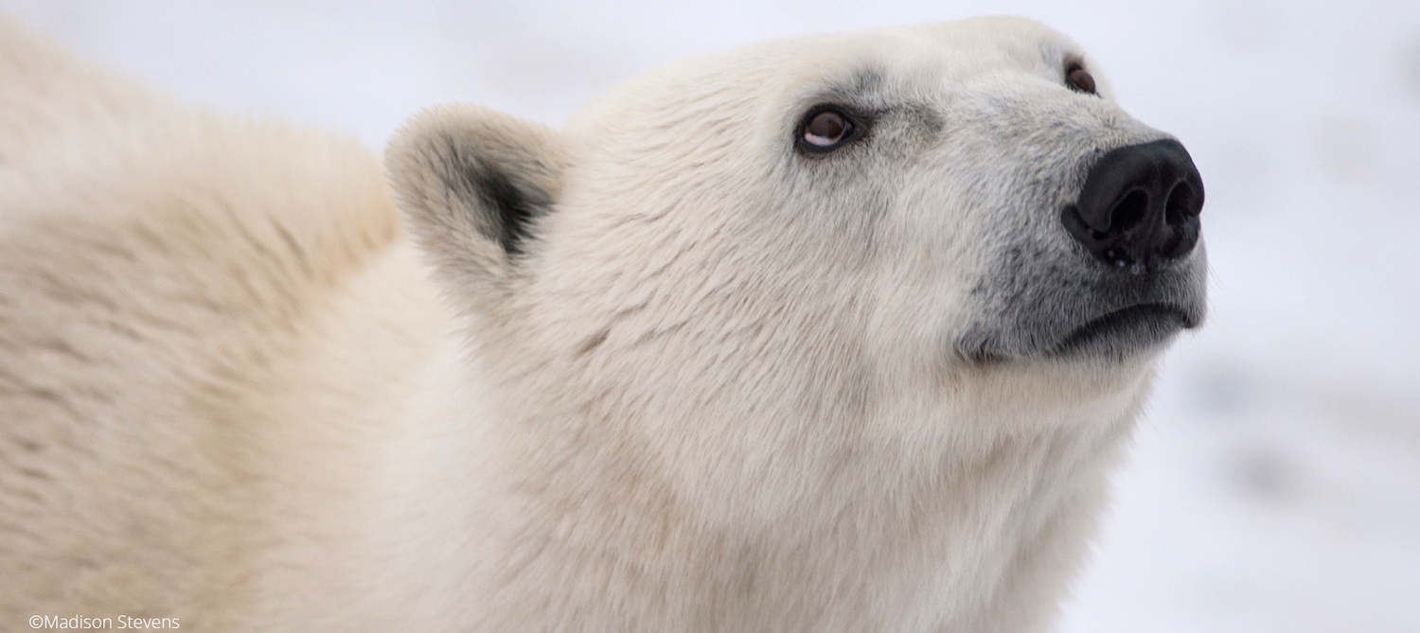
The polar bear is the youngest of the eight bear species. Scientists believe that the polar bear evolved between 350,000 – 6 million years ago from brown bear ancestors.

Slide 3
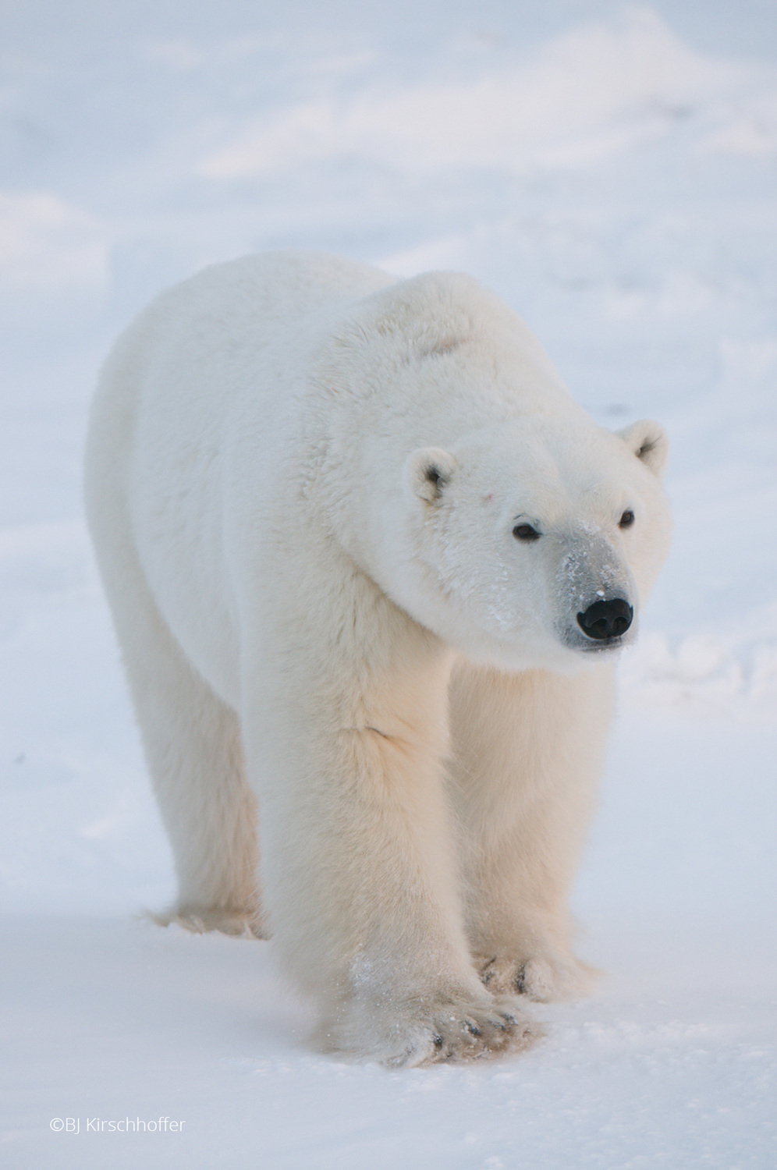
The polar bear is one of eight bear species. Its Latin name is
Ursus maritimus,
which means sea bear.

Slide 4
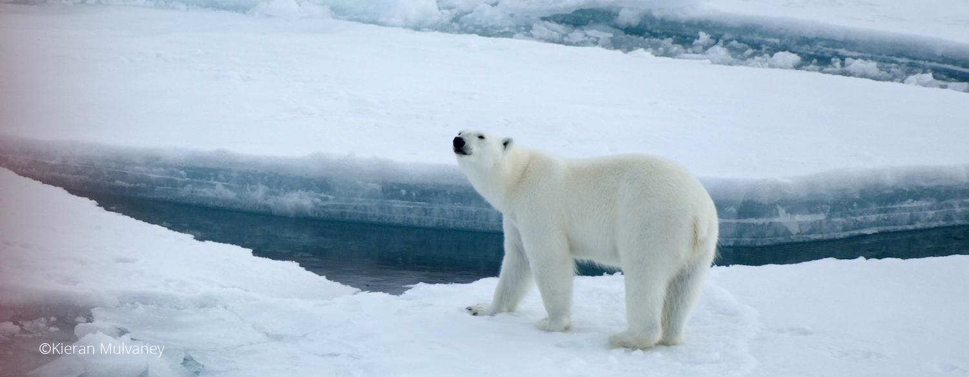
Polar bears range throughout the Arctic in areas where they can hunt seals at open leads. The five polar bear nations where the bears are found include the U.S. (Alaska), Canada, Russia, Greenland, & Norway.

Slide 5
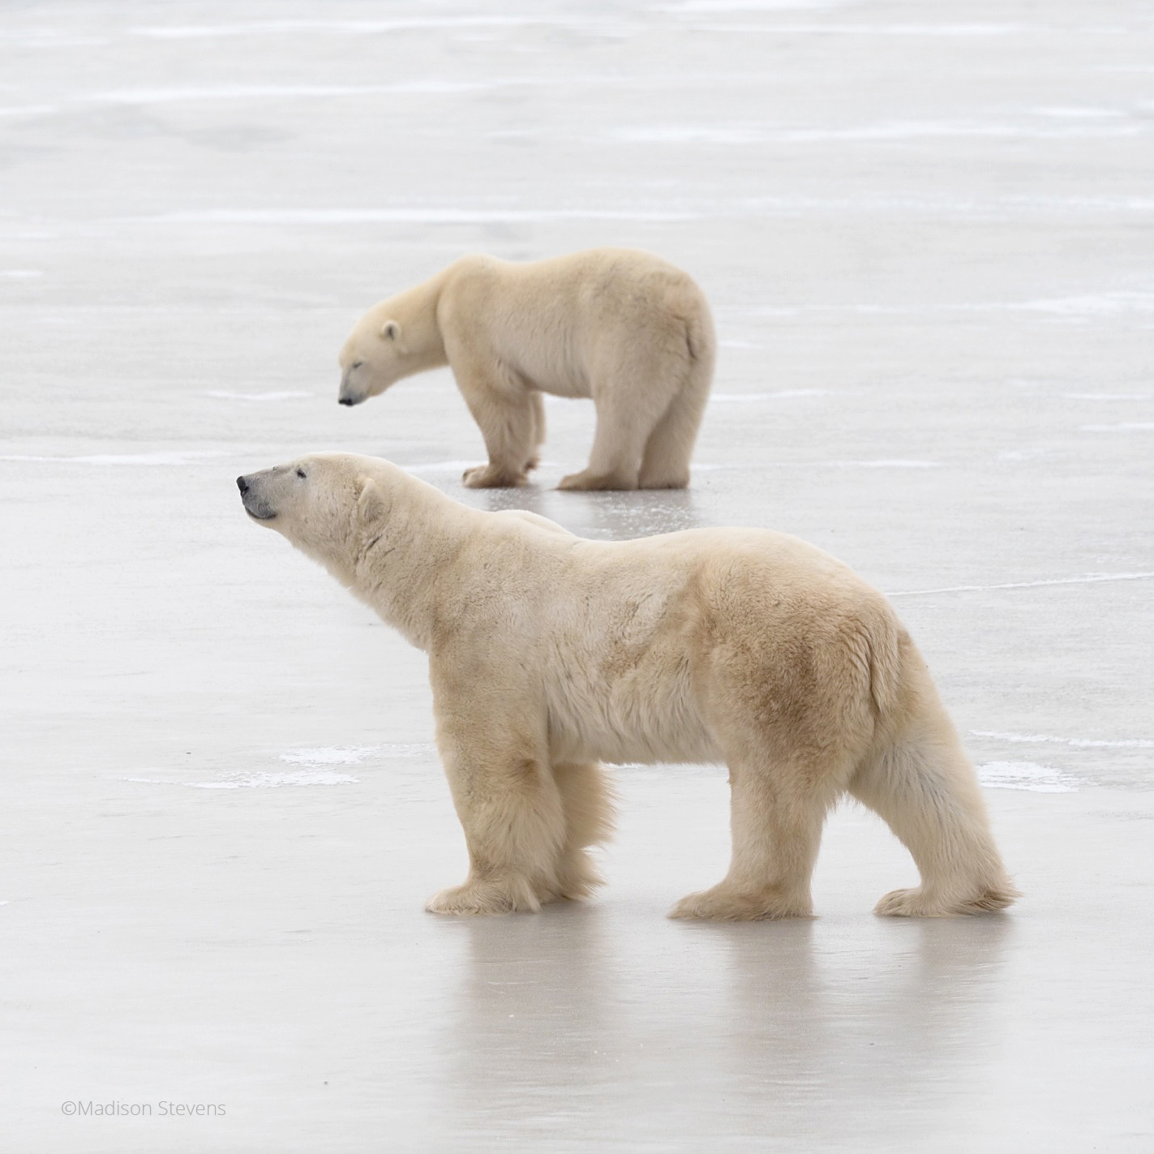
Polar bears are the world’s largest non-aquatic predators.
They top the food chain in the Arctic, where they prey primarily on seals.

Slide 6
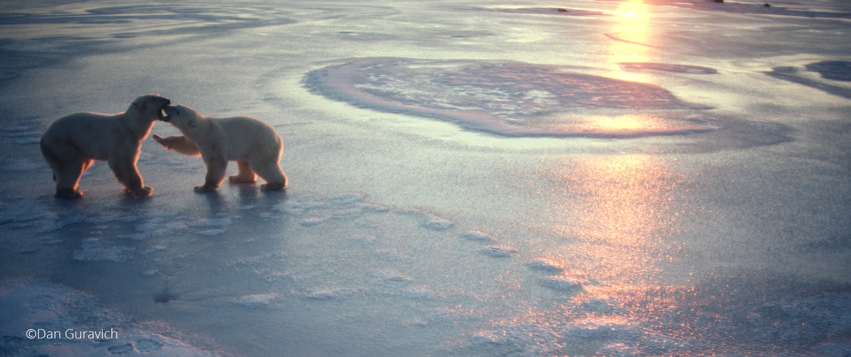
Scientists estimate that there are roughly 20,000 to 25,000 polar bears throughout the Arctic.

Slide 7
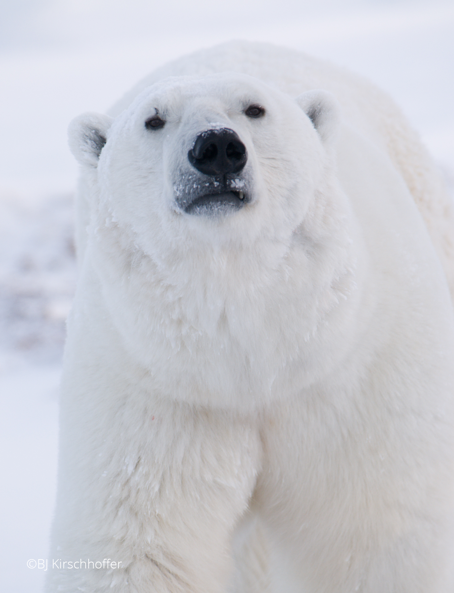
Adult male polar bears weigh from 351 to more than 544 kilos (775-1,200 pounds).
Females are considerably smaller, normally weighing 150 to 295 kilos (330 to 650 pounds).
Notes:
Bears over 1200 do occur, but they would be exceptional. For females, the typical weight range is 330-650 pounds. It is not that uncommon for female bears to weigh over 600 pounds in the autumn as they enter dens.

Slide 8
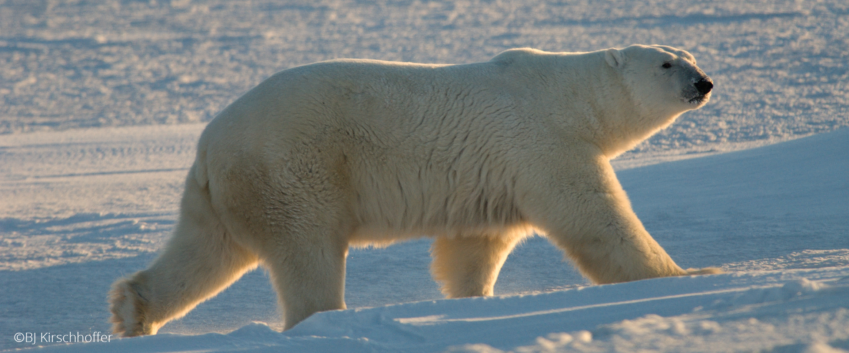
Adult male polar bears measure 2 to 3.1 meters long (6.5 feet to 12 feet).
Females measure 1.5 to 2.4 meters long (5 to 9 feet).

Slide 9
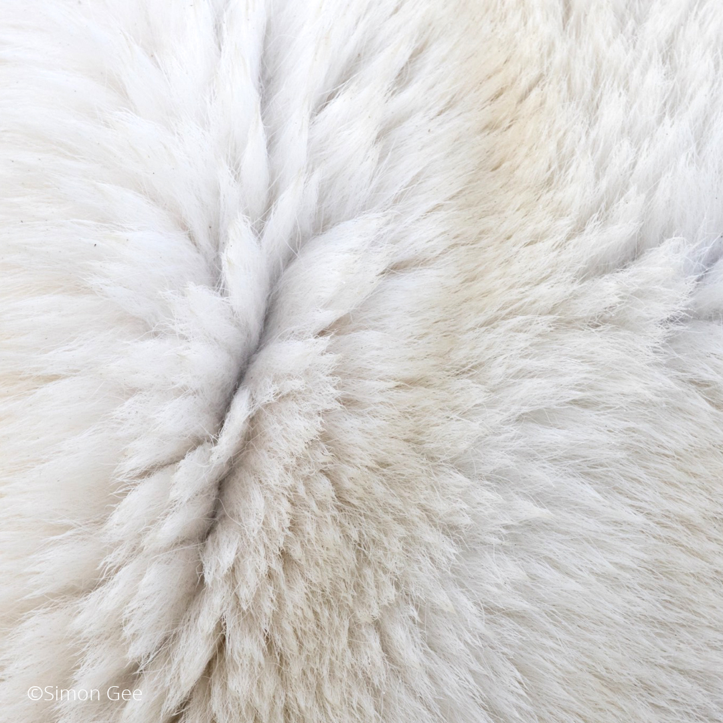
Polar bears are perfectly adapted for survival in the Far North.
They are well-insulated against the cold, with two layers of fur that include a thick undercoat topped by guard hairs.

Slide 10
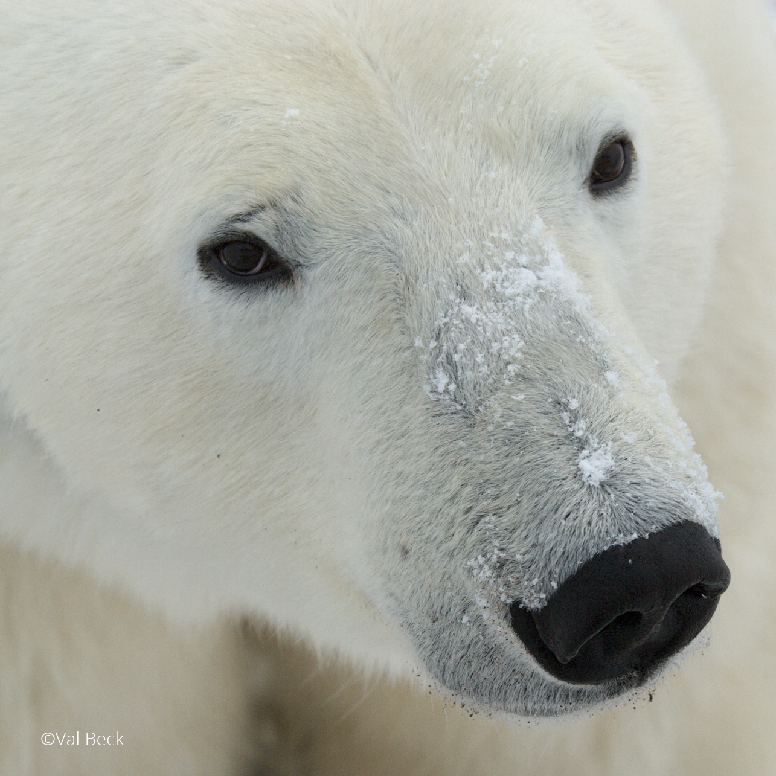
Polar bears have a superb sense of smell. They also have excellent hearing and eyesight. These heightened senses are necessary for survival in the changing conditions of the Arctic.

Slide 11
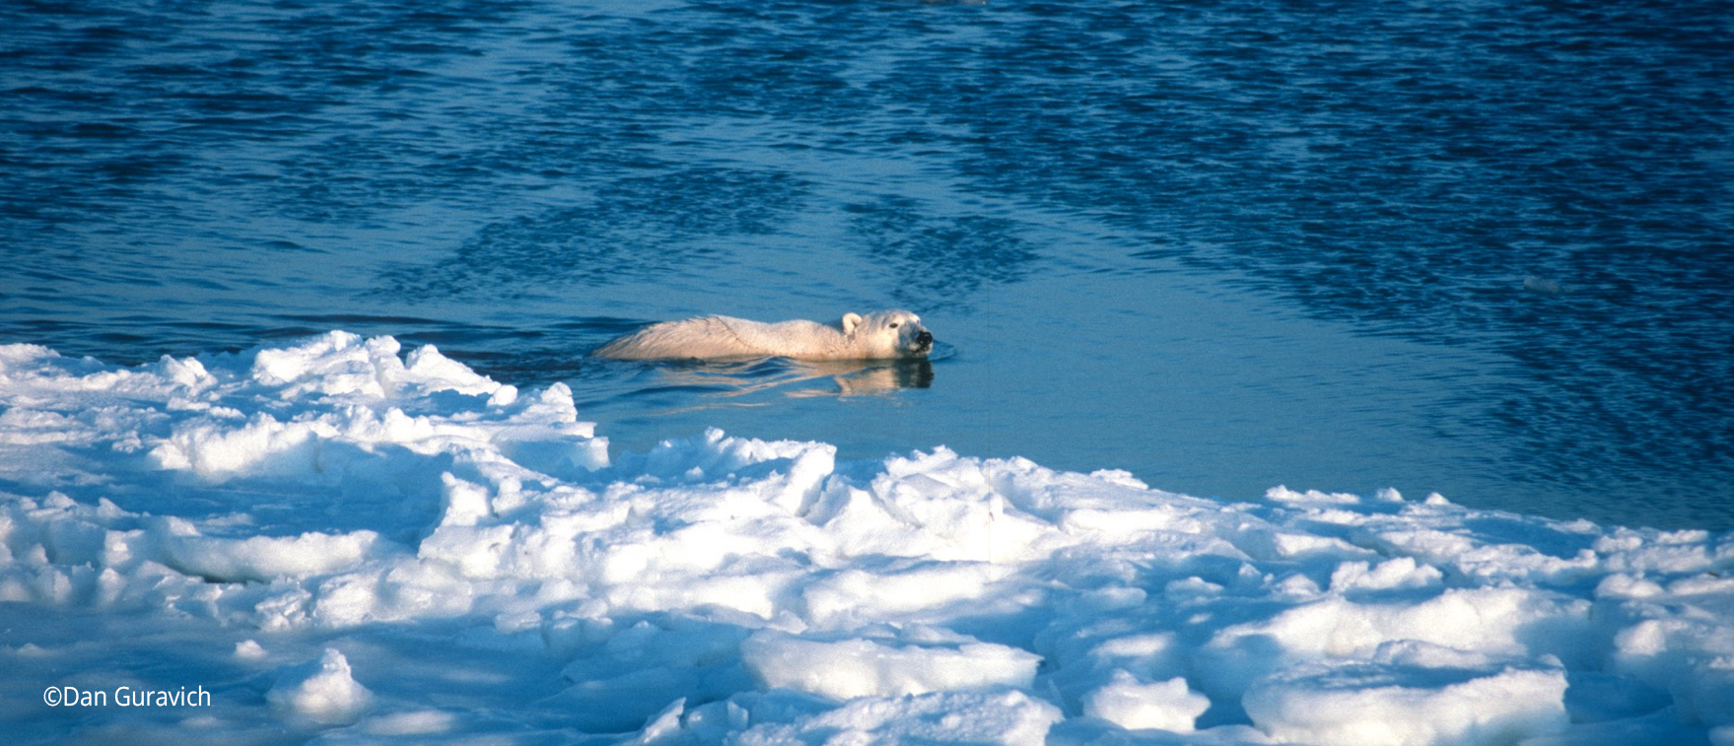
Polar bears are champion swimmers. They can swim 100 kilometers (60 miles) without rest. Rarely, they can swim several hundred kilometers.

Slide 12
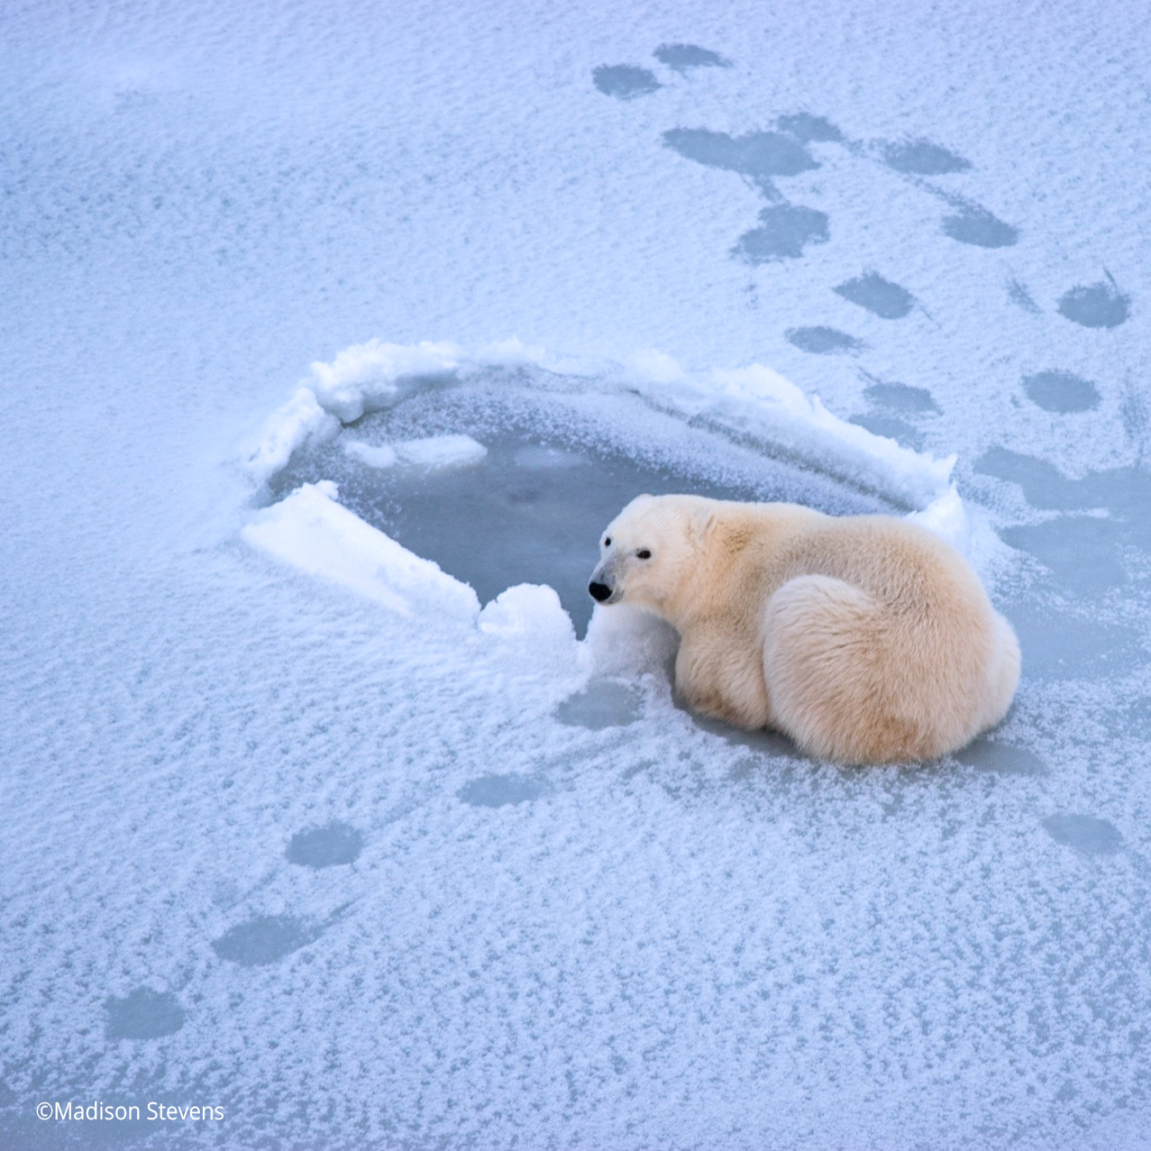
Polar bears are most at home
on the sea ice, where they prey
On ringed and bearded seals
That live beneath the ice.
The bears catch seals when
they surface at holes and cracks
to breathe. Polar bears also
breed and, in some cases,
den on the ice.

Slide 13
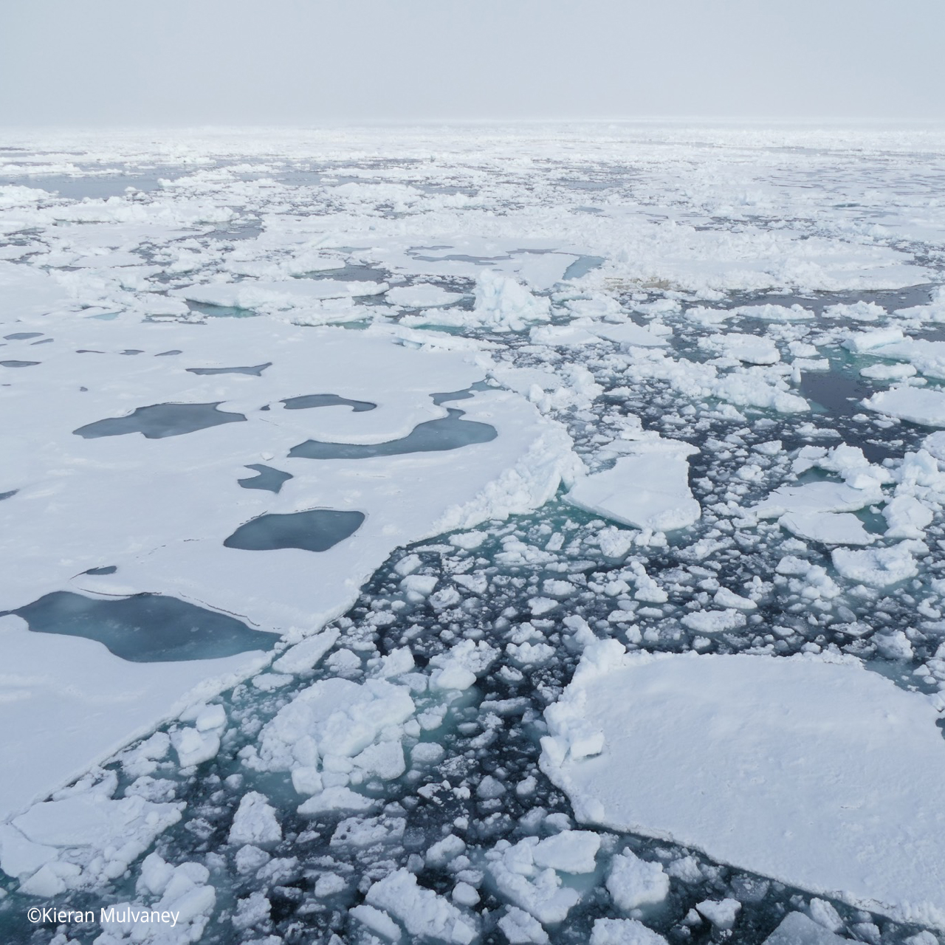
Sea ice can vary greatly in
thickness, age, floe size,
and concentration—
depending on the influences
of temperature, currents,
and wind.
For this reason, some sea ice
offers better hunting
conditions than other ice.
Hence, polar bears are
distributed in the Arctic
relative to the nature
of the ice.

Slide 14
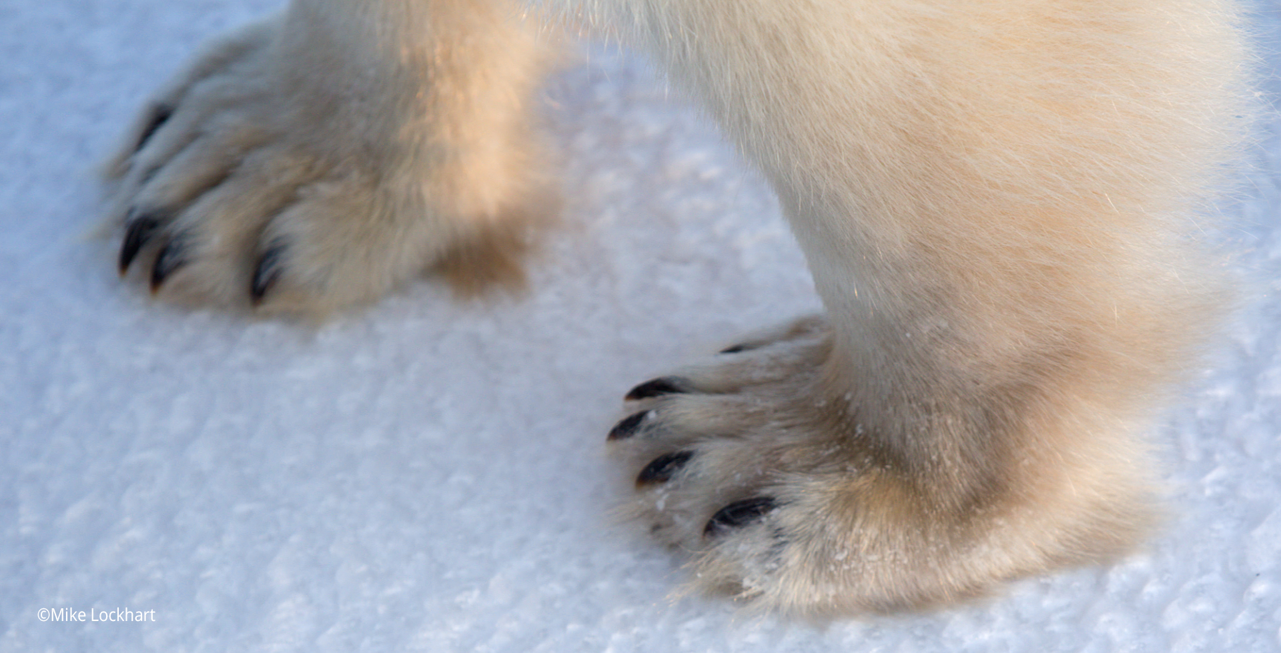
Polar bear paws are furred to help them grip the ice. The massive size of the forepaws measures up to 25 centimeters (10 inches) in diameter.

Slide 15
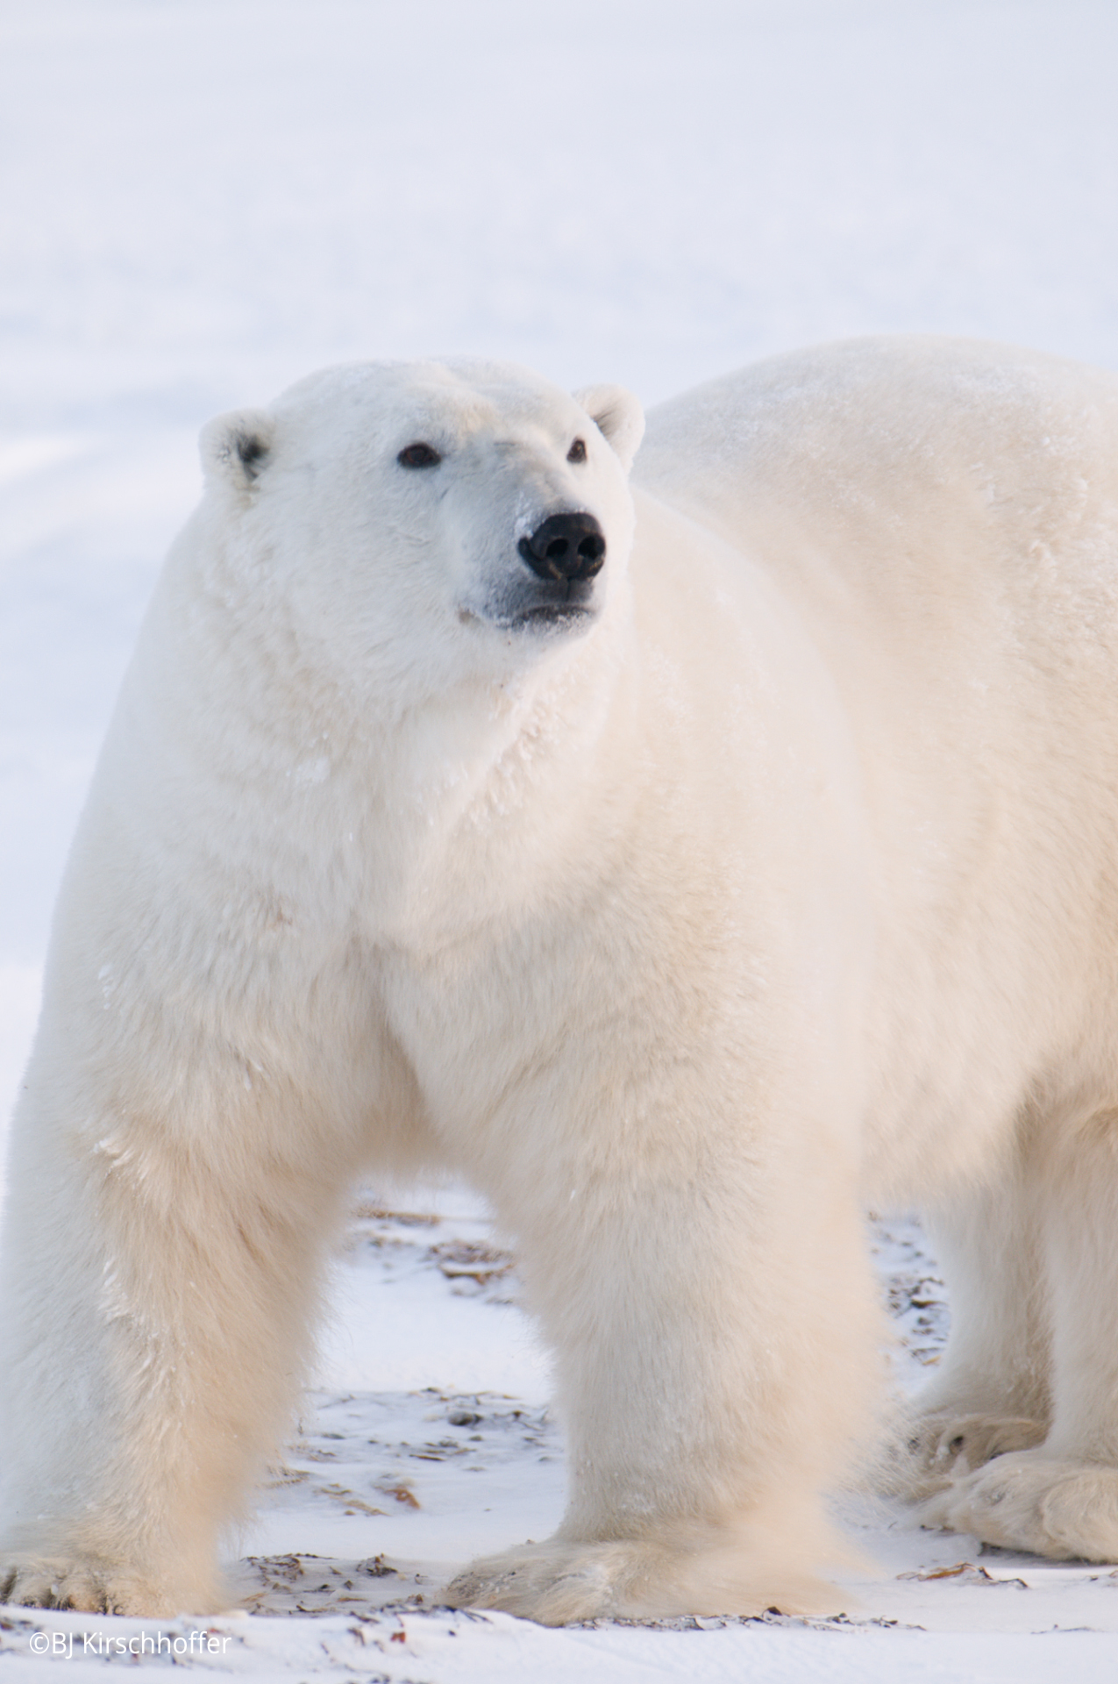
The polar bear’s fat layer, which is 7.6 to 11.4 centimeters thick (3 to 4.5 inches), is a key factor for survival during periods of scarcity in addition to protecting the bear from the cold and adding to its buoyancy in the water.

Slide 16
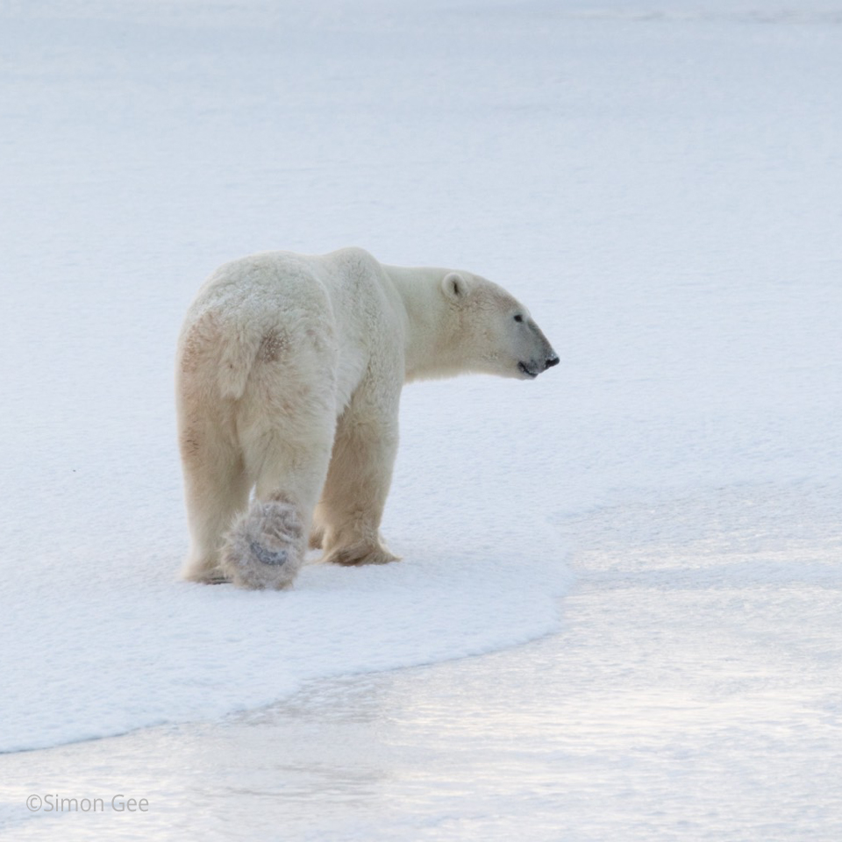
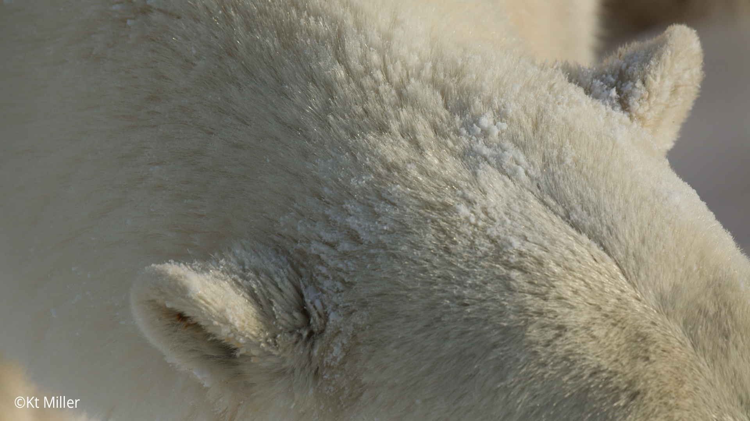
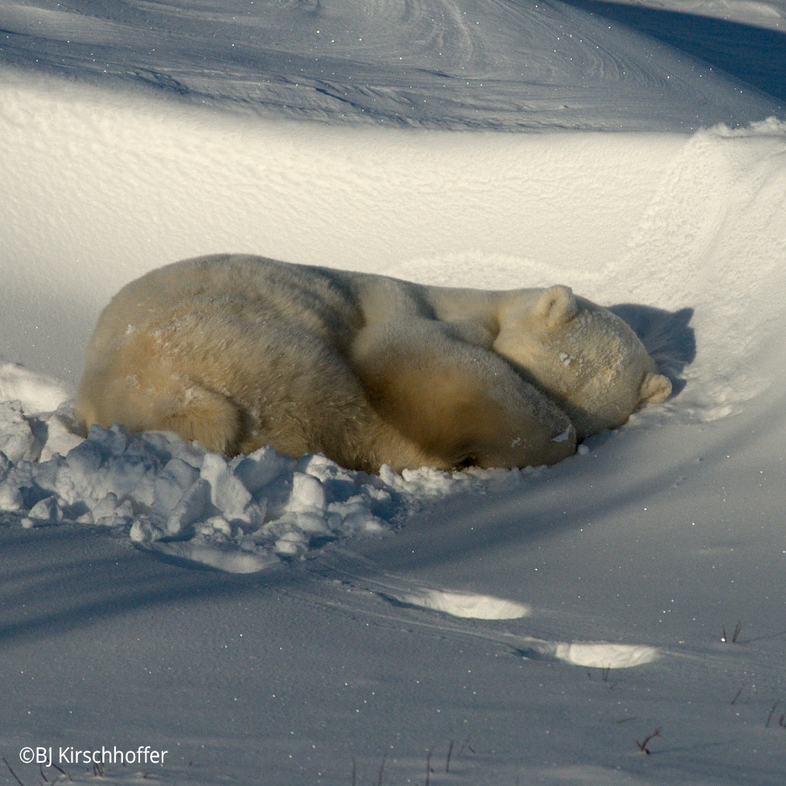
The polar bear’s compact ears and small tail help prevent heat loss. During a storm, polar bears will curl up in a day bed in the snow and cover their muzzle to keep it warm.

Slide 17
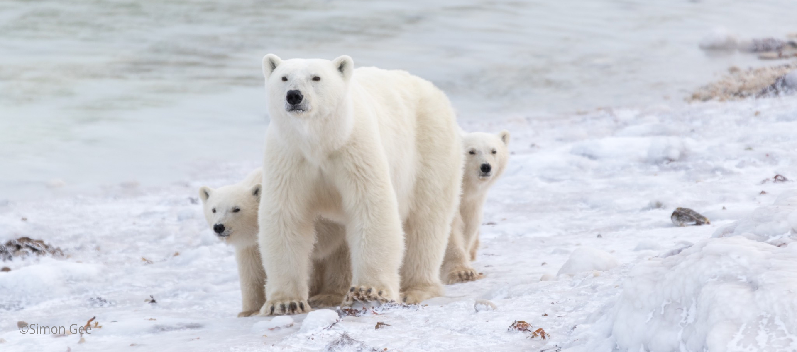
Female polar bears usually have two cubs. Mating takes place from March through May, but fertilized eggs are not implanted in the female’s uterus until the fall when the mother prepares to go into the den. This process is known as delayed implantation.

Slide 18
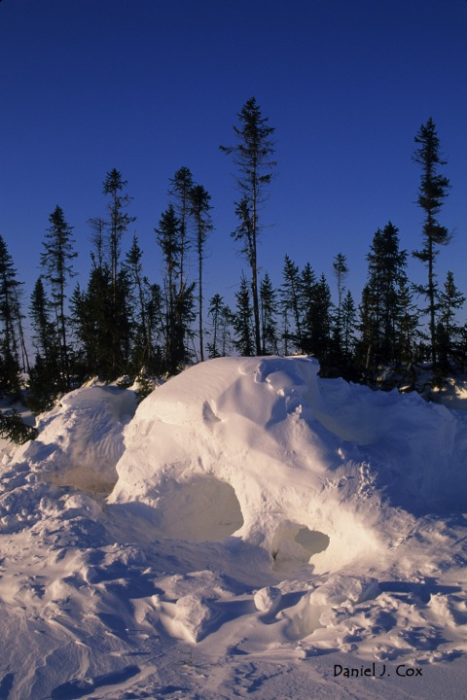
The female polar bear digs a maternity den in a snow bank in the fall. She gives birth to her cubs about two months after she enters the den. Newborns are 30.5 to 35.7 centimeters long (12 to 14 inches) and weigh little more than .45 kilograms (1 pound). They are covered with fine white hair.

Slide 19
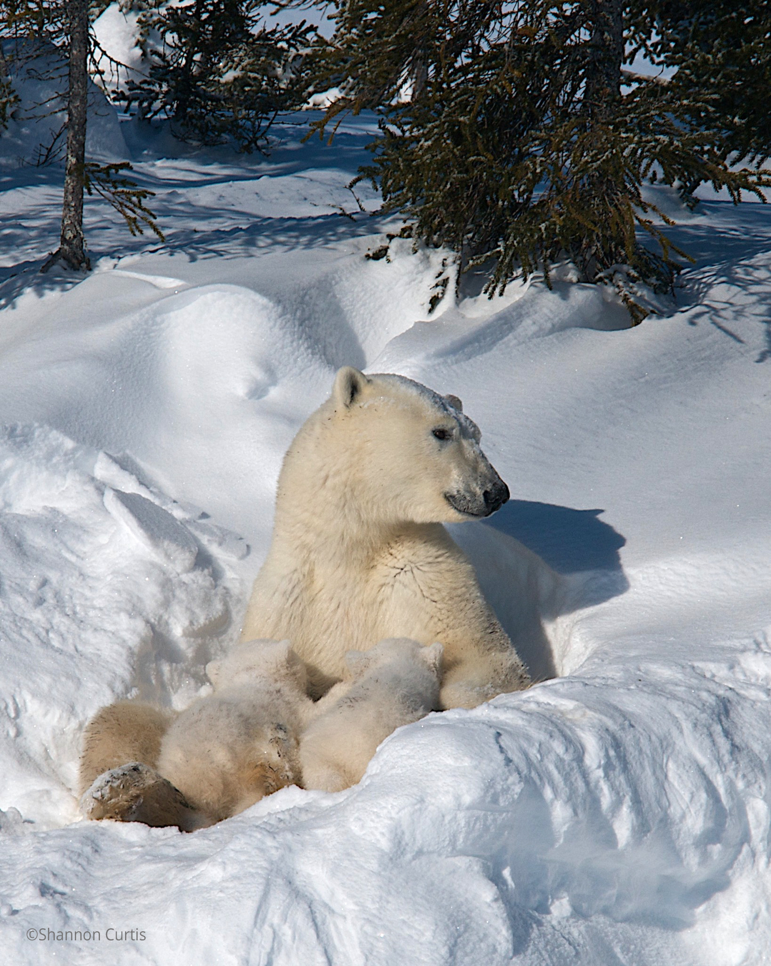
The female polar bear’s rich milk helps the cubs grow quickly. By the time the family leaves the den in March or April, the cubs have thick fur and weigh 11.3 to 13.6 kilos (25 to 30 pounds).

Slide 20
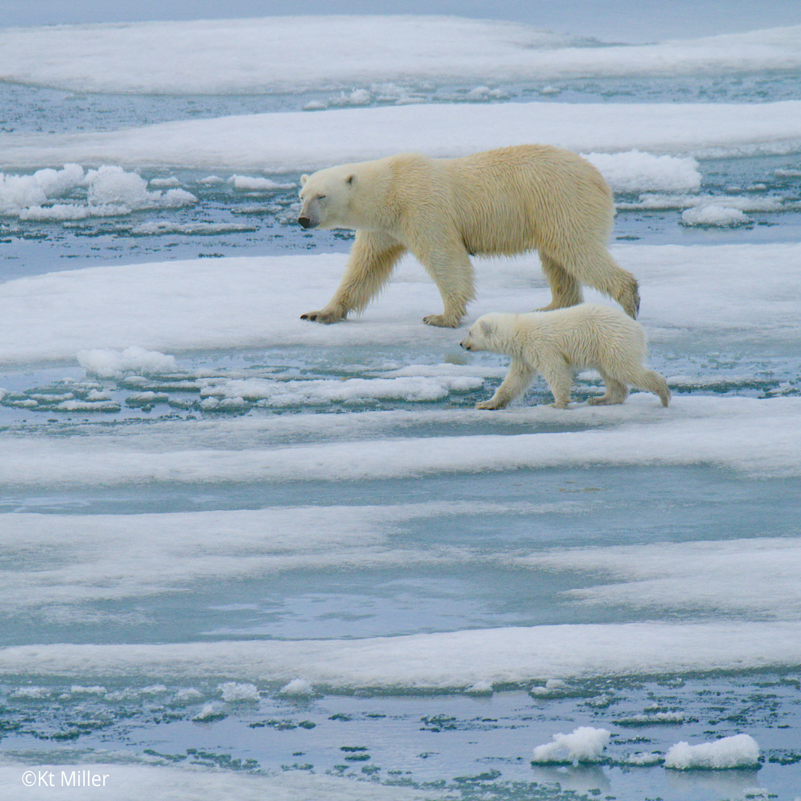
Polar bear cubs depend on their mother for survival, drinking her milk and consuming prey she has caught. Their mother’s success at hunting seals directly influences the well-being of the entire family.

Slide 21
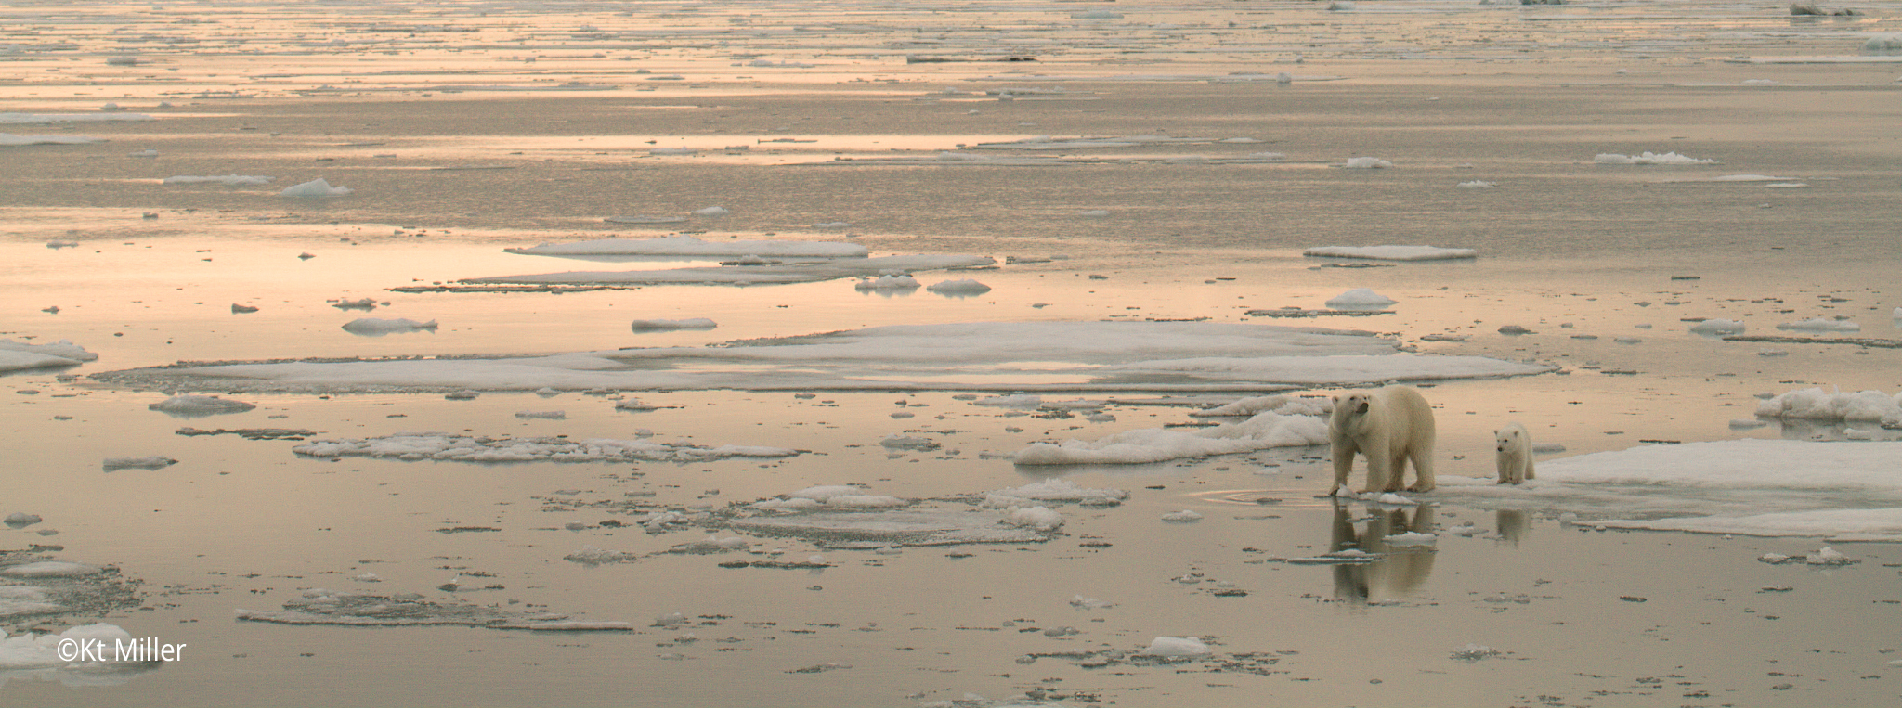
Polar bear cubs learn to hunt by watching their mother. They must learn to wait patiently for a seal to return to its breathing hole.

Slide 22
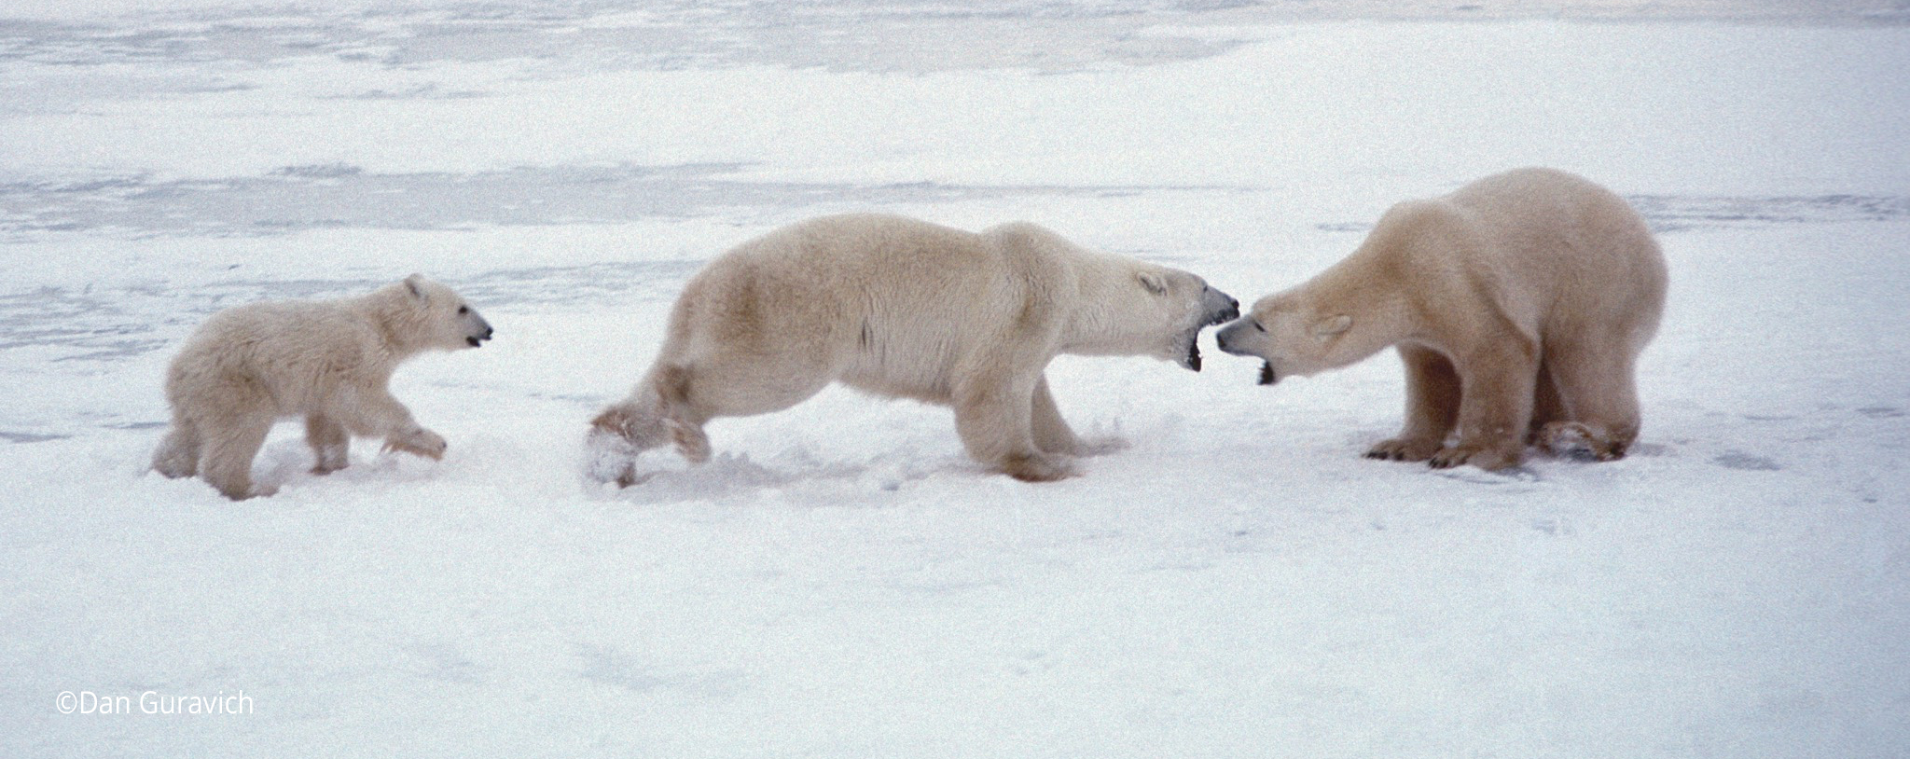
Females with cubs generally avoid adult male bears, which sometimes attack the young. Highly protective mother bears are capable of driving off much larger males.

Slide 23
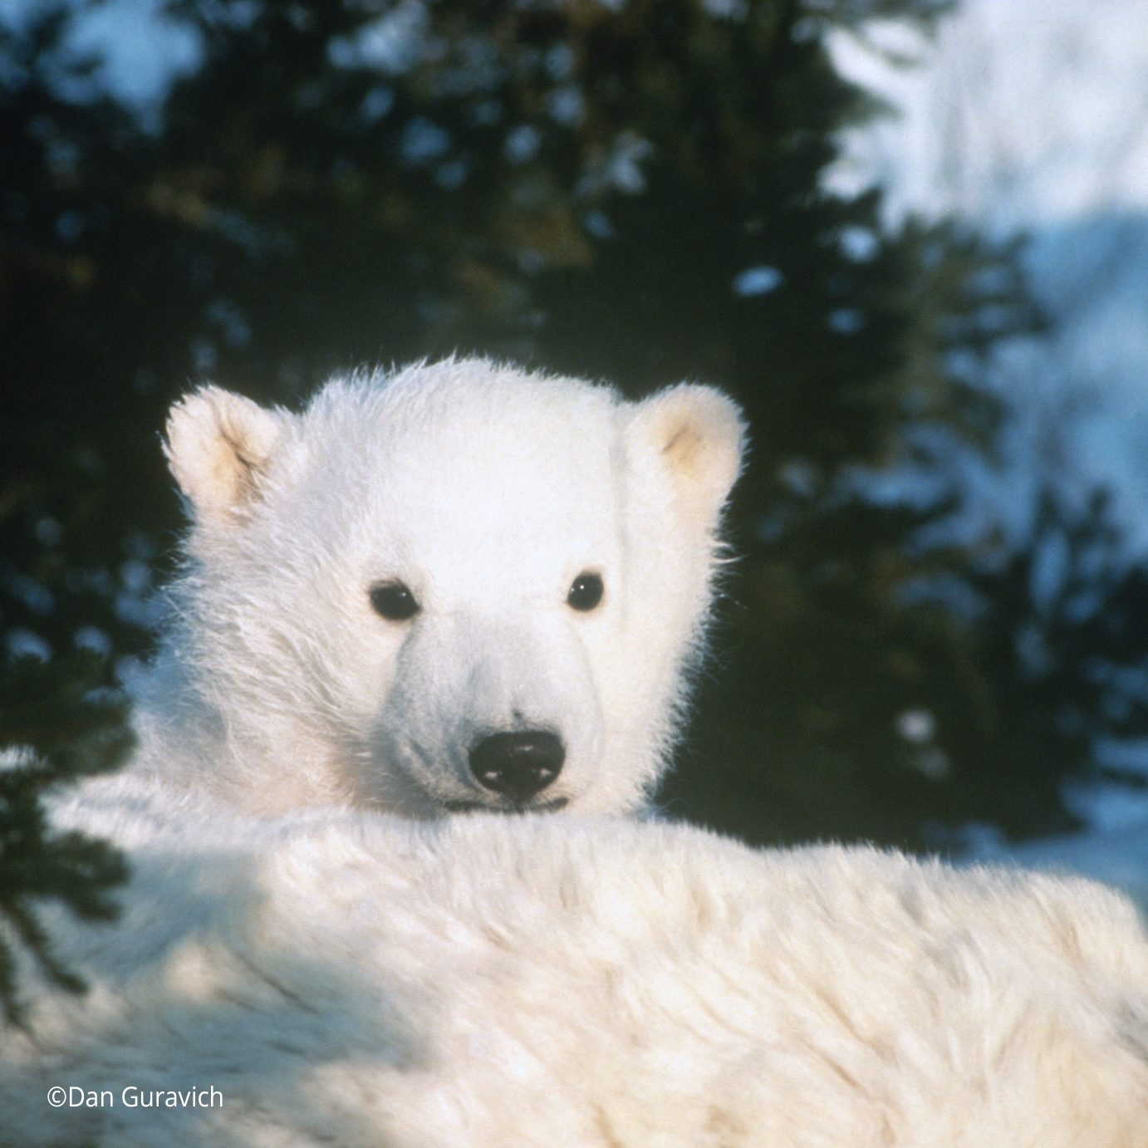
Without a mother to care for them and teach them how to hunt, orphaned cubs are seldom able to survive in the harsh environment of the Arctic.

Slide 24
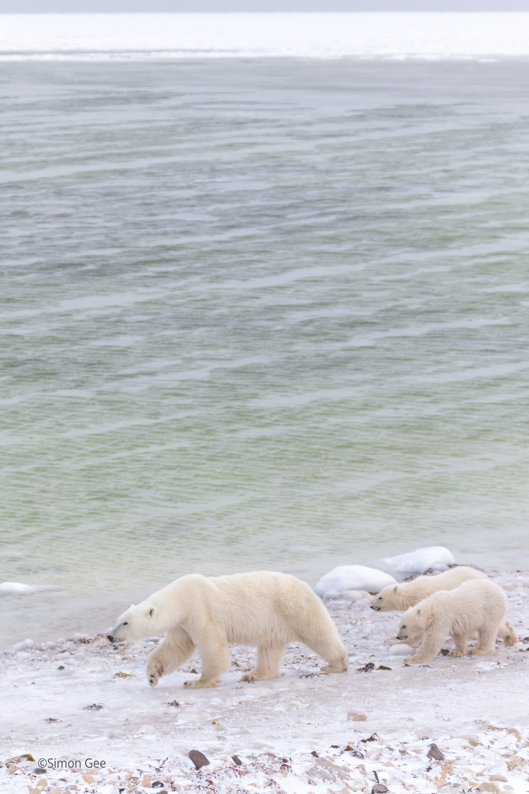
Cubs typically remain with their mothers for two-and-a-half years. Young bears are considered sub-adults until they reach maturity at age five or six. The sub-adult period, when young bears are newly on their own, is a vulnerable time in their life cycle. Starvation is the leading cause of death for sub-adult bears.

Slide 25
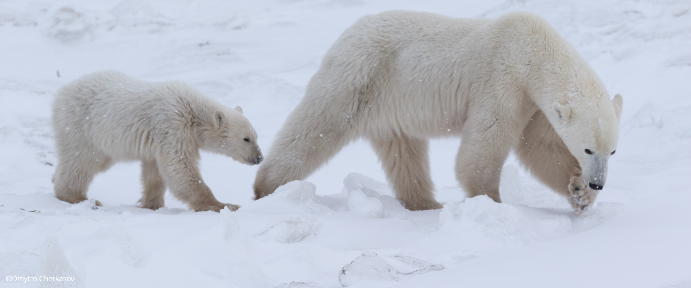
Those polar bears that manage to survive to adulthood have learned to master the challenges of arctic life. In typical conditions, the annual mortality rate of adult bears is surprisingly low – as little as five percent a year.

Slide 26
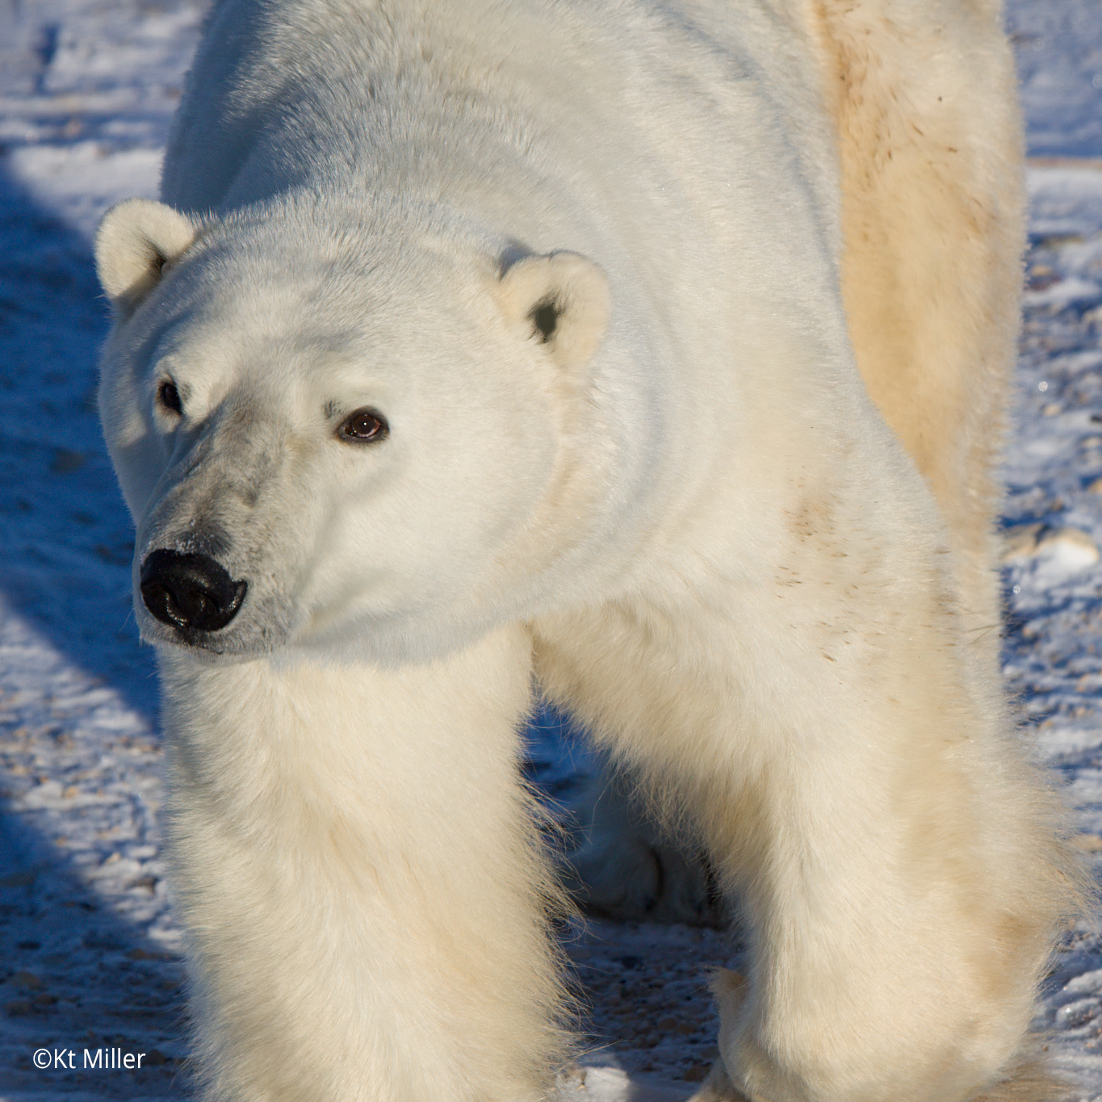
In the wild, adult polar bears live an average of 15 to 18 years, although biologists have tagged a few bears in their early 30s. Many bears in zoos live until their mid- to late- 30s. Debby, a polar bear at Winnipeg’s Assiniboine Park Zoo, lived to 42.

Slide 27
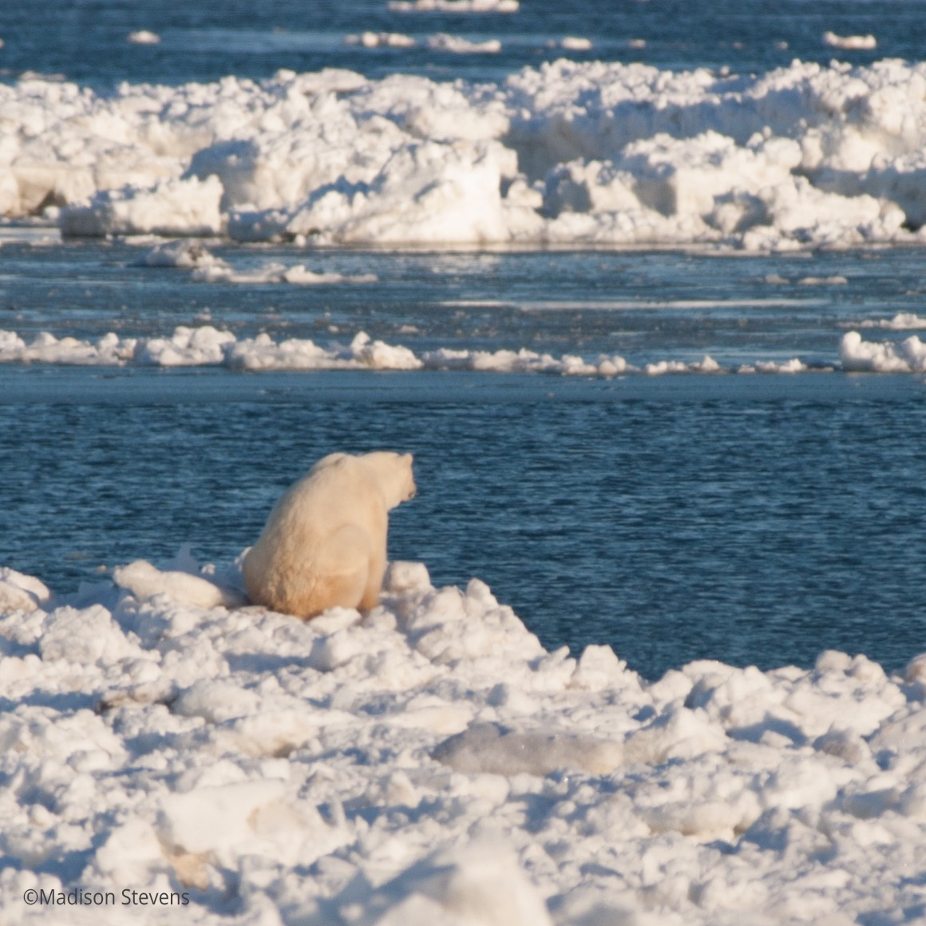
The biggest threat to polar bears are changes in their sea-ice habitat due to global warming. This warming trend is caused by a build-up of greenhouse gases in the atmosphere.

Slide 28
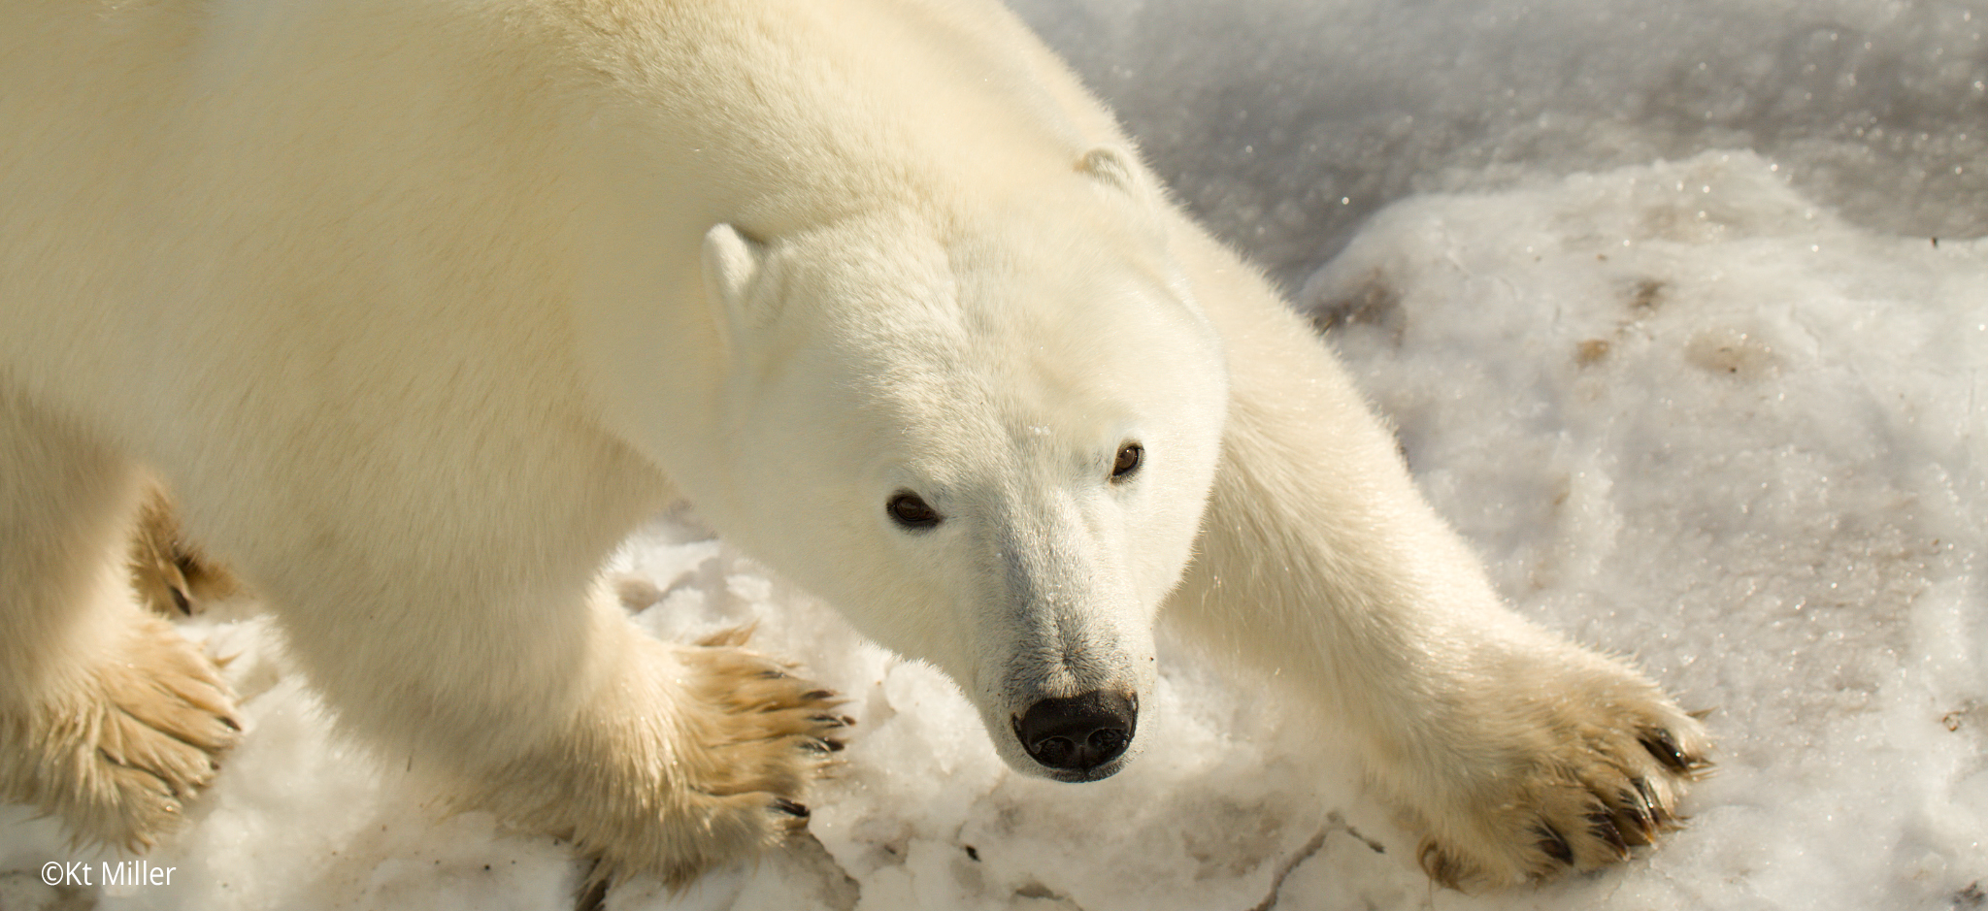
But scientists say it is not too late to help the polar bears!

Slide 29
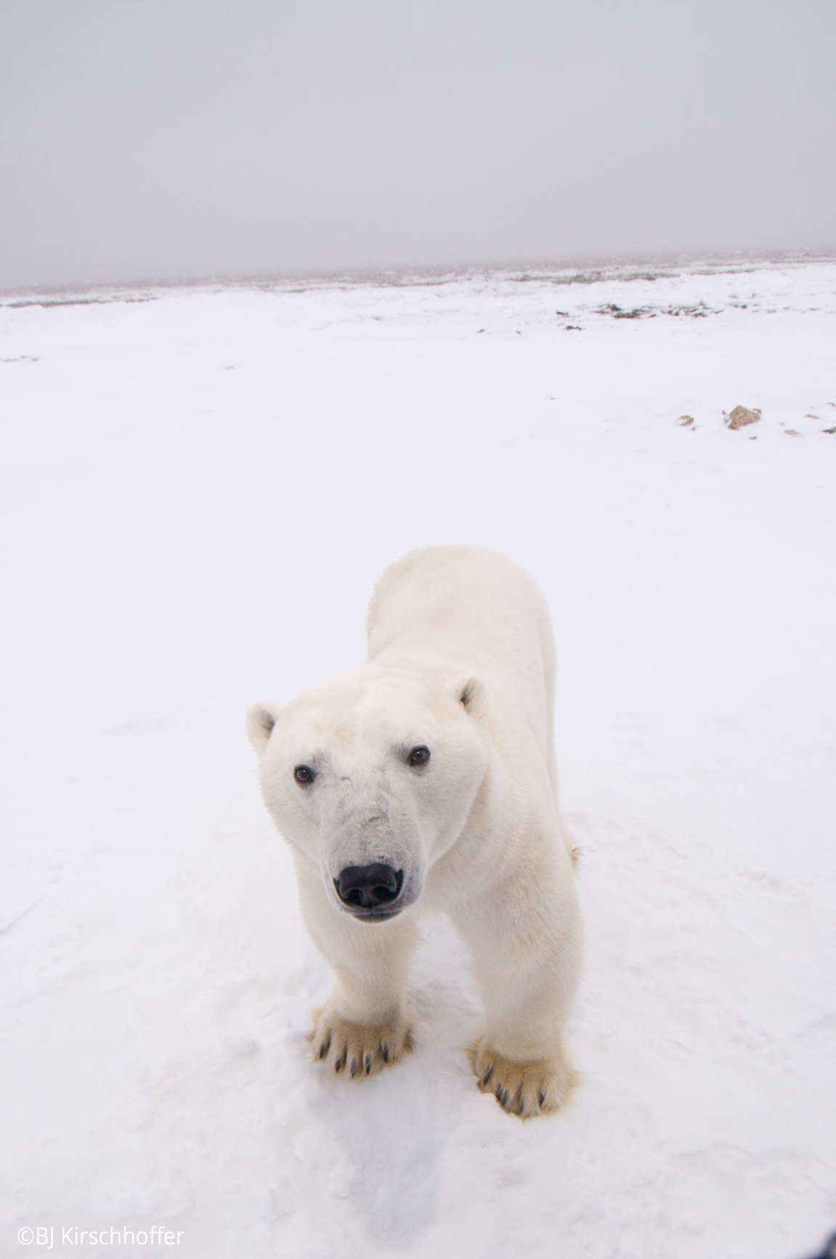
Here are some things
you can do:
Learn more about polar bears and climate change.
Talk about polar bears and climate change with your friends and family.
Share what you learned today!
Every action can make
a difference.
Notes:
Younger person “what you can do slide” For more ways to help polar bears: https://polarbearsinternational.org/get-involved

Slide 30
Here are some things you can do:
Learn more about polar bears and climate change and talk about it with family and friends.
Speak up for climate action by letting your representatives know this issue is important to you.
Encourage your family to support a shift towards renewable energy, clean transportation, and energy-efficient construction standards.
Share what you learned today!
Notes:
Older student “what you can do slide” For more ways to help polar bears: https://polarbearsinternational.org/get-involved

Slide 31
On behalf of polar bears everywhere, Polar Bears International thanks you!
© 2020 POLAR BEARS INTERNATIONAL
All photos copyrighted and property of © Polar Bears International. All Rights Reserved. Marks and text appearing in this presentation including, but not limited to, the Polar Bears International name, logo, and programs are trademarks, registered trademarks, or service marks of Polar Bears International.
Notes:
For more information:
www.polarbearsinternational.org
Please contact us at: info@pbears.org

