Slide 1

Stormwater Pollution Prevention Training
December 2025
Jimmy D. Jordan, P.G.
Environmental Manager
Charlotte Douglas International Airport
jdjordan@cltairport.com
980-288-3793

Slide 2
2025 Training Agenda
Part I – Introduction
Part II – Our Permit Requirements and Compliance
Part III - Stormwater Management at CLT Airport
Part IV – (SPCC)Oil Spill Prevention, Control, and Countermeasures Program

Slide 3
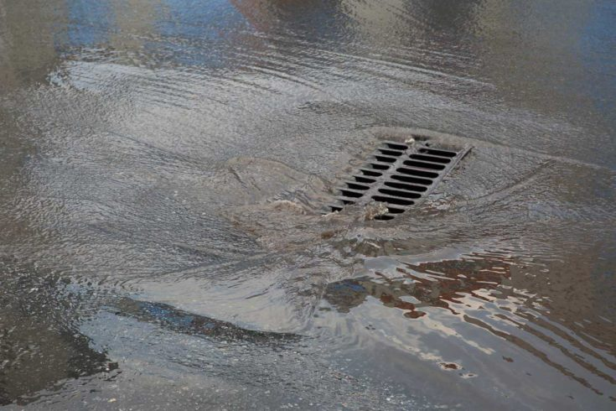
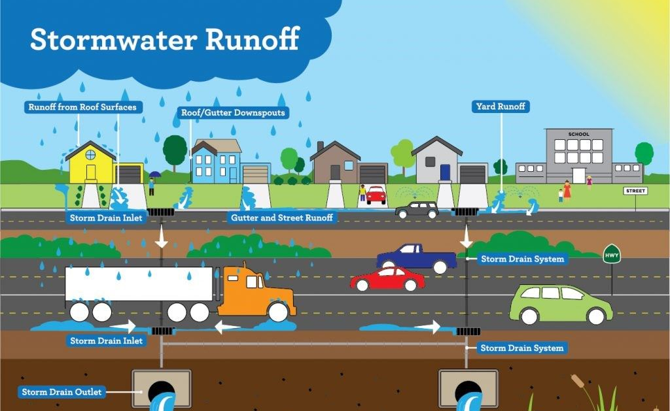
Introduction (1)
What is Stormwater ?
Stormwater is water that originates during precipitation events and snow/ice melt. Stormwater can soak into the soil (infiltrate), be held on the surface and evaporate, or runoff over impervious surfaces and end up in nearby streams, wetlands, rivers, or other water bodies (surface water).
Reference: http://en.wikipedia.org/wiki/Stormwater

Slide 4
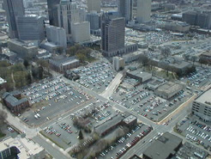
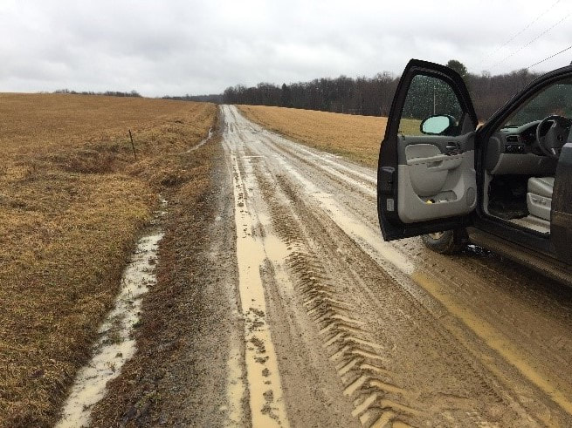
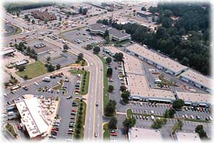
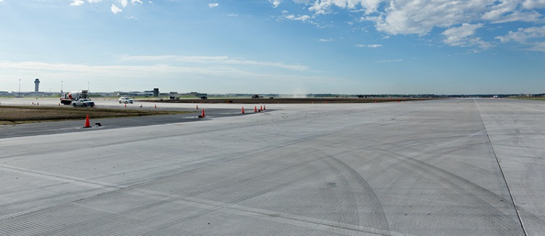
What are Impervious Surfaces ?
Building Rooftops
Parking Decks / Lots
Roadways
Hard Ground Surfaces

Slide 5


Stormwater Management…
Why bother?
Required by….
The Federal Government’s Clean Water Act of 1972. The CWA is the primary federal law in the United States governing water pollution.
Formerly, the “Federal Water Pollution Control Act” (1948)
CWA – original focus on waters for fishing, recreation, swimming
Amended; 1977, 1987
Clean Water State Revolving Fund – CWSRF 2014
Provided greater financial assistance to states for Water Quality projects and more flexibility for each state to prioritize their projects.
No Person shall cause or allow the discharge or disposal of Non-Stormwater, either directly or indirectly, to the Storm Water System, Waters of the State, or upon the land in a manner or amount that is likely to reach the Stormwater system or waters of the State………..
The CWA applies to “navigable waters” of the United States

Slide 6


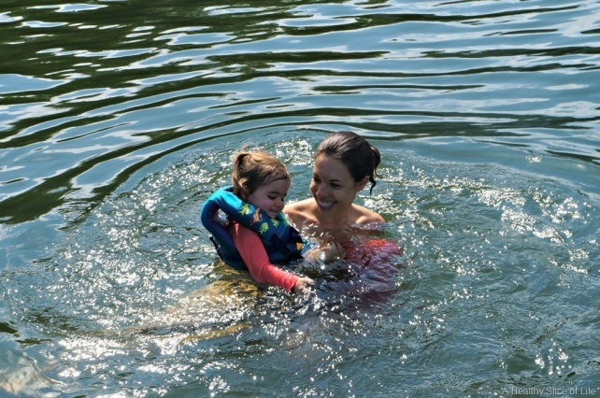
Stormwater Runoff…
Is not treated;
Ends up in streams, lakes, and Oceans;
Is a carrier of surface pollutants
Can have a negative effect on wildlife, plants, and aquatic ecosystems

Slide 7
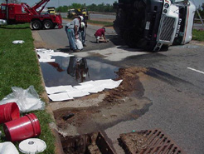
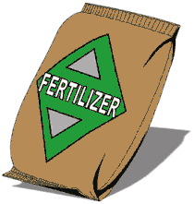
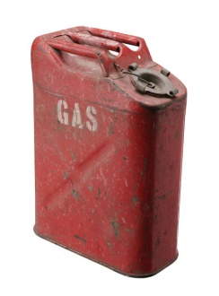

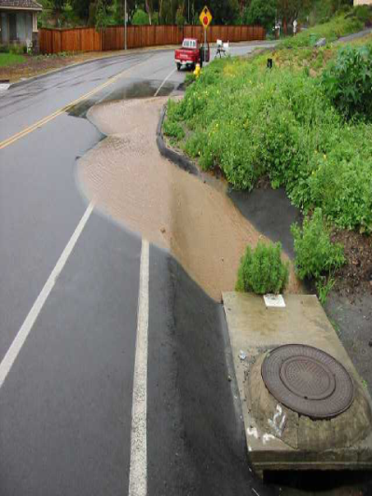
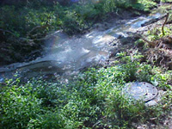
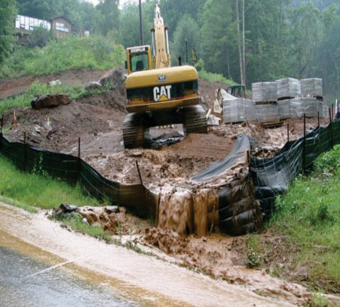
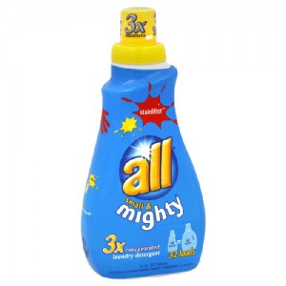
What are the Culprits?
Antifreeze / Deicing fluid
Oil / petroleum products
Sewage
Sediment
Detergents/Soaps
Wash water
Solid Waste (trash)
Herbicides and Pesticides
Fertilizers
Trace metals

Slide 8
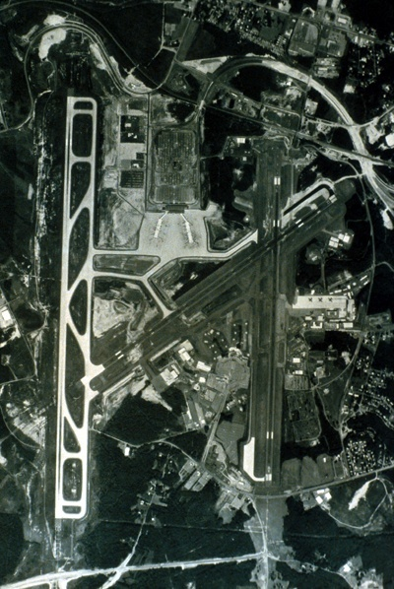
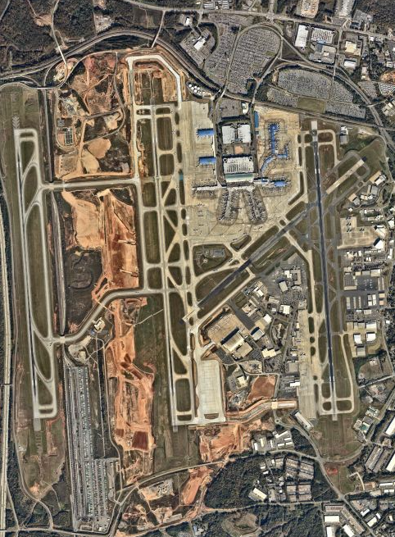
Impervious surface at CLT has increased about 900% since 1980

Slide 9
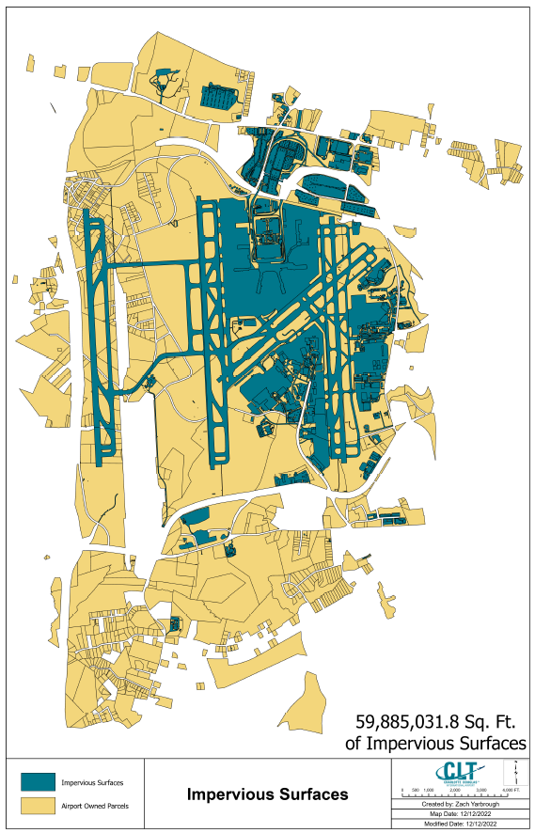
Paved/Impervious areas at CLT
2022 Total ~ around 60 Million square ft., of asphalt, concrete, rooftops, etc.*
*Sidewalk data not available.

Slide 10
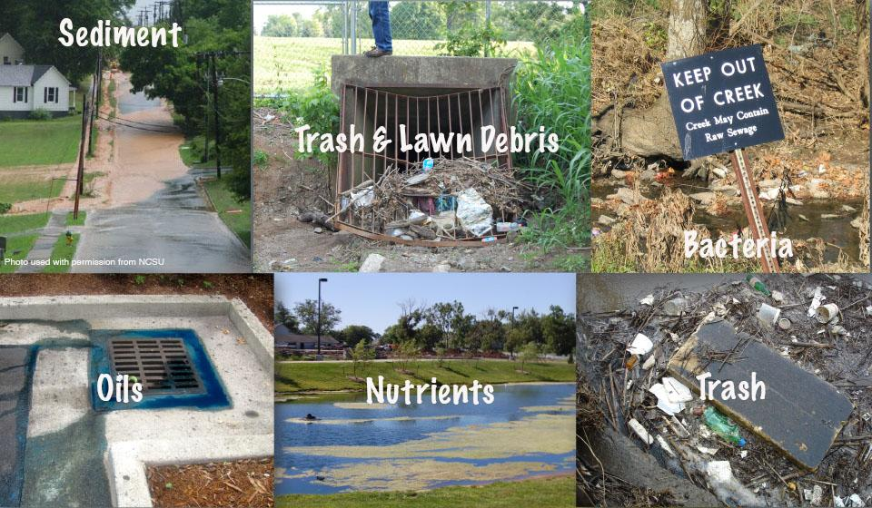
The End Result of Poor Stormwater Management?
Poor Water Quality affects…
  Wildlife
  Human Health
  Vegetation
  Recreation
  Economy
  Environment

Slide 11

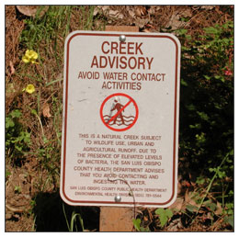
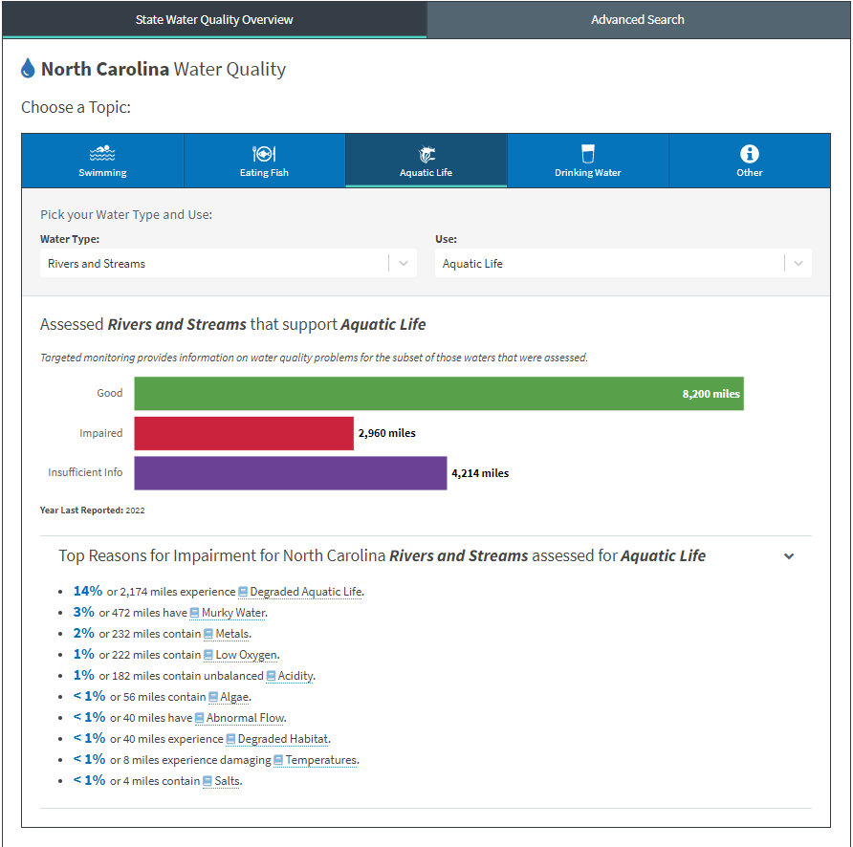
Impaired: A waterbody (i.e., stream reaches, lakes, waterbody segments) with chronic or recurring monitored violations of the applicable numeric and/or narrative water quality criteria
Reference: https://mywaterway.epa.gov/state/NC/water-quality-overview

Slide 12
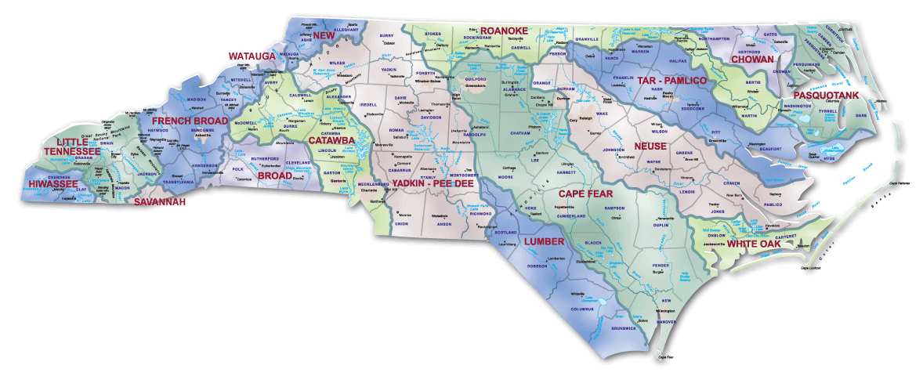
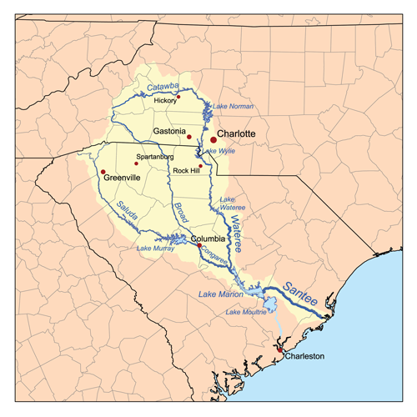
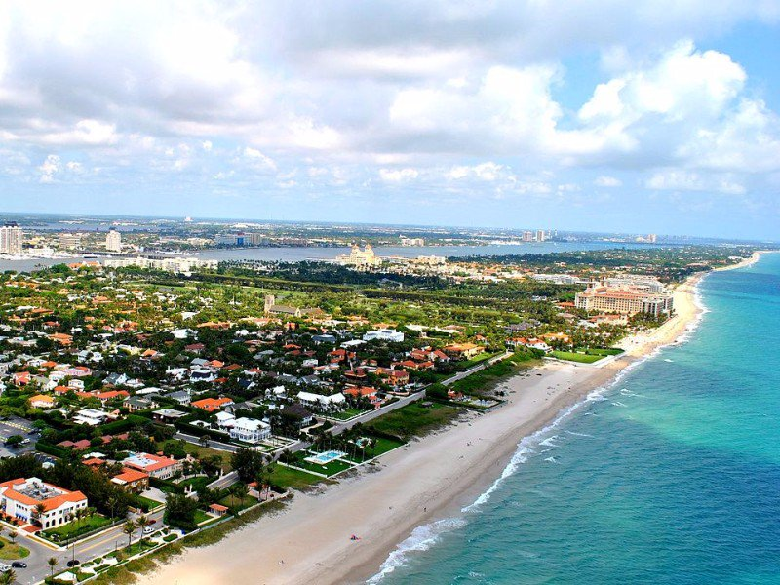
Where does the Water Go?

Slide 13
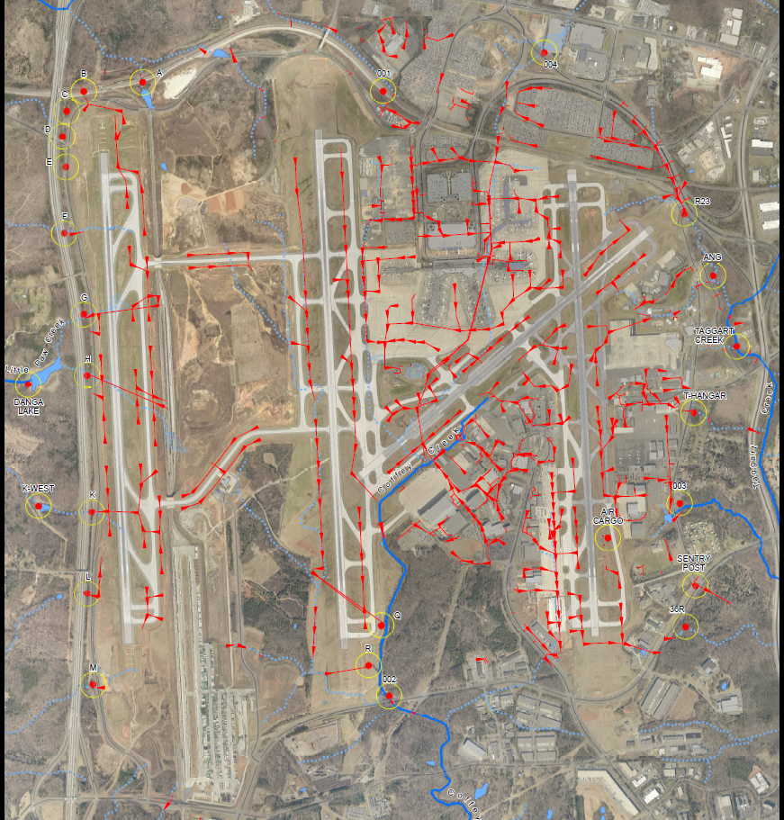
Locally at CLT
Storm drain location and flow direction.

Slide 14
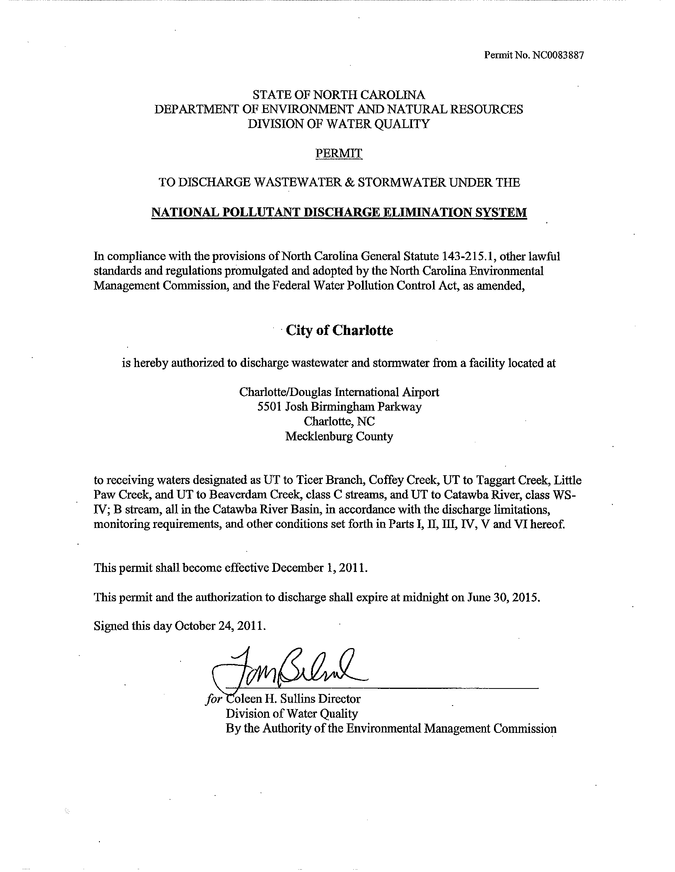
Part II – Our Permit Requirements and Compliance

Slide 15
CLT NPDES Stormwater Permit
What is an NPDES or “Stormwater” Permit?
A permit intended to control water pollution by regulating point source discharges;
The National Pollutant Discharge Elimination System (NPDES) permit program is administered under section 402 of the CWA
Focus is on operations and planning that can reduce pollution point sources
Regulates 3 types of activities (industrial, MS4, and construction)
NPDES permit program is administered by the States; in NC, by the Division of Water Resources at NCDEQ
The Airports NPDES Permit has been administratively extended by NCDEQ.

Slide 16
TWO TYPES OF POLLUTION SOURCES
POINT SOURCES
Pollutants that originate from a fixed location:
e.g. : Discharges from a pipe, leaks and spills of tanks, improper erosion and sediment control practices.
NON-POINT SOURCES
Pollutants that originate from stormwater flow and not from a fixed location.
e.g. : metals, sediment, microorganisms, and petroleum products from parking lots and street runoff.

Slide 17
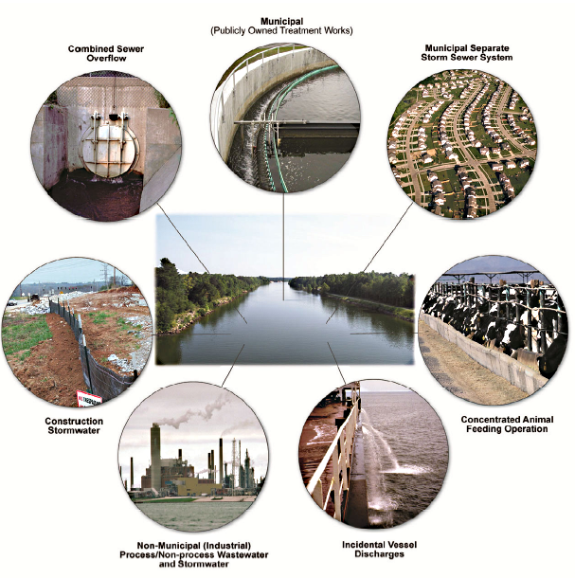
Point Source Discharges

Slide 18
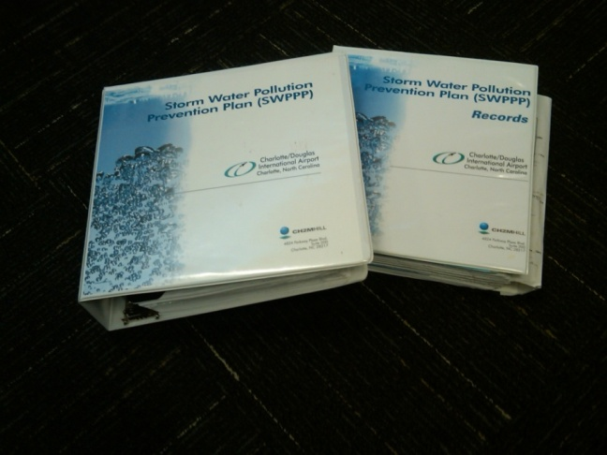
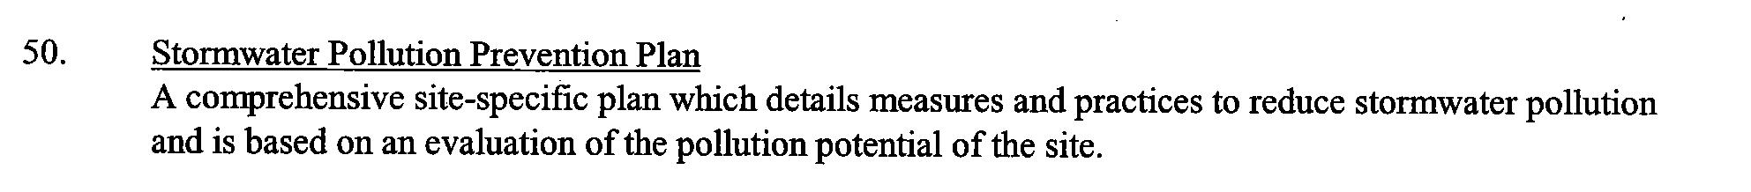
Permit Requirements
SWPPP – “The facility must develop a
Stormwater Pollution Prevention Plan………”
Secondary Containment Requirements.
Inspection Requirements.
Identification of Pollution Sources
Training Requirements.
Sampling and Laboratory Testing Requirements.
Record keeping requirements

Slide 19
Permitted discharges
Precipitation,
Condensate water
Well or groundwater discharges,
Spent de-icing fluid
Firefighting foam
Wash water (with restrictions)
These are the only things allowed to enter the Airport’s stormwater drains

Slide 20
Outfall Sampling Requirements
Sample 6 outfalls 4 times a year for 11 parameters
Sample 1 wastewater discharge 12 times a year for 10 parameters
Standard for Benzene* 51 ug/l
Sample 6 outfalls during 4 de-icing events for 9 parameters
Qualitative monitoring (visual inspection) at 26 outfalls 2 times a year
Acute toxicity** – once per quarter at wastewater discharge; during de-icing events over the permit life at 6 locations,
Benchmark values established for all parameters, most notably turbidity
Monthly discharge monitoring report (DMR) and end of year summary DMR
*Benzene is a colorless, flammable liquid with a sweet odor. Benzene is among the 20 most widely used chemicals in the United States. Benzene is known to cause cancer, based on evidence from studies in both people and lab animals, and has multiple exposure pathways.
**Acute toxicity tests are short-term exposure tests (hours or days) and use lethality as an endpoint. Results are reported in LC50, or concentration that will affect fifty percent of the sample size.

Slide 21
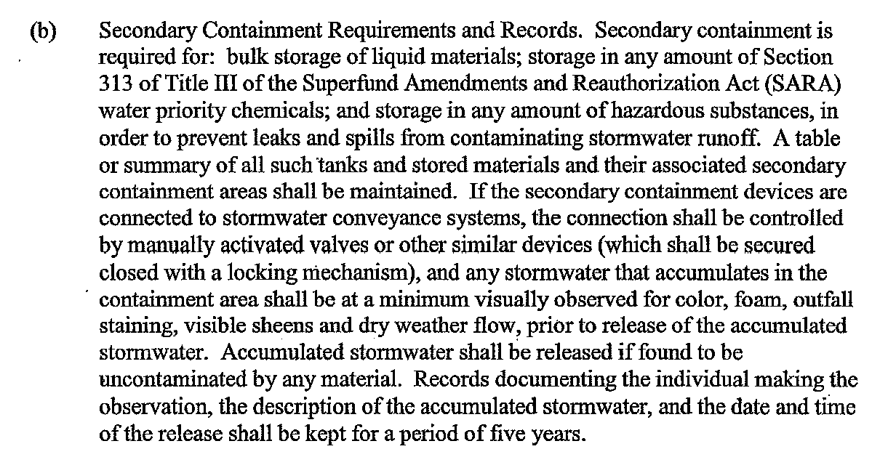
Secondary Containment Requirements
The above rule applies to any above-ground single container that exceeds 660 gallons or a collection of above-ground storage containers in close proximity to each other having a total combined storage capacity greater than 1,320 gallons

Slide 22
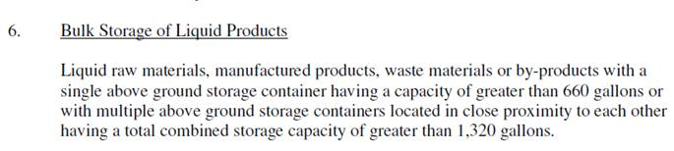
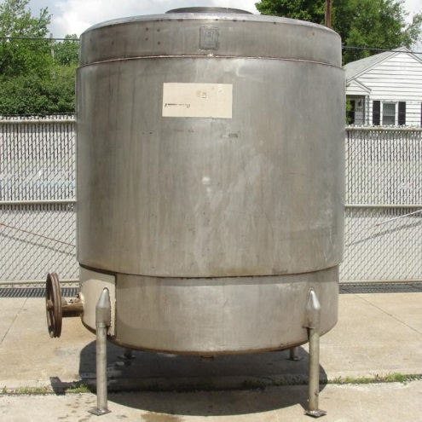
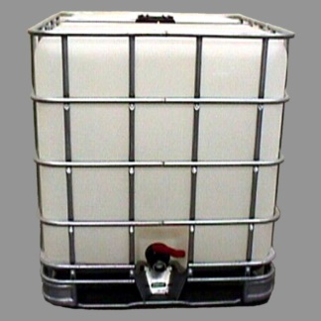
What is Bulk Storage ?

Slide 23
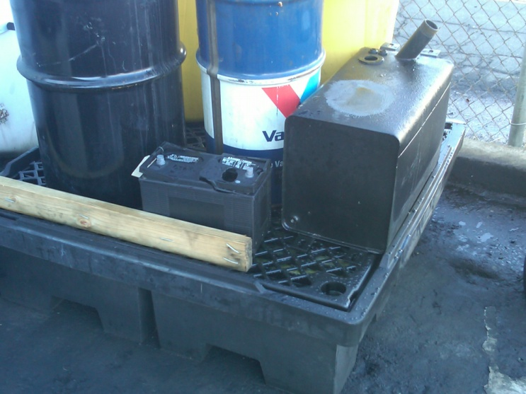
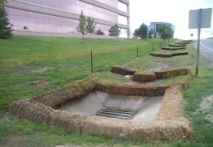
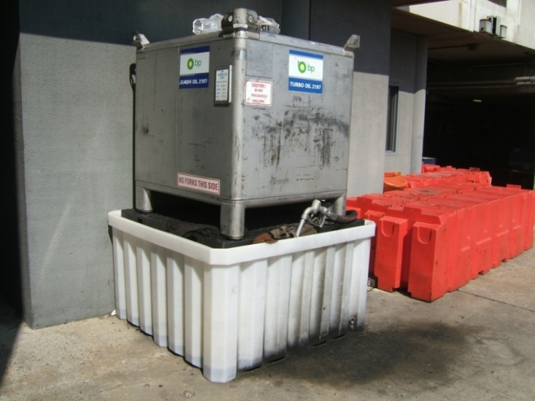
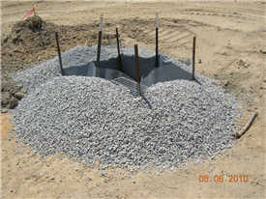
Good Practices

Slide 24
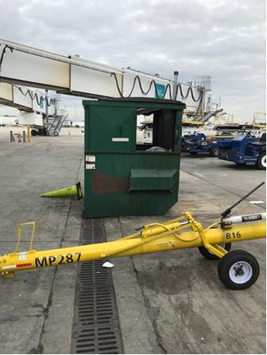
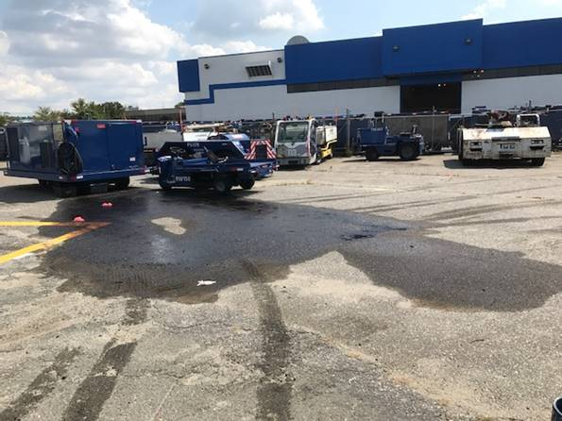
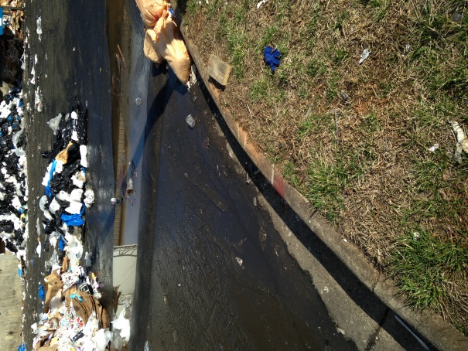
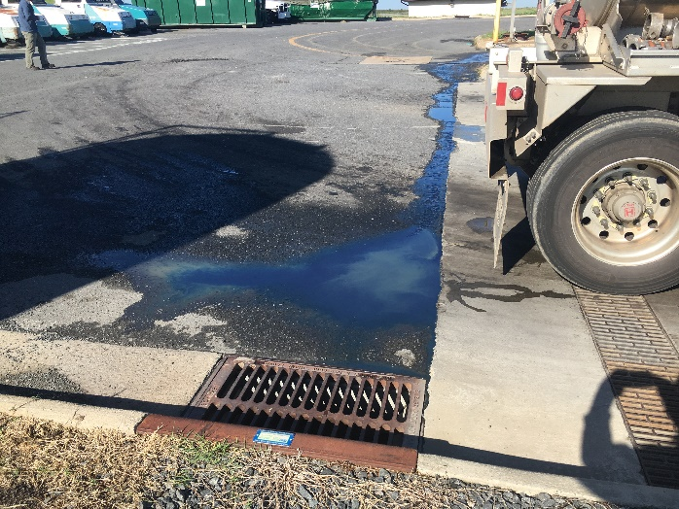
Not so good…

Slide 25
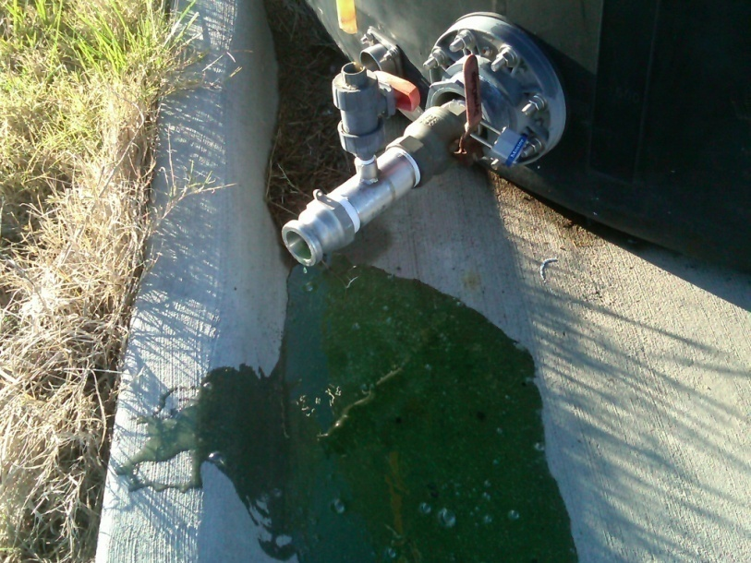
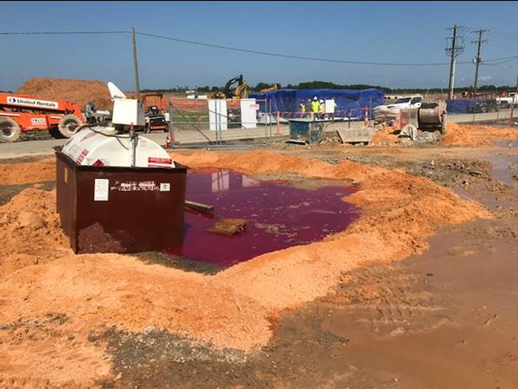
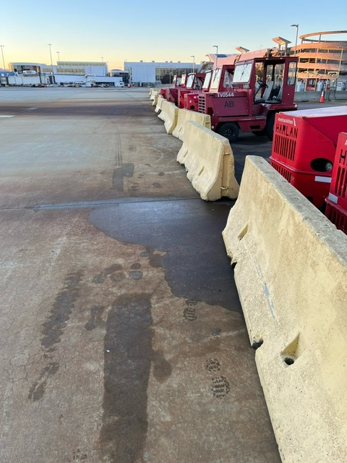
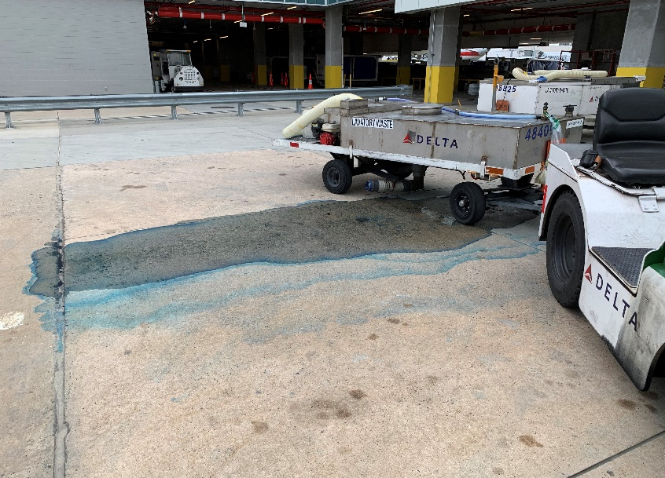
Preventable ?

Slide 26
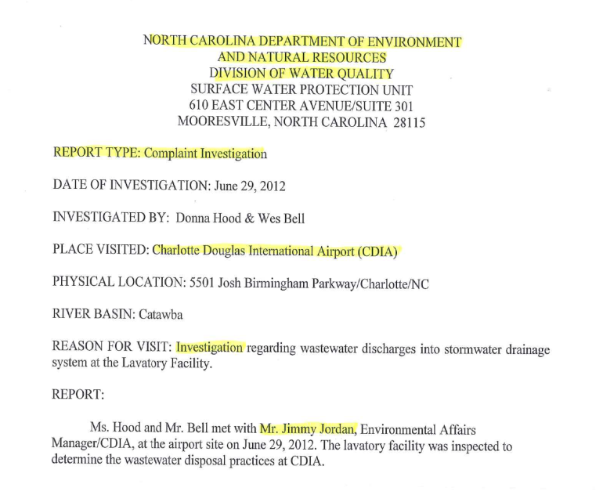

Non compliance

Slide 27
Penalties for non-compliance?
Notice of Violation, Consent Order, or Warning
Civil Penalty for violations of the CWA…
  Fines of up to $25,000 per day, per occurrence
  “Negligent Violators” fined $2,500 per day up to $25,000 per day and/or imprisonment up to 1 year – Second offenses are doubled
  Knowing and willful intent violations – up to half-million dollars
  “Imminent danger Provision” – fines >1M also up to 15 years prison sentence.
  State Level - Class I and Class II State Law penalties may vary up to $10,000 per day.

Slide 28
Specific Obligations – Airport’s Permit
Monthly or Quarterly Sampling and Qualitative Monitoring;
Monthly (and annual) Discharge Report submittals to Raleigh;
Development of a SWPPP (annual updates as necessary);
General Restraints on chemical use (detergents, e.g.);
Recordkeeping (up to 5 years);
Report Spills – Tenants should report spills to CLT;
Secondary Containment; and
Restraints on the usage of De-Icing chemicals.

Slide 29

Part III – Stormwater Management at CLT

Slide 30
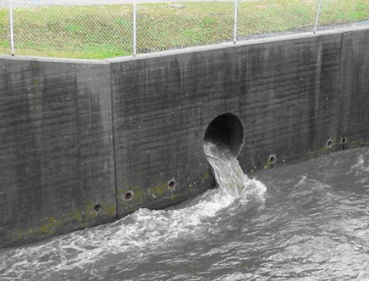
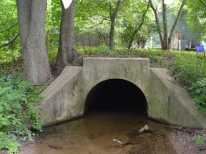
CLT Airport Stormwater* Discharges
Stormwater Discharges from CLT occur to 4 receiving waters:
Taggart Creek
Coffey Creek
Ticer Branch
Beaverdam Creek/Lake Wylie
*Airport Permit is a combined wastewater/stormwater “individual permit”

Slide 31
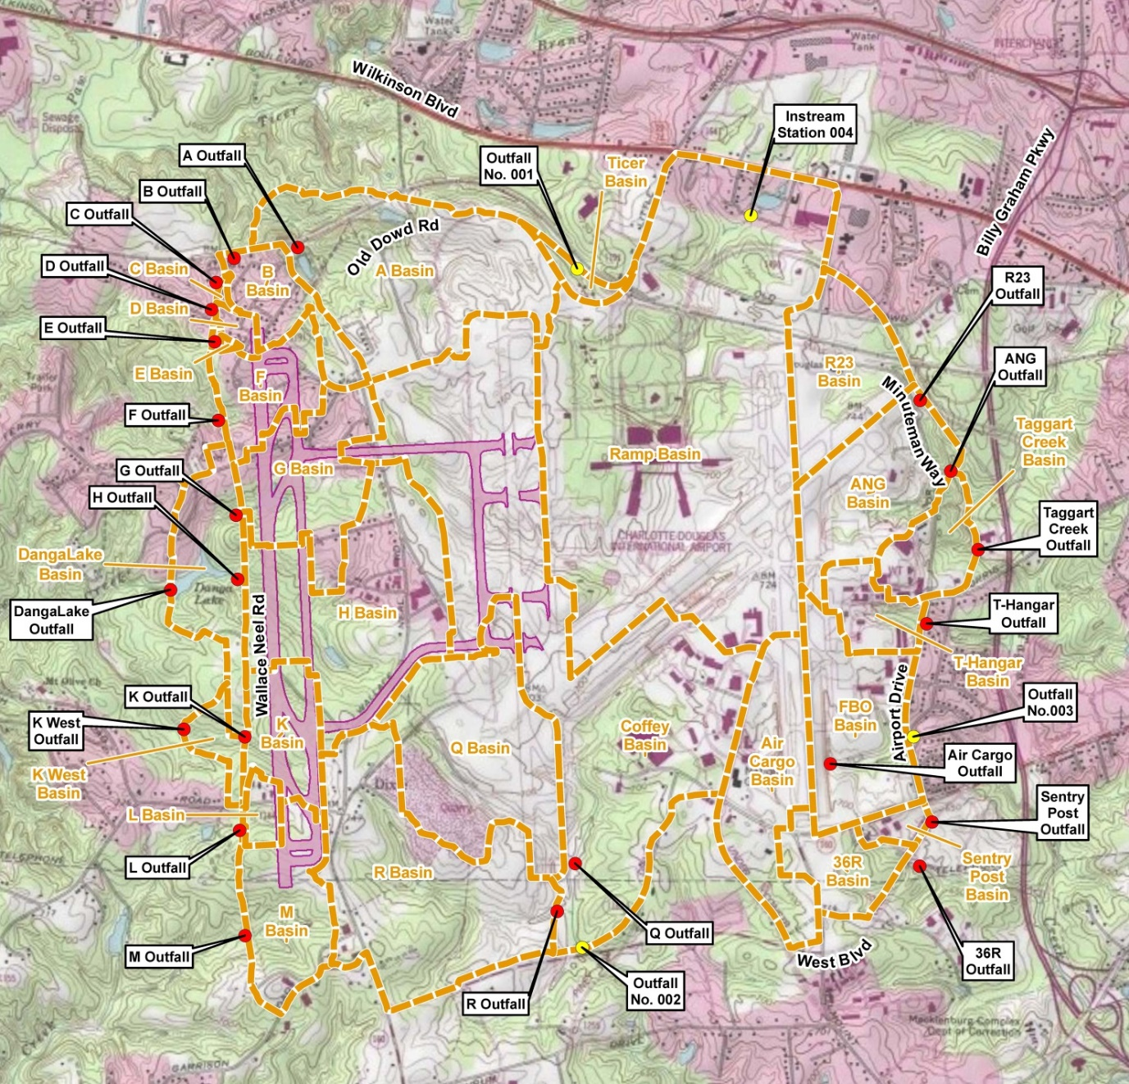
Outfall locations
Outfall – where stormwater leaves CLT and goes into adjacent property waters

Slide 32
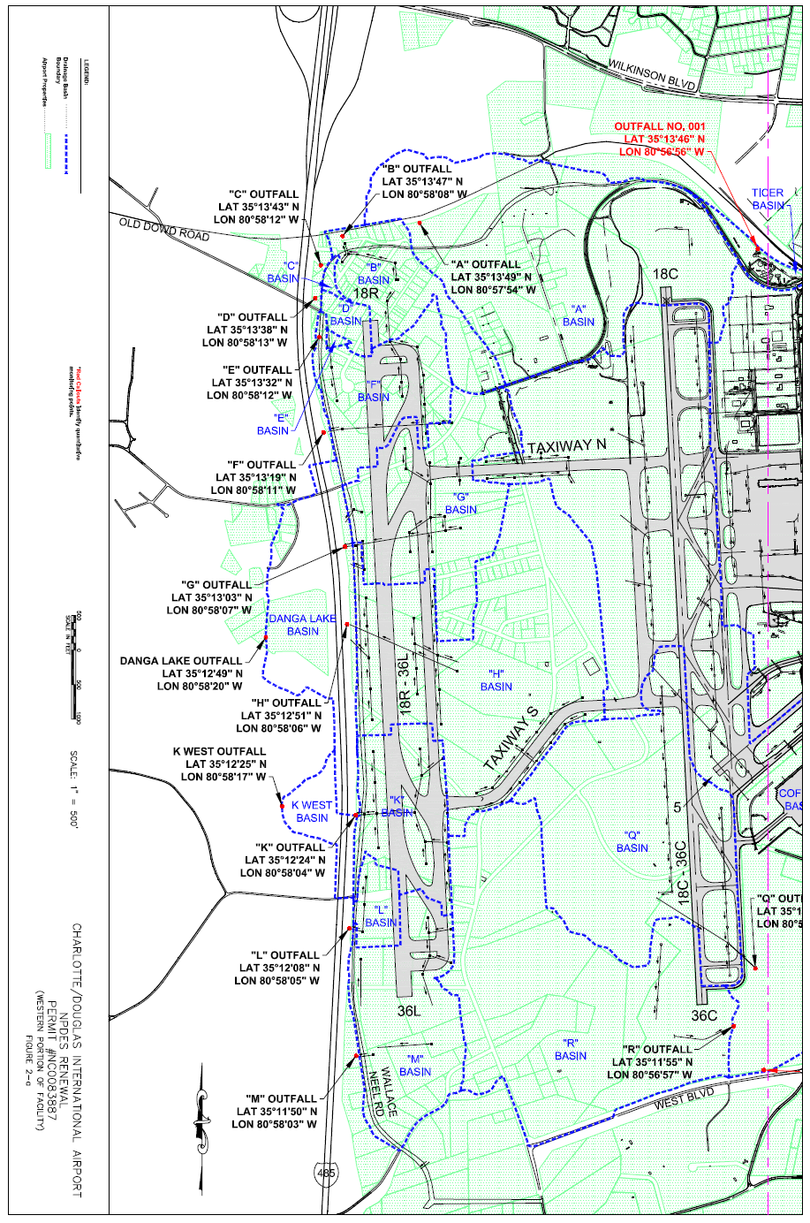
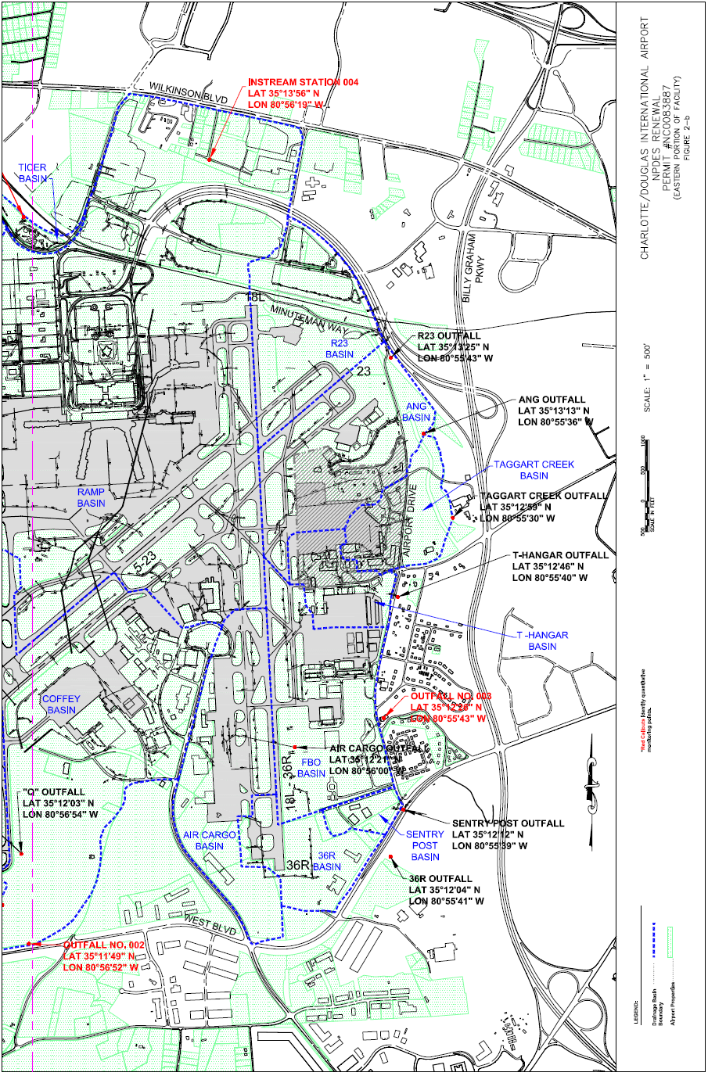

Slide 33


Coffey Creek
Coffey Creek Drainage Basin
CLT CENTER
Coffey Creek Basin drains 938 acres of CLT; 68% of that is Impervious Surface.
OUTFALL

Slide 34

Water Testing – what are we looking for?

Slide 35



ASIG Fuel Farm Sampling
E – effluent sample collected downstream of treatment system
Pimephales promelas (fathead minnow)

Slide 36




What about Aircraft, Vehicle, Buildings, Ramp,
& Equipment Washing?
Detergents must be biodegradable*
DO NOT wash near a storm drain, stay >150’ away
Use off site facilities where possible
Use “dry wash” techniques when feasible
Wash water pH between 6 and 9 Units
Large scale washing needs CLT Approval
Use of absorbent socks, pig mats, etc.
*Biodegradable detergent= low salt and phosphorous content, capable of breakdown by bacteria in the soil within 6 months.

Slide 37



Oil and Petroleum Products
Don’t leave OPEN containers outside;
Clean up spills;
Don’t store products near storm drains;
Keep absorbent socks & kitty litter on hand;
Stop leaks, repair equipment; and
*CLT will pickup drums of spent kitty litter or absorbent socks*.

Slide 38


Oil Can and Filter Recycling
NC Law forbids the practice of throwing oil filters in the garbage.

Slide 39




What happens when it rains?

Slide 40

Sediment and Erosion Control
Eroded Sediment is the No. 1 pollutant to stormwater systems in
Charlotte-Mecklenburg.

Slide 41


Slide 42

Lighter soil particles are washed away through the SW system, and into the stream, while the heavier sediment is left behind. This clouds the water and builds up the creek or stream floor. As the creeks and streams fill with sediment, the flow capacity of the stream is diminished, stream bank erosion occurs, and the risk of flooding is increased.
Major impact on aquatic ecology, altering habitats for aquatic organisms
Reduces light penetration for plant growth
Degrades water quality through the addition of pollutants such as heavy metals, nutrients, and
microbes attached to sediment particles
In 1972, the Clean Water Act established erosion and sediment control regulations to combat sedimentation of the Nations waterways.

Slide 43
Construction Site Inspection Documentation
Required under Sedimentation Pollution Control Act of 1973 (SPCA, North Carolina General Statutes, Chapter 113A Article 4) and Charlotte Mecklenburg County Soil Erosion and Sediment Control Ordinance for ≥ 1 Acre of land disturbance.
Basic Inspection Requirements
General Permit # NCG01
Inspect site once per 7 calendar days and within 24 hours of any rain event ≥ 1”, or at completion of any phase of grading;
Record: date, time, weather conditions, rainfall totals, inspector ID, needed maintenance, corrective actions, each phase of construction; and
Keep Inspection records on site, they are legal documents and can be used in court.

Slide 44


NC DEPT. of ENVIRONMENTAL QUALITY
Self Inspection and Self Monitoring Form
Form now has “Certificate of Coverage” ID and the new process requires to submit a Electronic Notice of Intent (e-NOI) to the regulating authority. $100 Annual Renewal Fee for each permit. Must keep records for 3yrs after project closeout.
NC DEQ Link:
https://deq.nc.gov/about/divisions/energy-mineral-land-resources/erosion-sediment-control/forms

Slide 45


Sediment and Erosion Control for Job Sites
Use silt fencing to control sediment runoff;
Establish ground cover within 7 Days on slopes, 14 days other areas;
Provide engineering mechanisms for management; and
≥ 1 acre disturbed? Erosion and Sediment Control Permit Required for approval by NCDEQ

Slide 46

Sediment and Erosion Control For Construction Entrances
Compacted subgrade;
Stone base or fabric;
Course aggregate on surface;
Locate on high-side of site;
Install storm drain protections;
Install multiple entrances as
needed; and
Allow for turning movements.

Slide 47



Stormwater Drains
Storm drain filters (drain inserts, coir fiber logs, straw, etc.);
Control dust;
Require subcontractors or site workers to sweep road as needed; and
Train your employees to know these drains are ONLY FOR RAIN.

Slide 48


Sediment and Erosion Controls for Retention Basins
Install basin perpendicular to flow;
Berm 1’ above top of outlet pipe;
Porous baffles;
Rock coffer for fore bay; and
Ensure baffle elevation =
Spillway elevation.
Inspect baffles weekly;
Maintain access for repairs, repair as needed;
Remove sediment when half full.
MAINTENANCE

Slide 49






BE Proactive instead of Reactive
Fix rills BEFORE they become a problem.
Muck out basins when ½ full
Keep gravel filters clean.

Slide 50




BE Proactive instead of Reactive
Dust control
Asset protection
Functional Filters

Slide 51


Aircraft Sewage Disposal Area
Curb drains AND trench drains at the Mid Field Fueling area leads to Coffey Creek.
Drains at midfield have been retrofitted with a patented filtering media to reduce the risk of contaminants entering the stormwater system
The stormwater runoff is not treated
Considered an illicit discharge by regulators
Closed circuit monitoring ☺
RUNOFF
FILTER MEDIA

Slide 52



Rule No. 1: Get it in the hole
Rule No. 2:
Keep it off the pavement

Slide 53


Other Rules for Lavatory Disposal
Waste Handling inside the Wash Bay Station
Waste water must NOT leave the Wash Bay
Contents of the tank go into the Triturator
Follow the rules on the sign posted
Do NOT wash your vehicle outside
Keep all waters away from grate and curb drains
Leave the station clean
Report equipment malfunctions to 4012
The presence of Blue Water on the pavement is an indicator of spills…

Slide 54



Waste (Dumpster) Containers
Your dumpsters should not leak.
Drain Valves should remain closed

Slide 55

Aircraft De-Icing

Slide 56

Aircraft De-Icing – What to know
Only propylene glycol should be used-fill trucks away from drains.
Repair Leaky nozzles, hoses, and other equipment.
NPDES Permit requires reporting of de-icing fluid usage to CLT monthly, and an annual summary report (prepared by CLT) to the State.

Slide 57

Sampling during De-Icing

Slide 58

….and more de-icing sampling

Slide 59

Report your Glycol Usage

Slide 60

Part IV
SPCC – Oil Spill Prevention, Control, and Countermeasures Program
1973 Section 311 of the CWA – Authorizes a program to prevent, prepare for, and respond to discharges of oil from vessels and facilities, and mandates regulations establishing procedures, methods, equipment, and other requirements.
Rule stated in 40 CRF 112.
EPA REGULATORY GUIDANCE LINK
https://www.epa.gov/sites/production/files/documents/spccbluebroch.pdf

Slide 61
Who is required to Comply?
The regulation applies to “facilities” that either:
    Have an aggregate capacity in above-ground oil storage of more than 1,320 gallons, or a total underground oil storage capacity of 42,000 gallons; and
    Could reasonably be expected to discharge oil in harmful quantities into navigable waters of the United States.

Slide 62

Know the Basics
Oil containers with at least 55 gallons, including drums and intermediate bulk containers (e.g. “tote tanks”) are specifically included in the scope of the rules;
Animal and vegetable oils, soluble oils, included;
Oil filled equipment is exempt from secondary containment & inspections. So is mobile equipment, so long as it is operated within the boundaries of the “facility”; and
Requirements include increased secondary containment capacity to hold both the largest tank volume plus precipitation.
1 gallon of oil contaminates a million gallons of fresh water

Slide 63

What is required to Comply?
Secondary Containment is required for single containers greater than 1,320 gallons or groups;
A written SPCC Plan;
Labeling of containers
Spill kits
Monthly inspections;
Written records
Manage and document water release from dikes; and
Contingency Plan.

Slide 64


Secondary Containment
Applies to aboveground containers
Any single oil container >1,320 gallons;
Accumulation area….. Is the total* greater than 1,320 gallons ?
Secondary containment MUST contain capacity of largest container plus rainfall
* 55 gallons or greater

Slide 65




Exempt containers
Single or multiple Containers less than 55 gallons; i.e., pallets of 5 gallon product pails
Completely Buried Tanks;
Permanently Closed Tanks; and
Mobile vehicular equipment.

Slide 66

Elements of the SPCC document
Secondary Containment descriptions
Engineering and Procedural Control Measures
Operating Procedures, Inspection records, Evaluations, and Testings;
Facility Diagram;
Drainage and Discharge Path Descriptions;
Response and Reporting Procedures;
Cleanup Measures and Countermeasures;
Training; and
Spill Planning, Notification, and Response.
An SPCC Plan must be……
at the onsite location;
available for inspection;
signed and authorized by management;
reviewed and updated after 5 years (or more frequent)
site specific, and revised as needed

Slide 67
CLT SPCC 2023
  CLT COVERAGE includes
    CLT Center and Fleet Maintenance
    Main Terminal; all Five Concourses and Ramp Area
    Lighting Vaults
    CLT ARFF Stations
    CLT Helicopter Pad
    Old Terminal
    CLT Business Valet Parking Deck
    Hourly Parking Deck and Consolidated Rental Car Facility
    Questions? Call or email jdjordan@cltairport.com/980-288-3793

Slide 68

Where can I find the latest Airport SPCC Plan ?
https://www.cltairport.com/business/business-resources/

Slide 69




Tote Storage

Slide 70


Mobile Equipment
Mobile equipment is exempt from SPCC as long as operated within the bounds of the “facility”. Spill Kits must be located nearby or must be carried with the vehicle.

Slide 71

Drums and Drum Storage
Drum Storage
Spill Kits must be located nearby;
Do not situate drums atop or adjacent to storm drains
CLTs SPCC plan allows for new unopened drums to be stored when secondary containment is not feasible, so long as spill kits are nearby and not near storm drains. (EPA Exemption ?)

Slide 72

Release of Contained Water
Secondary containment dikes (or concrete curb containments) valves should remain in the closed position.
Collected runoff must be observed. If clean water is present, the runoff can be released, but you must document the release.
Document each release event; keep on location. Minimal information must be kept for 5 years.

Slide 73

If you have this….

Slide 74
..then you must have this secondary containment release log

Slide 75


What about Floor Drains?
They should be plumbed to sanitary sewer, or oil-water separator, and not into the storm drain.

Slide 76

Reporting of Spills, oil or otherwise
Report spills to Airport Operations 704-359-4012

Slide 78





The Good…
The Bad…
Spill pallet…

Slide 79







The Ugly
Fix Leaks
Cover your products.
Clean up after your self.

Slide 80

Going Forward…

Slide 81


What Can you do?
Use drum and tote spill pallets;
Fix leaking equipment and clean up spills;
Use biodegradable cleaners and other products;
Report clogged drains;
Keep erosion and sediment control measures in good working order;
Lock up discharge points from totes, tanks, etc.;
Clean up spills of fuel, hydraulic oil, and oil, and dispose of the absorbents in a 55-gallon drum or other container; and
Report violators.
Provide this training presentation to those who work with you – Training Rosters should note the name of employees for whom this training presentation was provided. Your roster should be provided to jdjordan@cltairport.com or justin.klein@cltairport.com, or by other method, no later than Friday January 31, 2026.

Slide 82

And Remember….

Slide 83
Training Aids and Documents
Additional training aids and documentation provided on the Airport’s website:
Training Roster
Current Stormwater Pollution Prevention Plan (SWPPP)
Latest Annual Stormwater Training Presentation
Link to items listed above:
https://www.cltairport.com/business/business-resources/

