Slide 1
LinkedIn for Everyone
(Everything) about Your Personal Profile

Slide 2
Agenda
What exactly is LinkedIn?
How do I set up my profile?
How do I build my contacts?
How do I write my own posts?
Questions?

Slide 3
LinkedIn Facts & Figures
Business network
Users: 1 billion worldwide
USA: 214 mill.; Mexico 22 mill.; Türkiye: 15m; Polska: 6m …
“Sales platform”: Your product, your service, yourself
“Inspiraton”: for yourself, for your job …
Your personal resume - always at hand!
Bullshitting: everyone is an expert and wants to sell you something
Sexual harassment, far-right comments, hate postings

Slide 4
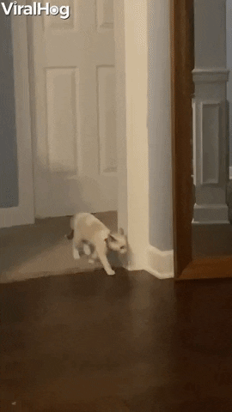
Your Profile I
Profile picture:
Professional portrait -> good smartphone camera or go to a photographer
Always set to be visible in profile!
Background: more possibilities, e.g.
personally authentic or job-related
Format: 1,128 x 191px
Verify your profile
simply using a passport - basis of trust

Slide 5
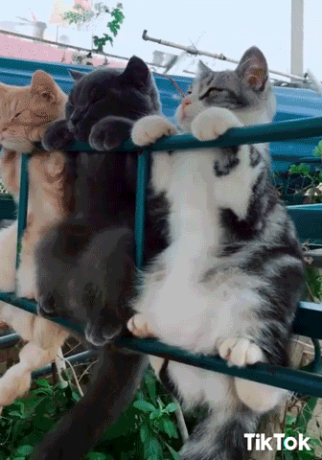
Your Profile II
Individual profile URL
Full name + possible addition (also for findability in search)
Profile slogan
Full sentences or list of attributes/descriptions etc.
120 characters for your personal branding
Info – About me
Your personal introduction
2,600 characters
Lists, paragraphs, emojis

Slide 6
Your Profile III
Which language do I use? -> Whom are you addressing?
Multilingual profiles possible
e.g.: English + Spanish

Slide 7
Making Connections I
The more details your profile has, the better and more varied the suggestions
Link (mobile phone) contacts
Follow or connect?
What is my intention?
Use search
Known people, companies, industries etc.

Slide 8
Making Connections II
Connecting with a message:
No empty phrases
Informal or formal address
Be authentic and take your time
DO NOT directly SELL!
Draw attention to yourself
Comment and like other posts

Slide 9
Writing Posts I
Structure/content of a post:
Hook – first sentence/words -> make the viewer stick around
Use bullet points for easier readability
Express your personal opinion, not just clichés
Use emojis purposefully
https://emojiterra.com/
Picture, video, document:
Square, portrait orientation – fills the screen!

Slide 10
Writing Posts II
Hashtags #
Hardly any significance, max 4-5 per post
Linking other people/companies
e.g. @UNTHA_shredding_technology
Can promote interaction
Negative if the person does not respond to the post

Slide 11
Algorithm I
Posting frequency:
1 to 3 per week (18 hours apart) – regularly!
The best formats:
Polls, document posts (PDFs), text-image, video (1-2min)
Interaction weighting:
Comment
Share with comment
Save
Like

Slide 12
Algorithm II
Interaction in the first 60-90 minutes is crucial
Max. edit the post once
Social Selling Index
https://www.linkedin.com/sales/ssi
+25% more reach when > 70/100

Slide 13
Artificial Intelligence Insights
Generative AI: ChatGPT, Gemini, etc.
Provides the most likely result
Might be wrong
Question the data basis
Energy consumption, deep fakes, etc.
Feed the prompt with information and instructions
The more details, the better the result
Review/revise the result

Slide 14
Key Takeaways
Take the time to make your profile professional and appealing
Connect with existing contacts
Expand your network
Write relevant posts with your personal opinion
Keep an eye on the algorithm and its preferences
AI can be help and an inspiration

Slide 15
One more thing …

Slide 16
Cat Content ..
6,5 billion cat pictures on the internet (2023)
Study* from Indiana, USA with 7,000 participants:
After viewing cat videos in their social media feed, most viewers felt more confident, motivated, and overall happier :)
*Myrick, J. G. (2015). Emotion regulation, procrastination, and watching cat videos online: Who watches Internet cats, why, and to what effect?. Computers in human behavior, 52, 168-176.

Slide 17
Questions??

Slide 18
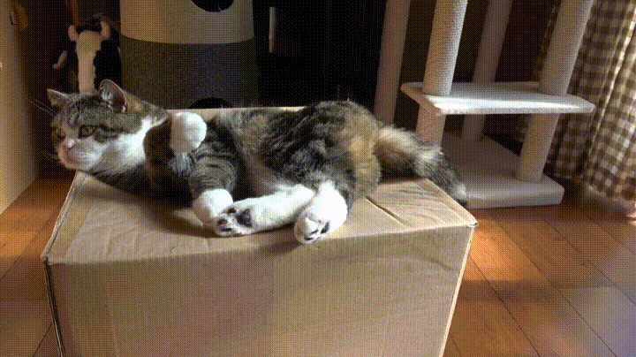
Thank you! Teşekkürler! Dziękuję! Gracias! Merci!

