Slide 1
Business Diversity and Concessions Programs Overview
Tamela Lee
Vice President of Business Diversity and Development
August 26, 2025

Slide 2
Agenda
  Overview
  Business Diversity and Development Department Overview
    Vision and Mission
    Objectives
    FY24 Concessions Achievements
  ACDBE Program
    Background
    08/15/25 Workshop Question
    US DOT ACDBE Final Rule Making
    ACDBE Program Overview, Questions, JV and Pro Forma
    FAQ & Approved ACDBE Certifying Entities
  SBEC Program
    FAQ
    SBEC Program Overview
    Approved Certifying Entity
  Identifying Partners
    08/15/25 Workshop Question
    Partnering Resources Info
    Active Participants List
  Keys to Success
  Additional Resources
  Ask BDD

Slide 3



Business Diversity & Development
MISSION
We lead with intention and integrity to educate, advocate and empower the utilization of diverse suppliers providing value to DFW and the business community.
Vision
To propel a continuous path for wealth creation and economic impact in the business community.

Slide 4

Business Diversity Objectives
Ensure Fair Access to Contract Opportunities
For all businesses and in particular for Disadvantaged, Small, Minority and Women Business Enterprises (AC/D/M/WBEs).
Ensure nondiscrimination in the award and administration of procurements.
Remove barriers to participation.
Promote the utilization of AC/D/M/WBEs.
Assist the development of firms that can compete successfully in the marketplace.

Slide 5
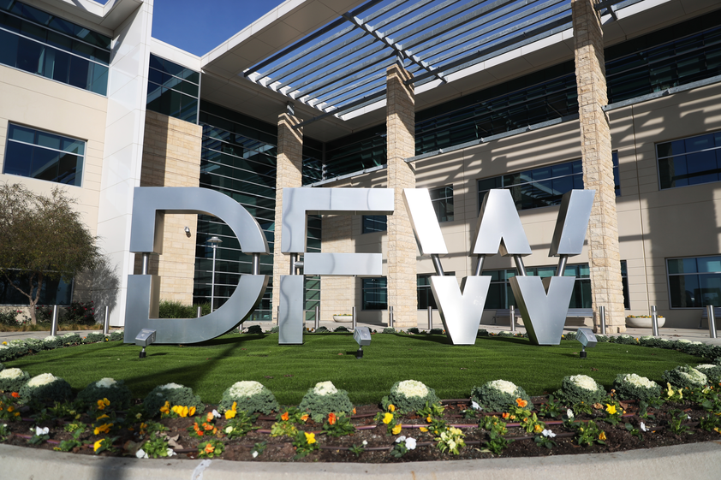
DFW FY24
Concessions Achievements
FY24 ACDBE Non-Rental Car Goal - 31%, FY24 ACDBE Participation Achievement-45%.
FY24 Total Non-Rental Car Revenue - $619M, Non-Rental Car ACDBE Revenue - $280M
FY24 ACDBE Car Rental Goal - 2%, FY24 ACDBE Car Rental Participation Achievement-3.56%.
SBEC Program Adopted in 2021: 8 awarded locations to date.
Notes:
The schedule of subcontractors form is where you will identify all subcontractors to be utilized on the contract including their certification status, scope of work , percentage and dollar commitment for each subcontractor.
DO NOT use ‘to be determined or TBD’ in lieu of a percentage and dollar commitment as that will deem you non-responsive.
We have to be able to determine the percentages and dollar amount associated with your proposed M/WBE participation.
The total of the subcontractors participation and the Prime's self-performance should total 100% as shown.
Again, this form requires a signature.
*If you are self-performing (this form still requires your signature and the percentage that you the Prime is committed to and should match the commitment form.

Slide 6

ACDBE Program
6

Slide 7

ACDBE Background
The Federal Aviation Administration, through the US Department of Transportation (DOT), requires every airport that is a recipient of FAA grant funds establishes an Airport Disadvantaged Business Enterprise (ACDBE) Program.
  ACDBE Regulations (49 CFR Part 23) require that ACDBE Programs submit to the FAA, or other applicable DOT departments, for approval a proposed DBE goal every three years.

Slide 8
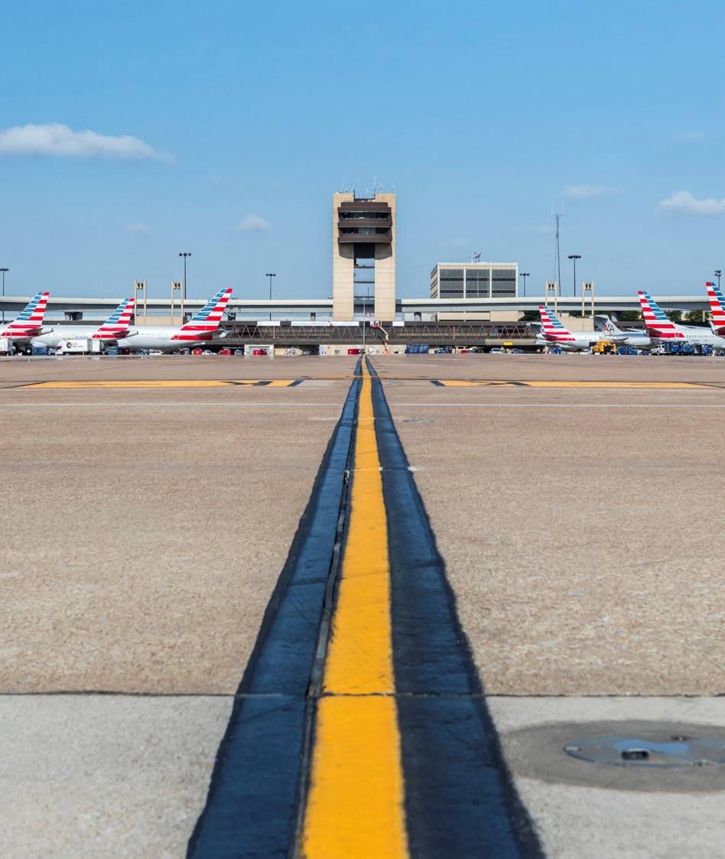
Airport Concessions Disadvantaged Business Enterprise (ACDBE) Program
US DOT ACDBE Final Rule Making
Contains updates to the administration of the ACDBE program regulations including ACDBE Active Participants List
Effective May 9, 2024
Contact NCTRCA for all questions related to ACDBE Certifications from the Final Rule Making

Slide 9




ACDBE Program Requirements Overview
Federal Programs (Federal Regulations)
Airport Concession Disadvantaged Business Enterprise (ACDBE)
51% owned and controlled by one or more socially and economically disadvantaged individuals
Business size based on FAA size standards
Personal Net Worth Threshold
ACDBE Program
  Airport Concessions
  Governed by 49 CFR, Part 23 and 26
  31% Annual Goal
Key ACDBE Program Points:
ACDBE certification not required to do business with DFW; however, ACDBE certification is required if counting toward goal.
Commodity codes must be relevant to scope of work.
No Local Geographic Preference.

Slide 10

08/15/2025 Airport Concessions Workshop Question
What kind of net worth or financial backing requirements do you have for new vendors?
Per the FAA, at least 15% of the capital required should be provided by the ACDBE.
(Additional details next slide.)
10

Slide 11

FAA ACDBE Regulation
The ACDBE should invest capital from its own resources or through a third-party arms-length loan at current market conditions.
  At least 15% of the capital required (including all capital contributions made to the joint venture, e.g., start-up capital, pre-opening expenses, facility construction, operating capital, reinvestment, etc) should be provided by the ACDBE from its own resources or through a third-party as previously referenced. (See 49 CFR Part 26.70)

Slide 12
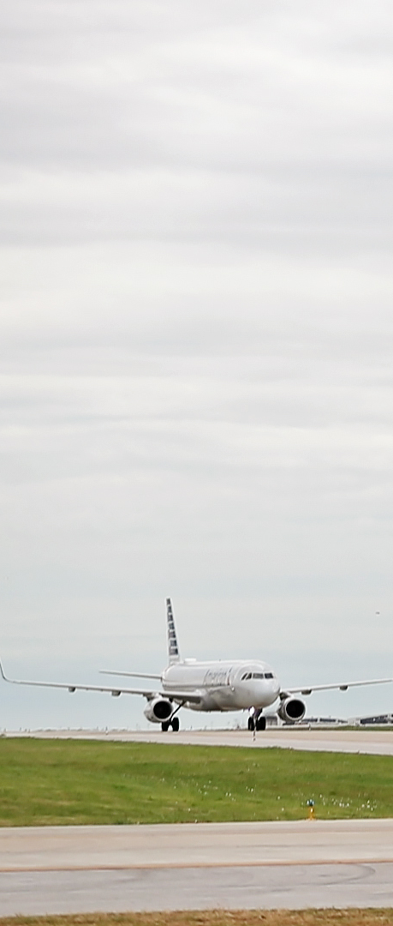
JOINT VENTURES
Joint venture means an association of an ACDBE firm and one or more other firms to carry out a single, for-profit business enterprise, for which the parties combine:
Property
Capital
Efforts
Skills
Knowledge
The ACDBE is responsible for a distinct, clearly defined portion of the work of the contract and who shares commensurate with its ownership interest in the:
Capital contribution
Control
Management
Risks
Profits

Slide 13
PARTNERING OPTIONS
ACDBE Concessions Opportunity
Options for Meeting an ACDBE Goal
100% ACDBE Participation
  The proposer is solely owned and operated as a certified ACDBE firm.
Percentage of participation
  A percentage of the business is designated to be owned, operated and/or maintained by a certified ACDBE through a sub-lease, management, operating and/or franchise agreement.
Percentage Participation by way of a Joint Venture Agreement
  A proposer enters into a joint venture agreement with a certified ACDBE partner, in which the ACDBE partner has a financial risk and reward commensurate with the ACDBE participation for the concession opportunity. For purposes of ACDBE participation, joint venture entities are not certified as ACDBEs.
Percentage of Goods/Services toward Vendor Purchases
  Percentage of total purchases for all goods and services awarded to ACDBE certified firm(s).
Team Selection
Exclusive teaming agreements for purposes of submitting a proposal not allowed.

Slide 14

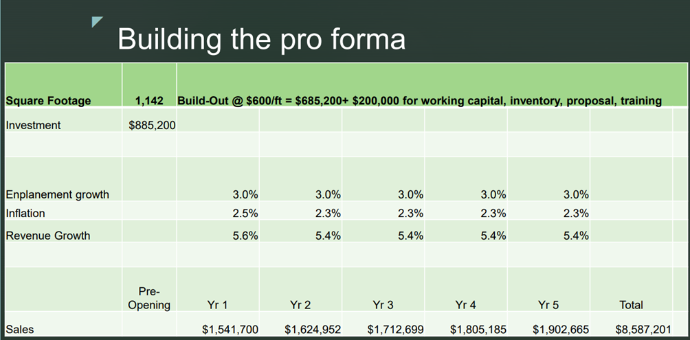
PRO FORMA
Why develop a Pro Forma?
Provides a framework for evaluating the financial potential of a concession opportunity
Allows for sensitivity analysis to assess the impact of various factors
Helps identify risks and opportunities
Facilitates informed decision-making
Assessing a Concessions Opportunity_2024 SOAR Conference
Notes:
The commitment to M/WBE participation form is where you will identify how you plan to meet the diversity goal. Only check one option and be sure to sign the form.
Self-Performance: Self performing Prime must perform at least 30% of the total cost of the contract within its own work force.
Self-Performance &Percentage Participation: Means the Prime will perform some of the work and will bring on an M/WBE subcontractor to complete the goal.
Percentage Participation: means the Prime will bring on a M/WBE firm
The last two: means you are unable to meet the goal and you are submitting a Good Faith Effort Plan

Slide 15
Frequently Asked Question
My company has the opportunity to participate in potential proposals as an ACDBE certified firm and I want to ensure I have the appropriate NAICS codes. Could you confirm what your required NAICS codes are?
The Business Diversity and Development Department does not communicate required NAICS codes in the Concessions proposal opportunities. However, the federal regulations that govern the ACDBE program does require ACDBEs to be certified in the trade of the contract/type of work to be undertaken. For example, an ACDBE participant in a retail joint venture must be certified as an ACDBE retail operator.
15

Slide 16


Approved Certifying Entities - ACDBE
NORTH CENTRAL TEXAS REGIONAL CERTIFICATION AGENCY
2261 Brookhollow Plaza Drive, Suite 300
Arlington, TX 76006
(817) 640-0606 or www.nctrca.org
(Processing timeframe: 60 – 90)
Key certifying agencies
The following agencies are members of the TUCP:
City of Houston, Office of Business Opportunity
City of Austin, Small and Minority Business Resources Department
Corpus Christi Regional Transportation Authority
North Central Texas Regional Certification Agency
South Central Texas Regional Certification Agency
Texas Department of Transportation
Use the TUCP certifying agencies regional map to determine the correct agency with which to apply. You can apply for ACDBE certification online through the Diversity Management System .
TUCP directory can be found on this website Diversity Management System .
(Processing timeframe: 30-45 days)

Slide 17
Frequently Asked Question
I am currently ACDBE certified through the Texas Unified Certification Program(TUCP), with Texas as my home state, but if I am interested in becoming SBEC certified should I apply under TUCP or NCTRA instead?
NCTRCA is the only approved certifying entity for the SBEC certification.
17

Slide 18
SBEC Program Requirements and Overview
Local Program
Small Business Enterprise Concession (SBEC)
Business size based on SBA size standards
Personal net worth threshold same as ACDBE
No Local Preference but must be certified in Texas
Gross receipts averaged over three (3) years
Certification expires and requires annual renewal
SBEC Program
  No Concessions specific goal.
  Must be 100% SBEC.
  Direct negotiation or competitive among other SBECs
Key SBEC Program Points:
SBECs can only joint venture with SBECs.
Commodity codes must be relevant to scope of work.
No GFEs for SBEC proposals.

Slide 19
PARTNERING OPTIONS
SBEC Concessions Opportunity
Options for Meeting SBEC Participation
100% SBEC owner-equity participation
Percentage of participation
  Percentage Owner-Equity Participation by way of a sublease, management, operating, franchise or joint venture agreement or partnerships only with other SBECs.
Team selection
  Exclusive teaming agreements for purposes of submitting a proposal not allowed.
Additional Program Requirement
An applicant does not need to be ACDBE certified to apply for the SBEC program but must meet SBEC certification requirements

Slide 20
Approved Certifying Entity - SBEC
NORTH CENTRAL TEXAS REGIONAL CERTIFICATION AGENCY
2261 Brookhollow Plaza Drive, Suite 300
Arlington, TX 76006
(817) 640-0606 or www.nctrca.org
(Processing timeframe: 60 – 90)

Slide 21
08/15/2025 Airport Concessions Workshop Question
How do we partner with companies such as HMS?
The Business Diversity and Development Department provides networking opportunities throughout the year for firms to connect whether through the SOAR Conference, Capacity Building Program sessions, collaboration with the Concessions Department and other resources.
21

Slide 22
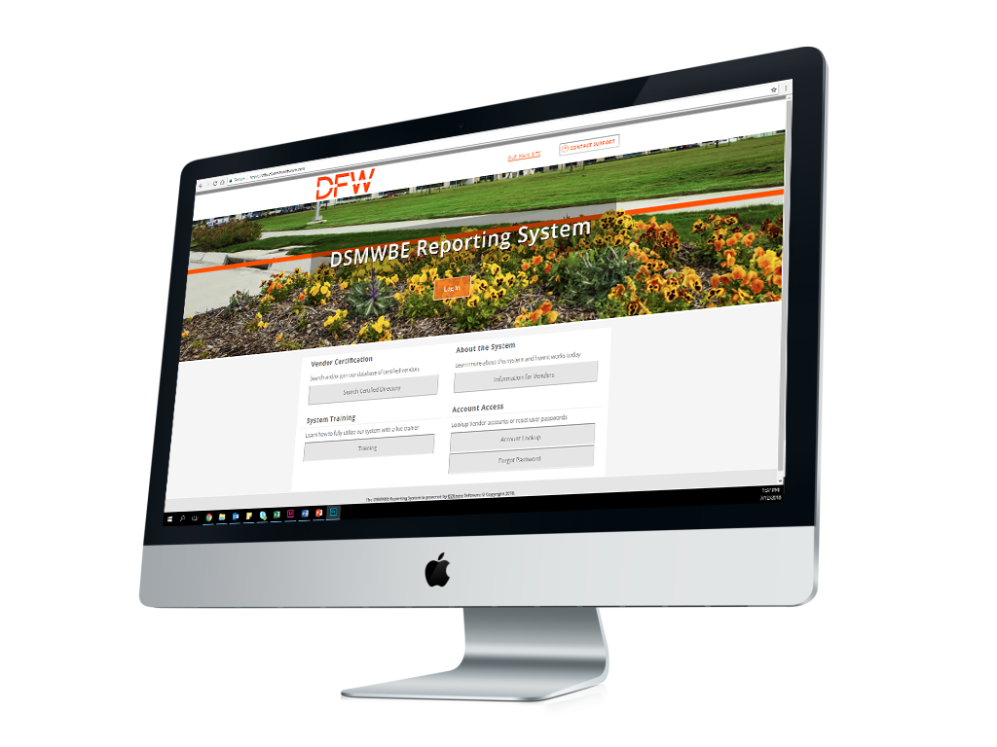

Identifying Prospective ACDBE, SBEC and M/WBE Partners
Pre-Proposal Sign In Sheet
Minority Chambers
Advocacy Organizations
Certification Agencies
  DFW’s Directory is not a ‘certification database
  It is a listing of certified firms that have expressed an interest in doing business with DFW or are currently doing business with DFW
DFW AC/D/S/M/WBE Online Directory
www.dfw.diversitysoftware.com
Federal Aviation Ad Administration
DBE/ACDBE Directory
(dbE-Connect)

Slide 23
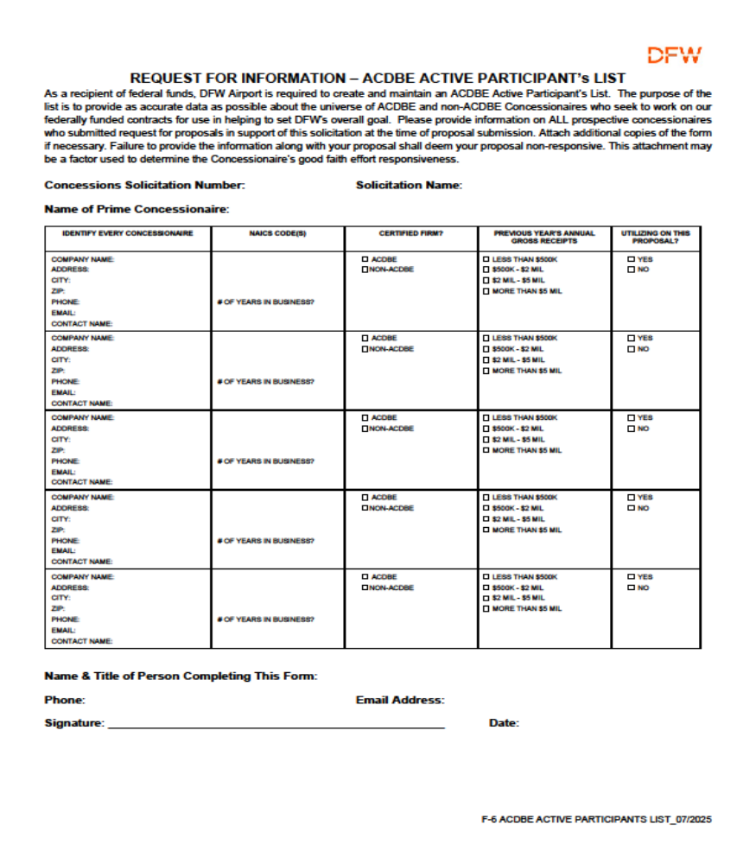
ACDBE Active Participants List
NEW FEDERAL REGULATION REQUIREMENT
Provide information on ALL prospective concessionaires who submitted an RFP in support of this solicitation.
Required at the time of proposal submission.
Attach additional copies of the form if necessary.
Failure to provide shall deem your proposal non-responsive.

Slide 24
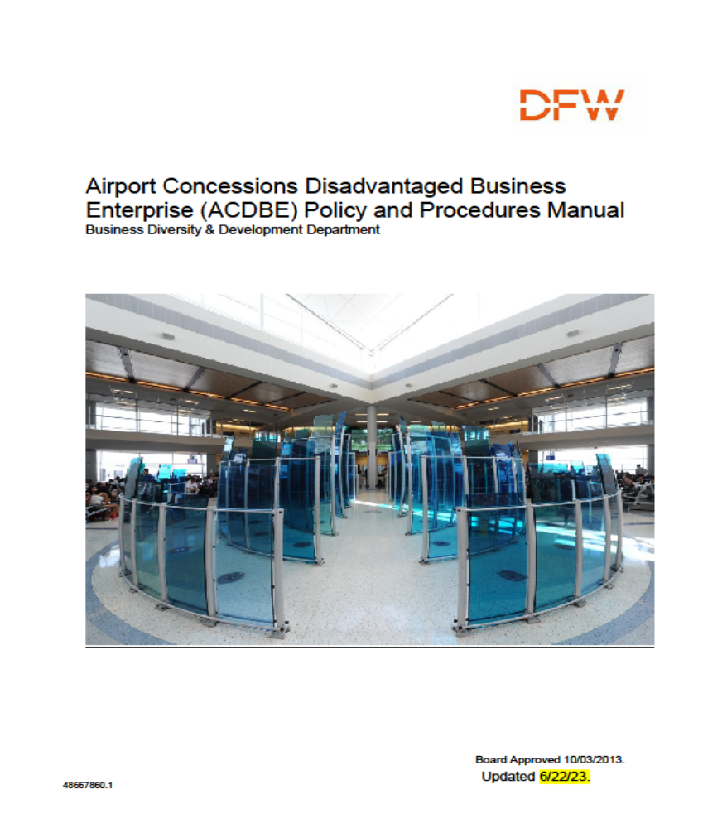
The Keys to Success
Understand the Business Diversity Program Requirements
  Difference in Programs
  Goal versus Commitment
  Required Forms and/or Evaluation Criteria
  Certification in proper NAICS codes
Bidding/Proposing
  Attend Pre-Proposal Meeting
  Submit questions in writing
  Communicate between Pre-Proposal Attendee and Proposal Preparer
  Proofread proposal response before submitting for compliance with Business Diversity requirements
Forms and/or Evaluation Criteria
  Complete and sign all required forms
  Provide exact dollar amounts and percentages for Diversity participation as requested
  Do not use “TBD” or “Up to a certain percentage”
  Submit applicable Certification Certificates
  JV Agreements must be submitted with the proposal
  Highly encouraged to use JV fillable template
Responsive versus Non-Responsive
  Responsive determinations move forward in the evaluation and consideration process
  Non-responsive determinations do not move forward.

Slide 25



Additional Resources
http://www.dfwairport.com/bdd
http://www.faa.gov/
  DFW ACDBE Program Manual
  DFW M/WBE Program Manual
  Joint Venture Agreement Template
  ACDBE Program
  Joint Venture Guidance
  Federal Regulations
25

Slide 26
Ask BDD?
Open Question & Answer Session

Slide 27
Thank you

