Slide 1


Slide 2














" Strategic Integrations - NAF Curriculum Enrichment through Industry Certifications"
“Strategic Integrations - NAF Curriculum Enrichment through Industry Certifications"

Slide 3
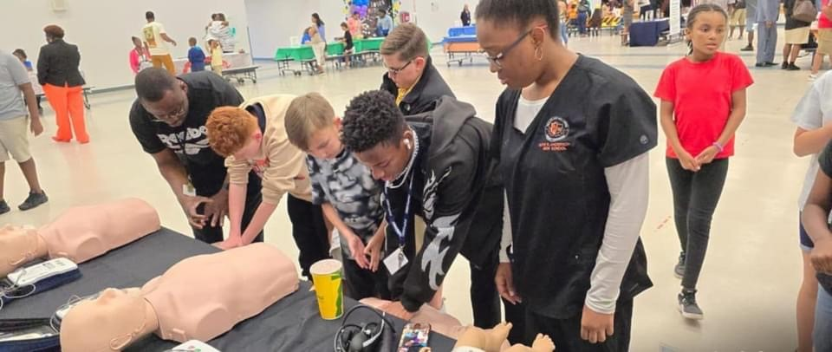

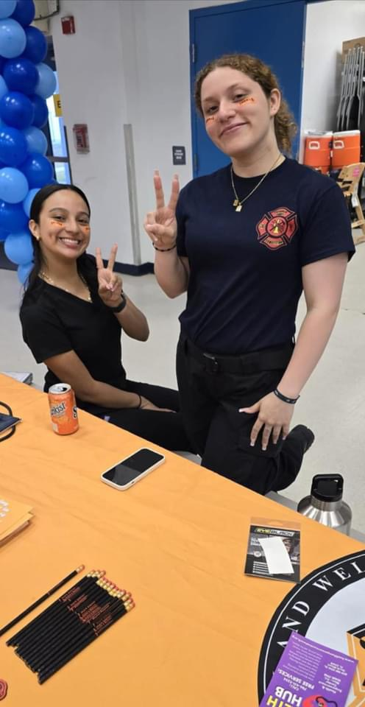
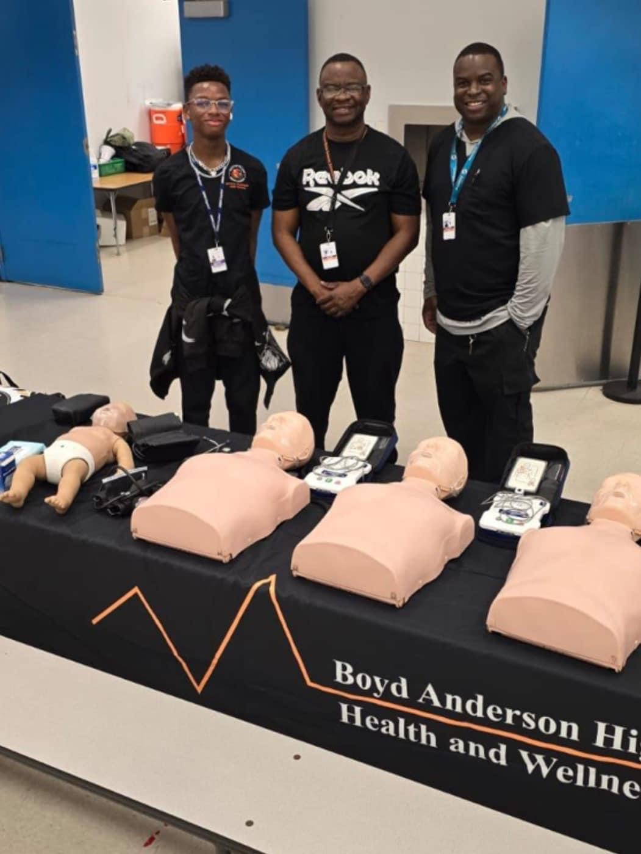



ACADEMY OF
HEALTH SCIENCE
NAF Courses
Health Careers Exploration
Foundations of Anatomy & Physiology I
Foundations of Anatomy & Physiology II
Certifications
Certified Medical Administrative Assistants
Patient Care Technician
Certified EKG Technician
Florida Framework
Course Number | Course Title
8417100 OR 2000350 OR 2000360 | Health Science Anatomy & Physiology OR Anatomy and Physiology OR Anatomy and Physiology Honors
8417110 | Health Science Foundations
8417131 | Allied Health Assisting 3

Slide 4



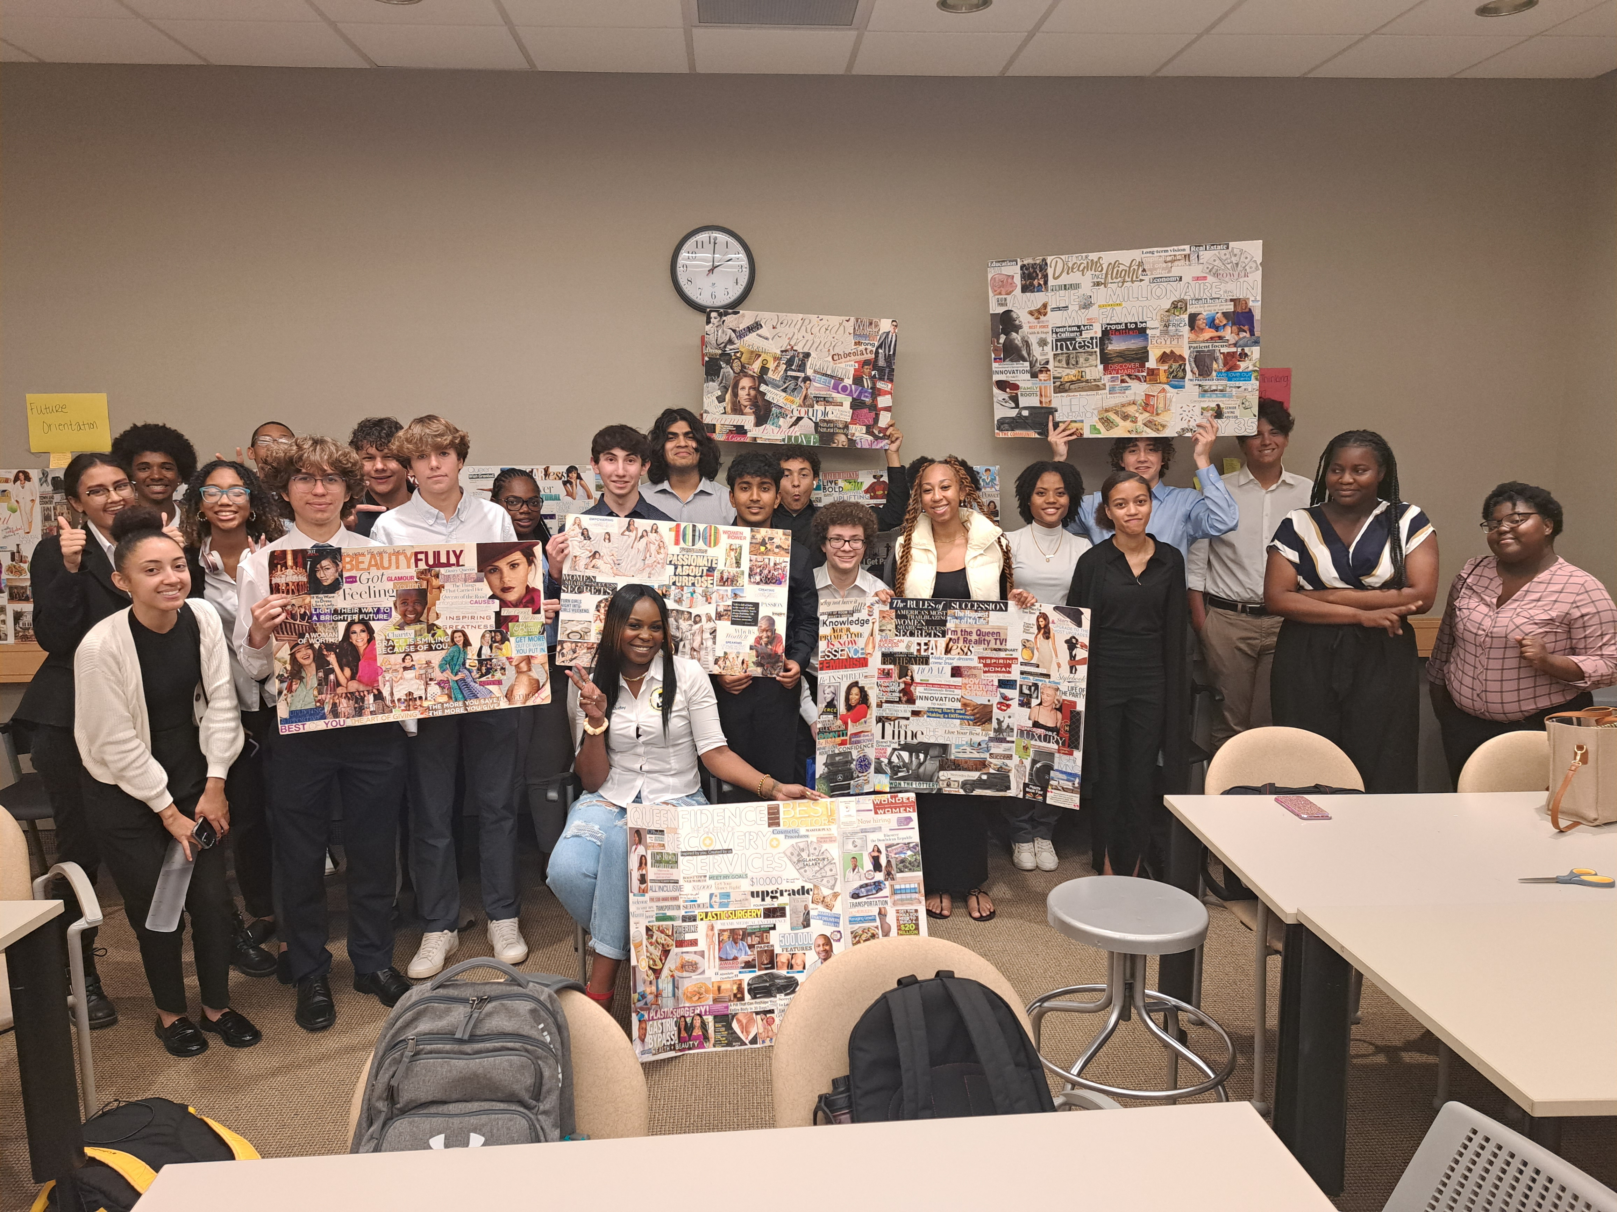
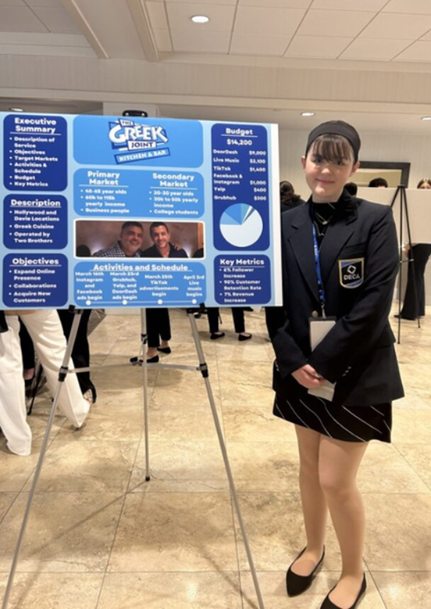
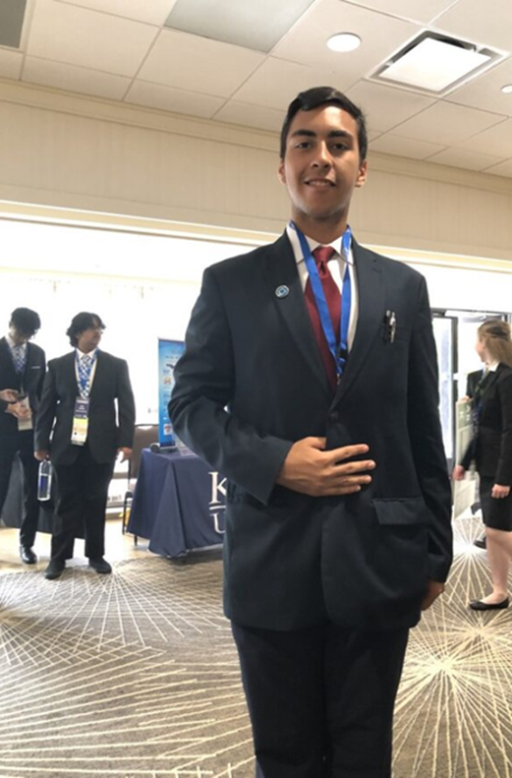



ACADEMY OF FINANCE
NAF Courses
Principals of Finance
Applied Finance
Financial Services
Principals of Accounting
Managerial Accounting
Business
Entrepreneurship (NFTE)
Certifications
QuickBooks
Entrepreneurship and Small Business
Design 4 Delight
Social Media Specialist
Entrepreneurship
Global Finance
Course Number | Course Title
8207310 | Digital Information Technology OR
8815150 | Business Communication and Technology
8203310 | Accounting Applications 1 (no substitutions)
8815130 | Financial Internship OR
8501420 | Finance Cooperative Education – OJT
8815160 | Managerial Accounting
8815170 | Business in a Global Economy
Course Number | Course Title
8812110 | Principles of Entrepreneurship
8812120 | Business Management and Law
8812000 | Business Ownership

Slide 5







ACADEMY OF INFORMATION TECHNOLOGY
NAF Courses
Principals of Information Technology
Introduction to Programming
Computer Science Principals
AP Computer Science
Graphic Design
Web Design
Introduction to Web and Social Media Design
Industry Certifications
HTML CSS
Java
Java Script
Adobe
  Animate
  Illustrator
  InDesign
  Photoshop
Python
Cybersecurity
A+
Applied Information Technology
Computer Science Principals
Course Number | Course Title
8207310 | Digital Information Technology OR
9003410 | Computer Fundamentals AND
9003420 | Web Technologies
9003430 | IT Systems & Applications
And one or more of the following courses:
9003440 | Database Essentials
9003450 | Programming Essentials
9003460 | Web Development Technologies
9003470 | Multimedia Technologies
9003480 | Computer Networking Fundamentals
9003490* | Cybersecurity Fundamentals
Course Number | Course Title
9007610 | Advanced Information Technology
9007210 | Foundations of Programming
9007220 | Procedural Programming
0200335 | Or AP Computer Science Principles
9007230 | Object-Oriented Programming Fundamentals**
0200320 | Or AP Computer Science A

Slide 6





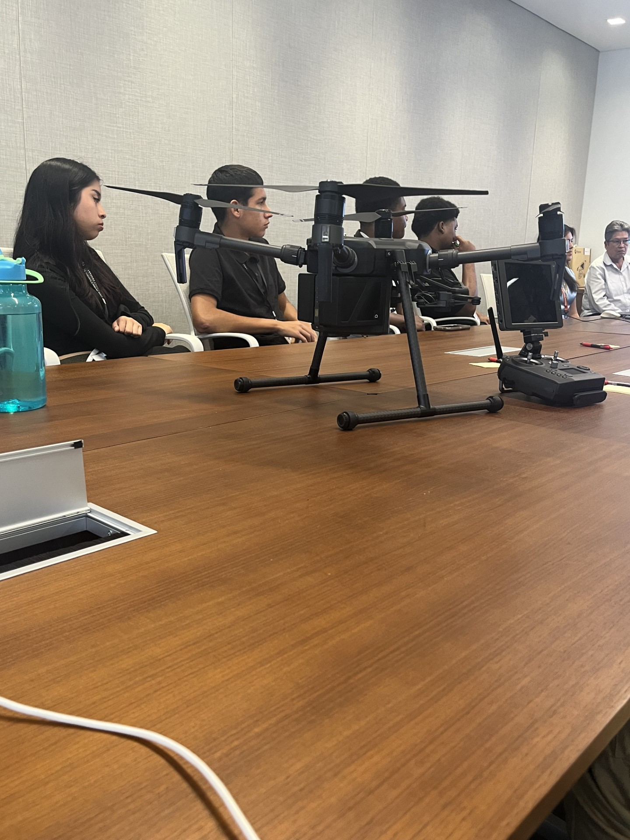
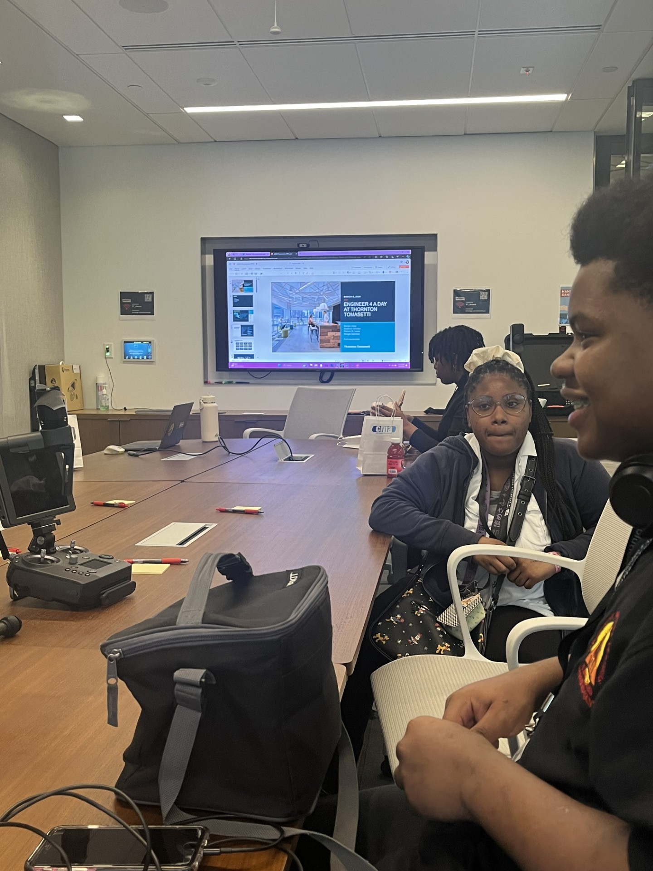
ACADEMY OF ENGINEERING
Naf Courses
Engineering and Design
Engineering Design Process
James Dyson Foundation
AP Computer Science A (CSA)
Project Lead the Way
Industry Certifications
AutoCAD
Inventor
Revit
Fusion 360
Solidworks
Engineering Pathways
Applied Engineering Technology
8600550 | Introduction to Engineering Design
8600520 | Principles of Engineering
8600530* 8600560* 8600590* 8600620* 8600630* | Digital Electronics Computer Integrated Manufacturing Civil Engineering and Architecture Aerospace Engineering Biotechnical Engineering
8600650** | Engineering Design and Development
8401110 | Applied Engineering Technology I
8401120 | Applied Engineering Technology II
8401130 | Applied Engineering Technology III

Slide 7

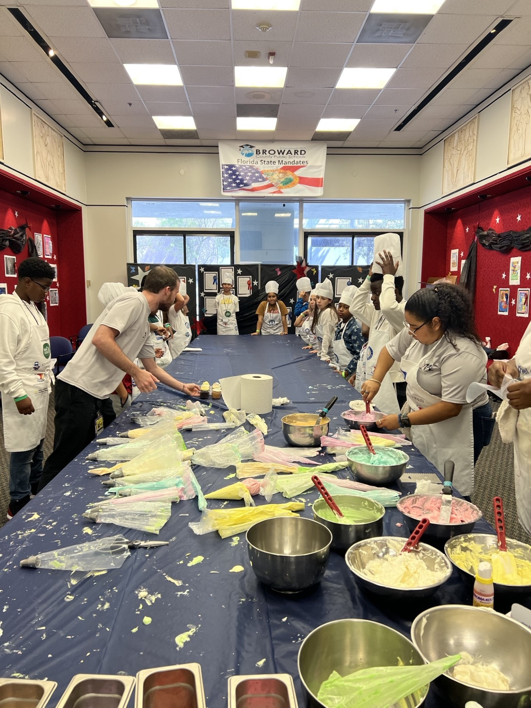


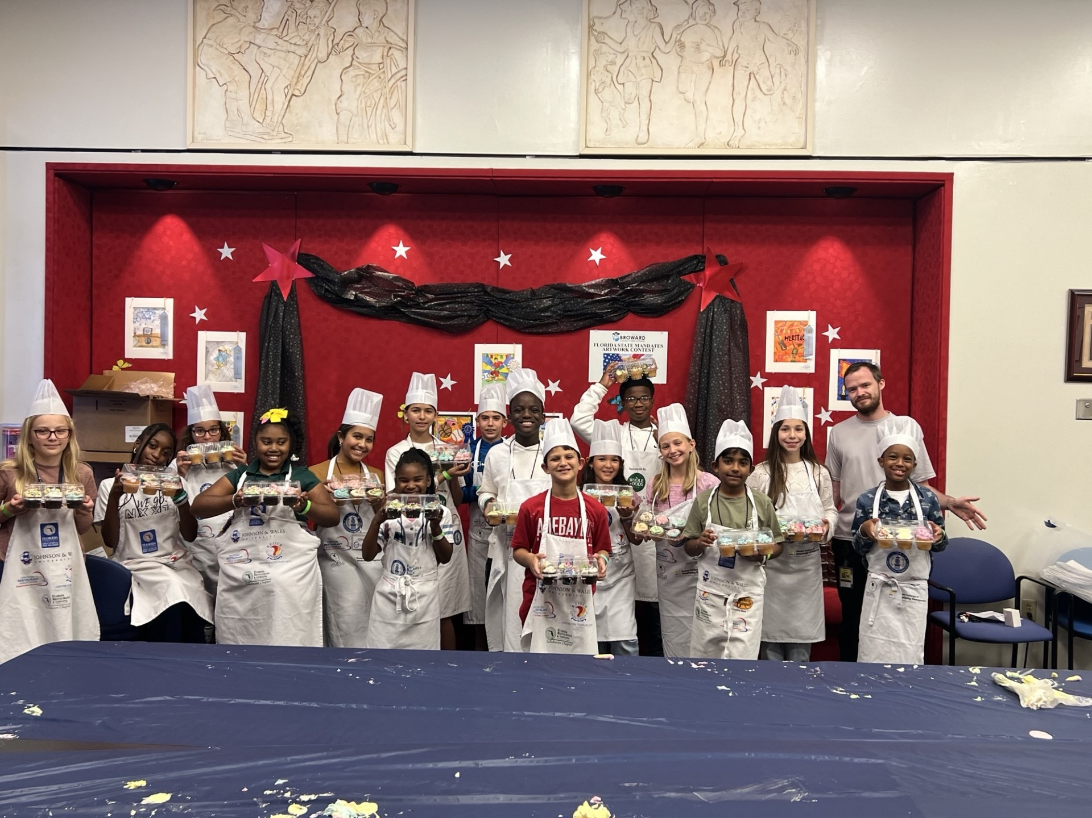
ACADEMY OF HOSPITALITY AND TOURISM
NAF Courses
Principals of Hospitality and Tourism
Delivering Great Customer Service
Hospitality Marketing
Event Planning
Industry Certifications
ServSafe
Entrepreneurship and Small Business Management
Design for Delight
Hospitality and Tourism Management
Culinary Arts
Course Number | Course Title
8850110 | Introduction to Hospitality & Tourism
8703110 | Technology for Hospitality & Tourism
8703120 | Hospitality & Tourism Marketing Management
8845130 OR 8800420 | Hospitality & Tourism Internship OR Hospitality & Tourism Cooperative Education - OJT
8703130 | Hospitality & Tourism Entrepreneurship
Course Number | Course Title
8800510 | Culinary Arts 1
8800520 | Culinary Arts 2
8800530 | Culinary Arts 3
8800540 OR 8800550 OR 8800560 | Culinary Arts 4 (Track 1) OR Culinary Arts 4 (Track 2) OR Culinary Arts 4 (Track 3)

Slide 8
RETURN ON INVESTMENT
Name of Test | Passing Rate | Return on Investment (August 23, 2023-May 6, 2024)
Quick Books | 210 | $215,880
Design for Delight | 133 | $136,724
ESB | 4048 | $4,161,344.00

Slide 9




Resources
Gmetrix/Learnkey | Certiport
Microsoft Office Specialist | Access Expert, Excel, Powerpoint, Outlook, Word, Word Expert, Excel Expert
Adobe Certified Professional | After Effects, Animate, Dreamweaver, Illustrator, InDesign, Photoshop, Premiere Pro
Cisco Certified Support Technician | Cybersecurity, Networking
IT Specialist | Artificial Intelligence, Cybersecurity, Databases, Device Configuration and Management, HTML and CSS, Java, Java Script, Networking, Python v2, Software Development, Introduction to Programming
Autodesk Certified User | AutoCAD, Inventor, Revit, Fusion360
Intuit | QuickBooks, Design for Delight, Entrepreneurship and Small Business
Comp TIA | IT Fundamentals, A+ 1100 Series, Network+, Security+

Slide 10



Activity
Create an account at https://gmetrix.com
Go to your account and click on Redeem Code
Copy the Access Code Provided to You
Your Curriculum for the Entrepreneurship and Small Business/Practice Tests will open
Review Curriculum: This resource supports our Academies of Finance and Academies of Hospitality and Tourism. (Third-party curriculum Network for Teaching Entrepreneurship, (NFTE)
Provides practice for the Entrepreneurship and Small Business Certification Exam
This link will be disabled in 30 minutes

Slide 11

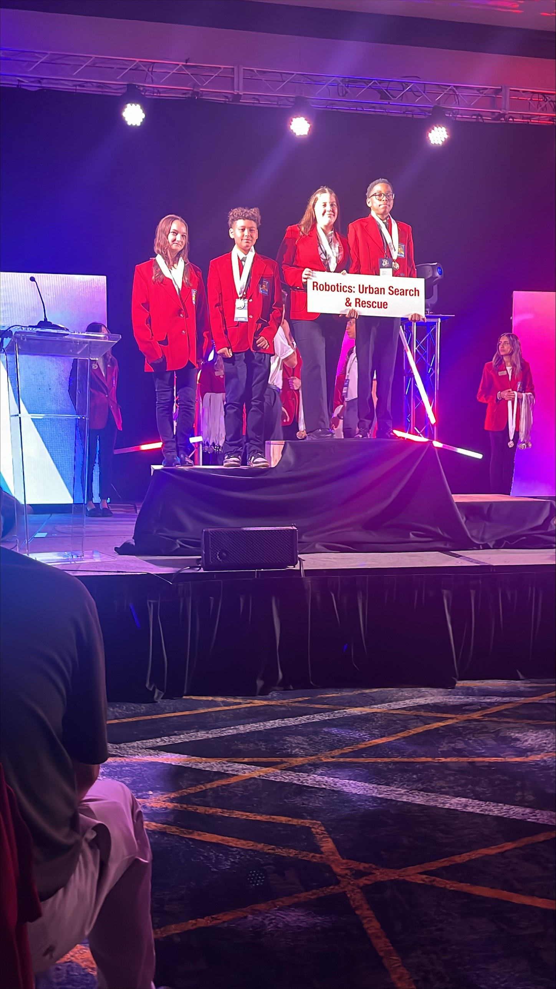

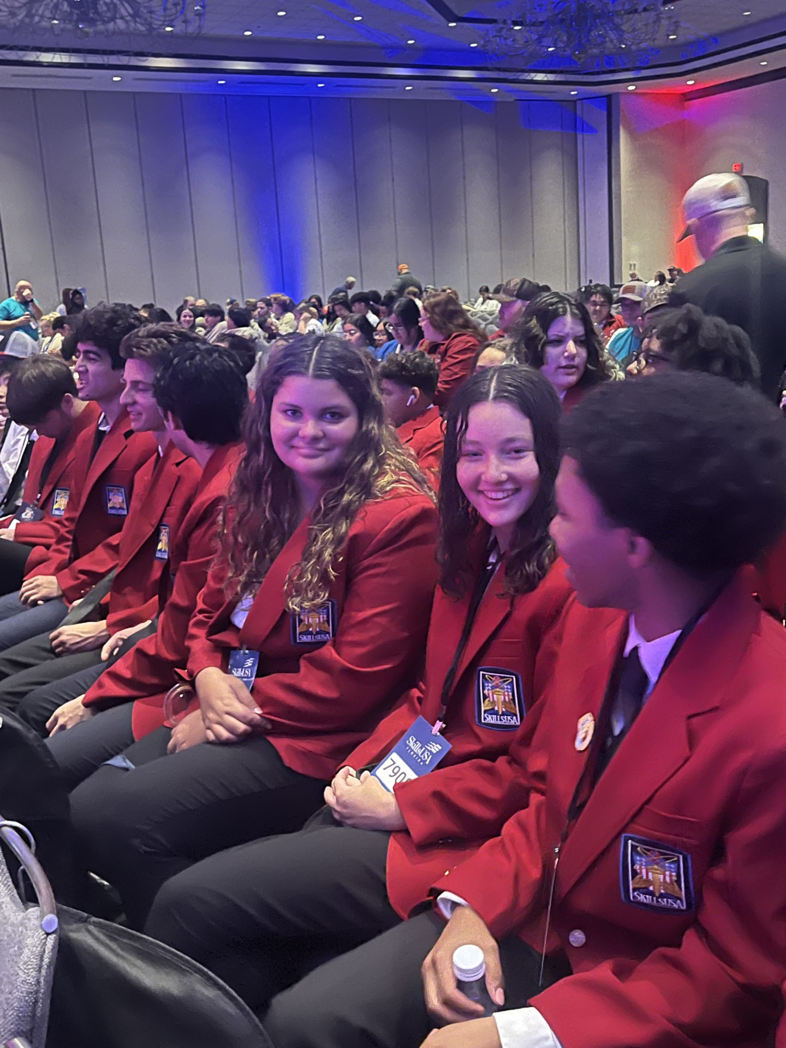

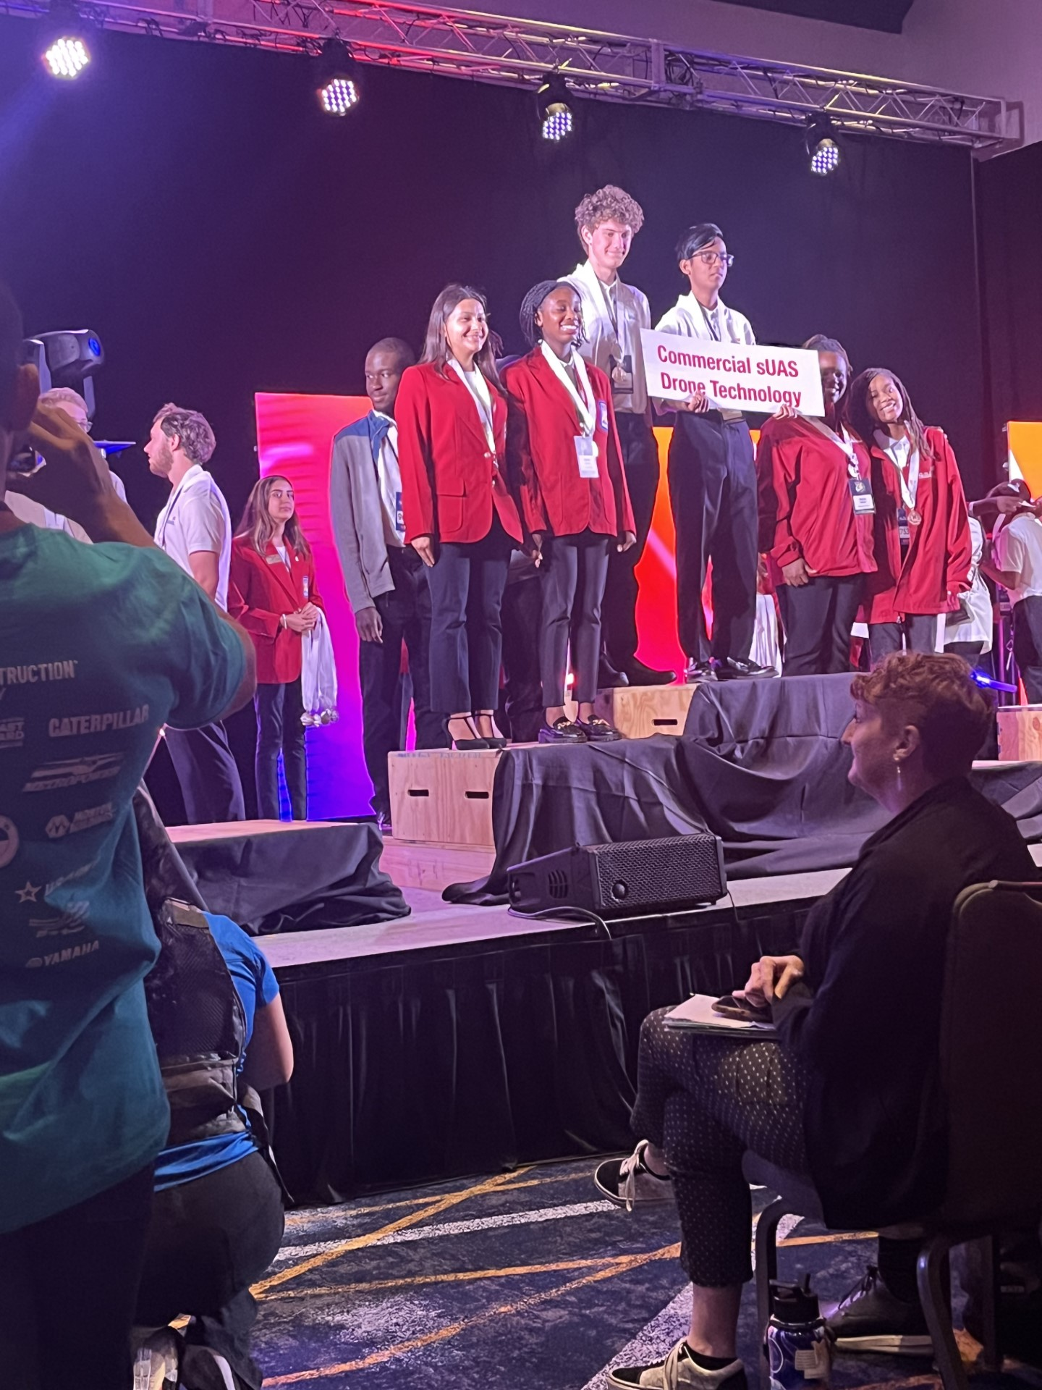
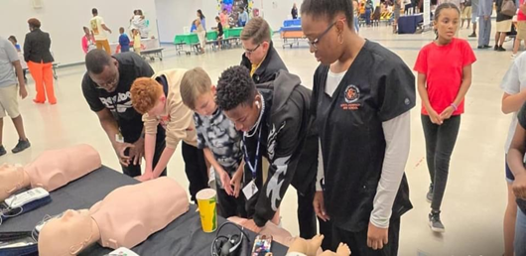
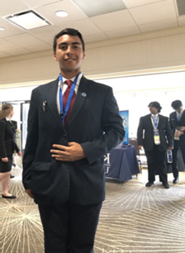
Career, Technical, Student Organizations

Slide 12


Slide 13
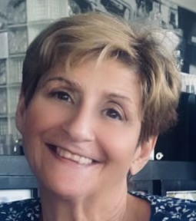

Contact Information
Jean Mason
Curriculum Facilitator
School Board of Broward County
Fort Lauderdale, Florida
Jean.mason@browardschools.com
(754) 321-8400

Slide 14

DON’T FORGET
to Complete this Session Evaluation!
Session Code:
#XXXX

