Slide 1


About NAF
We aim to provide access to opportunities for high school students and their communities by bringing schools and businesses together to better prepare students for college, career, and future success.
NAF.org

Slide 2

Introductions
Share:
Name and Role
Reflect on one of the following:
What topics are you most interested in exploring today?
What outcomes do you hope to achieve for your district, school, and community?
2
Notes:
Introductions Agenda Review
1. Network Highlights; 2. NAF Design Overview; 3. Tech Enabled Impact 4. Admissions and Pricing; 5. Questions & Next Steps

Slide 3





What We Do
NAF prepares young people for College and Career success.
Leads a national network of career academies — small, focused learning communities within public high schools.
Offers a proven, sustainable model connecting schools and businesses to prepare students for the future.
Aligns learning with high-demand, high-growth industries.
NAF is preparing a skilled talent pipeline for our country’s most viable industries, in partnership with high schools, employers, and community leaders.
Health
Sciences
Hospitality &
Tourism
Information
Technology
Engineering
Finance
*Additional industry themes represented and supported by NAF
3

Slide 4
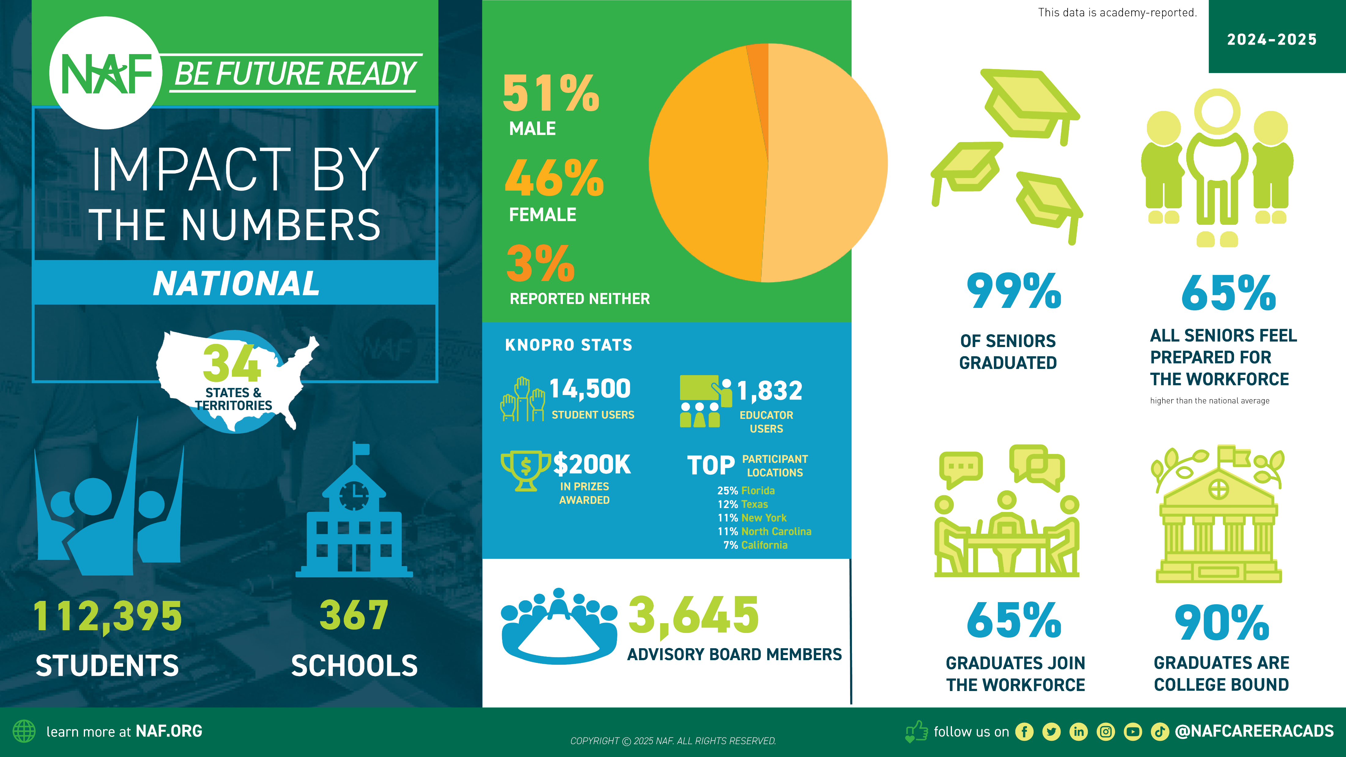
4

Slide 5

634 149
2024–2025
143
34
OUR CITIES
ACADEMIES
DISTRICTS
CITIES
STATES & TERRIRORIES
ALABAMA
Atmore Birmingham
ARIZONA
Glendale
CALIFORNIA
Azusa Burbank Compton Covina Dinuba Duarte Fresno Long Beach Los Angeles Milpitas Monrovia Orosi
Palo Alto Pomona Porterville Riverside
Tulare Vallejo
COLORADO
Denver Greeley
CONNECTICUT
East Hartford Hartford New Britain Stamford
WASHINGTON DC DELAWARE
Bridgeville Dover Felton Laurel Milford Newark Selbyville Smyrna Wilmington
Wyoming
FLORIDA
Fort Lauderdale Largo
Miami Naples Riverview Sanford Tampa
West Palm Beach
HAWAII
Honolulu
IDAHO
Pocatello
INDIANA
Sellersburg
KANSAS
Kansas City
LOUISIANA
Baton Rouge Lafayette
New Orleans
MARYLAND
Baltimore Bel Air Ellicott City Rockville
Upper Marlboro Westminster
MASSACHUSETTS
Chicopee New Bedford Roxbury
MICHIGAN
Detroit Farmington Flint
Grand Rapids Kentwood Pontiac Redford Southfield
MISSISSIPPI
Forest Jackson
MISSOURI
Hazelwood Jennings
NEVADA
Las Vegas
NEW HAMPSHIRE
Merrimack
NEW JERSEY
Elizabeth Fort Lee Jersey City Wayne
NEW YORK
Angola Cheektowaga Clarence Depew Elmira
Floral Park Garnerville Grand Island Hamburg Lancaster Middletown Monticello New York
North Tonawanda Northport Salamanca
West Seneca Westbury Wilson Yonkers Youngstown
NORTH CAROLINA
Asheboro
Burlington Cary Charlotte Concord
Durham Fayetteville Mooresville Sanford Smithfield Winston-Salem
OHIO
Columbus
PENNSYLVANIA
Scranton Uniontown
PUERTO RICO
Mayaguez
RHODE ISLAND
North Kingstown Providence
Wood River Junction
SOUTH CAROLINA
Columbia
SOUTH DAKOTA
Sioux Falls
TEXAS
Carrollton Dallas Richardson
VIRGIN ISLANDS
Christiansted St. Thomas
VIRGINIA
Alexandria
WASHINGTON
Federal Way Seattle
WISCONSIN
Milwaukee
learn more at NAF.ORG
COPYRIGHT © 2025 NAF. ALL RIGHTS RESERVED.
follow us on
@NAFCAREERACADS

Slide 6




The NAF Design
NAF ignites students’ passion for learning through an educational design featuring:
Academy Development & Structure
Advisory Board
Program of Study
Work-Based Learning
(Curriculum & Instruction)
6

Slide 7
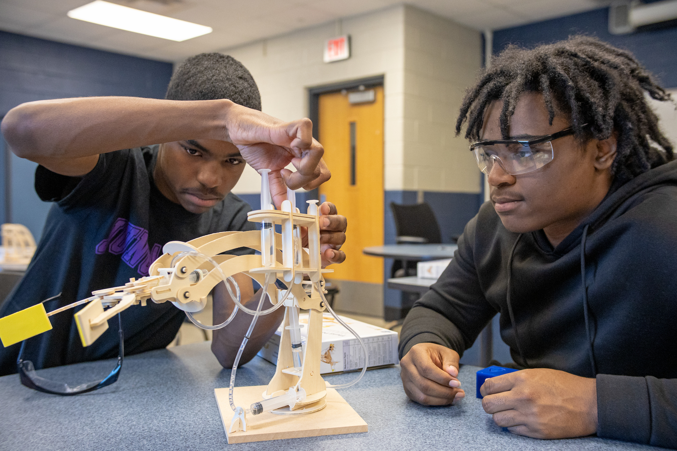
Academy Development & Structure
Building a strong foundation.
Flexible structure
Open, interest-based enrollment
Small learning communities
Enrolls 20+ students per grade level
Collaborative leadership — bringing together academy, business, and community leaders
Data collection and analysis to inform continuous improvement
7

Slide 8
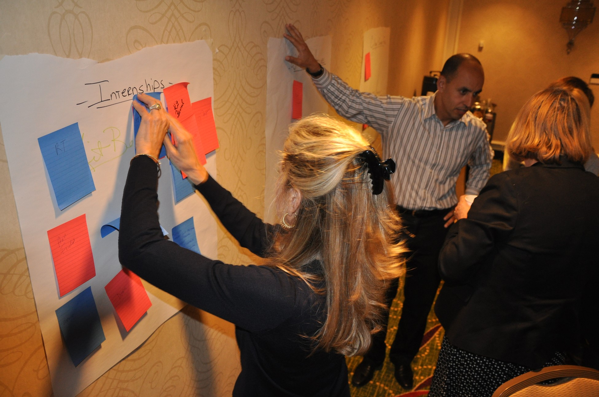
Advisory Board
Advisory boards bridge classroom and career.
10+ members, 80% from business and industry
Actively support work-based learning activities
Inform curriculum and support teacher development
Advocate for the academy through community engagement
Strategic, organized structure that promotes long-term sustainability
8

Slide 9

Program of Study
Connecting Coursework to Careers —Industry-Informed & Student-Centered
Career-connected curriculum that aligns with industry standards
Authentic, project learning experiences that builds career-readiness competencies
College-aligned coursework and certifications that strengthen post-secondary pathways
Health
Sciences
Hospitality &
Tourism
Information
Technology
Engineering
Finance
Future Ready Learning: ash.naf.org/public/learning
9

Slide 10
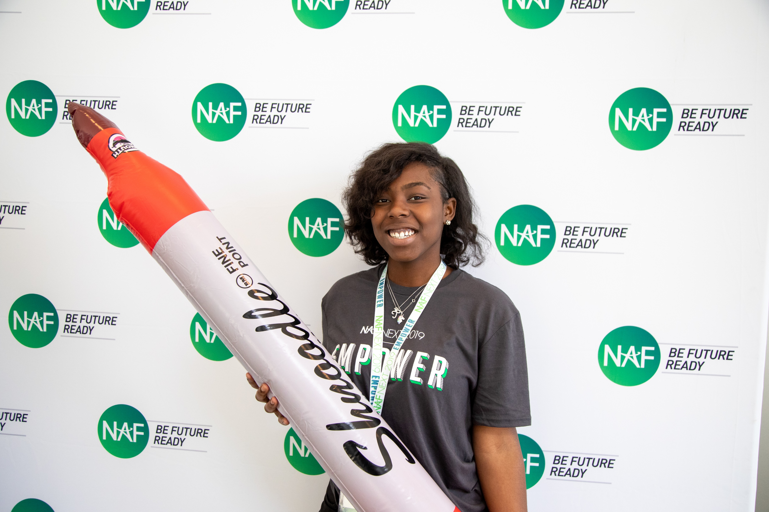
Career Pathways
In addition to NAF’s five core career themes, academy offerings have expanded to include the 14 career clusters and associated pathways that align with National Career Clusters Framework, as well as State-Approved career pathway courses.
National Career Clusters Framework, allowing academies to tailor pathways to local workforce needs.
Advanced Manufacturing
Construction
Supply Chain & Transportation
Arts, Entertainment, & Design
Hospitality, Events, & Tourism
Financial Services
Education
Healthcare & Human Services
Public Service & Safety
Agriculture
Energy & Natural Resources
Digital Technology
Marketing & Sales
Management & Entrepreneurship
10

Slide 11

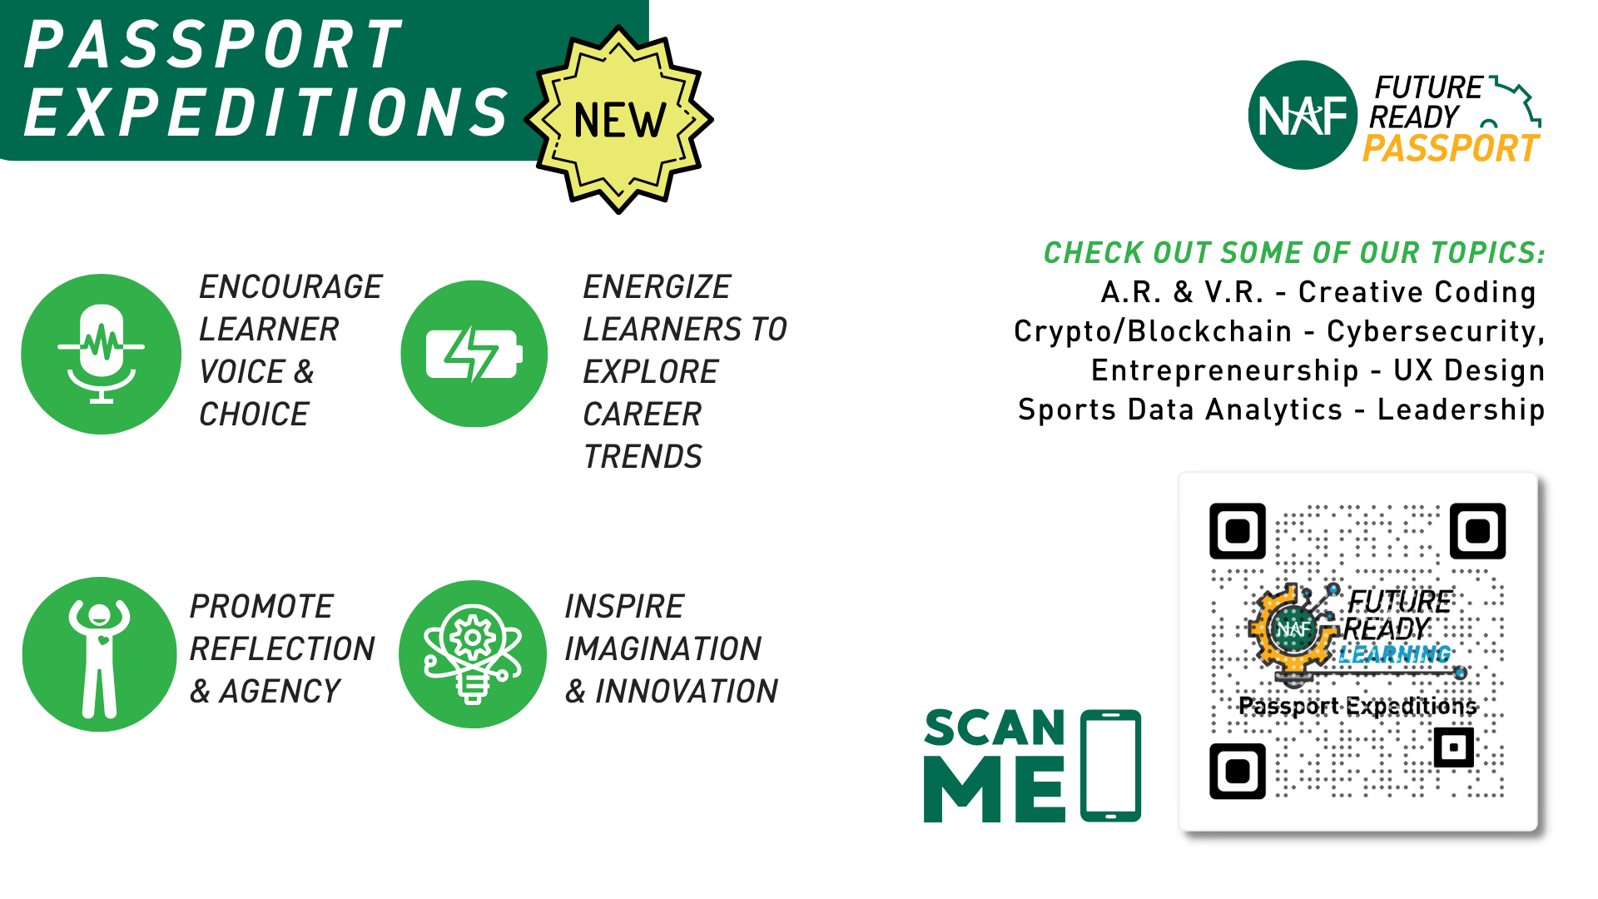


What is a NAF Expedition?
See all our Expeditions on
LEARNING.NAF.ORG
It’s a student-centered, career-connected, authentic project-based learning experience designed to:
Encourages Voice & Choice
Energizes Learners To Explore Careers
Promotes Learner Agency
Inspires Imagination & Innovation
REFLECT about your skills, learning goals, and purpose
STRETCH your knowledge and skills through active learning
SHOWCASE your innovations and learning in a dynamic way
INNOVATE and iterate solutions for real-world challenges
11

Slide 12

















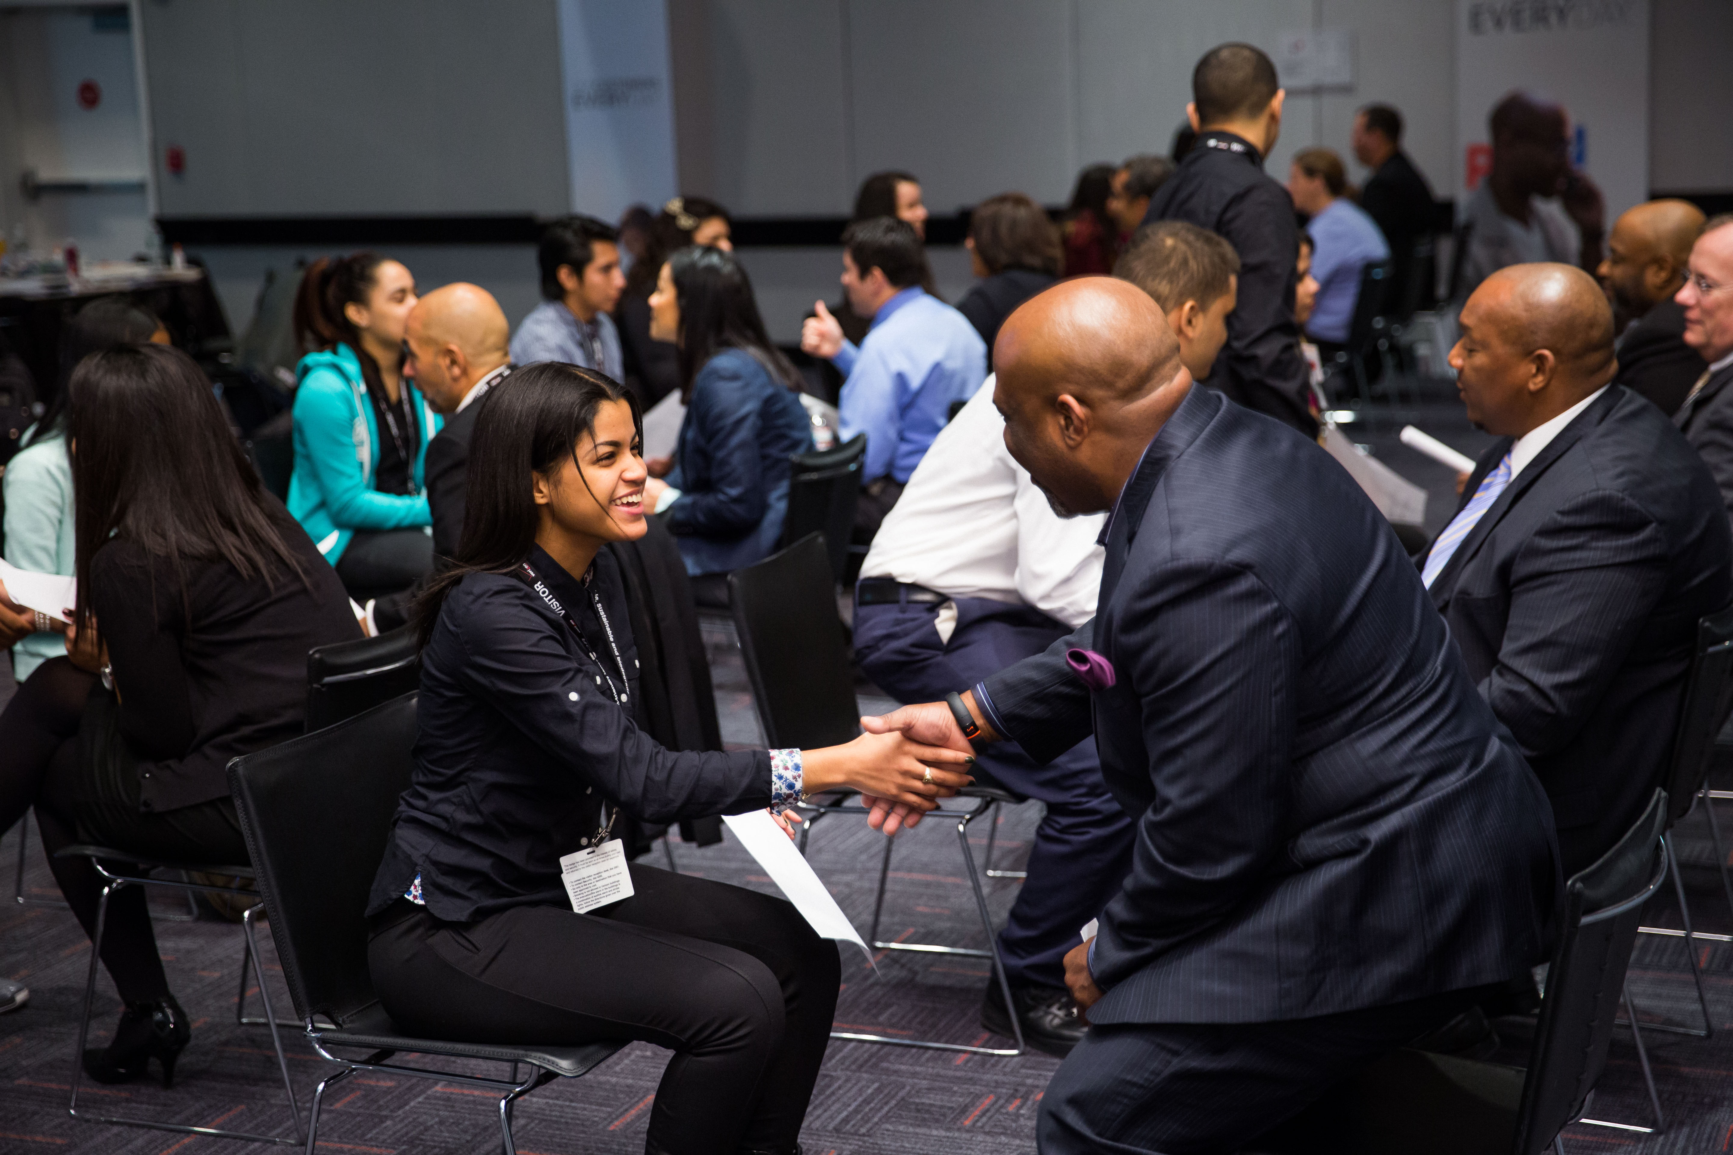




Work-Based Learning
CAREER AWARENESS
CAREER EXPLORATION
CAREER PREPARATION
Standards of High Quality WBL:
Interaction
Guest Speaker
Job Shadow
Mentorship
Informational Interview
Internship
Preparation & Reflection
Classroom-Connected
Clinicals
Outcome-Driven
Career Fair
Resume Coaching/ Review Session
Skills Workshop
Apprenticeship
Worksite Tour
Mock Interview
Partner Engagement Project
Mentored Industry Project
Impactful
More Impactful
Most Impactful
12

Slide 13
Outcomes-Driven WBL Approach
Student
Centered!
Our goal for every student.
ASPIRATIONS
SKILLS
CONNECTIONS
Define and map a plan for at least one career of interest
Build the 6 Future Ready skills
Receive continuous feedback from industry professionals
Be able to articulate their strengths
Develop at least three professional connections
✅ Communication ✅ Problem-Solving ✅ Social Awareness
✅ Collaboration
✅ Initiative & Self-Direction
✅ Planning for Success
Employees seek key transferable skills — at NAF, we call them Future Ready Skills.
13

Slide 14
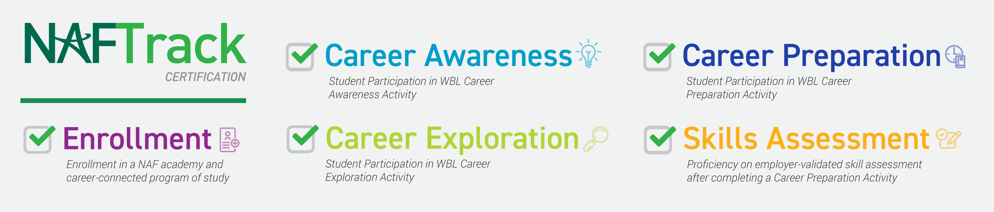
NAFTrack Certification
NAFTrack Certification is an employability credential that serves as NAF’s seal of college and career readiness.
To earn NAFTrack Certification, students:
Be enrolled in a NAF academy and career-connected program of study.
Participate in 1 work-based learning activity from each phase of the WBL continuum: Career Awareness, Career Exploration, and Career Preparation.
Demonstrate a level of mastery of the six Future Ready Skills, validated by an internship supervisor.
14

Slide 15
Tech-Enabled Impact
Outcomes-Driven Work-Based Learning
Innovation & Products
15

Slide 16



Outcomes-Driven WBL Tech Tools
WBL Tracker
Log WBL activities
Record student participation
Track AB participation
Analyze data to measure impact
Export reports, graphs, & tables
WBL Tracker (Educators)
WBL Skills Feedback Survey (Partners)
Support
Resources
WBL Student Reflection Form
Capture student feedback
View quantitative and qualitative data
Analyze data - dashboard or report export feature
WBL Student Reflection Form (Students)
Future Ready Skills Assessment (Partners)
Internships
Resource: Outcomes-Driven WBL Tech Tools Overview

Slide 17
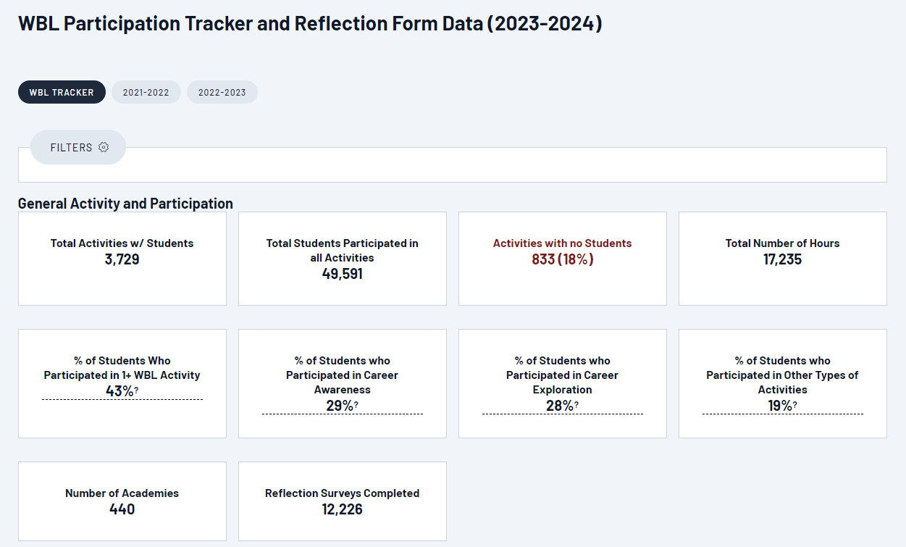
WBL Tracker Dashboard
View
WBL Tracker Overall Results
A
A
School Year: States which school year’s data you are looking at; default to current school year
B
Total Activities: Number of activities added that include students
B
C
D
C
Total Students: Total unique students
D
Activities with no Students: Number of activities added where students have not yet been added
E
E
% of Students who Participated: Based on unique students and broken down by continuum
F
Total Reflection Forms: Number of reflection forms completed by students
F
Explore Resources: https://ash.naf.org/public/wbl/tracker-resources
Notes:
From main dashboard, option to view dashboard data by activities or students.

Slide 18

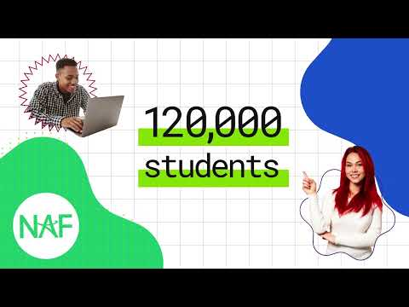
KnoPro
Powered by NAF
https://www.knopro.org/
Challenges
KnoPro: 100% Free Interactive Platform for High School Students (Ages 13–20)
Solve real-world problems from industry leaders (partner engagement project — 20 hours; anonymous mentors)
Build future-ready skills through daily activities & monthly challenges
Get feedback from virtual mentors and connect with professionals
Earn points for prizes like tech swag, scholarships, and more
Explore careers, expand networks, and strengthen resumes/college apps
Highlights
Monthly Challenges: Team or solo industry projects with $10k in cash prizes, in or outside of school ($5K, $3K, $2K)
Daily Skillbuilders: 10-minute activities with a daily $100 gift card winner
Work-Based Learning: Real interaction with industry professionals (Challenges fulfill career exploration activity)
Resources & Tools: Support for students, educators, and partners
Notes:
INSIDE THE NAF NETWORK
KnoPro Challenges fulfill Career Exploration activity:
Partner Engagement Project — 20 hours; anonymous mentors OUTSIDE THE NAF NETWORK
Recognition depends on the school, district, and state standards.
Some schools count it as a mentored industry project, or internship alternative, and certify it as approximately 20 WBL hours for Perkins funding.
Other schools or districts classify it as a career exploration or preparation activity.

Slide 19
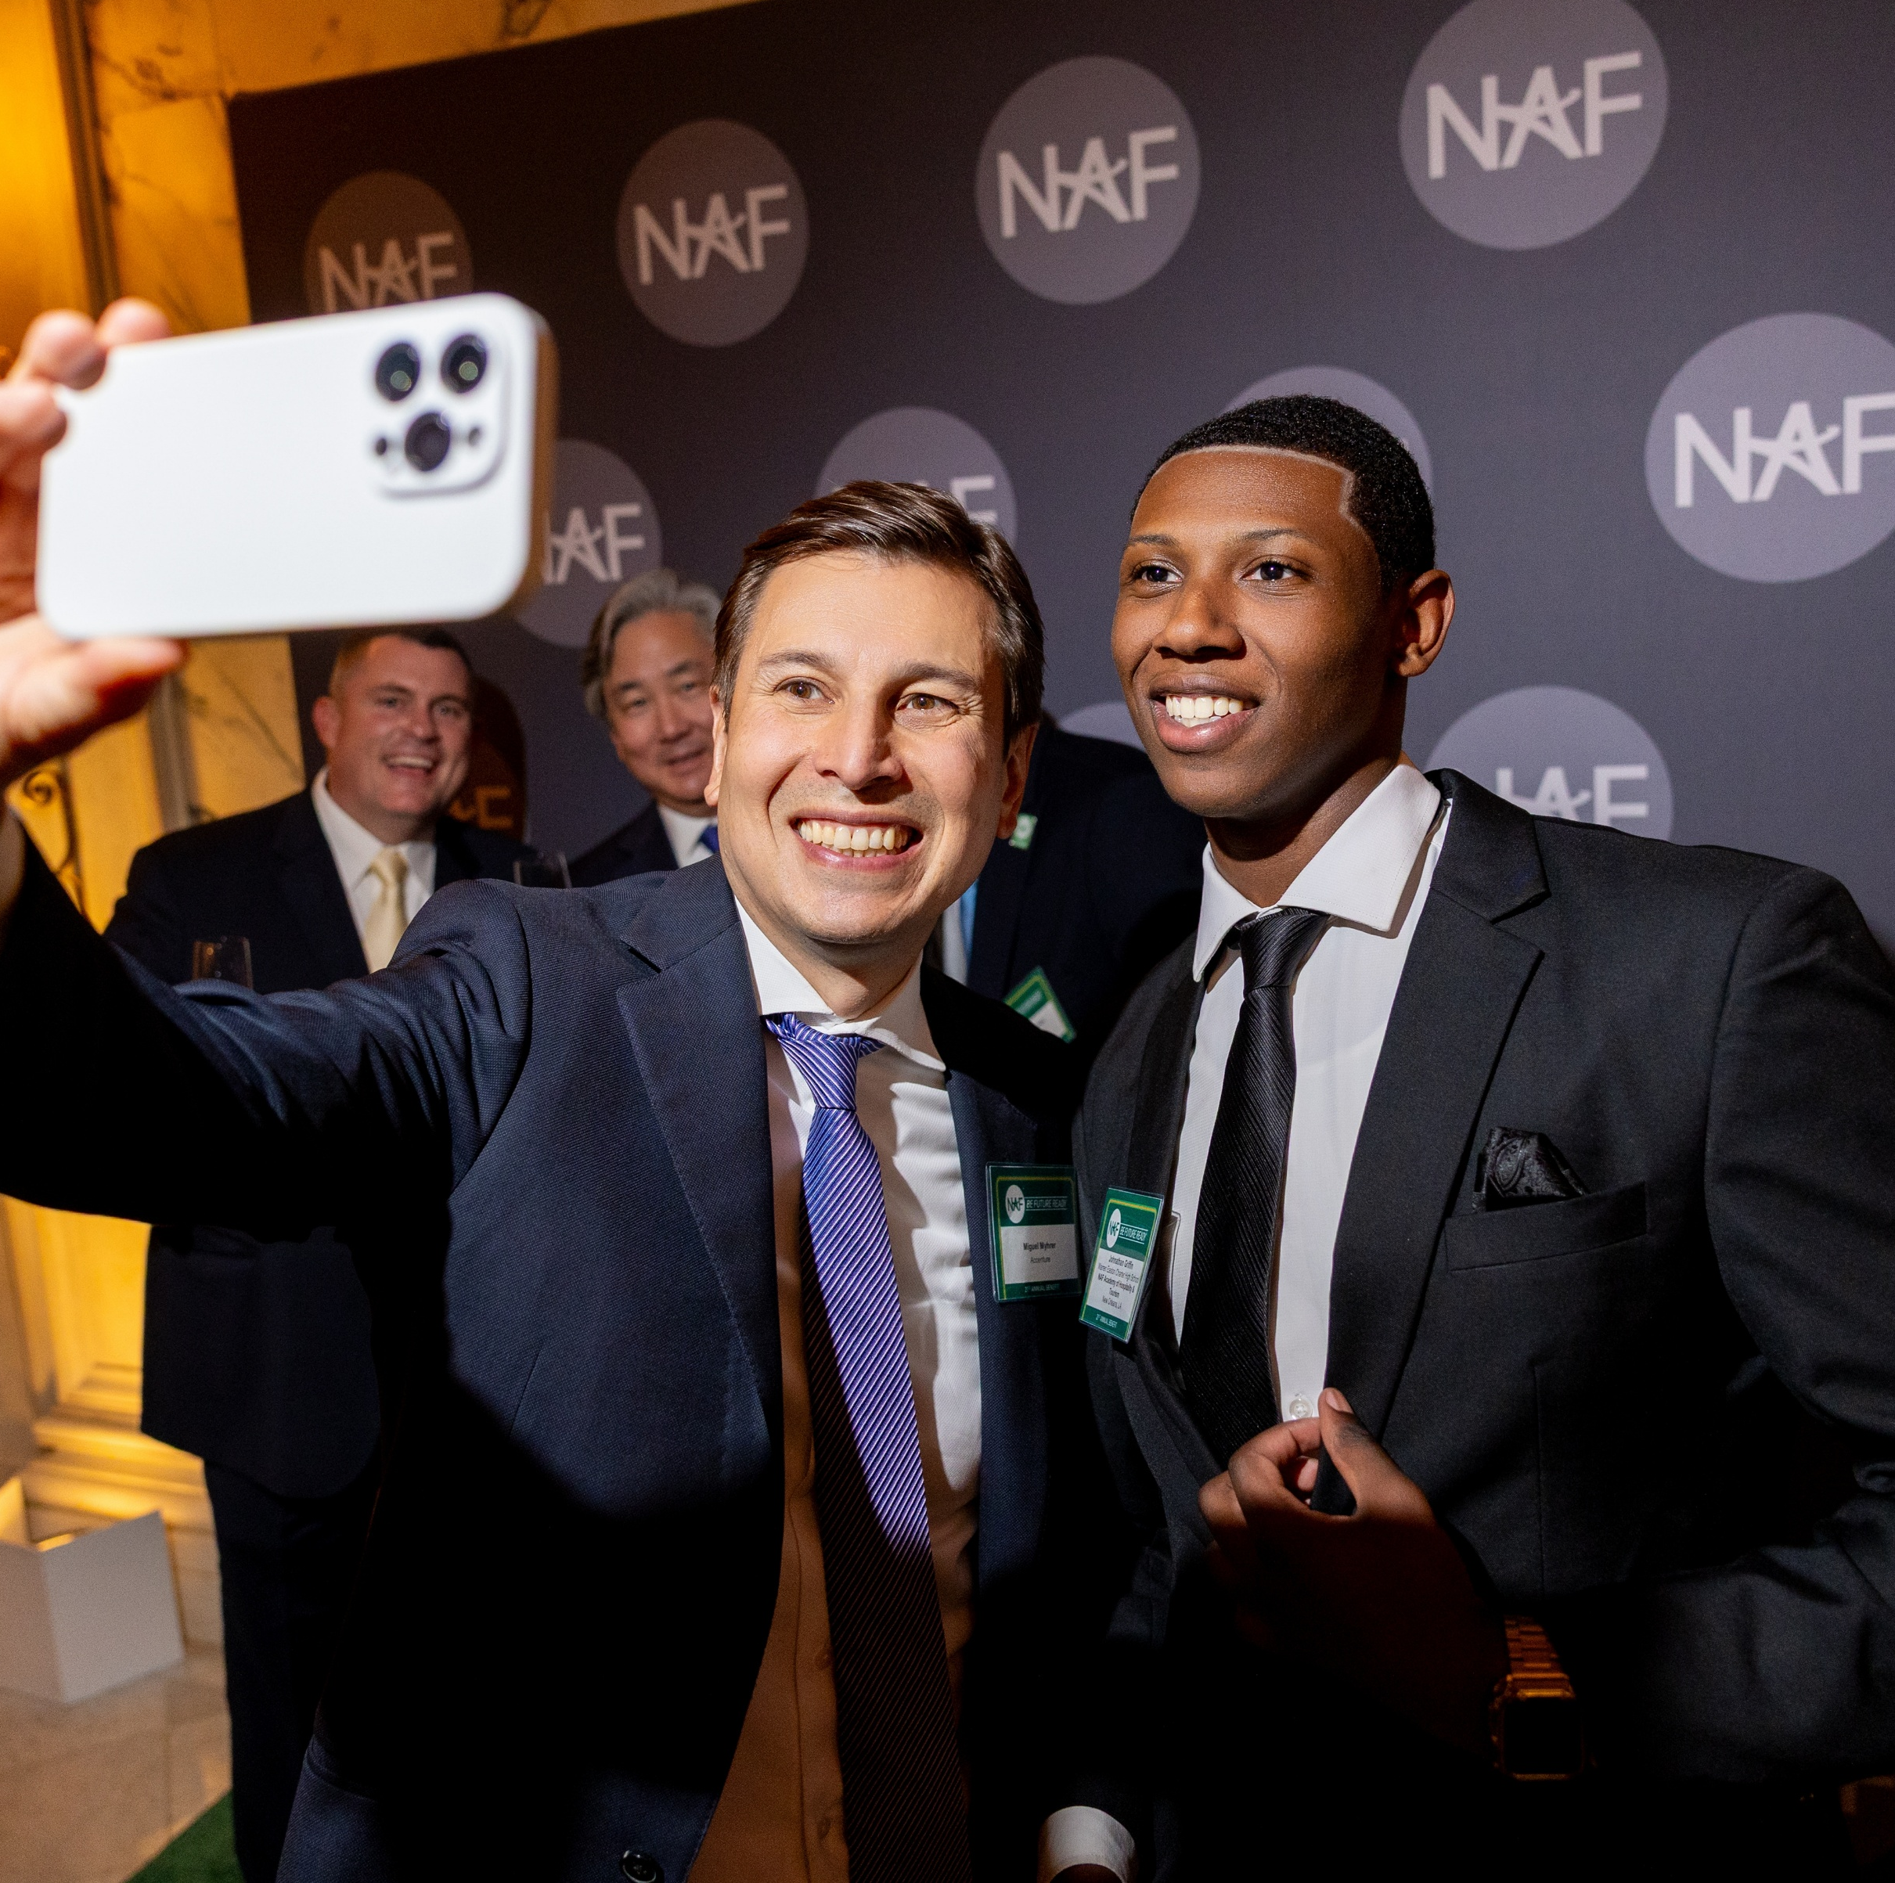
Where Opportunity Begins
Together, we can make essential opportunities possible by creating more effective educational experiences and transforming the high school journey.
NAF.org

Slide 20




















NAF Major Corporate Partners
NAF partners with companies to create tailored engagement programs.
Corporations of all sizes, including national brands, are committed to providing work-based learning opportunities through skill-based volunteerism and student internships.

Slide 21
NAF Board of Directors
Sanford I. Weill – Chairman Emeritus
Founder, NAF
Gregory J. Hayes –
Chairman
Executive Chairman, RTX
Kenneth I. Chenault – Vice Chairman
Chairman and Managing Director, General Catalyst
Robert Smith – Vice Chairman
Founder, Chairman and Chief Executive Officer, Vista Equity Partners
Eugene A. Ludwig – Secretary
Chief Executive Officer, SpringHarbor Financial
Jeffrey A. Brill
Partner, Skadden, Arps, Slate, Meagher & Flom LLP
Kermitt J. Brooks
Chief Legal Officer, The Guardian Life Insurance Company of America (Guardian Life)
Ursula M. Burns
Founding Partner of Integrum Holdings, Chairwoman, Teneo LLC, Retired Chairman & CEO, Xerox Corporation and VEON, Ltd.
Lisa Dughi
Chief Executive Officer, NAF
Bob Ferrell
Executive Vice President of Global Human Resources, World Wide Technology
Erin McSweeney
Chief People Officer, UnitedHealth Group
Jennifer Morgan
Chief Executive Officer, UKG
Nicola Palmer
Retired Chief Technology Ambassador, Verizon
Thomas Penny III
President, Donohoe Hospitality Services
Joseph J. Russo
Executive Vice President and President, Global Networks and Technology, Verizon
David L. Steward
Founder and Chairman, World Wide Technology
Sandy Torchia
Vice Chair, Talent and Culture, KPMG LLP
Joseph M. Tucci
Chairman & Co-Founder, Bridge Growth Partners
Marc Weill
Senior Advisor, Two Sigma Ventures
Dantaya Williams
Chief Human Resources Officer, RTX
Matthew Zielinski
EVP, President International Markets, Lenovo
Lauren Budzich-Goren
Strategy and Execution
Ex Officio Board Member & Chair, NAF Alumni Leadership Council, Senior Manager, US Commercial Transformation, J&J MedTech
NAF Board members are leaders in their fields and strong advocates for improving education and workforce development.
Through their leadership, guidance, and support, NAF is able to fulfill its mission of developing the next generation of future-ready employees.

Slide 22
NAF STEM Advisory Committee
Nicola Palmer
Chair
Retired Chief Technology Ambassador, Verizon
Alencia DeAnda-Gregg
AVP HR Business Partner Human
Resources Organization,
AT&T
Joseph Dill, DDS, MBA
Chief Dental Officer,
Delta Dental Plans Association
Lisa Dughi
Chief Executive Officer,
NAF
Vinay Iyengar
Partner,
Foundation Capital
Marilyn McDonald
Senior Vice President,
Commercial Digital & Innovation,
Moderna
Brian Monahan Global Client President; Head of Dentsu Innovation Initiative US, Head of Solutions
West dentsu international
Milanka Muecke
Director, Global Commercial Marketing, Workstation Business,
Lenovo
“Ram” Sankaran Ramanathan
Vice President, Network Systems,
Verizon
Juan F. Rodriguez
National Strategic Advisor – SLED K12
E-rate and Federal Funding,
World Wide Technology
Bobby Soni
Global Technology Consulting Leader,
KPMG International
Brian Thomas
President & CEO,
Lightspeed Systems
Developed in 2013 as an adjunct to NAF’s Board of Directors, the STEM Committee addresses the growing role of science, technology, engineering, and mathematics in the economy. It guides workforce development through strategies in curriculum, work-based learning, employee engagement, advisory boards, college access, and educator development while fostering collaboration among top STEM leaders to attract and support high-quality talent in STEM careers.

Slide 23
Admissions
Join the NAF Academy Network
23

Slide 24
Starting a NAF Academy
Choosing the Right Admissions Path!
🤝Full District Engagement Encourages effective, sustainable academy implementation and long-term success.
🎯Admissions Options Select the approach that supports your academy development needs to align district goals with the NAF design.
Year of Planning
Fast Track
24
Notes:
Who is Eligible?
NAF encourages full district engagement in creating academies to maximize successful and sustained academy implementation. The annual membership fee is $2,000 per academy, with multi-academy discounts available. Begin the process by completing NAF’s Interest Survey to indicate your interest and commitment to partnering with NAF.
https://naf.org/start-a-naf-academy/interest-survey/

Slide 25
Year of Planning
🚀 Getting Started
Form a dedicated, multi-disciplinary team with a shared vision to develop the Academy Design Plan.
🎯 Personalized Support Receive hands-on guidance and technical assistance to align the district’s programming goals with the NAF design and its twelve standards of practice.
📅 Flexible Timeline Typically completed within one school year, with the option to extend from 6 to 18 months.
🌱 Sustainable Foundation Provides the groundwork for long-term student success and community impact.
💲The application fee is $12,000 (a $2,000 annual membership fee applies upon Launch)
25

Slide 26
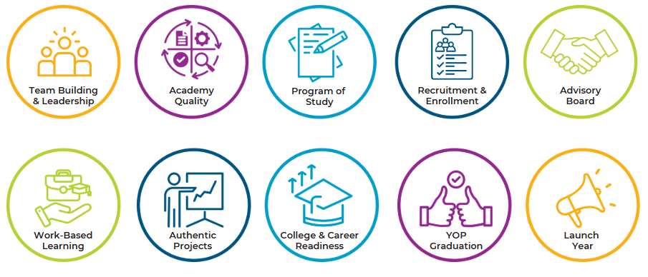
Year of Planning Roadmap
Focus Areas that Shape Your Academy Design Plan.
Resource: YOP Roadmap
26

Slide 27
Fast Track
🚀 Getting Started
Form a dedicated, multi-disciplinary team with a shared vision to develop the Academy Design Plan.
🎯 Alignment Focus Centers on documenting how your academy aligns with the NAF design and its twelve standards of practice.
⏱️ Condensed Timeline Typically completed within three months, though timing may vary based on your launch year goal.
💡 Immediate Benefits Enables early access to NAF resources, tools, and student opportunities.
💲The application fee is $4,000 + a $2,000 annual membership fee due at launch
27

Slide 28






Fast Track Pacing Guide
Your Accelerated Path to NAF Membership!
Admissions (Day 1 – Day 14)
Assessment (Day 15 – Day 21)
Evidence (Day 22 – Day 45)
Adjustments (Day 46 – Day 60)
Membership (Day 61 – Day 75)
District forms a Design Team (ADT) and meets with NAF to review the application process.
ADT submits a self-assessment to ensure alignment to NAF design.
ADT submits evidence of alignment to NAF design for initial review.
ADT revises the assessment, if needed, before NAF’s final review.
District verifies the membership agreement is signed and fees are paid — schedule graduation.
*The 90-Day sample timeline is flexible based on your launch year goal.
Resource: Fast Track Application Checklist
Graduation (Day 76 – Day 90)
28

Slide 29

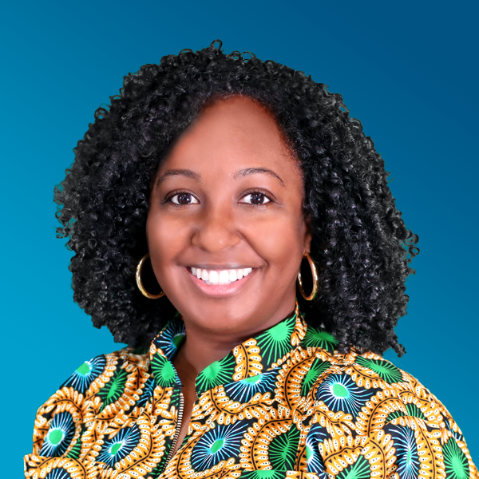

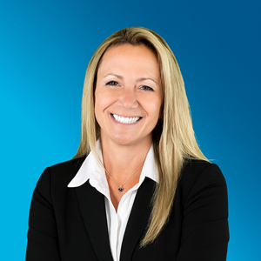
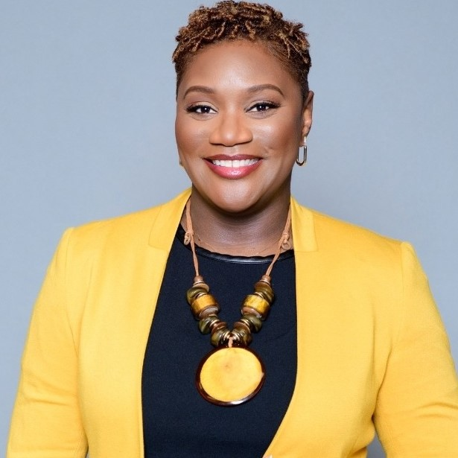

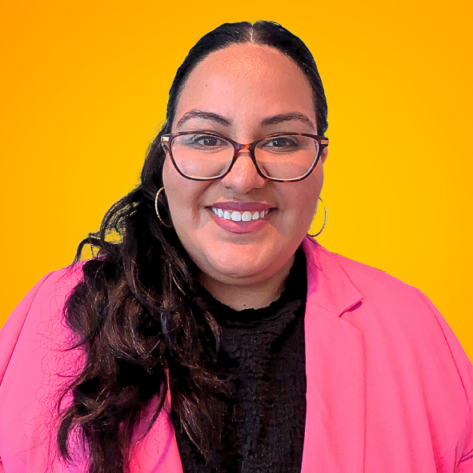

Team Building & Leadership
School leadership, advocacy, resources, master scheduling, and community support
Academy program coordination and leadership, advocacy, and overall management of implementing NAF’s design
Business/community liaison, work-based learning program, and internships
Student recruitment, supports and interventions, student scheduling, and social-emotional and academic advisement
School Administrator
Academy Lead
Work-Based Learning Coordinator
Counselor
Career-pathway expertise and integration through authentic project experiences and work-based learning strategies
Postsecondary education liaison and coordinating college/career activities
Core-content expertise and integration through authentic project experiences and work-based learning strategies
Students’ interests/needs, academy program impact/effectiveness, and recruitment
Career Pathway
Educator
College & Career Coordinator
Core-Content Educator
Academy Student
29

Slide 30

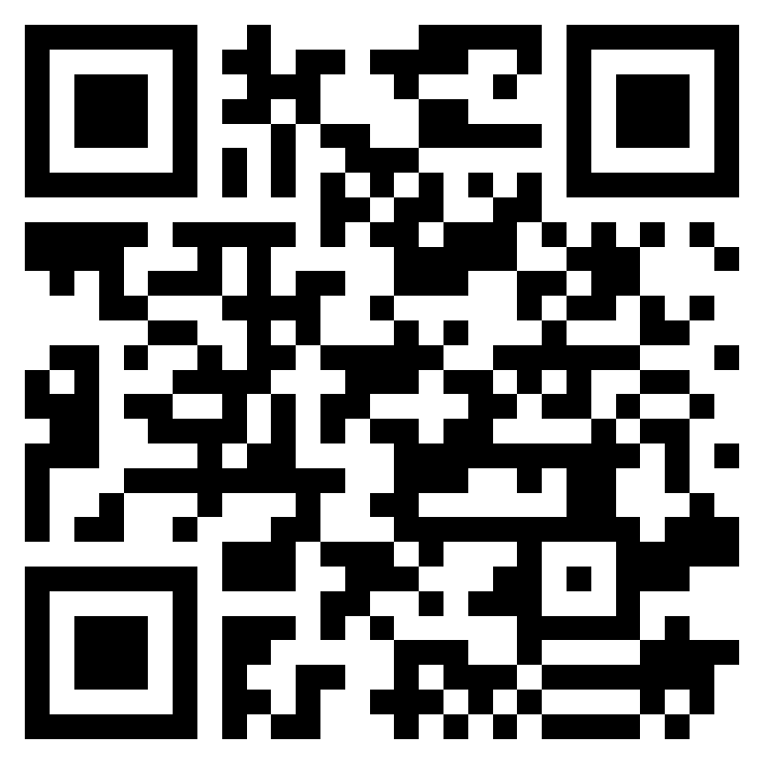
Next Steps
Reflect on the district vision and assess readiness — NAF Interest Survey.
Assess student interest and workforce support — select a career pathway.
Review budget considerations.
Form a multi-disciplinary team to launch a NAF career academy and complete admissions requirements.
Admissions Questions?
Scan QR Code To Request More Information
Jennifer Geisler, Director, Emerging Academies
jgeisler@naf.org

Slide 31
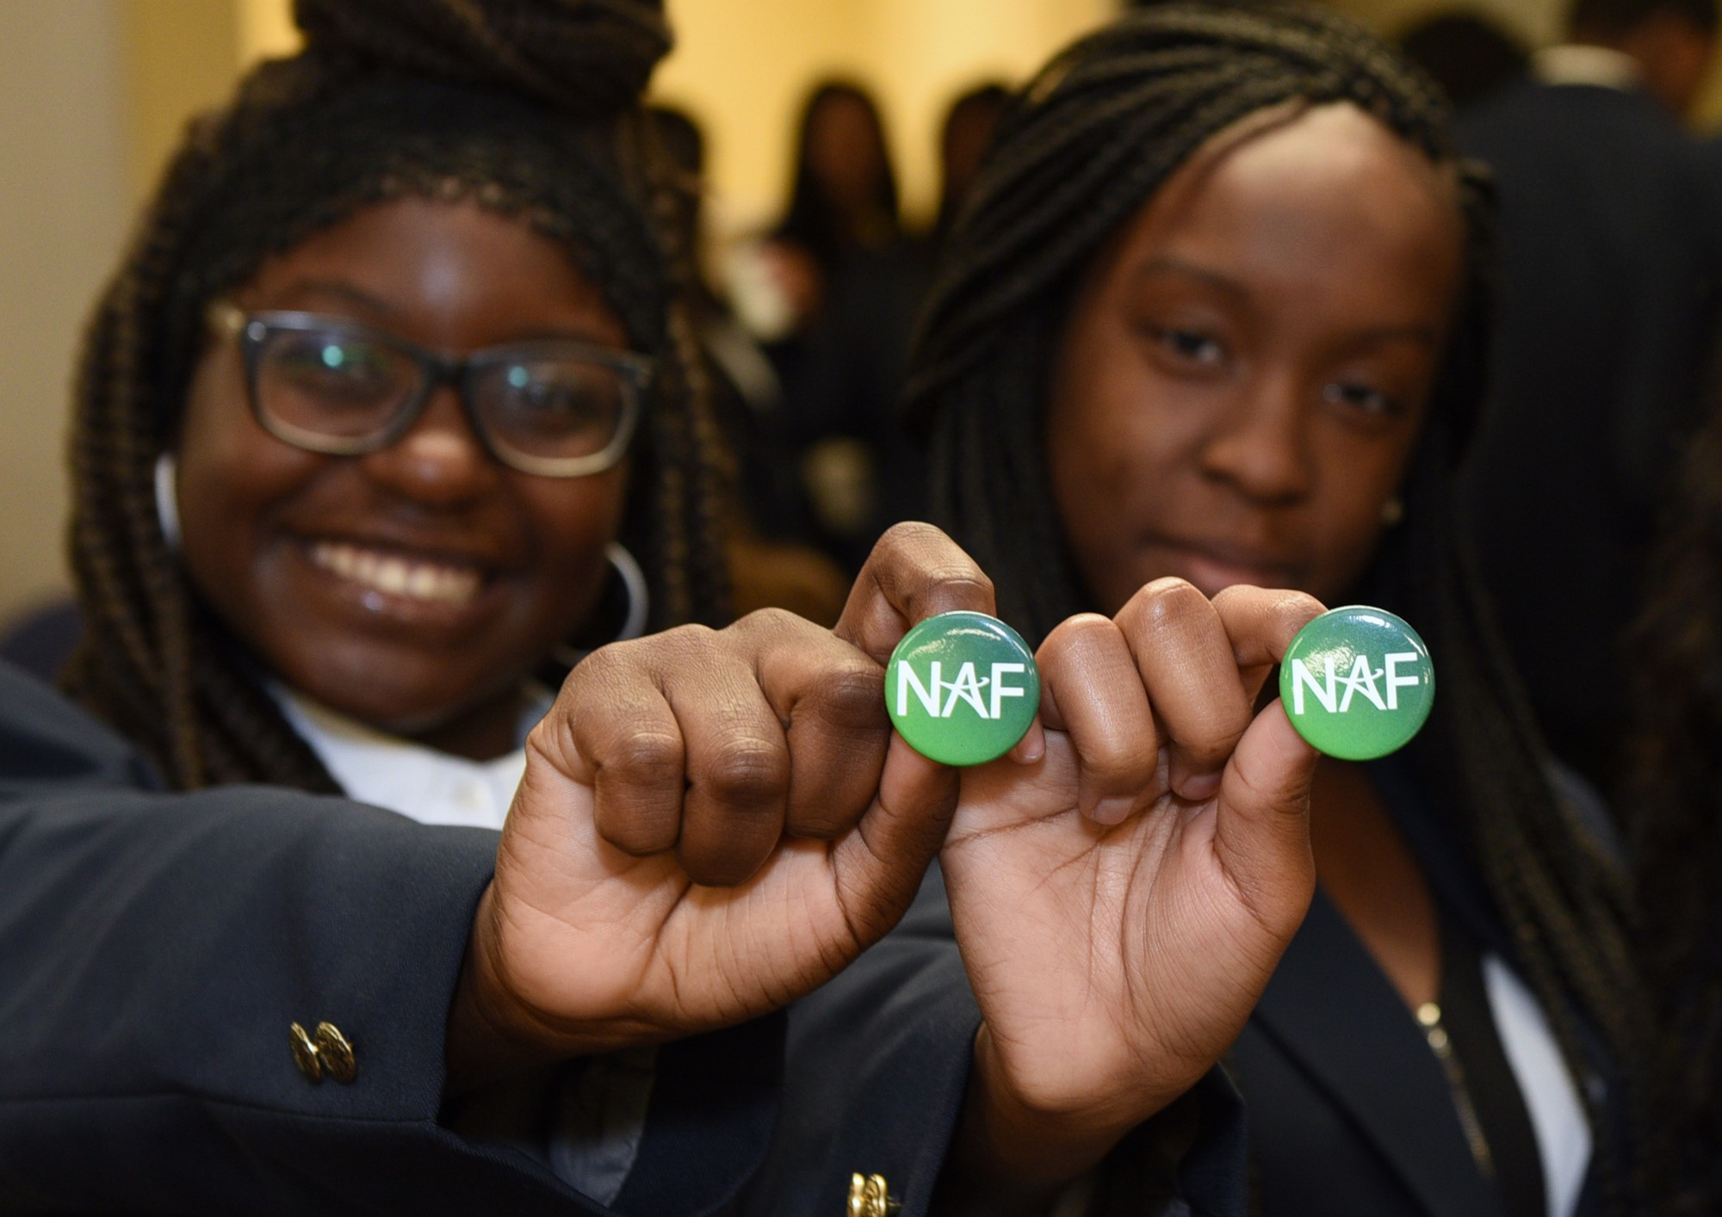
Questions
Learn More About NAF!
NAF Design
About NAF
Get to Know KnoPro
WBL Key Concepts
Alumni Benefits
NAFTrack Certification
Membership Benefits
31

Slide 32
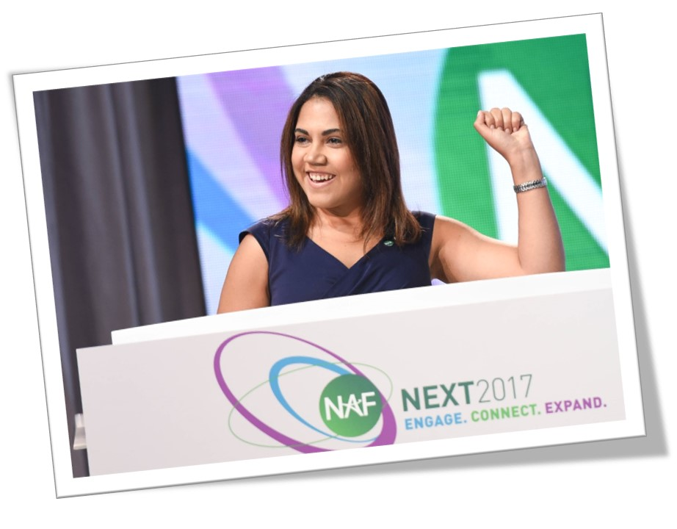
NAF Personal Impact
“This is where I started, and I made it!”
“Why was NAF and the internship experience life changing? Because I found a home, I found a place where I mattered, where people were genuinely interested in my success and development. The experience made my dreams more realistic, more tangible.”
-Jackie Burgos
NAF Alumna
Harvard Business School Class of 2014
32

Slide 33
33

