Slide 1


At NAF, we believe every student deserves access to the support and resources needed to prepare for the future.
1

Slide 2

Introductions
Share:
Name and Role
What specific outcomes are you aiming to achieve for the district, school, and community?
Reflect on one of the following:
What topics are you interested in exploring today?
Notes:
Agenda Review
1. Network Highlights; 2. NAF Design Overview; 3. Admissions process and Pricing; 4. Tech Enabled Impact 5. Questions & Next Steps

Slide 3


Notes:
https://www.youtube.com/watch?v=WHqagBn1uMo

Slide 4





NAF Builds Career
Success
NAF is a leader in the movement to prepare young people for college and career success.
A network of career academies which are small, focused learning communities within public high schools
Offering schools and businesses a proven and sustainable model for working together to ensure high school students are future ready
Themed around thriving high-need industries
NAF is preparing a skilled and diverse talent pipeline for our country’s most viable industries, in partnership with high schools, employers, and community leaders.
Health
Sciences
Hospitality &
Tourism
Information
Technology
Engineering
Finance
*Additional industry themes represented and supported by NAF
4

Slide 5


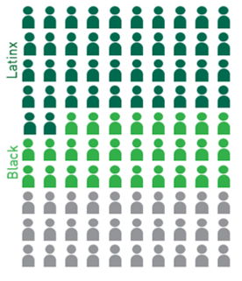
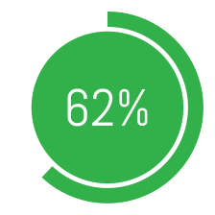
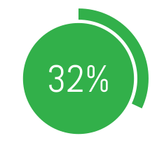
NAF Promotes
Equity
NAF serves majority students of color
NAF graduates and sends these students to college at higher rates
NAF spurs economic mobility and workforce diversity
NAF is uniquely positioned to improve outcomes for students of color and students from under-resourced communities.
67% eligible for
Free/Reduced Lunch
NAF students at risk of not graduating on time have a 10% higher high school graduation rate
An independent study of career academy graduates
(including NAF) showed:
Post-secondary enrollment for Black and Latinx NAF students
Young men of color earn 17% more per year
Positive effects on marriage and parenting
This is roughly the equivalent earning power of an associate's degree
Post-secondary enrollment for Black and Latinx non-NAF
CTE students
5
Notes:
NAF students at risk of not graduating are 10% more likely to graduate than non-NAF students.
99% of NAF seniors graduate, a rate that has remained consistent for the last four years.
89% of grads are college-bound - notably higher than the national rate of 70%.
76% of employees think their company should be doing more to increase diversity.
NAF meets employers’ interests by working closely to create engagement opportunities tailored to their DEI goals.

Slide 6
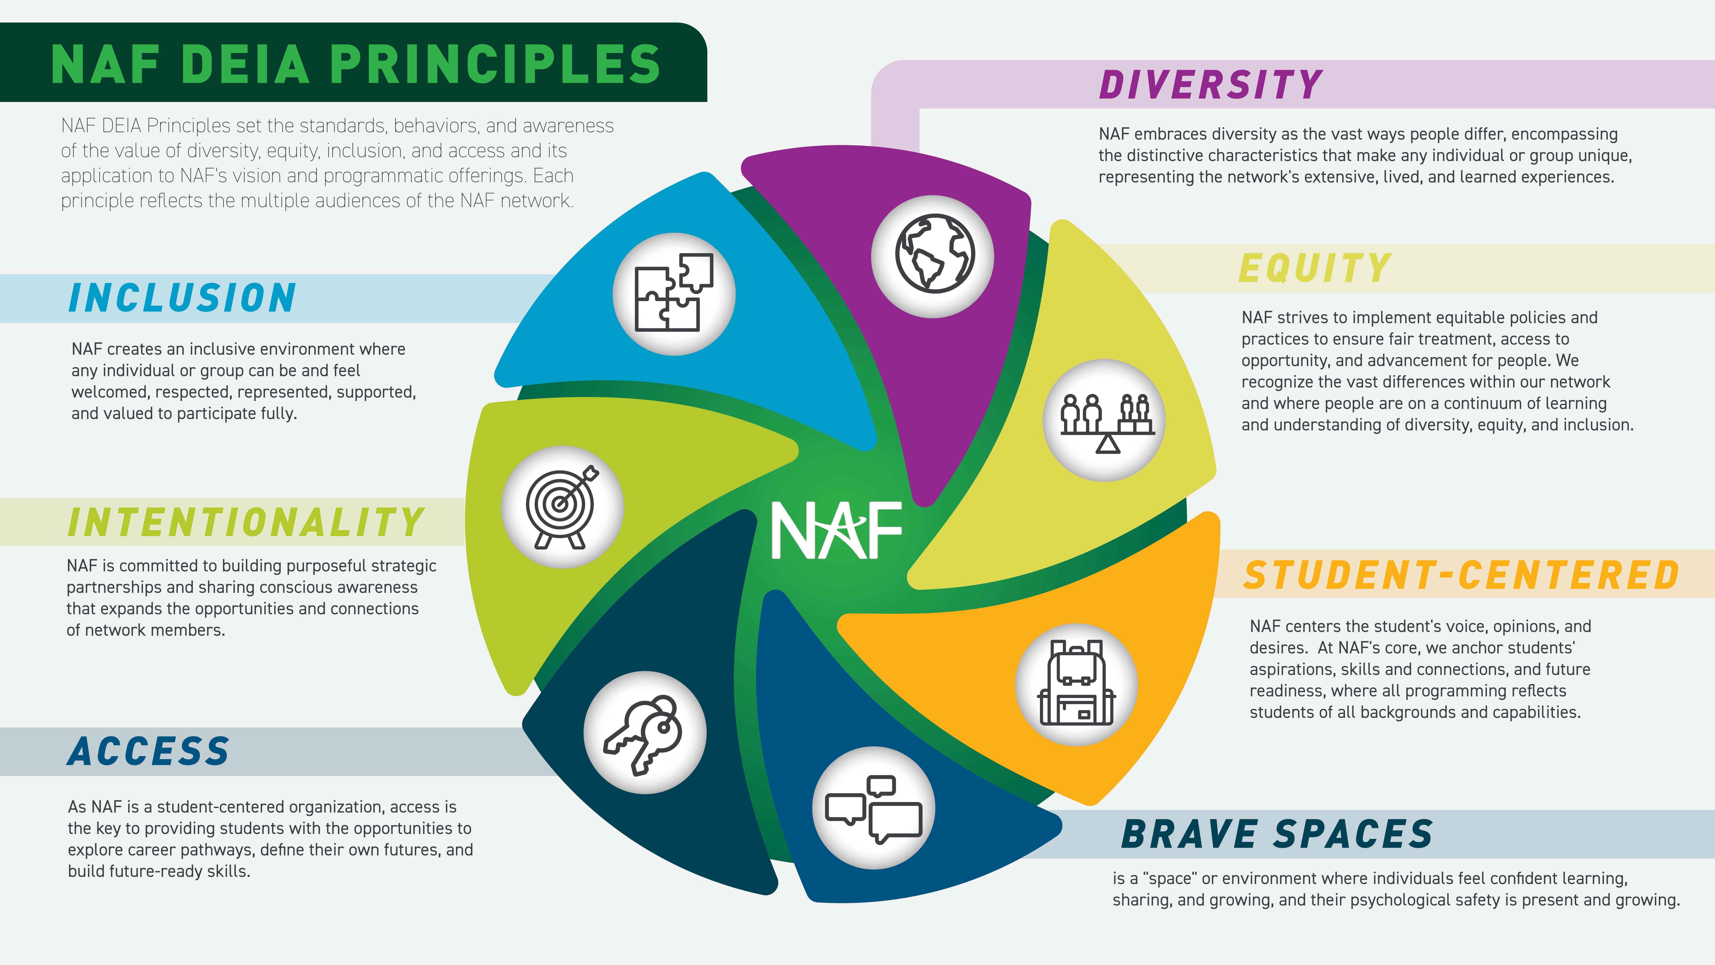
Notes:
NAF DEIA Principles set the standards for behaviors and increase awareness of the importance of diversity, equity, inclusion, and access and its alignment with NAF’s vision and programmatic offerings. Each principle is thoughtfully designed to consider the varied audiences within our network.

Slide 7
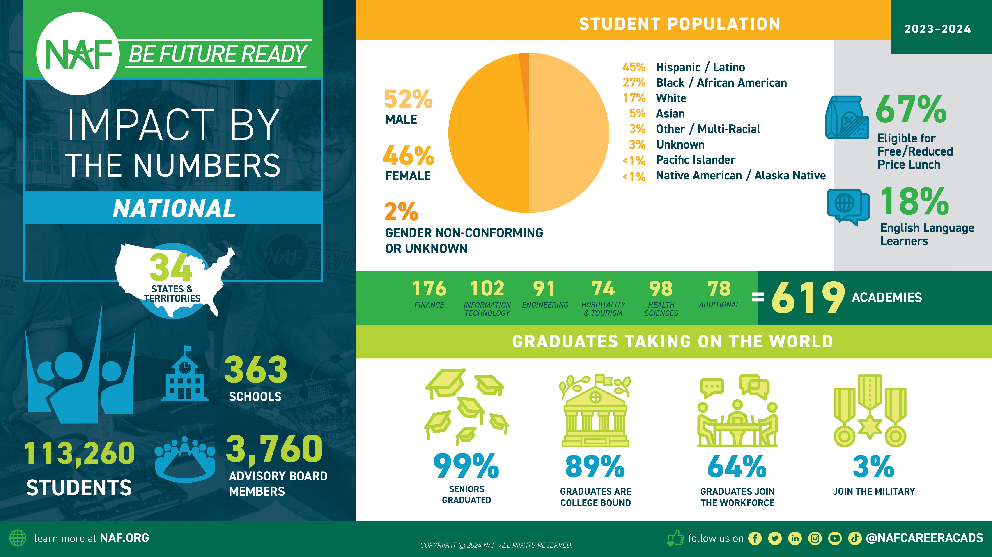

7

Slide 8
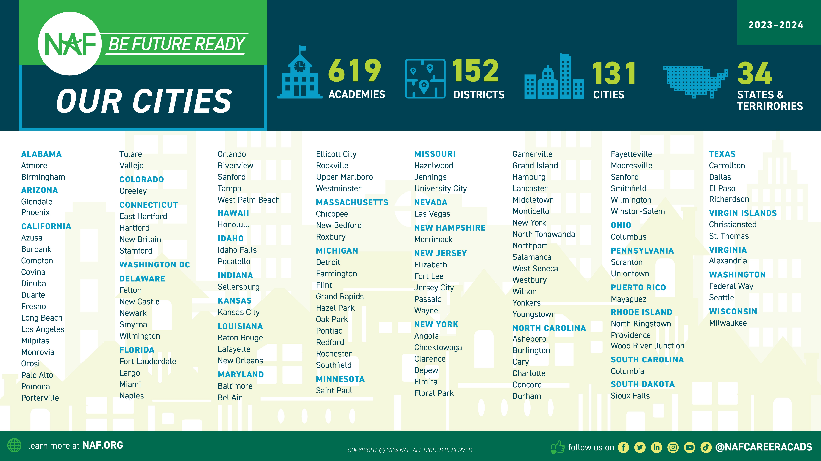



Our Approach: Work-based Learning Impact
Implementing an Outcomes Driven
Work-Based Learning* approach to ensure students are Future Ready:
Discover careers of interest
Make a plan to achieve their goals
Develop professional skills and monitor their growth
Build meaningful connections with professionals
Aspirations
Skill Sets
Connections
*WBL Participation Tracker is a tool to log WBL activities and record student participation to measure impact and assess equity.
Notes:
Find an academy near you.

Slide 9
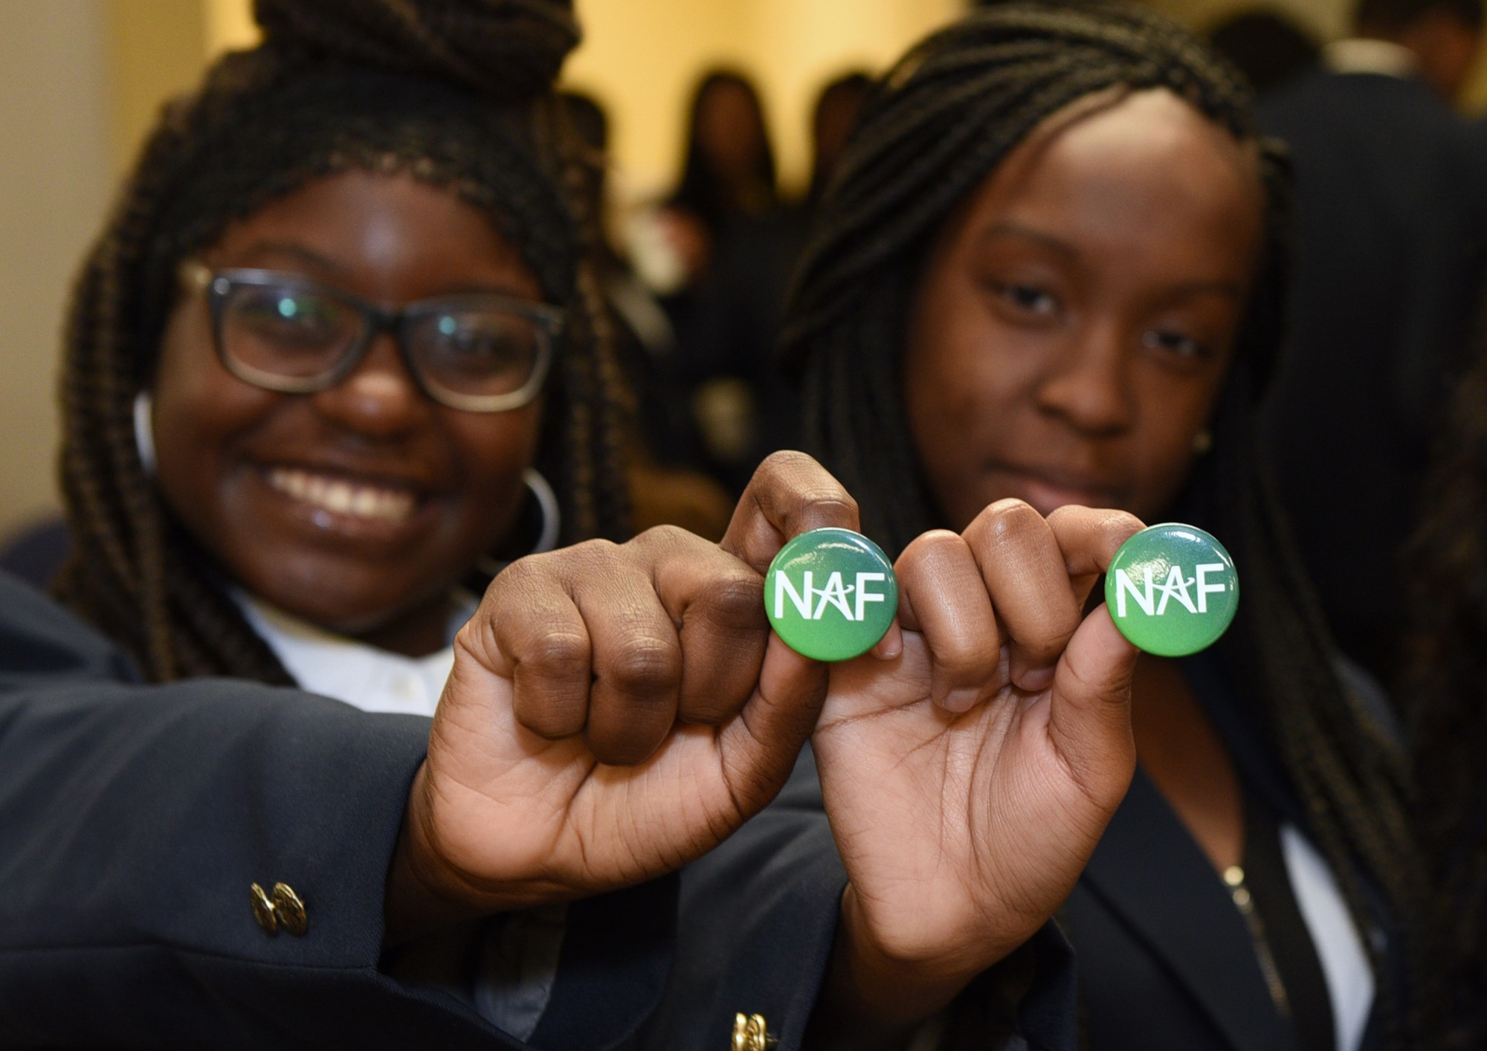




NAF Design
NAF ignites students’ passion for learning through an educational design featuring:
Academy Development
& Structure
Advisory
Board
Program of Study
Work-Based
Learning
(Curriculum & Instruction)
9

Slide 10
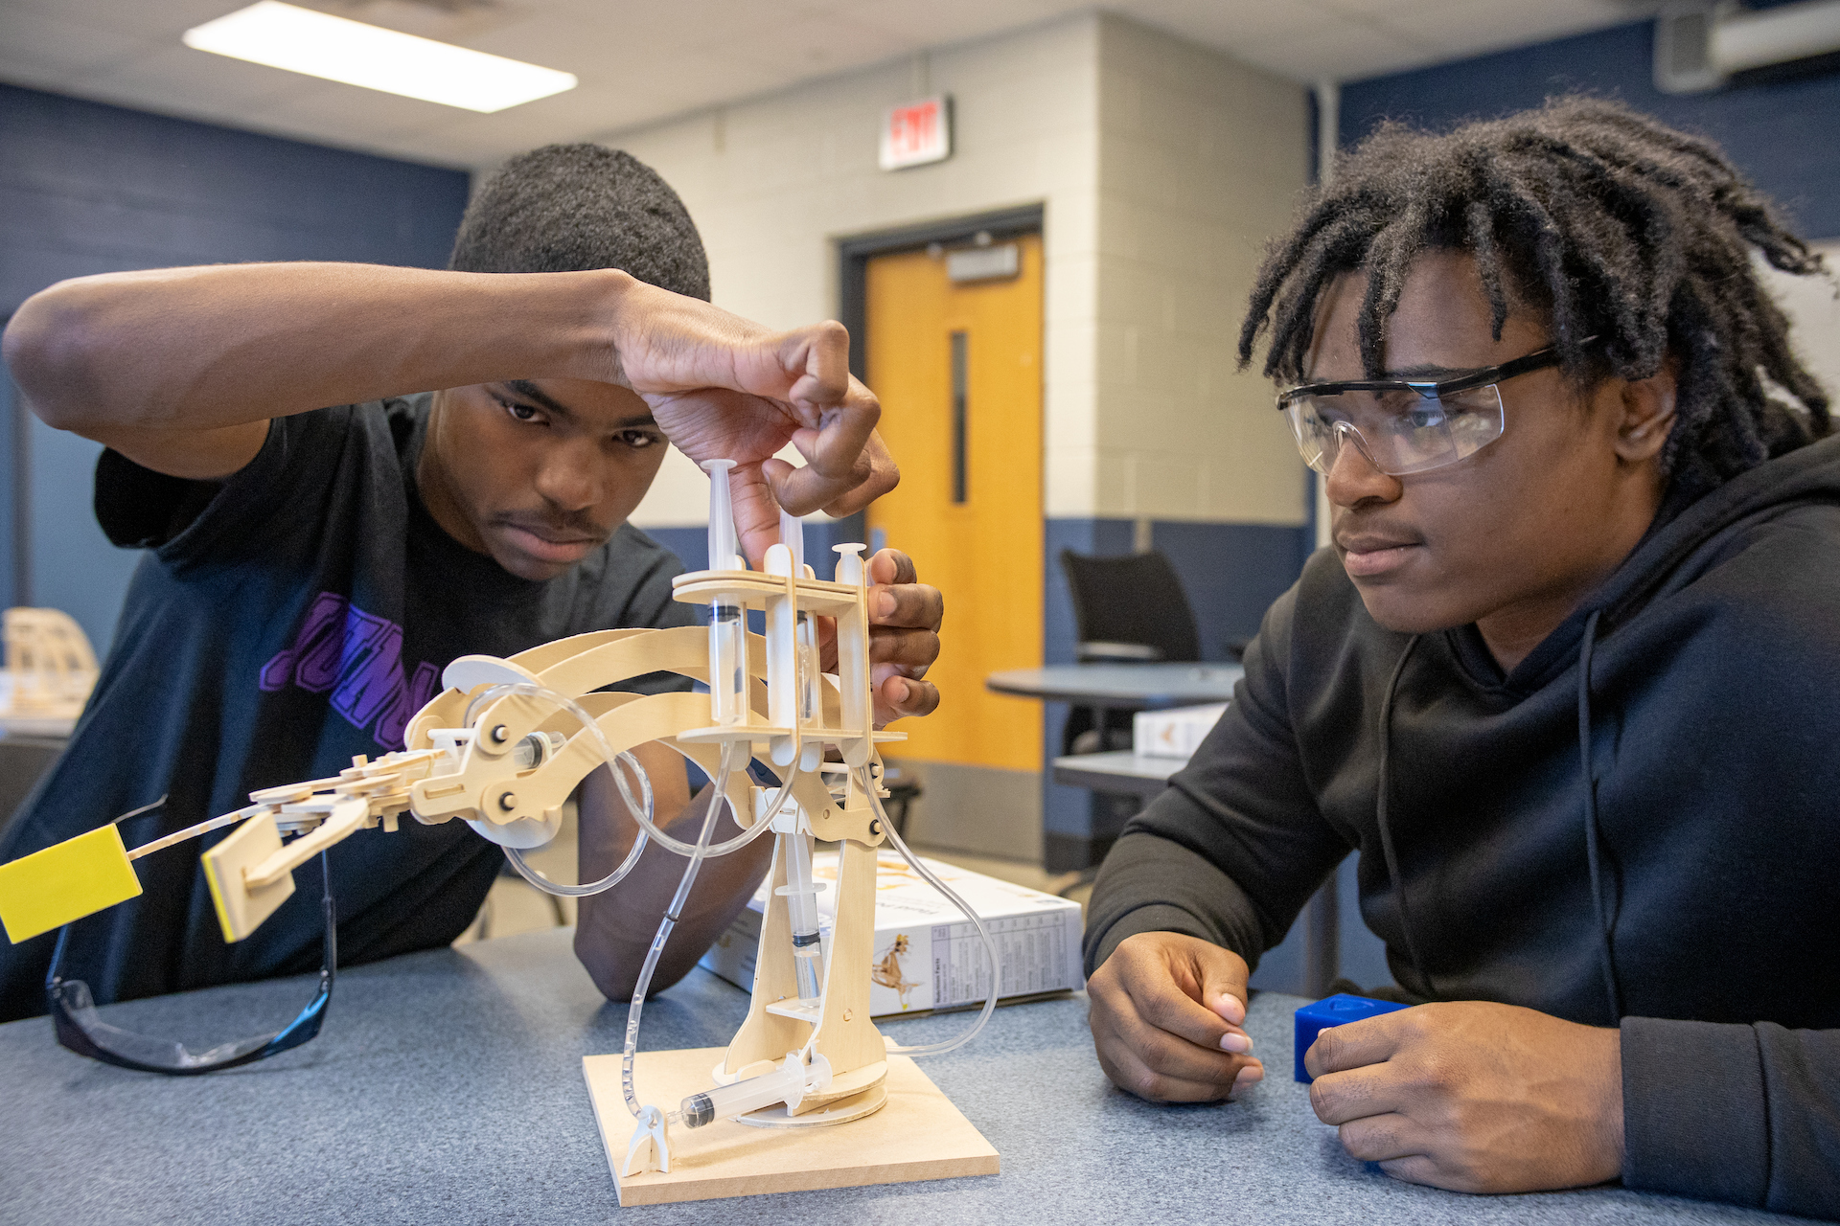
Academy Development &
Structure
Academy development and structure is crucial
to the successful implementation of a
high-quality, NAF career academy.
Small, focused learning communities
Fit within and enhance existing high school systems
Open choice enrollment with strategic marketing and recruitment plans
Enrolls at least 20 students per grade level
Flexible structure
Collaborative design bringing together academy, business, and community leaders
10

Slide 11
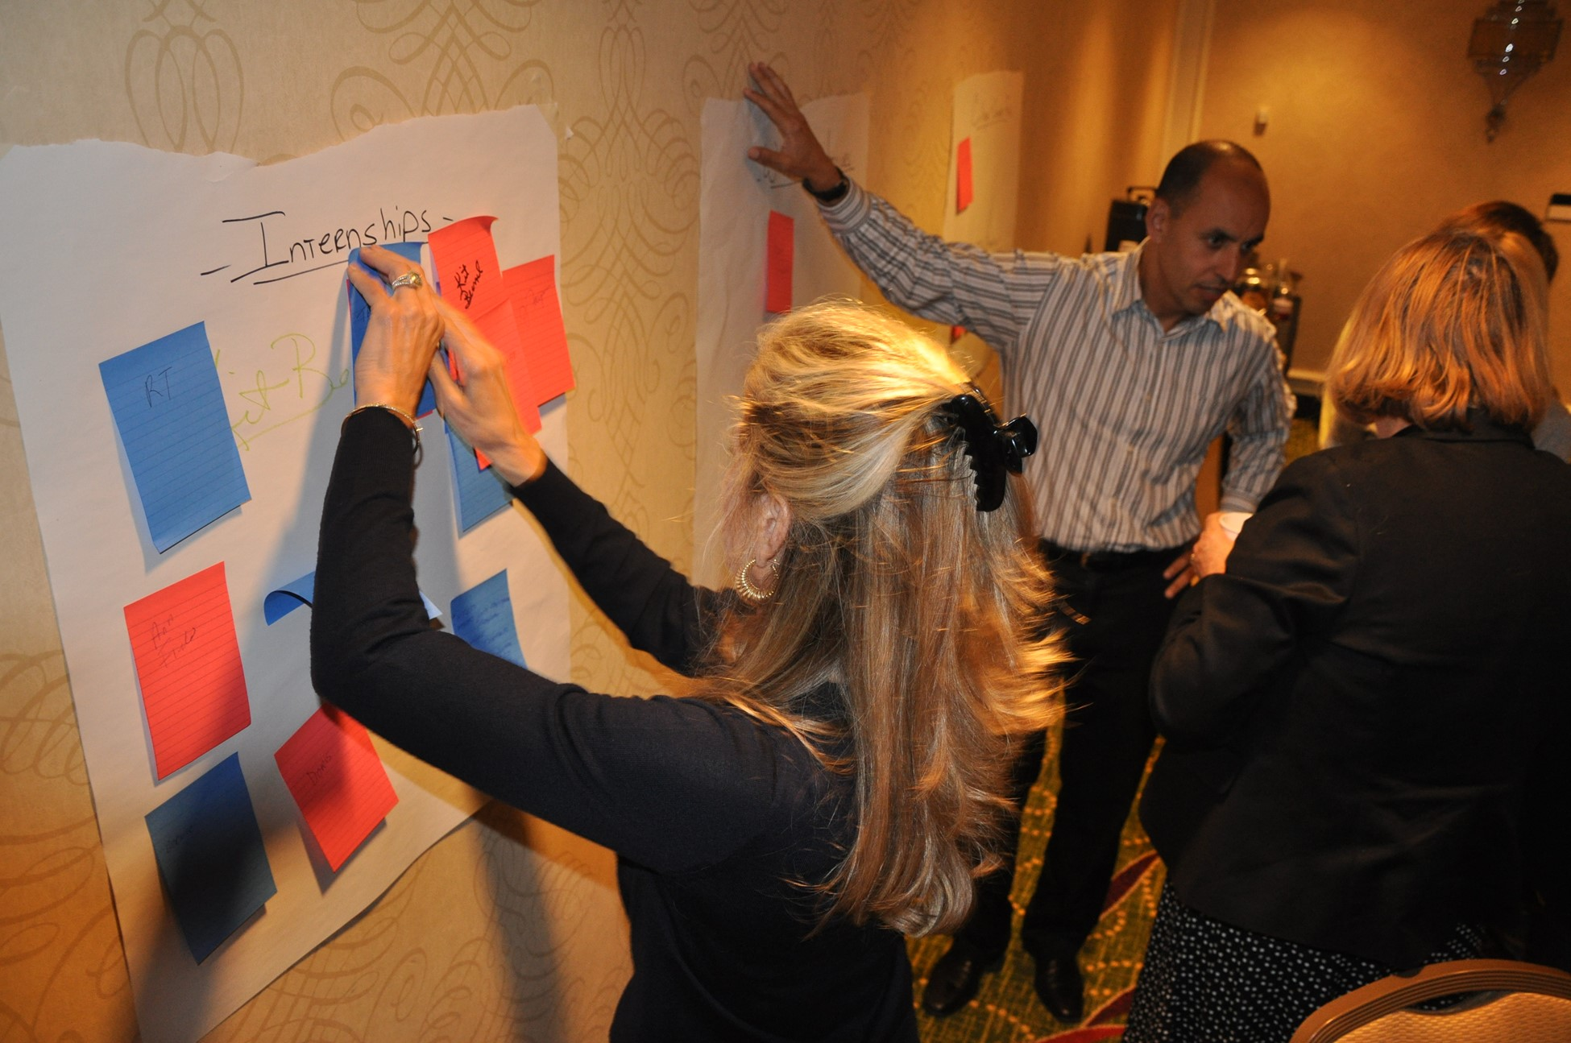
Advisory Board
Advisory boards and their members provide an essential bridge between the classroom and the workplace.
10-20 members
80% from the business community
Over 4,000 members nation-wide
Organize work-based learning activities
Inform curricula
Community advocates for the academy
Provide and solicit financial support
11

Slide 12

Program of Study
NAF provides and curates rigorous, career-themed curricula and authentic, career-connected projects that incorporate current industry standards and practices.
NAF also partners with organizations that provide free content and/or industry certifications!
Career-themed
Industry Validated
STEM Infused
Project-based
Health
Sciences
Hospitality &
Tourism
Information
Technology
Engineering
Finance
12

Slide 13
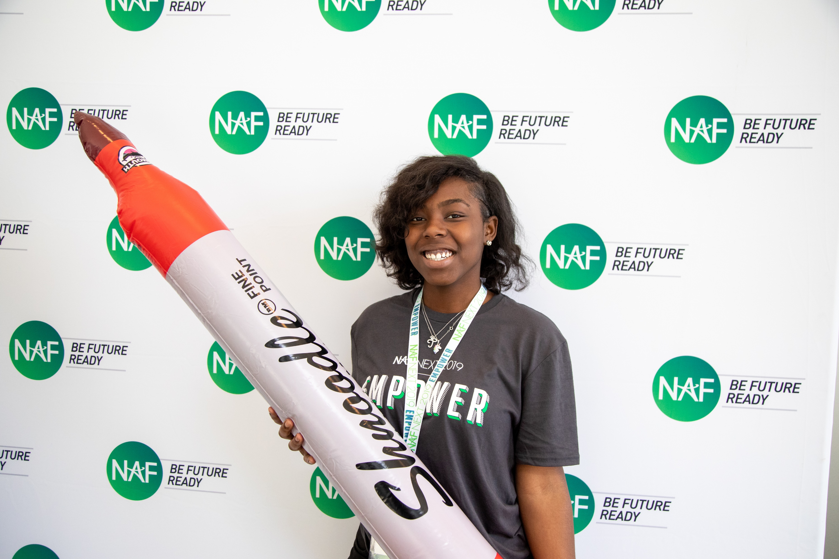
Career Pathways
In addition to NAF’s five core career themes, academy offerings have expanded to include the 16 career clusters and associated pathways outlined by the US Department of Education, as well as State-Approved career pathway courses.
U. S. Department of Education’s Office of Career, Technical, and Adult Education (OCTAE)
Program of Study framework consists of 16 career clusters representing 79 career pathways.
Agriculture, Food & Natural Resources
Architecture & Construction
Arts, Audio/Video Technology & Communications
Business, Management & Administration
Education & Training
Finance
Government & Public Administration
Health Science
Hospitality & Tourism
Human Services
Information Technology
Law, Public Safety, Corrections & Security
Manufacturing
Marketing
Science, Technology, Engineering & Mathematics
Transportation, Distribution & Logistics
State-Approved Pathway Courses
13

Slide 14



Customize Your Program
of Study
AOE Course Options
Project Lead the Way
https://www.pltw.org/our-programs
California Educators Together
https://ash.naf.org/public/learning/course/engineering-and-design
Intelitek
https://intelitek.com/stem-education/
Paxton Patterson
http://www.paxtonpatterson.com/stem-education
STEM 101
https://stem101.org/hs/
Other Considerations:
NAF Courses
Third Party Curricula
Dual Enrollment/Early College Courses
State-approved Career Pathway Courses
Curricula or content with a cost are marked with a , and those requiring professional development with a -
AOE Courses One-pager
14

Slide 15

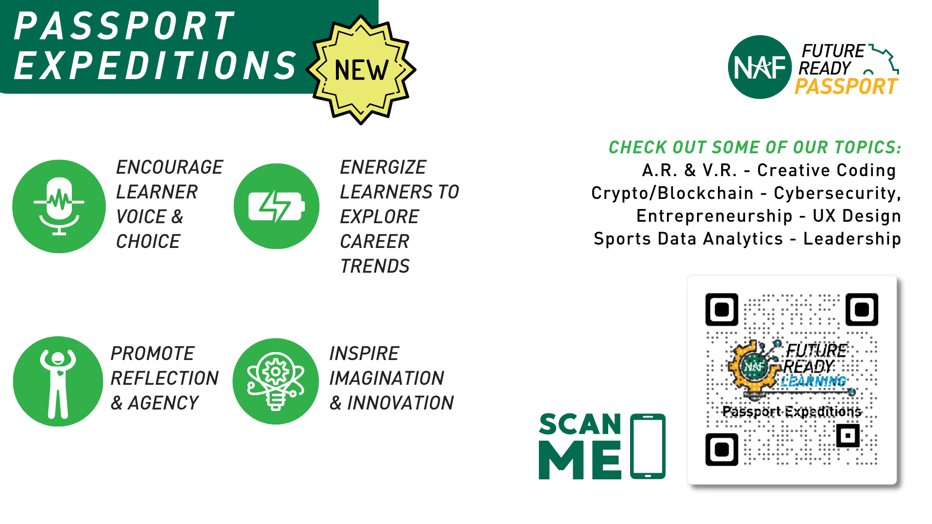

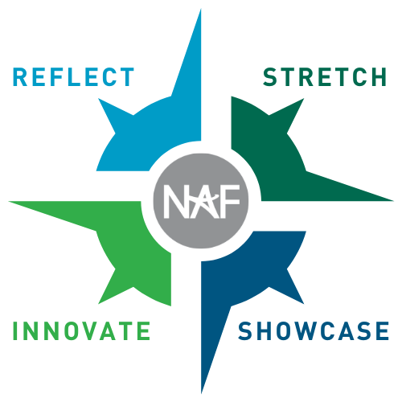
What is a NAF Expedition?
See all our Expeditions on
LEARNING.NAF.ORG
It’s a learner-centered and career-connected authentic project learning experience that’s intended to:
Encourages Voice & Choice
Energizes Learners To Explore Careers
Promotes Learner Agency
Inspires Imagination & Innovation
REFLECT about your skills, learning goals, and purpose
STRETCH your knowledge and skills through active learning
SHOWCASE your innovations and learning in a dynamic way
INNOVATE and iterate solutions for real-world challenges
15
Notes:
A series of free career-connected project-based learning experiences that combine hands-on, real-world projects with career exploration and preparation. Topics include: Computer Vision, Aerospace, Eco-tech, and more!

Slide 16
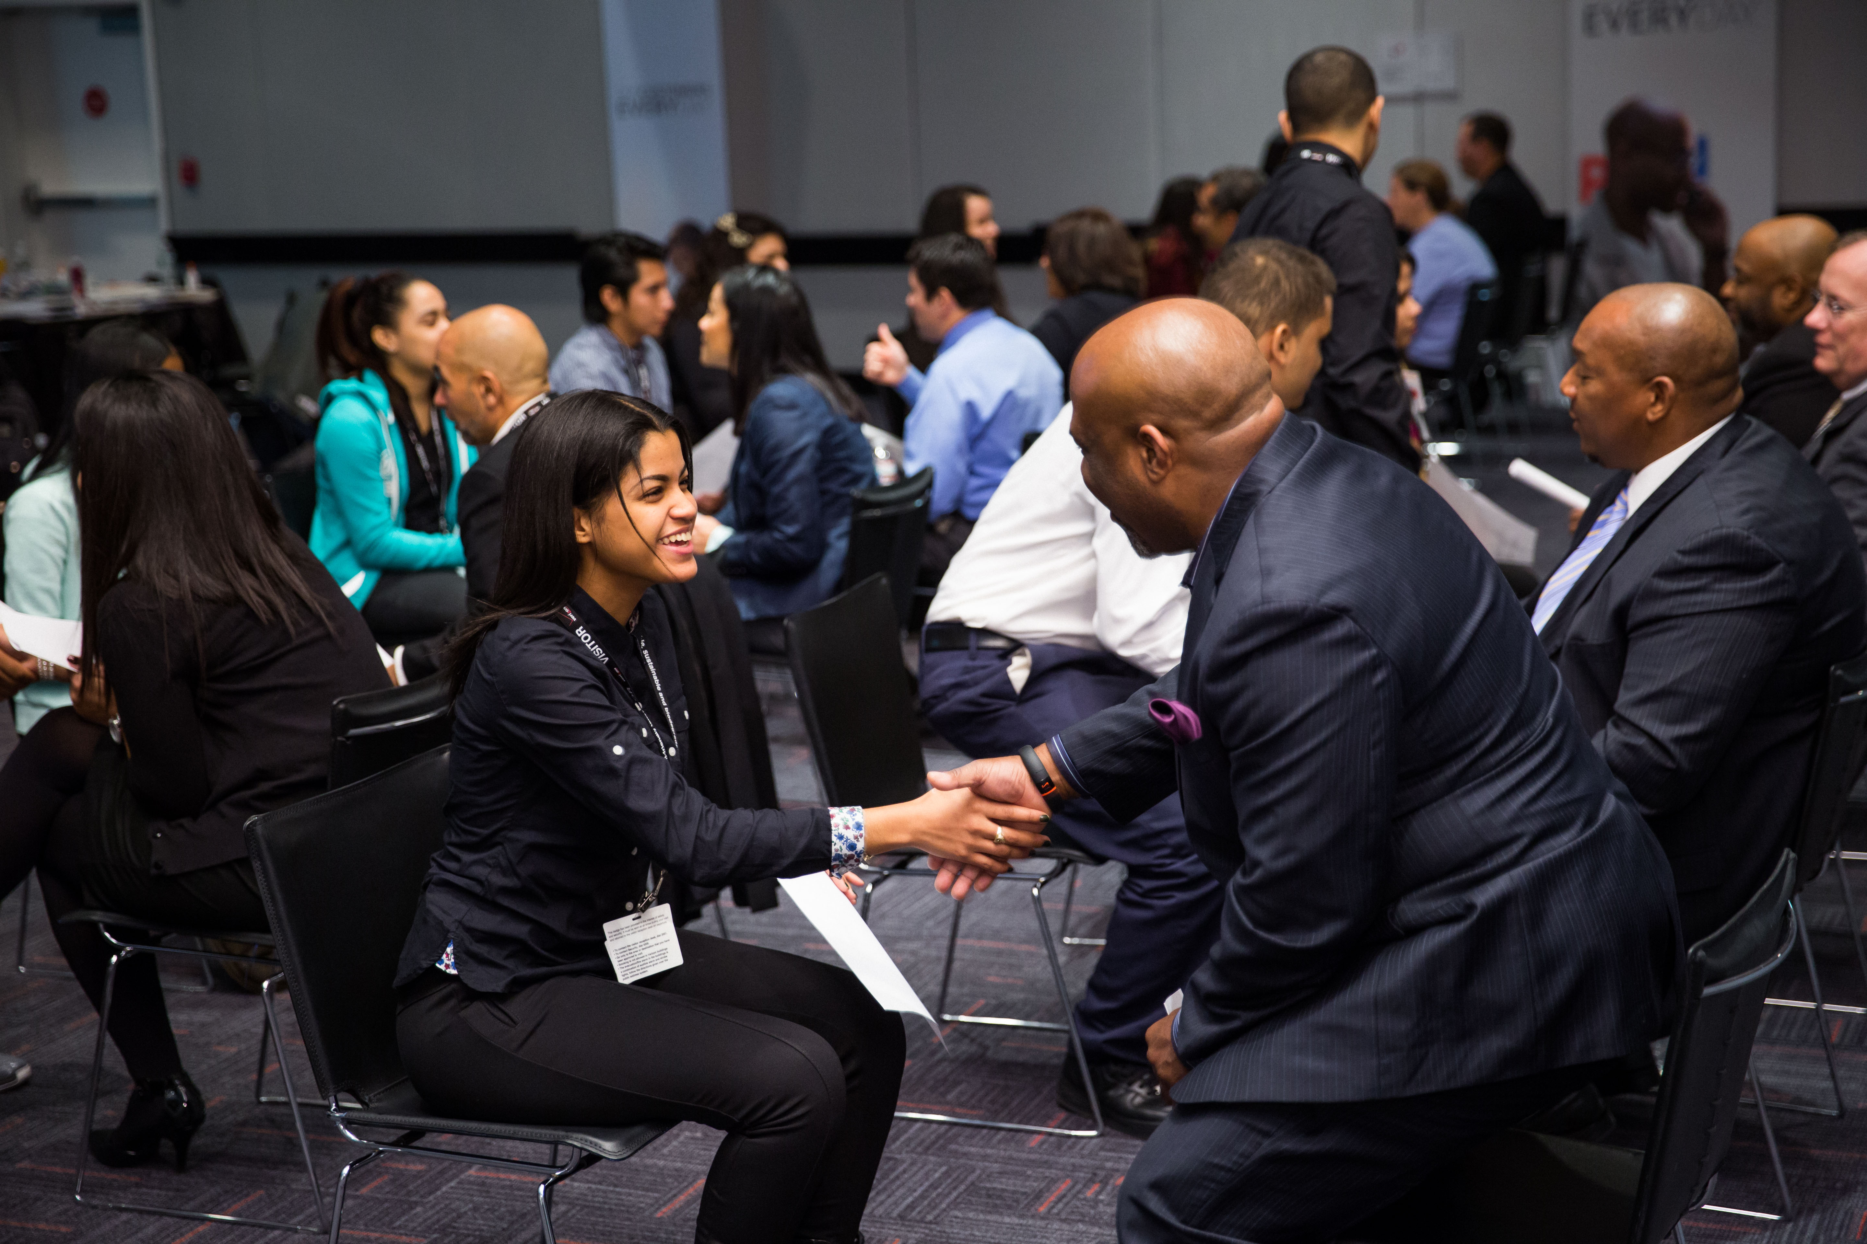

Work-Based Learning
Standards of High Quality WBL:
Interaction
Preparation & Reflection
Classroom-Connected
Outcome-Driven
Awareness
Exploration
Preparation
Guest Speaker
Worksite Tour
Career Fair
Informational Interview
Job Shadow
Mock Interview
Mentorship
Resume coaching/review
Skills Workshop
Partner Engagement Project
Internship
Mentored Industry Project
Clinical Experience
Apprenticeship/Youth Apprenticeship
Students must complete 2 activities of 40+ hours or 1 activity of 80 hours.
Supervisor/mentor completes Future Ready
Skills Assessment.
Impactful
More Impactful
16
Most Impactful
Notes:
NAF’s WBL continuum focuses on:
Awareness: Students build career awareness and aspirations, observing and receiving information through research and questioning.
Exploration: Students explore the workplace and build career skill sets, playing an active role in interacting with adults.
Preparation: Students apply learning and skills through practical experiences with industry professionals, making connections with for conditioned growth.

Slide 17
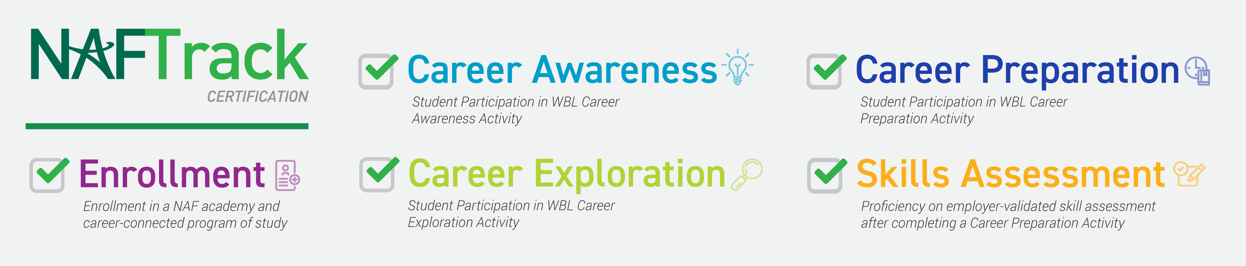
NAFTrack
Certification
NAFTrack Certification is an employability credential that serves as NAF’s seal of college and career readiness.
To earn NAFTrack Certification, students must:
Complete at least three Work-Based Learning activities across Career Awareness, Exploration, and Preparation.
Demonstrate mastery of six Future Ready Skills, employer validated completing Future Ready Skills Assessment.
17
Notes:
NAFTrack Certification is an employability credential that serves as NAF’s seal of college and career readiness.

Slide 18
Tech-Enabled Impact
Innovation & Products

Slide 19



Outcomes-Driven WBL
We want every student to achieve the following outcomes.
Connections
Develop at least three professional connections.
Skills
Build the 6 Future Ready skills.
Receive continuous feedback from industry professionals.
Be able to articulate their strengths.
Aspirations
Define and map a plan for at least one career of interest.
Employees seek key transferable skills. At NAF, we call them Future Ready Skills.
19
Notes:
Implementing an Outcomes-Driven Work-Based Learning program focused on student outcomes and impact to ensure students are Future Ready
Discover careers of interest;
Make a plan to achieve their goals;
Develop professional skills and monitor their growth;
Build meaningful connections with employer partners

Slide 20



Outcomes-Driven WBL
Tech Tools
WBL Tracker
Log WBL activities
Record student participation
Track AB participation
Analyze data to measure
impact & equity
Export reports, graphs, & tables
WBL Tracker
WBL Skills
Feedback Survey
Resources
WBL Student
Reflection Form
Capture student feedback
View quantitative and qualitative data
Analyze data - dashboard or report export feature
Support
WBL Student Reflection Form
Future Ready Skills Assessment
Internships
20

Slide 21
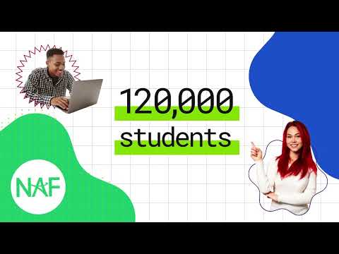
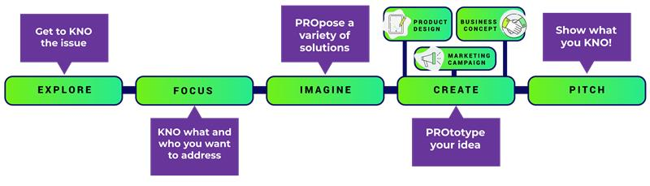
KnoPro
Powered by NAF
https://www.knopro.org/
KnoPro is an interactive, user-friendly platform.
Real-world, multi-sector projects where students learn to:
  Draft plans
  Build prototypes
  Pitch products
  Benefit from mentorship to expand their professional networks
  Build in-demand skills for resumes or college applications
Digital content and media support for students, educators, and industry partners.
Cash prizes and promotional opportunities for winning participants.
Tech-enabled WBL initiative, KnoPro –
featuring industry challenges and daily skillbuilders!
KnoPro corporate partners:
Sponsor or co-create Industry Challenges for students.
Engage their staff as mentors and judges in collaboration with NAF.
Build positive brand associations with students and gain insights from their projects.
Sponsor or create daily Skillbuilders—10-minute activities that help students develop a diverse skillset.
21
Notes:
Tech-Enabled Impact
KnoPro! Where students solve real-world problems they care about in either teams or solo. KnoPro is a real-world application where students build in-demand skills for resumes or college applications, and earn points that convert to prizes and cash.

Slide 22

ODIS
Powered by NAF
A New Way to Measure School Community Need —
Open Data Index for Schools
ODIS is a free, open data resource that provides robust insights into the challenges and barriers facing school communities.
Communities where NAF academies are located have an ODIS metric ~15% higher in terms of overall community stress compared to the national average.
  No other tool brings community data together at the level of school attendance boundaries (SAB) like ODIS.
Learn More about how to leverage ODIS to enhance student outcomes in your work — https://odis.naf.org/.
22
Notes:
Tech-Enabled Impact! ODIS
Other tools provide data at the city, county, or state levels, but ODIS is the first of its kind to do so at the school attendance boundary.

Slide 23

Student Recruitment
Develop a marketing strategy –
recruitment plans include the mission and vision statement, website design, brochure, and communication resources
Contact NAF’s Marketing & Communications Team to request your free custom logo – communications@naf.org
Consider NAF clothing and gear –
purchase at http://store.naf.org/
Notes:
Activity – Begin to formulate strategies that will support student recruitment efforts.
Collaborating with academy leaders to enhance curriculum and professional development
Participating in a variety of classroom activities and student projects
Leveraging connections to raise awareness for the academy and build community support
Finding, funding, or furnishing paid internship opportunities
Sample events
K-6th Expanded Learning After School Mentoring
6th - Pathway Exhibition Event for all students (interactive)
7th - One day field trip experience “Future Ready Lab” (one class per trip)
8th - Pathway Showcase Event (pathway ambassadors serve as hosts)
Sample Recruitment Timeline:
August -- Parent communication begins online (continues through Enrollment Center in Feb.)
September -- Mailers sent home
October -- Pathway Showcases, Application opens
November / December -- Campus Tours
January 15th -- Application closes
By January 20th -- acceptance letters mailed home
February -- Enrollment Center

Slide 24

Together, we can make essential opportunities possible by creating more effective educational experiences and transforming the high school journey.

Slide 25




















NAF Major Corporate
Partners
NAF partners with companies to create tailored engagement programs.
Corporations of all sizes, including national brands, are committed to providing work-based learning opportunities through skill-based volunteerism and student internships.
25

Slide 26
NAF Board of Directors
Sanford I. Weill – Chairman Emeritus
Founder, NAF
Gregory J. Hayes –
Chairman
Executive Chairman, RTX
Kenneth I. Chenault – Vice Chairman
Chairman and Managing Director, General Catalyst
Robert Smith –
Vice Chairman
Founder, Chairman and Chief Executive Officer, Vista Equity Partners
Eugene A. Ludwig – Secretary
Chief Executive Officer, SpringHarbor Financial
Jeffrey A. Brill
Partner, Skadden, Arps, Slate, Meagher & Flom LLP
Ursula M. Burns
Founding Partner of Integrum Holdings, Chairwoman, Teneo LLC, Retired Chairman & CEO, Xerox Corporation and VEON, Ltd.
Lynne Doughtie
Retired Chairman & Chief Executive Officer, KPMG LLP
Lisa Dughi
Chief Executive Officer, NAF
Alex Gorsky
Former Executive Chairman,
Johnson & Johnson
Erin McSweeney
Chief People Officer, UnitedHealth Group
Jennifer Morgan
Chief Executive Officer, UKG
Nicola Palmer
Retired Chief Technology Ambassador, Verizon
Thomas Penny III
President, Donohoe Hospitality Services
Joseph J. Russo
Executive Vice President and President, Global Networks and Technology, Verizon
David L. Steward
Founder and Chairman, World Wide Technology
Sandy Torchia
Vice Chair, Talent and Culture, KPMG LLP
Joseph M. Tucci
Chairman & Co-Founder, Bridge Growth Partners
Marc Weill
Senior Advisor, Two Sigma Ventures
Matthew Zielinski
EVP, President International Markets, Lenovo
Lauren Budzich-Goren
Strategy and Execution
Ex Officio Board Member & Chair, NAF Alumni Leadership Council, Senior Manager, US Commercial Transformation, J&J MedTech
NAF Board members are leaders in their fields and strong advocates for improving education and workforce development.
Through their leadership, guidance, and support, NAF is able to fulfill its mission of developing the next generation of future-ready employees.
26

Slide 27
NAF STEM Advisory
Committee
Nicola Palmer
Chair
Retired Chief Technology Ambassador,
Verizon
Alencia DeAnda-Gregg
AVP HR Business Partner Human
Resources Organization, AT&T
Joseph Dill, DDS, MBA
Chief Dental Officer, Delta Dental Plans Association
Lisa Dughi
Chief Executive Officer, NAF
Vinay Iyengar
Partner, Foundation Capital
Marilyn McDonald
Senior Vice President, Commercial
Digital & Innovation, Moderna
Brian Monahan
Global Client President; Head of Dentsu Innovation Initiative US, Head of Solutions
West dentsu international
Milanka Muecke
Director, Global Commercial Marketing, Workstation Business, Lenovo
“Ram” Sankaran Ramanathan
Vice President, Network Systems, Verizon
Juan F. Rodriguez
National Strategic Advisor – SLED K12
E-rate and Federal Funding,
World Wide Technology
Bobby Soni
Global Technology Consulting Leader,
KPMG International
Brian Thomas
President & CEO, Lightspeed Systems
Developed in 2013 as an adjunct to NAF’s Board of Directors, the STEM Committee addresses the growing role of science, technology, engineering, and mathematics in the economy.
It guides workforce development through strategies in curriculum, work-based learning, employee engagement, advisory boards, college access, and educator development while fostering collaboration among top STEM leaders to attract and support diverse talent in STEM careers.
27

Slide 28
Starting an Academy
NAF Admissions

Slide 29
Admissions
Getting Started
Form a dedicated team of stakeholders with a shared vision to start a NAF career academy. The multi-disciplinary team represents the school community and brings their expertise and perspective to develop the academy design plan. Refer to the Academy Design Team Prep Guide.
Year of Planning Program
Year of Planning: A customized developmental process for establishing a NAF academy. Schools with limited experience in designing a career-focused program receive personalized support and technical assistance to align your programming goals with the NAF Design before the academy launches. The planning phase typically lasts one school year but can extend from 6 to 18 months. This approach helps establish a sustainable foundation for academic success and builds the capacity to fulfill commitments to students and the community.
The application fee is $12,000 (a $2,000 annual membership fee applies upon Launch)
Fast Track Program
Fast Track: An accelerated path to NAF membership. The process is designed for existing career academies meeting most NAF standards, or are NCAC or Linked Learning Certified. The application process typically lasts three months but may vary based on your academy’s launch year goal. It involves gathering documentation to demonstrate alignment with the NAF Design. This approach allows for an expedited academy launch and access to support, resources, and connecting students to opportunities.
The application fee is $4,000 + a $2,000 annual membership fee
29
Notes:
Who is Eligible?
NAF promotes full district engagement in creating academies to maximize successful and sustained academy development. The annual membership fee is $2,000 per academy, with multi-academy discounts available. Begin the process by completing the NAF Interest Survey to indicate your interest and commitment to partnering with NAF.

Slide 30










Year of Planning
Roadmap
Key Steps to Developing
Your Academy Design Plan.
Team Building
& Leadership
Academy
Quality
Program of
Study
Student Recruitment
& Enrollment
Advisory
Board
Form a multi-disciplinary team with a shared vision to create a
career academy.
Hold the YOP Kickoff and develop an Action Plan to document Academy Design Plan progress.
Develop a career-connected program with advanced academics and early college options.
Develop an open choice student recruitment plan that emphasizes equitable and inclusive practices.
Develop an employer engagement plan to recruit business partners and advisory board members.
Work-Based
Learning
Authentic
Projects
College & Career
Readiness
YOP
Graduation
Launch
Year
Develop a work-based learning plan for academy grade levels to include advisory board participation.
Develop a career-connected authentic project-based learning plan per grade level.
Develop a college and career readiness plan.
Finalize your Academy Design Plan and schedule the graduation meeting.
Coordinate a new student orientation before school starts and prepare a press release to announce the academy opening.
30
Notes:
Follow these essential steps to develop YOUR academy design plan. Use this roadmap as a guide to customize your timeline and navigate the Year of Planning with ease!

Slide 31







Fast Track
Pacing Guide
Your Accelerated Path to
NAF Membership!
Getting
Started
Admissions
(Day 1 – Day 14)
Assessment
(Day 15 – Day 21)
Evidence
(Day 22 – Day 45)
Adjustments
(Day 46 – Day 60)
Membership
(Day 61 – Day 75)
Graduation
(Day 76 – Day 90)
The school/district forms a multi-disciplinary Academy Design Team (ADT) to establish a shared vision to start a NAF career academy. The ADT uses the Interest Survey to evaluate partnership alignment and readiness identifies expected outcomes for the district, school, and community, and contacts NAF to begin the admissions process. | The NAF Team evaluates partnership alignment and approves schools for the application process, then schedules a virtual meeting with approved applicants to review the Fast Track process. The ADT establishes team roles and deadlines to ensure timely submission of all required documentation. | The ADT reviews the Fast Track Assessment sample and agrees on responses for accuracy before submitting it online. The applicant submits the assessment on behalf of the ADT. A score of 15 or higher is required to proceed with the Fast Track process. | The ADT reviews the Evidence Checklist to understand NAF Standards. The applicant submits evidence demonstrating alignment of current practices with NAF’s Design. The NAF Team completes an initial review of evidence within 10 days, notifying the applicant if clarification or adjustments are needed. | The ADT uses feedback from the initial review to revise their online assessment within 15 days. The NAF Team then conducts a final review of the evidence to ensure alignment with NAF standards before processing the membership agreement and fees. | The applicant facilitates the signing of a NAF Membership Agreement to formalize the partnership and start the invoicing process. A $4,000 application fee is required before the Fast Track validation meeting, which the NAF Team schedules with key members of the ADT to finalize the application. | The admissions process concludes with a validation meeting to discuss alignment with the NAF Design. The ADT uses insights from this meeting to set goals and adjust their action plan for the Launch Year. A $2,000 annual membership fee is due upon the academy's launch.
*The 90-Day sample timeline is flexible based on your academy development needs.
31

Slide 32



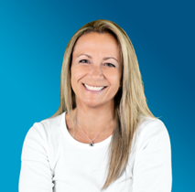
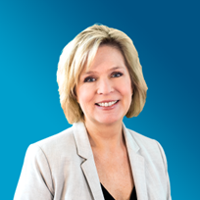



Academy Design Team
  School leadership, advocacy, resources, master scheduling, and community support
  Academy program coordination and leadership, advocacy, and overall management of implementing NAF’s design
  Business/community liaison, work-based learning program, and internships
  Student recruitment, supports and interventions, student scheduling, and social-emotional and academic advisement
School
Administrator
Academy
Lead
Work-Based
Learning Coordinator
Counselor
  Career-pathway expertise and integration through authentic project experiences and work-based learning strategies
  Postsecondary education liaison and coordinating college/career activities
  Core-content expertise and integration through authentic project experiences and work-based learning strategies
  Students’ interests/needs, academy program impact/effectiveness, and recruitment
Career Pathway
Educator
College & Career
Coordinator
Core-Content
Educator
Academy
Student
32
Notes:
Sample ADT
Recruit individuals with a shared vision to establish a career academy that aligns with the NAF design. The multi-disciplinary team represents the school community and brings their expertise and perspective to develop an academy design plan: school district leaders, high school administrators, career-pathway educators, business/community liaisons, post-secondary liaisons, etc.

Slide 33

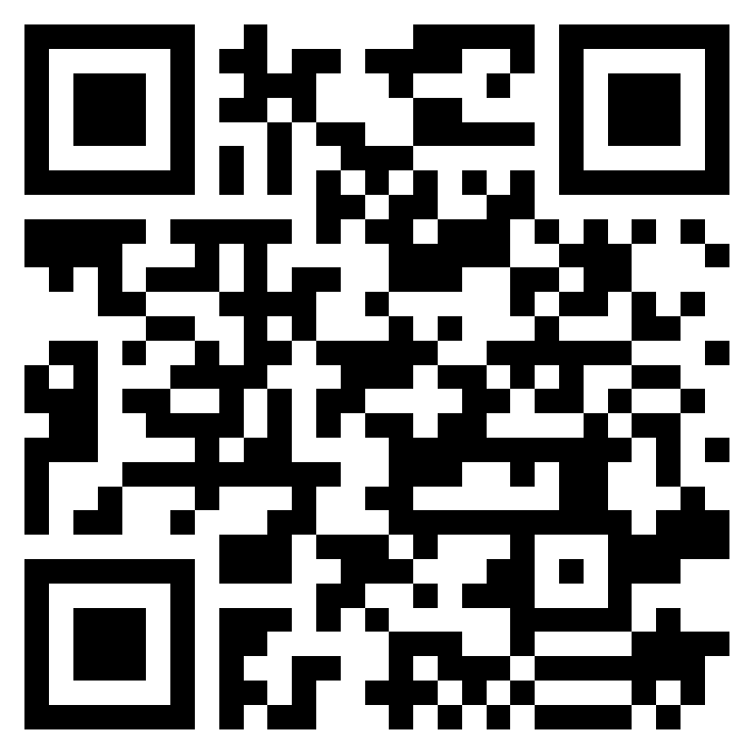
Join the NAF Network
Next Steps
Reflect on the district vision and assess readiness - NAF Interest Survey
Assess student interest and workforce support – select a career pathway
Review budget considerations
Recruit the Academy Design Team (ADT)
Submit Interest Form to begin application: https://naf.org/our-academies/start-a-naf-academy/contact
Admissions Questions?
Scan QR Code To Request More Information
Jennifer Geisler, Director, Emerging Academies
jgeisler@naf.org
33

Slide 34


Questions?
Learn More About NAF!
The NAF Difference
NAF National Data
Get to Know KnoPro
WBL Key Concepts
Alumni Benefits
About NAF
Watch NAF’s Approach to WBL
34

Slide 35
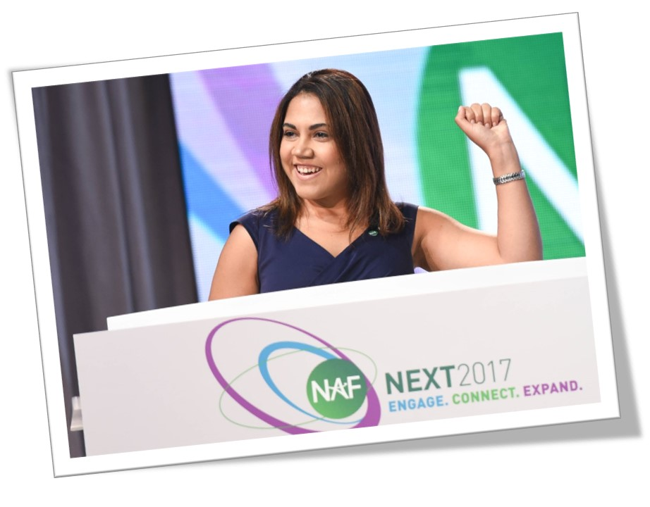
NAF Personal Impact
“This is where I started,
and I made it!”
“Why was NAF and the internship
experience life changing? Because I
found a home, I found a place where I
mattered, where people were genuinely
interested in my success and development. The experience made my dreams more realistic, more tangible.”
-Jackie Burgos
NAF Alumna
Harvard Business School
Class of 2014
https://youtu.be/gwh0lR5F1l0
35

Slide 36
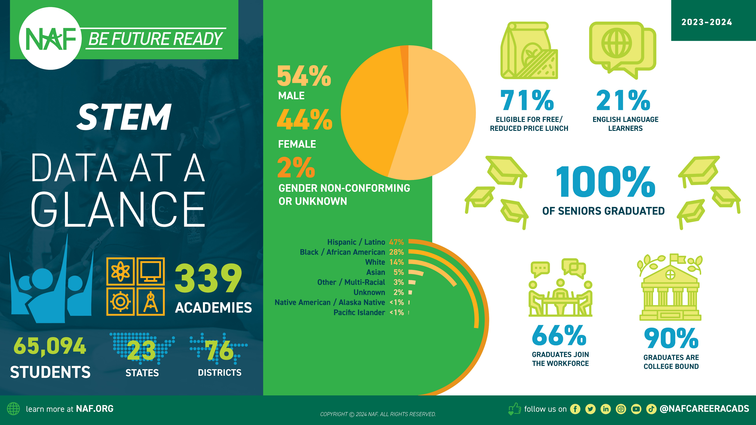

Slide 37
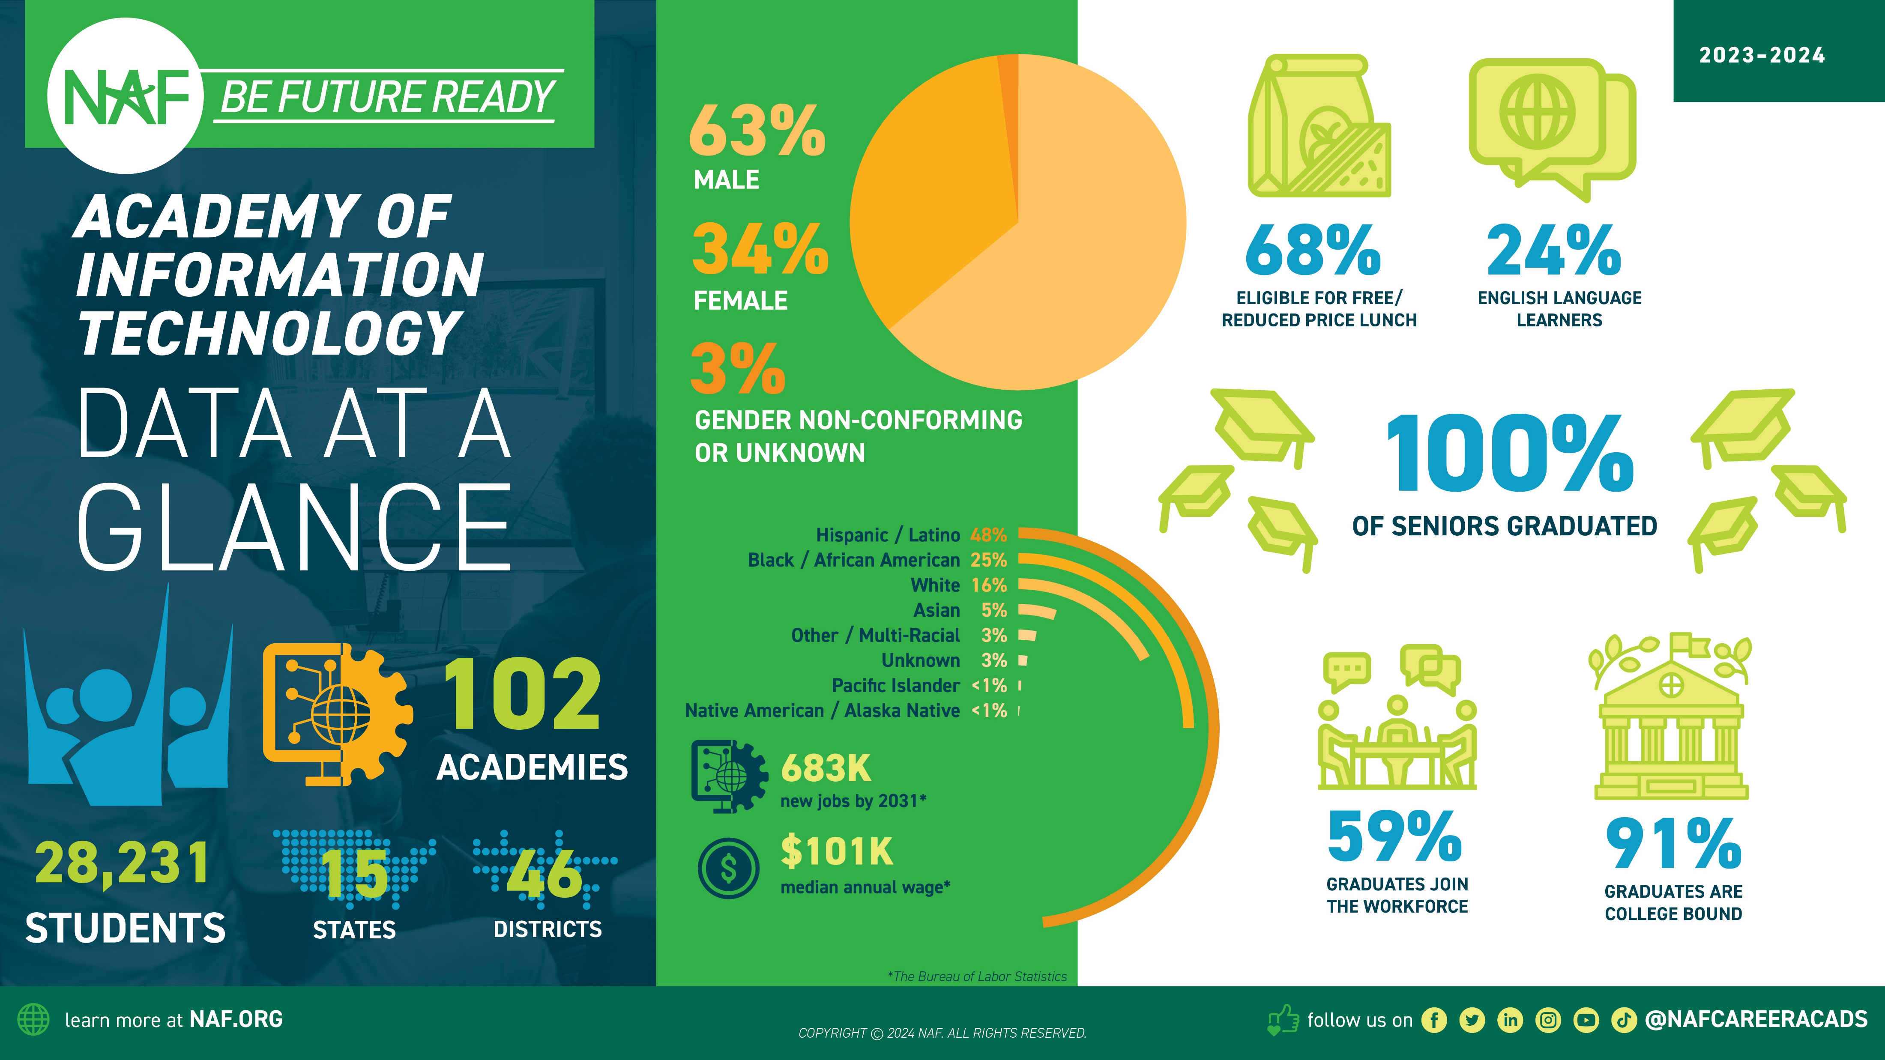

Slide 38
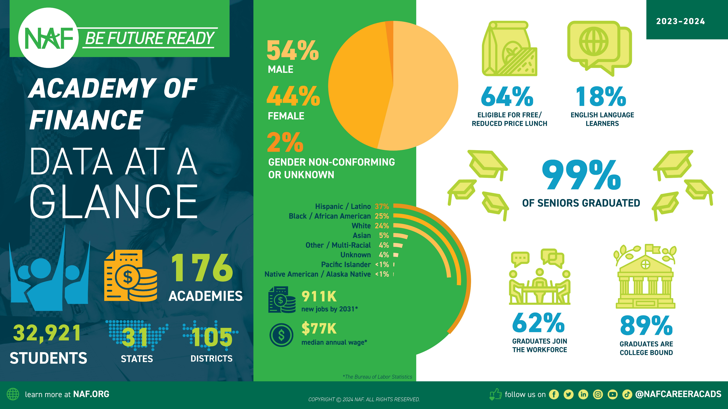

Slide 39


Slide 40
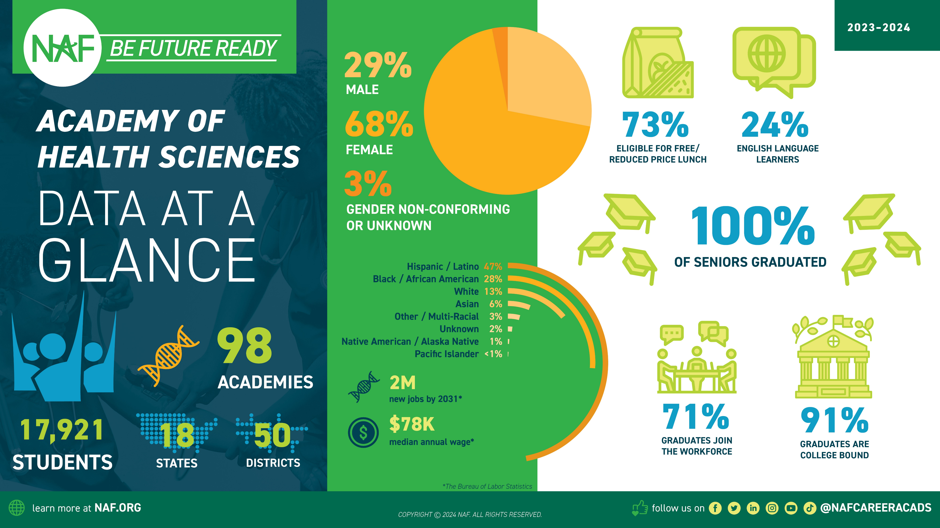

Slide 41
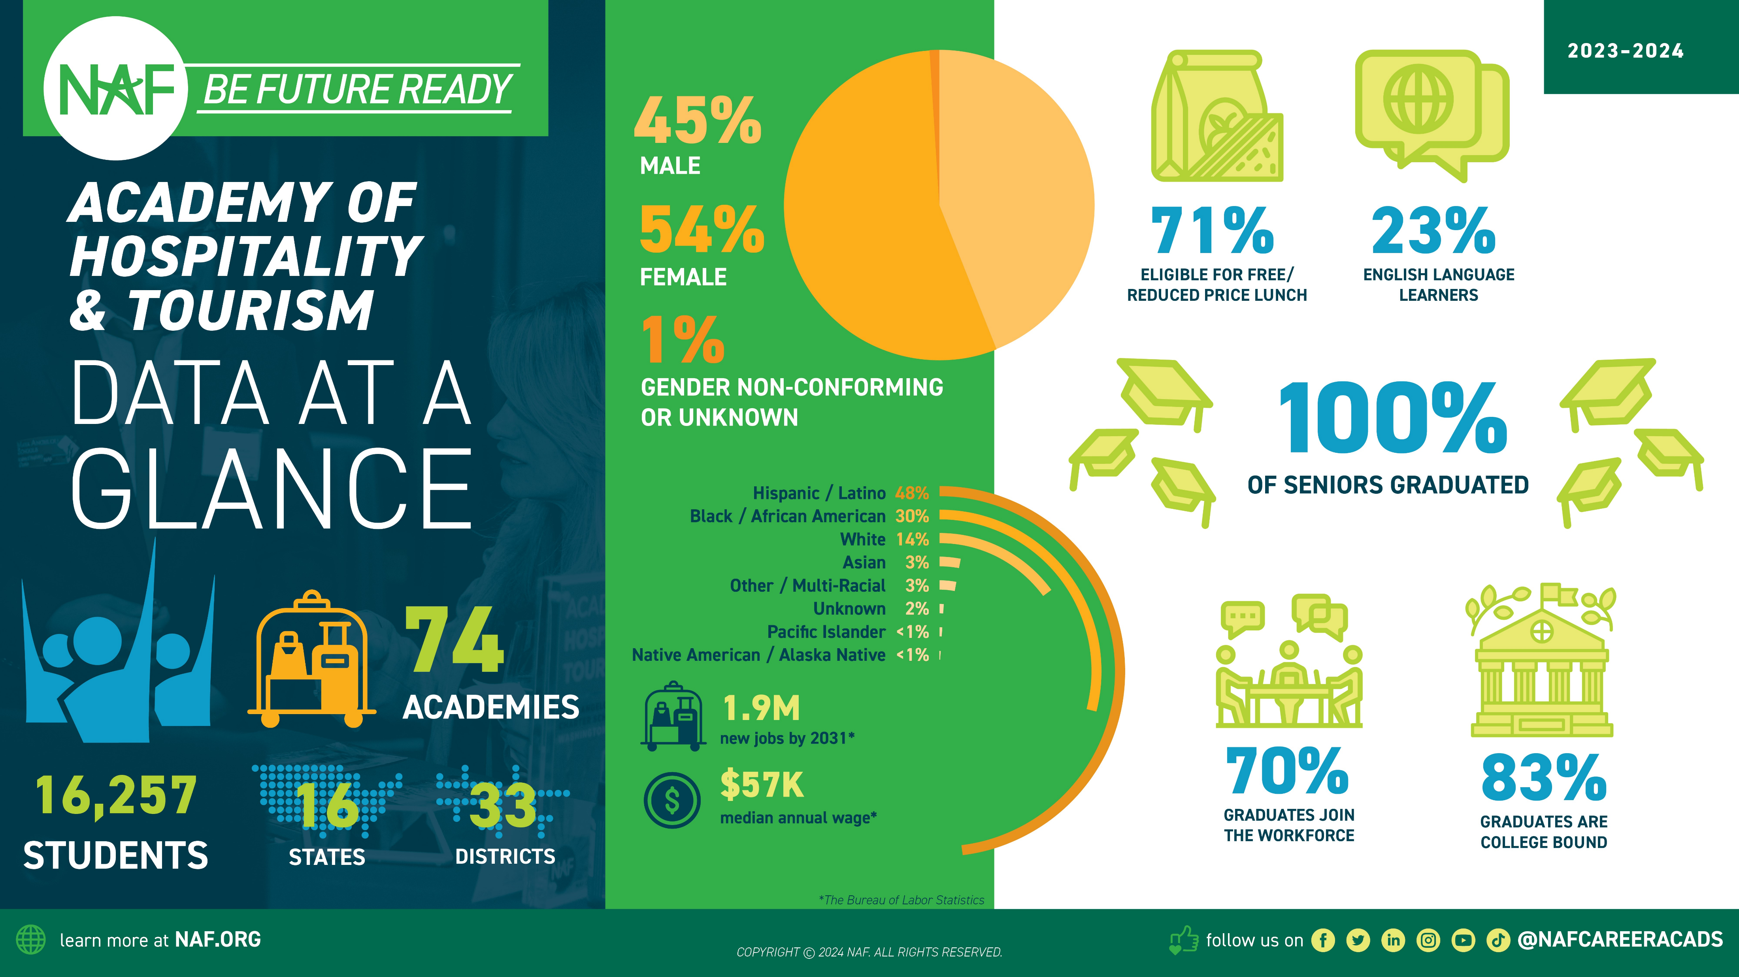

Slide 42
42

