Slide 1
At NAF, we believe every student deserves access to the support and resources needed to prepare for the future.
1

Slide 2
Introductions
Share:
Name and Role
What are your expected outcomes for the district, school, and community?
Reflect on one of the following:
What specific topics are you interested in exploring and learning about today?
What is the academy vision?
Notes:
Agenda Review
1. Network Highlights; 2. NAF Design Overview; 3. Admissions process and Pricing; 4. Tech Enabled Impact 5. Questions & Next Steps
What are the expected outcomes for the district, school, and community? Through a collaborative partnership with NAF?
Outcomes?
Enhanced Educational Experience
Increased Community Engagement
Resource Allocation and Support
Innovative Collaborations
Opportunities for Community
Long-term Sustainability

Slide 3
Notes:
https://www.youtube.com/watch?v=WHqagBn1uMo

Slide 4
NAF Builds Career
Success
NAF is a leader in the movement to prepare young people for college and career success.
A network of career academies which are small, focused learning communities within public high schools
Offering schools and businesses a proven and sustainable model for working together to ensure high school students are future ready.
Themed around thriving high-need industries
NAF is preparing a skilled and diverse talent pipeline for our country’s most viable industries, in partnership with high schools, employers, and community leaders.
Health
Sciences
Hospitality &
Tourism
Information
Technology
Engineering
Finance
*additional industry themes represented and supported by NAF
4

Slide 5
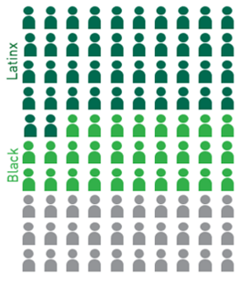
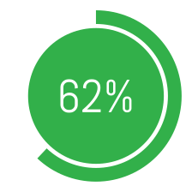
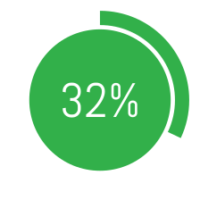
NAF Promotes
Equity
NAF serves majority students of color
NAF graduates and sends these students to college at higher rates
NAF spurs economic mobility and workforce diversity
NAF is uniquely positioned to improve outcomes for students of color and students from under-resourced communities.
67% receive
Free/Reduced Lunch
NAF students at risk of not graduating on time have a 10% higher high school graduation rate
An independent study of career academy graduates (including NAF) showed:
Post-secondary enrollment for Black and Latinx NAF students
Young men of color earn 17% more per year
Positive effects on marriage and parenting
This is roughly the equivalent earning power of an associate's degree
Post-secondary enrollment for Black and Latinx non-NAF CTE students
5
Notes:
NAF students at risk of not graduating are 11% more likely to graduate than non-NAF students.
99% of NAF seniors graduate, a rate that has remained consistent for the last four years.
76 % of employees think their company should be doing more to increase diversity.
NAF meets employers’ interest by working closely to create engagement opportunities tailored to their DEI goals.

Slide 6
Notes:
NAF DEIA Principles set the standards for behaviors and increase awareness of the importance of diversity, equity, inclusion, and access and its alignment with NAF’s vision and programmatic offerings. Each principle is thoughtfully designed to consider the varied audiences within our network.

Slide 7
7

Slide 8
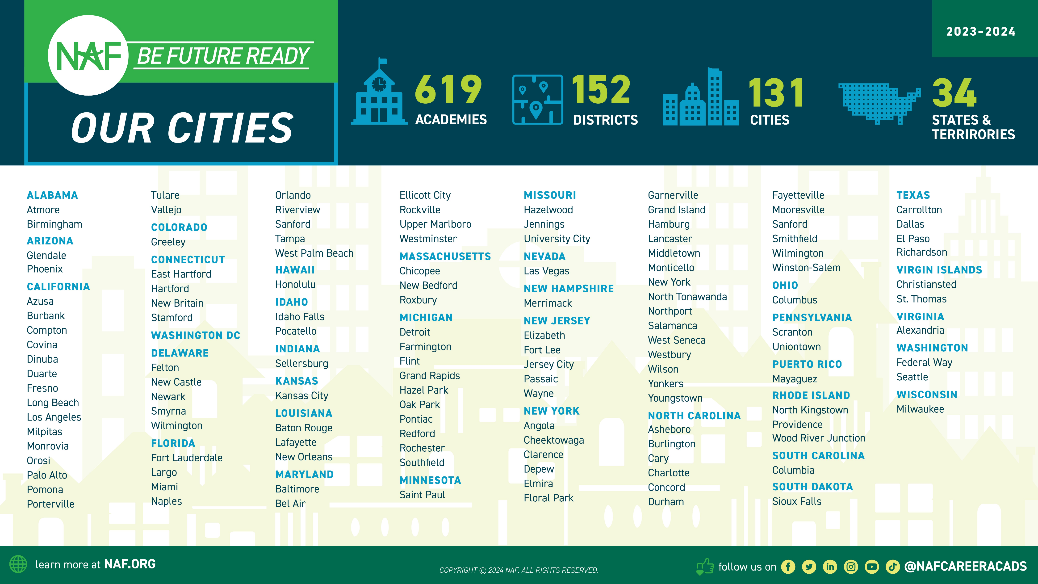
Our Approach: Work-based Learning Impact
Implementing an Outcomes Driven
Work-Based Learning* approach to ensure students are Future Ready:
Discover careers of interest
Make a plan to achieve their goals
Develop professional skills and monitor their growth
Build meaningful connections with professionals
Aspirations
Skill Sets
Connections
*WBL Participation Tracker is a tool to log WBL activities and record student participation to measure impact and assess equity.
Notes:
Find an academy near you.

Slide 9
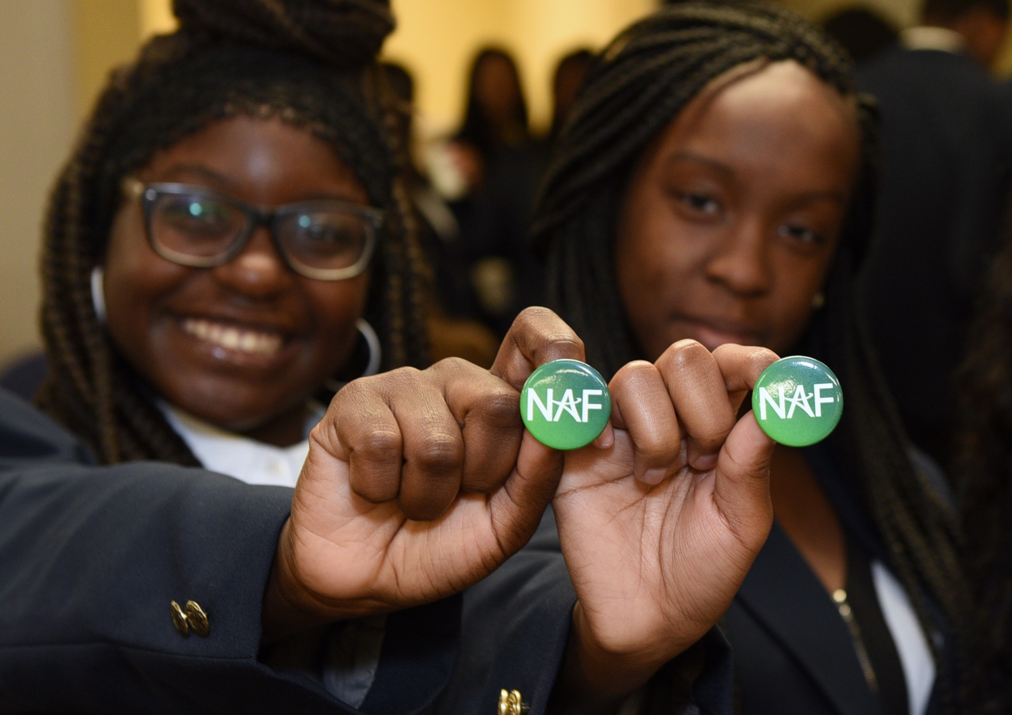
NAF Design
NAF ignites students’ passion for learning through an educational design featuring:
Academy Development & Structure
Advisory Board
Curriculum & Instruction
Work-Based Learning
9

Slide 10
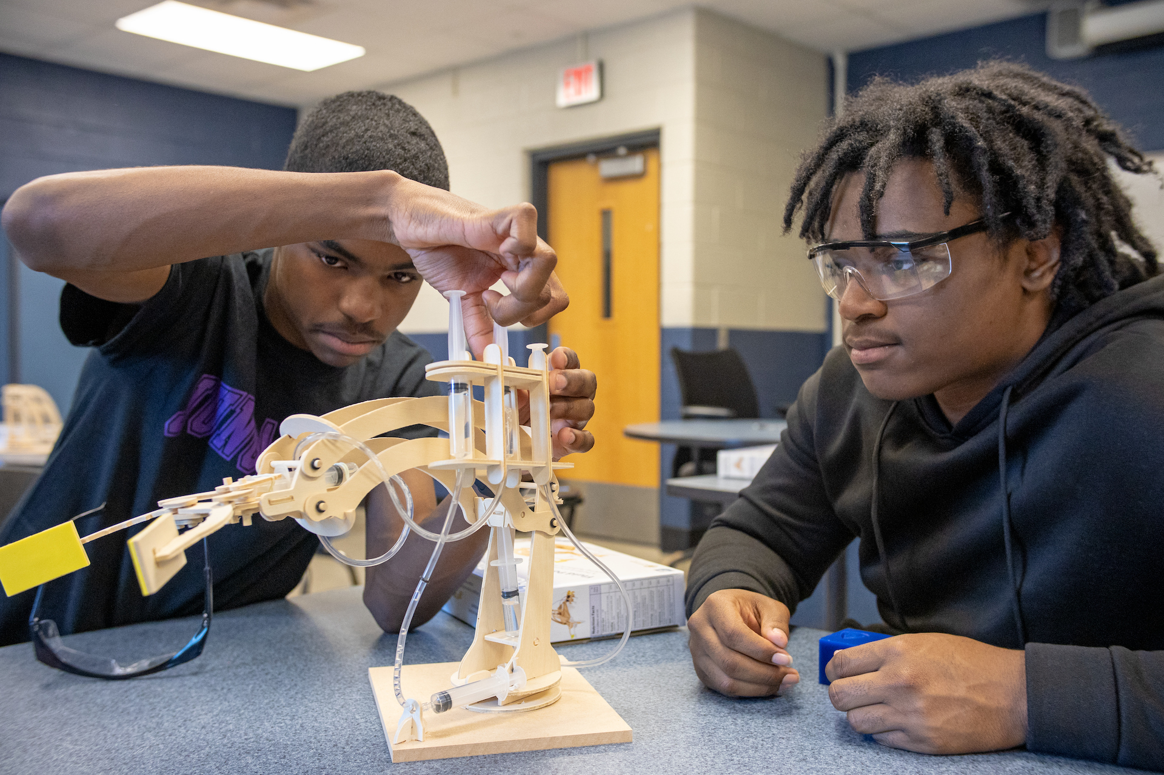
Academy Development &
Structure
Academy development and structure is crucial to the successful implementation of a high-quality, NAF career academy.
Small, focused learning communities
Fit within and enhance existing high school systems
Open choice enrollment with strategic marketing and recruitment plans
Enrolls at least 20 students per grade level
Flexible structure
Collaborative design bringing together academy, business, and community leaders
10

Slide 11
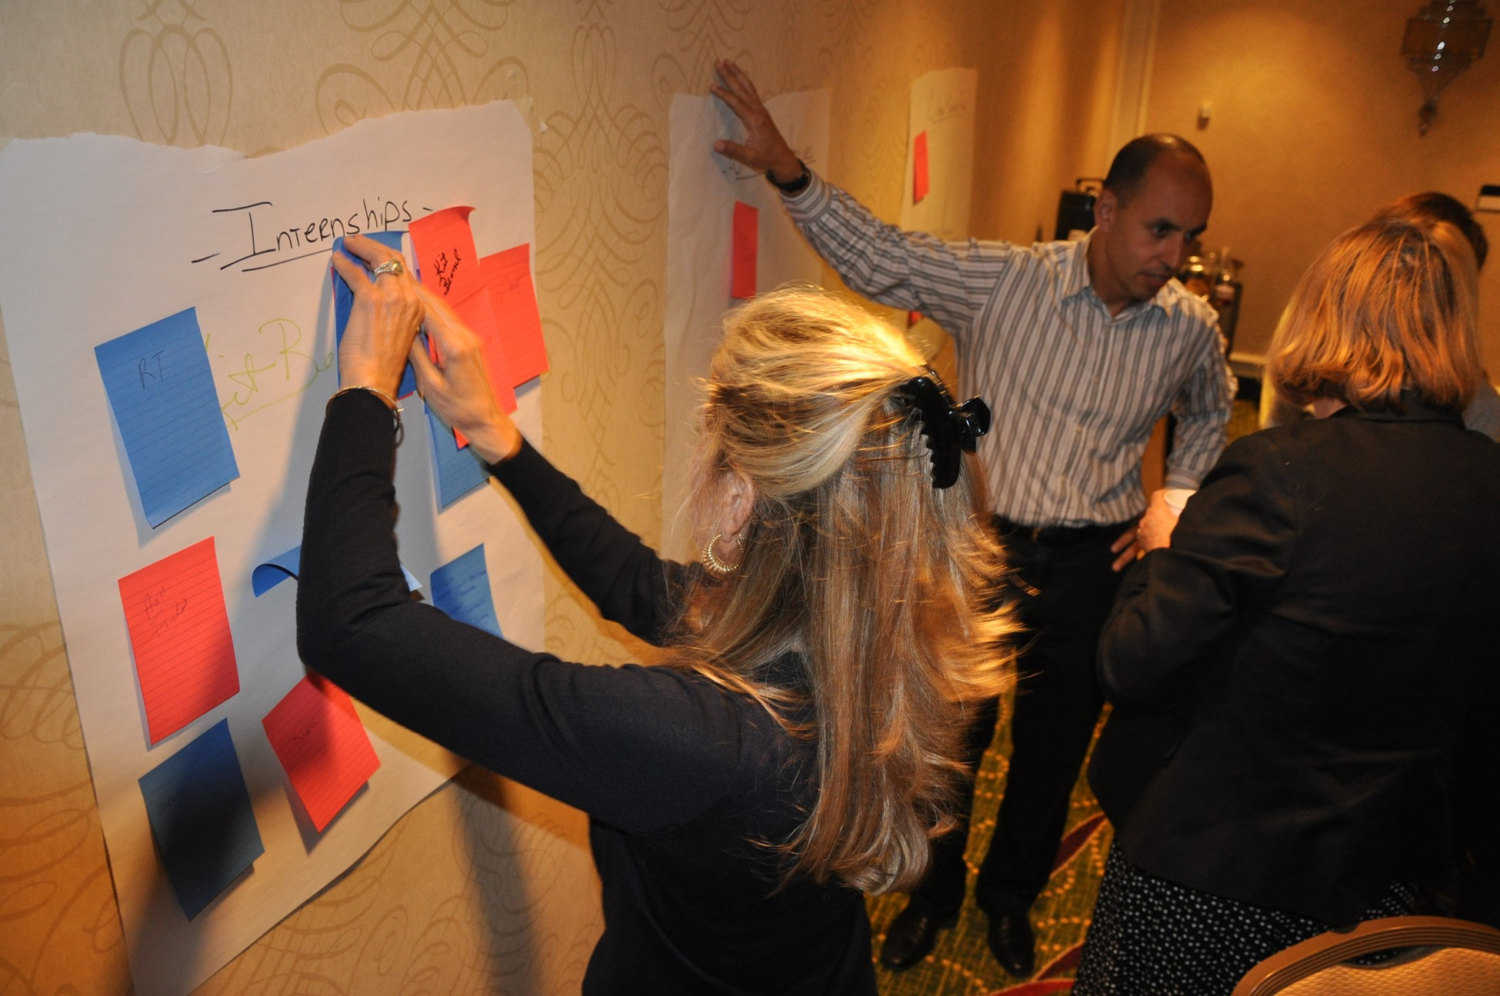
Advisory Board
Advisory boards and their members provide an essential bridge between the classroom and the workplace.
10-20 members
80% from the business community
Over 4,000 members nation-wide
Organize work-based learning activities
Inform curricula
Community advocates for the academy
Provide and solicit financial support
11

Slide 12
Curriculum & Instruction
NAF provides and curates rigorous, career-themed curricula and authentic, career-connected projects that incorporate current industry standards and practices.
NAF also partners with organizations that provide free content and/or industry certifications!
Career-themed
Industry Validated
STEM Infused
Project-based
Health
Sciences
Hospitality &
Tourism
Information
Technology
Engineering
Finance
12

Slide 13
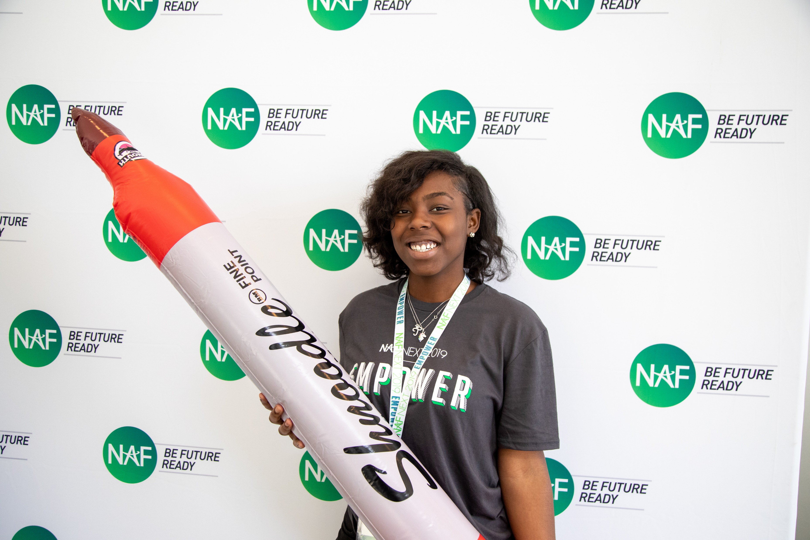
Program of Study
In addition to NAF’s five core career themes, academy offerings have expanded to include the 16 career clusters and associated pathways outlined by the US Department of Education, as well as State-Approved career pathway courses.
U. S. Department of Education’s Office of Career, Technical, and Adult Education (OCTAE) Program of Study framework consists of 16 career clusters representing 79 career pathways.
Dr. Amy Loyd, Assistant Secretary of Education, OCTAE on the Power of NAF
Agriculture, Food & Natural Resources
Architecture & Construction
Arts, Audio/Video Technology & Communications
Business, Management & Administration
Education & Training
Finance
Government & Public Administration
Health Science
Hospitality & Tourism
Human Services
Information Technology
Law, Public Safety, Corrections & Security
Manufacturing
Marketing
Science, Technology, Engineering & Mathematics
Transportation, Distribution & Logistics
State-Approved Pathway Courses
13

Slide 14
What is a NAF Expedition?
See all our Expeditions on
LEARNING.NAF.ORG
It’s a learner-centered and career-connected authentic project learning experience that’s intended to:
Encourages Voice & Choice
Energizes Learners To Explore Careers
Promotes Learner Agency
Inspires Imagination & Innovation
REFLECT about your skills, learning goals, and purpose
STRETCH your knowledge and skills through active learning
SHOWCASE your innovations and learning in a dynamic way
INNOVATE and iterate solutions for real-world challenges
14
Notes:
With a focus on project-based learning NAF is providing Future Ready Passport Expeditions; a series of authentic project learning experiences that energize learners to identify passion projects and inspire them to imagine innovative solutions to real-world issues in partnership with career experts.
Learners engage in self-reflection, research, and investigation using design thinking strategies or the engineering design process. Our expeditions offerings include Finance Expeditions, Tech Expeditions , and Engineering Expeditions with more under development.

Slide 15
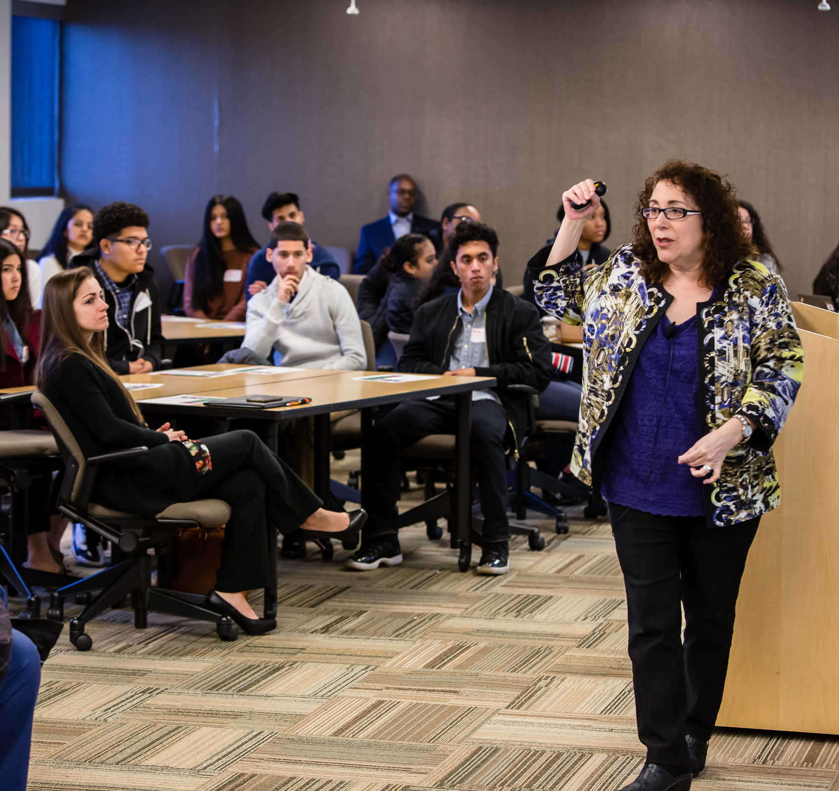
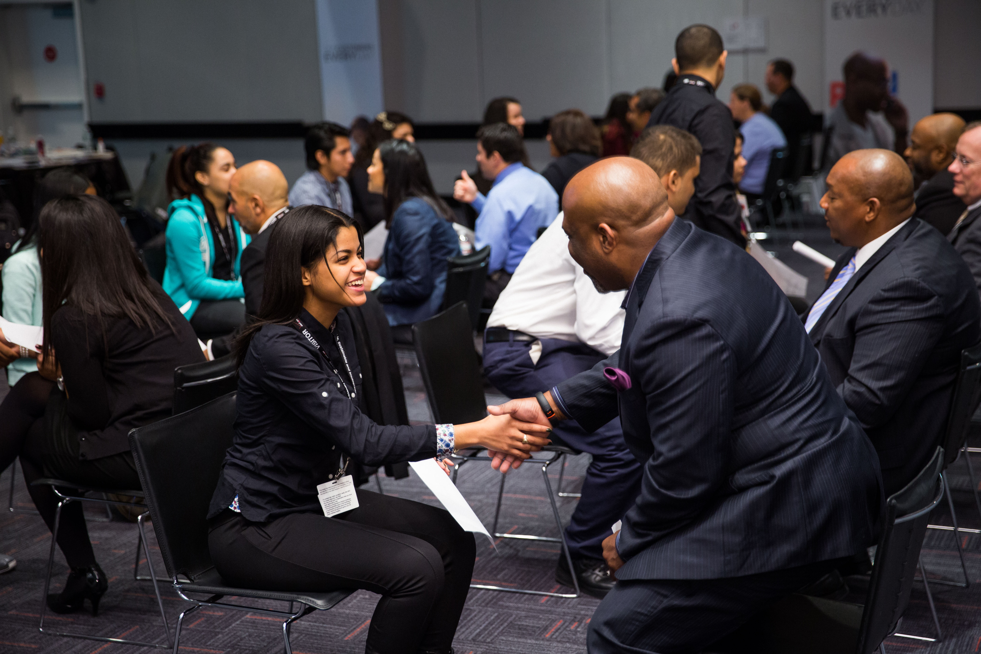
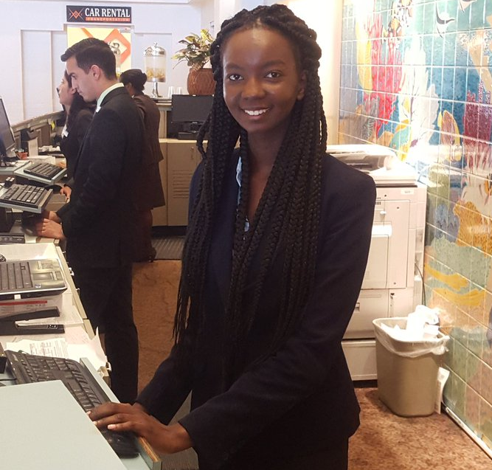
Work-Based Learning
Awareness
Exploration
Preparation
Guest Speaker
Worksite Tour
Career Fair
Informational Interview
Job Shadow
Resume coaching/review
Mock Interview
Mentorship
Skills Workshop
Partner Engagement Project
Internship
Clinical Experience
Apprenticeship
Youth Apprenticeship
Mentored Industry Project
Aspirations
Skill Sets
Connections
15

Slide 16
Outcomes Driven WBL
Approach
Students Discover Careers of Interest
Connections
Make a plan to achieve their goals
Develop professional skills and monitor their growth
Skills
Aspirations
Build meaningful connections with employer partners
16

Slide 17
Outcomes Driven WBL
Tech Tools
WBL Tracker
Log WBL activities
Record student participation
Track AB participation
Analyze data to measure impact & equity
Export reports, graphs, & tables
WBL Tracker
WBL Skills Feedback Survey
Resources
WBL Student Reflection Form
Capture student feedback
View quantitative and qualitative data
Analyze data - dashboard or report export feature
Support
WBL Student Reflection Form
Future Ready Skills Assessment
Internships
17

Slide 18
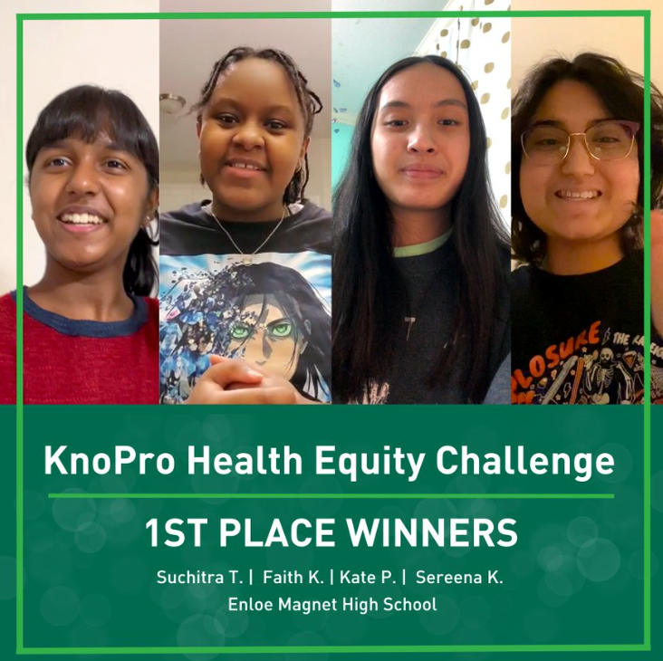
Tech-Enabled Impact
https://www.knopro.org/
KnoPro
KnoPro is an interactive, user-friendly product featuring:
Real-world, multi-sector projects with participants learning how to draft plans, build prototypes, and pitch products, while benefiting from mentorship, which also increases professional networks
Digital content and media to support students, educators, and industry partners
Cash prizes and promotion for winners
In 2022, NAF launched our first Tech-enabled WBL initiative KnoPro - with industry challenges and daily skill builders!
KnoPro Corporate partners:
Sponsor/co-create an Industry Challenge
Work with NAF to engage staff as mentors and judges
Create positive brand associations with students and learn from their projects and insights
Sponsor/create content for daily Skillbuilders—15-minute activities that help build a range of skills for students
18

Slide 19
Student Recruitment &
Marketing
Develop a marketing strategy – recruitment plans include the mission and vision statement, website design, brochure, and communication resources
Contact NAF’s Marketing & Communications Team to request your free custom logo – communications@naf.org
Consider NAF clothing and gear – purchase at http://store.naf.org/
Notes:
Activity – Begin to formulate strategies that will support student recruitment efforts.
Collaborating with academy leaders to enhance curriculum and professional development
Participating in a variety of classroom activities and student projects
Leveraging connections to raise awareness for the academy and build community support
Finding, funding, or furnishing paid internship opportunities
Sample events
K-6th Expanded Learning After School Mentoring
6th - Pathway Exhibition Event for all students (interactive)
7th - One day field trip experience “Future Ready Lab” (one class per trip)
8th - Pathway Showcase Event (pathway ambassadors serve as hosts)
Sample Recruitment Timeline:
August -- Parent communication begins online (continues through Enrollment Center in Feb.)
September -- Mailers sent home
October -- Pathway Showcases, Application opens
November / December -- Campus Tours
January 15th -- Application closes
By January 20th -- acceptance letters mailed home
February -- Enrollment Center

Slide 20
Together, we can make essential opportunities possible by creating more effective educational experiences and transforming the high school journey.

Slide 21
NAF Major Corporate
Partners
NAF works directly with companies to create custom engagement programs that match their needs.
Corporations large and small, including national brands, are committed to providing work-based learning opportunities through skill-based volunteerism and hiring NAF interns.
21

Slide 22
NAF Board of Directors
Sanford I. Weill – Chairman
Founder, NAF
Kenneth I. Chenault – Vice Chairman
Chairman and Managing Director, General Catalyst
Robert Smith – Vice Chairman
Founder, Chairman and Chief Executive Officer, Vista Equity Partners
Eugene A. Ludwig – Secretary
CEO, Spring Harbor Financial
Lisa Dughi
Chief Executive Officer, NAF
Jeffrey A. Brill
Partner, Skadden, Arps, Slate, Meagher & Flom LLP
Ursula M. Burns
Chairwoman, Teneo Ltd,
Retired Chairman & CEO, Veon Ltd, Retired Chairman and CEO, Xerox Corporation
Lynne Doughtie
Retired Chairman & Chief Executive Officer, KPMG
Alex Gorsky
Executive Chairman, Johnson & Johnson
Gregory J. Hayes
President & Chief Executive Officer, Raytheon Technologies
Erin McSweeney
Chief People Officer, UnitedHealth Group
Jennifer Morgan
Global Head of Portfolio Transformation & Talent, Blackstone
Nicola Palmer
Former Chief Technology Ambassador, Verizon
Thomas Penny III
President, Donohoe Hospitality Services
Marc Reed
Former Executive Vice President & Strategic Advisor to the Chairman, Verizon Communications
Larry Renfro
Vice Chairman, UnitedHealth Group, Founder & Managing Partner, Optum Ventures
David Steward
Chairman & Founder, World Wide Technology
Sandy Torchia
Vice Chair - Talent and Culture, KPMG
Joseph M. Tucci
Co-Chairman, GTY Technology Holdings, Inc.
Marc Weill
Senior Advisor, Two Sigma Ventures
Matthew Zielinski
SVP, President International Sales Organization, Lenovo
Lauren Budzich-Goren
Strategy and Execution
Chair, NAF Alumni Leadership Council
The NAF Board of Directors is made up of leaders in their fields who advocate for improving education in the United States.
Through their leadership, guidance and support, NAF is able to deliver on its promise of developing the next generation of future ready employees.
22

Slide 23
NAF STEM Advisory
Committee
Nicola Palmer - Chair
Retired Chief Technology Ambassador, Verizon
Alencia DeAnda-Gregg
Assistant Vice President Human Resources, AT&T
Joseph Dill, DDS, MBA
Chief Dental Officer, Delta Dental Plans Association
Vinay Iyengar
Investor, Two Sigma Ventures
Marilyn McDonald
Senior Vice President, B2B Customer Experiences, Mastercard
Brian Monahan Global Client President; Head of US Ventures, dentsu international
Milanka Muecke
Director, Global Commercial Communications and Brand Strategy, Lenovo
“Ram” Sankaran Ramanathan
Vice President, Network Systems, Verizon
Juan F. Rodriguez
Strategic Advisory – Public Sector K12, World Wide Technology
Bobby Soni
Global Technology Consulting Leader, KPMG International
Brian Thomas
President & CEO, Lightspeed Systems
Developed in 2013 as an adjunct committee to NAF’s Board of Directors to address the growing role that science, technology, engineering, and mathematics now play in the nation’s economy, the Committee offers opportunities for top STEM leaders to exchange perspectives to develop and attract a diverse population into STEM careers.
23

Slide 24
Starting an Academy
NAF Admissions

Slide 25
Admissions
Getting Started
Form a dedicated team of stakeholders with a shared vision to start a NAF career academy. The multi-disciplinary team represents the school community and brings their expertise and perspective to develop the academy design plan. Refer to Academy Design Team Prep Guide.
Year of Planning Program
Year of Planning: A customized developmental process for establishing a NAF academy. Schools with limited experience in designing a career-focused program receive personalized support and guided technical assistance to align their programming goals with the NAF Design before the academy launches. The planning phase typically lasts one school year but can extend from 6 to 18 months. This approach helps establish a sustainable foundation for academic success and builds the capacity to fulfill commitments to students and the community.
The application fee is $12,000
Fast Track Program
Fast Track: An accelerated path to NAF membership. The process is designed for existing career academies that meet most NAF standards, NCAC, or Linked Learning Certified, and seek full membership benefits. The application process typically lasts three months and involves gathering all necessary documentation to demonstrate alignment with the NAF Design. This approach allows for an expedited academy launch providing access to the associated support and resources.
The application fee is $4,000 + a $2,000 annual membership fee
25
Notes:
Who is Eligible?
NAF promotes full district engagement in creating academies to maximize successful and sustained academy development. The annual membership fee is $2,000 per academy, with multi-academy discounts available. Begin the process by completing the NAF Interest Survey to indicate your interest and commitment to partnering with NAF.

Slide 26
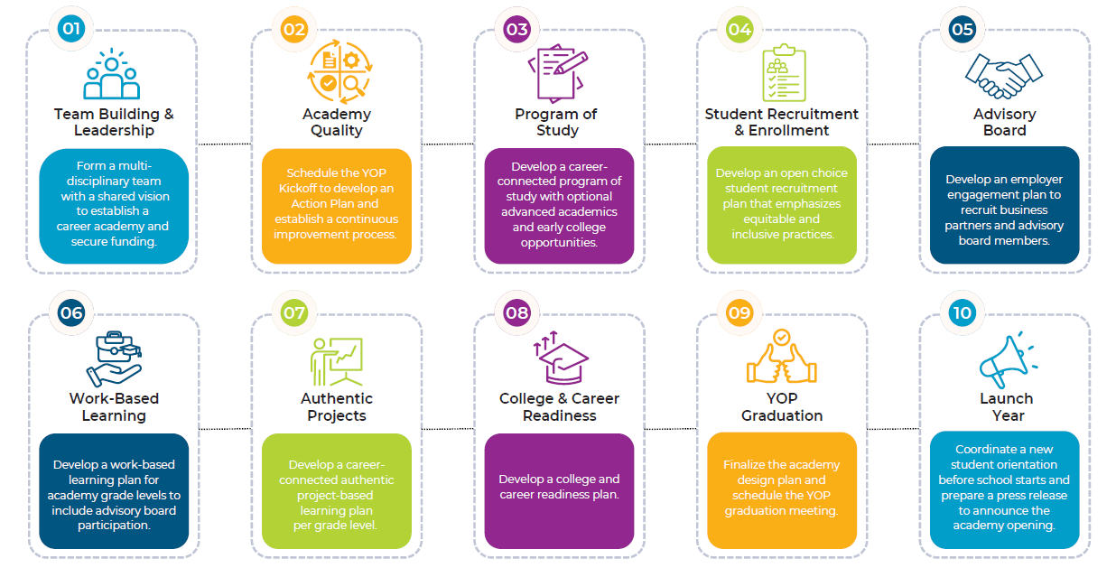
Year of Planning
Roadmap
Essential Steps to Developing Your Academy Design Plan.
26

Slide 27
Fast Track
Pacing Guide
Your Accelerated Path to NAF Membership!
The school/district forms a multi-disciplinary Academy Design Team with a shared vision to start a career academy. The Academy Design Team uses the Interest Survey to assess partnership alignment and readiness to start a NAF academy. | The NAF Team schedules a virtual meeting with approved applicants to review the application process. The Academy Design Team establishes roles and deadlines to ensure timely submission of all required documentation. | The Academy Design Team collaborates to review the Fast Track Assessment sample, agreeing on responses for accuracy before online submission. The applicant must achieve a score of 15 or higher to continue with the Fast Track process. | The applicant submits evidence demonstrating alignment of current practices with NAF’s Design. The NAF Team conducts an initial review of evidence and notifies the applicant if clarification or adjustments are needed. | The Academy Design Team incorporates feedback from the initial review into their online assessment, with a 15-day period to make the necessary adjustments. The NAF Team conducts a final review of the evidence to ensure partnership alignment. | The applicant facilitates the signing of a NAF Membership Agreement to formalize the partnership and initiate the invoicing process. A $4,000 application fee is required before the Fast Track validation meeting. | The admissions process concludes with a collaborative validation meeting to discuss alignment of current practices with the NAF Design. A $2,000 annual membership fee is due at the time of the academy's launch.
27

Slide 28
Academy Design Team
School leadership, advocacy, resources, master scheduling, and community support
Academy program coordination and leadership, advocacy, and overall management of implementing NAF’s design
Business/community liaison, work-based learning program, and internships
Student recruitment, supports and interventions, student scheduling, and social-emotional and academic advisement
School Administrator
Academy Lead
Work-Based Learning Coordinator
Counselor
Career-pathway expertise and integration through authentic project experiences and work-based learning strategies
Postsecondary education liaison and coordinating college/career activities
Core-content expertise and integration through authentic project experiences and work-based learning strategies
Students’ interests/needs, academy program impact/effectiveness, and recruitment
Career Pathway
Educator
College & Career Coordinator
Core-Content Educator
Academy Student
28
Notes:
Sample ADT Recruit individuals with a shared vision to establish a career academy that aligns with the NAF design. The multi-disciplinary team represents the school community and brings their expertise and perspective to develop an academy design plan: school district leaders, high school administrators, career-pathway educators, business/community liaisons, post-secondary liaisons, etc.

Slide 29
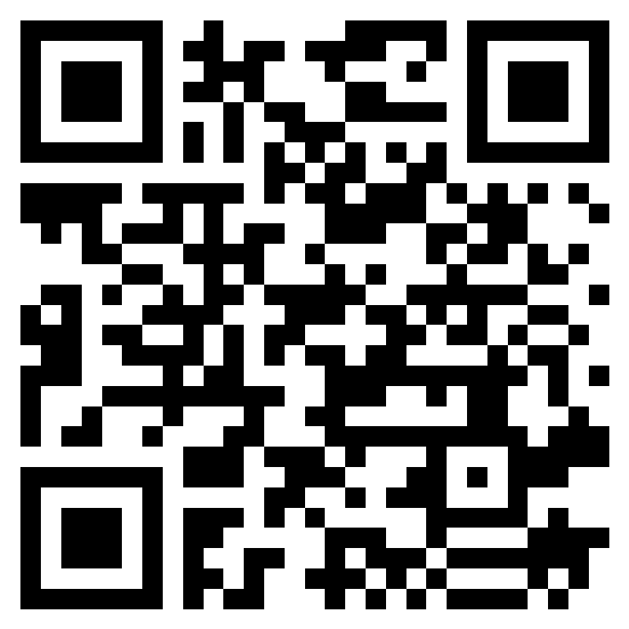
Join the NAF Network
Next Steps
Reflect on the district vision and assess readiness - NAF Interest Survey
Assess student interest and workforce support – select a career pathway
Review budget considerations
Recruit the Academy Design Team (ADT)
Submit Interest Form to begin application: https://naf.org/our-academies/start-a-naf-academy/contact
Admissions Questions?
Scan QR Code To Request More Information
Jennifer Geisler, Director, Emerging Academies
jgeisler@naf.org
29

Slide 30
Questions?
Learn More About NAF!
The NAF Difference
National Data
About NAF for Students
Shaping Our Future Workforce
Work-based Learning Standards
Alumni Network Benefits
Watch NAF’s Approach to WBL
30

Slide 31
NAF Personal Impact
“This is where I started, and I made it!”
“Why was NAF and the internship experience life changing? Because I found a home, I found a place where I mattered, where people were genuinely interested in my success and development. The experience made my dreams more realistic, more tangible.”
-Jackie Burgos
NAF Alumna
Harvard Business School Class of 2014
https://youtu.be/gwh0lR5F1l0
31

Slide 32
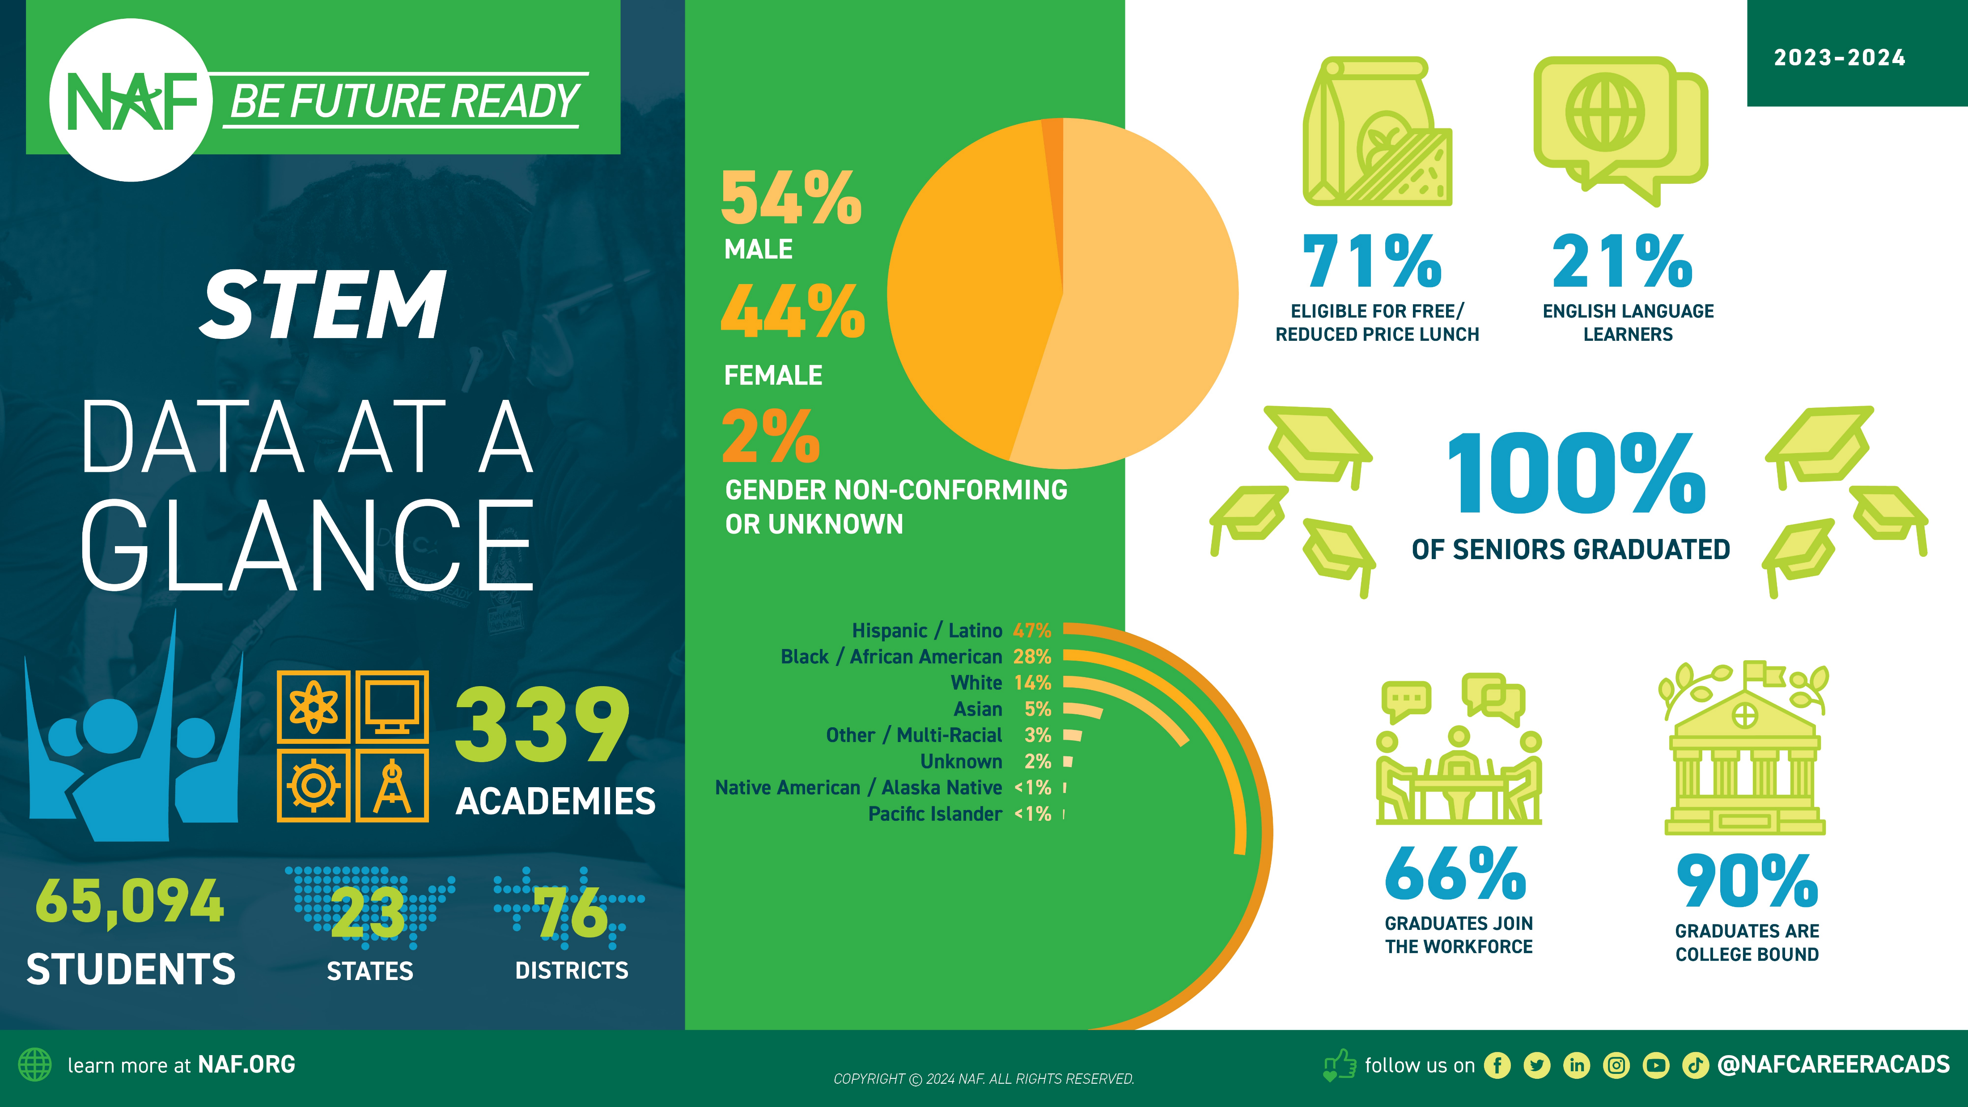

Slide 33
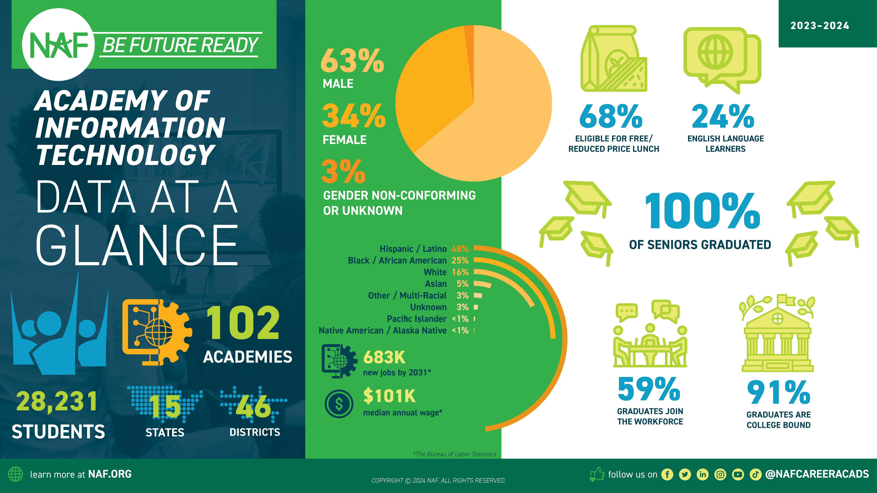

Slide 34
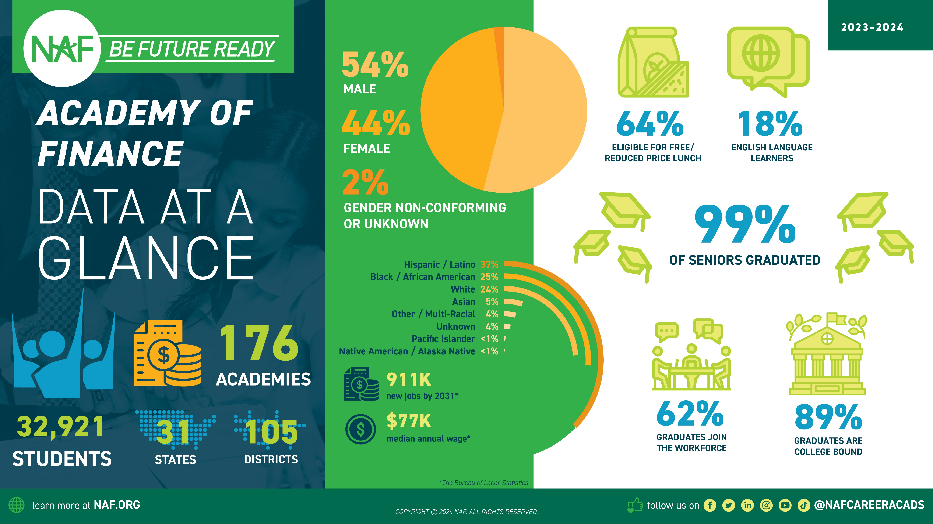

Slide 37
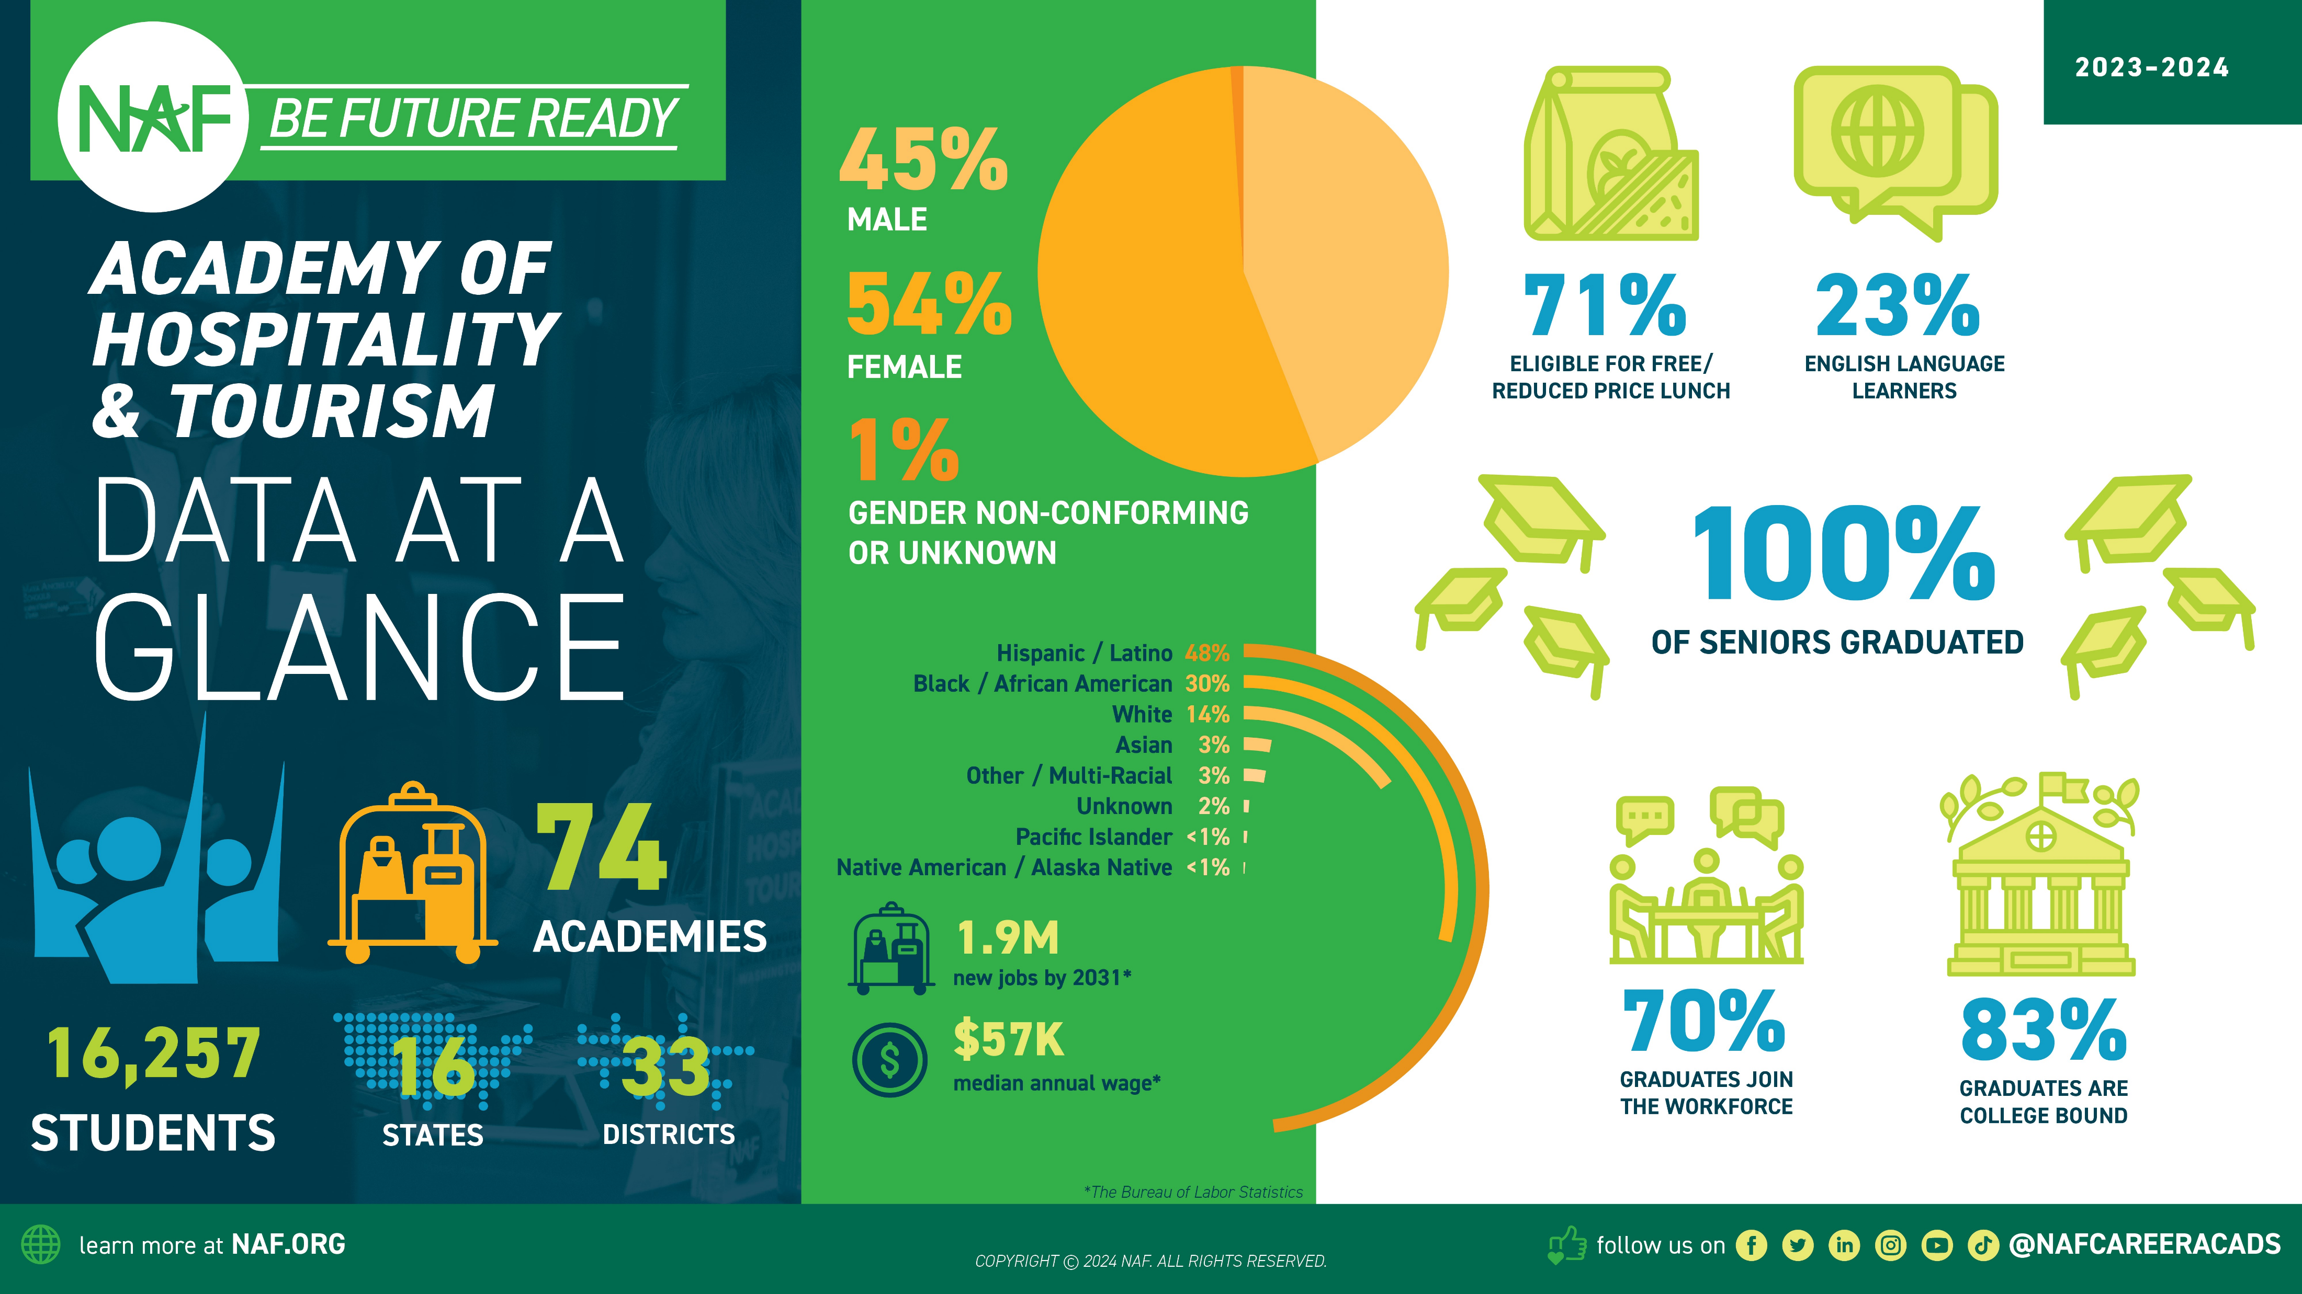

Slide 38
38

