Slide 1
At NAF, we believe every student deserves access to the support and resources needed to prepare for the future.

Slide 2
Introductions
Share:
Name and Role
What are the expected outcomes for the district, school, and community?
Reflect on one of the following:
What specific topics are you interested in exploring and learning about today?
What is the academy vision and mission?
Notes:
Agenda Review
1. Network Highlights; 2. NAF Design Overview; 3. Admissions process and Pricing; 4. Questions & Next Steps
What are the expected outcomes for the district, school, and community? Through a collaborative partnership with NAF?
Outcomes?
Enhanced Educational Experience
Increased Community Engagement
Resource Allocation and Support
Innovative Collaborations
Opportunities for Community
Long-term Sustainability

Slide 3
Notes:
https://www.youtube.com/watch?v=WHqagBn1uMo

Slide 4
Notes:
More than 113,000 students are enrolled in 619 NAF academies across 34 states and territories with 99% of NAF seniors graduated.

Slide 5
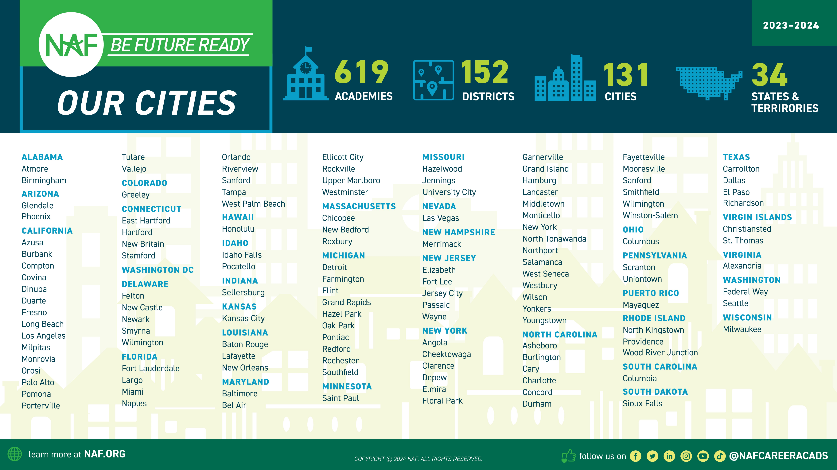
Our Approach: Work-based Learning Impact
Implementing an Outcomes Driven
Work-Based Learning* approach to ensure students are Future Ready:
Discover careers of interest
Make a plan to achieve their goals
Develop professional skills and monitor their growth
Build meaningful connections with professionals
Aspirations
Skill Sets
Connections
*WBL Participation Tracker is a tool to log WBL activities and record student participation to measure impact and assess equity.
Notes:
Find an academy near you.

Slide 6
NAF Builds Career
Success
NAF is a leader in the movement to prepare young people for college and career success.
A network of career academies which are small, focused learning communities within public high schools
Offering schools and businesses a proven and sustainable model for working together to ensure high school students are future ready.
Themed around thriving high-need industries
NAF is preparing a skilled and diverse talent pipeline for our country’s most viable industries, in partnership with high schools, employers, and community leaders.
Health
Sciences
Hospitality &
Tourism
Information
Technology
Engineering
Finance
*additional industry themes represented and supported by NAF
Notes:
For over 40 years, NAF has been partnering with high-need communities to improve student outcomes by implementing NAF academies – small learning communities within existing high schools. NAF academies focus on growing industries and those that support local business communities' workforce needs and interests. Students take career-focused courses with their general requirements and participate in hands-on work-based learning activities that provide practical learning experiences. We aim to address economic and social disparities while igniting students’ career aspirations!

Slide 7
Graduating from NAF
Leads to career success
Diversifying industries and strengthening communities
NAF Promotes
Equity
NAF is uniquely positioned to improve outcomes for students of color and students from under-resourced communities.
99% of NAF seniors graduate, a rate that has remained consistent for the last four years.
NAF students who graduate can earn more with their degree and by developing in-demand skills.
NAF provides a long-term solution for talent acquisition and a diverse future.
Close the gap:
NAF students at risk of not graduating are 11% more likely to graduate than non-NAF students.
of jobs are filled through personal and professional connections. Work-based learning builds relationships.
of employees think their company should be doing more to increase diversity.
80%
76%
NAF meets employers’ interest by working closely to create engagement opportunities tailored to their DEI goals.
In Miami-Dade, over 1,500 NAF students interned with a small business through COVID-19.
of Black and Latinx
NAF students will attend college, compared to 32% of non-NAF students.
of employers said students with high school internships had an advantage when applying.
62%
89%
ICF (2017), Transforming the American High School Experience: NAF’s Cohort Graduation Rates from 2011-2015 MDRC (2008), Career Academies: Long Term Impacts on Labor Market Outcomes, Educational Attainment, and Transitions to Adulthood
NCES (2020),The Condition of Education
The Harris Poll (2020), Diversity & Inclusion Workplace Survey
Workplace Intelligence (2014), The High School Career Study
Notes:
At NAF, we believe every student deserves access to the support and resources needed to prepare for the future.

Slide 8
Notes:
NAF DEIA Principles set the standards for behaviors and increase awareness of the importance of diversity, equity, inclusion, and access and its alignment with NAF’s vision and programmatic offerings. Each principle is thoughtfully designed to consider the varied audiences within our network.

Slide 9
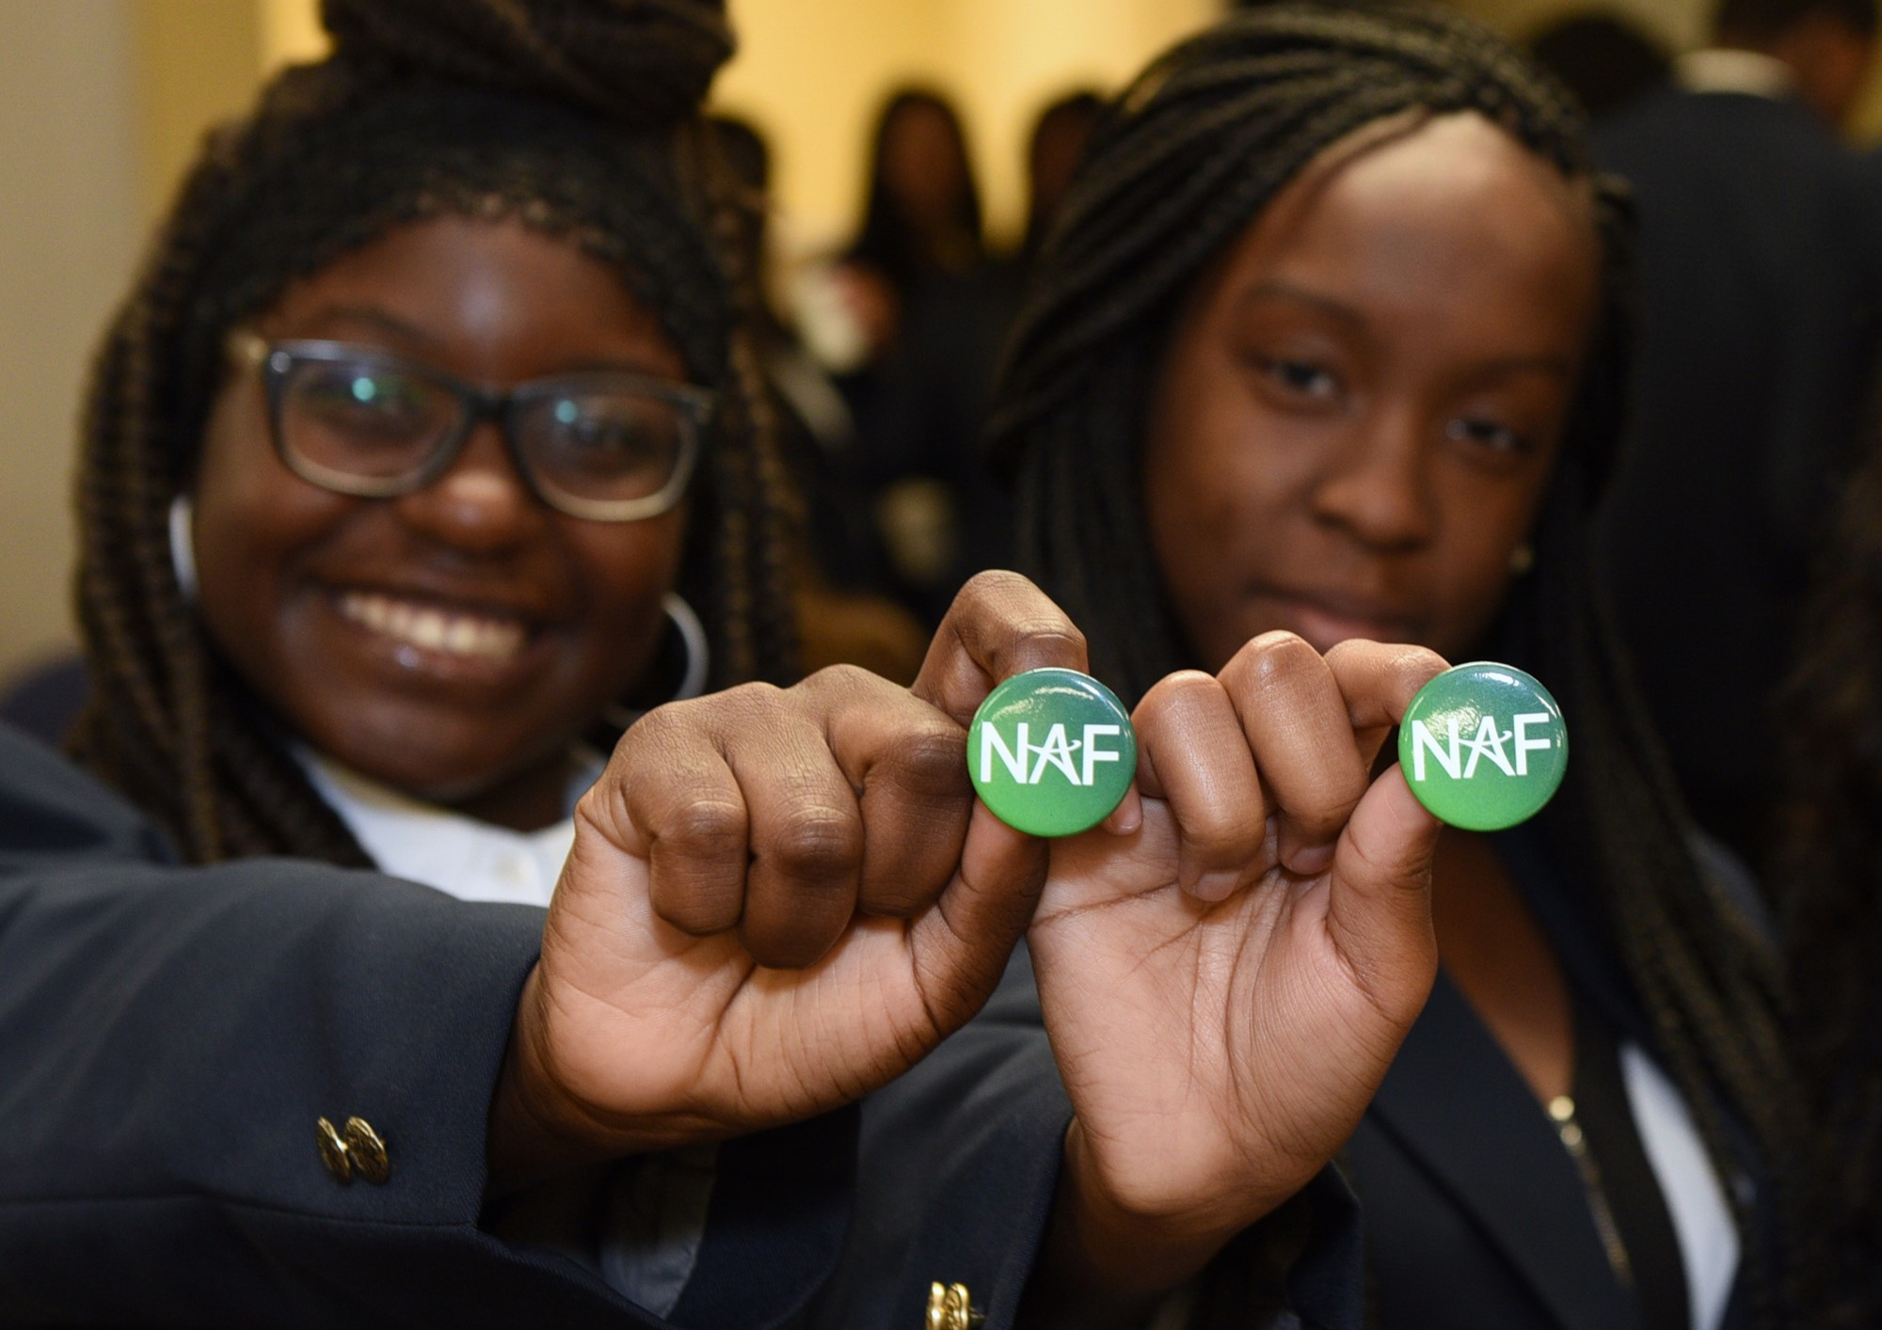
NAF Design
NAF ignites students’ passion for learning through an educational design featuring:
Academy Development & Structure
Advisory Board
Curriculum & Instruction
Work-Based Learning
Notes:
NAF’s design embraces four essential elements of practice that help ensure high school students are college, career, and future ready: academy development & structure, curriculum & instruction, advisory board, and work-based learning.
Each element is comprised of standards and strategic actions that reflect everyday academy practices for continuous growth and development.

Slide 10
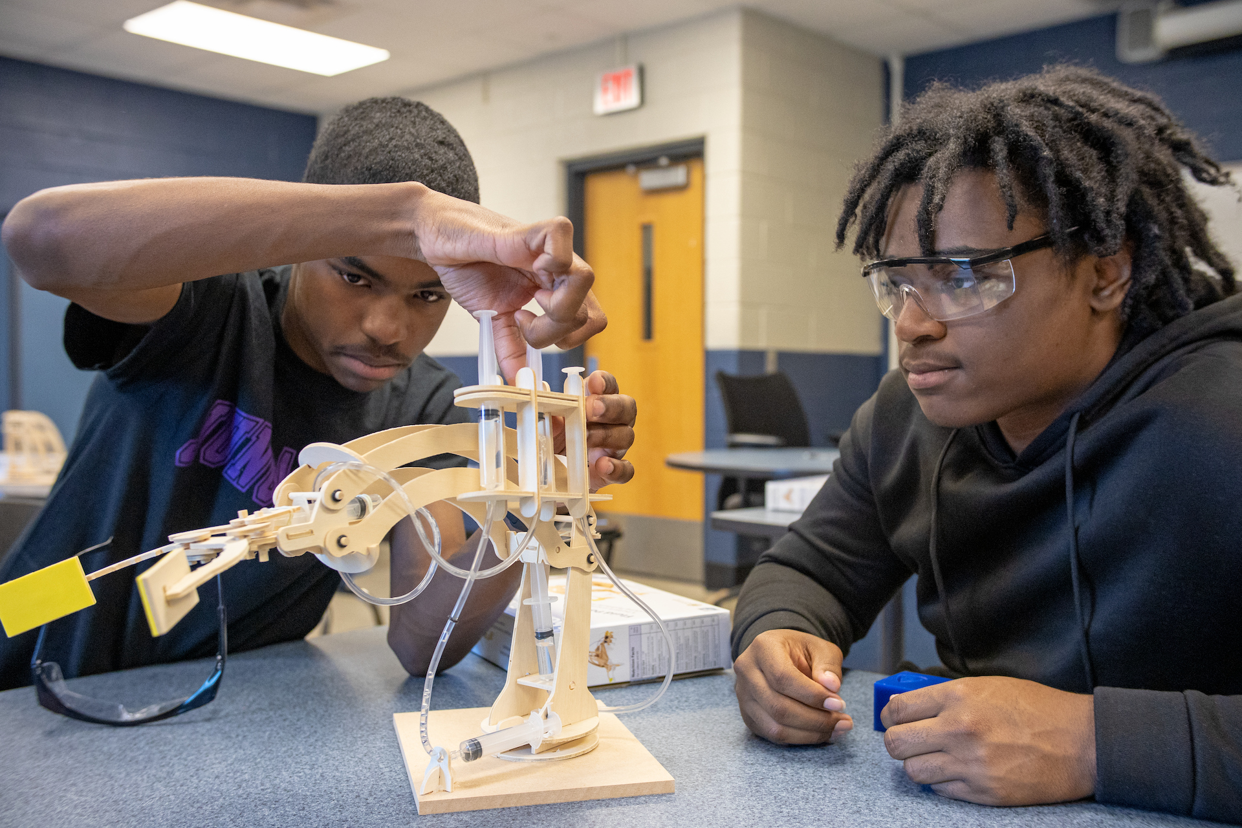
Academy Development &
Structure
Academy development and structure is crucial to the successful implementation of a high-quality, NAF career academy.
Small, focused learning communities
Fit within and enhance existing high school systems
Open choice enrollment with strategic marketing and recruitment plans
Enrolls at least 20 students per grade level
Flexible structure
Collaborative design bringing together academy, business, and community leaders
Notes:
NAF academies start with a sustainable foundation are structured as small, focused learning communities that fit within and enhance high school systems. NAF promotes open enrollment for its academies to maximize every student’s chance at a successful future. The flexible structure encourages teacher collaboration across subject areas and fosters personalization to meet student, school, district, and state needs and goals.

Slide 11
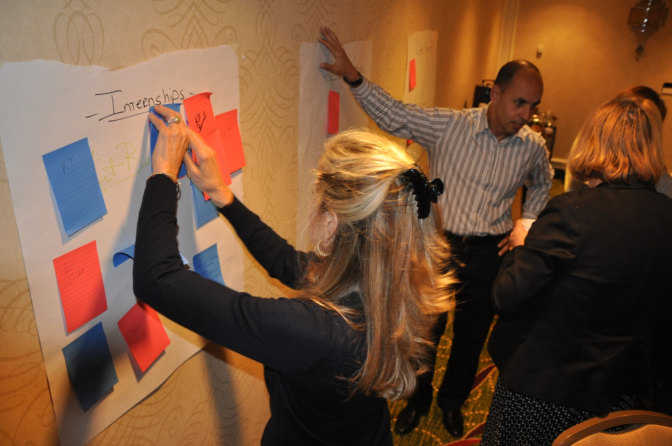
Advisory Board
Advisory boards and their members provide an essential bridge between the classroom and the workplace.
10-20 members
80% from the business community
Over 4,000 members nation-wide
Organize work-based learning activities
Inform curricula
Community advocates for the academy
Provide and solicit financial support
Notes:
Advisory boards and their members provide an essential bridge between the classroom and the workplace.
Collaborating with academy leaders to enhance curriculum and professional development
Participating in a variety of classroom activities and student projects
Leveraging connections to raise awareness for the academy and build community support
Finding, funding, or furnishing paid internship opportunities

Slide 12
Curriculum & Instruction
NAF provides and curates rigorous, career-themed curricula and authentic, career-connected projects that incorporate current industry standards and practices.
NAF also partners with organizations that provide free content and/or industry certifications!
Career-themed
Industry Validated
STEM Infused
Project-based
Health
Sciences
Hospitality &
Tourism
Information
Technology
Engineering
Finance
Notes:
NAF academies initially focused on five career themes: Finance, Hospitality & Tourism, Information Technology, Engineering, and Health Sciences. Students benefit from industry-vetted curricula infused with principles of science, technology, engineering, and math (STEM). Each NAF course is one semester. However, academies can pair courses to create a year-long class.
In addition to NAF curricula, NAF academies integrate other career-thematic curricular options into the course sequencing, partnering with Project Lead the Way, The STEM Academy, Paxton/Patterson, Cisco, Advanced Placement, International Baccalaureate, Cambridge, and Dual Enrollment courses
A few partner organizations include:
Google for Education
Cyber.org
Code.org
NGPG.org – Next Gen Personal Finance
LabXchange.org
teachengineering.org

Slide 13
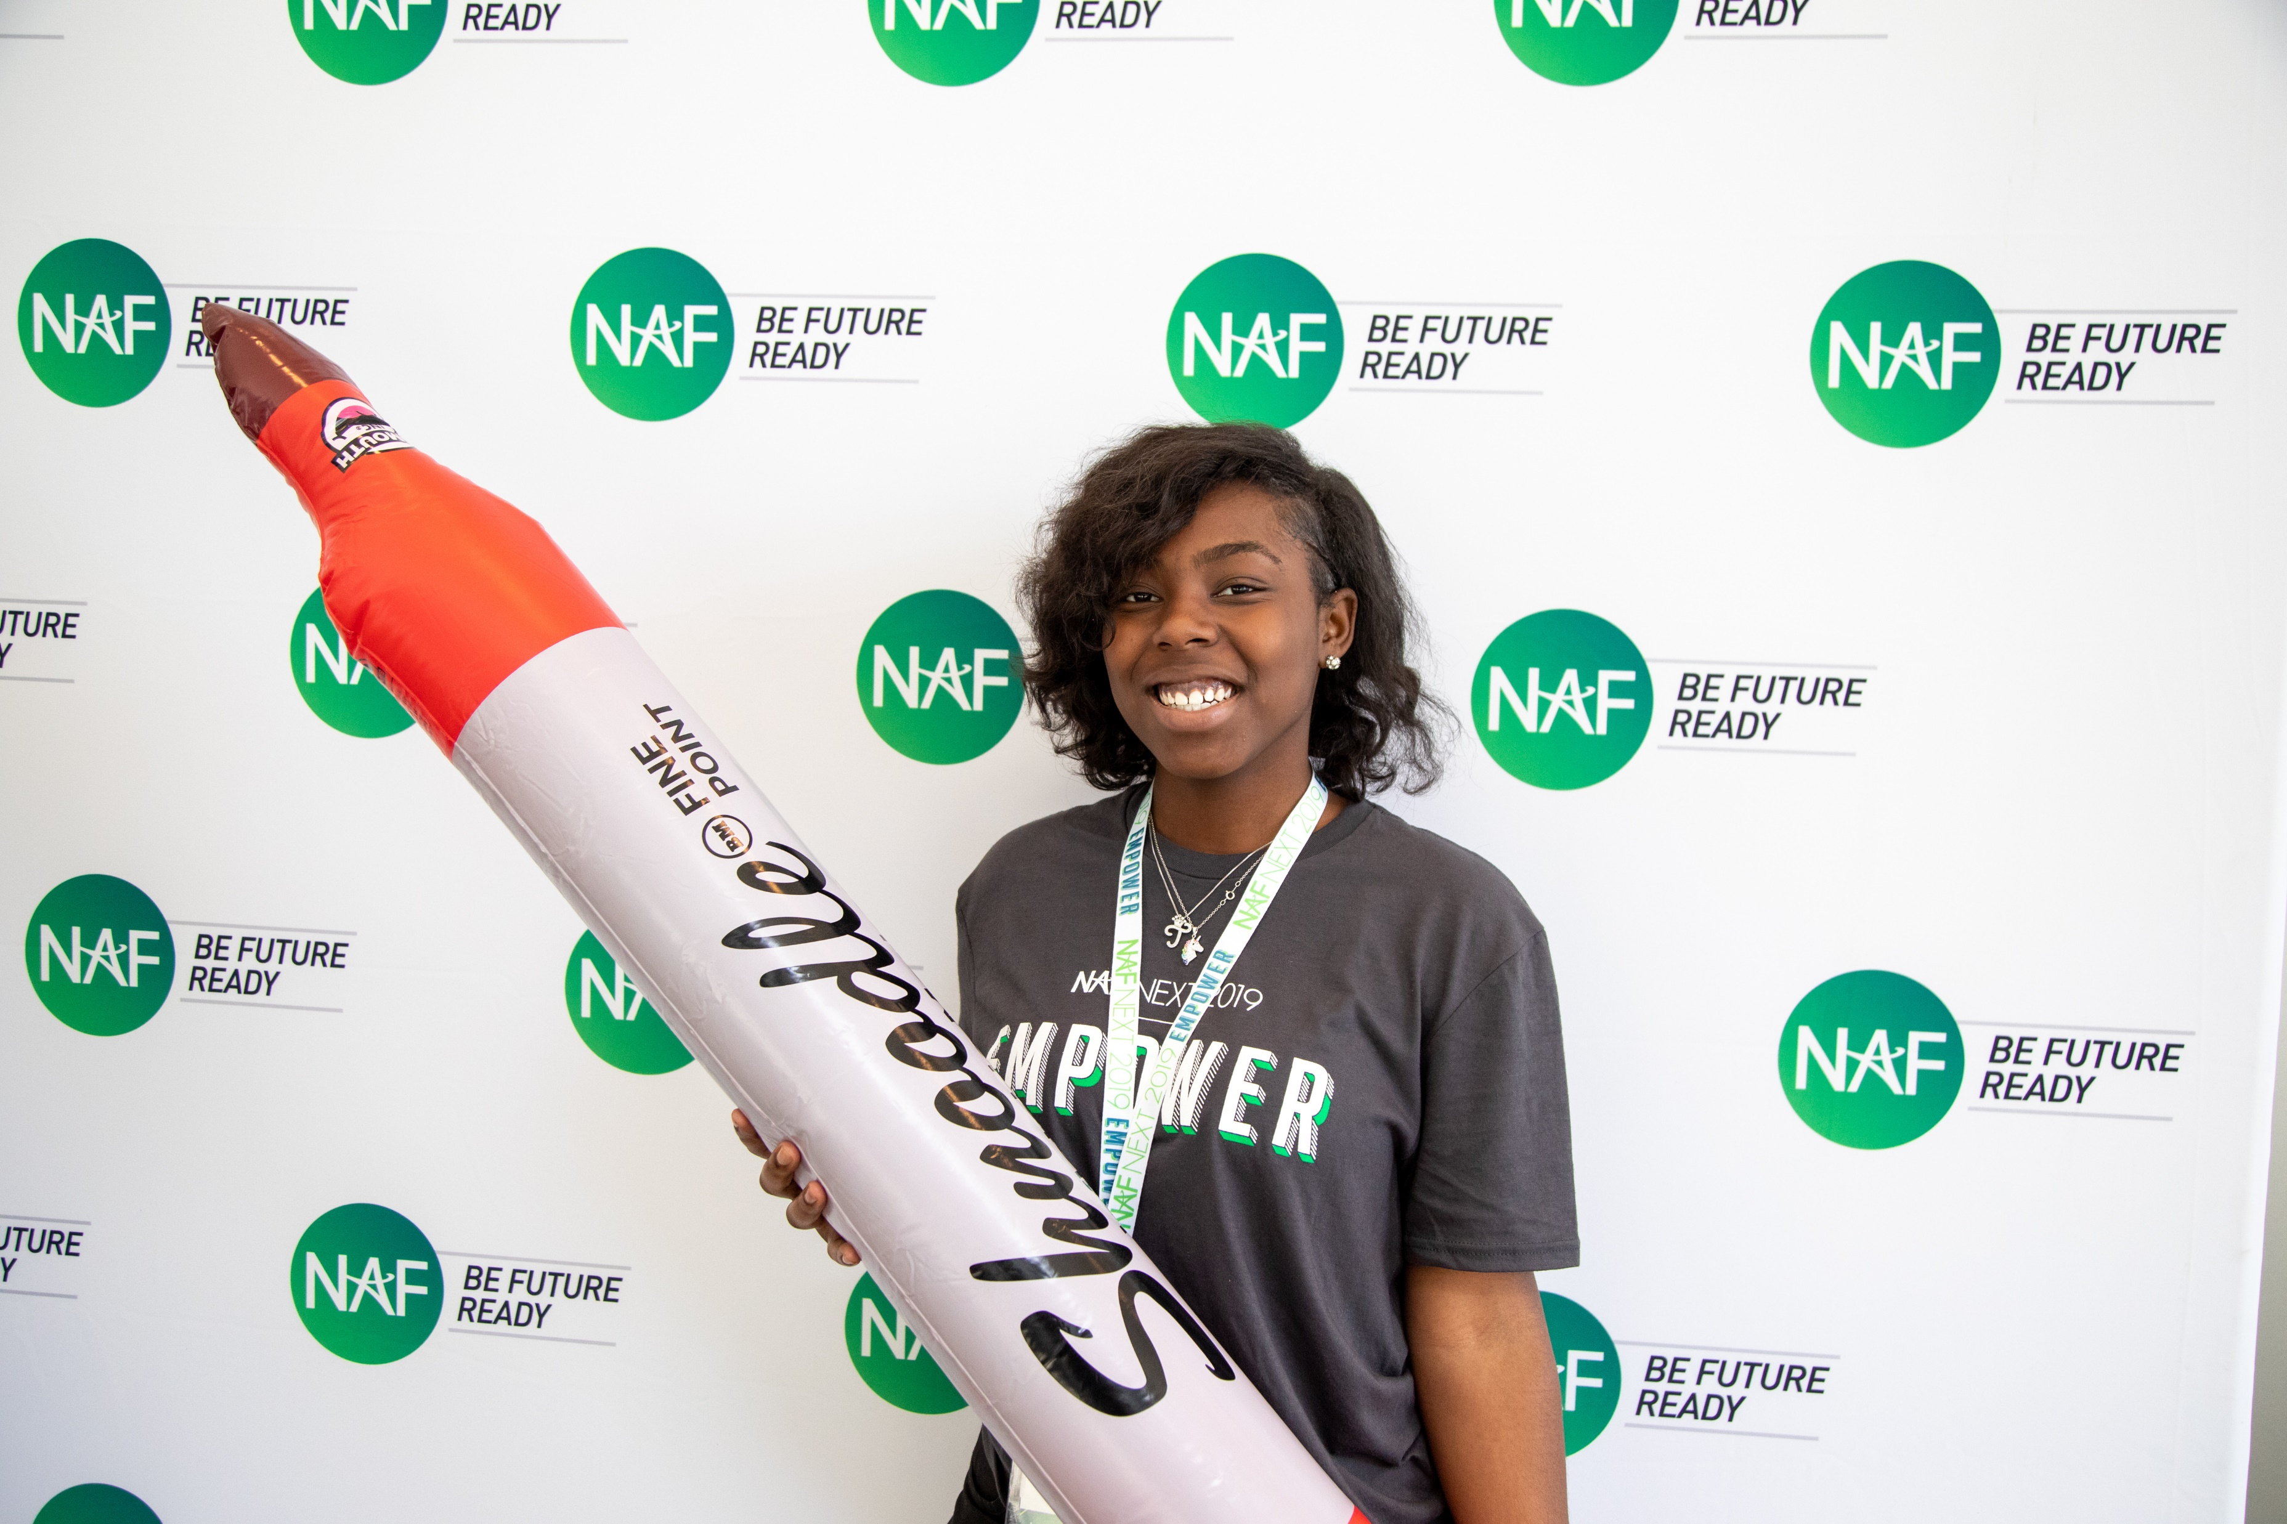
Program of Study
In addition to NAF’s five core career themes, academy offerings have expanded to include the 16 career clusters and associated pathways outlined by the US Department of Education, as well as State-Approved career pathway courses.
U. S. Department of Education’s Office of Career, Technical, and Adult Education (OCTAE) Program of Study framework consists of 16 career clusters representing 79 career pathways.
Dr. Amy Loyd, Assistant Secretary of Education, OCTAE on the Power of NAF
Agriculture, Food & Natural Resources
Architecture & Construction
Arts, Audio/Video Technology & Communications
Business, Management & Administration
Education & Training
Finance
Government & Public Administration
Health Science
Hospitality & Tourism
Human Services
Information Technology
Law, Public Safety, Corrections & Security
Manufacturing
Marketing
Science, Technology, Engineering & Mathematics
Transportation, Distribution & Logistics
State-Approved Pathway Courses
Notes:
In addition to NAF’s five core career themes, our Additional Pathways include high school-level courses provided by 3rd-party curriculum collaborators in various CTE pathways.
Additionally, NAF offers supports in aligning existing programs with state-level CTE requirements and federal funding opportunities – the NAF approach aligns with Perkins V accountability requirements. Watch Dr. Amy Loyd, Assistant Secretary of Education, Office of Career, Technical, and Adult Education at the U.S. Department of Education speak on the Power of NAF. LINK: https://youtu.be/QdqSgGrRyKk
https://careertech.org/what-we-do/career-clusters/
https://cte.ed.gov/initiatives/octaes-programs-of-study-design-framework

Slide 14
What is a NAF Expedition?
It’s a learner-centered and career-connected authentic project learning experience that’s intended to:
ENERGIZE LEARNERS TO EXPLORE CAREERS
INSPIRE IMAGINATION
& INNOVATION
WE HAVE 21+ EXPEDITIONS
WITH TOPICS INCLUDING:
Artificial Intelligence​
Entrepreneurship​
Cryptocurrencies ​
and Blockchain
Leadership​
Eco-Technology
Smart Hotels
Creative Coding
See all our Expeditions on
LEARNING.NAF.ORG
Notes:
Student curriculum resources include career-connected authentic project learning experiences. To learn more about NAF Expeditions, visit https://ash.naf.org/public/learning > Projects
Cryptocurrency & Blockchain
Cybersecurity
Entrepreneurship: Real Estate
Exploring Creative Coding
Exploring Virtual Reality and Augmented Reality
Entrepreneurship: Food Innovation With A Social Mission
Lead4Change - Leadership & Service Learning
NFTE's World Series of Innovation NAF Challenge Resource for Learners
Sports Data and Analytics
Exploring Virtual Reality and Augmented Reality
UX Design: From Idea to Launch
#NameAFuture
Eco-Tech
Computer Vision
Navigating to a Rewarding Career in Accounting
Smart Hotels
Future City - City Planning
Aerospace Engineering
Artificial Intelligence (AI)
Health Equity by MERCK
BevLaunch

Slide 15
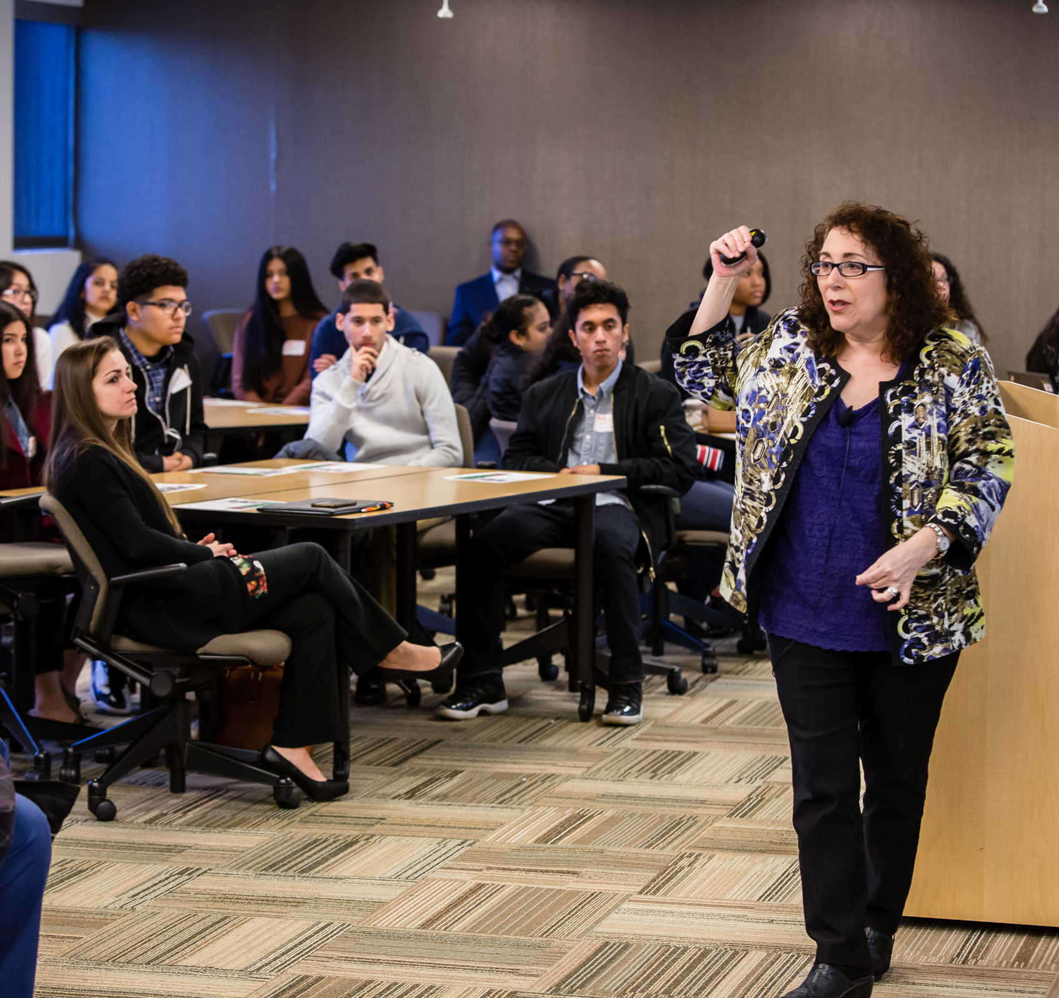
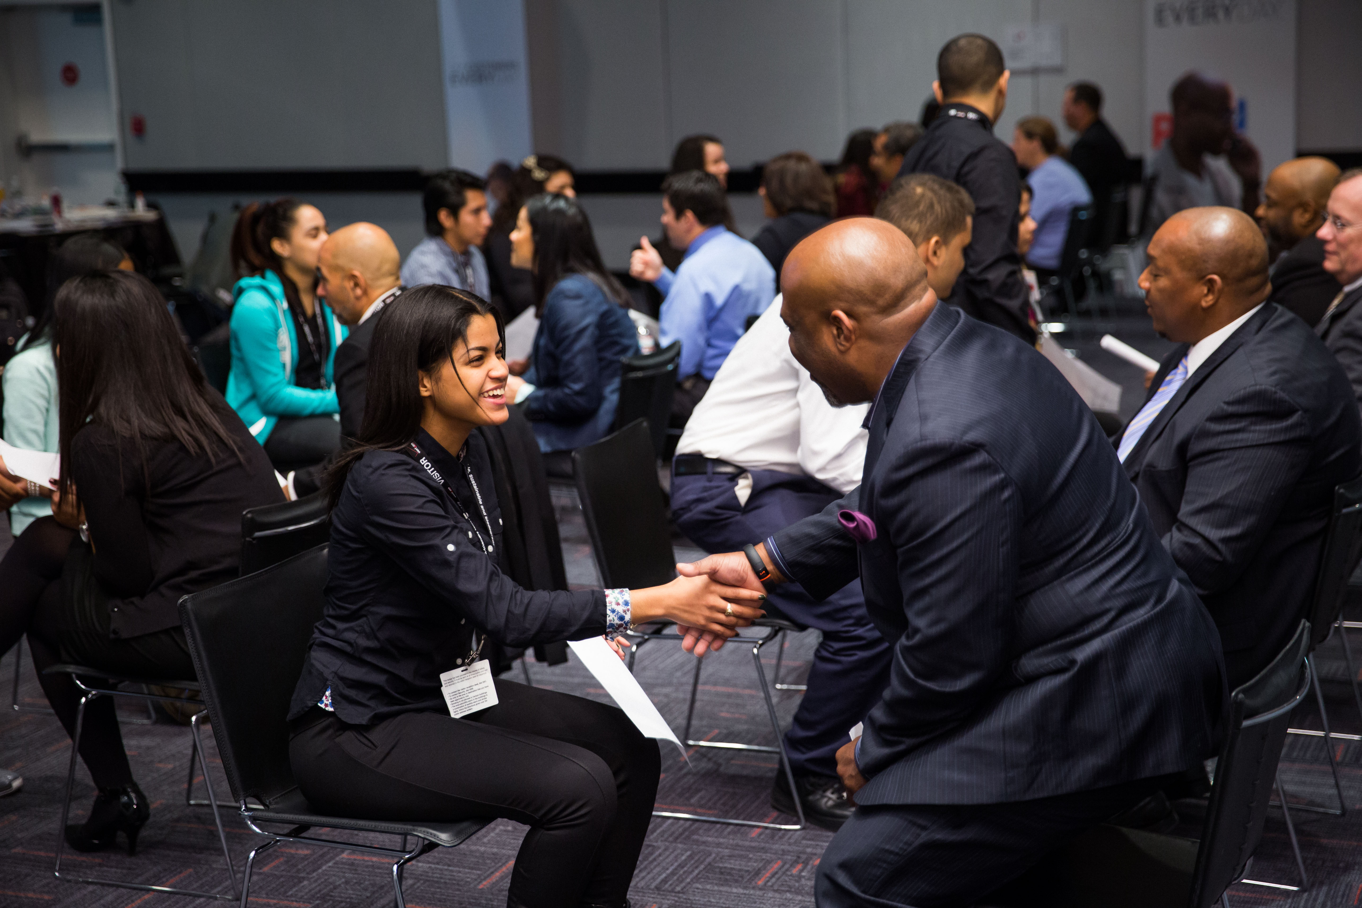
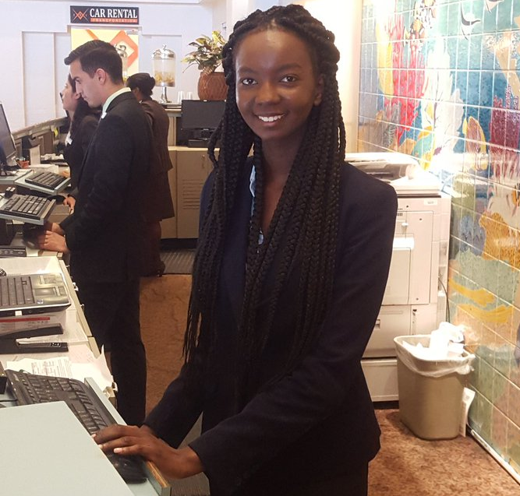
Work-Based Learning
Continuum
Awareness
Exploration
Preparation
Guest Speaker
Worksite Tour
Career Fair
Informational Interview
Job Shadow
Resume coaching/review
Mock Interview
Mentorship
Skills Workshop
Partner Engagement Project
80+ hours or two x 40-hour engagements
Paid Internship
Clinical Experience
Mentored Industry Project
Apprenticeships/Youth Apprenticeships
Aspirations
Skill Sets
Connections
Notes:
NAF’s WBL continuum focuses on:
Awareness: Students build career awareness and aspirations, observing and receiving information through research and questioning.
Exploration: Students explore the workplace and build career skill sets, playing an active role in interacting with adults.
Preparation: Students apply learning and skills through practical experiences with industry professionals, making connections with for conditioned growth.

Slide 16
Outcomes Driven WBL
Approach
Students Discover Careers of Interest
Make a plan to achieve their goals
Develop professional skills and monitor their growth
Aspirations
Skill Sets
Connections
Build meaningful connections with employer partners
Notes:
Implementing an Outcomes Driven Work-Based Learning program focused on student outcomes and impact to ensure students are Future Ready
Discover careers of interest; Make a plan to achieve their goals; Develop professional skills and monitor their growth; Build meaningful connections with employer partners
Aspirations
Each student will have defined and mapped a plan for at least one career path.
Skills
Each student will have worked to develop the 6 Future Ready skills, received continuous feedback from industry partners, Advisory Board members, and/or local community professionals, and be able to articulate their strengths.
Connections
Each student will develop at least three professional connections.

Slide 17
Outcomes Driven WBL
Tech Tools
WBL Tracker
Log WBL activities
Record student participation
Track AB participation
Analyze data to measure impact & equity
Export reports, graphs, & tables
WBL Tracker
WBL Skills Feedback Survey
Resources
WBL Student Reflection Form
Capture student feedback
View quantitative and qualitative data
Analyze data - dashboard or report export feature
Support
WBL Student Reflection Form
Future Ready Skills Assessment
Internships
Notes:
The WBL Participation Tracker is a tool for the network to log work-based learning activities and record student participation to measure impact & assess equity.
Additionally, the tracker provides and records data related to NAF’s annual academy quality process. Districts can consider Classlink or Clever - to upload student data.

Slide 18
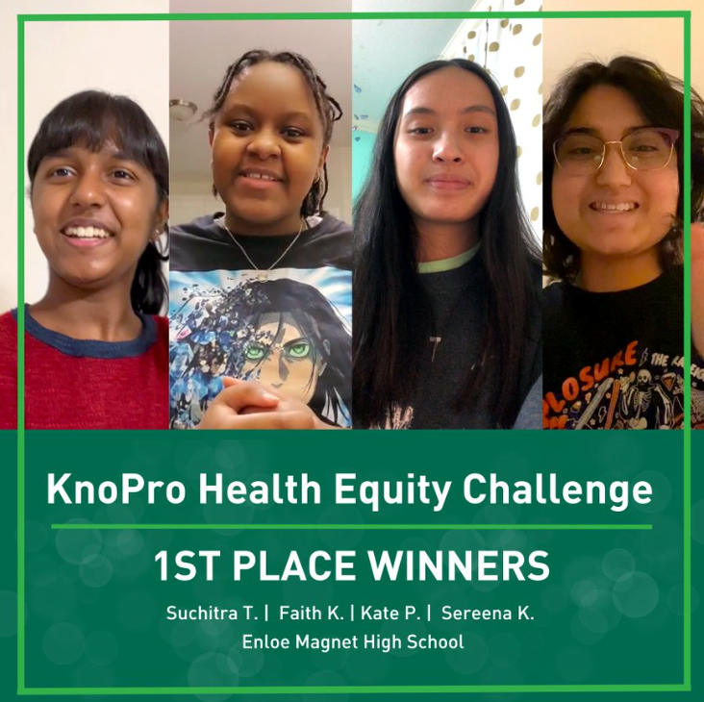
Tech-Enabled Impact
KnoPro
KnoPro is an interactive, user-friendly product featuring:
Real-world, multi-sector projects with participants learning how to draft plans, build prototypes, and pitch products, while benefiting from mentorship, which also increases professional networks
Digital content and media to support students, educators, and industry partners
Cash prizes and promotion for winners
In 2022, NAF launched our first Tech-enabled WBL initiative KnoPro - with industry challenges and daily skill builders!
KnoPro Corporate partners:
Sponsor/co-create an Industry Challenge
Work with NAF to engage staff as mentors and judges
Create positive brand associations with students and learn from their projects and insights
Sponsor/create content for daily Skillbuilders—15-minute activities that help build a range of skills for students
https://www.knopro.org/
Notes:
NAF is harnessing technology to bring Work-Based Learning (WBL) to youth in under-resourced communities across the country. And in 2022, NAF launched our first Tech-enabled WBL initiative, KnoPro, with industry challenges and daily skill builders. https://www.knopro.org/
Learn More about KnoPro – Flyer: https://ash.naf.org/public/downloadable-resource/index/KnoPro%20One-Pager Link: https://youtu.be/G95XeVBZnbo
KnoPro’s goal is to enable students, with support from their teachers and industry mentors, to develop the in-demand career skills and connections they need to #BeFutureReady.
The interactive platform was co-designed with high school teachers and students, for high school students across the United States. Any student 13+ years, or teacher who works with high school students, can use KnoPro. - 9/27/2023: NAF.org Press Release - https://naf.org/news_articles/revolutionizing-work-based-learning-knopro-a-new-digital-tool-expands-access-and-opportunity-for-high-school-students

Slide 19
Student Recruitment &
Marketing
Develop a marketing strategy – recruitment plans include the mission and vision statement, website design, brochure, and communication resources
Contact NAF’s Marketing & Communications Team to request your free custom logo - communications@naf.org
Consider NAF clothing and gear – purchase at http://store.naf.org/
Notes:
Activity – Begin to formulate strategies that will support student recruitment efforts.
Collaborating with academy leaders to enhance curriculum and professional development
Participating in a variety of classroom activities and student projects
Leveraging connections to raise awareness for the academy and build community support
Finding, funding, or furnishing paid internship opportunities
Sample events
K-6th Expanded Learning After School Mentoring
6th - Pathway Exhibition Event for all students (interactive)
7th - One day field trip experience “Future Ready Lab” (one class per trip)
8th - Pathway Showcase Event (pathway ambassadors serve as hosts)
Sample Recruitment Timeline:
August -- Parent communication begins online (continues through Enrollment Center in Feb.)
September -- Mailers sent home
October -- Pathway Showcases, Application opens
November / December -- Campus Tours
January 15th -- Application closes
By January 20th -- acceptance letters mailed home
February -- Enrollment Center

Slide 20
Together, we can make essential opportunities possible by creating more effective educational experiences and transforming the high school journey.

Slide 21
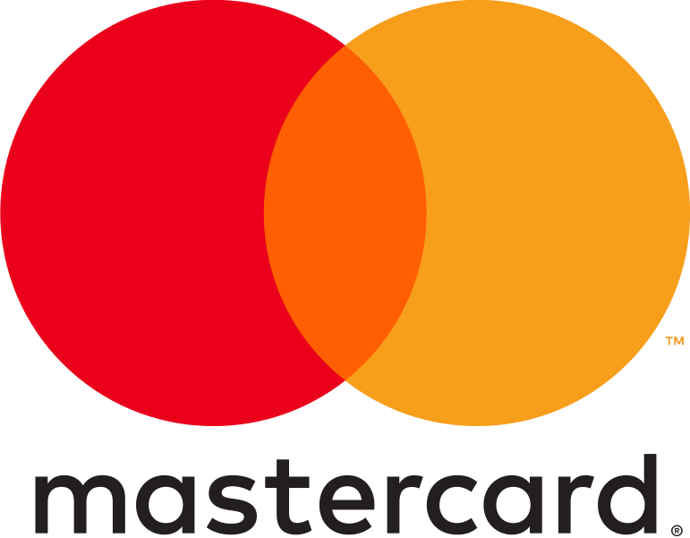
NAF Major Corporate Partners
NAF works directly with companies to create custom engagement programs that match their needs.
Corporations large and small, including national brands, are committed to providing work-based learning opportunities through skill-based volunteerism and hiring NAF interns.

Slide 22
NAF Board of Directors
The NAF Board of Directors is made up of leaders in their fields who advocate for improving education in the United States. Through their leadership, guidance and support, NAF is able to deliver on its promise of developing the next generation of future ready employees.
Sanford I. Weill – Chairman
Founder, NAF
Kenneth I. Chenault – Vice Chairman
Chairman and Managing Director, General Catalyst
Robert Smith – Vice Chairman
Founder, Chairman and Chief Executive Officer, Vista Equity Partners
Eugene A. Ludwig – Secretary
CEO, Spring Harbor Financial
Jeffrey A. Brill
Partner, Skadden, Arps, Slate, Meagher & Flom LLP
Ursula M. Burns
Chairwoman, Teneo Ltd,
Retired Chairman & CEO, Veon Ltd, Retired Chairman and CEO, Xerox Corporation
Lynne Doughtie
Retired Chairman & Chief Executive Officer, KPMG
Lisa Dughi
Chief Executive Officer, NAF
Alex Gorsky
Executive Chairman, Johnson & Johnson
Gregory J. Hayes
President & Chief Executive Officer, Raytheon Technologies
Erin McSweeney
Chief People Officer, UnitedHealth Group
Jennifer Morgan
Global Head of Portfolio Transformation & Talent, Blackstone
Nicola Palmer
Chief Technology Ambassador, Verizon
Thomas Penny III
President, Donohoe Hospitality Services
Marc Reed
Former Executive Vice President & Strategic Advisor to the Chairman, Verizon Communications
Larry Renfro
Vice Chairman, UnitedHealth Group, Founder & Managing Partner, Optum Ventures
James D. Robinson III
General Partner & Co-Founder, RRE Ventures
David Steward
Chairman & Founder, World Wide Technology
Joseph M. Tucci
Co-Chairman, GTY Technology Holdings, Inc.
Marc Weill
Senior Advisor, Two Sigma Ventures
Matthew Zielinski
SVP, President International Sales Organization, Lenovo
Shatiek Gatlin
(Ex-Officio)
Chair, NAF Alumni Leadership Council

Slide 23
NAF STEM Advisory Committee
Developed in 2013 as an adjunct committee to NAF’s Board of Directors to address the growing role that science, technology, engineering, and mathematics now play in the nation’s economy, the Committee offers opportunities for top STEM leaders to exchange perspectives to develop and attract a diverse population into STEM careers.
Nicola Palmer - Chair
Chief Technology Ambassador, Verizon
Miriam Hernandez-Kakol – Vice Chair
Retired, Global Head, Management Consulting Practice, KPMG International
Alecia Deanda-Gregg
Assistant Vice President, Human Resources, AT&T
Mike Golz
Senior Vice President & CIO Americas, SAP
Vinay Iyengar
Investor, Two Sigma Ventures
Conrod Kelly
Managing Director MSD Chile, Merck
Dana Lorberg
Retired Executive Vice President, Mastercard
Marilyn McDonald
Senior Vice President, B2B Customer Experiences, Mastercard
Brian Monahan Global Client President; Head of US Ventures, dentsu international
Milanka Muecke
Director, Global Commercial Communications and Brand Strategy, Lenovo
“Ram” Sankaran Ramanathan
Vice President, Network Systems, Verizon
Juan F. Rodriguez
Strategic Advisory – Public Sector K12, World Wide Technology
Brian Thomas
President & CEO, Lightspeed Systems

Slide 24
Starting a NAF Academy
Admissions

Slide 25
Admissions
Who is Eligible
NAF promotes full district engagement in creating academies to maximize successful and sustained academy development. The annual membership fee is $2,000 per academy, with multi-academy discounts available. Begin the process by completing the NAF Interest Survey to indicate your interest and commitment to partnering with NAF.
Step 1
Start a NAF academy in your school district by forming a dedicated team of stakeholders with a shared vision of building partnerships around a unique framework to facilitate essential opportunities by connecting students, educators, and businesses to strengthen communities. The multi-disciplinary team represents the school community and brings their expertise and perspective to develop an academy design plan. Recruit the Academy Design Team
Year of Planning Program
The Year of Planning is a customized developmental process for implementing a NAF academy. Districts with little or no experience designing a career-focused program receive personalized support and guided technical assistance to ensure that local programming goals align with NAF's design prior to the academy launch. This planning phase helps to establish a sustainable foundation that fosters academic success and builds the capacity to deliver on the promises made to academy students and the community.
The application fee is $12,000
Fast Track Program
The Fast Track process allows existing career academies implementing most NAF standards, NCAC, or Linked Learning Certified, to join the academy network with full membership benefits. The application involves gathering all necessary documentation to demonstrate that the existing career academy aligns with NAF’s design, allowing them to expedite the academy’s launch and receive the associated membership support and resources. Note: A $2,000 membership fee is due at the time of the academy's launch.
The application fee is $4,000
Notes:
The Fast Track process allows existing career academies implementing most NAF standards, NCAC, or Linked Learning Certified, to join the academy network with full membership benefits. The application includes gathering all necessary documentation to demonstrate that the existing career academy aligns with NAF’s design, allowing them to expedite the academy's launch and receive the associated support and resources. The Fast Track fees total $6,000; The fee includes 4,000 the Fast Track admission fee and 2,000 annual membership.

Slide 26
Year of Planning
Process
Academy Design Plan
Getting Started
Launch Year
Team Building & Leadership:
Recruit the Academy Design Team
Assign team roles and responsibilities
Establish the academy vision, mission, and goals
Assess current practices to determine alignment with NAF Academy Standards to develop the Action Plan
Design the academy structure with open enrollment process
Determine the program of study with career-themed integration strategies across the curriculum
Create a work-based learning program for each grade in the academy
Develop an employer engagement plan
Attend NAF Next 2024 in Kissimmee, FL, July 8-11
Operationalize the academy design plan
Evaluate student recruitment progress and modify marketing strategy as needed
Refine monitoring systems to evaluate student data, informing academy practices and ensuring educational equity for all students.
Notes:
The Year of Planning is a customized developmental process for implementing a NAF academy. Districts or schools with little or no experience designing a career-focused program receive personalized support and guided technical
assistance to ensure that local programming goals align with NAF's design prior to the academy's launch. This planning phase helps to establish a sustainable foundation that fosters academic success and builds the capacity to
fulfill the commitments made to academy students and the community. The YOP admission fee is 12,000.

Slide 27
YOP Pacing
Calendar
Month 1
Recruit Academy Design Team (ADT).
Month 2
Develop a career-themed program of study that includes advanced academic and early college options.
Month 3
Develop open, choice-based student recruitment plan.
Month 9-10
Month 4-5
Month 6-7
Month 7-8
Month 8-9
Month 5-6
Develop a continuous improvement plan to evaluate learner data and monitor learner achievement.
Develop an employer engagement plan that includes advisory board recruitment materials.
Develop a work-based learning plan for all academy grades with advisory board participation.
Develop a college and career readiness plan.
Schedule a YOP graduation readiness meeting with portfolio manager and calendar graduation meeting.
Coordinate a new student orientation open-house before school starts.
Develop a career-themed integration plan using authentic project learning experiences.
Complete YOP Snapshot 2* and update the Action Plan goals.
Complete YOP Snapshot 1* to develop Action Plan.
Complete YOP Assessment* for a provisional score including evidence upload.
Prepare a press release to announce the opening and organize Launch Year celebrations at the start of school.
Notes:
Sample Focus Calendar based on your timeline and implementation goals.

Slide 28
Academy Design Team
School Administrator
Counselor
Career Pathway
Educator
Core-Content Educator
Work-Based Learning Coordinator
College & Career Coordinator
Academy Lead
Academy Student
School leadership, advocacy, resources, master scheduling, and community support
Learner recruitment, supports and interventions, learner scheduling, and social-emotional and academic advisement
Academy program coordination and leadership, advocacy, and overall management of implementing NAF’s design
Business/community liaison, work-based learning program, and internships
Postsecondary education liaison and coordinating college/career activities
Students’ interests/needs, academy program impact/effectiveness, and recruitment
Core-content expertise and integration through authentic project experiences and work-based learning strategies
Career-pathway expertise and integration through authentic project experiences and work-based learning strategies
Notes:
Sample Team Recruit individuals with a shared vision to establish a career academy that aligns with the NAF design. The multi-disciplinary team represents the school community and brings their expertise and perspective to develop an academy design plan: school district leaders, high school administrators, career-pathway educators, business/community liaisons, post-secondary liaisons, etc.

Slide 29
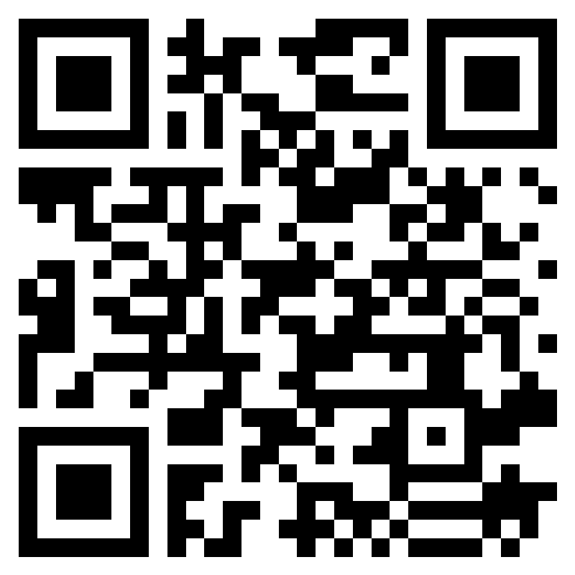
Join the NAF Network
Next Steps
Reflect on the district vision and assess readiness - NAF Interest Survey
Assess student interest and workforce support – select a career pathway
Review budget considerations
Recruit the Academy Design Team (ADT)
Submit Interest Form to begin application: https://naf.org/our-academies/start-a-naf-academy/contact
Admissions Questions?
Scan QR Code To Request More Information
Jennifer Geisler, Director, Emerging Academies
jgeisler@naf.org

Slide 30
NAF Resources
Learn More About NAF!
National Data
About NAF for Students
Shaping Our Future Workforce
Work-based Learning Standards
Alumni Network Benefits
Watch NAF’s Approach to WBL
Notes:
Link: https://youtu.be/UAisBfEkZuI
NAF marketing flyers for stakeholder conversations.

Slide 31
NAF Personal Impact
“This is where I started, and I made it!”
“Why was NAF and the internship experience life changing? Because I found a home, I found a place where I mattered, where people were genuinely interested in my success and development. The experience made my dreams more realistic, more tangible.”
-Jackie Burgos
NAF Alumna
Harvard Business School Class of 2014
https://youtu.be/gwh0lR5F1l0
Notes:
https://youtu.be/gwh0lR5F1l0 NAF PSA (31 seconds)

Slide 33
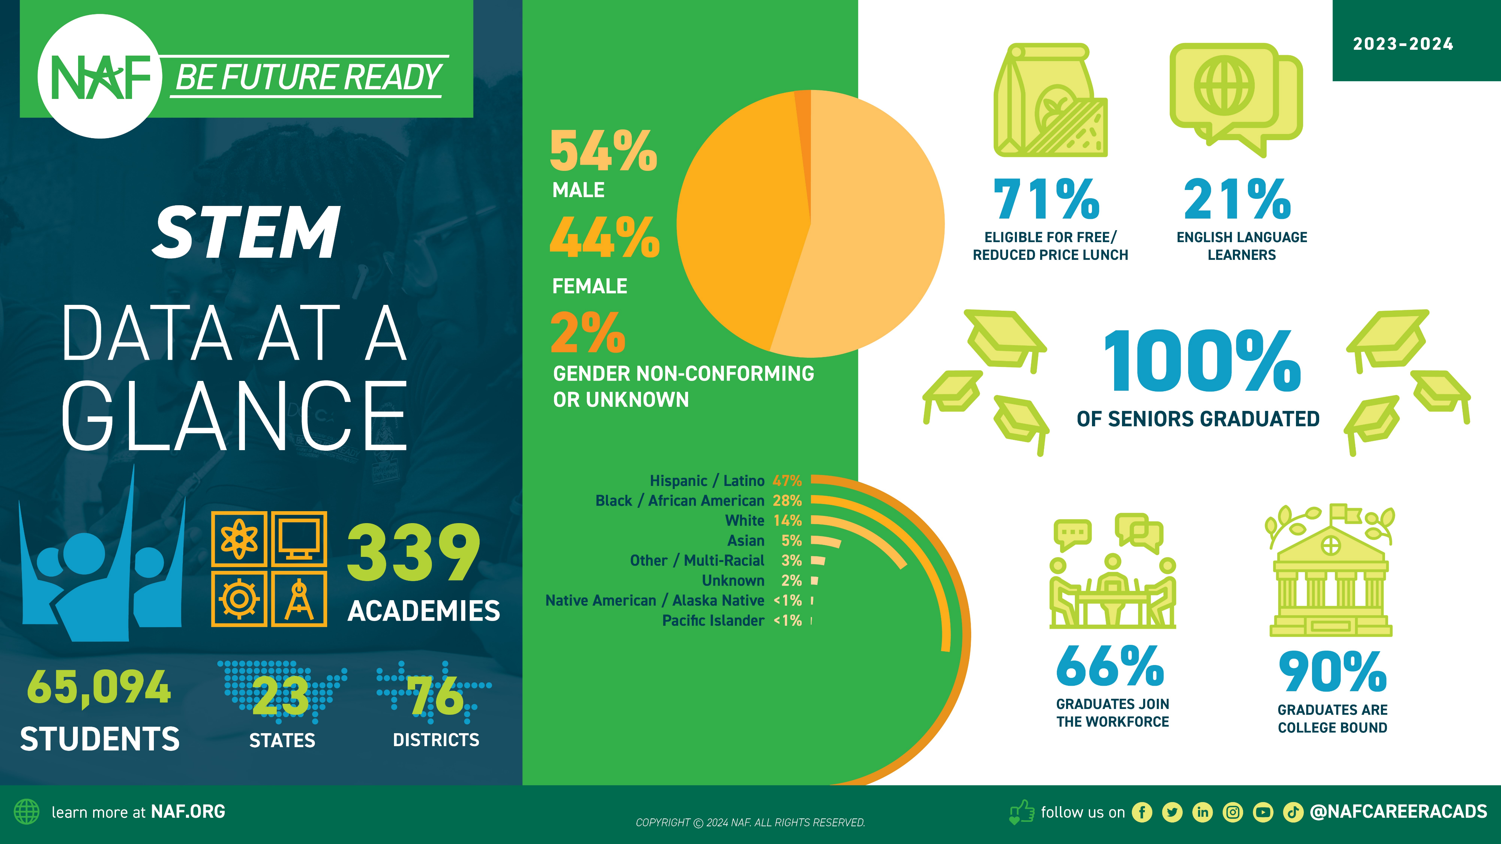

Slide 34
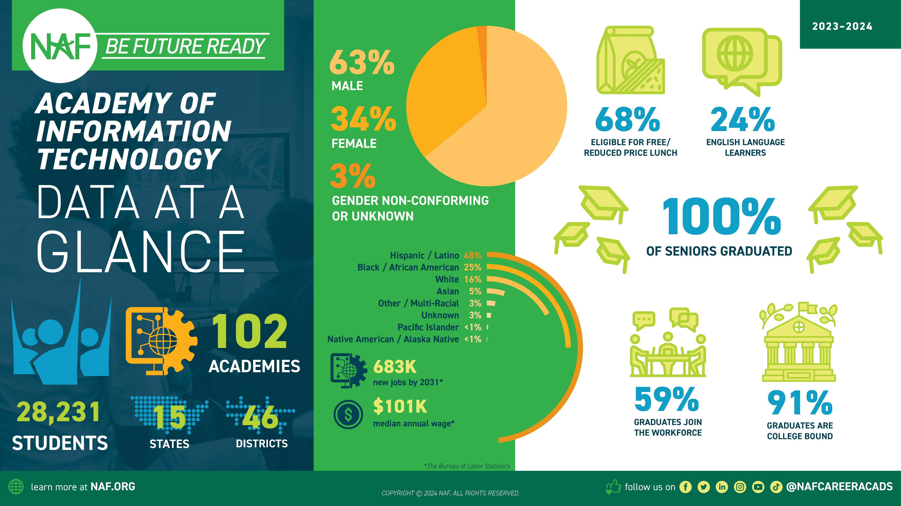

Slide 35
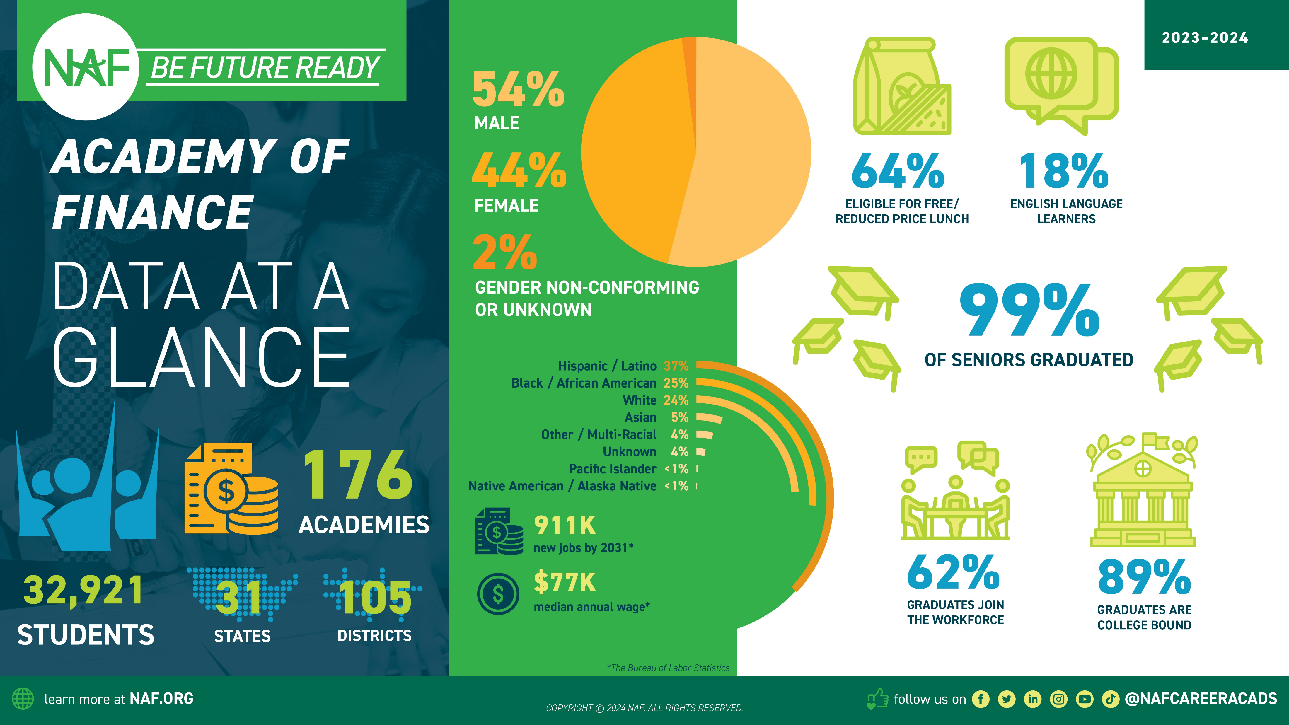

Slide 37
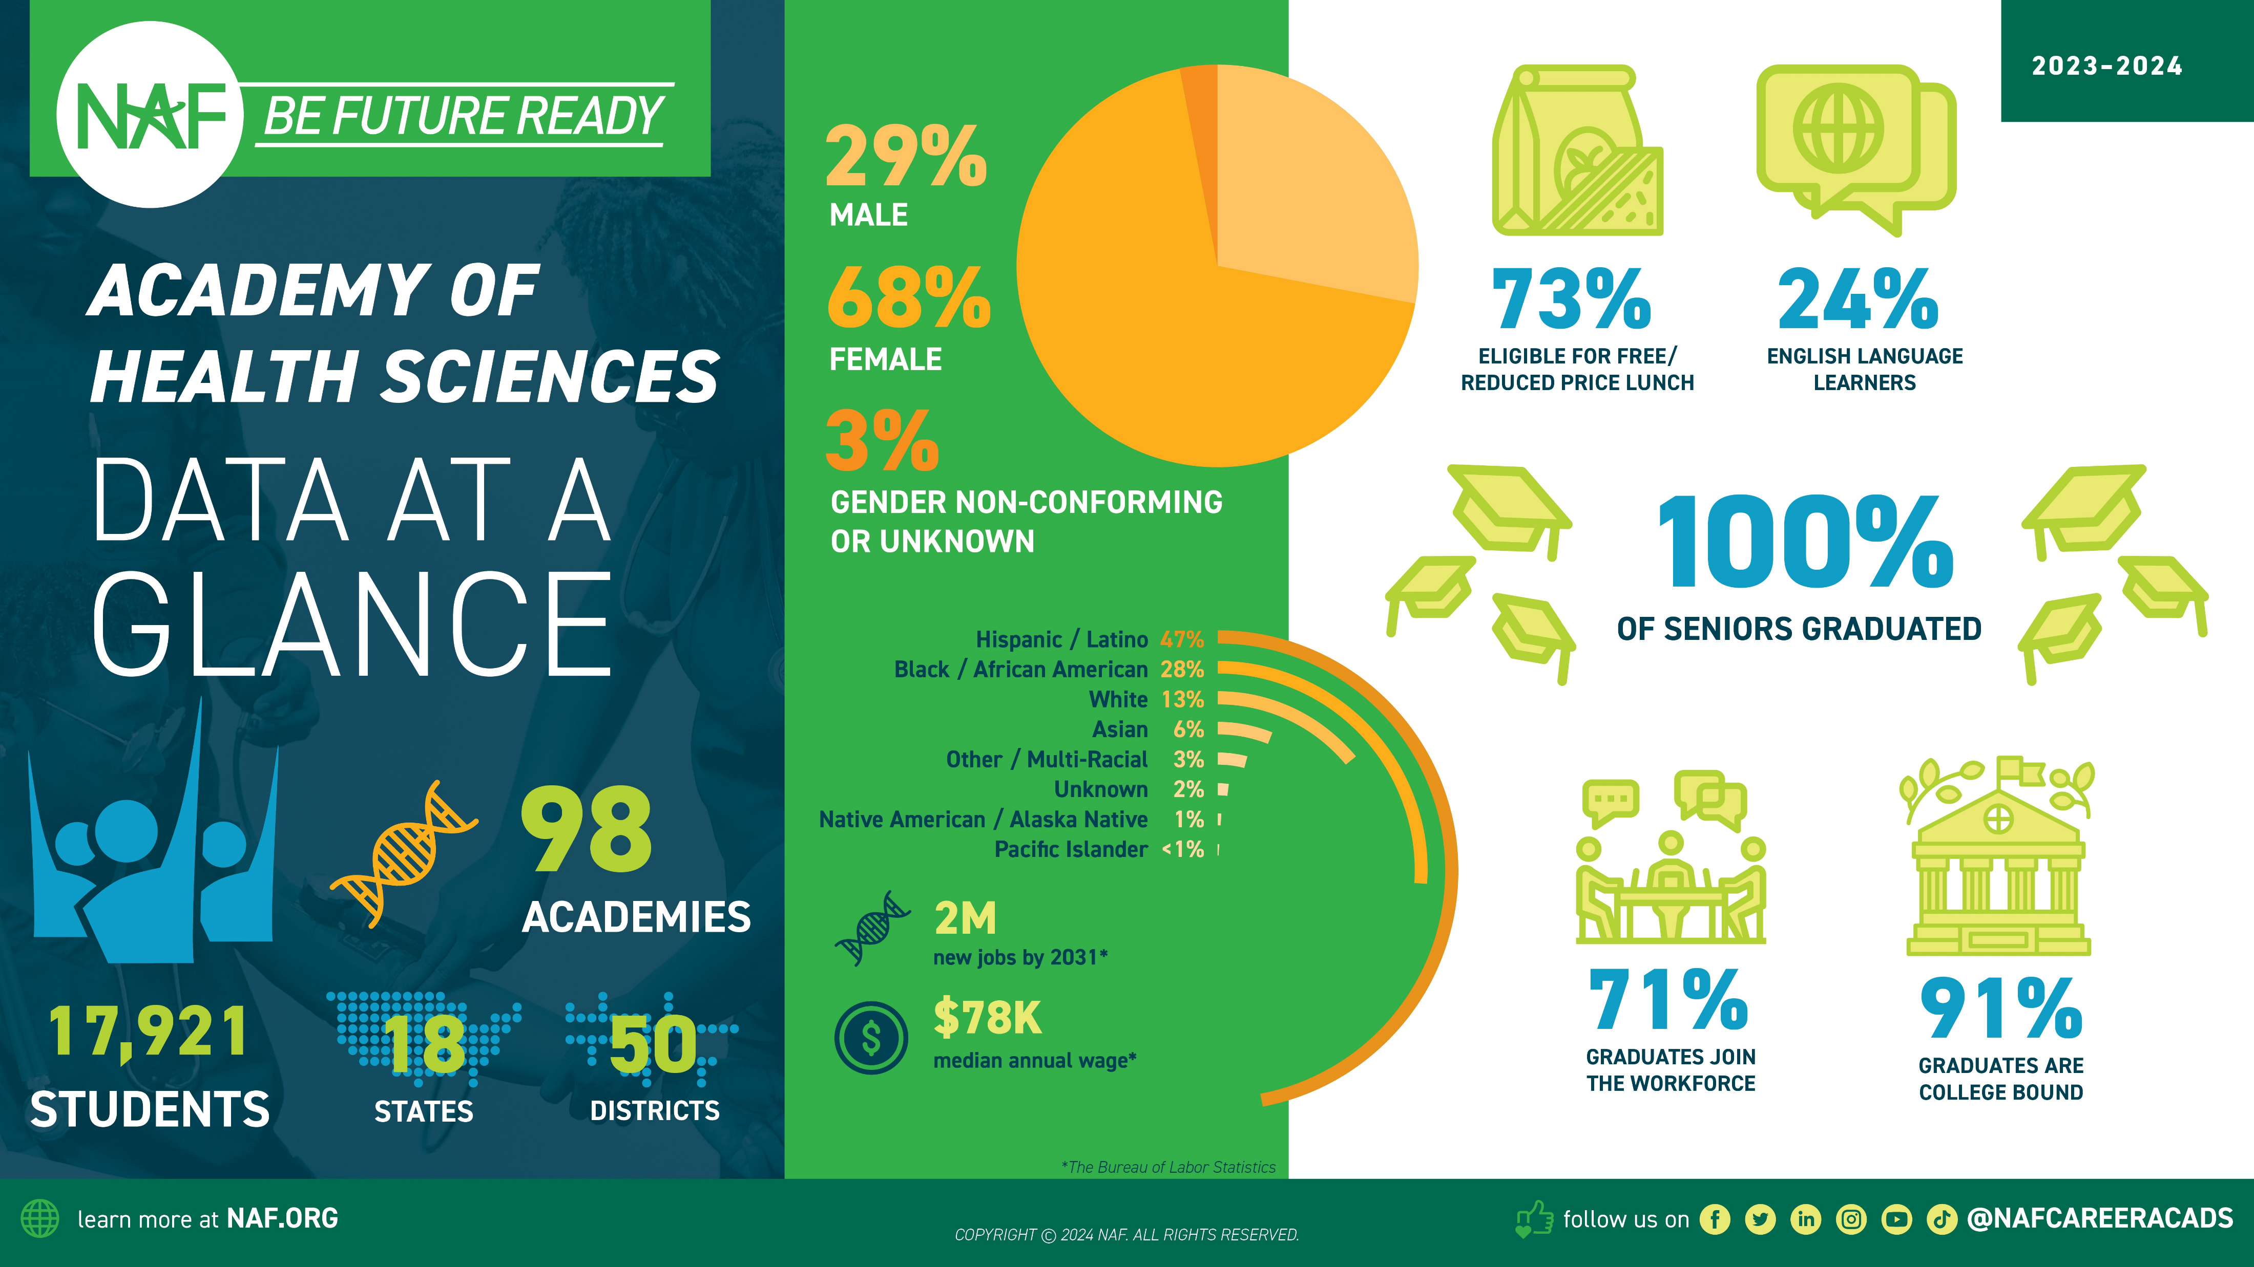

Slide 38
