Slide 1


About NAF
NAF is the national leader in career-connected education—the connective tissue between education and opportunity that brings educators, employers, and funders together to transform the high school experience
and strengthen the future workforce.

Slide 2

Introductions
Share:
Name and Role
Reflect on one of the following:
What topics are you most interested in exploring today?
What outcomes do you hope to achieve for your district, school, and community?
2
Notes:
Introductions
Agenda Review
1. Network Highlights; 2. NAF Design Overview; 3. Tech Enabled Impact 4. Admissions and Pricing; 5. Questions & Next Steps

Slide 3





What We Do
NAF prepares students for college, careers, and upward mobility.
NAF connects high school students to real-world careers through work-based learning, helping them discover their strengths and graduate with practical, transferable skills.
Operates within school systems, not outside of them.
Provides a results-driven design that connects students to industry.
Aligns curriculum to real workforce needs.
Health
Sciences
Hospitality &
Tourism
Information
Technology
Engineering
Finance
Additional industry themes represented and supported by NAF
3

Slide 4
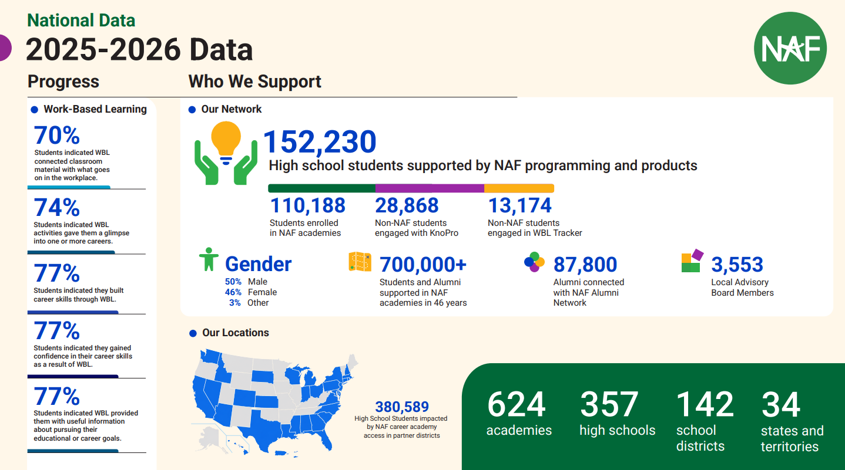

Slide 5
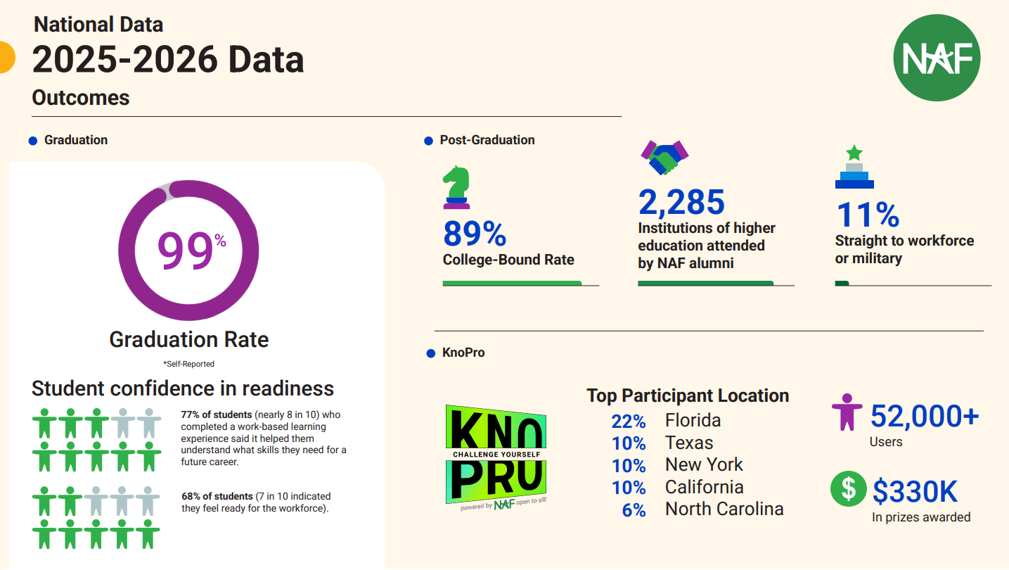

Slide 6




The NAF Design
NAF ignites students’ passion for learning through
an educational design featuring:
Academy Development
& Structure
Advisory
Board
Curriculum &
Instruction
Work-Based
Learning
6

Slide 7
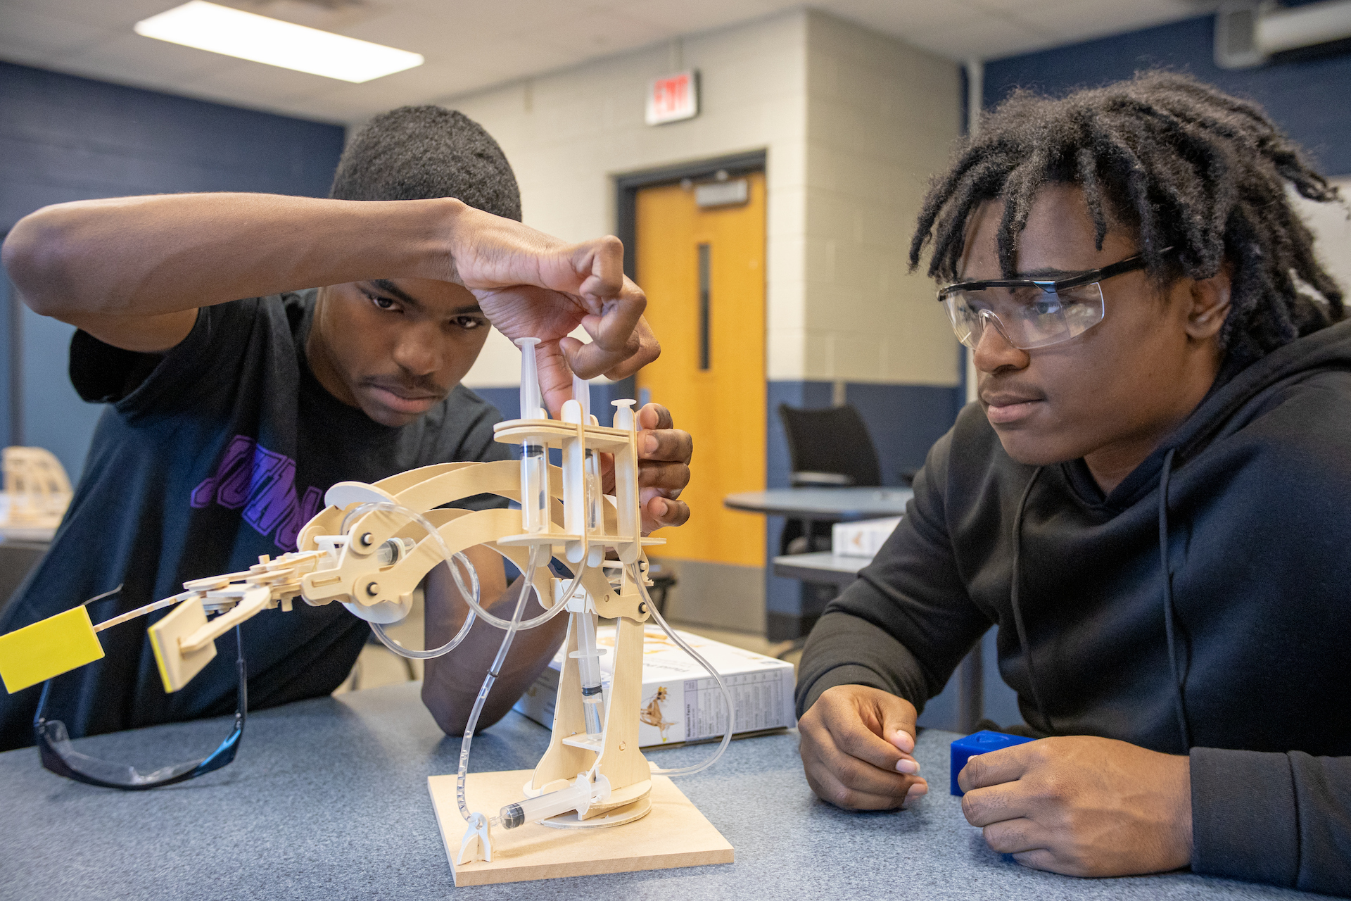
Academy Development & Structure
Building a strong foundation.
Flexible structure
Open, interest-based enrollment
Small learning communities
Enrolls 20+ students per grade level
Collaborative leadership — bringing together academy, business, and community leaders
Data collection and analysis to inform continuous improvement
7

Slide 8
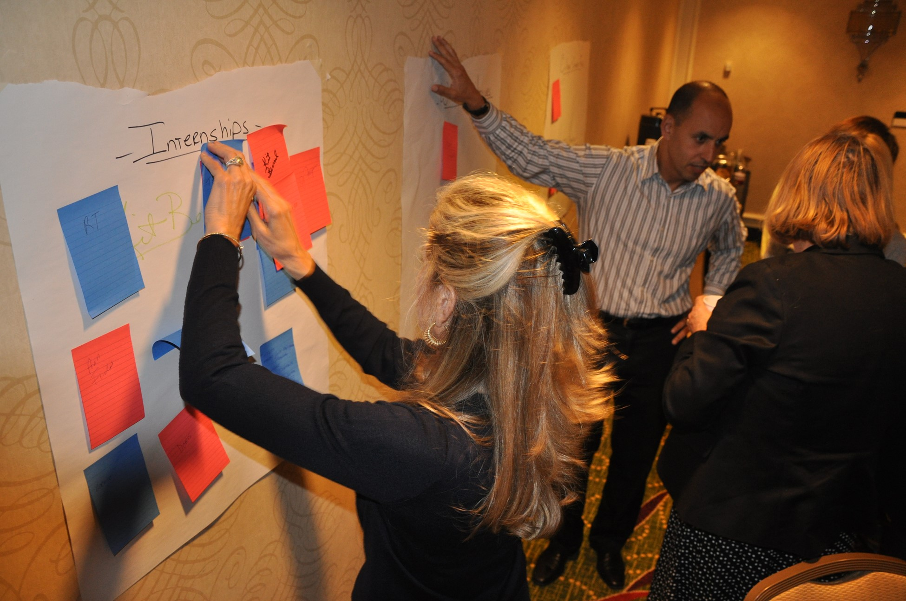
Advisory Board
Advisory boards bridge classroom and career.
10+ members, 80% from business and industry
Actively support work-based learning activities
Inform curriculum and support teacher development
Advocate for the academy through community engagement
Strategic, organized structure that promotes long-term sustainability
8

Slide 9

Curriculum & Instruction
Industry-informed, student-centered career learning.
Career–connected program of study aligned with local workforce needs and Advance CTE Career Clusters
Authentic, project-based learning that builds career-readiness competencies
College-aligned coursework and industry–recognized credentials that strengthen post-secondary pathways
Health
Sciences
Hospitality &
Tourism
Information
Technology
Engineering
Finance
Future Ready Learning: ash.naf.org/public/learning
9

Slide 10
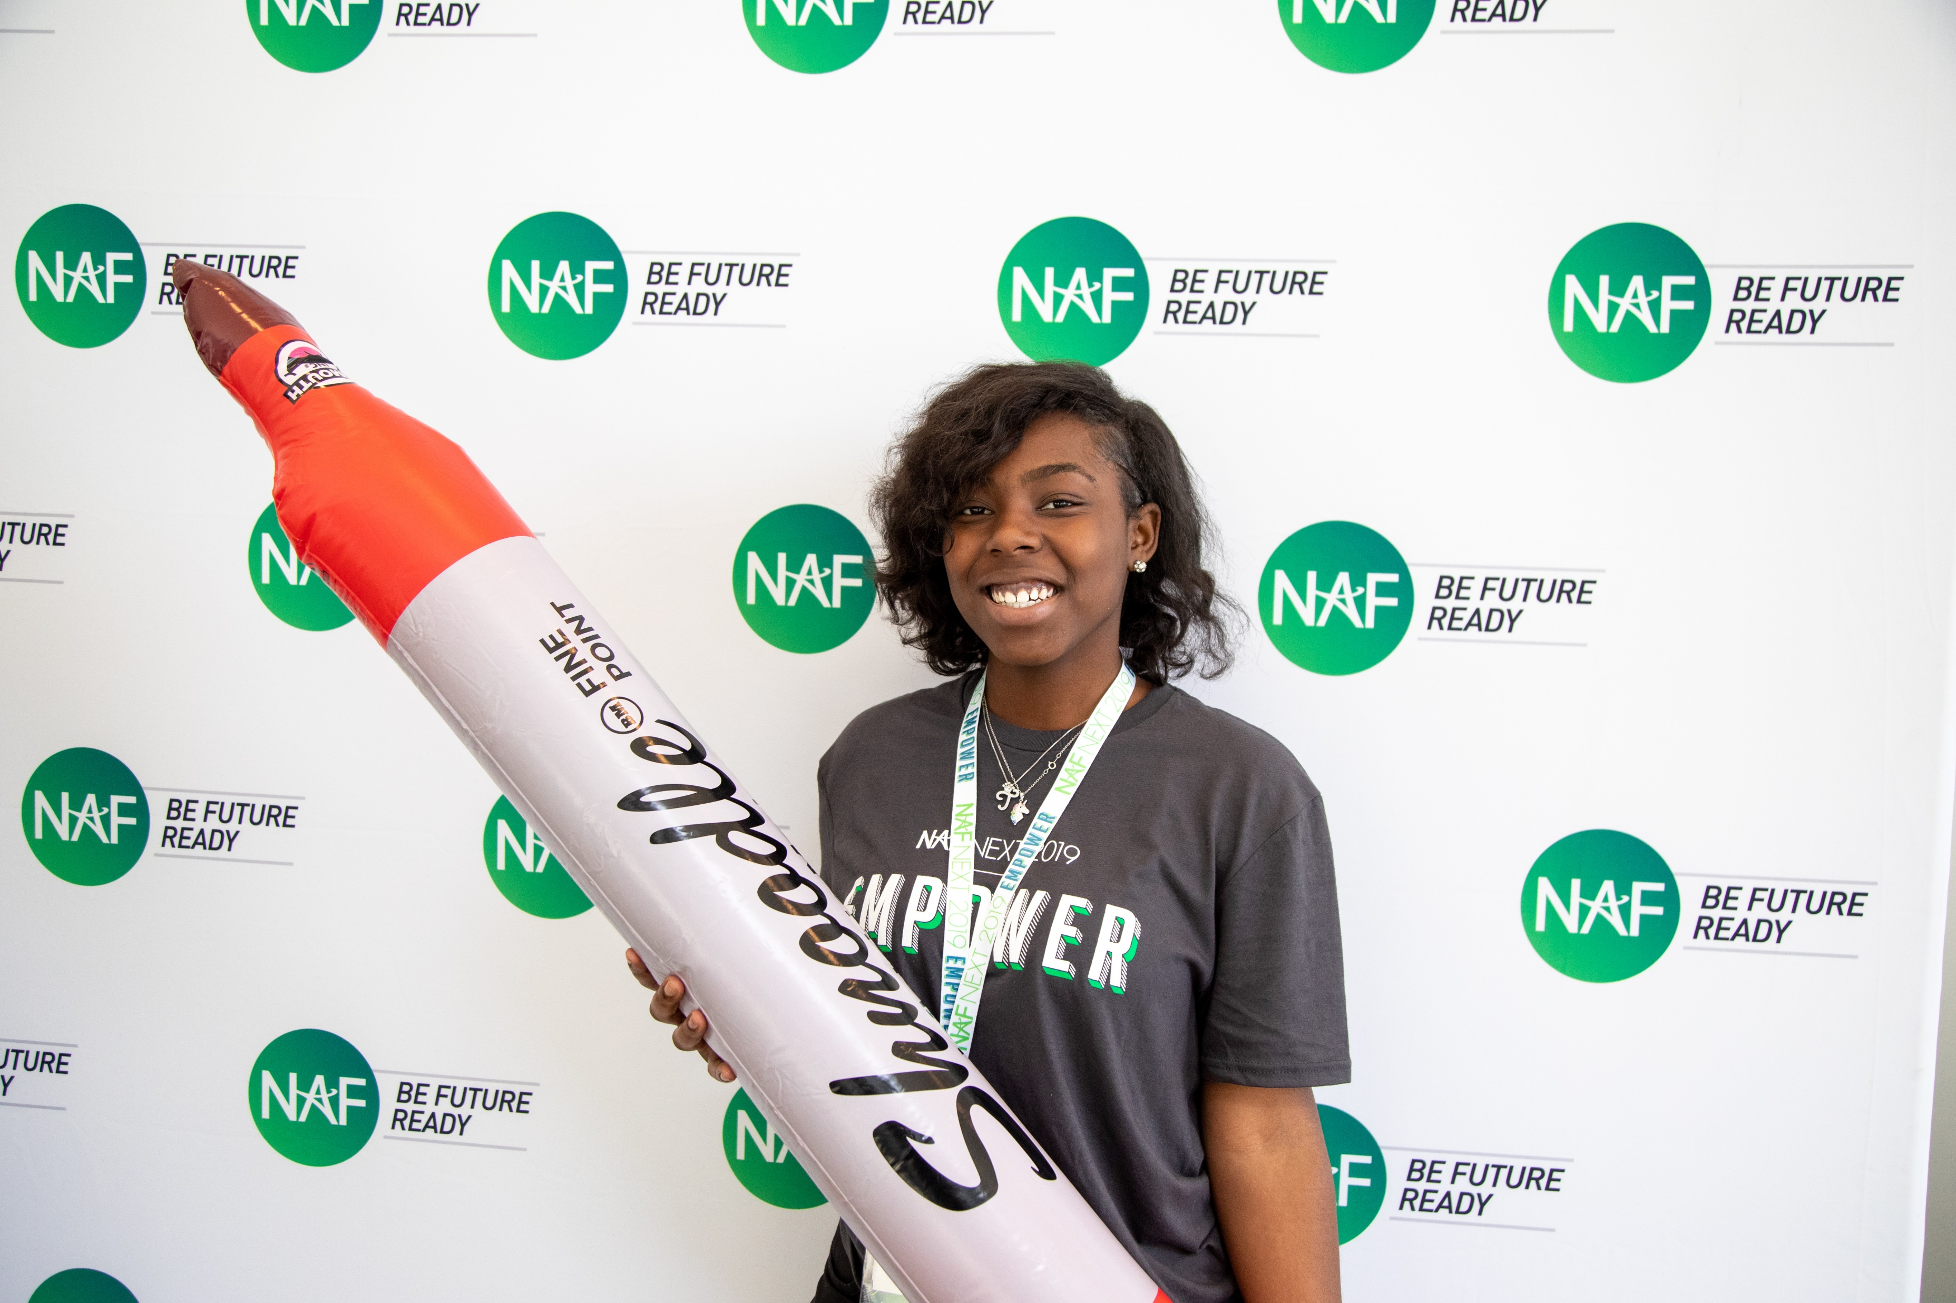
Career Pathways
In addition to NAF’s five core career themes, academy offerings have expanded to include the 14 career clusters and associated pathways that align with National Career Clusters Framework, as well as State-Approved career pathway courses.
National Career Clusters Framework, allowing academies to tailor pathways to local workforce needs.
Advanced Manufacturing
Construction
Supply Chain & Transportation
Arts, Entertainment, & Design
Hospitality, Events, & Tourism
Financial Services
Education
Healthcare & Human Services
Public Service & Safety
Agriculture
Energy & Natural Resources
Digital Technology
Marketing & Sales
Management & Entrepreneurship
10

Slide 11













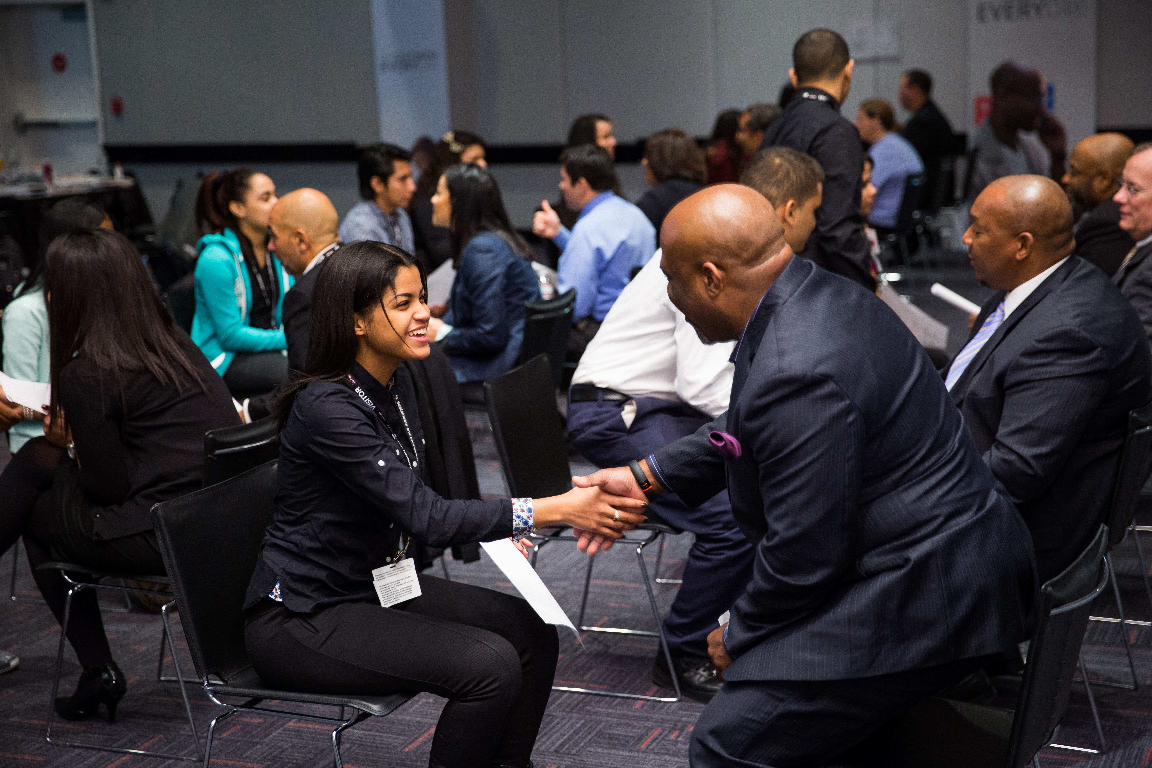




Work-Based Learning
CAREER AWARENESS
CAREER EXPLORATION
CAREER PREPARATION
Standards of
High Quality WBL:
Interaction
Guest Speaker
Job Shadow
Mentorship
Informational Interview
Internship
Preparation & Reflection
Classroom-Connected
Clinicals
Outcome-Driven
Career Fair
Resume Coaching/ Review Session
Skills Workshop
Apprenticeship
Worksite Tour
Mock Interview
Partner Engagement Project
Mentored Industry Project
Impactful
More Impactful
Most Impactful
11

Slide 12
Outcomes-Driven WBL Approach
Student
Centered!
Our goal for every student.
ASPIRATIONS
SKILLS
CONNECTIONS
Define and map a plan for at least one career of interest
Build the 6 career-ready skills
Receive continuous feedback
from industry professionals
Be able to articulate their strengths
Develop at least three professional connections
✅ Communication
✅ Problem-Solving
✅ Social Awareness
✅ Collaboration
✅ Initiative & Self-Direction
✅ Planning for Success
Employees seek key transferable skills — at NAF, we call them Future Ready Skills.
12

Slide 13
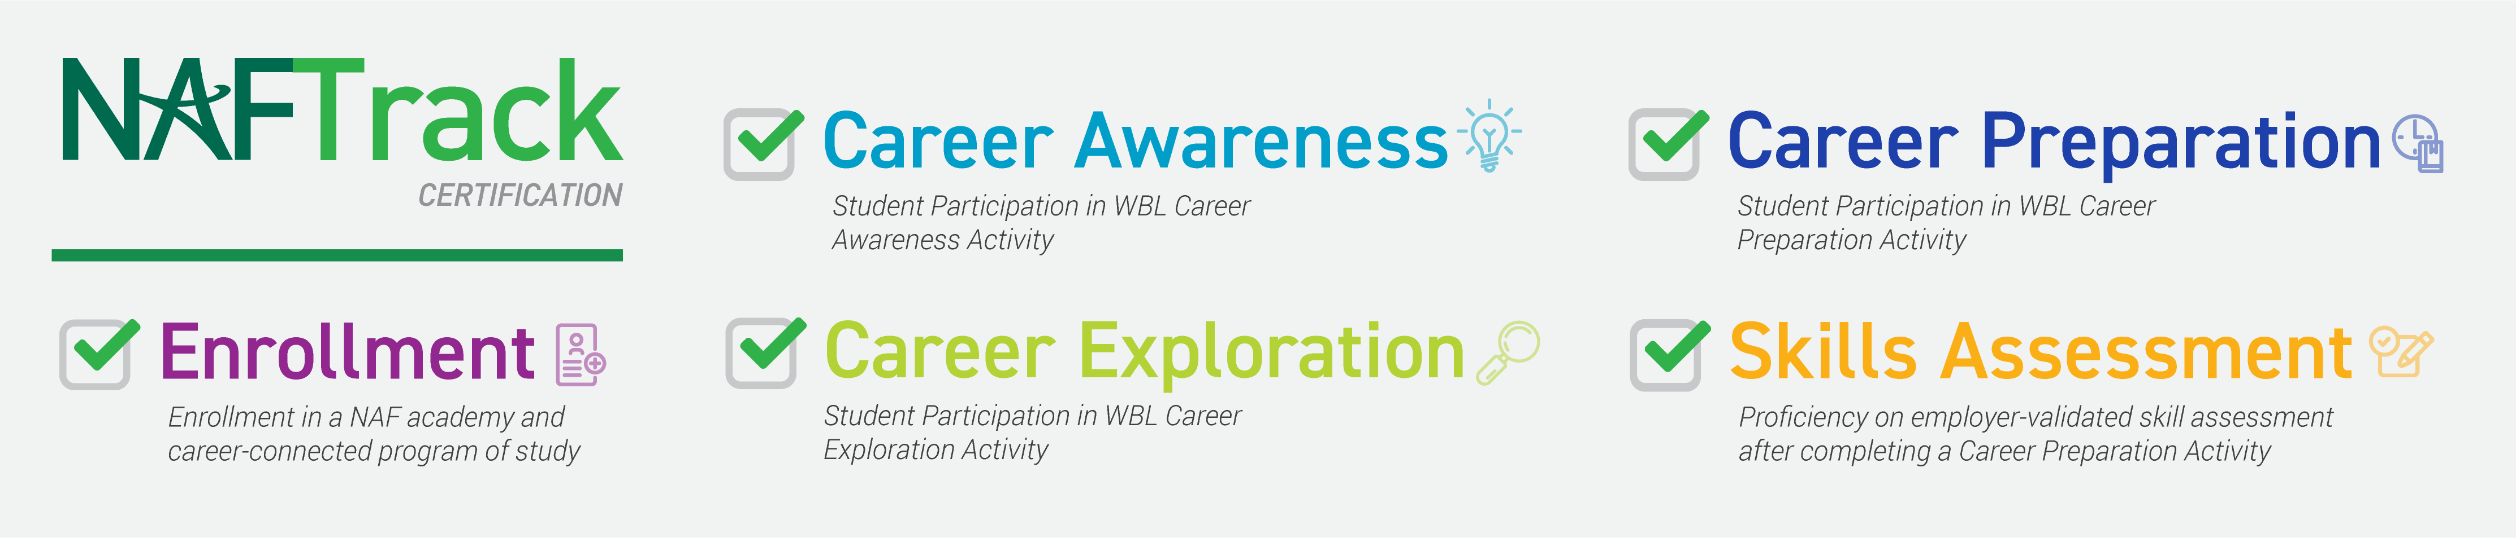
NAFTrack Certification
NAFTrack Certification is an employability credential that serves as NAF’s seal of college and career readiness.
To earn NAFTrack Certification, students:
Be enrolled in a NAF academy and career-connected program of study.
Participate in 1 work-based learning activity from each phase of the WBL continuum:
Career Awareness, Career Exploration, and Career Preparation.
Demonstrate a level of mastery of the six Future Ready Skills, validated by an internship supervisor.
13

Slide 14
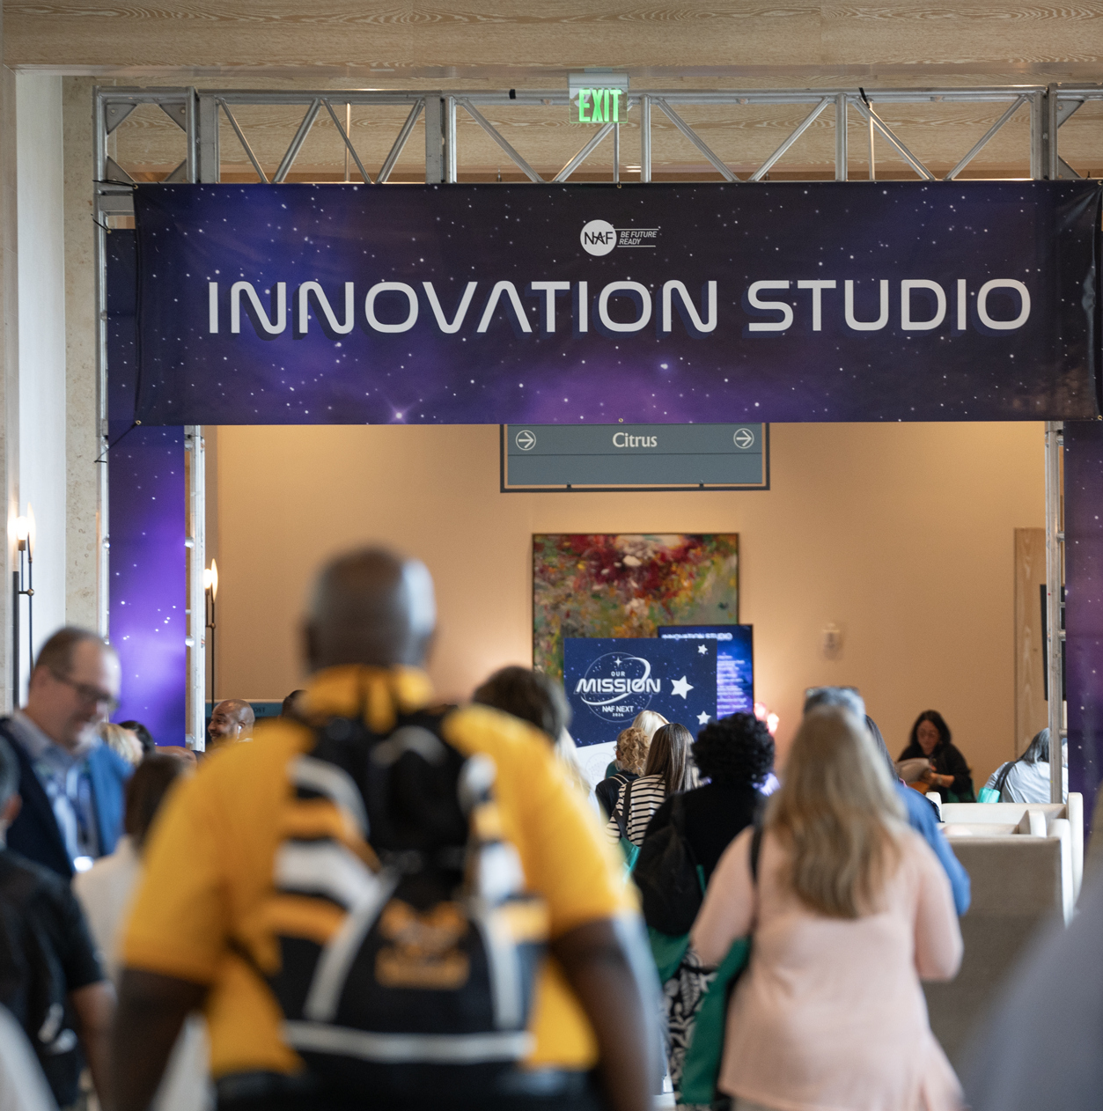
Innovation & Products
Tech-Enabled Impact!

Slide 15


Outcomes-Driven WBL Tech Tools
WBL Tracker
Log WBL activities
Record student participation
Track AB participation
Analyze data to measure
impact
Export reports, graphs, & tables
WBL Tracker
(Educators)
WBL Skills
Feedback Survey
(Partners)
Support
Resources
WBL Student
Reflection Form
Capture student feedback
View quantitative and
qualitative data
Analyze data - dashboard or report export feature
WBL Student Reflection Form
(Students)
Future Ready Skills Assessment
(Partners)
Internships
Resource: Outcomes-Driven WBL Tech Tools Overview

Slide 16
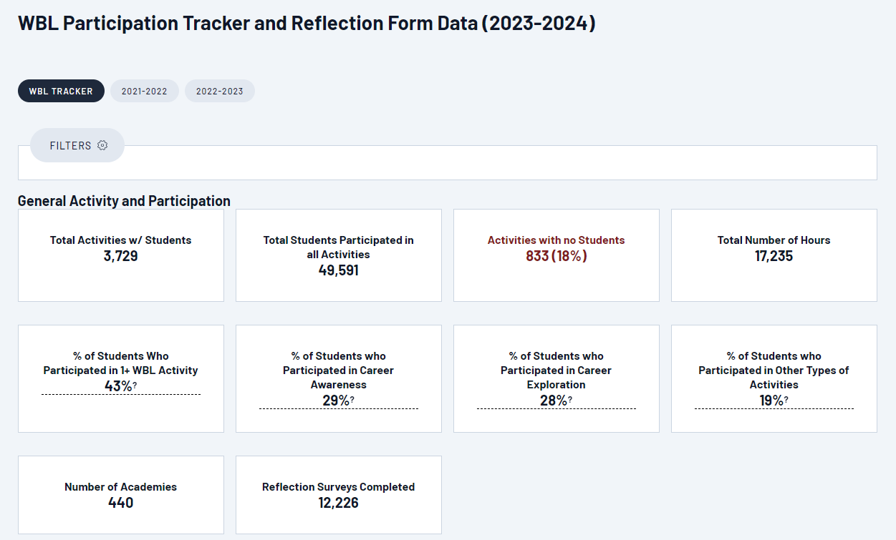
WBL Tracker Overall Results
WBL Tracker Dashboard
A
A
School Year: States which school year’s data you are looking at; default to current school year
B
Total Activities: Number of activities added that include students
B
C
D
C
Total Students: Total unique students
D
Activities with no Students: Number of activities added where students have not yet been added
E
E
% of Students who Participated: Based on unique students and broken down by continuum
F
Total Reflection Forms: Number of reflection forms completed by students
F
Explore Resources: https://ash.naf.org/public/wbl/tracker-resources
Notes:
From main dashboard, option to view dashboard data by activities or students.

Slide 17


KnoPro
Powered by NAF
Challenges
A 100% Free Digital Work-Based Learning Platform
for High School Students (Ages 13–20)
Take on KnoPro challenges for a chance to win $10,000 in cash prizes!
NAF Membership is not required — Pilot with a class or student group.
Industry Challenges
New Topic Monthly
Teams or solo
Cash prizes for winners ($5K, $3K, $2K)
Open to all U.S. high school students
Mentors
Answer your questions during Challenges
Provide feedback on your project
Skillbuilders
Daily (M-F): 10 mins
Learn a new skill
1 Winner each day
$100 gift card
https://www.knopro.org/
Notes:
Solve real-world problems from industry leaders (partner engagement project — 20 hours; anonymous mentors); Career Exploration Activity
Build future-ready skills through daily activities & monthly challenges
Get feedback from virtual mentors and connect with professionals
Earn points for prizes like tech swag, scholarships, and more
Explore careers, expand networks, and strengthen resumes/college apps
Highlights:
Monthly Challenges: Team or solo industry projects with $10k in cash prizes, in or outside of school ($5K, $3K, $2K)
Daily Skillbuilders: 10-minute activities with a daily $100 gift card winner
Work-Based Learning: Real interaction with industry professionals (Challenges fulfill career exploration activity)
Resources & Tools: Support for students, educators, and partners
INSIDE THE NAF NETWORK
KnoPro Challenges fulfill Career Exploration activity:
Partner Engagement Project — 20 hours; anonymous mentors
OUTSIDE THE NAF NETWORK
Recognition depends on the school, district, and state standards.
Some schools count it as a mentored industry project, or internship alternative, and certify it as approximately 20 WBL hours for Perkins funding.
Other schools or districts classify it as a career exploration or preparation activity.

Slide 18
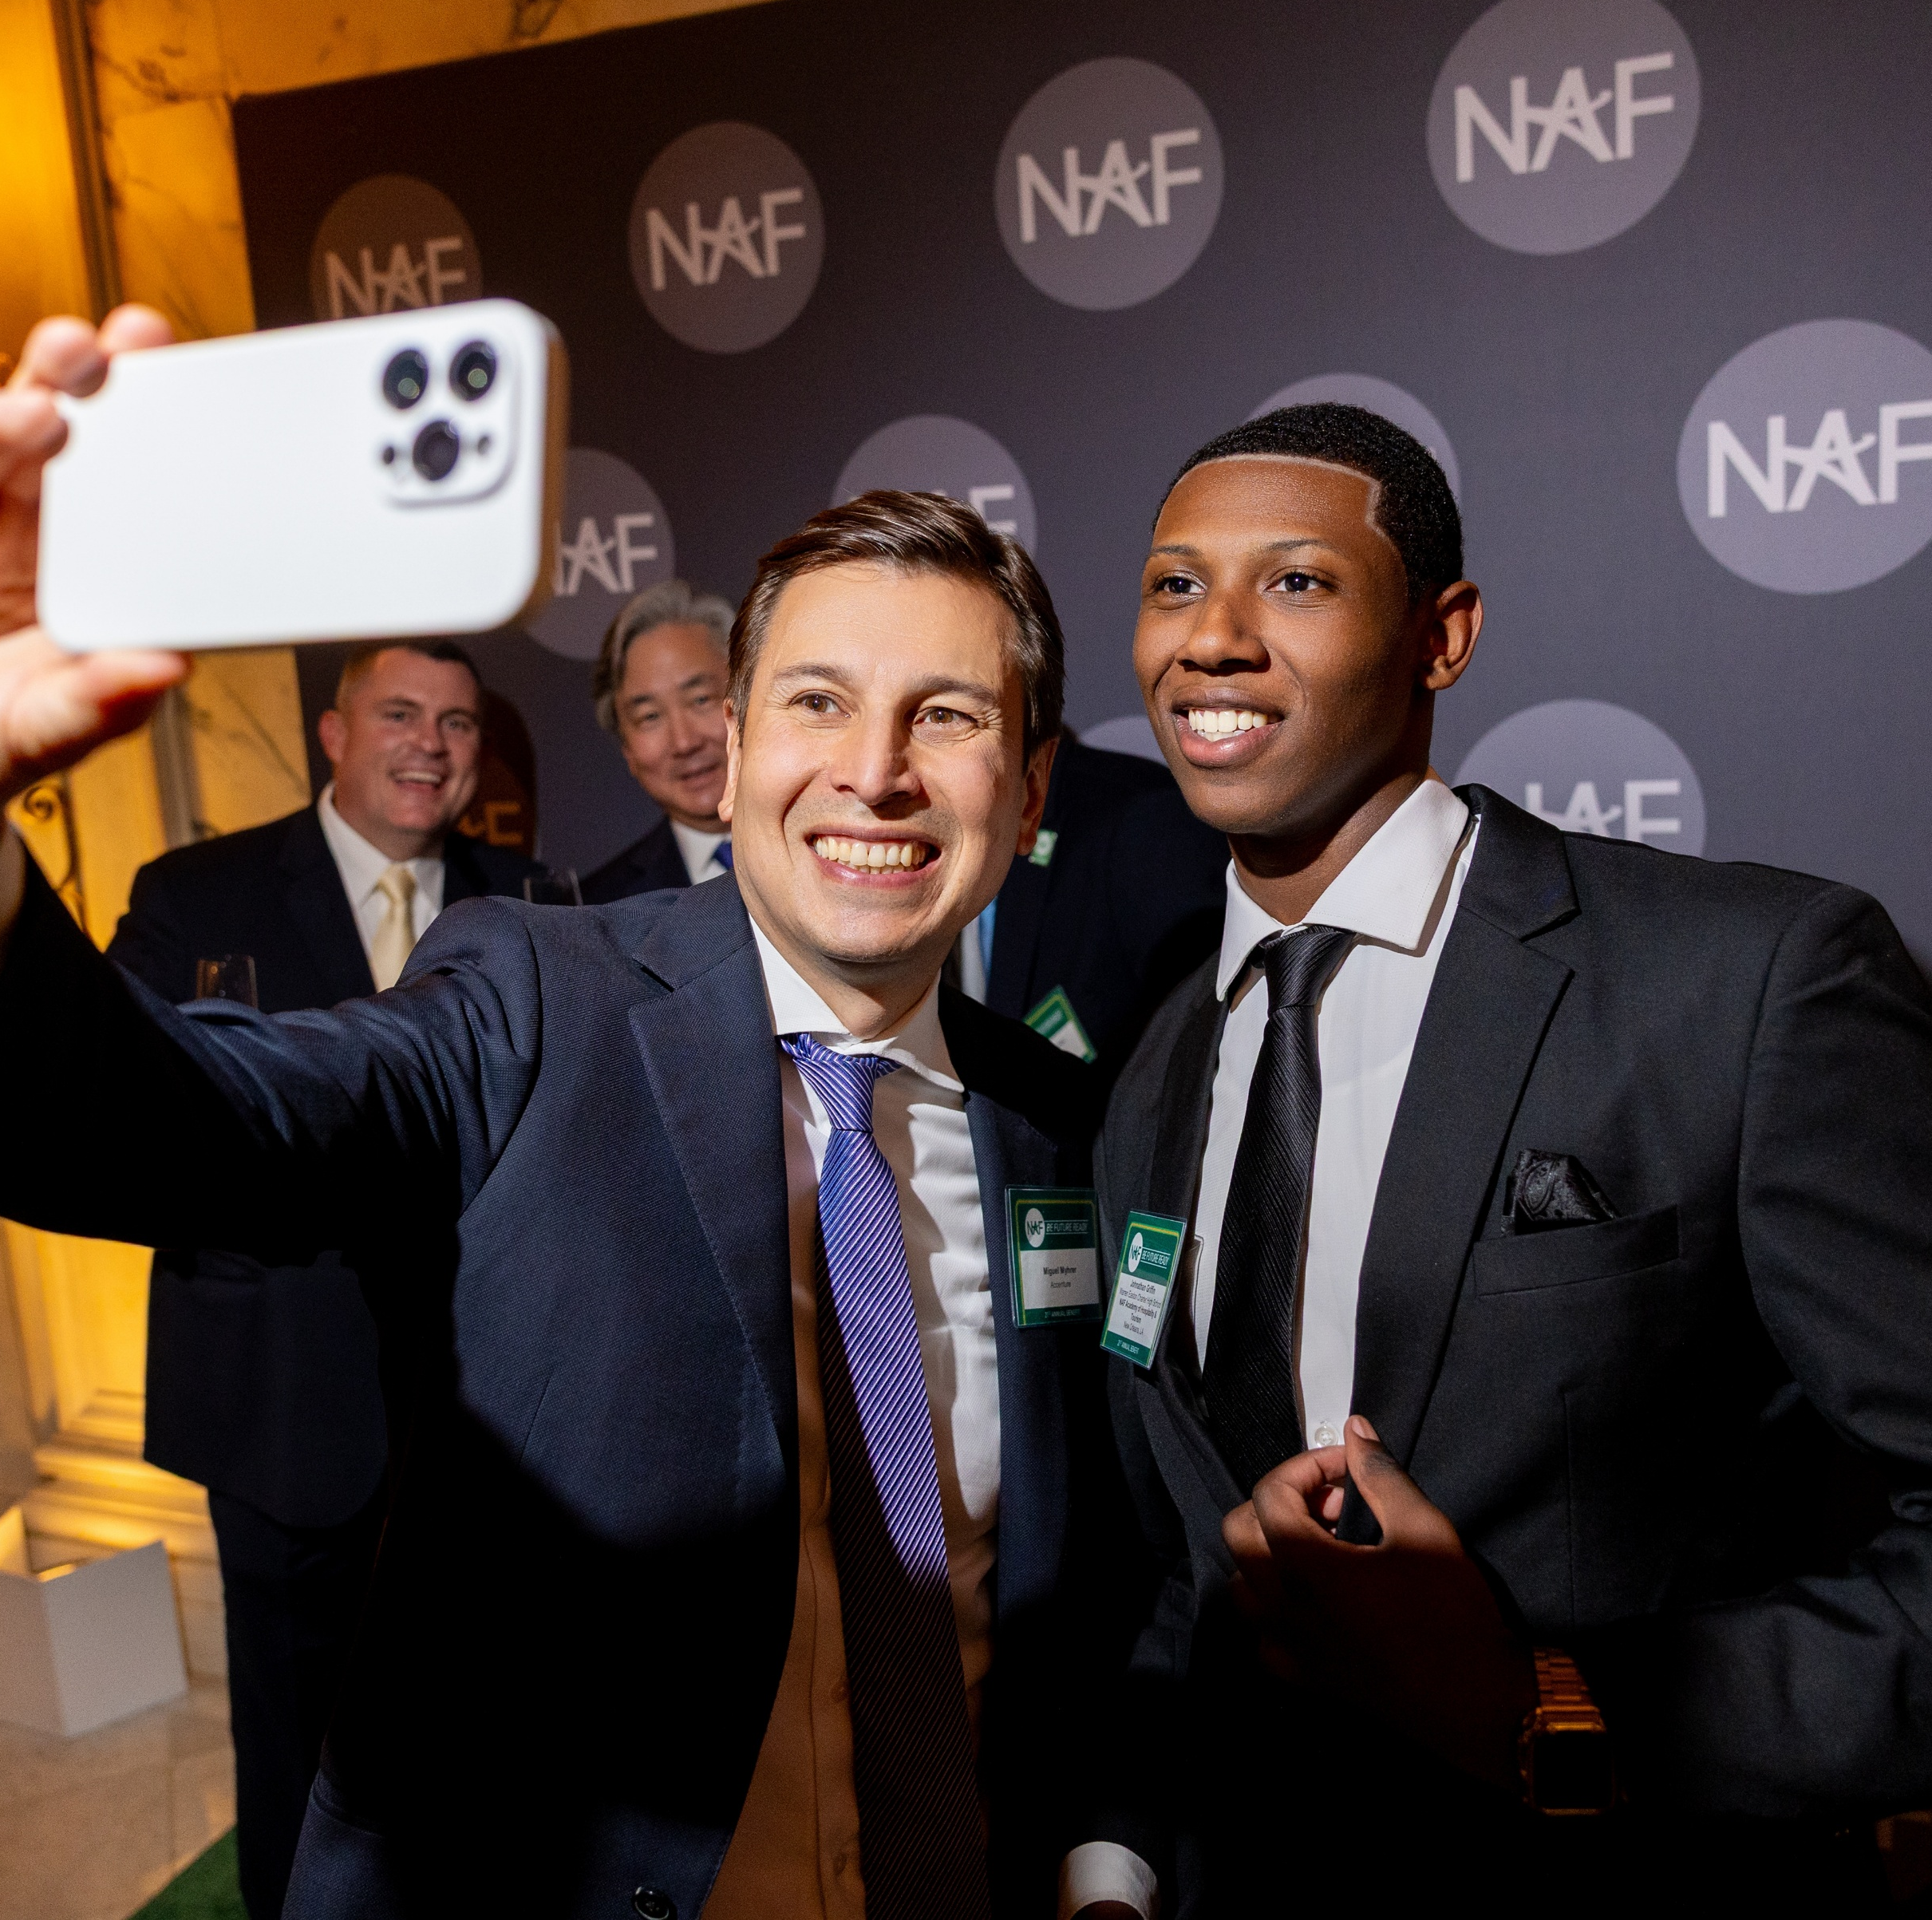
Where Opportunity Begins
Together, we can expand access to career-connected opportunities and real-world learning for high school students.

Slide 19










National Engagement Partners
NAF partners with companies to create tailored engagement programs.
Corporations of all sizes, including national brands, are committed to providing work-based learning opportunities through skill-based volunteerism and student internships.

Slide 20
Board of Directors
Sanford I. Weill – Chairman Emeritus
Founder, NAF
Gregory J. Hayes –
Chairman
Former Executive Chairman, RTX
Kenneth I. Chenault – Vice Chairman
Chairman and Managing Director, General Catalyst
Robert Smith –
Vice Chairman
Founder, Chairman and Chief Executive Officer, Vista Equity Partners
Eugene A. Ludwig – Secretary
27th Comptroller of the Currency Managing Partner, Canapi Ventures Founder and CEO, Cari Network and Ludwig Advisors
Chairman, Ludwig Institute for Shared Economic Prosperity
Lisa Dughi
Chief Executive Officer, NAF
Chike Aguh
Head of Innovation & Strategy, Kapor Center
Senior Advisor, The Project on Workforce at Harvard
Jeffrey A. Brill
Partner, Skadden, Arps, Slate, Meagher & Flom LLP
Kermitt J. Brooks
Chief Legal Officer, The Guardian Life Insurance Company of America (Guardian Life)
Ursula M. Burns
Founding Partner of Integrum Holdings, Chairwoman, Teneo LLC, Retired Chairman & CEO, Xerox Corporation and VEON, Ltd.
Bob Ferrell
Executive Vice President of Global Human Resources, World Wide Technology
Lawrence H. Gennari
Co-Founder and Partner,
Gennari Aronson, LLP
Kenneth M. Jones II
Senior Vice President and Chief Operating Officer, Chief Equity Officer, John D. and Catherine T. MacArthur Foundation
Julie Lammers
President & CEO, Britebound
Erin McSweeney
Chief People Officer, UnitedHealth Group
Jennifer Morgan
Chief Executive Officer, UKG
Nicola Palmer
Retired Chief Technology Ambassador, Verizon
Carla Thompson Payton
Chief Strategist & Impact Officer, W.K. Kellogg Foundation
Thomas Penny III
President, Donohoe Hospitality Services
Joseph J. Russo
Executive Vice President and President, Global Networks and Technology, Verizon
David L. Steward
Founder and Chairman, World Wide Technology
Sandy Torchia
Vice Chair, Talent and Culture, KPMG
Joseph M. Tucci
Chairman & Co-Founder, Bridge Growth Partners
Marc Weill
Senior Advisor, Two Sigma Ventures
Dantaya Williams
Chief Human Resources Officer,
RTX
Matthew Zielinski
EVP, President of International Markets, Lenovo
Lauren Budzich-Goren
Chair, NAF Alumni Leadership Council, Johnson & Johnson MedTech Commercial Strategy and Execution
NAF’s Board of Directors is composed of distinguished leaders from across industries who bring expertise, vision, and a shared commitment to NAF’s mission and expanding impact nationwide.
Through their leadership and guidance, NAF fulfills its mission to develop the next generation of future-ready employees.

Slide 21
STEM Advisory Committee
Established in 2013 as an adjunct to NAF’s Board of Directors, the STEM Committee addresses the growing role of science, technology, engineering, and mathematics in the economy.
Leading STEM executives guide NAF’s strategy across curriculum, work-based learning, employer engagement, advisory board development, college access, and professional development, while fostering collaboration to attract and support high-quality talent for STEM careers.
Nicola Palmer
Chair
Retired Chief Technology Ambassador,
Verizon
Alencia DeAnda-Gregg
AVP HR Business Partner Human
Resources Organization,
AT&T
Joseph Dill, DDS, MBA
Consultant, former Chief Dental Officer,
Delta Dental Plans Association
Mike Haberman
Senior Vice President,
Verizon
Vinay Iyengar
Founder and Managing Partner,
Anansi Capital
Brian Monahan
Senior Vice President,
Albertsons Media Collective
Milanka Muecke
Director, Global Commercial Marketing, Workstation Business,
Lenovo
Juan F. Rodriguez
National Strategic Advisor – SLED K12
E-rate and Federal Funding,
World Wide Technology
Bobby Soni
Global Technology Consulting Leader,
KPMG International
Brian Thomas
President & CEO,
Lightspeed Systems

Slide 22
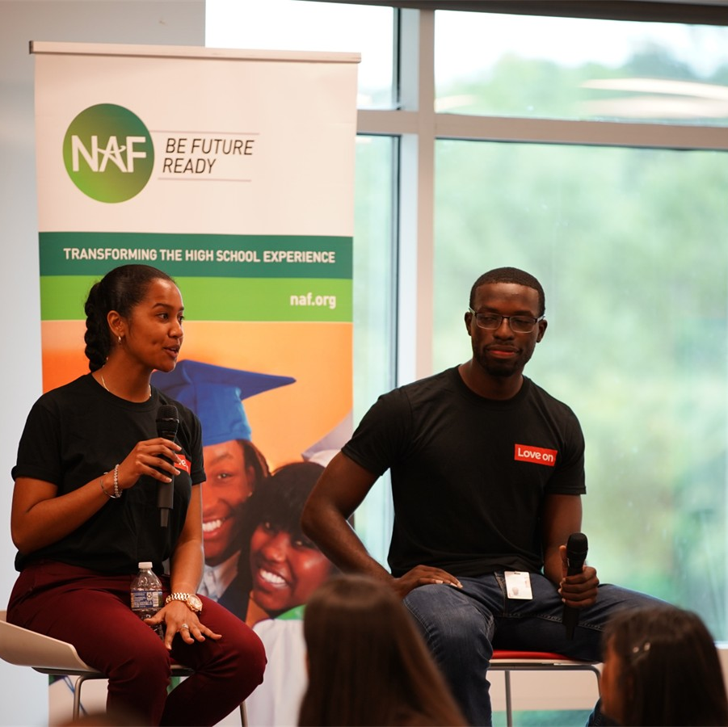
Workforce Development Committee
Established in 2024 to bring together HR, talent acquisition, and university relations leaders from our corporate partners to help identify direct workforce entry opportunities and expand opportunities for NAF alumni.
Marybeth Caulfield
Senior Manager, Global University Recruitment& Employer Brand,
Lenovo
Sarah D’Angelo
Director, Talent Development and University Recruitment,
Marriott International
Soléy Gonzalez
Associate Director, Corporate Social Responsibility,
RTX
Dora Moreira
University Recruiter,
World Wide Technology
Jim O’Neill
Associate Director, Campus Programs,
RTX
Kathleen Schaum
Executive Director, University Talent Acquisition,
KPMG US
Chris Van Bavel
Vice President, Global Talent Acquisition Innovations, Programs, and Solutions,
Marriott International
Notes:
Information Sharing:
Example: Hiring profiles — provide students, alumni, and educators the most in demand positions and requirements to inform their planning, aspirations, curriculum, and futures.

Slide 23
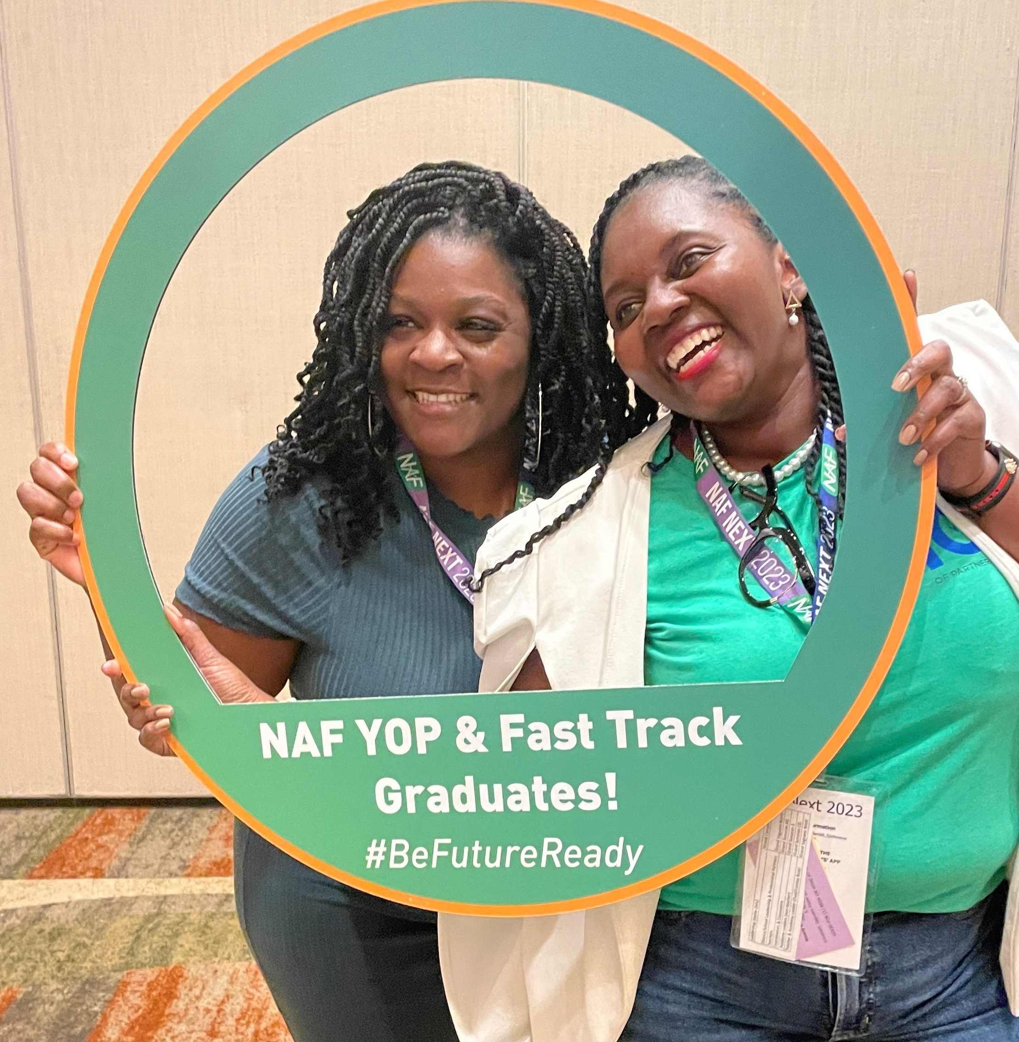
Admissions
Starting a NAF Academy!
🤝Full District Engagement
Build effective, sustainable academy implementation for long-term success.
🎯Admissions Options
Choose the approach that best aligns academy development with district goals and the NAF design.
Year of Planning
Fast Track
Notes:
Who is Eligible?
NAF encourages full district engagement in creating academies to maximize successful and sustained academy implementation. The annual membership fee is $2,000 per academy, with multi-academy discounts available. Begin the process by completing NAF’s Interest Survey to indicate your interest and commitment to partnering with NAF.
https://naf.org/start-a-naf-academy/interest-survey/

Slide 24
Year of Planning
🚀 Getting Started
Build a dedicated, multidisciplinary team with a shared vision to develop your Academy Design Plan.
🎯 Personalized Support
Receive hands-on guidance and technical assistance to align the district’s programming goals with the NAF design and its twelve standards of practice.
📅 Flexible Timeline
Typically completed within one school year, with the option to extend.
🌱 Sustainable Foundation
Provides the groundwork for long-term student success and community impact.
💲The application fee is $12,000 (a $2,000 annual membership fee applies upon Launch)
24

Slide 25
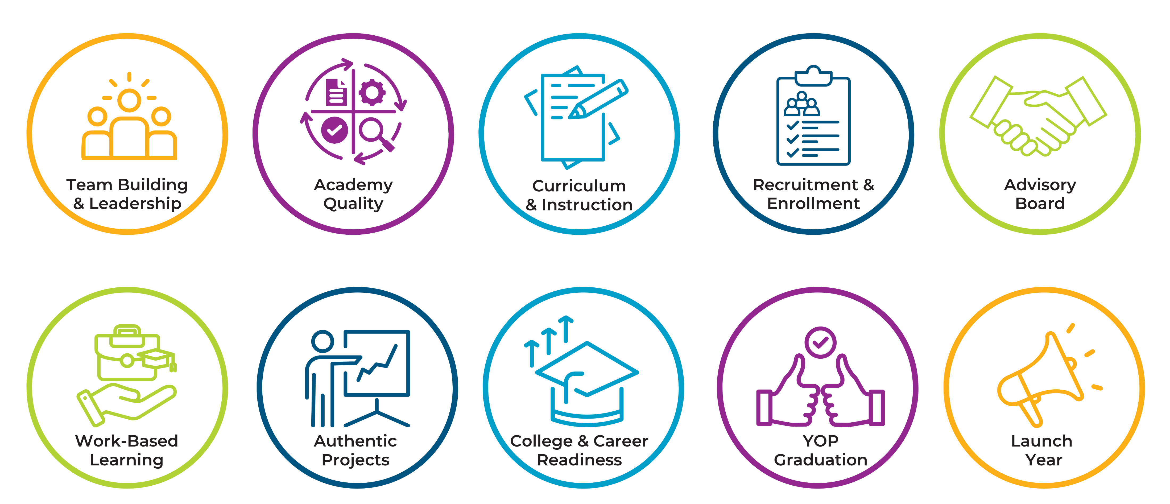
Year of Planning Roadmap
Focus Areas that Shape Your Academy Design Plan.
Resource: YOP Benefits
25

Slide 26
Fast Track
🚀 Getting Started
Build a dedicated, multidisciplinary team with a shared vision to develop your Academy Design Plan.
🎯 Alignment Focus
Centers on documenting how your academy aligns with the NAF design and its twelve standards of practice.
⏱️ Condensed Timeline
Typically completed within three months, though timing may vary based on your launch year goal.
💡 Immediate Benefits
Enables early access to NAF resources, tools, and student opportunities.
💲The application fee is $4,000 + a $2,000 annual membership fee due at launch
26

Slide 27
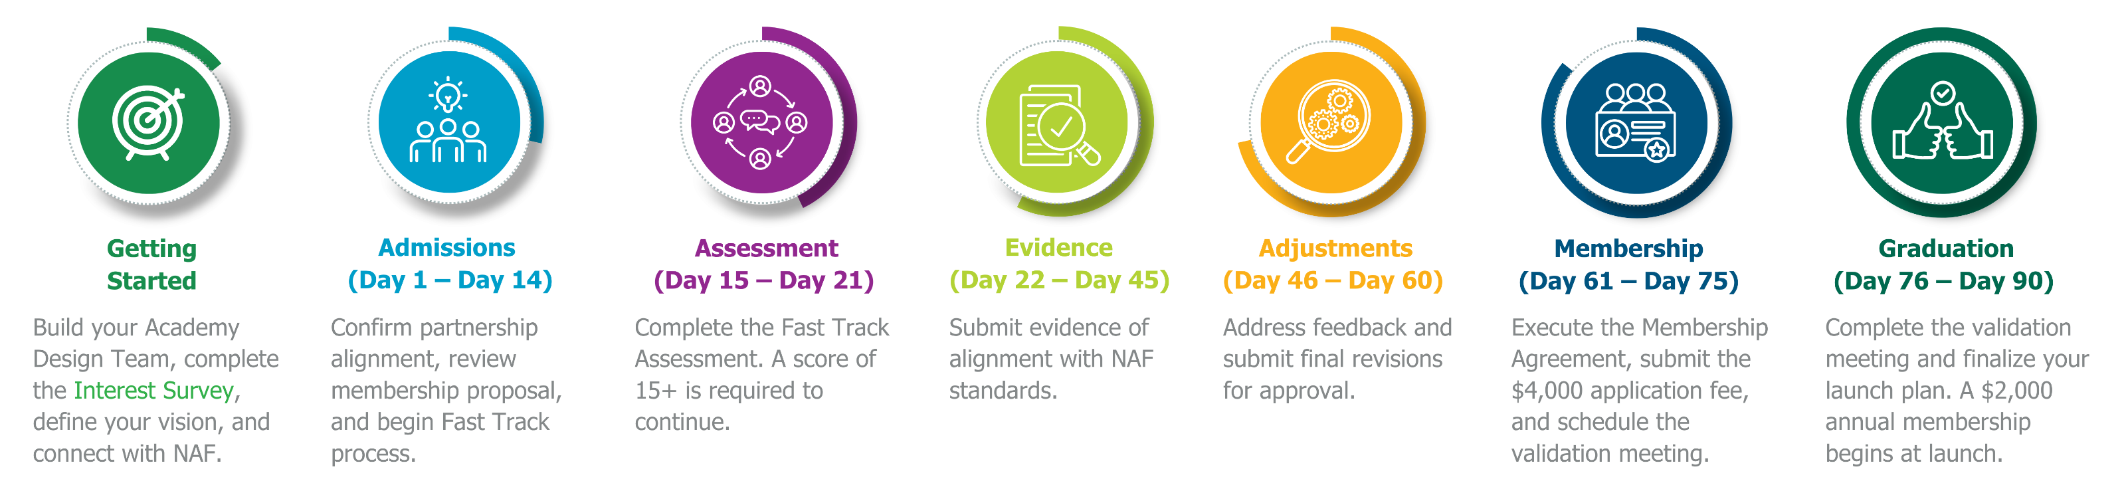
Fast Track Timeline
A 90-Day Path to NAF Membership!
For existing career academies that already meet most NAF standards. Validate alignment, accelerate your launch, and access NAF resources and ongoing support.
The sample 90-day timeline is flexible and can be adjusted to meet your target launch year.
Resource: Fast Track Pacing Guide
27

Slide 28



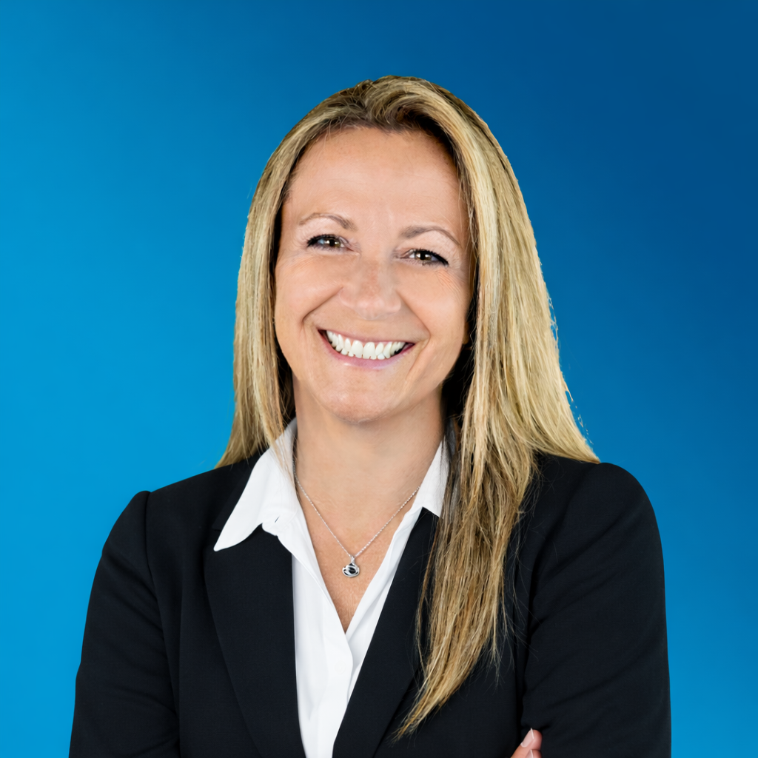
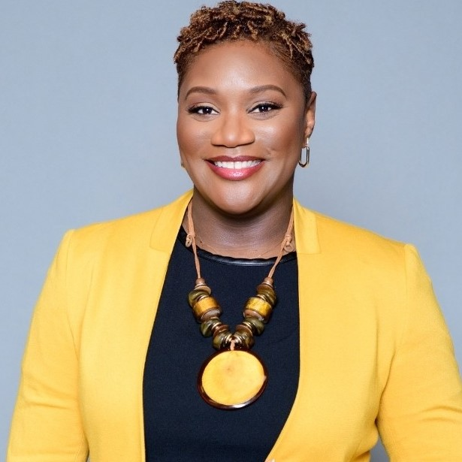

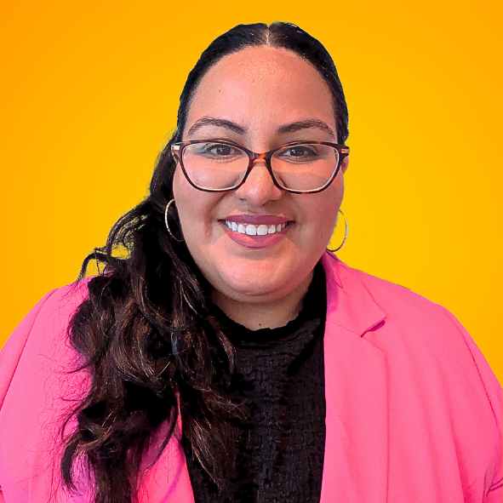

Team Building & Leadership
  Lead school operations and resource allocation, advocate for students, oversee master scheduling, and engage the community
  Lead academy program implementation, coordinate operations, advocate for students and program needs, and manage NAF deadlines and deliverables.
  Develop partnerships with business and community organizations while overseeing internships and WBL activities
  Support recruitment and scheduling, using academy and student data to inform interventions and advisement
School
Administrator
Academy
Lead
Work-Based
Learning Coordinator
Counselor
  Provide career-pathway expertise while integrating authentic projects and work-based learning strategies
  Coordinate college and career partnerships while monitoring students’ individualized college-and-career plans
  Deliver core-content instruction while integrating authentic project-based experiences and work-based learning strategies
  Advocate for student needs while providing feedback on program impact, effectiveness, and peer recruitment
Career Pathway
Educator
College & Career
Coordinator
Core-Content
Educator
Academy
Student
28

Slide 29

Next Steps
Reflect on your vision and readiness by completing the NAF Interest Survey.
Identify a career pathway based on student interest and workforce demand.
Review budget and funding considerations to support implementation.
Build a multidisciplinary team to lead academy development and launch your NAF academy.
Save the Date! NAF Next, Anaheim, CA, July 19-22.
Admissions Questions?
Scan QR Code To Request More Information
Jennifer Geisler, Director, Emerging Academies
jgeisler@naf.org

Slide 30
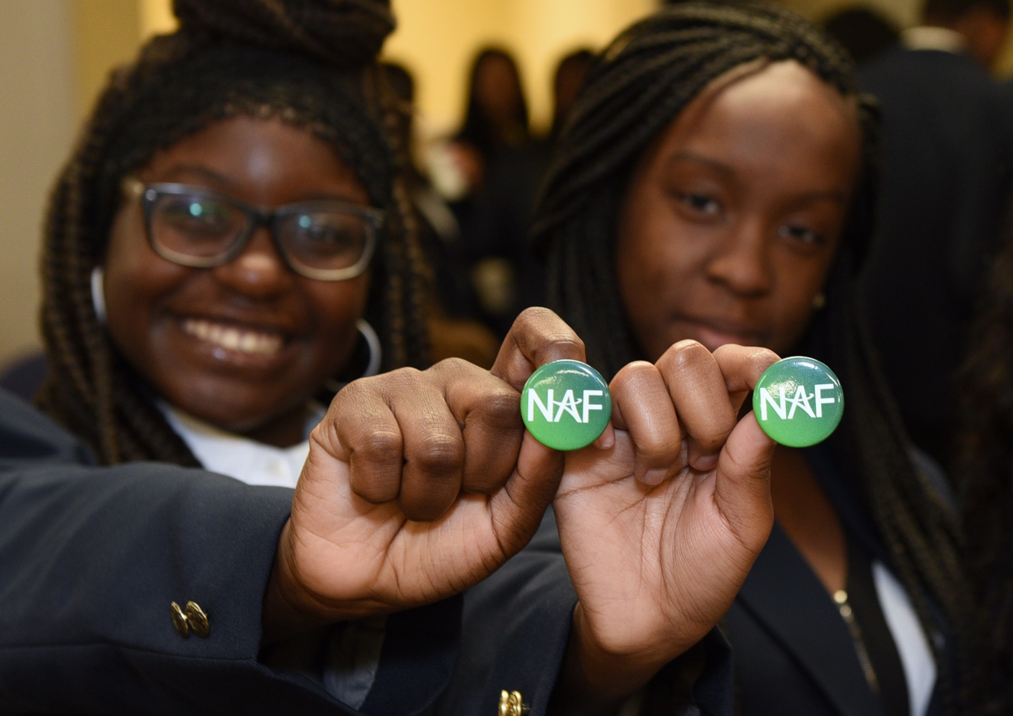
Questions
Learn More About NAF!
NAF Design
About NAF
Get to Know KnoPro
WBL Key Concepts
Alumni Benefits
NAFTrack Certification
Membership Benefits
30

Slide 31
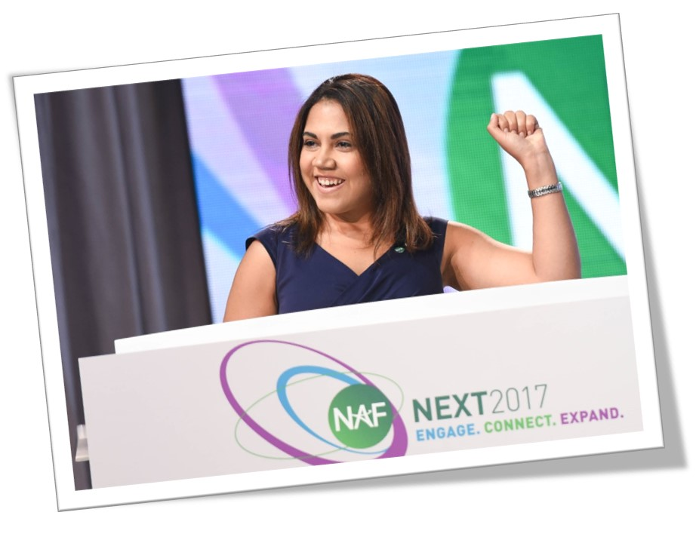
NAF Personal Impact
“This is where I started,
and I made it!”
“Why was NAF and the internship
experience life changing? Because I
found a home, I found a place where I
mattered, where people were genuinely interested in my success and development. The experience made my dreams more realistic, more tangible.”
-Jackie Burgos
NAF Alumna
Harvard Business School
Class of 2014
31

Slide 32
32

