Slide 1
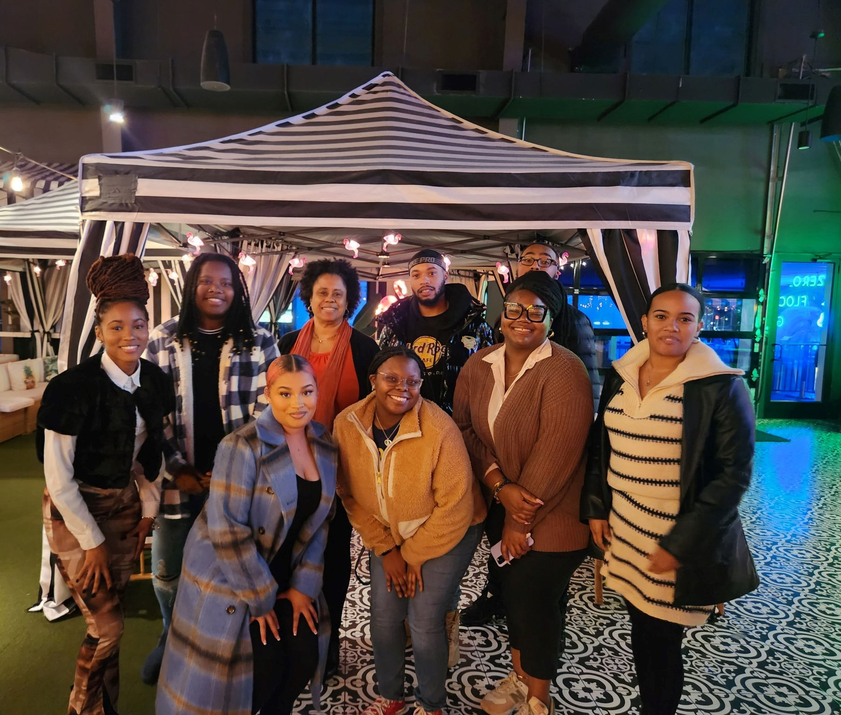
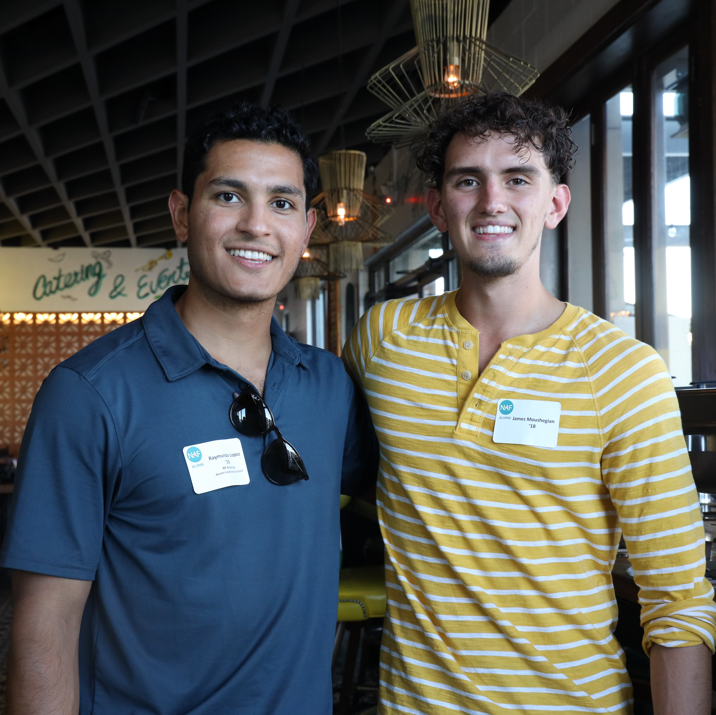
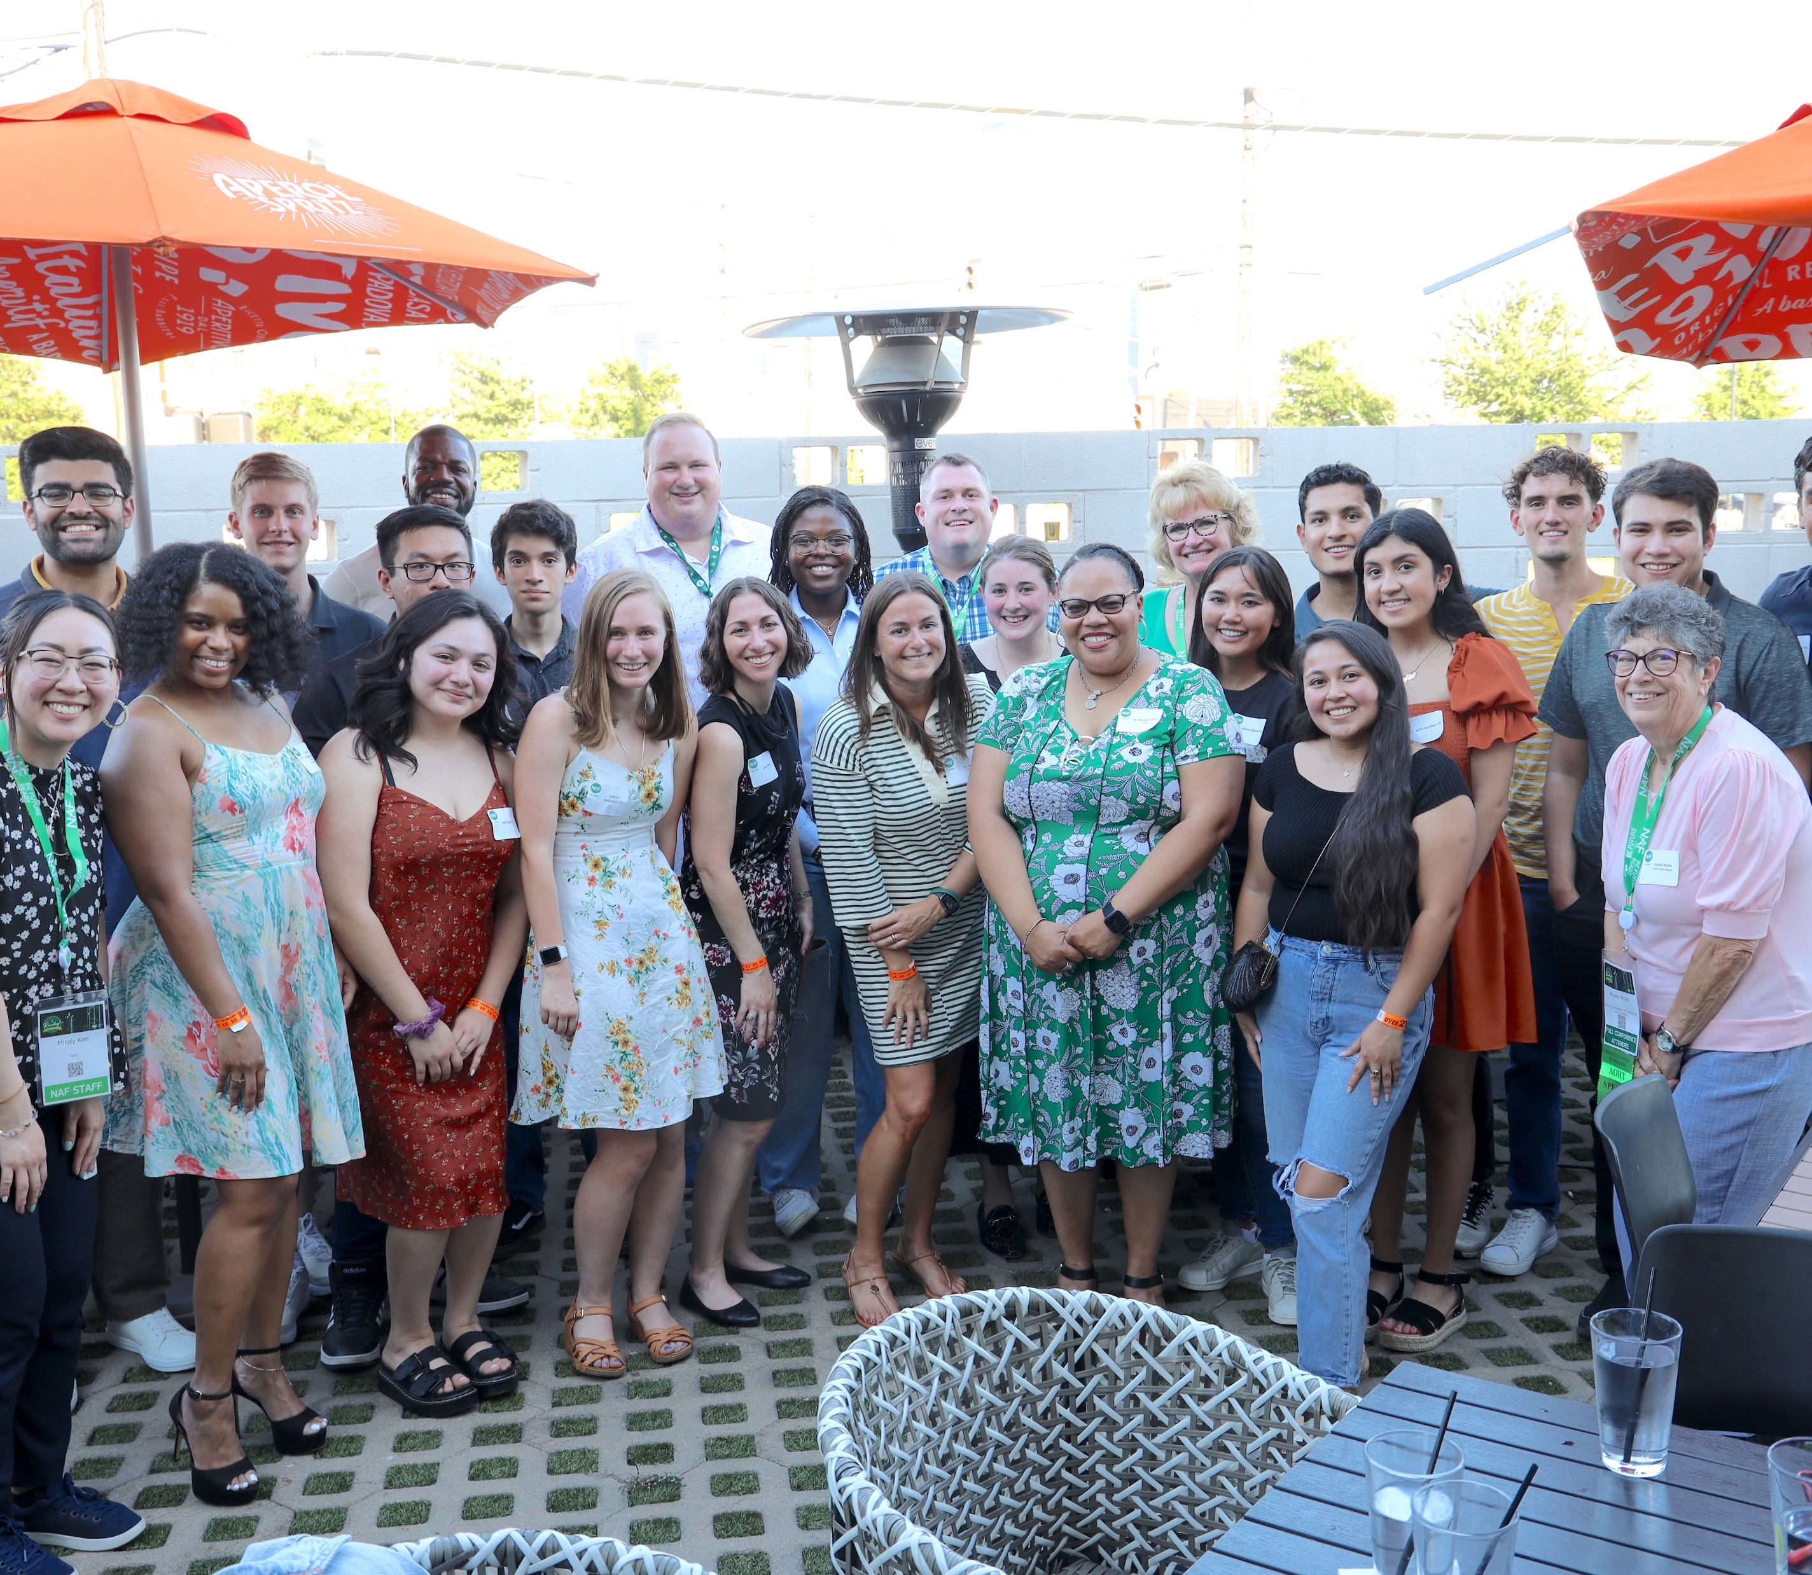
Why join the NAF Alumni Network?
Over 76,000 NAF alumni currently enjoy exclusive benefits including:
• Opportunities to attend/host In-person networking events and attend/speak at NAF national events.
• Access to the Alumni Opportunities Board (jobs/internships/scholarships) & the Alumni LinkedIn group.
• The ability to participate in mentoring opportunities such as our Alumni Mentorship Program and mentoring with corporate partners.
• Stories, resources, and opportunities in our monthly Alumni e-newsletters.
• Invitations to attend free virtual professional development sessions.

Slide 2
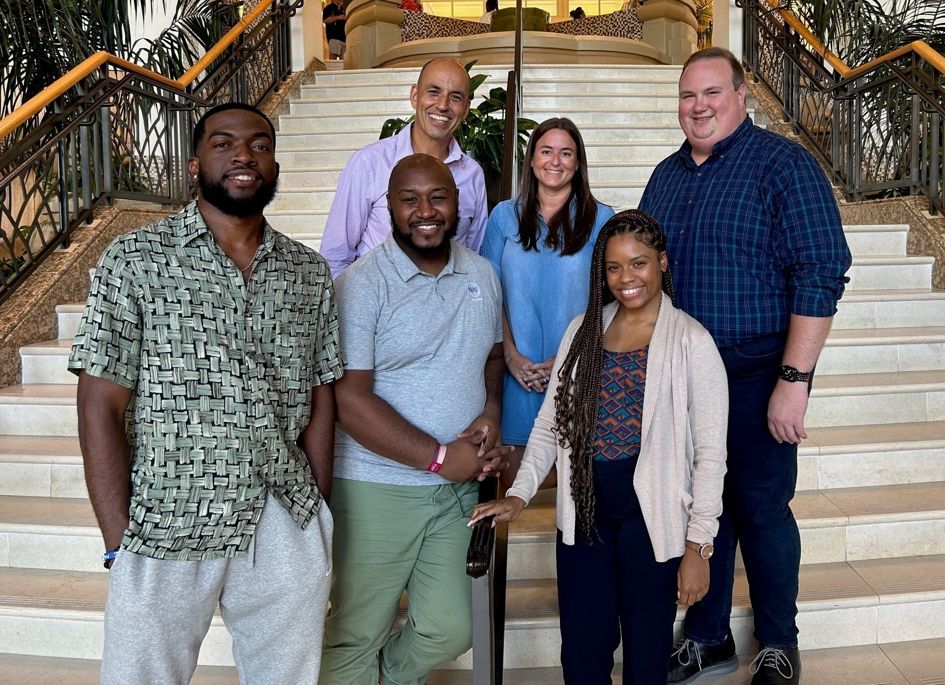
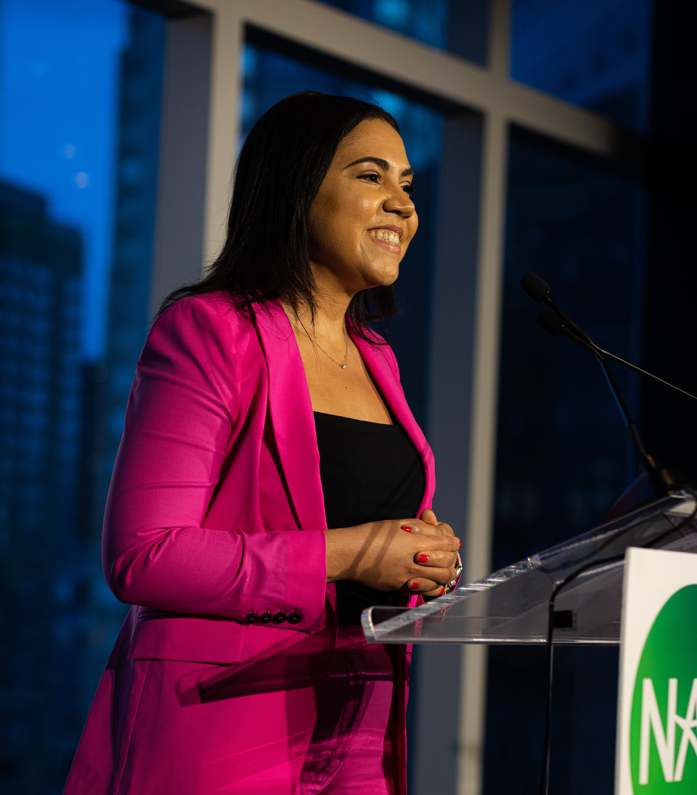
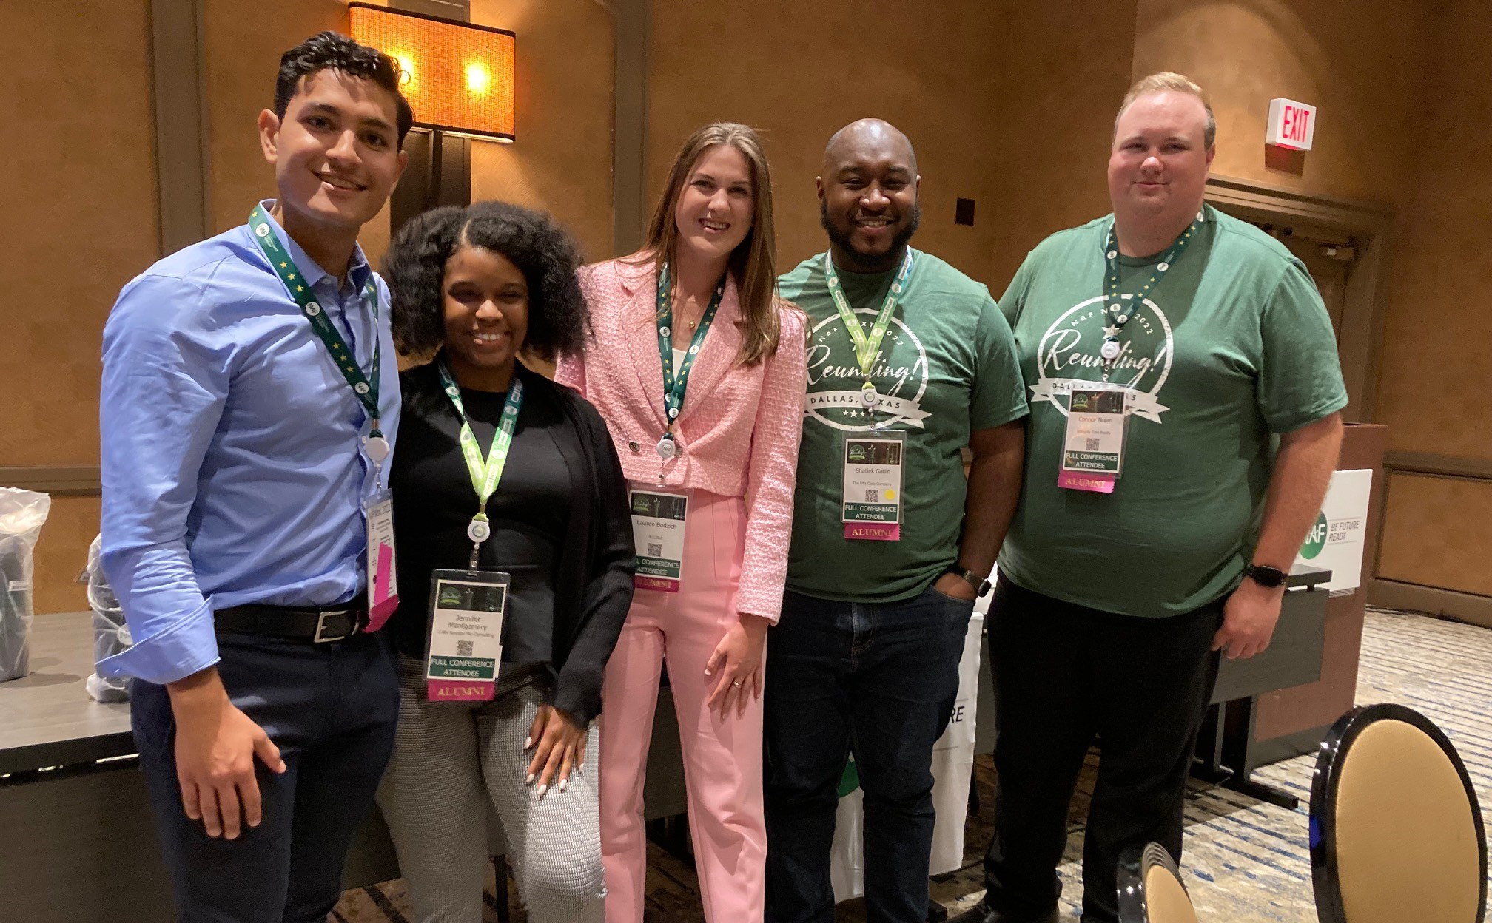
Alumni Leadership Council (ALC)
• Formed in 2014, the ALC is comprised of small group of alumni who hail from across the country.
• ALC members plan alumni events, speak at NAF National events, give back to their local academies, participate in pilots of NAF initiatives, and so much more.
• Council members have embraced NAF's public-private partnership model and the organization’s mission to empower high school students to achieve college and career success.
• The ALC currently has 13 active members and two subcommittees: Local Alumni Engagement and Alumni Industry Ambassadors
Notes:
The Alumni Leadership Council is comprised of NAF alumni of all ages who hail from around the country. Members are appointed based on involvement with, support of, and commitment to NAF students and alumni. Council members have embraced NAF's public-private partnership model and the organization’s mission to empower high school students to achieve college and career success.
ALC members plan and attend NAF alumni events, speak at NAF national events, serve as mentors, give back to their local academies, and much more.

Slide 3
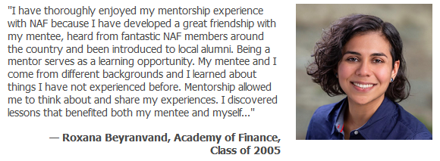
Alumni Mentorship Program
• Started in 2020, this is an exclusive program only open to NAF alumni.
• College-aged alumni are mentored by seasoned alumni professionals.
• Young alumni have a chance to learn professional skills and life lessons from alumni who once walked in their shoes.
• Seasoned alumni professionals have a chance to reconnect with NAF and make a difference in a young person’s life and career.

Slide 4
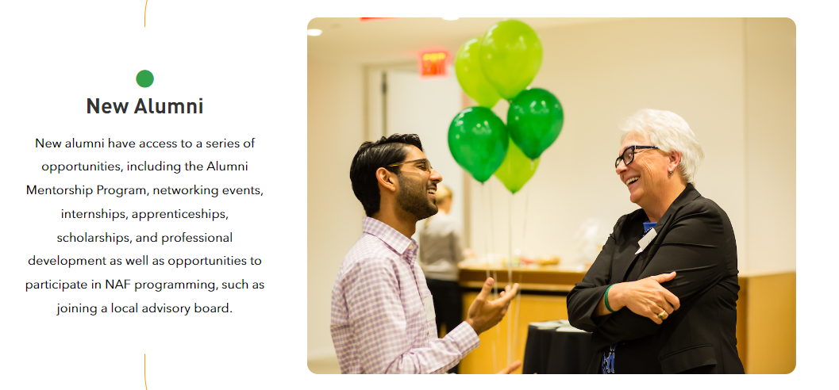
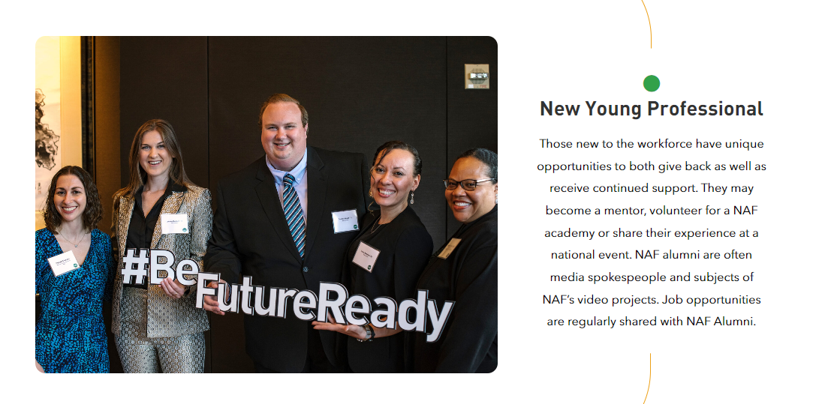
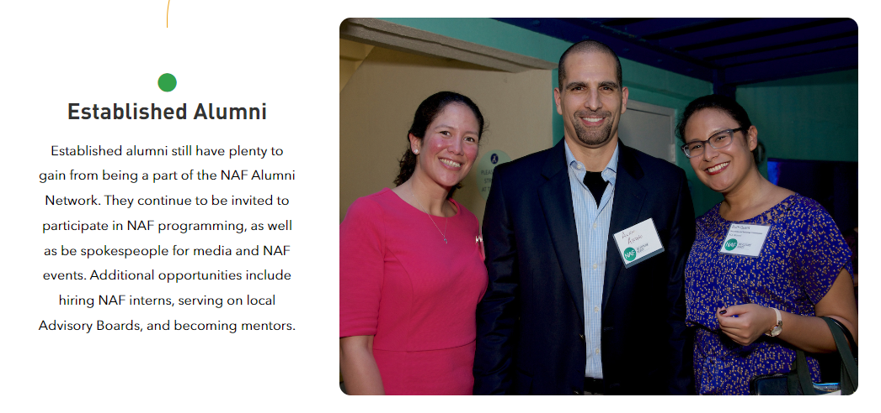
Get involved at any stage of your education or career!

Slide 5
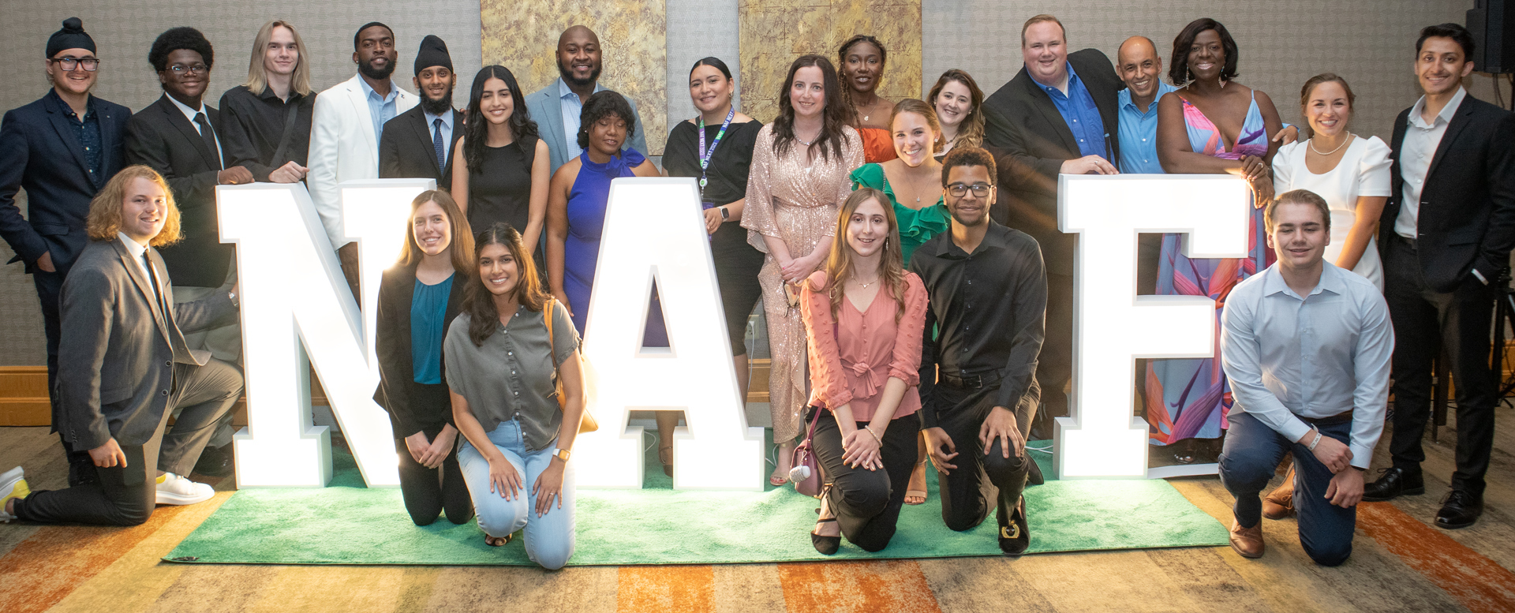
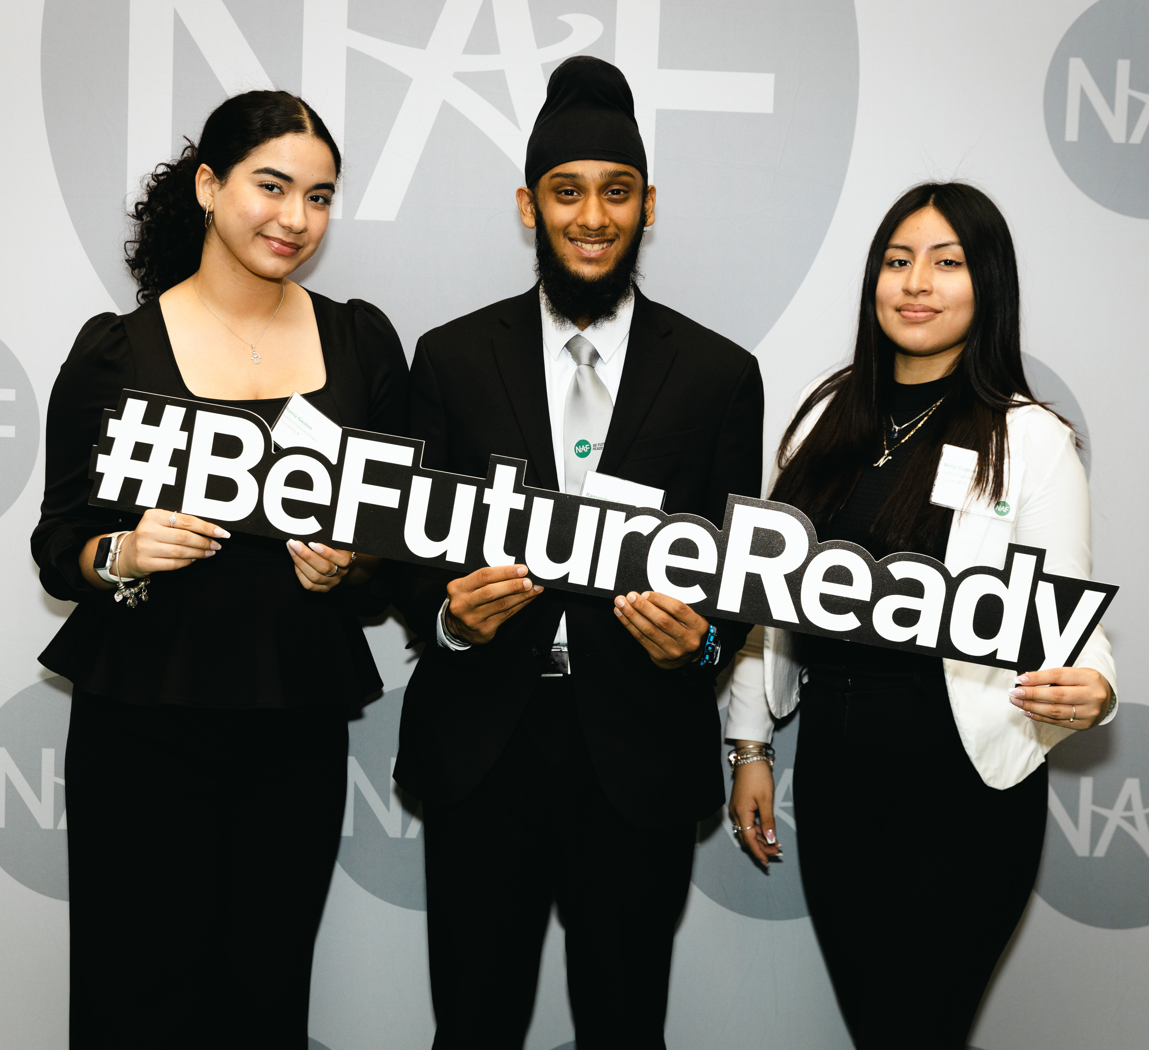
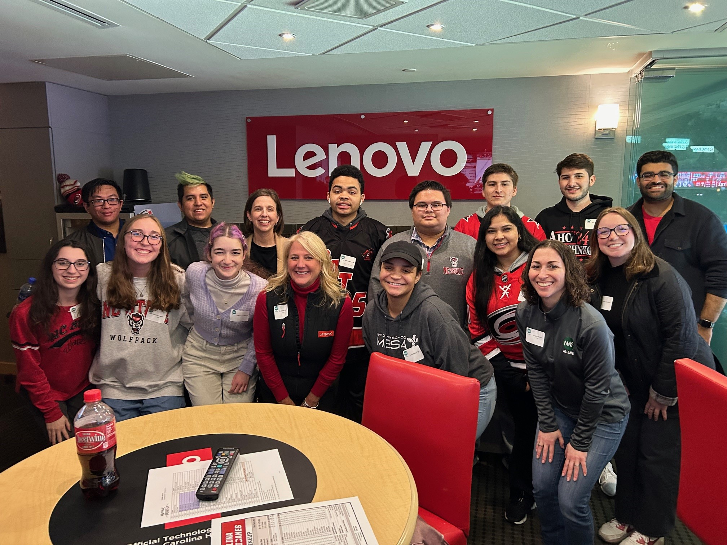
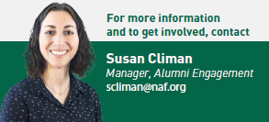
Get Involved!

