Slide 1
PROMPT ENGINEERING
SKILLS WORKSHOP
Notes:
Welcome! Today we’ll be exploring AI prompt engineering – what it is, how to use it, and why it’s an important skill to develop. Let’s jump in!

Slide 2
HOW TO USE THIS TEMPLATE
This skills workshop can be delivered by a partner or could be co-presented (educator & partner)
Skills workshops count as a Career Exploration activity
Slides you’re not using can be hidden or deleted
Each slide has speaker notes that can be customized and a facilitation guide
The length of the activities can be adjusted as needed

Slide 3
Speaker
Add photo
Name
Title
Company
Email (if you are comfortable listing it)
Notes:
Introduce yourself
Give a brief overview of your career
Talk about how/when you started using AI and how you use it in your job today

Slide 4
Topics for Today
How does AI work?
What is prompt engineering and how can you use it?
Why are AI skills important for careers?
How can you use AI to help develop ideas for potential careers of interest?
Notes:
During today’s workshop, we’ll be exploring multiple topics:
AI overview – How does AI work? What is prompt engineering and how can you use it?
We’ll then do an activity where you get to try out prompt engineering.
In the second half of the workshop, we’ll talk about why AI skills are important for your career and how you can use AI to generate ideas of potential careers you can pursue.
Finally, we’ll reflect on what we learned and think about next steps.

Slide 5
How many of you are
currently using AI?
Which one(s) are you using and how?
Notes:
Ask students questions to learn more about how they are currently using AI. You can change these questions depending on the situation. If you are delivering this workshop virtually, you can have students answer questions in the Chat.
Some additional potential questions:
How did you get started using AI?
What kinds of tasks have you used it for?
Have you only used it for school or do you use it in other ways?
How comfortable/confident do you feel using AI?
What do you know about AI and how do you feel about it?

Slide 6
What does the G stand for in AGI?
General
Generative
Giant
Generous
Notes:
You will see this acronym listed as AGI, GAI, or GenAI. There is actually more than 1 type of AI…let’s get into that!

Slide 7
Different types of AI
Generative - AI that “responds to a user’s prompt or request with generated original content, such as audio, images, software code, text or video.”
Predictive - “blends statistical analysis with machine learning algorithms to find data patterns and forecast future outcomes.”
Source: IBM
Notes:
The AI creating headlines for the past few years is generative AI but predictive AI has been around for a long time and we use it in a lot of different ways. You know when you’re texting and your phone recommends the rest of a sentence? That’s predictive AI. When you say, “Have a good…”, it uses its understanding of patterns and then forecasts potential next words. In this case, it might recommend, “weekend”. Today, we’re focusing on generative AI but it’s helpful to know predictive AI is another form of AI.

Slide 8
How many generative AI tools exist?
50
125
1,500
More than 10,000
Notes:
New AI tools are released all the time by both big companies and startups. The number of AI tools will continue to skyrocket since so many companies see this as a goldmine opportunity. Let’s look at some different databases of AI tools.

Slide 9

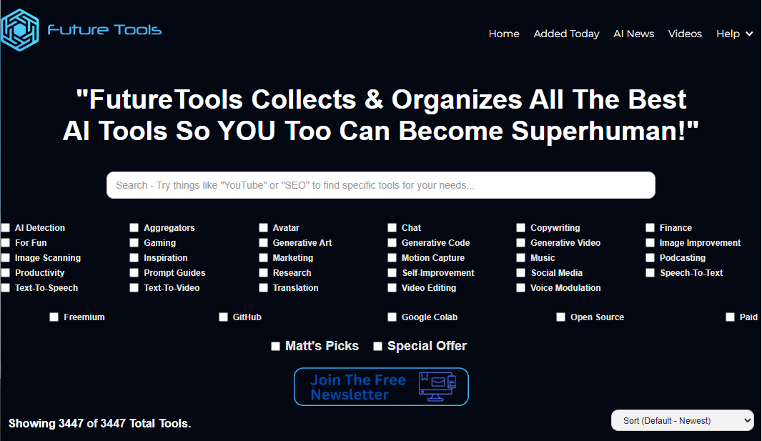
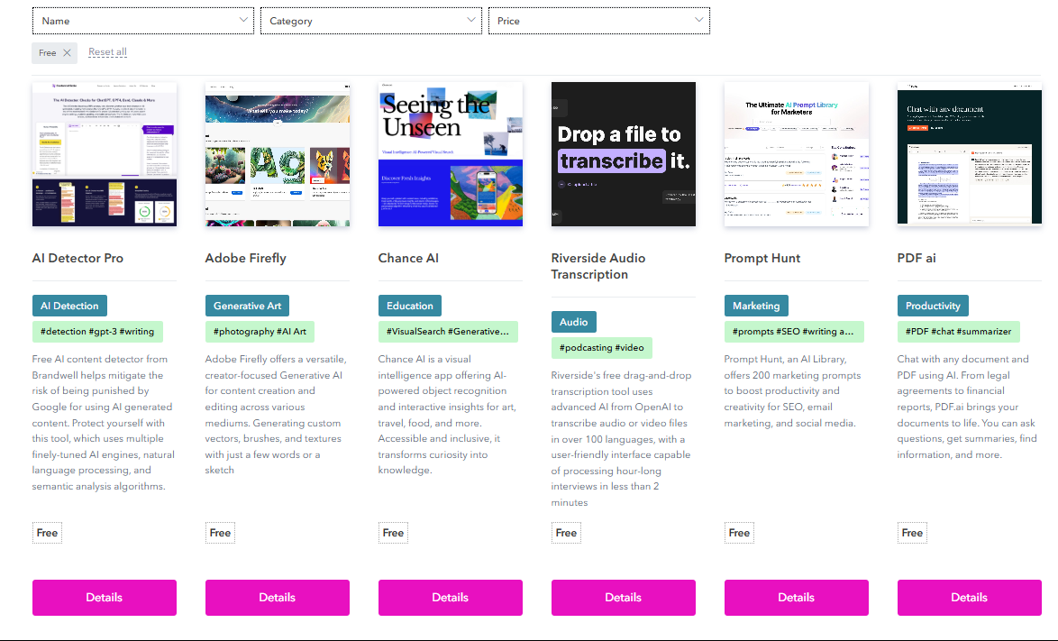
There are 10,000+ generative AI tools to try!
Notes:
AI Tools Directory and Future Tools are 2 helpful databases of AI tools. You can use the filters to find different options, including whether something is free or not.
https://www.futuretools.io/
https://aitoolsdirectory.com/
Exploring and playing around with different tools helps you build your AI skills.

Slide 10
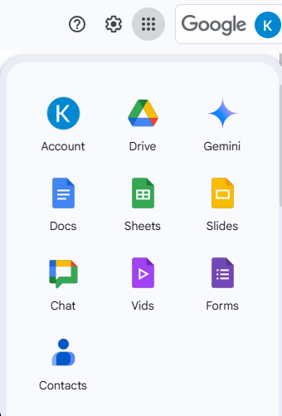
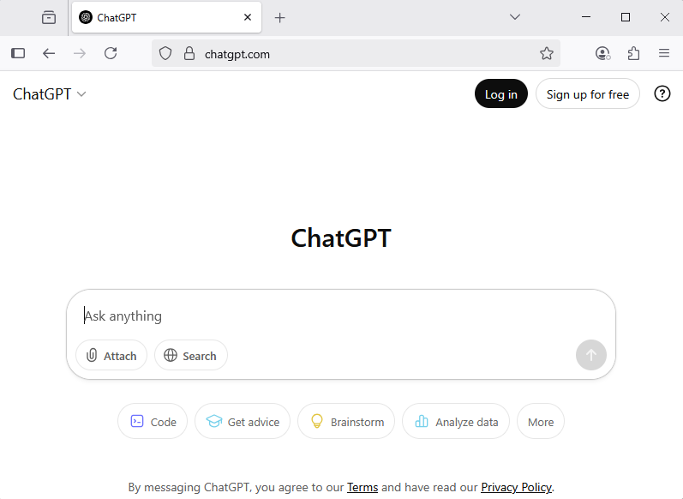
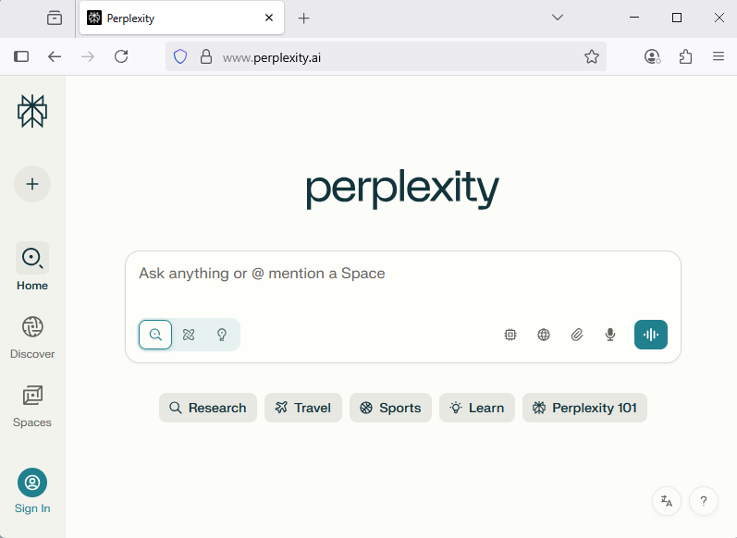
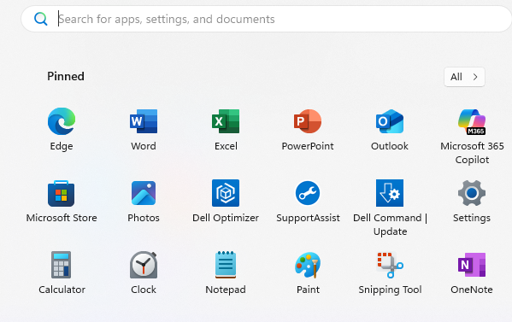
Accessing AI tools
Standalone systems with free and paid account options
AI tools built directly into
other systems
Notes:
There are a number of different AI tools available…over 10,000!
Some can handle multiple kinds of tasks while others are focused on one particular task (for example, editing sound).
The most common structures are standalone systems with free and paid account options and AI tools that are built directly into other systems.

Slide 11
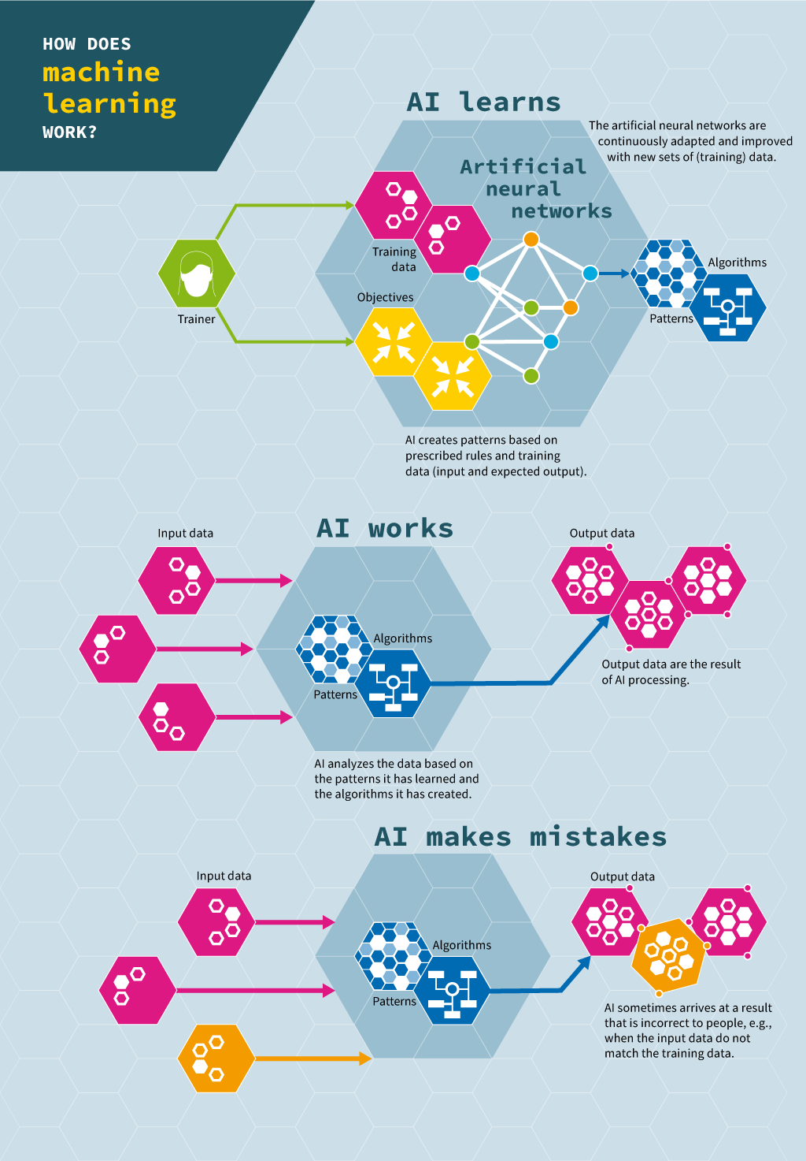

How does generative AI work?
Human trainer
Siemens Stiftung Media Portal for STEM Learning
Notes:
Walk students through the visual so they gain a better understanding of how AI learns and how AI works. Specific elements to point out:
A human trainer decides what to have AI learn on (how much information, what information, where it is, etc.)
AI continuously learns as it gains exposure to more information; it begins to develop pattern recognition
Once AI has learned and been tested, it is released more widely
The user inputs data (“prompt engineering”, then AI uses its knowledge to generate and produce something new
Outputs depend on many factors, including the prompt used, what that AI tool learned on, and other issues
The user can then refine the output by continuing to go back and forth with AI

Slide 12
What is prompt engineering?
“the process of refining what you ask a generative AI tool to do. Anyone can do this using natural language in generators like ChatGPT or DALL-E. It's also a technique AI engineers use when refining large language models (LLMs) with specific or recommended prompts.”
Enter a prompt
Refine the prompt based on what corrections or changes you want the AI to make
Definition: Coursera
Image: Siemens Stiftung Media Portal for STEM Learning
Notes:
A prompt is the term used for when you input data into an AI tool. Prompt engineering refers to the refining of this entry.

Slide 13
Creating effective prompts
Be specific.
“Act as if…”
Tell it how you want your output to be presented.
Use “do” and “don't”
Use examples.
Consider tone and audience.
Build on previous prompts.
Correct mistakes and give feedback.
Ask the AI to create prompts.
Source: Harvard University IT
Notes:
Prompt engineering is a skill you can continue to develop. These guidelines all help you create better, more effective prompts.
Tips below are from the Harvard article:
Be specific
Generic prompts like “Write a story” will produce generic results. What kind of story do you want? What genre? Is it for adults or children? How long should it be? Is it funny or serious? Adding this type of context and being specific, clear, and concise will help generate more useful outputs. More specificity can also limit the chances of inaccurate responses. If you’re looking for a good meal near Harvard Square, asking “What is the best restaurant in Cambridge?” could return results from Cambridge, UK. Asking “What is the best restaurant in Cambridge, Massachusetts, within walking distance of Harvard Yard” gives you a better chance of finding what you’re looking for.
“Act as if…”
Asking the AI to behave as if were a type of person, process, or object can be an easy way to start generating better prompts. The AI will attempt to emulate that role and tailor its answers accordingly. For example, imagine you wanted help creating a recipe based on ingredients you have in your kitchen. If you ask, “create a recipe using these ingredients,” followed by a list, you’ll get some general recipe suggestions. But if you added “act as if you are my personal trainer” first, the AI will consider this context in its response, perhaps suggesting a healthier recipe or a meal designed to refuel after a workout.
Tell it how you want your output to be presented
Generative AI can produce many different types of outputs, including code, stories, reports, summaries and synopses, dialogue, business communications, audio, images, and much more. Being specific about the type of output you want will produce better results. After describing what you want, try adding “Present this in the form of…” and your preferred output. Or start your prompt with, “Create a [format of output] about / that contains…” etc.
Use “do” and “don’t”
Telling AI what you do and don’t want in your response can save time and improve your result. To use the recipe example again, you can specify what foods you do want to include in your meal, and any that you specifically do not want, e.g. “Act as if you are my personal trainer. Create a recipe that will help me refuel after my workout. Do include tomatoes, chicken, and some type of carb. Don’t include chili peppers or any ingredients containing wheat.”
Use examples
Using an example of a sentence or paragraph that you’d like your output to resemble can give the AI a reference point to help improve results. However, it’s very important to not infringe on copyright. Don’t upload copyrighted works and ask the AI to rewrite / reproduce it or create a substantially similar work.
Consider tone and audience
Give the AI specifics about who your audience is and what sort of tone you’d like to set. For example, “Give me ideas for a best man’s speech that is funny and heartwarming but appropriate for a family audience” will generate better results than just “Write a best man’s speech”. Adding more specificity and context will further improve the output.
Build on previous prompts
You don’t have to get everything into your first prompt. Try starting with a basic question and adding to it over time. Change the wording or tone or add more context and specificity to guide the AI toward the output you’re looking for.
Correct mistakes and give feedback
Chat with the AI as if it’s a colleague or teammate and you’re working on a project together. Give feedback – tell it which parts of the output were useful and which parts could be improved. If you notice it got something wrong, tell it so it can correct its mistake.
Ask it to create your prompts or what else it needs from you
Stuck on how to create a good prompt? Ask AI to help by creating one for you! Start with a basic idea of what you want and ask the AI to expand on it for you, like “What should I ask you to help me write a blog post about AI?”. And simply adding “Tell me what else you need to do this” at the end of any prompt can fill in any gaps that will help the AI produce better outputs.

Slide 14
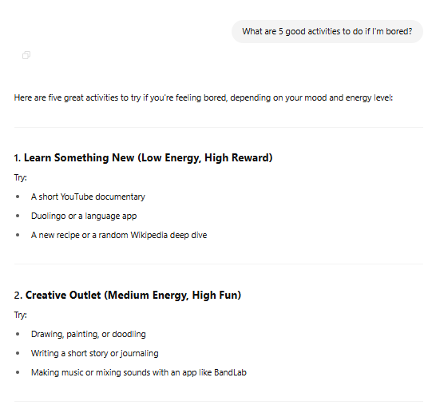
Prompts are a two-way exchange
Think of it like having a conversation with AI.
You should write your prompts in a way that mimics everyday speech. That way, AI tools can better understand what you’re asking for.
Source: Atlassian
Notes:
You may not get the output you’re envisioning on the first try. That’s ok! Continue going back and forth with the AI tool to refine the output so that it better reflects what you wanted it to generate.

Slide 15
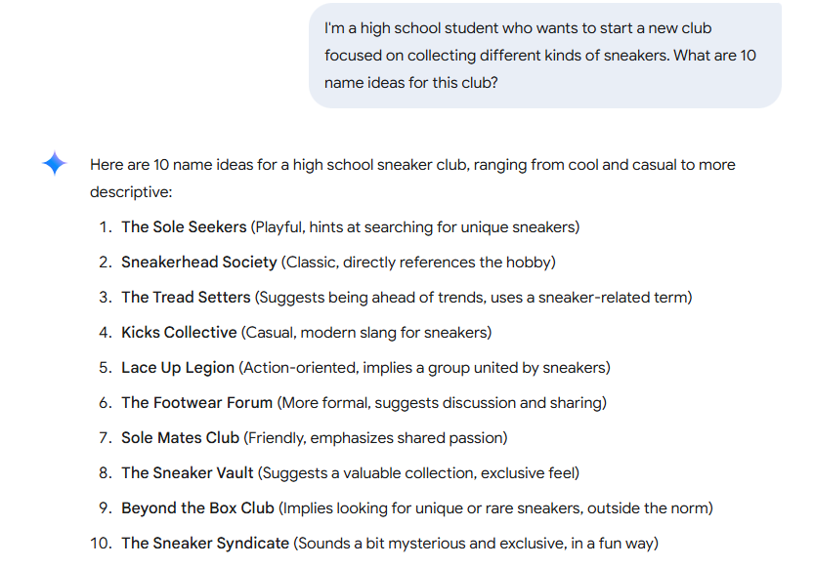
Text-generating AI example
AI used: Gemini
Notes:
This example uses Gemini, Google’s AI tool. Let’s look at some of the elements in this prompt. The user specified a little about who they are (in high school), what their goal is (starting a sneaker collecting club), and asked for a specific number of ideas in the output. Gemini then created those 10 ideas, giving some background on each one. This user could then choose a few to have Gemini expand on or they could decide they don’t like any of these and give Gemini more guidance on what they want.

Slide 16
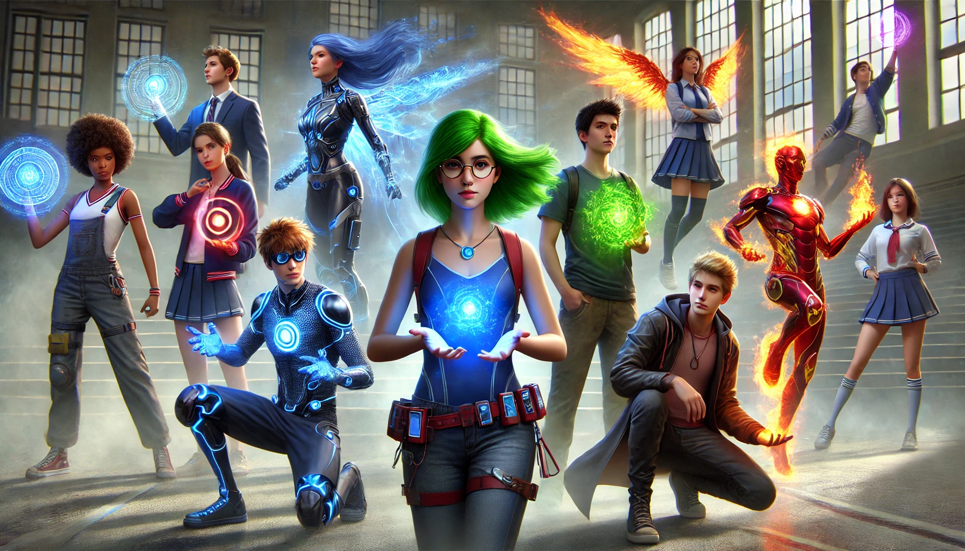
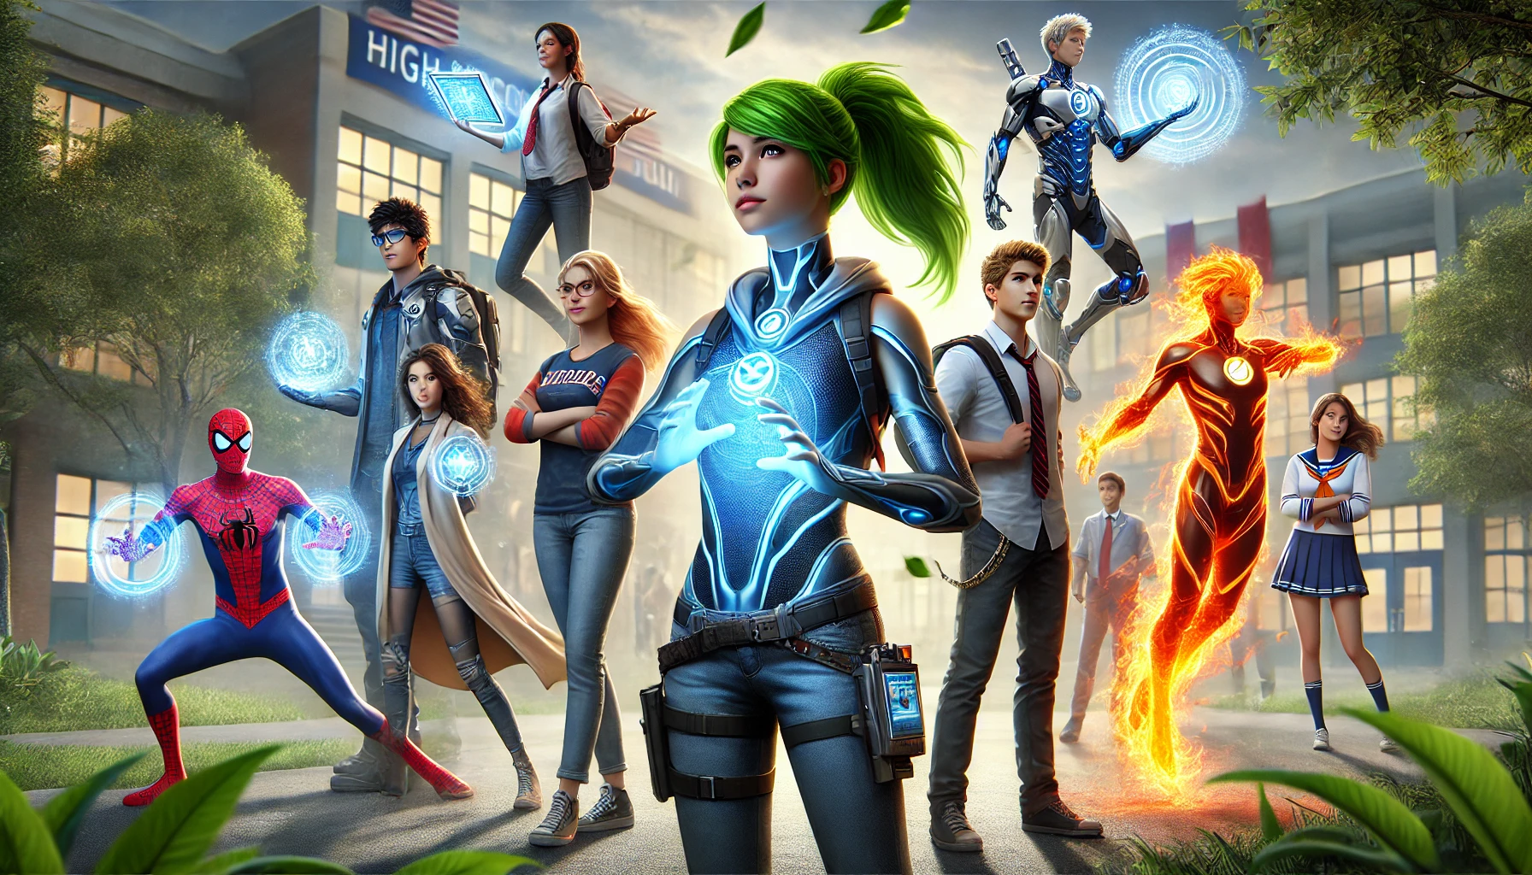
Image-generating AI
Prompt: Diverse high school students as different superheroes in a realistic image style.
ChatGPT response: Here are the images of the diverse high school students portrayed as superheroes in a realistic style. Each one showcases their unique powers and abilities, set against a high school campus backdrop. Let me know if you'd like any modifications or additional details!
Notes:
This example uses the image generation tool within ChatGPT. The user entered a prompt that including both the subjects they wanted depicted in the image as well as the kind of style. ChatGPT generated 2 initial options.

Slide 17

Image-generating AI
Response: Great! For the first image, can you have all the students be in business casual clothing and not have any wearing short skirts?
ChatGPT response: Here's the updated image with all the students in business casual clothing, displaying their superhero abilities in a more subtle way. Let me know if you'd like any further adjustments!
Notes:
The user decided they wanted the students to be in business casual clothing so they asked ChatGPT to make some changes based on the 1st of the 2 image ideas.

Slide 18




AI Head-to-Head
Prompt: Create a fierce dragon mascot image for a high school.
Co-Pilot (Microsoft)
Imagen (Gemini - Google)
ChatGPT (OpenAI)
Notes:
Depending on what they were trained on and how they learned, different AI tools can yield very different results even when given the exact same prompt.

Slide 19
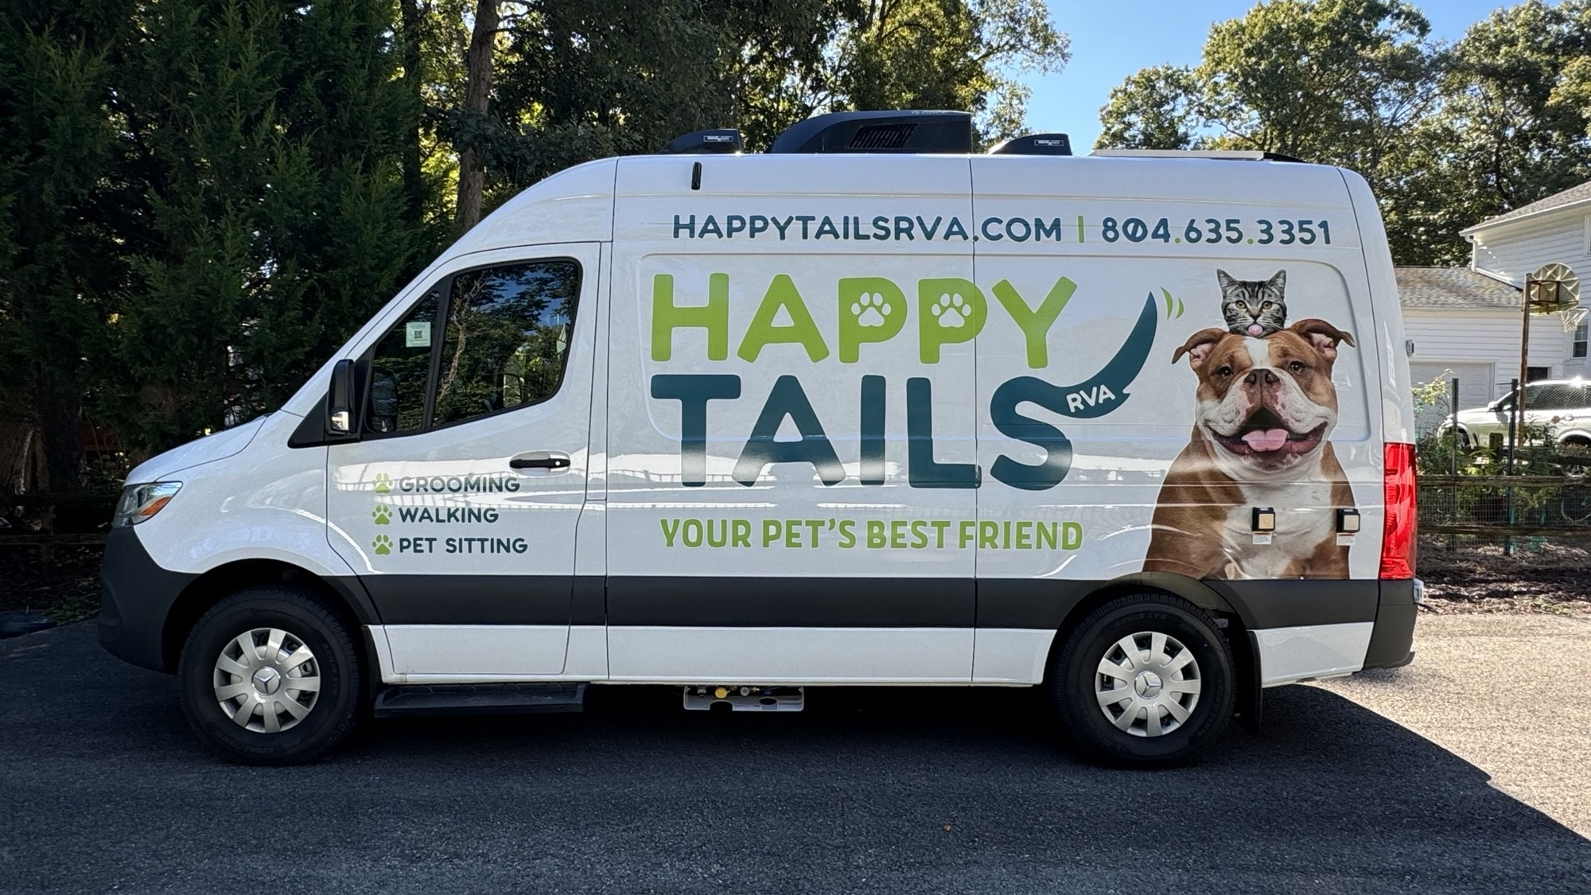

Prompt Engineering: Let’s try it!
Open a new browser tab and go to one of the following:
  https://gemini.google.com/app
  https://chatgpt.com/
  https://copilot.microsoft.com/
Choose one of the following projects:
  Creating a mobile-based business
  Planning a fundraiser for a charity
Using AI prompts, brainstorm and refine the business or event theme and create a logo for it.
What do you think about what the AI tool generated?
Notes:
Give students about 5-10 minutes for this activity.
Get them set up so they have an AI tool they are using and give them instructions about using that tool to brainstorm ideas based on one of the categories above. Once students have completed the activity, bring them back together and debrief on their experience.

Slide 20
Why Prompt Engineering & Other AI Skills Matter in Careers
Notes:
Now that you have tried prompt engineering, let’s talk about why it is an important skill for you to develop and use in the workplace.

Slide 21
What percentage of business leaders are more likely to hire a less experienced candidate with AI skills than a more experienced one without them?
20%
57%
71%
95%
Notes:
The correct answer is C – 71%. This shows how much employers care about AI skills and now evaluate job applicants with that in mind.

Slide 22
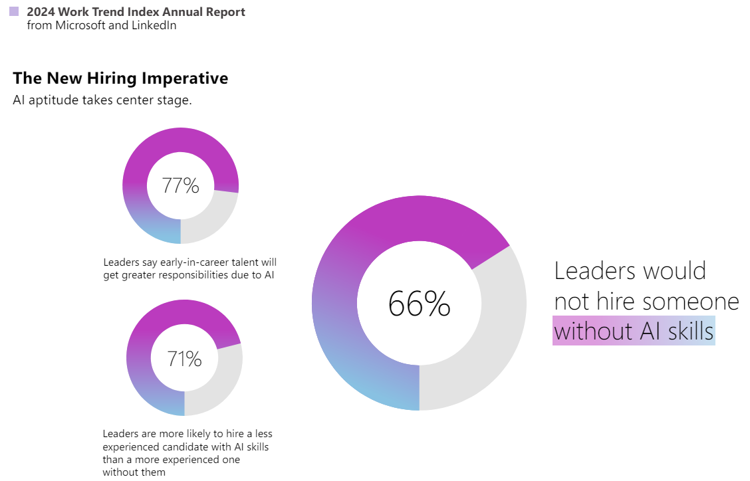

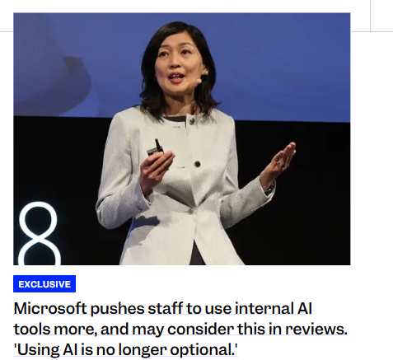
Employers value AI skills
Notes:
Employers now expect new hires to have AI skills that they can apply in their jobs. Questions about how you use AI might be asked during job interviews. The data on this slide really drives that point home and these numbers are even higher now. One key data point here is the fact that 71% of leaders are more likely to hire a less experienced candidate with AI skills than a more experienced one without them. This means that if you can show you have AI skills, you can be a stronger candidate.

Slide 23




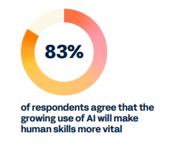

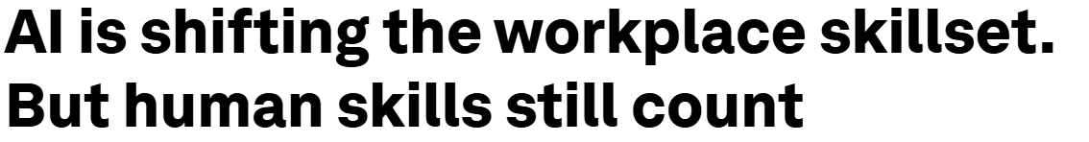
…but employers also still value human skills
Notes:
Employers still want their staff members to have strong communication, problem-solving, collaboration, and other skills. These are becoming even more important as more work incorporates AI elements. These are the exact kinds of skills you are developing in your NAF academy! ☺

Slide 24









You’re developing Future Ready Skills in your NAF academy!
ASPIRATIONS
COLLABORATION
COMMUNICATION
PROBLEM
SOLVING
SKILLS
CONNECTIONS
INITIATIVE &
SELF-DIRECTION
SOCIAL
AWARENESS
PLANNING FOR
SUCCESS
Notes:
The good news is that through your NAF academy coursework and WBL activities, you are actively developing the Future Ready Skills employers are looking for. Adding in the AI skills will help you become a more competitive applicant for jobs and other post-graduate opportunities.

Slide 25
Ways to use AI for career development
ASPIRATIONS
SKILLS
CONNECTIONS
List your activities and interests and ask AI to recommend related careers.
Ask what careers are predicted to grow the fastest in the next 10 years and which ones overlap with your interests.
List some dream companies you would want to work for and ask AI the kinds of job titles available there based on your interests.
List careers you are interested in and ask what the top skills are that you need.
Take the LinkedIn profiles of a few people and paste them in; ask what skills they have in common.
For a career you are interested, ask for a list of local companies, professional associations, and people in that field.
Ask AI to draft of a message to an industry professional requesting a conversation.
Notes:
AI can be a helpful tool in each step of the process of identifying careers of interest, developing your skills, and building professional connections. These are just a few suggestions of the kinds of prompts you could enter in each of these areas.

Slide 26
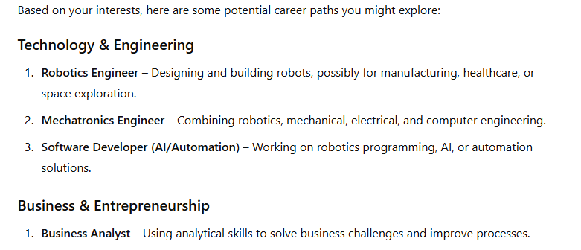
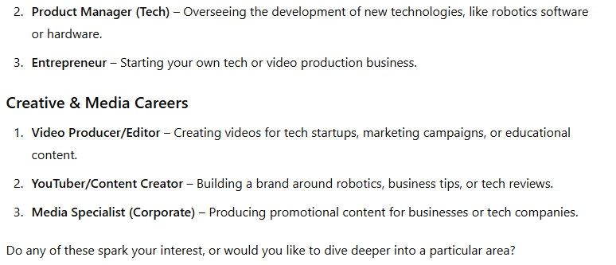
Career Aspirations example
Initial prompt: I am a high school student involved in the robotics club, Future Business Leaders of America, and I like creating videos. What are some careers that I can consider based on these interests?
ChatGPT response:
Notes:
In this example, the user is asking AI to generate some career ideas for them to explore. They listed some of their interests to give a sense of what they might be interested in. ChatGPT generated 9 career ideas based on this information.

Slide 27
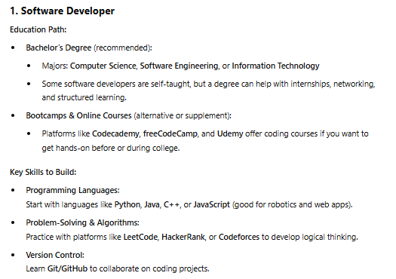
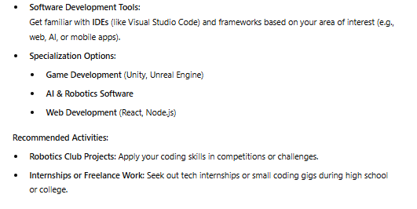
Career Aspirations example
Response: Software developer and video producer/editor both sound interesting! Can you tell me what education and skills I need for those careers?
ChatGPT response:
Great choices! Let’s break down what education and skills you’d need for software development and video production/editing to help you start preparing.
Notes:
After ChatGPT’s initial suggestions, the user identified 2 that they wanted to learn more about. They asked ChatGPT to list the education and skills needed for those careers. ChatGPT did that and listed some recommended activities.

Slide 28
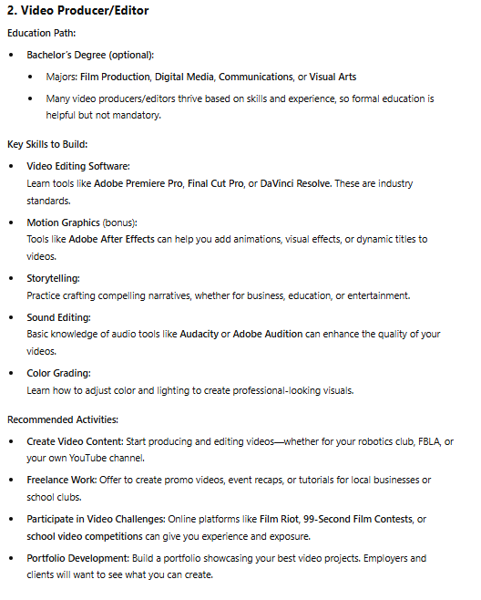
Career Aspirations example
ChatGPT response (cont.):
Do either of these paths sound like something you'd want to start preparing for now? I can suggest specific beginner projects or resources if you'd like!
Notes:
This is the second part of ChatGPT’s response to the prompt of listing information about the education and skills needed to become a video producer/editor. The user could then follow up with additional prompts to continue diving deeper into this topic.

Slide 29
Prompt Engineering for Career Development: Let’s try it!
Open a new browser tab and go to one of the following:
  https://gemini.google.com/app
  https://chatgpt.com/
  https://copilot.microsoft.com/
Use prompts to have the AI tool generate careers of interest, including the education & skills needed.
What do you think about what the AI tool generated?
Notes:
Give students about 5-10 minutes for this activity.
Get them set up so they have an AI tool they are using and give them instructions about using that tool to brainstorm ideas based on one of the categories above. Once students have completed the activity, bring them back together and debrief on their experience.

Slide 30



3 Takeaways
Employers are looking to hire people with AI skills, like prompt engineering
Experiment with AI tools
Learn more about AI
Notes:
Companies are using AI in a lot of ways, including the hiring process, and are looking for people who have AI skills like prompt engineering.
The best way to build these skills is to experiment! In the next month, try one or more of the techniques we covered today.
There are a lot of great free resources and courses you can do to learn more about AI. You can even earn certifications!

Slide 31
Q&A
What’s one new thing that
you learned today?
Notes:
Encourage students to reflect on the activities and the other information covered in the workshop. What is something new they learned? What surprised them most about what they experienced? What are they going to do next?

Slide 32
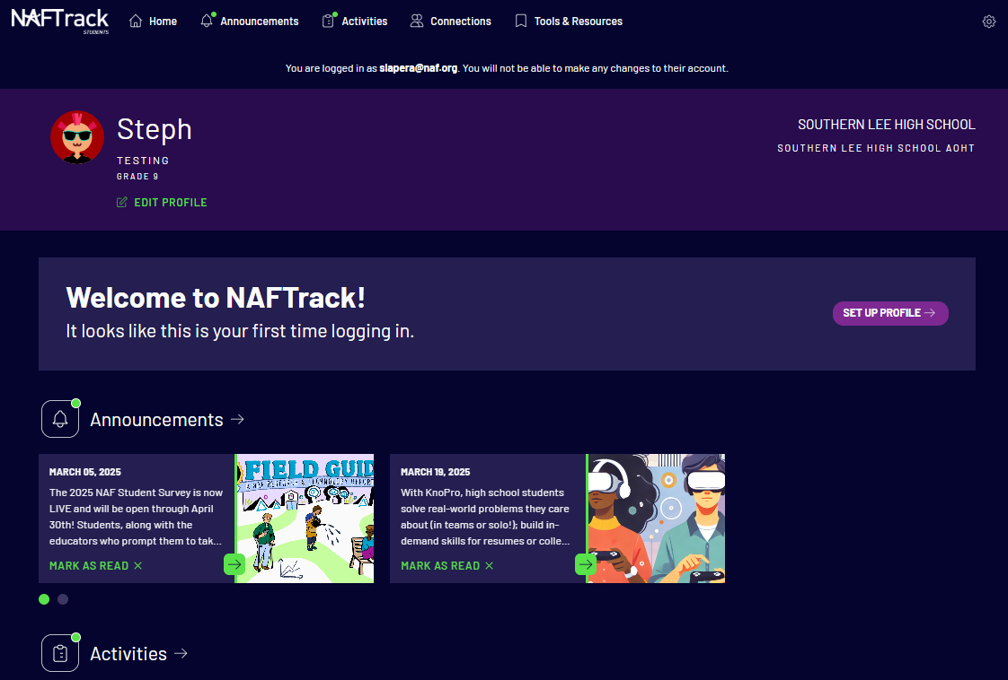
Complete your WBL Reflection Form!
Go to students.naftrack.org
Look for the WBL Reflection Form for the AI Prompt Engineering Skills Workshop in the Activities section
Complete the form
If it’s not visible, wait until tomorrow and complete it then

