Slide 1
How Can a Simulated Work Environment in Robotics Help Students Achieve Relevancy, Engagement, and Career Awareness

Slide 2

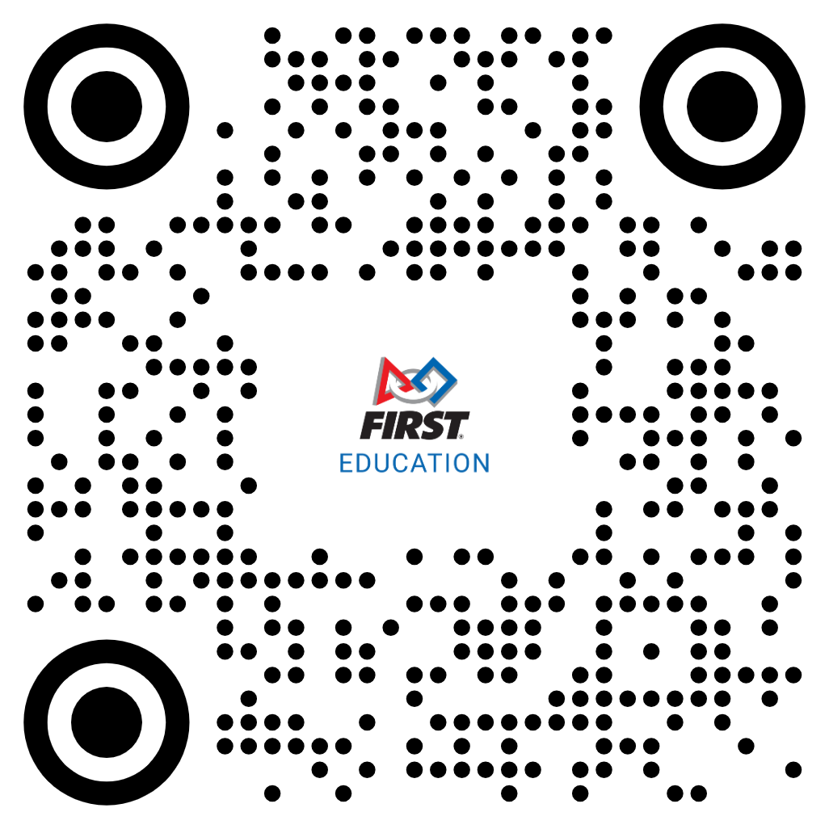
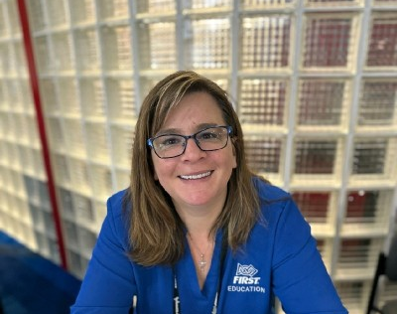
Welcome
Lori Birch
Sr Education and Workforce Development Specialist
Bachelors Southern IL University in Carbondale- Agriculture Education
2006 Became FIRST Robotics Competition Coach – Kremmling, Colorado
Taught Agriculture, Science, and STEM in rural Colorado for 15 years
Joint FIRST as an employee in 2019

Slide 3

You want to promote STEM education through robotics.
How can you ensure the program will help fill the ever-changing workforce needs?
Notes:
Divide room into groups at corners of the room

Slide 4
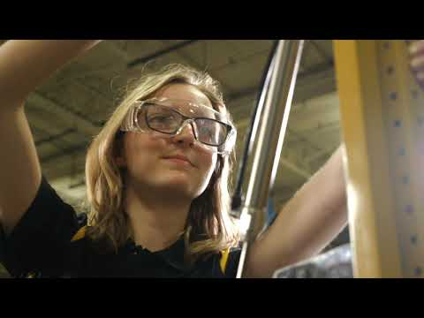

Slide 5
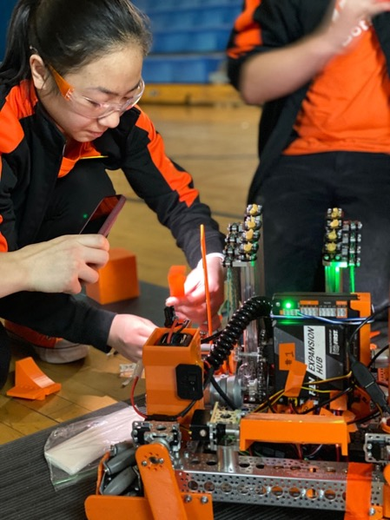
FIRST is a robotics community preparing young people for the future
Together with our sponsors, partners, mentors, and volunteers, we’re able to accomplish great things:
Building your future workforce
  Thrilling, team-based robotics competitions equip students with STEM workforce skills and instill a sense of accomplishment and self-confidence
Building a community of global citizens
  An inclusive community and powerful mentorship relationships empower young people to think big and feel hopeful for their future
Building a better future
  Together with our sponsors, partners, mentors, and volunteers, we inspire young people to channel their raw curiosity to think critically and seek ways to improve the world around them

Slide 6
Awards Based on Core Values
Check Award Descriptions here.
Teams spend a significant amount of time designing, building, programming their robot, and learning what it takes to be part of a team. For many teams, competitions are the reward for all their hard work throughout the season. However, FIRST Tech Challenge is more than a robot competition; in addition to robot matches, teams are also eligible to win judged awards. The judged awards represent a positive way to recognize teams who embody important values like Gracious Professionalism, teamwork, creativity, innovation, and the value of the engineering design process.
Control
Think
Inspire
Innovate
Connect
Design
Motivate
Impact in their community
Utilization of Design Tools
Discovery through STEM professionals
Creativity and Innovation
Programming
Engineering documentation showing how problems solved
Top award, best demonstrates skills in each award category.
CAD
Teamwork
STEM Outreach
Engineering Design
Computational Thinking
Business Development
Discovery
Innovation
Impact
Inclusion
Teamwork
Fun
6

Slide 7
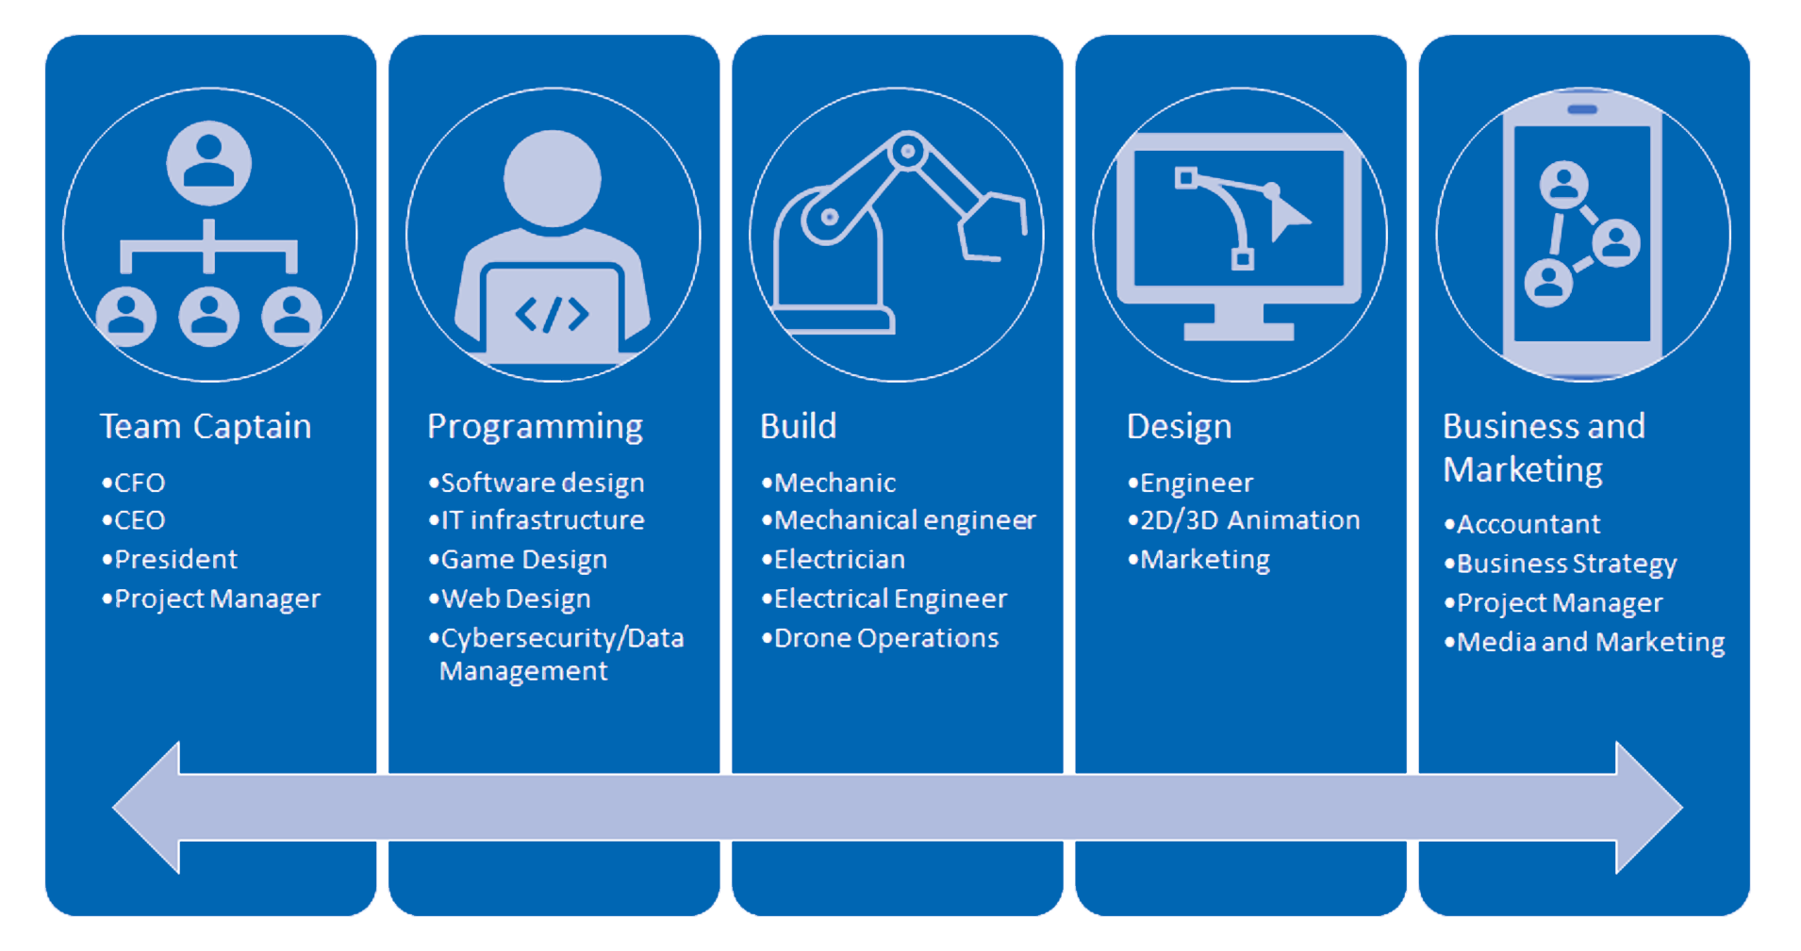
Simulated Job Roles on a FIRST Team
Notes:
What departments will the business need to be successful?

Slide 8
Discussion Questions
How might accomplishing a task in this job role affect the team as a whole?
What technical skills might the job require?
What holistic or soft skills might the job require?

Slide 9
Holistic Skills | PK-8 | 7-12 | 9-12
Communication | ● | ● | ●
Collaboration | ● | ● | ●
Critical Thinking | ● | ● | ●
Creativity | ● | ● | ●
Discovery | ● | ● | ●
Reasoning | ● | ● | ●
Problem Solving | ● | ● | ●
Conflict Resolution | ● | ● | ●
Time Management | ● | ● | ●
Risk Taking | ● | ● | ●
Ideation | ● | ● | ●
Exploration of Information | ● | ● | ●
Teamwork | ● | ● | ●
Effective Listening | ● | ● | ●
Technical Skills | PK-8 | 7-12 | 9-12
Simple Machines | ● | ● | ●
Software Coding | ● | ● | ●
Sensors | ● | ● | ●
Software Engineering | ○ | ● | ●
Rapid Prototyping | ○ | ● | ●
Drive Systems | ○ | ● | ●
Mechanical Assembly | ○ | ● | ●
Computer-Aided Design | ○ | ● | ●
Advanced Algorithms |  | ● | ●
Machine Vision |  | ● | ●
Machine Learning |  | ● | ●
Additive Manufacturing |  | ● | ●
Power Systems |  | ○ | ●
Advanced Fabrication |  | ○ | ●
● Pervasive throughout program
○ Emerging
Notes:
The experience of FIRST not only helps light the spark of STEM interest, but directly develop both holistic and technical skills. Whether from, Software engineering to computer aided design, additive manufacturing to machine learning, or teamwork to critical thinking, FIRST programs create a rich environment that exercises and nourishes the skills we desperately need in our workforce.

Slide 10
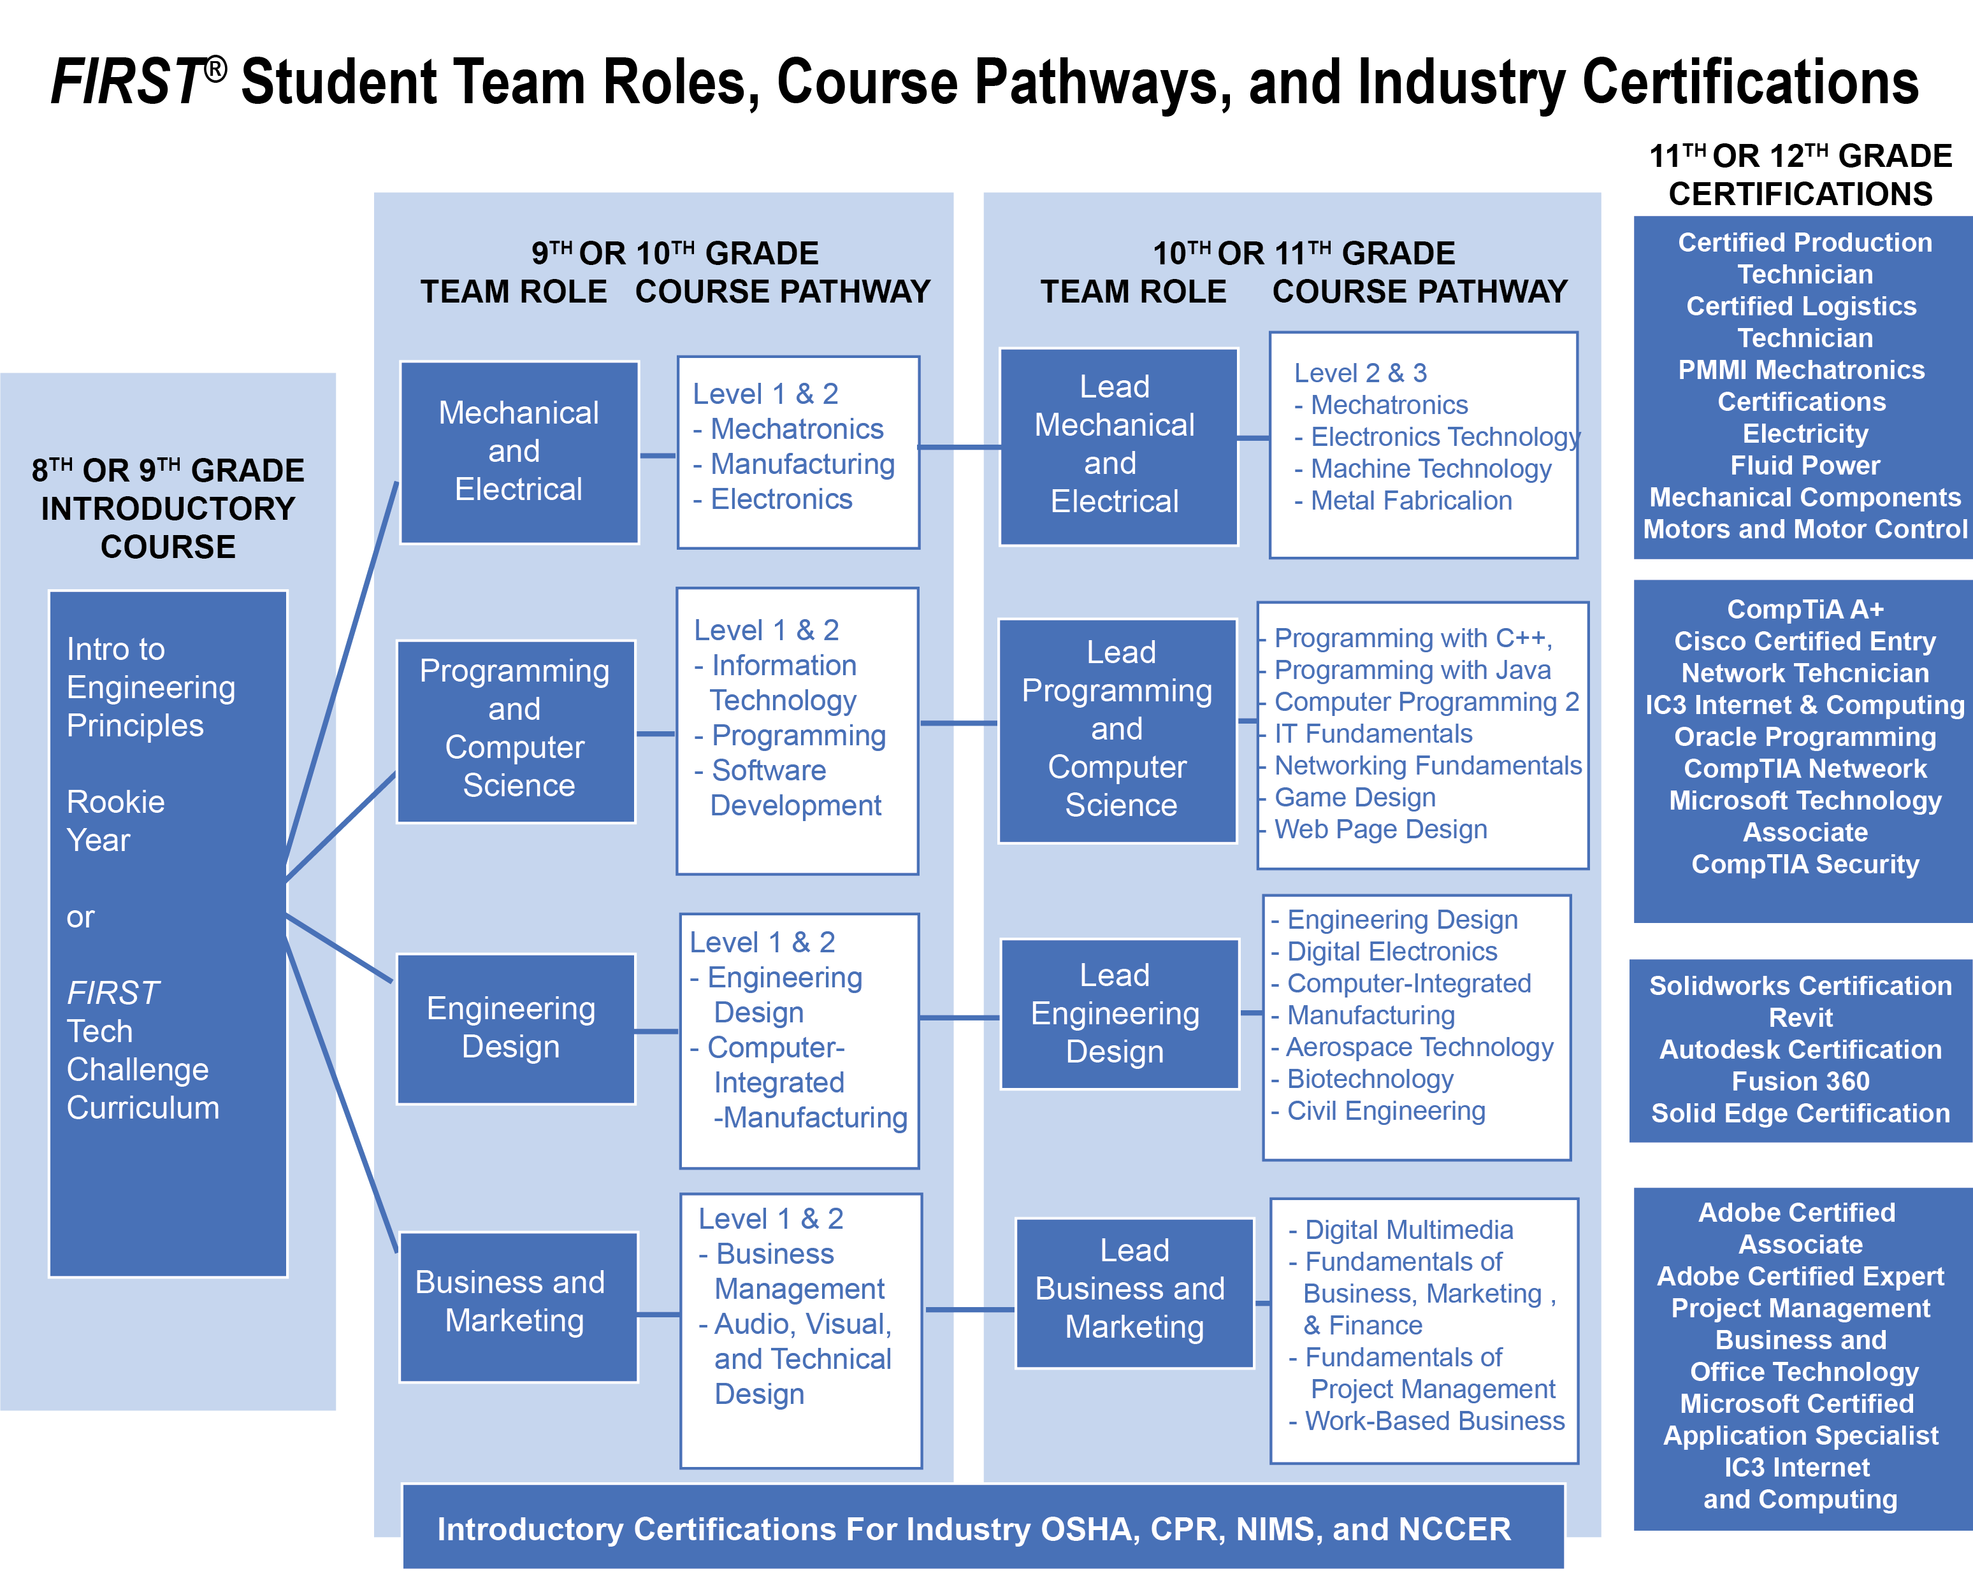
How do I integrate FIRST and these skills into the academy model?

Slide 11
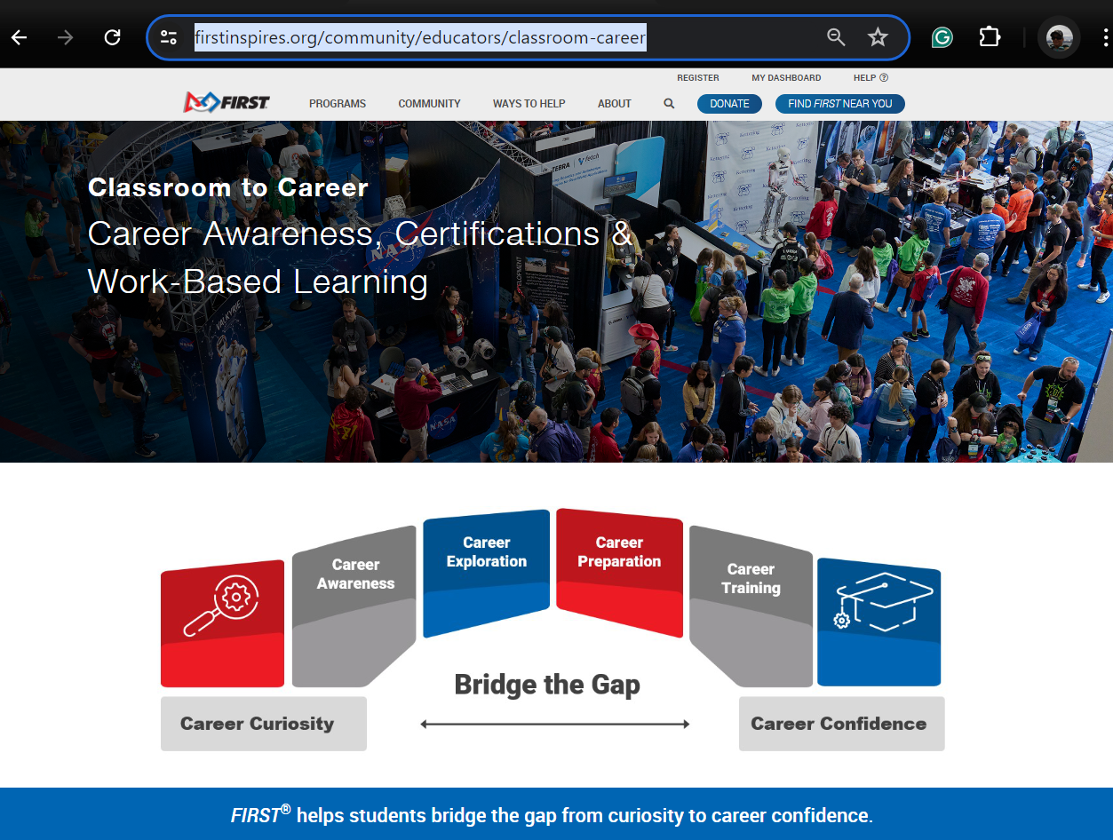
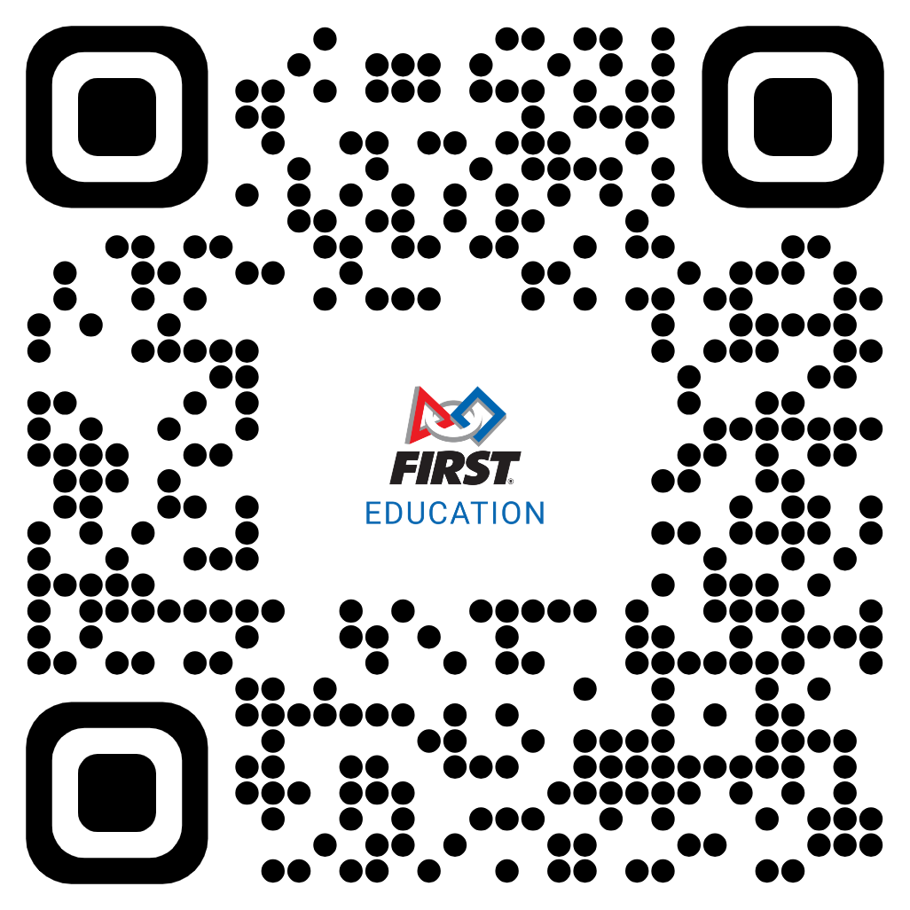
www.firstinspires.org/community/educators/classroom-career

Slide 12
Tasks for the site
Explore through the site:
  Take a look at the Industry Certification offered by our sponsors and the links to connecting FIRST to the sponsor.
  Explore the Career and Technical Education Page
    Note CTSO status is something that FIRST is developing strategies to achieve
    There are sample courses teachers can use at each level
    Work-Based Learning Tookits are available to explore.

Slide 13
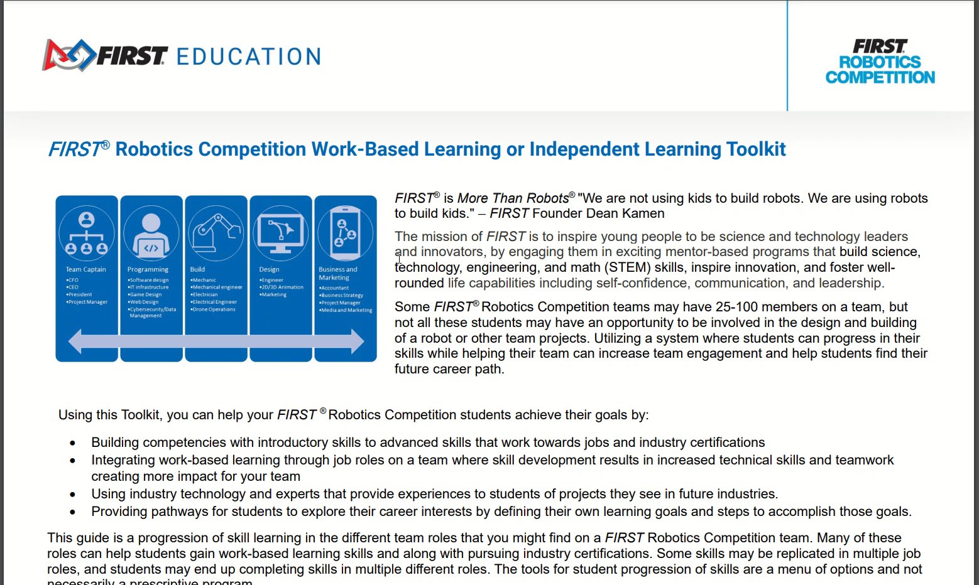

Slide 14
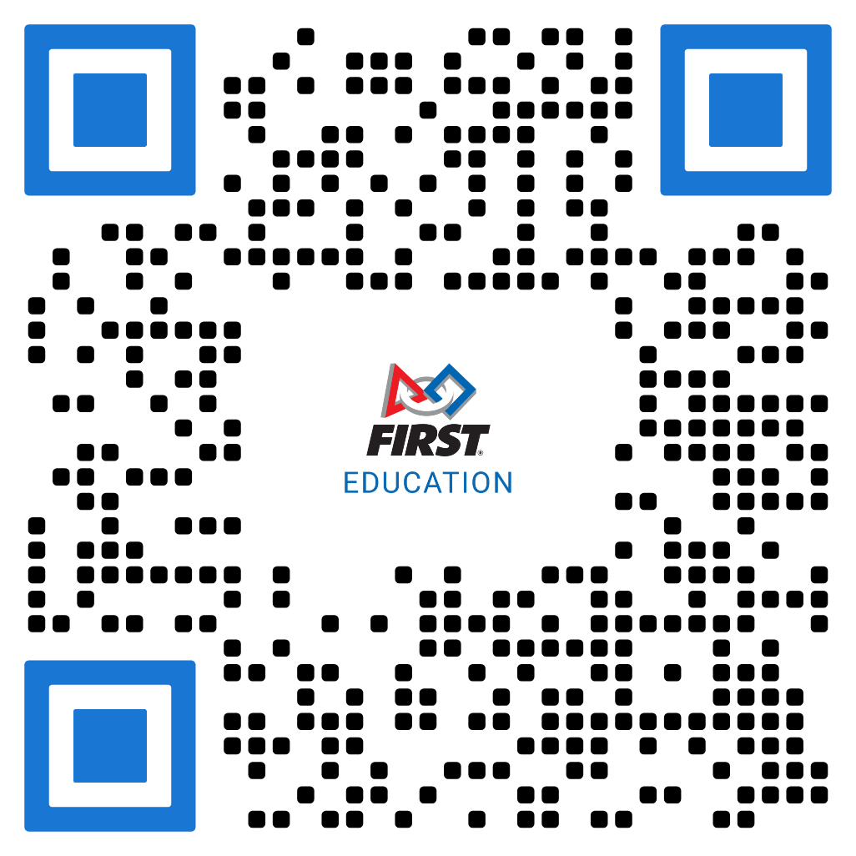
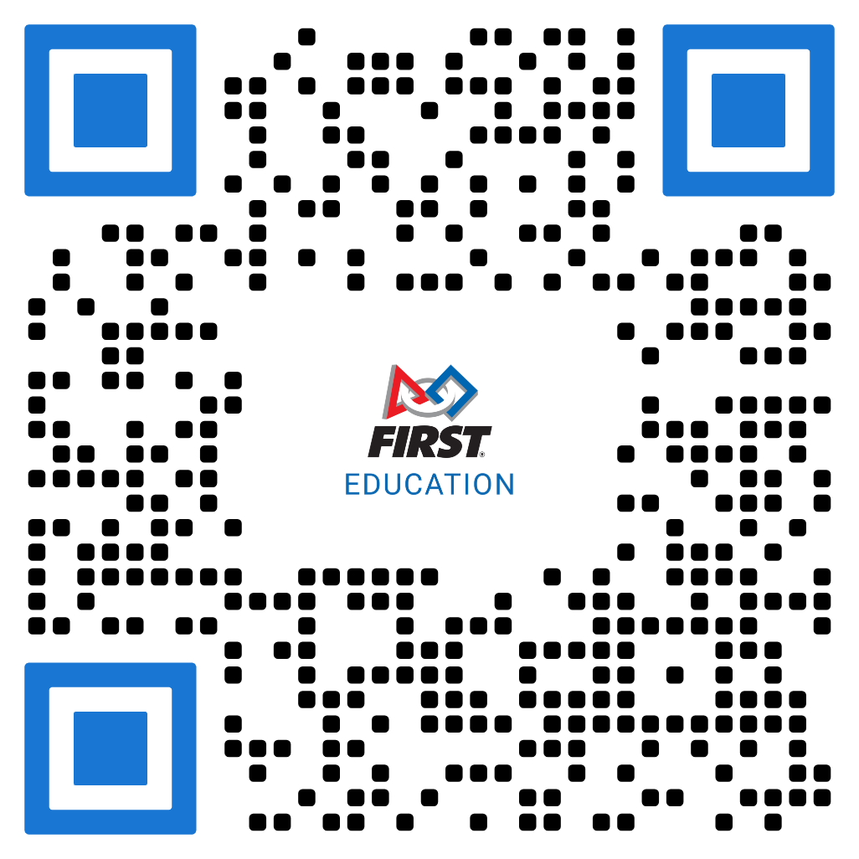


How can I track students work-based learning?

Slide 15
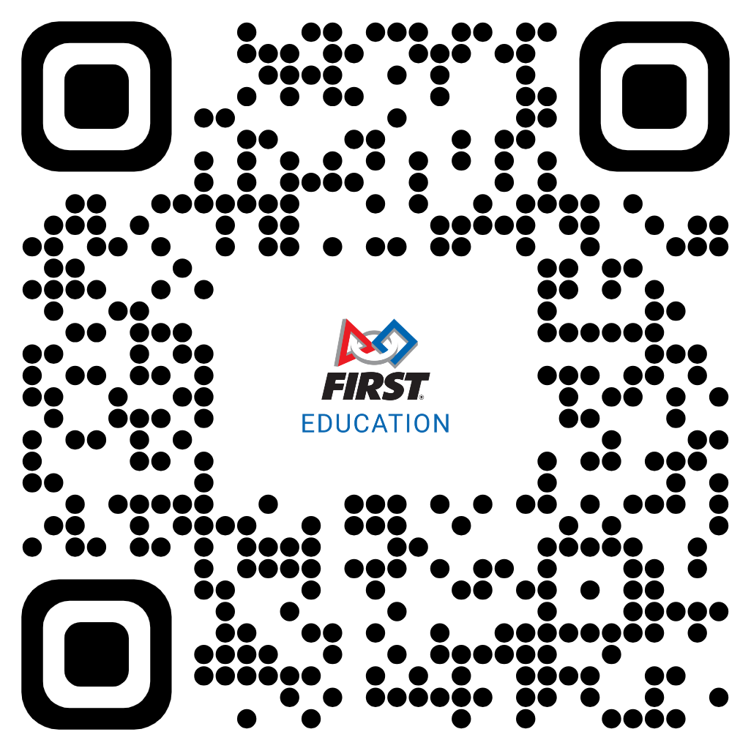

Want to Learn More About FIRST?
lbirch@firstinspires.org

