Slide 1
Charting Your Course for After High School: 3 Goals to Help You Succeed
Notes:
Today we’re going to talk about what you’ll be doing throughout your academy experience to get ready for the future! Whether it’s going to college or entering the workforce right after high school or taking another path, these are the goals that will help you be ready to succeed!

Slide 2
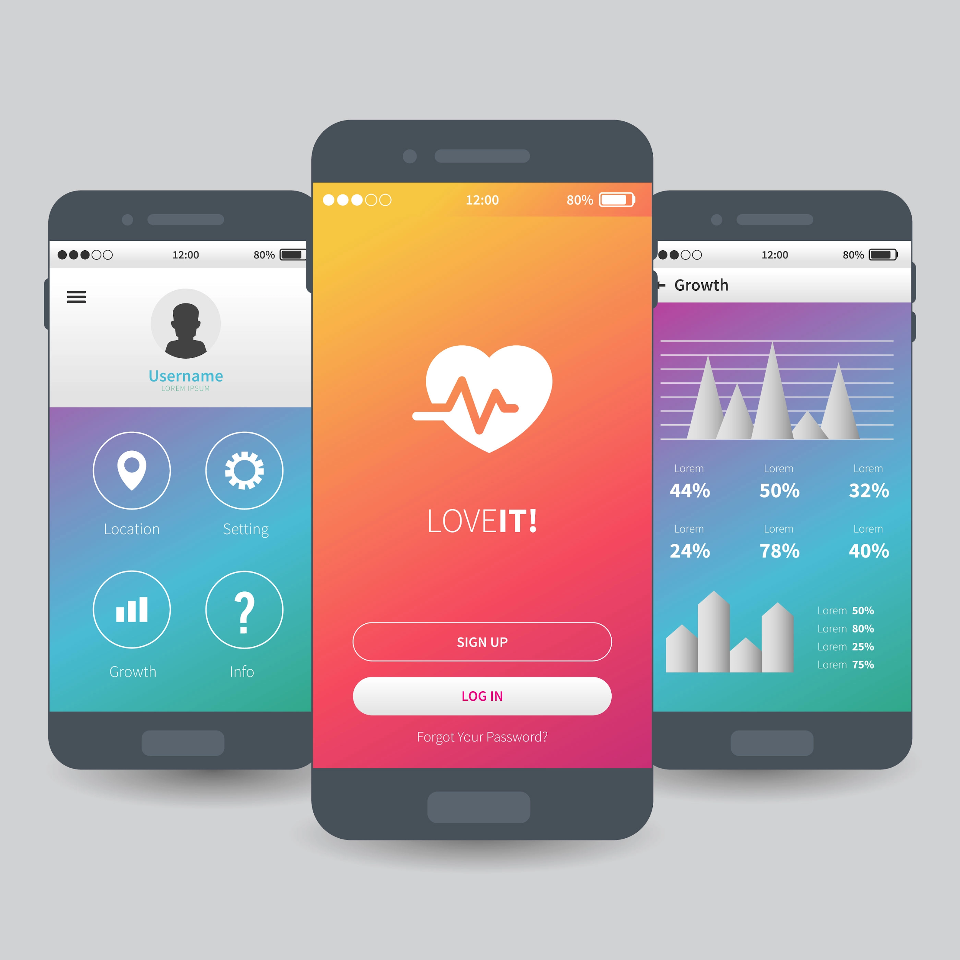
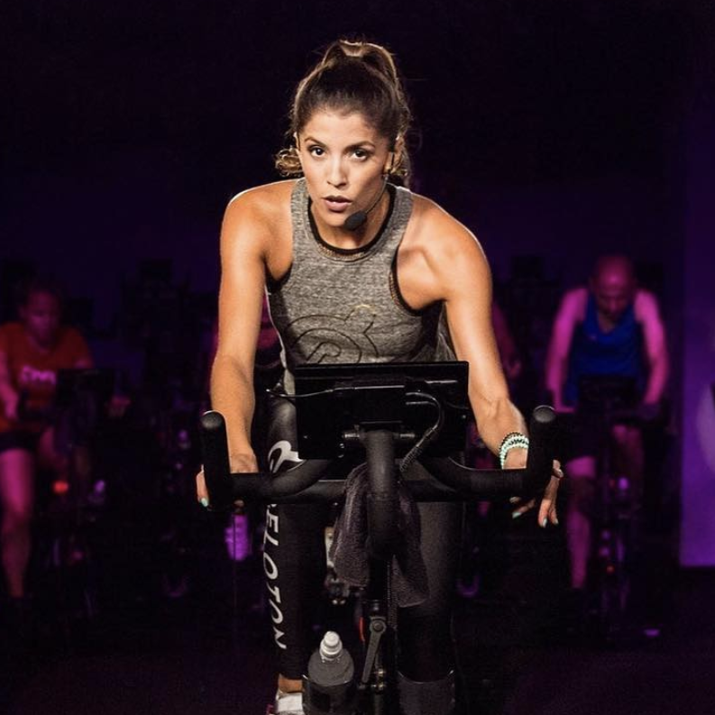
What do the following jobs have in common?
Uber/Lyft Driver
App Designer
Virtual Fitness Class Instructor
Chief Listening Officer for Social Media
Source: The Ladders
Notes:
Answer: These job titles did not exist until very recently (in most cases, ten years ago or less)
According to Forbes, by 2025, most estimates say, 25 percent of America’s jobs will be ones that don’t exist today.
A few interesting examples: commercial space pilots, new energy-related jobs (garbage as an energy source, solar batteries), sustainable construction (for example, organic concrete), expanded genetic counseling, and many more
Source: Jobs Of The Future Today: 20 Occupations That Will Change The Job Market And The World By 2025 (forbes.com)

Slide 3
3 Goals for Your NAF Academy Experience
ASPIRATIONS
SKILLS
CONNECTIONS
Notes:
Here are your 3 goals for your NAF academy experience. Let’s take a closer look at each one.

Slide 4
Goal 1: Aspirations
Choose at least one career you are interested in and develop a plan of how you will get there.
Notes:
Identifying a career and mapping the steps in the journey to achieving it will help you have a clear sense of what comes next. If you are not quite sure which path you want to pursue yet, that’s okay! Choosing one career to focus on at first doesn’t lock you in - it helps you learn how to chart your course forward, no matter how many potential careers you have in mind.

Slide 5
Goal 2: Skills
Develop the 6 Future Ready Skills, receive continuous feedback from industry professionals, and be able to communicate your strengths.
Notes:
“The only constant is change.” Developing the 6 Future Ready Skills is the best way to prepare yourself for whatever comes ahead. These are skills that will help you land, keep, and grow within a career for many years to come.

Slide 6
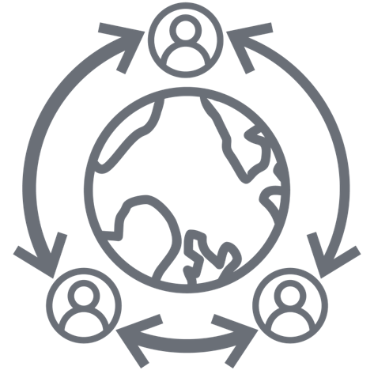
6 Future Ready Skills
COLLABORATION
COMMUNICATION
PROBLEM SOLVING
INITIATIVE & SELF-DIRECTION
SOCIAL AWARENESS
PLANNING FOR SUCCESS
Notes:
After doing extensive research (including with MHA Labs) and having a lot of conversations, NAF selected these as the 6 skills students need in order to be Future Ready.
You will be working on developing these skills throughout your NAF academy experience.

Slide 7
Goal 3: Connections
Build at least three professional connections.
Notes:
Who you know makes a difference. Research from multiple sources shows that as many as 85% of jobs are obtained through networking and that 70% or more of these positions are never advertised. Having professionals in your corner will help you learn more about the career you’re interested in and open doors to opportunities others may never even hear about.

Slide 8
How You Will Benefit from the 3 Goals
Notes:
Having specific goals you are working towards helps you in several ways:
1.) Tunes out the noise – You are bombarded by so much information on a daily basis. Having a few key things to focus on helps turn the volume down
2.) Makes the future come into focus – When you don’t know where you’re going, everything can feel blurry. WBL activities allow you to start getting clarity about what you want to do and what it takes to get there
3.) Builds confidence and connections – As you get feedback on their skills and work with others, it strengthens their relationships and gives them a stronger sense that they are capable of achieving their goals

Slide 9
Reflecting on Activities
REFLECTION IN ACTION
REFLECTION ON ACTION
Analyzing what’s happening
Adapting based on the situation
Anticipating what’s next
Thinking about your experience
Identifying what you learned
Planning what you would do differently in the future
Concepts adapted from Schön's model of reflection
Notes:
A critical part of the ODWBL approach is reflection. Reflection can happen in action (during an event) or on action (after an event). Taking time to look back at your experience and what you can learn from it will help so much both today and in the future.
Examples for each type of reflection:
1) Not all partners could attend the mock interview session so student groups had to be re-assigned as the activity began. This could impact some student results.
2) Holding a debrief for all students involved in the mock interview the class period following the activity to gain better understand of student experiences.

Slide 10
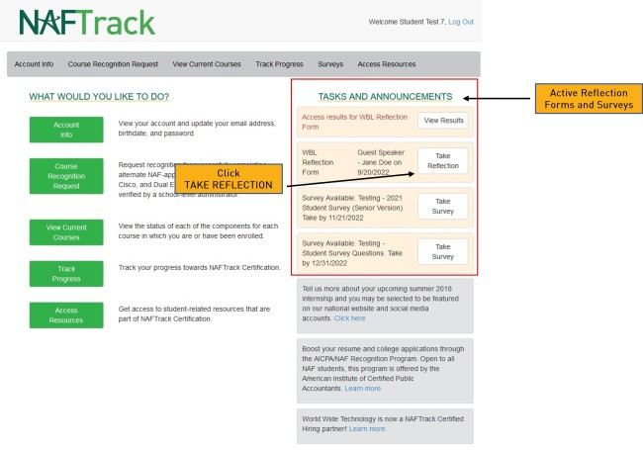
Reflection Form in Your NAFTrack Account
You’ll complete one after each activity
Before you complete the Reflection, verify that it’s right activity name by checking the title and date since you may see more than 1 in your “Tasks” list
Notes:
After each WBL activity, you will log into your NAFTrack account and complete a Reflection Form. You will be able to see all of your previous reflections and this will be a great place to come back to when you are working on your resume or any applications.

Slide 11
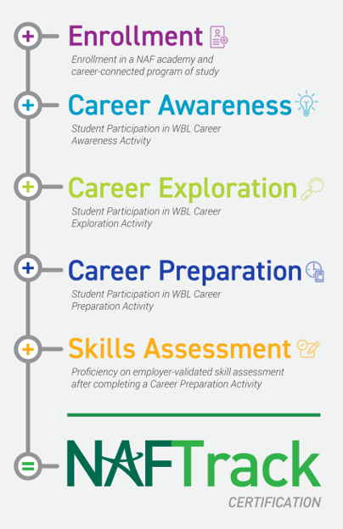
NAFTrack Certification
By completing WBL activities in different areas plus receiving feedback through a Future Ready Skills assessment, you can earn a credential from NAF
You will be able to see your progress in your NAFTrack account
NAFTrack Certification is a helpful addition to your resume and/or college application

Slide 12
3 Goals = Your Path to Success!
ASPIRATIONS
SKILLS
CONNECTIONS
Notes:
To recap, the 3 goals you’ll be working on throughout your academy experience are to identify and map a plan for at least one career path, develop the 6 Future Ready Skills and get feedback on them, and build at least 3 professional connections. Everything we do inside and outside the classroom will help you move towards achieving these goals and being well prepared for your future!

Slide 13
Activity
Notes:
Choose one from the Activity Options one-pager

