Slide 1

High Impact Portfolios & Resumes for Future Ready Students
Bria Jones | bria@bulbapp.com

Slide 2

“The main reason for the unemployment among job seekers is because of their inability to showcase their talent and skills. This is where a digital portfolio helps you.
Nowadays, Interviewers do not prefer to spend time reading your long professional history from your printed resume or CV.
According to a recent survey, the use of a personal CV Website impresses around 56% of employers. But, only 5% of the job seekers own one. Research shows 88% of HR professionals hire candidates with a digital portfolio.
Employers do not fancy an oral narration of your work. They want to see how you actually did it. A digital portfolio for a job interview is the best way to show off your accomplishments.”
-NexGen Innovators

Slide 3
What Story do You Want to Tell?
Think about what words come to mind when someone views your resume & portfolio.

Slide 4
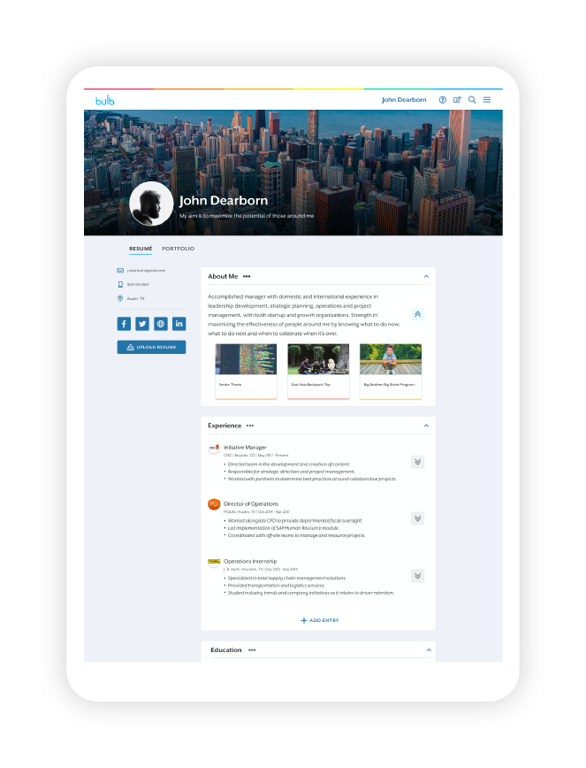
Think about your
experiences & accomplishments
in terms of IMPACT
& what makes you unique

Slide 5
List of Responsibilities vs.
Impact Statements
3 bullets of your biggest impacts
Data
Action Verbs
What was the purpose or goal?
What makes you unique?

Slide 6
Show your impact in 2 powerful ways
1. Use IMPACT statements to uniquely showcase your contribution
2. Provide authentic EXAMPLES of your work to back
up what you are saying on your resume

Slide 7
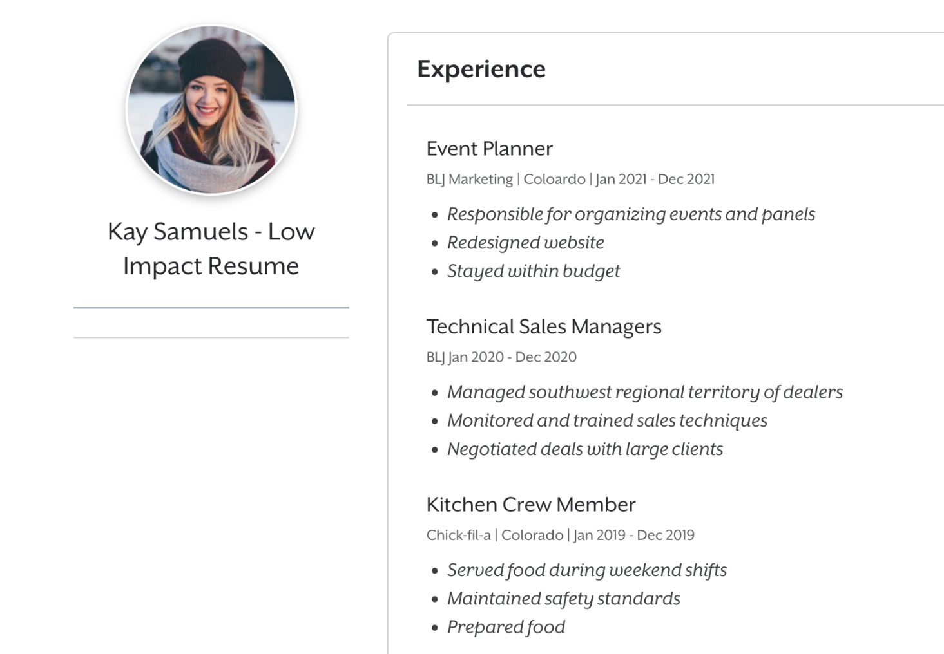
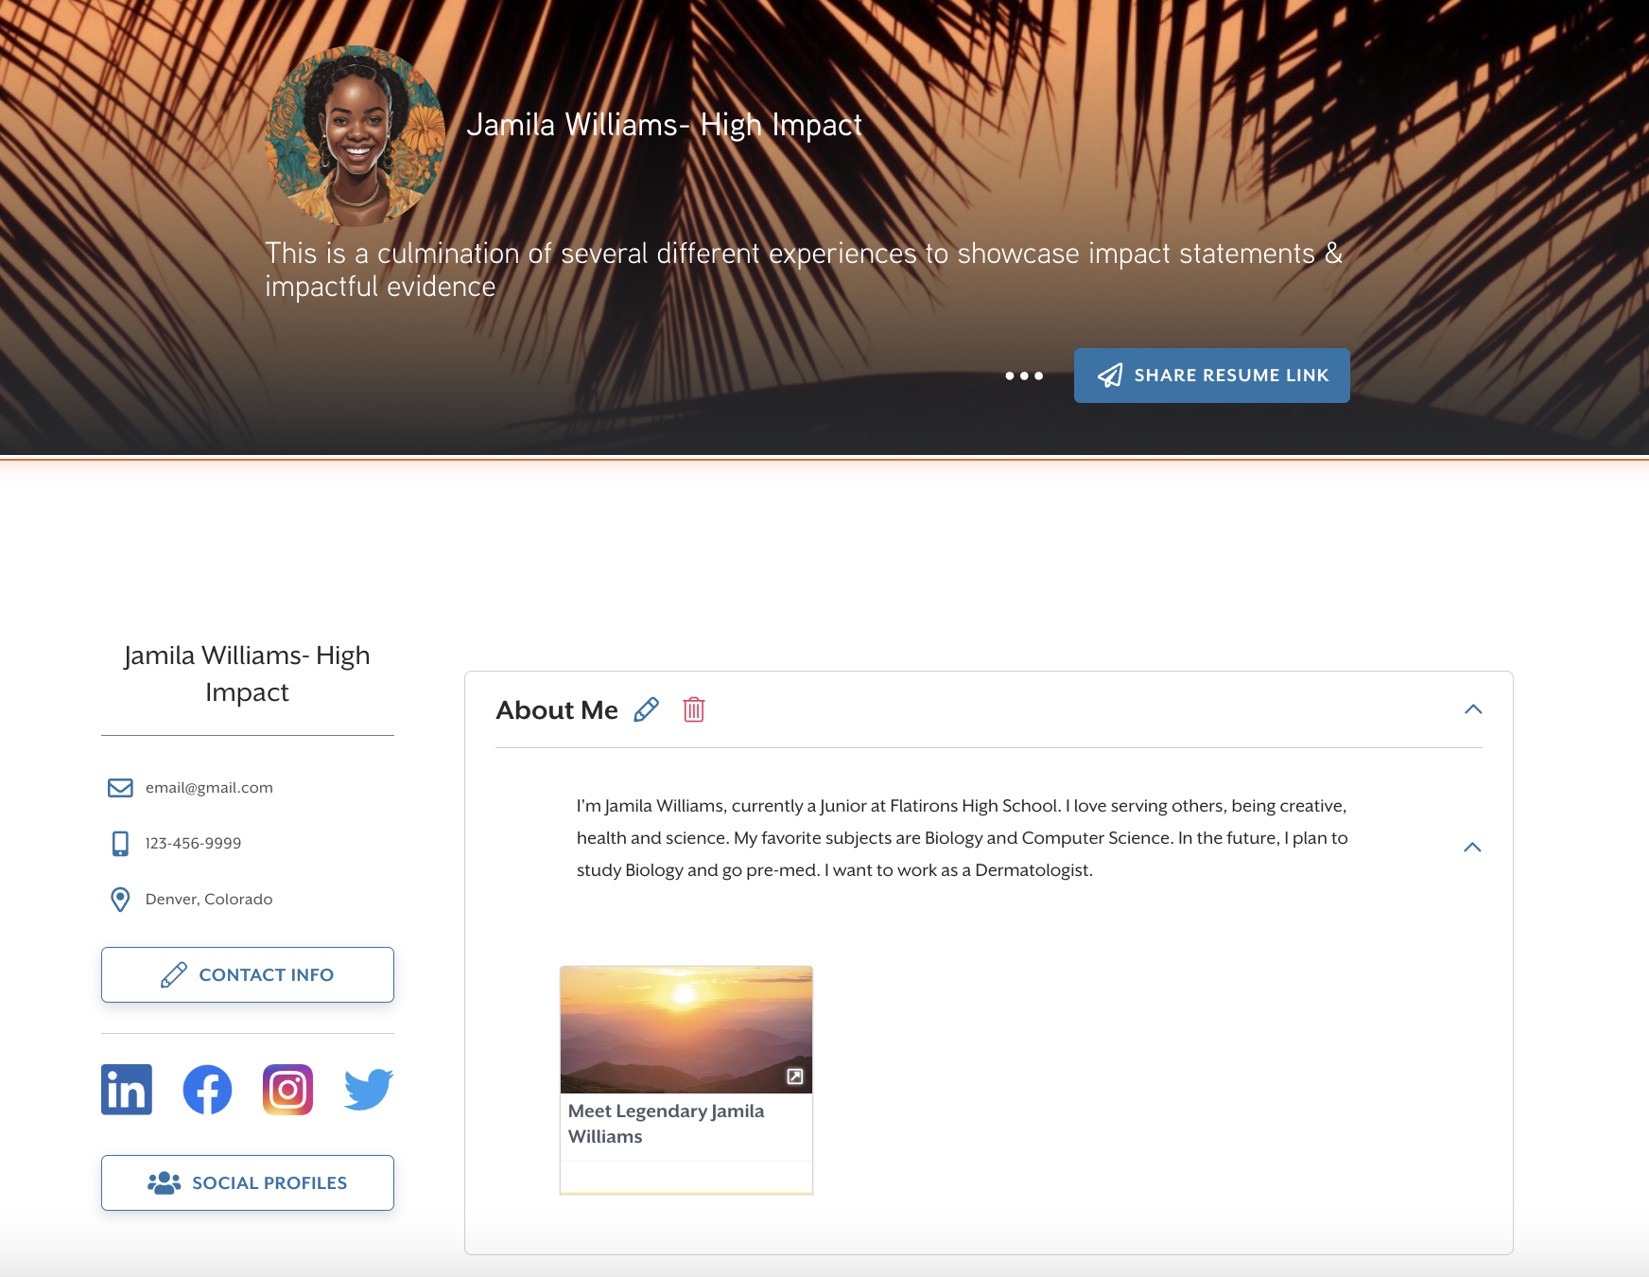
Low Impact vs. High Impact bulb Examples
View this Low Impact Example
https://www.bulbapp.com/kaysamuels/resume?token=ff78f5b1-f8fd-438b-89da-a25c18693757
View this Comparison Educator Example
https://www.bulbapp.com/kaysamuelsgood/resume?token=5a0e2615-aeb8-48d7-b1eb-3017756f70e5
View this High Impact Student Example
https://www.bulbapp.com/jamilawilliams/resume?token=b3159241-4394-477a-adf0-88e92b35285f

Slide 8
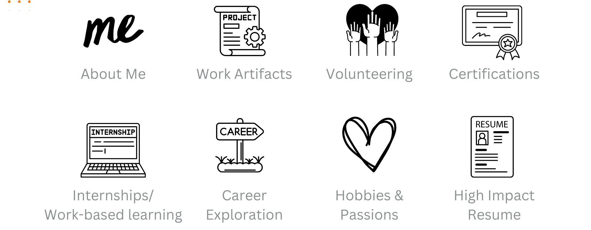
What you need in your portfolio

Slide 9
Share the Story of Your Evidence
What was your goal or purpose?
Obstacles/Challenges?
Result or Product- Visuals
Evaluation/What did you learn?/ What skills does this represent?/ Why did it matter?

Slide 10
Examples to inspire
Educator Examples:
Whitney Turner
Mr Jones
Kimberly Howard
Seneca Hart
Self Assessments
Evidence/Artifact Pages
Website Project
Freshman Artifacts
Soft Skills
Newspaper article
Cyber Security Competition
Student Examples:
Jamila
Derrell
Kelsie
Carlos
Lily
Brandon
Christine
Adrienne

Slide 11
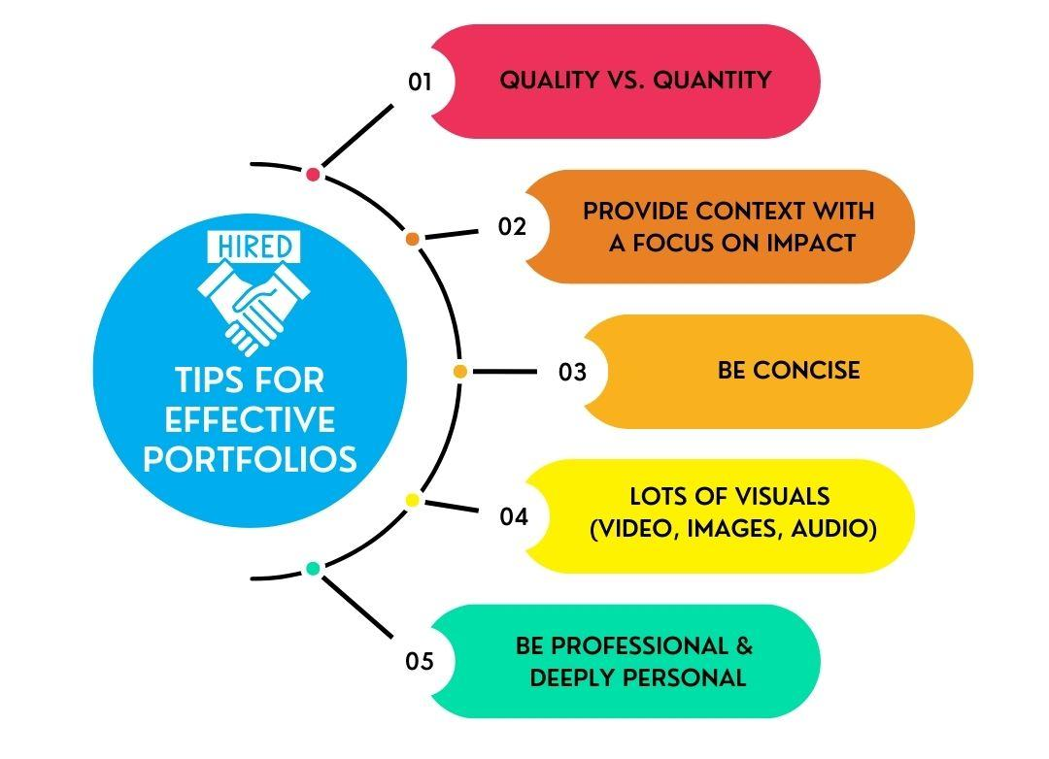
5 Tips for a High Impact Digital Resume and Portfolio

Slide 12
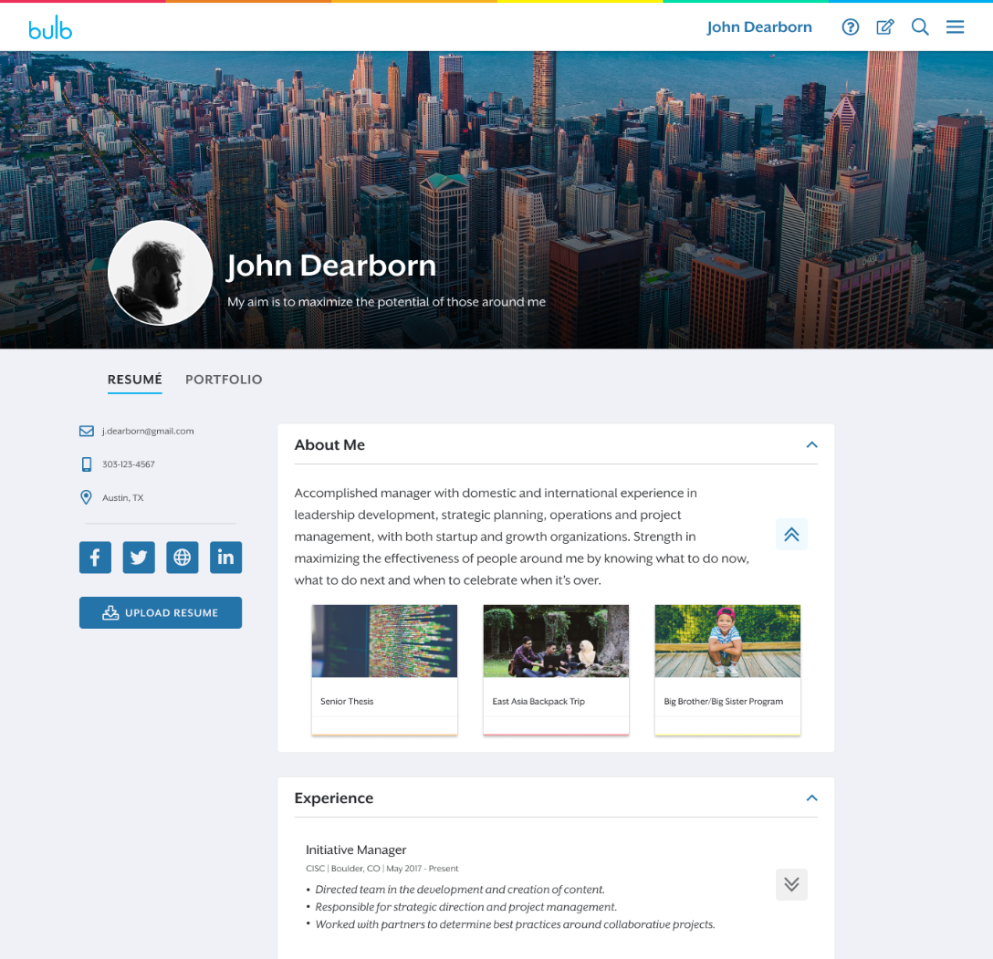
What is one take away you have about your portfolio or resume?

Slide 13
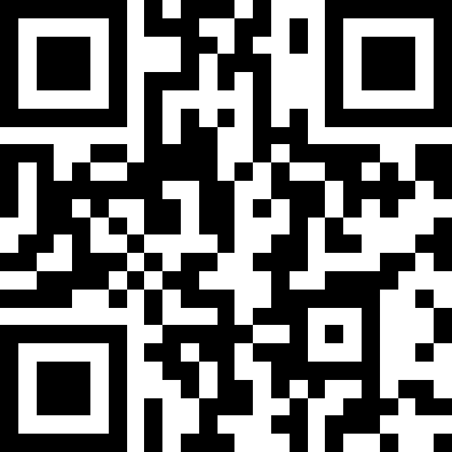





bulb is free for educators
Create an account at my.bulbapp.com
Follow bulb
#NAFNext
@NAFCareerAcads @NAF
@bulbapp
Come visit me at the bulb booth or reach out
Bria Jones - bria@bulbapp.com
https://tinyurl.com/bulbNAF24

Slide 14
Session Code:
#4725

