Slide 1
Health Sciences Librarian Anna Liss Jacobsen, MA, MLS jacobsea@iu.edu

Slide 2
outline
NIH Data Management Sharing Policy
DMP Tool
ORCID
What
Why
How
Further resources

Slide 3
What: Nih dms policy
January 25, 2023: NIH grant applications must include a data management and sharing plan (DMSP)
A DMSP is an outline of scientific data management, sharing and preservation activities during and after a research project
Plan for managing your scientific data during your project
Ensure your scientific data is usable when project is done
Short document
Addresses 6 elements

Slide 4
Why: Nih dms policy
Support open science initiatives
1
Increase reproducibility of research
2
Improve equity
3
Write a Protocol for your research data management activities
4

Slide 5
Nih dms policy – 6 Elements (1 of 3)
1. Data Type
Summarize research data
What data will be preserved and shared?
What information about the data (metadata) will be provided?
How to write a readme file
2. Related Tools, Software, and/or Code needed to access or use scientific data
Examples: Excel, R
Further information at IUPUI Nursing Libguide: Data

Slide 6
Nih dms policy – 6 Elements (2 of 3)
3. Standards
Data standards - agreed upon methods of communicating about data
Example
OMOP - clinical data
DDI - social and behavioral sciences
4. Data Preservation, Access, and Associated Timelines
Where will data be stored?
NIH supported repositories
How and when can data be accessed?
Further information at IUPUI Nursing Libguide: Data

Slide 7
Nih dms policy – 6 Elements (3 of 3)
5. Access, distribution or reuse of data
Reasons not to share data
Legal - intellectual property
Technical – storage, etc.
Ethical - privacy of human participants
Oversight of data management and sharing
Who manages, preserves and shares data?
Further information at IUPUI Nursing Libguide: Data

Slide 8
DMPTool.org
Plan builder
Sample plans
Tailored templates
Links to funder sites
Export
Free

Slide 9
Dmp tool
Access DMPTool.org
Create account with IUPUI email
Click Create Plan
Further guidance
Arizona State University tutorial
DMSP & DMP Examples

Slide 10
Questions / comments?

Slide 11
ORCID
Open Researcher and Contributor IDentifier

Slide 12
What: Orcid
Provides unique ID (ORCID ID) that distinguishes researchers from one another
Allows researchers to create and manage visibility of their CV data
Grants, articles, affiliations, etc.
Provides a long-lasting link to the researcher profile
API connects with other systems (SciENcv for NIH Biosketch)
Can automatically update (CrossRef)

Slide 13
Why get an ORCID?
Funders and Publishers
ORCID is required / supported by many funders, including NIH
Researchers
Disambiguate from other researchers with similar names
Share
Add your ORCID to webpages, email signatures, blogs, and social media accounts
Get a QR code to include your ORCID on conference posters
Help funders and publishers accurately link works to researcher
All major scholarly publishers support ORCIDs
Reduce administrative burden
Increase discoverability of your work

Slide 14
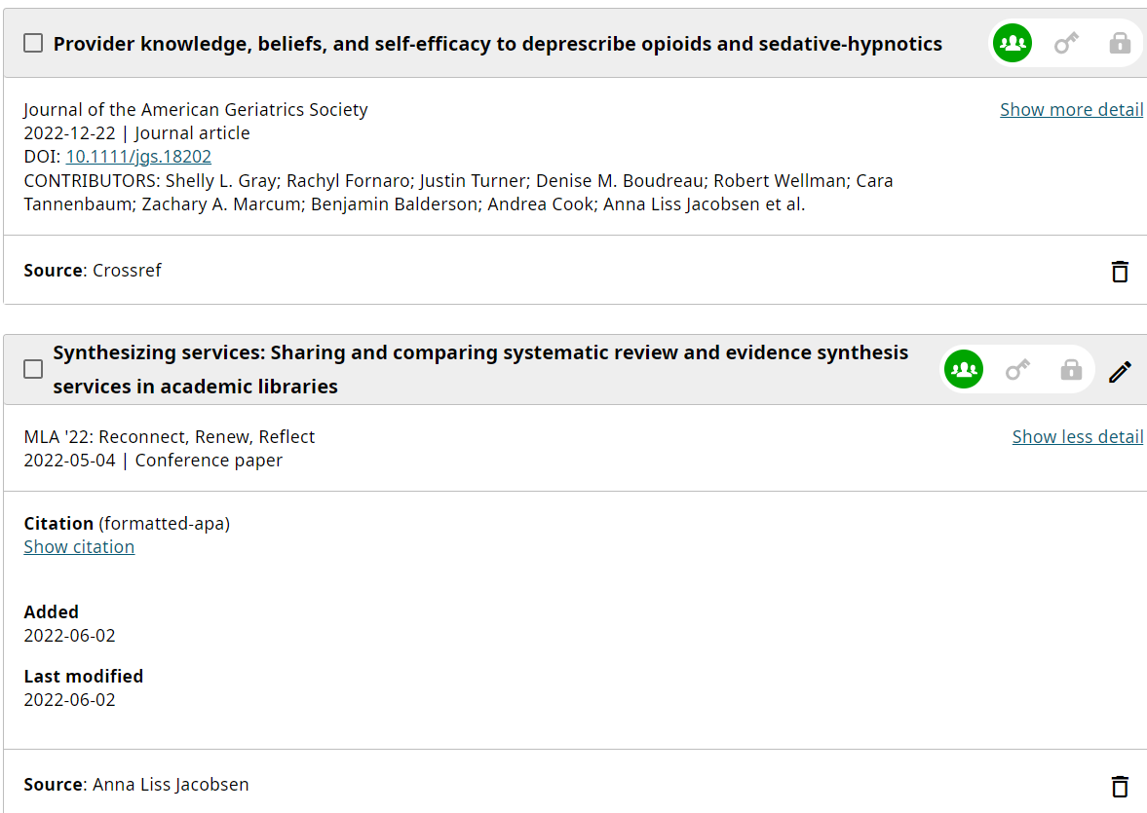
HOW TO’s: ORCID
Create ORCID profile
Identifying Information
Research Keywords
Set Visibility
Add activities
Funding
Works
Allow third party systems to update profile
CrossRef and more

Slide 15
Thank you
Anna Liss Jacobsen, jacobsea@iu.edu
IUPUI Health Sciences Librarian
https://iupui.libguides.com/nursing/home

