Slide 1
Elsevier-MTUN Symposium 2024
Open Source vs. Closed Systems for the AI Campus Development Ecosystem
Prof. Ir. Dr. Mohd Faizal Jamlos
Faculty of Electrical & Electronics Engineering Technology
Principal Fellow Centre for Automotive Engineering
Date : September 30th 2024
Venue : Zenith Hotel, Kuantan

Slide 2
AIM : To develop an optimum AI ecosystem in MTUN
WHERE ARE WE NOW?
WHERE DO WE WANT TO BE?
HOW WILL WE GET THERE?

Slide 3
AIM : To develop an optimum AI ecosystem in MTUN
WHERE ARE WE NOW
WHERE DO WE WANT TO BE?
HOW WILL WE GET THERE?

Slide 4
Pekerja Mahir
Adalah mengikut Piawaian Pengelasan Pekerjaan Malaysia (MASCO):
Pengurus;
Profesional; dan
Juruteknik dan professional bersekutu.

Slide 5
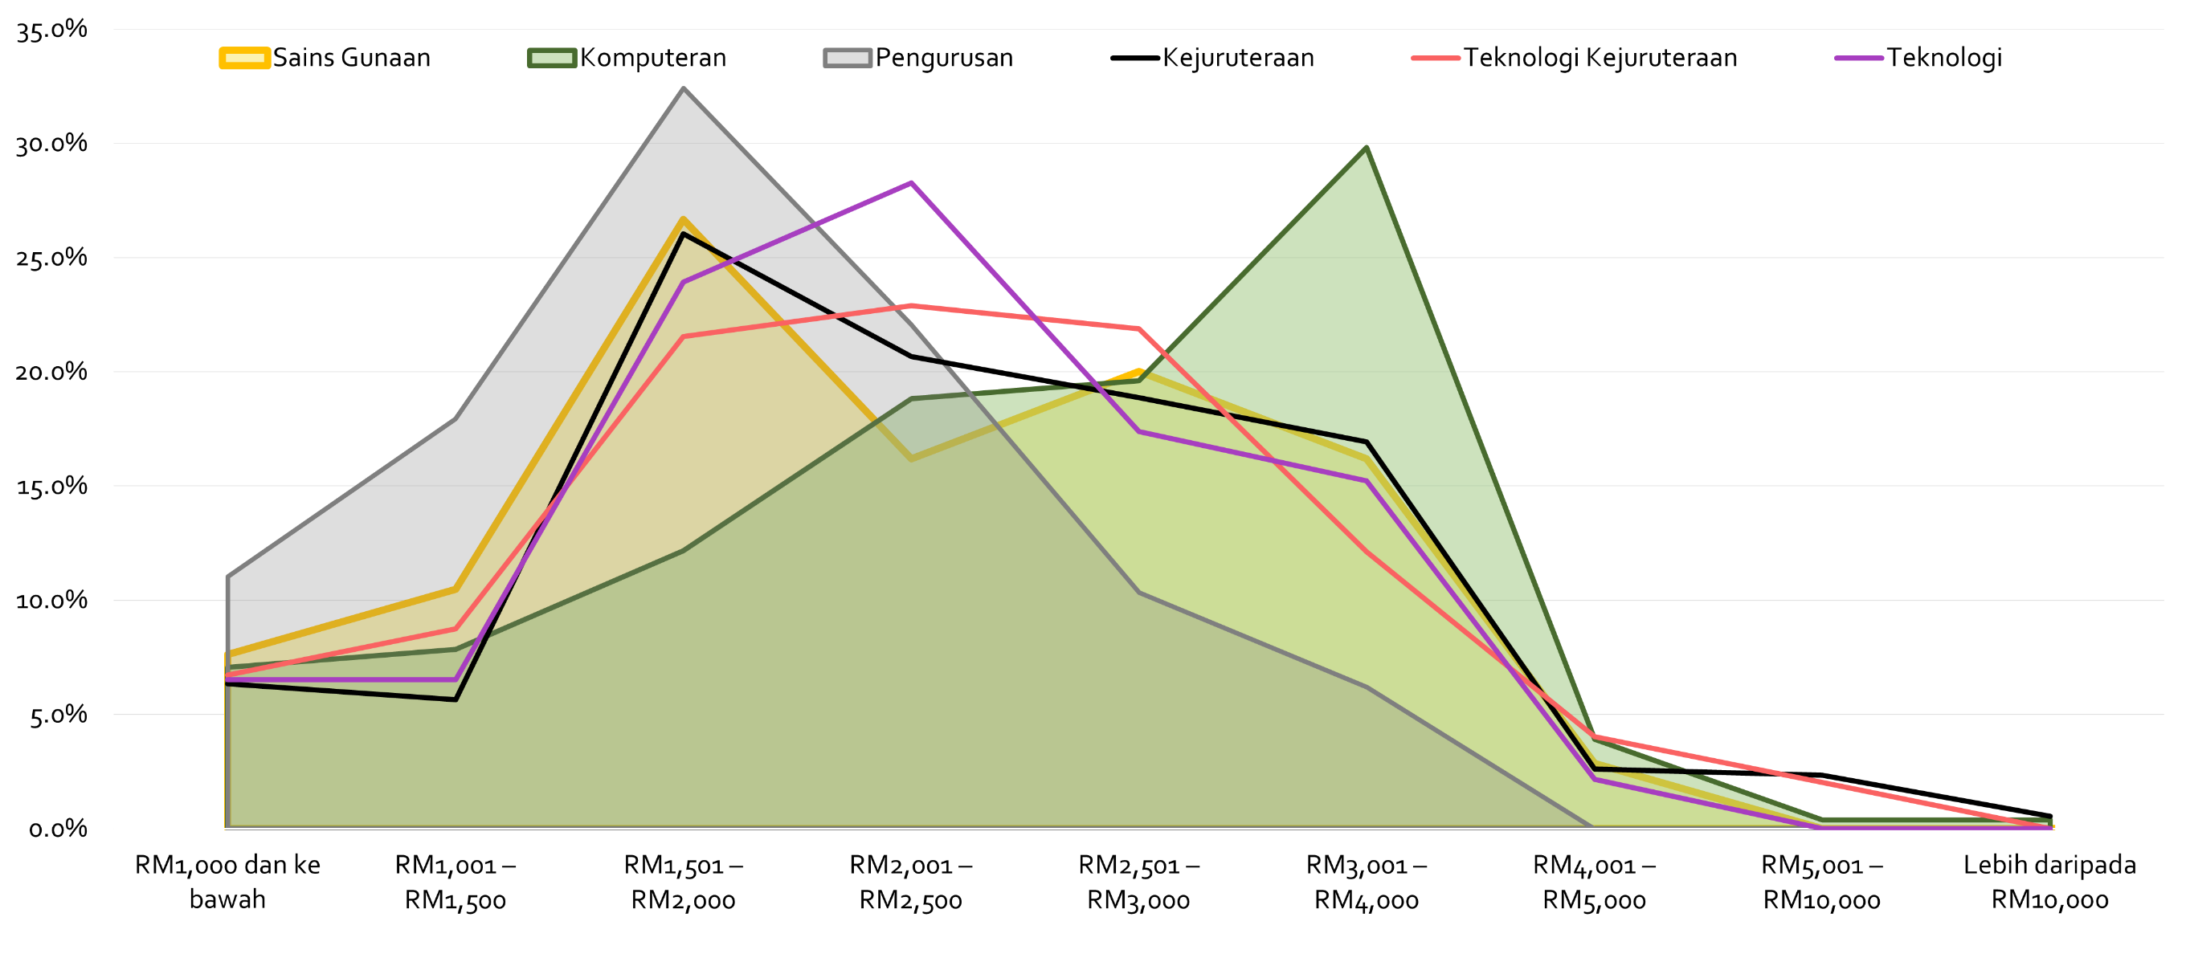
PENDAPATAN GRADUAN BEKERJA MENGIKUT JURUSAN GRADUAN IJAZAH PERTAMA, PERDANA

Slide 6
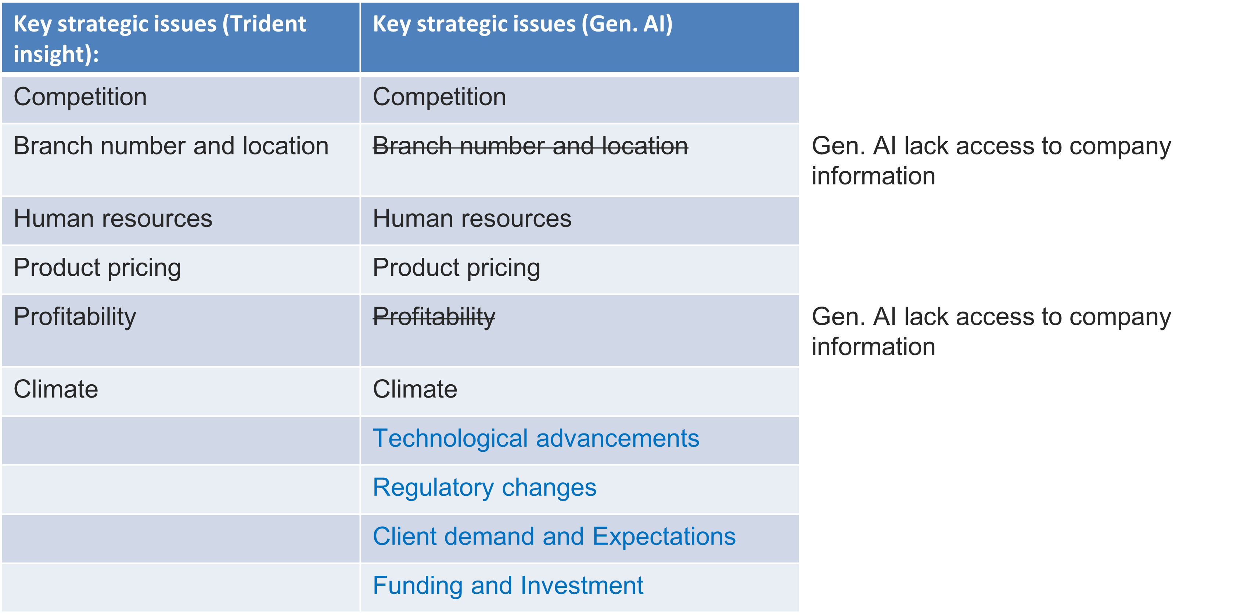
Overcoming Blind Spots and Predicting the Future in Manufacturing, Biotech, Business, Agriculture Engineering
Manufacturing
Biotech
Hong Leong Bank Adopts AI for Collections, Sees 15x Productivity Gain
Hong Leong‘s Group Managing Director and CEO Kevin Lam
Companies are supercharging productivity and efficiency with AI-powered tools like virtual assistants, intelligent search and content summarization.
MANUFACTURING CHALLENGES
Predictive Maintenance
Process Optimization
Training and Remote Assistance
By analyzing vast amounts of biological data, AI predict how different chemical compounds will interact with specific targets in the body. CardiaTec can compare healthy artery tissue with that of an artery where plaque buildup has led to a heart attack.
Namshik Han, a lecturer in AI drug discovery at the University of Cambridge, who has background in machine learning, computational biology, cancer genomics, and cancer epigenomics.

Slide 7
AIM : To develop an optimum AI ecosystem in MTUN
WHERE ARE WE NOW?
WHERE DO WE WANT TO BE?
HOW WILL WE GET THERE?

Slide 8
AI CAMPUS ECOSYSTEM TARGET
POLICY
Implement AI-Powered Faculty Initiative to Support all sectors covered in NIMP2030
Training Prompt Engineering to Reskilling Senior Staff Member
Achieving Premium Salary / Progressive Wage Policy among Graduates
Achieving Subject Matter Expert as Principle Consultant
Achieving Start-up level of Cockroach, Ponies, Centaurs, Unicorns, Decacorns, Hectocorn
AI INFRASTRUCTURE
Identify SME among researcher to develop the infra at initial stage
Introduction of Uni-Cloud as AI’s infra PoC among Institution of Higher Learning
Inciting promotion and competitive package by vendor
TRAINING & RESEARCH COLLABORATION
EXPERTISE
AI EXPERTISE TRANSFER KNOWLEDGE BASED ON APFI
Train-the-Trainer Program (TTT) for AI, Machine Learning, Cloud, Database & Data Analytics
Certification of Competency (CoC) for AI, Machine Learning, Immersing, Cloud, Database & Data Analytics
Research Collaboration (Matching Grant, Endowment, Attachment ) on Convergence Technology use case e.g. Biotechnology, Smart Manufacturing, Advanced Materials, Smart City
Data Scientist, Data Engineer & Database Engineer
Cloud Engineer
Immersing Technology (XR, VR, MR)
AI, Data Analytics & Machine Learning
Implementing those expertise in corresponding graduates field

Slide 9
Proposing AI-Powered Faculty Initiative (APFI)
Current & Trendy Faculty
Proposed AI-powered Faculty
Manufacturing
Manufacturing
+AI
E.g. Manufacturing, Biotechnology, Business, Materials Economy Driver
AI + Big Data + Cloud + Digital Twin + IoT + AR Technology Driver (Tools)
Civil
Civil
+ AI
Electrical & Electronics
Electrical & Electronics
+AI
Mechatronics
Mechatronics
+AI
Business Management
Business Management
+AI
Chemical
Chemical
+AI
Computing/ Computer Science
Computing/ Computer Science
Artificial Intelligence

Slide 10
Starting Basic Salaries Based on Progressive Wage Policy Pilot Project (Version 2)
*Malaysia Standard Classification of Occupations (MASCO)
MASCO 4D | MASCO Job title | Tajuk Pekerjaan MASCO | Starting Basic Salary for Entry Level Employees (RM)
2425 | Administrative Professionals | Profesional Pentadbiran | 3,245
3142 | Agricultural And Livestock Technicians | Juruteknik Pertanian Dan Penternakan | 2,230
7232 | Aircraft Engine Mechanics And Repairers | Mekanik Dan Pembaik Enjin Pesawat Udara | 2,555
2514 | Application Programmers | Pengaturcara Aplikasi | 3,630
2131 | Biologists, Botanists, Zoologists And Related Professionals | Profesional Biologi, Botani, Zoologi Dan Profesional Berkaitan | 3,745
2161 | Building Architects | Arkitek Bangunan | 3,140
3111 | Chemical And Physical Science Technicians | Juruteknik Sains Kimia Dan Fizik | 2,350
3116 | Chemical Engineering Technicians | Juruteknik Kejuruteraan Kimia | 2,995
2145 | Chemical Engineers | Jurutera Kimia | 3,585
2142 | Civil Engineers | Jurutera Awam | 3,115
2151 | Electrical Engineers | Jurutera Elektrik | 3,355
2152 | Electronic Engineers | Jurutera Elektronik | 3,410
2144 | Mechanical Engineers | Jurutera Mekanikal | 3,380
Ref.: Guidebook of Starting Basic Salaries and Annual Salary
Increment for Selected Sectors by Ministry of Human Resources

Slide 11
Starting Basic Salaries Based on Progressive Wage Policy Pilot Project (Version 2)
*Malaysia Standard Classification of Occupations (MASCO)
MASCO 4D | MASCO Job title | Tajuk Pekerjaan MASCO | Starting Basic Salary for Entry Level Employees (RM)
2523 | Computer Network Professionals | Profesional Rangkaian Komputer | 3,975
2511 | Computer Systems Analysts | Juruanalisis Sistem Komputer | 3,850
2531 | Cyber Security Professionals | Profesional Keselamatan Siber | 3,510
2524 | Data Professionals | Profesional Data | 3,565
2521 | Database Designers And Administrators | Pereka Dan Pentadbir Pangkalan Data | 3,415
2263 | Environmental And Occupational Health And Hygiene Professionals | Profesional Persekitaran Dan Kesihatan Pekerjaan Dan Kebersihan | 2,895
2413 | Financial Analysts | Juruanalisis Kewangan | 3,260
2522 | Information Technology System Administrators | Pentadbir Sistem Teknologi Maklumat | 3,520
2512 | Software Developers | Pembangun Perisian | 3,780
2833 | Translators, Interpreters And Other Linguists | Penterjemah, Jurubahasa, Dan Ahli Linguistik Lain | 4,675
2513 | Web And Multimedia Developers | Pembangun Web Dan Multimedia | 3,740
Ref.: Guidebook of Starting Basic Salaries and Annual Salary
Increment for Selected Sectors by Ministry of Human Resources

Slide 12
KAJIAN GAJI PREMUM & PURATA GAJI DI MALAYSIA MENGIKUT BIDANG
(PROGRAM IJAZAH PERTAMA)
Saiz buih adalah bilangan graduan bekerja
12

Slide 13
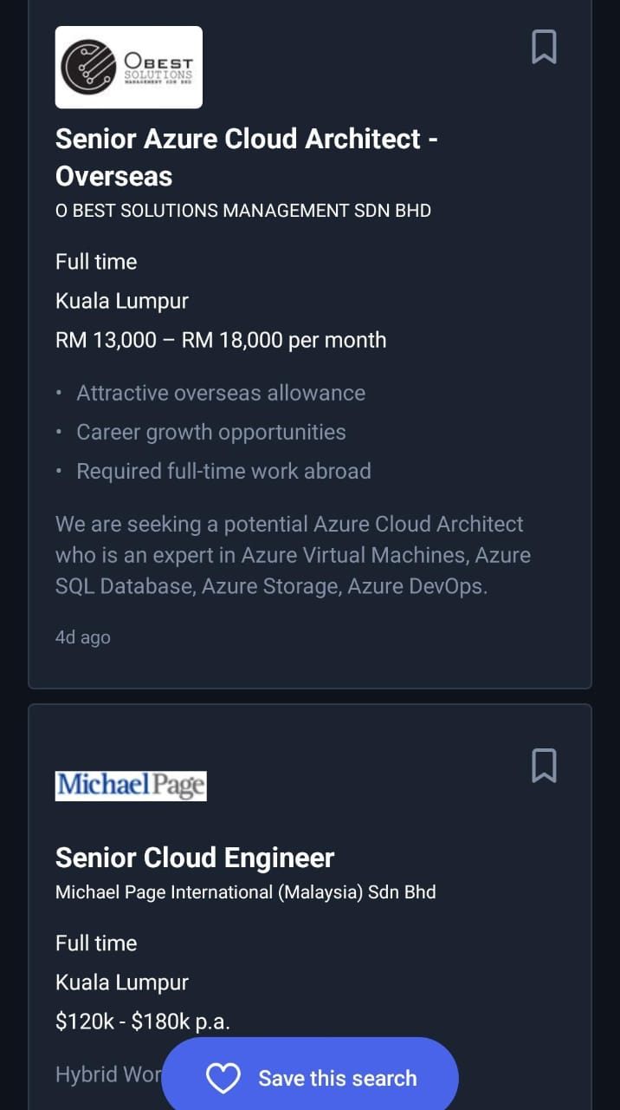
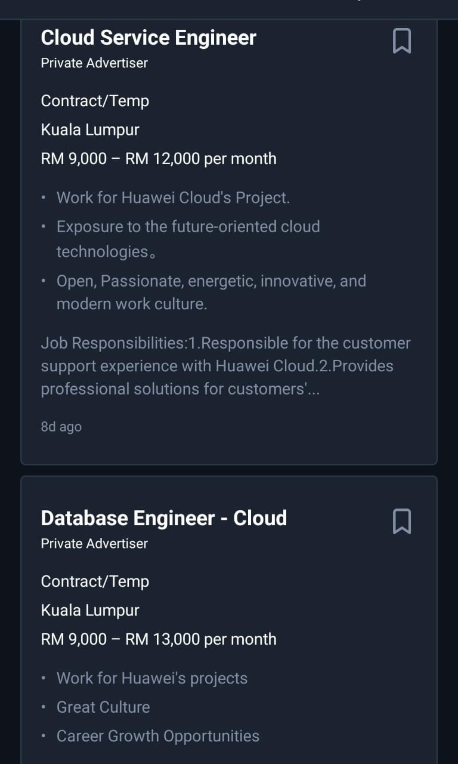
Basic Salary based on Current Industrial Demands
Job title | Starting Basic Salary for Entry Level Employees (RM)
Computational biologist | 5,930.00
Business Data Analyst | 4,672.00
Prompt Engineer | 5,000 – 8,000
Data Engineer | 3,750 – 5,000
Data Scientist | 5,000 – 7,000
Computational Chemical Engineer | 5,000 – 7,000
Chemical Engineer | 2,600
Computational Manufacturing Engineer | 5,000 – 7,000
Manufacturing Engineer | 2,700
Computational Physicist | 5,000 – 7,000

Slide 14
The first Generative AI for Density Functional Theory (DFT) and Molecular Dynamic (MD), Advance/ NanoLabo with the world's first AI-based material modeling feature, "Autopilot"

Slide 15
AIM : To develop an optimum AI ecosystem in MTUN
WHERE ARE WE NOW?
WHERE DO WE WANT TO BE?
HOW WILL WE GET THERE?

Slide 16
TOTAL NUMBER OF STAFF (USECASE of UMPSA)
38
Professor
TOTAL
1,874
139
Associate Professor
(Include Visiting /Adjunct Professor and Post-doctoral/ Fellow Consultant)
ACADEMIC STAFF
855
546
Lecturer
PROFESIONAL & MANAGEMENT
189
1265
756
48
Visiting (7)/
Adjunct Professor (7)
16*
214
Permanent
Contract
Permanent
Contract
Post-doctoral (15)
Fellow Consultant (12) Principal Research Consultant Fellow (3)
Fellow Principal Consultant (2)
35 *
4%
75%
SUPPORT STAFF
805
Expatriate
PhD Graduate
638
167
41 Language
Teacher
Academician (13)
SPA (5)
Post Doctoral (12)
Academician (605)
SPA (11)
Post Doctoral (15)
40
Vocational Training Officer
Permanent
Contract
Source : Registry Department UMPSA 2 May 2024

Slide 17
FACULTY / CENTRE / INSTITUTE (USECASE of UMPSA)
UMPSA PEKAN
Electrical and Electronics Engineering Technology (FTKEE)
Manufacturing and Mechatronic Engineering Technology (FTKPM)
Mechanical and Automotive Engineering Technology (FTKMA)
Computing (FK)
FACULTY | UMPSA GAMBANG
 |  | Chemical and Process Engineering Technology (FTKKP) Civil Engineering Technology (FTKA) Industrial Sciences and Technology (FIST) Industrial Management (FIM)
1. Centre for Modern Languages (PBM)
ACADEMIC CENTRE |  | Centre for Mathematical Sciences (PSM) Centre for Human Sciences (PSK)
1. Confucius Institute
INSTITUTE |  | 1. Institute of Postgraduate Studies (IPS)
1. Centre for Advanced Fluid and Processes (Fluid Centre)
Centre for Artificial Intelligence & Data Science (CAIDaS)
Centre for Advanced Intelligent Materials
Centre for Bioaromatic Research (Bioaromatic Centre)
Centre for Sustainability of Mineral and Resource Recovery Technology (SmaRRT Centre)
CENTRE of EXCELLENCE |  | 1. Centre for Automotive Engineering (Automotive Centre) Centre for Advanced Industrial Technology (AIT)

Slide 18
AI CLOUD INFRASTRUCTURE SELF-DEVELOPMENT (TIER 1 DATA CENTRE)
01
Identify the AI Development
Primary Usecase
(Large AI Training)
02
Identify server type and specifications, electrical power and heat take into account
(Huawei / Dell PowerEdge XE9680)
5
Major Steps
Identify the GPU
(Nvidia HGX H100 8-GPU SXM 80GB 700W
GPUs Assembly)
03
Database & Cloud Programming
(able to allocate independent account to control volume of ram, disk & CPU)
07
04
05
Foundation Model’s Pre-train and Inferencing
(To test the AI’s Cloud Performance & Reliability)

Slide 19
AI EXPERTISE TRANSFER KNOWLEDGE BASED ON APFI
FK + CAIDaS + PSM + FTKPM + FTKEE
FTKMA, FTKKP, FTKA, FIST, FIM
Fluid, Automotive, AIT, SmaRRT, Materials, Bioaromatics
01
Subject Master Expert + Usecase of Subject
(To Be Identify)
Outcomes:
Foundation Model for Robotics, Manufacturing, Transport, Protein, Biotechnology, Business and etc. based on APFI
02
Beneficiary Faculty
(1 Usecase of Subject)
03
Beneficiary Centre
(1 Usecase of Research Topic)

Slide 20
ABC Technology Usecase Implementation By SME

Slide 21
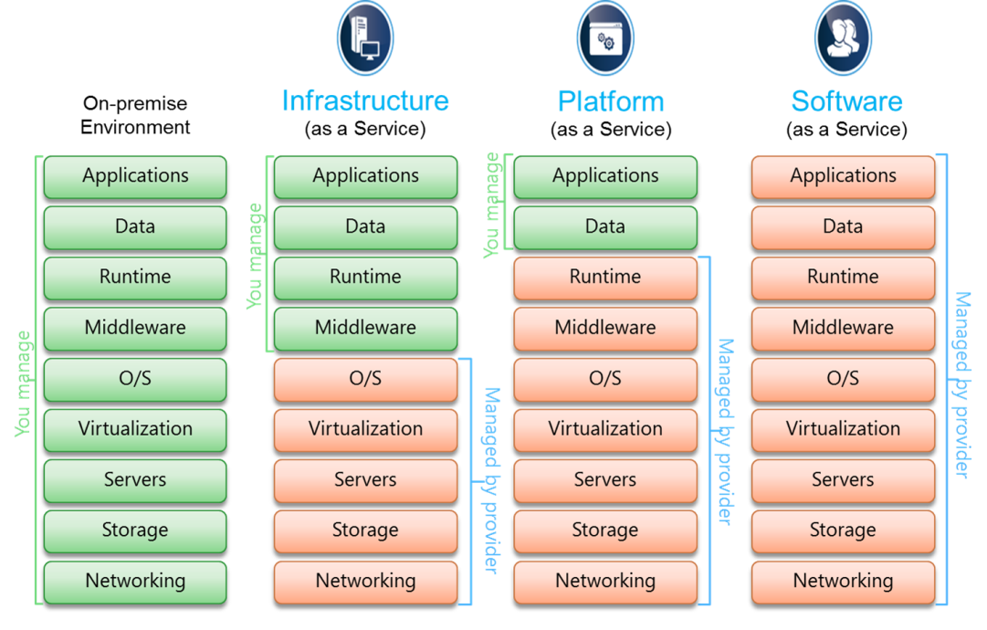
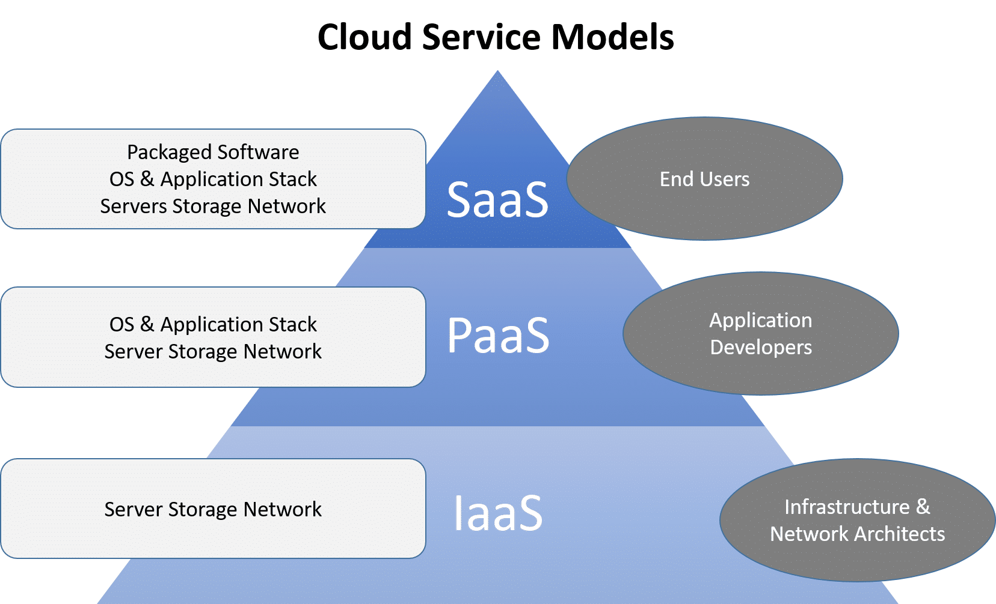
Cloud Models for AI Development

Slide 22
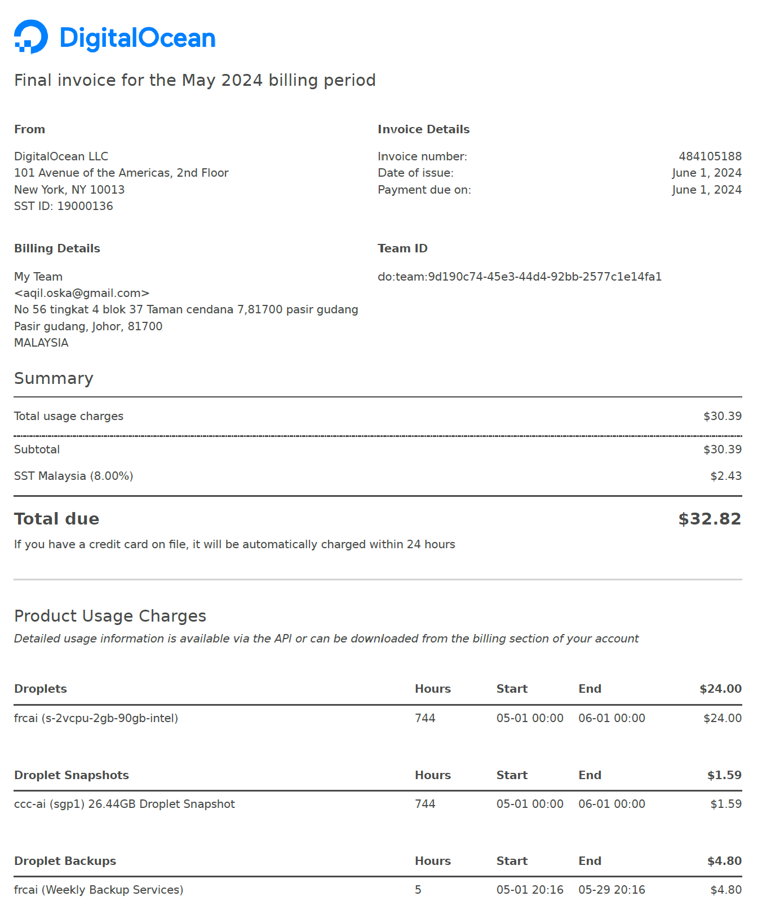
Existed AI Infrastructure (Cloud Server)
2GB ram, 90 GB disk ,2 CPU AMD – Digital Ocean (Singapore) – USD 32.82/month
Microsoft Azure

Slide 23
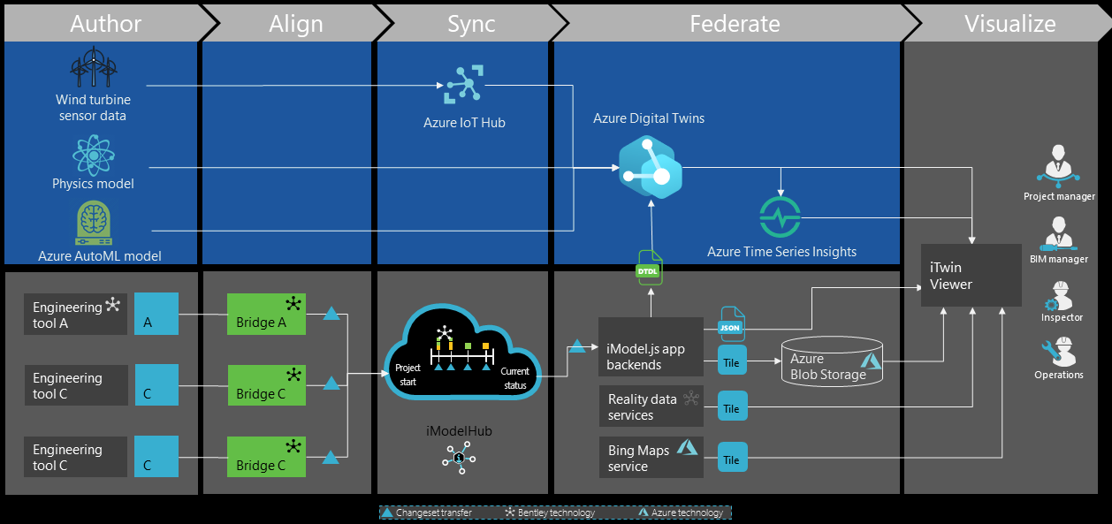
Closed System by Enterprise Solution

Slide 24
Applications by Cloud Provider
Web hosting, content delivery, big data, AI/ML, enterprise IT
Data analytics, AI/ML, media streaming, gaming, cloud-native apps
Leader in data and AI, Kubernetes expertise, low-latency global network
Broadest service range, strong global network, serverless computing
AWS
GCP
Spotify (analytics), Snapchat (real-time)
Netflix (streaming), Airbnb (scaling apps)
Multi-cloud management, hybrid cloud, enterprise IT, digital workspaces
Enterprise IT, hybrid cloud, AI, IoT, business continuity
Azure
MCP
Microsoft integration, hybrid cloud, strong enterprise support
Hybrid/multi-cloud, VMware integration, consistent infrastructure
Enterprises using Microsoft services
Enterprises with VMware infrastructure

Slide 25
Closed System by AWS vs. Azure vs. GCP vs. MCP
General Different
AWS
Amazon Web Services
Azure Microsoft Azure
GCP
Google Cloud Platform
MCP VMware
Multi-Cloud Platform
Owner
Amazon
Microsoft
Google
VMware
Largest market share, mature services, global coverage, diverse offerings (compute, storage, database, AI).
Seamless integration with Microsoft products (Windows, Active Directory, Office 365), strong hybrid cloud capabilities.
Superior AI, ML, and data analytics capabilities (BigQuery, TensorFlow), Kubernetes leadership.
Multi-cloud and hybrid cloud focus, strong in virtualization and container management across clouds.
Strength
Enterprises using Microsoft stack, hybrid cloud setups, AI/ML.
Data-heavy applications, machine learning, containerized applications.
Web hosting, enterprise IT workloads, big data, and AI/ML.
Multi-cloud, hybrid deployments, virtualization.
Use Cases
Extensive global network.
Strong global presence with a focus on hybrid cloud.
Growing global infrastructure.
Varies, dependent on cloud partners (AWS, Azure, etc.).
Regions

Slide 26
Summary of Cloud Pricing Options
Cloud Provider | Free Tier | Pay-As-You-Go | Reserved Instances | Spot Pricing / Preemptible | Sustained Use Discounts | Committed Use Contracts | Hybrid Cloud Discounts
AWS | 12-months limited free services | Yes | Save up to 75% | Yes, with Spot Instances | No | Yes, Savings Plans | AWS Outposts for hybrid
Azure | 12-months limited free services | Yes | Save up to 72% | Yes, with Spot VMs | No | Yes, with Hybrid Benefit | Azure Stack for hybrid
GCP | $300 credit, permanently free tier | Yes | Yes, up to 57% | Yes, Preemptible VMs | Yes, up to 30% | Yes, Committed Use | Anthos for hybrid
MCP | Trial periods for specific services | Yes | Yes | Yes (based on underlying cloud provider) | No | Yes | Extensive hybrid options
References: https://aws.amazon.com/pricing/ , https://azure.microsoft.com/en-us/pricing/ , https://cloud.google.com/pricing ,
https://aws.amazon.com/vmware/pricing/

Slide 27
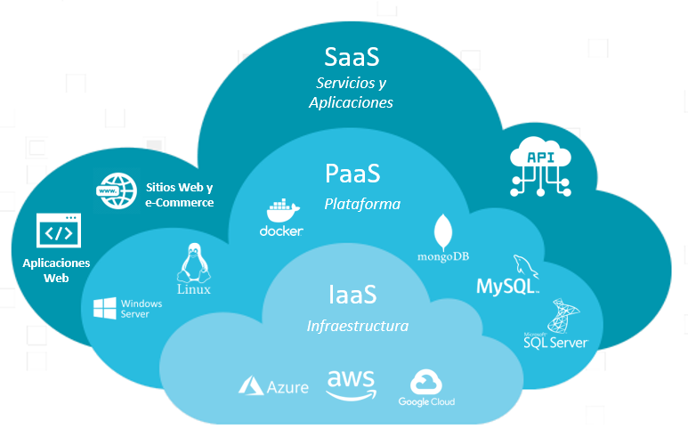
AI Open Source Platform and Tools
AI Open Source Platform and Tools
Rasa
TensorFlow open-source platform for machine learning developed by Google
Keras s a high-level API that simplifies the creation and training of deep neural networks
OpenCV
H2O.ai
PyTorch
Llama 3 is the latest version of Meta’s large language model, designed to enhance processing power, versatility, and accessibility

Slide 28
No Code AI and Machine Learning Program: Building Data Science Solutions
AI Open Source Platform and Tools
Rapid Miner makes machine learning processes very reliable, easy, and efficient
Teachable Machine enables professionals to employ Computer Vision and Deep Learning
KNIME is platform for data analytics that enables visual drag-and-drop pipeline construction.
Ikigai tool to build data science workflows and visualizations through modular functional blocks to make decisions
Dataiku automates entire data science workflow, from preparation to deployment
RD-Agent, An Open-Source AI Tool Designed to Automate and Optimize Research and Development Processes
For Application of:
ADL & Computer Vision
Speech Recognition & NLP
Reinforce learnings

Slide 29
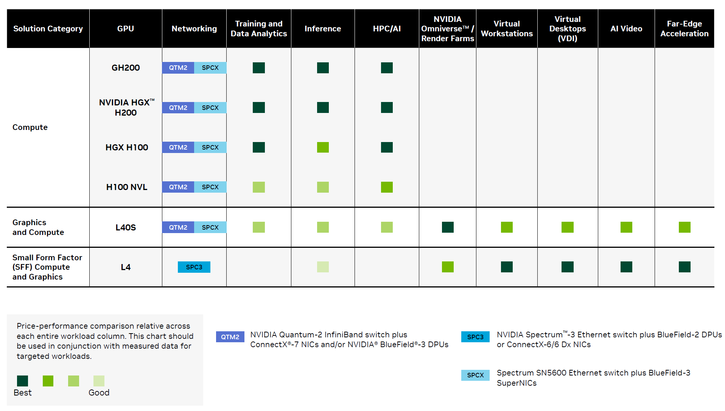
GPU Portfolio: NVIDIA Hopper™ and Ada Lovelace Architectures ()

Slide 30
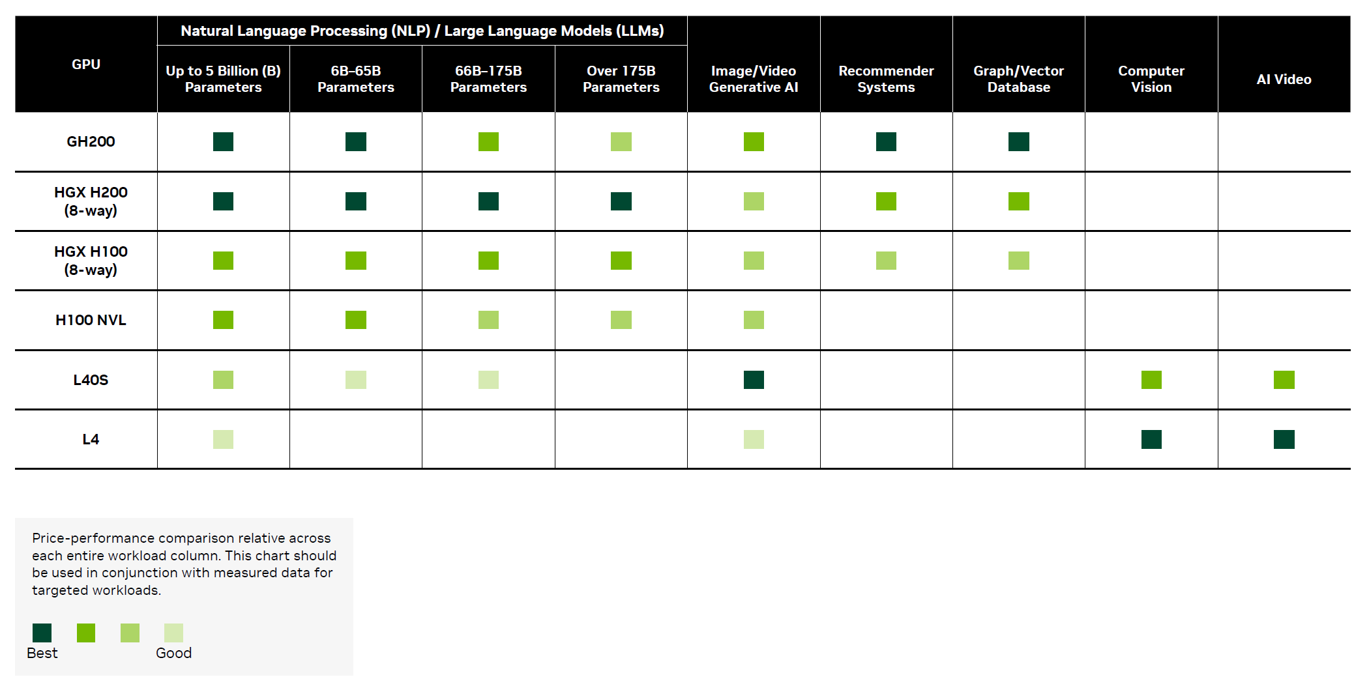
NVIDIA Inference Portfolio

Slide 31
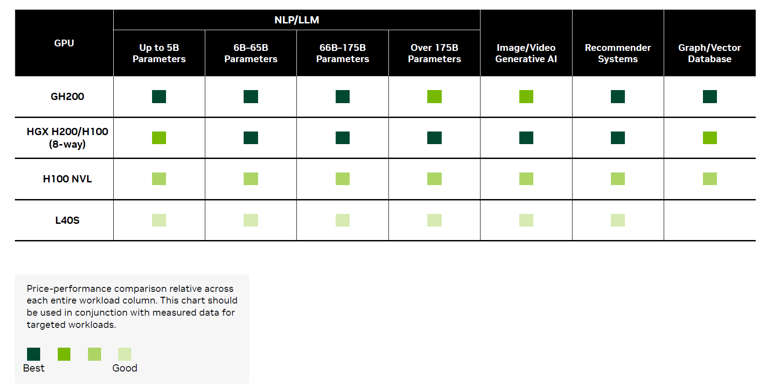
NVIDIA Training Portfolio

Slide 32
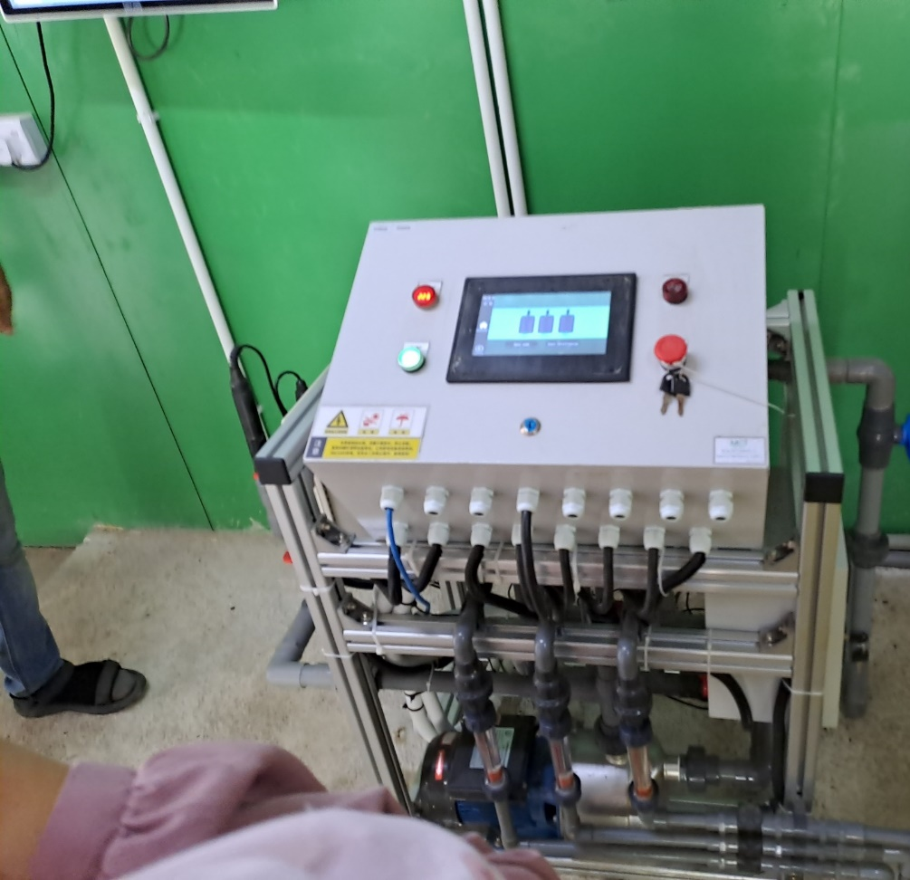
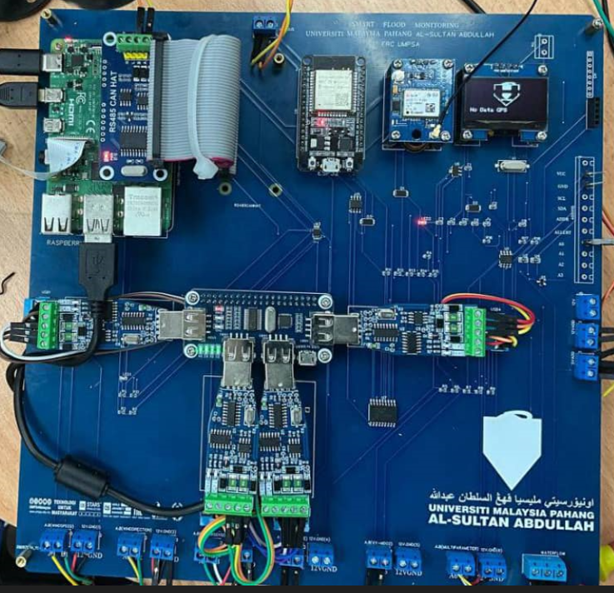
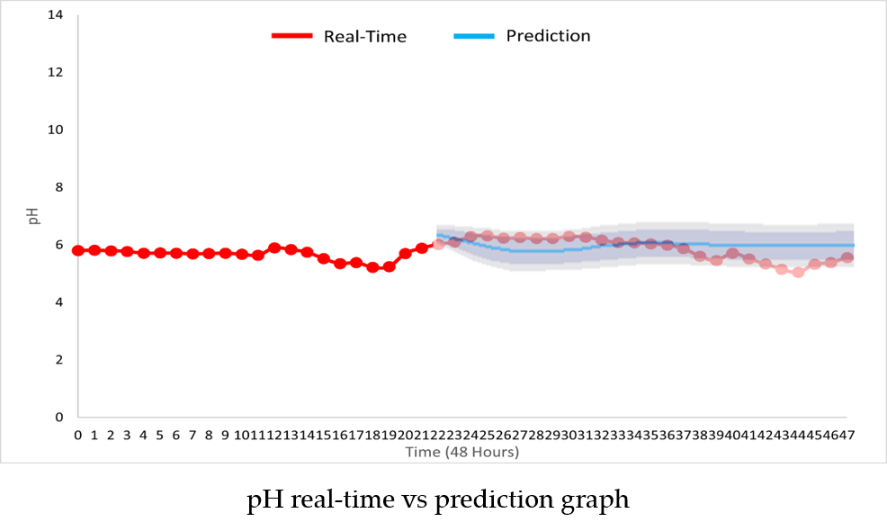
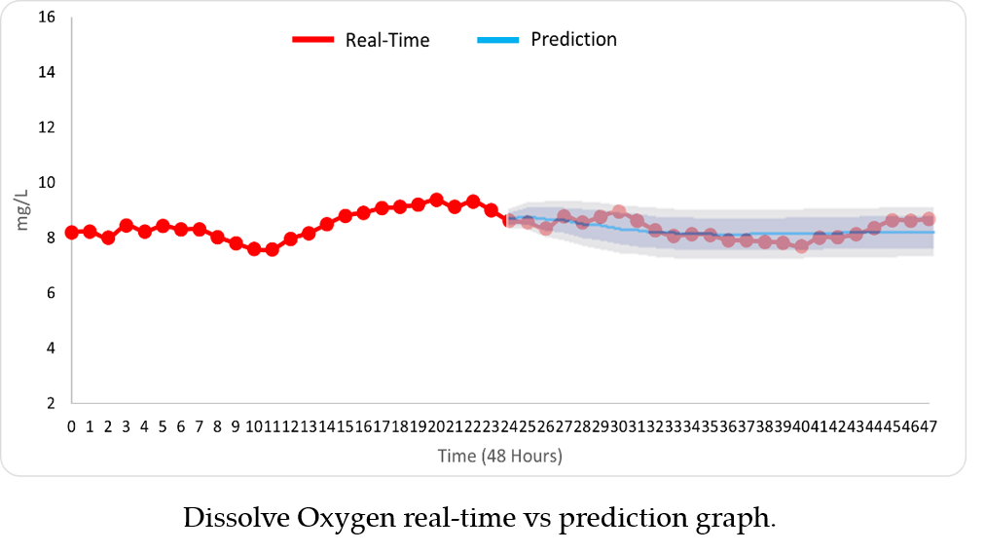
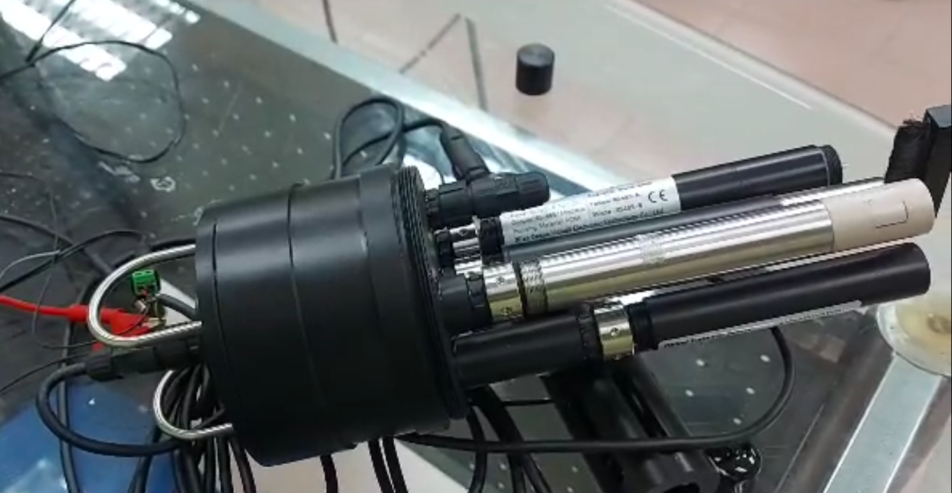
Current Project on Machine Learning & Data Analytics: i100 Water Measurement System
AI + Big Data + Cloud + Digital Twin + IoT + AR Technology Driver
Water Resources Economy Driver

Slide 33
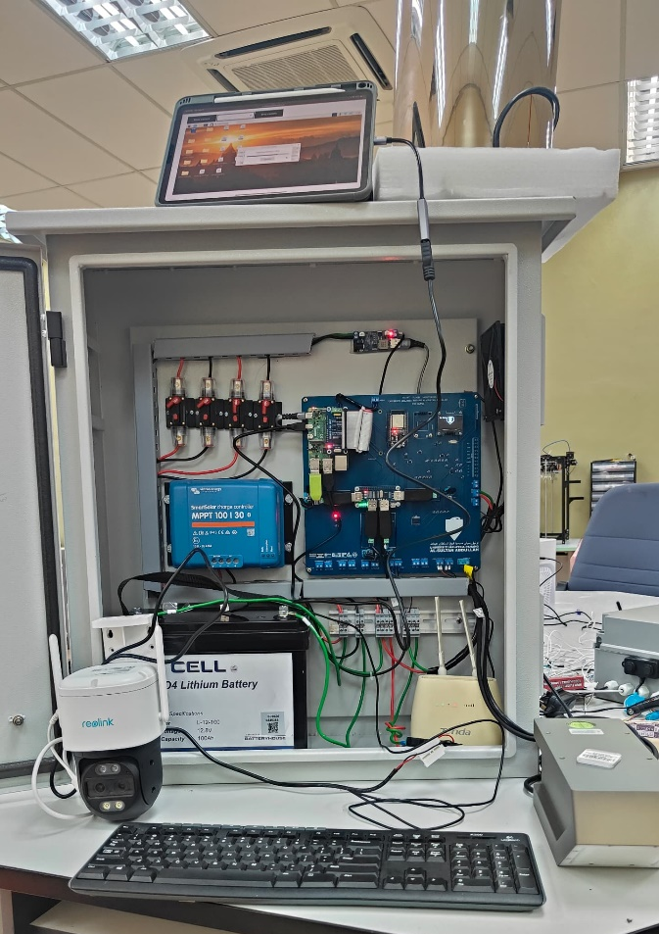
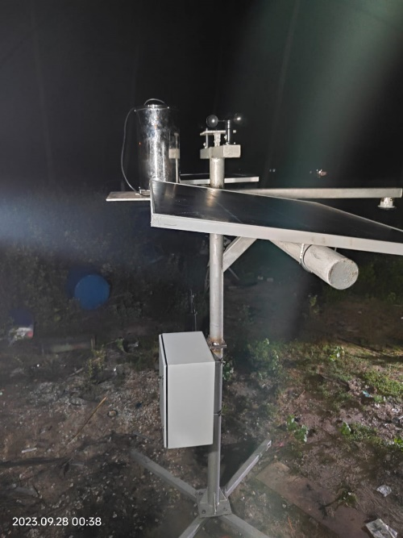
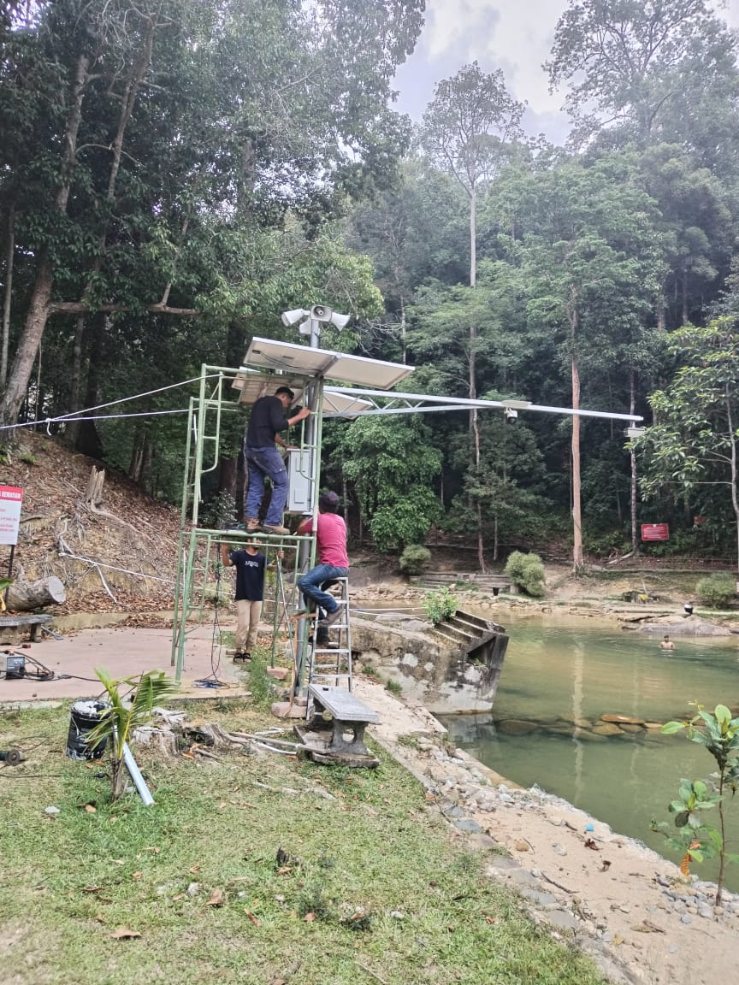
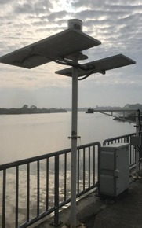
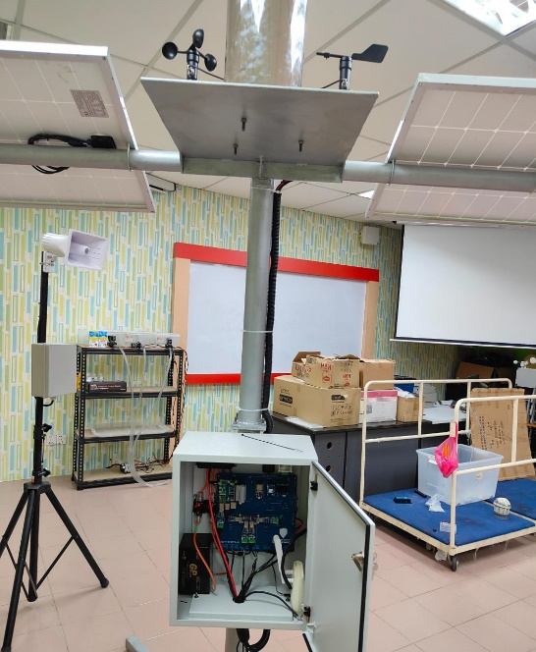
Past Project on Machine Learning & Data Analytics of UMPSA: Flood Forecasting
https://frc.ump.edu.my/frc_dashboard.html

Slide 34
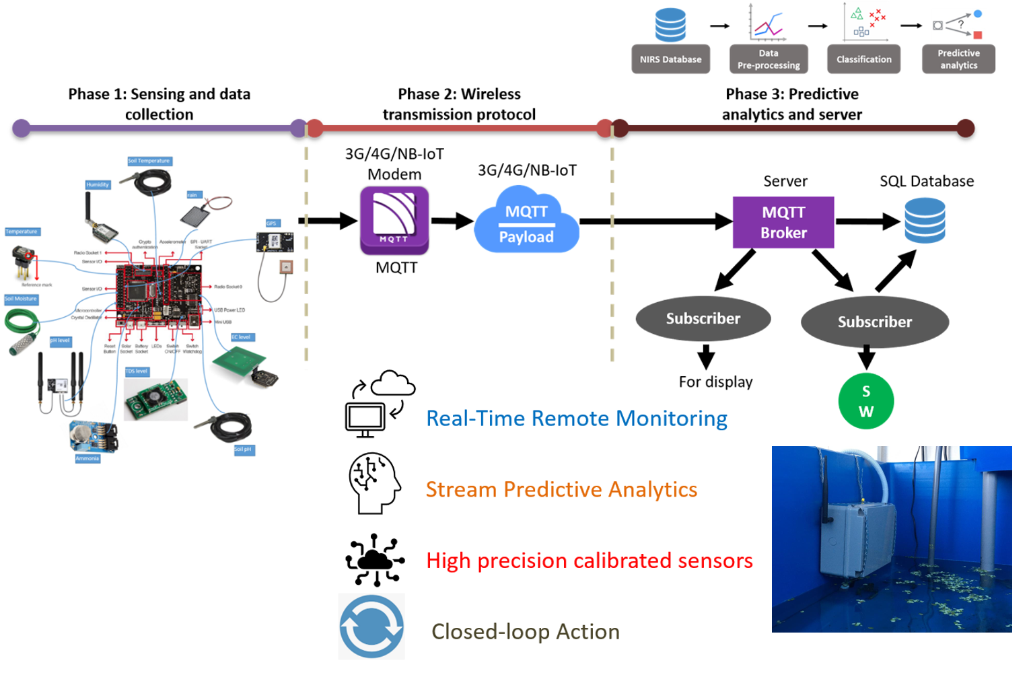
Past Project on Machine Learning & Data Analytics of UMPSA

Slide 35
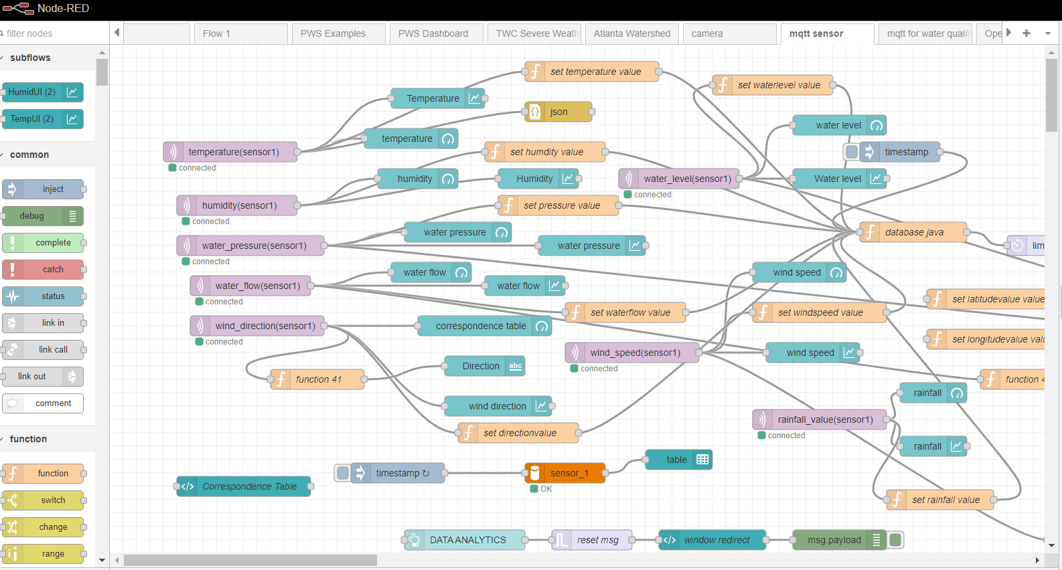
BIG DATA : Device-to-Cloud and Cloud-to-Device
(UMPSA Flood Research Committee Digital System)

Slide 36
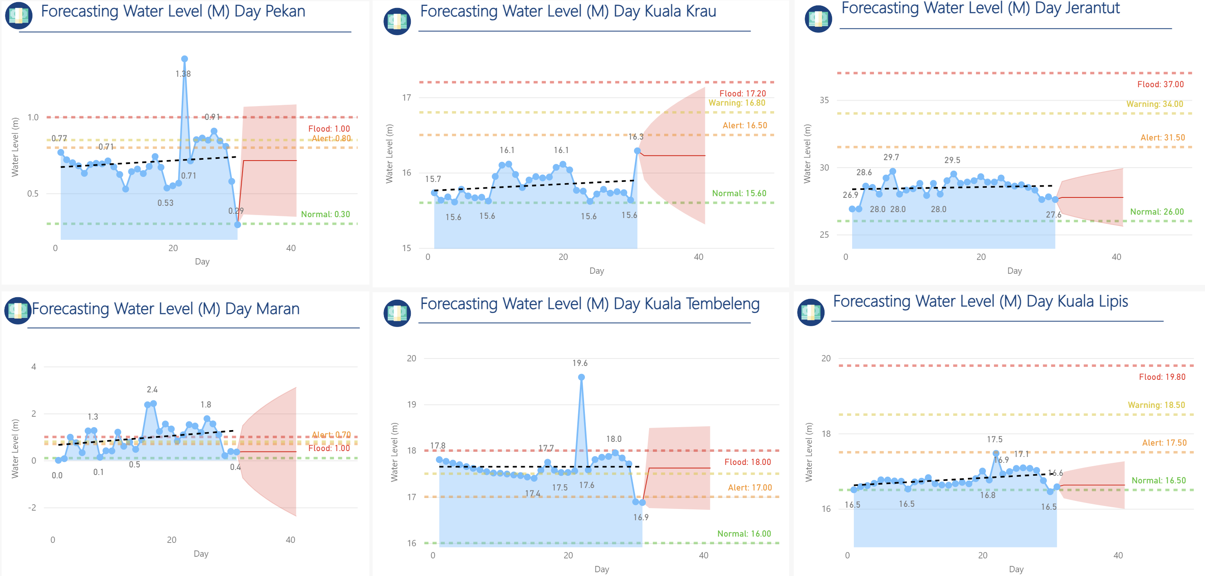
Past Project on Machine Learning & Data Analytics of UMPSA

Slide 37
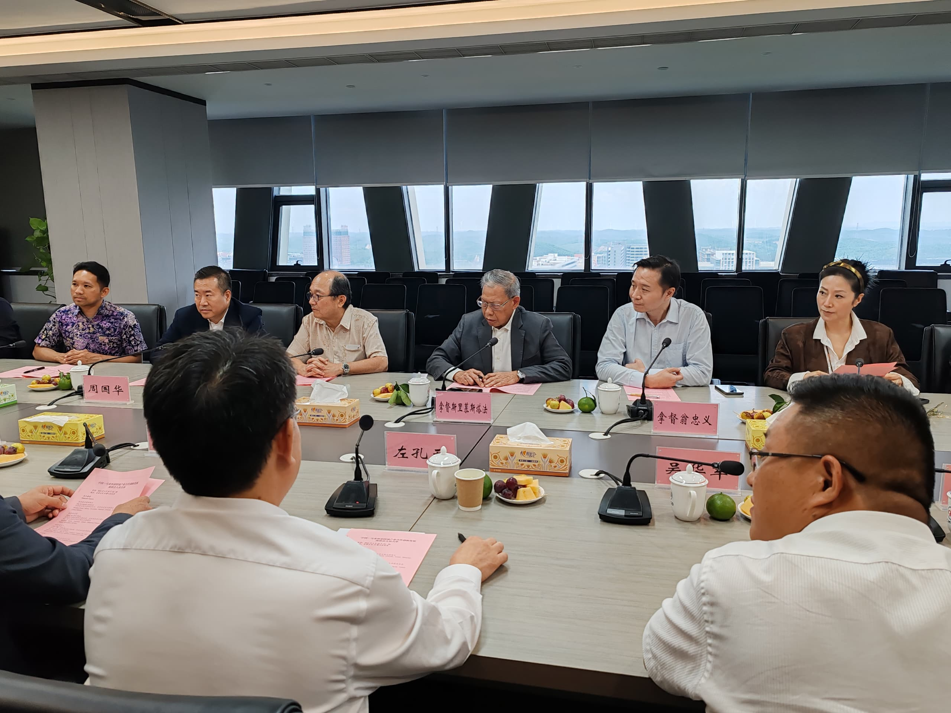
Machine Learning, Data Analytics & Blockchain Discussion For Custom Clearance in Beibu Gulf Port for China-Malaysia Qinzhou Industrial Park (CMQIP)
Led By:
Dato’ Sri Mustapa Mohamed, Adviser to the Society for the Promotion of SDGs
Dato’ Tan Teow Choon, Executive Director Belt & President of Malaysia Carbon Market Association
Dato’ Ong Chong Yi, Executive Director Belt & Road Initiative Caucus

Slide 38
AIM : SUCCEES To develop an optimum AI ecosystem in MTUN, now the turn will be on to culturize the RDICE
WHERE ARE WE NOW?
WHERE DO WE WANT TO BE?
HOW WILL WE GET THERE?

Slide 39
THANK YOU

